Slide 1
CS107, Lecture 1
Welcome to CS107!
reading:
Course Syllabus
Bryant & O’Hallaron, Ch. 1 (skim)
Honor Code and Collaboration Page

Slide 2

Asking Questions
Feel free to raise your hand at any time with a question
If you are more comfortable, you can post a question in the Ed forum thread for each day’s lecture (optionally anonymously)
We will monitor the thread throughout the lecture for questions
Visit Ed (or access via Canvas):
https://edstem.org/us/courses/97282/discussion
Today’s thread:
https://edstem.org/us/courses/97282/discussion/7867674
Notes:
If you have, someone else does too

Slide 3
Plan For Today
Introduction
CS107 Course Topics
CS107 Course Policies
Unix and the Command Line

Slide 4
Plan For Today
Introduction
CS107 Course Topics
CS107 Course Policies
Unix and the Command Line

Slide 5
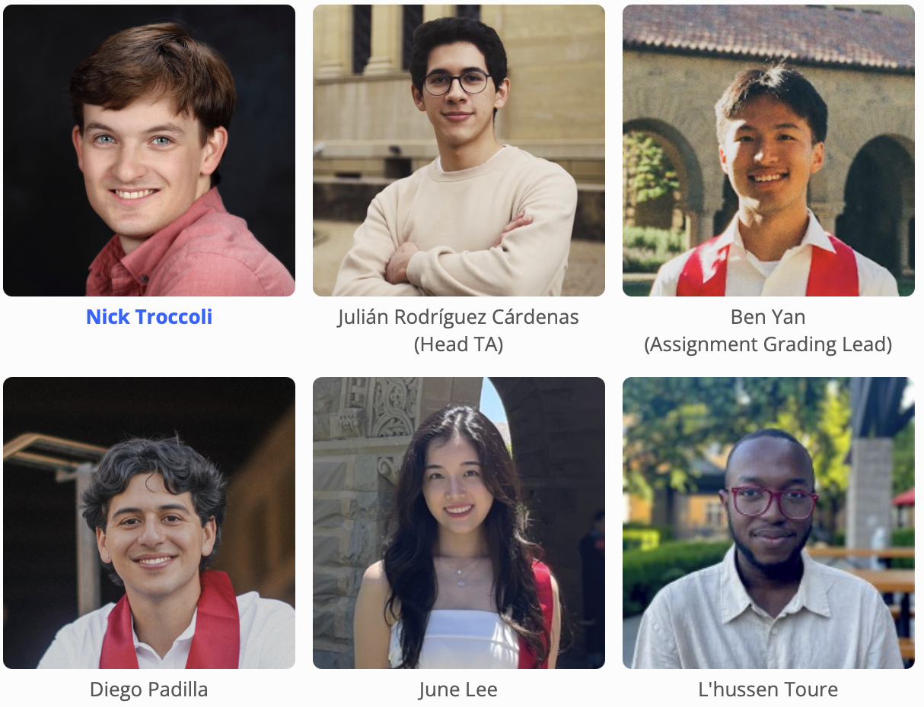
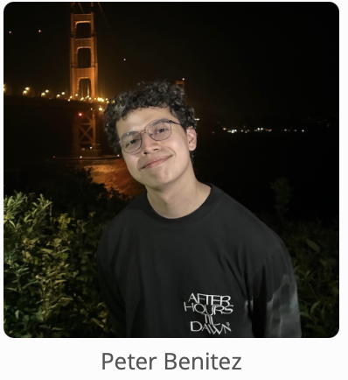
Teaching Team
About Nick Troccoli (troccoli@stanford.edu):
Lecturer in CS, taught CS106X, CS107, CS110, CS111
Stanford BS/MS (coterm) in CS
Systems track undergrad, AI track grad
Notes:
Head TA

Slide 6
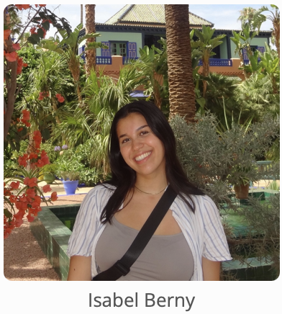
Companion Class: CS107ACE
CS107ACE is a 1-unit CR/NC supplementary companion course to CS107. It's designed to provide extra support and problem-solving resources for students, particularly for those who identify as coming from underrepresented or under-resourced backgrounds.
Entry by application; section M/W 1:30-2:20PM in Lathrop 014, beginning week 2.
In addition to all normal CS107 requirements such as lab
see https://web.stanford.edu/class/cs107ace/ for more details and the link to apply
Applications are still open! Isabel will go through applications and send out enrollment codes to accepted students by the end of the week. The final deadline for applications is Friday 4/3 at 5pm! (for late enrollment, email Isabel)

Slide 7
A Wonderful Community ❤️
I like to crochet!
I am scared of birds.
I can jump over a chair
I have two cats
I dance with Stanford XTRM K-pop!
I did not write a single line of code before coming to Stanford two quarters ago.
I can whistle a fantastic Twitter notification imitation.
I cannot distinguish cheerwine and dr. pepper
*Quotes taken from course welcome survey

Slide 8
Course Website
cs107.stanford.edu
Ed Discussion (includes course announcements): https://edstem.org/us/courses/97282/discussion
*lecture videos / lecture grades on Canvas
Notes:
Go there for quick tour

Slide 9
Plan For Today
Introduction
CS107 Course Topics
CS107 Course Policies
Unix and the Command Line

Slide 10
What is CS107?
The CS106 courses (or equivalent) provided you with a solid foundation in programming methodology and abstractions (variables, functions, data structures, pointers, recursion, classes, algorithms).
CS107 follows on this to build up and expand your breadth and depth of programming experience and techniques to show you how machines really work.
CS107 key question: how / why?

Slide 11
CS107: How/Why?
The CS106 series taught you how to solve problems as a programmer. CS107 goes a level deeper to understand the how and why:
How is data in our program really represented?
How does heap memory work?
How does a computer know how to run the code we write?
How does a program map onto the components of computer systems?
Why is my program doing X when I expected it to do Y?
Understanding computing at this level demystifies how these seemingly-complex systems work and can aid future projects you work on.
Notes:
I had a bug like yesterday!

Slide 12
Course Overview
Bits and Bytes - How can a computer represent integer numbers?
Chars and C-Strings - How can a computer represent and manipulate more complex data like text?
Pointers, Stack and Heap – How can we effectively manage all types of memory in our programs?
Generics - How can we use our knowledge of memory and data representation to write code that works with any data type?
Assembly - How does a computer interpret and execute C programs?
Heap Allocators - How do core memory-allocation operations like malloc and free work?
Ethics, Privacy, Partiality and Trust - How do we act responsibly in maintaining security, protecting privacy, and ensuring warranted trust in the systems we build and maintain?
Notes:
Don’t list everything, just pick a few
Set you up for success with a few key aspects

Slide 13
CS107 Learning Goals
The goals for CS107 are for students to gain mastery of
- writing C programs with complex use of memory and pointers
- an accurate model of the address space of C programs
- the compile/runtime behavior of C programs
to achieve competence in
- translating C to/from assembly
- writing programs that respect the limitations of computer arithmetic
- identifying bottlenecks and improving runtime performance
- working effectively in a Unix development environment
- using ethical frameworks and case studies to inform decision-making
and have exposure to
- understanding compilers and disassemblers
- a working understanding of the basics of computer architecture
Notes:
One level deeper

Slide 14
CS107 and Programming Experience
We hope that CS107 can help further develop your programming experience and comfort with programming.
CS107 focuses heavily on debugging and getting to the root of why something is happening.
Across assignments, we will be emphasizing how to become a better debugger, how to write better code, and how to further your software development skills.
Notes:
Better programmers have no bugs? No!
Bugs don’t go away, kinds of bugs change, get better at solving them
Important part of software development

Slide 15
Plan For Today
Introduction
CS107 Course Topics
CS107 Course Policies
Unix and the Command Line
Notes:
How are we going to get there?

Slide 16
Plan For Today
Introduction
CS107 Course Topics
CS107 Course Policies
  Course website
  Textbook
  Grading
  Getting Help
  Honor Code
Unix and the Command Line
Notes:
How are we going to get there?

Slide 17
Course Syllabus and Schedule
cs107.stanford.edu/syllabus
cs107.stanford.edu/calendar
Notes:
Go there for quick tour

Slide 18
CGOE Students
cs107.stanford.edu/cgoe

Slide 19
Getting Started Guide
cs107.stanford.edu/getting-started.html
(on course website under ”handouts”)
Notes:
Go there for quick tour

Slide 20
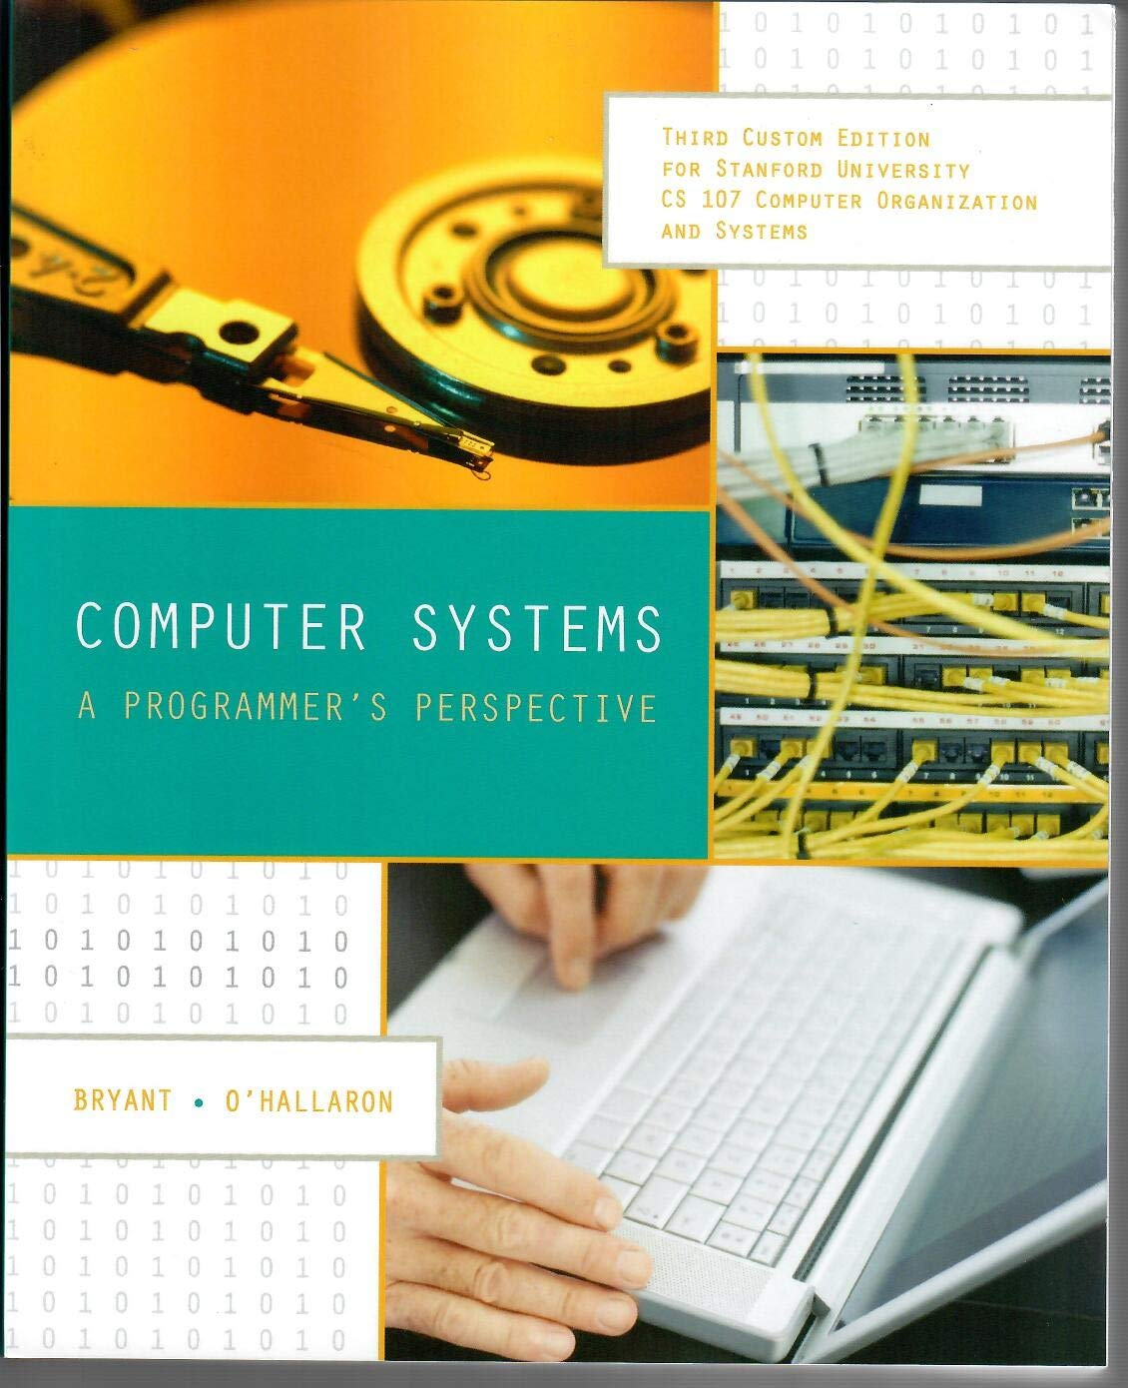

Textbook(s)
Computer Systems: A Programmer’s Perspective by Bryant & O’Hallaron, 3rd Edition
  3rd edition matters – important updates to content
  Stanford Library has generously scanned all readings for CS107 under “fair use” (private study, scholarship, research). [Canvas -> Files]. Please do not distribute.
  If you want more context, you may want to purchase a full copy
A C programming reference of your choice
  The C Programming Language by Kernighan and Ritchie (free link on course website Resources page)
  Other C programming books, websites, or reference sheets
Full textbook
CS107 full chapters
CS107-specific readings
The textbook (and C programming references) are very good resources in this course, especially post-midterm!
Notes:
t’s also good to give a reminder to the students that the PDF shouldn’t be distributed/reuploaded anywhere beyond their personal computers.

Slide 21
Course Structure
Lectures: understand concepts, see demos
Labs: learn tools, study code, discuss with peers
Assignments: build programming skills, synthesize lecture/lab content
  assign0: due next Monday (covers today and part of Wednesday’s lecture)
Great preview of homework!

Slide 22
Grading
  **** 35% Assignments
  * 5% Lab Participation
  * 5% Lecture Points
  ** 20% Midterm Exam
  **** 35% Final Exam
Read our full course policies document:
https://cs107.stanford.edu/syllabus.html

Slide 23
Grading
  **** 35% Assignments
  * 5% Lab Participation
  * 5% Lecture Points
  ** 20% Midterm Exam
  **** 35% Final Exam
Read our full course policies document:
https://cs107.stanford.edu/syllabus.html

Slide 24
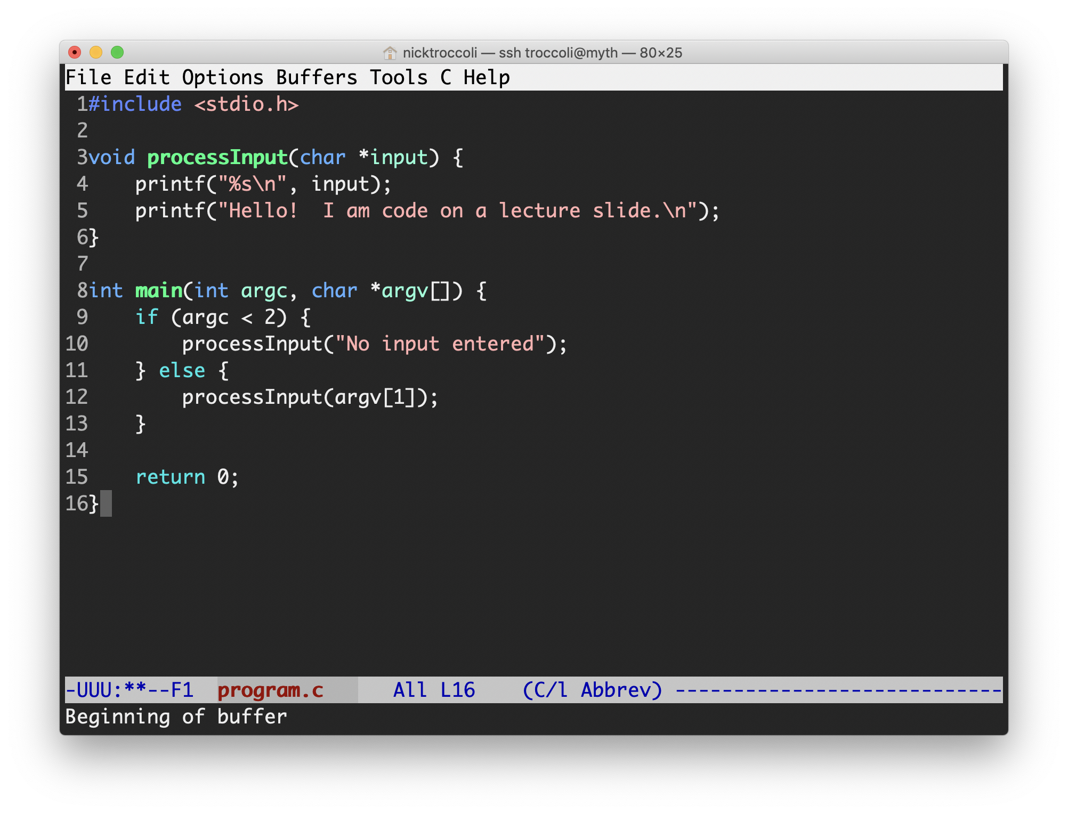
Assignments
7 programming assignments completed individually using Unix command line tools
  Free software, pre-installed on Myth machines / available on course website
  We will give out starter projects for each assignment
Graded on functionality (behavior) and style (elegance). Style weighted 15%, functionality 85%.
  Functionality graded using automated tools, given as point score – no TA review
  Style graded via automated tests and TA code review, given as bucket score
  Grades returned via course website
Weights of each assignment in course syllabus
Notes:
AUTOMATED functionality grading

Slide 25
The Style Bucket System
great | An outstanding job; reflects code that is notably clean, elegant and readable, with no issues present.
minor-issues | A good job; reflects code that demonstrates solid effort and is fairly successful at meeting expectations, but also has opportunities for improvement.
major-issue | Has more problems, but shows some effort and understanding. There was either a large concern, or several smaller concerns, in the submission.
multiple-major-issues | Has significant issues, either several large issues or a multitude of smaller ones, that together constitute very poor style work.
0 | No work submitted, or barely any changes from the starter assignment.

Slide 26
Assignments – Emphasizing the Process
When working on the assignments, it’s not just about completing the assignments, but how you complete the assignments.
“Process, instead of artifact”
Focus on how you approach the assignments to ensure you achieve the learning goals
  e.g. when you encounter a bug, make sure you exactly understand the root cause and fix before continuing.
  E.g. make sure you understand every code change you make and why it’s necessary
Notes:
Of course, completing the assignment is the target - but it’s not the only goal. It’s possible to complete assignments without learning what we set out to have you learn on each assignment. Unfortunately - but something that can come up on various homeworks. e.g. guess-and-check, I’m guilty of this too sometimes in debugging!
But this deprives you of the learning process. It’s how you approach the assignment that will maximize your learning, and set you up for success on the exams. Just completing the assignments isn’t enough - it’s how you complete them.

Slide 27
Assignment Late Policy
Assignments are due at 11:59PM PDT, but also allow for late submissions up to 2 days after the published deadline, with a cap:
Submitting by the published deadline does not incur any cap
Submitting after the deadline but within 24 hours means you can get at most 95% of the points.
Submitting between 24 hours and 48 hours after the deadline means you can get at most 87.5% of the points.
Submissions closed beyond 2 days, and this policy does not apply for the last assignment (assign6), where no late submissions are accepted except for Head-TA granted extensions. Assign5 permits submissions at most 1 day late except for Head-TA granted extensions. (extension form on course homepage)

Slide 28
Assignment Late Policy
Only the Head TA can grant extensions of the on-time deadline (via form submission on the course homepage) due to medical/emergency/extenuating circumstances, or extensions beyond the specified late period. All extension requests must be received in advance of the assignment deadline, or as soon as possible if extenuating circumstances occur later, or extenuating circumstances prevent reaching out prior to the deadline. Please do not hesitate to reach out to the course staff or the instructor if any personal circumstances or issues arise!

Slide 29
Question Break!
What questions do you have about the overall course goals, textbook or assignments?

Slide 30
Grading
  **** 35% Assignments
  * 5% Lab Participation
  * 5% Lecture Points
  ** 20% Midterm Exam
  **** 35% Final Exam
Read our full course policies document:
https://cs107.stanford.edu/syllabus.html

Slide 31
Lab Sections
Weekly 1-hour 20-minute in-person labs led by a CA, starting next week, offered Wednesdays through Fridays.
Hands-on practice in small groups with lecture material and course concepts. Designed to act as prep/preview of homework!
Graded on attendance + participation
Lab preference submissions open Tuesday 3/31 at 9AM PST and are not first-come first-serve. You may submit your preferences anytime until Thursday 4/2 11:59PM PST. Submit your preferences on the course website.

Slide 32
Grading
  **** 35% Assignments
  * 5% Lab Participation
  * 5% Lecture Points
  ** 20% Midterm Exam
  **** 35% Final Exam
Read our full course policies document:
https://cs107.stanford.edu/syllabus.html

Slide 33
Lecture Recordings
Because CS107 is offered on CGOE (for professional development students) this quarter, the course is being recorded for later viewing.
See the calendar page (or lecture dropdown) on the course website for slides and lecture code. Materials are posted the evening before each lecture.

Slide 34
Lecture Recordings
Because CS107 is not on CGOE (for professional development students) this quarter, the course is not officially recorded.
However, we have recording equipment provided in the lecture hall and will do our best to record each lecture ourselves. There may be quality issues and some content may be lost, but we’ll do our best!
See the calendar page (or lecture dropdown) on the course website for slides and lecture code. Materials are posted the evening before each lecture.

Slide 35
Lecture Points
At the same time, staying current with the material is essential to your success this quarter! Our goal is to incentivize staying current with lectures to enable you to start early on assignments and get the most out of labs.
Starting Fri, we’ll use Poll Everywhere and in-class worksheets for in-class activities. If you submit answers to all poll/worksheet questions in a lecture (regardless of correctness), you get credit for that lecture.
We provide 3 pre-excused absences for when you are ill, in COVID-19 isolation, or have other extenuating circumstances. They are intended only for these scenarios! Further absences reduces the overall course grade by 1%, up to a maximum of the lecture weight (5%).
Further excused absences are granted by the Head TA only in cases where you have already used your excused absences for extenuating circumstances and further extenuating circumstances necessitate additional accommodations.
Notes:
107 fast paced class, want to help you stay up to date with the material, set you up for success
- Lets you start early on assignments
- Take most advantage of labs
- Questions during lecture help shape lecture to be more helpful to you

Slide 36
Lecture Points
Polls require being present in the classroom – CGOE students can complete per-lecture quizzes by the end of the week each week.
We’ll do a PollEV dry run (doesn’t count) in lecture Wednesday, and lecture points will start with lecture on Fri 4/3.
Notes:
107 fast paced class, want to help you stay up to date with the material, set you up for success
- Lets you start early on assignments
- Take most advantage of labs
- Questions during lecture help shape lecture to be more helpful to you.
Want you to commit

Slide 37
Grading
  **** 35% Assignments
  * 5% Lab Participation
  * 5% Lecture Points
  ** 20% Midterm Exam
  **** 35% Final Exam
Read our full course policies document:
https://cs107.stanford.edu/syllabus.html

Slide 38
Exams
Midterm exam – Tuesday, May 5, 7-9PM outside of class
  If you have an academic or University conflict with this time, and absolutely cannot make the regularly scheduled midterm, we will offer 2 alternate midterm exam times. For any concerns, reach out to me (Nick).
Final exam – Wednesday, June 10, 8:30AM-11:30AM
  No alternate final! You MUST be able to take the final exam at the scheduled time (except for university athletics or OAE accommodations). If you have any concerns, please reach out to me (Nick).
Both exams are in-person, closed-book, closed-note, closed-computer paper-and-pencil exams. You are provided with a reference sheet during the exam.
CGOE students have a window during which to take the exams
Submit our exam information form by 11:59PM on Fri, April 17 if you have a midterm conflict, are a CGOE student wanting to take exams on campus, or if you want a left-handed desk!

Slide 39
AIWG Proctoring Study
This quarter, CS107 is participating in the Proctoring Study, meaning the midterm and final exams will be proctored, and some OAE exams will be administered by the Centralized Testing Center (CTC).
For this reason, OAE exam accommodations must be submitted to us at least 10 calendar days prior to the midterm, and no later than May 25th, 2026, at 5:00 pm for the final exam. For urgent OAE-related accommodation needs that arise after the deadline, please consult your OAE adviser.

Slide 40
Grading
  **** 35% Assignments
  * 5% Lab Participation
  * 5% Lecture Points
  ** 20% Midterm Exam
  **** 35% Final Exam
Read our full course policies document:
https://cs107.stanford.edu/syllabus.html

Slide 41
Question Break!
What questions do you have about section, lecture or exams?

Slide 42
Getting Help
Post on the Discussion Forum
  Online discussion forum for students; post questions, answer other students’ questions
  Best for course material discussions, course policy questions, short debugging questions or general assignment questions (DON’T POST ASSIGNMENT CODE!)
Visit Helper Hours
  Chat about course topics or just hang out
  Sign up in a queue for 1:1 TA help; schedule will be posted / hours start tomorrow.
  Mix of in-person-only and online-only helper hours
  Best for group work, coding/debugging questions (with TAs only!) or longer course material discussions

Slide 43
Course Staff Contact Information
3 forms on the course homepage for OAE, extensions, and exam info.
Email the grader on your assignment grade report for questions about assignment style or manual review grades - for questions about assignment autograder test scores, please email the assignment grading lead TA.
Email your lab TA for questions about section attendance grades, or for section accommodations (e.g. missing a section due to extenuating circumstances).
Email the Head TA for other requests, such as about Office of Accessible Education accommodations or other accommodations, enrollment questions, auditing, or other personal matters.
Can also email the instructor for questions about private/personal matters.
We are not able to answer course material or assignment questions via email; instead, take advantage of Ed or Helper hours resources!
Notes:
Communication - head ta main point of contact, me for personal matters, 3 forms to help us more quickly respond

Slide 44
OAE Accommodations
We are eager to do everything we can to support you and make you successful in CS107! Please upload your OAE letter via our OAE form on the course homepage as soon as possible. In particular, please let us know of any needed exam accommodations by Fri 4/17 if possible.

Slide 45
Course Flexibility
If you are ever sick or encounter an emergency or other exceptional circumstance, we have a variety of accommodation mechanisms, including:
  Extended time on assignments
  Makeup labs
  Lecture pre-excused misses
  Exam accommodations for emergencies/illness
  Ability to attend all helper hours remotely with Head TA permission
If you feel ill or are sick, please stay home and take care of yourself. We never want you to feel that you must attend class or helper hours if you are not feeling well. And if you are ill or have another emergency or exceptional circumstance, please reach out to us so that we can help!
Notes:
Can pull levers you didn’t even know existed

Slide 46
Stanford Honor Code
From http://honorcode.stanford.edu (newly updated Honor Code):
The Honor Code is an undertaking of the Stanford academic community, individually and collectively. Its purpose is to uphold a culture of academic honesty.
Students will support this culture of academic honesty by neither giving nor accepting unpermitted academic aid in any work that serves as a component of grading or evaluation, including assignments, examinations, and research.
Instructors will support this culture of academic honesty by providing clear guidance, both in their course syllabi and in response to student questions, on what constitutes permitted and unpermitted aid. Instructors will also not take unusual or unreasonable precautions to prevent academic dishonesty.
Students and instructors will also cultivate an environment conducive to academic integrity. While instructors alone set academic requirements, the Honor Code is a community undertaking that requires students and instructors to work together to ensure conditions that support academic integrity.
Notes:
Environment for all to do best work with integrity

Slide 47
Honor Code and CS107
It is your responsibility to ensure you have read and are familiar with the honor code guidelines posted on the main page of the course website. Please read them and come talk to us if you have any questions or concerns.
Please help us ensure academic integrity:
  Indicate any assistance received on HW (books, friends, etc.).
  Do not look at other people's solution code or answers
  Do not give your solutions to others or post them publicly on the web or our Ed forum.
  Tutoring is not appropriate for help with work that will be submitted for a grade.
  Do not use AI tools to write code/responses for you on assignments or any graded work.
https://cs107.stanford.edu/collaboration
Notes:
Not trying to scare you – trying to convince you

Slide 48
Honor Code and CS107
The resources that we designate as off limits are designated as such because:
We want the work you submit to be your own
This is the best way we believe we can achieve the learning goals for CS107
The learning happens in the process; appropriating someone else’s work as your own, or using help beyond what is allowed, means you deprive yourself of that process.
If you need help, please contact us and we will help you. We do not want you to feel any pressure to violate the Honor Code in order to succeed in this course.
  We also have a retraction policy that permits retracting all or part of previously-submitted assignment or other work up to 5 days after the on-time deadline, no questions asked (except for the final exam).
Notes:
Not trying to scare you – trying to convince you
If in a situation where you feel the only option is to violate the honor code, send me an email – will be so happy to help

Slide 49
Honor Code and CS107
We have sophisticated tools and detection mechanisms. Assignments are checked for similarity with help of robust software tools and processes. Concerns are reported to the Office of Community Standards. Any cases determined by the OCS process to be Honor Code violations will result in zero credit for the work of concern plus a course grade penalty of at least a one grade bucket decrease (e.g. B to B-) up to failing the course.
We tell you this to show you how seriously we take this – we want to foster an environment where everyone can do their best work with integrity.
Notes:
Not trying to scare you – trying to convince you
If in a situation where you feel the only option is to violate the honor code, send me an email – will be so happy to help

Slide 50
Use of AI Tools
AI tools can be extremely valuable in certain contexts and enable easier development / coding.
However, for CS107 our focus is on not just the artifact but also the process: developing skills to write code, debug code, and think critically about existing code and code you write, all of which will make you a more powerful computer scientist and let you work more effectively and efficiently!
For these reasons, you should only use AI tools in the same way that you would ask a friend in the class for help – high level questions, citations where needed, etc. You should not use AI tools to write code/responses for you on assignments or any graded work. Doing so is a violation of the Stanford Honor Code.
Notes:
You won’t learn what we want you to learn

Slide 51
Plan For Today
Introduction
CS107 Course Topics
CS107 Course Policies
Unix and the Command Line

Slide 52

What is Unix?
Unix: a set of standards and tools commonly used in software development.
  macOS and Linux are operating systems built on top of Unix
You can navigate a Unix system using the command line (“terminal”)
Every Unix system works with the same tools and commands

Slide 53

What is the Command Line?
The command-line is a text-based interface (i.e., terminal interface) to navigate a computer, instead of a Graphical User Interface (GUI).
Graphical User Interface
Text-based interface

Slide 54
Command Line Vs. GUI
Just like a GUI file explorer interface, a terminal interface:
shows you a specific place on your computer at any given time.
lets you go into folders and out of folders.
lets you create new files and edit files.
lets you execute programs.
Graphical User Interface
Command-line interface

Slide 55
Why Use Unix / the Command Line?
You can navigate almost any device using the same tools and commands:
  Servers
  Laptops and desktops
  Embedded devices (Raspberry Pi, etc.)
  Mobile Devices (Android, etc.)
Used frequently by software engineers:
  Web development: running servers and web tools on servers
  Machine learning: processing data on servers, running algorithms
  Systems: writing operating systems, networking code and embedded software
  Mobile Development: running tools, managing libraries
  And more…
We’ll use Unix and the command line to implement and execute our programs.
Notes:
Remote access is easy

Slide 56
Learning Unix and the Command Line
Using Unix and the command line can be intimidating at first:
  It looks retro!
  How do I know what to type?
It’s like learning a new language:
  At first, you may have to constantly look things up (resources on course website!)
  It’s important to spend as much time as possible (during labs and assignments) building muscle memory with the tools
More next time!
Notes:
Ask questions!

Slide 57
Assign0
Assignment 0 (Intro to Unix and C) is due in one week on Mon. 4/6 at 11:59PM PDT. It relies on material from this and the next lecture.
There are 5 parts to the assignment, which is meant to get you comfortable using the command line, and editing/compiling/running C programs:
Visit the website resources to become familiar with different Unix commands
Clone the assign0 starter project
Answer several questions in readme.txt
Compile a provided C program and modify it
Submit the assignment

Slide 58
Recap
CS107 is a programming class in C that teaches you about what goes on under the hood of programming languages and software.
We’ll use Unix and command line tools to write, debug and run our programs.
Please visit the course website, cs107.stanford.edu, where you can read the General Information page, information about the Honor Code in CS107, and more about CS107 course policies and logistics.
We’re looking forward to an awesome quarter!

