Slide 1
CS107 Lecture 25
Optimization, Caching, Writing Cache-Friendly Code
Reading: B&O 5

Slide 2

Caching
Processor speed is not the only bottleneck in program performance—memory access is perhaps even more of one!
Memory exists in levels and goes from very fast (registers) to very slow (disk).
Frequently accessed data tends to stay in faster memory.
memory abstraction

Slide 3
Caching
Virtually all caching depends on locality.
Temporal locality
Repeat access to the same data
tends to be co-located in time
Intuition: Memory I’ve accessed
recently is likely to be accessed again
very soon.
Spatial locality
Related data tends to be collocated in space.
Intuition: Memory I’ve recently accessed might be right next to memory I’ll need very soon.
Realistic scenario:
97% cache hit rate, cache hits incur 1 clock cycle, whereas cache misses incur 100
Thought Question: How much time is spent on the 3% of accesses that are cache misses?

Slide 4
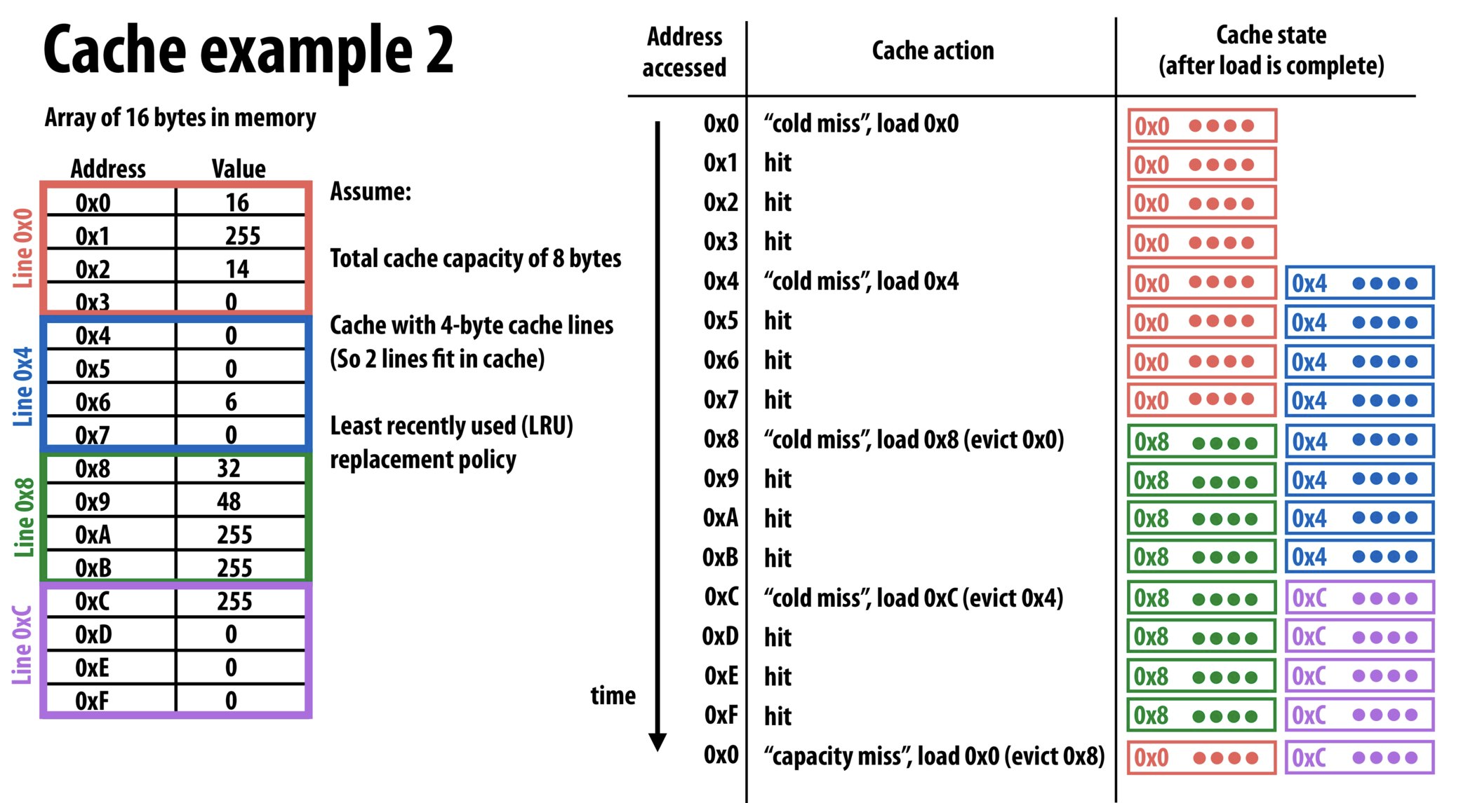
Caching
Virtually all caching depends on locality.
Credit: Kayvon Fatahalian and CS149

Slide 5
Demo: cache.c
Caching
The CPU can execute instructions quickly, but if it must wait for memory, it sits idle. Caches keep data the CPU needs as close to it as possible. Note: RAM officially holds the data and caches store copies.
Notes:
Demo overflow etc.

