Slide 1
CS107 Lecture 5
Bitwise Operators, Continued
reading:
Bryant & O’Hallaron, Ch. 2.1

Slide 2
CS107 Topic 1
How can a computer represent integer numbers?
Why is answering this question important?
Helps us understand the limitations of computer arithmetic (last week)
Shows us how to more efficiently perform arithmetic (today)
Shows us how we can encode data more compactly and efficiently (last time)
assign1: implement 3 programs that manipulate binary representations to (1) work around the limitations of arithmetic with addition, (2) simulate a chamber of gas particles, and (3) print Unicode text to the terminal.

Slide 3
Learning Goals
Learn about the bit shift operators
Understand when to use one bitwise operator vs. another in your program
Get practice with writing programs that manipulate binary representations

Slide 4
Lecture Plan
Recap: Bit Operators so far
Bit Shift Operators
Example: Powers of 2
Demo: GDB
cp -r /afs/ir/class/cs107/lecture-code/lect5 .

Slide 5
Lecture Plan
Recap: Bit Operators so far
Bit Shift Operators
Example: Powers of 2
Demo: GDB
cp -r /afs/ir/class/cs107/lecture-code/lect5 .

Slide 6
Bits and Bytes So Far
// 1. Data is really stored in binary
int x = 5; // really 0b00…0101 in memory!
// 2. We know what that binary representation is for integers
int y = -5; // two’s complement: 0b111...11011
// 3. We can use/manipulate a binary representation with bit ops
x |= 0x2; // turn on the 2nd bit from the right: 0b00…0111
// 4. A variable and its binary representation are
// one and the same
printf("%d\n", x); // prints 7!

Slide 7
Bitwise OR (|)
| with 1 is useful for turning select bits on.
int x = 5; // 0b101
// Turn on the 2nd bit from the right
x |= 0x2; // 0b111
| is useful for taking the union of bits.
int x = 5; // 0b00101
int y = 26; // 0b11010
int z = x | y; // 0b11111
printf("%d\n", z); // 31

Slide 8
Bitwise AND (&)
& with 0 is useful for turning select bits off.
int x = 5; // 0b101
// Turn off the 3rd bit from the right
x &= -5; // -5 is 0b111...1011
& is useful for taking the intersection of bits.
int x = 21; // 0b10101
int y = 27; // 0b11011
int z = x & y; // 0b10001
printf("%d\n", z); // 17

Slide 9
Bitwise XOR (^)
^ with 1 is useful for flipping select bits.
int x = 5; // 0b101
// Flip the 2nd bit from the right
x ^= 0x2; // 0b111

Slide 10
Bitwise NOT (~)
~ is useful for flipping all bits.
int x = 5; // 0b101
// Flip all bits
x = ~x; // 0b11111...1010, which is -6
// Take two’s complement (same as negating)
int y = ~x + 1; // same as -x

Slide 11
Bit Vectors and Sets
Instead of using arrays of e.g., Booleans in our programs, sometimes it’s beneficial to store that information in bits instead – more compact.
Example: we can represent current courses taken using a char and manipulate its contents using bit operators.
0 | 0 | 1 | 0 | 0 | 0 | 1 | 1
CS161
CS109
CS103
CS111
CS107
CS107E
CS106B
CS106A

Slide 12
Bit Vectors and Sets
#define CS106A 0x1 /* 0000 0001 */
#define CS106B 0x2 /* 0000 0010 */
#define CS107E 0x4 /* 0000 0100 */
#define CS107 0x8 /* 0000 1000 */
#define CS111 0x10 /* 0001 0000 */
#define CS103 0x20 /* 0010 0000 */
#define CS109 0x40 /* 0100 0000 */
#define CS161 0x80 /* 1000 0000 */
unsigned char myClasses = ...;
myClasses |= CS107; // Add CS107
if (myClasses & CS106B) {...
// taken CS106B!

Slide 13

Practice: Bit Masking
Practice: write an expression that, given a 32-bit integer j, flips (“complements”) the least-significant byte, and preserves all other bytes.
What operator is good for flipping certain bits?
What mask do we want?
How do we create that mask?
Respond on PollEv:
pollev.com/cs107

Slide 14
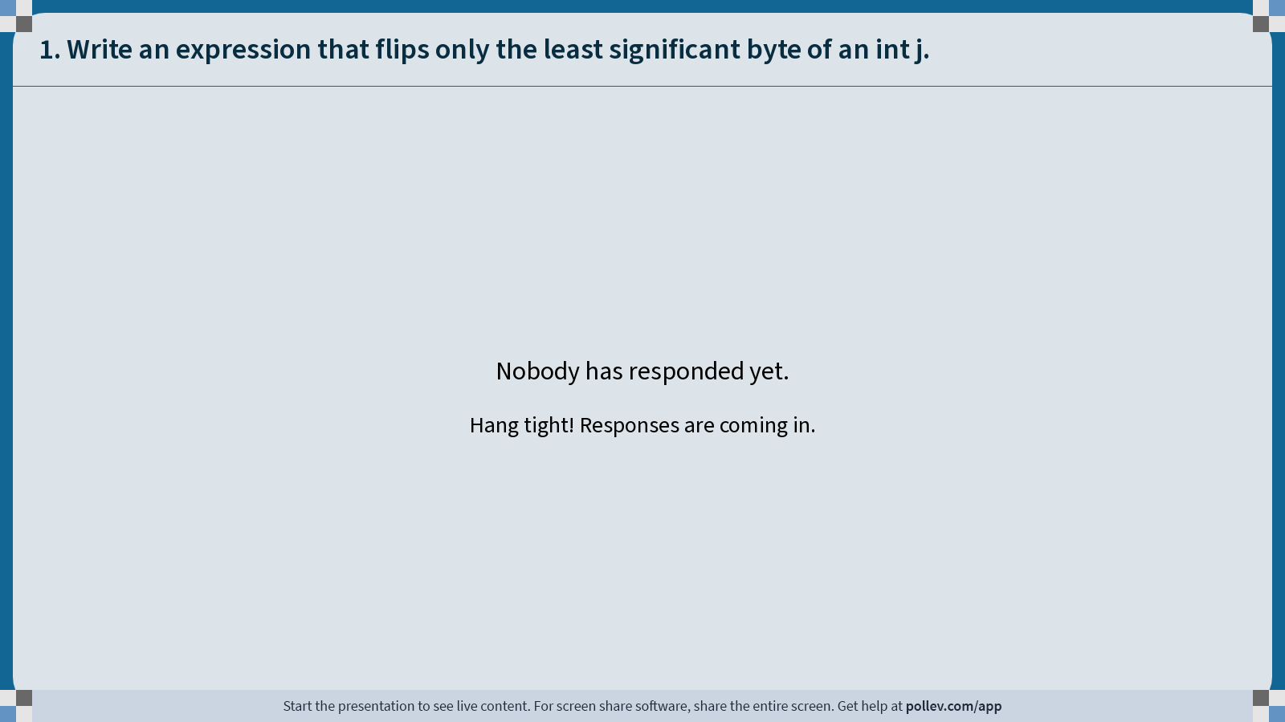
Notes:
Do not modify the notes in this section to avoid tampering with the Poll Everywhere activity.
More info at polleverywhere.com/support
1. Write an expression that flips only the least significant byte of an int j.
https://www.polleverywhere.com/free_text_polls/YbKevmLZMFFBO0kFuvAMV

Slide 15
Practice: Bit Masking
Practice: write an expression that, given a 32-bit integer j, flips (“complements”) the least-significant byte, and preserves all other bytes.
What operator is good for flipping certain bits?
What mask do we want?
How do we create that mask?
j ^ 0xff

Slide 16
Lecture Plan
Recap: Bit Operators so far
Bit Shift Operators
Example: Powers of 2
Demo: GDB
cp -r /afs/ir/class/cs107/lecture-code/lect5 .

Slide 17
Left Shift (<<)
The LEFT SHIFT operator shifts a bit pattern a certain number of positions to the left. New lower order bits are filled in with 0s, and bits shifted off the end are lost.
  x << k; // evaluates to x shifted to the left by k bits
  x <<= k; // shifts x to the left by k bits
8-bit examples:
  00110111 << 2 results in 11011100
  01100011 << 4 results in 00110000
  10010101 << 4 results in 01010000

Slide 18
Right Shift (>>)
The RIGHT SHIFT operator shifts a bit pattern a certain number of positions to the right. Bits shifted off the end are lost.
x >> k; // evaluates to x shifted to the right by k bits
x >>= k; // shifts x to the right by k bits
Shifts in 0s for unsigned numbers (“logical right shift”), shifts in sign bit (MSB) for signed numbers (“arithmetic right shift”). Preserves sign! (similar to sign extending when making a variable larger).
Key takeaway: two kinds of right shifts.

Slide 19
Right Shift (>>)
The RIGHT SHIFT operator shifts a bit pattern a certain number of positions to the right. Bits shifted off the end are lost.
x >> k; // evaluates to x shifted to the right by k bit
x >>= k; // shifts x to the right by k bits
unsigned short x = 2; // 0000 0000 0000 0010
x >>= 1; // 0000 0000 0000 0001
printf("%u\n", x); // 1

Slide 20
Right Shift (>>)
The RIGHT SHIFT operator shifts a bit pattern a certain number of positions to the right. Bits shifted off the end are lost.
x >> k; // evaluates to x shifted to the right by k bit
x >>= k; // shifts x to the right by k bits
short x = 2; // 0000 0000 0000 0010
x >>= 1; // 0000 0000 0000 0001
printf("%d\n", x); // 1

Slide 21
Right Shift (>>)
The RIGHT SHIFT operator shifts a bit pattern a certain number of positions to the right. Bits shifted off the end are lost.
x >> k; // evaluates to x shifted to the right by k bit
x >>= k; // shifts x to the right by k bits
short x = -2; // 1111 1111 1111 1110
x >>= 1; // 1111 1111 1111 1111
printf("%d\n", x); // -1

Slide 22
Shifting and Masking
int x = 0b1010010;
Suppose we have a 32-bit number.
How can we use bit operators to design a mask that turns on the i-th bit of a number for any i (0, 1, 2, …, 31)? (indexes are from right to left, LSB to MSB)
What operator is good for turning on certain bits?
What mask do we want?
How do we create that mask?

Slide 23
Shifting and Masking
int x = 0b1010010;
Suppose we have a 32-bit number.
How can we use bit operators to design a mask that turns on the i-th bit of a number for any i (0, 1, 2, …, 31)? (indexes are from right to left, LSB to MSB)
What operator is good for turning on certain bits?
What mask do we want?
How do we create that mask? How would we write this operation in code?
Respond on PollEv for #3:
pollev.com/cs107
🤔

Slide 24
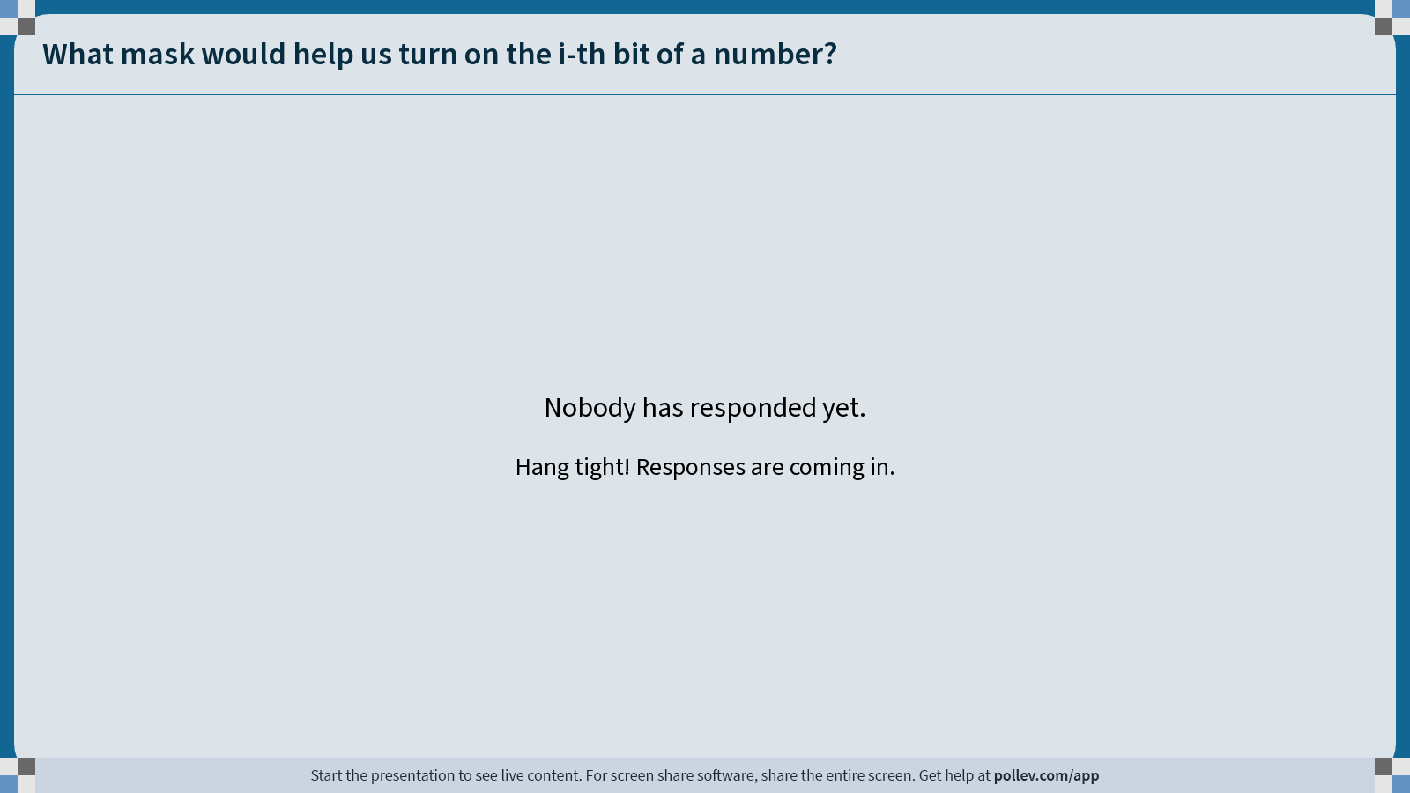
Notes:
Do not modify the notes in this section to avoid tampering with the Poll Everywhere activity.
More info at polleverywhere.com/support
What mask would help us turn on the i-th bit of a number?
https://www.polleverywhere.com/free_text_polls/3C7AXfREuRINkZeo2AhhN

Slide 25
Shifting and Masking
int x = 0b1010010;
Suppose we have a 32-bit number.
How can we use bit operators to design a mask that turns on the i-th bit of a number for any i (0, 1, 2, …, 31)? (indexes are from right to left, LSB to MSB)
What operator is good for turning on certain bits?
What mask do we want?
How do we create that mask? How would we write this operation in code?
x | (1 << i)
What if x is a 64-bit number (e.g. long) and i could be 0-63? It turns out there’s a problem with this expression…

Slide 26
Bit Operator Pitfalls
Number literals in your code default to int (if they fit in an int). Let’s say we want a long with the index-32 bit as 1:
long num = 1 << 32;
This doesn’t work! 1 is by default an int, and you can’t shift an int by 32 because it only has 32 bits (undefined behavior). You must specify that you want 1 to be a long.
long num = 1L << 32;

Slide 27
Shifting and Masking
long x = 0b1010010;
Suppose we have a 64-bit number.
How can we use bit operators to design a mask that turns on the i-th bit of a number for any i (0, 1, 2, …, 63)? (indexes are from right to left, LSB to MSB)
x | (1L << i)

Slide 28
Number Literal Suffixes
U makes a literal unsigned, and L makes a literal a long.
int w = -5 >> 1; // 0b1111...1101, -3
int x = -5U >> 1; // 0b0111...1101, 2147483645
long y = 1 << 32; // 0! (technically undefined)
long z = 1L << 32; // 4294967296

Slide 29
1L << i
What does 1L << i represent numerically?
A power of 2! Specifically, 2^{i}.

Slide 30
Lecture Plan
Recap: Bit Operators so far
Bit Shift Operators
Example: Powers of 2
Demo: GDB
cp -r /afs/ir/class/cs107/lecture-code/lect5 .

Slide 31
Powers of 2
Challenge: without using loops or math library functions, how could we detect whether a number is a power of 2?
What is true about a power of 2 but not other numbers? 🤔

Slide 32
Powers of 2
Key idea: A power of 2 minus 1 will have all bits below the original bit be 1, and everything else be 0. E.g.
0b10000 – 1 = 0b01111
0b100 – 1 = 0b011
Not true for other non-power-of-2 numbers (excluding 0):
0b10010 – 1 = 0b10001
Cool idea: no bits overlap between a power of 2 and a power of 2 minus 1. How is this handy?

Slide 33
Demo: Powers of 2
is_power_of_2.c

Slide 34
is_power_of_2
/* This function uses bitwise operators to return whether
* or not this number is a power of 2.
*/
bool is_power_of_2(unsigned int value) {
return value != 0 && (value & (value - 1)) == 0;
}

Slide 35
Lecture Plan
Recap: Bit Operators so far
Bit Shift Operators
Example: Powers of 2
Demo: GDB
cp -r /afs/ir/class/cs107/lecture-code/lect5 .

Slide 36
Introducing GDB
Is there a way to step through the execution of a program and print out its values as it’s running? E.g., to view binary representations? Yes!

Slide 37
The GDB Debugger
GDB is a command-line debugger, a text-based debugger similar to other debuggers you may have used, such as in Qt Creator.
Can add breakpoints at specific places in your program to pause there
Can step through execution line by line
Can print out values of variables in various ways (including binary)
Helps you track down where your program crashed
And much, much more!
GDB is essential to your success in CS107 this quarter! We’ll be building our familiarity with GDB over the course of the quarter.
Debugging guide: cs107.stanford.edu/resources/debugging.html

Slide 38
gdb on a program
gdb myprogram run gdb on executable
b Set breakpoint on a function (e.g., b main)
or line (b 42)
r 82 Run with provided args
n, s, continue control forward execution (next, step into, continue)
p print variable (p varname) or evaluated expression (p 3L << 10)
  p/t, p/x binary and hex formats.
  p/d, p/u, p/c
info args, locals
Important: gdb does not run the current line until you hit “next”
Notes:
Set args

Slide 39
Demo: Bitmasks and GDB
bits_playground.c
Notes:
Gdb bits_playground
Set breakpoint
Run with command line argument
Next to step through
Print x in base 10, binary and hex
Next
Step into function
Next through function
Continue to finish

Slide 40
gdb: highly recommended
Using GDB may seem like overkill vs. using printf statements. However, gdb is incredibly useful for assign1 (and all assignments):
A fast “C interpreter”: p + <expression>
  Sandbox/try out ideas around bitshift operators, signed/unsigned types, etc.
  Can print values out in binary!
  Once you’re happy, then make changes to your C file
Tip: Open two terminal windows and SSH into myth in both
  Keep one for emacs, the other for gdb/command-line
  Easily reference C file line numbers and variables while accessing gdb
Tip: Every time you update your C file, make and then rerun gdb.
Gdb takes practice! But the payoff is tremendous! ☺

Slide 41
Recap
Recap: Bit Operators so far
Bit Operators + GDB Demo: Courses
Demo 2: Practice and Powers of 2
Bit Shift Operators
Next time: How can a computer represent and manipulate more complex data like text?
Lecture 5 takeaways: We can use bit operators like &, |, ~, <<, etc. to manipulate the binary representation of values. A number is a bit pattern that can be manipulated arithmetically or bitwise at your convenience!

Slide 42
Extra Practice

Slide 43
Shift Operation Pitfalls
Technically, the C standard does not precisely define whether a right shift for signed integers is logical or arithmetic. However, almost all compilers/machines use arithmetic, and you can most likely assume this.
Operator precedence can be tricky! For example:
1<<2 + 3<<4 means 1 << (2+3) << 4 because addition and subtraction have higher precedence than shifts! Always use parentheses to be sure:
(1<<2) + (3<<4)

Slide 44
Color Wheel
Another application for storing data efficiently in binary is representing colors.
A color representation commonly consists of opacity (how transparent or opaque it is), and how much red/green/blue is in the color.
Key idea: we can encode each of these in 1 byte, in a value from 0-255! Thus, an entire color can be represented in one 4-byte integer.
0x 42 53 01 44
Opacity
Red
Green
Blue

Slide 45
Demo: Color Wheel
color_wheel.c
Notes:
Demo overflow etc.

Slide 46
Bit Masking
Bit masking is also useful for integer representations as well. For instance, we might want to check the value of the most-significant bit, or just one of the middle bytes.
Example: If I have a 32-bit integer j, what operation should I perform if I want to get just the lowest byte in j?
int j = ...;
int k = j & 0xff; // mask to get just lowest byte

Slide 47
Practice: Bit Masking
Practice 1: write an expression that, given a 32-bit integer j, sets its least-significant byte to all 1s, but preserves all other bytes.
Practice 2: write an expression that, given a 32-bit integer j, flips (“complements”) all but the least-significant byte, and preserves all other bytes.

Slide 48
Practice: Bit Masking
Practice 1: write an expression that, given a 32-bit integer j, sets its least-significant byte to all 1s, but preserves all other bytes.
  j | 0xff
Practice 2: write an expression that, given a 32-bit integer j, flips (“complements”) all but the least-significant byte, and preserves all other bytes.
j ^ ~0xff

Slide 49
More Exercises
long x = 0b1010010;
Suppose we have a 64-bit number.
How can we use bit operators, and the constant 1L or -1L to…
…design a mask that zeros out (i.e., turns off) the bottom i bits (and keeps the rest of the bits the same)?
🤔

Slide 50
More Exercises
long x = 0b1010010;
Suppose we have a 64-bit number.
How can we use bit operators, and the constant 1L or -1L to…
…design a mask that zeros out (i.e., turns off) the bottom i bits (and keeps the rest of the bits the same)?
x & (-1L << i)
🤔

