Slide 1
CS107, Lecture 7
C Strings, Buffer Overflows and Security
Reading: K&R (1.6, 5.5, Appendix B3) or Essential C section 3

Slide 2
CS107 Topic 2
How can a computer represent and manipulate more complex data like text?
Why is answering this question important?
Shows us how strings are represented in C and other languages (last time)
Helps us better understand buffer overflows, a common bug (this time)
Introduces us to pointers, because strings can be pointers (next time)
assign2: implement 2 functions a 1 program using those functions to find the location of different built-in commands in the filesystem. You’ll write functions to extract a list of possible locations and tokenize that list of locations.

Slide 3
Learning Goals
Understand how to use the built-in string functions for common string tasks
Learn more about the risks of buffer overflows and how to mitigate them

Slide 4
Lecture Plan
Recap: Strings so far
Searching in Strings
Practice: Password Verification
Buffer Overflows and Security
cp -r /afs/ir/class/cs107/lecture-code/lect7 .

Slide 5
Lecture Plan
Recap: Strings so far
Searching in Strings
Practice: Password Verification
Buffer Overflows and Security
cp -r /afs/ir/class/cs107/lecture-code/lect7 .

Slide 6
C Strings
C strings are arrays of characters ending with a null-terminating character '\0'.
String operations such as strlen use the null-terminating character to find the end of the string.
Side note: use strlen to get the length of a string. Don’t use sizeof!
index | 0 | 1 | 2 | 3 | 4 | 5 | 6 | 7 | 8 | 9 | 10 | 11 | 12 | 13
value | 'H' | 'e' | 'l' | 'l' | 'o' | ',' | ' ' | 'w' | 'o' | 'r' | 'l' | 'd' | '!' | '\0'

Slide 7
Common string.h Functions
Function | Description
strlen(str) | returns the # of chars in a C string (before null-terminating character).
strcmp(str1, str2), strncmp(str1, str2, n) | compares two strings; returns 0 if identical, <0 if str1 comes before str2 in alphabet, >0 if str1 comes after str2 in alphabet. strncmp stops comparing after at most n characters.
strchr(str, ch) strrchr(str, ch) | character search: returns a pointer to the first occurrence of ch in str, or NULL if ch was not found in str. strrchr find the last occurrence.
strstr(haystack, needle) | string search: returns a pointer to the start of the first occurrence of needle in haystack, or NULL if needle was not found in haystack.
strcpy(dst, src), strncpy(dst, src, n) | copies characters in src to dst, including null-terminating character. Assumes enough space in dst. Strings must not overlap. strncpy stops after at most n chars, and does not add null-terminating char.
strcat(dst, src), strncat(dst, src, n) | concatenate src onto the end of dst. strncat stops concatenating after at most n characters. Always adds a null-terminating character.
strspn(str, accept), strcspn(str, reject) | strspn returns the length of the initial part of str which contains only characters in accept. strcspn returns the length of the initial part of str which does not contain any characters in reject.

Slide 8
Substrings
We can combine pointer arithmetic and copying to make any substrings we’d like.
// Want just "ace"
char str1[8];
strcpy(str1, "racecar");
char str2[4];
strncpy(str2, str1 + 1, 3);
str2[3] = '\0';
printf("%s\n", str1); // racecar
printf("%s\n", str2); // ace

Slide 9
char * vs. char[]
What kind string do I want to create?
To create a string with space for new characters -> create a char[]
  space on the stack for actual characters
To create a string without making stack space for new characters -> char *
  Space for 8 byte pointer – not making space for new characters on the stack
char str1[8]; // Space for new chars
strcpy(str1, "racecar");
char *otherstr = str1 + 4; // points to existing chars

Slide 10
C Strings As Parameters
When we pass a string as a parameter, it is passed as a char * (pointer to its first character). We can still operate on the string the same way as with a char[].
int doSomething(char *str) {
char secondChar = str[1];
...
}
// can also write this, but it is really a pointer
int doSomething(char str[]) { ...

Slide 11
char * vs. char[]
You can reassign char * pointers like any other variable type:
char myString[6];
strcpy(myString, "Hello");
char *myOtherString = myString;
myOtherString = myString + 2; // ok
You cannot reassign arrays (but you can change their contents):
char myString[6];
Char otherString[6];
strcpy(myString, "Hello");
otherString = myString; // not allowed
strcpy(otherString, myString); // ok

Slide 12
Lecture Plan
Recap: Strings so far
Searching in Strings
Practice: Password Verification
Buffer Overflows and Security
cp -r /afs/ir/class/cs107/lecture-code/lect7 .

Slide 13
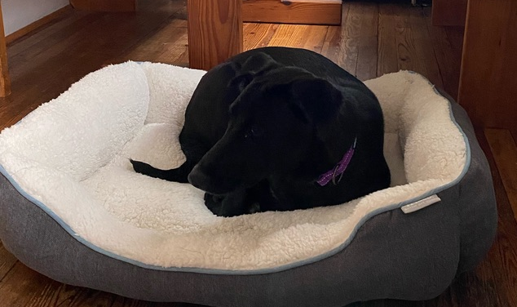
Searching For Letters
strchr returns a pointer to the first occurrence of a character in a string, or NULL if the character is not in the string.
char bailey[7];
strcpy(bailey, "Bailey");
char *letterI = strchr(bailey, 'i');
printf("%s\n", bailey); // Bailey
printf("%s\n", letterI); // iley
For multiple occurrences, strchr returns a pointer to the first one. Use strrchr to obtain a pointer to the last occurrence.
0xf1 | 0xf2 | 0xf3 | 0xf4 | 0xf5 | 0xf6 | 0xf7
'B' | 'a' | 'i' | 'l' | 'e' | 'y' | '\0'
bailey
0xee
0xf3
letterI

Slide 14
Searching For Strings
strstr returns a pointer to the first occurrence of the second string in the first, or NULL if it cannot be found.
char str[9];
strcpy(str, "Stanford");
char *substr = strstr(str, "for");
printf("%s\n", str); // Stanford
printf("%s\n", substr); // ford
If there are multiple occurrences of the string, strstr returns a pointer to the first one.
0xf1 | 0xf2 | 0xf3 | 0xf4 | 0xf5 | 0xf6 | 0xf7 | 0xf8 | 0xf9
'S' | 't' | 'a' | 'n' | 'f' | 'o' | 'r' | 'd' | '\0'
str
0xee
0xf5
substr

Slide 15
String Spans
strspn returns the length of the initial part of the first string which contains only characters in the second string. (useful for chopping strings up, checking characters used).
char bailey[10];
strcpy(bailey, "Bailey Dog");
int spanLength = strspn(bailey, "aBeoi"); // 3
“How many places can we go in the first string before I encounter a character not in the second string?”

Slide 16
String Spans
strcspn (c = “complement”) returns the length of the initial part of the first string which contains only characters not in the second string.
char bailey[10];
strcpy(bailey, "Bailey Dog");
int spanLength = strcspn(bailey, "driso"); // 2
“How many places can we go in the first string before I encounter a character in the second string?”

Slide 17
str[c]spn vs. strstr
strspn/strcspn can’t search for substrings because it does not pay attention to the order of the characters in the second string. strstr allows us to search for substrings within another string.
// these are all equivalent
int spanLength = strcspn(bailey, "driso");
int spanLength = strcspn(bailey, "sirdo");
int spanLength = strcspn(bailey, "odris");

Slide 18
Arrays of Strings
We can make an array of strings to group multiple strings together:
char *stringArray[5]; // space to store 5 char *s
We can also use the following shorthand to initialize a string array:
char *stringArray[] = {
"Hello",
"Hi",
"Hey there"
};

Slide 19
Arrays of Strings
We can access each string using bracket syntax:
printf("%s\n", stringArray[0]); // print out first string
When an array of any type is passed as a parameter in C, C passes a pointer to the first element of the array. This is what argv is in main!
void myFunction(char *stringArray[]) {
// is really this (both are equivalent):
void myFunction(char **stringArray) {

Slide 20
Practice: Password Verification
Write a function verifyPassword that accepts a candidate password and certain password criteria and returns whether the password is valid.
bool verifyPassword(char *password, char *validChars, char *badSubstrings[], int numBadSubstrings);
password is valid if it contains only letters in validChars, and does not contain any substrings in badSubstrings.

Slide 21
Practice: Password Verification
bool verifyPassword(char *password, char *validChars, char *badSubstrings[], int numBadSubstrings);
Example:
char *invalidSubstrings[] = { "1234" };
bool valid1 = verifyPassword("1572", "0123456789",
invalidSubstrings, 1); // true
bool valid2 = verifyPassword("141234", "0123456789",
invalidSubstrings, 1); // false

Slide 22
Practice: Password Verification
verify_password.c
Notes:
stdbool

Slide 23
Lecture Plan
Recap: Strings so far
Searching in Strings
Practice: Password Verification
Buffer Overflows and Security
cp -r /afs/ir/class/cs107/lecture-code/lect7 .

Slide 24
Recall: Buffer Overflows
We must make sure there is enough space in the destination to hold the entire copy, including the null-terminating character. Writing past memory bounds is called a “buffer overflow”. It can allow for security vulnerabilities!
char str1[14];
strcpy(str1, "hello, world!");
char str2[6];
strcpy(str2, str1); // not enough space - overwrites other memory!
0 | 1 | 2 | 3 | 4 | 5 | 6 | 7 | 8 | 9 | 10 | 11 | 12 | 13
'h' | 'e' | 'l' | 'l' | 'o' | ',' | ' ' | 'w' | 'o' | 'r' | 'l' | 'd' | '!' | '\0'
str1
0 | 1 | 2 | 3 | 4 | 5
'h' | 'e' | 'l' | 'l' | 'o' | ','
' ' | 'w' | 'o' | 'r' | 'l' | 'd' | '!' | '\0'
str2
- other program memory -

Slide 25
Buffer Overflow Impacts
Buffer overflows are not merely functionality bugs; they can cause a range of unintended behavior:
Let the user access memory they shouldn’t be able to access
Let the user modify memory they shouldn’t be able to access
  Change a value that is used later in the program
  User changes the program to execute their own custom instructions instead
  And more…
It’s our job as programmers to find and fix buffer overflows and other bugs not just for the functional correctness of our programs, but to protect people who use and interact with our code.
Notes:
e.g. input password to expose correct password or gain unauthorized access
e.g. overwrite number of attempts to give more attempts

Slide 26

Buffer Overflow Example: ./buf
// first argument is the name, second is the password
int main(int argc, char *argv[]) {
char secret[4] = "123";
// assume secret comes right after name in memory
// (this is not always true)
char name[4];
strcpy(name, argv[1]);
if (strcmp(secret, argv[2]) == 0) {
printf("You're in!\n");
}
return 0;
}
Which of these arguments would cause the program to print “You’re in!”?
./buf abcdefg efg
./buf abcd abcd
./buf a a
./buf abcdefgh abcd
🤔
name |  |  |  | secret
? | ? | ? | ? | '1' | '2' | '3' | '\0'
Respond on PollEv:
pollev.com/cs107
Notes:
What is the problematic line? strcpy

Slide 27
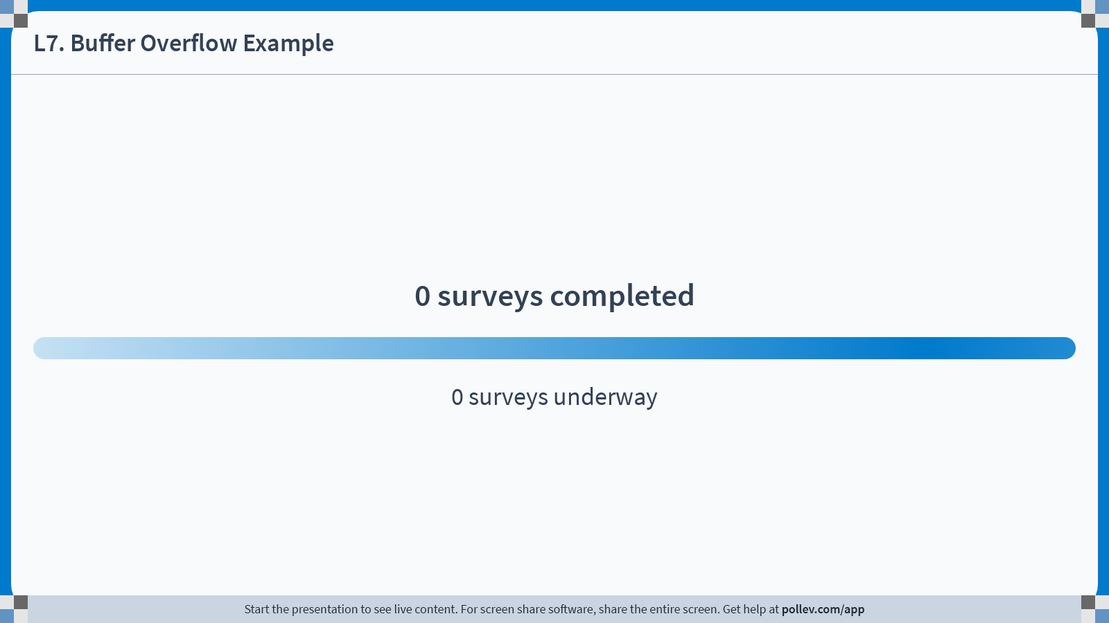
Notes:
Do not modify the notes in this section to avoid tampering with the Poll Everywhere activity.
More info at polleverywhere.com/support
L7. Buffer Overflow Example
https://www.polleverywhere.com/surveys/vpfozqGGjvb2jpSspQazS?display_state=chart&activity_state=opened&state=opened&flow=Engagement&onscreen=persist

Slide 28
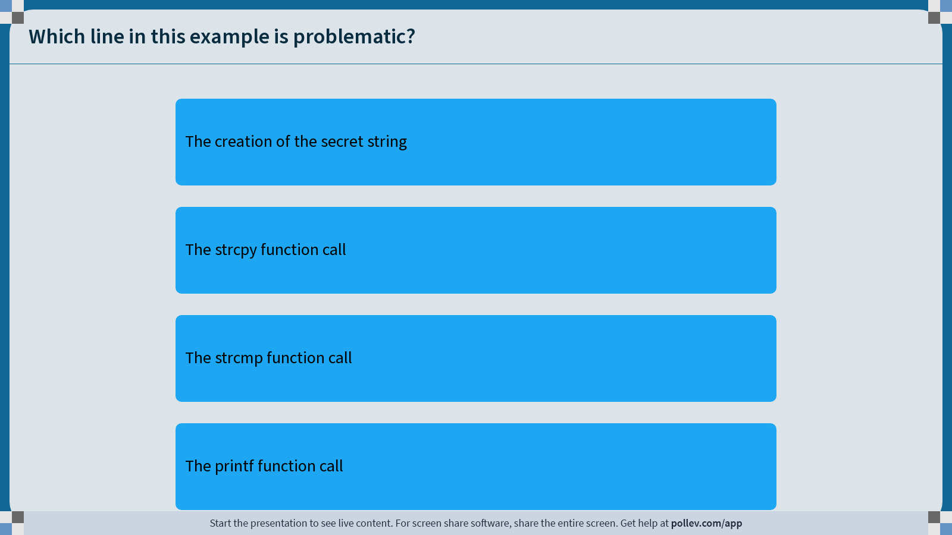
Notes:
Do not modify the notes in this section to avoid tampering with the Poll Everywhere activity.
More info at polleverywhere.com/support
Which line in this example is problematic?
https://www.polleverywhere.com/multiple_choice_polls/7yazv326jZ7mwleWPMO7e?display_state=chart&activity_state=opened&state=opened&flow=Engagement&onscreen=persist&hide=instructions

Slide 29
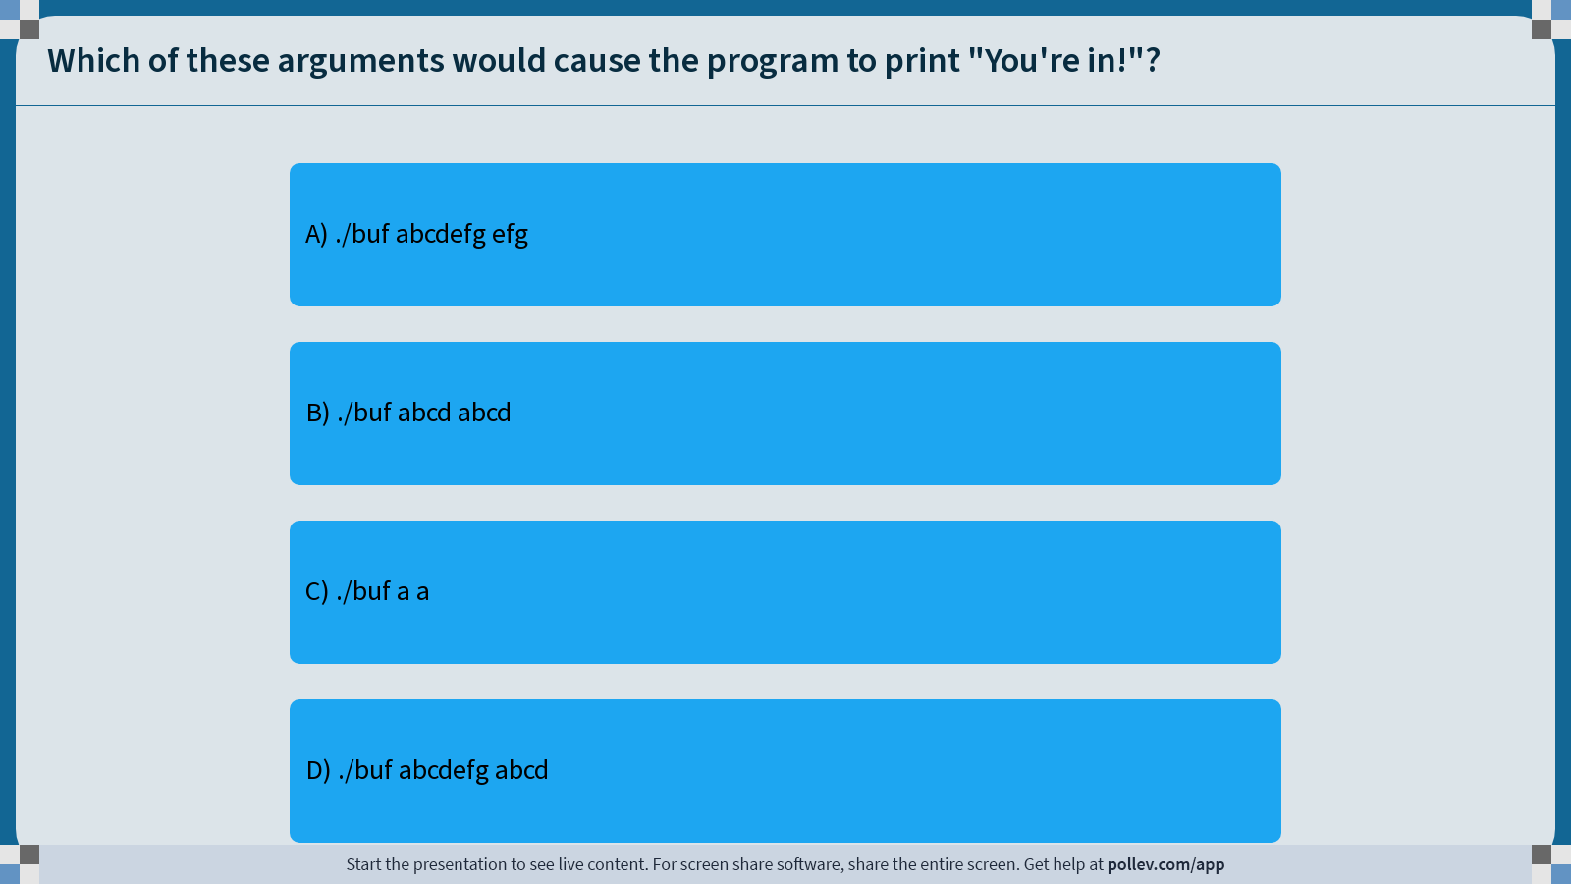
Notes:
Do not modify the notes in this section to avoid tampering with the Poll Everywhere activity.
More info at polleverywhere.com/support
Which of these arguments would cause the program to print "You're in!"?
https://www.polleverywhere.com/multiple_choice_polls/rZHJ7tsGtsr1HBP7jYKNe?display_state=chart&activity_state=opened&state=opened&flow=Engagement&onscreen=persist&hide=instructions

Slide 30
Buffer Overflow Example: ./buf
// first argument is the name, second is the password
int main(int argc, char *argv[]) {
char secret[4] = "123";
// assume secret comes right after name in memory
// (this is not always true)
char name[4];
strcpy(name, argv[1]);
if (!strcmp(secret, argv[2])) {
printf("You're in!\n");
}
return 0;
}
Which of these arguments would cause the program to print “You’re in!”?
./buf abcdefg efg
./buf abcd abcd
./buf a a
./buf abcdefgh abcd
name |  |  |  | secret
? | ? | ? | ? | '1' | '2' | '3' | '\0'

Slide 31
Buffer Overflow Example: ./buf
// first argument is the name, second is the password
int main(int argc, char *argv[]) {
char secret[4] = "123";
// assume secret comes right after name in memory
// (this is not always true)
char name[4];
strcpy(name, argv[1]);
if (!strcmp(secret, argv[2])) {
printf("You're in!\n");
}
return 0;
}
Which of these arguments would cause the program to print “You’re in!”?
./buf abcdefg efg
./buf abcd abcd
./buf a a
./buf abcdefgh abcd
name |  |  |  | secret
'a' | 'b' | 'c' | 'd' | 'e' | 'f' | 'g' | '\0'

Slide 32
Buffer Overflow Impacts
AOL instant messenger buffer overflow: allowed remote attackers to execute code: https://www.cvedetails.com/cve/CVE-2002-0362/
Morris Worm: first internet worm to gain widespread attention; exploited buffer overflow in Unix command called ”finger”: https://www.zdnet.com/article/the-morris-worm-internet-malware-turns-25/

Slide 33
How can we fix buffer overflows?
There’s no single solution to fix all buffer overflows; instead, it’s a combination of techniques to avoid them as much as possible:
Constant vigilance while programming (checking arrays and where they are modified)
Carefully reading documentation
Thorough testing to uncover issues before release
Thorough documentation to document assumptions in your code
(Where possible) use of tools that reduce the possibility for buffer overflows

Slide 34
How can we fix buffer overflows?
There’s no single solution to fix all buffer overflows; instead, it’s a combination of techniques to avoid them as much as possible:
Constant vigilance while programming (checking arrays and where they are modified)
Carefully reading documentation
Thorough testing to uncover issues before release
Thorough documentation to document assumptions in your code
(Where possible) use of tools that reduce the possibility for buffer overflows

Slide 35
How Can We Fix Overflows?
Documentation & MAN Pages (Written by Others)
  “The strcpy() function copies the string pointed to by src, including the terminating null byte (‘\0’), to the buffer pointed to by dest. The strings may not overlap, and the destination string dest must be large enough to receive the copy. Beware of buffer overruns! (See BUGS.) …
  BUGS
  If the destination string of a strcpy() is not large enough, then anything might happen. Overflowing fixed-length string buffers is a favorite cracker technique for taking complete control of the machine. Any time a program reads or copies data into a buffer, the program first needs to check that there’s enough space. This may be unnecessary if you can show that overflow is impossible, but be careful: programs can get changed over time, in ways that may make the impossible possible.”

Slide 36
How can we fix buffer overflows?
There’s no single solution to fix all buffer overflows; instead, it’s a combination of techniques to avoid them as much as possible:
Constant vigilance while programming (checking arrays and where they are modified)
Carefully reading documentation
Thorough testing to uncover issues before release
Thorough documentation to document assumptions in your code
(Where possible) use of tools that reduce the possibility for buffer overflows

Slide 37
How Can We Fix Overflows?
Valgrind: Your Greatest Ally
Write your own tests
Consider writing tests before writing the main program
✨ cs107.stanford.edu/testing.html ✨
On future assignments, you’ll get practice writing some tests prior to writing code, and adding additional tests as you write code.
Makes it easier to write tests entirely based on intended behavior, without being influenced by the actual implementation.
Notes:
Want to find bugs in testing, not production

Slide 38
How can we fix buffer overflows?
There’s no single solution to fix all buffer overflows; instead, it’s a combination of techniques to avoid them as much as possible:
Constant vigilance while programming (checking arrays and where they are modified)
Carefully reading documentation
Thorough testing to uncover issues before release
Thorough documentation to document assumptions in your code
(Where possible) use of tools that reduce the possibility for buffer overflows

Slide 39
Code Documentation
/* Function: myFunction
* This function assumes that the provided string is
* at most length 10.
* ...
*/
void myFunction(char *str) {
...

Slide 40
How can we fix buffer overflows?
There’s no single solution to fix all buffer overflows; instead, it’s a combination of techniques to avoid them as much as possible:
Constant vigilance while programming (checking arrays and where they are modified)
Carefully reading documentation
Thorough testing to uncover issues before release
Thorough documentation to document assumptions in your code
(Where possible) use of tools that reduce the possibility for buffer overflows

Slide 41
Memory Safe Systems Programming
Idea 5: Choose your Tools & Languages Carefully
Existing code bases or requirements for a project may dictate what tools you use. Knowing C is crucial – it is and will remain widely used.
When you you are choosing tools for systems programming, consider languages that can help guard against programmer error.
Rust (Mozilla)
Go (Google)
Project Verona (Microsoft)

Slide 42

Memory Safe Systems Programming
“Memory safety vulnerabilities are a class of vulnerability affecting how memory can be accessed, written, allocated, or deallocated in unintended ways. Experts have identified a few programming languages that both lack traits associated with memory safety and also have high proliferation across critical systems, such as C and C++. Choosing to use memory safe programming languages at the outset, as recommended by the Cybersecurity and Infrastructure Security Agency’s (CISA) Open-Source Software Security Roadmap is one example of developing software in a secure-by-
design manner.”

Slide 43
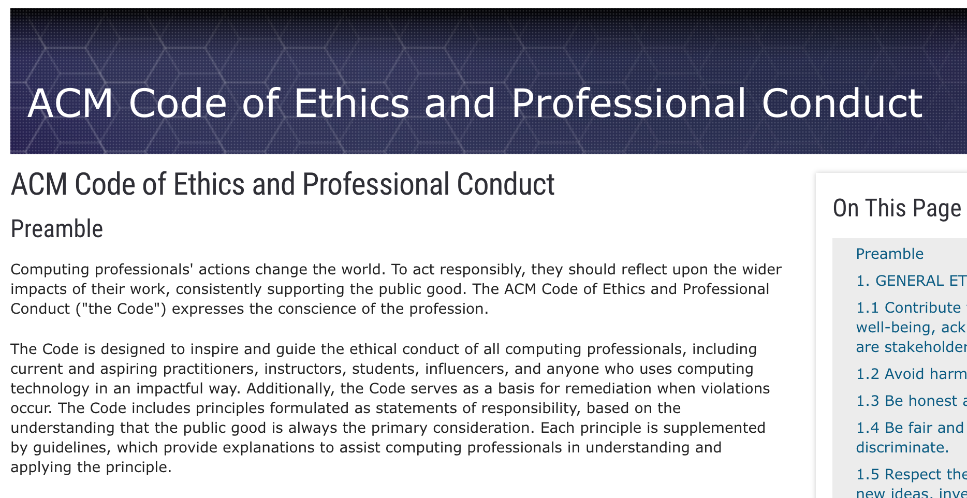
Association for Computing Machinery (ACM) Code of Ethics
https://www.acm.org/code-of-ethics
Notes:
responsibility in bigger context
Thinking about larger consequences that may put users at risk
Understand implications and risks of software we write

Slide 44
ACM Code of Ethics on Security
2.9 Design and implement systems that are robustly and usably secure.
Breaches of computer security cause harm. Robust security should be a primary consideration when designing and implementing systems. Computing professionals should perform due diligence to ensure the system functions as intended, and take appropriate action to secure resources against accidental and intentional misuse, modification, and denial of service. As threats can arise and change after a system is deployed, computing professionals should integrate mitigation techniques and policies, such as monitoring, patching, and vulnerability reporting. Computing professionals should also take steps to ensure parties affected by data breaches are notified in a timely and clear manner, providing appropriate guidance and remediation.
To ensure the system achieves its intended purpose, security features should be designed to be as intuitive and easy to use as possible. Computing professionals should discourage security precautions that are too confusing, are situationally inappropriate, or otherwise inhibit legitimate use.
In cases where misuse or harm are predictable or unavoidable, the best option may be to not implement the system.
https://www.acm.org/code-of-ethics
Notes:
Risks are real, appear in rea—world software

Slide 45
Buffer Overflows
We must always ensure that memory operations we perform don’t improperly read or write memory.
  E.g. don’t copy a string into a space that is too small!
  E.g. don’t ask for the string length of an uninitialized string!
The Valgrind tool is a memory checker tool we’ll introduce next time that can help track down (some, but not all) memory-related issues.

Slide 46
Recap
Recap: Strings so far
Searching in Strings
Practice: Password Verification
Buffer Overflows and Security
Lecture 7 takeaway: string searching functions allow us to search for characters, substrings, and spans. Buffer overflows can cause significant functionality and security issues!
cp -r /afs/ir/class/cs107/lecture-code/lect7 .

Slide 47
Extra Practice

Slide 48
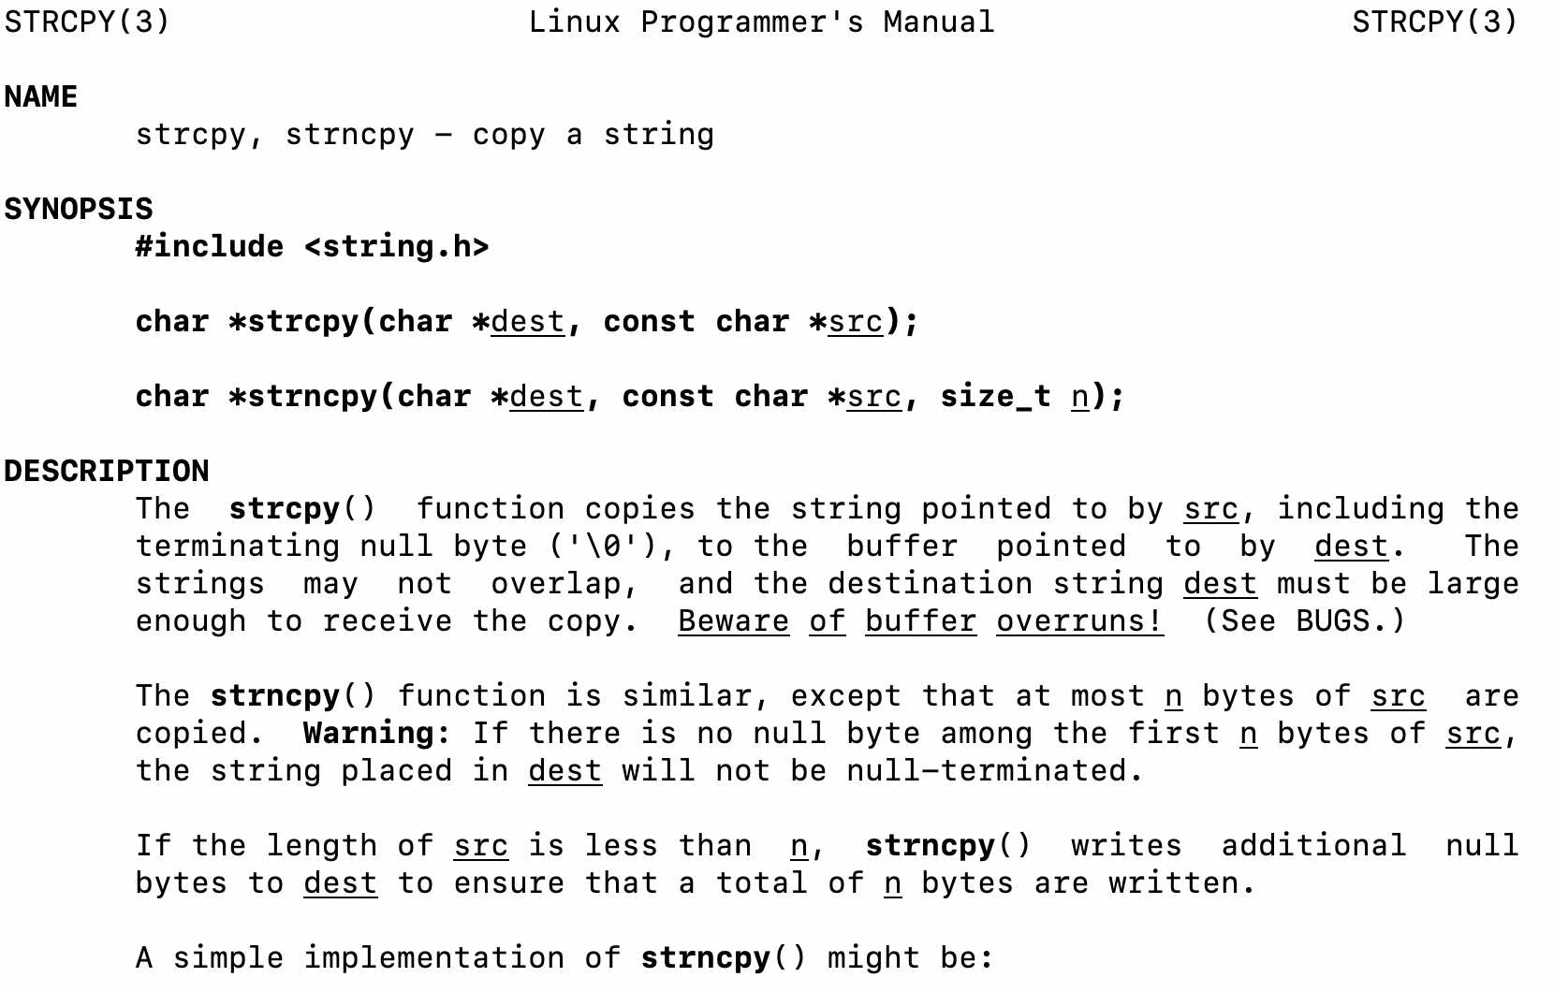
2. Code study: strncpy
0x60 | 0x61 | 0x62 | 0x63 | 0x64 | 0x65 | 0x66
'M' | 'o' | 'n' | 'd' | 'a' | 'y' | '\0'
buf
0x58 | 0x59 | 0x5a | 0x5b
'F' | 'r' | 'i' | '\0'
str
1
2
3
4
5
6
7
8
char *strncpy(char *dest, const char *src, size_t n) {
size_t i;
for (i = 0; i < n && src[i] != '\0'; i++)
dest[i] = src[i];
for ( ; i < n; i++)
dest[i] = '\0';
return dest;
}
🤔
What happens if we call strncpy(buf, str, 5);?

Slide 49
2. Code study: strncpy
0x60 | 0x61 | 0x62 | 0x63 | 0x64 | 0x65 | 0x66
'M' | 'o' | 'n' | 'd' | 'a' | 'y' | '\0'
buf
0x58 | 0x59 | 0x5a | 0x5b
'F' | 'r' | 'i' | '\0'
str
1
2
3
4
5
6
7
8
char *strncpy(char *dest, const char *src, size_t n) {
size_t i;
for (i = 0; i < n && src[i] != '\0'; i++)
dest[i] = src[i];
for ( ; i < n; i++)
dest[i] = '\0';
return dest;
}
dest
src
n
5
i
What happens if we call strncpy(buf, str, 5);?

