Slide 1
CS107, Lecture 9
Pointers and Arrays
Reading: K&R (5.2-5.5) or Essential C section 6

Slide 2

CS198 Section Leading
cs198@cs.stanford.edu

Slide 3
Who should section lead?
For this round of applications, we are looking for applicants have completed the equivalent of CS106B… and that’s you!
We are looking for section leaders from all backgrounds who can relate to students and clearly explain concepts.

Slide 4
What do section leaders do?
Teach a weekly 50 minute section
Help students in the LaIR
Grade CS106 assignments
Hold IGs with students
Grade midterms and finals
Get paid $18.50/hour (more with seniority)
Have fun!

Slide 5
Time and requirements
You’ll need to:
Section lead for two quarters!
Take CS198 for 3-4 units (1st quarter only)
Attend staff meetings (Monday, 4:30-5:30PM)
Attend Monday workshops (7:30-9pm) for first 4 weeks of first quarter
Attend Wednesday workshops (based on availability) for first 4 weeks of first quarter
Fulfill all teaching, LaIR, and grading responsibilities

Slide 6
Why section lead?
“Learn to teach; teach to learn”
Work directly with students
Participate in fun events
Join an amazing group of people
Leave your mark on campus

Slide 7
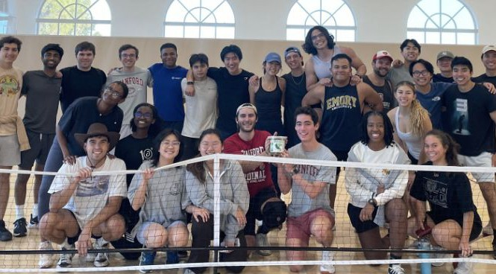
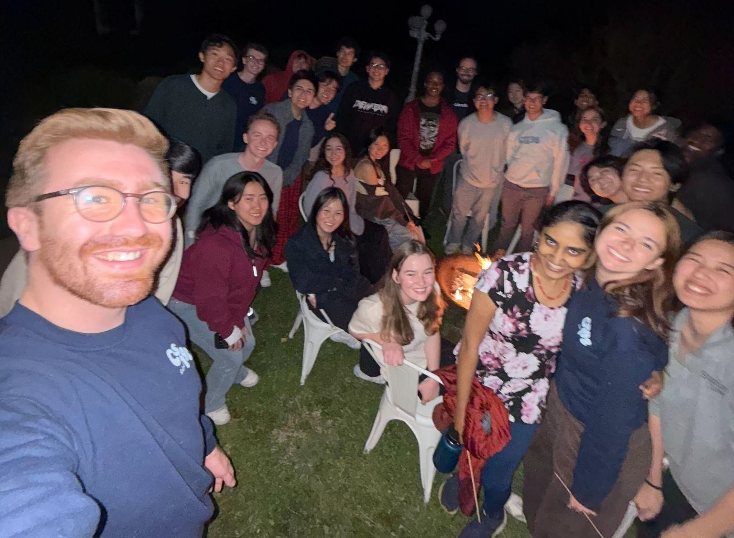
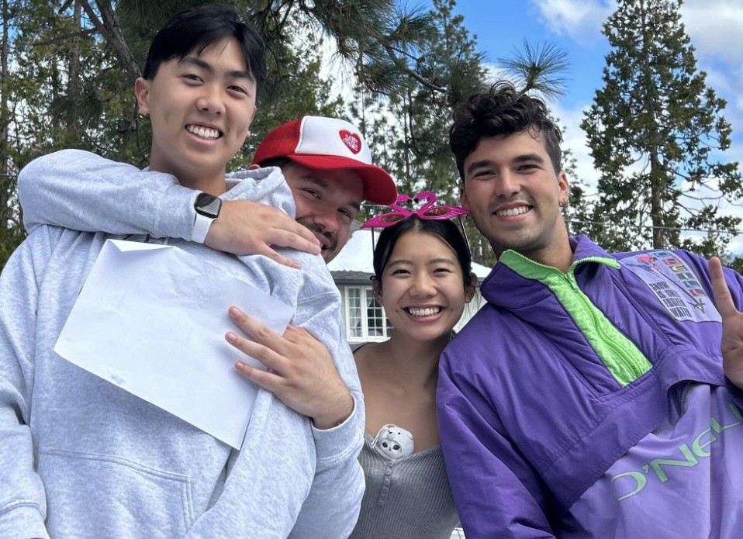
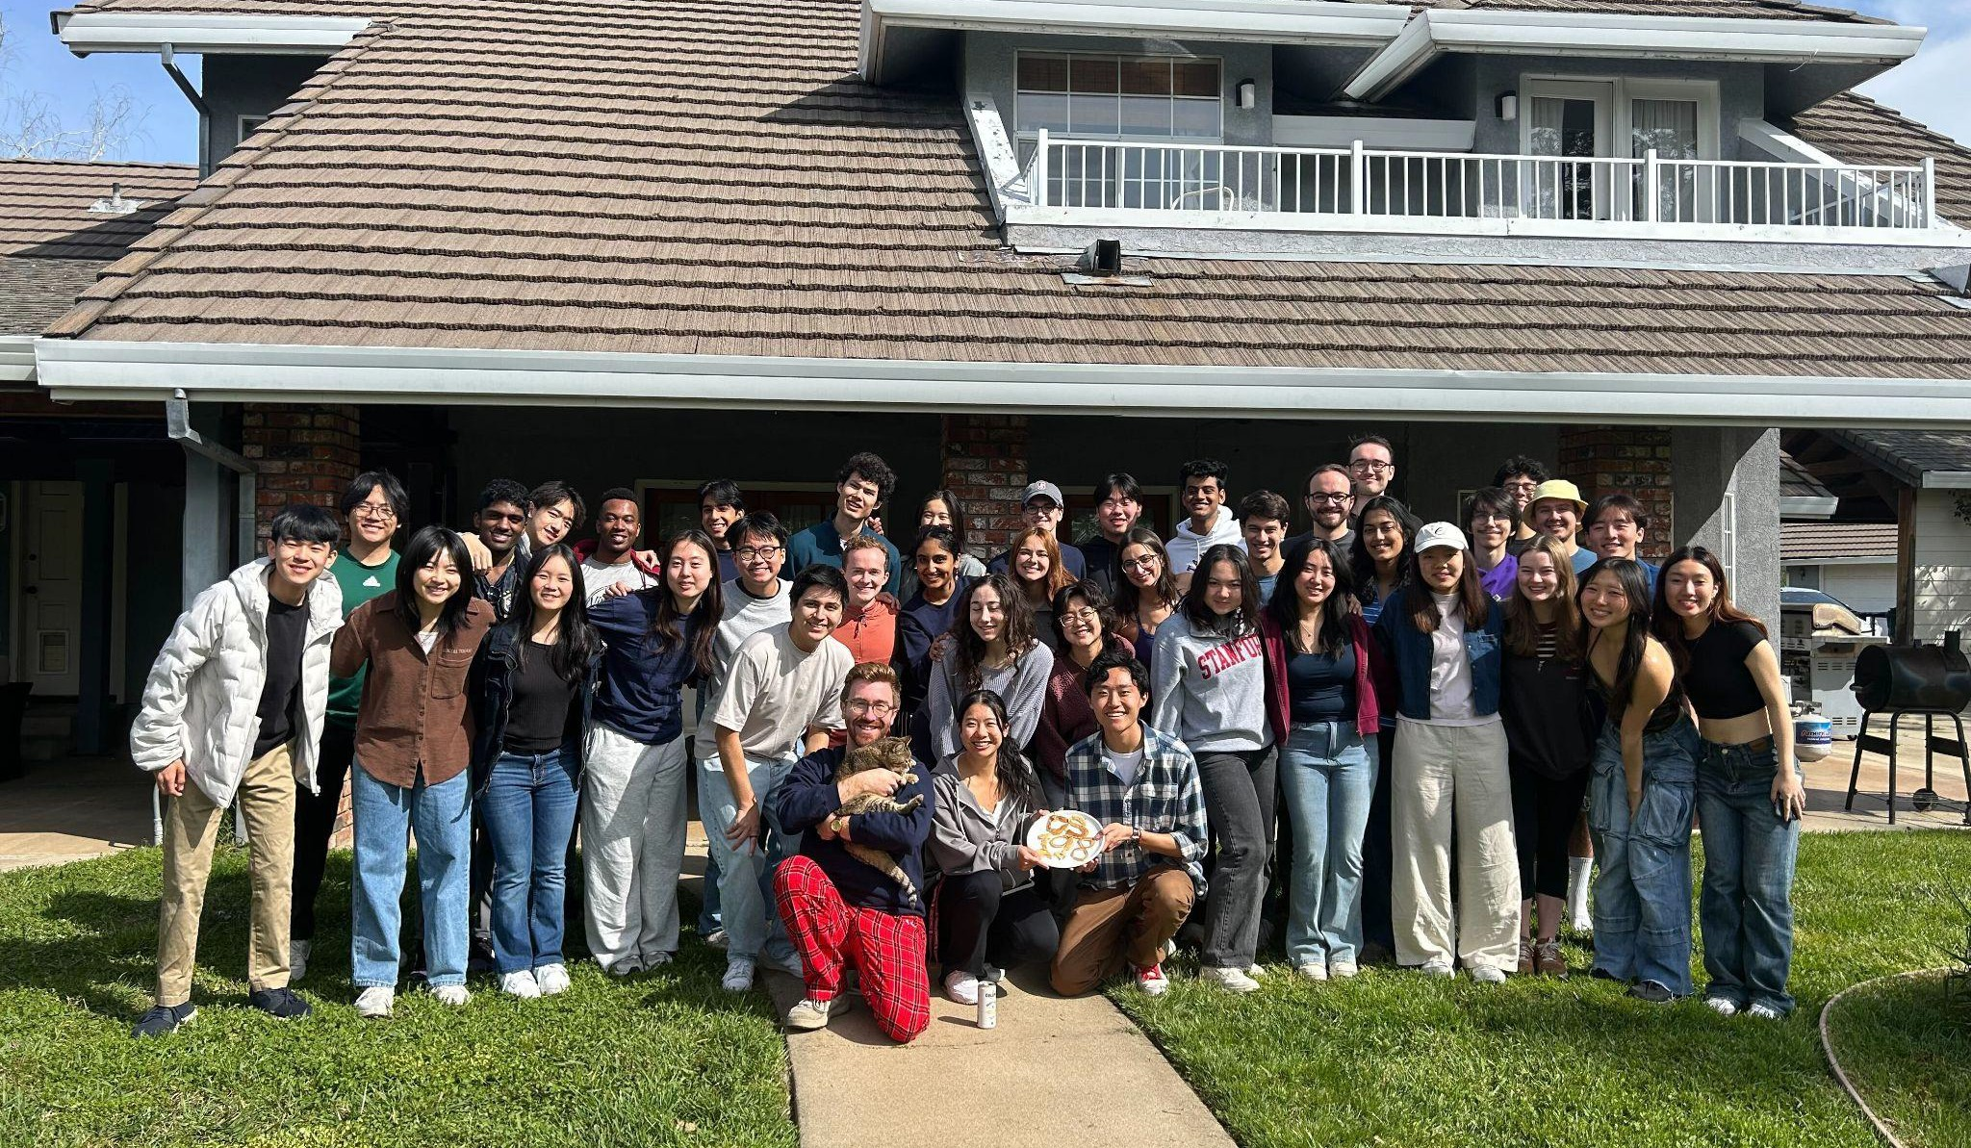
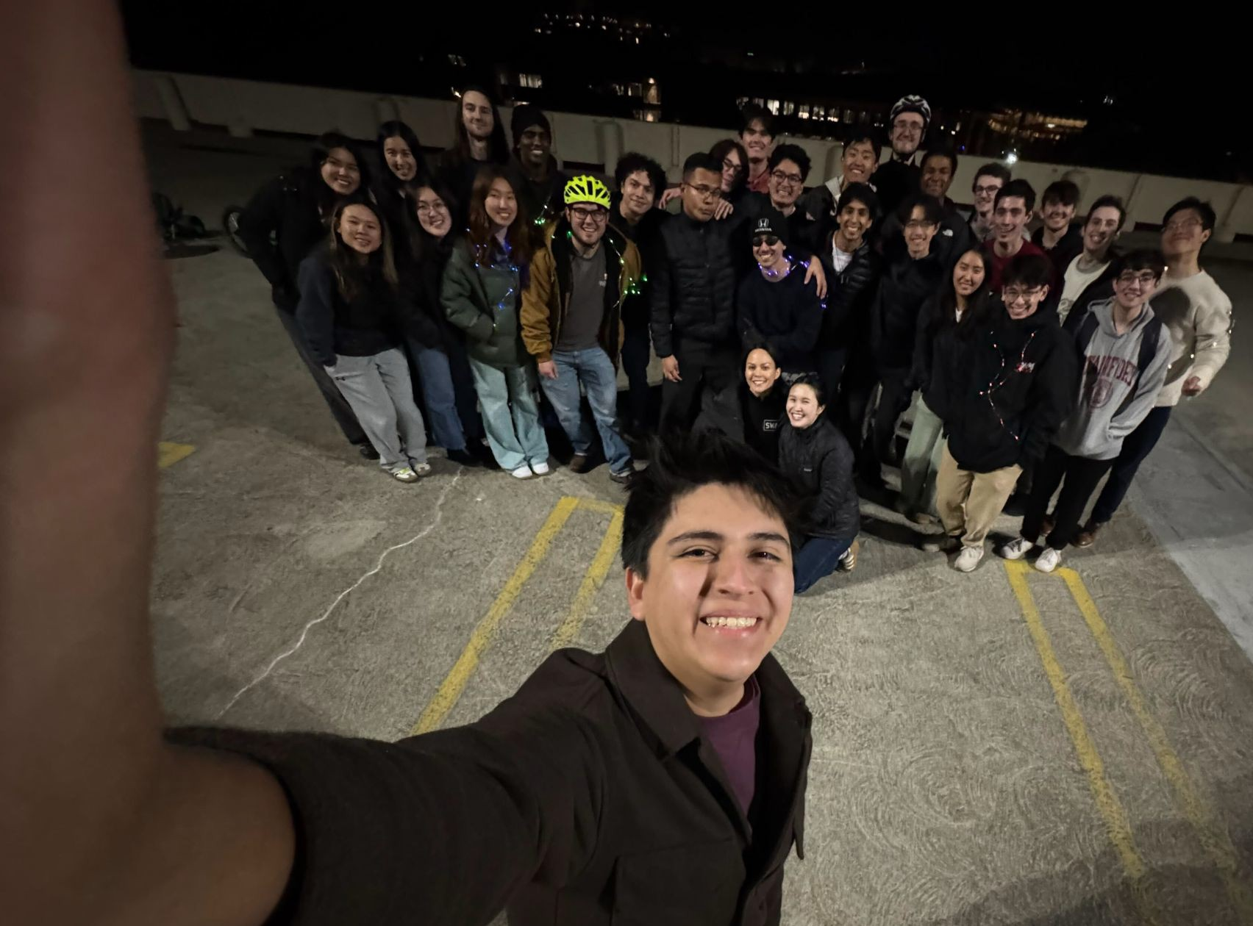
Participate in fun events
LaIR Formal
Special D
BAWK
Lecturer Hangouts
New SL Picnic
Swag
And more!

Slide 8
Apply Now
Application is open now!
Deadline: Thursday, April 24th at 11:59PM PT
Online application: cs198.stanford.edu Contact us: cs198@cs.stanford.edu

Slide 9
CS107 Topic 3: How can we effectively manage all types of memory in our programs?

Slide 10
CS107 Topic 3
How can we effectively manage all types of memory in our programs?
Why is answering this question important?
Shows us how we can pass around data efficiently with pointers (this time)
Introduces us to the heap and allocating memory that we manually manage (next time)
Helps us better understand use-after-free vulnerabilities, a common bug (next week)
assign3: implement a function using resizable arrays to read lines of any length from a file and write 2 programs using that function to print the last N lines of a file and print just the unique lines of a file. These programs emulate the tail and uniq Unix commands!

Slide 11
Learning Goals
Learn about pointers and how they help us access data without making copies
Understand arrays and how they relate to pointers
Get more practice using memory diagrams to understand code behavior

Slide 12
Lecture Plan
Review: Pointers
Double Pointers
Pointer Arithmetic
Arrays in Memory
cp -r /afs/ir/class/cs107/lecture-code/lect9 .

Slide 13
Lecture Plan
Review: Pointers
Double Pointers
Pointer Arithmetic
Arrays in Memory
cp -r /afs/ir/class/cs107/lecture-code/lect9 .

Slide 14
Pointers and Memory
A pointer is a variable that stores a memory address.
Memory is a big array of bytes, and each byte has a unique numeric index that is commonly written in hexadecimal. A pointer stores one of these “indexes”.
Because there is no pass-by-reference in C like in C++, pointers let us pass around the address of one instance of memory, instead of making many copies.
Pointers are also essential for allocating memory on the heap, and to refer to memory generically, both of which we will cover later.
Address | Value
 | …
0x105 | '\0'
0x104 | 'e'
0x103 | 'l'
0x102 | 'p'
0x101 | 'p'
0x100 | 'a'
 | …

Slide 15
Pass By Value
When you pass a value as a parameter, C passes a copy of that value.
void myFunc(int val) {
val = 3;
}
int main(int argc, char *argv[]) {
int x = 2;
myFunc(x);
printf("%d", x); // 2!
...
}
STACK
Address | Value
 | …
0x1f0 | 2
 | …
x
main()

Slide 16
Pass By Value
When you pass a value as a parameter, C passes a copy of that value.
void myFunc(int val) {
val = 3;
}
int main(int argc, char *argv[]) {
int x = 2;
myFunc(x);
printf("%d", x); // 2!
...
}
STACK
Address | Value
 | …
0x1f0 | 2
 | …
x
main()

Slide 17
Pass By Value
When you pass a value as a parameter, C passes a copy of that value.
void myFunc(int val) {
val = 3;
}
int main(int argc, char *argv[]) {
int x = 2;
myFunc(x);
printf("%d", x); // 2!
...
}
STACK
Address | Value
 | …
0x1f0 | 2
 | …
0x10 | 2
 | …
x
main()
myFunc()
val

Slide 18
Pass By Value
When you pass a value as a parameter, C passes a copy of that value.
void myFunc(int val) {
val = 3;
}
int main(int argc, char *argv[]) {
int x = 2;
myFunc(x);
printf("%d", x); // 2!
...
}
STACK
Address | Value
 | …
0x1f0 | 2
 | …
0x10 | 2
 | …
x
main()
myFunc()
val

Slide 19
Pass By Value
When you pass a value as a parameter, C passes a copy of that value.
void myFunc(int val) {
val = 3;
}
int main(int argc, char *argv[]) {
int x = 2;
myFunc(x);
printf("%d", x); // 2!
...
}
STACK
Address | Value
 | …
0x1f0 | 2
 | …
0x10 | 3
 | …
x
main()
myFunc()
val

Slide 20
Pass By Value
When you pass a value as a parameter, C passes a copy of that value.
void myFunc(int val) {
val = 3;
}
int main(int argc, char *argv[]) {
int x = 2;
myFunc(x);
printf("%d", x); // 2!
...
}
STACK
Address | Value
 | …
0x1f0 | 2
 | …
x
main()

Slide 21
Pointers
Pointers allow us to pass around the location of data so that the original data can be modified in other functions.
Example: I want to write a function myFunc that can change the value of an existing integer to be 3.
int main(int argc, char *argv[]) {
int x = 2;
myFunc(???);
printf("%d", x); // want to print 3
...
}
Notes:
Could also return new value in this case

Slide 22
Pointers
int x = 2;
// Make a pointer that stores the address of x.
// (& means "address of")
int *xPtr = &x;
// Dereference the pointer to go to that address.
// (* means "dereference")
printf("%d", *xPtr); // prints 2
If declaration: “pointer”
ex: int * is "pointer to an int”
If operation: "dereference/the value at address”
ex: *num is "the value at address num"
*

Slide 23
Pointers
int x = 2;
// & adds a * to the type (e.g. int -> int *)
int *xPtr = &x;
// Dereferencing removes a * from the type (e.g. int * -> int)
int y = *xPtr;

Slide 24
Pointers
A pointer lets us pass where a particular instance of data is, so it can be modified.
void myFunc(int *intPtr) {
*intPtr = 3;
}
int main(int argc, char *argv[]) {
int x = 2;
myFunc(&x);
printf("%d", x); // 3!
...
}
STACK
Address | Value
 | …
0x1f0 | 2
 | …
x
main()

Slide 25
Pointers
A pointer lets us pass where a particular instance of data is, so it can be modified.
void myFunc(int *intPtr) {
*intPtr = 3;
}
int main(int argc, char *argv[]) {
int x = 2;
myFunc(&x);
printf("%d", x); // 3!
...
}
STACK
Address | Value
 | …
0x1f0 | 2
 | …
x
main()

Slide 26
Pointers
A pointer lets us pass where a particular instance of data is, so it can be modified.
void myFunc(int *intPtr) {
*intPtr = 3;
}
int main(int argc, char *argv[]) {
int x = 2;
myFunc(&x);
printf("%d", x); // 3!
...
}
STACK
Address | Value
 | …
0x1f0 | 2
 | …
0x10 | 0x1f0
 | …
x
main()
myFunc()
intPtr

Slide 27
Pointers
A pointer lets us pass where a particular instance of data is, so it can be modified.
void myFunc(int *intPtr) {
*intPtr = 3;
}
int main(int argc, char *argv[]) {
int x = 2;
myFunc(&x);
printf("%d", x); // 3!
...
}
STACK
Address | Value
 | …
0x1f0 | 2
 | …
0x10 | 0x1f0
 | …
x
main()
myFunc()
intPtr

Slide 28
Pointers
A pointer lets us pass where a particular instance of data is, so it can be modified.
void myFunc(int *intPtr) {
*intPtr = 3;
}
int main(int argc, char *argv[]) {
int x = 2;
myFunc(&x);
printf("%d", x); // 3!
...
}
STACK
Address | Value
 | …
0x1f0 | 3
 | …
0x10 | 0x1f0
 | …
x
main()
myFunc()
intPtr

Slide 29
Pointers
A pointer lets us pass where a particular instance of data is, so it can be modified.
void myFunc(int *intPtr) {
*intPtr = 3;
}
int main(int argc, char *argv[]) {
int x = 2;
myFunc(&x);
printf("%d", x); // 3!
...
}
STACK
Address | Value
 | …
0x1f0 | 3
 | …
x
main()

Slide 30
C Parameters
If you are performing an operation with some input and do not care about any changes to the input, pass the data type itself.
If you are modifying a specific instance of some value, pass the location of what you would like to modify and dereference that location to access what’s there.
If a function takes an address (pointer) as a parameter, it can go to that address if it needs the actual value.
Do I care about modifying this instance of my data? If so, I need to pass where that instance lives, as a parameter, so it can be modified.

Slide 31
Exercise 1
We want to write a function that prints out the square of a number. What should go in each of the blanks?
void printSquare(__?__) {
int square = __?__ * __?__;
printf("%d", square);
}
int main(int argc, char *argv[]) {
int num = 3;
printSquare(__?__); // should print 9
}

Slide 32
Exercise 1
We want to write a function that prints out the square of a number. What should go in each of the blanks?
void printSquare(int x) {
x = x * x;
printf("%d", x);
}
int main(int argc, char *argv[]) {
int num = 3;
printSquare(num); // should print 9
}
We are performing a calculation with some input and do not care about any changes to the input, so we pass the data type itself.

Slide 33
Pointers Practice
void makeUpper(char *ptr) {
__1__ = toupper(__2__);
}
int main(int argc, char *argv[]) {
char ch = 'h';
// want to modify ch to be capital
makeUpper(__3__);
printf("%c\n", ch); // should print 'H'
return 0;
}
What should go in each of the blanks so that this code correctly modifies ch to be capitalized?
🤔

Slide 34
Pointers Practice
void makeUpper(char *ptr) {
*ptr = toupper(*ptr);
}
int main(int argc, char *argv[]) {
char ch = 'h';
// want to modify ch to be capital
makeUpper(&ch);
printf("%c\n", ch); // should print 'H'
return 0;
}
We are modifying a specific instance of the letter, so we pass the location of the letter we would like to modify.

Slide 35
Pointers Summary
void doSomething(TYPE *ptr) {
// access/change val with *ptr
}
int main(int argc, char *argv[]) {
TYPE myVariable = ...
// want to modify myVariable
makeUpper(&myVariable);
// now myVariable should be different
return 0;
}
General rule: if we want to modify a variable with type TYPE in another function, we pass in TYPE * as a parameter. We can then dereference it within the function to get/set the value pointed to.

Slide 36
Lecture Plan
Review: Pointers
Double Pointers
Pointer Arithmetic
Arrays in Memory
cp -r /afs/ir/class/cs107/lecture-code/lect9 .

Slide 37

Exercise 3
Sometimes, we would like to modify a string’s pointer itself, rather than just the characters it points to. E.g. we want to write a function skipSpaces that modifies a string pointer to skip past any initial spaces. What should go in each of the blanks?
void skipSpaces(__1__) {
...
}
int main(int argc, char *argv[]) {
char *str = " hello";
skipSpaces(__2__);
printf("%s", str); // should print "hello"
}
Respond on PollEv: pollev.com/cs107
🤔

Slide 38
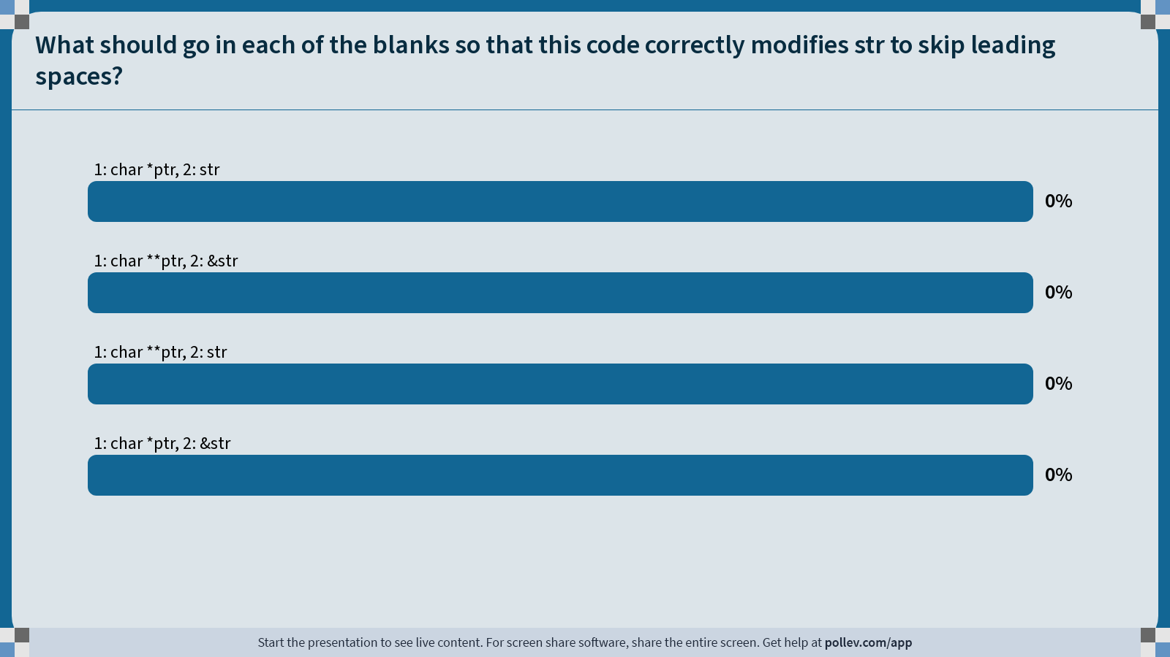
Notes:
Do not modify the notes in this section to avoid tampering with the Poll Everywhere activity.
More info at polleverywhere.com/support
What should go in each of the blanks so that this code correctly modifies str to skip leading spaces?
https://www.polleverywhere.com/multiple_choice_polls/pF9z5hTfgJLttYoF7riv3?state=opened&flow=Default&onscreen=persist

Slide 39
Exercise 3
Sometimes, we would like to modify a string’s pointer itself, rather than just the characters it points to. E.g. we want to write a function skipSpaces that modifies a string pointer to skip past any initial spaces. What should go in each of the blanks?
void skipSpaces(char **strPtr) {
...
}
int main(int argc, char *argv[]) {
char *str = " hello";
skipSpaces(&str);
printf("%s", str); // should print "hello"
}
We are modifying a specific instance of the string pointer, so we pass the location of the string pointer we would like to modify.

Slide 40
Pointers to Strings
Address | Value
 | …
 | …
void skipSpaces(char **strPtr) {
int numSpaces = strspn(*strPtr, " ");
*strPtr += numSpaces;
}
int main(int argc, char *argv[]) {
char *myStr = " hi";
skipSpaces(&myStr);
printf("%s\n", myStr); // hi
return 0;
}
STACK
main()

Slide 41
Pointers to Strings
Address | Value
 | …
0x105 | 0xf
 | …
 | …
0x13 | '\0'
0x12 | 'i'
0x11 | 'h'
0x10 | ' '
0xf | ' '
 | …
void skipSpaces(char **strPtr) {
int numSpaces = strspn(*strPtr, " ");
*strPtr += numSpaces;
}
int main(int argc, char *argv[]) {
char *myStr = " hi";
skipSpaces(&myStr);
printf("%s\n", myStr); // hi
return 0;
}
STACK
main()
myStr
DATA SEGMENT

Slide 42
Pointers to Strings
Address | Value
 | …
0x105 | 0xf
 | …
 | …
0x13 | '\0'
0x12 | 'i'
0x11 | 'h'
0x10 | ' '
0xf | ' '
 | …
void skipSpaces(char **strPtr) {
int numSpaces = strspn(*strPtr, " ");
*strPtr += numSpaces;
}
int main(int argc, char *argv[]) {
char *myStr = " hi";
skipSpaces(&myStr);
printf("%s\n", myStr); // hi
return 0;
}
STACK
main()
myStr
DATA SEGMENT

Slide 43
Pointers to Strings
Address | Value
 | …
0x105 | 0xf
 | …
 | …
0xf0 | 0x105
 | …
 | …
0x13 | '\0'
0x12 | 'i'
0x11 | 'h'
0x10 | ' '
0xf | ' '
 | …
void skipSpaces(char **strPtr) {
int numSpaces = strspn(*strPtr, " ");
*strPtr += numSpaces;
}
int main(int argc, char *argv[]) {
char *myStr = " hi";
skipSpaces(&myStr);
printf("%s\n", myStr); // hi
return 0;
}
main()
myStr
STACK
skipSpaces()
strPtr
DATA SEGMENT

Slide 44
Pointers to Strings
Address | Value
 | …
0x105 | 0xf
 | …
 | …
0xf0 | 0x105
0xe8 | 2
 | …
 | …
0x13 | '\0'
0x12 | 'i'
0x11 | 'h'
0x10 | ' '
0xf | ' '
 | …
void skipSpaces(char **strPtr) {
int numSpaces = strspn(*strPtr, " ");
*strPtr += numSpaces;
}
int main(int argc, char *argv[]) {
char *myStr = " hi";
skipSpaces(&myStr);
printf("%s\n", myStr); // hi
return 0;
}
main()
myStr
STACK
strPtr
skipSpaces()
numSpaces
DATA SEGMENT

Slide 45
Pointers to Strings
Address | Value
 | …
0x105 | 0xf
 | …
 | …
0xf0 | 0x105
0xe8 | 2
 | …
 | …
0x13 | '\0'
0x12 | 'i'
0x11 | 'h'
0x10 | ' '
0xf | ' '
 | …
void skipSpaces(char **strPtr) {
int numSpaces = strspn(*strPtr, " ");
*strPtr += numSpaces;
}
int main(int argc, char *argv[]) {
char *myStr = " hi";
skipSpaces(&myStr);
printf("%s\n", myStr); // hi
return 0;
}
main()
myStr
STACK
strPtr
skipSpaces()
numSpaces
DATA SEGMENT

Slide 46
Pointers to Strings
Address | Value
 | …
0x105 | 0x11
 | …
 | …
0xf0 | 0x105
0xe8 | 2
 | …
 | …
0x13 | '\0'
0x12 | 'i'
0x11 | 'h'
0x10 | ' '
0xf | ' '
 | …
void skipSpaces(char **strPtr) {
int numSpaces = strspn(*strPtr, " ");
*strPtr += numSpaces;
}
int main(int argc, char *argv[]) {
char *myStr = " hi";
skipSpaces(&myStr);
printf("%s\n", myStr); // hi
return 0;
}
main()
myStr
STACK
strPtr
skipSpaces()
numSpaces
DATA SEGMENT
Notes:
strPtr
*strPtr
**strPtr
&myStr
myStr

Slide 47
Pointers to Strings
Address | Value
 | …
0x105 | 0x11
 | …
 | …
0x13 | '\0'
0x12 | 'i'
0x11 | 'h'
0x10 | ' '
0xf | ' '
 | …
void skipSpaces(char **strPtr) {
int numSpaces = strspn(*strPtr, " ");
*strPtr += numSpaces;
}
int main(int argc, char *argv[]) {
char *myStr = " hi";
skipSpaces(&myStr);
printf("%s\n", myStr); // hi
return 0;
}
STACK
main()
myStr
DATA SEGMENT

Slide 48
Pointers to Strings
Address | Value
 | …
0x105 | 0x11
 | …
 | …
0x13 | '\0'
0x12 | 'i'
0x11 | 'h'
0x10 | ' '
0xf | ' '
 | …
void skipSpaces(char **strPtr) {
int numSpaces = strspn(*strPtr, " ");
*strPtr += numSpaces;
}
int main(int argc, char *argv[]) {
char *myStr = " hi";
skipSpaces(&myStr);
printf("%s\n", myStr); // hi
return 0;
}
STACK
main()
myStr
DATA SEGMENT
Weird thought – 0x11 is a string.

Slide 49
Making Copies
Address | Value
 | …
0x105 | 0xf
 | …
 | …
0xf0 | 0xf
 | …
 | …
0x13 | '\0'
0x12 | 'i'
0x11 | 'h'
0x10 | ' '
0xf | ' '
 | …
void skipSpaces(char *strPtr) {
int numSpaces = strspn(strPtr, " ");
strPtr += numSpaces;
}
int main(int argc, char *argv[]) {
char *myStr = " hi";
skipSpaces(myStr);
printf("%s\n", myStr); // hi
return 0;
}
main()
myStr
STACK
skipSpaces()
strPtr
This advances skipSpace’s own copy of the string pointer, not the instance in main.
DATA SEGMENT

Slide 50
Lecture Plan
Review: Pointers
Double Pointers
Pointer Arithmetic
Arrays in Memory
cp -r /afs/ir/class/cs107/lecture-code/lect9 .

Slide 51
Pointer Arithmetic
When you do pointer arithmetic, you are adjusting the pointer by a certain number of places (e.g. characters).
char *str = "apple"; // e.g. 0xff0
char *str1 = str + 1; // e.g. 0xff1
char *str3 = str + 3; // e.g. 0xff3
printf("%s", str); // apple
printf("%s", str1); // pple
printf("%s", str3); // le
DATA SEGMENT
Address | Value
 | …
0xff5 | '\0'
0xff4 | 'e'
0xff3 | 'l'
0xff2 | 'p'
0xff1 | 'p'
0xff0 | 'a'
 | …

Slide 52
Pointer Arithmetic
Pointer arithmetic does not work in bytes. Instead, it works in the size of the type it points to.
// nums points to an int array
int *nums = … // e.g. 0xff0
int *nums1 = nums + 1; // e.g. 0xff4
int *nums3 = nums + 3; // e.g. 0xffc
printf("%d", *nums); // 52
printf("%d", *nums1); // 23
printf("%d", *nums3); // 34
STACK
Address | Value
 | …
0x1004 | 1
0x1000 | 16
0xffc | 34
0xff8 | 12
0xff4 | 23
0xff0 | 52
 | …

Slide 53
Pointer Arithmetic
Pointer arithmetic does not work in bytes. Instead, it works in the size of the type it points to.
// nums points to an int array
int *nums = … // e.g. 0xff0
int *nums3 = nums + 3; // e.g. 0xffc
int *nums2 = nums3 - 1; // e.g. 0xff8
printf("%d", *nums); // 52
printf("%d", *nums2); // 12
printf("%d", *nums3); // 34
STACK
Address | Value
 | …
0x1004 | 1
0x1000 | 16
0xffc | 34
0xff8 | 12
0xff4 | 23
0xff0 | 52
 | …

Slide 54
Pointer Arithmetic
When you use bracket notation with a pointer, you are actually performing pointer arithmetic and dereferencing:
char *str = "apple"; // e.g. 0xff0
// both of these add two places to str,
// and then dereference to get the char there.
// E.g. get memory at 0xff2.
char thirdLetter = str[2]; // 'p'
char thirdLetter = *(str + 2); // 'p'
DATA SEGMENT
Address | Value
 | …
0xff5 | '\0'
0xff4 | 'e'
0xff3 | 'l'
0xff2 | 'p'
0xff1 | 'p'
0xff0 | 'a'
 | …

Slide 55
Pointer Arithmetic
Pointer arithmetic with two pointers does not give the byte difference. Instead, it gives the number of places they differ by.
// nums points to an int array
int *nums = … // e.g. 0xff0
int *nums3 = nums + 3; // e.g. 0xffc
int diff = nums3 - nums; // 3
STACK
Address | Value
 | …
0x1004 | 1
0x1000 | 16
0xffc | 34
0xff8 | 12
0xff4 | 23
0xff0 | 52
 | …

Slide 56
Pointer Arithmetic
How does the code know how many bytes it should look at once it visits an address? At compile time, C can figure out the sizes of different data types, and the sizes of what they point to.
int x = 2;
int *xPtr = &x; // e.g. 0xff0
// C knows to print out just the 4 bytes at xPtr
printf("%d", *xPtr); // 2

Slide 57
Pointer Arithmetic
How does the code know how many bytes it should add when performing pointer arithmetic? At compile time, C can figure out the sizes of different data types, and the sizes of what they point to.
int nums[] = {1, 2, 3};
// C knows to add 4 bytes here
int *intPtr = nums + 1;
char str[6];
strcpy(str, "CS107");
// C knows to add 1 byte here
char *charPtr = str + 1;

Slide 58
Lecture Plan
Review: Pointers
Double Pointers
Pointer Arithmetic
Arrays in Memory
cp -r /afs/ir/class/cs107/lecture-code/lect9 .

Slide 59
Arrays
When you declare an array, contiguous memory is allocated on the stack to store the contents of the entire array.
char str[6];
strcpy(str, "apple");
The array variable (e.g. str) is not a pointer; it refers to the entire array contents. In fact, sizeof returns the size of the entire array!
int arrayBytes = sizeof(str); // 6
STACK
Address | Value
 | …
0x105 | '\0'
0x104 | 'e'
0x103 | 'l'
0x102 | 'p'
0x101 | 'p'
0x100 | 'a'
 | …
str

Slide 60
Arrays
An array variable refers to an entire block of memory. You cannot reassign an existing array to be equal to a new array.
int nums[] = {1, 2, 3};
int nums2[] = {4, 5, 6, 7};
nums = nums2; // not allowed!
An array’s size cannot be changed once you create it; you must create another new array instead.

Slide 61
Arrays as Parameters
STACK
When you pass an array as a parameter, C makes a copy of the address of the first array element, and passes it (a pointer) to the function.
void myFunc(char *myStr) {
...
}
int main(int argc, char *argv[]) {
char str[3];
strcpy(str, "hi");
myFunc(str);
...
}
Address | Value
0x1f2 | '\0'
0x1f1 | 'i'
0x1f0 | 'h'
 | ...
0xff
0xfe
0xfd
0xfc
0xfb
0xfa
0xf9
0xf8
 | ...
main()
str
0x1f0
myFunc()
mystr

Slide 62
Arrays as Parameters
STACK
When you pass an array as a parameter, C makes a copy of the address of the first array element and passes it (a pointer) to the function.
void myFunc(char *myStr) {
…
}
int main(int argc, char *argv[]) {
char str[3];
strcpy(str, "hi");
// equivalent
char *arrPtr = str;
myFunc(arrPtr);
...
}
Address | Value
0x1f2 | '\0'
0x1f1 | 'i'
0x1f0 | 'h'
0x1e8 | 0x1f0
 | …
0x10 | 0x1f0
 | …
str
main()
arrPtr
myStr
myFunc()

Slide 63
Arrays and Pointers
STACK
We can also make a pointer equal to an array; it will point to the first element in that array.
int main(int argc, char *argv[]) {
char str[6];
strcpy(str, "apple");
char *ptr = str;
// equivalent
char *ptr = &str[0];
// confusingly equivalent, avoid
char *ptr = &str;
...
}
Address | Value
 | …
0x105 | '\0'
0x104 | 'e'
0x103 | 'l'
0x102 | 'p'
0x101 | 'p'
0x100 | 'a'
0xf8 | 0x100
 | …
main()
str
ptr

Slide 64
Arrays as Parameters
STACK
This also means we can no longer get the full size of the array using sizeof, because now it is just a pointer.
void myFunc(char *myStr) {
int size = sizeof(myStr); // 8
}
int main(int argc, char *argv[]) {
char str[3];
strcpy(str, "hi");
int size = sizeof(str); // 3
myFunc(str);
...
}
Address | Value
0x1f2 | '\0'
0x1f1 | 'i'
0x1f0 | 'h'
 | ...
0xff
0xfe
0xfd
0xfc
0xfb
0xfa
0xf9
0xf8
main()
str
0x1f0
myFunc()
mystr

Slide 65
sizeof returns the size of an array, or 8 for a pointer. Therefore, when we pass an array as a parameter, we can no longer use sizeof to get its full size.

Slide 66
Arrays Summary
When you create an array, you are making space for each element in the array.
When you create a pointer, you are making space for an 8 byte address.
Arrays ”decay to pointers” when you perform arithmetic or pass as parameters.
You can set a pointer equal to an array; that pointer will point to the array’s first element
&arr does nothing on arrays, but &ptr on pointers gets its address
sizeof(arr) gets the size of an array in bytes, but sizeof(ptr) is always 8
Only strings have null terminating characters at the end – other arrays do not

Slide 67
Recap
Review: Pointers
Double Pointers
Pointer Arithmetic
Arrays in Memory
Next time: stack vs. heap
Lecture 9 takeaway: pointers let us store the addresses of data and pass them as parameters. We can use double pointers if we want to change the value of a pointer in another function.
Notes:
20min
25min
10min
10min
15min

Slide 68
3. Bonus: Tricky addresses
1
2
3
4
5
6
7
8
9
10
11
12
void tricky_addresses() {
char buf[] = "Local";
char *ptr1 = buf;
char **double_ptr = &ptr1;
printf("ptr1's value: %p\n", ptr1);
printf("ptr1’s deref : %c\n", *ptr1);
printf(" address: %p\n", &ptr1);
printf("double_ptr value: %p\n", double_ptr);
printf("buf's address: %p\n", &buf);
char *ptr2 = &buf;
printf("ptr2's value: %s\n", ptr2);
}
What is stored in each variable?
🤔

Slide 69
3. Bonus: Tricky addresses
1
2
3
4
5
6
7
8
9
10
11
12
void tricky_addresses() {
char buf[] = "Local";
char *ptr1 = buf;
char **double_ptr = &ptr1;
printf("ptr1's value: %p\n", ptr1);
printf("ptr1’s deref : %c\n", *ptr1);
printf(" address: %p\n", &ptr1);
printf("double_ptr value: %p\n", double_ptr);
printf("buf's address: %p\n", &buf);
char *ptr2 = &buf;
printf("ptr2's value: %s\n", ptr2);
}
0x28 | 0x29 | 0x2a | 0x2b | 0x2c | 0x2d
'L' | 'o' | 'c' | 'a' | 'l' | '\0'
buf
0x10
ptr1
0x18
double_ptr
0x20
While Line 10 raises a compiler warning, functionally it will still work—because pointers are addresses.
ptr2

Slide 70
3. Bonus: Tricky addresses
1
2
3
4
5
6
7
8
9
10
11
12
void tricky_addresses() {
char buf[] = "Local";
char *ptr1 = buf;
char **double_ptr = &ptr1;
printf("ptr1's value: %p\n", ptr1);
printf("ptr1’s deref : %c\n", *ptr1);
printf(" address: %p\n", &ptr1);
printf("double_ptr value: %p\n", double_ptr);
printf("buf's address: %p\n", &buf);
char *ptr2 = &buf;
printf("ptr2's value: %s\n", ptr2);
}
0x28 | 0x29 | 0x2a | 0x2b | 0x2c | 0x2d
'L' | 'o' | 'c' | 'a' | 'l' | '\0'
buf
0x10
0x28
ptr1
0x18
0x10
double_ptr
0x20
0x28
While Line 10 raises a compiler warning, functionally it will still work—because pointers are addresses.
ptr2

Slide 71
Pen and paper: A * Wars Story
1
2
3
4
5
6
7
8
9
void binky() {
int a = 10;
int b = 20;
int *p = &a;
int *q = &b;
*p = *q;
p = q;
}
Lines 2-5: Draw a diagram.
Line 7: Update your diagram.
Line 8: Update your diagram.
0xffe800
10
0xffe808
0xffe800
a
p
0xffe804
20
0xffe810
0xffe804
b
q
🤔

Slide 72
Pen and paper: A * Wars Story
1
2
3
4
5
6
7
8
9
void binky() {
int a = 10;
int b = 20;
int *p = &a;
int *q = &b;
*p = *q;
p = q;
}
Lines 2-5: Draw a diagram.
Line 7: Update your diagram.
Line 8: Update your diagram.
0xffe800
10
0xffe808
0xffe800
a
20
p
0xffe804
20
0xffe810
0xffe804
b
q

Slide 73
Pen and paper: A * Wars Story
1
2
3
4
5
6
7
8
9
void binky() {
int a = 10;
int b = 20;
int *p = &a;
int *q = &b;
*p = *q;
p = q;
}
Lines 2-5: Draw a diagram.
Line 7: Update your diagram.
Line 8: Update your diagram.
0xffe800
20
0xffe808
0xffe800
a
p
0xffe804
0xffe804
20
0xffe810
0xffe804
b
q
Notes:
If you want to play around with this code in gdb, I encourage you to! It’s located in this arrptr.c.

Slide 74
* Wars: Episode I (of 2)
In variable declaration, * creates a pointer.
0xf0
'r'
char ch = 'r';
ch stores a char
ch
0xe8
0xf0
char *cptr = &ch;
cptr stores an address of a char
(points to a char)
cptr
char **strptr = &cptr;
strptr stores an address of a char *
(points to a char *)
0xe0
0xe8
strptr
Notes:
I’ve always found pointers difficult because there are really two use cases for the star operator. One of them happens when you are creating the variable, and the other one is when you actually access the variable. Let’s talk about the first one.

Slide 75
* Wars: Episode II (of 2)
In reading values from/storing values, * dereferences a pointer.
0xf0
'r'
char ch = 'r';
ch = ch + 1;
Increment value stored in ch
ch
's'
0xe8
0xf0
char *cptr = &ch;
cptr
char **strptr = &cptr;
0xe0
0xe8
strptr
Notes:
Okay, so that was variable declaration. When you first make the metaphorical box that has the metaphorical arrow pointing to a metaphorical other box.
The second case to use the star (asterisk) is when you are reading/writing values. This is called dereferencing.

Slide 76
* Wars: Episode II (of 2)
In reading values from/storing values, * dereferences a pointer.
0xf0
's'
char ch = 'r';
ch = ch + 1;
Increment value stored in ch
ch
't'
0xe8
0xf0
char *cptr = &ch;
*cptr = *cptr + 1;
Increment value stored at memory address in cptr
(increment char pointed to)
cptr
char **strptr = &cptr;
0xe0
0xe8
strptr
Notes:
First line here, declare the pointer variable. Okay. Now, the second line dereferences to read and also dereferences to write.
Read the value. From where? From the address that cptr points to. ‘s’. + 1. ‘t’.
Store the value. To where? To the address that cptr points to.

Slide 77
* Wars: Episode II (of 2)
In reading values from/storing values, * dereferences a pointer.
0xf0
't'
0xf1
?
char ch = 'r';
ch = ch + 1;
Increment value stored in ch
ch
0xe8
0xf0
0xe8
0xf1
char *cptr = &ch;
*cptr = *cptr + 1;
Increment value stored at memory address in cptr
(increment char pointed to)
cptr
char **strptr = &cptr;
*strptr = *strptr + 1;
Increment value stored at memory address in cptr
(increment address pointed to)
0xe0
0xe8
strptr
Notes:
The exact same thing happens with double pointers.

Slide 78
Skip spaces
1
2
3
4
5
6
7
8
9
10
  void skip_spaces(char **p_str) {
  int num = strspn(*p_str, " ");
  *p_str = *p_str + num;
  }
  int main(int argc, char *argv[]){
  char *str = " Hi!";
  skip_spaces(&str);
  printf("%s", str); // "Hi!"
  return 0;
  }
' ' | ' ' | 'H' | 'i' | '!' | '\0'
str
p_str
' ' | ' ' | 'H' | 'i' | '!' | '\0'
str
p_str
What diagram most accurately depicts program state at Line 4 (before skip_spaces returns to main)?
' ' | ' ' | 'H' | 'i' | '!' | '\0'
🤔
str
p_str

Slide 79
Skip spaces
1
2
3
4
5
6
7
8
9
10
  void skip_spaces(char **p_str) {
  int num = strspn(*p_str, " ");
  *p_str = *p_str + num;
  }
  int main(int argc, char *argv[]){
  char *str = " Hi!";
  skip_spaces(&str);
  printf("%s", str); // "Hi!"
  return 0;
  }
' ' | ' ' | 'H' | 'i' | '!' | '\0'
str
p_str
' ' | ' ' | 'H' | 'i' | '!' | '\0'
str
p_str
What diagram most accurately depicts program state at Line 4 (before skip_spaces returns to main)?
' ' | ' ' | 'H' | 'i' | '!' | '\0'
str
p_str

