Slide 1
CS107, Lecture 6
C Strings
Reading: K&R (1.9, 5.5, Appendix B3) or Essential C section 3
Ed Discussion

Slide 2
CS107 Topic 2: How can a computer represent more complex data items, like text?

Slide 3
CS107 Topic 2
How can a computer represent more complex data items, like text?
Why is answering this question important?
Illustrates how strings are represented in C and other languages (this time)
Helps us better understand buffer overflows (this time and next time)
Serves as a gentle reintroduction to pointers (next Wednesday)

Slide 4
char
A char is a variable type that represents a single character (aka a "glyph”).
  char letter = 'A';
  char plus = '+';
  char zero = '0';
  char space = ' ';
  char newline = '\n';
  char tab = '\t';
  char quote = '\'';
  char backslash = '\\';

Slide 5
ASCII
Under the hood, C represents each char as a one-byte integer, which serves as
its "ASCII value".
Uppercase letters are numbered sequentially
Lowercase letters are numbered sequentially
Digit characters are numbered sequentially
Lowercase letters are 32 more than their uppercase equivalents (bit flip!)
  char upper = 'A’; // actually 65
  char lower = 'a’; // actually 97 (or rather, 65 + 32)
  char zero = '0’; // actually 48

Slide 6
Common ctype.h Functions
Function | Description
isalpha(ch) | true if ch is 'a' through 'z' or 'A' through 'Z'
islower(ch) | true if ch is 'a' through 'z'
isupper(ch) | true if ch is 'A' through 'Z'
isspace(ch) | true if ch is a space, tab, new line, etc.
isdigit(ch) | true if ch is '0' through '9'
toupper(ch) | returns uppercase equivalent of a letter
tolower(ch) | returns lowercase equivalent of a letter
Remember: these return a char; they don’t modify an existing char!
More documentation with man isalpha, man tolower

Slide 7
Common ctype.h Functions
bool isLetter = isalpha('A'); // true
bool isCapital = isupper('f’); // false
char uppercaseB = toupper('b');
bool isDigit = isdigit('4'); // true

Slide 8
C Strings
C doesn’t have a dedicated data type for strings. Instead, a string is represented as an array of characters with a sentinel value marking its end.
'\0' is the null-terminating character, and you always need one extra slot in an array for it. You’ll also hear it called the null byte or the zero byte. I use all three interchangeably.
index | 0 | 1 | 2 | 3 | 4 | 5
char | 'H' | 'e' | 'l' | 'l' | 'o' | '\0'
"Hello"

Slide 9
String Length
C strings are not objects. (In fact, nothing in C is an object.) If we want to compute the length of the string, we must calculate it ourselves.
We typically call the built-in strlen function to compute string length. The null-terminating character doesn’t contribute to the length.
int length = strlen(myStr); // e.g., 13
index | 0 | 1 | 2 | 3 | 4 | 5 | 6 | 7 | 8 | 9 | 10 | 11 | 12 | 13
value | 'H' | 'e' | 'l' | 'l' | 'o' | ',' | ' ' | 'w' | 'o' | 'r' | 'l' | 'd' | '!' | '\0'
Caution: strlen is O(N) because it scans the entire string afresh! You should save the value if you plan to refer to the length later.

Slide 10
C Strings As Parameters
When we pass a string as a parameter, it is passed as a char *. C passes the location of the first character rather than a copy of the whole array.
int foo(char *str) {
...
}
char string[6];
...
foo(string); // equivalently foo(&string[0])

Slide 11
C Strings As Parameters
When we pass a string as a parameter, it is passed as a char *. C passes the location of the first character rather than a copy of the whole array.
int foo(char *str) {
...
str[0] = 'c'; // modifies original string!
printf("%s\n", str); // prints cello
}
char string[6];
... // code to build string to be "Hello"
foo(string);
We still use a char * the same way we use a char[].

Slide 12
Common string.h Functions
Function | Description
strlen(str) | returns the # of chars in a C string (before null-terminating character).
strcmp(str1, str2), strncmp(str1, str2, n) | compares two strings; returns 0 if identical, <0 if str1 comes before str2 in alphabet, >0 if str1 comes after str2 in alphabet. strncmp stops comparing after at most n characters.
strchr(str, ch) strrchr(str, ch) | character search: returns a pointer to the first occurrence of ch in str, or NULL if ch was not found in str. strrchr find the last occurrence.
strstr(haystack, needle) | string search: returns a pointer to the start of the first occurrence of needle in haystack, or NULL if needle was not found in haystack.
strcpy(dst, src), strncpy(dst, src, n) | copies characters in src to dst, including null-terminating character. Assumes enough space in dst. Strings must not overlap. strncpy stops after at most n chars, and does not add null-terminating char.
strcat(dst, src), strncat(dst, src, n) | concatenate src onto the end of dst. strncat stops concatenating after at most n characters. Always adds a null-terminating character.
strspn(str, accept), strcspn(str, reject) | strspn returns the length of the initial part of str which contains only characters in accept. strcspn returns the length of the initial part of str which does not contain any characters in reject.
Notes:
Man pages work too!

Slide 13
The string library: strcmp
strcmp(str1, str2): compares two strings (note: ==, <, etc. don’t work)
returns 0 if both strings are identical
< 0 if str1 is lexicographically smaller than str2
> 0 if str1 is lexicographically larger than str2
int cmp = strcmp(str1, str2);
if (cmp == 0) {
// equal
} else if (cmp < 0) {
// str1 comes before str2
} else {
// str1 comes after str2
}
$ ./strcmp_ex cat camel 2
String "cat" comes after "camel" in the alphabet.
Up to character 2, "cat" is the same as "camel" in the alphabet.

Slide 14
The string library: strcpy
strcpy(dst, src): copies the contents of src into the string dst, including the null terminator. (Note that you can’t copy a C string using =.)
char str1[6]; // include space for '\0'
strcpy(str1, "hello");
char str2[6];
strcpy(str2, str1);
str2[0] = 'c';
printf("%s", str1); // hello
printf("%s", str2); // cello
$ ./strcmp_ex cat camel 2
String "cat" comes after "camel" in the alphabet.
Up to character 2, "cat" is the same as "camel" in the alphabet.

Slide 15
Copying Strings - strcpy
char str1[6];
strcpy(str1, "hello");
char str2[6];
strcpy(str2, str1);
0 | 1 | 2 | 3 | 4 | 5
'h' | 'e' | 'l' | 'l' | 'o' | '\0'
str1
0 | 1 | 2 | 3 | 4 | 5
'h' | 'e' | 'l' | 'l' | 'o' | '\0'
str2
?
?
?
?
?
?

Slide 16
Copying Strings - strcpy
We must make sure there is enough space in the destination to hold the entire copy, including the null-terminating character.
char str2[6]; // not enough space!
strcpy(str2, "hello, world!"); // overwrites other memory!
Writing past memory bounds is called a buffer overflow.

Slide 17
Copying Strings – Buffer Overflows
char str1[14];
strcpy(str1, "hello, world!");
char str2[6];
strcpy(str2, str1); // not enough space - overwrites other memory!
0 | 1 | 2 | 3 | 4 | 5 | 6 | 7 | 8 | 9 | 10 | 11 | 12 | 13
'h' | 'e' | 'l' | 'l' | 'o' | ',' | ' ' | 'w' | 'o' | 'r' | 'l' | 'd' | '!' | '\0'
str1
0 | 1 | 2 | 3 | 4 | 5
? | ? | ? | ? | ? | ?
str2
- other program memory -

Slide 18
Copying Strings – Buffer Overflows
char str1[14];
strcpy(str1, "hello, world!");
char str2[6];
strcpy(str2, str1); // not enough space - overwrites other memory!
0 | 1 | 2 | 3 | 4 | 5 | 6 | 7 | 8 | 9 | 10 | 11 | 12 | 13
'h' | 'e' | 'l' | 'l' | 'o' | ',' | ' ' | 'w' | 'o' | 'r' | 'l' | 'd' | '!' | '\0'
str1
0 | 1 | 2 | 3 | 4 | 5
'h' | 'e' | 'l' | 'l' | 'o' | ','
str2
- other program memory -

Slide 19
Copying Strings – Buffer Overflows
char str1[14];
strcpy(str1, "hello, world!");
char str2[6];
strcpy(str2, str1); // not enough space - overwrites other memory!
0 | 1 | 2 | 3 | 4 | 5 | 6 | 7 | 8 | 9 | 10 | 11 | 12 | 13
'h' | 'e' | 'l' | 'l' | 'o' | ',' | ' ' | 'w' | 'o' | 'r' | 'l' | 'd' | '!' | '\0'
str1
0 | 1 | 2 | 3 | 4 | 5
'h' | 'e' | 'l' | 'l' | 'o' | ','
' '
str2
- other program memory -
😢

Slide 20
Copying Strings – Buffer Overflows
char str1[14];
strcpy(str1, "hello, world!");
char str2[6];
strcpy(str2, str1); // not enough space - overwrites other memory!
0 | 1 | 2 | 3 | 4 | 5 | 6 | 7 | 8 | 9 | 10 | 11 | 12 | 13
'h' | 'e' | 'l' | 'l' | 'o' | ',' | ' ' | 'w' | 'o' | 'r' | 'l' | 'd' | '!' | '\0'
str1
0 | 1 | 2 | 3 | 4 | 5
'h' | 'e' | 'l' | 'l' | 'o' | ','
' ' | 'w' | 'o' | 'r' | 'l' | 'd' | '!' | '\0'
str2
- other program memory -
😢

Slide 21
Copying Strings - strncpy
strncpy(dst, src, n): copies at most the first n bytes from src into the string dst. If there is no null-terminating character in these bytes, then dst won’t get a null terminator either.
// copying "automata"
char str[8];
strncpy(str, "automata", 8); // doesn’t write a '\0’!
When we fail to terminate a character array with a '\0'but treat it as a C string anyway, we can’t expect C string functions to work properly, e.g., strlen may continue reading beyond the bounds of str in search of '\0'!

Slide 22

String Copying Exercise
What value should go in the blank at right?
4
5
6
12
strlen("hello")
something else
char str[______];
strcpy(str, "hello");
Notes:
Ideal: strlen(“Hello”) + 1
Also ok: 6
Wasteful: 12

Slide 23
String Exercise
What is printed out by the following program
int main(int argc, char *argv[]) {
char str[9];
strcpy(str, "Hi earth");
str[2] = '\0’;
printf("str = %s, len = %zu\n",
str, strlen(str));
return 0;
}
str = Hi, len = 8
str = Hi, len = 2
str = Hi earth, len = 8
str = Hi earth, len = 2
None/other
Notes:
strlen ld
B

Slide 24
The string library: str(n)cat
strcat(dst, src): concatenates the contents of src into the string dst.
strncat(dst, src, n): same, but concats at most n bytes from src.
char str1[13]; // enough space for strings + '\0'
strcpy(str1, "hello ");
strcat(str1, "world!"); // removes old '\0', adds new '\0' at end
printf("%s", str1); // hello world!
Both strcat and strncat remove the old '\0' and add a new one at the end. Note that we can’t concatenate C strings using + as we can in C++ or Python.
$ ./strcmp_ex cat camel 2
String "cat" comes after "camel" in the alphabet.
Up to character 2, "cat" is the same as "camel" in the alphabet.

Slide 25
Concatenating Strings
char str1[13];
strcpy(str1, "hello ");
char str2[7];
strcpy(str2, "world!");
strcat(str1, str2);
0 | 1 | 2 | 3 | 4 | 5 | 6 | 7 | 8 | 9 | 10 | 11 | 12
'h' | 'e' | 'l' | 'l' | 'o' | ' ' | '\0' | ? | ? | ? | ? | ? | ?
str1
0 | 1 | 2 | 3 | 4 | 5 | 6
'w' | 'o' | 'r' | 'l' | 'd' | '!' | '\0'
str2

Slide 26
Concatenating Strings
char str1[13];
strcpy(str1, "hello ");
char str2[7];
strcpy(str2, "world!");
strcat(str1, str2);
0 | 1 | 2 | 3 | 4 | 5 | 6 | 7 | 8 | 9 | 10 | 11 | 12
'h' | 'e' | 'l' | 'l' | 'o' | ' ' | 'w' | ? | ? | ? | ? | ? | ?
str1
0 | 1 | 2 | 3 | 4 | 5 | 6
'w' | 'o' | 'r' | 'l' | 'd' | '!' | '\0'
str2

Slide 27
Concatenating Strings
char str1[13];
strcpy(str1, "hello ");
char str2[7];
strcpy(str2, "world!");
strcat(str1, str2);
0 | 1 | 2 | 3 | 4 | 5 | 6 | 7 | 8 | 9 | 10 | 11 | 12
'h' | 'e' | 'l' | 'l' | 'o' | ' ' | 'w' | 'o' | 'r' | 'l' | 'd' | '!' | '\0'
str1
0 | 1 | 2 | 3 | 4 | 5 | 6
'w' | 'o' | 'r' | 'l' | 'd' | '!' | '\0'
str2

Slide 28
Substrings and char *
You can also create a char * variable yourself that points to an address within in an existing string.
char str[3];
str[0] = 'H';
str[1] = 'i';
str[2] = '\0';
char *alias = str; // points to 'H'

Slide 29
Substrings
Since C strings are pointers to characters, we can adjust the pointer to overlook characters at the beginning.
// want just "car"
char chars[8];
strcpy(chars, "racecar");
char *str1 = chars;
char *str2 = chars + 4; // equivalently, str2 = &chars[4]
0xf1 | 0xf2 | 0xf3 | 0xf4 | 0xf5 | 0xf6 | 0xf7 | 0xf8
'r' | 'a' | 'c' | 'e' | 'c' | 'a' | 'r' | '\0'
chars
0xee
0xf1
0xd2
0xf5
str1
str2

Slide 30
Substrings
Since C strings are pointers to characters, we can adjust the pointer to overlook characters at the beginning.
char chars[8];
strcpy(chars, "racecar");
char *str1 = chars;
char *str2 = chars + 4;
printf("%s\n", str1); // racecar
printf("%s\n", str2); // car
0xf1 | 0xf2 | 0xf3 | 0xf4 | 0xf5 | 0xf6 | 0xf7 | 0xf8
'r' | 'a' | 'c' | 'e' | 'c' | 'a' | 'r' | '\0'
chars
0xee
0xf1
0xd2
0xf5
str1
str2

Slide 31
C String Etudes
What is printed?
char str[9];
strcpy(str, "potatoes");
char *word = str + 2;
strcpy(word, "mat");
printf("%s\n", str);
matoes
mattoes
pomat
pomatoes
pomitoes
pomidoes
0xf0
word
0xe0 | 0xe1 | 0xe2 | 0xe3 | 0xe4 | 0xe5 | 0xe6 | 0xe7 | 0xe8
'P' | 'o' | 't' | 'a' | 't' | 'o' | 'e' | 's' | '\0'
buf
Notes:
C, D, or F
D

Slide 32
C String Etudes
What is printed?
char str[9];
strcpy(str, ”potatoes");
char *word = str + 2;
strncpy(word, "mid", 2);
printf("%s\n", str);
matoes
mattoes
pomat
pomatoes
pomitoes
pomidoes
0xf0
word
0xe0 | 0xe1 | 0xe2 | 0xe3 | 0xe4 | 0xe5 | 0xe6 | 0xe7 | 0xe8
'P' | 'o' | 't' | 'a' | 't' | 'o' | 'e' | 's' | '\0'
buf
Notes:
C, D, or F
D

Slide 33
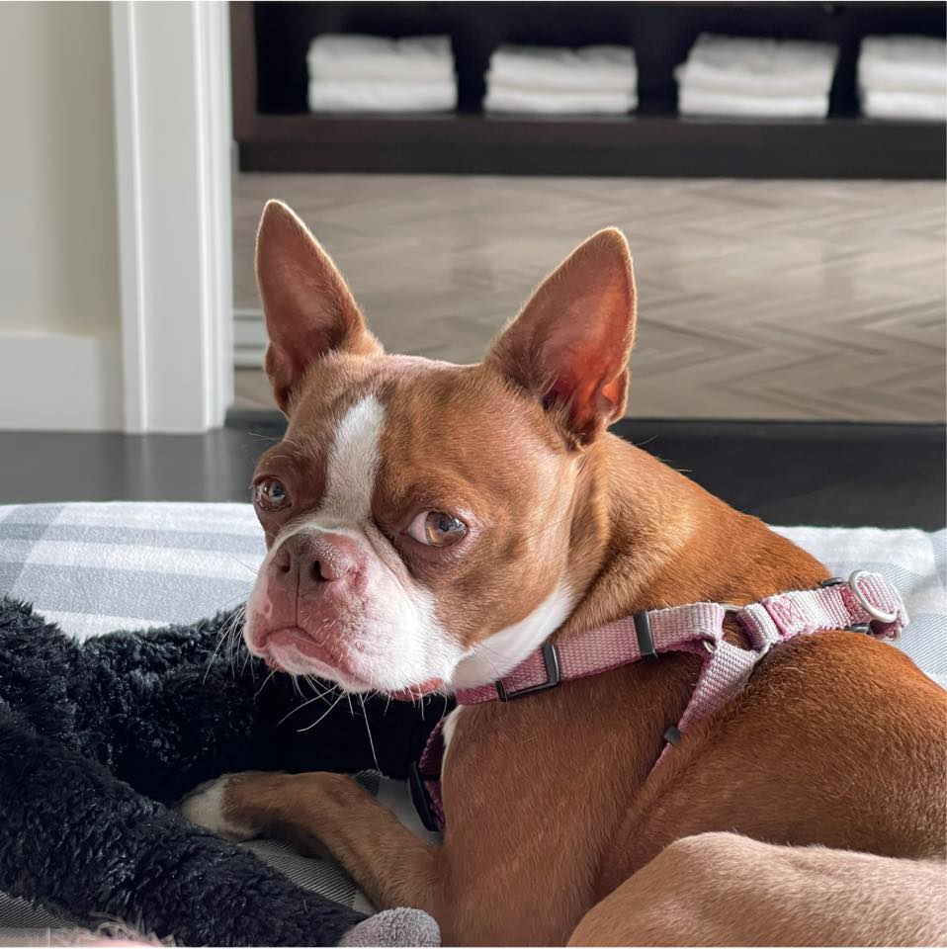
String Diamond
Write a function diamond that accepts a string parameter and prints its letters in a "diamond" format as shown below.
For example, diamond("doris") should print:
  d
  do
  dor
  dori
  doris
  oris
  ris
  is
  s

Slide 34
Practice: String Diamond
string_diamond.c
Notes:
stdbool

Slide 35
Searching For Letters
strchr returns a pointer to the first occurrence of a character in a string, or NULL if the character is not in the string.
char laureate[15];
strcpy(laureate, "Katalin Kariko");
char *first = strchr(laureate, 'a');
char *last = strrchr(laureate, 'a');
printf("%s\n", laureate); // Katalin Kariko
printf("%s\n", first); // atalin Kariko
printf("%s\n", last); // ariko
If there are multiple occurrences of the letter, strchr returns a pointer to the first one. Use strrchr to obtain a pointer to the last occurrence.

Slide 36
Searching For Strings
strstr returns a pointer to the first occurrence of the second string in the first, or NULL if it cannot be found.
char laureate[17];
strcpy(laureate, "Carolyn Bertozzi");
char *zz = strstr(laureate, "zz");
printf("%s\n", laureate); // Carolyn Bertozzi
printf("%s\n", zz); // zzi
If there are multiple occurrences of the string, strstr returns a pointer to the first one.

Slide 37
String Spans
strspn returns the length of the initial part of the first string which contains only characters in the second string.
char laureate[17];
strcpy(laureate, "Barry Sharpless");
int length = strspn(laureate + 1, "road"); // 3
"How many places can we go in the first string before I encounter a character not in the second string?"

Slide 38
String Spans
strcspn (c = "complement") returns the length of the initial part of the first string which contains only characters not in the second string.
char laureate[17];
strcpy(laureate, "Barry Sharpless");
int length = strcspn(laureate + 2, "abcde"); // 6
"How many places can we go in the first string before I encounter a character in the second string?"

Slide 39
C Strings As Parameters
When we pass a string as a parameter, it is passed as a char *. We can still operate on the string the same way as with a char[].
int foo(char *str) {
char ch = str[1];
...
}
// can also write this, but it is really a pointer
int foo(char str[]) { ...

Slide 40
Arrays of Strings
We can make an array of strings to group multiple strings together:
char *array[5]; // space to store 5 char *s
We can also use the following shorthand to initialize a string array:
char *array[] = {
"Hello",
"Hi",
"Hey there"
};

Slide 41
Arrays of Strings
We can access each string using bracket syntax:
printf("%s\n", array[0]); // print out first string
When an array is passed as a parameter in C, C passes a pointer to the array’s first element. In fact, you’re already seen this with main’s argv parameter! This means we write the parameter type as:
void func(char **array) {
// equivalent to this, but it is really a double pointer
void func(char *array[]) {

Slide 42
Practice: Password Verification
Write a function verifyPassword that accepts a candidate password and certain password criteria and returns whether the password is valid.
bool verifyPassword(char *password, char *validChars,
char *badSubstrings[], size_t count);
password is valid if it contains only letters in validChars and does not contain any substrings in badSubstrings.

Slide 43
Practice: Password Verification
bool verifyPassword(char *password, char *validChars,
char *badSubstrings[], size_t count);
Example:
char *invalidSubstrings[] = {"1234" , "4132"};
bool valid1 = verifyPassword("1572", "0123456789",
invalidSubstrings, 2); // true
bool valid2 = verifyPassword("141234", "0123456789",
invalidSubstrings, 2); // false

Slide 44
Practice: Password Verification
verify_password.c
Notes:
stdbool

