Slide 1
CS107, Lecture 7
C Strings
Reading: K&R (1.9, 5.5, Appendix B3) or Essential C section 3
Ed Discussion

Slide 2
Recall: Buffer Overflows
We must make sure there is enough space in the destination to hold the entire copy, including the null-terminating character.
char str2[6]; // not enough space!
strcpy(str2, "hello, world!"); // overwrites other memory!
Buffer overflows are dangerous because they allow data meant for one part of memory to spill over into another, potentially overwriting variables, control data, or even assembly code instructions.
Such overwrites can lead to program instability and crashes, and they can even be exploited to redirect execution to malicious code.

Slide 3
Recall: Buffer Overflows
char str1[14];
strcpy(str1, "hello, world!");
char str2[6];
strcpy(str2, str1); // not enough space - overwrites other memory!
0 | 1 | 2 | 3 | 4 | 5 | 6 | 7 | 8 | 9 | 10 | 11 | 12 | 13
'h' | 'e' | 'l' | 'l' | 'o' | ',' | ' ' | 'w' | 'o' | 'r' | 'l' | 'd' | '!' | '\0'
str1
0 | 1 | 2 | 3 | 4 | 5
'h' | 'e' | 'l' | 'l' | 'o' | ','
' ' | 'w' | 'o' | 'r' | 'l' | 'd' | '!' | '\0'
str2
- other program memory -

Slide 4
Buffer Overflow Impacts
Buffer overflows can be serious, as they can lead to runtime errors and even introduce security vulnerabilities. Examples include:
  accessing memory you shouldn’t be able to access
  modifying memory you shouldn’t be modifying
  changing the value of a variable used later in the program
  changing the program to execute your assembly code instructions instead of its own
It’s our job as programmers to find and fix buffer overflows and other bugs, not just for the functional correctness of our programs, but to protect people who use and interact with our code.

Slide 5
Buffer Overflow Impacts
AOL instant messenger buffer overflow: allowed remote attackers to execute code:
https://www.cvedetails.com/cve/CVE-2002-0362/
https://www.computerworld.com/article/2586310/aol-instant-messenger-vulnerable-to-hackers.html
Morris Worm: first internet worm to gain widespread attention; exploited buffer overflow in Unix command called "finger":
https://en.wikipedia.org/wiki/Morris_worm

Slide 6
How can we identify buffer overflows?
There’s no single solution that works for everything. Finding and repairing overflow vulnerabilities require a combination of software development techniques:
  vigilance while programming (scrutinizing array reads and writes, pointer arithmetic)
  carefully reading documentation
  thoroughly testing to identify issues before shipping product
  thoroughly documenting assumptions in your code
  using software tools to methodically examine code for suspicious function calls

Slide 7
How can we identify buffer overflow?
  MAN page for gets():
  char *gets(char *s);
  Never use gets(). Because it is impossible to tell without knowing the data in advance how many characters gets() will read, and because gets() will continue to store characters past the end of the buffer, it is extremely dangerous to use. It has been used to break computer security. Use fgets() instead.

Slide 8
How can we identify buffer overflows?
Valgrind: your best friend for this
Write your own tests
Consider writing tests before writing the main program
✨ cs107.stanford.edu/testing.html ✨

Slide 9
How Can We Fix Overflows?
Documentation & MAN Pages (Written by Others)
  The strcpy() function copies the string pointed to by src, including the terminating null byte (‘\0’), to the buffer pointed to by dest. The strings may not overlap, and the destination string dest must be large enough to receive the copy. Beware of buffer overruns!
  If the destination string of a strcpy() is not large enough, then anything might happen. Overflowing fixed-length string buffers is a favorite cracker technique for taking complete control of the machine. Any time a program reads or copies data into a buffer, the program first needs to check that there’s enough space. This may be unnecessary if you can show that overflow is impossible, but be careful: programs can get changed over time, in ways that may make the impossible possible.

Slide 10
Memory Safe Systems Programming
Choose your Tools & Languages Carefully
Existing code bases or requirements for a project may dictate what tools you use. Knowing C is crucial – it is and will remain widely used.
When you you are choosing tools for systems programming, consider languages that can help guard against programmer error.
Rust (Mozilla)
Go (Google)
Project Verona (Microsoft)

Slide 11
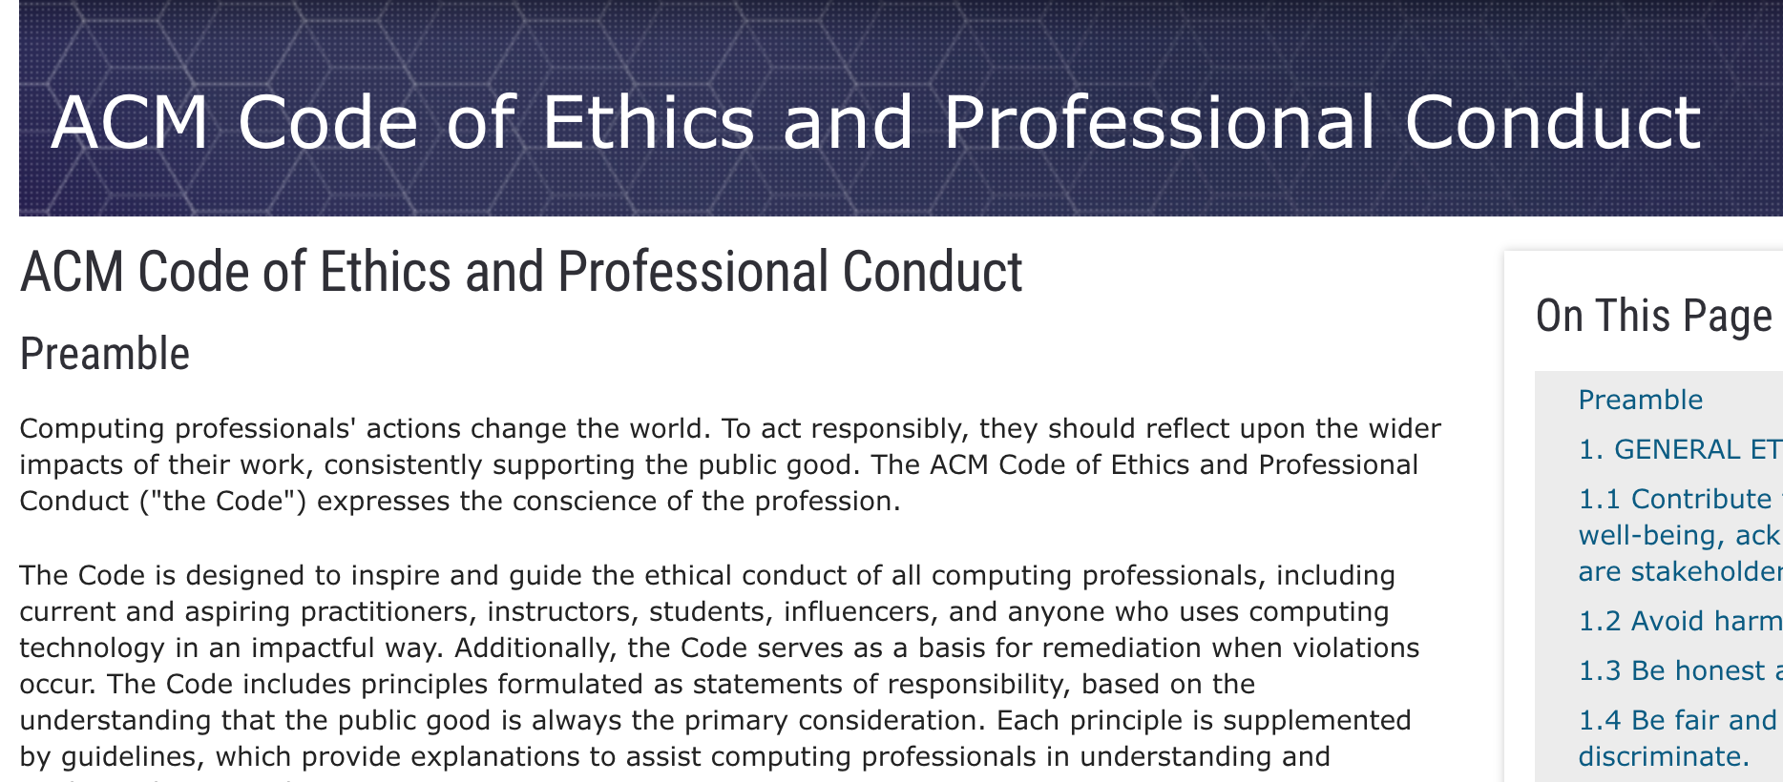
Association for Computing Machinery (ACM) Code of Ethics

Slide 12
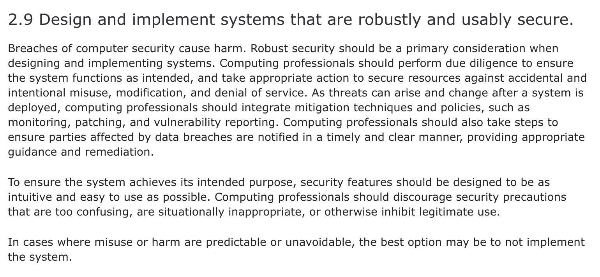
ACM Code of Ethics on Security

Slide 13
Demo: Memory Errors
memory_errors.c

