Slide 1

M U S E
Turn music into memories.
dt+UX² Software Launch

Slide 2




Our team
Alema F.
UX Designer
Tiffany M.
App Developer
Nylah D.
App Developer
Vincent N.
UX Designer
M U S E

Slide 3
R O A D M A P
Problem
Our solution
Design evolution
Final product
Future ideas

Slide 4

Check-in
When was the last time you have consistently kept a journal?
M U S E

Slide 5
Problem

Slide 6
Problem
Current memory-making techniques are one-dimensional and time consuming.
M U S E

Slide 7
Existing solutions
Journaling is time-consuming, and photos only capture visual details.
M U S E

Slide 8
Our solution

Slide 9
Needfinding
Users want:
Memories connected to their environment
Platform to easily see memories
M U S E

Slide 10
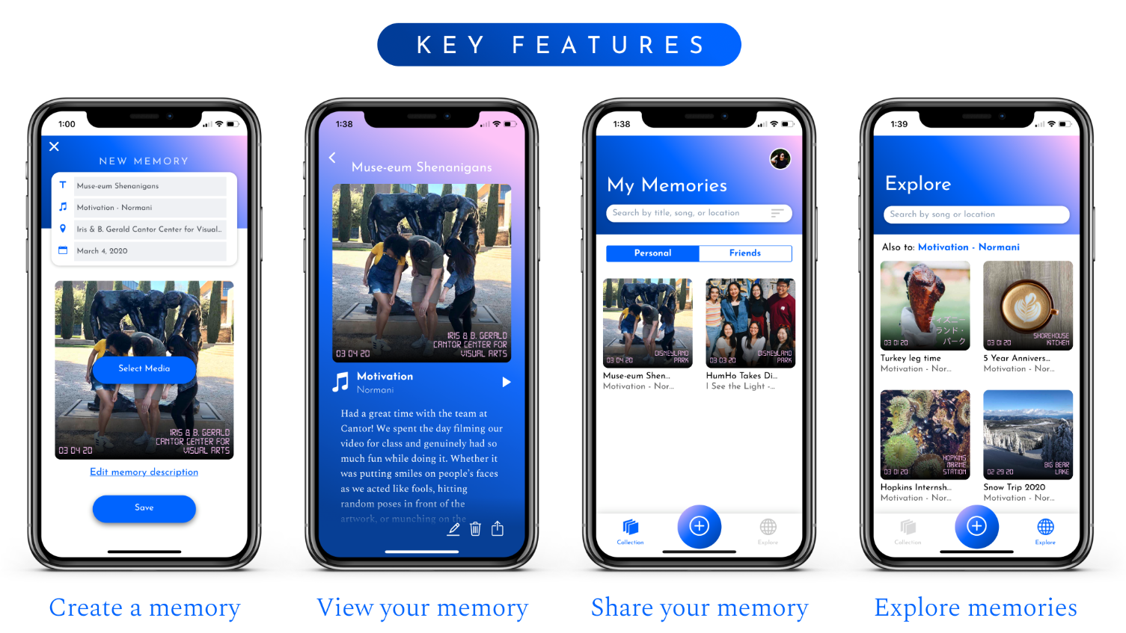
Solution: Muse
VALUE PROPOSITION:
Turn music into memories.
M U S E

Slide 11
Solution: Muse
SOLUTION:
Muse interweaves music with memories to make memories a delight.
M U S E

Slide 12
Muse app video

Slide 13
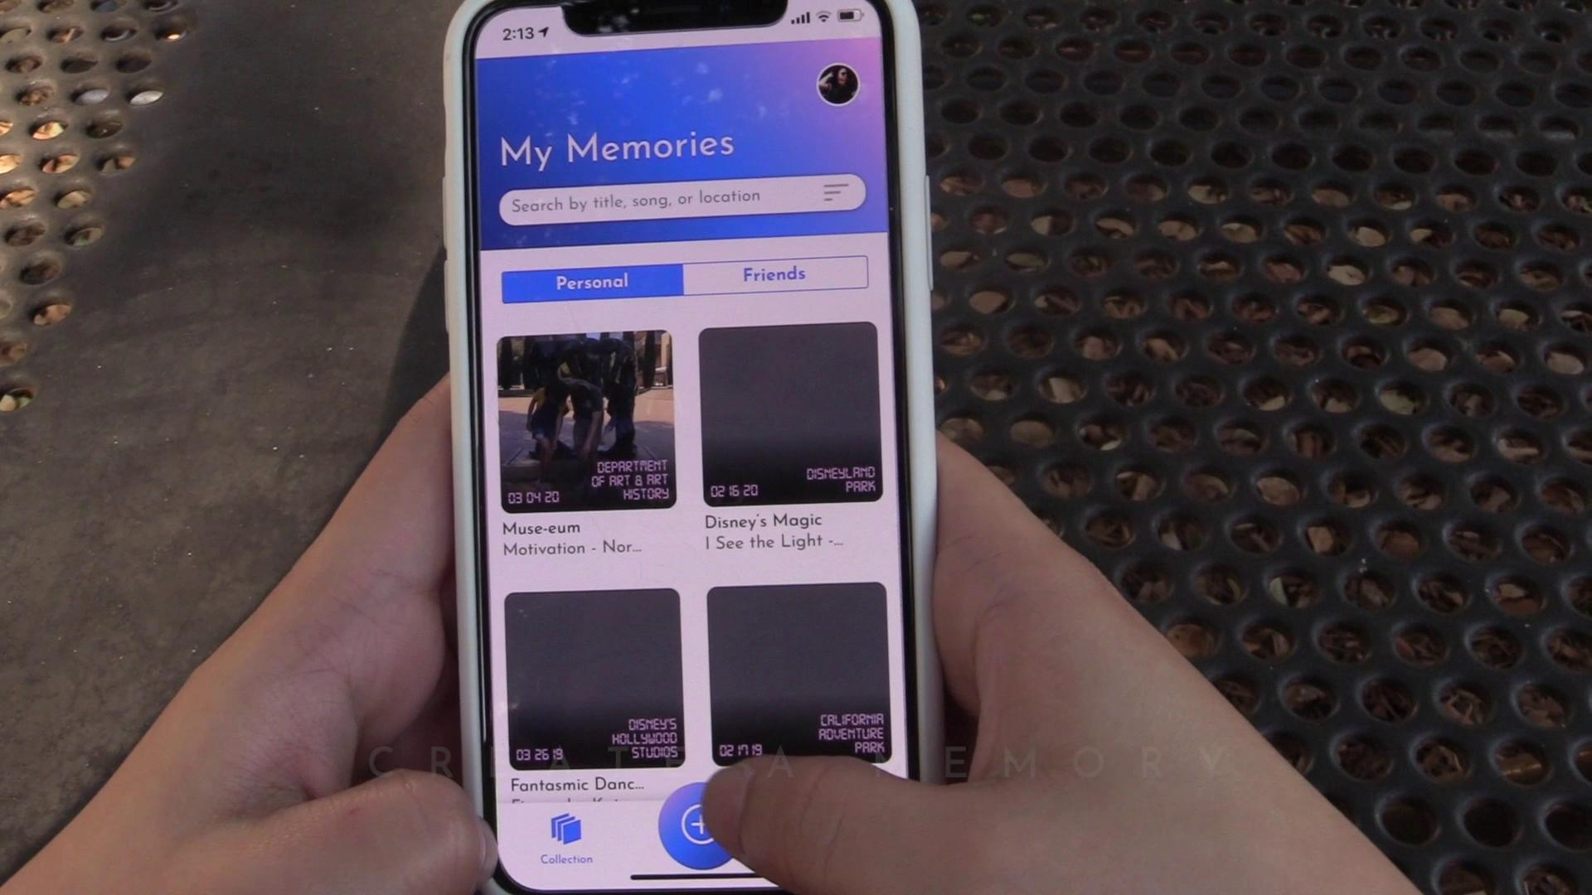
Muse app video
M U S E

Slide 14
Design evolution:
From Rechords to Muse
Notes:
How did we get to our current design?
It all started a year ago when this project actually went under the name of Rechords
However, this quarter, the name, much like the project’s UI, has gone through a change.

Slide 15
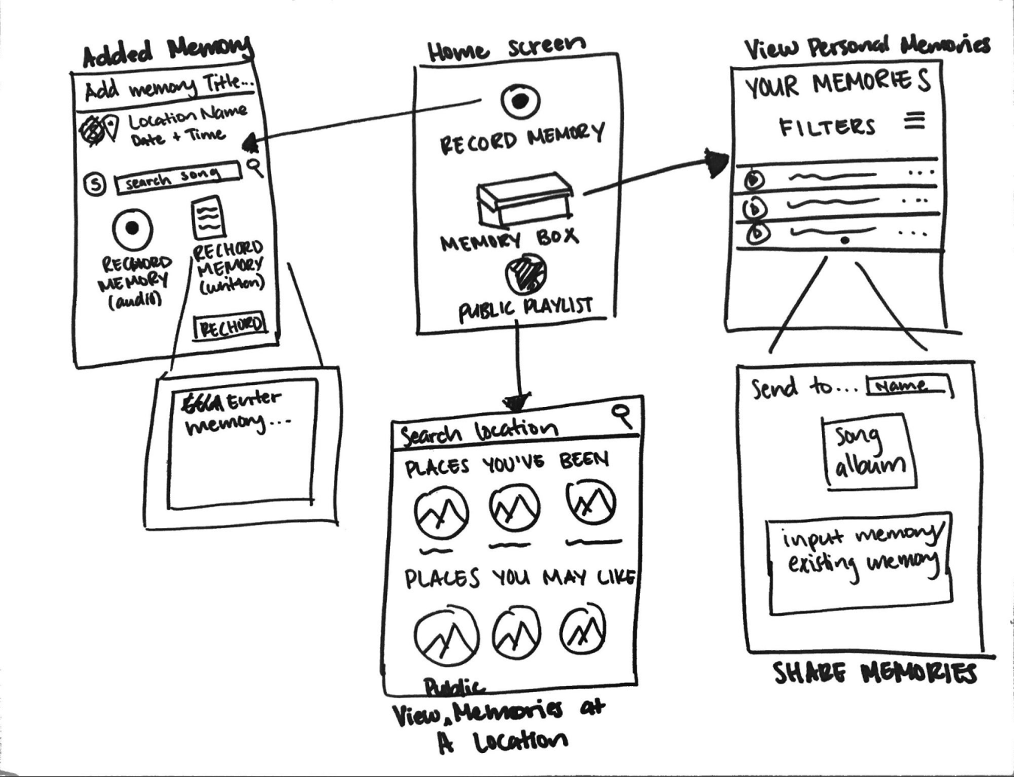
Rechords: Initial sketches
M U S E
Notes:
The design process began with initial sketches of different ways we could execute our idea. One of these ideas involved a smartwatch interface, which we decided to convert into the mobile app interface that you see here.
Key features that we took away: playlist design allowed for intuitive navigation and the ability to record the details of your memory with voice recording or by just typing as normal

Slide 16
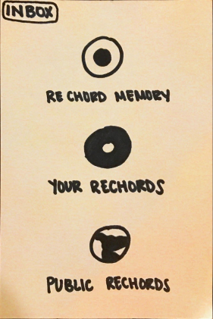
Rechords: Sketches to low-fi
M U S E
Notes:
We carried these features into our low-fi prototype.
The only major change that occurred was with our terminology, which was changed to fit the original name Rechords

Slide 17
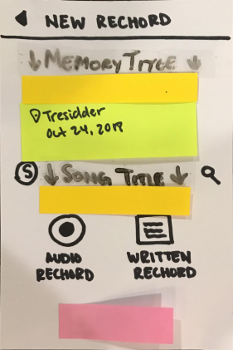
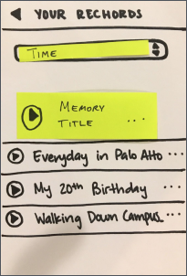
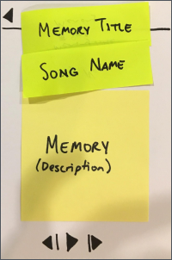
Rechords: Low-fi prototype
M U S E
Notes:
Kept option to do an audio recording or written recording
Maintained playlist design and started playing around with album cover idea to display the memory description

Slide 18
Rechords: Low-fi to med-fi
M U S E
Notes:
Results from our user testing with our low-fi prototype showed that participants wanted more emphasis on the addition of a song to a memory since it was the key feature of our project
And there was too much information on the “new rechord” screen”
We addressed these concerns in our medium-fi prototype

Slide 19
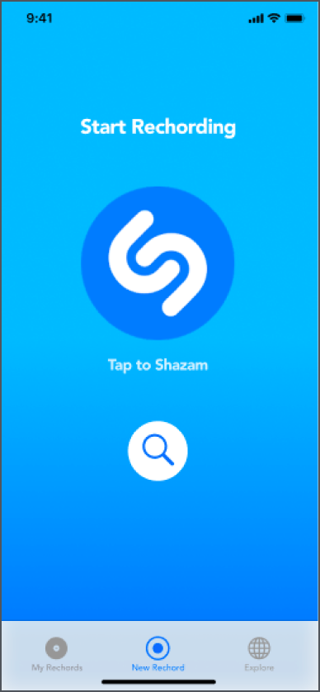
Rechords: Low-fi to med-fi
M U S E
Notes:
To emphasize the music aspect, we switched to tab navigation with the default/home screen being the one where you start capturing a new memory
To capture a memory you begin by choosing the song for the memory either through shazam or just simply searching

Slide 20
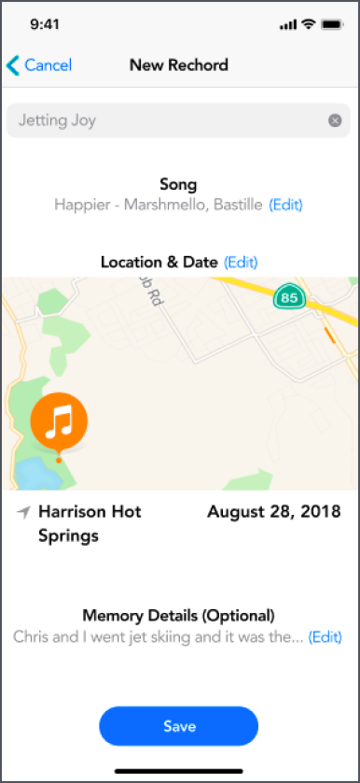
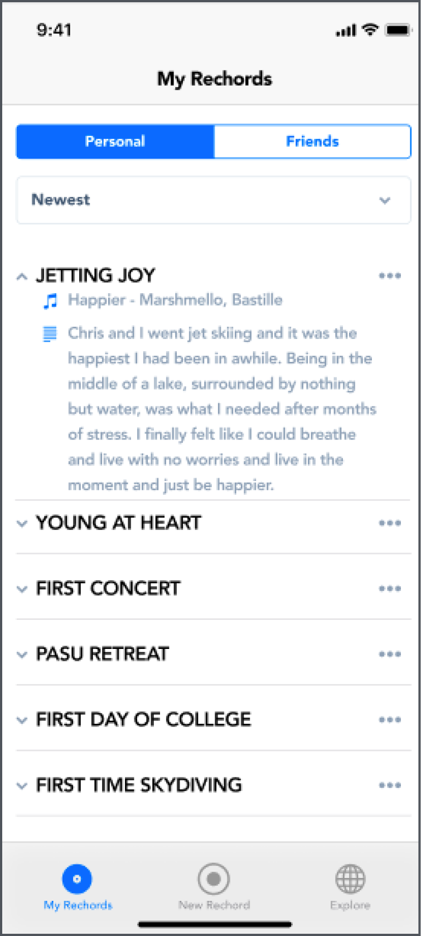
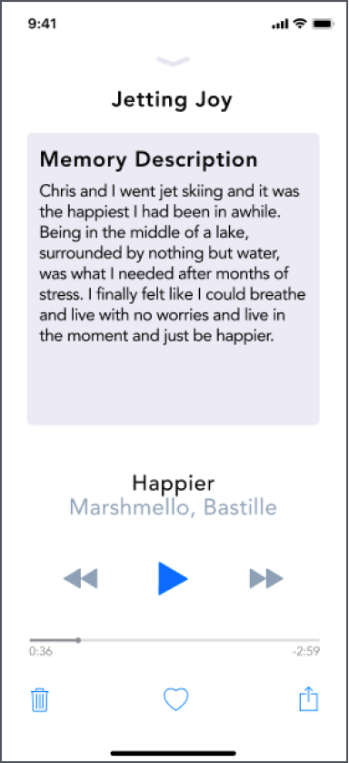
Rechords: Med-fi prototype
M U S E
Notes:
Tried to minimize the amount of information users see in the new rechord page
Continued with the playlist design...
...As well as the album cover idea

Slide 21
Rechords: Med-fi to hi-fi
M U S E
Notes:
From heuristic evaluation, design needs a personal touch so we fully embraced our vinyl and album motifs

Slide 22
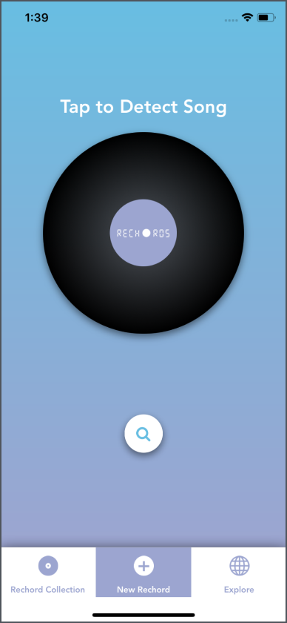
Rechords: Med-fi to hi-fi
M U S E
Notes:
Defined our color scheme

Slide 23
Rechords: Med-fi to hi-fi
M U S E
Notes:
Logo in place of shazam button but serving the same functionality

Slide 24
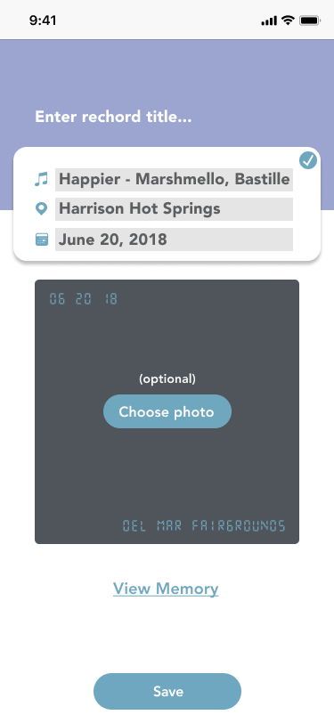
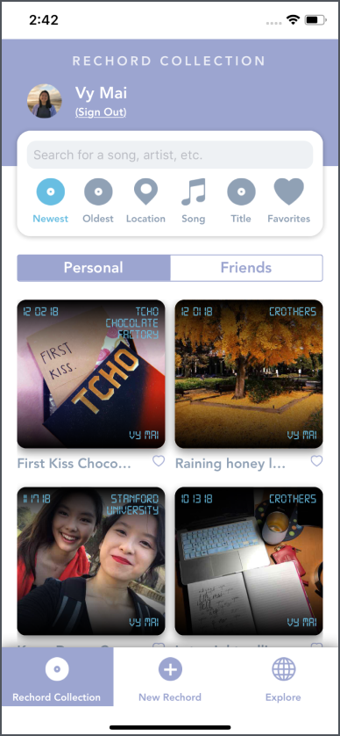
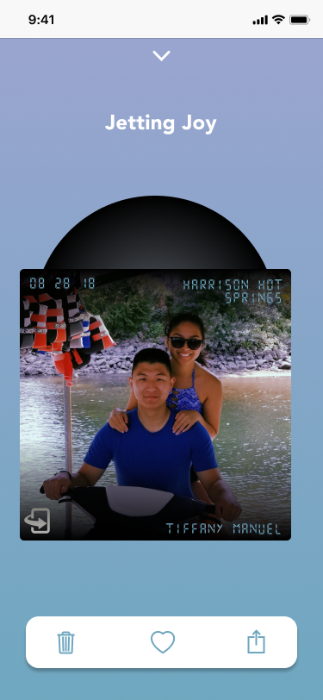
Rechords: Hi-fi prototype #1
M U S E
Notes:
Flip to see memory details
Scratched the playlist design and embraced our use of album covers to make the app more fun and personal

Slide 25
Rechords: Hi-fi #1 to hi-fi #2
M U S E
Notes:
This was the version of the project that we started out with for 194h
Wanted our ui to be more vibrant (purple and blue is quite muted)
After doing some usability tests to determine other parts of the UI that could be improved, we came up with...

Slide 26
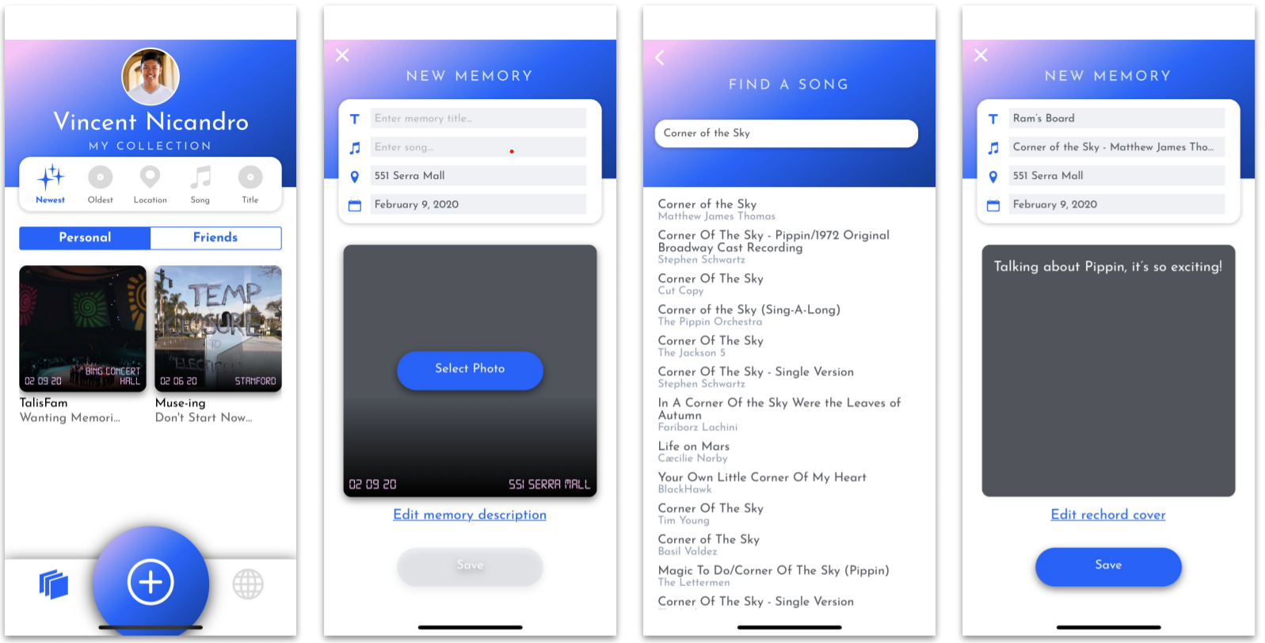
Rechords: Hi-fi #1 to hi-fi #2
M U S E
Notes:
Introduced a new color scheme and gradient

Slide 27
Rechords: Hi-fi #1 to hi-fi #2
M U S E
Notes:
From usability testing it was unclear that this was how people would start creating a memory

Slide 28
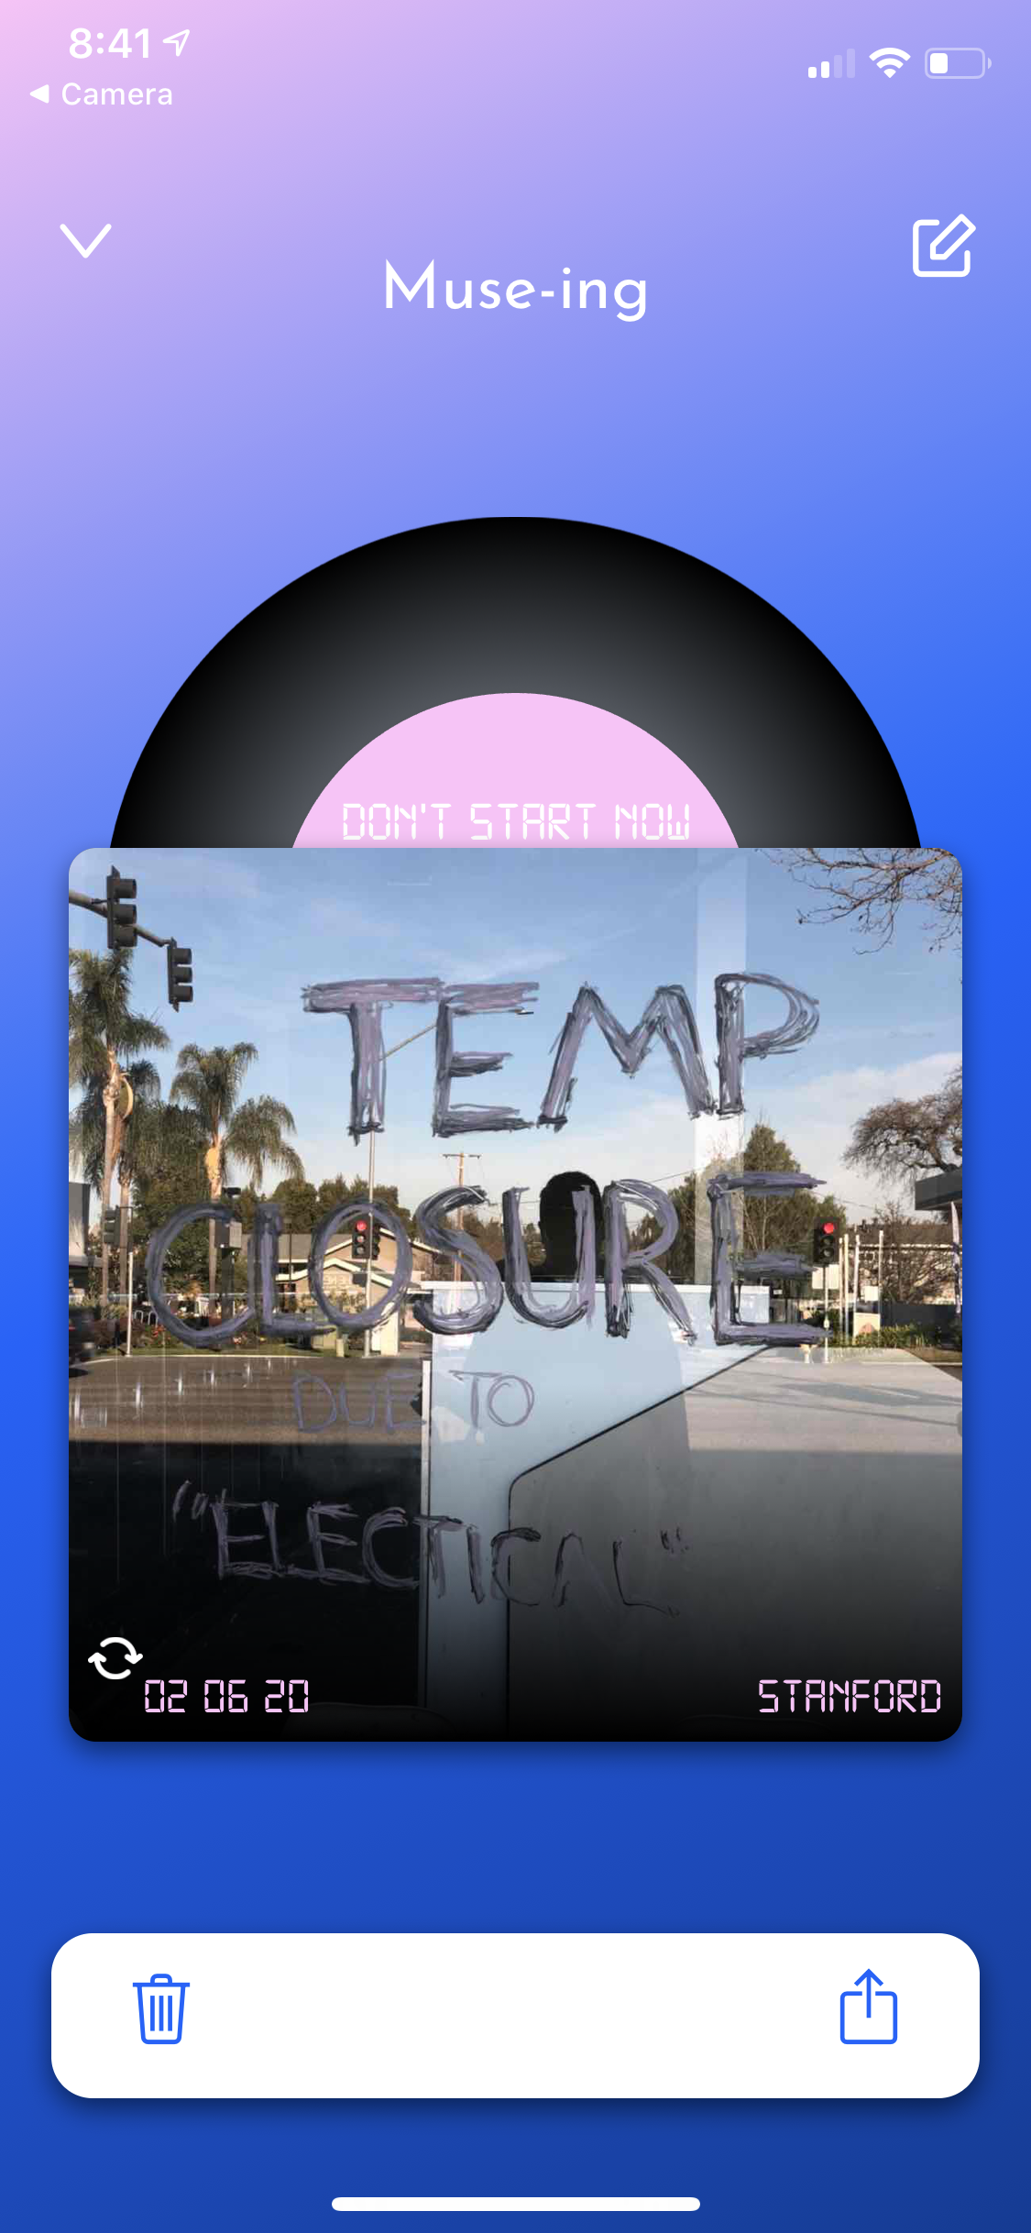
Muse: Hi-fi prototype #2
M U S E
Notes:
Notice that we no longer have the “shazam” screen because users simply enter the song through the new memory screen
Very similar to the UI from our first hi-fi prototype

Slide 29
Muse: Hi-fi #2 to hi-fi #3
M U S E
Notes:
After talking to a visiting UX designer, she pointed out how our ui, primarily the header was pretty cluttered and had too much going on so we took steps to simplify our design

Slide 30
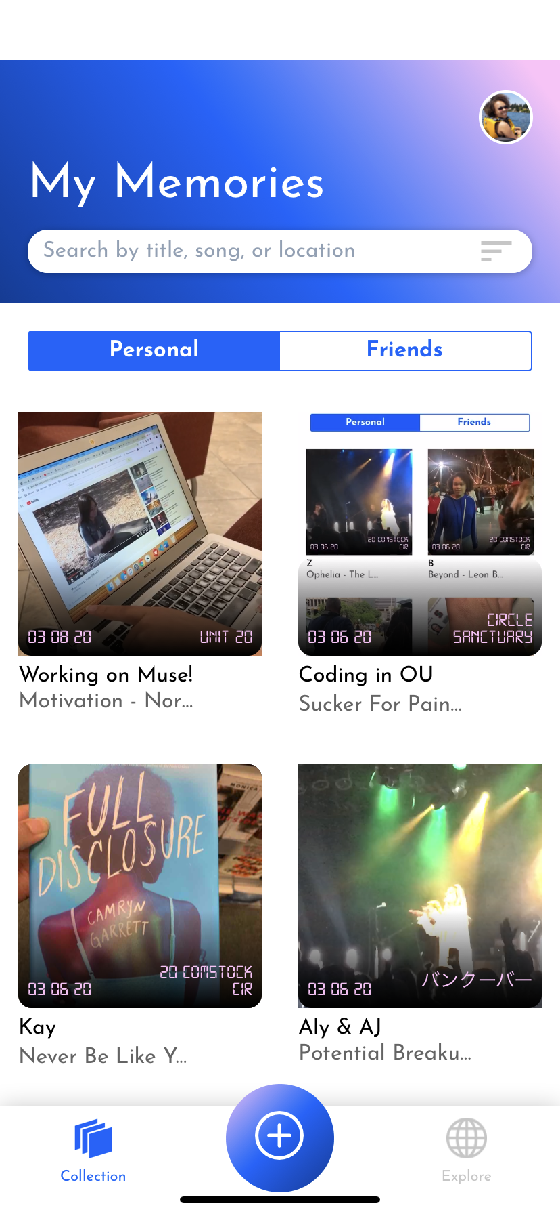
Muse: Hi-fi #2 to hi-fi #3
M U S E

Slide 31
Muse: Hi-fi #2 to hi-fi #3
M U S E
Notes:
Realized that there was no point in making the user’s name the main header because that’s not really information that needs to be communicated to the user
We decided to put the sorting options into their own menu which can be accessed in the search bar
Allowed us to allocate more real estate on this page to the actual memories themselves

Slide 32
Muse: Hi-fi #2 to hi-fi #3
M U S E
Notes:
After feedback from the class we also made the plus button a lot smaller and labeled the tabs since the icons alone were not very telling of what users could expect to find

Slide 33
Overall design evolution
M U S E

Slide 34
Final design + task flows

Slide 35
Muse: Hi-fi prototype #3
M U S E

Slide 36
Live demo

Slide 37
Implementation

Slide 38





Implementation
React Native
Expo
Firebase
Google Maps
API
Spotify
API
M U S E

Slide 39
Future enhancements

Slide 40
Future enhancements
MULTIMEDIA MEMORIES: multiple videos + photos, gifs, slideshows
M U S E

Slide 41
Future enhancements
CURATED MEMORIES: Staff-curated memories collections, community collections
M U S E

Slide 42
Future enhancements
BUSINESS MODEL: aggregate data, sponsored memories, sponsored artists, subscription for pro features
M U S E

Slide 43
Summary
Notes:
Problem: Memory-making is time-consuming and one-dimensional
Our solution: Muse - music + memories
Design evolution + Final product: ideas to our final product
Future ideas: Areas for Muse to grow and refine

Slide 44
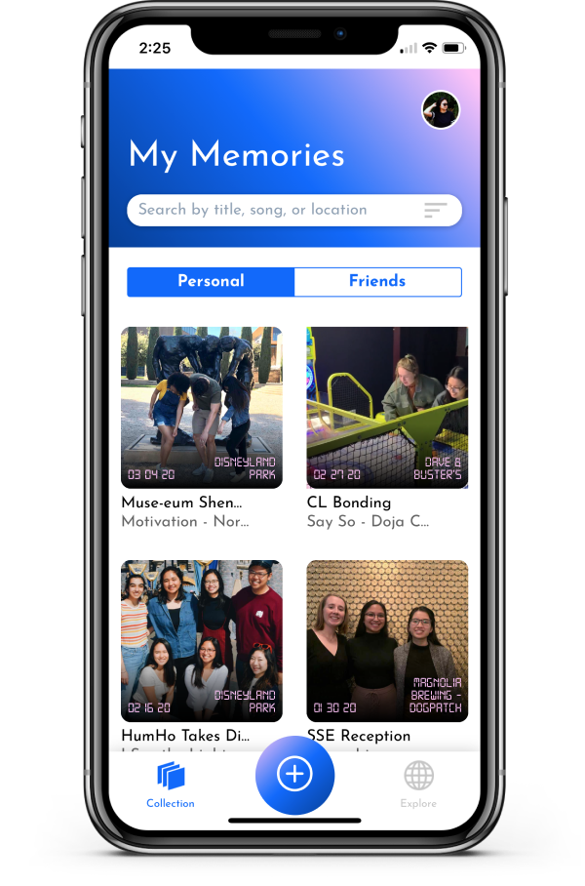
Turn music into memories.
M U S E
Start musing at https://stanford.io/2vJ4tRP
Notes:
Problem: Memory-making is time-consuming and one-dimensional
Our solution: Muse - music + memories
Design evolution + Final product: ideas to our final product
Future ideas: Areas for Muse to grow and refine

