Slide 1

M U S E
Turn music into memories.
Hi-Fi Prototype 3

Slide 2


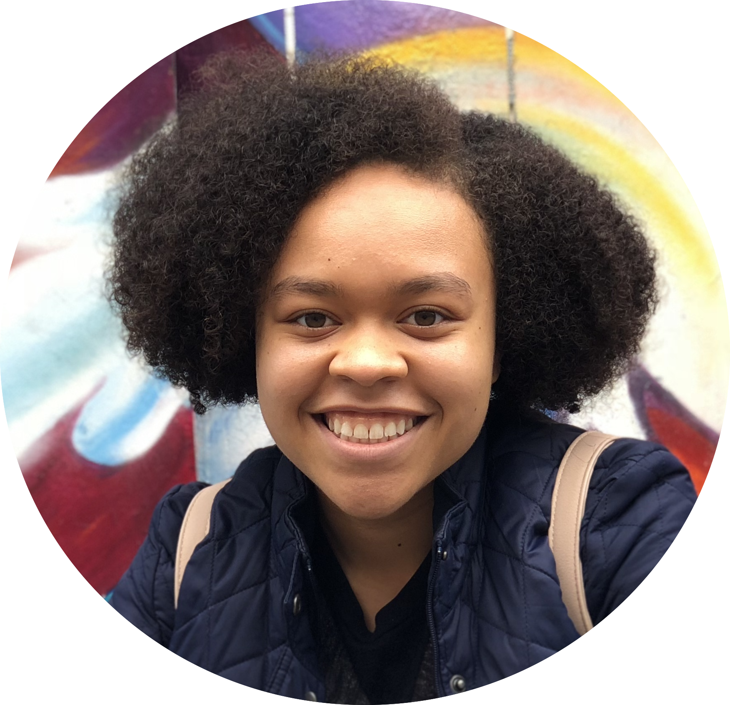

Our team
Alema F.
UX Designer
Tiffany M.
App Developer
Nylah D.
App Developer
Vincent N.
UX Designer
M U S E

Slide 3
R O A D M A P
Introduction
Interface changes + task flows
Live demo
Future work

Slide 4

Introduction
VALUE PROPOSITION: Turn music into memories.
PROBLEM: Current forms of memory-keeping have disadvantages: journaling is time-consuming, and photos only capture visual details.
SOLUTION: Muse interweaves music with memories to make looking back on life a delight.
M U S E

Slide 5
Interface changes + task flows
Notes:
Major: UI changes + terminology (primarily everything in collection tab), adding a memory made more explicit (trashed Shazam Screen and replaced with new New Memory Screen + new tab navigation) -- usability test, adding a title for the memory (placed into white bar) -- usability test
Minor: Made the app more flexible by implementing functionality that allows users to search for any existing public location collection (as opposed to only searching through hard-coded locations like Crothers) -- allows for more flexibility during usability tests

Slide 6
Viewing a memory
OBSERVATION: 8/9 users were confused with how to view the content in a memory because it was obscured in the flip interaction.
CHANGE: The screen now displays the cover, song, and memory as separate components to interact with.
M U S E

Slide 7
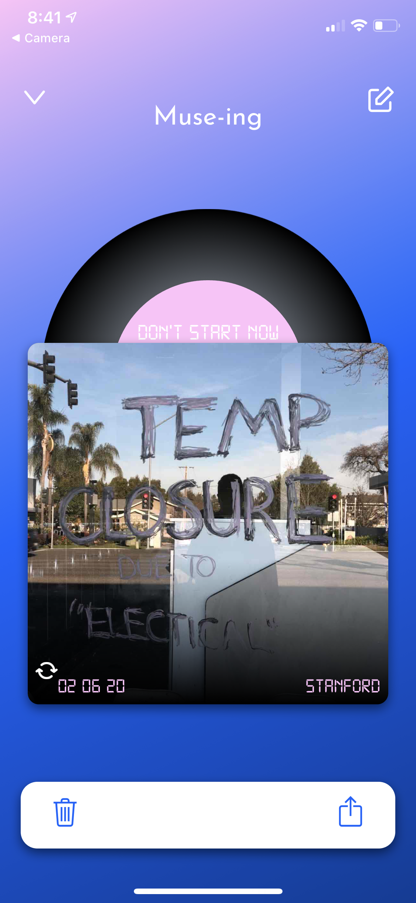
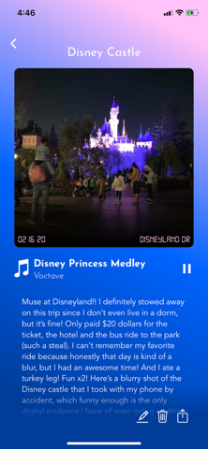
Viewing a memory
M U S E

Slide 8
Explore screen
OBSERVATION: 4/9 users didn’t know how to interact with the Explore screen because there wasn’t enough reason to.
CHANGE: The screen is now populated with the 10 most recently shared memories from the global community.
M U S E

Slide 9
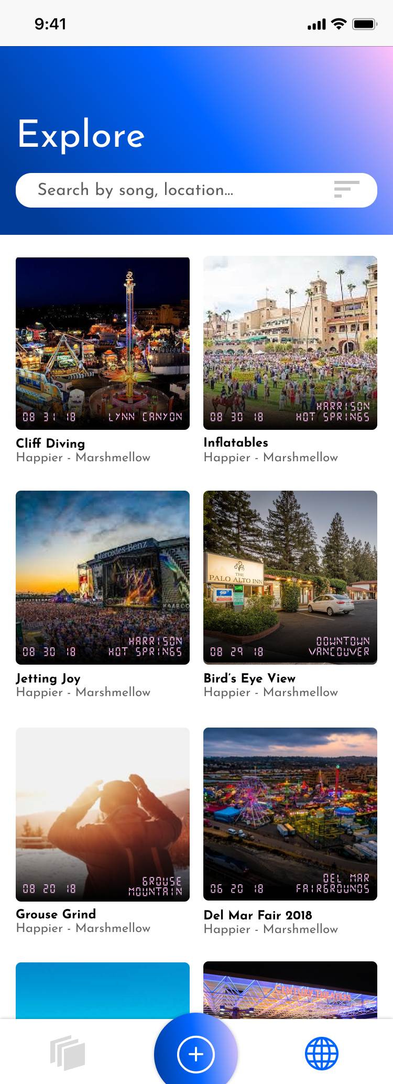
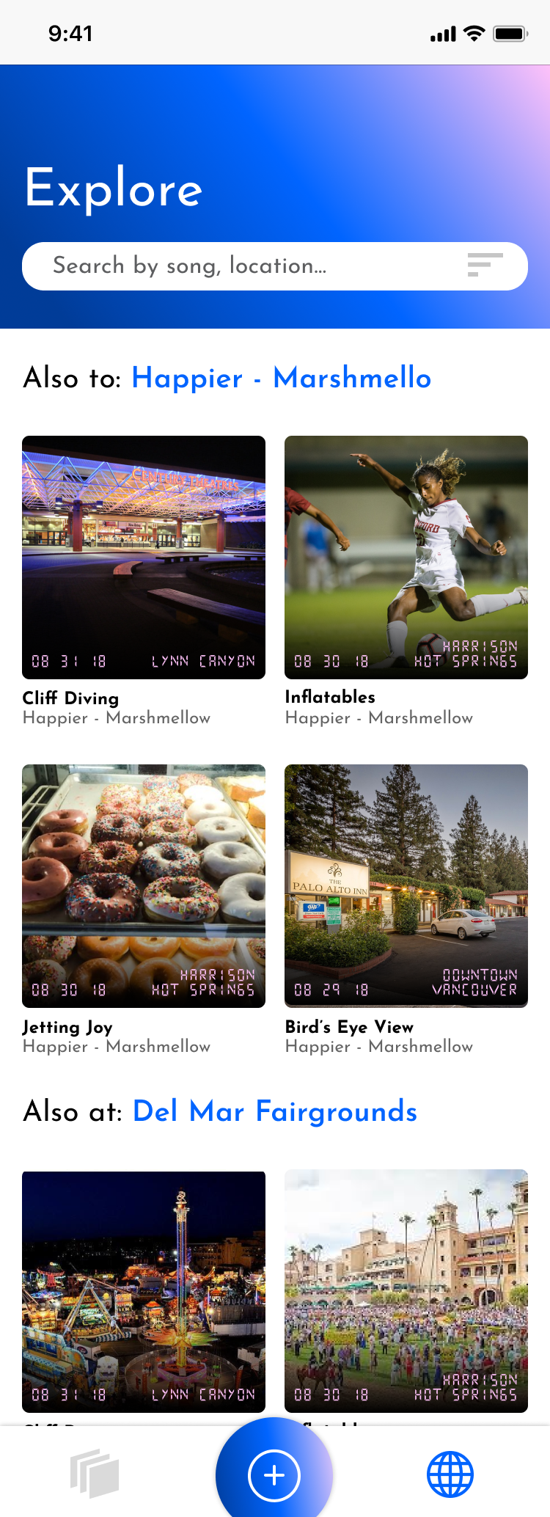
Explore screen
M U S E

Slide 10
Other recent developments
MUSE PLAYS MUSIC: The app can now play music! We’ve changed the user flow for logging in by having users log in with Spotify.
GENERAL AESTHETIC CHANGES: We incorporated user/instructor feedback to clean the app.
ADD A FRIEND: We added an add a friend feature!
M U S E

Slide 11
Live demo
Notes:
Major: UI changes + terminology (primarily everything in collection tab), adding a memory made more explicit (trashed Shazam Screen and replaced with new New Memory Screen + new tab navigation) -- usability test, adding a title for the memory (placed into white bar) -- usability test
Minor: Made the app more flexible by implementing functionality that allows users to search for any existing public location collection (as opposed to only searching through hard-coded locations like Crothers) -- allows for more flexibility during usability tests

Slide 12
Future work

Slide 13
Things to work on
THE WHOLE MUSIC THING: While we can play music, we’re unclear if it’ll be in a deployable state.
EXPLORE TAB: Working to finish the Explore tab completely with some minor transition things.
PROFILE PICS: Yes.
MULTIMEDIA COVERS: Integrate multimedia (multiple photos, videos) into the albums. Stretch goal!
M U S E

Slide 14
Thanks!
M U S E

