Slide 1

Stanford CS224W:
Node Embeddings
Note to other teachers and users of these slides: We would be delighted if you found our material useful for giving your own lectures. Feel free to use these slides verbatim, or to modify them to fit your own needs. If you make use of a significant portion of these slides in your own lecture, please include this message, or a link to our web site: http://cs224w.Stanford.edu
CS224W: Machine Learning with Graphs
Jure Leskovec, Stanford University
http://cs224w.stanford.edu

Slide 2
Stanford CS224W:
Announcements
CS224W: Machine Learning with Graphs
Jure Leskovec, Stanford University
http://cs224w.stanford.edu

Slide 3
Course Logistics: Colab 0
Colab 0 will be released today by 9PM on our course website
Colab 0:
  Overview of NetworkX and PyTorch Geometric
  Does not need to be handed in
  TAs will hold a recitation session to walk you through Colab 0:
    Time: Friday (09/27), 3-4pm PT
    Location: Zoom, link is posted on Ed
    Session will be recorded

Slide 4
Course Logistics: Colab 1
Colab 1 will be released today by 9PM on our course website
Colab 1:
  Will cover material from Lectures 1-2, so you can get started right away!
  Due on Thursday 10/10 (2 weeks from today)
  Submit written answers and code on Gradescope

Slide 5
Stanford CS224W:
Node Embeddings
CS224W: Machine Learning with Graphs
Jure Leskovec, Stanford University
http://cs224w.stanford.edu

Slide 6
Recap: Traditional ML
Given an input graph, extract node, link and graph-level features, then learn a model (SVM, neural network, etc.) that maps features to labels.
Input Graph
Structured Features
Learning Algorithm
Prediction
Feature engineering
(node-level, edge-level, graph-level features)
Downstream
prediction task

Slide 7
Graph Representation Learning
Graph Representation Learning alleviates the need to do feature engineering every single time.
Input Graph
Structured Features
Learning Algorithm
Prediction
Feature Engineering
Representation Learning --Automatically
learn the features
Downstream
prediction task

Slide 8



Graph Representation Learning
Goal: Efficient task-independent feature learning for machine learning with graphs!
node
vector
$$u$$
$$f:u→ℝ^{d}$$
$$ℝ^{d}$$
Feature representation, embedding
Notes:
Underlying motivation

Slide 9

Why Embedding?
Task: Map nodes into an embedding space
  Similarity of embeddings between nodes indicates their similarity in the network. For example:
    Both nodes are close to each other (connected by an edge)
  Encode network information
  Potentially used for many downstream predictions
Vec
Tasks
Node classification
Link prediction
Graph classification
Anomalous node detection
Clustering
….
$$ℝ^{d}$$
embeddings

Slide 10
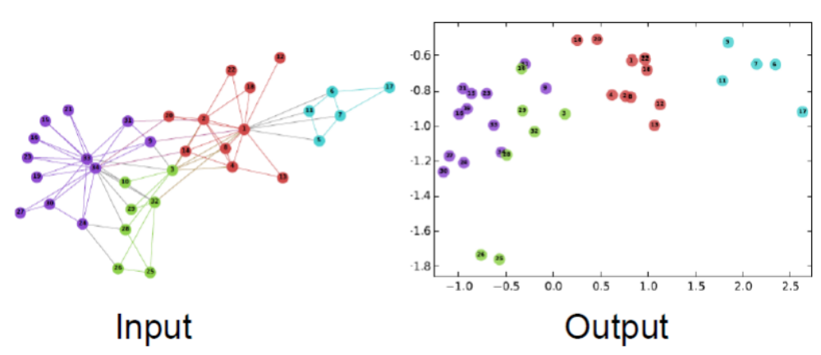
Example Node Embedding
2D embedding of nodes of the Zachary’s Karate Club network:
Image from: Perozzi et al. DeepWalk: Online Learning of Social Representations. KDD 2014.

Slide 11
Stanford CS224W:
Node Embeddings:
Encoder and Decoder
CS224W: Machine Learning with Graphs
Jure Leskovec, Stanford University
http://cs224w.stanford.edu

Slide 12
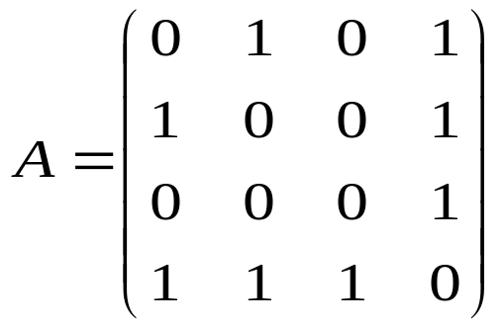
Setup
Assume we have an (undirected) graph G:
  V is the vertex set.
  A is the adjacency matrix (assume binary).
  For simplicity: No node features or extra information is used
4
3
2
1
V: {1, 2, 3, 4}

Slide 13
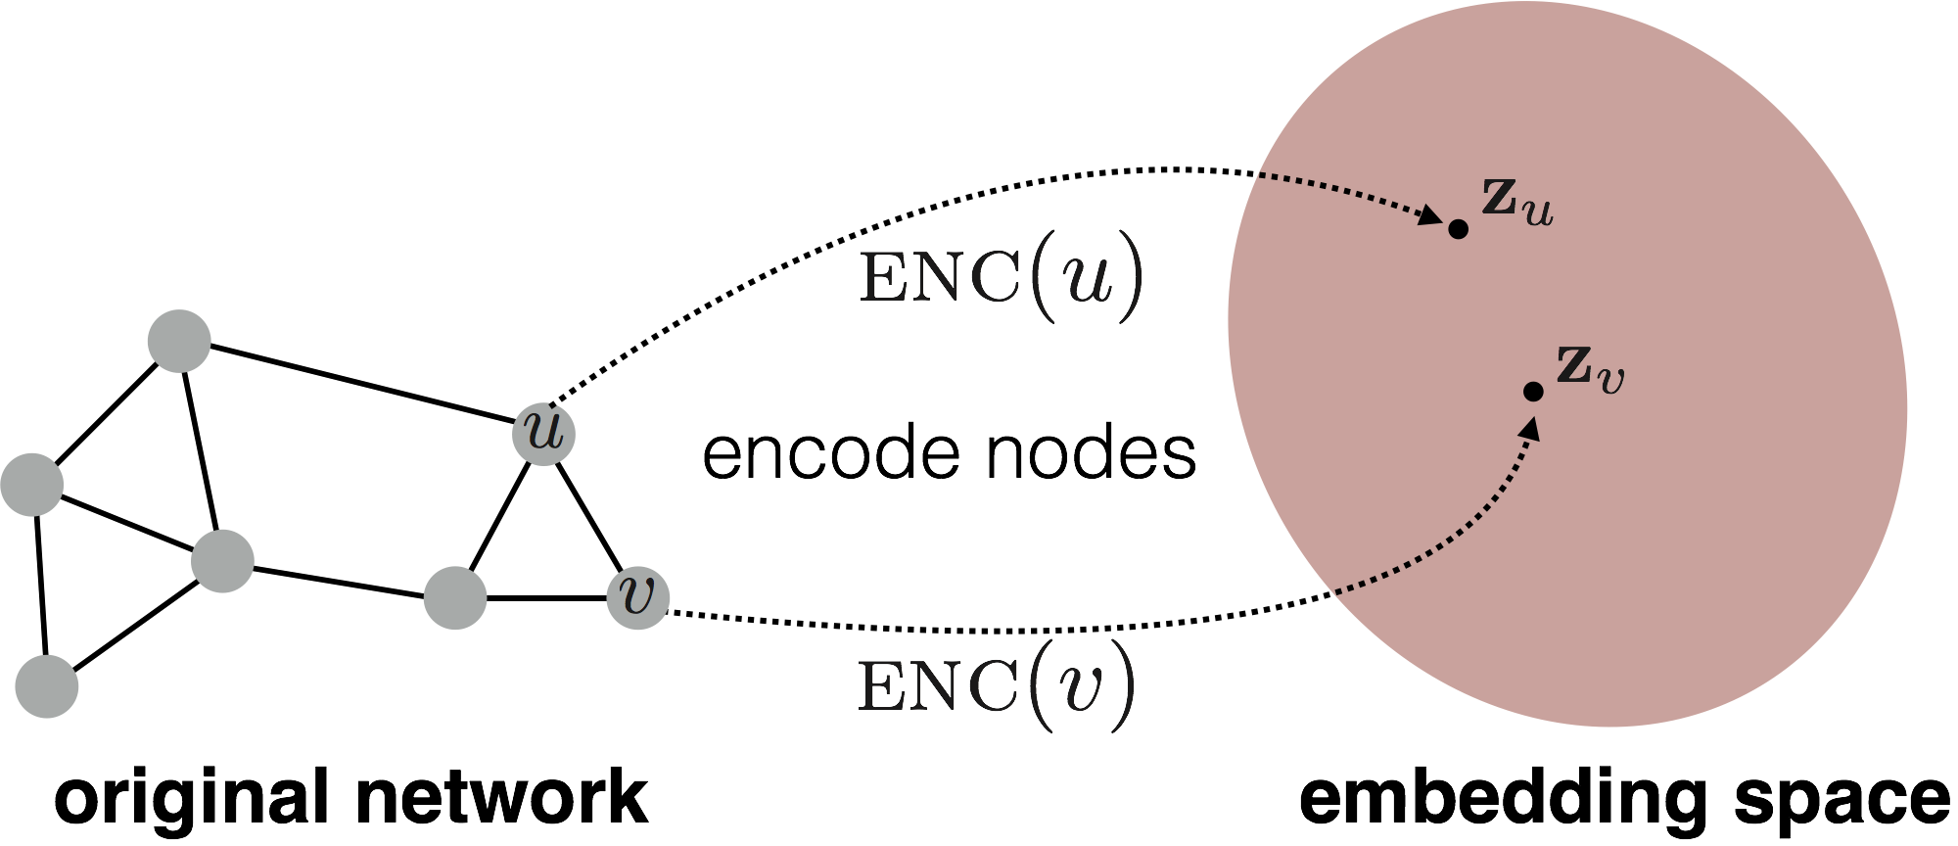
Embedding Nodes
Goal is to encode nodes so that similarity in the embedding space (e.g., dot product) approximates similarity in the graph

Slide 14

Embedding Nodes
Goal:
$$similarity\left(u,v\right) ≈ z_{v}^{Τ}z_{u}$$
in the original network
Similarity of the embedding
Need to define!

Slide 15
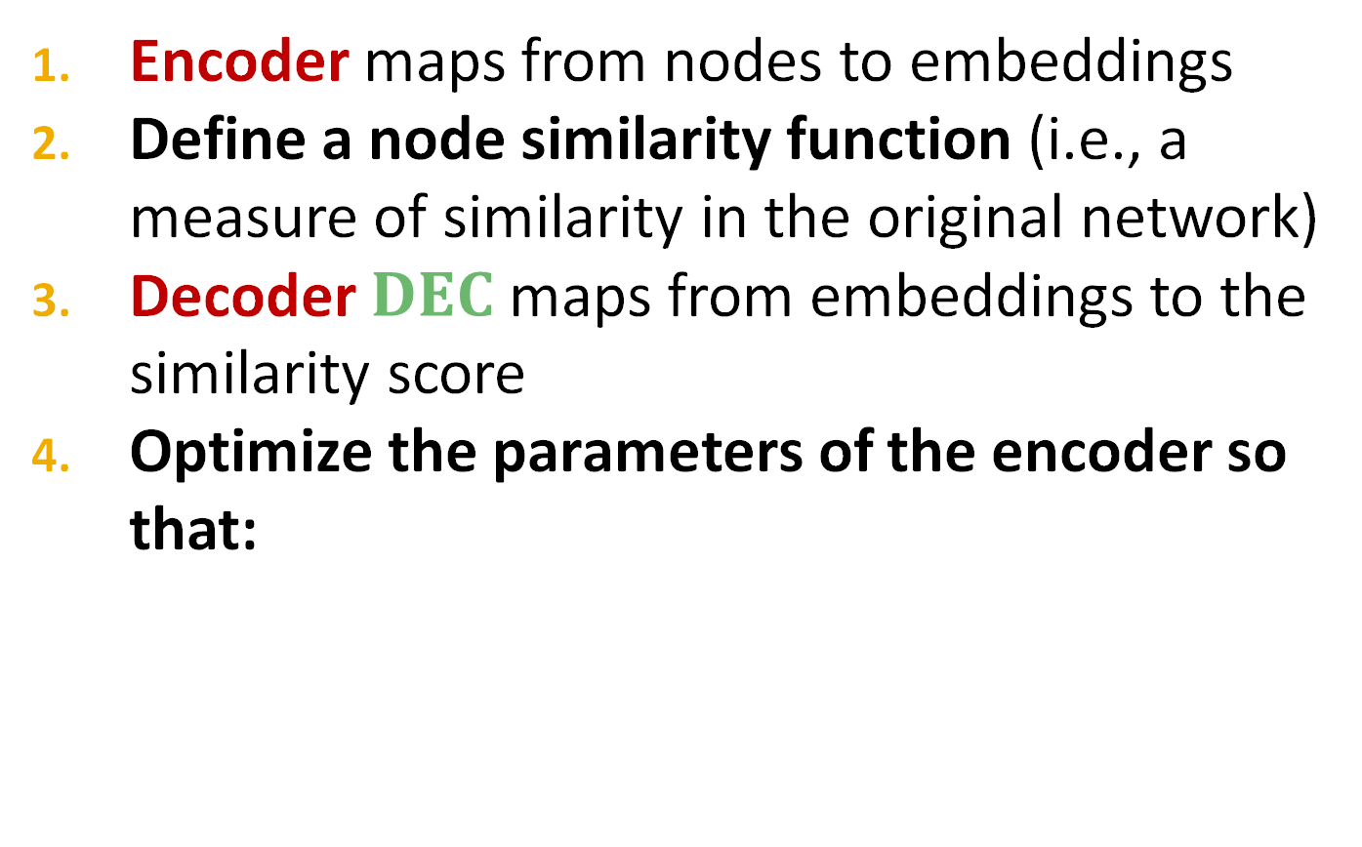


Learning Node Embeddings
Encoder maps from nodes to embeddings
Define a node similarity function (i.e., a measure of similarity in the original network)
Decoder $DEC$ maps from embeddings to the similarity score
Optimize the parameters of the encoder so that:
$${DEC(z}_{v}^{Τ}z_{u})$$
$$similarity\left(u,v\right) ≈ z_{v}^{Τ}z_{u}$$
in the original network
Similarity of the embedding
Notes:
Note that other distance measures other than dot products could be used (e.g., Euclidean distance), but the dot product is the standard measure of similarity used.

Slide 16
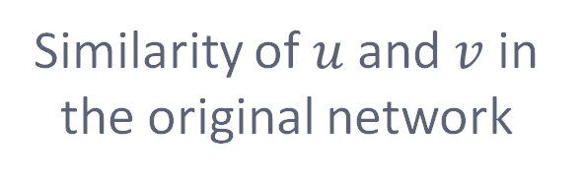

Two Key Components
Encoder: maps each node to a low-dimensional vector
Similarity function: specifies how the relationships in vector space map to the relationships in the original network
d-dimensional embedding
$$ENC\left(v\right)=z_{v}$$
node in the input graph
$$similarity\left(u,v\right) ≈ z_{v}^{Τ}z_{u}$$
Decoder
Similarity of $u$ and $v$ in the original network
dot product between node embeddings
Notes:
Note again that other distance measures other than dot products could be used (e.g., Euclidean distance), but the dot product is the standard measure of similarity used.

Slide 17



“Shallow” Encoding
Simplest encoding approach: Encoder is just an embedding-lookup
$$ENC\left(v\right)=z_{v}=Z⋅v$$
matrix, each column is a node embedding [what we learn / optimize]
$$Ζ∈ℝ^{d×\left|𝒱\right|}$$
indicator vector, all zeroes except a one in column indicating node v
$$v∈𝕀^{\left|𝒱\right|}$$

Slide 18
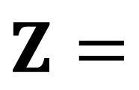
“Shallow” Encoding
Simplest encoding approach: encoder is just an embedding-lookup
embedding vector for a specific node
embedding matrix
Dimension/size of embeddings
$$Z=$$
one column per node

Slide 19
“Shallow” Encoding
Simplest encoding approach: Encoder is just an embedding-lookup
Each node is assigned a unique
embedding vector
(i.e., we directly optimize
the embedding of each node)
Many methods: DeepWalk, node2vec

Slide 20
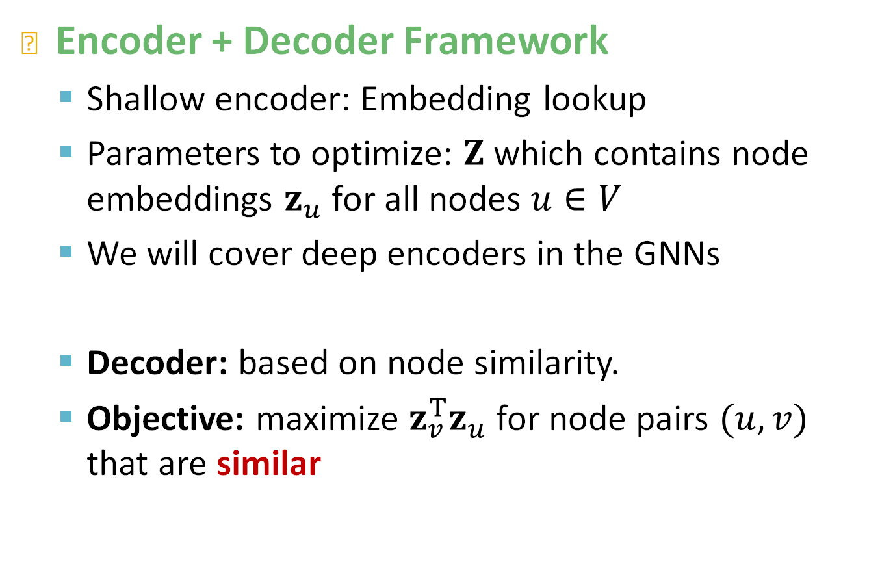
Framework Summary
Encoder + Decoder Framework
  Shallow encoder: Embedding lookup
  Parameters to optimize: $Z$ which contains node embeddings $z_{u}$ for all nodes $u∈V$
  We will cover deep encoders in the GNNs
  Decoder: based on node similarity.
  Objective: maximize $z_{v}^{Τ}z_{u}$ for node pairs $(u, v)$ that are similar

Slide 21
How to Define Node Similarity?
Key choice of methods is how they define node similarity.
Should two nodes have a similar embedding if they…
  are linked?
  share neighbors?
  have similar “structural roles”?
We will now learn node similarity definition that uses random walks, and how to optimize embeddings for such a similarity measure.

Slide 22
Note on Node Embeddings
This is unsupervised/self-supervised way of learning node embeddings.
  We are not utilizing node labels
  We are not utilizing node features
  The goal is to directly estimate a set of coordinates (i.e., the embedding) of a node so that some aspect of the network structure (captured by DEC) is preserved.
These embeddings are task independent:
  They are not trained for a specific task but can be used for any task.

Slide 23
Stanford CS224W:
Random Walk Approaches for Node Embeddings
CS224W: Machine Learning with Graphs
Jure Leskovec, Stanford University
http://cs224w.stanford.edu

Slide 24

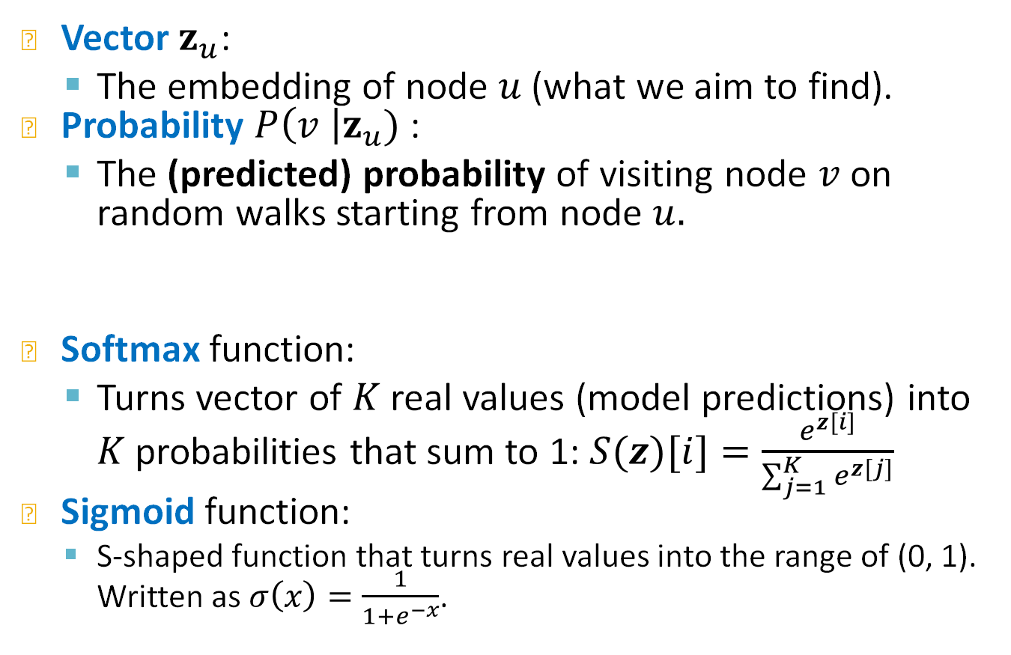
Notation
Vector$z_{u}$:
  The embedding of node $u$ (what we aim to find).
Probability $P\left(v \right|z_{u})$ :
  The (predicted) probability of visiting node $v$ on random walks starting from node $u.$
Softmax function:
  Turns vector of $K$ real values (model predictions) into $K$ probabilities that sum to 1: $S(z)[i]=\frac{e^{z[i]}}{\sum_{j=1}^{K}{e^{z[j]}}}$
Sigmoid function:
  S-shaped function that turns real values into the range of (0, 1). Written as $σ\left(x\right)=\frac{1}{1+e^{−x}}$.
Our model prediction based on $z_{u}$
Non-linear functions used to produce predicted probabilities

Slide 25
Random Walk
10
9
12
2
Step 3
Step 4
1
8
Step 5
3
11
Given a graph and a starting point, we select a neighbor of it at random, and move to this neighbor; then we select a neighbor of this point at random, and move to it, etc. The (random) sequence of points visited this way is a random walk on the graph.
4
Step 2
Step 1
6
5
7

Slide 26
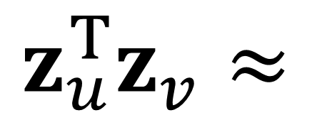
Random-Walk Embeddings
probability that u and v co-occur on a random walk over the graph
$$z_{u}^{Τ}z_{v}≈$$

Slide 27
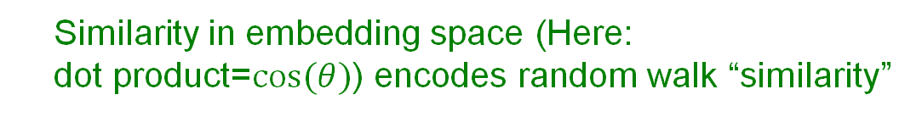
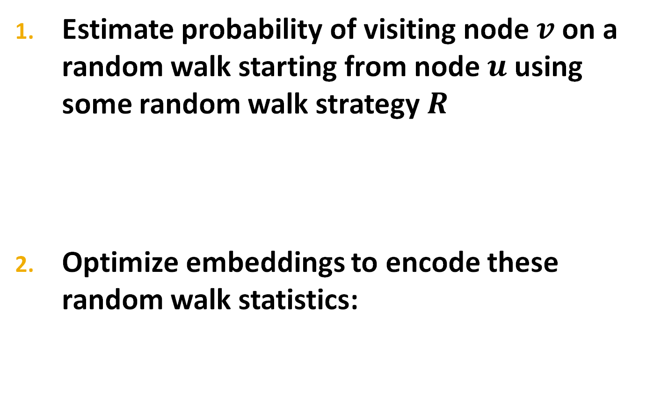
Random-Walk Embeddings
Estimate probability of visiting node $v$ on a random walk starting from node $u$ using some random walk strategy $R$
Optimize embeddings to encode these random walk statistics:
  Similarity in embedding space (Here:
  dot product=$cos(θ)$) encodes random walk “similarity”

Slide 28
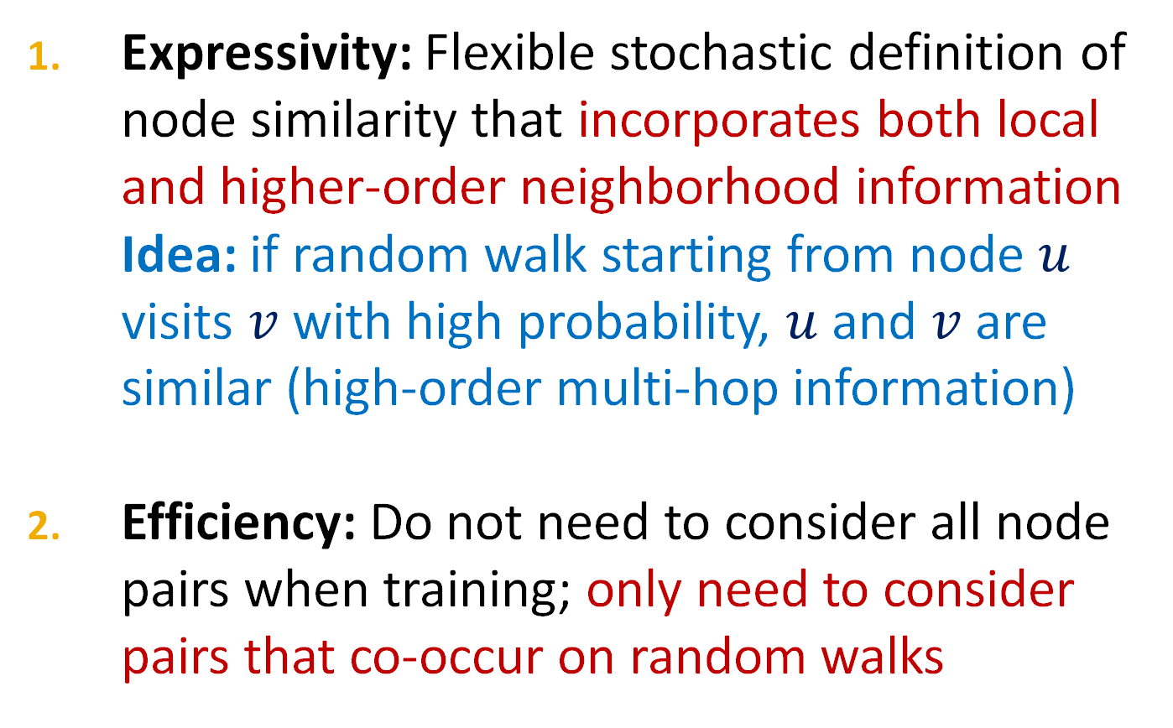
Why Random Walks?
Expressivity: Flexible stochastic definition of node similarity that incorporates both local and higher-order neighborhood information
Idea: if random walk starting from node $u$ visits $v$ with high probability, $u$ and $v$ are similar (high-order multi-hop information)
Efficiency: Do not need to consider all node pairs when training; only need to consider pairs that co-occur on random walks

Slide 29
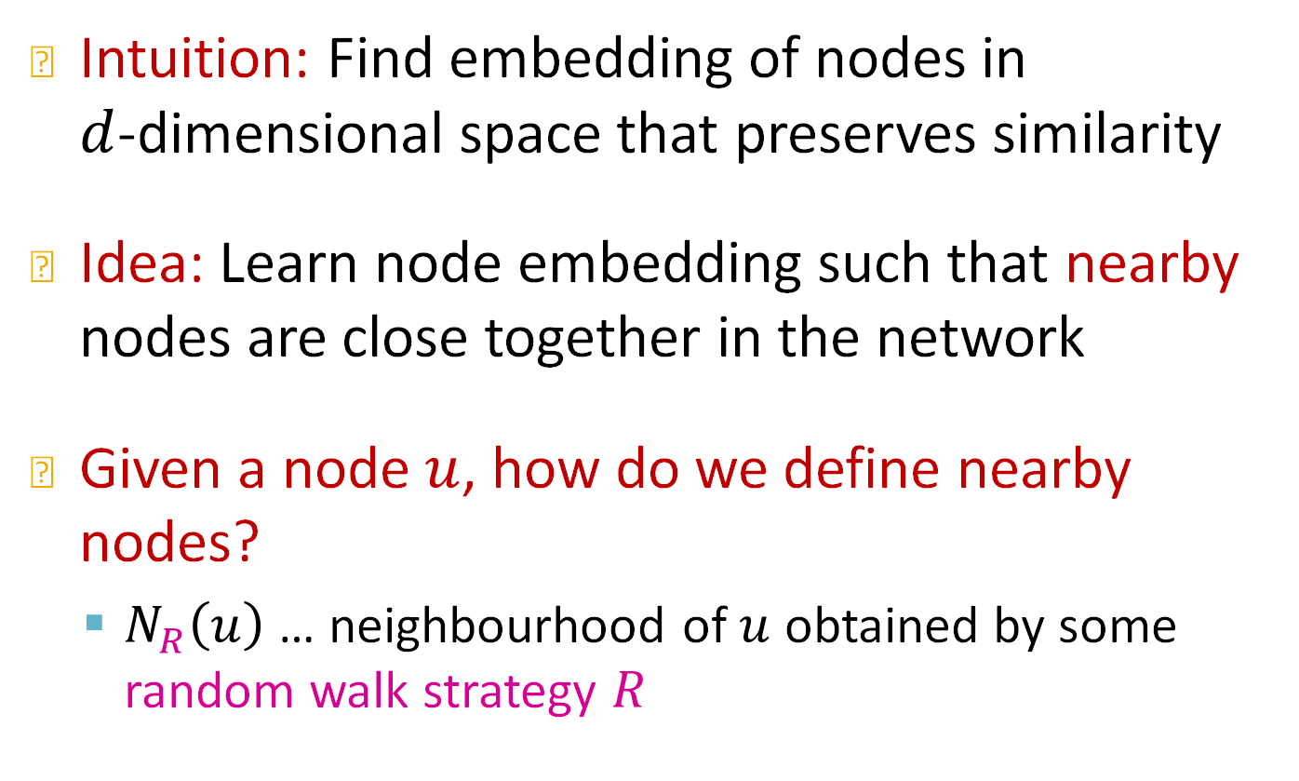
Unsupervised Feature Learning
Intuition: Find embedding of nodes in
$d$-dimensional space that preserves similarity
Idea: Learn node embedding such that nearby nodes are close together in the network
Given a node $u$, how do we define nearby nodes?
  $N_{R}\left(u\right)$ … neighbourhood of $u$ obtained by some random walk strategy $R$

Slide 30
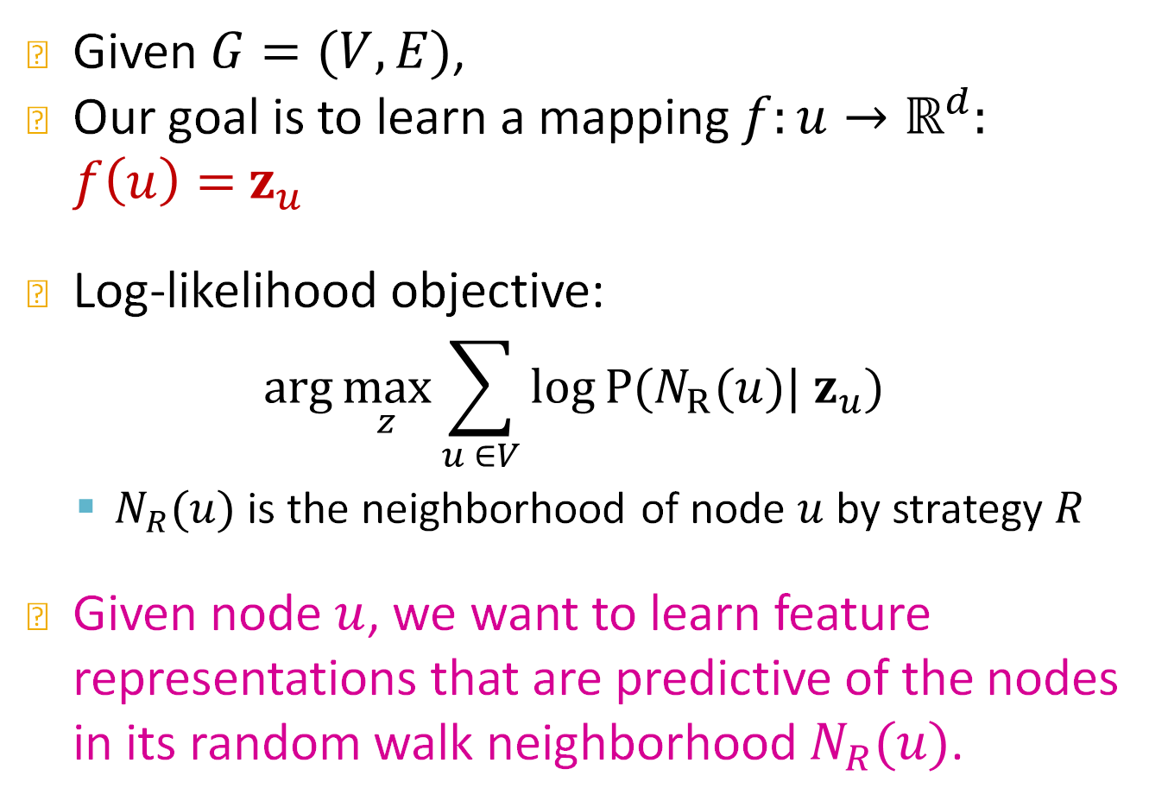
Feature Learning as Optimization
Given $G=(V,E)$,
Our goal is to learn a mapping $f:u→ℝ^{d}:$
$f\left(u\right)=$ $z_{u}$
Log-likelihood objective:
$$\text{arg}\max_{z}{\sum_{u ∈V}{\log{P(N_{R}(u})| z_{u})}}$$
  $N_{R}(u)$ is the neighborhood of node $u$ by strategy $R$
Given node $u$, we want to learn feature representations that are predictive of the nodes in its random walk neighborhood $N_{R}(u)$.

Slide 31
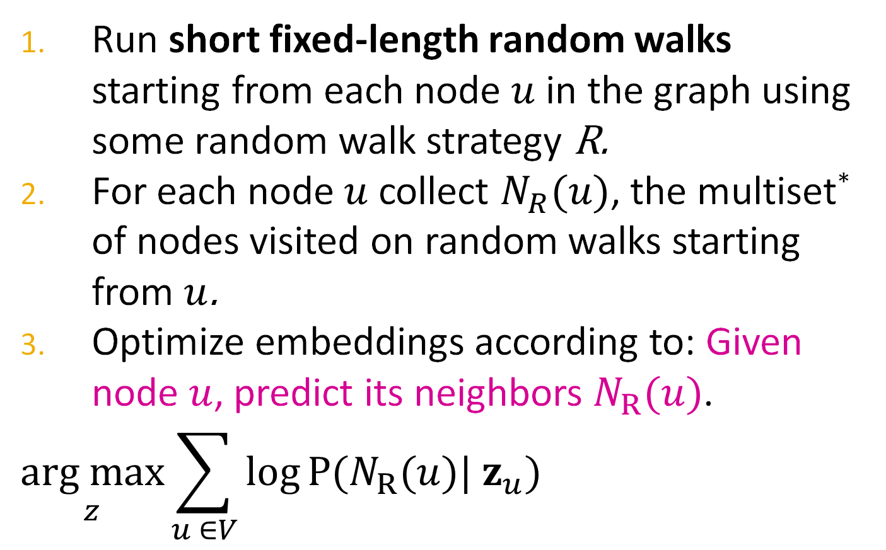
Random Walk Optimization
Run short fixed-length random walks starting from each node $u$ in the graph using some random walk strategy R.
For each node $u$ collect $N_{R}(u)$, the multiset* of nodes visited on random walks starting from $u$.
Optimize embeddings according to: Given node $u$, predict its neighbors $N_{R}(u)$.
$$\underset{z}{arg max}{\sum_{u ∈V}{\log{P(N_{R}(u})| z_{u})}}$$
Maximum likelihood objective
*$N_{R}(u)$ can have repeat elements since nodes can be visited multiple times on random walks

Slide 32
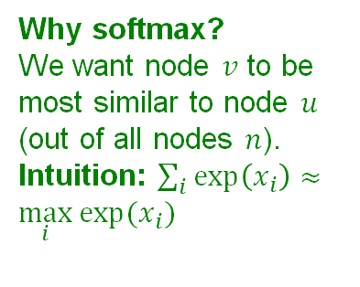
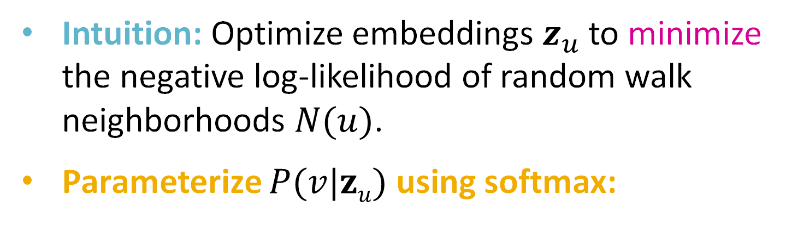
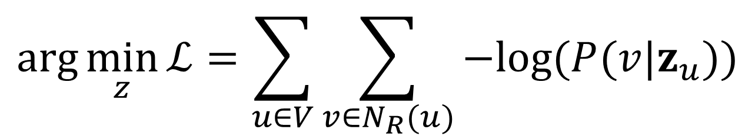
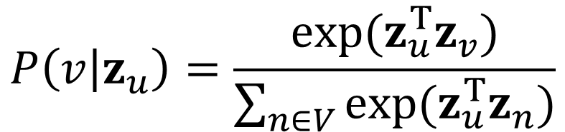
Random Walk Optimization
Equivalently,
$$\arg{\min_{z}{ℒ}}=\sum_{u∈V}{\sum_{v∈N_{R}(u)}{−log⁡(P(v|z_{u}))}}$$
Intuition: Optimize embeddings $z_{u}$ to minimize the negative log-likelihood of random walk neighborhoods $N(u)$.
Parameterize $P(v|zu)$ using softmax:
Why softmax?
We want node $v$ to be most similar to node $u$ (out of all nodes $n$).
Intuition: $\sum_{i}{exp\left(x_{i}\right)}≈\max_{i}{exp⁡(x_{i})}$
$$P\left(v | z_{u}\right)=\frac{exp⁡(z_{u}^{T}z_{v})}{\sum_{n∈V}{exp⁡(z_{u}^{T}z_{n})}}$$

Slide 33
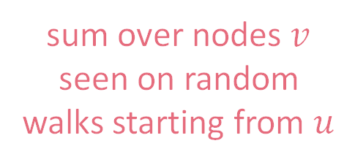
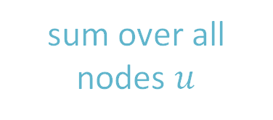
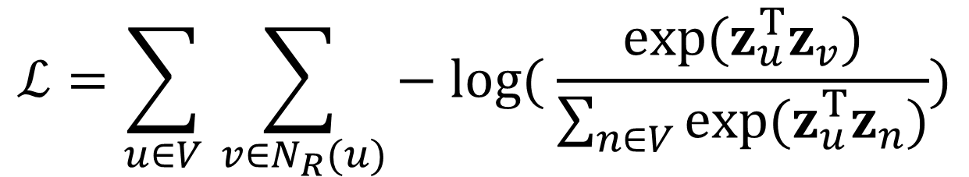
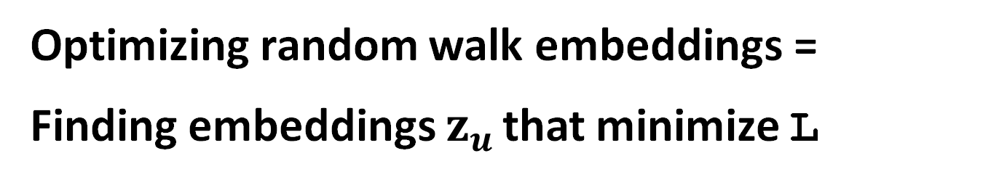
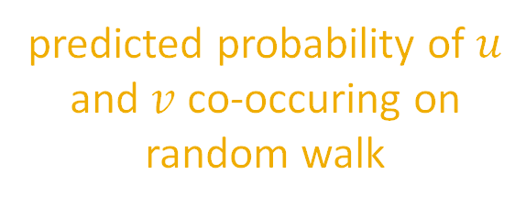
Random Walk Optimization
Putting it all together:
$$ℒ=\sum_{u∈V}{\sum_{ v∈N_{R}(u)}{− log⁡( \frac{exp⁡(z_{u}^{T}z_{v})}{\sum_{n∈V}{exp⁡(z_{u}^{T}z_{n})}})}}$$
sum over all nodes $u$
sum over nodes $v$ seen on random walks starting from $u$
predicted probability of $u$ and $v$ co-occuring on random walk
Optimizing random walk embeddings =
Finding embeddings $z_{u}$ that minimize L

Slide 34
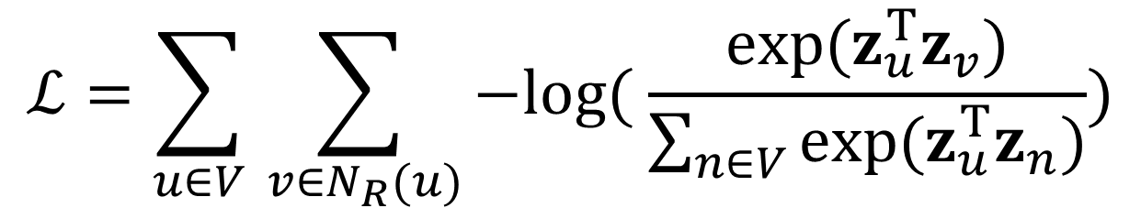
Random Walk Optimization
But doing this naively is too expensive!
$$ℒ=\sum_{u∈V}{\sum_{ v∈N_{R}(u)}{−log⁡( \frac{exp⁡(z_{u}^{T}z_{v})}{\sum_{n∈V}{exp⁡(z_{u}^{T}z_{n})}})}}$$
Nested sum over nodes gives O(|V|²) complexity!

Slide 35
Random Walk Optimization
But doing this naively is too expensive!
$$ℒ=\sum_{u∈V}{\sum_{ v∈N_{R}(u)}{−log⁡( \frac{exp⁡(z_{u}^{T}z_{v})}{\sum_{n∈V}{exp⁡(z_{u}^{T}z_{n})}})}}$$
The normalization term from the softmax is the culprit… can we approximate it?

Slide 36
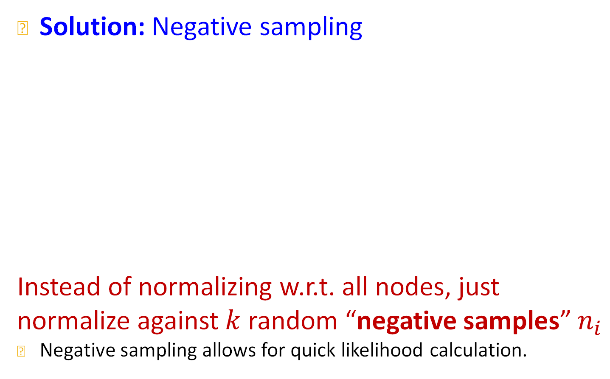
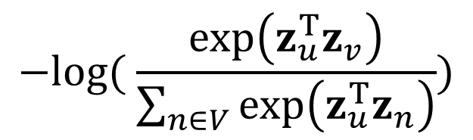
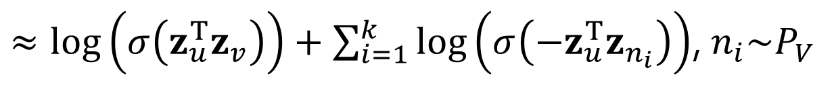
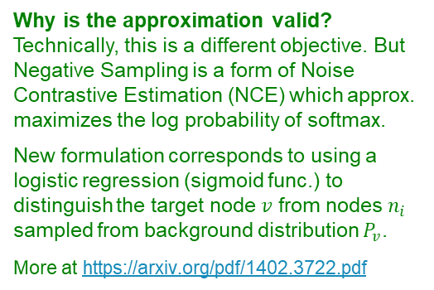
Negative Sampling
Why is the approximation valid?
Technically, this is a different objective. But Negative Sampling is a form of Noise Contrastive Estimation (NCE) which approx. maximizes the log probability of softmax.
New formulation corresponds to using a logistic regression (sigmoid func.) to distinguish the target node $v$ from nodes $n_{i}$ sampled from background distribution $P_{v}$.
More at https://arxiv.org/pdf/1402.3722.pdf
Solution: Negative sampling
Instead of normalizing w.r.t. all nodes, just normalize against $k$ random “negative samples” $n_{i}$
Negative sampling allows for quick likelihood calculation.
$$−log⁡( \frac{\exp\left(z_{u}^{T}z_{v}\right)}{\sum_{n∈V}{\exp\left(z_{u}^{T}z_{n}\right)}})$$
$≈\log\left(σ\left(z_{u}^{T}z_{v}\right)\right)+\sum_{i=1}^{k}{\log\left(σ\left(−z_{u}^{T}z_{n_{i}}\right)\right)}$, $n_{i}\sim P_{V}$
sigmoid function
(makes each term a “probability” between 0 and 1)
random distribution
over nodes
Notes:
-- Why is this approximation valid?
-- We loose soft-max by doing it?
-- Why can we move the log inside the sum in the approximation?

Slide 37
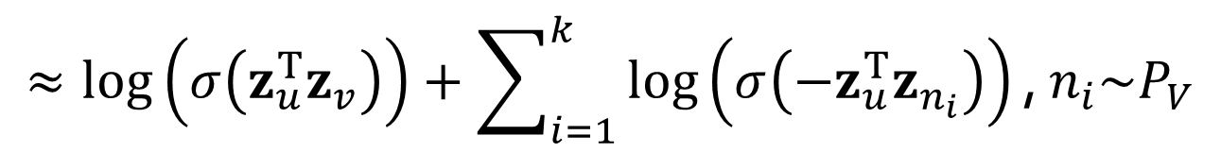
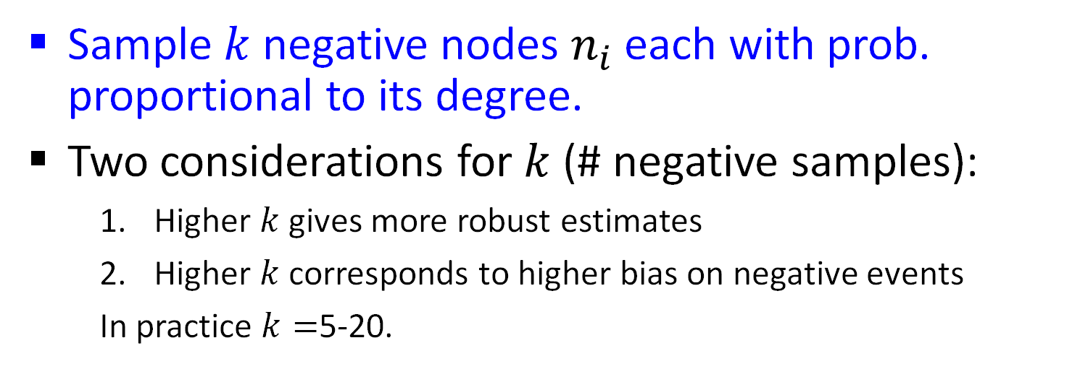
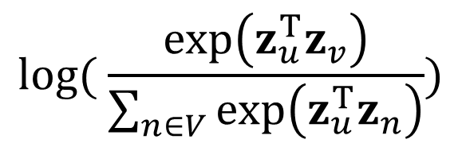
Negative Sampling
$$log⁡( \frac{\exp\left(z_{u}^{T}z_{v}\right)}{\sum_{n∈V}{\exp\left(z_{u}^{T}z_{n}\right)}})$$
random distribution
over nodes
$$≈\log\left(σ\left(z_{u}^{T}z_{v}\right)\right)+\sum_{i=1}^{k}{\log\left(σ\left(−z_{u}^{T}z_{n_{i}}\right)\right)}\text{, }n_{i}\sim P_{V}$$
Sample $k$ negative nodes $n_{i}$each with prob. proportional to its degree.
Two considerations for $k$ (# negative samples):
  Higher $k$ gives more robust estimates
  Higher $k$ corresponds to higher bias on negative events
  In practice $k=$5-20.
Can negative sample be any node or only the nodes not on the walk? People often sample any node (for efficiency).

Slide 38
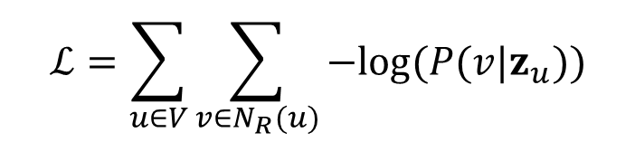
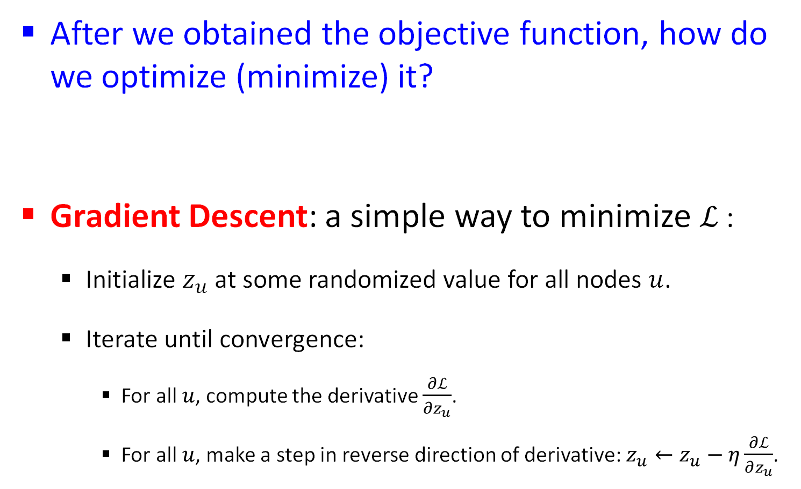

Stochastic Gradient Descent
After we obtained the objective function, how do we optimize (minimize) it?
Gradient Descent: a simple way to minimize $ℒ$:
  Initialize $z_{u}$ at some randomized value for all nodes $u$.
  Iterate until convergence:
    For all $u$, compute the derivative $\frac{∂ℒ}{∂z_{u}}$.
    For all $u$, make a step in reverse direction of derivative: $z_{u}←z_{u}−η\frac{∂ℒ}{∂z_{u}}$.
$$ℒ=\sum_{u∈V}{\sum_{v∈N_{R}(u)}{−log⁡(P(v|z_{u}))}}$$
$η$: learning rate

Slide 39
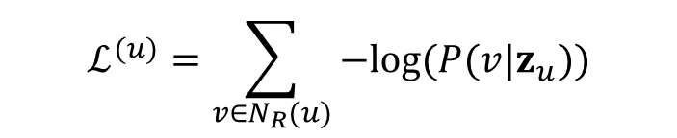
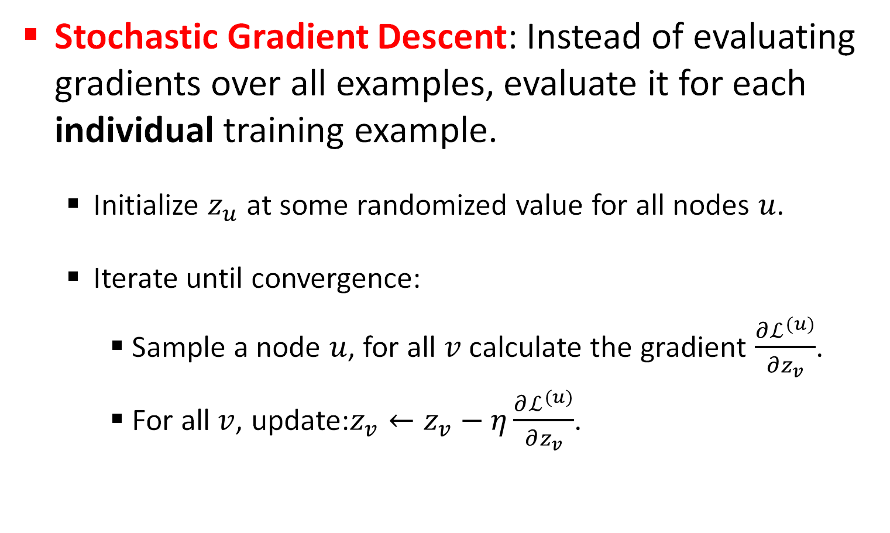
Stochastic Gradient Descent
Stochastic Gradient Descent: Instead of evaluating gradients over all examples, evaluate it for each individual training example.
  Initialize $z_{u}$ at some randomized value for all nodes $u$.
  Iterate until convergence:
    Sample a node $u$, for all $v$ calculate the gradient $\frac{∂ℒ^{(u)}}{∂z_{v}}$.
    For all$v$, update:$z_{v}←z_{v}−η\frac{∂ℒ^{(u)}}{∂z_{v}}$.
$$ℒ^{(u)}=\sum_{v∈N_{R}(u)}{−log⁡(P(v|z_{u}))}$$

Slide 40
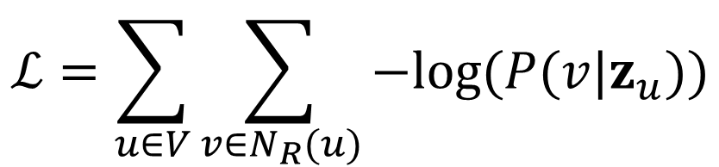
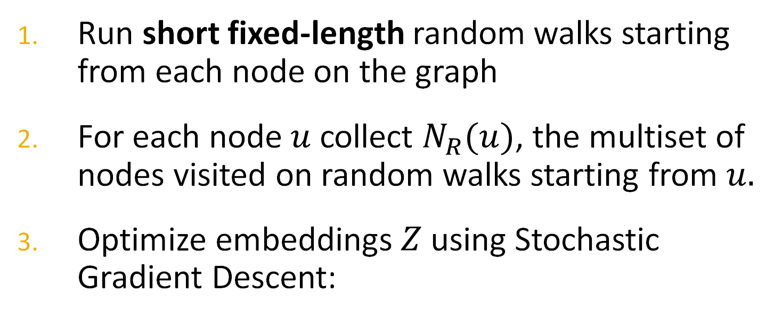
Random Walks: Summary
Run short fixed-length random walks starting from each node on the graph
For each node $u$ collect $N_{R}(u)$, the multiset of nodes visited on random walks starting from $u.$
Optimize embeddings $Z$ using Stochastic Gradient Descent:
$$ℒ=\sum_{u∈V}{\sum_{v∈N_{R}(u)}{−log⁡(P(v|z_{u}))}}$$
We can efficiently approximate this using negative sampling!

Slide 41
How should we randomly walk?
So far we have described how to optimize embeddings given a random walk strategy R
What strategies should we use to run these random walks?
  Simplest idea: Just run fixed-length, unbiased random walks starting from each node (i.e., DeepWalk from Perozzi et al.)
    The issue is that such notion of similarity is too constrained
How can we generalize this?
Reference: Perozzi et al. DeepWalk: Online Learning of Social Representations. KDD.​

Slide 42
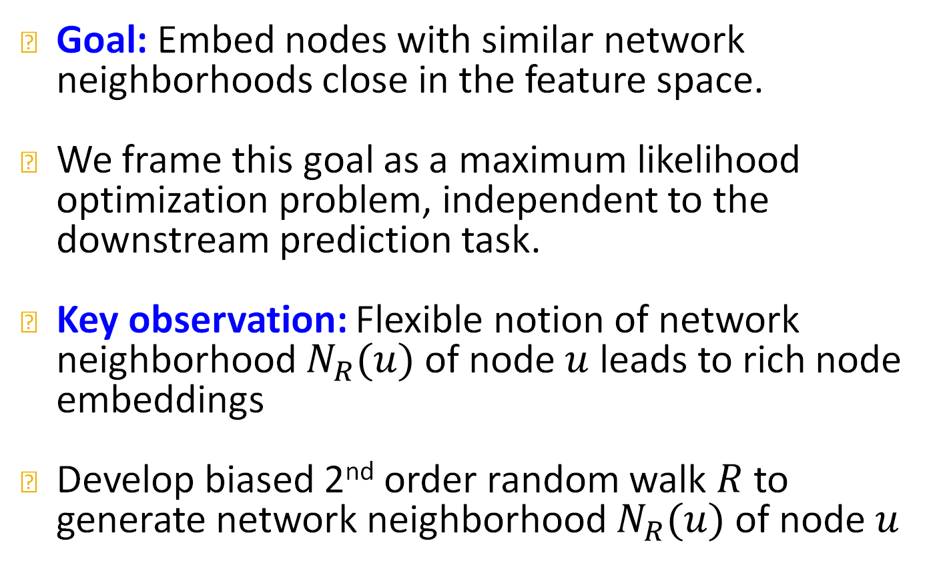
Overview of node2vec
Goal: Embed nodes with similar network neighborhoods close in the feature space.
We frame this goal as a maximum likelihood optimization problem, independent to the downstream prediction task.
Key observation: Flexible notion of network neighborhood $N_{R}(u)$ of node $u$ leads to rich node embeddings
Develop biased 2nd order random walk $R$ to generate network neighborhood $N_{R}(u)$ of node $u$
Reference: Grover et al. node2vec: Scalable Feature Learning for Networks. KDD.

Slide 43
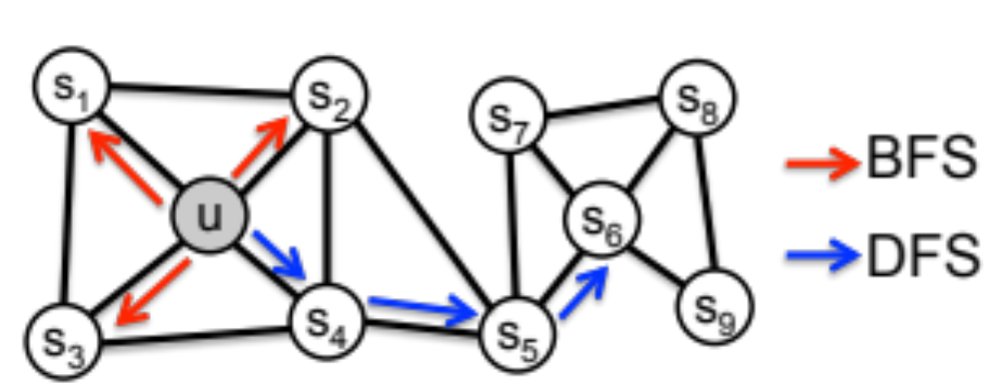
node2vec: Biased Walks
Idea: use flexible, biased random walks that can trade off between local and global views of the network (Grover and Leskovec).

Slide 44

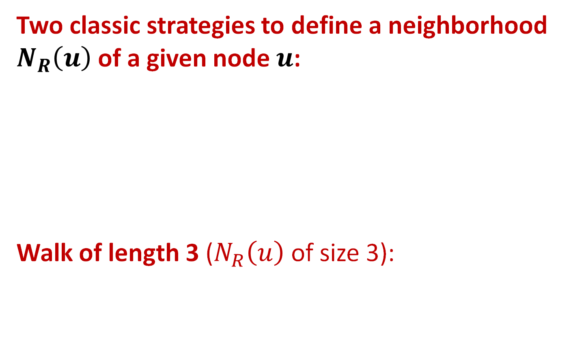

node2vec: Biased Walks
Two classic strategies to define a neighborhood $N_{R}\left(u\right)$ of a given node $u$:
Walk of length 3 ($N_{R}\left(u\right)$ of size 3):
$$N_{BFS}\left(u\right)=\{ s_{1},s_{2},s_{3}\}$$
Local microscopic view
$$N_{DFS}\left(u\right)=\{ s_{4},s_{5},s_{6}\}$$
Global macroscopic view

Slide 45
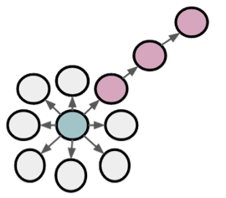
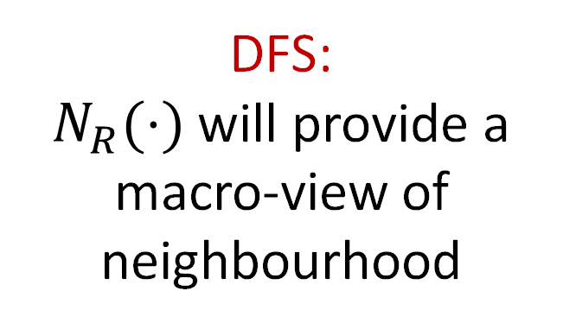
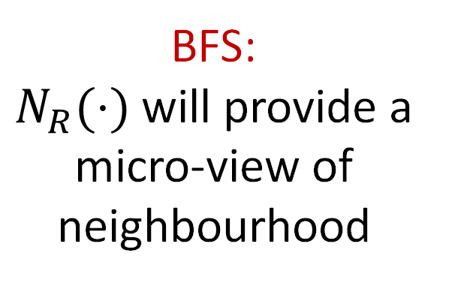
BFS vs. DFS
u
BFS:
$N_{R}(⋅)$ will provide a micro-view of neighbourhood
DFS:
$N_{R}(⋅)$will provide a macro-view of neighbourhood

Slide 46
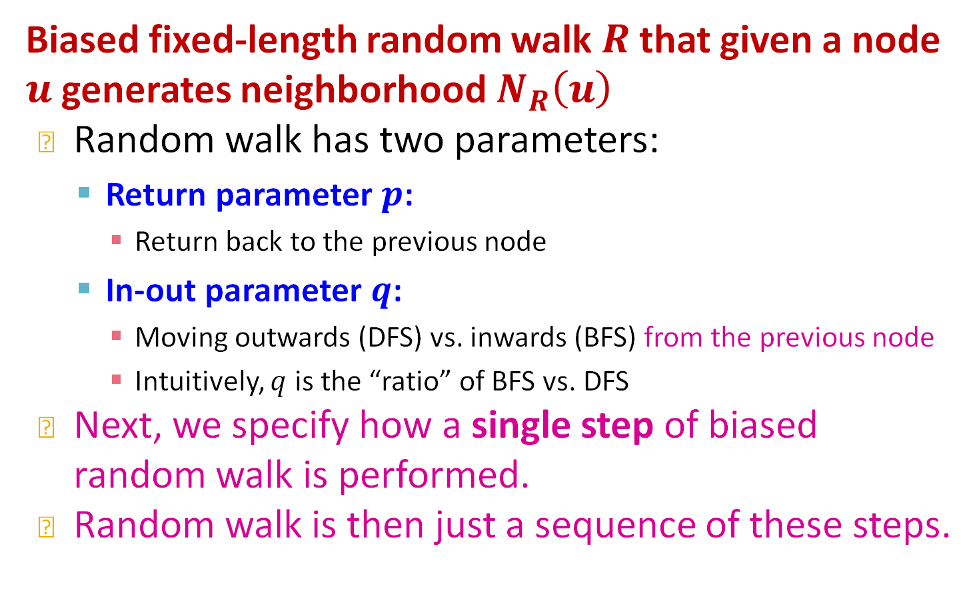
Interpolating BFS and DFS
Biased fixed-length random walk $R$ that given a node $u$ generates neighborhood $N_{R}\left(u\right)$
Random walk has two parameters:
  Return parameter $p$:
    Return back to the previous node
  In-out parameter $q$:
    Moving outwards (DFS) vs. inwards (BFS) from the previous node
    Intuitively, $q$ is the “ratio” of BFS vs. DFS
Next, we specify how a single step of biased random walk is performed.
Random walk is then just a sequence of these steps.

Slide 47

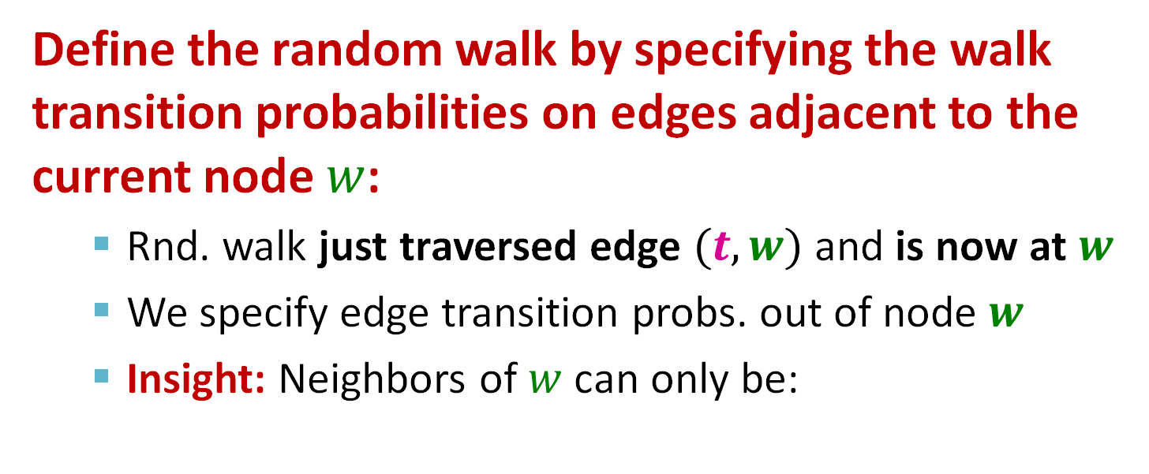


One Step of the Biased Random Walk
Define the random walk by specifying the walk transition probabilities on edges adjacent to the current node $w$:
  Rnd. walk just traversed edge $(t,w)$ and is now at $w$
  We specify edge transition probs. out of node $w$
  Insight: Neighbors of $w$ can only be:
Distance 1 from $t$
s₁
s₂
w
Distance 2 from $t$
u
t
Distance 0 from $t$

Slide 48


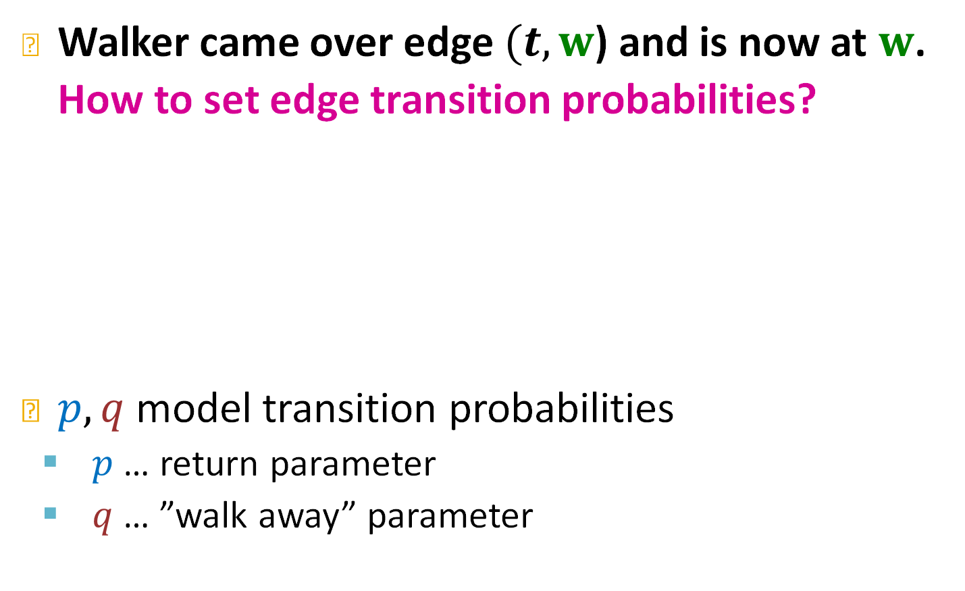
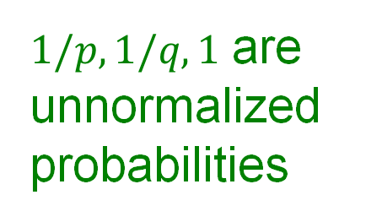


One Step of the Biased Random Walk
Walker came over edge $(t,w$) and is now at $w$. How to set edge transition probabilities?
$p,q$ model transition probabilities
  $p$ … return parameter
  $q$ … ”walk away” parameter
s₁
$$1$$
$$1/q$$
s₂
$1/p,1/q,1$ are unnormalized
probabilities
w
$$1/q$$
u
w
$$1/p$$
s₃

Slide 49
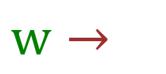
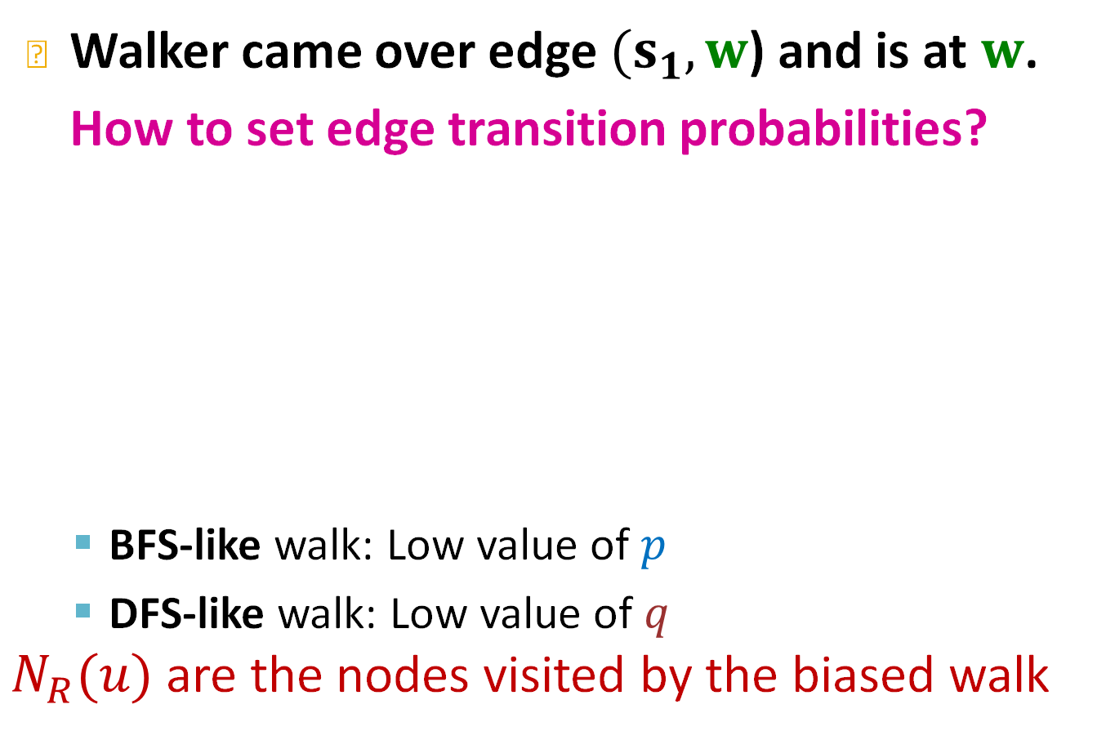




One Step of the Biased Random Walk
Walker came over edge $(s_{1},w$) and is at $w$. How to set edge transition probabilities?
  BFS-like walk: Low value of $p$
  DFS-like walk: Low value of $q$
$N_{R}(u)$ are the nodes visited by the biased walk
Target$x$
Prob.
Dist. $(t,x)$
0
1
2
2
s₁
$$1$$
$$1/q$$
s₂
t
s₁
s₂
s₃
$$1/p$$
$$1$$
$$1/q$$
$$1/q$$
w
$w→$
$$1/q$$
u
t
$$1/p$$
s₃
Unnormalized
transition prob.
segmented based on distance from $t$

Slide 50


node2vec algorithm
1) Compute edge transition probabilities:
  For each edge $(t, w)$ we compute edge walk probabilities (based on $p,q$) of edges $(w,⋅)$
2) Simulate $r$ random walks of length $l$ starting from each node $u$
3) Optimize the node2vec objective using Stochastic Gradient Descent
Linear-time complexity
All 3 steps are individually parallelizable

Slide 51
Other Random Walk Ideas
Different kinds of biased random walks:
  Based on node attributes (Dong et al.).
  Based on learned weights (Abu-El-Haija et al.)
Alternative optimization schemes:
  Directly optimize based on 1-hop and 2-hop random walk probabilities (as in LINE from Tang et al.).
Network preprocessing techniques:
  Run random walks on modified versions of the original network (e.g., Ribeiro et al. struct2vec, Chen et al. HARP).

Slide 52
Summary so far
Core idea: Embed nodes so that distances in embedding space reflect node similarities in the original network.
Different notions of node similarity:
  Naïve: Similar if two nodes are connected
  Random walk approaches (covered today)

Slide 53
Summary so far
So, what method should I use..?
No one method wins in all cases….
  E.g., node2vec performs better on node classification while alternative methods perform better on link prediction (Goyal and Ferrara, survey).
Random walk approaches are generally more efficient.
In general: Must choose definition of node similarity that matches your application.

Slide 54
Stanford CS224W:
Embedding Entire Graphs
CS224W: Machine Learning with Graphs
Jure Leskovec, Stanford University
http://cs224w.stanford.edu

Slide 55



Embedding Entire Graphs
Goal: Want to embed a subgraph or an entire graph $G$. Graph embedding: $z_{G}$.
Tasks:
  Classifying toxic vs. non-toxic molecules
  Identifying anomalous graphs
$$z_{G}$$

Slide 56


Approach 1
Simple (but effective) approach 1:
Run a standard graph embedding technique on the (sub)graph $G$.
Then just sum (or average) the node embeddings in the (sub)graph $G.$
Used by Duvenaud et al. to classify molecules based on their graph structure
$$z_{G}=\sum_{v∈G}{z_{v}}$$

Slide 57

Approach 2
Approach 2: Introduce a “virtual node” to represent the (sub)graph and run a standard graph embedding technique
Proposed by Li et al. as a general technique for subgraph embedding

Slide 58
Summary
We discussed 2 ideas to graph embeddings:
Approach 1: Embed nodes and sum/avg them
Approach 2: Create super-node that spans the (sub) graph and then embed that node.

Slide 59

Preview: Hierarchical Embeddings
DiffPool: We can also hierarchically cluster nodes in graphs, and sum/avg the node embeddings according to these clusters.

Slide 60
Stanford CS224W:
Matrix Factorization and Node Embeddings
CS224W: Machine Learning with Graphs
Jure Leskovec, Stanford University
http://cs224w.stanford.edu

Slide 61

Embeddings & Matrix Factorization
Recall: encoder as an embedding lookup
embedding vector for a specific node
embedding matrix
Dimension/size of embeddings
$$Z=$$
one column per node
Objective: maximize $z_{v}^{Τ}z_{u}$ for node pairs $(u, v)$ that are similar

Slide 62






Connection to Matrix Factorization
Simplest node similarity: Nodes $u, v$ are similar if they are connected by an edge
This means: $z_{v}^{Τ}z_{u}=A_{u, v}$
which is the $(u, v)$ entry of the graph adjacency matrix $A$
Therefore, $Z^{T}Z=A$
$$Z^{T}$$
$$Z$$
4
3
$$×$$
2
1
$$z_{u}$$
$$z_{v}$$

Slide 63

Matrix Factorization
The embedding dimension $d$ (number of rows in $Z$) is much smaller than number of nodes $n$.
Exact factorization $A=Z^{T}Z$ is generally not possible
However, we can learn $Z$ approximately
Objective:$\min_{Z}∥A−Z^{T}Z∥_{2}$
  We optimize $Z$ such that it minimizes the L2 norm (Frobenius norm) of $A−Z^{T}Z$
  Note today we used softmax instead of L2. But the goal to approximate $A$ with $Z^{T}Z$ is the same.
Conclusion: Inner product decoder with node similarity defined by edge connectivity is equivalent to matrix factorization of $A.$

Slide 64

Random Walk-based Similarity
DeepWalk and node2vec have a more complex node similarity definition based on random walks
DeepWalk is equivalent to matrix factorization of the following complex matrix expression:
  Explanation of this equation is on the next slide.
$$log\left(vol(G)\left( \frac{1}{T} \sum_{r=1}^{T}{{(D^{−1}A)}^{r}}\right)D^{−1}\right)−\log{b}$$
Network Embedding as Matrix Factorization: Unifying DeepWalk, LINE, PTE, and node2vec.

Slide 65




Random Walk-based Similarity
Volume of graph
$$vol\left(G\right)=\sum_{i}{\sum_{j}{A_{i,j}}}$$
Node2vec can also be formulated as a matrix factorization (albeit a more complex matrix)
Refer to the paper for more details:
Diagonal matrix $D$
$$D_{u,u}=deg⁡(u)$$
$$\log\left(vol(G)\left( \frac{1}{T} \sum_{r=1}^{T}{{(D^{−1}A)}^{r}}\right)D^{−1}\right)−\log{b}$$
context window size
See Lec 3 slide 30:
$T={|N}_{R}\left(u\right)|$
Number of
negative samples
Power of normalized
adjacency matrix
Network Embedding as Matrix Factorization: Unifying DeepWalk, LINE, PTE, and node2vec.

Slide 66

How to Use Embeddings
How to use embeddings $z_{i}$ of nodes:
  Clustering/community detection: Cluster points $z_{i}$
  Node classification: Predict label of node $i$ based on $z_{i}$
  Link prediction: Predict edge $(i,j)$ based on ${(z}_{i},z_{j})$
    Where we can: concatenate, avg, product, or take a difference between the embeddings:
      Concatenate: ${f(z}_{i},z_{j})$= ${g([z}_{i},z_{j}])$
      Hadamard: ${f(z}_{i},z_{j})$= ${g(z}_{i}∗z_{j})$ (per coordinate product)
      Sum/Avg: ${f(z}_{i},z_{j})$= ${g(z}_{i}+z_{j})$
      Distance: ${f(z}_{i},z_{j})$= ${g(||z}_{i}−z_{j}|{\left.​\right|}_{2})$
  Graph classification: Graph embedding $z_{G}$via aggregating node embeddings or virtual-node.
  Predict label based on graph embedding $z_{G}$.

Slide 67
Today’s Summary
We discussed graph representation learning, a way to learn node and graph embeddings for downstream tasks, without feature engineering.
Encoder-decoder framework:
  Encoder: embedding lookup
  Decoder: predict score based on embedding to match node similarity
Node similarity measure: (biased) random walk
  Examples: DeepWalk, Node2Vec
Extension to Graph embedding: Node embedding aggregation

Slide 68
Limitations (1)
Limitations of node embeddings via matrix factorization and random walks
  Transductive (not inductive) method:
    Cannot obtain embeddings for nodes not in the training set
    Cannot apply to new graphs
      If you apply DeepWalk to the same graph multiple times, each time you’ll get a different embedding each time. Why?
4
A newly added node 5 at test time
(e.g., new user in a social network)
3
2
Cannot compute its embedding
with DeepWalk / node2vec. Need to recompute all node embeddings.
1
5
Training set

Slide 69
Limitation (2)
Cannot capture structural similarity:
  Node 1 and 11 are structurally similar – part of one triangle, degree 2, …
  However, they have very different embeddings.
    It’s unlikely that a random walk will reach node 11 from node 1.
DeepWalk and node2vec do not capture structural similarity.
3
13
4
5
10
2
12
1
11

Slide 70
Limitations (3)
Cannot utilize node, edge and graph features
4
Feature vector
(e.g. protein properties in a
protein-protein interaction graph)
3
2
1
5
DeepWalk / node2vec embeddings do not incorporate such node features
Solution to these limitations: Deep Representation Learning and Graph Neural Networks
(To be covered in depth next)

Slide 71
*****Notes from 2024/25******
Finished nicely in time. Good lecture.
No changes needed.
Talked too much. Talk less and go slower.

