Slide 1

Stanford CS224W:
GNN Training
Note to other teachers and users of these slides: We would be delighted if you found our material useful for giving your own lectures. Feel free to use these slides verbatim, or to modify them to fit your own needs. If you make use of a significant portion of these slides in your own lecture, please include this message, or a link to our web site: http://cs224w.Stanford.edu
CS224W: Machine Learning with Graphs
Jure Leskovec, Stanford University
Charilaos Kanatsoulis, Stanford University
http://cs224w.stanford.edu

Slide 2
Announcements
Project information released on course website
Project counts 30% towards your final grade
Due Dates:
Colab 1 due this Thursday, 10/10
Homework 1 due next Thursday, 10/17
Project Proposal is due Tuesday, 10/22
HW1 recitation session on Wed 1:30PM
Notes:
We have updated and released project information on the course website. This year we are emphasizing a lot on the project and it counts 30%

Slide 3
Response to high-frequency feedbacks
More in Person Office Hours
We have increased in person OHs to 5 sessions.
Project Partner Coordination
We have created a pinned thread on Ed to facilitate finding project partners: https://edstem.org/us/courses/67691/discussion/5366313
Keep track of deadlines
We’ll make weekly announcement about deadlines via Ed.
Additional resources
Please come to the office hour and our TAs will pinpoint you with relevant resources!
Notes:
Based on your responses we will take the following 4 actions

Slide 4
Course project
Goal: create long-lasting resources for your technical profiles + broader graph ML community
Three types of projects
  1) Real-world applications of GNNs
  2) Tutorial on PyG functionality
  3) Implementation of cutting-edge research
We will publish your blog posts on our course’s Medium page!
Notes:
The idea of the project is to create a long lasting resource for technical and non-technical people show the power and diversity of graph ML. What we want to emphasize is how general and broad the graph representation is and how impactful it is in a lot of businesses:
Finance, e-commerce businesses, drug design, we can represent
Transactions, interactions and bonds as graphs and develop very accurate predictive models for these domains.
Having said that, we generally have 3 types of projects.
The first refers to real-world applications of graphs and GNNs.
2. Tutorialish blogpost type of project in PyG. This kind of project will be a tutorial or a guide on a given topic, a technical subject, a method, or a function in PyG. Described the notion of attention and how it can be used for graphs within PyG
3. Involves Implementation benchmarking of cutting-edge research methods.
These are three Different types of project
Publish projects on as blogspots on cs224w medium. Spread the world across the community. These blogposts get a lot of viewership. The impact of your project is much bigger than a pdf.

Slide 5
1) Real-world applications of GNNs
Goal: identify a specific use case and demonstrate how GNNs and PyG can be used to solve this problem
Output: blog post, Google colab
Example use cases
  Fraud detection
  Predicting drug interactions
  Friend recommendation
Check out the featured posts in the project information doc on the course website
Notes:
Idea: identify a specific use case / application
Output: blogpost, visualization, colab where people can run your code:
Examples: traffic monitoring, 3d pose estimation, multi-agent systems in robotics
Find an interesting domain and apply what you learn in class to that domain
Or in practical terms, get Real dataset and have a metric to measure success
I highly recommend using existing dataset and not collect the dataset yourself. Collecting datasets takes longer than you expect and can lead to unsuccessful projects.

Slide 6
2) Tutorial on PyG functionality
Goal: develop a tutorial that explains how to use existing PyG functionality
Output: blog post, Google colab
Example topics for tutorials
  PyG’s explainability module
  Methods for graph sampling (e.g., negative sampling, sampling on heterogeneous graphs)
  Tutorial on GraphGym, a platform for designing and evaluating GNNs
Check out example tutorials from PyG
Notes:
Tutorial/ overview
Explain how an existing concepts of graph ML works, existing functionalities of PyG work
GNNs and explainability was one example and the code was pushed into PyG

Slide 7
3) Implementation of research
Goal: implement interesting methods from a recent research paper in graph ML
Output: PR to PyG contrib, short blog post
Project details
  Implementation should include comprehensive testing and documentation on new functionality
  Try to build on existing PyG and PyTorch code wherever possible
  Note: this project is more manageable if you are already comfortable with PyTorch and deep learning. We also highly recommend group of 3.
Notes:
This is a more software engineering type of project
Create a new implementation and submit as a pull request to PYG repo
And a short blogpost on what this implementation is doing
P details:
-If you are interested in that you should talk to us, because your code would live forever in PyG
-
-engineering involved fitting into a bigger ecosystem

Slide 8
Project logistics
Project is worth 30% of your course grade
  Project proposal (2 pages), due October 22
  Project milestone, due November 7
  Final reports, due December 12
We recommend groups of 3, but groups of 2 are also allowed
  Each group will be assigned a CA mentor who will provide feedback
Full project description is released on the course website!

Slide 9
Stanford CS224W:
GNN Augmentation and Training
CS224W: Machine Learning with Graphs
Jure Leskovec, Stanford University
http://cs224w.stanford.edu

Slide 10
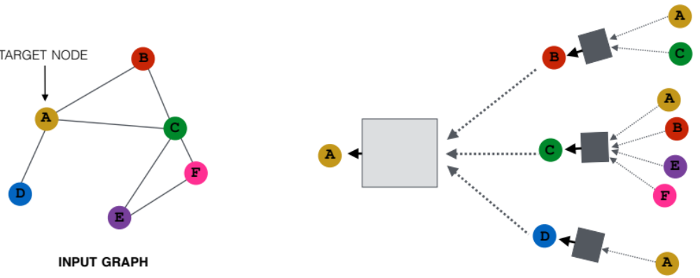
Recap: A General GNN Framework
J. You, R. Ying, J. Leskovec. Design Space of Graph Neural Networks, NeurIPS 2020
(5) Learning objective
(2) Aggregation
GNN Layer 2
(1) Message
(3) Layer connectivity
GNN Layer 1
(4) Graph augmentation

Slide 11
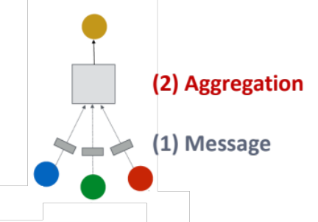
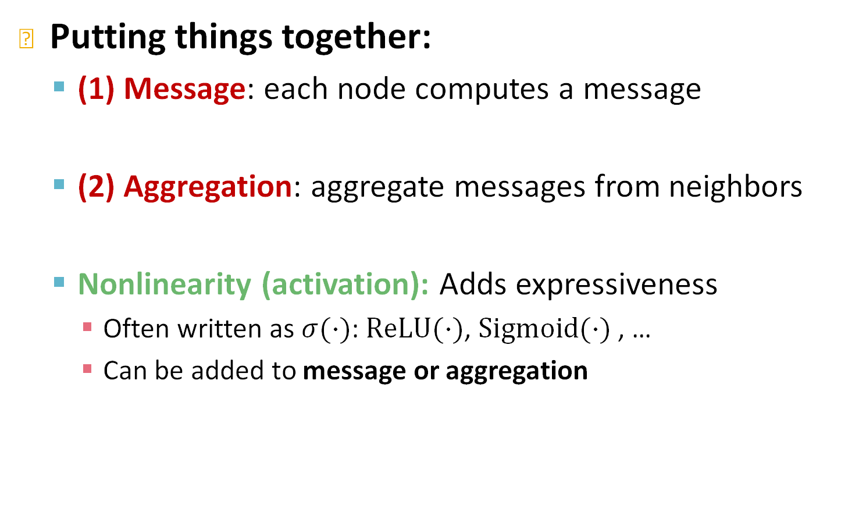

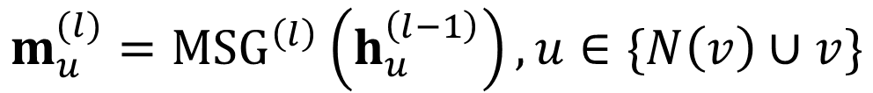
Recap: A Single GNN Layer
Putting things together:
  (1) Message: each node computes a message
  (2) Aggregation: aggregate messages from neighbors
  Nonlinearity (activation): Adds expressiveness
    Often written as $σ(⋅)$: $ReLU(⋅)$, $Sigmoid(⋅)$ , …
    Can be added to message or aggregation
$$m_{u}^{(l)}={MSG}^{\left(l\right)}\left(h_{u}^{\left(l−1\right)}\right), u∈\{N\left(v\right)∪v\}$$
$$h_{v}^{(l)}={AGG}^{\left(l\right)}\left(\left\{m_{u}^{\left(l\right)}, u∈N\left(v\right)\right\},m_{v}^{\left(l\right)}\right)$$

Slide 12
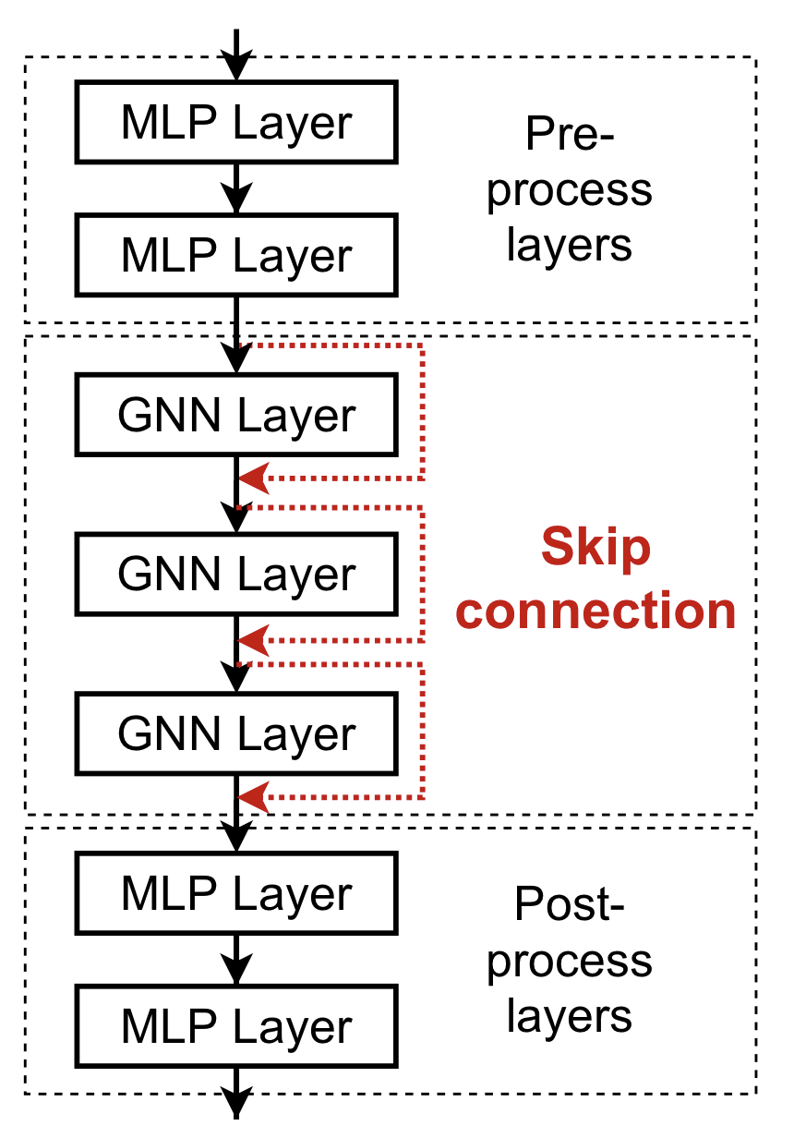
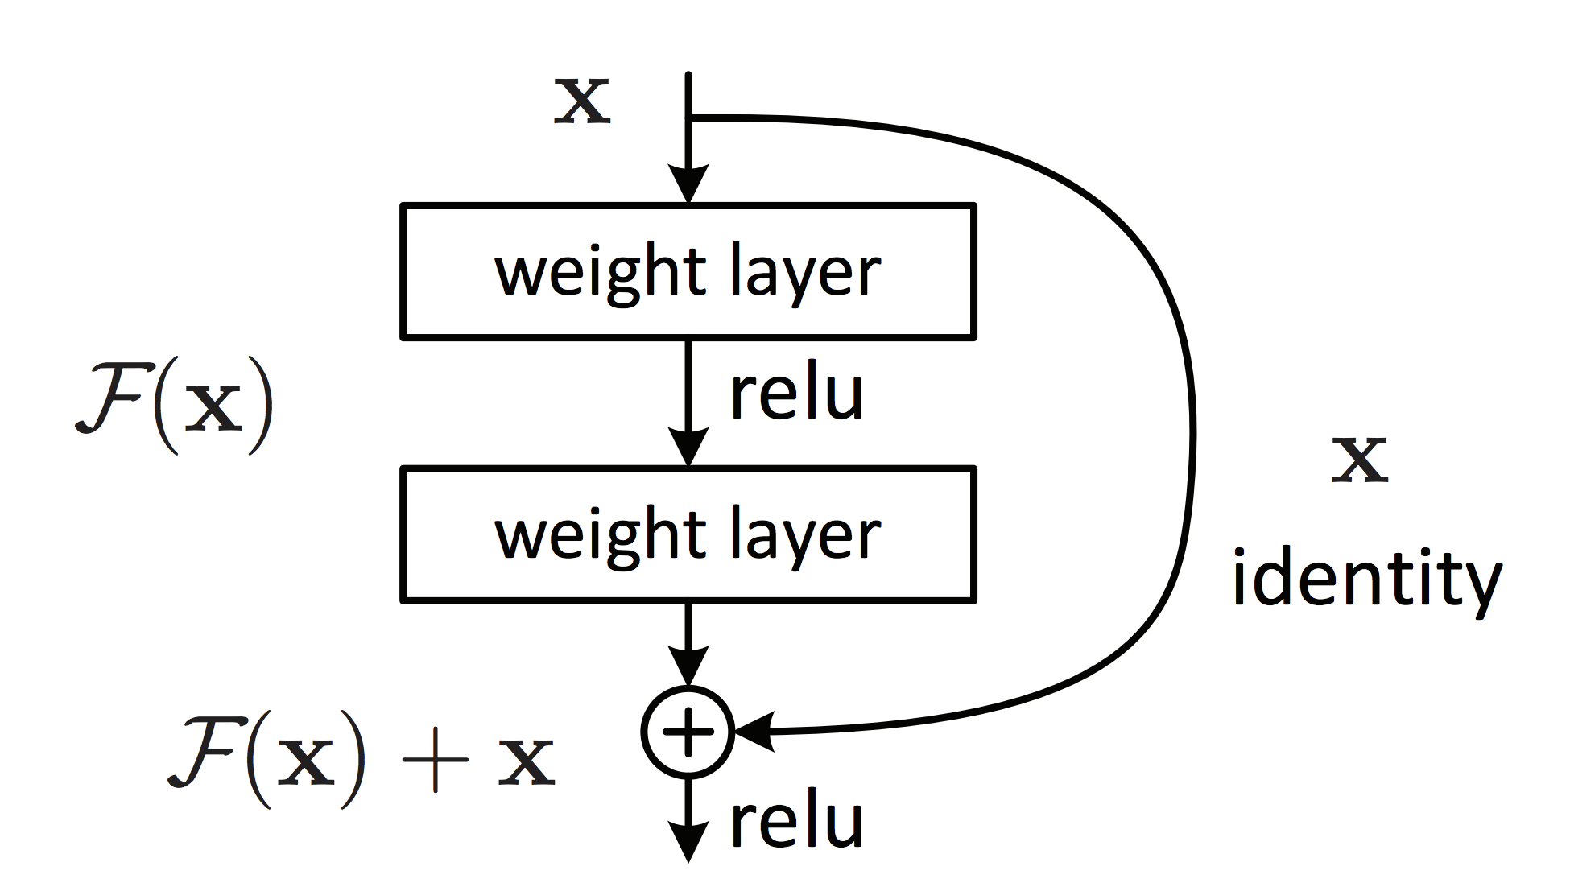
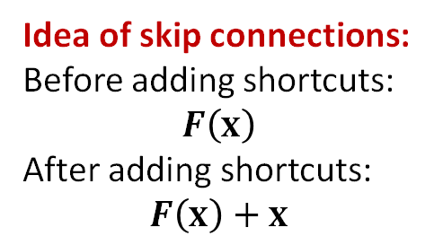
Recap: GNN Layer Connectivity
He et al. Deep Residual Learning for Image Recognition, CVPR 2015
What if my problem still requires many GNN layers?
Lesson 2: Add skip connections in GNNs
  Observation from over-smoothing: Node embeddings in earlier GNN layers can sometimes better differentiate nodes
  Solution: We can increase the impact of earlier layers on the final node embeddings, by adding shortcuts in GNN
Duplicate into two branches
Idea of skip connections:
Before adding shortcuts:
$$F\left(x\right)$$
After adding shortcuts:
$$F\left(x\right)+x$$
Sum two branches

Slide 13
Recap: Graph Manipulation
Graph Feature manipulation
  The input graph lacks features → feature augmentation
Graph Structure manipulation
  The graph is too sparse → Add virtual nodes / edges
  The graph is too dense → Sample neighbors when doing message passing
  The graph is too large → Sample subgraphs to compute embeddings
    Will cover later in lecture: Scaling up GNNs

Slide 14
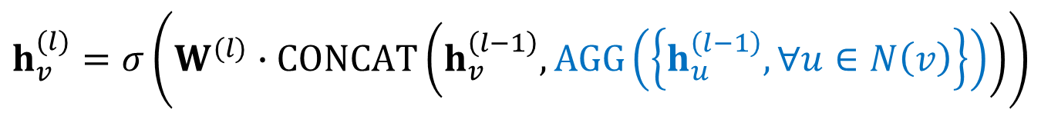



Classical GNN Layers: GraphSAGE
Hamilton et al. Inductive Representation Learning on Large Graphs, NeurIPS 2017
GraphSAGE
  Two-stage aggregation
    Stage 1: Aggregate from node neighbors
    Stage 2: Further aggregate over the node itself
$$h_{v}^{(l)}=σ\left(W^{(l)}∙CONCAT\left(h_{v}^{\left(l−1\right)}, AGG\left(\left\{h_{u}^{\left(l−1\right)},∀u∈N\left(v\right)\right\}\right)\right)\right)$$
$$h_{N(v)}^{(l)}←AGG\left(\left\{h_{u}^{(l−1)},∀u∈N\left(v\right)\right\}\right)$$
$$h_{v}^{(l)}←σ\left(W^{(l)}⋅CONCAT(h_{v}^{\left(l−1\right)},h_{N(v)}^{(l)})\right)$$
$$h_{v}^{(l)}←σ\left(W_{1}^{(l)}⋅h_{v}^{\left(l−1\right)}+W_{2}^{(l)}⋅h_{N(v)}^{(l)})\right)$$

Slide 15
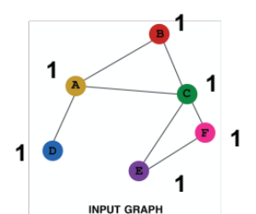
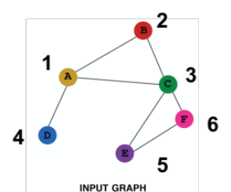
Feature Augmentation on Graphs
Feature augmentation: constant vs. one-hot
 | Constant node feature | One-hot node feature
Expressive power | Medium. All the nodes are identical, but GNN can still learn from the graph structure | High. Each node has a unique ID, so node-specific information can be stored
Inductive learning (Generalize to unseen nodes) | High. Simple to generalize to new nodes: we assign constant feature to them, then apply our GNN | Low. Cannot generalize to new nodes: new nodes introduce new IDs, GNN doesn’t know how to embed unseen IDs
Computational cost | Low. Only 1 dimensional feature | High. High dimensional feature, cannot apply to large graphs
Use cases | Any graph, inductive settings (generalize to new nodes) | Small graph, transductive settings (no new nodes)

Slide 16

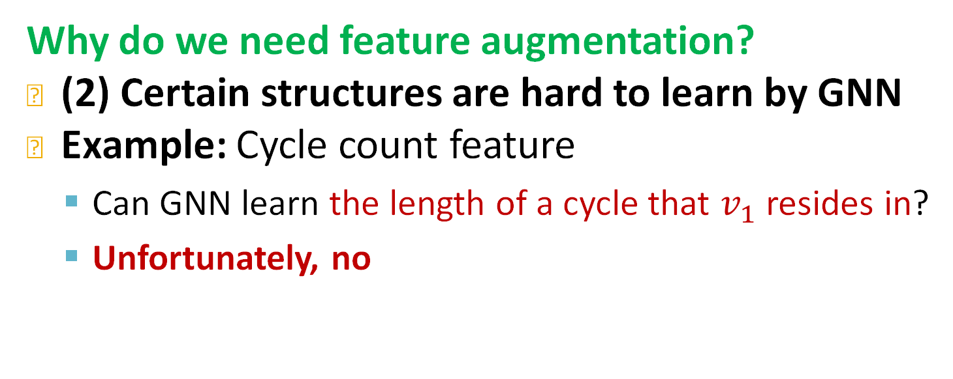



Feature Augmentation on Graphs
Why do we need feature augmentation?
(2) Certain structures are hard to learn by GNN
Example: Cycle count feature
  Can GNN learn the length of a cycle that $v_{1}$ resides in?
  Unfortunately, no
$v_{1}$ resides in a cycle with length 3
$v_{1}$ resides in a cycle with length 4
$$v_{1}$$
$$v_{1}$$

Slide 17
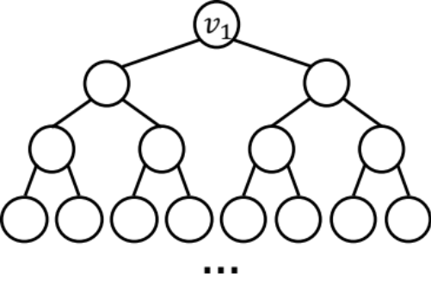


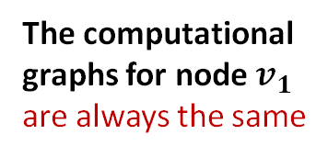
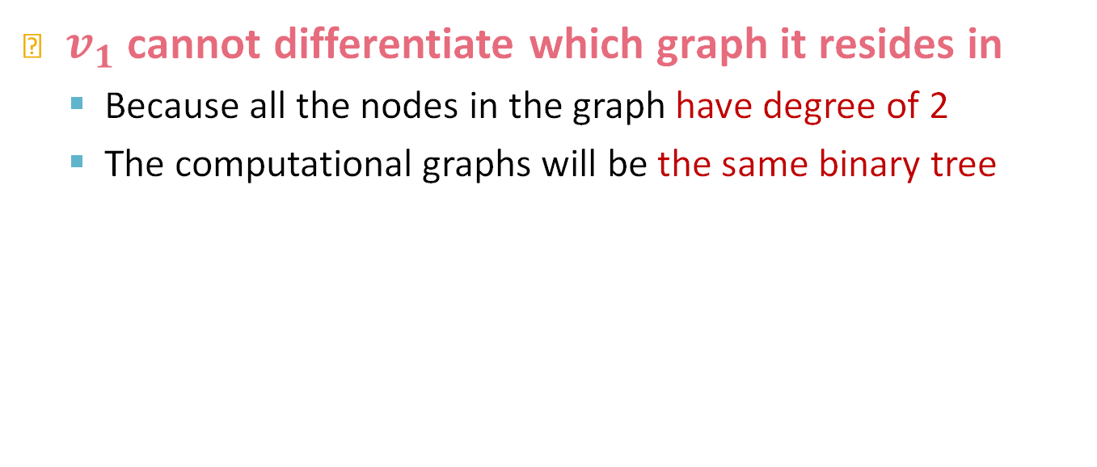
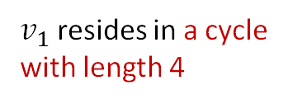
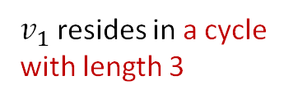



Feature Augmentation on Graphs
$v_{1}$ cannot differentiate which graph it resides in
  Because all the nodes in the graph have degree of 2
  The computational graphs will be the same binary tree
$v_{1}$ resides in a cycle with length 3
$v_{1}$ resides in a cycle with length 4
The computational graphs for node $v_{1}$ are always the same
$$v_{1}$$
$$v_{2}$$
$v_{1}$ resides in a cycle with infinite length
$$…$$
$$v_{1}$$
$$…$$

Slide 18



Feature Augmentation on Graphs
J. You, J. Gomes-Selman, R. Ying, J. Leskovec. Identity-aware Graph Neural Networks, AAAI 2021
Why do we need feature augmentation?
(2) Certain structures are hard to learn by GNN
Solution:
  We can use cycle count as augmented node features
Augmented node feature for $v_{1}$
Augmented node feature for $v_{1}$
We start from cycle with length 0
  [0, 0, 0, 1, 0, 0]
  [0, 0, 0, 0, 1, 0]
$v_{1}$ resides in a cycle with length 3
$v_{1}$ resides in a cycle with length 4
$$v_{1}$$
$$v_{1}$$

Slide 19
Feature Augmentation on Graphs
Why do we need feature augmentation?
(2) Certain structures are hard to learn by GNN
Other commonly used augmented features:
  Degree distribution
  Clustering coefficient
  PageRank
  Centrality
  …
Any feature we have introduced can be used!

Slide 20
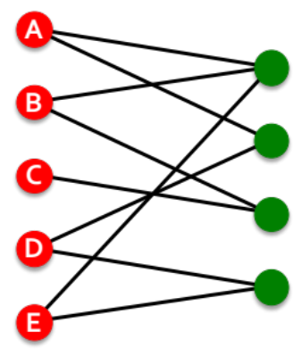
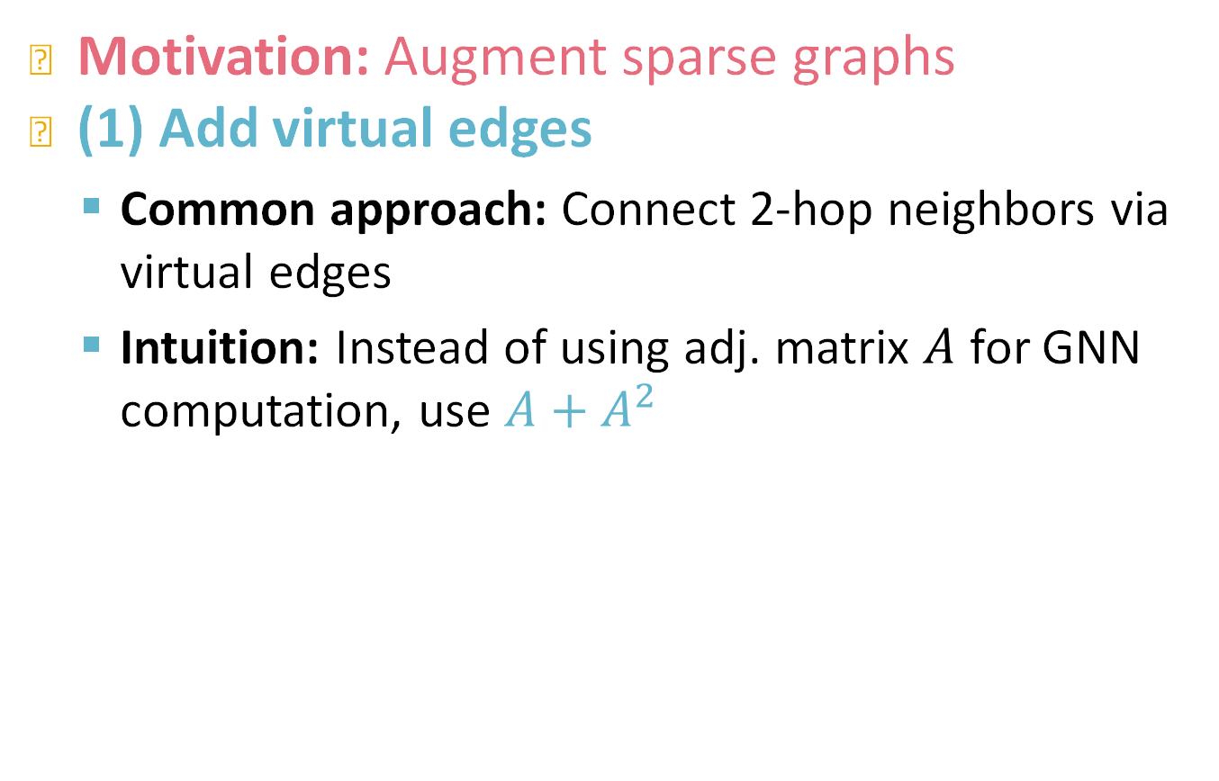
Add Virtual Nodes / Edges
Motivation: Augment sparse graphs
(1) Add virtual edges
  Common approach: Connect 2-hop neighbors via virtual edges
  Intuition: Instead of using adj. matrix $A$ for GNN computation, use $A+A^{2}$
Authors
Papers
  Use cases: Bipartite graphs
    Author-to-papers (they authored)
    2-hop virtual edges make an author-author collaboration graph

Slide 21
Add Virtual Nodes / Edges
Motivation: Augment sparse graphs
(2) Add virtual nodes
  The virtual node will connect to all the nodes in the graph
    Suppose in a sparse graph, two nodes have shortest path distance of 10
    After adding the virtual node, all the nodes will have a distance of 2
      Node A – Virtual node – Node B
  Benefits: Greatly improves message passing in sparse graphs
The virtual node

Slide 22
Node Neighborhood Sampling
Hamilton et al. Inductive Representation Learning on Large Graphs, NeurIPS 2017
Previously:
  All the nodes are used for message passing
New idea: (Randomly) sample a node’s neighborhood for message passing

Slide 23
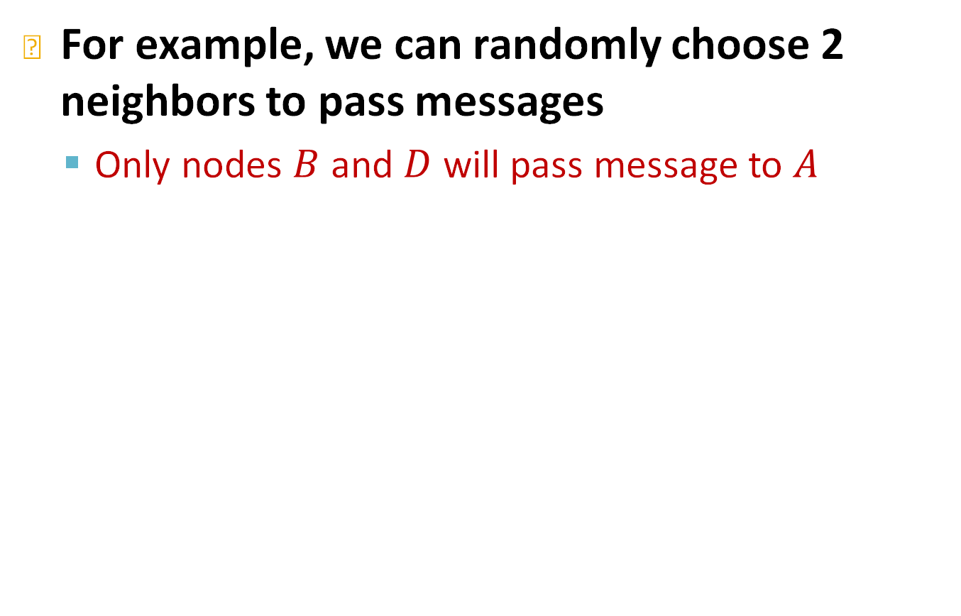
Neighborhood Sampling Example
For example, we can randomly choose 2 neighbors to pass messages
  Only nodes $B$ and $D$ will pass message to $A$

Slide 24
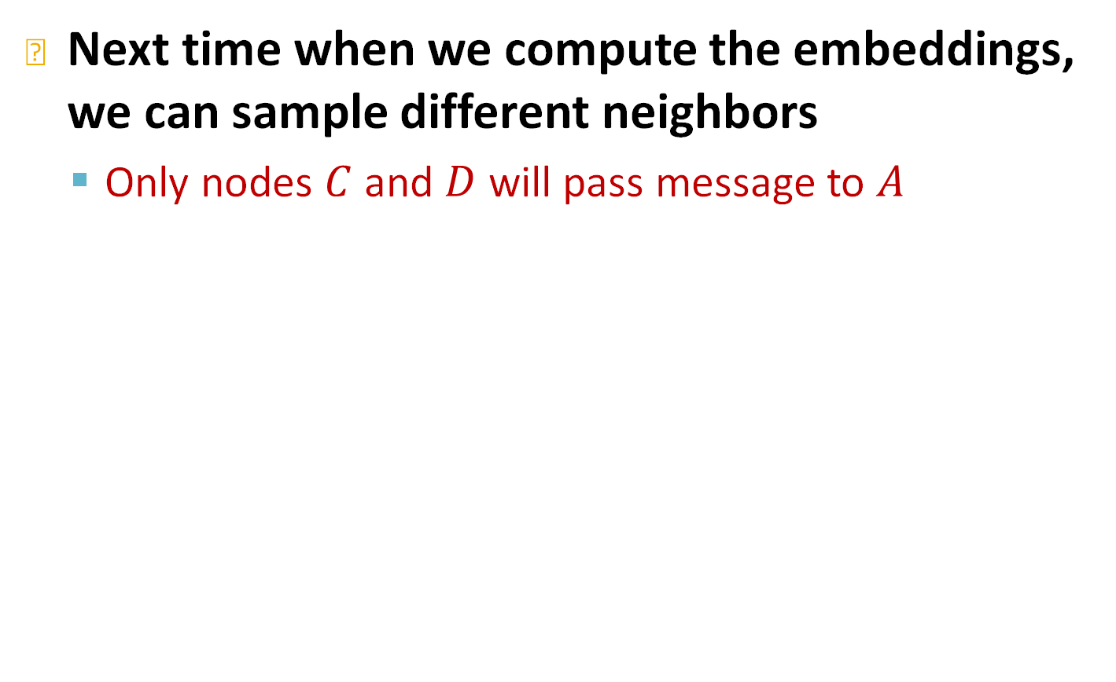
Neighborhood Sampling Example
Next time when we compute the embeddings, we can sample different neighbors
  Only nodes $C$ and $D$ will pass message to $A$

Slide 25
Neighborhood Sampling Example
Ying et al. Graph Convolutional Neural Networks for Web-Scale Recommender Systems, KDD 2018
In expectation, we can get embeddings similar to the case where all the neighbors are used
  Benefits: Greatly reduce computational cost
  And in practice it works great!

Slide 26
Stanford CS224W:
Prediction with GNNs
CS224W: Machine Learning with Graphs
Jure Leskovec, Stanford University
http://cs224w.stanford.edu
Notes:
Let's go one step further and discuss prediction with GNNs

Slide 27
A General GNN Framework (4)
J. You, R. Ying, J. Leskovec. Design Space of Graph Neural Networks, NeurIPS 2020
(5) Learning objective
Next: How do we train a GNN?
Notes:
The questions we are tryimg to answerHow do we train a GNN? What is the Learning objective and how do we design a loss function?

Slide 28
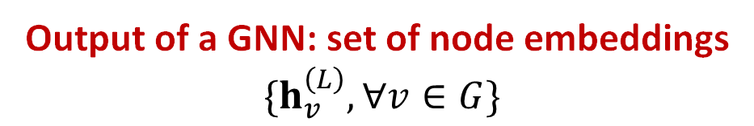
GNN Training Pipeline
So far what we have covered
Evaluation metrics
Input Graph
Graph Neural Network
Node embeddings
Prediction head
Predictions
Labels
Loss function
Output of a GNN: set of node embeddings
$$\{h_{v}^{\left(L\right)}, ∀v∈G\}$$
Notes:
The GNN pipeline is as follows: first I have the input graph, that encodes the graph structure and node attributes, This input graph is both an input to the GNN and a parameter of it as it defines the computation graph that the GNN is designed on, and the GNNs performs some local message-passing operations to generate powerful node embeddings.
How do we go from node embeddings to predictions
After the GNN architecture we have the prediction head that takes as input the node embeddings at produces predictions at the node level, e.g. the node class, the graph level, e.g., the graph class or edge level, the existence or not of an edge and based on these predictions it measures the discrepancy between the predictions and the true labels, using a loss function. The training code measures the difference between predictions and labels and backpropagates this information back to the architecture to update the trainable parameters. Of course on top of that we have the evaluation metric that measure the success of our predictions. Note that the evaluation metrics are usually different but related to the loss function. For example, the loss can be the logistic or L1 loss and the evaluation metrics can be precision recall, hit rates f1 scores and many more.

Slide 29
GNN Training Pipeline (1)
Evaluation metrics
Input Graph
Graph Neural Network
Node embeddings
Prediction head
Predictions
Labels
Loss function
(1) Different prediction heads:
Node-level tasks
Edge-level tasks
Graph-level tasks
Notes:
Usually we have 3 types of prediction heads for ,e.g., node classifi, link prediction, graph classification or regression

Slide 30
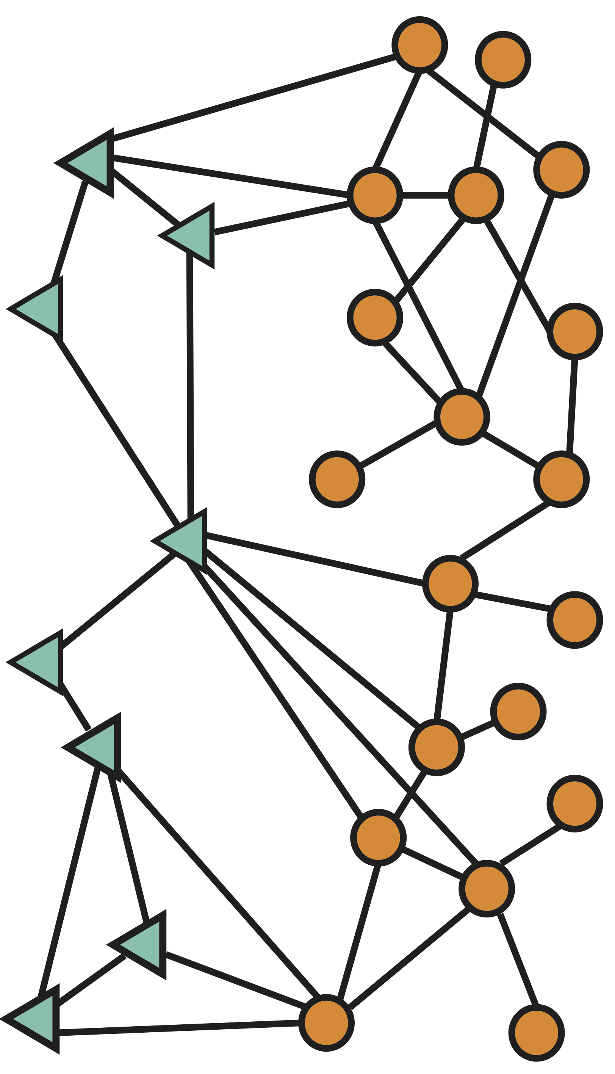
GNN Prediction Heads
Idea: Different task levels require different prediction heads
Node-level prediction
Graph-level prediction
Edge-level prediction
Notes:
Class of a node, e.g., whether a paper is engineering or scientific, edge-level drags diseases, graph level represents a molecule and we want to see if this molecule is effective on a disease.

Slide 31
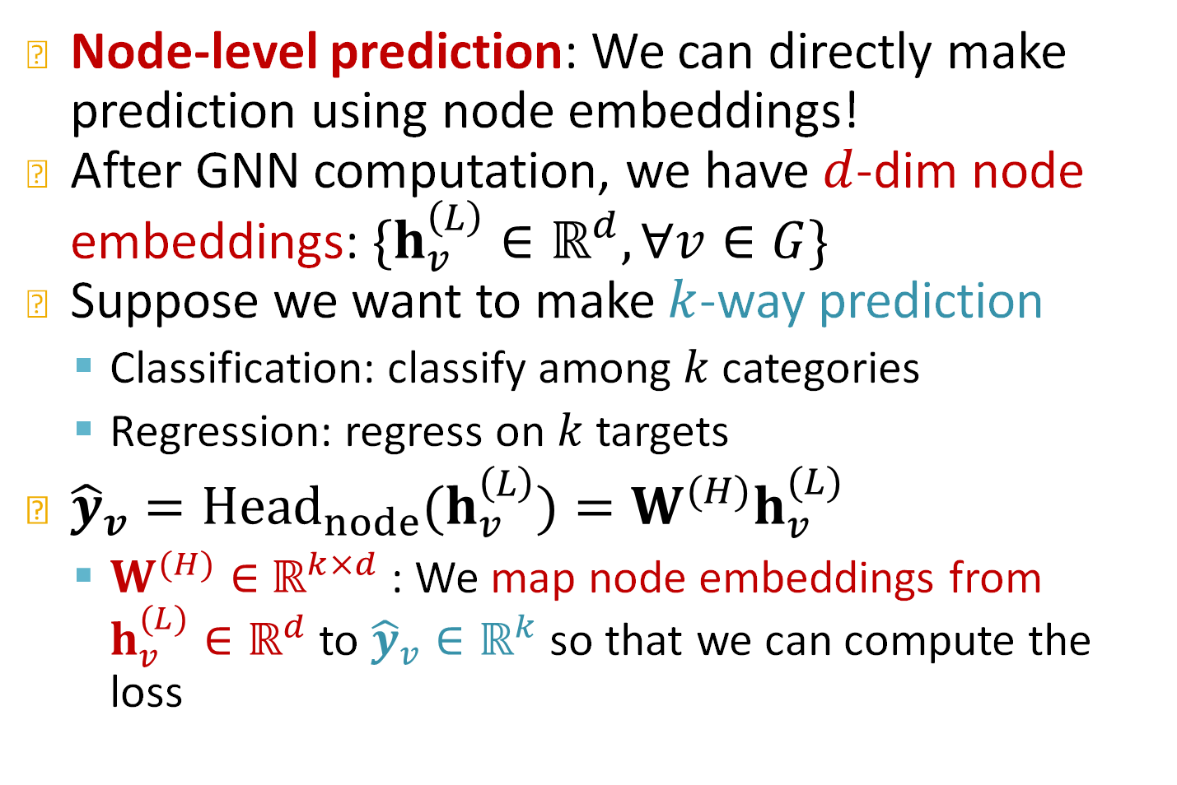
Prediction Heads: Node-level
Node-level prediction: We can directly make prediction using node embeddings!
After GNN computation, we have $d$-dim node embeddings: $\{h_{v}^{\left(L\right)}∈ℝ^{d}, ∀v∈G\}$
Suppose we want to make $k$-way prediction
  Classification: classify among $k$ categories
  Regression: regress on $k$ targets
${\hat{y}}_{v}={Head}_{node}(h_{v}^{\left(L\right)})=W^{(H)}h_{v}^{(L)}$
  $W^{(H)}∈$ $ℝ^{k×d}$: We map node embeddings from $h_{v}^{(L)}∈ℝ^{d}$ to ${\hat{y}}_{v}∈ℝ^{k}$so that we can compute the loss
Notes:
Here is how the prediction head for node level prediction works.
For the node-level....
W is the parameter matrix that maps
If the task is regression we can leave it as is and if it is classification we can pass it through a nonlinearity so the output looks like a probability of a node belonging to specific class, so ….

Slide 32
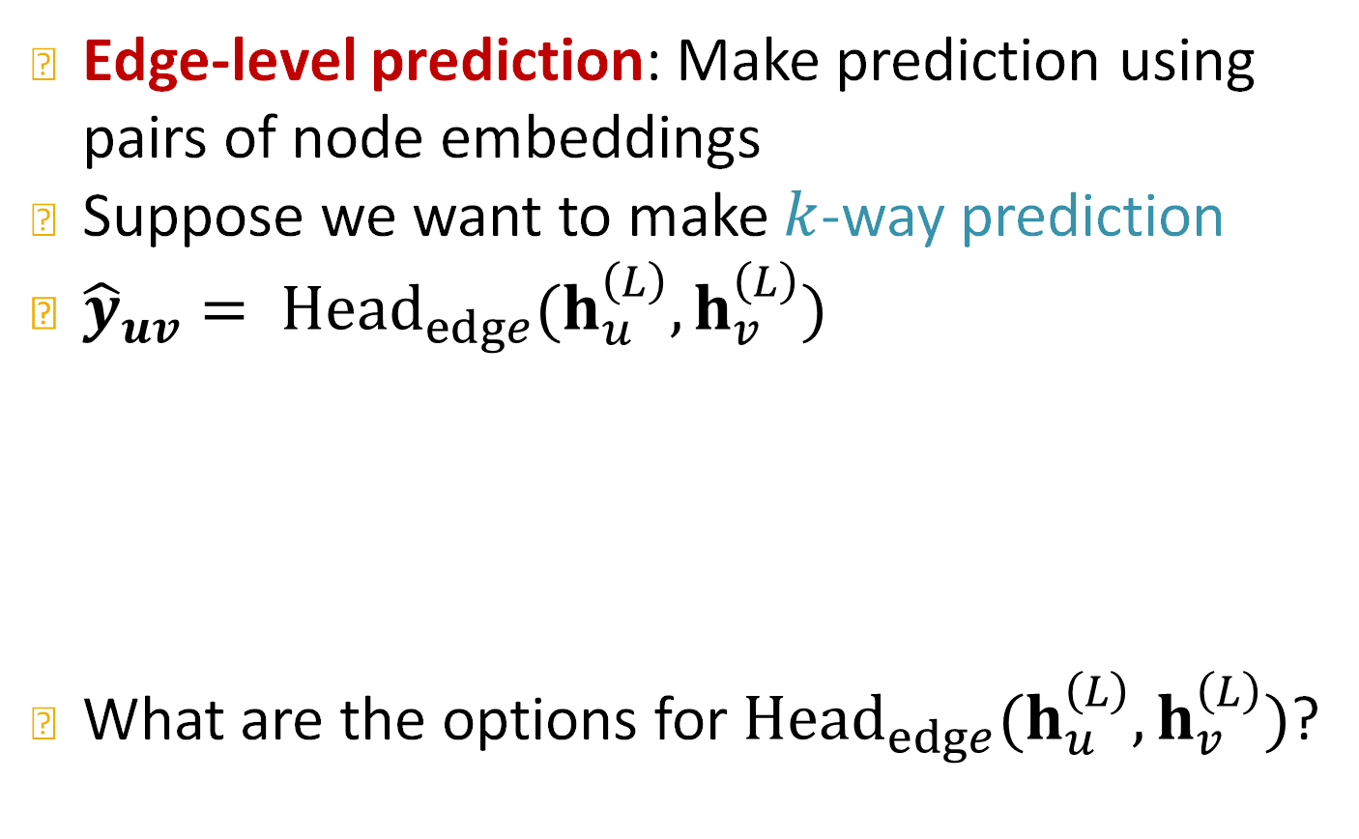


Prediction Heads: Edge-level
Edge-level prediction: Make prediction using pairs of node embeddings
Suppose we want to make $k$-way prediction
${\hat{y}}_{uv}= {Head}_{edge}(h_{u}^{\left(L\right)},h_{v}^{\left(L\right)})$
What are the options for ${Head}_{edge}(h_{u}^{\left(L\right)},h_{v}^{\left(L\right)})$?
$$h_{u}^{\left(L\right)}$$
?
$$h_{v}^{\left(L\right)}$$
Notes:
For edge level things become more complex since, we make predictions using pairs of node embeddings. So the prediction head takes as input the embeddings for the nodes and outputs
When I say edge-level prediction maybe I am predicting the probability of an edge between u and v. What are the options for this head

Slide 33


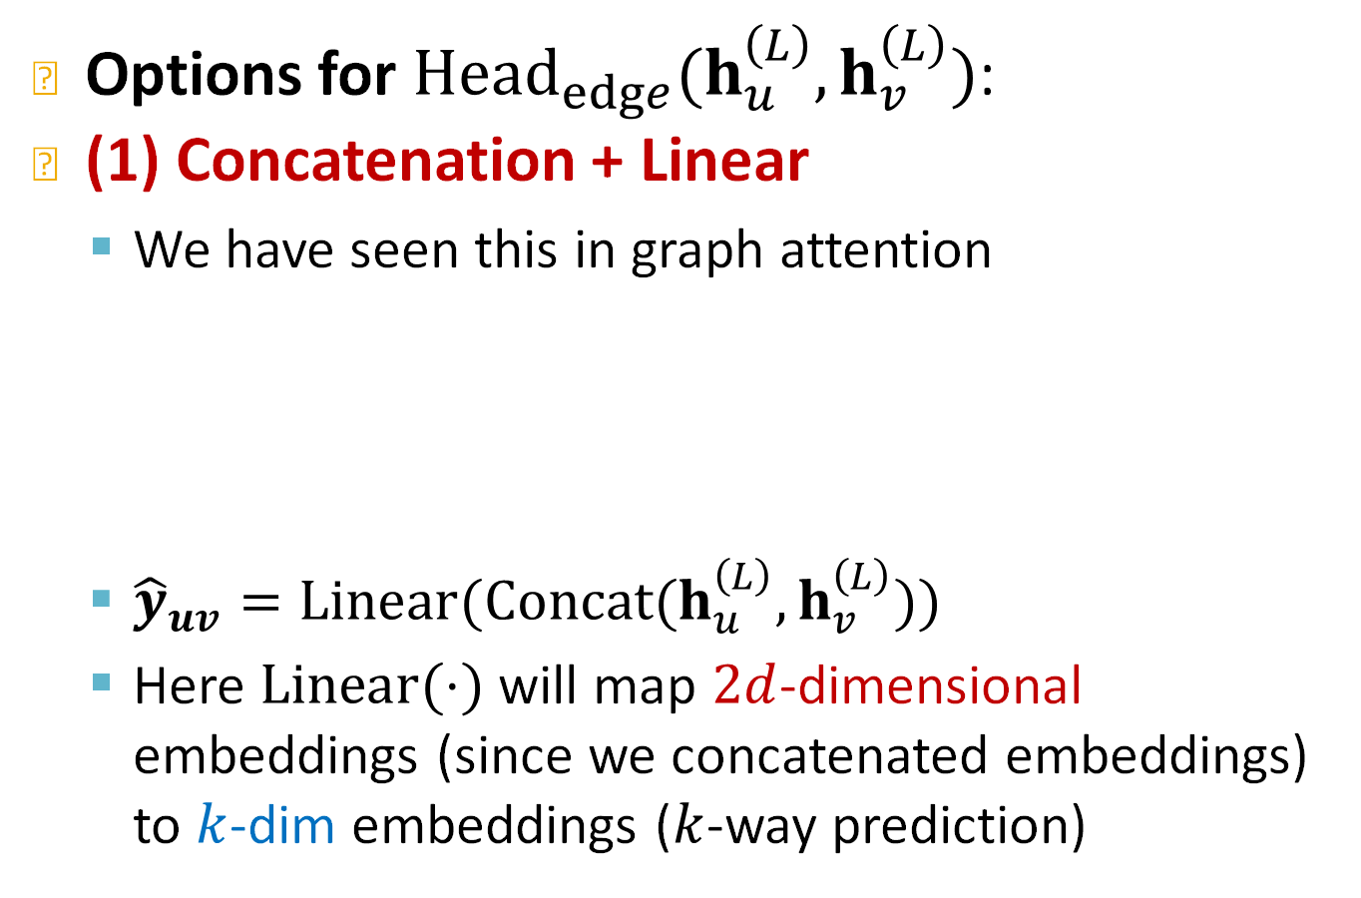

Prediction Heads: Edge-level
Options for ${Head}_{edge}(h_{u}^{\left(L\right)},h_{v}^{\left(L\right)})$:
(1) Concatenation + Linear
  We have seen this in graph attention
  ${\hat{y}}_{uv}=Linear(Concat(h_{u}^{\left(L\right)},h_{v}^{\left(L\right)}))$
  Here $Linear(⋅)$ will map $2d$-dimensional embeddings (since we concatenated embeddings) to $k$-dim embeddings ($k$-way prediction)
Concatenate
Linear
$$\hat{y_{uv}}$$
Notes:
It takes these two embeddings and it allows them to interact through this linear matrix W

Slide 34
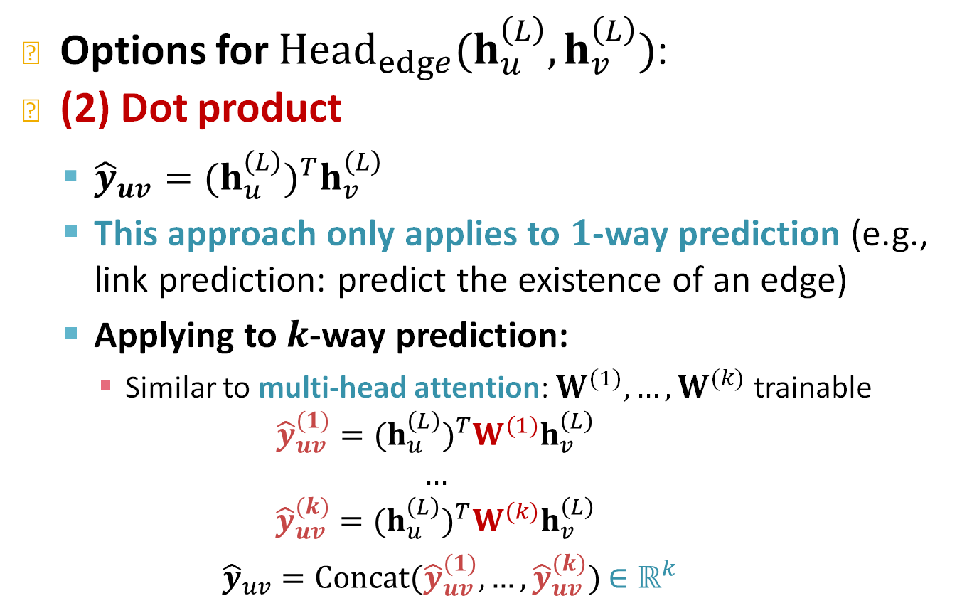
Prediction Heads: Edge-level
Options for ${Head}_{edge}(h_{u}^{\left(L\right)},h_{v}^{\left(L\right)})$:
(2) Dot product
  ${\hat{y}}_{uv}={{(h}_{u}^{\left(L\right)})}^{T}h_{v}^{\left(L\right)}$
  This approach only applies to $1$-way prediction (e.g., link prediction: predict the existence of an edge)
  Applying to $k$-way prediction:
    Similar to multi-head attention: $W^{(1)},…,W^{(k)}$ trainable
    $${\hat{y}}_{uv}^{(1)}={{(h}_{u}^{\left(L\right)})}^{T}W^{(1)}h_{v}^{\left(L\right)}$$
    $$…$$
    $${\hat{y}}_{uv}^{(k)}={{(h}_{u}^{\left(L\right)})}^{T}W^{(k)}h_{v}^{\left(L\right)}$$
    ${\hat{y}}_{uv}=Concat({\hat{y}}_{uv}^{(1)},…,{\hat{y}}_{uv}^{(k)})$ $∈ℝ^{k}$
Notes:
What is also a very cool choice is using the dot product. The output is simply the dot product or similarity between.
How can you generalize to k-way prediction?
Here if you have k-way prediction you need to learn k different W matrices. What this effectively does is to project an rotate them in a different space before computing the dot product. People usually prefer this one than concatenation. The intuition is that things that are connected should be close to each other in the embedding space.

Slide 35
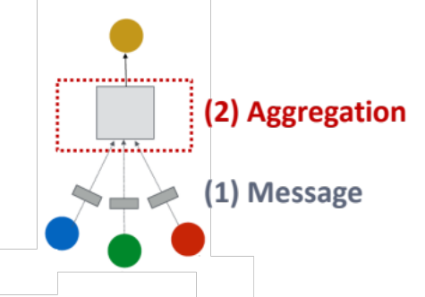
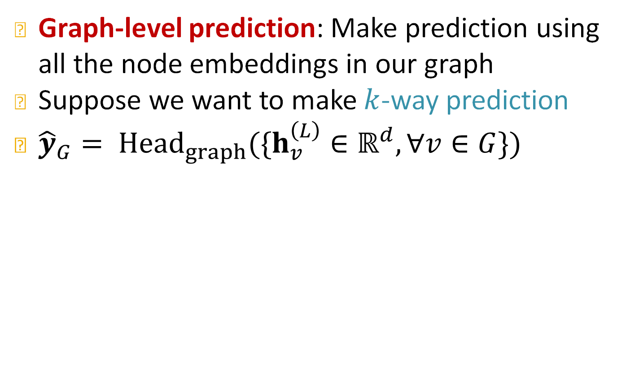
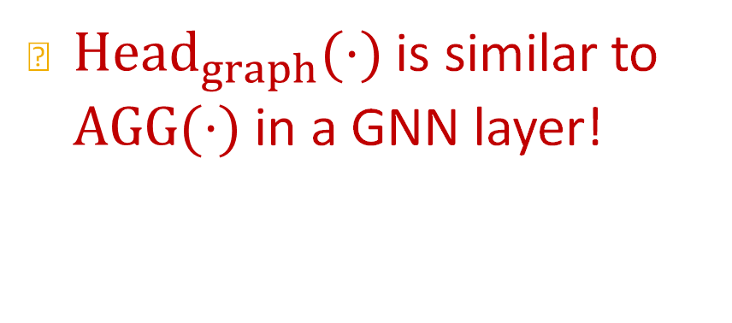
Prediction Heads: Graph-level
Graph-level prediction: Make prediction using all the node embeddings in our graph
Suppose we want to make $k$-way prediction
${\hat{y}}_{G}= {Head}_{graph}(\{h_{v}^{\left(L\right)}∈ℝ^{d}, ∀v∈G\})$
Graph-level prediction
${Head}_{graph}(⋅)$ is similar to $AGG(⋅)$ in a GNN layer!
Notes:
The third prediction head we will discuss about is the graph-level prediction head. Here you want to make a prediction using …
For every node in the graph I create an embedding and this prediction head takes all embeddings and
Permutation invariant

Slide 36
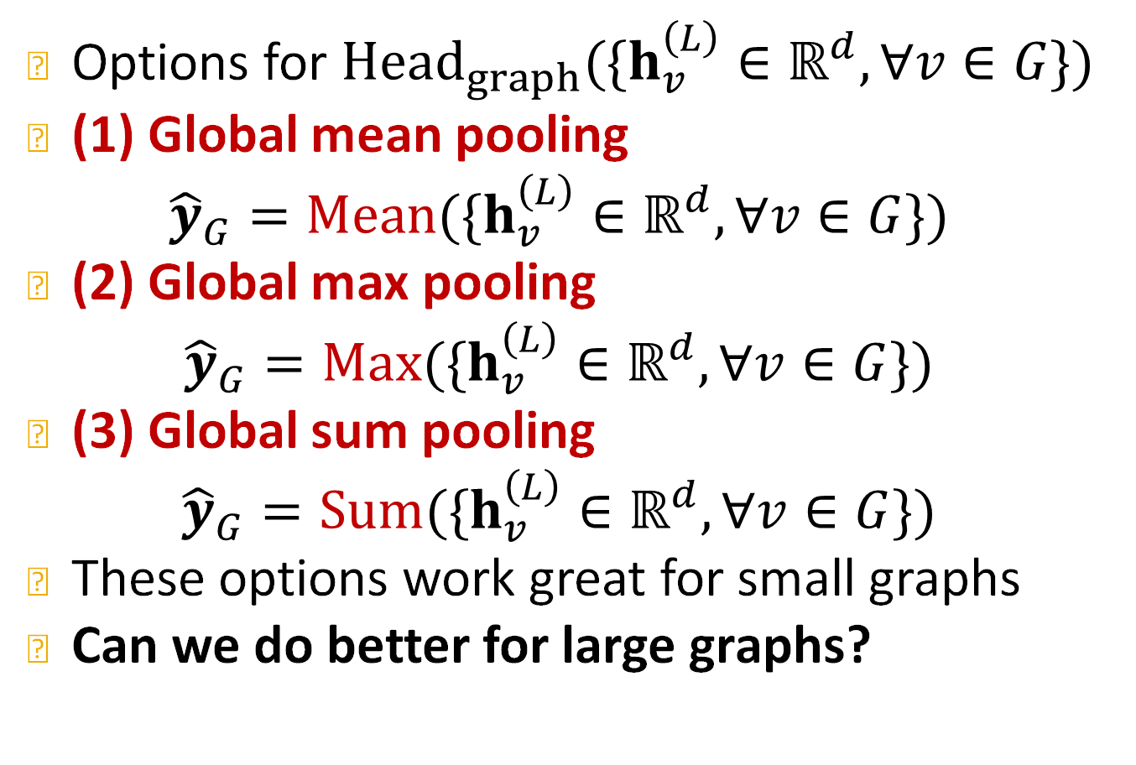
Prediction Heads: Graph-level
K. Xu*, W. Hu*, J. Leskovec, S. Jegelka. How Powerful Are Graph Neural Networks, ICLR 2019
Options for ${Head}_{graph}(\{h_{v}^{\left(L\right)}∈ℝ^{d}, ∀v∈G\})$
(1) Global mean pooling
$${\hat{y}}_{G}=Mean(\{h_{v}^{\left(L\right)}∈ℝ^{d}, ∀v∈G\})$$
(2) Global max pooling
$${\hat{y}}_{G}=Max(\{h_{v}^{\left(L\right)}∈ℝ^{d}, ∀v∈G\})$$
(3) Global sum pooling
$${\hat{y}}_{G}=Sum(\{h_{v}^{\left(L\right)}∈ℝ^{d}, ∀v∈G\})$$
These options work great for small graphs
Can we do better for large graphs?
Notes:
Max pooling makes a lot of sense in computer vision. Here in graph learning it makes less sense, next lecture we will talk about how expressive are this operation. Sum is the most expressive pooling operation. This is good for small graphs.

Slide 37
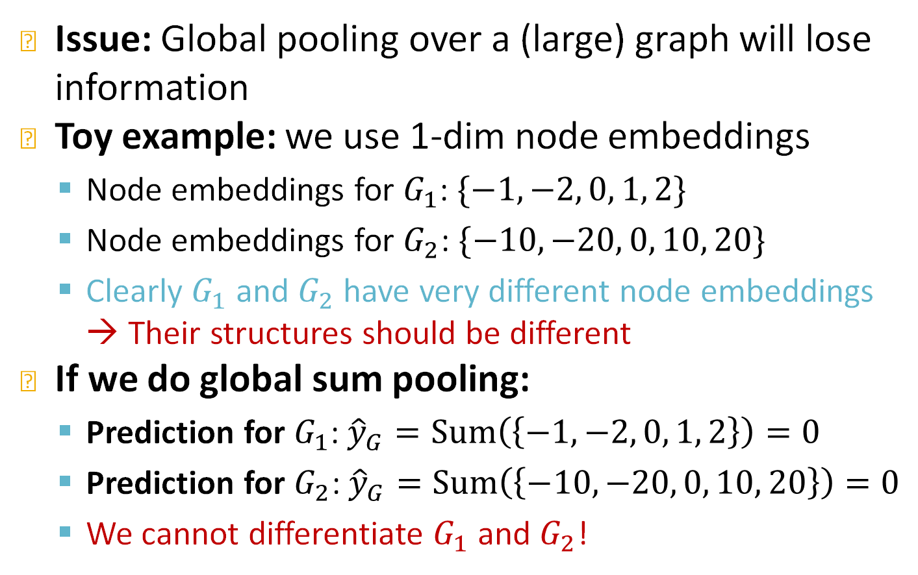
Issue of Global Pooling
Issue: Global pooling over a (large) graph will lose information
Toy example: we use 1-dim node embeddings
  Node embeddings for $G_{1}$: $\{−1, −2, 0, 1, 2\}$
  Node embeddings for $G_{2}$: $\{−10, −20, 0, 10, 20\}$
  Clearly $G_{1}$ and $G_{2}$ have very different node embeddings → Their structures should be different
If we do global sum pooling:
  Prediction for $G_{1}$: ${\hat{y}}_{G}=Sum\left(\left\{−1, −2, 0, 1, 2\right\}\right)=0$
  Prediction for $G_{2}$: ${\hat{y}}_{G}=Sum\left(\left\{−10, −20, 0, 10, 20\right\}\right)=0$
  We cannot differentiate $G_{1}$ and $G_{2}$!

Slide 38
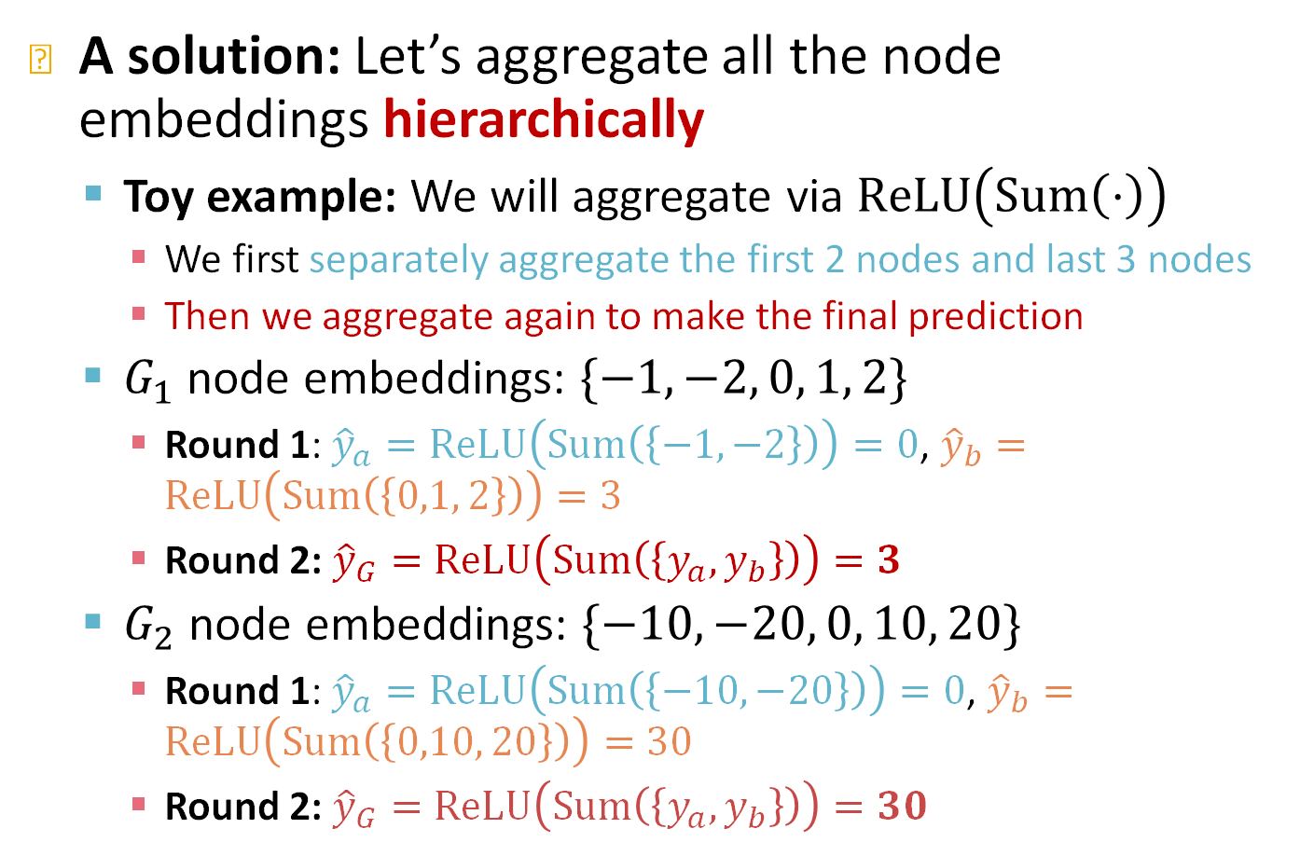
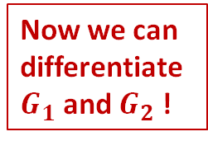
Hierarchical Global Pooling
A solution: Let’s aggregate all the node embeddings hierarchically
  Toy example: We will aggregate via $ReLU\left(Sum\left(⋅\right)\right)$
    We first separately aggregate the first 2 nodes and last 3 nodes
    Then we aggregate again to make the final prediction
  $G_{1}$ node embeddings: $\{−1, −2, 0, 1, 2\}$
    Round 1: ${\hat{y}}_{a}=ReLU\left(Sum\left(\left\{−1, −2\right\}\right)\right)=0$, ${\hat{y}}_{b}=ReLU\left(Sum\left(\left\{0,1, 2\right\}\right)\right)=3$
    Round 2: ${\hat{y}}_{G}=ReLU\left(Sum\left(\left\{y_{a}, y_{b}\right\}\right)\right)=3$
  $G_{2}$ node embeddings: $\{−10, −20, 0, 10, 20\}$
    Round 1: ${\hat{y}}_{a}=ReLU\left(Sum\left(\left\{−10, −20\right\}\right)\right)=0$, ${\hat{y}}_{b}=ReLU\left(Sum\left(\left\{0,10, 20\right\}\right)\right)=30$
    Round 2: ${\hat{y}}_{G}=ReLU\left(Sum\left(\left\{y_{a}, y_{b}\right\}\right)\right)=30$
Now we can differentiate $G_{1}$ and $G_{2}$ !
Notes:
For bigger graphs you want to do this embedding hierarchically somehow obeying the structure of the graph

Slide 39
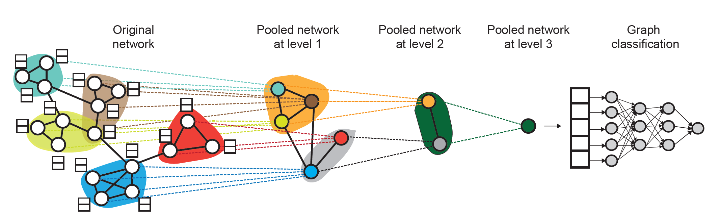
Hierarchical Pooling In Practice
Ying et al. Hierarchical Graph Representation Learning with Differentiable Pooling, NeurIPS 2018
DiffPool idea:
  Hierarchically pool node embeddings
  Leverage 2 independent GNNs at each level
    GNN A: Compute node embeddings
    GNN B: Compute the cluster that a node belongs to
  GNNs A and B at each level can be executed in parallel

Slide 40
Hierarchical Pooling In Practice
DiffPool idea:
  For each Pooling layer
    Use clustering assignments from GNN B to aggregate node embeddings generated by GNN A
    Create a single new node for each cluster, maintaining edges between clusters to generated a new pooled network
  Jointly train GNN A and GNN B

Slide 41
Stanford CS224W:
Training Graph Neural Networks
CS224W: Machine Learning with Graphs
Jure Leskovec, Stanford University
http://cs224w.stanford.edu

Slide 42
GNN Training Pipeline (2)
(2) Where does ground-truth come from?
Supervised labels
Unsupervised signals
Evaluation metrics
Input Graph
Graph Neural Network
Node embeddings
Prediction head
Predictions
Labels
Loss function
Notes:
The question is: where do these labels come from and how do I come up with loss functions?

Slide 43
Supervised vs Unsupervised
Supervised learning on graphs
  Labels come from external sources
    E.g., predict drug likeness of a molecular graph
Unsupervised learning on graphs
  Signals come from graphs themselves
    E.g., link prediction: predict if two nodes are connected
Sometimes the differences are blurry
  We still have “supervision” in unsupervised learning
    E.g., train a GNN to predict node clustering coefficient
  An alternative name for “unsupervised” is “self-supervised”
Notes:
Usually in learning labels come from …, and this is called supervised learning or you can think of unsupervised lea....., where.
Usually link prediction is thought as a self-supervised learning tasks because you have to generate positive examples and you have to generate negative examples to learn.
Sometimes we train a GNN to predict some property of the node and this property is based on the graph structure.
A way to think about it is through self-supervised learning where supervision comes from the data.

Slide 44
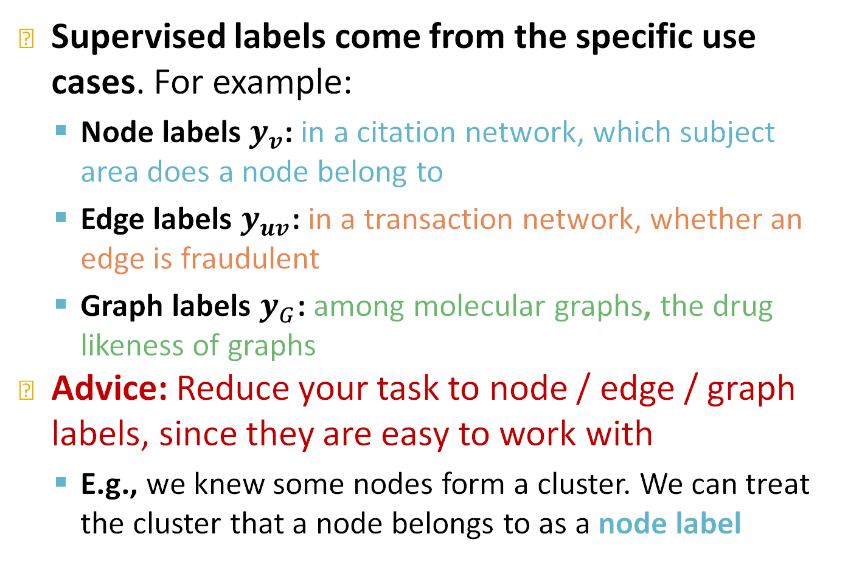
Supervised Labels on Graphs
Supervised labels come from the specific use cases. For example:
  Node labels $y_{v}$: in a citation network, which subject area does a node belong to
  Edge labels $y_{uv}$: in a transaction network, whether an edge is fraudulent
  Graph labels $y_{G}$: among molecular graphs, the drug likeness of graphs
Advice: Reduce your task to node / edge / graph labels, since they are easy to work with
  E.g., we knew some nodes form a cluster. We can treat the cluster that a node belongs to as a node label
Notes:
Paper
Transaction, label externally
Dug likeness, toxicity.
Formulate task as node/..., since these are the type of tasks you can learn on graphs

Slide 45
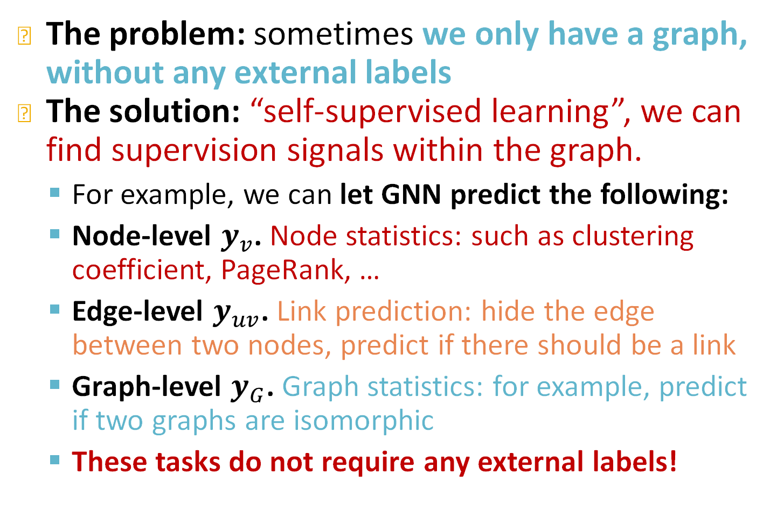
Unsupervised Signals on Graphs
The problem: sometimes we only have a graph, without any external labels
The solution: “self-supervised learning”, we can find supervision signals within the graph.
  For example, we can let GNN predict the following:
  Node-level $y_{v}$. Node statistics: such as clustering coefficient, PageRank, …
  Edge-level $y_{uv}$. Link prediction: hide the edge between two nodes, predict if there should be a link
  Graph-level $y_{G}$. Graph statistics: for example, predict if two graphs are isomorphic
  These tasks do not require any external labels!
Notes:
Node level are a bit naïve but in principle you can do it
For link prediction it is very realistic. Let's see if we can recover the links we have predicted. We can also learn toe do 2-hop or k-hop reasoning by predicting a 2-hop or k-hop relation between nodes.
For graph level we can set our task to learn graph statistics, e.g., if two graphs are isomorphic or one is a subgraph of the other.
Edge level, you can learn to fill in the masked structure of a graph, for in molecular graphs in translates to learn the property of the molecule and
You can think a lot about masked objective functions.

Slide 46
GNN Training Pipeline (3)
Evaluation metrics
Input Graph
Graph Neural Network
Node embeddings
Prediction head
Predictions
Labels
Loss function
(3) How do we compute the final loss?
Classification loss
Regression loss
Notes:
The last think I would like to discuss about is Where the loss comes from. Classification loss and regression loss

Slide 47
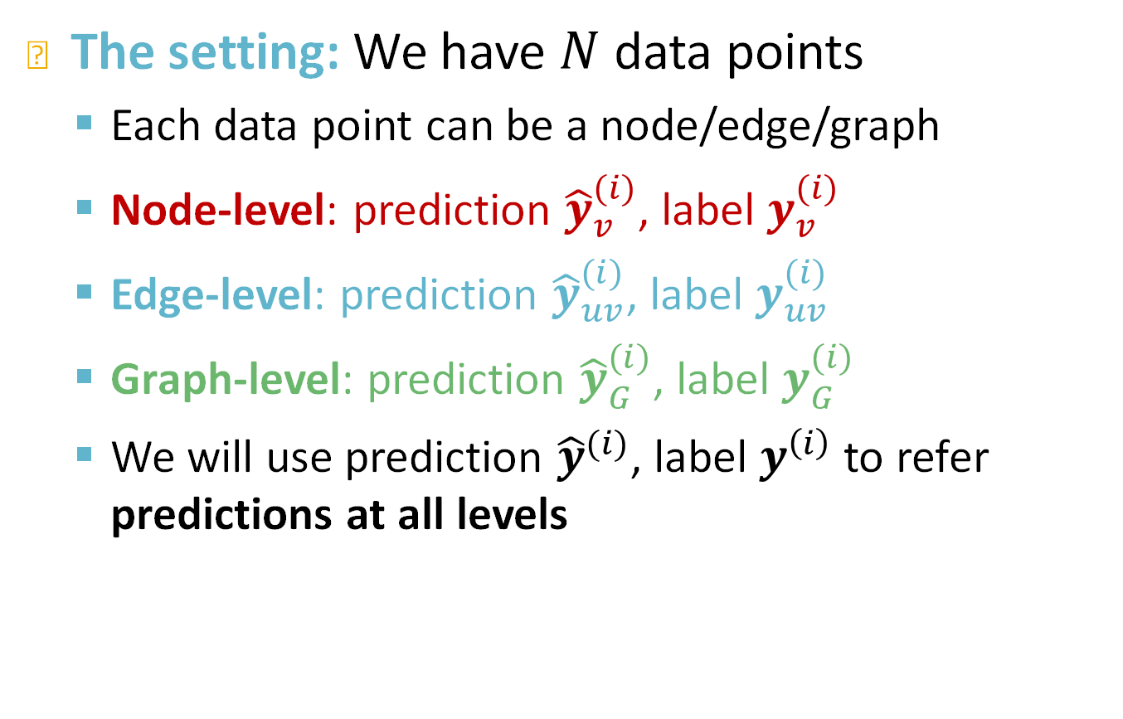
Settings for GNN Training
The setting: We have $N$ data points
  Each data point can be a node/edge/graph
  Node-level: prediction ${\hat{y}}_{v}^{(i)}$, label $y_{v}^{(i)}$
  Edge-level: prediction ${\hat{y}}_{uv}^{(i)}$, label $y_{uv}^{(i)}$
  Graph-level: prediction ${\hat{y}}_{G}^{(i)}$, label $y_{G}^{(i)}$
  We will use prediction ${\hat{y}}^{(i)}$, label $y^{\left(i\right)}$ to refer predictions at all levels
Notes:
The setting
Prediction for node edge and graph. And hat represents the prediction of the I-th object, and y without any symbol represents the ground truth label of the I-th node edge graph
The reason why I show you this is because when I split the data into training / val and test things can become quite interesting

Slide 48
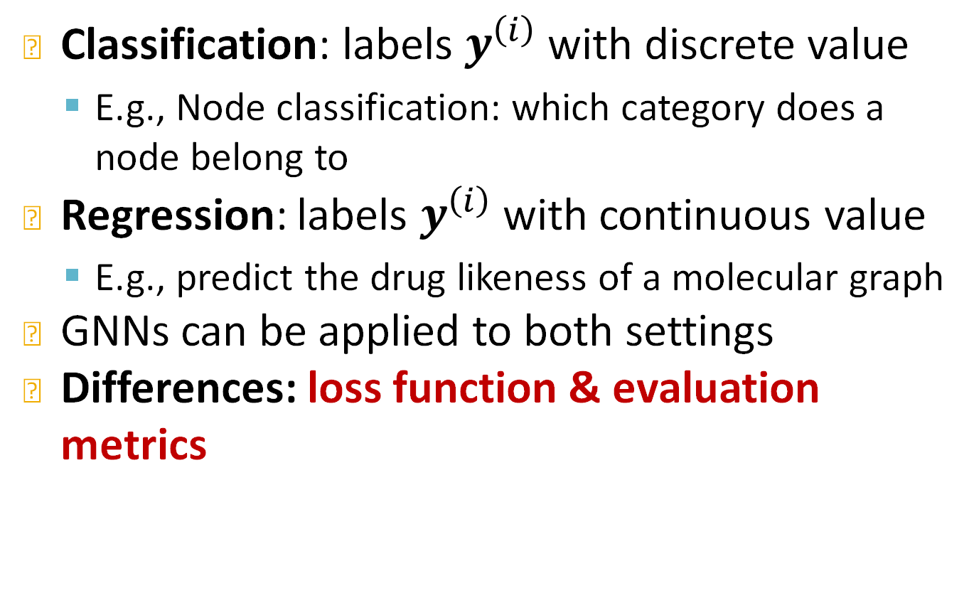
Classification or Regression
Classification: labels $y^{\left(i\right)}$ with discrete value
  E.g., Node classification: which category does a node belong to
Regression: labels $y^{\left(i\right)}$ with continuous value
  E.g., predict the drug likeness of a molecular graph
GNNs can be applied to both settings
Differences: loss function & evaluation metrics
Notes:
Classification or regression tasks

Slide 49
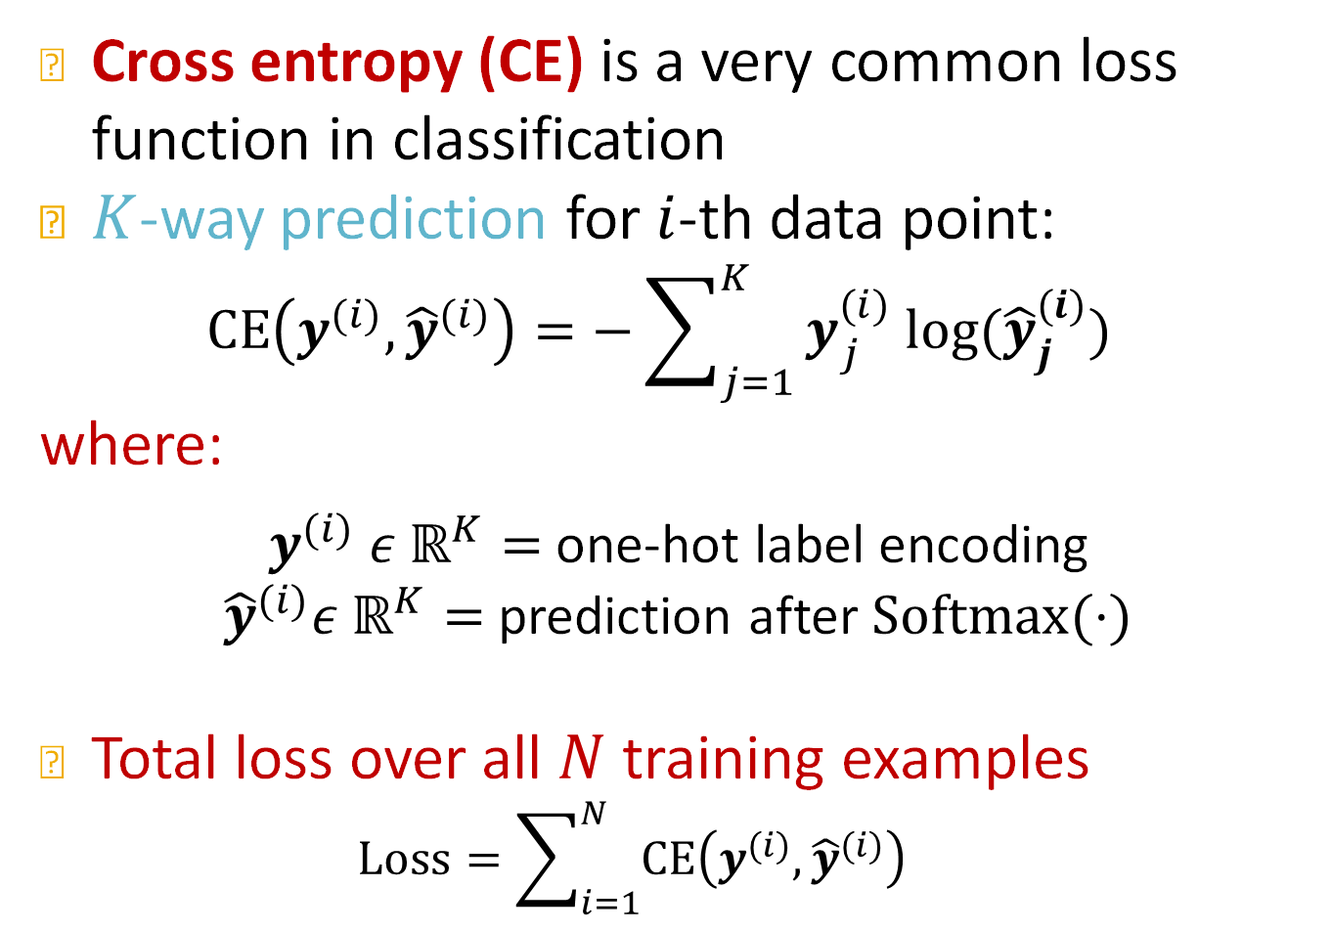


Classification Loss
Cross entropy (CE) is a very common loss function in classification
$K$-way prediction for $i$-th data point:
$$CE\left(y^{(i)}, {\hat{y}}^{(i)}\right)=−\sum_{j=1}^{K}{y_{j}^{(i)} log⁡({\hat{y}}_{j}^{(i)})}$$
where:
$y^{(i)} ε ℝ^{K}=$ one-hot label encoding
${\hat{y}}^{(i)}ε ℝ^{K}=$ prediction after $Softmax(⋅)$
Total loss over all $N$ training examples
  $$Loss=\sum_{i=1}^{N}{CE\left(y^{(i)}, {\hat{y}}^{(i)}\right)}$$
$i$-th data point
$j$-th class
Label
Prediction
E.g.
0 | 0 | 1 | 0 | 0
E.g.
0.1 | 0.3 | 0.4 | 0.1 | 0.1
Notes:
The most common classification loss is CE
True label I can think about it as one hot encoding
Prediction is a prob distr over the classes
The bigger the value here the smaller the loss would be

Slide 50
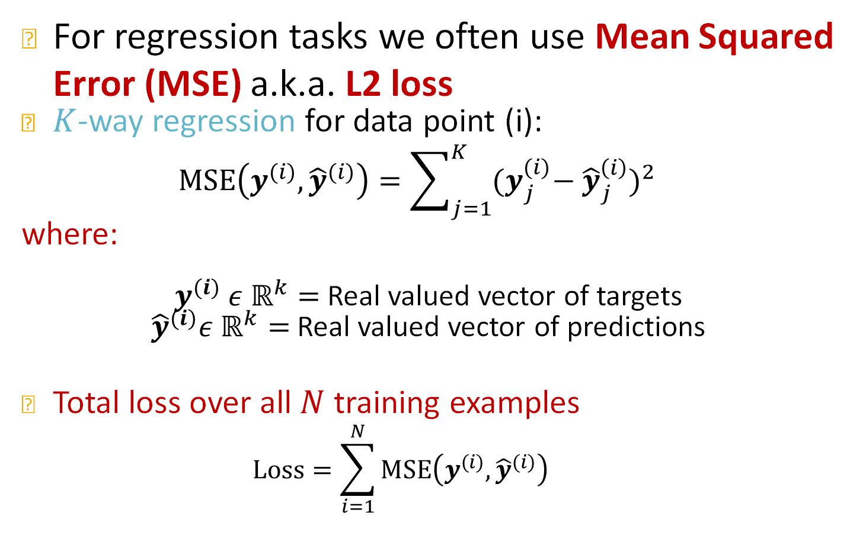


Regression Loss
For regression tasks we often use Mean Squared Error (MSE) a.k.a. L2 loss
$K$-way regression for data point (i):
$$MSE\left(y^{(i)}, {\hat{y}}^{(i)}\right)=\sum_{j=1}^{K}{{{(y}_{j}^{(i)}− {\hat{y}}_{j}^{\left(i\right)})}^{2}}$$
where:
$y^{(i)} ε ℝ^{k}=$ Real valued vector of targets
${\hat{y}}^{(i)}ε ℝ^{k}=$Real valued vector of predictions
Total loss over all $N$ training examples
  $$Loss=\sum_{i=1}^{N}{MSE\left(y^{(i)}, {\hat{y}}^{(i)}\right)}$$
$i$-th data point
$j$-th target
E.g.
1.4 | 2.3 | 1.0 | 0.5 | 0.6
E.g.
0.9 | 2.8 | 2.0 | 0.3 | 0.8
Notes:
Most common loss is MSE. Measuring the square of the discrepancy between the true and predicted value. MSE per example. MAE. Two most common losses that you can use

Slide 51
GNN Training Pipeline (4)
(4) How do we measure the success of a GNN?
Accuracy
ROC AUC
Evaluation metrics
Input Graph
Graph Neural Network
Node embeddings
Prediction head
Predictions
Labels
Loss function
Notes:
In terms of evaluation

Slide 52
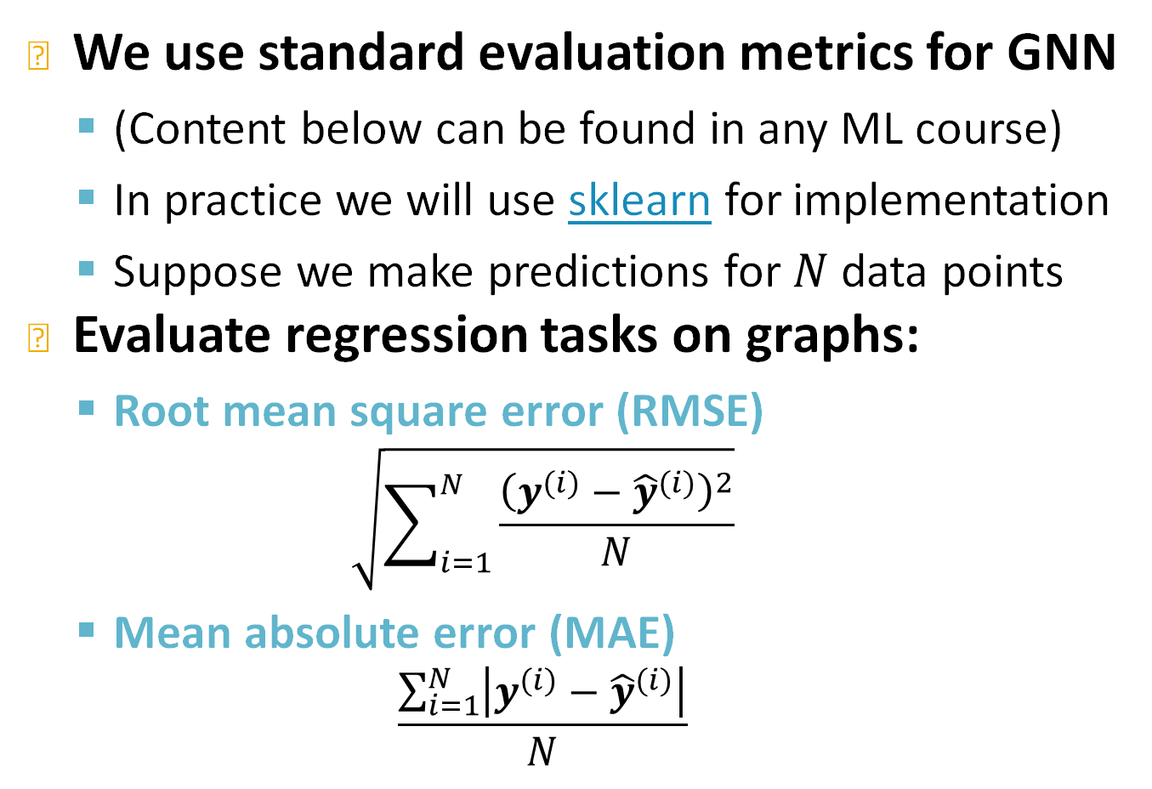
Evaluation Metrics: Regression
We use standard evaluation metrics for GNN
  (Content below can be found in any ML course)
  In practice we will use sklearn for implementation
  Suppose we make predictions for $N$ data points
Evaluate regression tasks on graphs:
  Root mean square error (RMSE)
  $$\sqrt{\sum_{i=1}^{N}{\frac{{\left(y^{(i)}−{\hat{y}}^{(i)}\right)}^{2}}{N}}}$$
  Mean absolute error (MAE)
  $$\frac{\sum_{i=1}^{N}{\left|y^{(i)}−{\hat{y}}^{(i)}\right|}}{N}$$

Slide 53
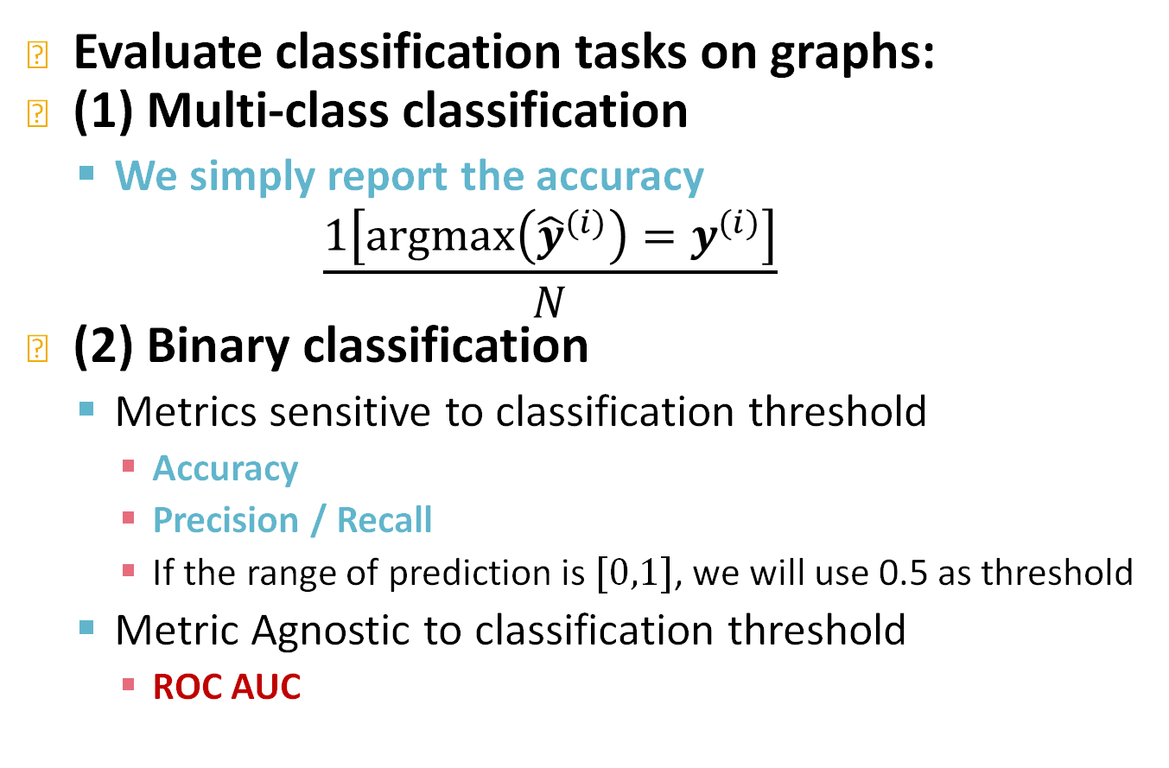
Evaluation Metrics: Classification
Evaluate classification tasks on graphs:
(1) Multi-class classification
  We simply report the accuracy
  $$\frac{1\left[argmax\left({\hat{y}}^{(i)}\right)=y^{(i)}\right]}{N}$$
(2) Binary classification
  Metrics sensitive to classification threshold
    Accuracy
    Precision / Recall
    If the range of prediction is $[0,1]$, we will use 0.5 as threshold
  Metric Agnostic to classification threshold
    ROC AUC
Notes:
For classification, the simplest metric is accuracy which is simply the fraction of testing examples that I classified correctly. But in reality in classification you need to define a threshold to decide what is positive and what is negative. Metrics such as acc, prec, and recall are sensitive to the choice of classification threshold
Area under the receiver operating characteristic curve. This metric is between .5 and 1 .5 means its random prediction, 1 is perfect and there is a very nice interpretation of what the value means.

Slide 54
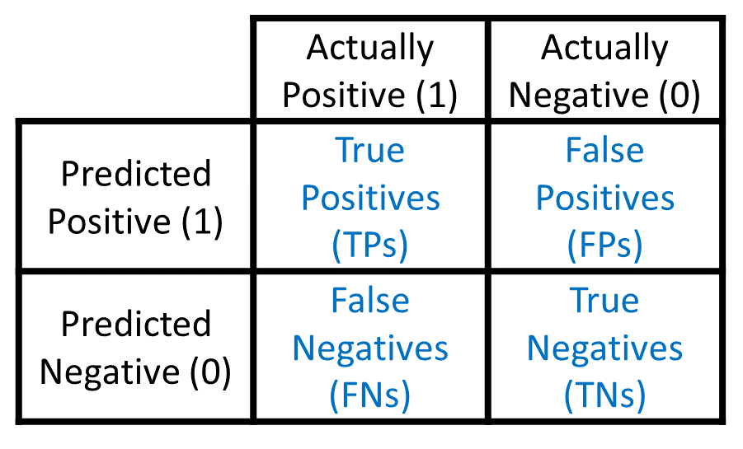
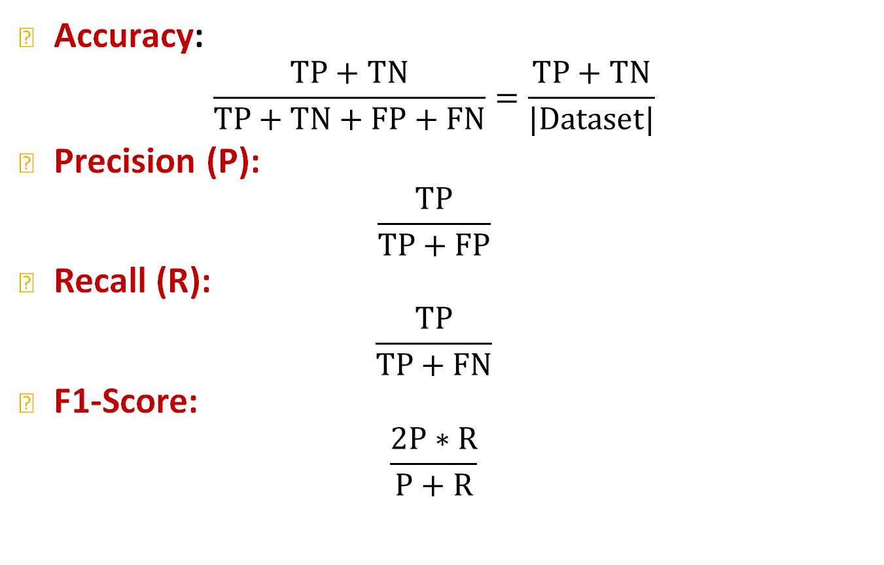
Metrics for Binary Classification
Accuracy:
$$\frac{TP+TN}{TP+TN+FP+FN}=\frac{TP+TN}{|Dataset|}$$
Precision (P):
$$\frac{TP}{TP+FP}$$
Recall (R):
$$\frac{TP}{TP+FN}$$
F1-Score:
$$\frac{2P∗R}{P+R}$$
Confusion matrix
Sklearn Classification Report
Notes:
People start with what is called a confusion matrix. If your model is accurate you have high count here and here and low count here and here. TP because, TN because, FP, FN
These are the errors. Error that I predicted something and put it in the negative side and error that I predicted something and put it in the negative side.
Precision says. Out of everything I think is positive, what is actually positive? Probability of sample that is predicted positive to be actually positive.
Recall: Probability of something actually positive to be predicted positive
F1 score is the harmonic avg of precision and recall
If your dataset is skewed. You have a large number of positiives, it is very easy to have high accuracy

Slide 55


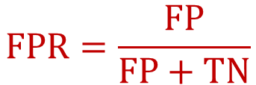
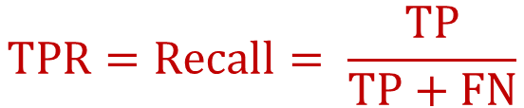
(4) Evaluation Metrics
ROC Curve: Captures the tradeoff in TPR and FPR as the classification threshold is varied for a binary classifier.
$$TPR=Recall= \frac{TP}{TP+FN}$$
$$TPR$$
$$FPR=\frac{FP}{FP+TN}$$
Note: the dashed line represents performance of a random classifier
Image Credit: Wikipedia
$$FPR$$
Notes:
Probability of something actually negative to be predicted positive
Rate positive prediction when something is negative
Rate positive prediction when something is positive
Probability of a positive being above a negative
If your prediction is random then the curve will go along along the diagonal and area under the curve is 0.5.
If AUC is 0.5 it means that half of the time the positives are above negatives. It means that positive and negatives are in random order. If AUC is 1 it means that all positives are on top and all negatives are on bottom.

Slide 56
(4) Evaluation Metrics
ROC AUC: Area under the ROC Curve.
Intuition: The probability that a classifier will rank a randomly chosen positive instance higher than a randomly chosen negative one
Content Credit: Wikipedia
Notes:
This is what people do in binary classification and the distribution of the classes are k

Slide 57
Stanford CS224W:
Setting-up GNN Prediction Tasks
CS224W: Machine Learning with Graphs
Jure Leskovec, Stanford University
http://cs224w.stanford.edu

Slide 58
GNN Training Pipeline (5)
Evaluation metrics
Input Graph
Graph Neural Network
Node embeddings
Prediction head
Predictions
Labels
Loss function
(5) How do we split our dataset into train / validation / test set?
Dataset split
Notes:
Last thing I want to discuss today is how to do dataset splitting. How to evaluate this metrics in a good way. For graphs this is not trivial. When you have independent data you put some in training/validation/test. I have a fixed split, I run validation to choose the best hyperparameters and then a use the test set to evaluate the efficacy of the model.

Slide 59
Dataset Split: Fixed / Random Split
Fixed split: We will split our dataset once
  Training set: used for optimizing GNN parameters
  Validation set: develop model/hyperparameters
  Test set: held out until we report final performance
A concern: sometimes we cannot guarantee that the test set will really be held out
Random split: we will randomly split our dataset into training / validation / test
  We report average performance over different random seeds
Notes:
I have a fixed split, I run validation to choose the best hyperparameters and then a use the test set to evaluate the efficacy of the model. After choosing the right model with the correct hyperparameters we can use the train and validation set to train the model before trying the test set.

Slide 60
Why Splitting Graphs is Special
Suppose we want to split an image dataset
  Image classification: Each data point is an image
  Here data points are independent
    Image 5 will not affect our prediction on image 1
Training
Validation
Test
2
1
3
6
5
4
Notes:
If datapoints are independent it is very easy to split them without extra considerations

Slide 61
Why Splitting Graphs is Special
Splitting a graph dataset is different!
  Node classification: Each data point is a node
  Here data points are NOT independent
    Node 5 will affect our prediction on node 1, because it will participate in message passing → affect node 1’s embedding
What are our options?
Training
Validation
Test
2
1
3
6
5
4
Notes:
In graphs nodes are connected to each other and predictions are not independent of each other

Slide 62
Why Splitting Graphs is Special
Solution 1 (Transductive setting): The input graph can be observed in all the dataset splits (training, validation and test set).
We will only split the (node) labels
  At training time, we compute embeddings using the entire graph, and train using node 1&2’s labels
  At validation time, we compute embeddings using the entire graph, and evaluate on node 3&4’s labels
Training
Validation
Test
2
1
3
6
5
4
Notes:
Several options: go to the graph

Slide 63
Why Splitting Graphs is Special
Solution 2 (Inductive setting): We break the edges between splits to get multiple graphs
  Now we have 3 graphs that are independent. Node 5 will not affect our prediction on node 1 any more
  At training time, we compute embeddings using the graph over node 1&2, and train using node 1&2’s labels
  At validation time, we compute embeddings using the graph over node 3&4, and evaluate on node 3&4’s labels
Training
Validation
Test
2
1
3
6
5
4
Notes:
I realize these graphs are trivial and in practice we have more complex graphs

Slide 64
Transductive / Inductive Settings
Transductive setting: training / validation / test sets are on the same graph
  The dataset consists of one graph
  The entire graph can be observed in all dataset splits, we only split the labels
  Only applicable to node / edge prediction tasks
Inductive setting: training / validation / test sets are on different graphs
  The dataset consists of multiple graphs
  Each split can only observe the graph(s) within the split. A successful model should generalize to unseen graphs
  Applicable to node / edge / graph tasks

Slide 65
Example: Node Classification
Transductive node classification
  All the splits can observe the entire graph structure, but can only observe the labels of their respective nodes
Training
Validation
Test
Inductive node classification
  Suppose we have a dataset of 3 graphs
  Each split contains an independent graph
Training
Validation
Test
Notes:
Which one you choose depends on the task. You can think of transductive as semi-supervised training, where we see the graph structure but we inly observe a sybset of the node labels
Inductive setting I learn over one or multiple graphs and I need to generalize over unseen graphs

Slide 66
Example: Graph Classification
Only the inductive setting is well defined for graph classification
  Because we have to test on unseen graphs
  Suppose we have a dataset of 5 graphs. Each split will contain independent graph(s).
Training Validation Test

Slide 67
Example: Link Prediction
Goal of link prediction: predict missing edges
Setting up link prediction is tricky:
  Link prediction is an unsupervised / self-supervised task. We need to create the labels and dataset splits on our own
  Concretely, we need to hide some edges from the GNN and let the GNN predict if the edges exist
2
2
2
1
3
1
3
1
3
?
5
4
5
4
5
4
Original graph
Input graph to GNN
Predictions made by GNN
Notes:
For link prediction things become a bit more complicated, because the goal..... and setting up link prediction is tricky

Slide 68
Setting up Link Prediction
2
1
3
Message edges
Supervision edges
5
4
Original graph
For link prediction, we will split edges twice
Step 1: Assign 2 types of edges in the original graph
  Message edges: Used for GNN message passing
  Supervision edges: Use for computing objectives
  After step 1:
    Only message edges will remain in the graph
    Supervision edges are used as supervision for edge predictions made by the model, will not be fed into GNN!

Slide 69



Setting up Link Prediction
Step 2: Split edges into train / validation / test
Option 1: Inductive link prediction split
  Suppose we have a dataset of 3 graphs. Each inductive split will contain an independent graph
2
7
12
1
3
6
8
11
13
$$G_{1}$$
$$G_{2}$$
$$G_{3}$$
5
4
10
9
15
14
Training set
Validation set
Test set
Notes:
Training graph with message and supervision edges
Validation
Test
I do this if I want to build models that generalize across graphs

Slide 70
Setting up Link Prediction
Step 2: Split edges into train / validation / test
Option 1: Inductive link prediction split
  Suppose we have a dataset of 3 graphs. Each inductive split will contain an independent graph
  In train or val or test set, each graph will have 2 types of edges: message edges + supervision edges
    Supervision edges are not the input to GNN
Message
edge
Supervision
edge
2
7
12
1
3
6
8
11
13
$$G_{1}$$
$$G_{2}$$
$$G_{3}$$
5
4
10
9
15
14
Training set
Validation set
Test set

Slide 71
Setting up Link Prediction
Option 2: Transductive link prediction split:
  This is the default setting when people talk about link prediction
  Suppose we have a dataset of 1 graph
2
1
3
5
4

Slide 72
Setting up Link Prediction
Option 2: Transductive link prediction split:
  By definition of “transductive”, the entire graph can be observed in all dataset splits
    But since edges are both part of graph structure and the supervision, we need to hold out validation / test edges
    To train the training set, we further need to hold out supervision edges for the training set
  Next: we will show the exact settings
2
1
3
5
4

Slide 73
Setting up Link Prediction
Option 2: Transductive link prediction split:
2
1
3
5
4
The original graph
2
2
2
1
3
1
3
1
3
5
4
5
4
5
4
(1) At training time:
Use training message edges to predict training supervision edges
(2) At validation time:
Use training message edges & training supervision edges to predict validation edges
(3) At test time:
Use training message edges & training supervision edges & validation edges to predict test edges
Notes:
Everything you used on the left you use it to predict supervision on the right
Divide edges into 4 buckets
Message edges/ supervision 1/ supervision 2/ supervision 3

Slide 74
Setting up Link Prediction
Option 2: Transductive link prediction split:
Why do we use growing number of edges?
After training, supervision edges are known to GNN. Therefore, an ideal model should use supervision edges in message passing at validation time.
The same applies to the test time.
2
2
2
1
3
1
3
1
3
5
4
5
4
5
4
(1) At training time:
Use training message edges to predict training supervision edges
(2) At validation time:
Use training message edges & training supervision edges to predict validation edges
(3) At test time:
Use training message edges & training supervision edges & validation edges to predict test edges

Slide 75
Setting up Link Prediction
Summary: Transductive link prediction split:
    Note: Link prediction settings are tricky and complex. You may find papers do link prediction differently.
    Luckily, we have full support in PyG and GraphGym
2
2
Training message edges
Training supervision edges
Validation edges
Test edges
1
3
1
3
Split
5
4
5
4
The original graph
Split Graph with 4 types of edges

Slide 76
GNN Training Pipeline
Dataset split
Evaluation metrics
Input Graph
Graph Neural Network
Node embeddings
Prediction head
Predictions
Labels
Loss function
Implementation resources:
GraphGym further implements the full pipeline to facilitate GNN design

Slide 77
Summary of the Lecture
We introduce a general GNN framework:
  GNN Layer:
    Transformation + Aggregation
    Classic GNN layers: GCN, GraphSAGE, GAT
  Layer connectivity:
    The over-smoothing problem
    Solution: skip connections
  Graph Augmentation:
    Feature augmentation
    Structure augmentation
  Learning Objectives
    The full training pipeline of a GNN

Slide 78
Good!
Finished in time. 1 min over.
Did not have to rush too badly in the end.
Projects took 10minutes
Skipped the slides on feature augmentation
In 2024 I can also skip the DiffPool slides

