Slide 1

Stanford CS224W:
How Expressive are Graph Neural Networks?
Note to other teachers and users of these slides: We would be delighted if you found our material useful for giving your own lectures. Feel free to use these slides verbatim, or to modify them to fit your own needs. If you make use of a significant portion of these slides in your own lecture, please include this message, or a link to our web site: http://cs224w.Stanford.edu
CS224W: Machine Learning with Graphs
Charilaos Kanatsoulis and Jure Leskovec, Stanford University
http://cs224w.stanford.edu

Slide 2
Stanford CS224W:
Graph Neural Networks
ANNOUNCEMENTS
My email: charilaos@cs.stanford.edu
Please reach out with any questions, etc.!
CS224W: Machine Learning with Graphs
Charilaos Kanatsoulis and Jure Leskovec, Stanford University
http://cs224w.stanford.edu

Slide 3
Announcements
Homework 1 recitation session was yesterday (Wed Oct 9th)
  Check Ed for recording
Colab 1 due today
Homework 1 due in 1 week
Colab 2 will be released today by 9PM on our course website
  Due on Thursday, October 24 (2 weeks from now)

Slide 4
Recap: GNN Training Pipeline
Dataset split
Evaluation metrics
Input Graph
Graph Neural Network
Node embeddings
Prediction head
Predictions
Labels
Loss function
Implementation resources:
PyG provides core modules for this pipeline
GraphGym further implements the full pipeline to facilitate GNN design

Slide 5
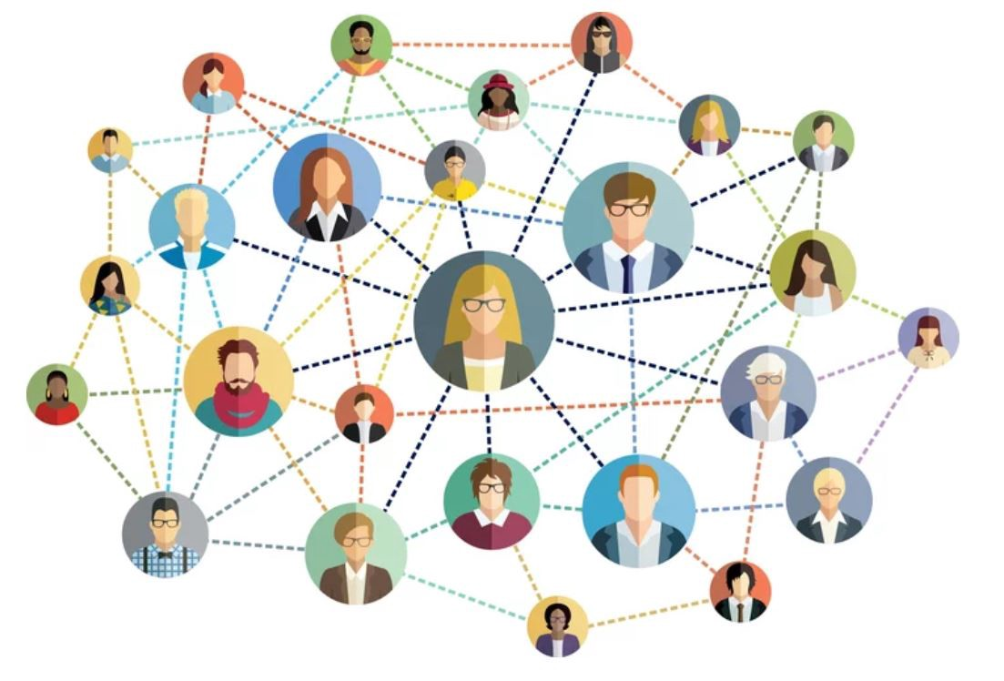
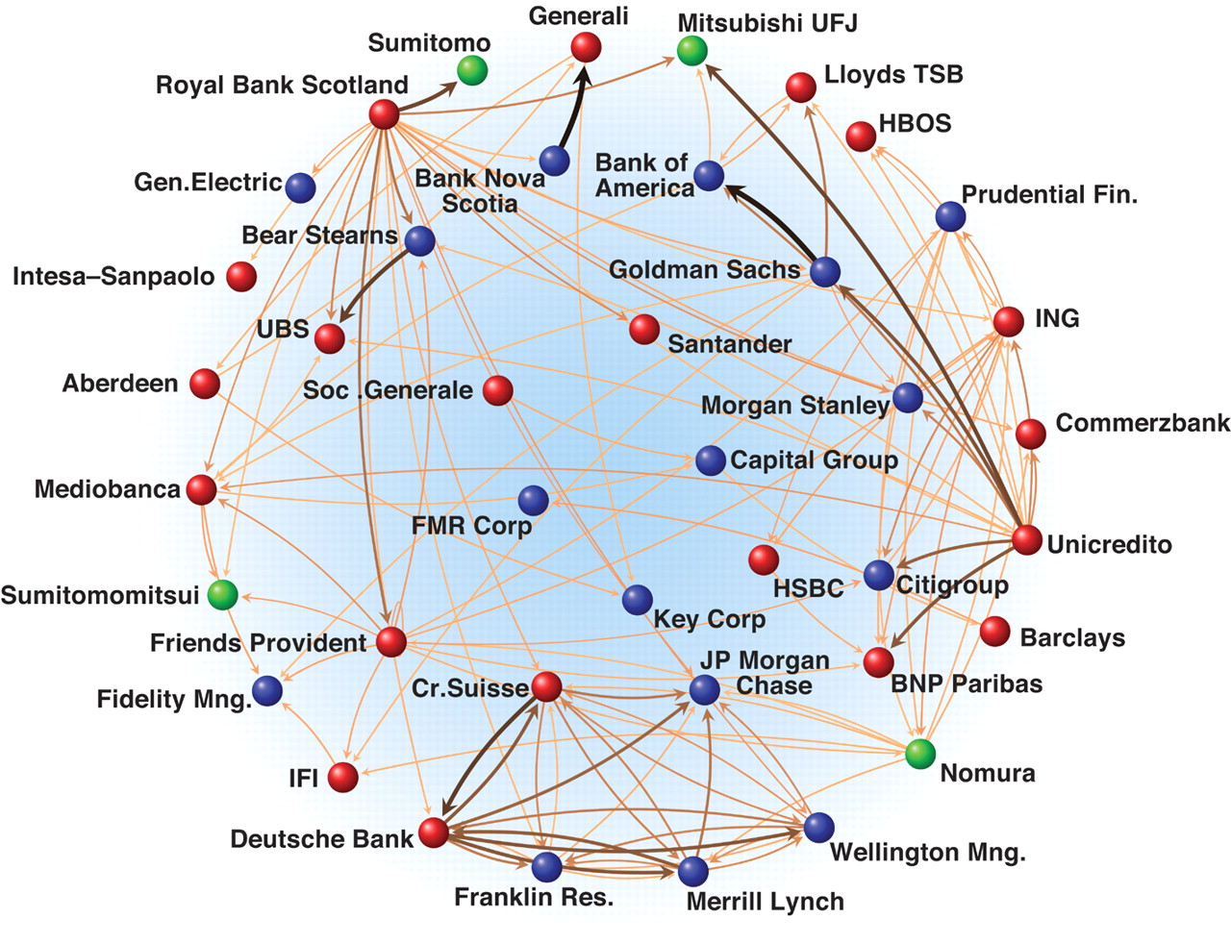
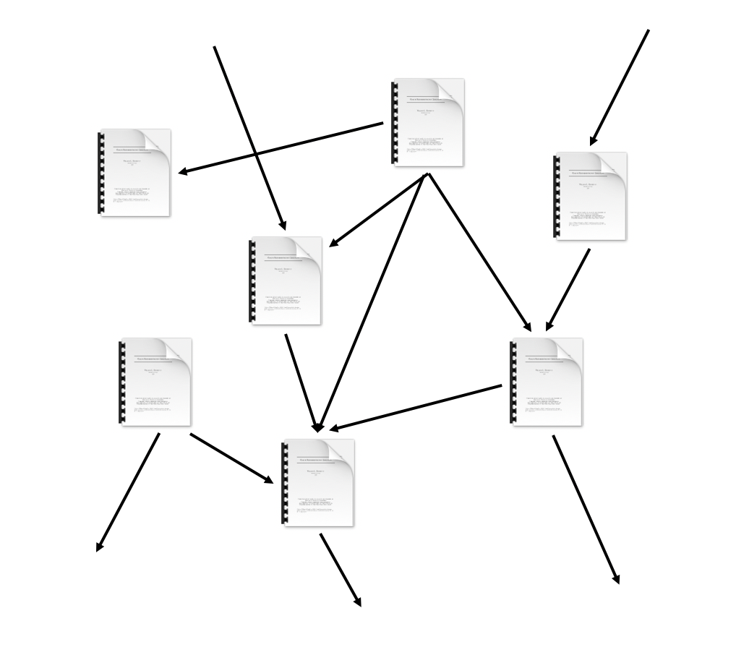
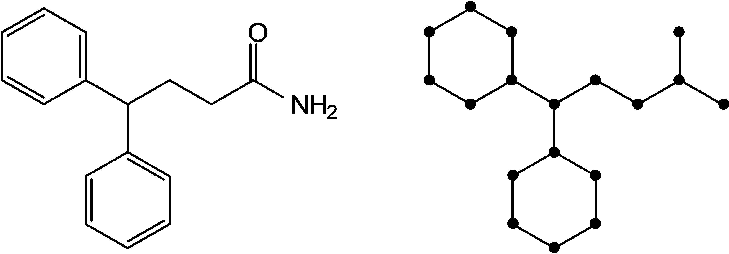
Information modalities in Graphs
Image credit: Medium
Image credit: Science
Social Networks
Economic Networks
Image credit: MDPI
Citation Networks
Molecules
Notes:
At least two modalities of information
Although we know pretty well how to process the entity level information, processing the graph structure is way more complex.

Slide 6
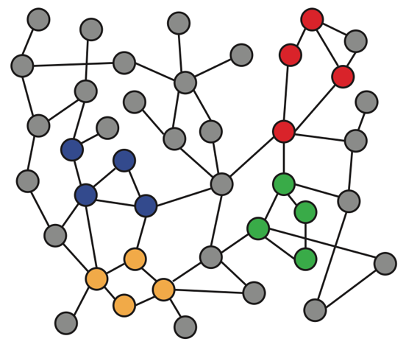
Why is Graph Deep Learning Hard?
Graphs are complex.
Complex topological structure (i.e., no spatial locality like grids)
No fixed node ordering or reference point
vs.
Text
Networks
Images
Notes:
Borrowed this slide from the first lecture
The graph is an abstract structure and there is no canonical order of the nodes which makes things complicated. Why? Because there is a combinatorial number of ways I can represent a

Slide 7
Theory of GNNs
How powerful are GNNs?
Many GNN models have been proposed (e.g., GCN, GAT, GraphSAGE, design space).
What is the expressive power (ability to distinguish different graph structures) of these GNN models?
How to design a maximally expressive GNN model?
Notes:
In todays lecture we will analyze the ability of GNNs to effectively process the graph structure and answer.
We will actually formalize this abstact question and discuss the expressive power in terms of the ability of a GNN to distinguish different graph structures?

Slide 8
Graph Isomorphism problem
A classical expressivity test is Graph isomorphism.
  Given a pair of graphs, can we tell if they are isomorphic?
Open problem (a polynomial time algorithm does not exist, has not been proven NP-complete).
1
2
1
2
3
3
5
4
5
4
Notes:
As I said today we are discussing the expressive power of GNNs in processing graph structures and more specifically will study the ability of GNN to tackle the GIP
Tell this two graphs apart? What does that mean? To produce different node or graph representations for these two graphs.
This is a very difficult problem. In fact .... Can someone tell me why is it difficult?

Slide 9
A simpler problem
Given a pair of nodes with different neighborhood structures. Is there a GNN that can always tell them apart?
1
2
3
5
4
1
2
3
4
5
2
5
1
5
4
3
5
1
2
4
1
5
1
2
4
2
5
1
2
4
3
5
4
1
2
4
2
5
1
5
3
5
Notes:
This is a simpler but super relevant problem, because after all GNN implicitely work with computational graphs, so in order to build a powerful GNN we need to design it in such a way the produces different representations for nodes with different computation graphs.

Slide 10
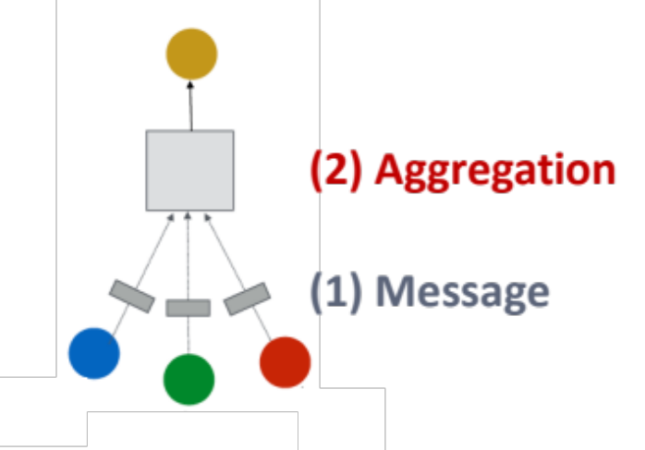
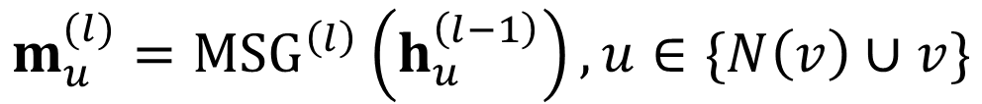

Background: A Single GNN Layer
We focus on message passing GNNs:
  (1) Message: each node computes a message
  (2) Aggregation: aggregate messages from neighbors
$$m_{u}^{(l)}={MSG}^{\left(l\right)}\left(h_{u}^{\left(l−1\right)}\right), u∈\{N\left(v\right)∪v\}$$
$$h_{v}^{(l)}={AGG}^{\left(l\right)}\left(\left\{m_{u}^{\left(l\right)}, u∈N\left(v\right)\right\},m_{v}^{\left(l\right)}\right)$$

Slide 11
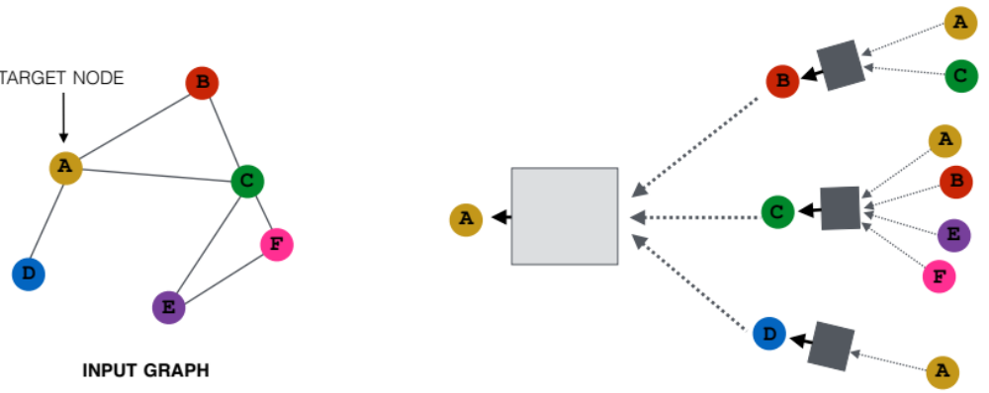
Background: Many GNN Models
Many GNN models have been proposed:
  GCN, GraphSAGE, GAT, Design Space etc.
?
?
?
?
Different GNN models use different
neural networks in the box
Notes:
We will see that different msg and aggregation operations correspond to different expressivity of the GNN models

Slide 12
GNN Model Example (1)
GCN (mean-pool)
[Kipf and Welling ICLR 2017]
?
?
?
?
Element-wise mean pooling +
Linear + ReLU non-linearity

Slide 13
GNN Model Example (2)
GraphSAGE (max-pool)
[Hamilton et al. NeurIPS 2017]
?
?
?
?
MLP + element-wise max-pooling

Slide 14
Note: Node Colors
We use node same/different colors to represent nodes with same/different features.
  For example, the graph below assumes all the nodes share the same feature.
Key question: How well can a GNN distinguish different graph structures?
1
2
3
5
4
Notes:
In the remaining of the lecture we will use node colors to represent node features
Same color means same feature different colors mean different features. The number just indicate the node ids nothing else
Can we get different embeddings, different colors for nodes that have different substructures

Slide 15
Local Neighborhood Structures
We specifically consider local neighborhood structures around each node in a graph.
  Example: Nodes 1 and 5 have different neighborhood structures because they have different node degrees.
1
2
3
5
4
Notes:
To answer this question

Slide 16
Local Neighborhood Structures
We specifically consider local neighborhood structures around each node in a graph.
  Example: Nodes 1 and 4 both have the same node degree of 2. However, they still have different neighborhood structures because their neighbors have different node degrees.
1
2
3
5
4
Node 1 has neighbors of degrees 2 and 3.
Node 4 has neighbors of degrees 1 and 3.

Slide 17
Local Neighborhood Structures
We specifically consider local neighborhood structures around each node in a graph.
  Example: Nodes 1 and 2 have the same neighborhood structure because they are symmetric within the graph.
1
2
3
5
4
Node 1 has neighbors of degrees 2 and 3.
Node 2 has neighbors of degrees 2 and 3.
And even if we go a step deeper to 2nd hop neighbors, both nodes
have the same degrees (Node 4 of degree 2)
Notes:
Whiteboard

Slide 18
Local Neighborhood Structures
Key question: Can GNN node embeddings distinguish different node’s local neighborhood structures?
  If so, when? If not, when will a GNN fail?
Next: We need to understand how a GNN captures local neighborhood structures.
  Key concept: Computational graph
Notes:
To answer this question we need to ….., or in other words we need to analyze the msg and aggregation operations and how they capture neighbor

Slide 19
Computational Graph (1)
In each layer, a GNN aggregates neighboring node embeddings.
A GNN generates node embeddings through a computational graph defined by the neighborhood.
  Ex: Node 1’s computational graph (2-layer GNN)
1
1
2
3
2
5
5
4
1
5
1
2
4
Notes:
One tool to do that is the computation graph. The computation graph gives as a schema on how the msg and aggre funtion operate in the GNN
The important thing to note here is that the computation
The computation graph describes how information propagates to arrive at neighbor 1
1-hop
2-hop 1,5 coming from 2 and 1,2,4 coming from 5

Slide 20
Computational Graph (2)
Ex: Nodes 1 and 2’s computational graphs.
1
2
1
2
3
2
5
1
5
5
4
1
5
1
2
4
2
5
1
2
4
Notes:
You can also do it for node 2. And they might look different because 1 gets there info from node 2 and node 2 form node 1
(Node 1 and 2 have exactly a similar structure, mathematically they are called automorphic and thus the admit the same comp graphs apart from the node Id's)
(We can swap 1 and 2 and will end up with exactly the same representation)

Slide 21
Computational Graph (3)
Ex: Nodes 1 and 2’s computational graphs.
But GNN only sees node features (not IDs):
1
2
3
5
4
Notes:
But today our model does not see node id's. All the model will see is the features, and you can see that the computational graphs are the same for the two nodes

Slide 22
Computational Graph (4)
A GNN will generate the same embedding for nodes 1 and 2 because:
  Computational graphs are the same.
  Node features (colors) are identical.
Note: GNN does not
care about node ids, it
just aggregates features
vectors of different nodes.
1
2
1
2
3
5
4
GNN won’t be able to distinguish nodes 1 and 2
Notes:
Which means that nodes 1 and 2 are guaranteed to get the same embedding, and that is because the gnn does not see the node ids it just sees the features. In the case of nodes 1 and 2 this is a good thing as (Node 1 and 2 have exactly a similar structure, mathematically they are called automorphic and thus the admit the same comp graphs apart from the node Id's)

Slide 23
Computational Graph
In general, different local neighborhoods define different computational graphs
1
2
3
5
4
1
2
3
4
5
2
5
1
5
4
3
5
1
2
4
1
5
1
2
4
2
5
1
2
4
3
5
4
1
2
4
2
5
1
5
3
5
Notes:
And you can do the same for every node in the graph and different

Slide 24
Computational Graph
Computational graphs are identical to rooted subtree structures around each node.
1
2
Rooted subtree structures
(defined by recursively unfolding neighboring nodes from the root nodes)
3
5
4
1
2
3
4
5
2
5
1
5
4
3
5
1
2
4
1
5
1
2
4
2
5
1
2
4
3
5
4
1
2
4
2
5
1
5
3
5
Notes:
And basically we have a way to describe the information flow to get the embedding of each node with these rooted...

Slide 25
Computational Graph
GNN‘s node embeddings capture rooted subtree structures.
Most expressive GNN maps different rooted subtrees into different node embeddings (represented by different colors).
Embedding
1
2
3
4
5
2
5
1
5
4
3
5
1
2
4
1
5
1
2
4
2
5
1
2
4
5
4
1
2
4
2
5
1
5
3
5
Notes:
So overall GNNs ...
The point here is that if two nodes have different computation graphs / different rooted subtree structures the best possible GNN will map them to different representation
This is what we want our best model to do. Different trees give different embeddings. What does it mean that different trees give different embeddings?
Will nodes with different neighboring structures have always different computation graphs/ rooted subtree structure? Maybe skip it here

Slide 26
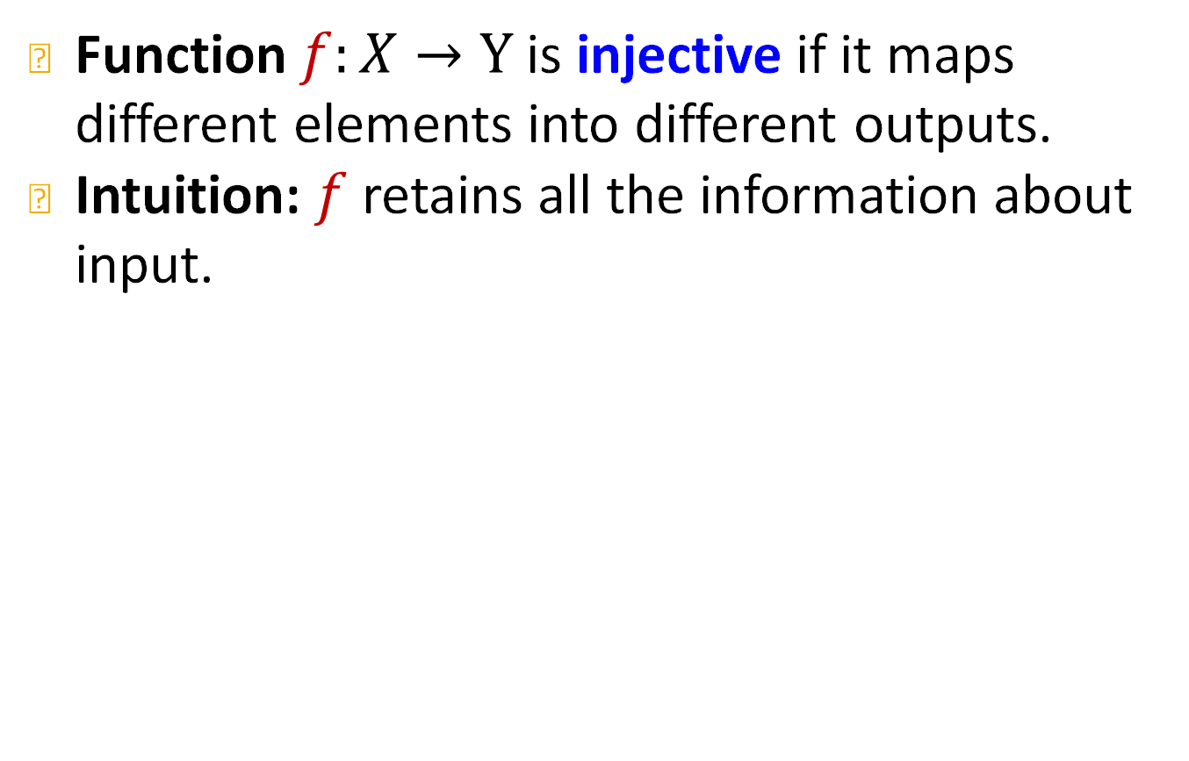



Recall: Injective Function
Function $f:X→Y$ is injective if it maps different elements into different outputs.
Intuition: $f$ retains all the information about input.
$$X$$
$$Y$$
$$f$$
1
D
B
2
C
3
A
Notes:
It means that different inputs give different outputs and going back to highshool math this is an injective function
Imagine that X is the tree and y is the embedding. Intuitively why injectivity is so important is because it is information preserving, which means that from the output you can go back to the input

Slide 27

How Expressive is a GNN?
Most expressive GNN should map subtrees to the node embeddings injectively.
Embedding space
$$ℝ^{d}$$
Subtrees
1
2
3
4
5
2
5
1
5
4
3
5
1
2
4
1
5
1
2
4
2
5
1
2
4
5
4
1
2
4
2
5
1
5
3
5
Notes:
To rephrase our goal we want our most expressive GNN

Slide 28

How Expressive is a GNN?
Key observation: Subtrees of the same depth can be recursively characterized from the leaf nodes to the root nodes.
From leaves
to the root
From leaves
to the root
(2 neighbors, 3 neighbors)
$$≠$$
(1 neighbor, 3 neighbors)
1
4
2
5
3
5
2 neighbors
3 neighbors
1 neighbor
3 neighbors
1
5
1
2
4
4
1
2
4
Input features are uniform
Input features are uniform
Notes:
Key observation: which means that we can work from the bottom up
let's say if we start from the leaf nodes here we see thatn node 2 has 2 neighbors and 5 3 neighbors, if the msg+ aggr function is injective then this information will be preserved in the embedding and then when we will aggregate info from node 2 and 5 to 1 and msg and agg are injective this information will also be preserved
Same for the othr graph. So the final embeddings will be different

Slide 29

How Expressive is a GNN?
If each step of GNN’s aggregation can fully retain the neighboring information, the generated node embeddings can distinguish different rooted subtrees.
Fully retain neighboring information
(2 neighbors, 3 neighbors)
$$≠$$
(1 neighbor, 3 neighbors)
1
4
2
5
3
5
2 neighbors
3 neighbors
1 neighbor
3 neighbors
Fully retain neighboring information
4
1
2
4
1
5
1
2
4
Input features are uniform
Input features are uniform
Notes:
So for the whole operation to be injective so for the GNN to be injective towards the whole tree, it sufficies to show that each level is injective and we preserve injectivity for the whole tree.

Slide 30
How Expressive is a GNN?
In other words, most expressive GNN would use an injective neighbor aggregation function at each step.
  Maps different neighbors to different embeddings.
Injective neighbor aggregation
1
4
2
5
3
5
Injective neighbor aggregation
1
5
1
2
4
4
1
2
4
Input features are uniform
Input features are uniform

Slide 31
How Expressive is a GNN?
Summary so far
  To generate a node embedding, GNNs use a computational graph corresponding to a subtree rooted around each node.
  GNN can fully distinguish different subtree structures if every step of its neighbor aggregation is injective.
Input graph
Computational graph
= Rooted subtree
1
Using injective neighbor aggregation
→ distinguish different subtrees
1
2
3
2
5
5
4
1
5
1
2
4
Notes:
We set our self this goal of understanding the expressivity of GNNs.
We formulated that as distinguishing nodes with different neighborhoods
We connected that to the architecture side of it by noting that the architecture is described by the computation graph or rooted subtree that describes what info flow to the embedding
We said that the architecture needs to be injective for each rooted subtree and showed that
It sufficies to show that injectivity is preserved at each individual layer with the msg and agg functions

Slide 32
Stanford CS224W:
Designing the Most Powerful
Graph Neural Network
CS224W: Machine Learning with Graphs
Jure Leskovec, Stanford University
http://cs224w.stanford.edu

Slide 33
Expressive Power of GNNs
Key observation: Expressive power of GNNs can be characterized by that of neighbor aggregation functions they use.
  A more expressive aggregation function leads to a more expressive GNN.
  Injective aggregation function leads to the most expressive GNN.
Next:
  Theoretically analyze expressive power of aggregation functions.
Notes:
Now we are going to look at existing arch and benchmark them and see if they have these injective function

Slide 34
Neighbor Aggregation
Observation: Neighbor aggregation can be abstracted as a function over a multi-set (a set with repeating elements).
Examples of multi-set
Equivalent
Neighbor aggregation
Multi-set function
Same color indicates the same features.
Notes:
One important think to note that will facilitate our upcoming analysis is that...
A multi-set is a set with repeating elements. The order of the elements in a set does not matter and the same applies for the multiset, i.e., the order doesn't matter.
Multiset is not something complicated it is just a set with repeated elements where the order doesn't matter
We can rephrase any agg function as a function of multisets.
Here we point out that agg is a multiset function of colors or in other words a multi-set function of node features

Slide 35
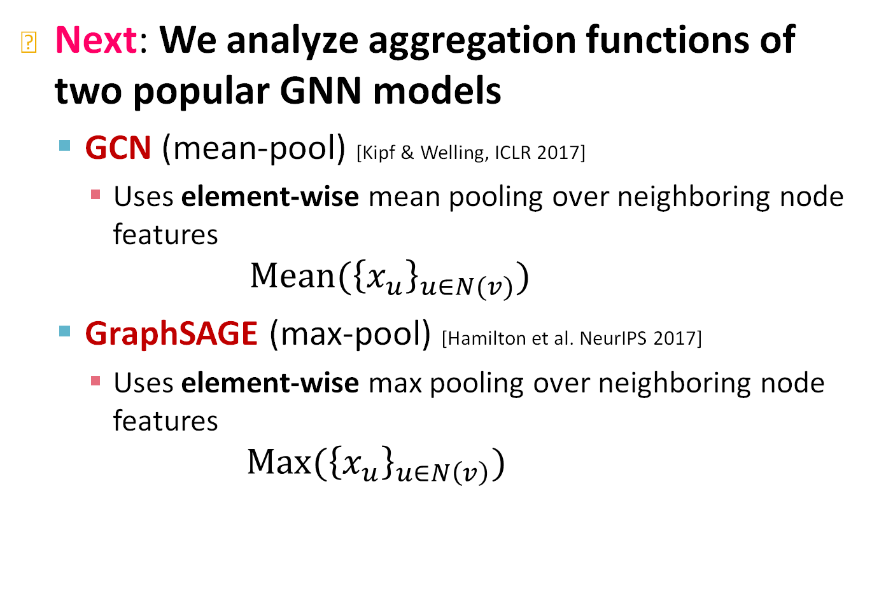
Neighbor Aggregation
Next: We analyze aggregation functions of two popular GNN models
  GCN (mean-pool) [Kipf & Welling, ICLR 2017]
    Uses element-wise mean pooling over neighboring node features
    $$Mean({\left\{x_{u}\right\}}_{u∈N(v)})$$
  GraphSAGE (max-pool) [Hamilton et al. NeurIPS 2017]
    Uses element-wise max pooling over neighboring node features
      $$Max({\left\{x_{u}\right\}}_{u∈N\left(v\right)})$$
Notes:
As multiset functions
Max over each coordinate

Slide 36
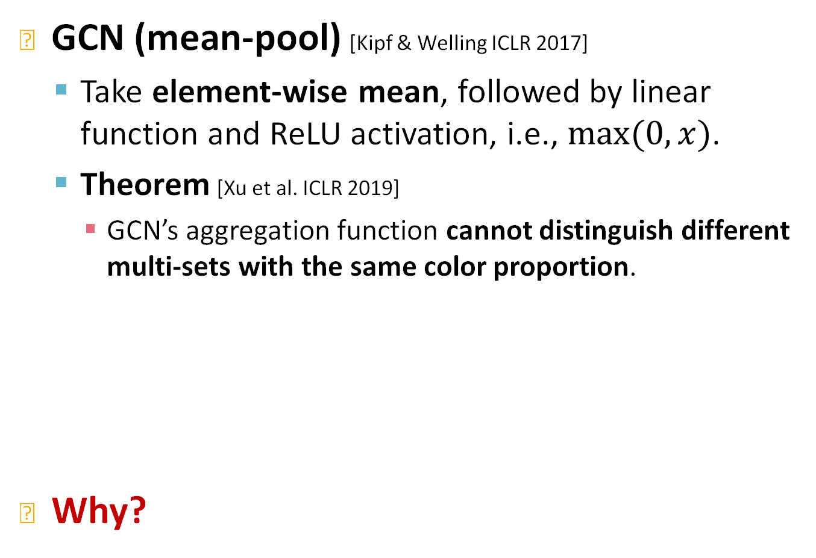
Neighbor Aggregation: Case Study
GCN (mean-pool) [Kipf & Welling ICLR 2017]
  Take element-wise mean, followed by linear function and ReLU activation, i.e., $max⁡(0, x)$.
  Theorem [Xu et al. ICLR 2019]
    GCN’s aggregation function cannot distinguish different multi-sets with the same color proportion.
Why?
Failure case
Notes:
It is not an injective functions. It is very easy to come up with examples

Slide 37
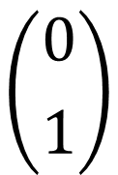
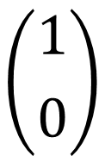
Neighbor Aggregation
For simplicity, we assume node features (colors) are represented by one-hot encoding.
  Example: If there are two distinct colors:
  This assumption is sufficient to illustrate how GCN fails.
$$\left({1 \atop 0}\right)$$
$$\left({0 \atop 1}\right)$$

Slide 38
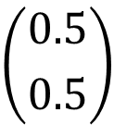

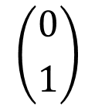


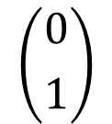
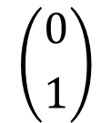
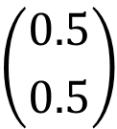
Neighbor Aggregation: Case Study
GCN (mean-pool) [Kipf & Welling ICLR 2017]
  Failure case illustration
Same outputs!
Linear + ReLU
Linear + ReLU
$$\left({0.5 \atop 0.5}\right)$$
$$\left({0.5 \atop 0.5}\right)$$
Element-wise-
mean-pool
$$\left({1 \atop 0}\right)$$
$$\left({0 \atop 1}\right)$$
$$\left({1 \atop 0}\right)$$
$$\left({1 \atop 0}\right)$$
$$\left({0 \atop 1}\right)$$
$$\left({0 \atop 1}\right)$$

Slide 39
Neighbor Aggregation: Case Study
GraphSAGE (max-pool) [Hamilton et al. NeurIPS 2017]
  Apply an MLP, then take element-wise max.
  Theorem [Xu et al. ICLR 2019]
    GraphSAGE’s aggregation function cannot distinguish different multi-sets with the same set of distinct colors.
Why?
Failure case
Notes:
Ignores the counts of each color

Slide 40
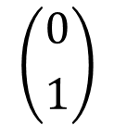
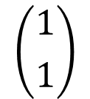
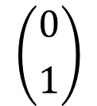
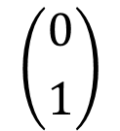
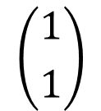


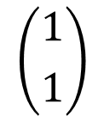



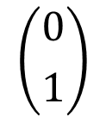
Neighbor Aggregation: Case Study
GraphSAGE (max-pool) [Hamilton et al. NeurIPS 2017]
  Failure case illustration
The same outputs!
Element-wise- max-pool
$$\left({1 \atop 1}\right)$$
$$\left({1 \atop 1}\right)$$
$$\left({1 \atop 1}\right)$$
For simplicity, assume the one-hot encoding after MLP.
$$\left({1 \atop 0}\right)$$
$$\left({0 \atop 1}\right)$$
$$\left({1 \atop 0}\right)$$
$$\left({1 \atop 0}\right)$$
$$\left({0 \atop 1}\right)$$
$$\left({0 \atop 1}\right)$$
$$\left({1 \atop 0}\right)$$
$$\left({1 \atop 0}\right)$$
$$\left({0 \atop 1}\right)$$
MLP

Slide 41
Summary So Far
We analyzed the expressive power of GNNs.
Main takeaways:
  Expressive power of GNNs can be characterized by that of the neighbor aggregation function.
  Neighbor aggregation is a function over multi-sets (sets with repeating elements)
  GCN and GraphSAGE’s aggregation functions fail to distinguish some basic multi-sets; hence not injective.
  Therefore, GCN and GraphSAGE are not maximally powerful GNNs.
Notes:
We built all this framework to characterize the expressivity of gnns, we showed that gcn and sage are not maximally powerful ,so the obvious next step is to design a maximally powerful gnn

Slide 42
Designing Most Expressive GNNs
Our goal: Design maximally powerful GNNs in the class of message-passing GNNs.
This can be achieved by designing injective neighbor aggregation function over multi-sets.
Here, we design a neural network that can model injective multiset function.

Slide 43

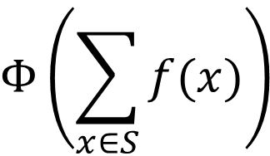






Injective Multi-Set Function
Theorem [Xu et al. ICLR 2019]
Any injective multi-set function can be expressed as:
Some non-linear function
$$Φ\left(\sum_{x∈S}{f(x)}\right)$$
Some non-linear function
Sum over multi-set
$$S$$
: multi-set
$$Φ$$
$$f$$
$$+$$
$$f$$
$$+$$
$$f$$
Notes:
Key result: theorem

Slide 44

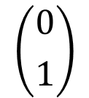
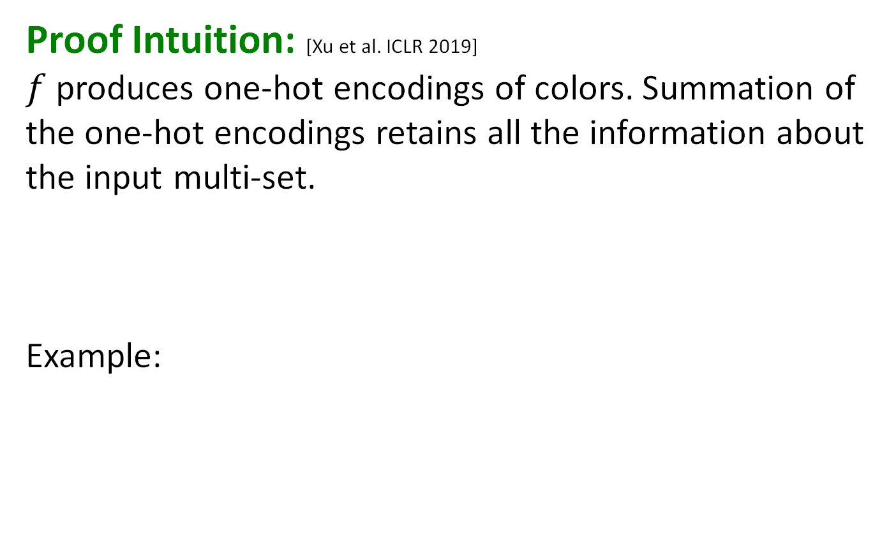

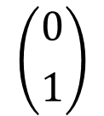
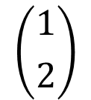






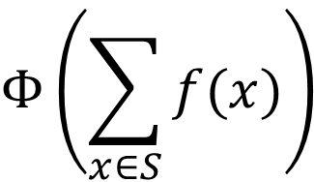


Injective Multi-Set Function
Proof Intuition: [Xu et al. ICLR 2019]
$f$ produces one-hot encodings of colors. Summation of the one-hot encodings retains all the information about the input multi-set.
Example:
$$Φ\left(\sum_{x∈S}{f(x)}\right)$$
$$Φ$$
$$f$$
$$+$$
$$f$$
$$+$$
$$f$$
$$\left({1 \atop 0}\right)$$
$$+$$
$$\left({0 \atop 1}\right)$$
$$+$$
$$\left({0 \atop 1}\right)$$
$$=$$
$$\left({1 \atop 2}\right)$$
One-hot
Notes:
The first step guarantees injectivity , I will assign distinct representations to distinct multisets, and the second guarantees that I can actually model any injective function
Can you imagine what type of functions we will use?

Slide 45
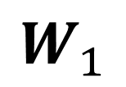
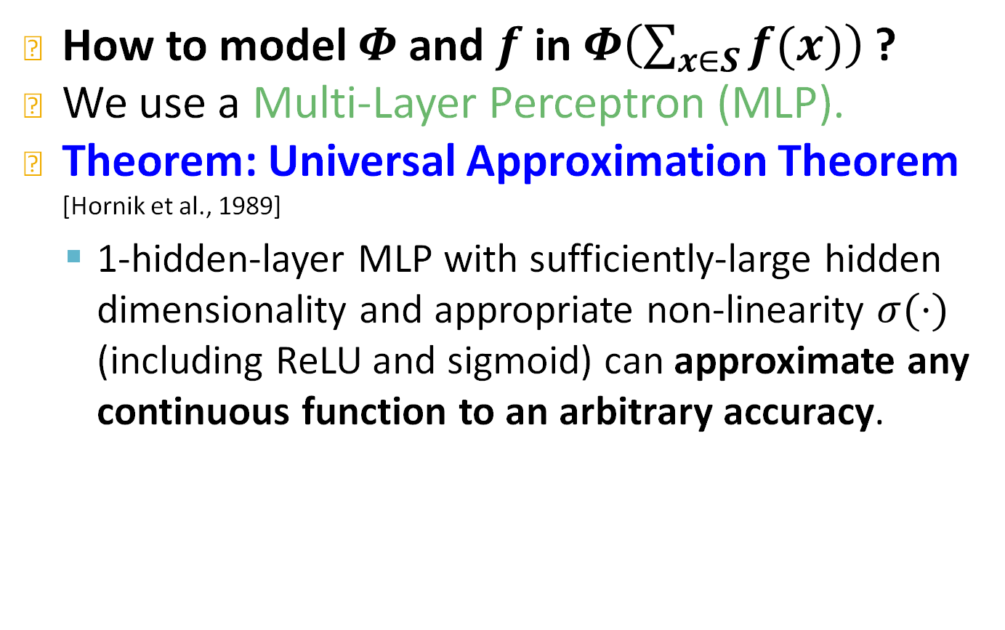

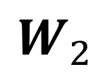
Universal Approximation Theorem
How to model $Φ$ and $f$ in $Φ\left(\sum_{x∈S}{f(x)}\right)$ ?
We use a Multi-Layer Perceptron (MLP).
Theorem: Universal Approximation Theorem [Hornik et al., 1989]
  1-hidden-layer MLP with sufficiently-large hidden dimensionality and appropriate non-linearity $σ(⋅)$ (including ReLU and sigmoid) can approximate any continuous function to an arbitrary accuracy.
$$W_{1}$$
$$σ$$
$$W_{2}$$
Input
Output

Slide 46
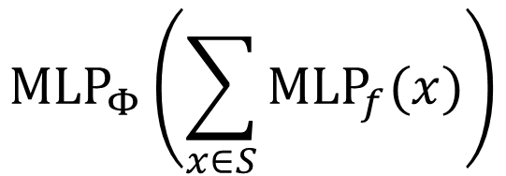
Injective Multi-Set Function
We have arrived at a neural network that can model any injective multiset function.
  In practice, MLP hidden dimensionality of 100 to 500 is sufficient.
$${MLP}_{Φ}\left(\sum_{x∈S}{{MLP}_{f}(x)}\right)$$
Notes:
Different MLPs

Slide 47
Most Expressive GNN
Graph Isomorphism Network (GIN) [Xu et al. ICLR 2019]
  Apply an MLP, element-wise sum, followed by another MLP.
Theorem [Xu et al. ICLR 2019]
  GIN‘s neighbor aggregation function is injective.
No failure cases!
GIN is THE most expressive GNN in the class of message-passing GNNs we have introduced!
$${MLP}_{Φ}\left(\sum_{x∈S}{{MLP}_{f}(x)}\right)$$
Notes:
Motivated by the previous theorem we can design an injective aggregation function for a GNN.
As I said passing each element in the multiset thorugh an mlp and then sum over all elements guarantees a unique output for unique multisets, which means that in our most expressive GNN we should use summation aggregation which is preceded by an mlp

Slide 48
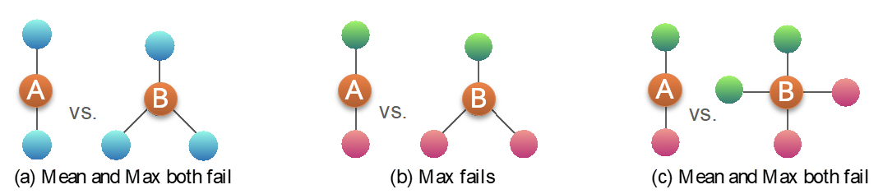
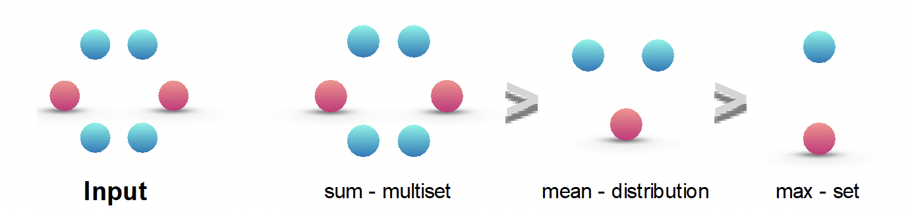
Discussion: The Power of Pooling
Failure cases for mean and max pooling:
Ranking by discriminative power:
Colors represent feature values
Notes:
Say that when the node features are non-repeating, then, mean/max pooling can be also as discriminative as sum-pooling.
But when features are repeating, mean/max pooling may fail to capture very obvious graph structures.

Slide 49
Full Model of GIN
So far: We have described the neighbor aggregation part of GIN.
We now describe the full model of GIN by relating it to WL graph kernel (traditional way of obtaining graph-level features).
  We will see how GIN is a “neural network” version of the WL graph kernel.
Notes:
We don't have our final model yet but we have our aggre function

Slide 50
Graph Isomorphism problem
A classical expressivity test is Graph isomorphism.
  Given a pair of graphs, can we tell if they are isomorphic?
Open problem (a polynomial time algorithm does not exist, has not been proven NP-complete)
1
2
1
2
3
3
5
4
5
4

Slide 51
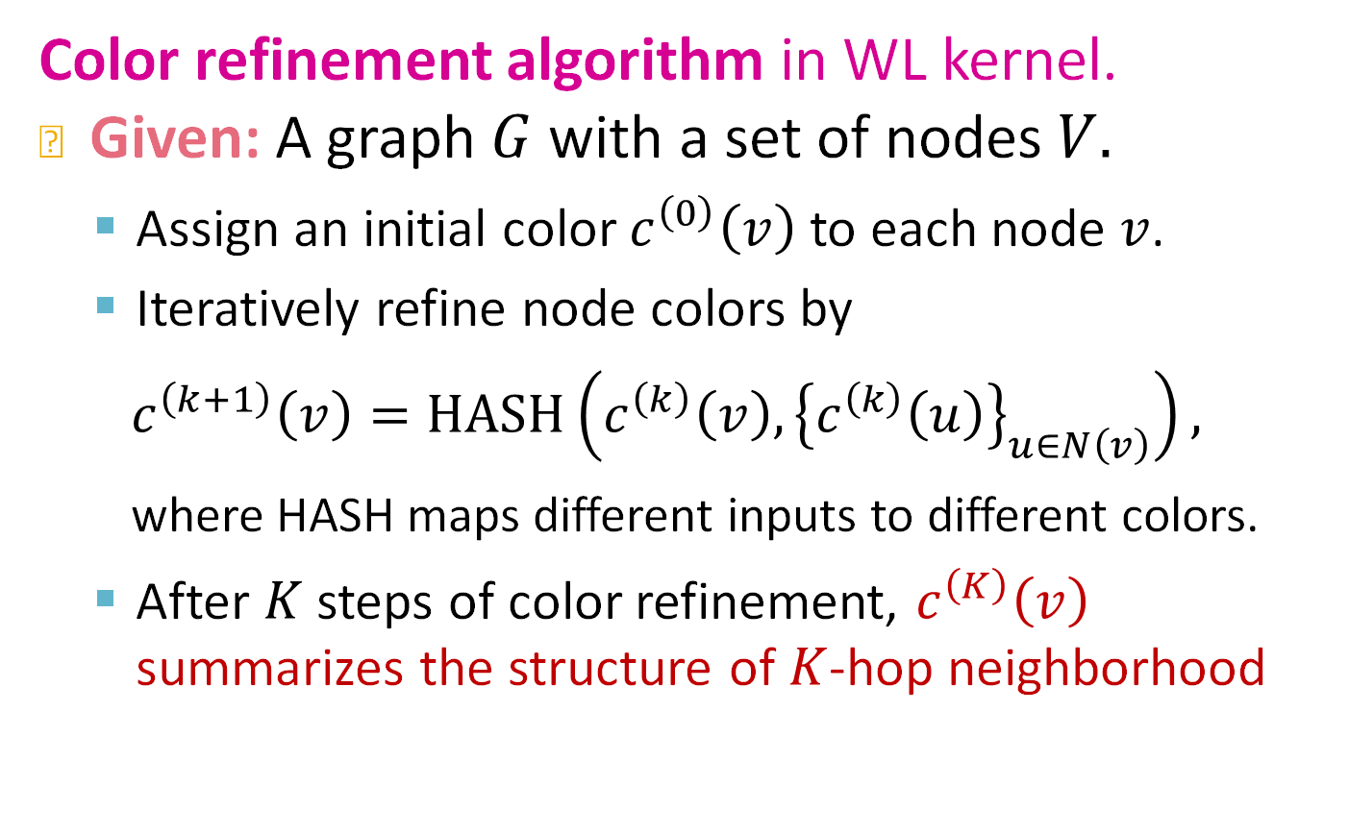
Relation to WL Graph Kernel
Color refinement algorithm in WL kernel.
Given: A graph $G$ with a set of nodes $V.$
  Assign an initial color $c^{\left(0\right)}\left(v\right)$ to each node $v$.
  Iteratively refine node colors by
  ${ c}^{\left(k+1\right)}\left(v\right)=HASH\left({c^{\left(k\right)}\left(v\right), \left\{c^{\left(k\right)}\left(u\right)\right\}}_{u∈N\left(v\right)}\right),$
  where HASH maps different inputs to different colors.
  After $K$ steps of color refinement, $c^{\left(K\right)}\left(v\right)$ summarizes the structure of $K$-hop neighborhood

Slide 52
Color Refinement (1)
Example of color refinement given two graphs
  Assign initial colors
  Aggregate neighboring colors
1
1
1
1
1
1
1
1
1
1
1
1
1,111
1,11
1,11
1,111
1,1111
1,111
1,1111
1,111
1,1
1,1
1,1
1,1

Slide 53
Color Refinement (2)
Example of color refinement given two graphs
  Aggregated colors:
  Injectively HASH the aggregated colors
1,111
1,11
1,11
1,111
1,1111
1,111
1,1111
1,111
1,1
1,1
1,1
1,1
HASH table: Injective!
4
3
3
4
1,1
1,11
1,111
1,1111
-->
-->
-->
-->
2
3
4
5
5
4
5
4
2
2
2
2

Slide 54

Color Refinement (3)
Example of color refinement given two graphs
Process continues until a stable coloring is reached
Two graphs are considered isomorphic if they have the same set of colors.
11
8
$$≠$$
9
11
12
11
13
10
7
7
7
6

Slide 55
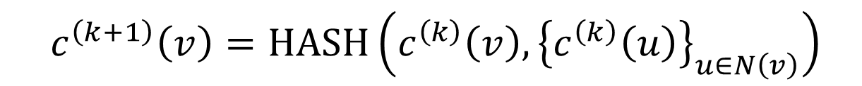
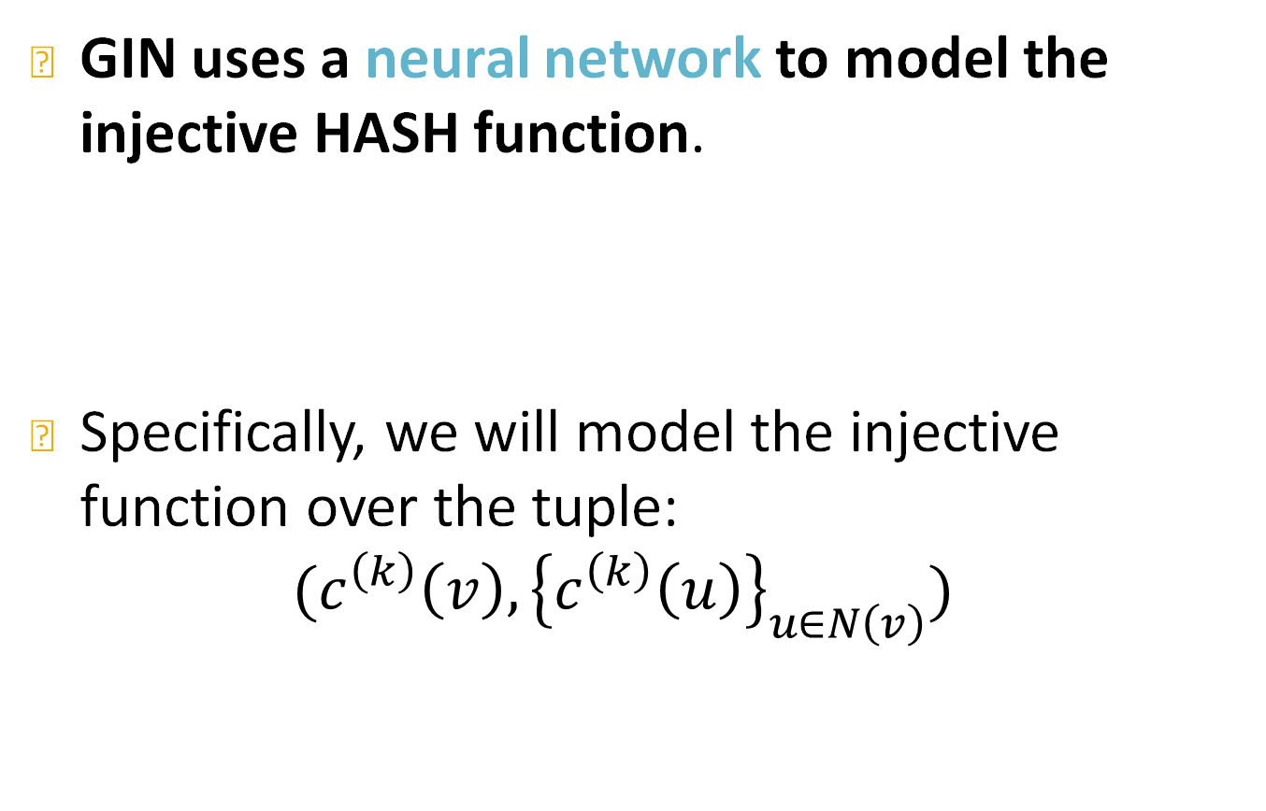
The Complete GIN Model
GIN uses a neural network to model the injective HASH function.
Specifically, we will model the injective function over the tuple:
$${{(c}^{\left(k\right)}\left(v\right), \left\{c^{\left(k\right)}\left(u\right)\right\}}_{u∈N\left(v\right)})$$
$${ c}^{\left(k+1\right)}\left(v\right)=HASH\left({c^{\left(k\right)}\left(v\right), \left\{c^{\left(k\right)}\left(u\right)\right\}}_{u∈N\left(v\right)}\right)$$
Root node features
Neighboring node colors

Slide 56
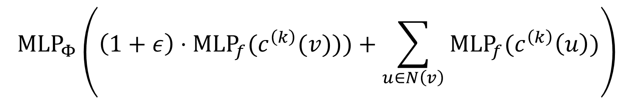
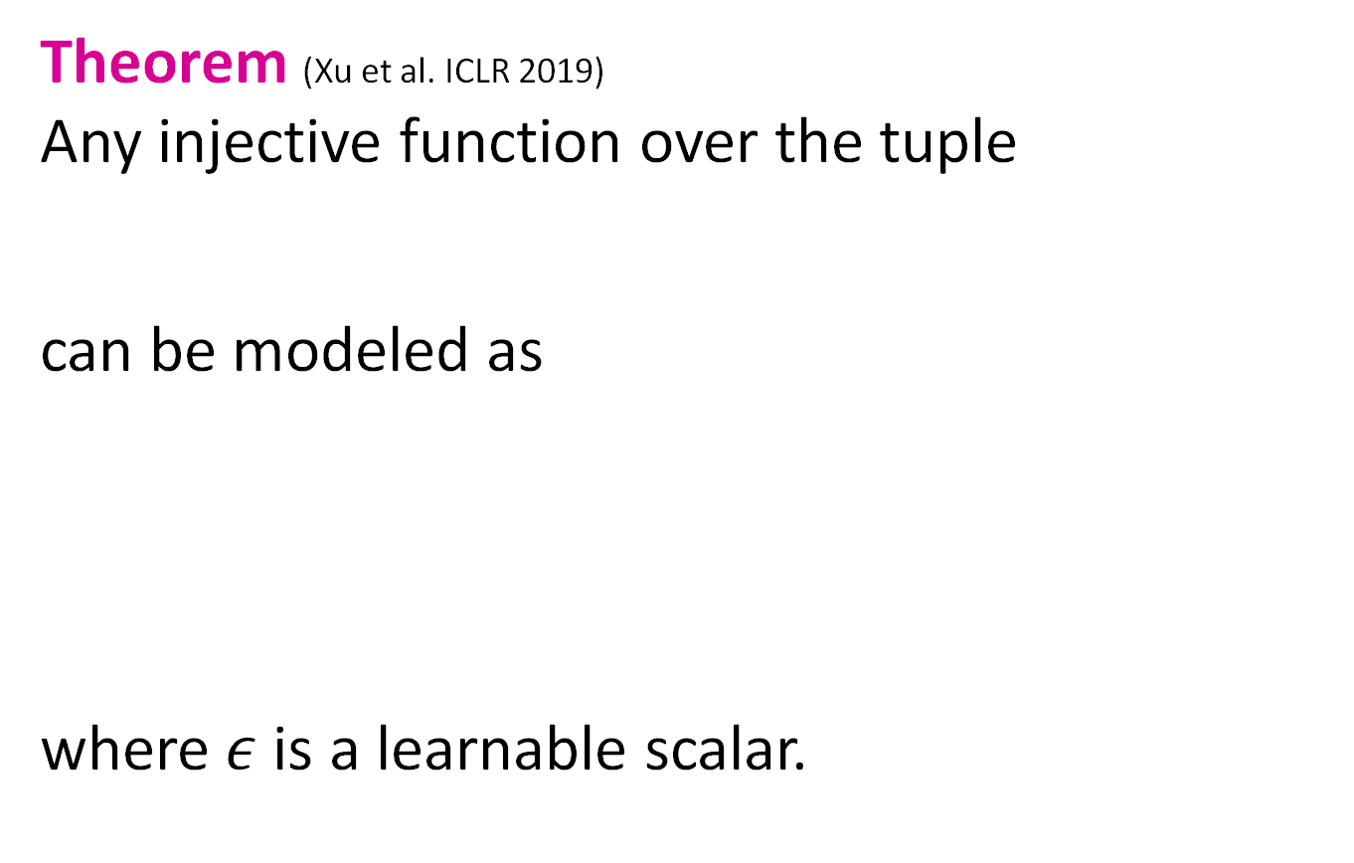
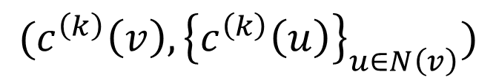
The Complete GIN Model
Theorem (Xu et al. ICLR 2019)
Any injective function over the tuple
can be modeled as
where $ε$ is a learnable scalar.
Root node feature
$${{(c}^{\left(k\right)}\left(v\right), \left\{c^{\left(k\right)}\left(u\right)\right\}}_{u∈N\left(v\right)})$$
Neighboring node features
$${MLP}_{Φ}\left(\left(1+ε\right)⋅{MLP}_{f}(c^{\left(k\right)}(v)))+\sum_{u∈N\left(v\right)}{{MLP}_{f}(c^{\left(k\right)}\left(u\right))}\right)$$

Slide 57
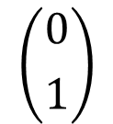
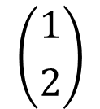
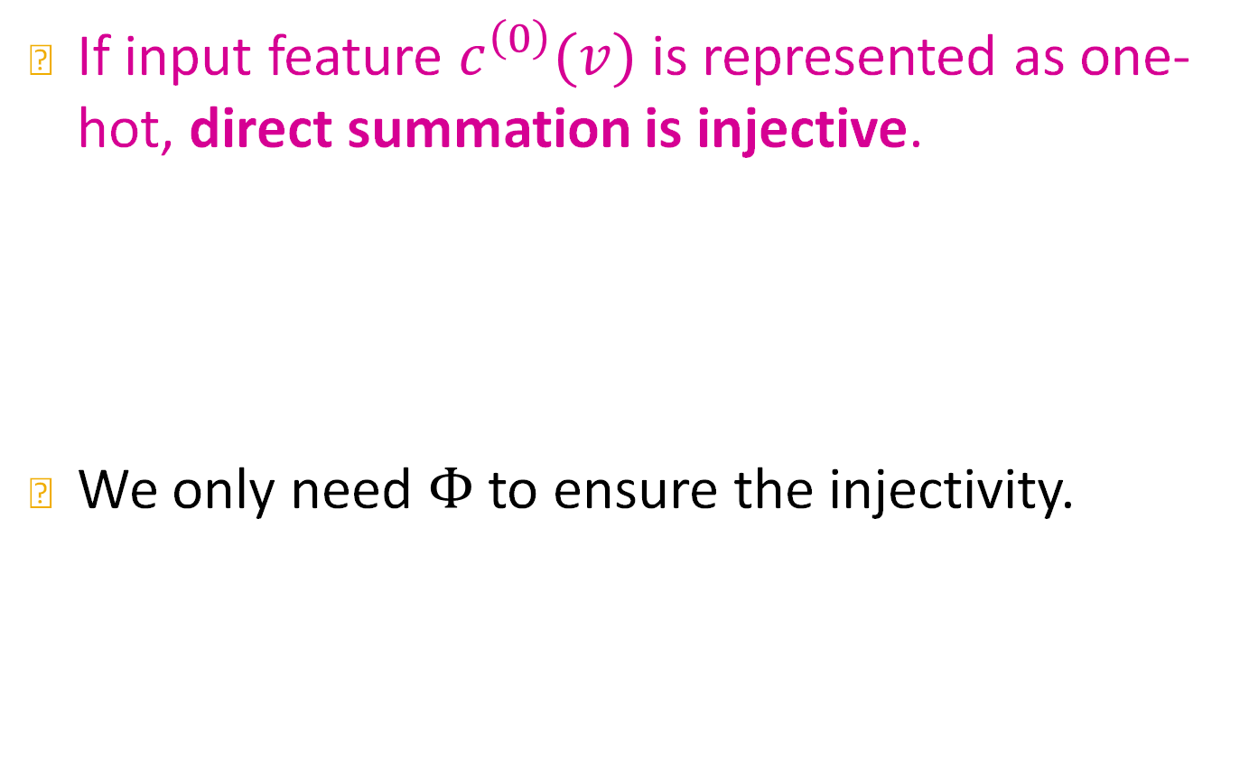







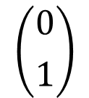
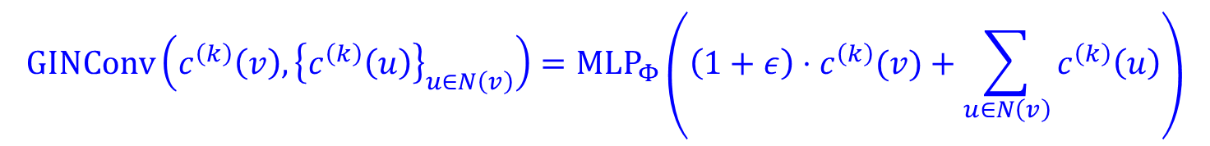
The Complete GIN Model
If input feature $c^{\left(0\right)}(v)$ is represented as one-hot, direct summation is injective.
We only need $Φ$ to ensure the injectivity.
Example:
$$Φ$$
$$+$$
$$+$$
$$\left({1 \atop 0}\right)$$
$$+$$
$$\left({0 \atop 1}\right)$$
$$+$$
$$\left({0 \atop 1}\right)$$
$$=$$
$$\left({1 \atop 2}\right)$$
$$GINConv\left({c^{\left(k\right)}\left(v\right), \left\{c^{\left(k\right)}\left(u\right)\right\}}_{u∈N\left(v\right)}\right)={MLP}_{Φ}\left(\left(1+ε\right)⋅c^{\left(k\right)}(v)+\sum_{u∈N\left(v\right)}{c^{\left(k\right)}\left(u\right)}\right)$$
Root node features
Neighboring node features
This MLP can provide “one-hot” input
feature for the next layer.
Notes:
Transform the embedding to something task specific
PyG you can implement GINconv as follows. What happened to the second MLP?

Slide 58
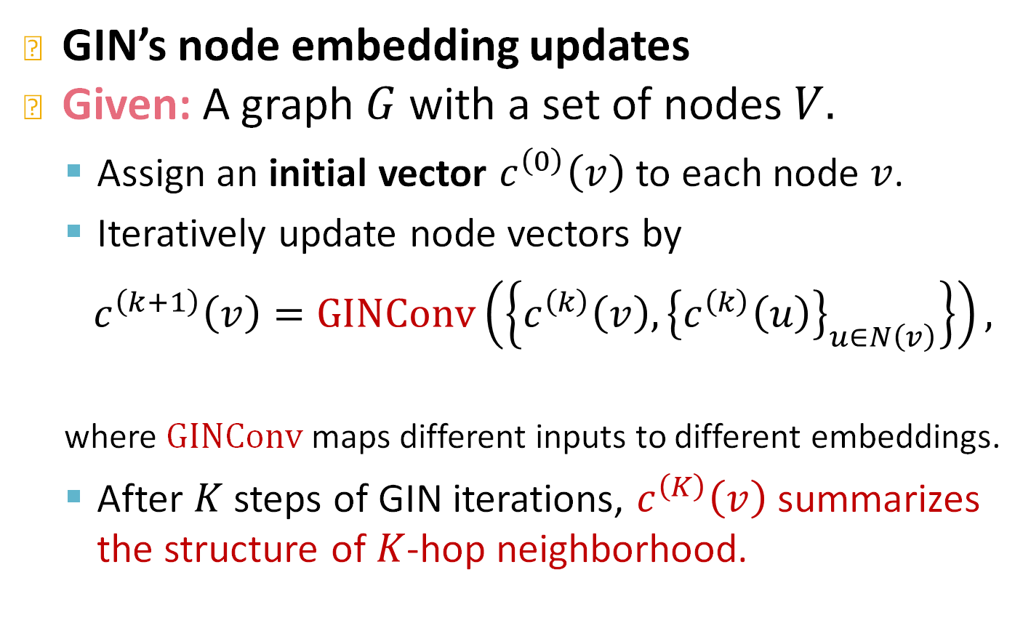
The Complete GIN Model
GIN’s node embedding updates
Given: A graph $G$ with a set of nodes $V.$
  Assign an initial vector $c^{\left(0\right)}\left(v\right)$ to each node $v$.
  Iteratively update node vectors by
  ${ c}^{\left(k+1\right)}\left(v\right)=GINConv\left(\left\{{c^{\left(k\right)}\left(v\right), \left\{c^{\left(k\right)}\left(u\right)\right\}}_{u∈N\left(v\right)}\right\}\right),$
  where $GINConv$ maps different inputs to different embeddings.
  After $K$ steps of GIN iterations, $c^{\left(K\right)}\left(v\right)$ summarizes the structure of $K$-hop neighborhood.
Differentiable color HASH function

Slide 59
GIN and WL Graph Kernel
GIN can be understood as differentiable neural version of the WL graph Kernel:
Advantages of GIN over the WL graph kernel are:
  Node embeddings are low-dimensional; hence, they can capture the fine-grained similarity of different nodes.
  Parameters of the update function can be learned for the downstream tasks.
 | Update target | Update function
WL Graph Kernel | Node colors (one-hot) | HASH
GIN | Node embeddings (low-dim vectors) | GINConv

Slide 60
Expressive Power of GIN
Because of the relation between GIN and the WL graph kernel, their expressive is exactly the same.
  If two graphs can be distinguished by GIN, they can be also distinguished by the WL kernel, and vice versa.
How powerful is this?
  WL kernel has been both theoretically and empirically shown to distinguish most of the real-world graphs [Cai et al. 1992].
  Hence, GIN is also powerful enough to distinguish most of the real graphs!
Notes:
GIN is not a universal approximator, and that is not surprising because of graph isomorphism. Showing that GIN is a universal approacimator of all graphs would not be a CS problem but a filed-medal award level of result in math so you can see why this is not surprising. Nevertheless it is worth assessing the expressive power of GIN and we can see

Slide 61
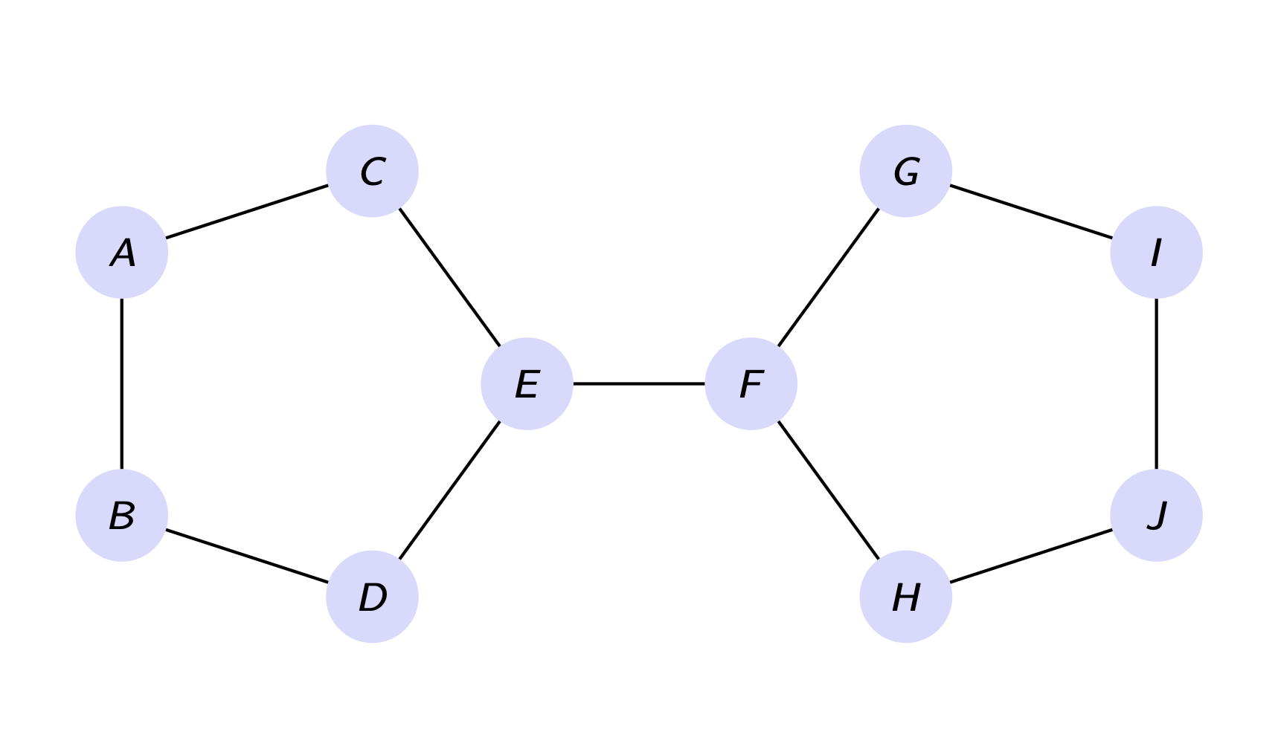

Some bad news
The WL kernel cannot distinguish between some basic graph structures, e.g.,
The WL kernel cannot count important sub-structures, e.g., cycles and cliques.

Slide 62

Why do we care about cycles?
The bonds between different atoms in chemical compounds form cycles.
The hexagon is the most common polygon in organic compounds ⇒ yields stable materials.

Slide 63

Why cliques and quasi-cliques?

Slide 64



Improving GNNs’ Power
Can the expressive power of GNNs be improved?
  There are basic graph structures that existing GNN framework cannot distinguish, such as difference in cycles.
  GNNs’ expressive power can be improved to resolve the above problem. [You et al. AAAI 2021, Li et al. NeurIPS 2020, Kanatsoulis et al. ICLR 2024]
Computational graphs for nodes $v_{1}$ and $v_{2}$:
A
$$v_{1}$$
B
$$v_{2}$$

Slide 65
Summary of the Lecture
We design a neural network that can model an injective multi-set function.
We use the neural network for neighbor aggregation function and arrive at GIN---the most expressive GNN model.
The key is to use element-wise sum pooling, instead of mean-/max-pooling.
GIN is closely related to the WL graph kernel.
Both GIN and WL graph kernel can distinguish most of the real graphs!

Slide 66
Stanford CS224W:
When Things Don’t Go As Planned
CS224W: Machine Learning with Graphs
Jure Leskovec, Stanford University
http://cs224w.stanford.edu

Slide 67

General Tips
Data preprocessing is important:
  Node attributes can vary a lot! Use normalization
    E.g. probability ranges $(0,1)$, but some inputs could have much larger range, say $(−1000, 1000)$
Optimizer: ADAM is relatively robust to learning rate
Activation function
  ReLU activation function often works well
  Other good alternatives: LeakyReLU, PReLU
  No activation function at your output layer
  Include bias term in every layer
Embedding dimensions:
  32, 64 and 128 are often good starting points

Slide 68
Debugging Deep Networks
Debug issues: Loss/accuracy not converging during training
  Check pipeline (e.g. in PyTorch we need zero_grad)
  Adjust hyperparameters such as learning rate
  Pay attention to weight parameter initialization
  Scrutinize loss function!
Important for model development:
  Overfit on (part of) training data:
    With a small training dataset, loss should be essentially close to 0, with an expressive neural network
  Monitor the training & validation loss curve

Slide 69



Resources on Graph Neural Networks
GraphGym:
Easy and flexible end-to-end GNN pipeline
based on PyTorch Geometric (PyG)
GNN frameworks:
Implements a variety
of GNN architectures
DGL
GraphNets
Auto-differentiation frameworks

Slide 70
Resources on Graph Neural Networks
Tutorials and overviews:
  Relational inductive biases and graph networks (Battaglia et al., 2018)
  Representation learning on graphs: Methods and applications (Hamilton et al., 2017)
Attention-based neighborhood aggregation:
  Graph attention networks (Hoshen, 2017; Velickovic et al., 2018; Liu et al., 2018)
Embedding entire graphs:
  Graph neural nets with edge embeddings (Battaglia et al., 2016; Gilmer et. al., 2017)
  Embedding entire graphs (Duvenaud et al., 2015; Dai et al., 2016; Li et al., 2018) and graph pooling (Ying et al., 2018, Zhang et al., 2018)
  Graph generation and relational inference (You et al., 2018; Kipf et al., 2018)
  How powerful are graph neural networks(Xu et al., 2017)
Embedding nodes:
  Varying neighborhood: Jumping knowledge networks (Xu et al., 2018), GeniePath (Liu et al., 2018)
  Position-aware GNN (You et al. 2019)
Spectral approaches to graph neural networks:
  Spectral graph CNN & ChebNet (Bruna et al., 2015; Defferrard et al., 2016)
  Geometric deep learning (Bronstein et al., 2017; Monti et al., 2017)
Other GNN techniques:
  Pre-training Graph Neural Networks (Hu et al., 2019)
  GNNExplainer: Generating Explanations for Graph Neural Networks (Ying et al., 2019)

