Slide 1

Stanford CS224W: GNN Theory 2, Breaking the Limits of the WL kernel
Note to other teachers and users of these slides: We would be delighted if you found our material useful for giving your own lectures. Feel free to use these slides verbatim, or to modify them to fit your own needs. If you make use of a significant portion of these slides in your own lecture, please include this message, or a link to our web site: http://cs224w.Stanford.edu
CS224W: Machine Learning with Graphs
Charilaos Kanatsoulis and Jure Leskovec, Stanford University
http://cs224w.stanford.edu

Slide 2
Announcements
Homework 1 due Thursday, 10/17
  Late submissions accepted until end of day Monday, 10/21
Project Proposal due Tuesday, 10/22
Colab 2 due Thursday, 10/24

Slide 3
Response to high-resolution feedbacks
Move recitation time
We will host our recitations in the evenings from now on to accommodate remote students. Recordings are also available via Ed posts.
Clarification on project feedbacks
After project proposal, you will be assigned a TA to mentor your project for detailed feedbacks.
Lecture pace
We will slow down the pace.
Individual questions around lecture content
Please come to OH for in-depth QA.

Slide 4
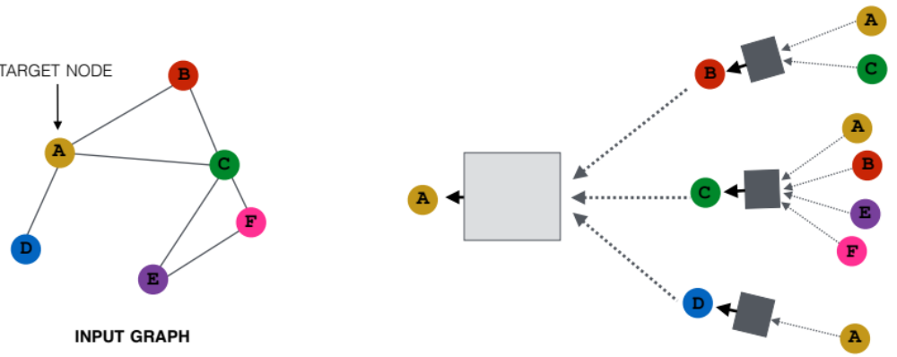
Recap: A General GNN Framework
J. You, R. Ying, J. Leskovec. Design Space of Graph Neural Networks, NeurIPS 2020c
(5) Learning objective
(2) Aggregation
GNN Layer 1
(1) Message
(3) Layer connectivity
GNN Layer 2
(4) Graph augmentation

Slide 5
Recap: GNN Training Pipeline
Dataset split
Evaluation metrics
Input Graph
Graph Neural Network
Node embeddings
Prediction head
Predictions
Labels
Loss function
Today’s lecture: Can we make GNN representation more expressive?

Slide 6
Stanford CS224W: Limitations of
Graph Neural Networks
CS224W: Machine Learning with Graphs
Jure Leskovec, Stanford University
http://cs224w.stanford.edu

Slide 7
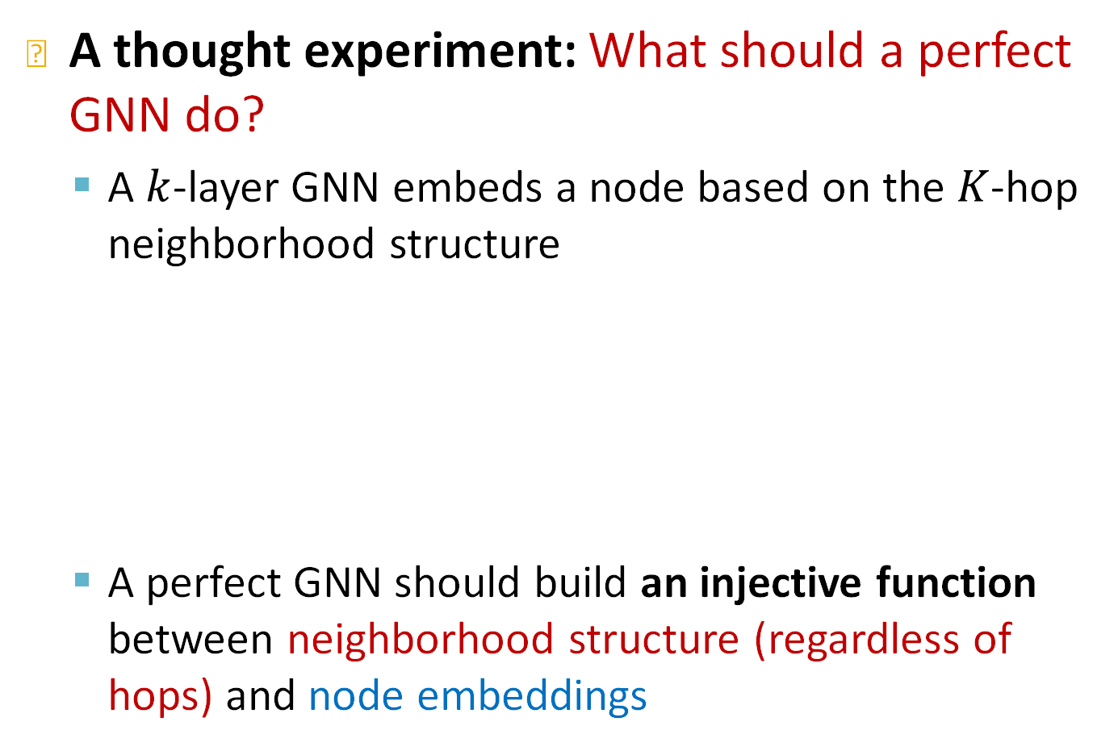
A “Perfect” GNN Model
A thought experiment: What should a perfect GNN do?
  A $k$-layer GNN embeds a node based on the $K$-hop neighborhood structure
  A perfect GNN should build an injective function between neighborhood structure (regardless of hops) and node embeddings
Notes:
It looks at the k-hop neighborhood of the node and ideally generates an injective embedding with respect to the k-hop neighborhood

Slide 8






A “Perfect” GNN Model
For a perfect GNN (ignore node attributes for now):
  Observation 1: If two nodes have the same neighborhood structure, they must have the same embedding
  Observation 2: If two nodes have different neighborhood structure, they must have different embeddings
$$h_{v_{1}}=h_{v_{2}}$$
$$v_{1}$$
$$v_{2}$$
$$h_{v_{1}}≠h_{v_{3}}$$
$$v_{1}$$
$$v_{3}$$
(Considering that attributes of all nodes are the same)

Slide 9
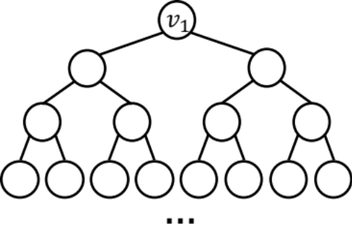
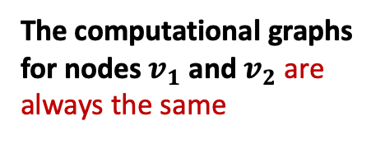

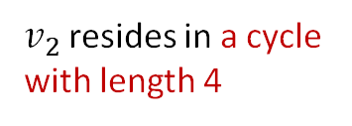
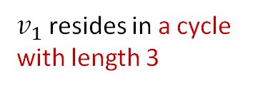

Imperfections of Existing GNNs
J. You, J. Gomes-Selman, R. Ying, J. Leskovec. Identity-aware Graph Neural Networks, AAAI 2021
Observation 2 often cannot be satisfied:
  The GNNs we have introduced so far are not perfect
  In previous lecture, we discussed that their expressive power is upper bounded by the WL test
  For example, message passing GNNs cannot count the cycle length:
The computational graphs for nodes $v_{1}$ and $v_{2}$ are always the same
$v_{1}$ resides in a cycle with length 3
$v_{2}$ resides in a cycle with length 4
(ignoring node attributes)
$$v_{1}$$
$$v_{2}$$
Notes:
However, Observations 1 & 2 are imperfect

Slide 10
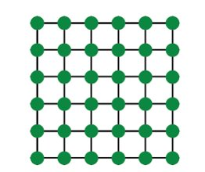
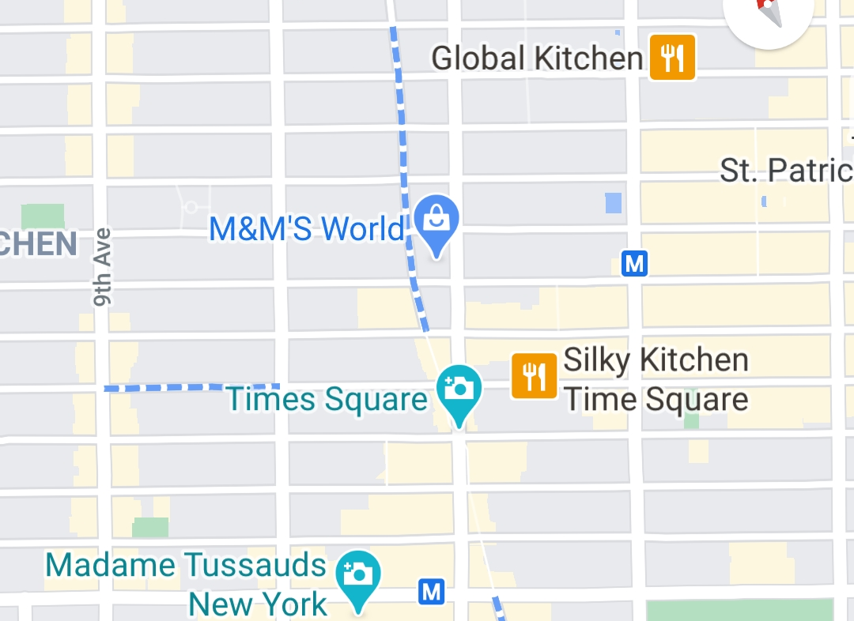




Imperfections of Existing GNNs
J. You, R. Ying, J. Leskovec. Postion-aware Graph Neural Networks, ICML 2019
Observation 1 could also have issues:
  Even though two nodes may have the same neighborhood structure, we may want to assign different embeddings to them
  Because these nodes appear in different positions in the graph
  We call these tasks Position-aware tasks
  Even a perfect GNN will fail for these tasks:
$$v_{2}$$
$$v_{2}$$
$$v_{1}$$
$$v_{1}$$
A grid graph
NYC road network
Notes:
Imagine you are building google maps and what you wan to do is give eta times from a given location to another location. New york and what eta to go to times square. Times square is her and in the grid graph you are somewhere here. And the eta between these two nodes clearly has to be different that
You want the embeddings to be different.
The hypothesis that we had before that when two nodes have the same neighborhood structure should have the same embeddings. That would

Slide 11
Plan for the Lecture
We will resolve both issues by building more expressive GNNs
Fix issues in Observation 2:
  Build message passing GNNs that are more expressive than WL test
  Example method: Structurally-aware GNNs
Fix issues in Observation 1:
  Create node embeddings based on their positions in the graph
  Example method: Position-aware GNNs

Slide 12
Stanford CS224W: A Spectral Perspective of message-passing GNNs
CS224W: Machine Learning with Graphs
Charilaos Kanatsoulis and Jure Leskovec, Stanford University
http://cs224w.stanford.edu

Slide 13
More Failure Cases for GNNs
J. You, J. Gomes-Selman, R. Ying, J. Leskovec. Identity-aware Graph Neural Networks, AAAI 2021
GNNs exhibit three levels of failure cases in structure-aware tasks:
  Node level
  Edge level
  Graph level
Notes:
We learned that GNNs would fail for position-aware tasks
But can GNN perform perfectly in structure-aware tasks?
Unfortunately, NO.

Slide 14







GNN Failure 1: Node-level Tasks
Different Inputs but the same computational graph → GNN fails
A
$$v_{1}$$
B
$$v_{2}$$
Example input graphs
Existing GNNs’ computational graphs
$$v_{1}$$
A
$$=$$
B
$$v_{2}$$
$$…$$
$$…$$

Slide 15






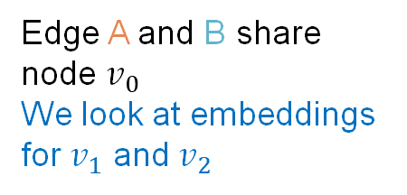


GNN Failure 2: Edge-level Tasks
Different Inputs but the same computational graph → GNN fails
$$v_{1}$$
$$v_{2}$$
Example input graphs
A
B
Edge A and B share node $v_{0}$
We look at embeddings for $v_{1}$ and $v_{2}$
$$v_{0}$$
Existing GNNs’ computational graphs
$$=$$
$$v_{1}$$
A
B
$$v_{2}$$
$$…$$
$$…$$

Slide 16
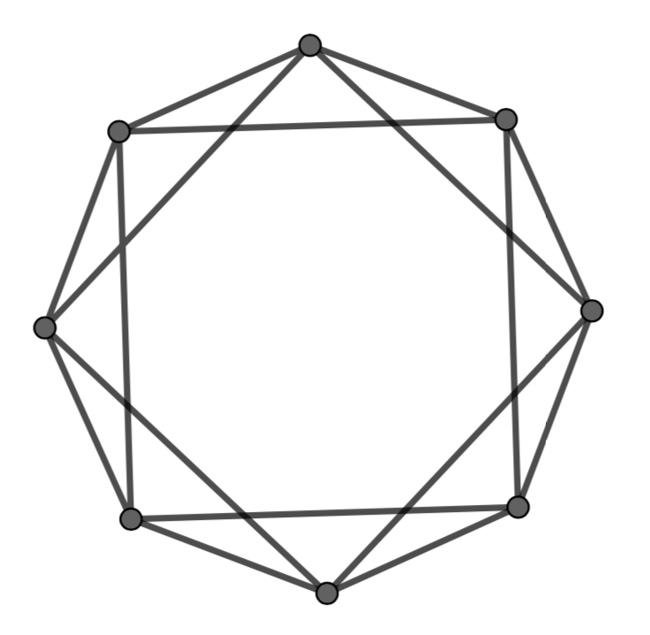
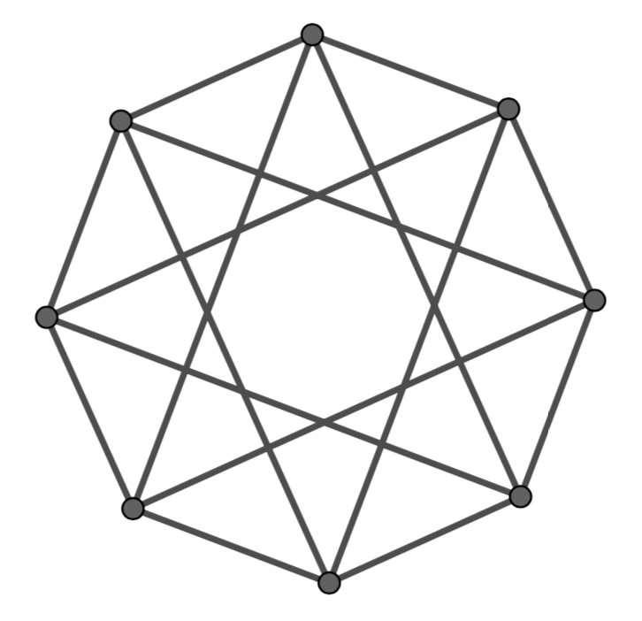
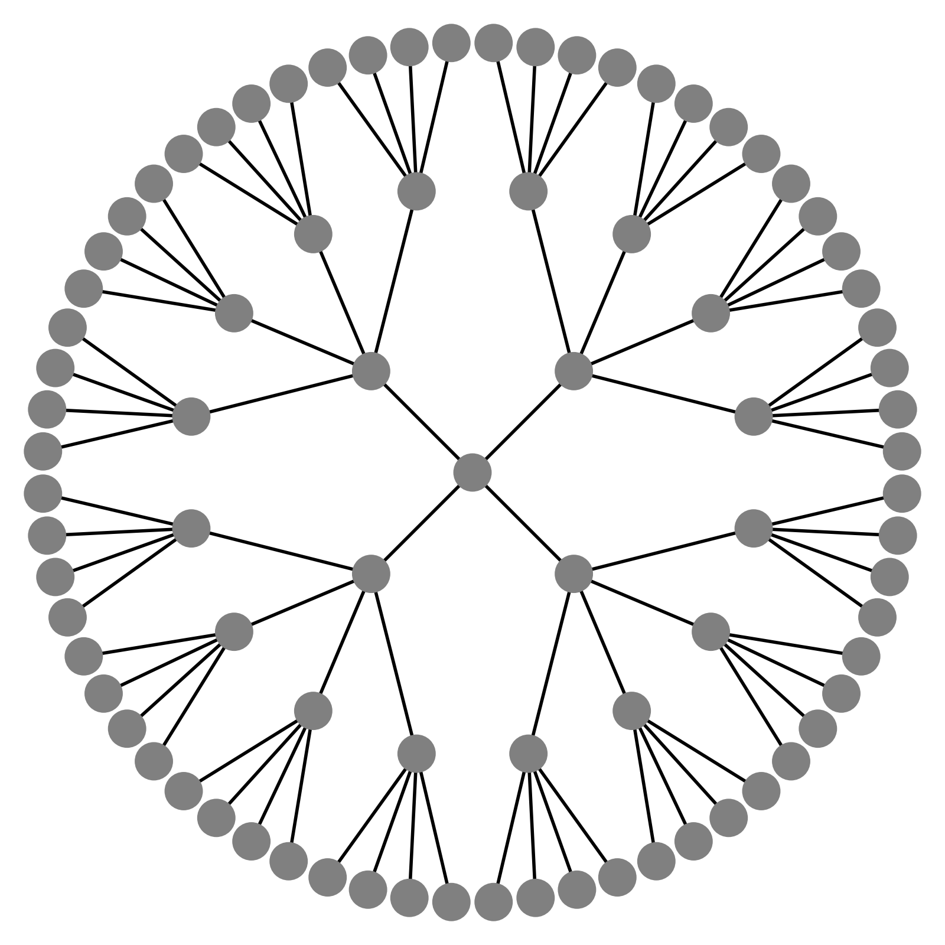

GNN Failure 3: Graph-level Tasks
Different Inputs but the same computational graph → GNN fails
A
B
Example input graphs
We look at embeddings for each node
For each node:
For each node:
A
B
Existing GNNs’ computational graphs
$$=$$

Slide 17
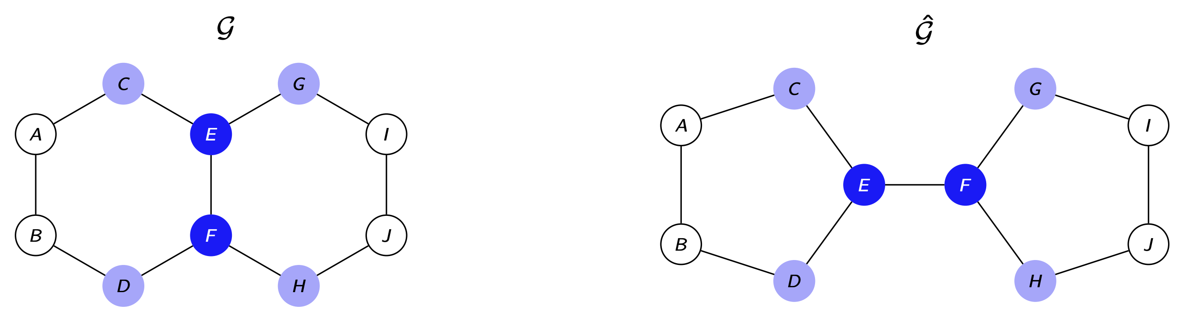
Limitation of the WL kernel
The WL kernel colors inherit the graph symmetries.
Symmetric colors are associated with limitations involving the spectral decomposition of the graph.

Slide 18
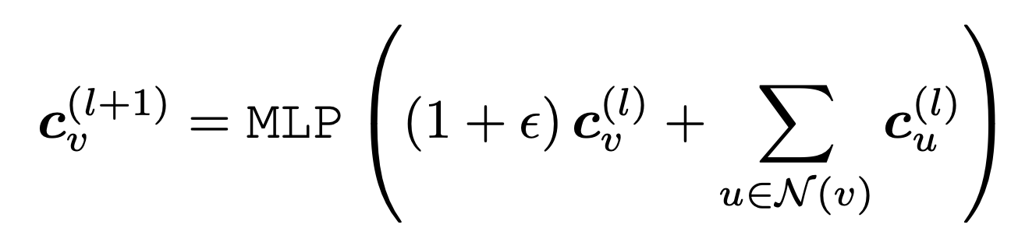
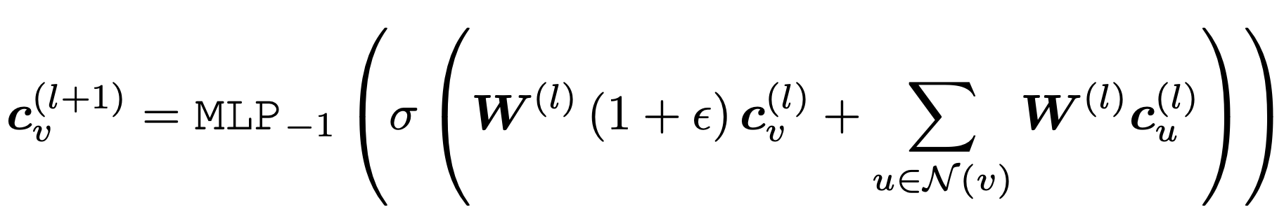
Matrix representation of GIN
Fix this slide. Explain notation. Explain what is going on.
Recall the GIN update:
  We can unroll the first MLP layer:
  denotes all the MLP layers except the first.

Slide 19
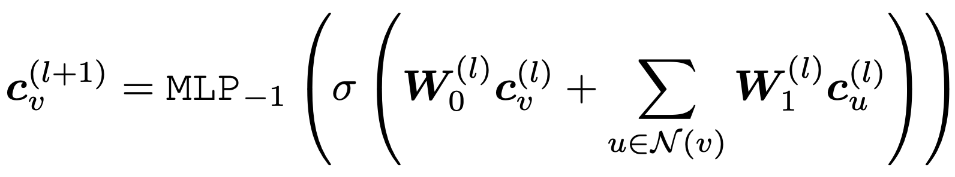
Matrix representation of GIN
Fix this slide. Explain notation. Explain what is going on.
Recall the GIN update:
  We can unroll the first MLP layer:
  denotes all the MLP layers except the first.

Slide 20
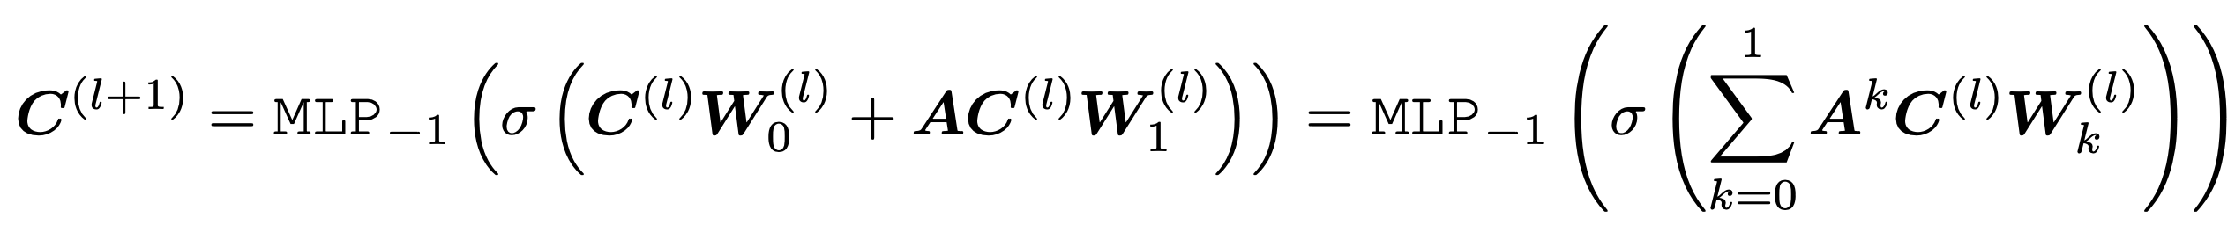
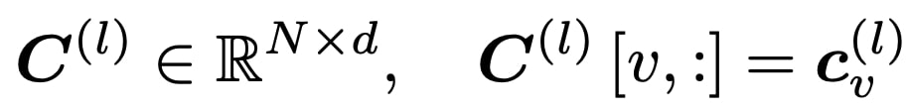
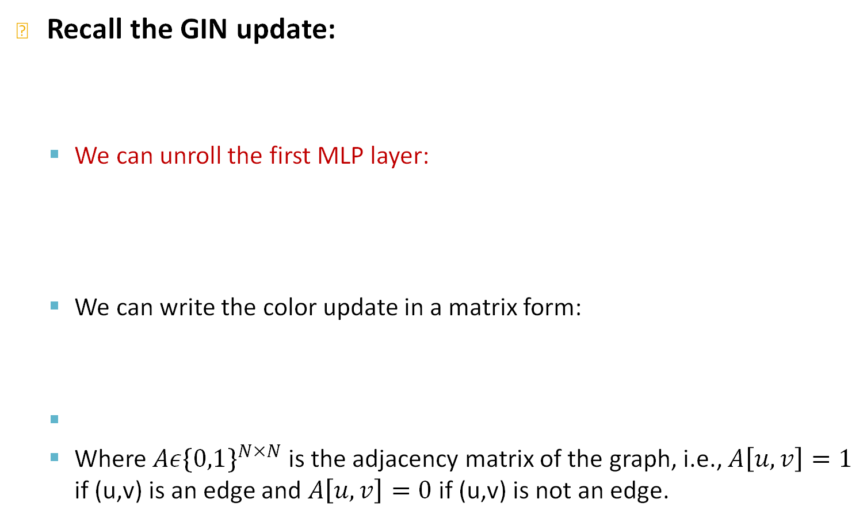
Matrix representation of GIN
Fix this slide. Explain notation. Explain what is going on.
Recall the GIN update:
  We can unroll the first MLP layer:
  We can write the color update in a matrix form:
  Where $Aε{\{0,1\}}^{N×N}$ is the adjacency matrix of the graph, i.e., $A\left[u,v\right]=1$ if (u,v) is an edge and $A\left[u,v\right]=0$ if (u,v) is not an edge.

Slide 21
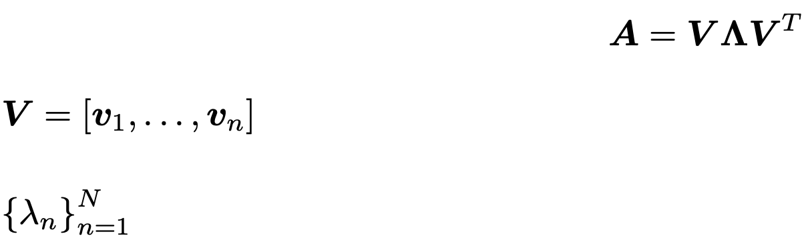
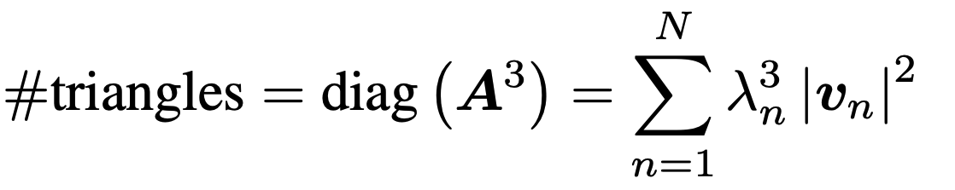
Spectral Graph Representation
Let's compute the eigenvalue decomposition of the graph adjacency matrix A.
is the orthonormal matrix of eigenvectors
I is the diagonal matrix of eigenvalues
  The eigenvalue (spectral) decomposition of the adjacency is a universal characterization of the graph.
  Different graphs have different spectral decompositions
  The number of cycles in a graph can be viewed as functions of eigenvalues and eigenvectors, e.g.,

Slide 22
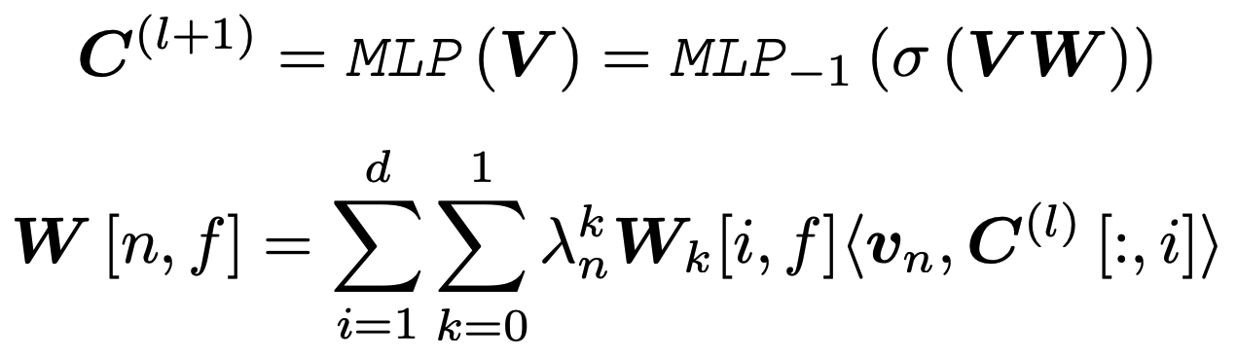
GNN as functions of eigenvectors
We can interpret GIN layers as MLPs operating on the eigenvectors:
If we replace A with the spectral decomposition
The weights of the first MLP layer depend on the eigenvalues and the dot product between the eigenvectors and the colors at the previous level.

Slide 23
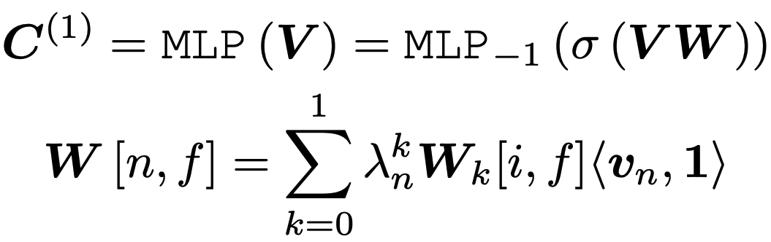
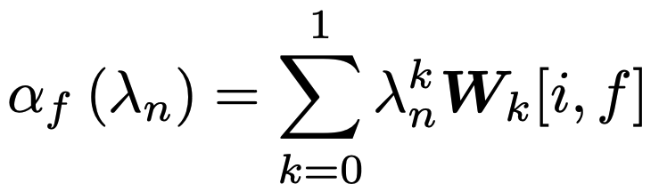
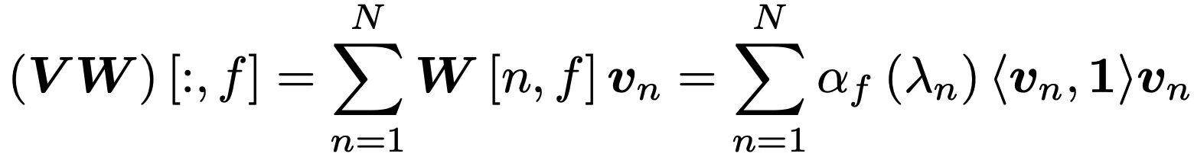
GNN with uniform initial colors
We can interpret GIN layers as MLPs operating on the eigenvectors:
If we zoom in
The new node colors only depend on the eigenvectors that are not orthogonal to 1.
Graphs with symmetries admit eigenvectors orthogonal to 1.

Slide 24
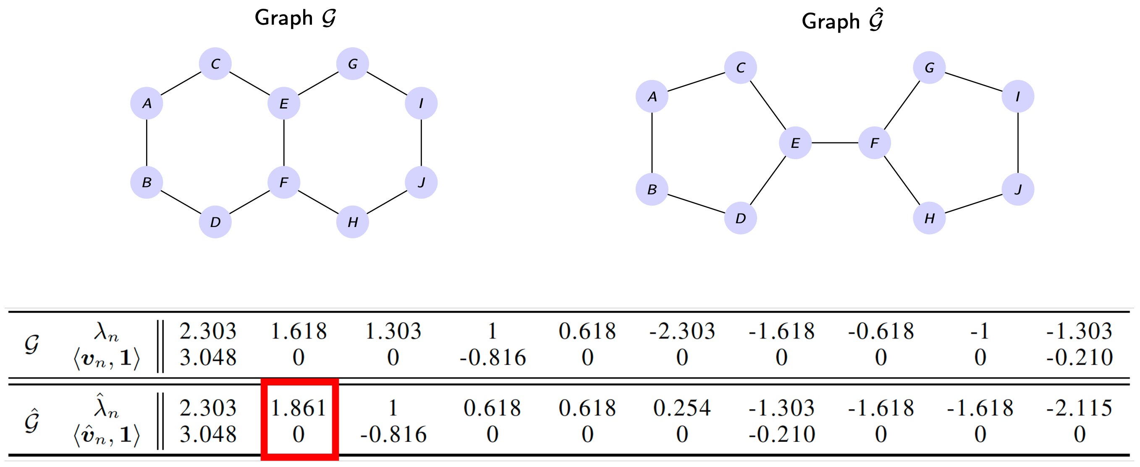
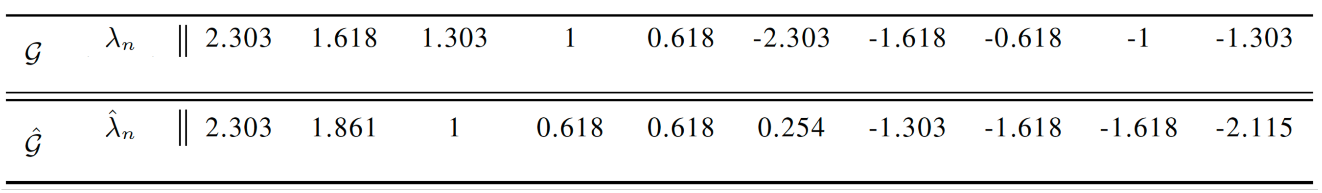
Spectral limitation of the WL kernel
The WL kernel cannot distinguish between some basic graph structures, e.g.,

Slide 25
Spectral limitation of the WL kernel
The WL kernel cannot distinguish between some basic graph structures, e.g.,

Slide 26
Spectral limitation of the WL kernel
The WL kernel cannot count basic graph structures:

Slide 27
Limitations of the WL kernel
Summary: The limitations of the WL kernel are limitations of the initial node color.
  These limitations are well understood in the spectral domain.
    Constant node colorings are orthogonal with adjacency eigenvectors and critical spectral components (eigenvalues and eigenvectors) are omitted.
  In a high level, colors generated by the WL kernel obey the same symmetries as graph structure.
  These joint symmetries lock the message-passing operations to limited representations.

Slide 28
Stanford CS224W:
Feature Augmentation: Structurally-Aware GNNs
CS224W: Machine Learning with Graphs
Jure Leskovec, Stanford University
http://cs224w.stanford.edu
Notes:
Identity-Aware
Graph Neural Networks

Slide 29
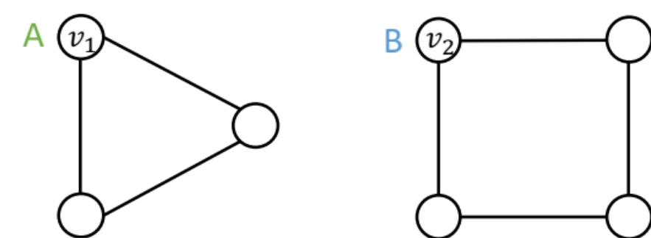
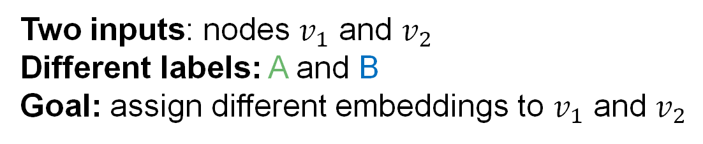
Our Approach
We use the following thinking:
  Two different inputs (nodes, edges, graphs) are labeled differently
  A “failed” model will always assign the same embedding to them
  A “successful” model will assign different embeddings to them
  Embeddings are determined by GNN computational graphs:
Two inputs: nodes $v_{1}$ and $v_{2}$
Different labels: A and B
Goal: assign different embeddings to $v_{1}$ and $v_{2}$

Slide 30
Feature Augmentation on Graphs
Why do we need feature augmentation?
(1) Input graph does not have node features
  This is common when we only have the adj. matrix
Standard approaches:
b) Assign unique IDs to nodes
  These IDs are converted into one-hot vectors
2
One-hot vector for node with ID=5
1
3
ID = 5
6
  [0, 0, 0, 0, 1, 0]
4
5
Total number of IDs = 6

Slide 31
Naïve Solution is not Desirable
A naïve solution: One-hot encoding
  Encode each node with a different ID, then we can always differentiate different nodes/edges/graphs
1000
0100
1000
Input graphs
0001
0100
0010
0001
0100
$$v_{2}$$
Computational graphs are clearly different if each node has a different ID
0001
0010
0100
Computational graphs

Slide 32
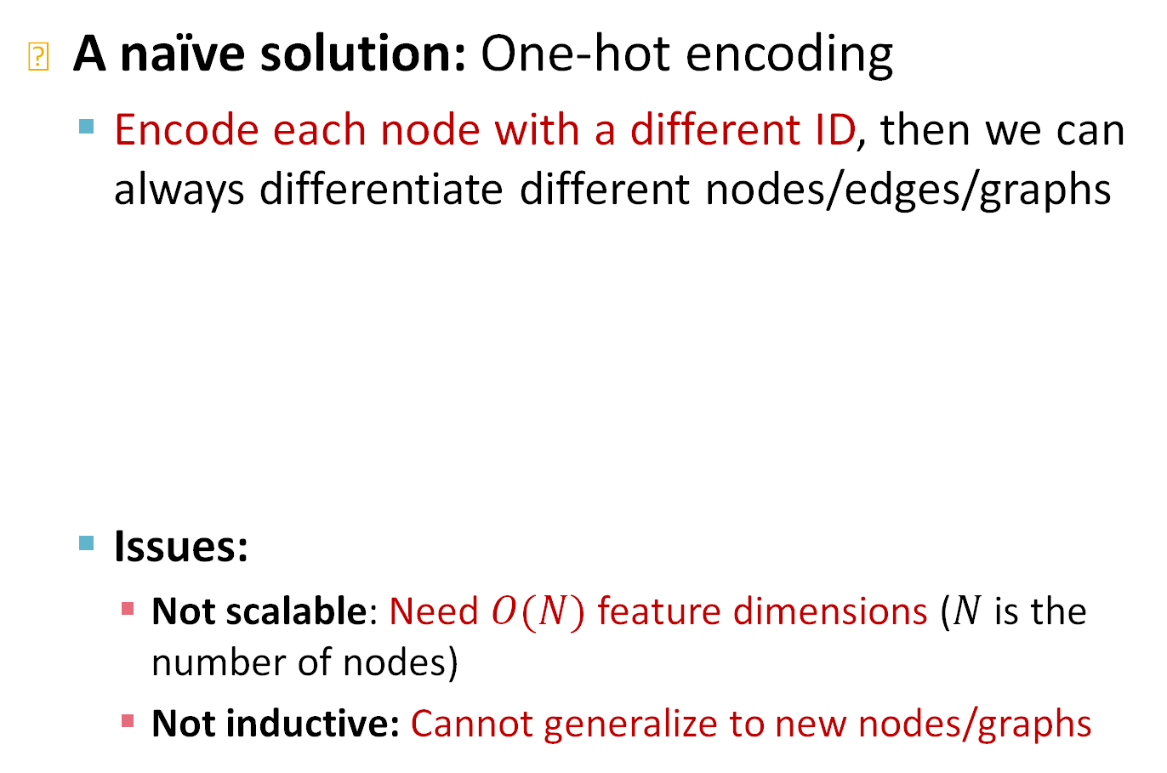
Naïve Solution is not Desirable
A naïve solution: One-hot encoding
  Encode each node with a different ID, then we can always differentiate different nodes/edges/graphs
  Issues:
    Not scalable: Need $O(N)$ feature dimensions ($N$ is the number of nodes)
    Not inductive: Cannot generalize to new nodes/graphs
1000
0100
1000
Input graphs
0001
0100
0010
0001

Slide 33
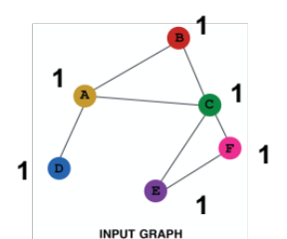
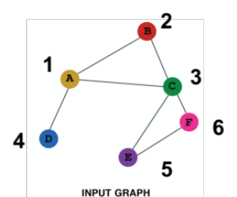
Feature Augmentation on Graphs
Feature augmentation: constant vs. one-hot
 | Constant node feature | One-hot node feature
Expressive power | Medium. All the nodes are identical, but GNN can still learn from the graph structure | High. Each node has a unique ID, so node-specific information can be stored
Inductive learning (Generalize to unseen nodes) | High. Simple to generalize to new nodes: we assign constant feature to them, then apply our GNN | Low. Cannot generalize to new nodes: new nodes introduce new IDs, GNN doesn’t know how to embed unseen IDs
Computational cost | Low. Only 1 dimensional feature | High. High dimensional feature, cannot apply to large graphs
Use cases | Any graph, inductive settings (generalize to new nodes) | Small graph, transductive settings (no new nodes)

Slide 34

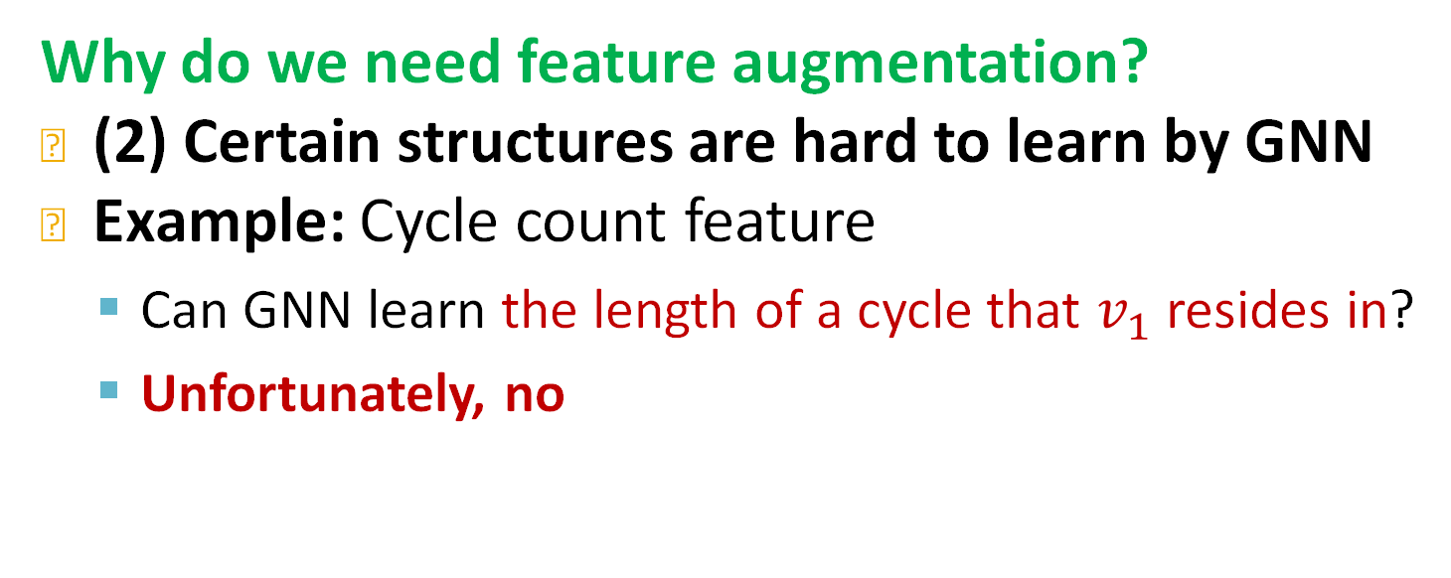



Feature Augmentation on Graphs
Why do we need feature augmentation?
(2) Certain structures are hard to learn by GNN
Example: Cycle count feature
  Can GNN learn the length of a cycle that $v_{1}$ resides in?
  Unfortunately, no
$v_{1}$ resides in a cycle with length 3
$v_{1}$ resides in a cycle with length 4
$$v_{1}$$
$$v_{1}$$

Slide 35


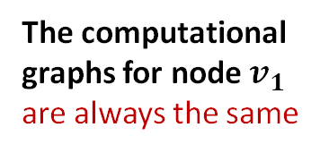
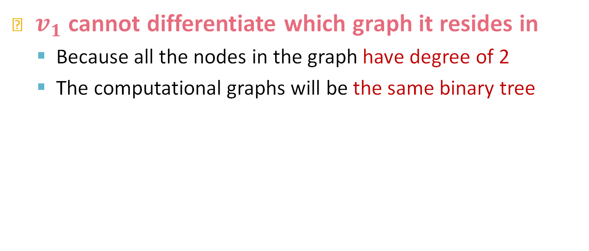
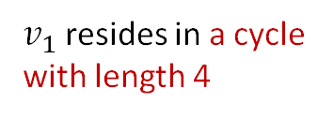



Feature Augmentation on Graphs
$v_{1}$ cannot differentiate which graph it resides in
  Because all the nodes in the graph have degree of 2
  The computational graphs will be the same binary tree
$v_{1}$ resides in a cycle with length 3
$v_{1}$ resides in a cycle with length 4
The computational graphs for node $v_{1}$ are always the same
$$v_{1}$$
$$v_{2}$$
$v_{1}$ resides in a cycle with infinite length
$$…$$
$$v_{1}$$
$$…$$

Slide 36



Feature Augmentation on Graphs
J. You, J. Gomes-Selman, R. Ying, J. Leskovec. Identity-aware Graph Neural Networks, AAAI 2021
Why do we need feature augmentation?
(2) Certain structures are hard to learn by GNN
Solution:
  We can use cycle count as augmented node features
Augmented node feature for $v_{1}$
Augmented node feature for $v_{1}$
We start from cycle with length 0
  [0, 0, 0, 1, 0, 0]
  [0, 0, 0, 0, 1, 0]
$v_{1}$ resides in a cycle with length 3
$v_{1}$ resides in a cycle with length 4
$$v_{1}$$
$$v_{1}$$

Slide 37
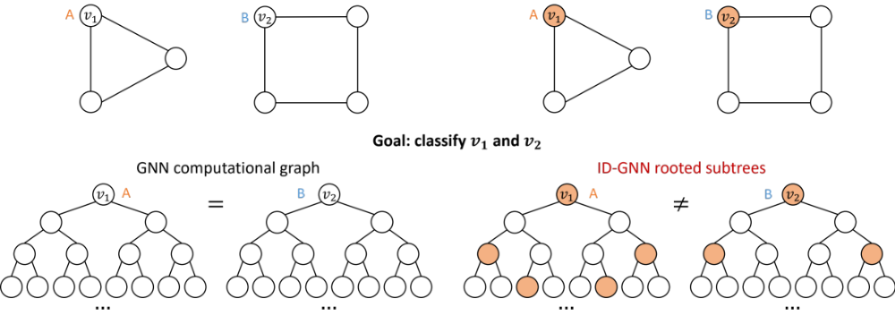


ID-GNN-Fast
J. You, J. Gomes-Selman, R. Ying, J. Leskovec. Identity-aware Graph Neural Networks, AAAI 2021
$$v_{1}$$
$$v_{2}$$
1
0
2
2
1
0
2
0
Cycle count at each level
length-3 cycles = 2
length-3 cycles = 0
Idea: Count cycles originating from a given node, use it as initial feature.
  Include identity information as an augmented node feature
  Use cycle counts in each layer as an augmented node feature. Also can be used together with any GNN

Slide 38
Closed loops as node features
C. Kanatsoulis, A. Ribeiro. Graph Neural Network Are More Powerful Than we Think, ICASSP 2024
We can also use the diagonals of the adjacency powers as augmented node features.
They correspond to the closed loops each node is involved in.
Augmented node feature for $v_{1}$
Augmented node feature for $v_{1}$
  [1, 0, 2, 2, 6, 8]
  [1, 0, 2, 0, 8, 0]
$v_{1}$ resides in a cycle with length 3
$v_{1}$ resides in a cycle with length 4
$$v_{1}$$
$$v_{1}$$

Slide 39
Expressive Power
C. Kanatsoulis, A. Ribeiro. Graph Neural Network Are More Powerful Than we Think, ICASSP 2024
Theorem: If two graphs have adjacency matrices with different eigenvalues, there exists a GNN with closed-loop initial node features that can always tell them apart.
GNNs with structural initial node features can produce different representations for almost all real-world graphs.
GIN with structural initial node features is strictly more powerful than the WL-kernel.

Slide 40
Feature Augmentation on Graphs
Why do we need feature augmentation?
(2) Certain structures are hard to learn by GNN
Other commonly used augmented features:
  Clustering coefficient
  PageRank
  Centrality
  …
Any feature we have introduced in
Lecture 1 can be used!

Slide 41
Feature Augmentation on Graphs
Feature augmentation: constant vs. Structure
 | Constant node feature | Structure-aware node feature
Expressive power | Medium. All the nodes are identical, but GNN can still learn from the graph structure | High. Each node has a structure-aware ID, so node-specific information can be stored
Inductive learning (Generalize to unseen nodes) | High. Simple to generalize to new nodes: we assign constant feature to them, then apply our GNN | High. Simple to generalize to new nodes: can count triangles or closed loops for any graph
Computational cost | Low. Only 1 dimensional feature | Low/High. Depending on the structures we are counting
Use cases | Any graph, inductive settings (generalize to new nodes) | Any graph, inductive settings (generalize new nodes)

Slide 42
Stanford CS224W:
Counting Graph Substructures with GNNs
CS224W: Machine Learning with Graphs
Charilaos Kanatsoulis and Jure Leskovec, Stanford University
http://cs224w.stanford.edu
Notes:
Identity-Aware
Graph Neural Networks

Slide 43
Random samples as node ID's
C. Kanatsoulis, A. Ribeiro. Counting Graph Substructures with Graph Neural Networks, ICLR 2024
Can we count graph substructures with GNNs only?
Assign unique IDs to nodes
  These IDs are represented by random samples
  Each node will be represented by a different set of random variables
2
1
3
Random samples for node 3
6
  [0.2, 1.5, -2.3, -10.1]
4
5
Total number of random samples = 4

Slide 44
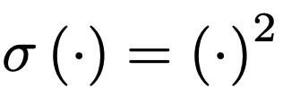
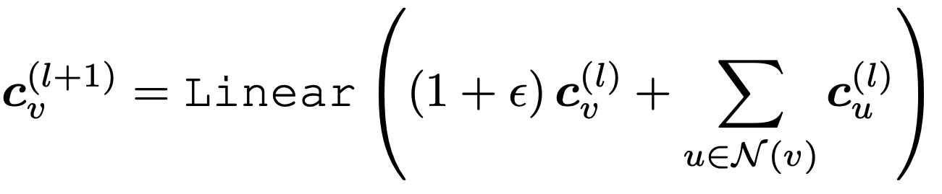
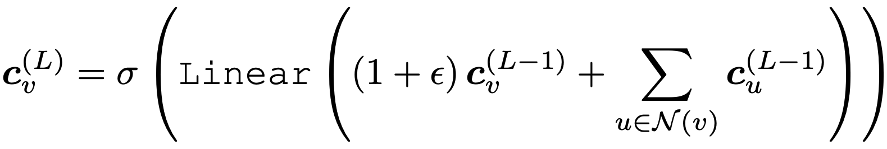
Designing a simple GNN
C. Kanatsoulis, A. Ribeiro. Counting Graph Substructures with Graph Neural Networks, ICLR 2024
We design a simple GNN
  With SUM Aggregations and Linear Message Functions.
  We add a square pointwise nonlinearity in the last layer.

Slide 45
Independent Processing of samples
2
  Node 1 [3.3, -1.7, -1.2, -0.1]
  Node 2 [-0.1, -5.4, 3.0, -9.8]
  Node 3 [0.2, 1.5, -2.3, -10.1]
  Node 4 [0.5, 1.9, -12.7, 11.1]
  Node 5 [5.1, -0.7, -2.9, -13.5]
  Node 6 [-1.2, 7.5, -0.3, -7.9]
1
3
6
4
5

Slide 46
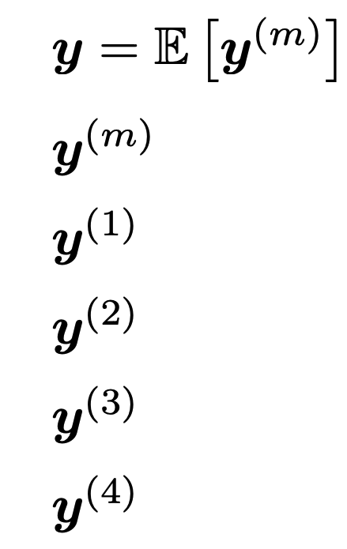
Independent Processing of samples
2
  Node 1 [3.3, -1.7, -1.2, -0.1]
  Node 2 [-0.1, -5.4, 3.0, -9.8]
  Node 3 [0.2, 1.5, -2.3, -10.1]
  Node 4 [0.5, 1.9, -12.7, 11.1]
  Node 5 [5.1, -0.7, -2.9, -13.5]
  Node 6 [-1.2, 7.5, -0.3, -7.9]
1
3
6
4
5
-0.1
3.3
0.2
GNN
-1.2
0.5
5.1

Slide 47
Independent Processing of samples
  Node 1 [3.3, -1.7, -1.2, -0.1]
  Node 2 [-0.1, -5.4, 3.0, -9.8]
  Node 3 [0.2, 1.5, -2.3, -10.1]
  Node 4 [0.5, 1.9, -12.7, 11.1]
  Node 5 [5.1, -0.7, -2.9, -13.5]
  Node 6 [-1.2, 7.5, -0.3, -7.9]
-0.1
3.3
0.2
GNN
-1.2
0.5
5.1
-9.8
-0.1
-10.1
GNN
-7.9
11.1
-13.5

Slide 48
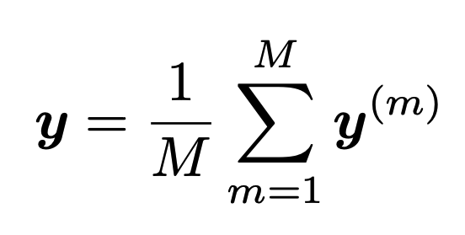
Counting Cycles with GNNs
C. Kanatsoulis, A. Ribeiro. Counting Graph Substructures with Graph Neural Networks, ICLR 2024
To maintain inductive capability the final output:
  Which in practice is computed as:
  We can show that the previous procedure computes the closed loops of a graph:
  And a GNN can break the limits of the WL kernel and count important substructures in the graph.

Slide 49
Stanford CS224W: Position-aware
Graph Neural Networks
CS224W: Machine Learning with Graphs
Jure Leskovec, Stanford University
http://cs224w.stanford.edu
Notes:
Now we will talk about.... that can do these shortest path/google maps types of tasks.

Slide 50
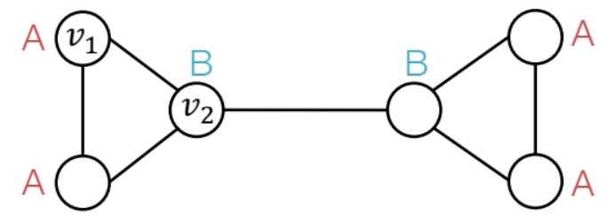
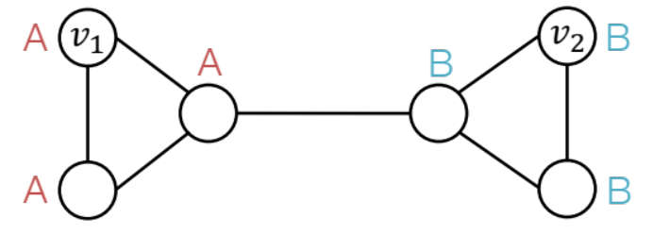
Two Types of Tasks on Graphs
J. You, R. Ying, J. Leskovec. Postion-aware Graph Neural Networks, ICML 2019
There are two types of tasks on graphs
Nodes are labeled by their structural roles in the graph
Nodes are labeled by their positions in the graph
Structure-aware task
Position-aware task
Notes:
We haven't talked much about graph task in terms of graph structure.
So far we have built GNNs that are very good at structure-aware tasks, meaning that they produce node embeddings the encode the local neighborhood of each node. Automorphic nodes. For example here you might have a small molecule and you want to know if ot will bind to some target, and binding probably depends on whether you are at the edge or middle of the graph, so what is relevant is are you on the outside or inside of the graph.
You might have a citation network were papers are citing each other here we have a community of ML papers and a community of medical papers and a new paper comes in and you will assign a label not accoring to the local structure but the community it belongs to.

Slide 51
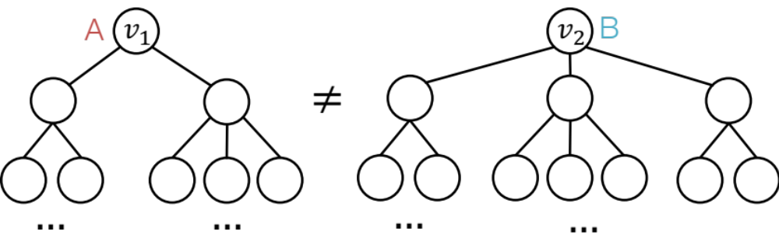
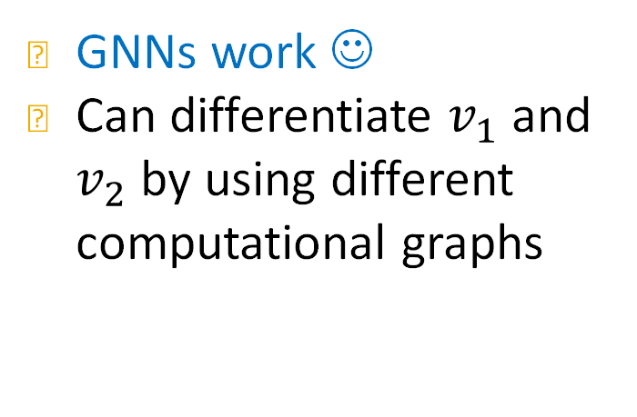
Structure-aware Tasks
We showed how to design GNNs to work well for structure-aware tasks
Structure-aware task
GNNs work ☺
Can differentiate $v_{1}$ and $v_{2}$ by using different computational graphs
Notes:
If the computation graphs ae the same but local neighborhoods are different we discussed about ways to overcome that.

Slide 52
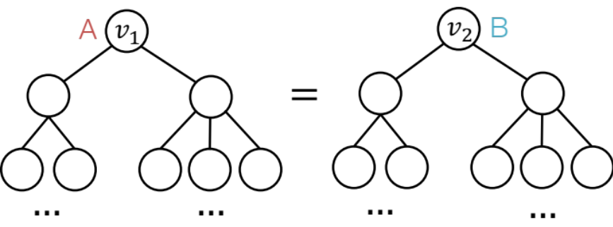
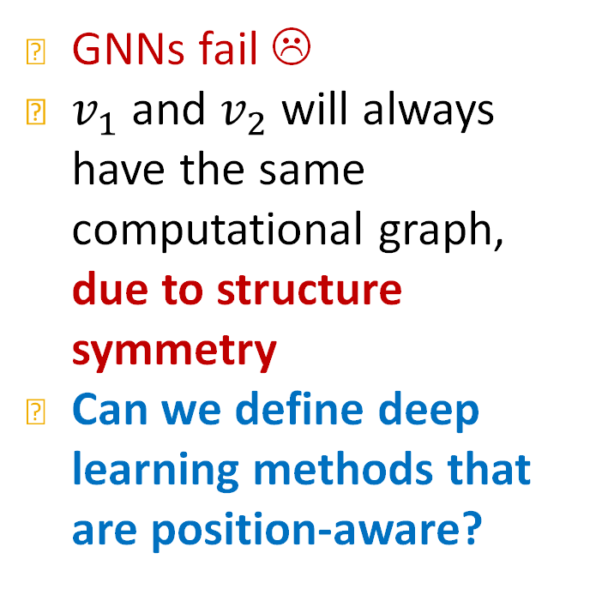
Position-aware Tasks
GNNs will always fail for position-aware tasks
GNNs fail ☹
$v_{1}$ and $v_{2}$ will always have the same computational graph, due to structure symmetry
Can we define deep learning methods that are position-aware?
Position-aware task
Notes:
Position-aware is really challenging, our current models are simply not able to learn position, because these two nodes, will always have the same computation graph no matter if we do any of the previous tricks because after all they are completely symmetric.
And somehow we want to break this symmetry

Slide 53
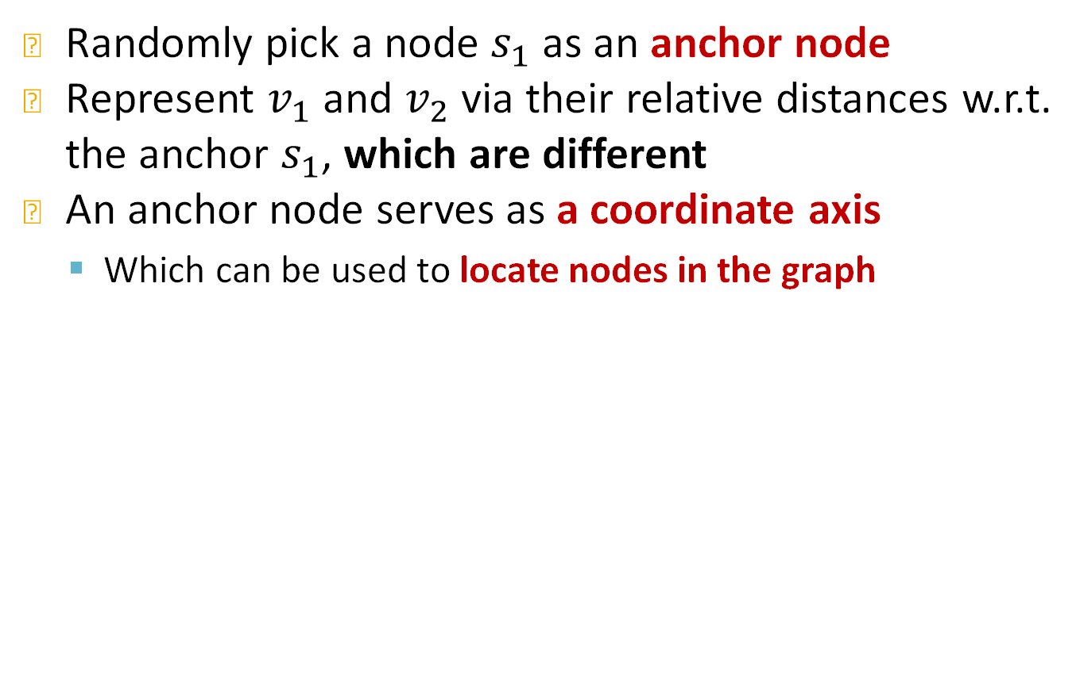
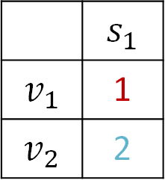



Power of “Anchor”
Randomly pick a node $s_{1}$ as an anchor node
Represent $v_{1}$ and $v_{2}$ via their relative distances w.r.t. the anchor $s_{1}$, which are different
An anchor node serves as a coordinate axis
  Which can be used to locate nodes in the graph
Relative Distances
A
$$v_{1}$$
$$v_{2}$$
B
A
B
 | $$s_{1}$$
$$v_{1}$$ | 1
$$v_{2}$$ | 2
$$s_{1}$$
A
B
Anchor
Notes:
One way to overcome this problem is to introduce a notion of distance in the graph, which we can do with respect to an anchor. So we say aha node s1 is our anchor and we will measure elative distances in the graph with respect to that anchor.
Although these two nodes are structurally equivalent, if you think them with respect to some distance from an anchor, we can differentiate them
Feature

Slide 54






Power of “Anchors”
Pick more nodes $s_{1}, s_{2}$ as anchor nodes
Observation: More anchors can better characterize node position in different regions of the graph
Many anchors –> Many coordinate axes
Relative Distances
A
$$v_{1}$$
$$v_{2}$$
B
 | $$s_{1}$$ | $$s_{2}$$
$$v_{1}$$ | 1 | 2
$$v_{2}$$ | 2 | 1
A
B
$$s_{1}$$
$$s_{2}$$
A
B
Anchor
Anchor
Notes:
And of course we can do more than one anchor
And can start have a list of features for node 1 and node 2 that are different from one another, and these are distances

Slide 55







Power of “Anchor-sets”
Generalize anchor from a single node to a set of nodes
  We define distance to an anchor-set as the minimum distance to all the nodes in the ancho-set
Observation: Large anchor-sets can sometimes provide more precise position estimate
  We can save the total number of anchors
Relative Distances
A
$$v_{1}$$
B
A
B
 | $$s_{1}$$ | $$s_{2}$$ | $$s_{3}$$
$$v_{1}$$ | 1 | 2 | 1
$$v_{3}$$ | 1 | 2 | 0
$$s_{1}$$
$$s_{2}$$
$$s_{3}$$
A
$$v_{3}$$
B
Anchor
Size-2
Anchor-set
Anchor $s_{1}$, $s_{2}$ cannot differentiate node $v_{1}$, $v_{3}$, but anchor-set $s_{3}$ can
Notes:
And what we can do is

Slide 56

Anchor Set: Theory
Goal: Embed the metric space $\left(V, d\right)$ into the Euclidian space $ℝ^{k}$ such that the original distance metric is preserved.
  For every node pairs $u,v∈V$, the Euclidian embedding distance ${\left\|z_{u}−z_{v}\right\|}_{2}$ is close to the original distance metric $d\left(u,v\right)$.

Slide 57

Anchor Set: Theory
Bourgain Theorem [Informal] [Bourgain 1985]
  Consider the following embedding function of node $v∈V$.
  $$f\left(v\right)=\left(d_{min}\left(v,S_{1,1}\right),d_{min}\left(v,S_{1,2}\right),…,d_{min}\left(v,S_{log n,clog n}\right)\right)∈ℝ^{c\log^{2}{n}}$$
  where
    $c$ is a constant.
    $S_{i,j}⊂V$ is chosen by including each node in $V$ independently with probability $\frac{1}{2^{i}}$.
    $d_{min}\left(v,S_{i,j}\right)≡\min_{u∈S_{i,j}}{d\left(v,u\right)}$.
  The embedding distance produced by $f$ is provably close to the original distance metric $\left(V, d\right)$.
Notes:
We sample logarithmically many along the I axis, we sample logarithmically many along the j axis, I defines how likely it's node is and j is just repeated samples with the same likelihood probability
I is the same probability, j says that we sample with the same probability j times, and you can built for this node a relatively big feature vector

Slide 58

Anchor Set: Theory
P-GNN follows the theory of Bourgain theorem
  First samples $O(\log^{2}{n})$ anchor sets $S_{i,j}$.
  Embed each node $v$ via
    $\left(d_{min}\left(v,S_{1,1}\right),d_{min}\left(v,S_{1,2}\right),…,d_{min}\left(v,S_{log n,clog n}\right)\right)∈ℝ^{c\log^{2}{n}}$.
P-GNN maintains the inductive capability
  During training, new anchor sets are re-sampled every time.
  P-GNN is learned to operate over the new anchor sets.
  At test time, given a new unseen graph, new anchor sets are sampled.
Notes:
This gives as a recipe on designing GNNs with these positional features. We sample logarithmically many along the I axis, we sample logarithmically many along the j axis, I defines how likely it's node is and j is just repeated samples with the same likelihood
This node is now positionally aware, and if you add this node as feature to the GNN, this GNN now knows how to distinguish between these nodes
You maintain this inductive capability because at each gradient step you sample the anchor set, and when you sample again during test time you are somehow within distribution
This gives you a set of features for each node and you can add them as extra features to the GNN

Slide 59








Position Information: Summary
Position encoding for graphs: Represent a node’s position by its distance to randomly selected anchor-sets
  Each dimension of the position encoding is tied to an anchor-set
A
$$v_{1}$$
B
A
B
 | $$s_{1}$$ | $$s_{2}$$ | $$s_{3}$$
$$v_{1}$$ | 1 | 2 | 1
$$v_{3}$$ | 1 | 2 | 0
$$s_{1}$$
$$s_{2}$$
$v_{1}$’s Position encoding
$$s_{3}$$
$v_{3}$’s Position encoding
A
$$v_{3}$$
B
Anchor
Size-2
Anchor-set

Slide 60
How to Use Position Information
The simple way: Use position encoding as an augmented node feature (works well in practice)
  Issue: Since each dimension of position encoding is tied to a random anchor set, dimensions of positional encoding can be randomly permuted, without changing its meaning
  Imagine you permute the input dimensions of a normal NN, the output will surely change

Slide 61

How to Use Position Information
The rigorous solution: Requires a special NN that can maintain the permutation invariant property of position encoding
  Permuting the input feature dimension will only result in the permutation of the output dimension, the value in each dimension won’t change
  Position-aware GNN paper has more details
Notes:
DeepSet

Slide 62
ID-GNN Experiments
Since ID-GNN naturally extends GNN, it can be applied to all the GNN tasks we have learned
 | Graph Property Prediction | Real-world Prediction
Node level | Node clustering coefficient 4 datasets | Node classification 2 datasets
Edge Level | Shortest path distance between pair of nodes 4 datasets | Link prediction 4 datasets
Graph Level | Graph clustering coefficient 2 datasets | Graph classification 4 datasets

Slide 63
ID-GNN Experiments
Select 4 base GNN architectures:
  GCN, GraphSAGE, GAT, GIN
Consider 3 variants for each architecture:
  GNN
  ID-GNN-Fast: Cycle counts as additional node features
  ID-GNN-Full: Full version, use heterogenous message passing
Apply to 3 levels of tasks:
  Node / Edge / Graph level
Fair comparison:
  Fix all the hyperparameters
  Control the computational budget for all the models to be the same

Slide 64

ID-GNNs are Superior to GNNs
ID-GNNs consistently outperform GNNs in graph property prediction tasks
3 levels of tasks, each with different datasets
3 types of models, each with 4 base architectures
ID-GNNs vs GNNs:
40% improvement on average

Slide 65

ID-GNNs are Superior to GNNs
ID-GNNs consistently outperform GNNs in real-world prediction tasks
3 levels of tasks, each with different datasets
3 types of models, each with 4 base architectures
ID-GNNs vs GNNs:
8% improvement on average

Slide 66


Review: GCN (mean-pool)
Given: Graph $G=(V, E)$ with input node feat. $X_{v}$ for $v∈V$, where $E$ includes the self-loop.
  $\left(v,v\right)∈E$ for all $v∈V$.
Set input node embeddings: $h_{v}^{(0)}=X_{v}$ for $v∈V$.
For $k$ $∈\left\{0,…,K−1\right\}$,
  For all $v∈V$, aggregate neighboring info. as
  $h_{v}^{(k+1)}=ReLU\left(W_{k} \frac{1}{|N\left(v\right)|}\sum_{u∈N\left(v\right)}{h_{u}^{(k)}}\right)$
Final node embedding: $z_{v}=h_{v}^{(K)}$
$$v$$
Learnable weight matrix
Mean-pooling

Slide 67





Review: Matrix Formulation of GCN
GCN aggregations can be formulated as matrix vector product.
Let $H^{(k)}=[h_{1}^{(1)}…h_{|V|}^{(k)}]^{T}$
Let $A$ be the adjacency matrix (w/ self-loop)
Then: $\sum_{u∈N(v)}{h_{u}^{(k)}}=A_{v,:}H^{(k)}$
Let $D$ be diagonal matrix where
$D_{v,v}=Deg\left(v\right)=|N\left(v\right)|$
  The inverse of $D$: $D^{−1}$ is also diagonal:
  $D_{v,v}^{−1}=1/|N\left(v\right)|$
Therefore,
Matrix of hidden embeddings $H^{(k)}$
$$h_{i}^{(k)}$$
$$\frac{1}{|N\left(v\right)|}\sum_{u∈N\left(v\right)}{h_{u}^{(k)}}$$
$$H^{(l+1)}=D^{−1}AH^{(l)}$$

Slide 68

Review: Matrix Formulation of GCN
GCN’s neighbor aggregation
$h_{v}^{(k+1)}=ReLU\left(W_{k}\frac{1}{|N\left(v\right)|}\sum_{u∈N\left(v\right)}{h_{u}^{(k)}}\right)$
In matrix form:
  $$H^{(k+1)}=ReLU\left(\tilde{A}H^{(k)}W_{k}^{T}\right)$$
where$\tilde{A}=D^{−1}A$.
Note: The original GCN uses re-normalized version: $\tilde{A}=D^{−1/2}AD^{−1/2}.$
  Empirically, this version of $\tilde{A}$ often gives better performance than $D^{−1}A$.

Slide 69

Review: GCN for Node Classification
2-layer GCN for $C$-class node classification :
$f_{θ}(A, X)=softmax\left(\tilde{A} ReLU\left(\tilde{A}XW_{1}\right)W_{2}\right)$,
where
  $θ=\{W_{1},W_{2}\}$ is all learnable parameters
  The softmax outputs the class probability distribution for every node:
    $f_{θ}\left(A, X\right)∈$ $ℝ^{|V|×C}$: class probability matrix of nodes in $V$.
    $f_{θ}{\left(A, X\right)}_{v}∈ℝ^{C}$ is the class probability for node $v$
    ${X∈ℝ^{|V|×D_{0}}, W}_{1}∈ℝ^{D_{1}×D_{0}}, W_{2}∈ℝ^{C×D_{1}}$
Prediction linear-layer

Slide 70

Review: GCN Training and Inference
During training, minimize the cross-entropy loss over the training nodes $V_{train}⊂V$:
  $ℒ_{train}\left(θ;A, X\right)=\sum_{v∈V_{train}}{−\log{f_{θ}{\left(A, X\right)}_{v,c_{v}} }}$
  where $c_{v}∈\{1, …, C\}$ is the ground-truth class of node $v$.
Let $θ^{∗}={argmin}_{θ}ℒ_{train}\left(θ;A, X\right)$ be the learned GCN parameter.
At inference time, for node $v$:
  Apply the learned GCN
  Predict the class $c_{v}^{∗}={argmax}_{c}f_{θ^{∗}}{\left(A, X\right)}_{v,c }$

