Slide 1

Stanford CS224W:
Graph Transformers
Note to other teachers and users of these slides: We would be delighted if you found our material useful for giving your own lectures. Feel free to use these slides verbatim, or to modify them to fit your own needs. If you make use of a significant portion of these slides in your own lecture, please include this message, or a link to our web site: http://cs224w.Stanford.edu
CS224W: Machine Learning with Graphs
Charilaos Kanatsoulis and Jure Leskovec, Stanford University
http://cs224w.stanford.edu

Slide 2
Announcements
Homework 1 due today
  Late submissions accepted until end of day Monday, 10/21
Regrade request deadlines
  Colab 1: Thursday, 10/24
    Solutions and statistics released on Ed

Slide 3
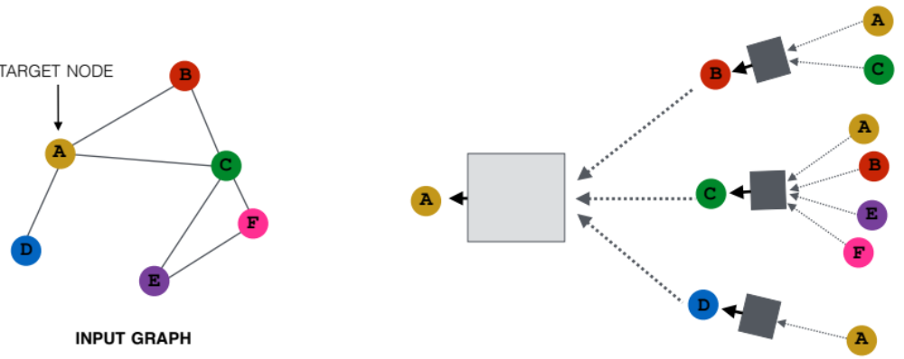
Recap: A General GNN Framework
J. You, R. Ying, J. Leskovec. Design Space of Graph Neural Networks, NeurIPS 2020c
(5) Learning objective
(2) Aggregation
GNN Layer 2
(1) Message
(3) Layer connectivity
GNN Layer 1
(4) Graph augmentation

Slide 4
Recap: A General GNN Framework
J. You, R. Ying, J. Leskovec. Design Space of Graph Neural Networks, NeurIPS 2020c
We know a lot about the design space of GNNs
What does the corresponding design space for Graph Transformers look like?
GNN design space
Graph Transformer design space
(5) Learning objective
?
(2) Aggregation
GNN Layer 2
(1) Message
GNN Layer 1
(3) Layer connectivity
(4) Graph augmentation

Slide 5
Stanford CS224W:
Intro to Transformers
CS224W: Machine Learning with Graphs
Charilaos Kanatsoulis and Jure Leskovec, Stanford University
http://cs224w.stanford.edu

Slide 6

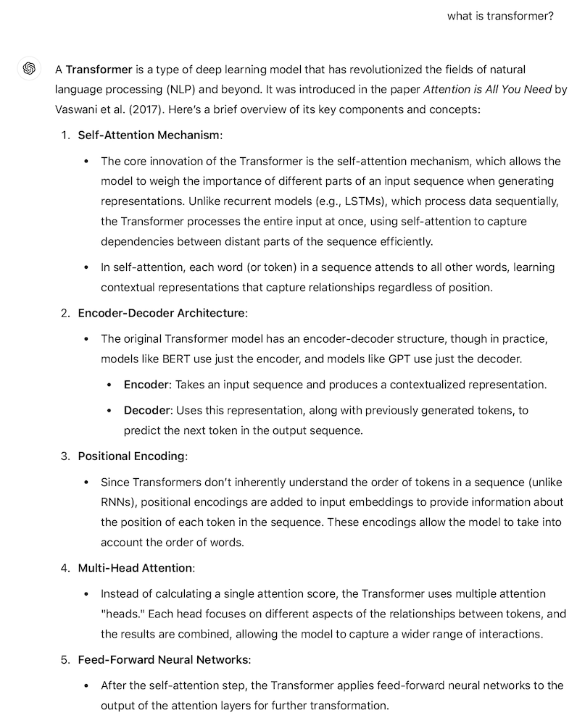
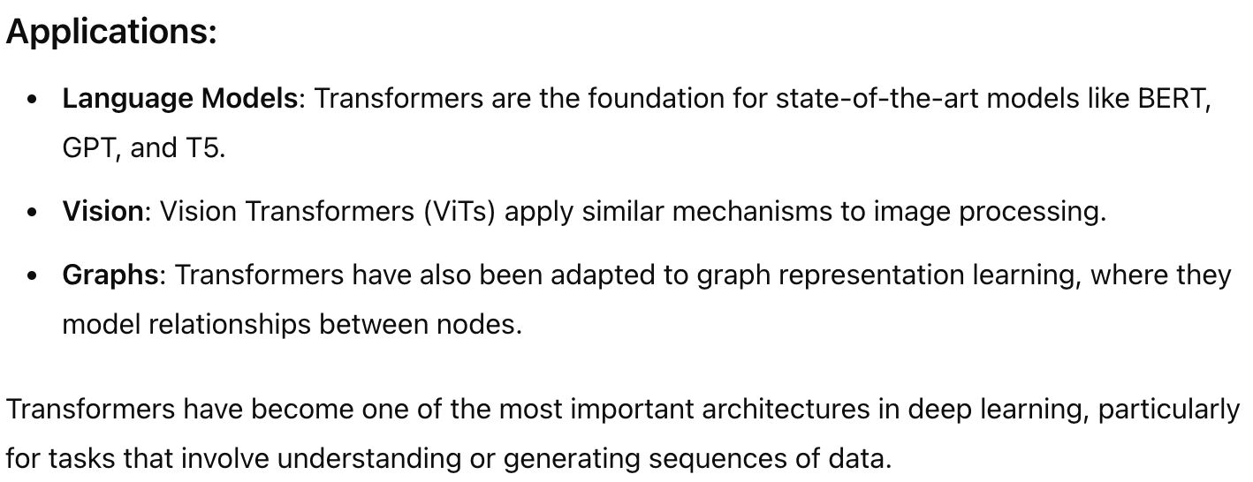
The Backbone of Generative AI
Notes:
This morning I was wavering on how to motivate you on such a hot topic, but then I thought why not asking my favorite transformer what a transformer
And the answer was

Slide 7
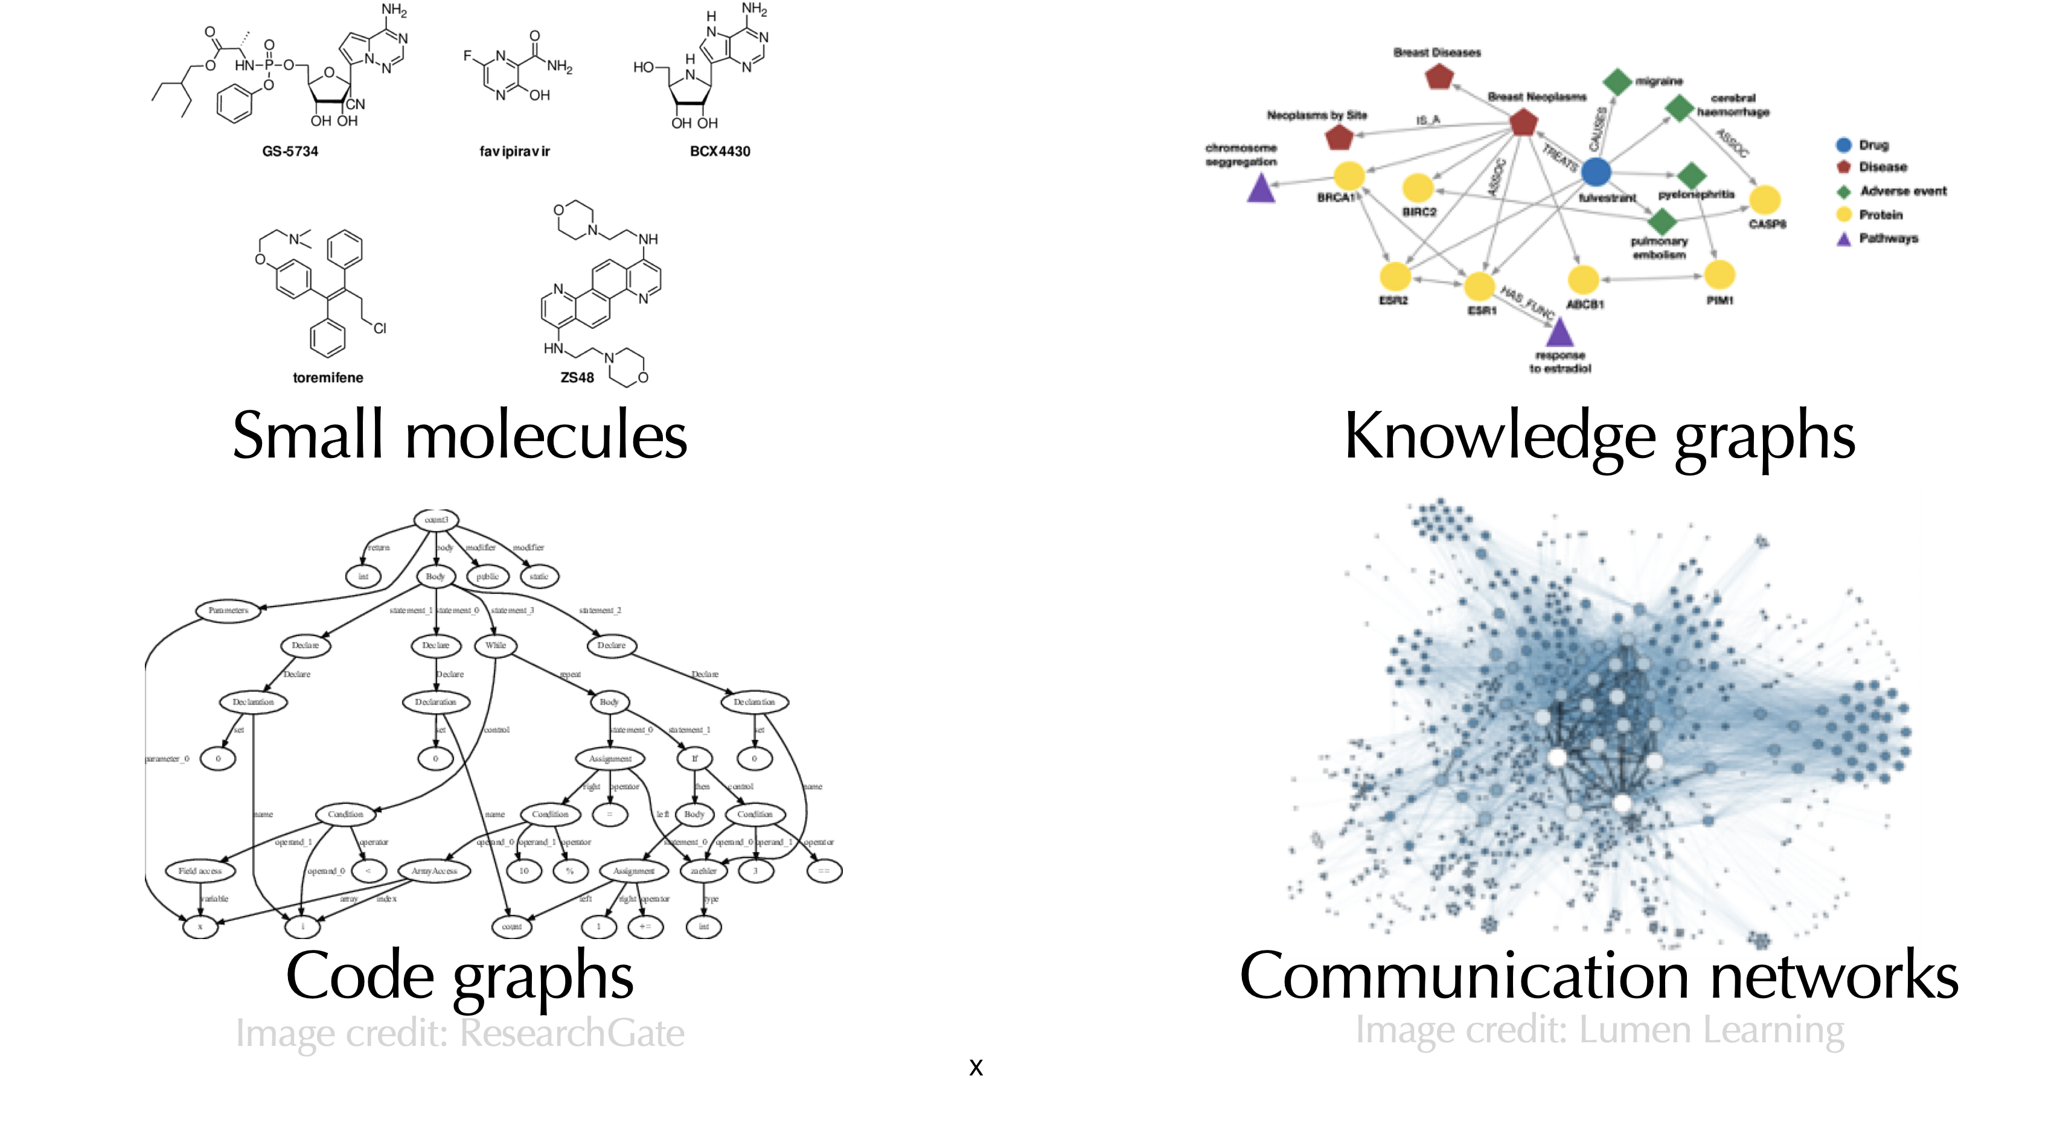
Goal: Bring Power of Transformers to Graphs
There is lots of multi-billon node/graph scale data to learn from
Notes:
What we need to make transformers work is data, and we do have a huge amount of graph data, e.g., we have billions of molecules from multiple data sources, we have massive social networks, and knowledge graphs. So overall there is an avalanche of graph data from multiple and diverse high-impact domains

Slide 8
Plan for Today
Part 1:
  Introducing Transformers
  Relation to message passing GNNs
Part 2:
  A new design landscape for graph Transformers
Part 3 (time permitting):
  Sign invariant Laplacian positional encodings for graph Transformers

Slide 9
Stanford CS224W: Transformers
CS224W: Machine Learning with Graphs
Jure Leskovec, Stanford University
http://cs224w.stanford.edu

Slide 10








Transformers Ingest Tokens
Transformers map 1D sequences of vectors to 1D sequences of vectors
OUTPUT
Transformer
Tokens
$$x_{1}$$
$$x_{2}$$
$$x_{3}$$
$$x_{4}$$
$$x_{5}$$
$$x_{6}$$
$$x_{7}$$
$$x_{8}$$
The
cat
sat
on
the
mat
and
sang
INPUT
Notes:
Transformer is a function that takes as input a sequence of tokens and it produces at the output another sequence of vectors or tokens/embedding for each token. In the context of language these tokens correspond to pieces of data, words or subword, and the question is what is the output.

Slide 11







Transformers Ingest Tokens
Transformers map 1D sequences of vectors to 1D sequences of vectors known as tokens
  Tokens describe a ”piece” of data – e.g., a word
What output sequence?
  Option 1: next token => GPT
Next token
cat
sat
on
the
mat
and
sang
OUTPUT
$$x_{2}$$
$$x_{3}$$
$$x_{4}$$
$$x_{5}$$
$$x_{6}$$
$$x_{7}$$
$$x_{8}$$
Transformer
Tokens
$$x_{1}$$
$$x_{2}$$
$$x_{3}$$
$$x_{4}$$
$$x_{5}$$
$$x_{6}$$
$$x_{7}$$
$$x_{8}$$
The
cat
sat
on
the
mat
and
sang
INPUT
Notes:
One option is that the output is another sequence of tokens, and the task here is next token prediction the-->cat, cat--> sat, and as most of you know this is how this is how the gpt model is being trained.

Slide 12
Transformers Ingest Tokens
Transformers map 1D sequences of vectors to 1D sequences of vectors known as tokens
  Tokens describe a ”piece” of data – e.g., a word
What output sequence?
  Option 1: next token => GPT
  Option 2: pool (e.g., sum-pool) to get sequence level-embedding (e.g., for classification task)
Sum pool
Predict: kids story
OUTPUT
Transformer
Tokens
$$x_{1}$$
$$x_{2}$$
$$x_{3}$$
$$x_{4}$$
$$x_{5}$$
$$x_{6}$$
$$x_{7}$$
$$x_{8}$$
The
cat
sat
on
the
mat
and
sang
INPUT
Notes:
This is not the only use of a transformer, the transformer can also be used for classification, and in that case the transformer produces and embedding for each token and then we can use the embeddings of each token, combine them into an embedding via a sum pooling function and classify thi

Slide 13
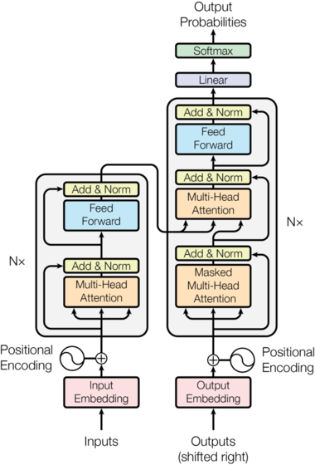
Transformer Blueprint
How are tokens processed?
Lots of components
  Normalization
  Feed forward networks
  Positional encoding (more later)
  Multi-head self-attention
What does self-attention block do?
Notes:
For those of you that have read the original transformer paper, there is this super famous diagram that involve four basic components

Slide 14
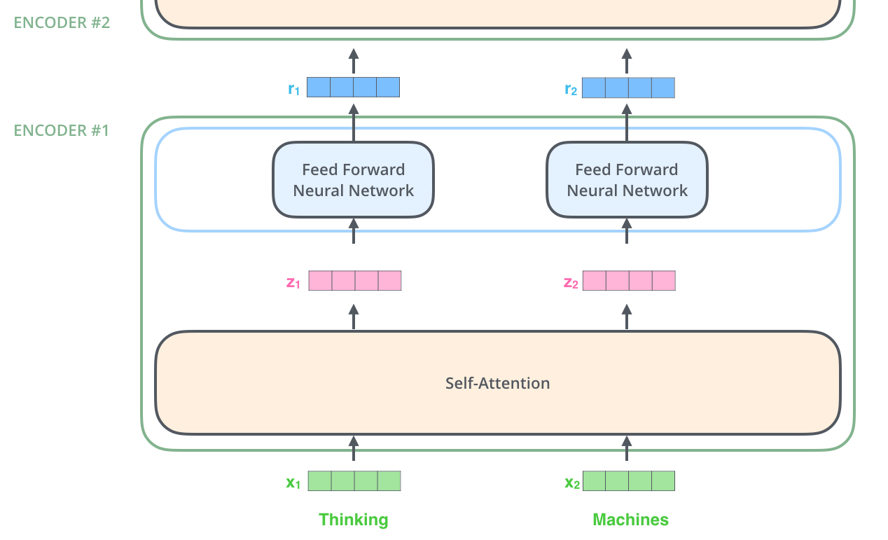
Self-attention
Before “multi-head” self-attention, what is “single head” self-attention?
See: Illustrated Transformer tutorial, https://jalammar.github.io/illustrated-transformer/
Notes:
Before multi-head let's see what single head attention does. Like the transformer itself, takes as input a sequence of tokens or vectors and outputs a sequence of embeddings

Slide 15
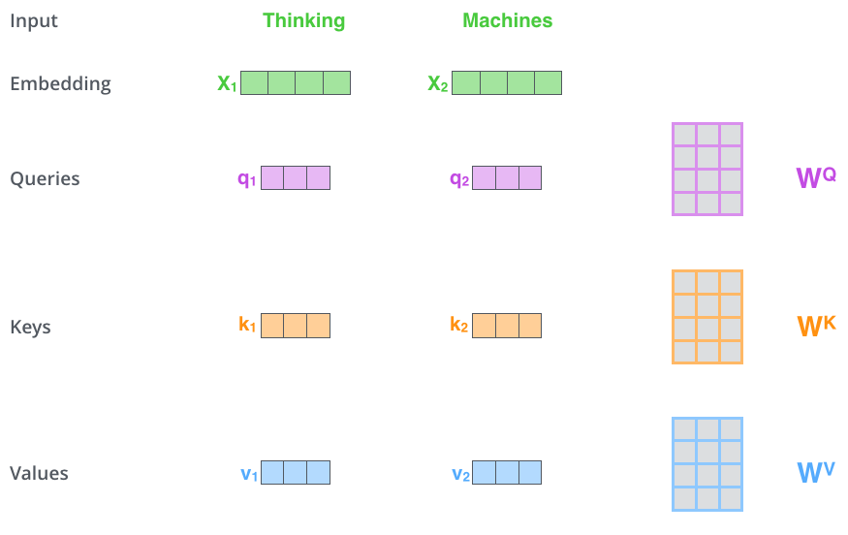
Self-attention
Step 1: compute “key, value, query” for each input
Step 1
Model parameters
See: Illustrated Transformer tutorial, https://jalammar.github.io/illustrated-transformer/
Notes:
Compute a q k v for each of the tokens and these q,k,v are nothing but a linear projection of the token embeddings, or in simpler words we multiply x1 by matrix and x2 by. So given a sequqnce of vectors you produce three vectors for each one

Slide 16
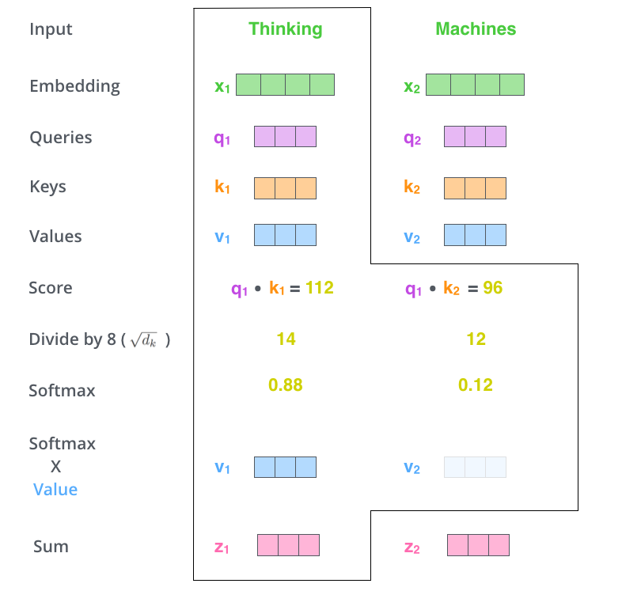
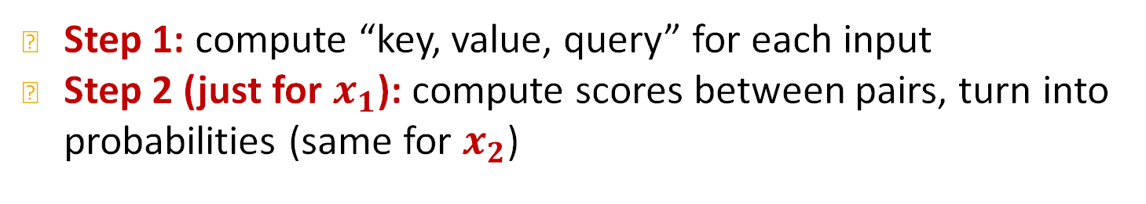
Self-attention
Step 1: compute “key, value, query” for each input
Step 2 (just for $x_{1}$): compute scores between pairs, turn into probabilities (same for $x_{2}$)
Step 1
Step 2
Model parameters
(num heads)
See: Illustrated Transformer tutorial, https://jalammar.github.io/illustrated-transformer/
Notes:
In the second step you take the query of the first token and you compare it to the keys of all token, and this comparison happens with the dot product first, so
We get some score that model how relevant a token is with respect to another token, to understanding another token
The next step is normalization to get a probability distribution with all other tokens, and you can interpet it as the probability distribution of two tokens coocuring but this is not exactly that.

Slide 17
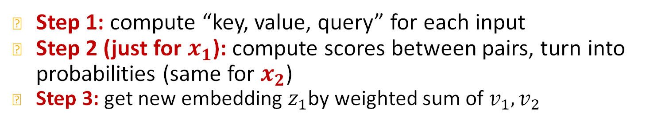
Self-attention
Step 1: compute “key, value, query” for each input
Step 2 (just for $x_{1}$): compute scores between pairs, turn into probabilities (same for $x_{2}$)
Step 3: get new embedding $z_{1}$by weighted sum of $v_{1},v_{2}$
Step 1
Step 2
Step 3
$$z_{1}=0.88v_{1}+0.12v_{2}$$
See: Illustrated Transformer tutorial, https://jalammar.github.io/illustrated-transformer/
Notes:
In step 3 now we compute a new embedding for each token as a convex combination of all other tokens. And you don't sum the x's but you some the values. And you can do the same for x2

Slide 18
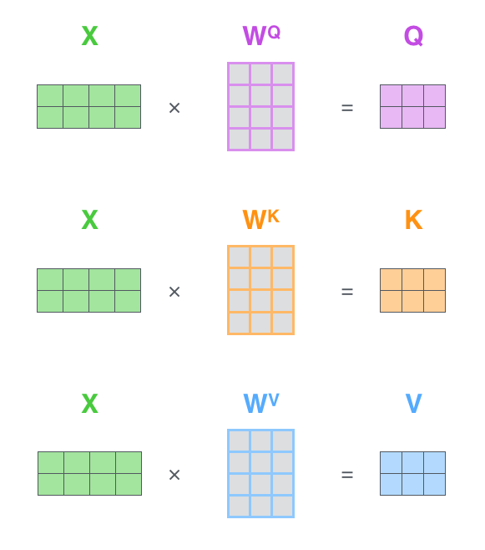
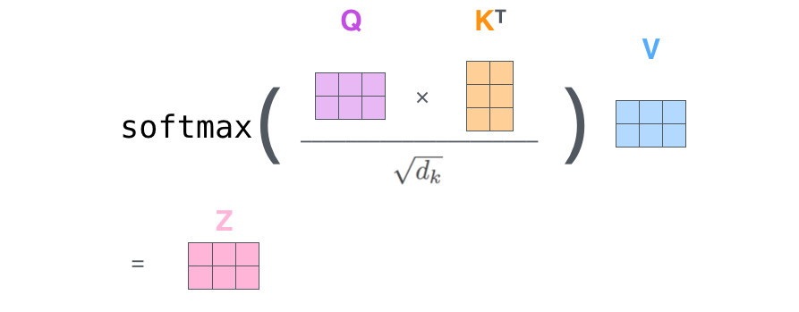
Self-attention
Same calculation in matrix form
Step 1
Step 2
Step 3
Model parameters
See: Illustrated Transformer tutorial, https://jalammar.github.io/illustrated-transformer/
Notes:
This can also be written in a matrix form

Slide 19
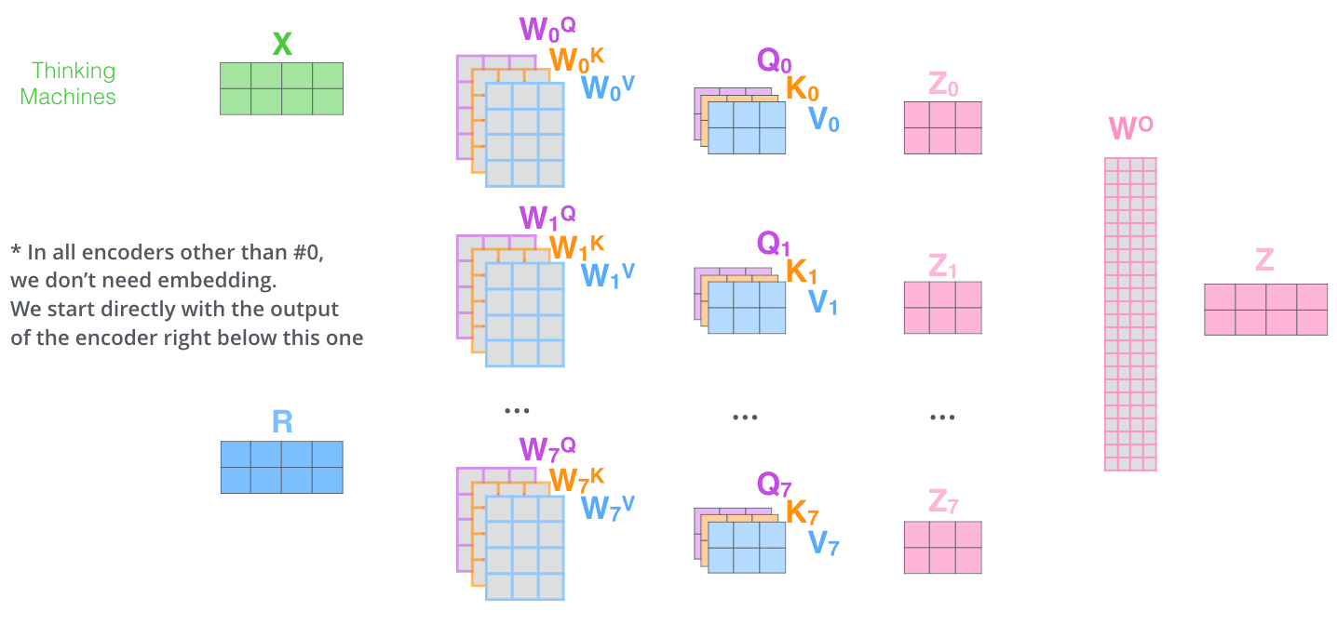
Multi-head self-attention
Do many self-attentions in parallel, and combine
Different heads can learn different “similarities” between inputs
Each has own set of parameters
See: Illustrated Transformer tutorial, https://jalammar.github.io/illustrated-transformer/
Notes:
That was single head self attention and for multihead you can do single head multiple times in parallel with different weight matrices for example 8 times and / separate sets of parameters these different heads model different similarities between tokens
Multiple emebeddings and we can project them to a lower dimensional space by concatenating them and them multiplying with another parameter matrix W0 to produce a new embedding
This was a generic introduction to transformers.

Slide 20









Comparing Transformers and GNN
Similarity: GNNs also take in a sequence of vectors (in no particular order) and output a sequence of embeddings
Difference: GNNs use message passing, Transformer uses self-attention
$$z_{1}$$
OUTPUT
$$z_{1}$$
$$z_{2}$$
$$z_{3}$$
$$z_{2}$$
Node embeddings
$$z_{3}$$
GNN
$$x_{1}$$
Node features
$$x_{2}$$
$$x_{1}$$
$$x_{2}$$
$$x_{3}$$
$$x_{3}$$
INPUT
Notes:
This is a graph class and we are interested in building graph transformers. TO do that we first need to find similarities and differences between T and GNNs.

Slide 21
Comparing Transformers and GNN
Difference: GNNs use message passing, Transformer uses self-attention
Are self-attention and message passing really different?
Message Passing
Vs.
Self-attention
Notes:
What I want to talk about next is how different are they really. From a schematic perspective they look different but in reality they are very similar.

Slide 22
Stanford CS224W:
Self-attention vs. message passing
CS224W: Machine Learning with Graphs
Jure Leskovec, Stanford University
http://cs224w.stanford.edu
Notes:
So let's compare

Slide 23



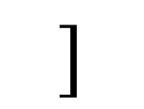

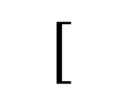


Interpreting the Self-Attention Update
Recall Formula for attention update:
Inputs stored row-wise
$$Att\left(X\right)=softmax\left({QK}^{T}\right)V$$
$$[$$
$$]$$
$$X=$$
$$x_{i}$$
$Q=XW^{Q},K=XW^{K}$, $V=XW^{V}$
OUTPUT
$$z_{1}$$
$$z_{2}$$
$$z_{3}$$
$$z_{4}$$
$$z_{5}$$
Transformer
$$x_{1}$$
$$x_{2}$$
$$x_{3}$$
$$x_{4}$$
$$x_{5}$$
Input tokens

Slide 24

Interpreting the Self-Attention Update
Recall Formula for attention update:
Inputs stored row-wise
$$Att\left(X\right)=softmax\left({QK}^{T}\right)V$$
$$[$$
$$]$$
$$X=$$
$$x_{i}$$
$Q=XW^{Q},K=XW^{K}$, $V=XW^{V}$
OUTPUT
This formula gives the embedding for all tokens simultaneously
What if we simplify to just token ?
$$z_{1}$$
$$z_{2}$$
$$z_{3}$$
$$z_{4}$$
$$z_{5}$$
$$x_{1}$$
Transformer
$$x_{1}$$
$$x_{2}$$
$$x_{3}$$
$$x_{4}$$
$$x_{5}$$
Input tokens

Slide 25

Interpreting the Self-Attention Update
Recall Formula for attention update:
Inputs stored row-wise
$$Att\left(X\right)=softmax\left({QK}^{T}\right)V$$
$$[$$
$$]$$
$$X=$$
$$x_{i}$$
$Q=XW^{Q},K=XW^{K}$, $V=XW^{V}$
OUTPUT
This formula gives the embedding for all tokens simultaneously
What if we simplify to just token ?
$$z_{1}$$
$$z_{2}$$
$$z_{3}$$
$$z_{4}$$
$$z_{5}$$
$$x_{1}$$
$$z_{1}=\sum_{j=1}^{5}{softmax_{j}\left(q_{1}^{T}k_{j}\right)v_{j}}$$
Transformer
How to interpret this?
$$x_{1}$$
$$x_{2}$$
$$x_{3}$$
$$x_{4}$$
$$x_{5}$$
Input tokens

Slide 26


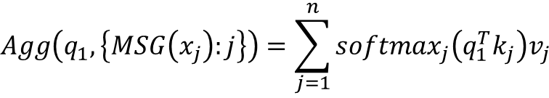
Interpreting the Self-Attention Update
Inputs stored row-wise
$$Att\left(X\right)=softmax\left({QK}^{T}\right)V$$
$$[$$
$$]$$
$$X=$$
$$x_{i}$$
$Q=XW^{Q},K=XW^{K}$, $V=XW^{V}$
This formula gives the embedding for all tokens simultaneously
If we simplify to just token what does the update look like?
$$x_{1}$$
$$z_{1}=\sum_{j=1}^{5}{softmax_{j}\left(q_{1}^{T}k_{j}\right)v_{j}}$$
How to interpret this?
Steps for computing new embedding for token 1:
  1. Compute message from j:
  2. Compute query for 1:
  3. Aggregate all messages:
$\left(v_{j}, k_{j}\right)=MSG\left(x_{j}\right)={{(W}^{V}x}_{j},{W^{K}x}_{j}$)
$q_{1}=MSG\left(x_{1}\right)=W^{Q}x_{1}$
$${Agg\left(q_{1},\left\{MSG\left(x_{j}\right):j\right\}\right)=\sum_{j=1}^{n}{softmax_{j}\left(q_{1}^{T}k_{j}\right)v_{j}}}_{ }$$
Notes:
(v,k) first

Slide 27
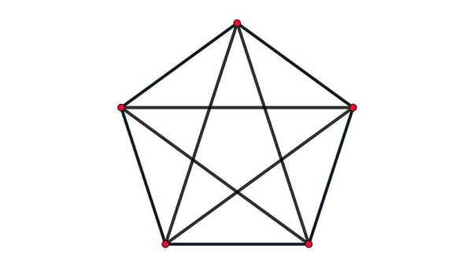
Self-Attention as Message Passing
Takeaway: Self-attention can be written as message + aggregation – i.e., it is a GNN!
But so far there is no graph – just tokens.
  So what graph is this a GNN on?
Clearly tokens = nodes, but what are the edges?
Key observation:
  Token 1 depends on (receives “messages” from) all other tokens
  ➔ the graph is fully connected!
Alternatively: if you only sum over you get ~GAT
$$j∈N(i)$$
$$z_{1}=\sum_{j=1}^{5}{softmax_{j}\left(q_{1}^{T}k_{j}\right)v_{j}}$$
Steps for computing new embedding for token 1:
  1. Compute message from j:
  2. Compute query for 1:
  3. Aggregate all messages:
$\left(v_{j}, k_{j}\right)=MSG\left(x_{j}\right)={{(W}^{V}x}_{j},{W^{K}x}_{j}$)
$q_{1}=MSG\left(x_{1}\right)=W^{Q}x_{1}$
$${Agg\left(q_{1},\left\{MSG\left(x_{j}\right):j\right\}\right)=\sum_{j=1}^{n}{softmax_{j}\left(q_{1}^{T}k_{j}\right)v_{j}}}_{ }$$
Notes:
Which is an odd think to say since a GNNs work with an underlying graph and in self attention there is no graph just
Imagine we don’t have a fully connected graph but we have a real graph → GAT

Slide 28
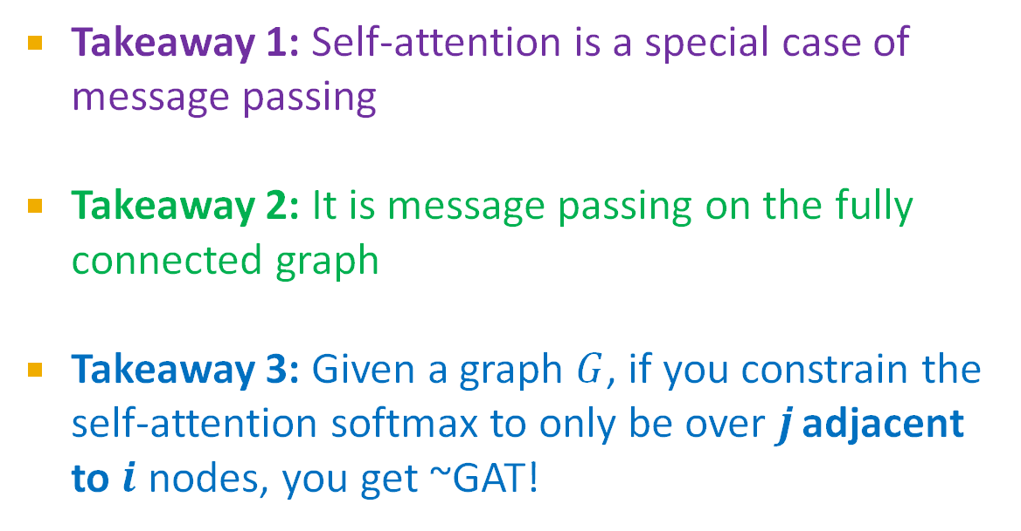
Self-Attention as Message Passing
Takeaway 1: Self-attention is a special case of message passing
Takeaway 2: It is message passing on the fully connected graph
Takeaway 3: Given a graph $G$, if you constrain the self-attention softmax to only be over $j$adjacent to $i$ nodes, you get ~GAT!
Steps for computing new embedding for token 1:
  1. Compute message from j:
  2. Compute query for 1:
  3. Aggregate all messages:
$\left(v_{j}, k_{j}\right)=MSG\left(x_{j}\right)={{(W}^{V}x}_{j},{W^{K}x}_{j}$)
$q_{1}=MSG\left(x_{1}\right)=W^{Q}x_{1}$
$${Agg\left(q_{1},\left\{MSG\left(x_{j}\right):j\right\}\right)=\sum_{j=1}^{n}{softmax_{j}\left(q_{1}^{T}k_{j}\right)v_{j}}}_{ }$$

Slide 29
Plan for Today
Part 1:
  Introducing Transformers
  Relation to message passing GNNs
Part 2:
  A new design landscape for graph Transformers
Part 3 (Time-permitting):
  Sign invariant Laplacian positional encodings for graph Transformers
Notes:
That was part 1, what is a transformer and how it relates to everything we have done in this class.
What components are required

Slide 30
Stanford CS224W:
A New Design Landscape for Graph Transformers
CS224W: Machine Learning with Graphs
Jure Leskovec, Stanford University
http://cs224w.stanford.edu

Slide 31
Recap: A General GNN Framework
J. You, R. Ying, J. Leskovec. Design Space of Graph Neural Networks, NeurIPS 2020c
We know a lot about the design space of GNNs
What does the corresponding design space for Graph Transformers look like?
GNN design space
Graph Transformer design space
(5) Learning objective
?
(2) Aggregation
GNN Layer 2
(1) Message
GNN Layer 1
(3) Layer connectivity
(4) Graph augmentation
Notes:
What do we need for a graph transformer

Slide 32
Processing Graphs with Transformers
We start with graph(s)
How to input a graph into a Transformer?
OUTPUT
START
Transformer
?
$$x_{1}$$
$$x_{2}$$
$$x_{3}$$
$$x_{4}$$
$$x_{5}$$
Notes:
The million dollar question here is how
The graph has this abstract structure transformers work with sequences which are very well-defined structures, how to

Slide 33
Components of a Transformer
J. You, R. Ying, J. Leskovec. Design Space of Graph Neural Networks, NeurIPS 2020c
To understand how to process graphs with Transformers we must:
  Understand the key components of the Transformer. Seen already:
      1) tokenizing,
      2) self-attention
  Decide how to make suitable graph versions of each
OUTPUT
Transformer
(2) Attention module
$$x_{1}$$
$$x_{2}$$
$$x_{3}$$
$$x_{4}$$
$$x_{5}$$
(1) Input tokens
Notes:
To reason about that we will approach the task from two directions: What are the key components that make the T successful. We need to have a graph equivalent of them. And we will also approach it from another direction which is, what information from the graph we should be puting in, graph structure, node attributes and edge attributes
How to make things fit
So far we have discussed the token

Slide 34
A final key piece: token ordering
There is one other key missing piece we have not yet discussed…
Notes:
There is one extra component that make things work and this is the positional encodings

Slide 35

A final key piece: token ordering
There is one other key missing piece we have not yet discussed …
First recall update formula
Key Observation: order of tokens does not matter!!!
$$z_{1}=\sum_{j=1}^{5}{softmax_{j}\left(q_{1}^{T}k_{j}\right)v_{j}}$$
Notes:
To get to it

Slide 36










A final key piece: token ordering
There is one other key missing piece we have not yet discussed …
First recall update formula
Key Observation: order of tokens does not matter!!!
$$z_{1}=\sum_{j=1}^{5}{softmax_{j}\left(q_{1}^{T}k_{j}\right)v_{j}}$$
Outputs swap, but do not otherwise change
$$z_{1}$$
$$z_{2}$$
$$z_{3}$$
$$z_{4}$$
$$z_{5}$$
$$z_{6}$$
$$z_{7}$$
$$z_{8}$$
$$z_{2}$$
$$z_{1}$$
$$z_{3}$$
$$z_{4}$$
$$z_{5}$$
$$z_{6}$$
$$z_{7}$$
$$z_{8}$$
Transformer
Transformer
$$x_{1}$$
$$x_{2}$$
$$x_{3}$$
$$x_{4}$$
$$x_{5}$$
$$x_{6}$$
$$x_{7}$$
$$x_{8}$$
$$x_{2}$$
$$x_{1}$$
$$x_{3}$$
$$x_{4}$$
$$x_{5}$$
$$x_{6}$$
$$x_{7}$$
$$x_{8}$$
The
cat
sat
on
the
mat
and
sang
cat
The
sat
on
the
mat
and
sang
Swap tokens 1 and 2

Slide 37
A final key piece: Token ordering
This is a problem
Same predictions no matter what order the words are in! (A “bag of words” prediction model)…
  How to fix?
Identical outputs
Sum pool
Sum pool
$$z_{1}$$
$$z_{2}$$
$$z_{3}$$
$$z_{4}$$
$$z_{5}$$
$$z_{6}$$
$$z_{7}$$
$$z_{8}$$
$$z_{2}$$
$$z_{1}$$
$$z_{3}$$
$$z_{4}$$
$$z_{5}$$
$$z_{6}$$
$$z_{7}$$
$$z_{8}$$
Transformer
Transformer
$$x_{1}$$
$$x_{2}$$
$$x_{3}$$
$$x_{4}$$
$$x_{5}$$
$$x_{6}$$
$$x_{7}$$
$$x_{8}$$
$$x_{2}$$
$$x_{1}$$
$$x_{3}$$
$$x_{4}$$
$$x_{5}$$
$$x_{6}$$
$$x_{7}$$
$$x_{8}$$
The
cat
sat
on
the
mat
and
sang
cat
The
sat
on
the
mat
and
sang
Swap tokens 1 and 2

Slide 38
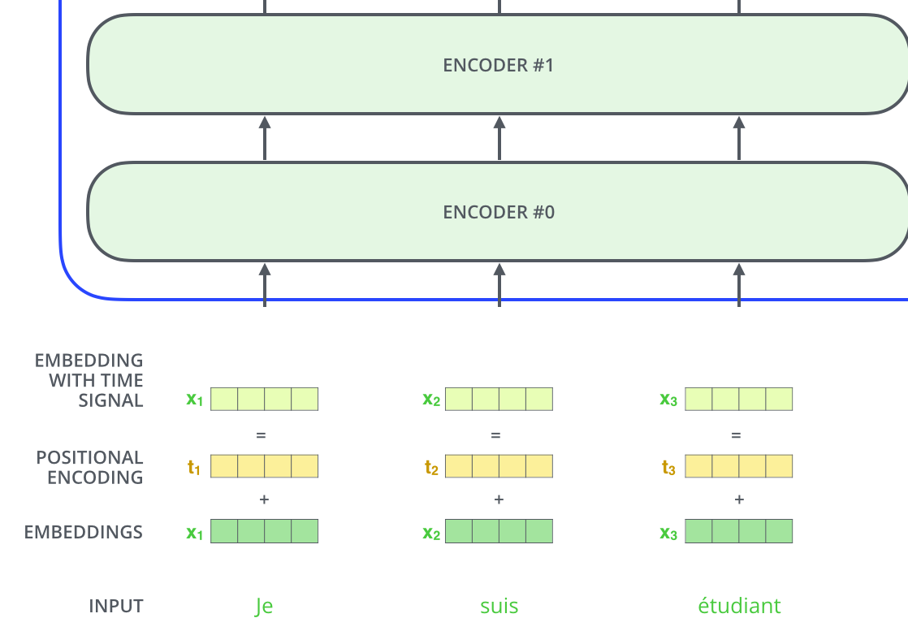
Positional Encodings
Transformer doesn’t know order of inputs
Extra positional features needed so it knows that
  Je = word 1,
  suis = word 2
  etc.
For NLP, positional encoding vectors are learnable parameters
Notes:
To overcome this issue we introduce this extra features or extra embedding vectors. Instead of having one for each individual token we have a positional encoding for each individual token location
This is token no 1 this is token no2
Input sequence and we add to it
Gives as embedding ith time signal which is an embedding with positional information. And this works great
Summation can express concatenation

Slide 39
Components of a Transformer
J. You, R. Ying, J. Leskovec. Design Space of Graph Neural Networks, NeurIPS 2020
Key components of Transformer
      (1) tokenizing
      (2) positional encoding
      (3) self-attention
Key question: What should these be for a graph input?
How to chose these for graph data?
Transformer
(3) self-attention
(2) Positional encoding
+
+
+
+
+
+
+
+
$$x_{1}$$
$$x_{2}$$
$$x_{3}$$
$$x_{i}$$
(1) Tokens

Slide 40
Processing Graphs with Transformers
J. You, R. Ying, J. Leskovec. Design Space of Graph Neural Networks, NeurIPS 2020
A graph Transformer must take the following inputs:
  (1) Node features?
  (2) Adjacency information?
  (3) Edge features?
Key components of Transformer
      (1) tokenizing
      (2) positional encoding
      (3) self-attention
Notes:
That’s on the side of what the transformer needs
What’s on the side of what the graph provides and what type of data we should be able to process
And we are looking for a way to match the three components on the left with the components on the right
And there are many ways to do that, e.g., we can incorporate the graph structure into the attention and somehow sum over neighbors, we are not going to do that
In general this is an open research question, doesn’t have to be one-to-one
Another thing that people do is put both node and edge features into the tokenizer and this is something people explore recently
Today we will actually discuss how to do that end to end

Slide 41
Processing Graphs with Transformers
J. You, R. Ying, J. Leskovec. Design Space of Graph Neural Networks, NeurIPS 2020
A graph Transformer must take the following inputs:
  (1) Node features?
  (2) Adjacency information?
  (3) Edge features?
There are many ways to do this
Different approaches correspond to different “matchings” between graph inputs (1), (2), (3) transformer components (1), (2), (3)
Key components of Transformer
      (1) tokenizing
      (2) positional encoding
      (3) self-attention

Slide 42
Processing Graphs with Transformers
J. You, R. Ying, J. Leskovec. Design Space of Graph Neural Networks, NeurIPS 2020
A graph Transformer must take the following inputs:
  (1) Node features?
  (2) Adjacency information?
  (3) Edge features?
There are many ways to do this
Different approaches correspond to different “matchings” between graph inputs (1), (2), (3) transformer components (1), (2), (3)
Key components of Transformer
      (1) tokenizing
      (2) positional encoding
      (3) self-attention
Today
Notes:
The adjacency information will be preserved with the use of positional encodings
And the edge features will somehow augment the self attention
Super active research area

Slide 43


Nodes as Tokens
Q1: what should our tokens be?
Sensible Idea: node features = input tokens
This matches the setting for the “attention is message passing on the fully connected graph” observation
OUTPUT
START
$$z_{1}$$
$$z_{2}$$
$$z_{3}$$
$$z_{4}$$
$$z_{5}$$
Transformer
?
$$x_{1}$$
$$x_{2}$$
$$x_{3}$$
$$x_{4}$$
$$x_{5}$$
(1) Input tokens = Node features
Notes:
Thinking of self attention as…. Nodes are tokens
People split graphs into subgraphs and think of these subgraphs as tokens

Slide 44
Processing Graphs with Transformers
J. You, R. Ying, J. Leskovec. Design Space of Graph Neural Networks, NeurIPS 2020c
Problem? We completely lose adjacency info!
How to also inject adjacency information?
OUTPUT
START
$$z_{1}$$
$$z_{2}$$
$$z_{3}$$
$$z_{4}$$
$$z_{5}$$
Transformer
?
$$x_{1}$$
$$x_{2}$$
$$x_{3}$$
$$x_{4}$$
$$x_{5}$$
(1) Input tokens = Node features

Slide 45

How to Add Back Adjacency Info?
Idea: Encode adjacency info in the positional encoding for each node
Positional encoding describes where a node is in the graph
$$z_{1}$$
$$z_{2}$$
$$z_{3}$$
$$z_{4}$$
$$z_{5}$$
OUTPUT
Transformer
(2) Positional encoding
+
+
+
+
+
INPUT
(1) Input tokens = Node features

Slide 46
How to Add Back Adjacency Info?
Idea: Encode adjacency info in the positional encoding for each node
Positional encoding describes where a node is in the graph
Q2: How to design a good positional encoding?
$$z_{1}$$
$$z_{2}$$
$$z_{3}$$
$$z_{4}$$
$$z_{5}$$
OUTPUT
Transformer
(2) Positional encoding
+
+
+
+
+
INPUT
(1) Input tokens = Node features

Slide 47
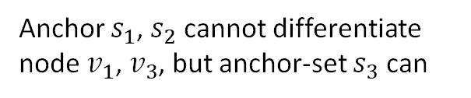


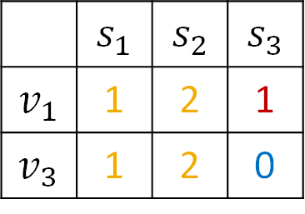




Option 1: relative distances
Last lecture: positional encoding based on relative distances
Similar methods based on random walks
This is a good idea! It works well in many cases
Especially strong for tasks that require counting cycles
B
A
$$v_{1}$$
A
B
$$s_{1}$$
$$s_{2}$$
$$s_{3}$$
A
$$v_{3}$$
Anchor
Size-2
Anchor-set
B
Relative Distances
 | $$s_{1}$$ | $$s_{2}$$ | $$s_{3}$$
$$v_{1}$$ | 1 | 2 | 1
$$v_{3}$$ | 1 | 2 | 0
Positional encoding for node
=
$$v_{1}$$
Anchor $s_{1}$, $s_{2}$ cannot differentiate node $v_{1}$, $v_{3}$, but anchor-set $s_{3}$ can

Slide 48
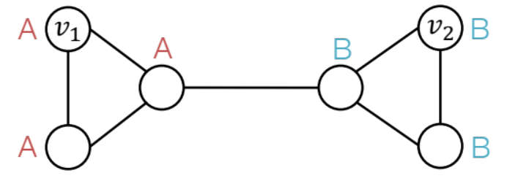
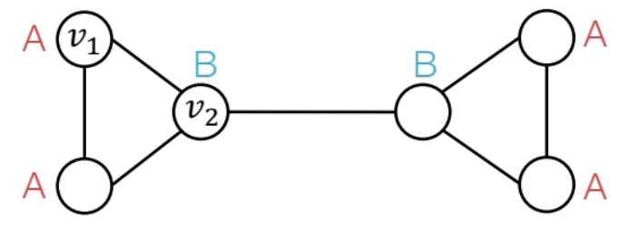
Option 1: Relative distances
Last lecture: Relative distances useful for position-aware task
But not suited to structure-aware tasks
B
A
$$v_{1}$$
A
B
$$s_{1}$$
$$s_{2}$$
$$s_{3}$$
A
$$v_{3}$$
Anchor
Size-2
Anchor-set
B
Relative Distances
 | $$s_{1}$$ | $$s_{2}$$ | $$s_{3}$$
$$v_{1}$$ | 1 | 2 | 1
$$v_{3}$$ | 1 | 2 | 0
Positional encoding for node
=
$$v_{1}$$
Anchor $s_{1}$, $s_{2}$ cannot differentiate node $v_{1}$, $v_{3}$, but anchor-set $s_{3}$ can

Slide 49
Option 2: Laplacian Eigenvector Positional Encodings
What other ways to make positional encoding?

Slide 50




Laplacian Eigenvector Positional Encodings
What other ways to make positional encoding?
Draw on knowledge of Graph Theory (many useful and powerful tools)
Key object: Laplacian Matrix L = Degrees - Adjacency
  Each graph has its own Laplacian matrix
  Laplacian encodes the graph structure
  Several Laplacian variants that add degree information differently
1 | 0 | 0 | 0
0 | 2 | 0 | 0
0 | 0 | 2 | 0
0 | 0 | 0 | 1
0 | 1 | 0 | 0
1 | 0 | 1 | 0
0 | 1 | 0 | 1
0 | 0 | 1 | 0
-
$$v_{2}$$
$$v_{3}$$
L =
$$v_{1}$$
$$v_{4}$$
Degree of each node
Adjacency
Notes:
We take the degrees of each node
The Laplacian comes up in the heat equation
Diffusion equation and this Laplacian matrix is a discretized form of that continuous differential operator
But this form does not serve our purposes yet because it is a matrix and the positional encoding should be a vector.

Slide 51
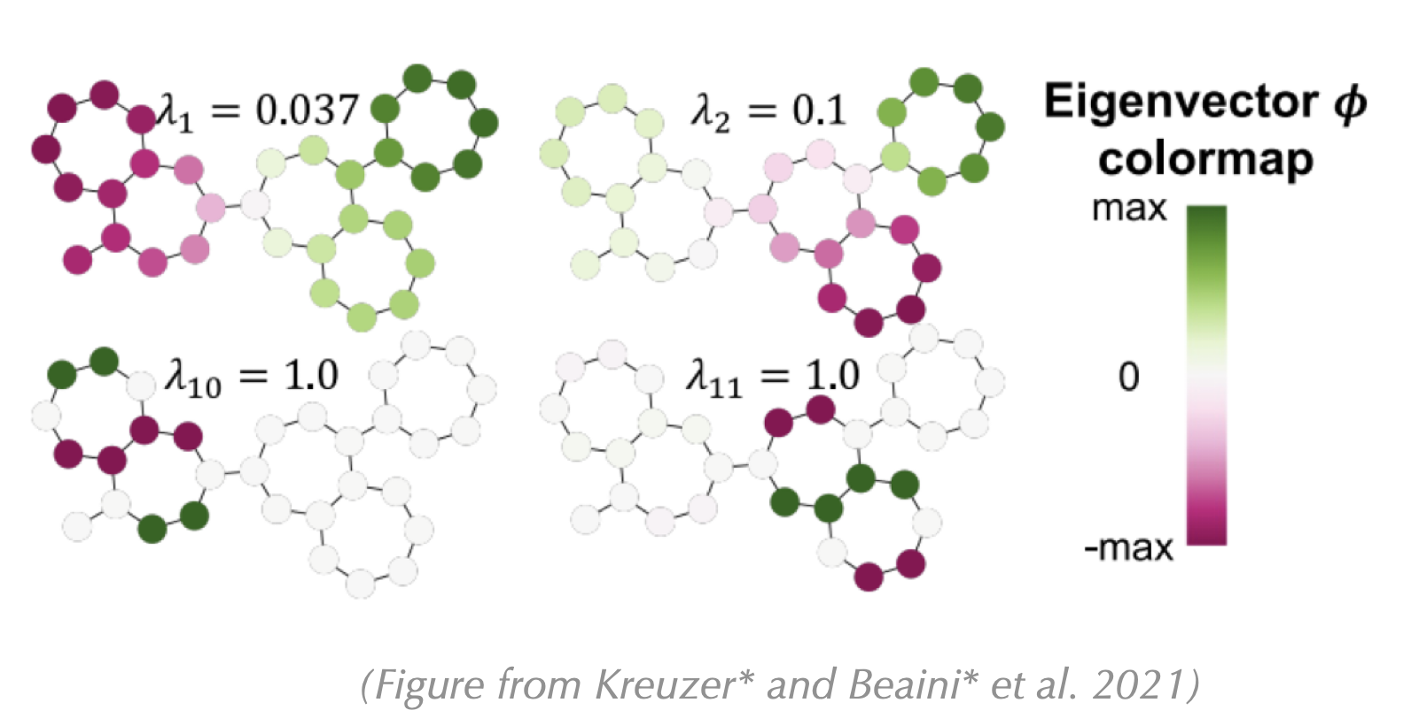
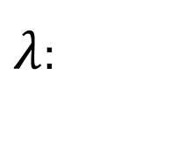




Laplacian Eigenvector Positional Encodings
Laplacian matrix captures graph structure
Its eigenvectors inherit this structure
This is important because eigenvectors are vectors (!) and so can be fed into a Transformer
Eigenvectors with small eigenvalue = global structure, large eigenvalue = local symmetries
Visualize one eigenvector
Refresher
$$v$$
$$Lv = λv$$
Eigenvector: such that
$$L:n ×n$$
matrix
$$v:n$$
dimensional vector
$λ$:
Scalar eigenvalue
Notes:
But we can get vectors for each node from this matrix
What is nice about eigenvectors is that the can be used as node embeddings and these node embeddings give different colors to the nodes of the graph
For example
Top eigenvectors help drawing Planar graphs, the bottom are somehow responsible for spectral clustering, they give insights about the connectivity and bipartiness of the graph

Slide 52

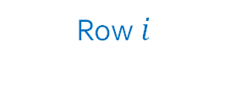
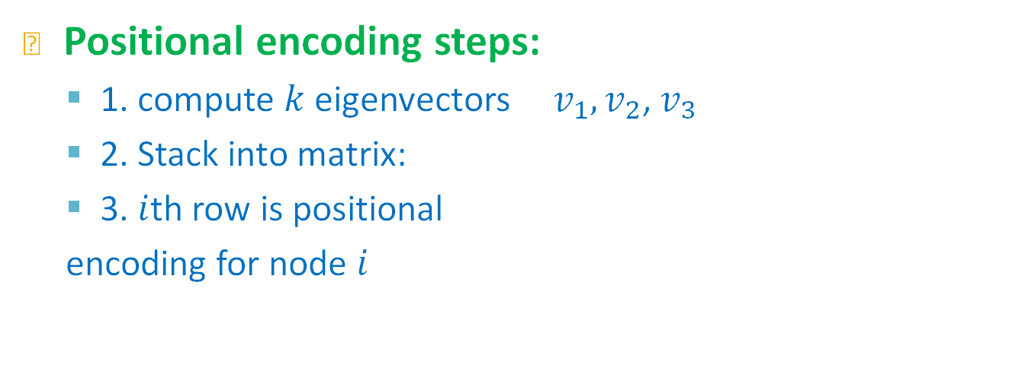







Laplacian Eigenvector Positional Encodings
Positional encoding steps:
  1. compute $k$ eigenvectors $v_{1}, v_{2}$, $v_{3}$
  2. Stack into matrix:
  3. $i$th row is positional
  encoding for node $i$
$$(k=3)$$
$$n$$
  nodes
  Row $i$
Transformer
$$x_{1}$$
$$x_{2}$$
Positional encoding features
$$x_{3}$$
+
+
+
+
+
+
+
+
$$x_{1}$$
$$x_{2}$$
$$x_{3}$$
$$x_{i}$$
Node features
INPUT
Notes:
What is supercool about eigenvectors is that they are ordered. Each eigenvector is attached to an eigenvalue and therefore first eigenvector will correspond to the first eigenvalue and so on so forth.
Nby k matrix so the way to take embeddings out of this matrix is that the ith row…and in that case we will have a 3-d positional encoding for each node that we can put here
Summarize
Laplacian
Matrix
Vector decades of mathematical studies of eigenvectors
Positional encoding
Interestingly positional encodings can also help improve performance of GNNs

Slide 53
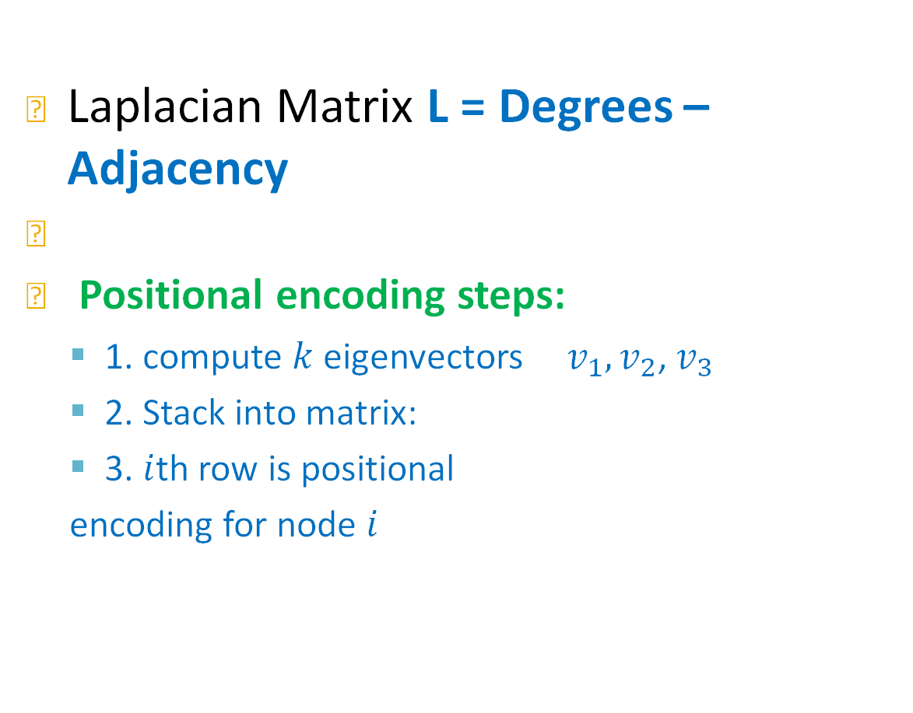


Summary: Laplacian Eigenvector Positional Encodings
Laplacian Matrix L = Degrees – Adjacency
f
Positional encoding steps:
  1. compute $k$ eigenvectors $v_{1}, v_{2}$, $v_{3}$
  2. Stack into matrix:
  3. $i$th row is positional
  encoding for node $i$
Transformer
$$v$$
$$Lv = λv$$
Eigenvector: such that
(2) Positional encoding
+
+
+
+
+
$$(k=3)$$
INPUT
$$n$$
53
  Row $i$
  nodes
Laplacian Eigenvector positional encodings can also be used with message-passing GNNs
  This helps for same reasons as structural and relative-distance based positional encodings in previous lecture
Notes:
Interestingly positional encodings can also help improve performance of GNNs

Slide 54
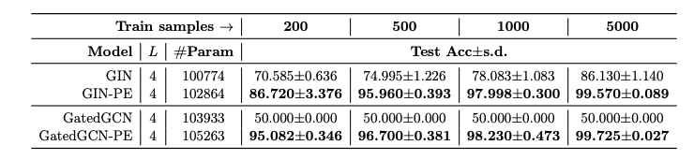
Laplacian Eigenvectors in Practice
Task: given a graph, predict YES if it has a cycle, NO otherwise
“PE” indicates using Laplacian Eigenvector Pos. Enc.

Slide 55
Processing Graphs with Transformers
A graph Transformer must take the following inputs:
  (1) Node features?
  (2) Adjacency information?
  (3) Edge features?
There are many ways to do this
Different approaches correspond to different “matchings” between graph inputs (1), (2), (3) transformer components (1), (2), (3)
Key components of Transformer
      (1) tokenizing
      (2) positional encoding
      (3) self-attention
S0 far

Slide 56
Processing Graphs with Transformers
A graph Transformer must take the following inputs:
  (1) Node features?
  (2) Adjacency information?
  (3) Edge features?
There are many ways to do this
Different approaches correspond to different “matchings” between graph inputs (1), (2), (3) transformer components (1), (2), (3)
Key components of Transformer
      (1) tokenizing
      (2) positional encoding
      (3) self-attention
Left to do

Slide 57


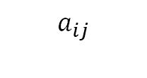

Edge Features in Self-Attention
Not clear how to add edge features in the tokens or positional encoding
How about in the attention?
is an n x n matrix. Entry describes “how much” token contributes to the update of token
$$Att\left(X\right)=softmax\left({QK}^{T}\right)V$$
$${\left[a_{ij}\right]=QK}^{T}$$
$$a_{ij}$$
$$j$$
$$i$$
Do Transformers Really Perform Bad for Graph Representation? Ying et al. NeurIPS 2021

Slide 58
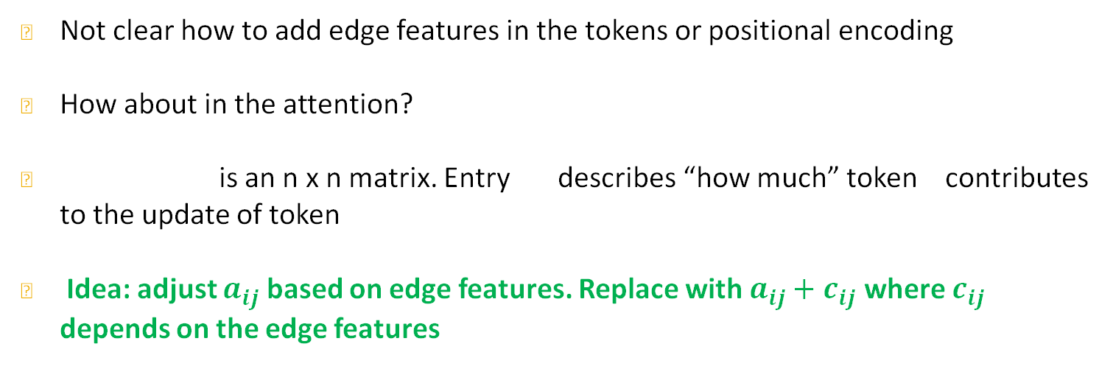
Edge Features in Self-Attention
Not clear how to add edge features in the tokens or positional encoding
How about in the attention?
is an n x n matrix. Entry describes “how much” token contributes to the update of token
Idea: adjust $a_{ij}$ based on edge features. Replace with $a_{ij}+c_{ij}$ where $c_{ij}$ depends on the edge features
$$Att\left(X\right)=softmax\left({QK}^{T}\right)V$$
$${\left[a_{ij}\right]=QK}^{T}$$
$$a_{ij}$$
$$j$$
$$i$$
Do Transformers Really Perform Bad for Graph Representation? Ying et al. NeurIPS 2021
Notes:
Cij is not the edge feature yet. Cij will allow do increase or decrease the weighting according to the edge features.

Slide 59

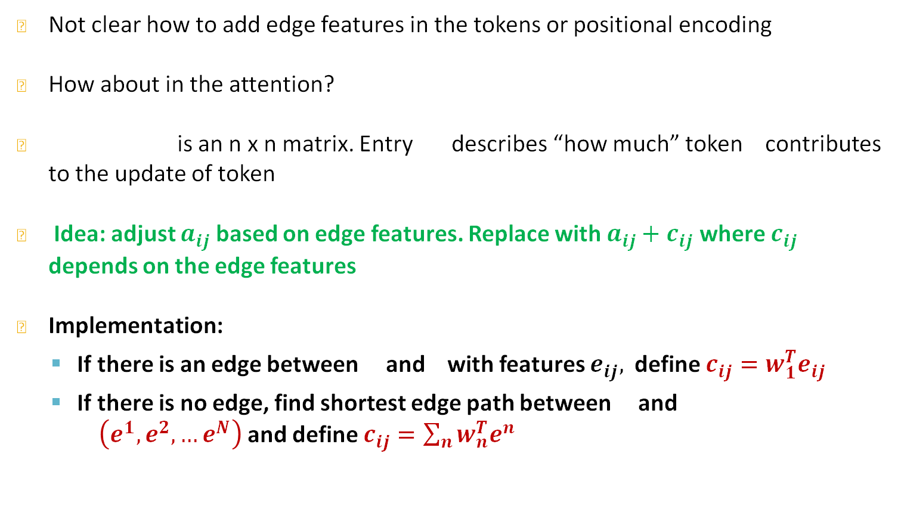




Edge Features in Self-Attention
Not clear how to add edge features in the tokens or positional encoding
How about in the attention?
is an n x n matrix. Entry describes “how much” token contributes to the update of token
Idea: adjust $a_{ij}$ based on edge features. Replace with $a_{ij}+c_{ij}$ where $c_{ij}$ depends on the edge features
Implementation:
  If there is an edge between and with features $e_{ij},$ define $c_{ij}=w_{1}^{T}e_{ij}$
  If there is no edge, find shortest edge path between and $\left(e^{1}, e^{2}, …e^{N}\right)$and define $c_{ij}=\sum_{n}{w_{n}^{T}e^{n}}$
$$Att\left(X\right)=softmax\left({QK}^{T}\right)V$$
$${\left[a_{ij}\right]=QK}^{T}$$
$$a_{ij}$$
$$j$$
$$i$$
Learned parameters $w_{1}$
$$i$$
$$j$$
$$i$$
$$j$$
Learned parameters $w_{1}, …,w_{N}$
Do Transformers Really Perform Bad for Graph Representation? Ying et al. NeurIPS 2021
Notes:
There are many ways to do that, let’s check one option
Eij The problem is that a_ij is a scalar and each edge might have multiple features so we can hit it with a learnable parameter w1
That doesn’t handle the case when there is no edge, and we can just leave it like that

Slide 60
Summary: Graph Transformer Design Space
(1) Tokenization
  Usually node features
  Other options, such as subgraphs, and node + edge features (not discussed today)
(2) Positional Encoding
  Relative distances, or Laplacian eigenvectors
  Gives Transformer adjacency structure of graph
(3) Modified Attention
  Reweight attention using edge features
OUTPUT
Transformer
(3) Modified Attention
(2) Positional encoding
+
+
+
+
+
(1) Input tokens
Notes:
That’s basically the landscape we have

Slide 61
Summary: Graph Transformer Design Space
GNN design space
Graph Transformer design space
(5) Learning objective
Transformer
(2) Aggregation
(3) Modified Attention
GNN Layer 1
(1) Message
(2) Positional encoding
GNN Layer 2
+
+
+
+
+
(3) Layer connectivity
(4) Graph augmentation
(1) Input tokens

Slide 62
Plan for Today
Part 1:
  Introducing Transformers
  Relation to message passing GNNs
Part 2:
  A new design landscape for graph Transformers
Part 3:
  Sign invariant Laplacian positional encodings for graph Transformers

Slide 63
Stanford CS224W: Powerful Positional Encodings for Graph Transformers
CS224W: Machine Learning with Graphs
Jure Leskovec, Stanford University
http://cs224w.stanford.edu

Slide 64
Recall: Laplacian Eigenvector Positional Encodings
Laplacian Matrix L = Degrees – Adjacency
f
Transformer
$$v$$
$$Lv = λv$$
Eigenvector: such that
(2) Positional encoding
+
+
+
+
+
$$(k=3)$$
INPUT
$$n$$
64
  Row $i$
  nodes

Slide 65
Laplacian Eigenvector Positional Encodings
Laplacian Eigenvector positional encodings work!
But is this the best we can do?
  Hint: no
Q: What is the problem with the current approach?
  A1: Eigenvectors are not arbitrary vectors
  A2: They have special structure that we have been ignoring!
To use eigenvectors properly we must account for their structure in our models

Slide 66
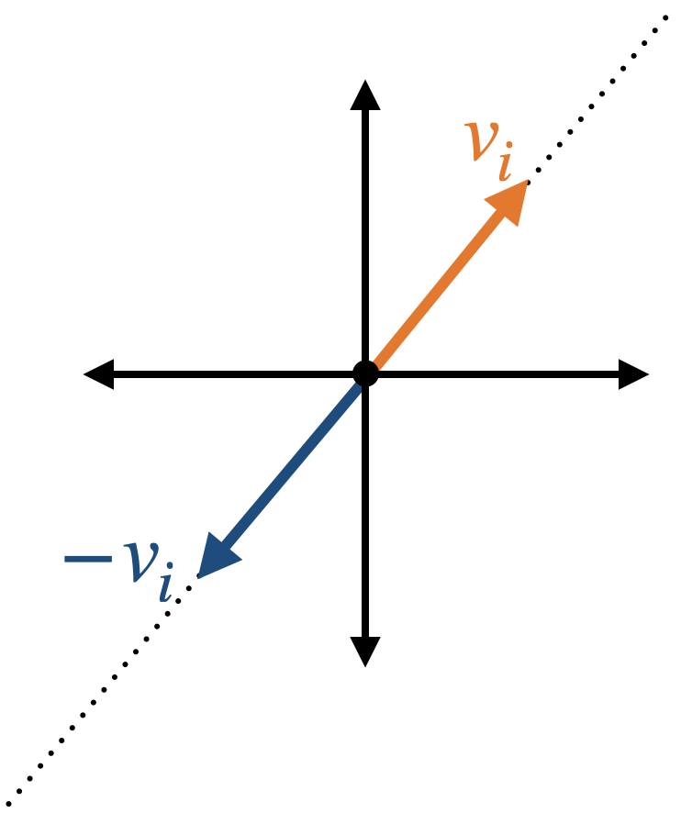
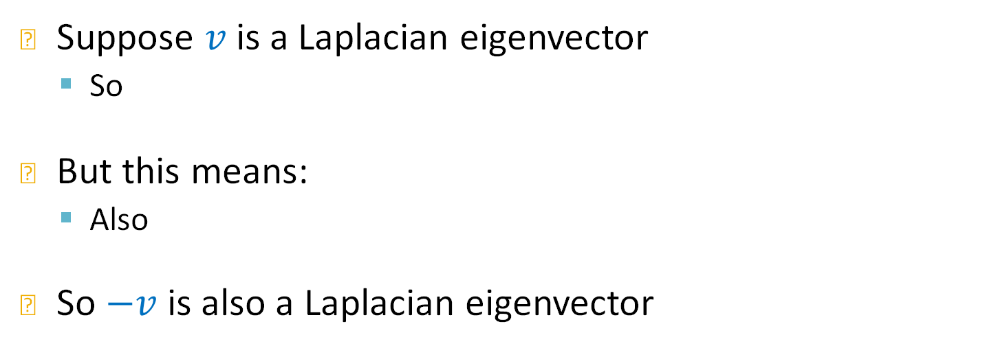


Eigenvector Sign Ambiguity
Suppose $v$is a Laplacian eigenvector
  So
But this means:
  Also
So $−v$is also a Laplacian eigenvector
$$Lv = λv$$
$$L(−v) = λ(−v)$$
The choice of sign is arbitrary!
Notes:
In the ideal case that eigenvectors are unique there is a symmetry
Pick a sign choice at random

Slide 67

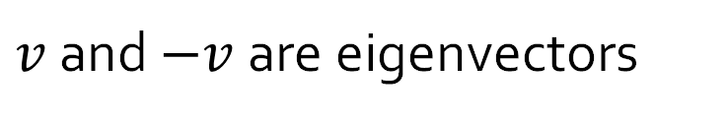
Sign Ambiguity is a Problem
Both
But when we use them as positional encodings we pick one arbitrarily
Why does this matter for positional encodings?
$v$ and $−v$ are eigenvectors
$v_{1}, v_{2}$, $v_{3}$
Transformer
+
+
+
+
+
+
+
+
$$x_{1}$$
$$x_{2}$$
$$x_{3}$$
$$x_{i}$$
Jure Leskovec, Stanford CS224W: Machine Learning with Graphs

Slide 68
Sign Ambiguity is a Problem
Both
But when we use them as positional encodings we pick one arbitrarily
Why does this matter for positional encodings?
$v$ and $−v$ are eigenvectors
$v_{1}, v_{2}$, $v_{3}$
What if we picked the other sign?
Transformer
+
+
+
+
+
+
+
+
$$x_{1}$$
$$x_{2}$$
$$x_{3}$$
$$x_{i}$$
Jure Leskovec, Stanford CS224W: Machine Learning with Graphs

Slide 69

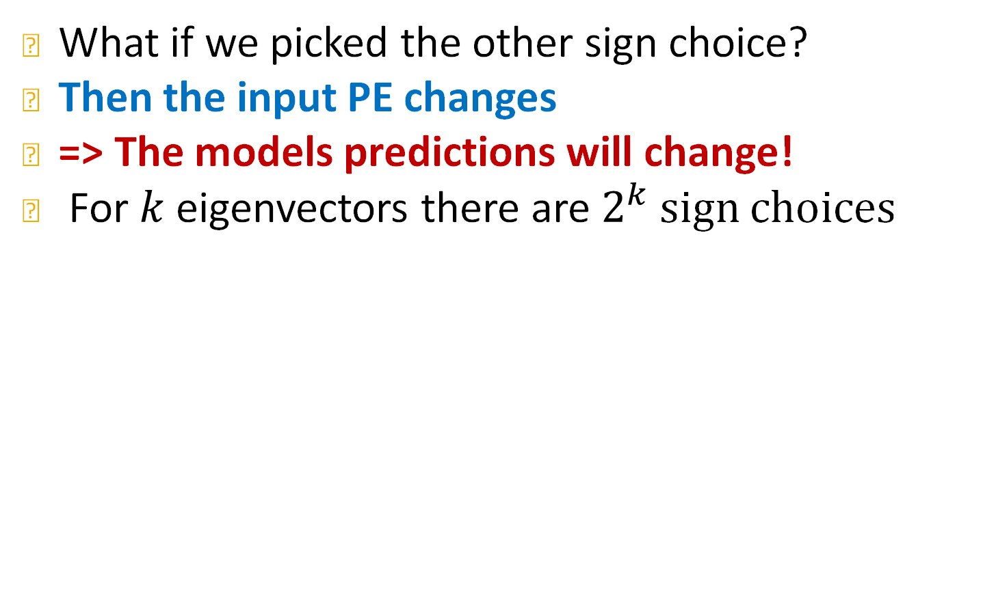

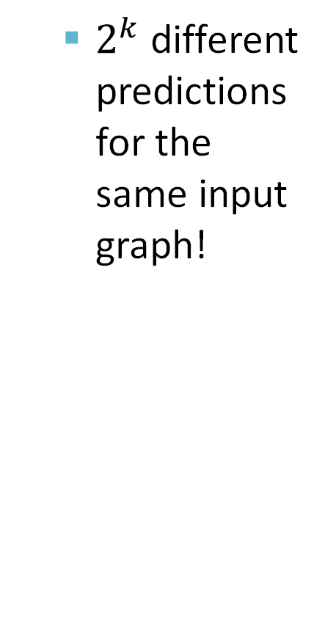
Sign Ambiguity is a Problem
What if we picked the other sign choice?
Then the input PE changes
=> The models predictions will change!
For $k$ eigenvectors there are $2^{k}$ sign choices
$$v_{1}$$
  $2^{k}$ different predictions for the same input graph!
${{−v}_{1}v}_{2}$, $v_{3}$
Transformer
+
+
+
+
+
+
+
+
$$x_{1}$$
$$x_{2}$$
$$x_{3}$$
$$x_{i}$$
Jure Leskovec, Stanford CS224W: Machine Learning with Graphs
Notes:
If we flip the sign this whole column changes which means that this feature for the i-th node changes which means that the positional encoding changes

Slide 70
How to fix sign ambiguity
Simple Idea: randomly flip the signs of eigenvectors during training
  I.e., data augmentation
  Model will learn to not use the sign information
  Issue: exponentially many sign choices is very difficult to learn
Jure Leskovec, Stanford CS224W: Machine Learning with Graphs
Notes:
People know about the problem

Slide 71
How to fix sign ambiguity
Better Idea: build a neural network that is invariant to sign choices!
  Since it is invariant, the predictions will no longer depend on the sign choice
$$v_{1}$$
${{−v}_{1}v}_{2}$, $v_{3}$
Transformer
+
+
+
+
+
+
+
+
$$x_{1}$$
$$x_{2}$$
$$x_{3}$$
$$x_{i}$$
Jure Leskovec, Stanford CS224W: Machine Learning with Graphs
Notes:
Baje the symmetry into the model

Slide 72
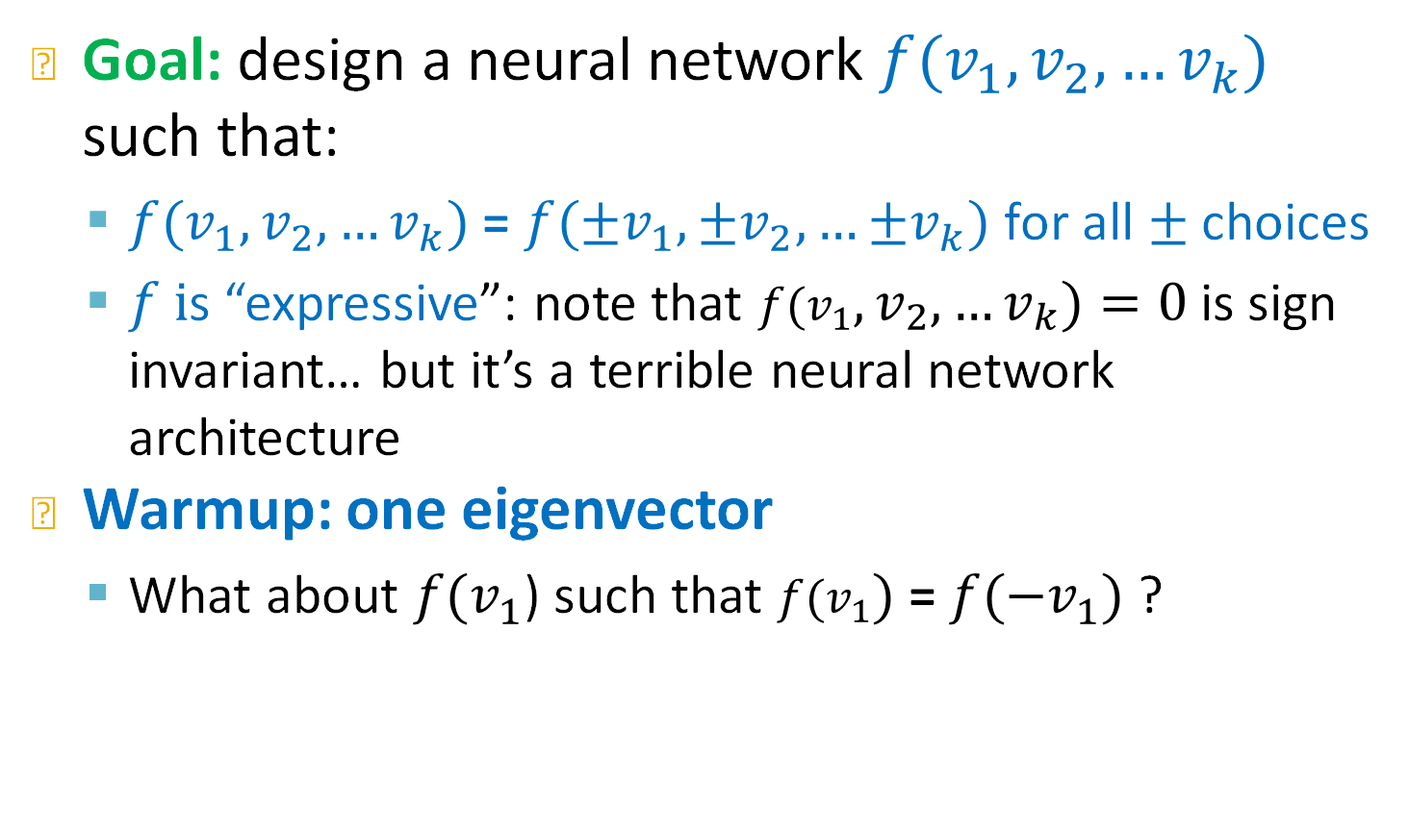
Sign Invariant Neural Networks
Goal: design a neural network ${f(v}_{1},v_{2},…v_{k})$ such that:
  ${f(v}_{1},v_{2},…v_{k})$ = ${f(±v}_{1},{±v}_{2},…{±v}_{k})$ for all $±$ choices
  $f i$s “expressive”: note that ${f(v}_{1},v_{2},…v_{k})=0$ is sign invariant… but it’s a terrible neural network architecture
Warmup: one eigenvector
  What about ${f(v}_{1}$) such that ${f(v}_{1})$ = ${f(−v}_{1})$ ?
Jure Leskovec, Stanford CS224W: Machine Learning with Graphs

Slide 73
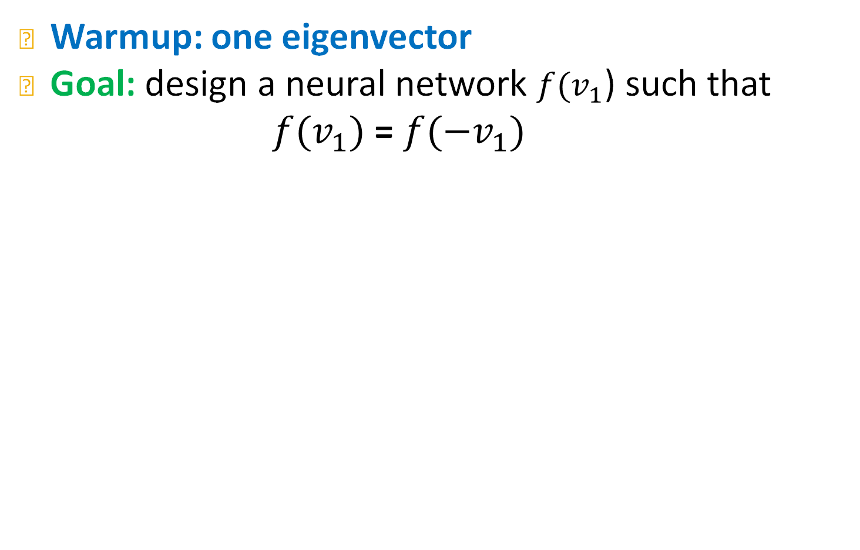
Sign Invariant Neural Networks
Warmup: one eigenvector
Goal: design a neural network ${f(v}_{1}$) such that ${f(v}_{1})$ = ${f(−v}_{1})$
Jure Leskovec, Stanford CS224W: Machine Learning with Graphs

Slide 74
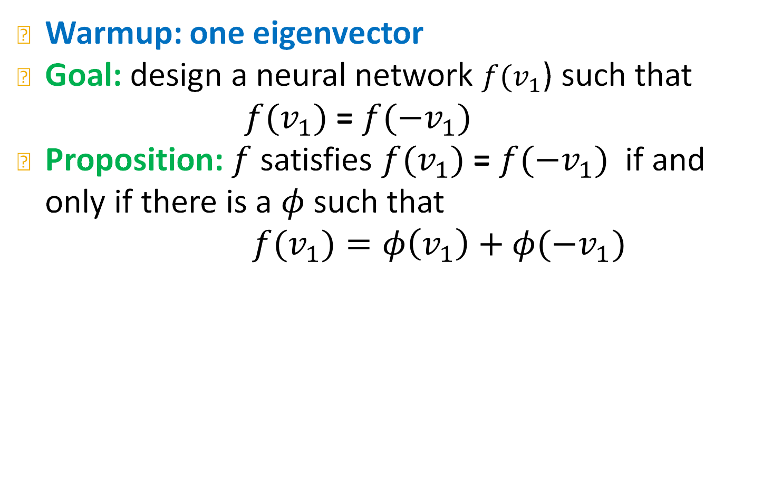
Sign Invariant Neural Networks
Warmup: one eigenvector
Goal: design a neural network ${f(v}_{1}$) such that ${f(v}_{1})$ = ${f(−v}_{1})$
Proposition: $f$ satisfies ${f(v}_{1})$ = ${f(−v}_{1})$ if and only if there is a $φ$ such that
${f(v}_{1})=φ\left(v_{1}\right)+φ(−v_{1})$
Jure Leskovec, Stanford CS224W: Machine Learning with Graphs

Slide 75
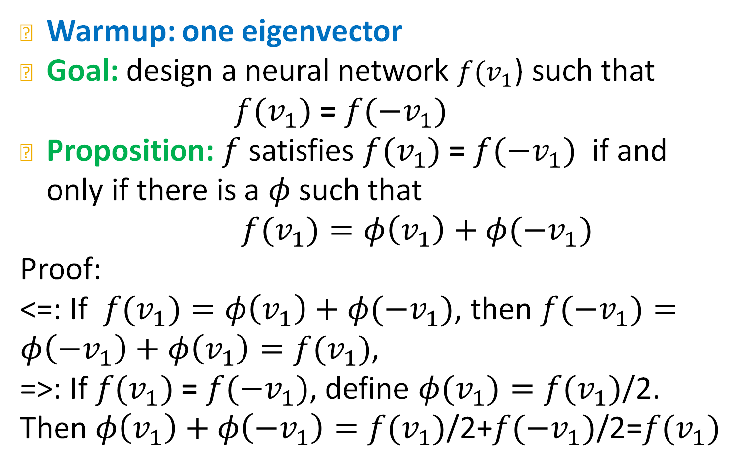
Sign Invariant Neural Networks
Warmup: one eigenvector
Goal: design a neural network ${f(v}_{1}$) such that ${f(v}_{1})$ = ${f(−v}_{1})$
Proposition: $f$ satisfies ${f(v}_{1})$ = ${f(−v}_{1})$ if and only if there is a $φ$ such that
${f(v}_{1})=φ\left(v_{1}\right)+φ(−v_{1})$
Proof:
<=: If ${f(v}_{1})=φ\left(v_{1}\right)+φ(−v_{1})$, then ${f(−v}_{1})=φ\left(−v_{1}\right)+φ\left(v_{1}\right)={f(v}_{1})$,
=>: If ${f(v}_{1})$ = ${f(−v}_{1})$, define ${φ(v}_{1})={f(v}_{1})$/2.
Then $φ\left(v_{1}\right)+φ\left(−v_{1}\right)={f(v}_{1})\text{/2}\text{+}{f(−v}_{1})\text{/2}\text{=}{f(v}_{1})$
Jure Leskovec, Stanford CS224W: Machine Learning with Graphs

Slide 76
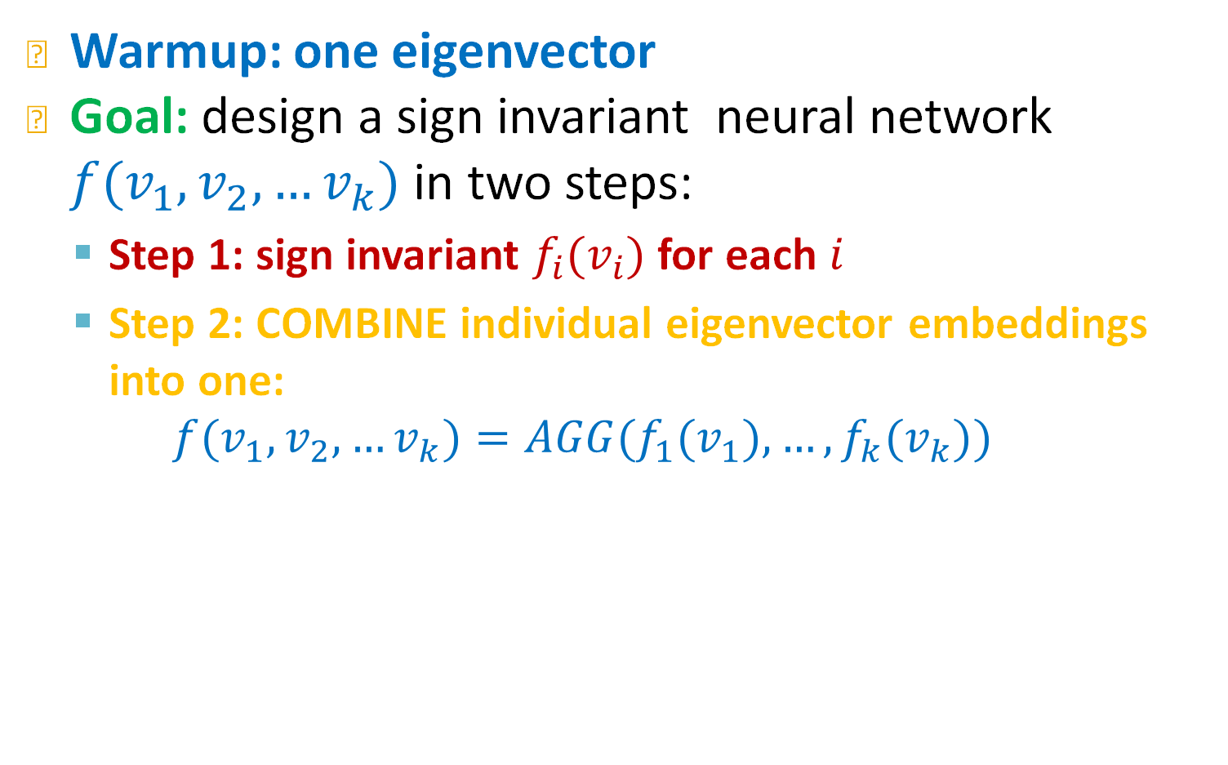
Sign Invariant Neural Networks
Warmup: one eigenvector
Goal: design a sign invariant neural network ${f(v}_{1},v_{2},…v_{k})$ in two steps:
  Step 1: sign invariant ${f_{i}(v}_{i})$for each $i$
  Step 2: COMBINE individual eigenvector embeddings into one:
  $${f(v}_{1},v_{2},…v_{k})=AGG({f_{1}(v}_{1}), …,{f_{k}(v}_{k}))$$
Jure Leskovec, Stanford CS224W: Machine Learning with Graphs

Slide 77
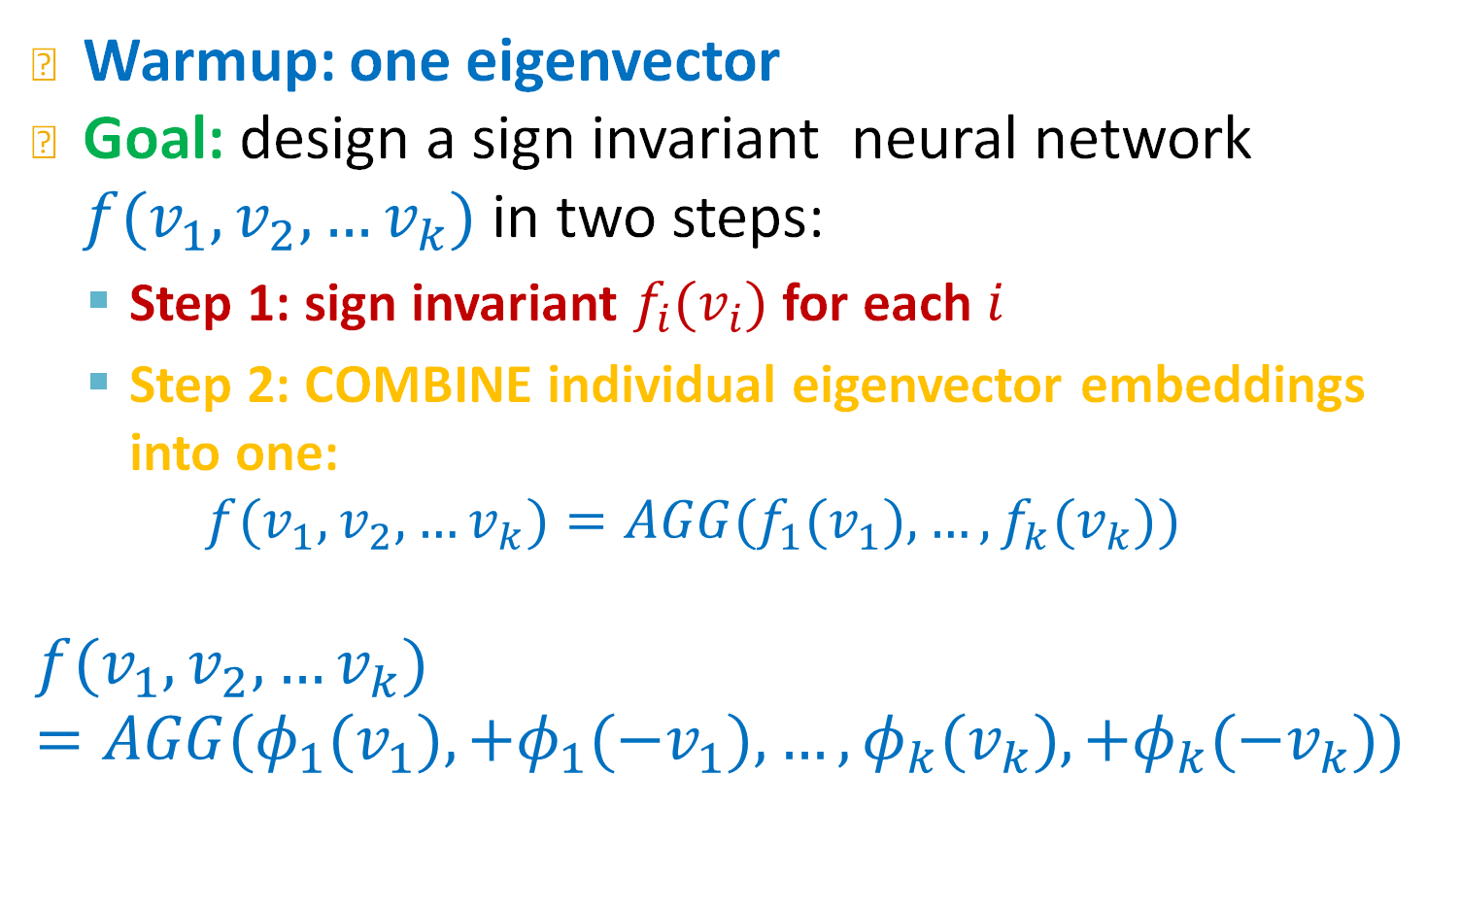
Sign Invariant Neural Networks
Warmup: one eigenvector
Goal: design a sign invariant neural network ${f(v}_{1},v_{2},…v_{k})$ in two steps:
  Step 1: sign invariant ${f_{i}(v}_{i})$for each $i$
  Step 2: COMBINE individual eigenvector embeddings into one:
  $${f(v}_{1},v_{2},…v_{k})=AGG({f_{1}(v}_{1}), …,{f_{k}(v}_{k}))$$
$${f(v}_{1},v_{2},…v_{k})=AGG({φ_{1}(v}_{1}),+{φ_{1}(−v}_{1}),…,{φ_{k}(v}_{k}),+{φ_{k}(−v}_{k}))$$
Use model for one eigenvector
Combine using another neural net $AGG=ρ$
Jure Leskovec, Stanford CS224W: Machine Learning with Graphs

Slide 78
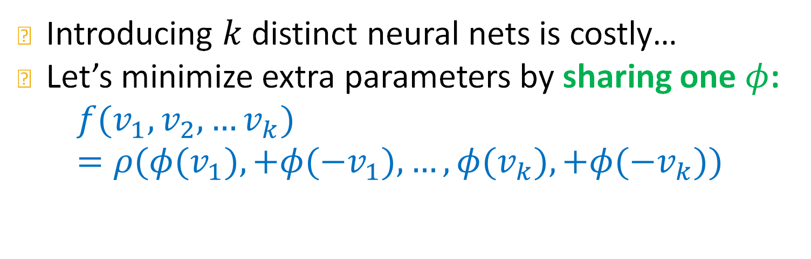
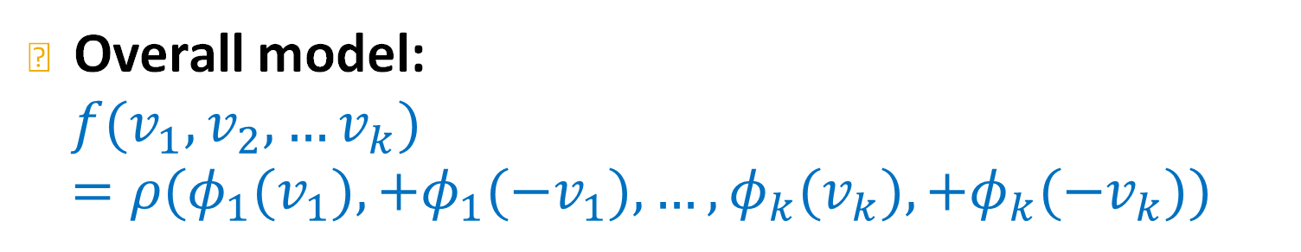
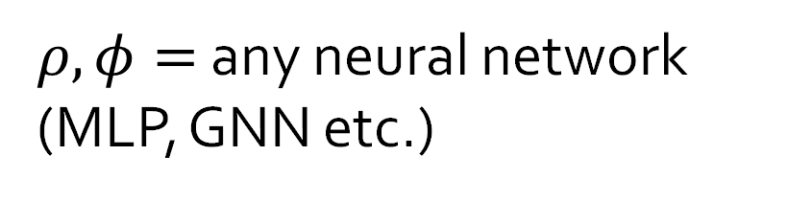
Sign Invariant Neural Networks
Overall model:
$${f(v}_{1},v_{2},…v_{k})=ρ({φ_{1}(v}_{1}),+{φ_{1}(−v}_{1}),…,{φ_{k}(v}_{k}),+{φ_{k}(−v}_{k}))$$
Introducing $k$ distinct neural nets is costly…
Let’s minimize extra parameters by sharing one $φ$:
$${f(v}_{1},v_{2},…v_{k})=ρ({φ(v}_{1}),+{φ(−v}_{1}),…,{φ(v}_{k}),+{φ(−v}_{k}))$$
$ρ,φ=$any neural network (MLP, GNN etc.)
SignNet
Jure Leskovec, Stanford CS224W: Machine Learning with Graphs

Slide 79
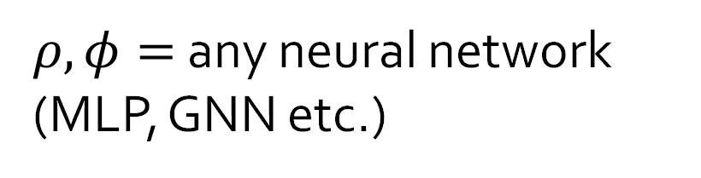
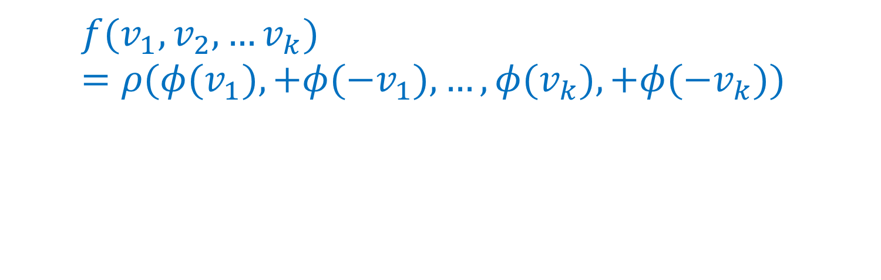
Sign Invariant Neural Networks
Overall model:
$${f(v}_{1},v_{2},…v_{k})=ρ({φ(v}_{1}),+{φ(−v}_{1}),…,{φ(v}_{k}),+{φ(−v}_{k}))$$
$ρ,φ=$any neural network (MLP, GNN etc.)
SignNet
Jure Leskovec, Stanford CS224W: Machine Learning with Graphs

Slide 80
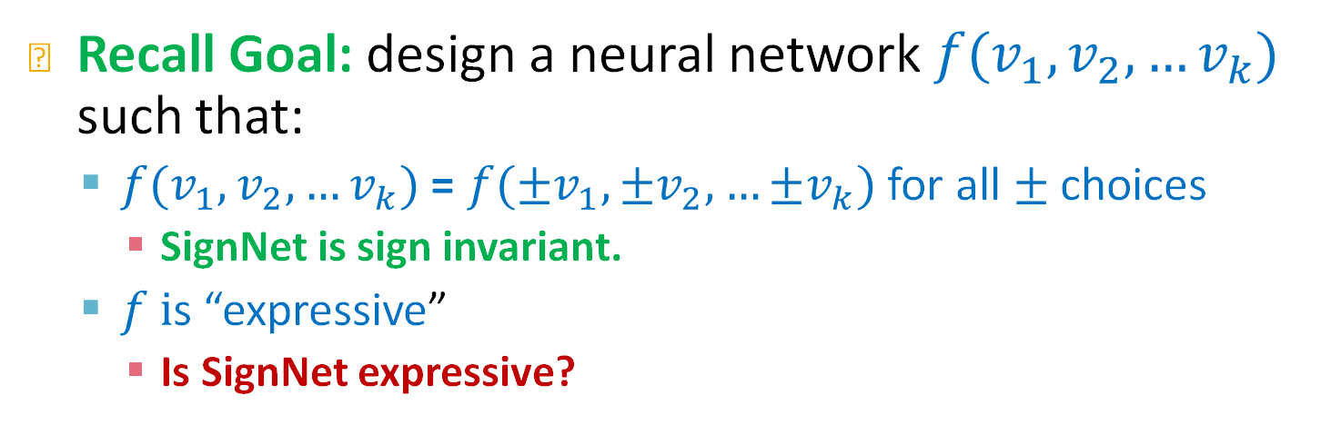
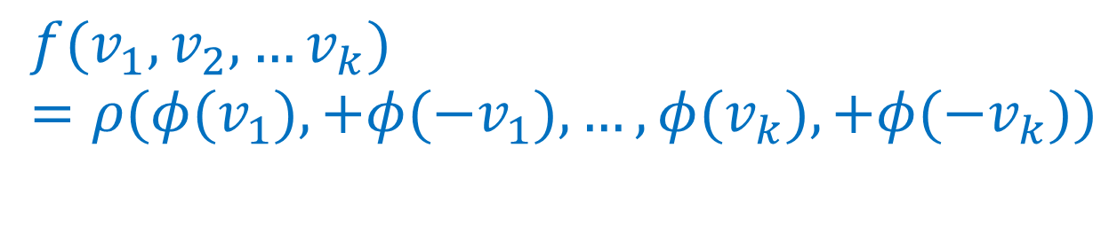
Sign Invariant Neural Networks
Recall Goal: design a neural network ${f(v}_{1},v_{2},…v_{k})$ such that:
  ${f(v}_{1},v_{2},…v_{k})$ = ${f(±v}_{1},{±v}_{2},…{±v}_{k})$ for all $±$ choices
    SignNet is sign invariant.
  $f i$s “expressive”
    Is SignNet expressive?
$${f(v}_{1},v_{2},…v_{k})=ρ({φ(v}_{1}),+{φ(−v}_{1}),…,{φ(v}_{k}),+{φ(−v}_{k}))$$
$ρ,φ=$any neural network (MLP, GNN etc.)
SignNet
Jure Leskovec, Stanford CS224W: Machine Learning with Graphs

Slide 81


Sign Invariant Neural Networks
Recall Goal: design a neural network ${f(v}_{1},v_{2},…v_{k})$ such that:
  ${f(v}_{1},v_{2},…v_{k})$ = ${f(±v}_{1},{±v}_{2},…{±v}_{k})$ for all $±$ choices
    SignNet is sign invariant.
  $f i$s “expressive”
    Is SignNet expressive?
Theorem: if $f$is sign invariant, then there exist functions $ρ, φ$ such that
$${f(v}_{1},v_{2},…v_{k})=ρ({φ(v}_{1}),+{φ(−v}_{1}),…,{φ(v}_{k}),+{φ(−v}_{k}))$$
SignNet can express all sign invariant functions!!
Jure Leskovec, Stanford CS224W: Machine Learning with Graphs

Slide 82

Sign Invariant Neural Networks
Many eigenvector case
Strategy: design a neural network ${f(v}_{1}$) such that ${f(v}_{1})$ = ${f(−v}_{1})$
Proposition: $f$ satisfies ${f(v}_{1})$ = ${f(−v}_{1})$ if and only if there is a $φ$ such that
${f(v}_{1})=φ\left(v_{1}\right)+φ(−v_{1})$
Jure Leskovec, Stanford CS224W: Machine Learning with Graphs

Slide 83

SignNet in practice
How to use SignNet in practice?
  Step 1: Compute eigenvectors
  Step 2: get eigenvector embeddings using SignNet
  Step 3: concatenate SignNet embeddings with node features X
  Step 4: pass through main GNN/Transformer as usual.
  Step 5: Backpropagate gradients to train SignNet + Prediction model jointly.
Jure Leskovec, Stanford CS224W: Machine Learning with Graphs

Slide 84




Small molecule property prediction with SignNet
Task: given a small molecule, predict its solubility
$$f($$
$)=$solubulity
50% reduction in test error
Jure Leskovec, Stanford CS224W: Machine Learning with Graphs

Slide 85
Plan for Today
Part 1:
  Transformers to message passing on fully connected graph
Part 2:
  New design landscape for graph Transformers
    Tokenization
    Positional encoding
    Modified self-attention
Part 3:
  Sign invariant Laplacian positional encodings for graph Transformers

Slide 86
Summary: Graph Transformer Design Space
New design space for graph Transformers
GNN design space
Graph Transformer design space
(5) Learning objective
Transformer
(2) Aggregation
(3) Modified Attention
GNN Layer 1
(1) Message
(2) Positional encoding
GNN Layer 2
+
+
+
+
+
(3) Layer connectivity
(4) Graph augmentation
(1) Input tokens

Slide 87
A final key piece: token ordering
J. You, R. Ying, J. Leskovec. Design Space of Graph Neural Networks, NeurIPS 2020c
There is one other key missing piece we have not yet discussed
First recall update formula
Key Observation: order of tokens does not matter!!!
$$z_{1}=\sum_{j=1}^{5}{softmax_{j}\left(q_{1}^{T}k_{j}\right)v_{j}}$$
Outputs swap, but do not otherwise change
$$z_{1}$$
$$z_{2}$$
$$z_{3}$$
$$z_{4}$$
$$z_{5}$$
$$z_{2}$$
$$z_{1}$$
$$z_{3}$$
$$z_{4}$$
$$z_{5}$$
Transformer
Transformer
$$x_{1}$$
$$x_{2}$$
$$x_{3}$$
$$x_{4}$$
$$x_{5}$$
Swap tokens 1 and 2
$$x_{2}$$
$$x_{1}$$
$$x_{3}$$
$$x_{4}$$
$$x_{5}$$

Slide 88
Processing Graphs with Transformers
J. You, R. Ying, J. Leskovec. Design Space of Graph Neural Networks, NeurIPS 2020c
A graph Transformer must take the following inputs:
  (1) Node features?
  (2) Adjacency information?
  (3) Edge features?
There are many ways to do this
Different approaches correspond to different “matchings” between graph inputs (1), (2), (3) transformer components (1), (2), (3)
Today:
  node features ⬄ tokenizing
  adjacency information ⬄ positional encoding
  (3) ⬄ (3)
Key components of Transformer
      (1) tokenizing
      (2) self-attention
      (3) positional encoding
Today

Slide 89
Components of a Transformer
J. You, R. Ying, J. Leskovec. Design Space of Graph Neural Networks, NeurIPS 2020c
Key components of graph data
  (1) How to input node features?
  (2) How to input adjacency information?
  (3) How to input edge features?
Key components of Transformer
      (1) tokenizing
      (2) positional encoding
      (3) self-attention
Key question: what should these be for a graph input?
Transformer
(2) self-attention
(3) Positional encoding
+
+
+
+
+
+
+
+
$$x_{1}$$
$$x_{2}$$
$$x_{3}$$
$$x_{i}$$
(1) Tokens

Slide 90

A final key piece: token ordering
J. You, R. Ying, J. Leskovec. Design Space of Graph Neural Networks, NeurIPS 2020c
Outputs swap, but do not otherwise change
Sum pool
Sum pool
Transformer
Transformer
$$x_{1}$$
$$x_{2}$$
$$x_{3}$$
$$x_{4}$$
$$x_{5}$$
$$x_{6}$$
$$x_{7}$$
$$x_{8}$$
$$x_{1}$$
$$x_{2}$$
$$x_{3}$$
$$x_{4}$$
$$x_{5}$$
$$x_{6}$$
$$x_{7}$$
$$x_{8}$$
The
cat
sat
on
the
mat
and
sang
The
cat
sat
on
the
mat
and
sang

Slide 91
A final key piece: token ordering
J. You, R. Ying, J. Leskovec. Design Space of Graph Neural Networks, NeurIPS 2020c
$$z_{1}=\sum_{j=1}^{5}{softmax_{j}\left(q_{1}^{T}k_{j}\right)v_{j}}$$
Outputs swap, but do not otherwise change
$$z_{1}$$
$$z_{2}$$
$$z_{3}$$
$$z_{4}$$
$$z_{5}$$
$$z_{2}$$
$$z_{1}$$
$$z_{3}$$
$$z_{4}$$
$$z_{5}$$
Transformer
Transformer
$$x_{1}$$
$$x_{2}$$
$$x_{3}$$
$$x_{4}$$
$$x_{5}$$
Swap tokens 1 and 2
$$x_{2}$$
$$x_{1}$$
$$x_{3}$$
$$x_{4}$$
$$x_{5}$$

Slide 92

Sign Ambiguity is a Problem
Both
But when we use them as positional encodings we pick one arbitrarily
Why does this matter for positional encodings?
$v$ and $−v$ are eigenvectors
What if we picked the other sign?
The input to the model changes!
This will change the models predictions!
But the sign shouldn’t do this!!!
${−v}_{1}, v_{2}$, $v_{3}$
Transformer
+
+
+
+
+
+
+
+
$$x_{1}$$
$$x_{2}$$
$$x_{3}$$
$$x_{i}$$
Jure Leskovec, Stanford CS224W: Machine Learning with Graphs

Slide 93










Closer Look at Self-Attention
Formula for attention update:
All inputs
$$Att\left(X\right)=softmax\left(K^{T}Q\right)V$$
$$[$$
$$]$$
$=softmax\left({\left(XW^{K}\right)}^{T}(XW^{Q})\right)$ $XW^{V}$
$$X=$$
$$x_{i}$$
This formula gives the embedding for all tokens simultaneously
If we simplify to just token what does the update look like?
OUTPUT
$$z_{i}$$
$$x_{i}$$
$$z_{i}=\sum_{j=1}^{n}{softmax_{j}\left(q_{i}^{T}k_{j}\right)v_{j}}$$
Transformer
$$=\sum_{j=1}^{n}{\frac{e^{q_{i}^{T}k_{j}}}{\sum_{l}{e^{q_{i}^{T}k_{l}}}}{. v}_{j}}$$
$$x_{i}$$
$$x_{1}$$
$$x_{2}$$
$$x_{3}$$
$$=\sum_{j=1}^{n}{\frac{e^{q_{i}^{T}k_{j}}}{\sum_{l}{e^{q_{i}^{T}k_{l}}}}{. W^{V}x}_{j}}$$
Input tokens
$$z_{i}$$
is a combination of all
$$x_{j}$$

Slide 94




Closer Look at Self-Attention
Inputs stored row-wise
$$Att\left(X\right)=softmax\left(K^{T}Q\right)V$$
$$[$$
$$]$$
$$X=$$
$$x_{i}$$
$=softmax\left({\left(XW^{K}\right)}^{T}(XW^{Q})\right)$ $XW^{V}$
Token 1 receives messages from all other tokens
This formula gives the embedding for all tokens simultaneously
If we simplify to just token what does the update look like?
Steps for computing new embedding:
  1. Compute message from j:
  2. Compute for 1:
  3. Aggregate all messages:
2
3
4
5
$$v_{2}, k_{2}$$
$$x_{1}$$
1
$$z_{1}=\sum_{j=1}^{5}{softmax_{j}\left(q_{1}^{T}k_{j}\right)v_{j}}$$
How to interpret this?
$MSG\left(x_{j}\right)=\left(v_{j}, k_{j}\right)={{(W}^{V}x}_{j},{W^{K}x}_{j}$)
$q_{1}=W^{Q}x_{1}$
$${Agg\left(\left\{MSG\left(x_{j}\right):j\right\}, q_{1}\right)=\sum_{j=1}^{n}{softmax_{j}\left(q_{1}^{T}k_{j}\right)v_{j}}}_{ }$$

Slide 95






Closer Look at Self-Attention
Formula for attention update:
$$Att\left(X\right)=softmax\left(K^{T}Q\right)V$$
$=softmax\left({\left(XW^{K}\right)}^{T}(XW^{Q})\right)$ $XW^{V}$
This formula gives the embedding for all tokens simultaneously
If we simplify to just token what does the update look like?
Steps for computing new embedding:
  Compute message from j:
  Compute for all i:
  Aggregate all messages:
$$v_{j}, k_{j}$$
$$x_{i}$$
$k_{j}=W^{K}x_{j}$
$$z_{i}=\sum_{j=1}^{n}{softmax_{j}\left(q_{i}^{T}k_{j}\right)v_{j}}$$
i
$$z_{i}$$
${m_{j}=(v}_{j }, k_{j})={{(W}^{V}x}_{j},{W^{K}x}_{j}$)
$q_{i}=W^{Q}x_{i}$
$${Agg\left(\left\{m_{j}:j\right\}, q_{i}\right)=\sum_{j=1}^{n}{softmax_{j}\left(q_{i}^{T}k_{j}\right)v_{j}}}_{ }$$

Slide 96
Closer Look at Self-Attention
Formula for attention update:
$$Att\left(X\right)=softmax\left(K^{T}Q\right)V$$
$=softmax\left({\left(XW^{K}\right)}^{T}(XW^{Q})\right)$ $XW^{V}$
This formula gives the embedding for all tokens simultaneously
If we simplify to just token what does the update look like?
Steps for computing new embedding:
  Compute message from j:
  Compute for all i:
  Aggregate all messages:
$$v_{j}, k_{j}$$
$$x_{i}$$
$k_{j}=W^{K}x_{j}$
$$z_{i}=\sum_{j=1}^{n}{softmax_{j}\left(q_{i}^{T}k_{j}\right)v_{j}}$$
i
$$z_{i}$$
${m_{j}=(v}_{j }, k_{j})={{(W}^{V}x}_{j},{W^{K}x}_{j}$)
$q_{i}=W^{Q}x_{i}$
$${Agg\left(\left\{m_{j}:j\right\}, q_{i}\right)=\sum_{j=1}^{n}{softmax_{j}\left(q_{i}^{T}k_{j}\right)v_{j}}}_{ }$$

Slide 97



Closer Look at Self-Attention
Formula for attention update:
$$Att\left(X\right)=softmax\left(K^{T}Q\right)V$$
$=softmax\left({\left(XW^{K}\right)}^{T}(XW^{Q})\right)$ $XW^{V}$
This formula gives the embedding for all tokens simultaneously
If we simplify to just token what does the update look like?
$$v_{j}, k_{j}$$
$$x_{i}$$
$k_{j}=W^{K}x_{j}$
i
$$z_{i}=\sum_{j=1}^{n}{softmax_{j}\left(q_{i}^{T}k_{j}\right)v_{j}}$$
Updating embedding I
  Compute message from j:
  Compute for all i:
  Aggregate all messages:
${m_{j}=(v}_{j }, k_{j})={{(W}^{V}x}_{j},{{(W}^{K}x}_{j}$)
$$=\sum_{j=1}^{n}{\frac{e^{q_{i}^{T}k_{j}}}{\sum_{l}{e^{q_{i}^{T}k_{l}}}}{. v}_{j}}$$
$q_{i}=W^{Q}x_{i}$
$$=\sum_{j=1}^{n}{\frac{e^{q_{i}^{T}k_{j}}}{\sum_{l}{e^{q_{i}^{T}k_{l}}}}{. W^{V}x}_{j}}$$
$$z_{i}$$
$${Agg\left(\left\{m_{j}:j\right\}, q_{i}\right)=\sum_{j=1}^{n}{softmax_{j}\left(q_{i}^{T}k_{j}\right)v_{j}}}_{ }$$

Slide 98
Why Positional Encodings?
Transformer doesn’t know order of inputs
For language, extra "positional” features needed so it knows that
  Je = word 1,
  suis = word 2
  etc.
But graphs don’t have a “node 1”
Instead, the issue is a naïve Transformer does not know the adjacency structure A

Slide 99
Comparing Transformers and GNN
$$z_{1}$$
OUTPUT
$$z_{2}$$
$$z_{1}$$
$$z_{2}$$
$$z_{3}$$
…
Node embeddings
$$z_{3}$$
Transformer
$$x_{1}$$
$$x_{1}$$
$$x_{2}$$
$$x_{3}$$
…
$$x_{2}$$
Node features
$$x_{3}$$
INPUT

Slide 100


Why Positional Encodings?
Only node features are fed into Transformer
Hence the Transformer does not know the adjacency structure A
Transformer
$$x_{1}$$
$$x_{1}$$
$$x_{2}$$
$$x_{3}$$
…
$$x_{2}$$
Node features
$$x_{3}$$
INPUT
Does not know that $x_{1}$that $x_{3}$ are connected!!

