Slide 1

Stanford CS224W:
Knowledge Graph Embeddings
Note to other teachers and users of these slides: We would be delighted if you found our material useful for giving your own lectures. Feel free to use these slides verbatim, or to modify them to fit your own needs. If you make use of a significant portion of these slides in your own lecture, please include this message, or a link to our web site: http://cs224w.Stanford.edu
CS224W: Machine Learning with Graphs
Charilaos Kanatsoulis and Jure Leskovec, Stanford University
http://cs224w.stanford.edu

Slide 2

Announcements
https://snap.stanford.edu/graphlearning-workshop-2024/
Feel free to join in person! Poster session will be great!

Slide 3
Announcements
Colab 2 due today
  Gradescope submissions close at 11:59 PM
Homework 1 grade is released!
Homework 2 has been updated:
  Due Monday, 11/04 (1.5 weeks from now)
  We have deleted question 4
  TAs will hold a recitation session for HW 2:
    Time: Friday (10/25), 12:45-1:30pm
    Location: Zoom, link has be posted on Ed
    Session will be recorded

Slide 4







Recap: Heterogeneous Graphs
Heterogeneous graphs: a graph with multiple relation types
$$r_{1}$$
B
Target node
$$r_{3}$$
A
$$r_{2}$$
C
$$r_{1}$$
$$r_{3}$$
$$r_{2}$$
F
D
E
$$r_{1}$$
Input graph
Notes:
Multiple types of nodes and multiple type of relationships

Slide 5







Recap: Relational GCN
Learn from a graph with multiple relation types
Use different neural network weights for different relation types!
Aggregation
C
$$r_{1}$$
B
Target node
$$r_{3}$$
B
A
F
$$r_{2}$$
C
A
C
$$r_{1}$$
$$r_{3}$$
$$r_{2}$$
F
E
D
E
$$r_{1}$$
D
Input graph
Neural networks
Notes:
Generalization of message-passing GNN that allow us to learn with multiple relation types
And this generalization use …
The idea is that different message functions and potentially different aggregation functions also depend on the relations type of each entity

Slide 6
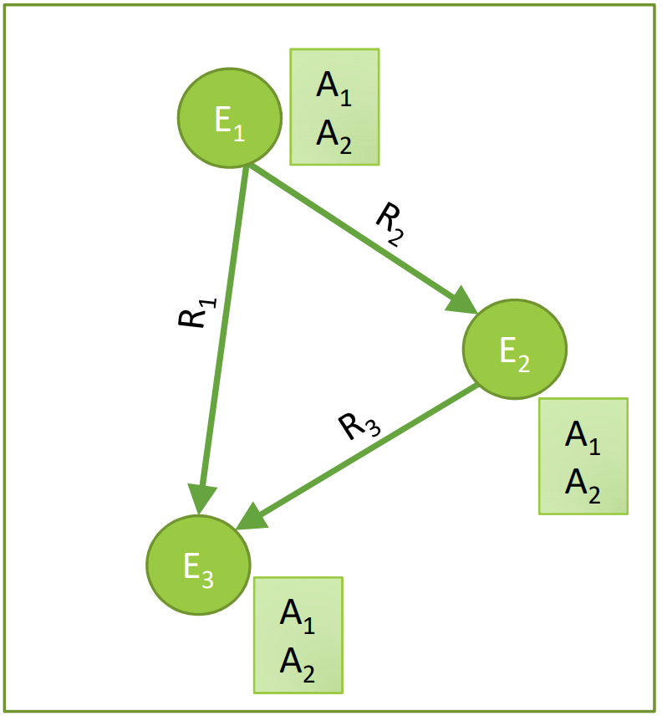
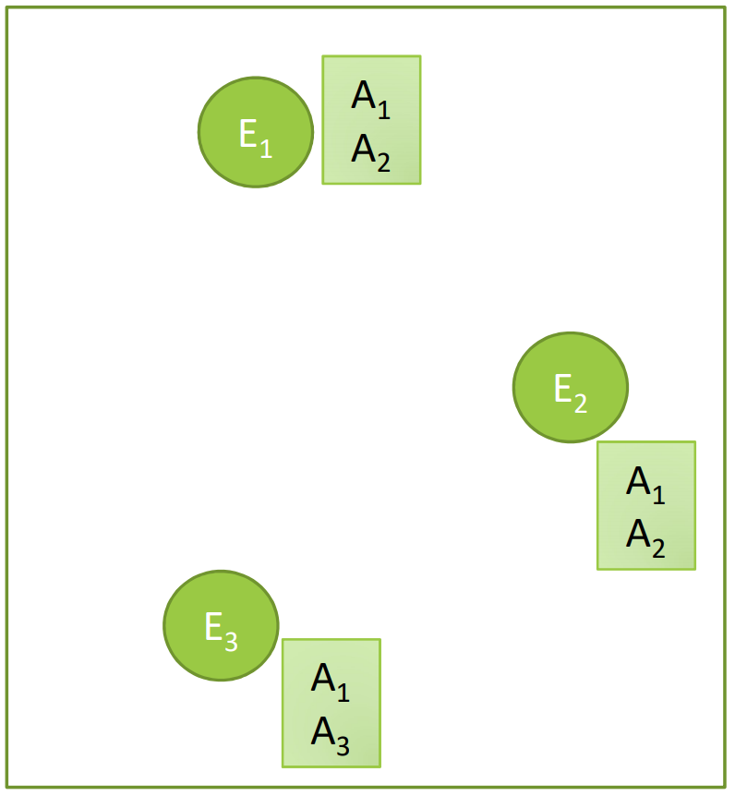
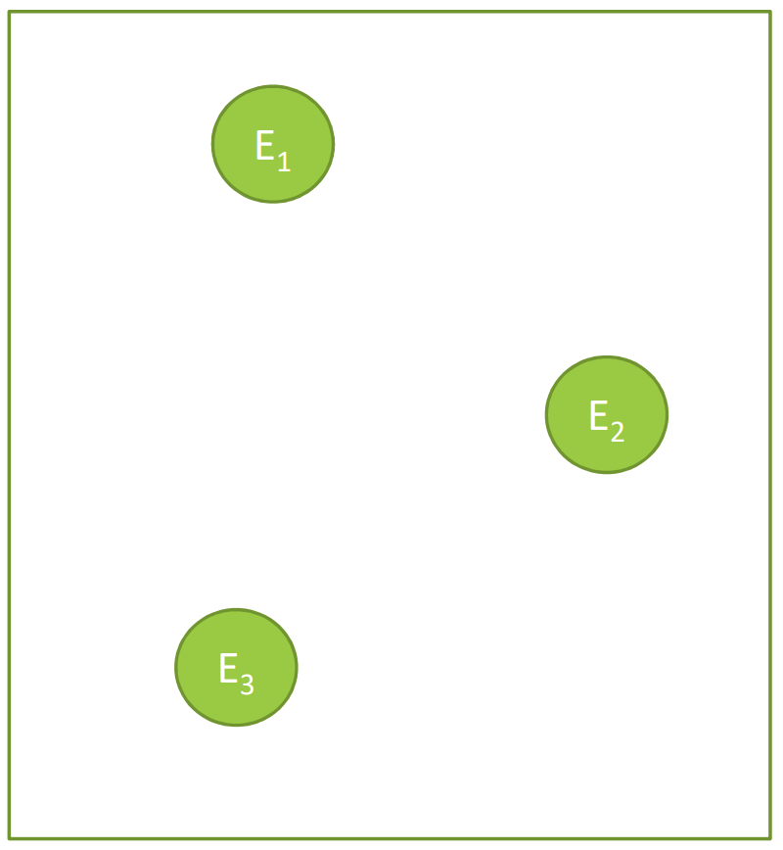
Today: Knowledge Graphs (KG)
Knowledge in graph form:
  Capture entities, types, and relationships
Nodes are entities
Nodes are labeled with
their types
Edges between two nodes
capture relationships
between entities
KG is an example of a
heterogeneous graph
Notes:
The idea is that you can codify the knowledge at a given domain through a graph, the knowledge graph
Basically …
The way we thing about a KG is that rather than encoding the type of entities as attributes,you can think these attributes as links to other attributes
You have the knowledge that C was born in Athens and instead of using Athens as attribute you have a link of type was born between charilaos and athens

Slide 7
Example: Bibliographic Networks
Node types: paper, title, author, conference, year
Relation types: pubWhere, pubYear, hasTitle, hasAuthor, cite
Notes:
What are some examples of these graphs
I want to understand the structure of science and what a scientist is doing
Graph with node types and different relation types between them. So here I have a schema of this graph

Slide 8
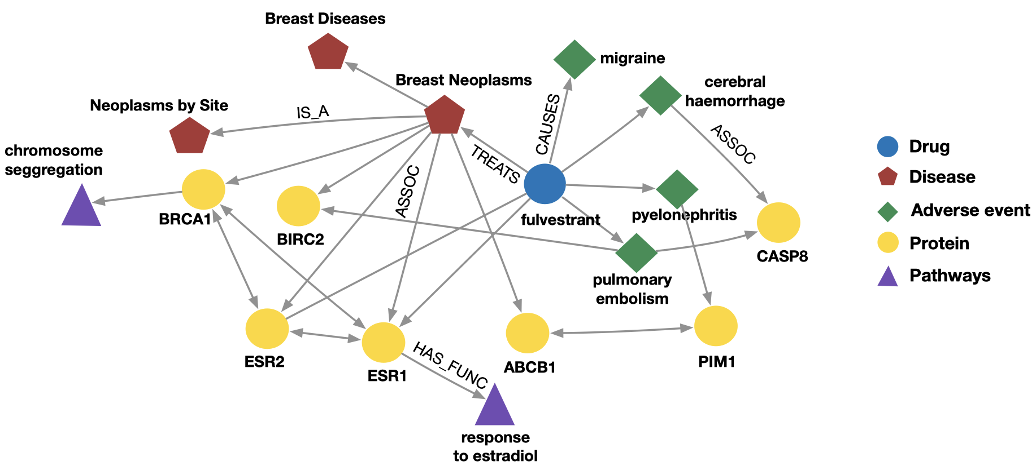
Example: Bio Knowledge Graphs
Node types: drug, disease, adverse event, protein, pathways
Relation types: has_func, causes, assoc, treats, is_a
Notes:
http://home.cse.ust.hk/~yqsong/papers/2017-HIN-Metagraph.pdf
Another example where graphs are heavily used is in biology and medicine
Biology and medicine is doing, is trying to find relationships between different biomedical entities
Here are some proteins that do not work well in your body because you have that disease
This proteins are part of some biological processes called pathways
If you take this drug you will have these adverse side effects,
So overall I codify knowledge from biology and medicine
The links might take months or years to figure out that these proteins interact with each other
Tons of medical analysis to end up with a particular link, e.g., this drug has this side effect.
A way to codify knowledge

Slide 9
Knowledge Graphs in Practice
Examples of knowledge graphs
Google Knowledge Graph
Amazon Product Graph
Facebook Graph API
IBM Watson
Microsoft Satori
Project Hanover/Literome
LinkedIn Knowledge Graph
Yandex Object Answer
Notes:
Commercially available KGs,
Google has each own KG from which it is serving search results
Amazon is thinking about their product graph as a source of knowledge about products and properties and how they are related
Facebook is thinking about its entire ecosystem as a KG, friendship network, but also all other profile information is codified
IBM Watson that won the jeopardy challenge “presented trivia clues phrased as answers, to which they must respond in the form of a question that correctly identifies whatever the clue is describing.”
Microsoft has its own KG called Satori
There is others as well
Integral part of every information system

Slide 10
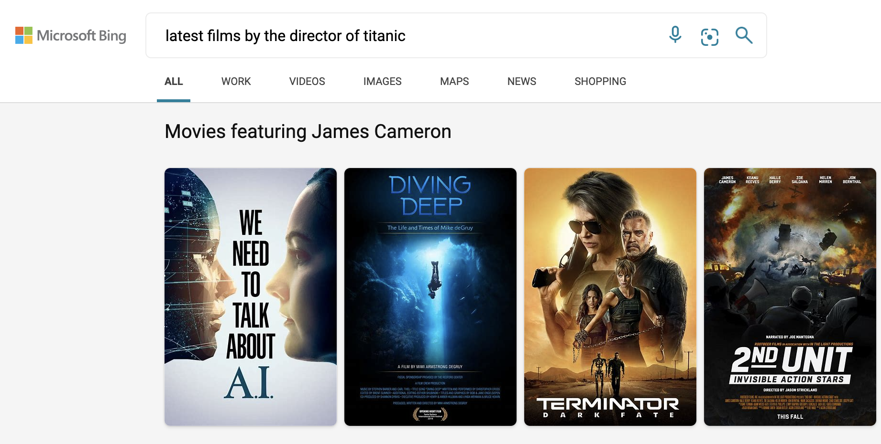
Applications of Knowledge Graphs
Serving information:
Image credit: Bing
Notes:
To give you some more context if you go to a search engine today search …
That is a query in the KG and they spread it out into a graph, and every movie is a node, every director is a node and there are relationships between those
So you can go to a KG and say here are the movies
(factual knowledge)

Slide 11
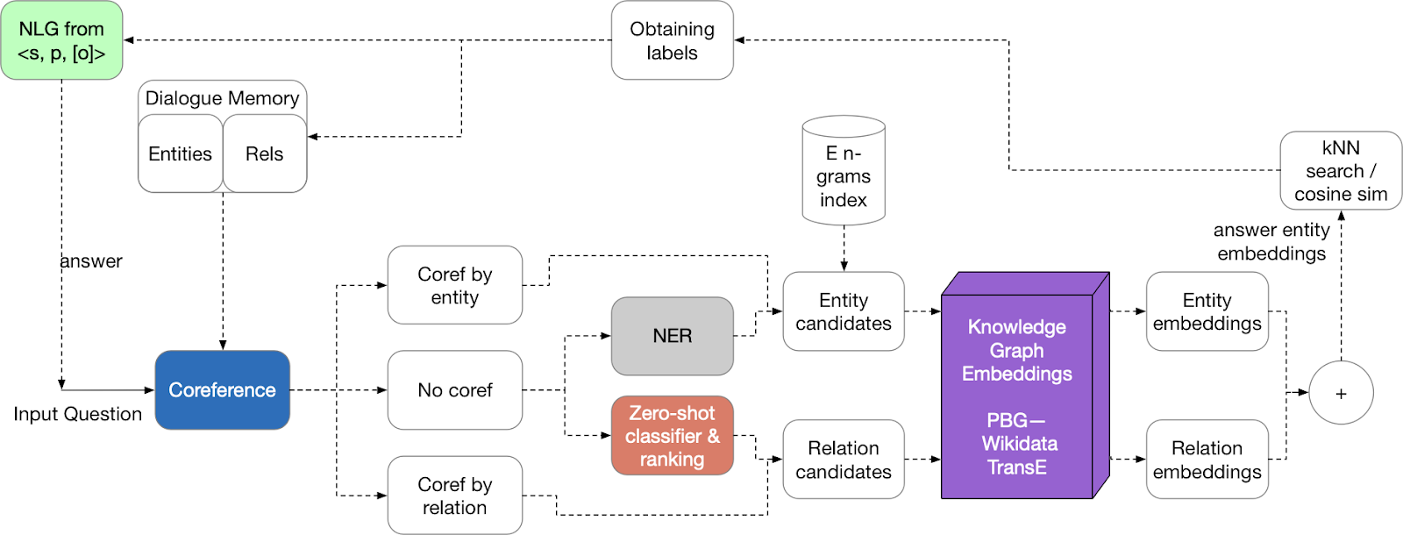
Applications of Knowledge Graphs
Question answering and conversation agents
Image credit: Medium

Slide 12
Knowledge Graph Datasets
Publicly available KGs:
  FreeBase, Wikidata, Dbpedia, YAGO, NELL, etc.
Common characteristics:
  Massive: Millions of nodes and edges
  Incomplete: Many true edges are missing
Given a massive KG, enumerating all the possible facts is intractable!
Can we predict plausible BUT missing links?
Notes:
Freebase but then was acquired by google
Wikidata is graph representation of all the knowledge in Wikipedia
Dbpedia
Crawled the web and extracted knowledge from the web in a structured form
Notoriously incomplete
KG are great, KG is explicitely captured, you can edit it, you can improve it you know it is there
This Is on one say and then you say I have language models on the other side they also capture knowledge
What is very hard to say is whether a language model is able to capture something, will it hallucinate, will it be able to recall
A combination of these two works really well, one the one hand you have private knowledge which you curate, you know how to engineer, you update it and so on
Language model that can retrieve from the knowledge graph
There is space for both to exist and they are very complementary technologies
Identify missing relationships in KG

Slide 13

Example: Freebase
Freebase
  ~80 million entities
  ~38K relation types
  ~3 billion facts/triples
Datasets: FB15k/FB15k-237
  A complete subset of Freebase, used by researchers to learn KG models
93.8% of persons from Freebase have no place of birth and 78.5% have no nationality!
[1] Paulheim, Heiko. "Knowledge graph refinement: A survey of approaches and evaluation methods." Semantic web 8.3 (2017): 489-508.
[2] Min, Bonan, et al. "Distant supervision for relation extraction with an incomplete knowledge base." Proceedings of the 2013 Conference of the North American Chapter of the Association for Computational Linguistics: Human Language Technologies. 2013.
Notes:
To give you an example
Born in, is a brother of
80% of the humans have no nationality. Could you predict or infer person’s nationality based on the patterns of connection they have in the knowledge graph
And the standard benchmark dataset
Small KGs
Relation types instance of those relations

Slide 14
Stanford CS224W:
Knowledge Graph Completion
CS224W: Machine Learning with Graphs
Jure Leskovec, Stanford University
http://cs224w.stanford.edu

Slide 15
KG Completion Task
Given an enormous KG, can we complete the KG?
  For a given (head, relation), we predict missing tails.
    (Note this is slightly different from link prediction task)
J.R.R Tolkien
Science Fiction
missing relation: genre
Example task: predict the tail “Science Fiction” for (“J.K. Rowling”, “genre”)
genre
genre
Influence
genre
Fantasy
Stephen King
genre
Influence
J.K. Rowling
Influence
Influence
C.S. Lewis
genre
Influence
Alan Poe
Tragicomedy
Lloyd Alexander
Notes:
Figure out relationships that are not explicitly stated in the KG
Slightly different than link prediction
KG about literature, books authors and genres The link of a particular genre or author is missing,
JK rowling genre I want to predict science finction
Pattern of connection to predict this missing genre
How is that different from link prediction, I am giving a head the relation and I want to find the tail

Slide 16

Recap: “Shallow” Encoding
Simplest encoding approach: encoder is just an embedding-lookup
embedding vector for a specific node
embedding matrix
Dimension/size of embeddings
one column per node
Notes:
How are we going to do that
We are going to learn a shallow embedding for every node, for every entity and we are also going to learn an embedding for every relation

Slide 17
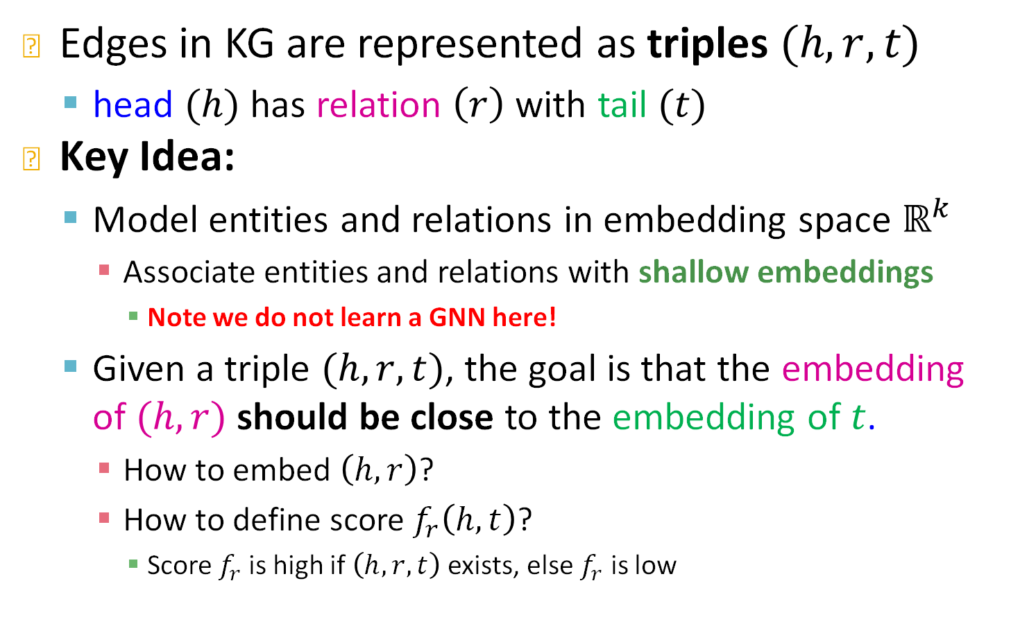
KG Representation
Edges in KG are represented as triples $(h,r,t)$
  head $(h)$ has relation $\left(r\right)$ with tail $(t)$
Key Idea:
  Model entities and relations in embedding space $ℝ^{k}$
    Associate entities and relations with shallow embeddings
      Note we do not learn a GNN here!
  Given a triple $(h,r,t)$, the goal is that the embedding of $(h,r)$ should be close to the embedding of $t$.
    How to embed $\left(h,r\right)$?
    How to define score $f_{r}\left(h,t\right)$?
      Score $f_{r}$is high if $\left(h,r,t\right)$ exists, else $f_{r}$ is low
Notes:
We are going to think of a KG as a set of triples Maria studies CS224w node for maria node for CS224W and there is a relation of type teaches
We are going to compose the entity+relation
Embedding of entity, embedding of relation and we will guess the tail
No GNNs today, but shallow embeddings
How do I score the proximity to the tail

Slide 18
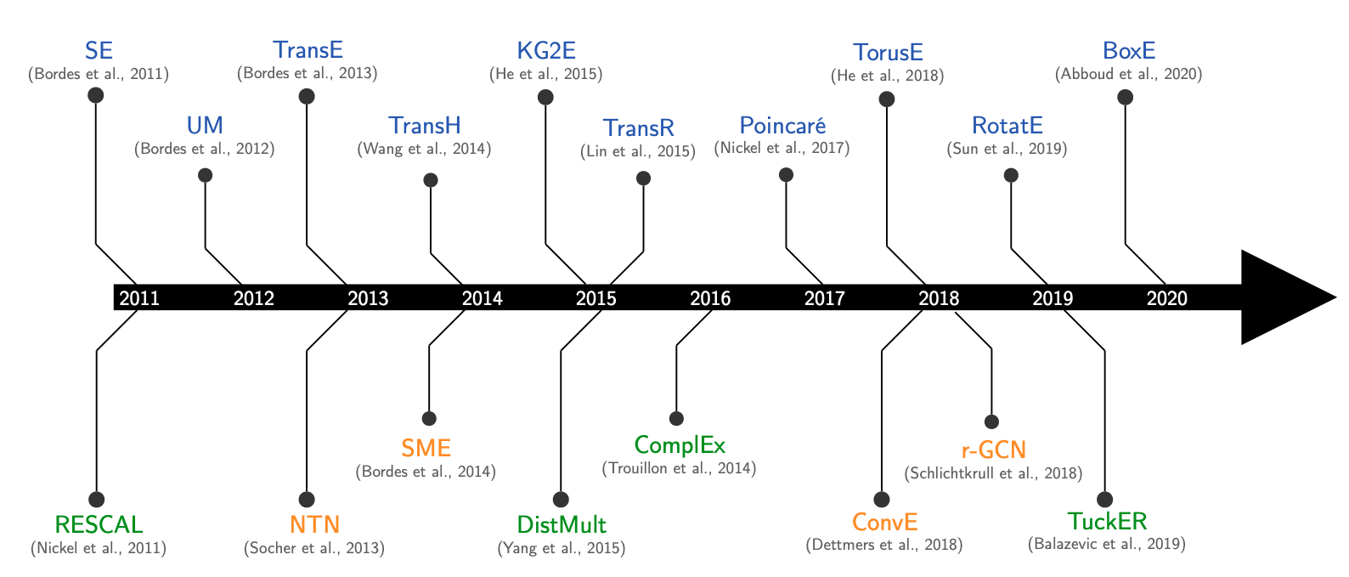
Many KG Embedding Models
Many KG embedding Models:
Notes:
I show you Timeline of this field
Started 10-15 years ago and show you how it developed over time. We will talk about some milestone in this KG modeling

Slide 19
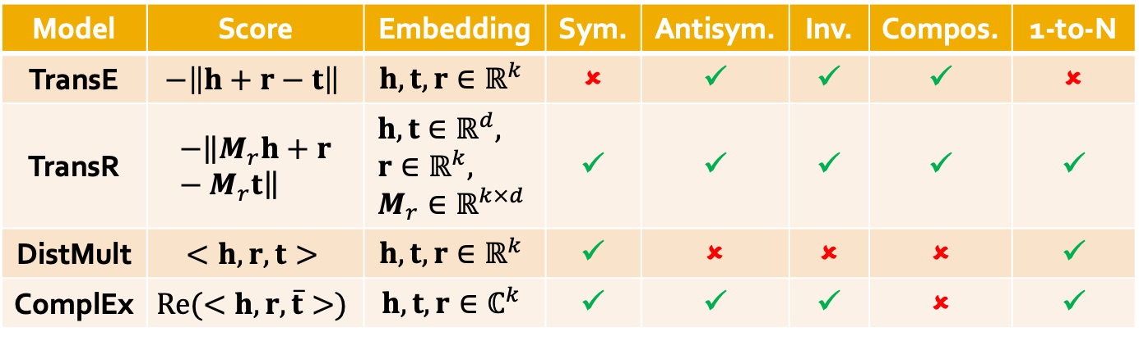
Today: Different Models
We are going to learn about different KG embedding models (shallow/transductive embs):
Different models are…
  …based on different geometric intuitions
  …capture different types of relations (have different expressivity)
Model | Score | Embedding | Sym. | Antisym. | Inv. | Compos. | 1-to-N
TransE | $$−\left\|h+r−t\right\|$$ | $$h,t,r∈ℝ^{k}$$ | ✗ | ✓ | ✓ | ✓ | ✗
TransR | $$−\left\|M_{r}h+r−M_{r}t\right\|$$ | $$h,t∈ℝ^{d}, \\ r∈ℝ^{k}, \\ M_{r}∈ℝ^{k×d}$$ | ✓ | ✓ | ✓ | ✓ | ✓
DistMult | $$<h,r,t>$$ | $$h,t,r∈ℝ^{k}$$ | ✓ | ✗ | ✗ | ✗ | ✓
ComplEx | $$Re(<h,r,\overline{t}>)$$ | $$h,t,r∈ℂ^{k}$$ | ✓ | ✓ | ✓ | ✗ | ✓
Notes:
They are going to differ in terms of their scoring function
Scoring function gives the probability of link between h,r,t, measures the proximity between the head relation pair and tail
Different models different score functions can model relations with different properties

Slide 20
Stanford CS224W:
Knowledge Graph Completion:
TransE
CS224W: Machine Learning with Graphs
Jure Leskovec, Stanford University
http://cs224w.stanford.edu

Slide 21
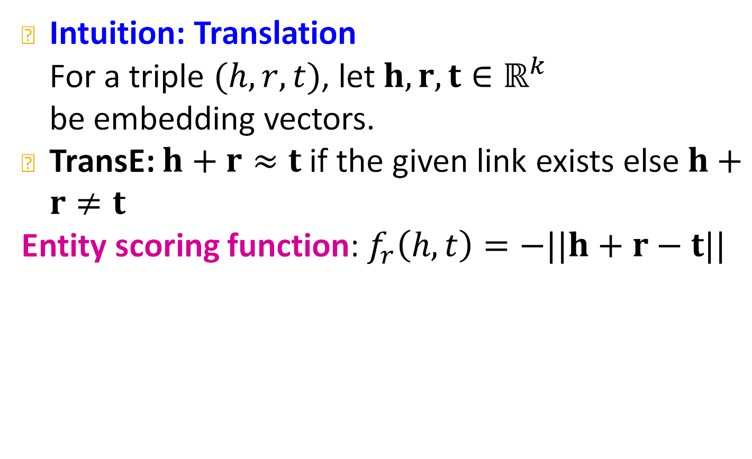



TransE
Bordes et al., Translating embeddings for modeling multi-relational data, NeurIPS 2013.
Intuition: Translation
For a triple $(h,r,t)$, let $h,r,t∈ℝ^{k}$
be embedding vectors.
TransE: $h+r≈t$ if the given link exists else $h+r≠t$
Entity scoring function: $f_{r}\left(h,t\right)=−||h+r−t||$
embedding vectors will appear in boldface
$$t$$
$$r$$
Nationality
$$h$$
Obama
U.S.A
Notes:
2013 neurips paper

Slide 22
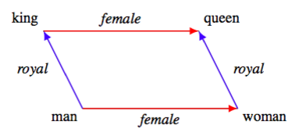
TransE: Idea
Entity embeddings
Notes:
This is interesting because it has a very compelling geometric intuition
Suppose we have a kg with 4 entities and 2 relations and the 2d representation of their embedding
The semantic meaning of each embedding is translated to a nice geometric interpretation

Slide 23
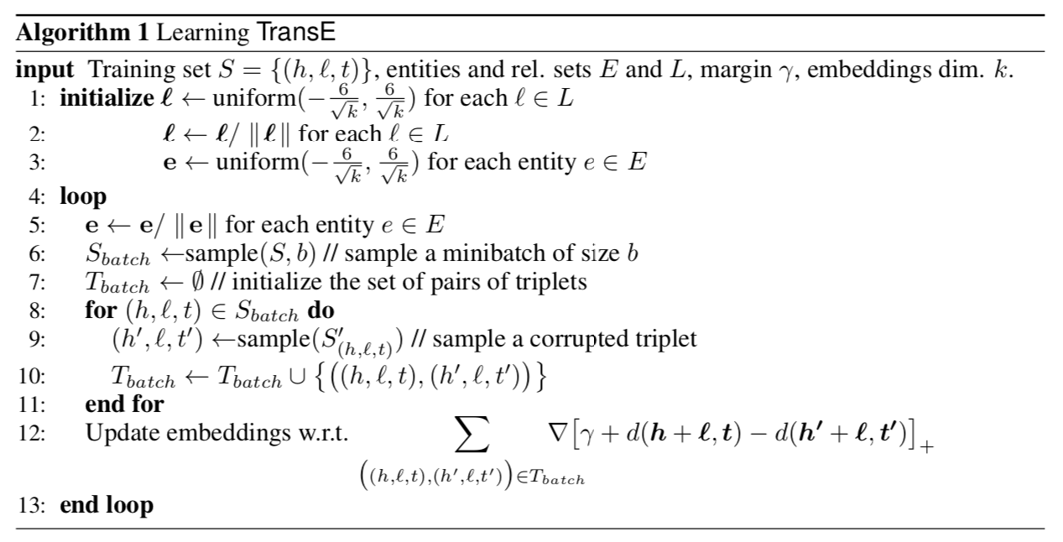

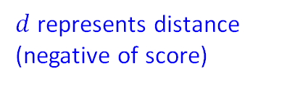


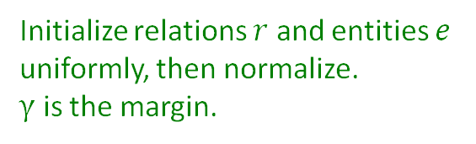
TransE: How to Learn
$$r$$
$$R$$
$$r$$
$$r$$
$$R$$
Initialize relations $r$ and entities $e$ uniformly, then normalize.
$γ$ is the margin.
$$r$$
$$r$$
$$r$$
$$r$$
$$R$$
Sample triplet $(h’, r, t)$that does not appear in the KG.
$$r$$
$$r$$
$d$ represents distance (negative of score)
$$r$$
$$r$$
$$r$$
$$r$$
$$r$$
positive sample
negative sample
$$r$$
$$r$$
Contrastive loss: Favors lower distance (or higher score) for valid triplets, high distance (or lower score) for corrupted ones
Notes:
Scary you with the big slide
Initialize randomly according to this commonly used heuristic
Then the training part starts. You normalize the embeddings of all entities, then you sample some triplets to be your training batch
Then you are doing something extremely useful. You not only sample positive triplets but also negative or corrupted triplets. We talked about that yesterday.
Mona liza So we sample some edges that don’t exist in a way that makes sense. For example we don’t want to sample a triplet mona liza is not in the sea
And here I am saying in a way that makes sense but they is very advanced literature to explain what makes sense mean or effective ways to do negative sampling
So here we maximize the distance between positive and negative triplets or in other words put a high score on valid triplets and low score on corrupted ones

Slide 24
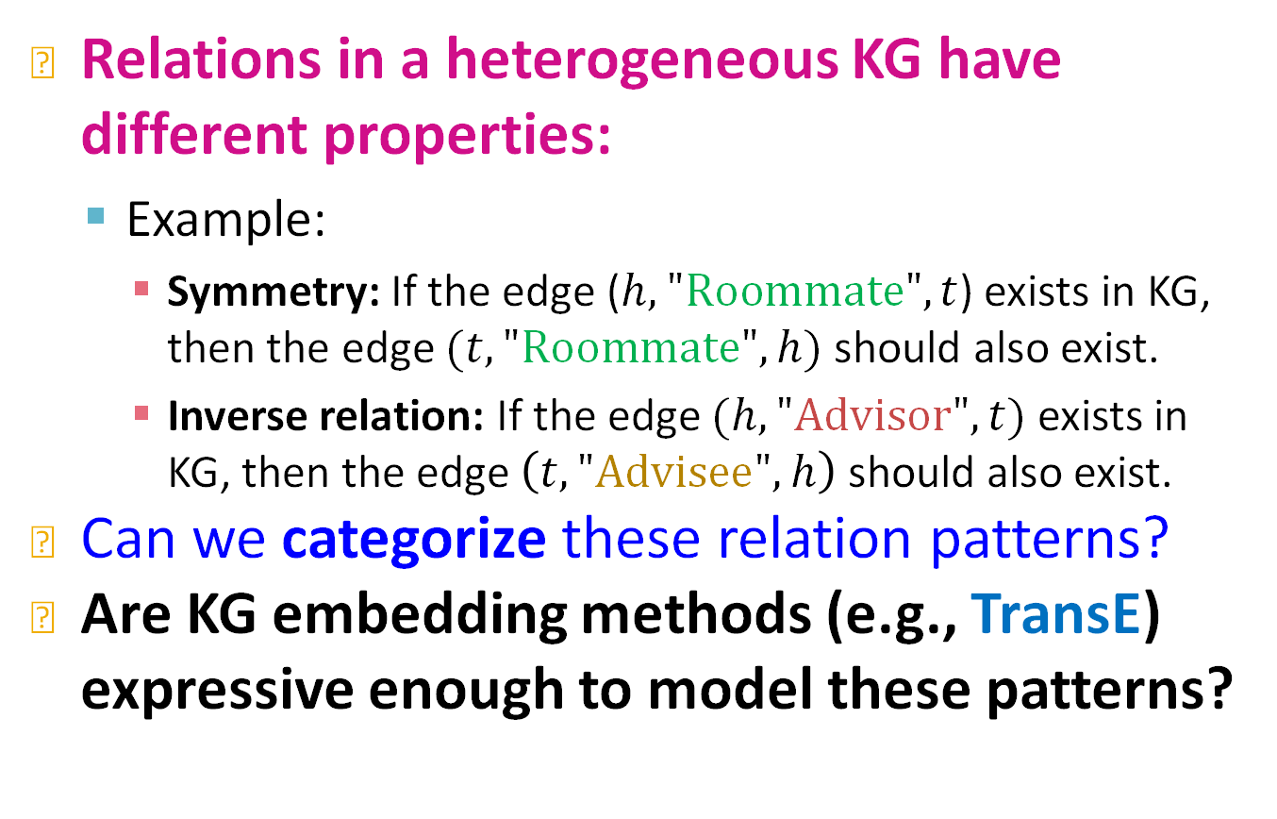
Connectivity Patterns in KG
Relations in a heterogeneous KG have different properties:
  Example:
    Symmetry: If the edge ($h,"Roommate",t$) exists in KG, then the edge $(t,"Roommate",h)$ should also exist.
    Inverse relation: If the edge $(h,"\text{Advisor}\text{"}, t)$ exists in KG, then the edge $\left(t,"Advisee",h\right)$ should also exist.
Can we categorize these relation patterns?
Are KG embedding methods (e.g., TransE) expressive enough to model these patterns?
Notes:
Different score function correspond to different expressivity and they can model relations with different properties
!!!!

Slide 25
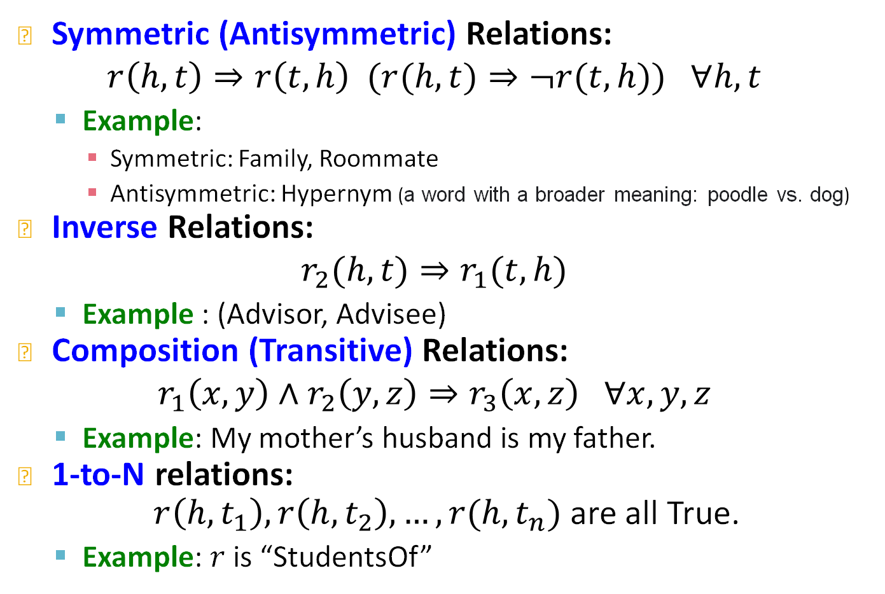
Four Relation Patterns
Symmetric (Antisymmetric) Relations:
$$r\left(h,t\right)⇒r\left(t,h\right) (r(h,t)⇒¬r(t,h)) ∀h,t$$
  Example:
    Symmetric: Family, Roommate
    Antisymmetric: Hypernym (a word with a broader meaning: poodle vs. dog)
Inverse Relations:
$$r_{2}(h,t)⇒r_{1}(t,h)$$
  Example : (Advisor, Advisee)
Composition (Transitive) Relations:
$$r_{1}\left(x,y\right)∧r_{2}\left(y,z\right)⇒r_{3}\left(x,z\right) ∀x,y,z$$
  Example: My mother’s husband is my father.
1-to-N relations:
$r\left(h,t_{1}\right), r\left(h,t_{2}\right), …, r(h,t_{n})$ are all True.
  Example: $r$ is “StudentsOf”
Notes:
Today we are going to talk about five
Hypernym is the relation of two words where the tail has a broader meaning than the head I go from poodle to dog, dog is a hypernym of poodle
Symmetric relation pattern show the ability to model undirected graphs whereas antisymmetric models directed graphs
Inverse relation I already talked about that. Relation of one type implies an inverse relation at a different direction
Transitive or compositional relations
John mechanic

Slide 26
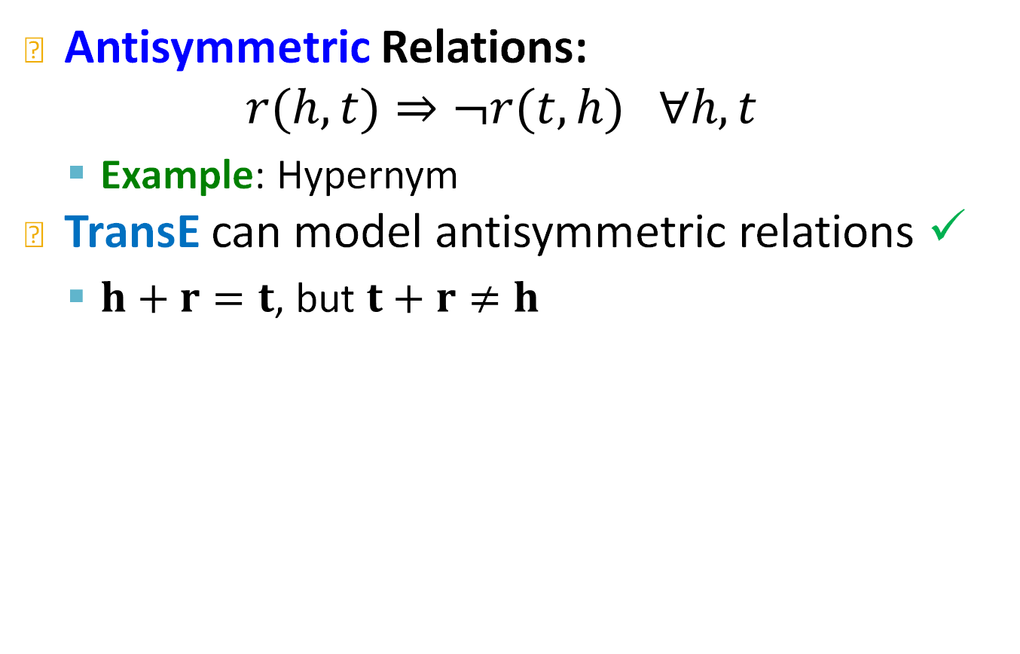




Antisymmetric Relations in TransE
Antisymmetric Relations:
$$r(h,t)⇒¬r(t,h) ∀h,t$$
  Example: Hypernym
TransE can model antisymmetric relations ✓
  $h+r=t$, but $t+r≠h$
    (a word with a broader meaning: poodle vs. dog)
$$r$$
$$r$$
$$h$$
$$t$$

Slide 27
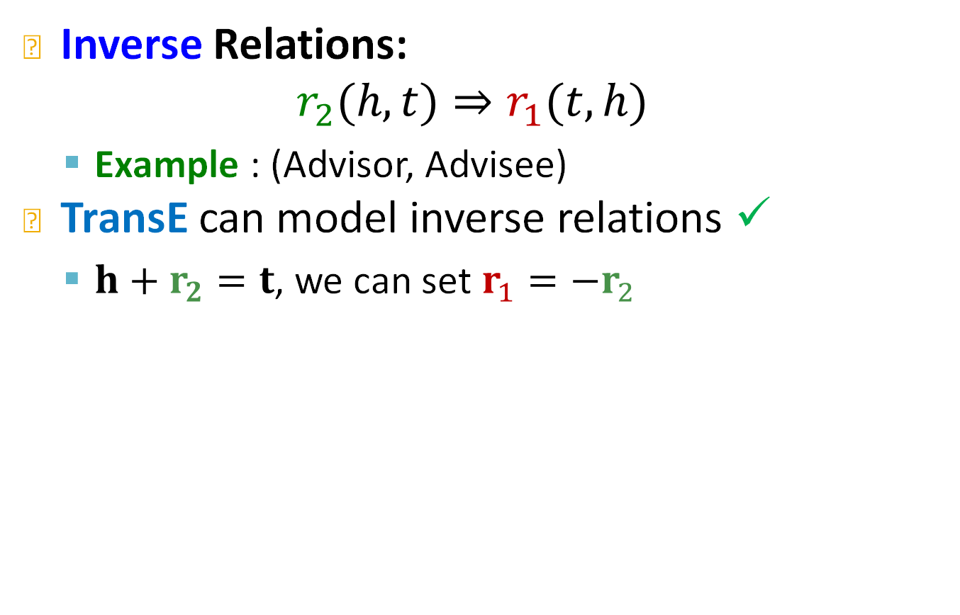



Inverse Relations in TransE
Inverse Relations:
$$r_{2}(h,t)⇒r_{1}(t,h)$$
  Example : (Advisor, Advisee)
TransE can model inverse relations ✓
  $h+r_{2}=t$, we can set $r_{1}=−r_{2}$
$$r_{1}$$
$$t$$
$$h$$
$$r_{2}$$

Slide 28

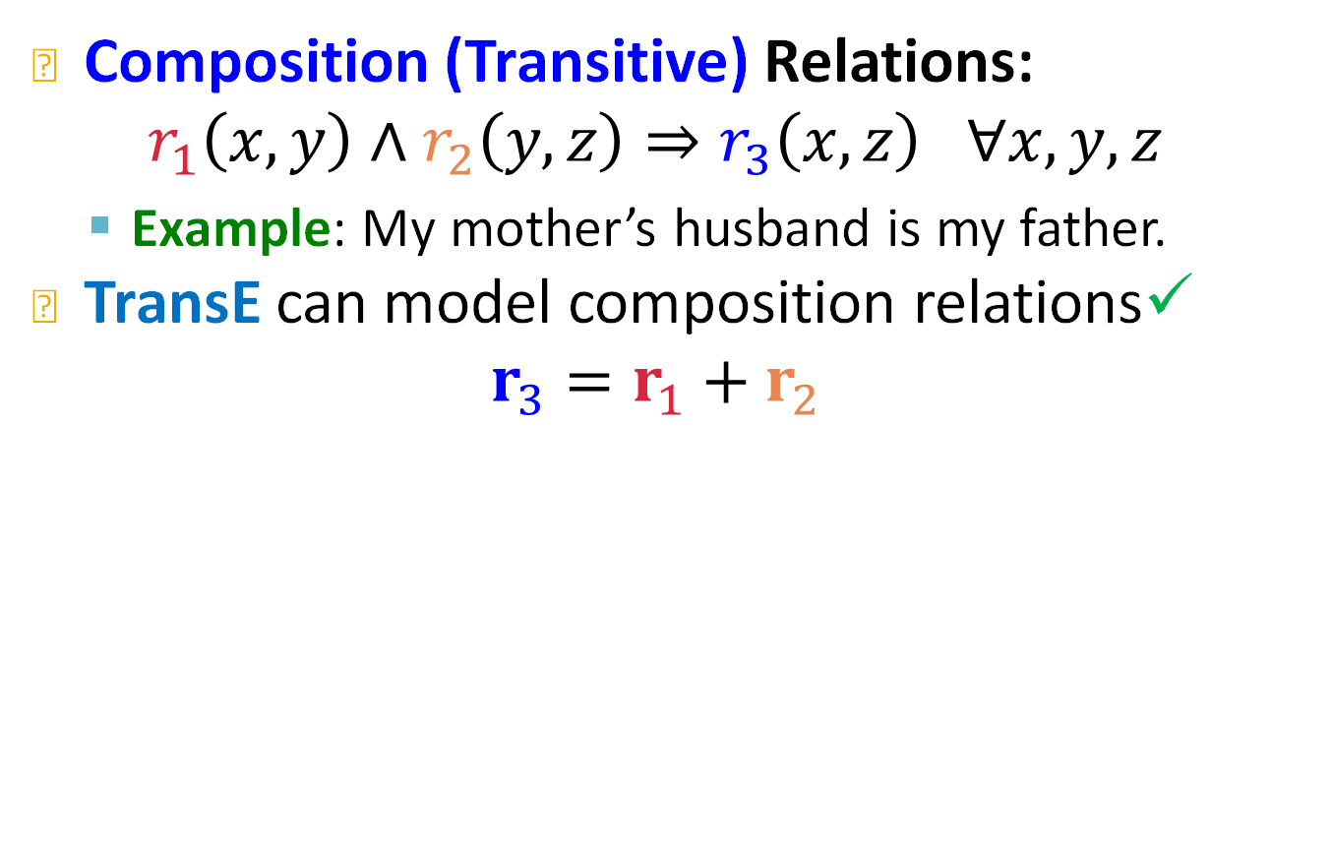





Composition in TransE
Composition (Transitive) Relations:
$$r_{1}\left(x,y\right)∧r_{2}\left(y,z\right)⇒r_{3}\left(x,z\right) ∀x,y,z$$
  Example: My mother’s husband is my father.
TransE can model composition relations✓
$$r_{3}=r_{1}+r_{2}$$
$$y$$
$$r_{1}$$
$$r_{2}$$
$$x$$
$$z$$
$$r_{3}$$
Notes:
Multihop composite or transitive relationships

Slide 29
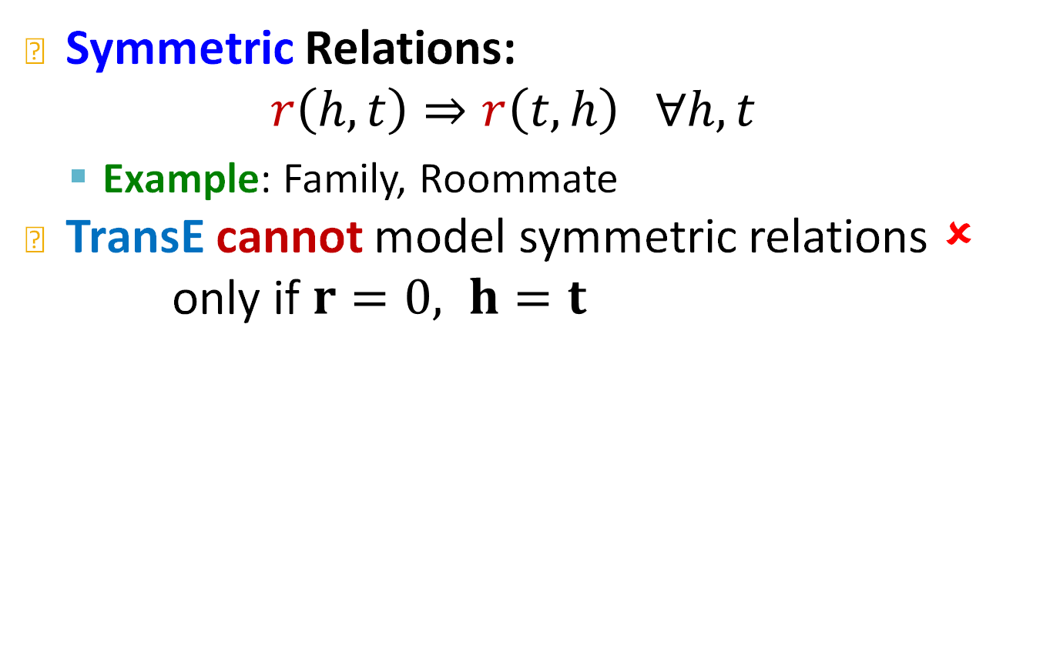
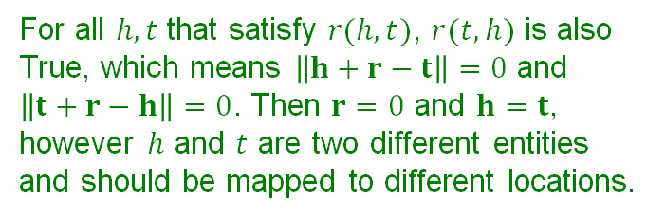



Limitation: Symmetric Relations
Symmetric Relations:
$$r\left(h,t\right)⇒r\left(t,h\right) ∀h,t$$
  Example: Family, Roommate
TransE cannot model symmetric relations ✗
only if $r=0, h=t$
For all $h,t$ that satisfy $r(h,t)$, $r(t,h)$ is also True, which means $\left\|h+r−t\right\|=0$ and $\left\|t+r−h\right\|=0$. Then $r=0$ and $h=t$, however $h$ and $t$ are two different entities and should be mapped to different locations.
$$r$$
$$t$$
$$h$$
Notes:
Reapply the vector and go back to head

Slide 30

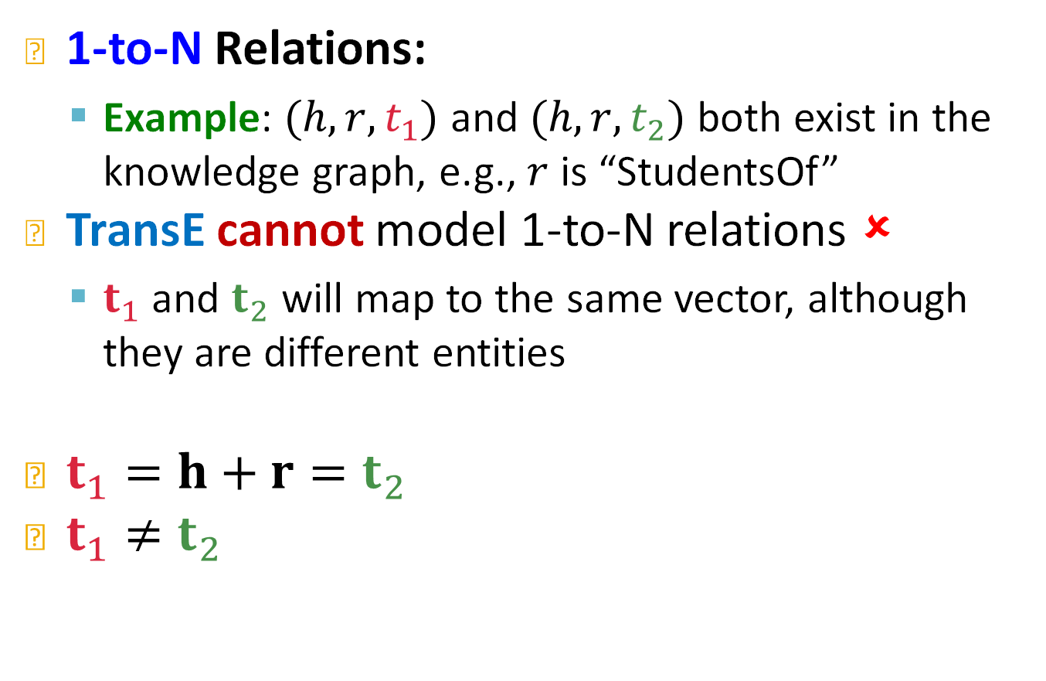




Limitation: 1-to-N Relations
1-to-N Relations:
  Example: $(h,r,t_{1})$ and $(h,r,t_{2})$ both exist in the knowledge graph, e.g., $r$ is “StudentsOf”
TransE cannot model 1-to-N relations ✗
  $t_{1}$ and $t_{2}$ will map to the same vector, although they are different entities
$t_{1}=h+r=t_{2}$
$t_{1}≠t_{2}$
$$t_{1}$$
$$t_{2}$$
$$r$$
contradictory!
$$r$$
$$h$$

Slide 31
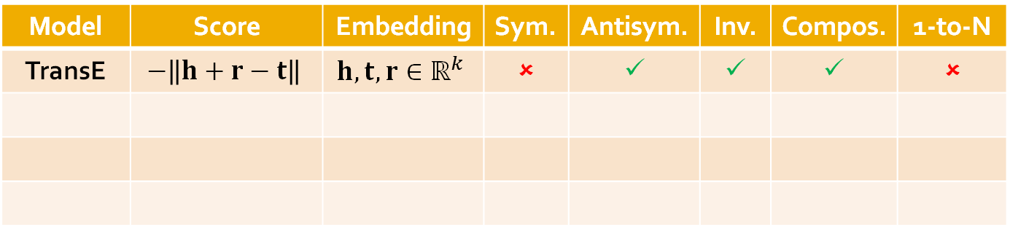
Today: KG Completion Models
What we learned so far:
Model | Score | Embedding | Sym. | Antisym. | Inv. | Compos. | 1-to-N
TransE | $$−\left\|h+r−t\right\|$$ | $$h,t,r∈ℝ^{k}$$ | ✗ | ✓ | ✓ | ✓ | ✗
Notes:
It has this nice interpretation of learning to move towards a given direction and the direction is given by the relation

Slide 32
Stanford CS224W:
Knowledge Graph Completion:
TransR
CS224W: Machine Learning with Graphs
Jure Leskovec, Stanford University
http://cs224w.stanford.edu

Slide 33
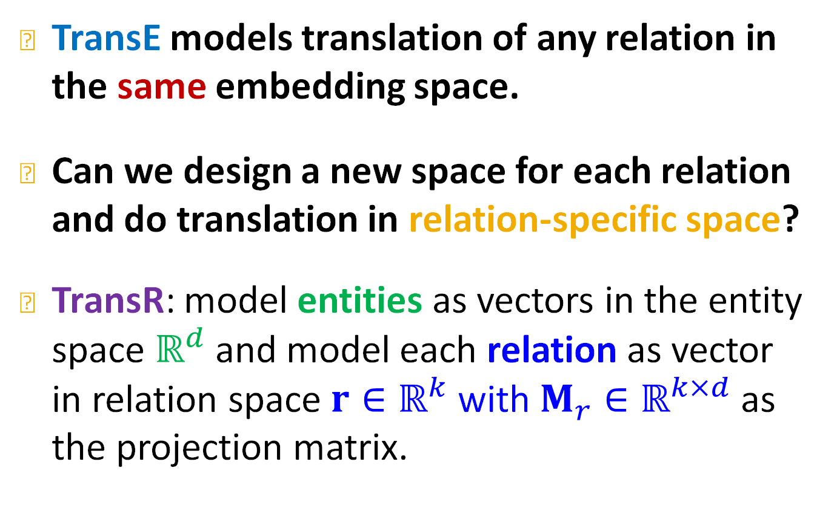
TransR
Lin et al., Learning entity and relation embeddings for knowledge graph completion, AAAI 2015
TransE models translation of any relation in the same embedding space.
Can we design a new space for each relation and do translation in relation-specific space?
TransR: model entities as vectors in the entity space $ℝ^{d}$ and model each relation as vector in relation space ${r∈ℝ}^{k}$ with $M_{r}∈ℝ^{k×d}$ as the projection matrix.
Notes:
Box
Here we learn embeddings of entities embeddings of relations and a linear mapping from relations to entities
transR

Slide 34

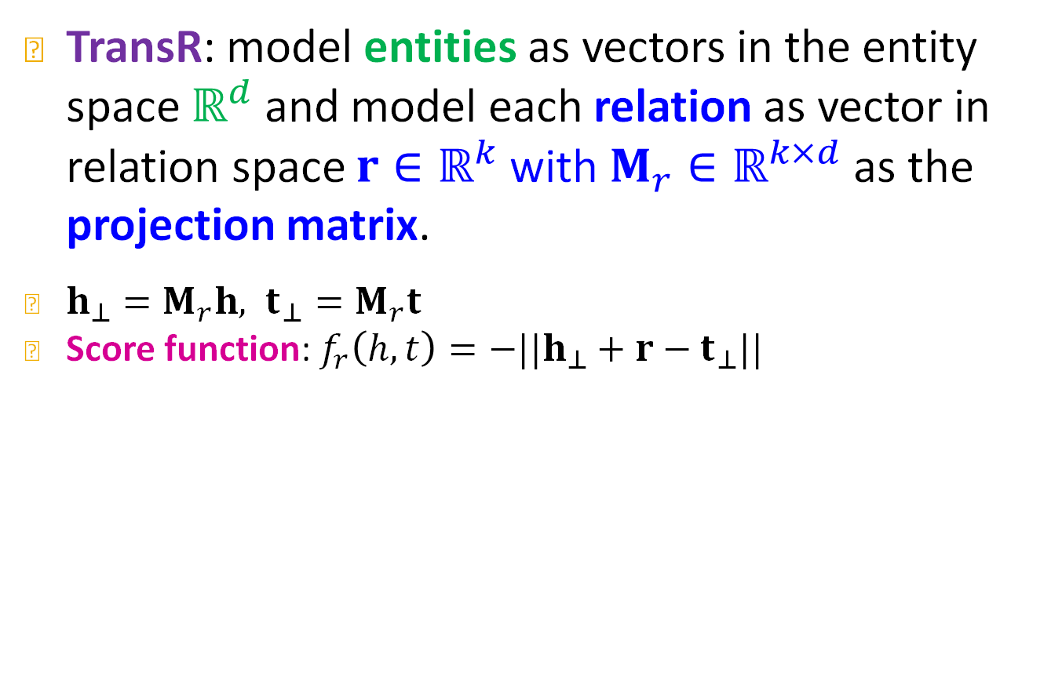



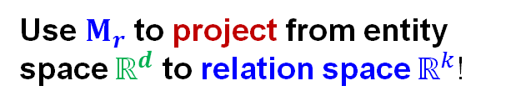




TransR
TransR: model entities as vectors in the entity space $ℝ^{d}$ and model each relation as vector in relation space ${r∈ℝ}^{k}$ with $M_{r}∈ℝ^{k×d}$ as the projection matrix.
$h_{⊥}=M_{r}h, t_{⊥}=M_{r}t$
Score function: $f_{r}\left(h,t\right)=−||h_{⊥}+r−t_{⊥}||$
Use $M_{r}$ to project from entity space $ℝ^{d}$ to relation space $ℝ^{k}$!
Space of entities:${ ℝ}^{d}$
Space of relation $r$: $ℝ^{k}$
$M_{r}$
$$t$$
$$h$$
$$r$$
$$t_{⊥}$$
$$h_{⊥}$$
Notes:
For every relation I am going to learn a relation embedding and a relation matrix and then I will use the matrix to project heads and tails into the relation space and I will do transE in the relation space

Slide 35
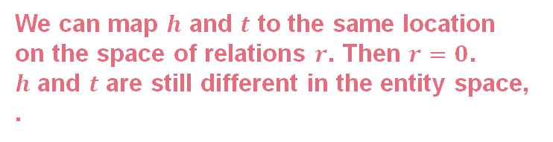
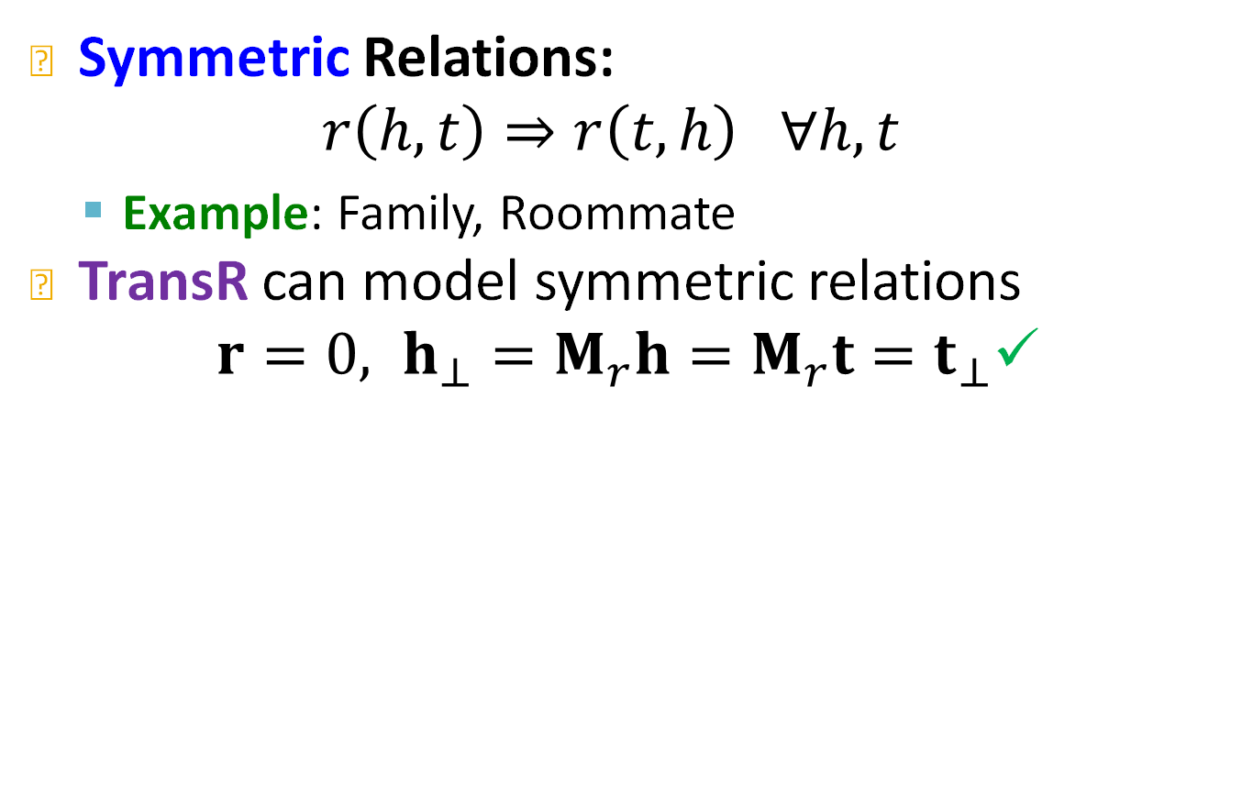


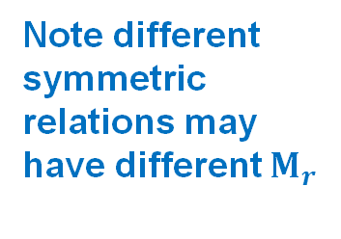




Symmetric Relations in TransR
Symmetric Relations:
$$r\left(h,t\right)⇒r\left(t,h\right) ∀h,t$$
  Example: Family, Roommate
TransR can model symmetric relations
$r=0, h_{⊥}=M_{r}h=M_{r}t=t_{⊥}$✓
Note different symmetric relations may have different $M_{r}$
Space of entities:${ ℝ}^{d}$
Space of relation $r$: $ℝ^{k}$
$$t$$
We can map $h$ and $t$ to the same location on the space of relations $r$. Then $r=0$.
$h$ and $t$ are still different in the entity space, .
$$M_{r}$$
$$h$$
$$t_{⊥},h_{⊥}$$
Notes:
X, y coordinate

Slide 36
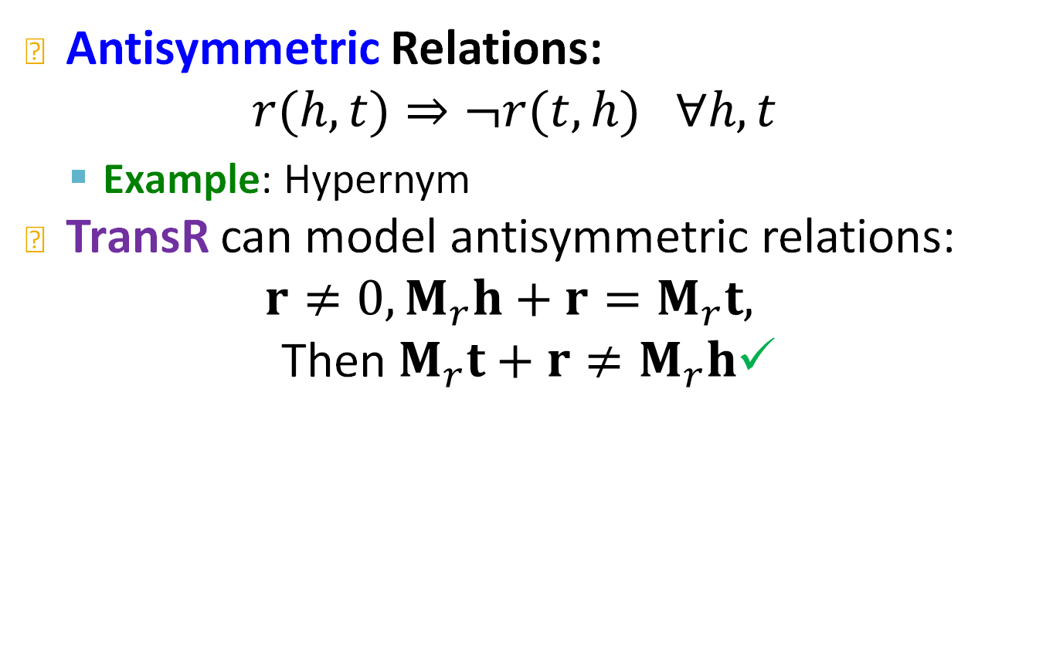







Antisymmetric Relations in TransR
Antisymmetric Relations:
$$r(h,t)⇒¬r(t,h) ∀h,t$$
  Example: Hypernym
TransR can model antisymmetric relations:
$$r≠0,M_{r}h+r=M_{r}t,$$
Then$M_{r}t+r≠M_{r}h$✓
Space of entities:${ ℝ}^{d}$
Space of relation $r$: $ℝ^{k}$
$$t$$
$$r$$
$$M_{r}$$
$$t_{⊥}$$
$$r$$
$$h$$
$$h_{⊥}$$
Notes:
Trans R is transE in the relation space

Slide 37

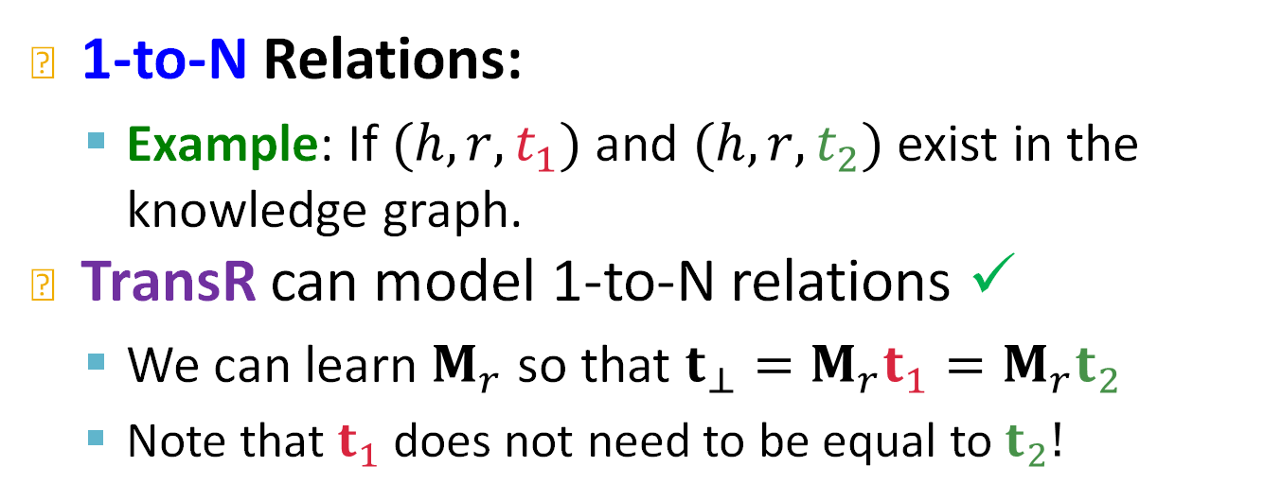




1-to-N Relations in TransR
1-to-N Relations:
  Example: If $(h,r,t_{1})$ and $(h,r,t_{2})$ exist in the knowledge graph.
TransR can model 1-to-N relations ✓
  We can learn $M_{r}$ so that $t_{⊥}=M_{r}t_{1}=M_{r}t_{2}$
  Note that $t_{1}$ does not need to be equal to $t_{2}!$
$$t_{1}$$
$$M_{r}$$
$$t_{2}$$
$$r$$
$$t_{⊥}$$
$$h_{⊥}$$
$$h$$
Notes:
Whiteboard. So we have fixed deficiencies of TransE

Slide 38
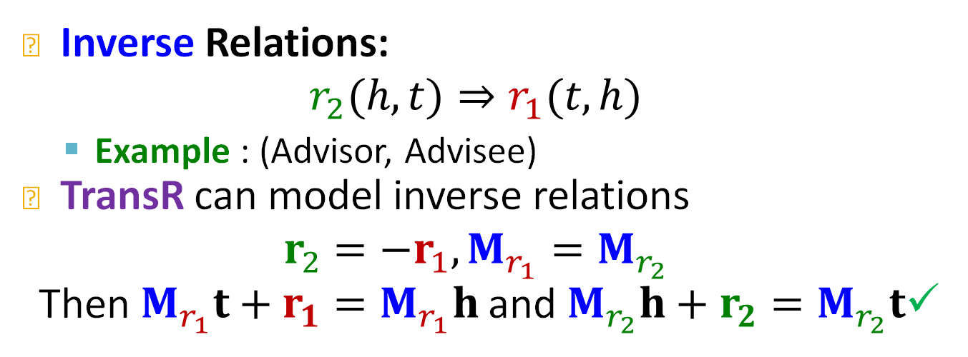



Inverse Relations in TransR
Inverse Relations:
$$r_{2}(h,t)⇒r_{1}(t,h)$$
  Example : (Advisor, Advisee)
TransR can model inverse relations
$$r_{2}=−r_{1},M_{r_{1}}=M_{r_{2}}$$
Then$M_{r_{1}}t+r_{1}=M_{r_{1}}h$ and $M_{r_{2}}h+r_{2}=M_{r_{2}}t$✓
Space of entities:${ ℝ}^{d}$
Space of relation $r$: $ℝ^{k}$
$$t$$
$$t_{⊥}$$
$$M_{r_{1}}=M_{r_{2}}$$
$$r_{1}$$
$$r_{2}$$
$$h$$
$$h_{⊥}$$
Notes:
tansE

Slide 39
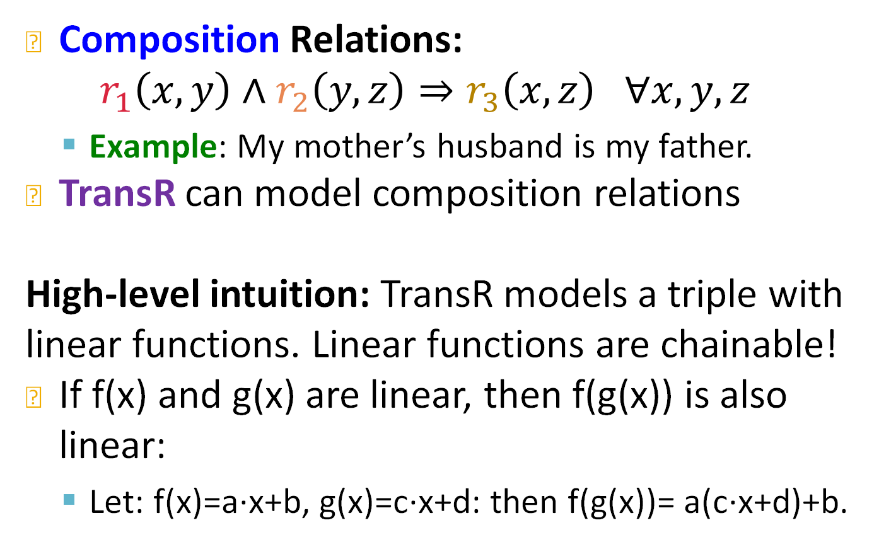
Composition Relations in TransR
Composition Relations:
$$r_{1}\left(x,y\right)∧r_{2}\left(y,z\right)⇒r_{3}\left(x,z\right) ∀x,y,z$$
  Example: My mother’s husband is my father.
TransR can model composition relations
High-level intuition: TransR models a triple with linear functions. Linear functions are chainable!
If f(x) and g(x) are linear, then f(g(x)) is also linear:
  Let: f(x)=a∙x+b, g(x)=c∙x+d: then f(g(x))= a(c∙x+d)+b.

Slide 40

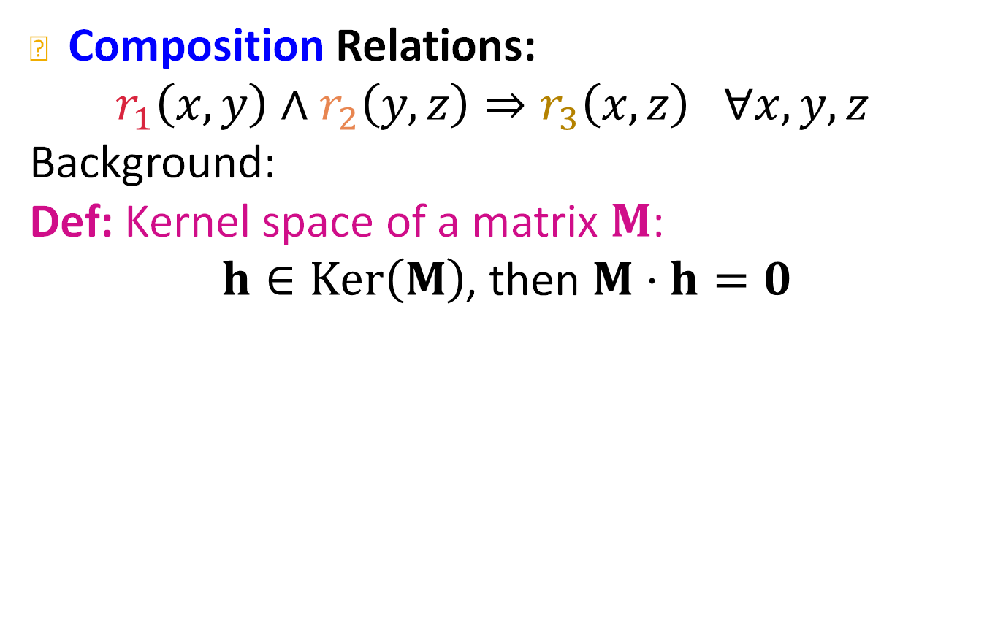



Composition Relations in TransR
Composition Relations:
$$r_{1}\left(x,y\right)∧r_{2}\left(y,z\right)⇒r_{3}\left(x,z\right) ∀x,y,z$$
Background:
Def: Kernel space of a matrix $M$:
$h∈Ker\left(M\right)$, then $M⋅h=0$
$$Ker\left(M\right)$$
$$M$$
$$h$$
$$0$$

Slide 41
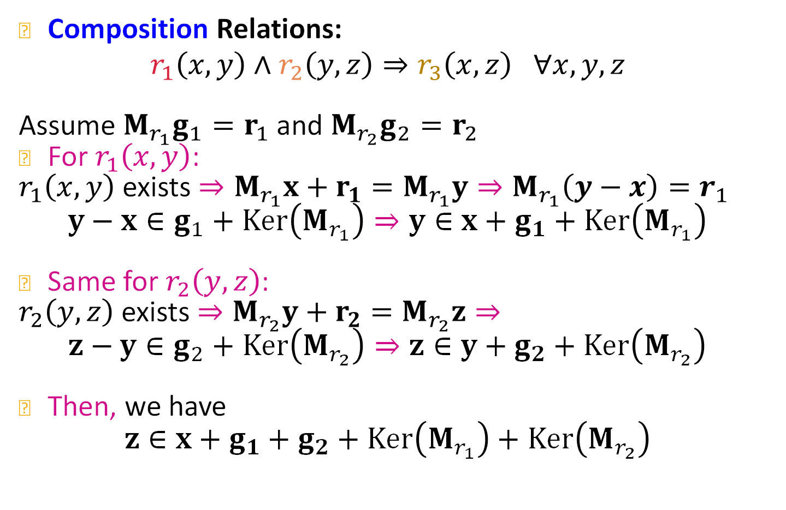
Composition Relations in TransR
Composition Relations:
$$r_{1}\left(x,y\right)∧r_{2}\left(y,z\right)⇒r_{3}\left(x,z\right) ∀x,y,z$$
Assume ${M_{r_{1}}g}_{1}=r_{1}$ and $M_{r_{2}}g_{2}=r_{2}$
For $r_{1}\left(x,y\right)$:
$r_{1}\left(x,y\right)$ exists $⇒M_{r_{1}}x+r_{1}=M_{r_{1}}y⇒M_{r_{1}}\left(y−x\right)=r_{1}$
$$y−x∈g_{1}+Ker\left(M_{r_{1}}\right)⇒y∈x+g_{1}+Ker\left(M_{r_{1}}\right)$$
Same for $r_{2}\left(y,z\right)$:
$r_{2}\left(y,z\right)$ exists $⇒M_{r_{2}}y+r_{2}=M_{r_{2}}z⇒$
$$z−y∈g_{2}+Ker\left(M_{r_{2}}\right)⇒z∈y+g_{2}+Ker\left(M_{r_{2}}\right)$$
Then, we have
$z∈x+g_{1}+g_{2}+Ker\left(M_{r_{1}}\right)+Ker\left(M_{r_{2}}\right)$

Slide 42
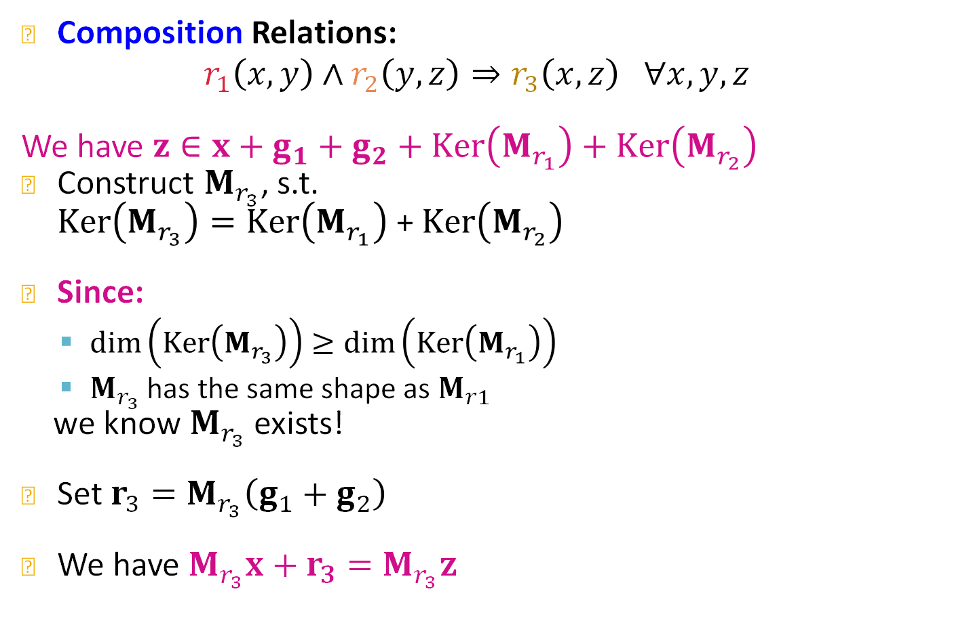
Composition Relations in TransR
Composition Relations:
$$r_{1}\left(x,y\right)∧r_{2}\left(y,z\right)⇒r_{3}\left(x,z\right) ∀x,y,z$$
We have $z∈x+g_{1}+g_{2}+Ker\left(M_{r_{1}}\right)+Ker\left(M_{r_{2}}\right)$
Construct $M_{r_{3}}$, s.t.
$Ker\left(M_{r_{3}}\right)=Ker\left(M_{r_{1}}\right)$ + $Ker\left(M_{r_{2}}\right)$
Since:
  $\dim\left(Ker\left(M_{r_{3}}\right)\right)≥\dim\left(Ker\left(M_{r_{1}}\right)\right)$
  $M_{r_{3}}$ has the same shape as $M_{r1}$
we know $M_{r_{3}}$ exists!
Set $r_{3}=M_{r_{3}}\left(g_{1}+g_{2}\right)$
We have $M_{r_{3}}x+r_{3}=M_{r_{3}}z$

Slide 43
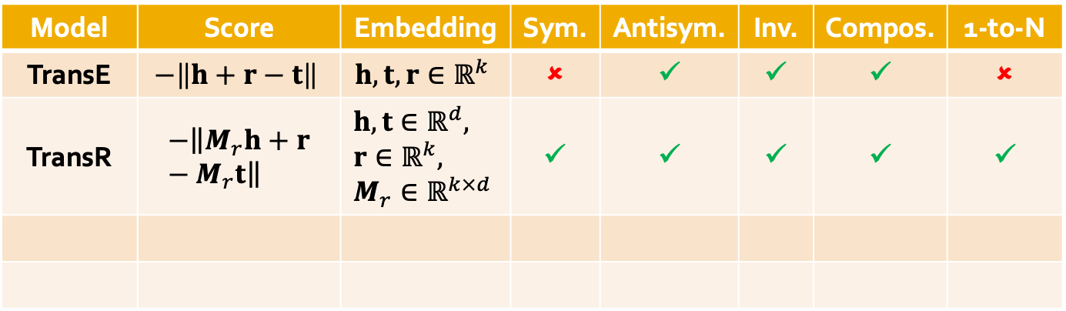
Today: KG Completion Models
What we learned so far:
Model | Score | Embedding | Sym. | Antisym. | Inv. | Compos. | 1-to-N
TransE | $$−\left\|h+r−t\right\|$$ | $$h,t,r∈ℝ^{k}$$ | ✗ | ✓ | ✓ | ✓ | ✗
TransR | $$−\left\|M_{r}h+r−M_{r}t\right\|$$ | $$h,t∈ℝ^{d}, \\ r∈ℝ^{k}, \\ M_{r}∈ℝ^{k×d}$$ | ✓ | ✓ | ✓ | ✓ | ✓
Notes:
I got more expressive power. What is the cost of expressive power? I have to learn a matrix for each relation

Slide 44
Stanford CS224W:
Knowledge Graph Completion:
DistMult
CS224W: Machine Learning with Graphs
Jure Leskovec, Stanford University
http://cs224w.stanford.edu

Slide 45
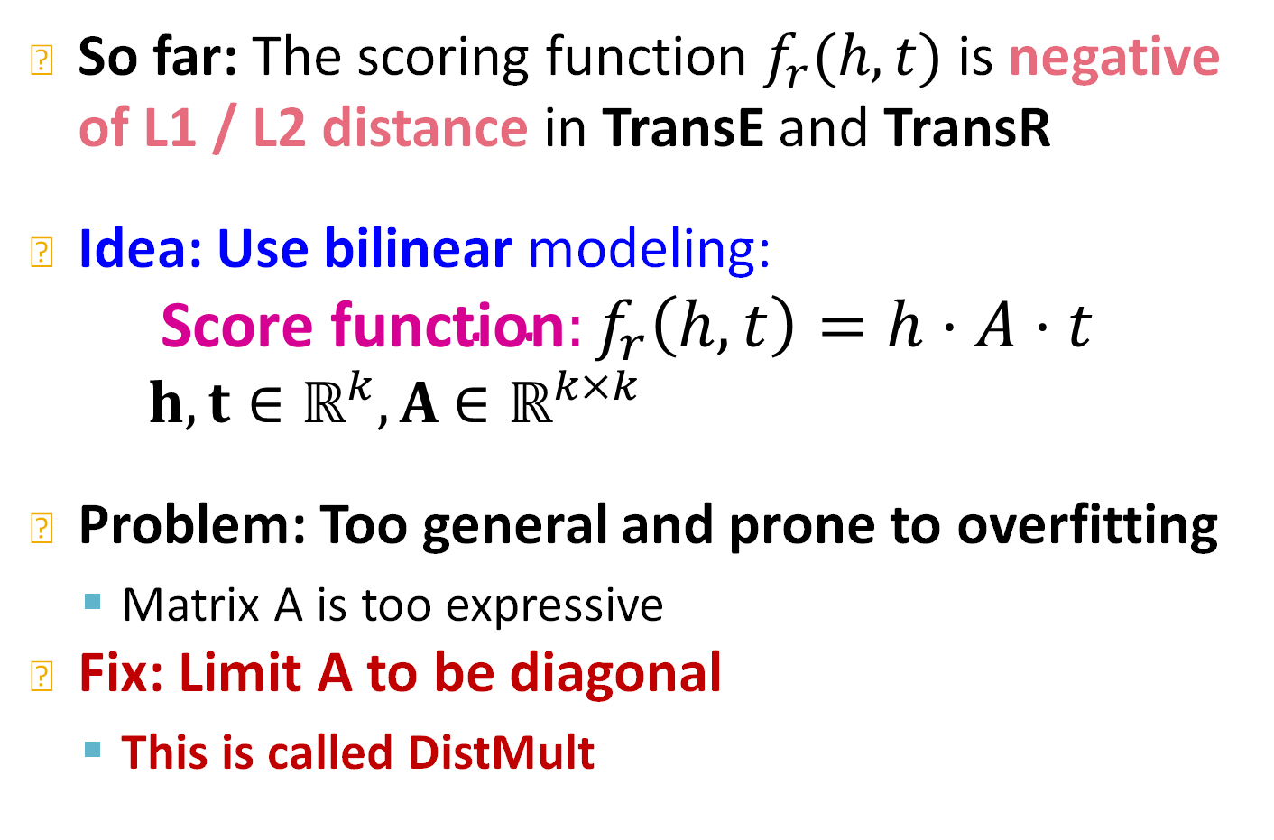
New Idea: Bilinear Modeling
Yang et al, Embedding Entities and Relations for Learning and Inference in Knowledge Bases, ICLR 2015
So far: The scoring function $f_{r}(h,t)$ is negative of L1 / L2 distance in TransE and TransR
Idea: Use bilinear modeling:
$${\text{Score} \text{function}:f}_{r}\left(h,t\right)=h⋅A⋅t$$
$h,t∈ℝ^{k}, A$ $∈ℝ^{k×k}$
Problem: Too general and prone to overfitting
  Matrix A is too expressive
Fix: Limit A to be diagonal
  This is called DistMult
Notes:
So far ..
Can we use a different scoring function
To many degrees of freedom it won’t work that well

Slide 46
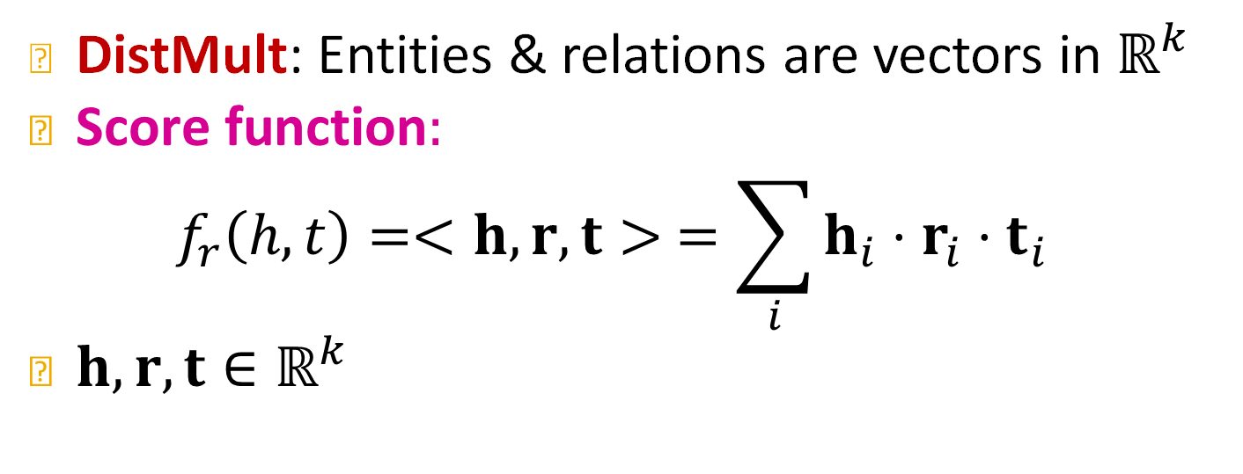




New Idea: Bilinear Modeling
Yang et al, Embedding Entities and Relations for Learning and Inference in Knowledge Bases, ICLR 2015
DistMult: Entities & relations are vectors in $ℝ^{k}$
$\text{Score} \text{function}:$
$$f_{r}\left(h,t\right)=<h, r,t> =\sum_{i}{h_{i}⋅r_{i}⋅t_{i}}$$
$h,r,t∈ℝ^{k}$
$$f_{r}(h,t)$$
Sum
$$r$$
Product
$$h$$
$$t$$
Notes:
Distmul maps entities and relations into a k dimensional space
Score function: we multiply coordinate wise h r ant and them sum over all coordinates
First you do Hadamard product and then you sum it up

Slide 47

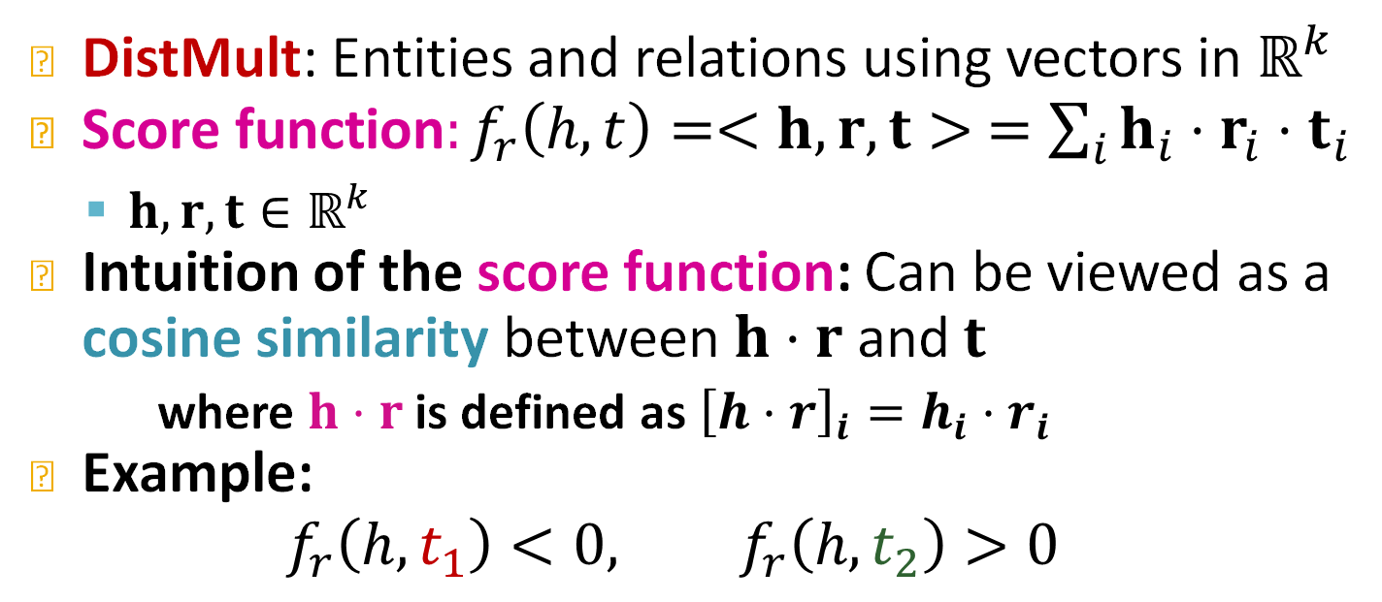
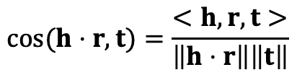

DistMult
DistMult: Entities and relations using vectors in $ℝ^{k}$
${\text{Score} \text{function}:f}_{r}\left(h,t\right)=<h, r,t> =\sum_{i}{h_{i}⋅r_{i}⋅t_{i}}$
  $h,r,t∈ℝ^{k}$
Intuition of the score function: Can be viewed as a cosine similarity between $h⋅r$ and $t$
  where $h⋅r$ is defined as ${\left[h⋅r\right]}_{i}=h_{i}⋅r_{i}$
Example:
$$f_{r}\left(h,t_{1}\right)<0, f_{r}\left(h,t_{2}\right)>0$$
Hadamard product
$$t_{2}$$
$$cos⁡(h⋅r,t)=\frac{<h, r,t>}{\left\|h⋅r\right\|\left\|t\right\|}$$
$$h⋅r$$
$$<h, r,t> =cos⁡(h⋅r,t)\left\|h⋅r\right\|\left\|t\right\|$$
$$t_{1}$$
Notes:
Intuition
The ebeding for head and relation is this coordinatewise product

Slide 48
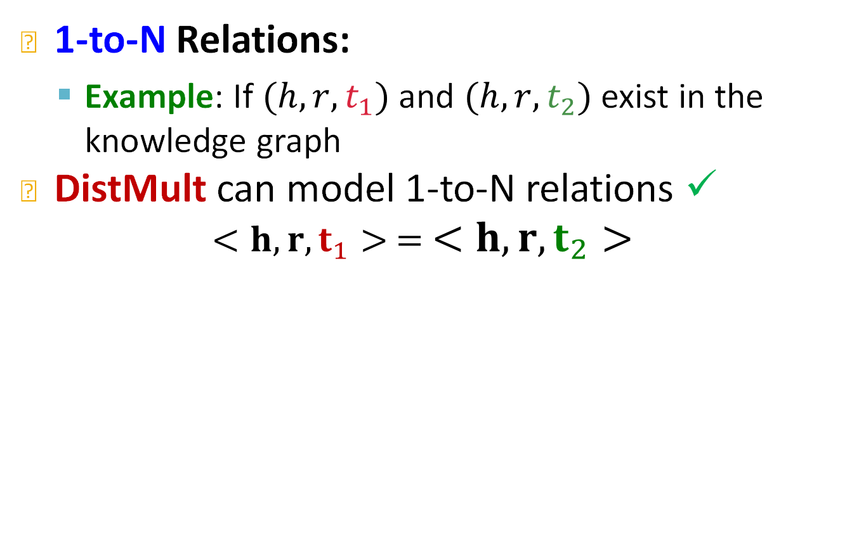


1-to-N Relations in DistMult
1-to-N Relations:
  Example: If $(h,r,t_{1})$ and $(h,r,t_{2})$ exist in the knowledge graph
DistMult can model 1-to-N relations ✓
$$<h,r,t_{1}> = <h,r,t_{2}>$$
$$t_{1}$$
$$t_{2}$$
$$h⋅r$$
Notes:
Project, larger angle smaller cosine

Slide 49
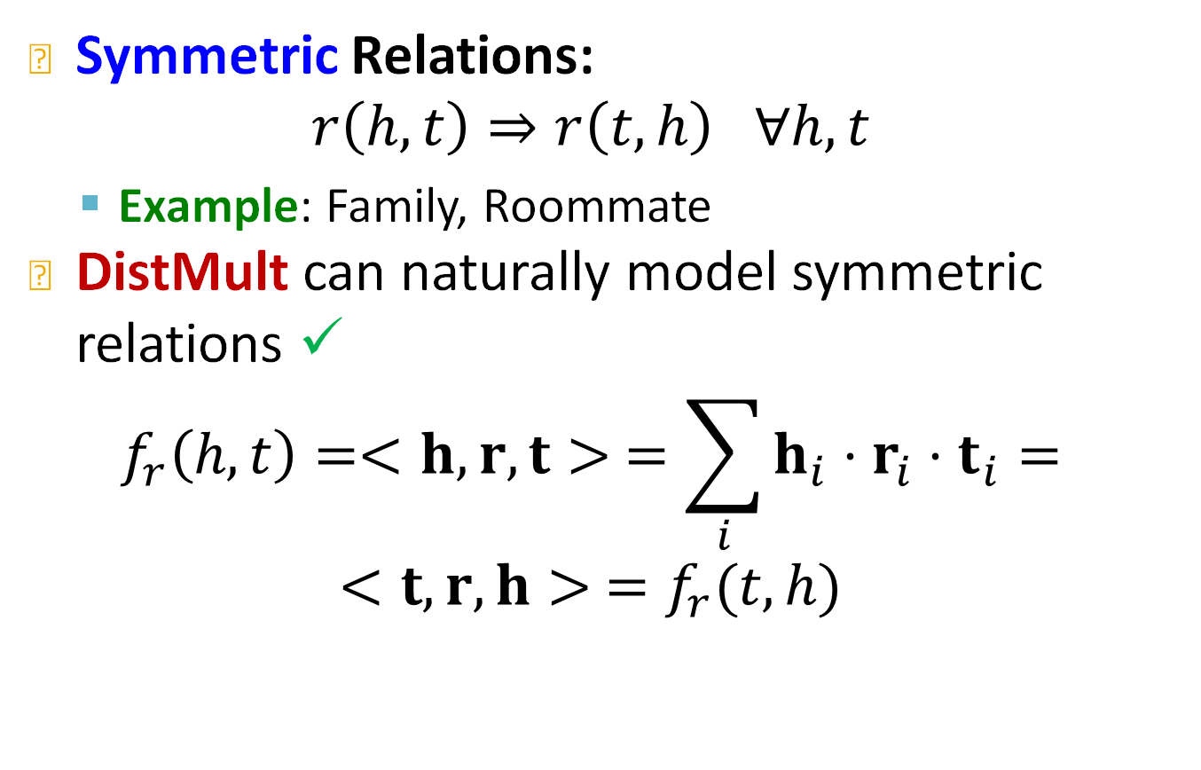
Symmetric Relations in DistMult
Symmetric Relations:
$$r\left(h,t\right)⇒r\left(t,h\right) ∀h,t$$
  Example: Family, Roommate
DistMult can naturally model symmetric relations ✓
$$f_{r}\left(h,t\right)=<h, r,t> =\sum_{i}{h_{i}⋅r_{i}⋅t_{i}}=$$
$$<t, r,h> =f_{r}(t,h)$$
Due to the commutative property of multiplication.
Notes:
Multiplication is commutative. I get the same value, h and t are of relation r t and h are of relation r
The order of head and tail in the dot product does not mater when we are dealing with real numbers
1-to-N for free
Symmetry for free

Slide 50
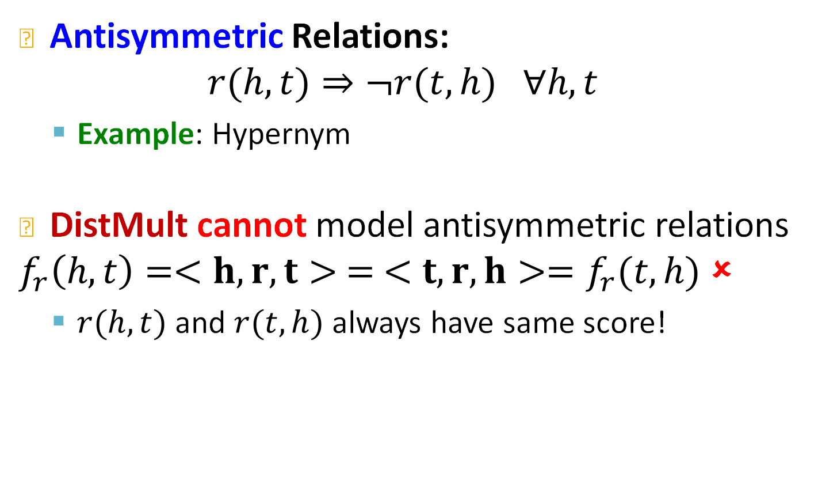
Limitation: Antisymmetric Relations
Antisymmetric Relations:
$$r(h,t)⇒¬r(t,h) ∀h,t$$
  Example: Hypernym
DistMult cannot model antisymmetric relations
$f_{r}\left(h,t\right)=<h,r,t> = <t,r,h>=f_{r}(t,h)$ ✗
  $r(h,t)$ and $r(t,h)$ always have same score!
DistMult cannot differentiate between head entity and tail entity! This means that all relations are modelled as symmetric regardless, i.e., even anti-symmetric relations will be represented as symmetric.
Notes:
Cannot differentiate between head and tail
all relations are modelled as symmetric regardless
!!!!!

Slide 51
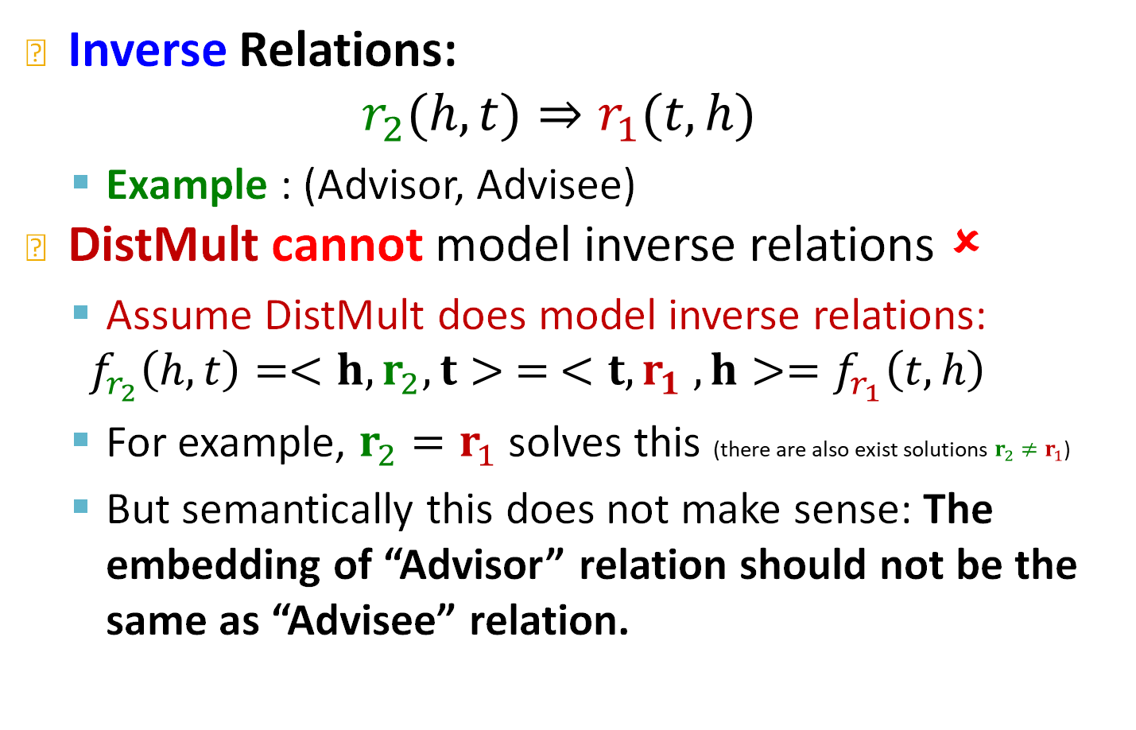
Limitation: Inverse Relations
Inverse Relations:
$$r_{2}(h,t)⇒r_{1}(t,h)$$
  Example : (Advisor, Advisee)
DistMult cannot model inverse relations ✗
  Assume DistMult does model inverse relations:
  $$f_{r_{2}}\left(h,t\right)=<h,r_{2},t> = <t,r_{1} ,h>=f_{r_{1}}\left(t,h\right)$$
  For example, $r_{2}=r_{1}$ solves this (there are also exist solutions $r_{2}≠r_{1}$)
  But semantically this does not make sense: The embedding of “Advisor” relation should not be the same as “Advisee” relation.
Notes:
Even if we model the inverse relation semantically this does not make any sense

Slide 52
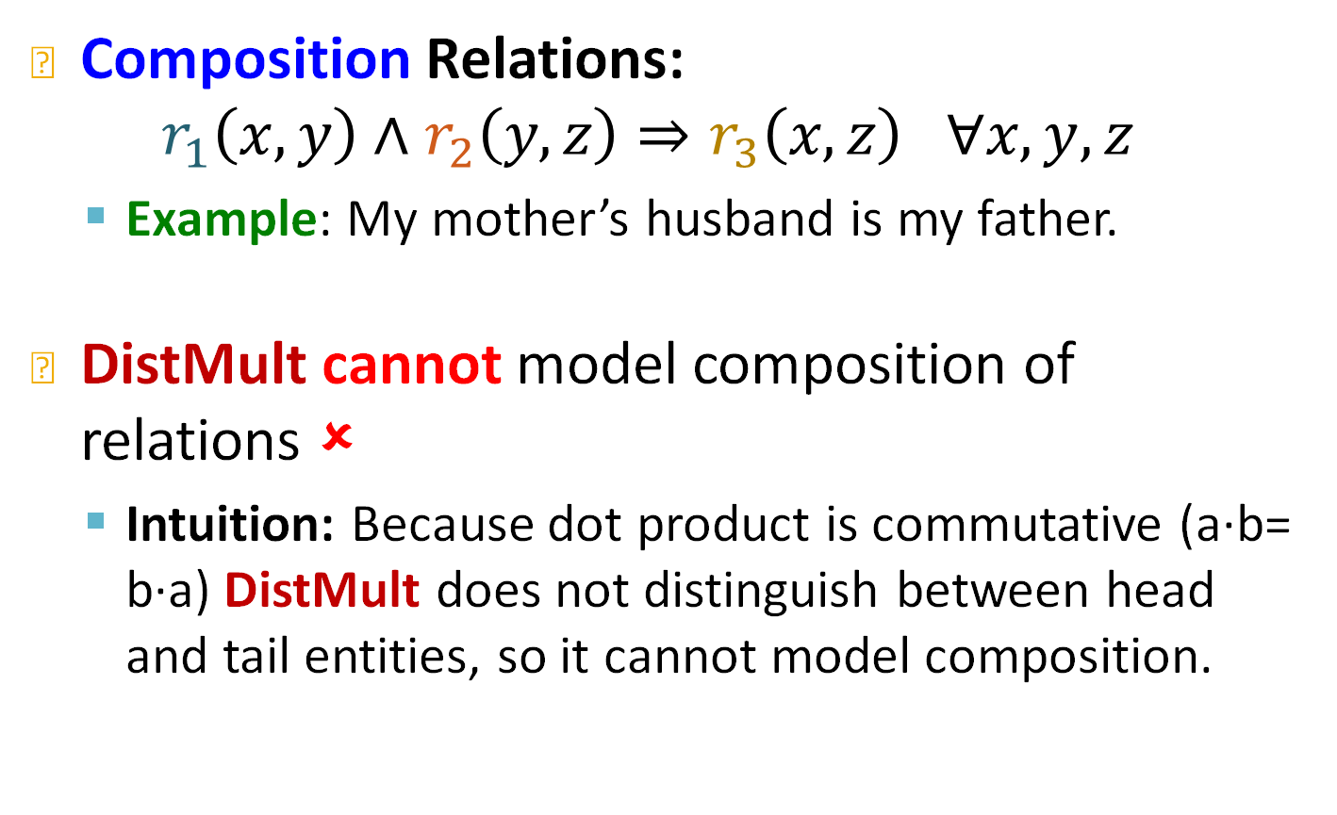
Limitation: Composition Relations
Composition Relations:
$$r_{1}\left(x,y\right)∧r_{2}\left(y,z\right)⇒r_{3}\left(x,z\right) ∀x,y,z$$
  Example: My mother’s husband is my father.
DistMult cannot model composition of relations ✗
  Intuition: Because dot product is commutative (a∙b= b∙a) DistMult does not distinguish between head and tail entities, so it cannot model composition.
Notes:
Kathrin is my mother John is her husband
John is my father

Slide 53
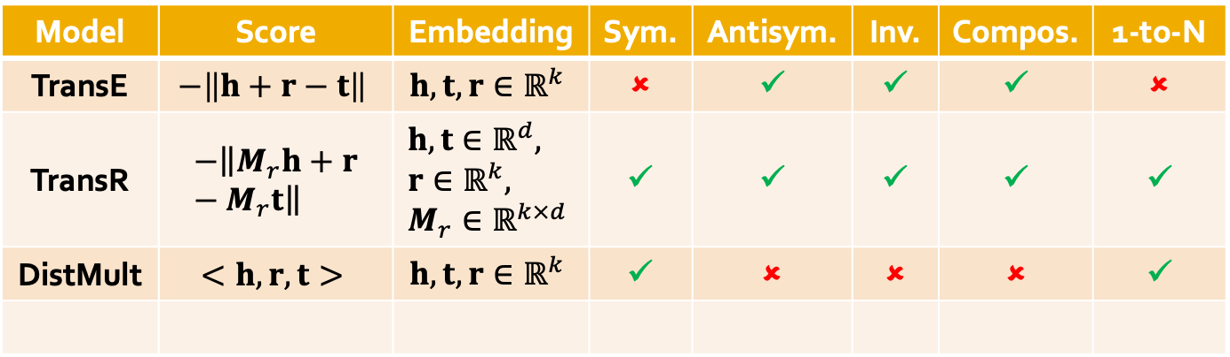
Today: KG Completion Models
What we learned so far:
Model | Score | Embedding | Sym. | Antisym. | Inv. | Compos. | 1-to-N
TransE | $$−\left\|h+r−t\right\|$$ | $$h,t,r∈ℝ^{k}$$ | ✗ | ✓ | ✓ | ✓ | ✗
TransR | $$−\left\|M_{r}h+r−M_{r}t\right\|$$ | $$h,t∈ℝ^{d}, \\ r∈ℝ^{k}, \\ M_{r}∈ℝ^{k×d}$$ | ✓ | ✓ | ✓ | ✓ | ✓
DistMult | $$<h,r,t>$$ | $$h,t,r∈ℝ^{k}$$ | ✓ | ✗ | ✗ | ✗ | ✓
Notes:
Discrete mathematics and map it down to the continuous space. See how these work and when they break
So we have a space to map the embeddings a score that implies a geometric relation between the embeddings, whether you can express certain relation patterns

Slide 54
Stanford CS224W:
Knowledge Graph Completion:
ComplEx
CS224W: Machine Learning with Graphs
Jure Leskovec, Stanford University
http://cs224w.stanford.edu
Notes:
In the complex method we are going to embed in the complex space
In the meta level all these method use mathematical relations to map down to the embedding space
Discrete mathematics and map it down to the embedding space. See how these work and when they break

Slide 55
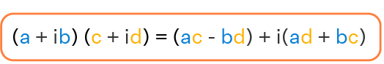
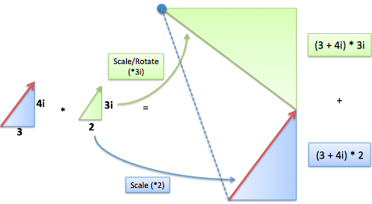

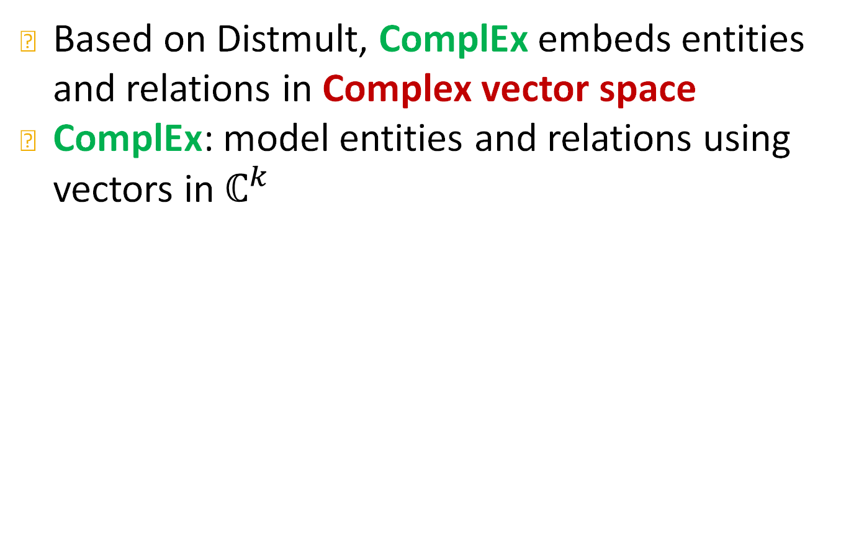





ComplEx
Trouillon et al, Complex Embeddings for Simple Link Prediction, ICML 2016
Based on Distmult, ComplEx embeds entities and relations in Complex vector space
ComplEx: model entities and relations using vectors in $ℂ^{k}$
$$u∈ℂ^{k}$$
$$a∈ℝ^{k}$$
$$b∈ℝ^{k}$$
Re$(u)$
Complex multiplication:
$$\overline{u}=a−bi$$
$$u=a+bi$$
Example multiplication:
=-6+17i
$\overline{u}$ is called a conjugate
Im$(u)$
Notes:
Extension of distmul embeds

Slide 56




ComplEx
Based on Distmult, ComplEx embeds entities and relations in Complex vector space
ComplEx: model entities and relations using vectors in $ℂ^{k}$
Score function $f_{r}\left(h,t\right)=Re\left(\sum_{i}{h_{i}⋅r_{i}⋅{\overline{t}}_{i}}\right)$
$$f_{r}(h,t)$$
$$=\left\langle Re\left(h_{i}\right),Re\left(r_{i}\right),Re\left(t_{i}\right)\right\rangle +\left\langle Re\left(h_{i}\right),Im\left(r_{i}\right),Im\left(t_{i}\right)\right\rangle +\left\langle Im\left(h_{i}\right),Re\left(r_{i}\right),Im\left(t_{i}\right)\right\rangle −⟨Im\left(h_{i}\right),Im\left(r_{i}\right),Re\left(t_{i}\right)⟩$$
Sum
$$r$$
Inner Product
$$h$$
$$\overline{t}$$

Slide 57

ComplEx Score Function
$$f_{r}\left(h,t\right)=Re\left(\sum_{i}{h_{i}⋅r_{i}⋅{\overline{t}}_{i}}\right) \\ =\sum_{i}{Re(h_{i}⋅r_{i}⋅{\overline{t}}_{i})} \\ =\sum_{i}{Re((Re\left(h_{i}\right)+iIm\left(h_{i}\right))⋅(Re\left(r_{i}\right)+iIm\left(r_{i}\right))⋅(Re\left(t_{i}\right)−iIm(t_{i}))}) \\ =\sum_{i}{\begin{aligned}Re\left(h_{i}\right)Re\left(r_{i}\right)Re\left(t_{i}\right)+Re\left(h_{i}\right)Im\left(r_{i}\right)Im\left(t_{i}\right) \\ +Im\left(h_{i}\right)Re\left(r_{i}\right)Im\left(t_{i}\right)−Im\left(h_{i}\right)Im\left(r_{i}\right)Re\left(t_{i}\right)\end{aligned}} \\ =\left\langle Re\left(h_{i}\right),Re\left(r_{i}\right),Re\left(t_{i}\right)\right\rangle +\left\langle Re\left(h_{i}\right),Im\left(r_{i}\right),Im\left(t_{i}\right)\right\rangle +\left\langle Im\left(h_{i}\right),Re\left(r_{i}\right),Im\left(t_{i}\right)\right\rangle −⟨Im\left(h_{i}\right),Im\left(r_{i}\right),Re\left(t_{i}\right)⟩$$

Slide 58

Antisymmetric Relations in ComplEx
Antisymmetric Relations:
$$r(h,t)⇒¬r(t,h) ∀h,t$$
  Example: Hypernym
ComplEx can model antisymmetric relations ✓
  The model is expressive enough to learn
    High $f_{r}\left(h,t\right)=Re(\sum_{i}{h_{i}⋅r_{i}⋅{\overline{t}}_{i}})$
    Low $f_{r}\left(t,h\right)=Re(\sum_{i}{t_{i}⋅r_{i}⋅{\overline{h}}_{i}})$
    Due to the asymmetric modeling using complex conjugate.
Notes:
Every entity has two embeddings, an embedding when it is a head and an embedding when it is a tail
One is the conjugate of the other

Slide 59

Symmetric Relations in ComplEx
Symmetric Relations:
$$r\left(h,t\right)⇒r\left(t,h\right) ∀h,t$$
  Example: Family, Roommate
ComplEx can model symmetric relations ✓
  When $Im\left(r\right)=0$, we have
    $f_{r}\left(h,t\right)=Re\left(\sum_{i}{h_{i}⋅r_{i}⋅{\overline{t}}_{i}}\right)=\sum_{i}{Re\left(r_{i}⋅h_{i}⋅{\overline{t}}_{i}\right)}$
    $=\sum_{i}{r_{i}⋅Re\left(h_{i}⋅{\overline{t}}_{i}\right)=}\sum_{i}{r_{i}⋅Re\left({\overline{h}}_{i}⋅t_{i}\right)=}$ $\sum_{i}{Re\left(r_{i}⋅{\overline{h}}_{i}⋅t_{i}\right)=}f_{r}(t,h)$
Notes:
Same as distmul

Slide 60

Inverse Relations in ComplEx
Inverse Relations:
$$r_{2}(h,t)⇒r_{1}(t,h)$$
  Example : (Advisor, Advisee)
ComplEx can model inverse relations ✓
  $r_{1}={\overline{r}}_{2}$
  Complex conjugate of
  $r_{2}=\underset{r}{argmax}{Re(<h,r,\overline{t}>)}$ is exactly $r_{1}=\underset{r}{argmax}{Re(<t,r,\overline{h}>)}$.
Notes:
Orthogonal to each other

Slide 61

Composition and 1-to-N
Composition Relations:
$$r_{1}\left(x,y\right)∧r_{2}\left(y,z\right)⇒r_{3}\left(x,z\right) ∀x,y,z$$
  Example: My mother’s husband is my father.
1-to-N Relations:
  Example: If $(h,r,t_{1})$ and $(h,r,t_{2})$ exist in the knowledge graph
ComplEx share the same property with DistMult
  Cannot model composition relations
  Can model 1-to-N relations

Slide 62



Today: KG Completion Models
What we learned so far:
Model | Score | Embedding | Sym. | Antisym. | Inv. | Compos. | 1-to-N
TransE | $$−\left\|h+r−t\right\|$$ | $$h,t,r∈ℝ^{k}$$ | ✗ | ✓ | ✓ | ✓ | ✗
TransR | $$−\left\|M_{r}h+r−M_{r}t\right\|$$ | $$h,t∈ℝ^{k}, \\ r∈ℝ^{d}, \\ M_{r}∈ℝ^{d×k}$$ | ✓ | ✓ | ✓ | ✓ | ✓
DistMult | $$<h,r,t>$$ | $$h,t,r∈ℝ^{k}$$ | ✓ | ✗ | ✗ | ✗ | ✓
ComplEx | $$Re(<h,r,\overline{t}>)$$ | $$h,t,r∈ℂ^{k}$$ | ✓ | ✓ | ✓ | ✗ | ✓
RotateE | $$−\left\|h∘r−t\right\|$$ | $$h,t,r∈ℂ^{k}$$ | ✓ | ✓ | ✓ | ✓ | ✗
$∘$…Hadamard product:
TransE and RotatE: they both satisfy a weaker notion of 1-to-N - that many tails can be equidistant to r*h / r + h

Slide 63
KG Embeddings in Practice
Sun et al, RotatE: Knowledge Graph Embedding by Relational Rotation in Complex Space, ICLR 2019
Different KGs may have drastically different relation patterns!
There is not a general embedding that works for all KGs, use the table to select models
Try TransE for a quick run if the target KG does not have much symmetric relations
Then use more expressive models, e.g., ComplEx, RotatE (TransE in Complex space)

Slide 64
Empirical comparison
Model | FB15k-237 |  |  | WN18RR
 | MR↓ | MRR↑ | H10↑ | MR↓ | MRR↑ | H10↑
TransE | 357 | .294 | .465 | 3384 | .226 | .501
TransR
DisMult | 254 | .241 | .419 | 5110 | .43 | .49
ComplEx | 339 | .247 | .428 | 5261 | .44 | .51
RotatE | 177 | 0.338 | 0.533 | 3340 | 0.476 | 0.571

Slide 65
Summary of Knowledge Graph
Link prediction / Graph completion is one of the prominent tasks on knowledge graphs
Introduce TransE / TransR / DistMult / ComplEx models with different embedding space and expressiveness
Next: Reasoning in Knowledge Graphs

Slide 66



Limitation: Composition Relations
Unclear if this is true.
Perhaps just say: Since DistMult does not distinguish between head and tail entities, it can only model symmetric relations
Composition Relations:
$$r_{1}\left(x,y\right)∧r_{2}\left(y,z\right)⇒r_{3}\left(x,z\right) ∀x,y,z$$
  Example: My mother’s husband is my father.
DistMult cannot model composition relations ✗
  Intuition: DistMult defines a hyperplane for each (head, relation), the union of the hyperplane induced by multi-hops of relations, e.g., $(r_{1},r_{2})$, cannot be expressed using a single hyperplane.
$$r_{3}$$
$$r_{2}$$

Slide 67




Limitation: Composition Relations
Unclear if this is true.
Perhaps just say: Since DistMult does not distinguish between head and tail entities, it can only model symmetric relations
Composition Relations:
$$r_{1}\left(x,y\right)∧r_{2}\left(y,z\right)⇒r_{3}\left(x,z\right) ∀x,y,z$$
  Example: My mother’s husband is my father.
DistMult cannot model composition relations ✗
Intuition: DistMult defines a hyperplane for each (head, relation), the union of the hyperplane induced by multi-hops of relations, e.g., $(r_{1},r_{2})$, cannot be expressed using a single hyperplane.
Detailed derivation
$$y_{2}$$
Pick one $y$ s.t. $f_{r_{1}}\left(x,y\right)>0$, e.g., $y_{2}$
Then $y_{2}⋅r_{2}$ defines a new hyperplane
$$y_{2}⋅r_{2}$$

Slide 68



Limitation: Composition Relations
Composition Relations:
$$r_{1}\left(x,y\right)∧r_{2}\left(y,z\right)⇒r_{3}\left(x,z\right) ∀x,y,z$$
  Example: My mother’s husband is my father.
DistMult cannot model composition relations ✗
Intuition: DistMult defines a hyperplane for each (head, relation), the union of the hyperplane induced by multi-hops of relations, e.g., $(r_{1},r_{2})$, cannot be expressed using a single hyperplane.
Unclear if this is true.
Perhaps just say: Since DistMult does not distinguish between head and tail entities, it can only model symmetric relations
Detailed derivation
Pick another $y$ s.t. $f_{r_{1}}\left(x,y\right)>0$, e.g., $y_{3}$
Then $y_{3}⋅r_{2}$ defines another hyperplane
$$y_{3}⋅r_{3}$$
$$y_{3}$$

Slide 69


Limitation: Composition Relations
Composition Relations:
$$r_{1}\left(x,y\right)∧r_{2}\left(y,z\right)⇒r_{3}\left(x,z\right) ∀x,y,z$$
  Example: My mother’s husband is my father.
DistMult cannot model composition relations ✗
  Intuition: DistMult defines a hyperplane for each (head, relation), the union of the hyperplane induced by multi-hops of relations, e.g., $(r_{1},r_{2})$, cannot be expressed using a single hyperplane.
Unclear if this is true.
Perhaps just say: Since DistMult does not distinguish between head and tail entities, it can only model symmetric relations
Detailed derivation
Combine both hyperplanes together, then for all $z$ in the shadow area, there exists $y∈\left\{y_{2},y_{3}\right\}$, s.t., $f_{r_{2}}\left(y,z\right)>0$
$$y_{3}⋅r_{3}$$
$$y_{2}⋅r_{2}$$

Slide 70



Limitation: Composition Relations
Composition Relations:
$$r_{1}\left(x,y\right)∧r_{2}\left(y,z\right)⇒r_{3}\left(x,z\right) ∀x,y,z$$
  Example: My mother’s husband is my father.
DistMult cannot model composition relations ✗
  Intuition: DistMult defines a hyperplane for each (head, relation), the union of the hyperplane induced by multi-hops of relations, e.g., $(r_{1},r_{2})$, cannot be expressed using a single hyperplane.
Unclear if this is true.
Perhaps just say: Since DistMult does not distinguish between head and tail entities, it can only model symmetric relations
Detailed derivation
$$z_{1}$$
Combine both hyperplanes together, then for all $z$ in the shadow area, there exists $y∈\left\{y_{2},y_{3}\right\}$, s.t., $f_{r_{2}}\left(y,z\right)>0$
$$z_{2}$$
$$z_{3}$$

Slide 71

Limitation: Composition Relations
Composition Relations:
$$r_{1}\left(x,y\right)∧r_{2}\left(y,z\right)⇒r_{3}\left(x,z\right) ∀x,y,z$$
  Example: My mother’s husband is my father.
DistMult cannot model composition relations ✗
  Intuition: DistMult defines a hyperplane for each (head, relation), the union of the hyperplane induced by multi-hops of relations, e.g., $(r_{1},r_{2})$, cannot be expressed using a single hyperplane.
Unclear if this is true.
Perhaps just say: Since DistMult does not distinguish between head and tail entities, it can only model symmetric relations
Detailed derivation
$$z_{1}$$
According to the composition relations, we also want $f_{r_{3}}\left(x,z\right)>0,$ $∀z∈\left\{shadow area\right\}$. However, this area inherently cannot be expressed by a single hyperplane defined by $x⋅r_{3}$, no matter what $r_{3}$ is.
$$z_{2}$$
$$z_{3}$$

Slide 72
Nodes from 2022/23
Lecture did not go well.
Too much detail.
Lots of sloppiness. Need thorough review!
Proofs are unclear. Too many properties.
Perhaps take a few proofs and explain them.

