Slide 1

Note to other teachers and users of these slides: We would be delighted if you found our material useful for giving your own lectures. Feel free to use these slides verbatim, or to modify them to fit your own needs. If you make use of a significant portion of these slides in your own lecture, please include this message, or a link to our web site: http://cs224w.Stanford.edu
Stanford CS224W:
Relational Deep Learning
CS224W: Machine Learning with Graphs
Charilaos Kanatsoulis
Jure Leskovec, Stanford University
http://cs224w.stanford.edu
Notes:
World premier

Slide 2
Announcements
(11/7) Colab 3 is due today
(11/7) Project Milestone is due today
(11/14) Homework 3 is due in a week
  Keep an eye out on Ed – HW3 recitation will happen this weekend (Sat Afternoon)
Colab 4 will be released today (due after thanksgiving break)
The exam is coming up (in 2 weeks) - we just released the practice exam on ed.

Slide 3
Response to high-frequency feedbacks
Extended Office hour
We have added 6 hours of additional OH for the next two weeks. Check out here for schedule: https://edstem.org/us/courses/67691/discussion/5651218
Early Release of Practice Exam
The practice exam is released today! It is available here:https://edstem.org/us/courses/67691/discussion/5664636
Stay tuned for practice exam recitation time soon!

Slide 4
Stanford CS224W:
Relational Databases
CS224W: Machine Learning with Graphs
Jure Leskovec, Stanford University
http://cs224w.stanford.edu

Slide 5
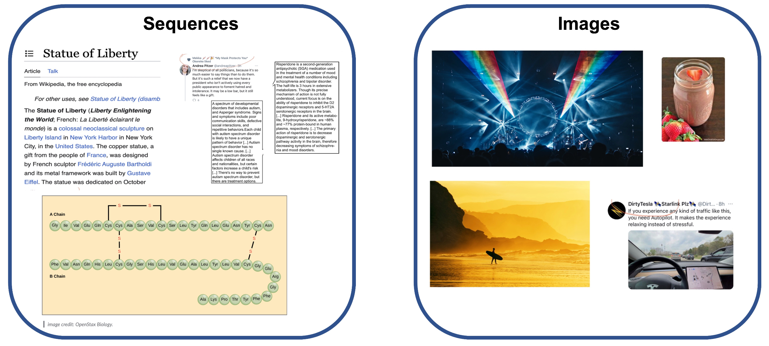
Deep Learning Revolution

Slide 6
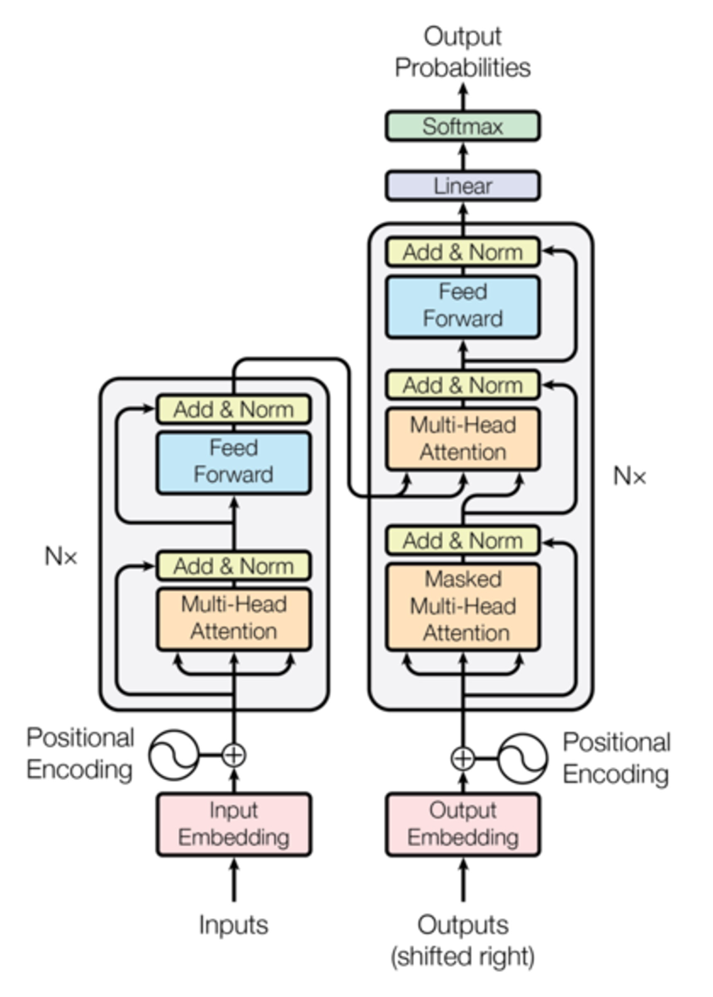
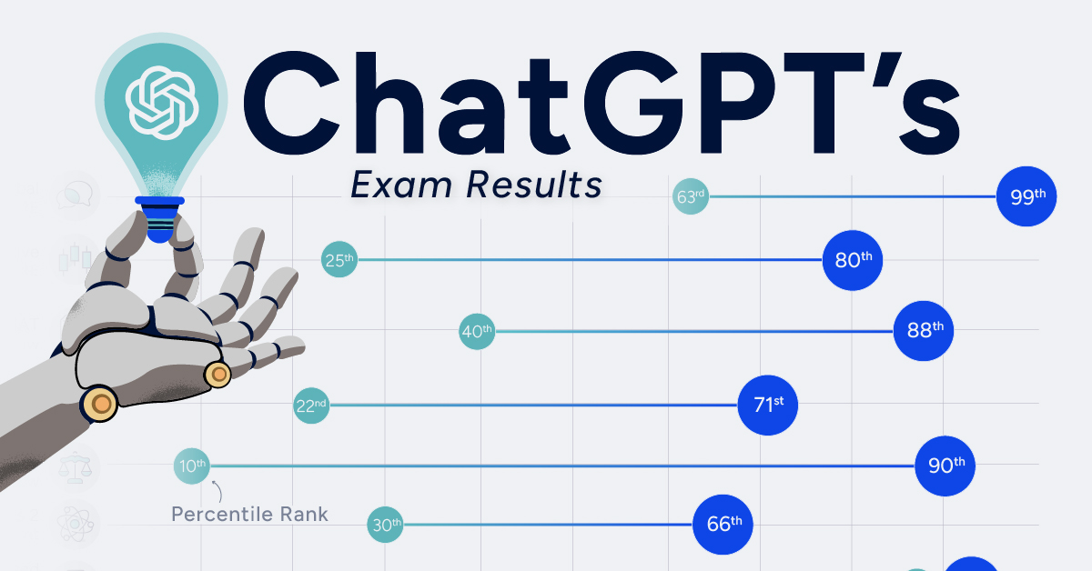
Deep Learning Revolution
These breakthroughs are fueled by Transformers

Slide 7

Deep Learning Revolution
These breakthroughs are fueled by Data
Notes:
The second key factor of the success of Large DL models is that they are trained on a lot and a lot of data. What you can say is that the ….
We train all these LLm and vision models on opensource data, data that is on the internet

Slide 8
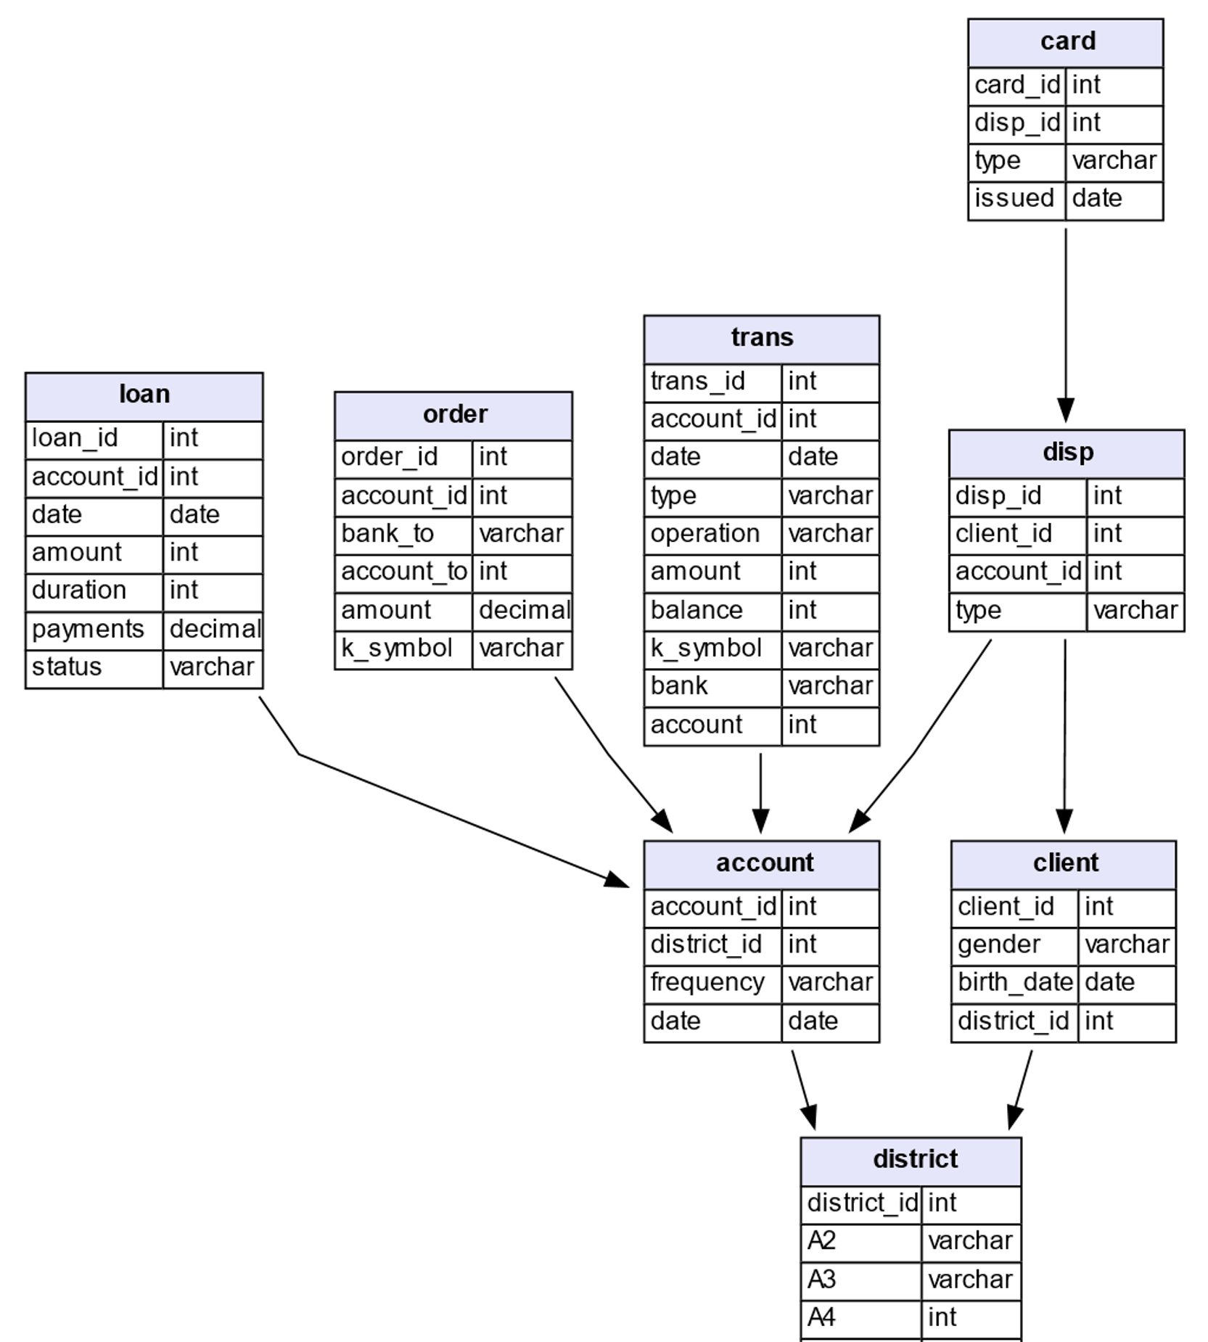
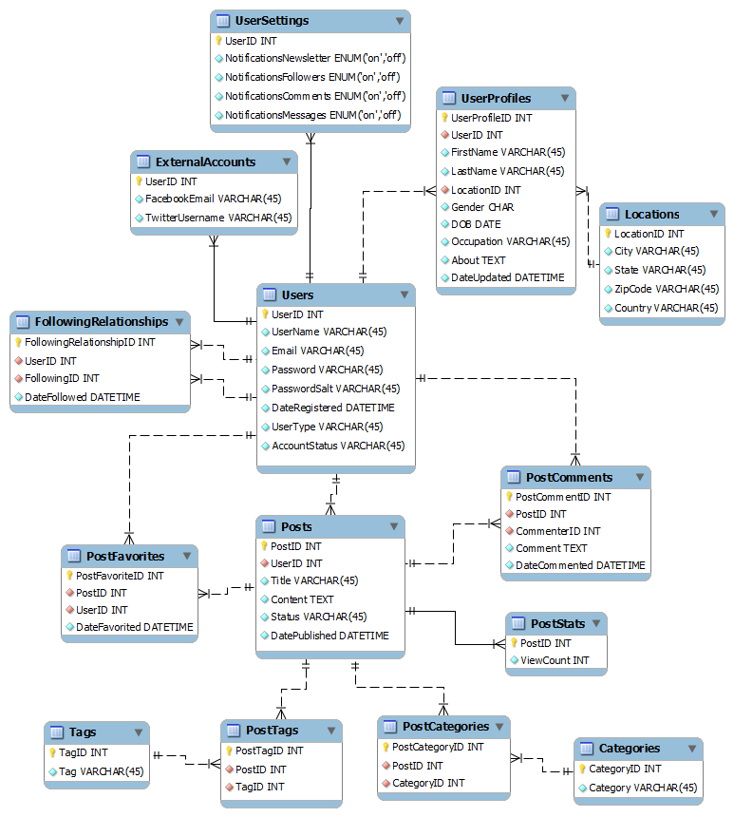
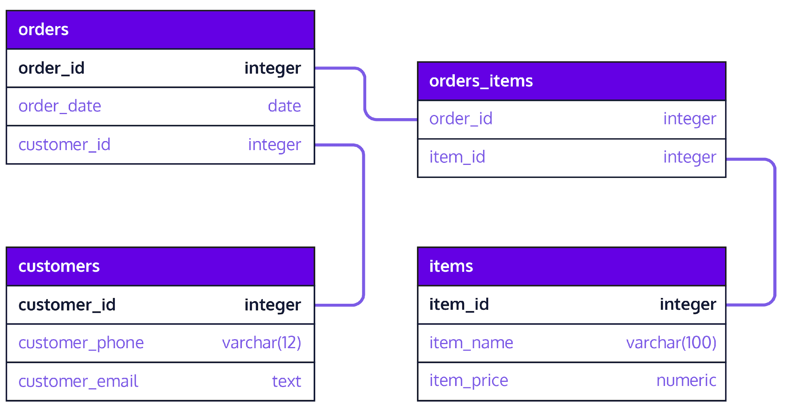
Data stored in Relational Databases
Commerce
Finance
Social Media
Notes:
But there is one even more common and more important and more impactful data-type out there, which is private data, data that is stored in the form of relational tables, that is stored in modern DB, data warehouses
Data is stored in the form of tables and are interelinked with primary foreign key relations
What we are interested in this lecture is to extend the power of DL to the most common data type in the world, which is a set of relational tables interlinked with primary foreign key relations

Slide 9
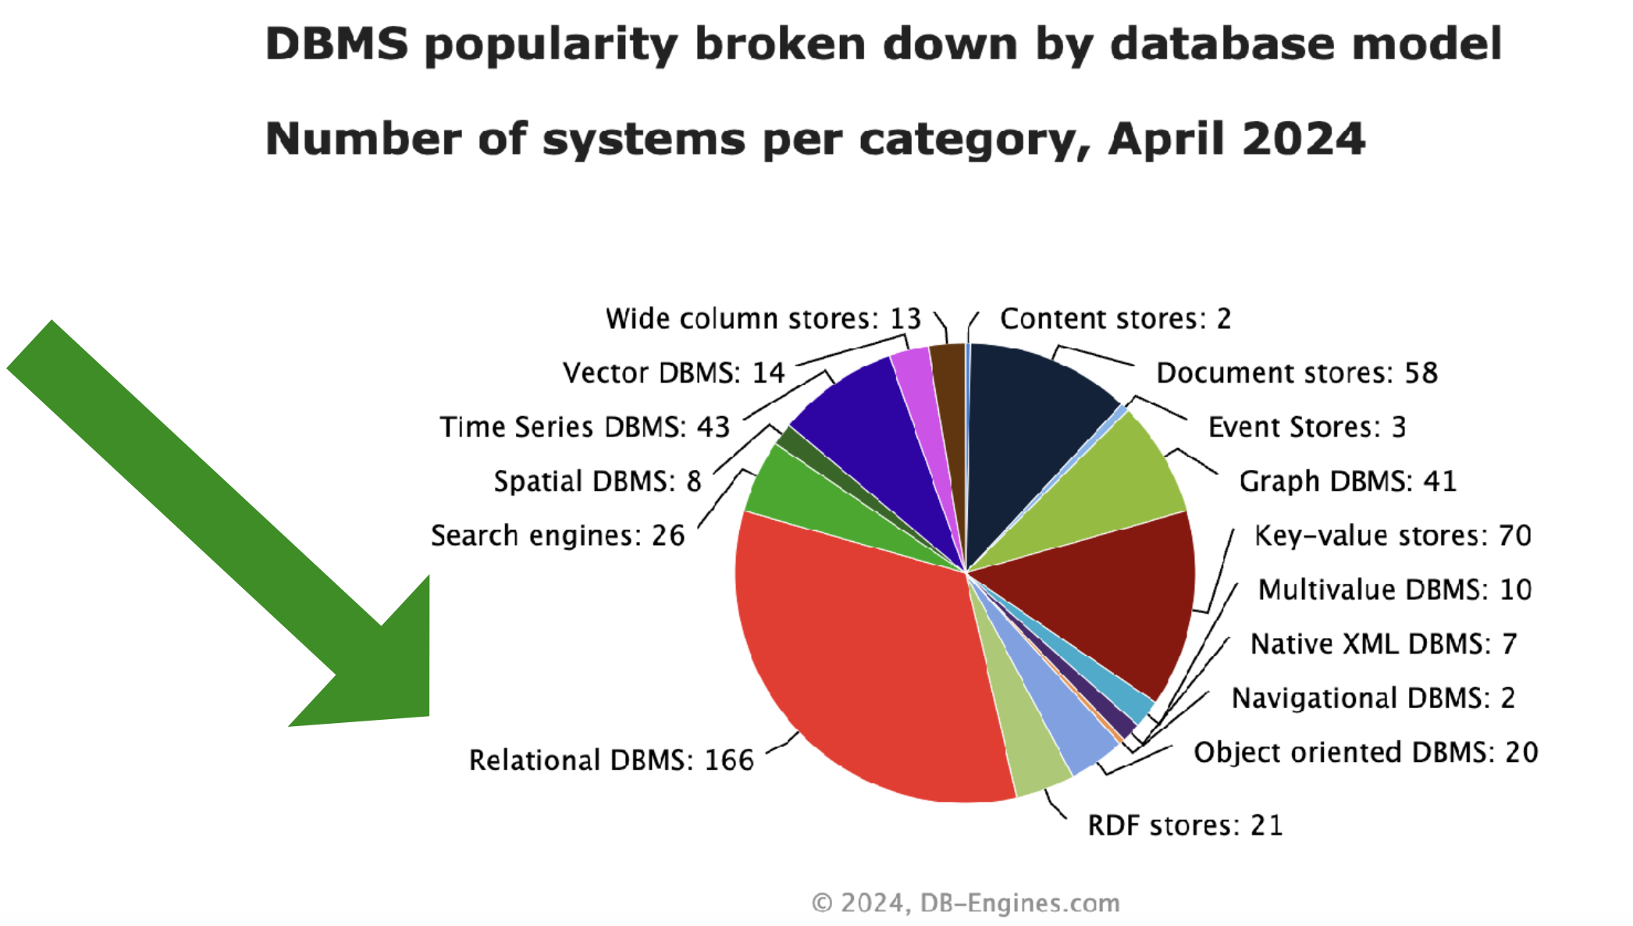
Database Management Systems
Notes:
Report
To see how popular relational tables are lets look at the popularity of DBMS
A database management system (DBMS) is a software used for manipulating (storing, querying) a collection of logically related data (database).
A DBMS together with a database form the database system.
A DBMS that supports the relational data model, is often denoted as a RDBMS. In case it supports other data models it is often subsumed as a NoSQL-System.

Slide 10
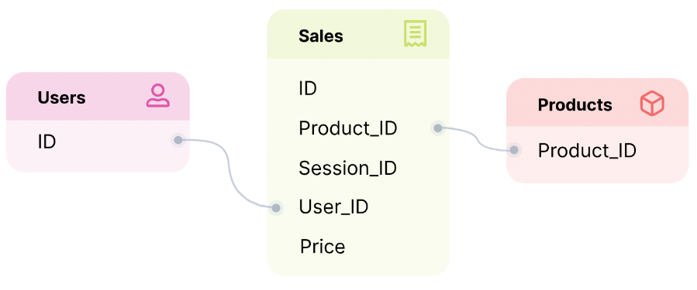
Predictions on Relational Data
Which products will a user purchase in the next 7 days?
Will an active user churn in the next 90 days?
What will be the total sales for each product in the next 30 days?
Notes:
Once you have these data in the relational table form there is a variety of interesting questions you can ask
Deep learning on RelDB is because we want to answer predictive querries BUSiness strategy
I this lecture we will use this very simple schema of an ecomerce website a lot … recording which user is buying which product
Reccomender systems
Not buy anything
Optimize the INVENTORY
Predictive Tasks on E-commerce data

Slide 11
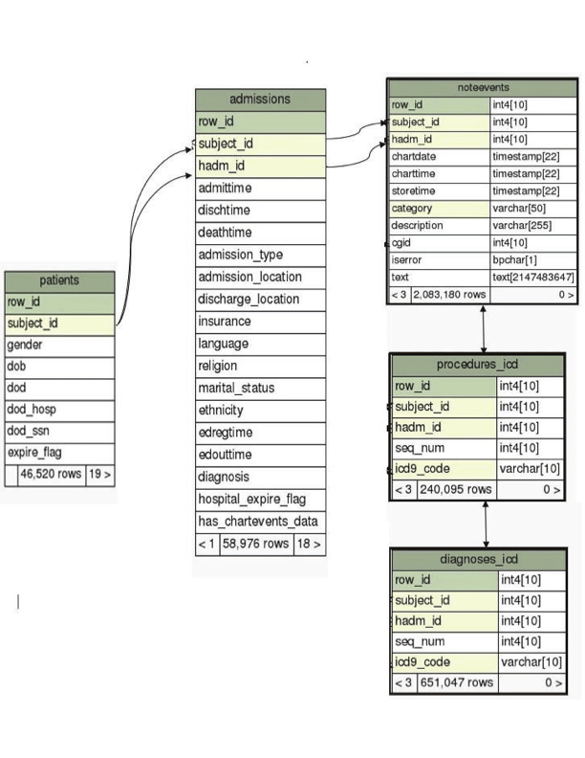
Predictions on Relational Data
Will a patient return if discharged from the hospital?
Which hospital admissions have greatest risk to life in the next 24 hours
Notes:
But you can have way more complex schemas
You can also ask very important predictive questions based on these electronic health care recored
How safw it is to discharge a patient
Are there patients that require special treatment based on increased life risk
The point I wnt to make with the last two slides is that there exist very important questions I can ask/ predictive questions that can be answered by processing data that are in the form of tables connected with primary foreign key links
Predictive Tasks on Electronic Healthcare Records

Slide 12
Doing AI is slow & complex
Input data cleaning, curation
Target label engineering
Feature engineering
Architecture & hyperparameter search
ML Ops
6-12 months of time for a team of data scientists, data engineers and product engineers
Notes:
When companies do AI or ML over this type of data they are really struggling to deliver systems for predictions or even forecasts. They are complex and slow.
It usually takes … to build such systems and it takes so long because the pipeline involves
Data preparation including labeling
Feature engineering
Model selection, development and training
Hyper parameter tuning
Validation
Inferencing

Slide 13
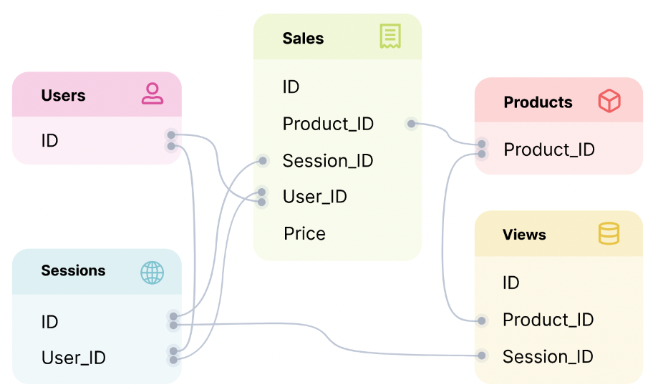
Impedance Mismatch
Goal: Learn a user churn model based on their sales, purchased products and browsing behavior
#monthly sales | sum weekly item price | #orders relative to Sunday | Label
… | … | … | …
… | … | … | …
… | … | … | …
Examples
Features
Features are chosen arbitrarily (e.g., aggregations, time windows)
Only a limited set of data is used
Issues with point-in-time correctness/information leakage
Notes:
Why is ML over relational data so brittle?
The reason is that there is this kind of Impedence Mismatch between how the data is naturally stored or structured and how the data are modeled after processing to be ready for known ML models
To see this let’s say our goal is tp …..
And I have a schema here and the problem is that today there is no ML or AI method that you can just apply to the set of these tables to learn from it
What you have to do is to take these tables and massage them, join them into a single table
You have to do feature engineering
You could say that what predicts user’s churn is maybe the number …
You can see that I can apply a gazillion of statistics put them in a table and use my favorite ML method to answer predictive queries

Slide 14
Key Question
How to leverage the data without going through the longest duration tasks (extraction, transformation, loading)?
We want ML algorithms that can process data in its natural form!
Notes:
Feature emgineering

Slide 15
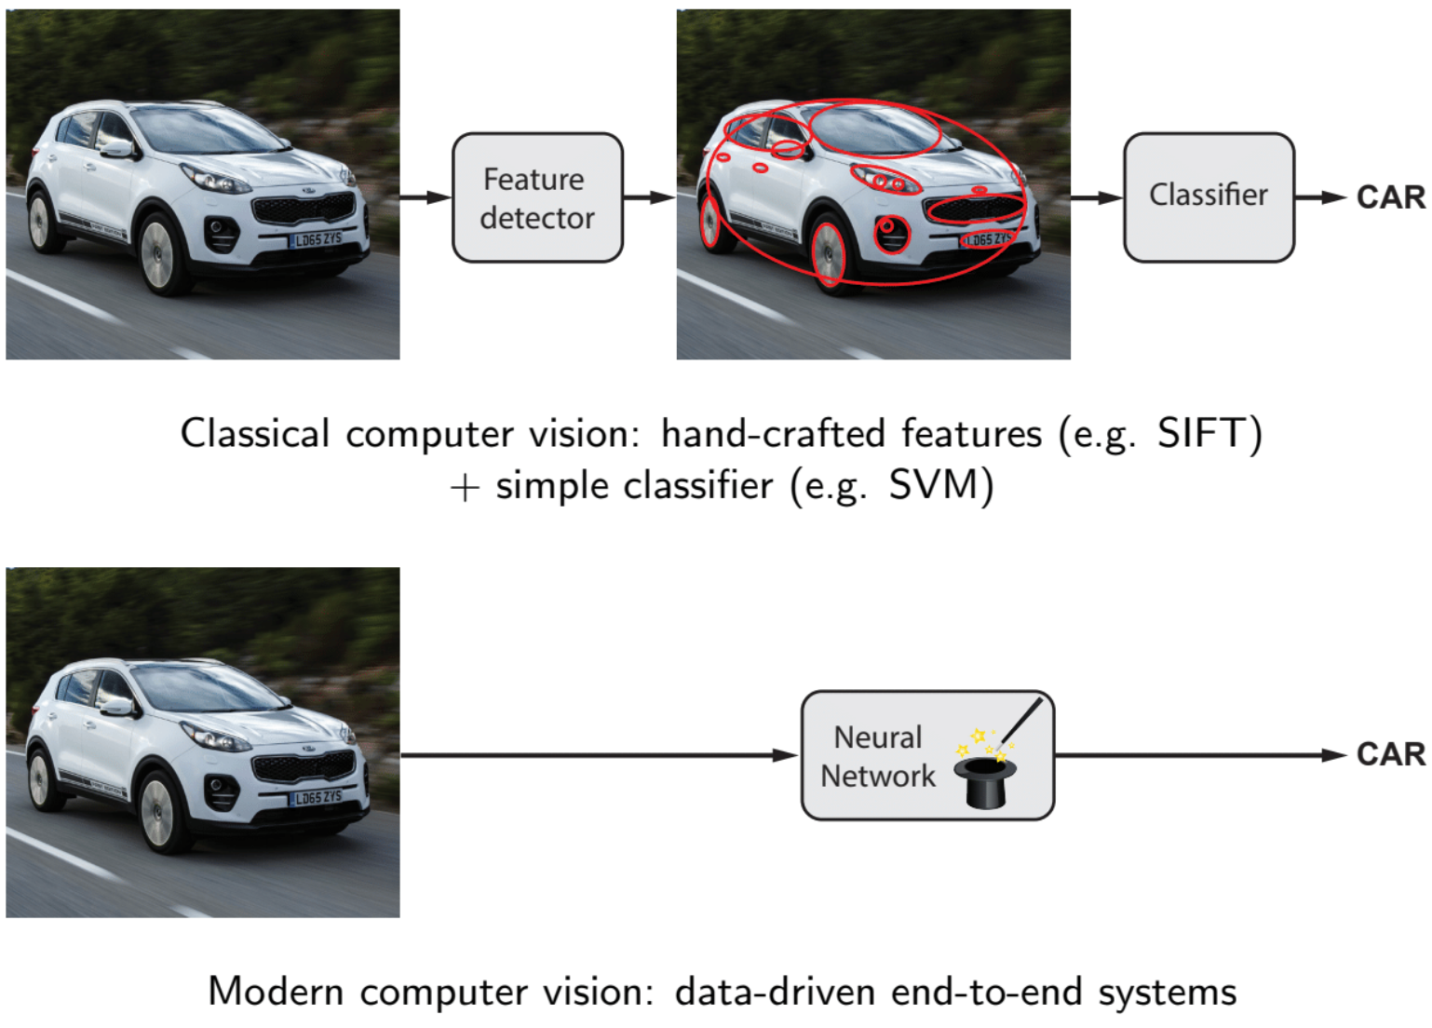
CV moved to end-to-end learning
Notes:
This trend has been observed in other fields as well
In classical computer vision you would manually craft some features you would use your gabor filters or whatever and then you would train a classifier
This was old school CV

Slide 16
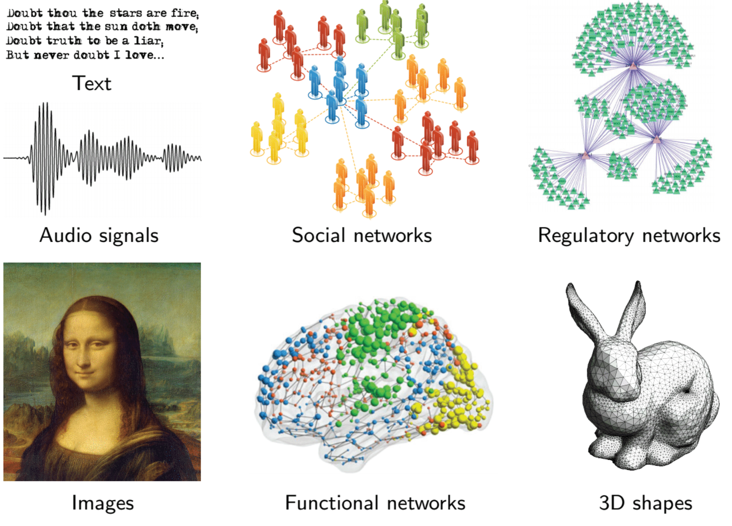
Modern ML
Today we want to design deep learning models that operate on relational tables
But modern deep learning toolbox is designed for different type of inputsta

Slide 17
Stanford CS224W:
Generalizing Deep Learning to Databases
CS224W: Machine Learning with Graphs
Jure Leskovec, Stanford University
http://cs224w.stanford.edu
Notes:
How to …

Slide 18
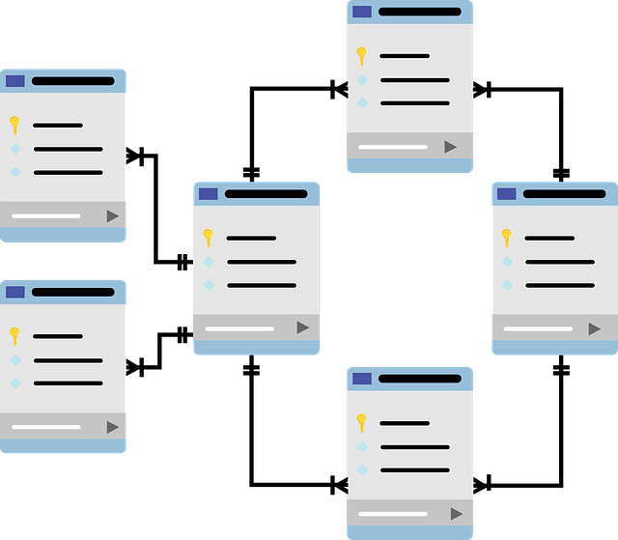
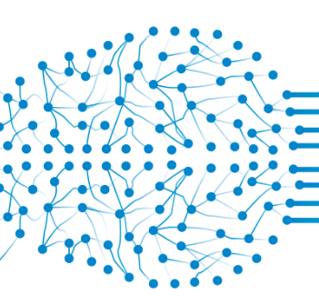
Deep Learning on Relational Tables
Prediction
Relational Deep Learning
Notes:
Introduce a novel DL framework to perform DL on relational tables
We call this type of deep learning RDL

Slide 19
What is RDL?
End-to-end deep learning on relational tables (i.e., databases)
Works directly on relational tables, no transformations, no feature engineering
Casts predictive tasks as graph representation learning problems
Jure Leskovec, Stanford CS224W: Machine Learning with Graphs, http://cs224w.stanford.edu
Notes:
We will generalize GML from social networks, KG, molecules and all the data we have discussed to relational tables, to databases
So we have a whole new bouquet of application

Slide 20
Impact and Consequences
More accurate models
(no feature engineering)
More robust models
(model-learned features automatically “update” over time)
Shorter time to models
(no mundane ETL work)
Simpler infrastructure
(no pipelines, no feature stores, etc.)
Jure Leskovec, Stanford CS224W: Machine Learning with Graphs, http://cs224w.stanford.edu
Notes:
you learn over the entire data, similar boost that CV experience from subhuman to superhuman performance.
As new data come in features become obsolete and traditional ML methods become obsolete, constantly engineering new features, hust retrain the model
Extract transform load

Slide 21
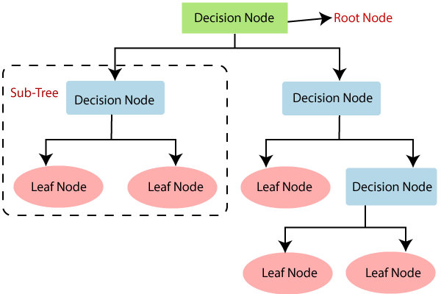
Related Work: Tabular ML
Great for building
models on one table
  But most data is not
  a single table!
Deep learning is not dominant:
  Hypothesis: Because single table already contains features engineered from other tables (loss of information)
RDL accounts for relations between multiple tables, unlike tabular ML!
Jure Leskovec, Stanford CS224W: Machine Learning with Graphs, http://cs224w.stanford.edu
Notes:
Does not work as well

Slide 22
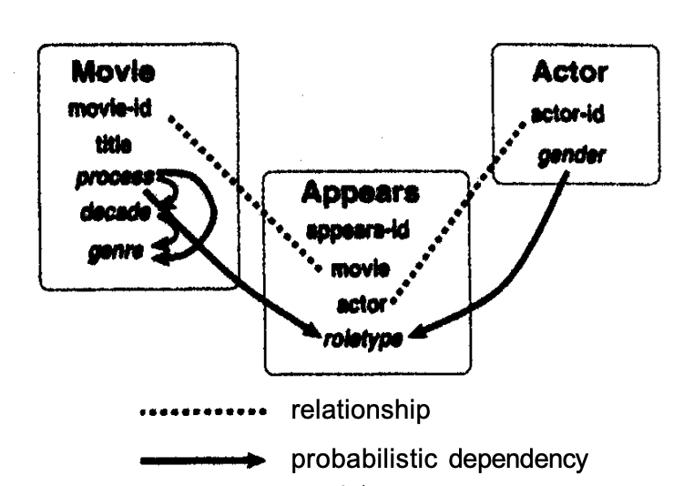
Related Work: Stat. Rel. Learning
[Friedman et al., 1999]
Learns a distribution
(graphical model) over
the relational structure
  Predictions via world
  model + inductive logic programming
  Only works with categorical variables
  Does not scale to large data
RDL a scalable, expressive inheritor of Statistical Relational Learning
Jure Leskovec, Stanford CS224W: Machine Learning with Graphs, http://cs224w.stanford.edu
Notes:
Daphne coller and Stanford collegues
Baayesian network

Slide 23
Stanford CS224W:
Relational Deep Learning
CS224W: Machine Learning with Graphs
Jure Leskovec, Stanford University
http://cs224w.stanford.edu
Notes:
How do you generalize deep learning to relational tables? How do you do RDL?

Slide 24
Insight: A Data is a graph!
Jure Leskovec, Stanford CS224W: Machine Learning with Graphs, http://cs224w.stanford.edu
Notes:
These schema has three tables and there are three nodes in the graph. This is not true. The schema shows a hight level structure. This schema does not tell you that there are three nodes but three types of nodes
The point of this slide is to show how we create a graph from a relational DB schema.

Slide 25








A Database is a graph!
$20
$80
$15
$20
$80
$80
$15
Users
Sales
Products
Jure Leskovec, Stanford CS224W: Machine Learning with Graphs, http://cs224w.stanford.edu
Notes:
You will see that the schema is a graph but also the data across tables is a graph. I will be more formal later.
You will take every line every row of the table and you will write it as a node and t
Then primary foreign key relation I will create an edge
Go step by stp
Users products sales
Tripartite structure

Slide 26
Just do ML on a Graph!
ML in the language of graphs:
Node-level:
  Churn
  Life-time value
  Next best action
Link-level:
  Product affinity
  Recommendations
Graph-level:
  Fraud, money
  laundering
$20
$80
$15
$20
$80
$80
$15
Users
Sales
Products
Jure Leskovec, Stanford CS224W: Machine Learning with Graphs, http://cs224w.stanford.edu
Notes:
An this is super cool because now I know how to do DL over this DB
DB into a graph and learn representation for the nodes in the graph the users the procucts and transaction without doing any feature engineering
What is also nice is that the language of GML problems is quite rich
I can define
TLV how much are they predicted or forecasted to buy in the next two months
Next best action. Increase or decrease the price of the product
The point I want to make is that the language of GML is rich enough to cover the majority of predictive tasks in DB

Slide 27




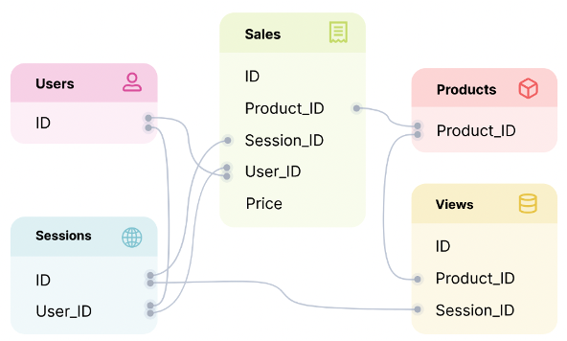
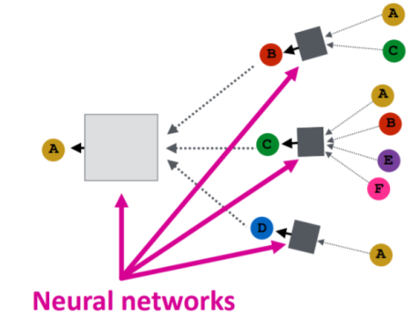
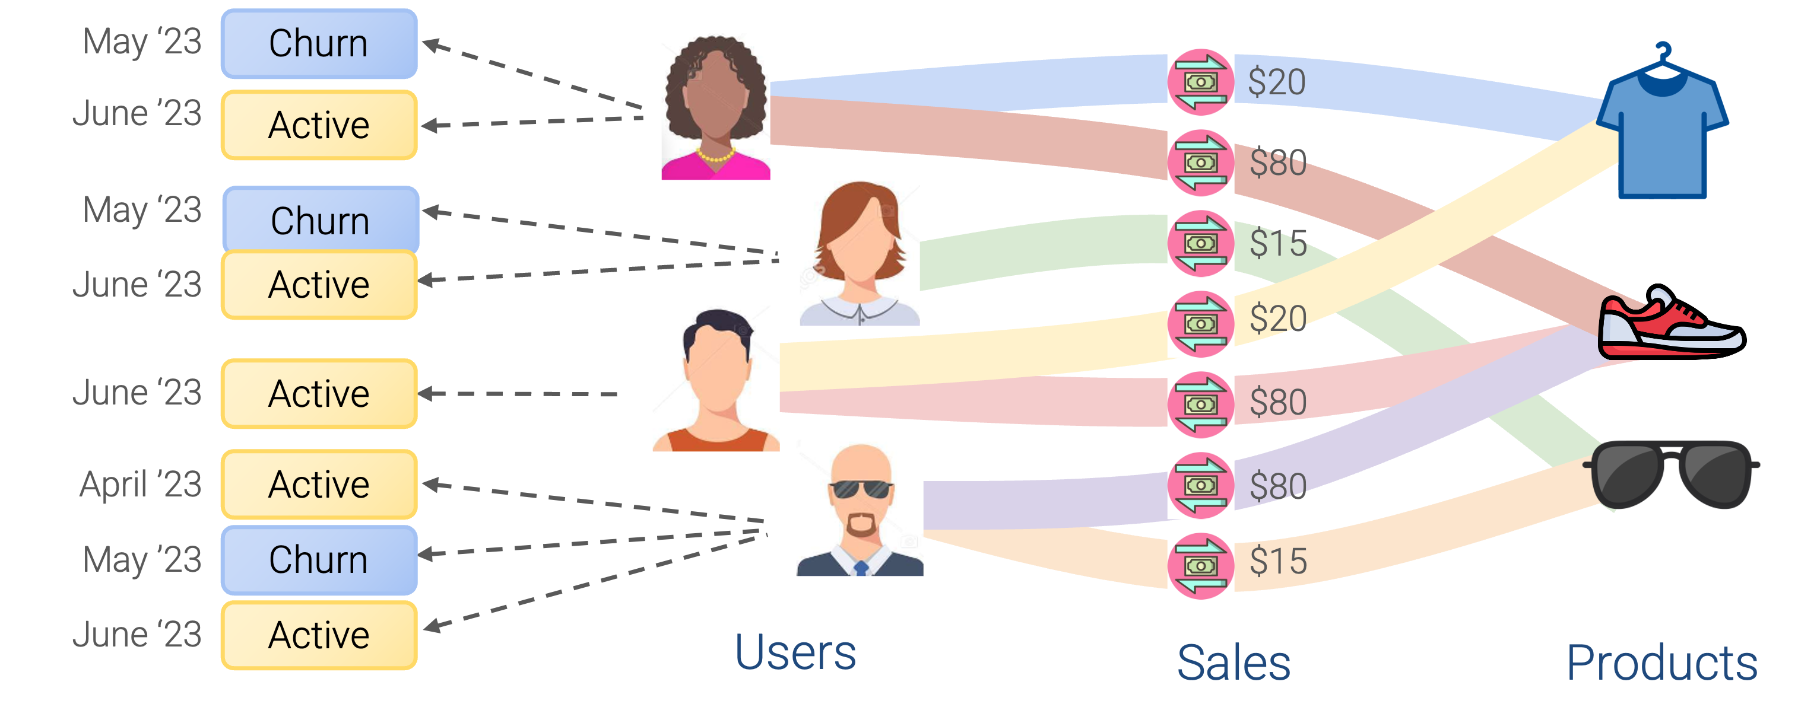
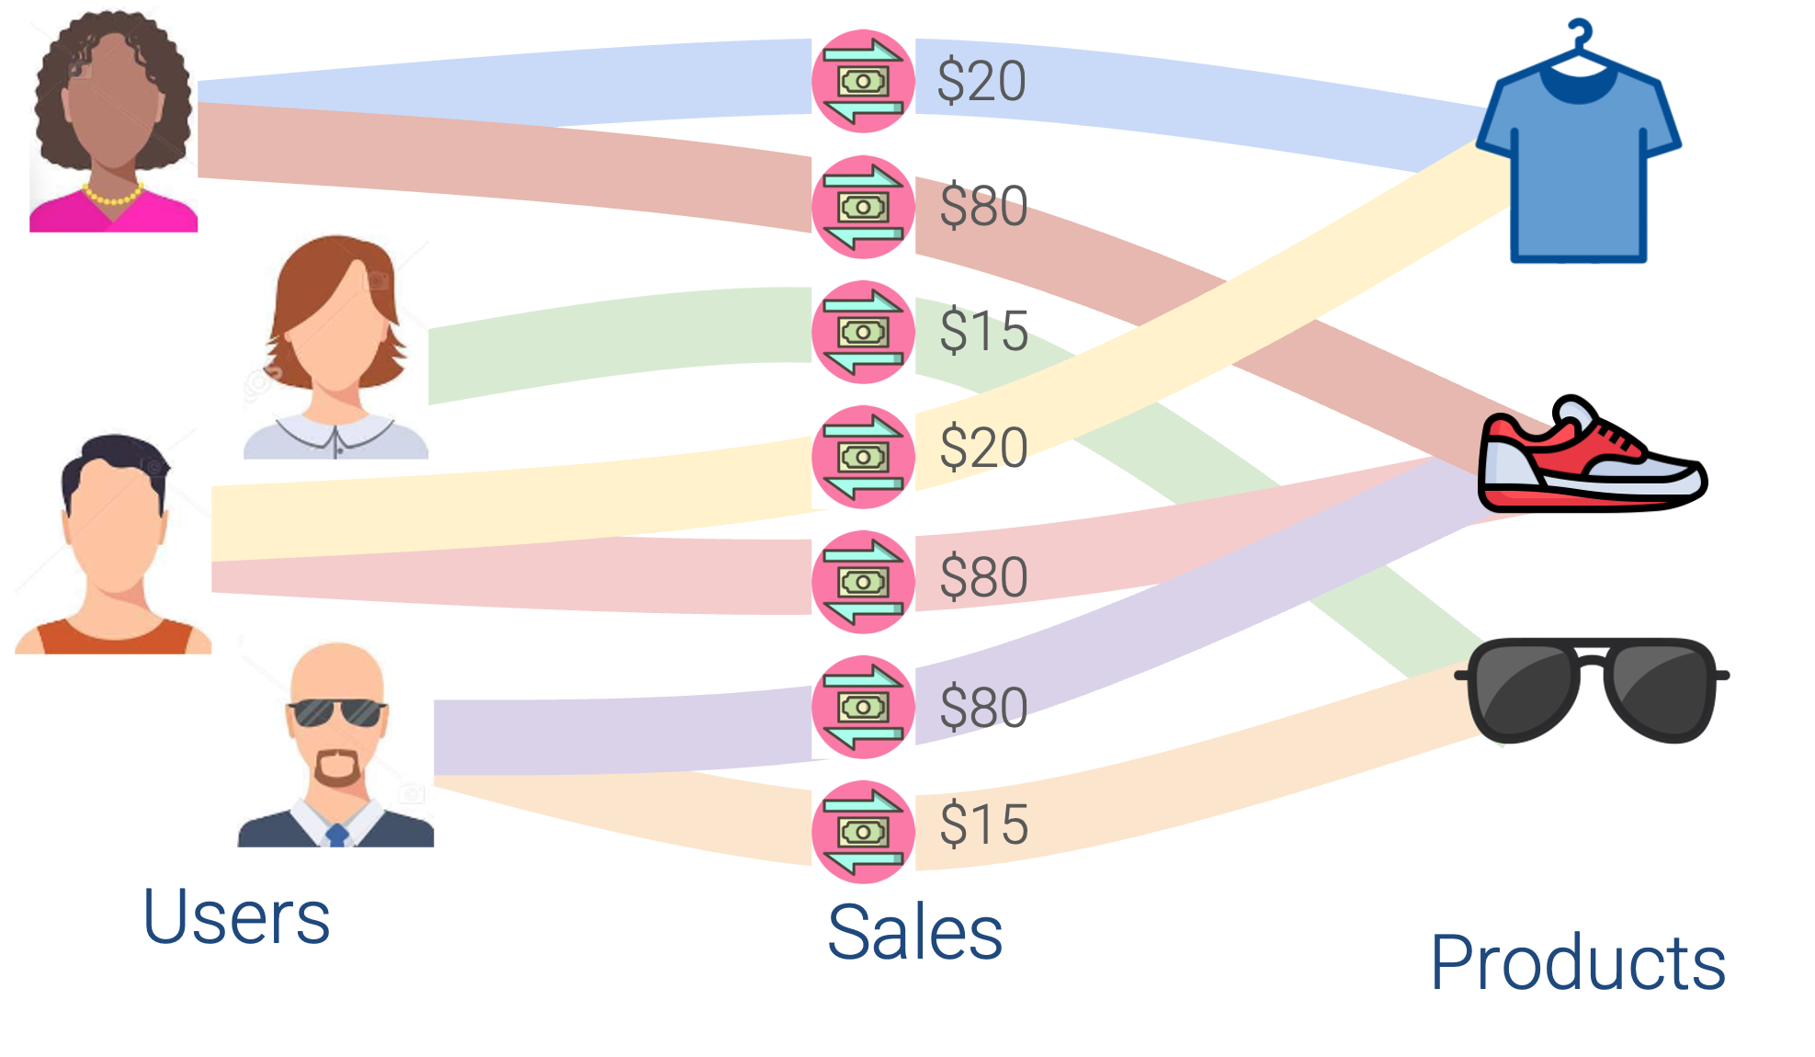
Graph ML Problem Solving Pipeline
Graph Problem
Graph ML
Solutions
Jure Leskovec, Stanford CS224W: Machine Learning with Graphs, http://cs224w.stanford.edu
Notes:
Relational DB to Graph
Graph to Graph Problem
Graph ML to solve the graph problem
how to come up with solutions and how they compare to other techniques

Slide 28
Stanford CS224W:
Relational Database Graph
CS224W: Machine Learning with Graphs
Jure Leskovec, Stanford University
http://cs224w.stanford.edu

Slide 29



Databases
Real-world data are stored in databases
Transaction
Transaction Table
Trans ID | User ID | Product ID | Value | Timestamp
… | … | … | … | …
… | … | … | … | …
… | … | … | … | …
… | … | … | … | …
100 | 51 | 345 | $1000 | 1710281001
… | … | … | … | …
User
Product

Slide 30
Relational Databases
Databases are often relational
Transaction Table
Trans ID | User ID | Product ID | Value | Timestamp
… | … | … | … | …
… | … | … | … | …
… | … | … | … | …
… | … | … | … | …
100 | 51 | 345 | $1000 | 1710281001
… | … | … | … | …
Transaction
User Table
Product Table
User
Product
User ID | Gender
... | ...
51 | Male
Product ID | Category
... | ...
345 | Bike
Relational databases as heterogeneous graphs

Slide 31
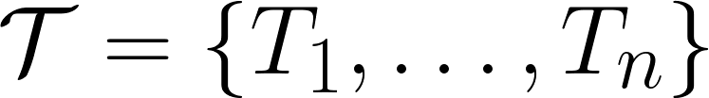

Mathematically…
Transaction Table
Trans ID | User ID | Product ID | Value | Timestamp
… | … | … | … | …
… | … | … | … | …
… | … | … | … | …
… | … | … | … | …
100 | 51 | 345 | $1000 | 1710281001
… | … | … | … | …
User Table
Product Table
User ID | Gender
... | ...
51 | Male
Product ID | Category
... | ...
345 | Bike
A database is a set of tables and
Links between tables
Jure Leskovec, Stanford CS224W: Machine Learning with Graphs, http://cs224w.stanford.edu

Slide 32
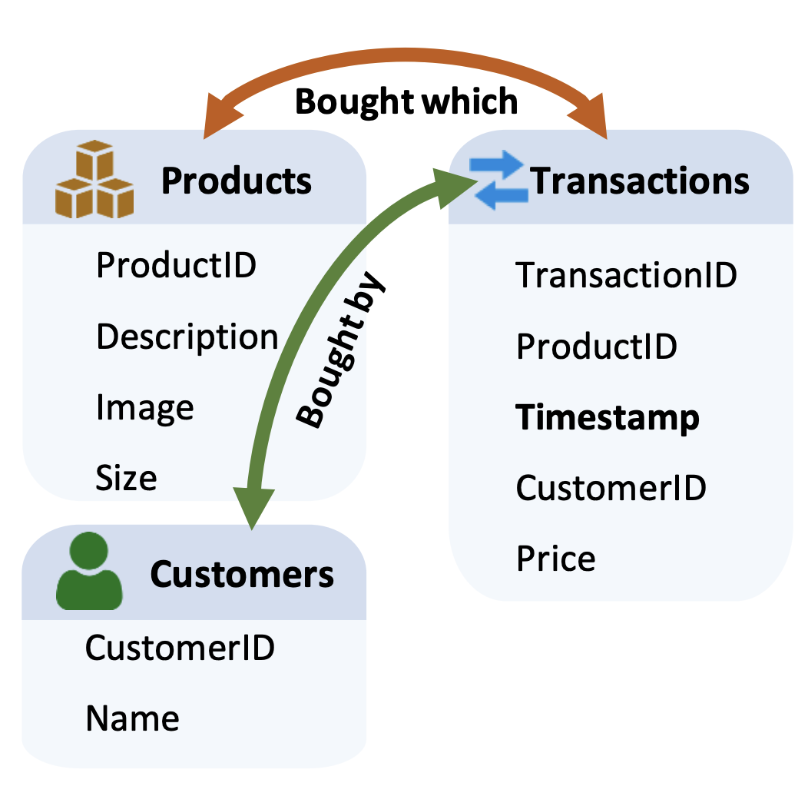
Schema Graph
The schema graph represents the high-level structure of the heterogeneous graph
Jure Leskovec, Stanford CS224W: Machine Learning with Graphs, http://cs224w.stanford.edu
Notes:
To represent the high level structure of a DB we use the schema graph
The schema graph arises from the given relational tables. Each node denotes a table, and an edge between tables indicates that primary keys in one are foreign keys in the other.

Slide 33
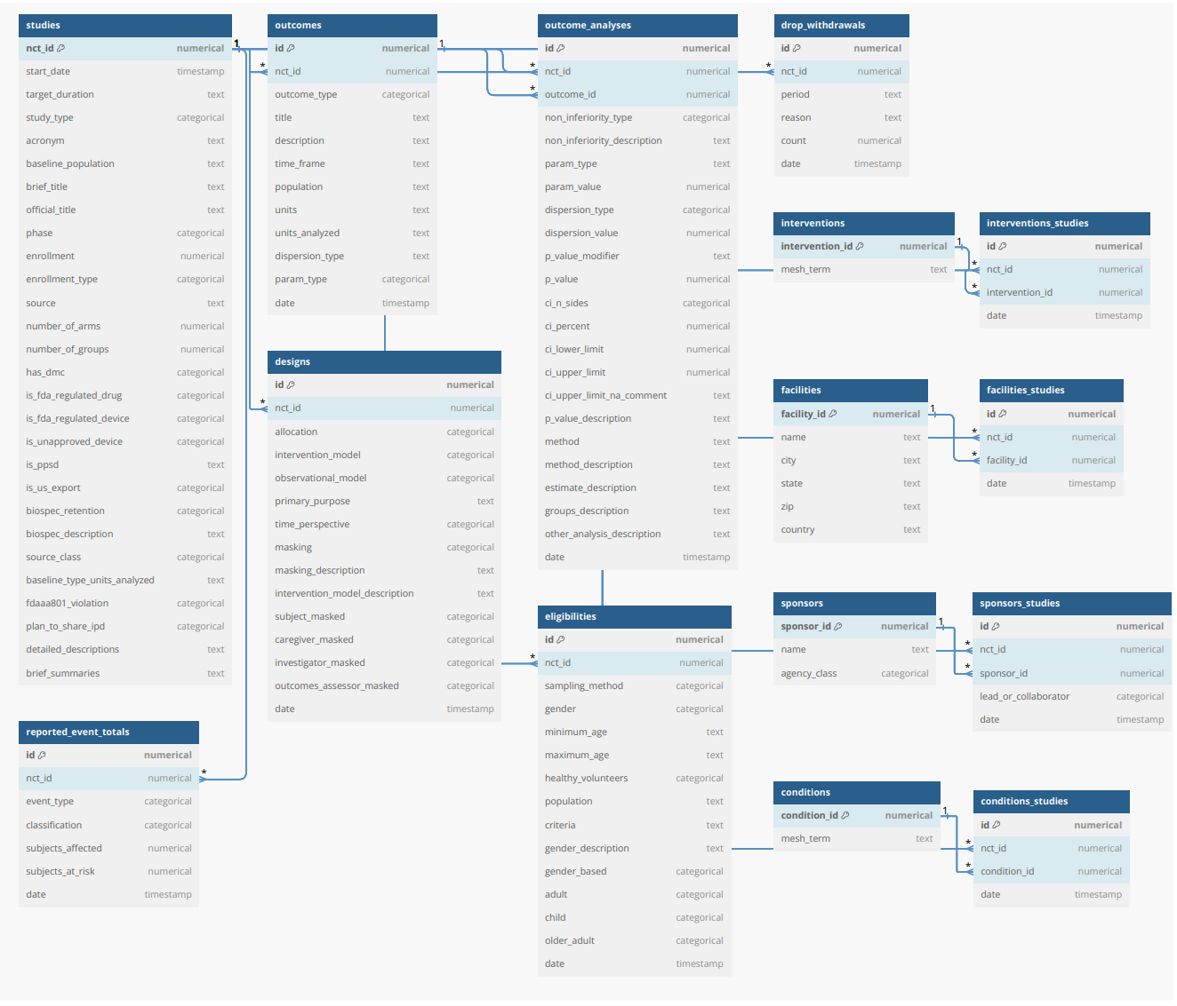
Rel-trial Schema Graph
The schema graphs can be more complex
Jure Leskovec, Stanford CS224W: Machine Learning with Graphs, http://cs224w.stanford.edu

Slide 34
Relational Entity Graph
Relational Entity Graph:
Create connections via primary-foreign keys
$20
$80
$15
$20
$80
$80
$15
Users
Sales
Products
Jure Leskovec, Stanford CS224W: Machine Learning with Graphs, http://cs224w.stanford.edu
Notes:
With the schema graph as a guideline we can create the
Every user becomes a node every product become a node and every transaction becomes a node
And we have edges between users and transactions and transactions and products dictated by the primary foreign keys tripartite graph structure

Slide 35

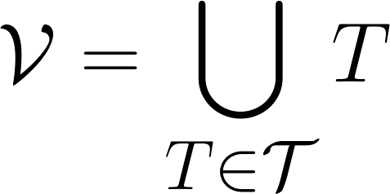

Mathematically…
Given database of tables and relations
Each table is a set of entities possessing a primary key and optional foreign keys
The relational entity graph is such that
  the set of nodes is defined by all rows in all tables
  The set of edges is defined by connecting two entities whose primary and foreign keys match
Jure Leskovec, Stanford CS224W: Machine Learning with Graphs, http://cs224w.stanford.edu

Slide 36
Entities in Relational Entity Graph
Transaction Table
Trans ID | User ID | Product ID | Value | Timestamp
… | … | … | … | …
… | … | … | … | …
… | … | … | … | …
… | … | … | … | …
100 | 51 | 345 | $1000 | 1710281001
… | … | … | … | …
User Table
Product Table
User ID | Gender
... | ...
51 | Male
Product ID | Category
... | ...
345 | Bike
Entities also have features (different than KGs)

Slide 37
Stanford CS224W:
Predictive Tasks in Relational Databases
CS224W: Machine Learning with Graphs
Jure Leskovec, Stanford University
http://cs224w.stanford.edu

Slide 38
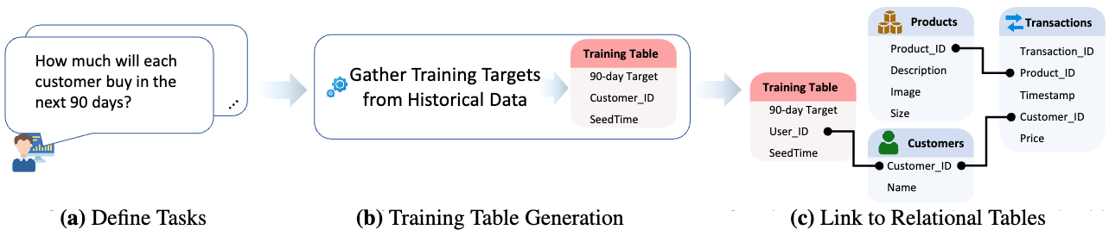
Overview of the Approach
Next:
  Define task(s)
  Relational Deep Learning
Jure Leskovec, Stanford CS224W: Machine Learning with Graphs, http://cs224w.stanford.edu
Notes:
The next step is to define a task
Then from historical data I will create the training table that tells me how many products will the user buy the next 90 days
Now that I created the training table I can connect it back to my schema
I have the labels and I can train a GNN to predict the labels

Slide 39
Defining a Task
Example: Predict whether a user is going to churn in the next 30 days?
Most tasks are temporal:
  Customer’s label changes
  over time
  Database changes over time
    For every time, a feature needs to be recomputed
To define a task, we need:
  Entity
  Label
  Time
Temporal tasks as especially challenging because features are time dependent:
For every time, a feature needs to be recomputed
Entity’s label can change between time steps
Jure Leskovec, Stanford CS224W: Machine Learning with Graphs, http://cs224w.stanford.edu
Notes:
AGAIN
First we need to define a task
If I ask this question today the answer might be different compared to asking the same question tomorrow
For every day of the year I need to recompute the feature
To define a task we need to define three things
The user might churn but the user may come back
The user will have multiple labels depending on the time

Slide 40
Defining a Task: Training Table
Training Table: A special table containing training labels
  (entity ID, time, labels)
    Classification, Regression, Multi-class
  time column is essential for temporal prediction tasks
    An entity may have different labels at different times
    Only use information up to the time of label
Jure Leskovec, Stanford CS224W: Machine Learning with Graphs, http://cs224w.stanford.edu
Notes:
Then we need to define a training table
We don’t want to learn from the future and have information leakage

Slide 41
Defining a Task: Training Table
Training Table: A special table containing training labels
  (entity ID, time, labels)
    Classification, Regression, Multi-class
Training Table
Entity ID | Timestamp | Label
99 | 10172024 | 1
99 | 10182024 | 1
… | … | …
100 | 10172024 | 1
100 | 10182024 | 0
… | … | …
Jure Leskovec, Stanford CS224W: Machine Learning with Graphs, http://cs224w.stanford.edu
Notes:
Then we need to define a training table
We don’t want to learn from the future and have information leakage

Slide 42
Example: Churn
Schema:
Example prediction task:
  Predict whether a user is going to churn
    Zero sales in the next 30 days.
Training table:
  (user, time, churn label)
Jure Leskovec, Stanford CS224W: Machine Learning with Graphs, http://cs224w.stanford.edu

Slide 43
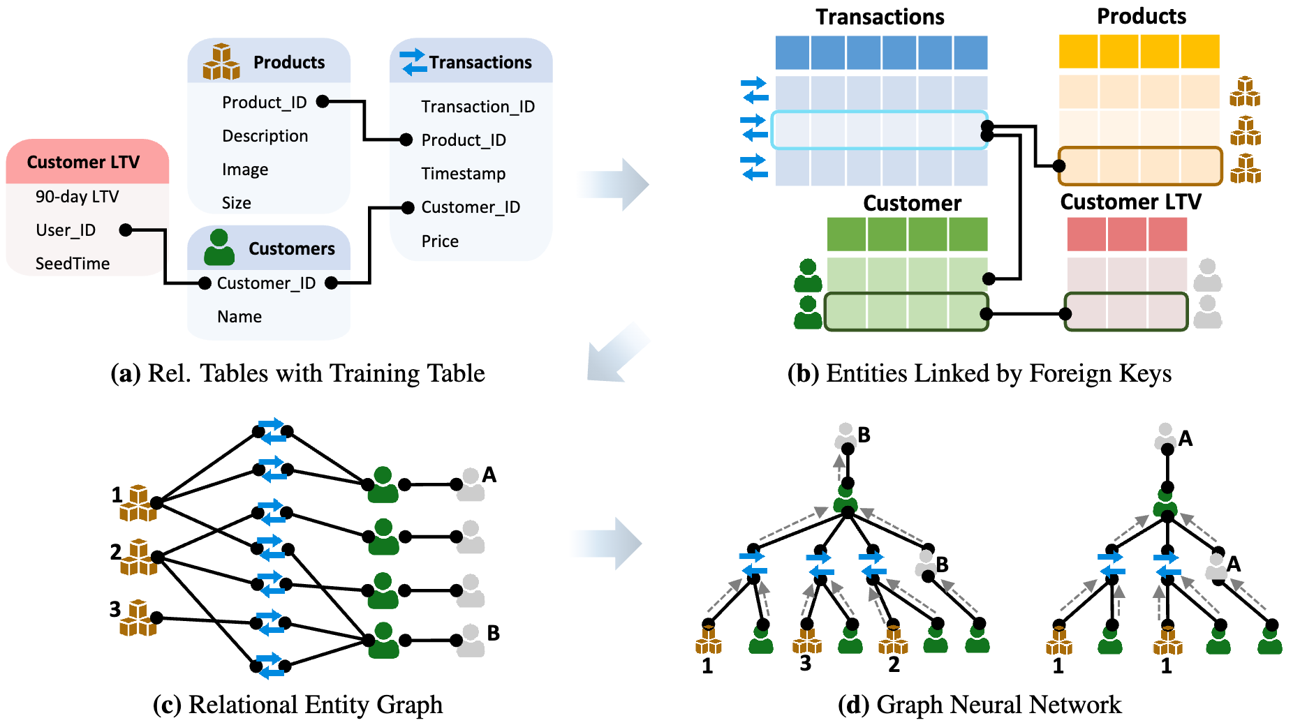
Relational Deep Learning
Jure Leskovec, Stanford CS224W: Machine Learning with Graphs, http://cs224w.stanford.edu

Slide 44
Relational Entity Graph
Relational Entity Graph:
Create connections via primary-foreign keys
$20
$80
$15
$20
$80
$80
$15
Users
Sales
Products
Jure Leskovec, Stanford CS224W: Machine Learning with Graphs, http://cs224w.stanford.edu
Notes:
With the schema graph as a guideline we can create the

Slide 45
Connect the Training Table
Training labels together with timestamps are attached to the graph
May ‘23
Churn
$20
June ’23
Active
$80
May ‘23
Churn
$15
June ‘23
Active
$20
June ‘23
Active
$80
April ’23
Active
$80
May ’23
Churn
$15
June ‘23
Active
Users
Sales
Products
Jure Leskovec, Stanford CS224W: Machine Learning with Graphs, http://cs224w.stanford.edu

Slide 46
Stanford CS224W:
Relational GNN
CS224W: Machine Learning with Graphs
Jure Leskovec, Stanford University
http://cs224w.stanford.edu
Notes:
How do the GNNs fit in to this?

Slide 47
Relational Deep Learning
Jure Leskovec, Stanford CS224W: Machine Learning with Graphs, http://cs224w.stanford.edu

Slide 48
GNN on the Entity Graph
Node’s neighborhood defines a computation graph
Nodes learn how to optimally use information from neighbors to obtain enhanced node representations
$20
May ‘23
Churn
$80
$15
$20
$80
$80
$15
June ‘23
Active
Users
Sales
Products
Entity Graph
GNN computation graphs
Jure Leskovec, Stanford CS224W: Machine Learning with Graphs, http://cs224w.stanford.edu
Notes:
AGAIN
Columns of the tables define the attributes
How will the GNN operate? The GNN will say, aha I am in may 23 and
I want to predict whether user will chirn in the next three months
Then it will go around this user and will create a computation graph which in that case involves nodes that have timestamps before may 23
I can learn from the transactions that happened in May and I can learn from the transaction that happened in JUne

Slide 49
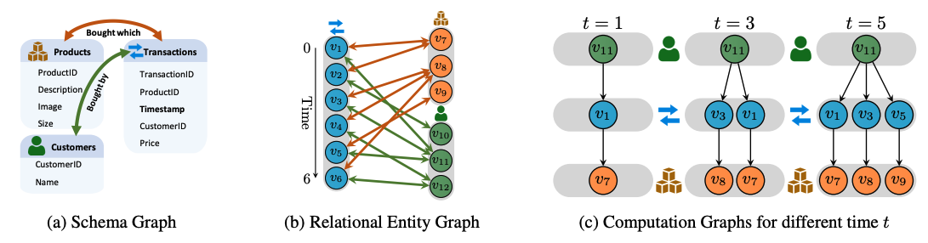
GNNs on Temporal Graphs
The computation graph for each node is time-dependent
Message+Aggregation becomes time-dependent
Sampling over neighbors is time-dependent
Notes:
Three different kinds of graphs. (a) The schema graph arises from the given relational tables. Each node denotes a table, and an edge between tables indicates that primary keys in one are foreign keys in the other. (b) The entity graph has one node for each entity in each table, and edges given by primary-foreign key links. The entity graph is heterogeneous with node and edge types defined by the schema graph. The nodes have a timestamp (illustrated by arrow-of-time), originating from the timestamp column of the table. (c) Using a temporal sampling strategy and a task description in form of training table containing different time s, we obtain time-consistent computation graphs as training examples that naturally respect temporal order and map well to parallel compute.

Slide 50
GNN vs Feature Engineering
GNN-based features:
Hand-engineered features:
VS.
SUM(TRANSACTIONS.Price)
over (-30, 0) days
AVG(TRANSACTIONS.Price)
over (-30, 0) days
...
GNN aggregation is learnable version of hand-crafted features!
GNNs give better performance by learning optimal features.
Jure Leskovec, Stanford CS224W: Machine Learning with Graphs, http://cs224w.stanford.edu
Notes:
AGAIN
Feature engineering is join + Aggregation, join over two tables, aggregation happens over some fixed time window
Talk about embeddings.
Useful as input embedding feature for other downstream tasks

Slide 51

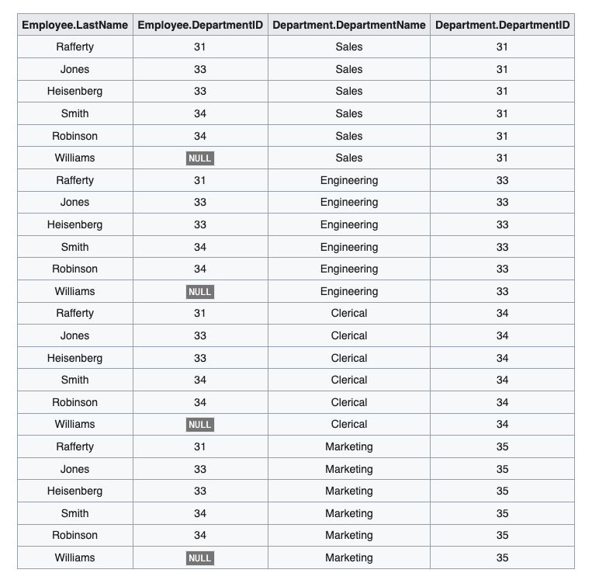
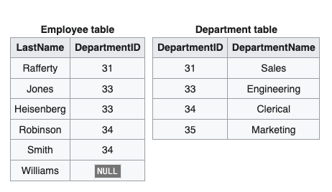
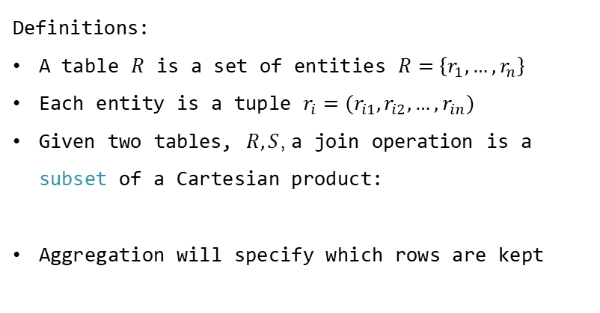
SQL joins vs Graph edges
Definitions:
A table $R$ is a set of entities $R=\left\{r_{1}, …, r_{n}\right\}$
Each entity is a tuple $r_{i}=(r_{i1}, r_{i2},…, r_{in})$
Given two tables, $R, S$, a join operation is a subset of a Cartesian product:
Aggregation will specify which rows are kept
Ex.1: Cross Join
https://en.wikipedia.org/wiki/Relational_algebra
Notes:
Feature emgineering

Slide 52
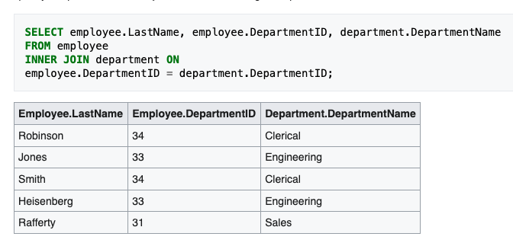
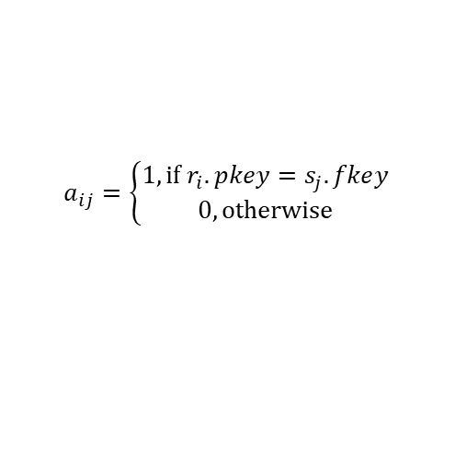

SQL joins vs Graph edges
Connection between SQL Joins and graph edges
Ex.2: Inner Join
$$R⋈S≔\{r∪s|r∈R∧s∈S∧Fun(r,s)\}$$
$$Fun\left(r,s\right):r.pkey=s.fkey$$
$$S$$
$$a_{ij}=\left\{\begin{aligned}1, if r_{i}.pkey=s_{j}.fkey \\ 0, otherwise\end{aligned}\right.$$
$$R$$
These are exactly the pkey-fkey edges!
https://en.wikipedia.org/wiki/Relational_algebra
Notes:
Feature emgineering

Slide 53



GNNs perform a JOIN+AGG
Input:
USER_ID | VALUE | DATE
1 | 20 | 01-01
1 | 80 | 01-02
2 | 15 | 01-01
3 | 20 | 01-02
3 | 80 | 01-03
$20
USER_ID
1
2
3
$80
$15
$20
$80
GNN can learn:
USER_ID | SUM(VALUE)
1 | 80
2 | 0
3 | 100
Learnable Aggregation
Temporal embedding
Fact representation
SELECT SUM(VALUE)
FROM SALES
WHERE DATE > 01-01
GROUP BY USER_ID
Jure Leskovec, Stanford CS224W: Machine Learning with Graphs, http://cs224w.stanford.edu
Notes:
AGAIN
Neural version of join + aggregation

Slide 54
Benefits of GNNs
GNNs learn how to aggregate information:
They can discard neighboring
node information that is irrelevant for the given downstream task
They can detect fine-grained patterns within local
neighborhoods (e.g., buying
behavior over the last year)
Jure Leskovec, Stanford CS224W: Machine Learning with Graphs, http://cs224w.stanford.edu
Notes:
Manually it would be impossible to recover
automatically

Slide 55
Benefits of GNNs
GNNs can exchange information
across training examples:
Instead of treating examples
as isolated, there now exists an
inter-dependency between entities
(e.g., users with similar features,
users with similar behavior)
GNN can use these features to
enrich an entity’s representation
How is the buying behavior of users that have bought similar products?
How is the buying behavior of users that have looked at similar products?
Jure Leskovec, Stanford CS224W: Machine Learning with Graphs, http://cs224w.stanford.edu
Notes:
Collaborative filtering

Slide 56
Benefits of GNNs
Training labels
...
Which user has bought which product?
Multi-hop reasoning across table boundaries can catch information
which is hard to pre-compute beforehand
How active was the user in the past?
Jure Leskovec, Stanford CS224W: Machine Learning with Graphs, http://cs224w.stanford.edu
Notes:
We as humans will never be able to compute features that are combinations of three joins that a GNN can do
Manually it would be impossible to recover
Find a signal 3 or 4 tables away to make a prediction about a specific entity

Slide 57
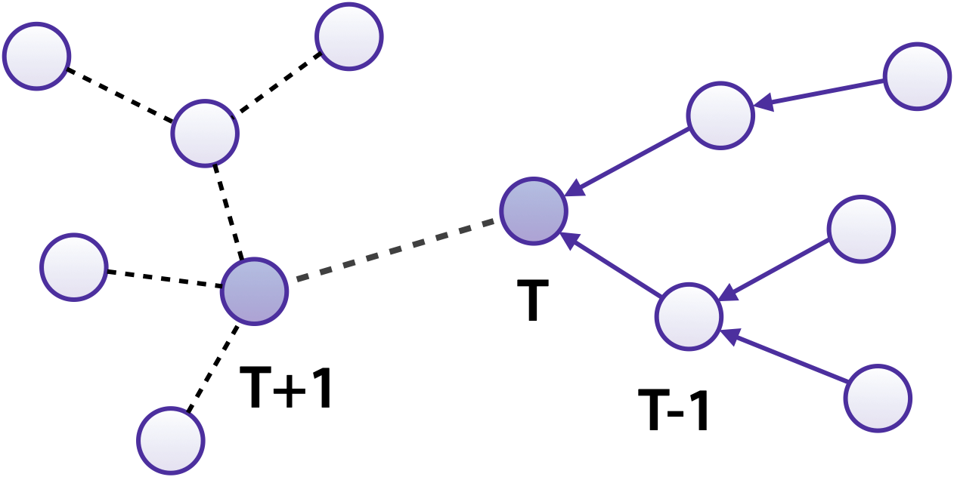
Benefits of GNNs
First-class temporal support
  Capture fine-grained relative and seasonal features via temporal embeddings
  Avoid data leakage via temporal sampling directly during data loading
Not available for sampling
Available for sampling
Jure Leskovec, Stanford CS224W: Machine Learning with Graphs, http://cs224w.stanford.edu
Notes:
Temporality comes for free

Slide 58
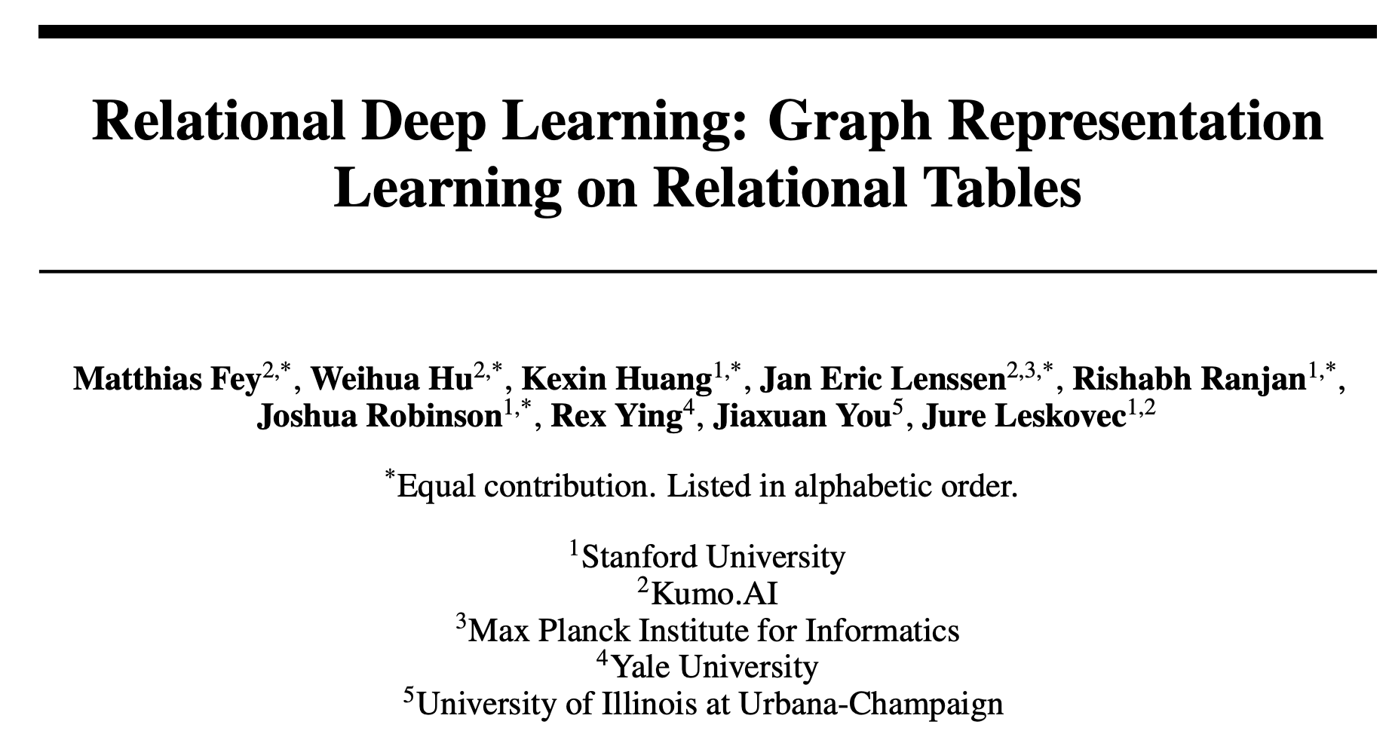
Full Vision Described in Paper
Available at: https://relbench.stanford.edu

Slide 59

Stanford CS224W:
RELBENCH
CS224W: Machine Learning with Graphs
Jure Leskovec, Stanford University
http://cs224w.stanford.edu
Notes:
Our group has worked really hard to create a relational deep learning benchmark

Slide 60
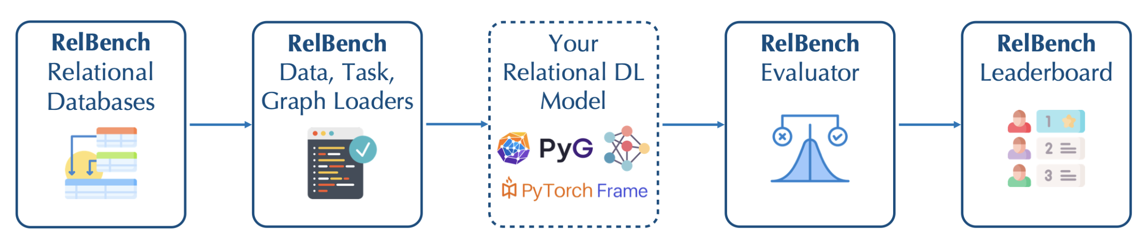
Enabling Research on RDL
Relbench is more than just a collection of Databases
Automatically download datasets
Load database and task tables
Standardized evaluation protocol:
  Prevents temporal leakage from test set
Framework-agnostic data structures: use your favorite ML stack!

Slide 61


PyF and PyG Integration
Load as a PyG graph
Train GNN end-to-end
Temporal neighbor sampling
Use PyTorch Frame to encode tables

Slide 62
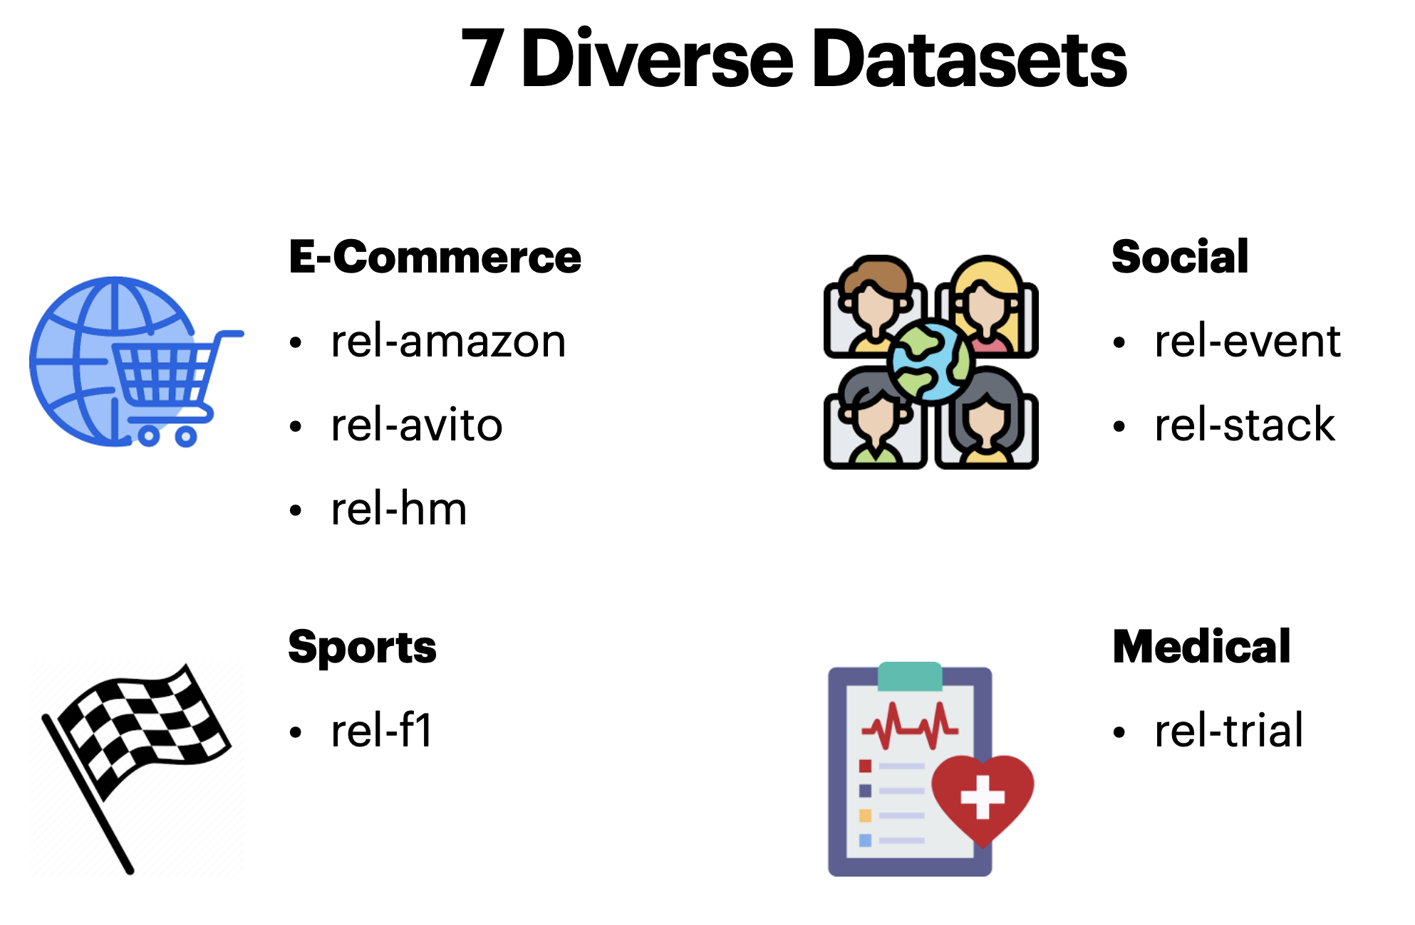
RelBench Datasets

Slide 63
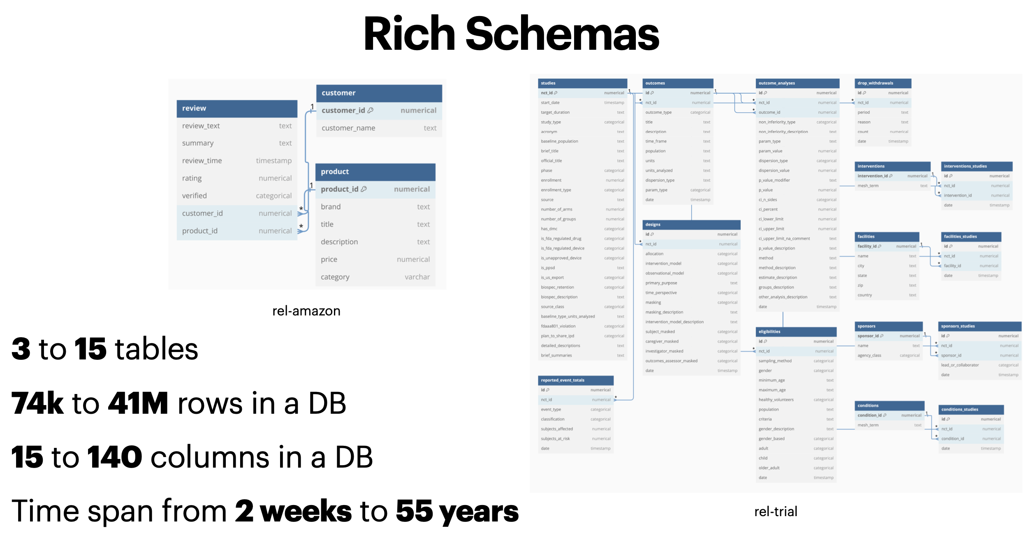
RelBench Datasets

Slide 64
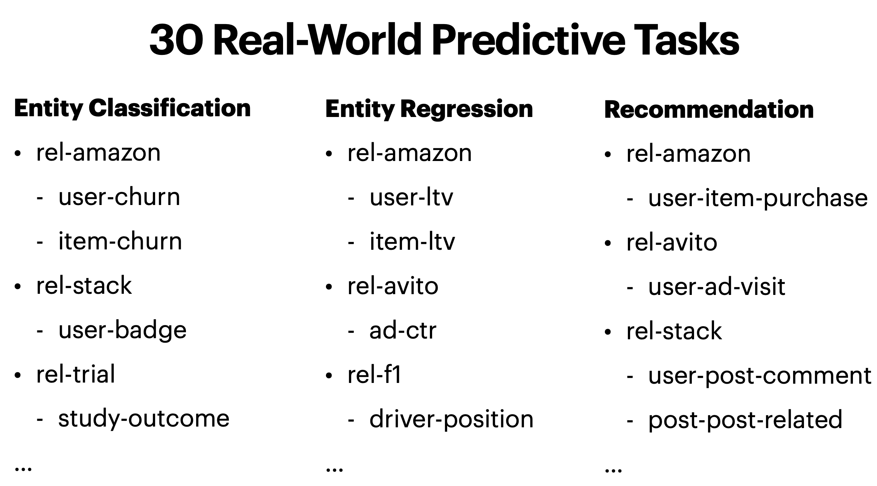
RelBench Tasks

Slide 65
RelBench Tasks
rel-amazon-churn (classification)
  Will customer churn?
rel-amazon-ltv (regression)
  Future Life-Time Value (LTV) of customer?
rel-stackex-engage (classification)
  Will user make post/comment/vote?
rel-stackex-votes (regression)
  Future upvotes of a post?
Jure Leskovec, Stanford CS224W: Machine Learning with Graphs, http://cs224w.stanford.edu

Slide 66
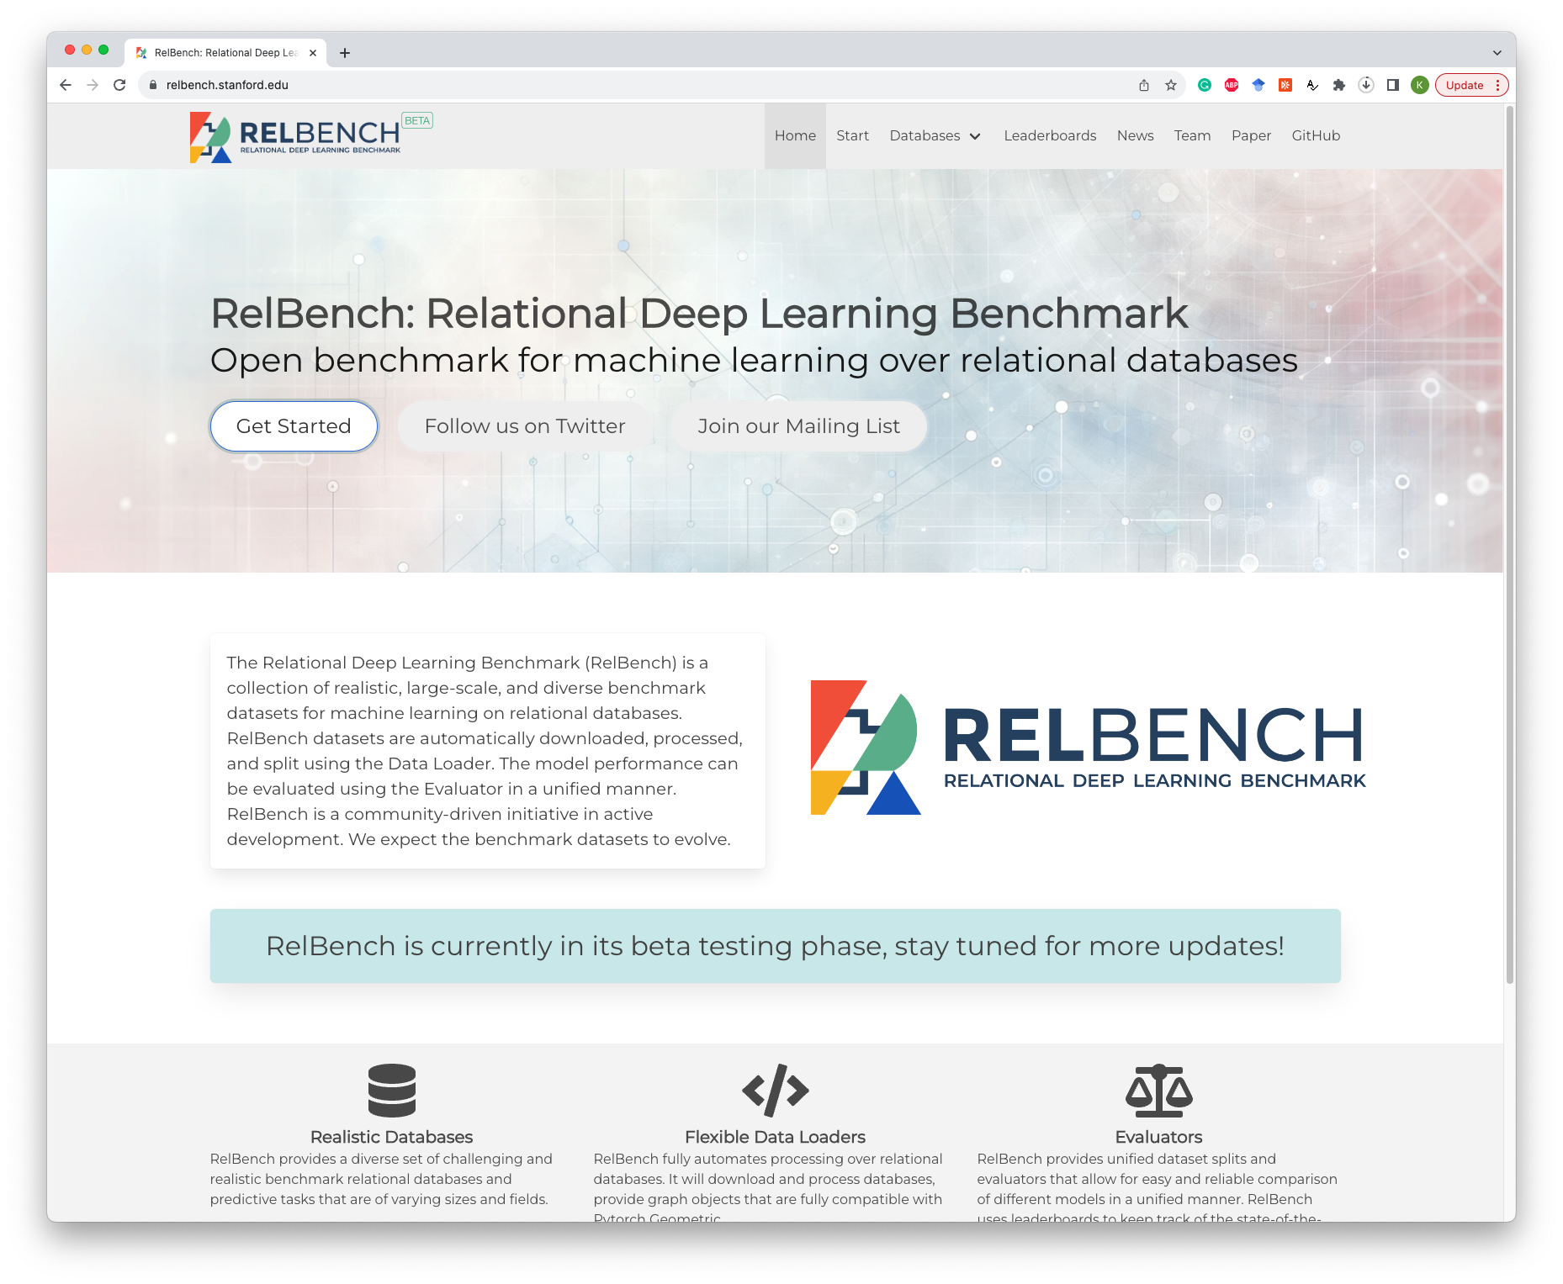
See website to get started
https://relbench.stanford.edu

Slide 67
Stanford CS224W:
GNN vs expert Data Scientist
CS224W: Machine Learning with Graphs
Jure Leskovec, Stanford University
http://cs224w.stanford.edu

Slide 68

Expert Data Scientist
Recruited Experienced Data Scientist
5 years in industry (specializing in financial databases)
Responsible for full model building lifecycle (more detail next)
(Alejandro)

Slide 69


Slide 70
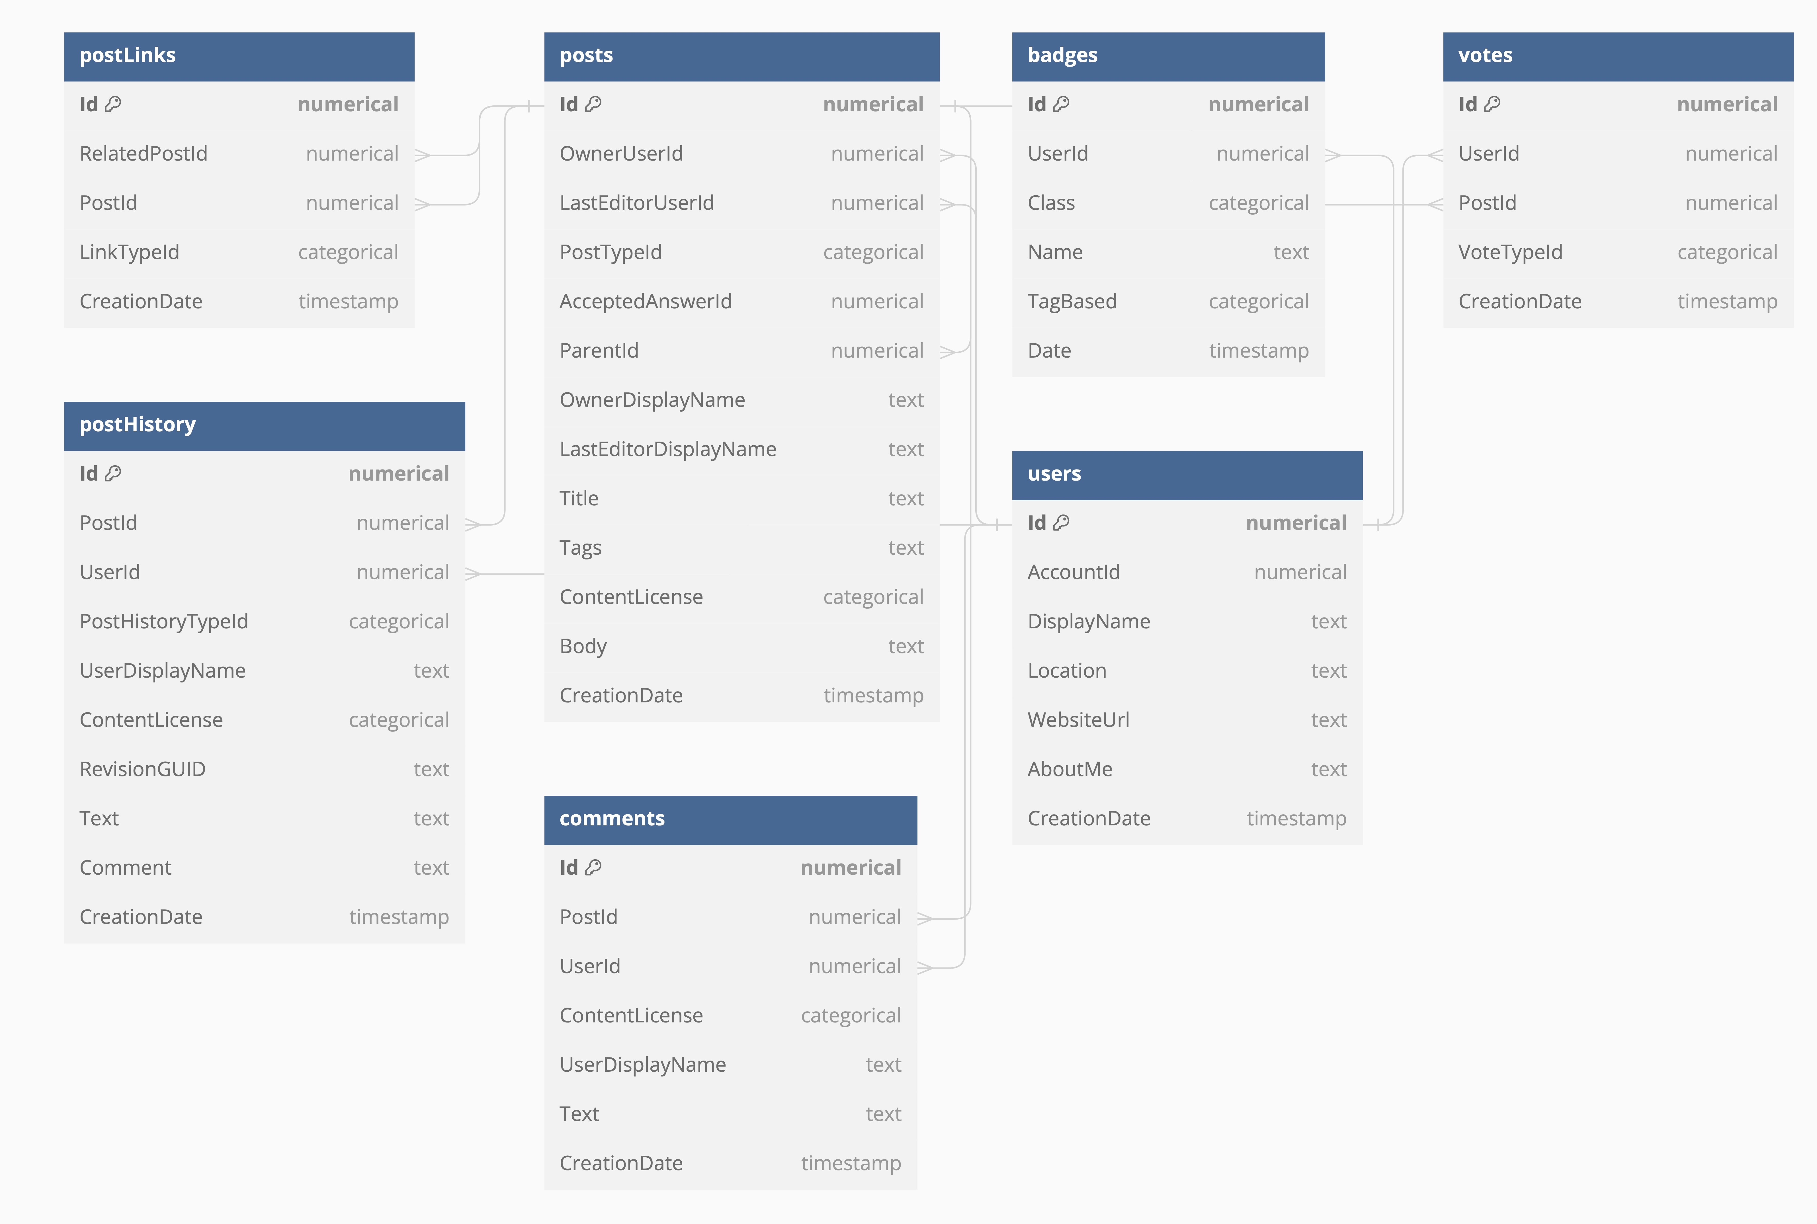
Representative Relbench task
Stack Exchange Database
Q: Will a user be active in the next 6 months?

Slide 71
Expert Data Scientist Workflow
Task: Will a user be active in the next 6 months?

Slide 72

Expert Data Scientist Workflow
Manual work
Task: Will a user be active in the next 6 months?
Exploratory Data Analysis (EDA)
4hrs

Slide 73
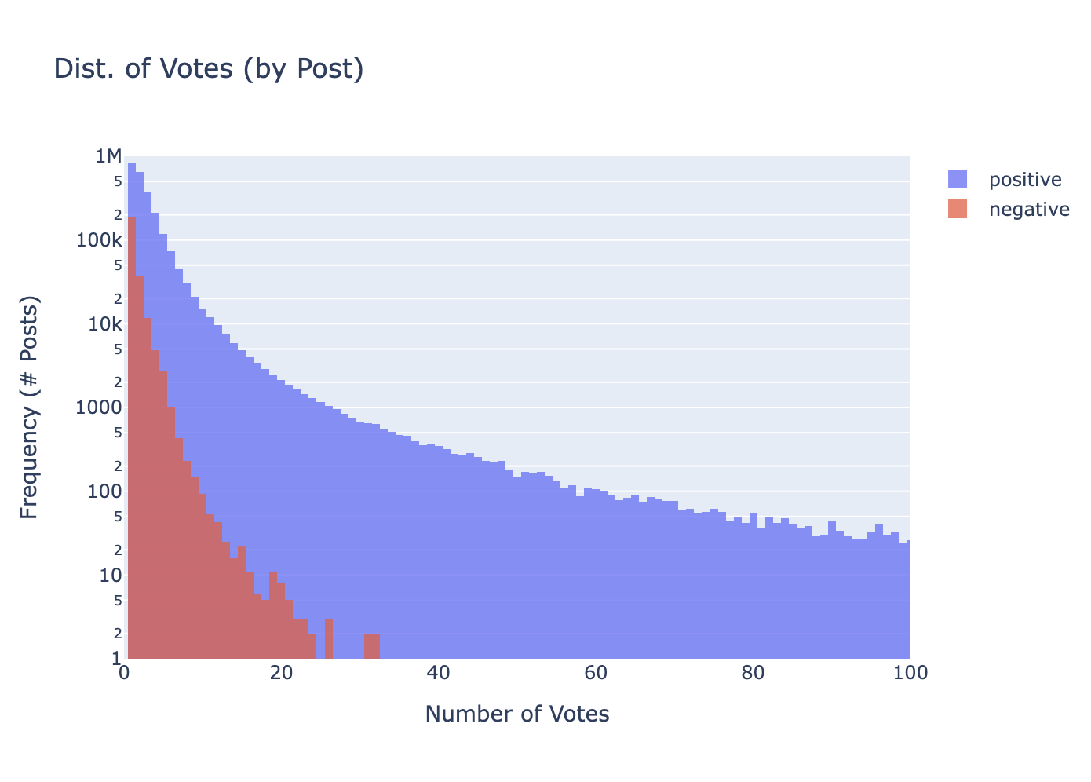
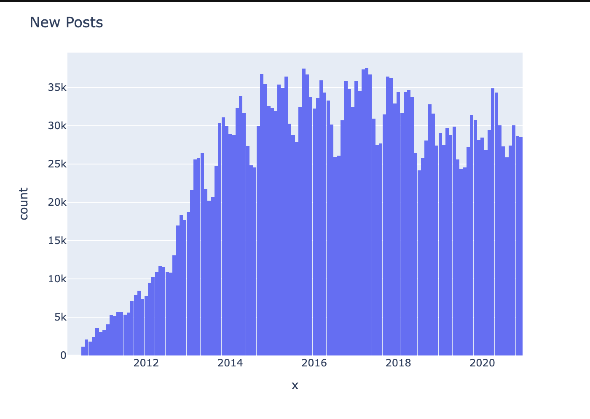
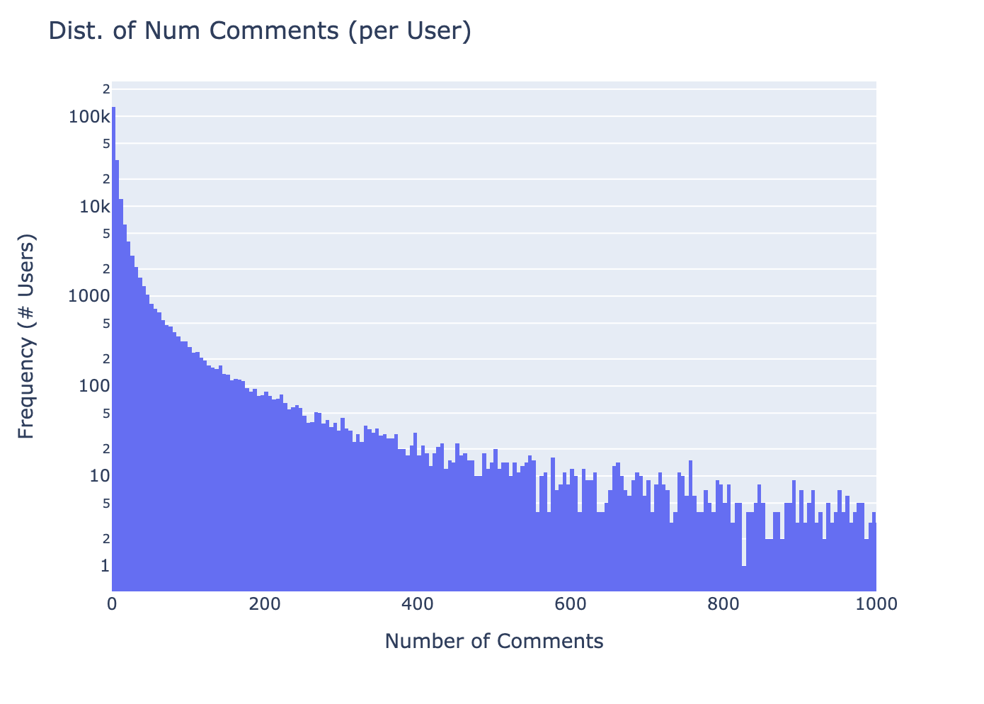
Expert Data Scientist Workflow
Manual work
Task: Will a user be active in the next 6 months?
Exploratory Data Analysis (EDA)
4hrs
Example observations
Activity is seasonal
Comments follow power law
Negative votes are infrequent

Slide 74

Expert Data Scientist Workflow
Manual work
Task: Will a user be active in the next 6 months?
Exploratory Data Analysis (EDA)
4hrs
Example features
weeks_since_last_comment
Feature Ideation
0.5hr
badge_score
location_is_null

Slide 75
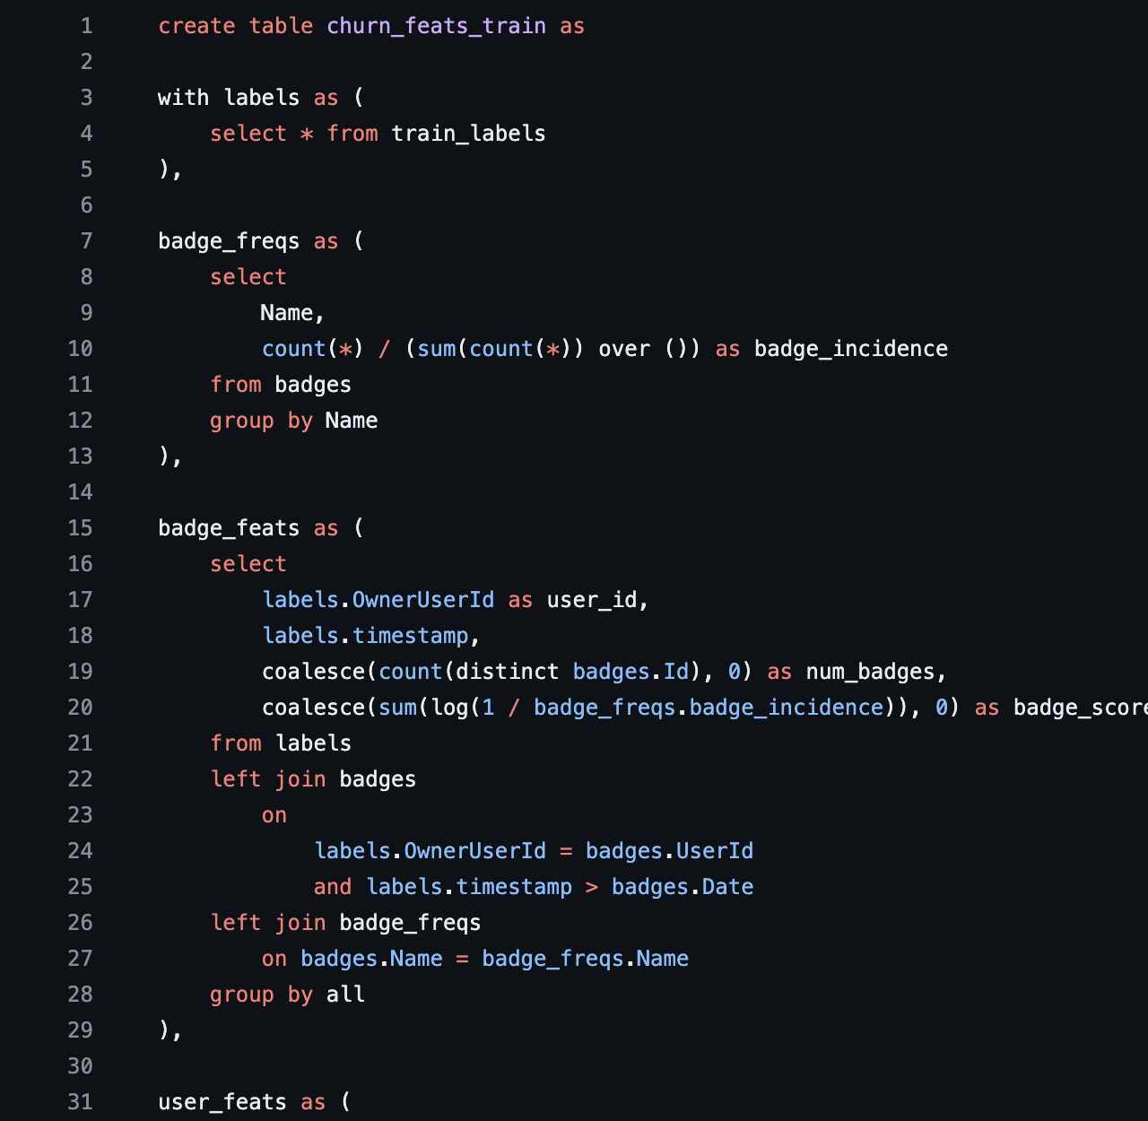
Expert Data Scientist Workflow
Manual work
Task: Will a user be active in the next 6 months?
Exploratory Data Analysis (EDA)
4hrs
Example features
weeks_since_last_comment
Feature Ideation
0.5hr
badge_score
location_is_null
SQL query writing
5hr
100s of lines of code

Slide 76
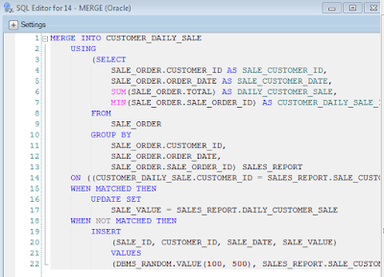
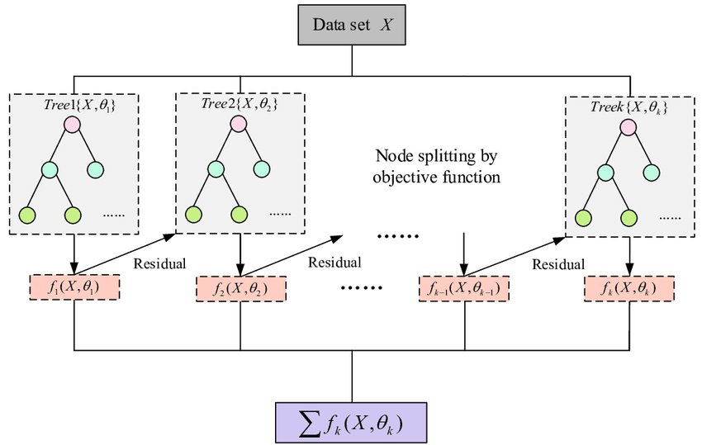
Expert Data Scientist Workflow
Manual work
Task: Will a user be active in the next 6 months?
Exploratory Data Analysis (EDA)
4hrs
Example features
weeks_since_last_comment
Feature Ideation
0.5hr
badge_score
location_is_null
SQL query writing
5hr
XGBoost hparam sweep
2hr

Slide 77
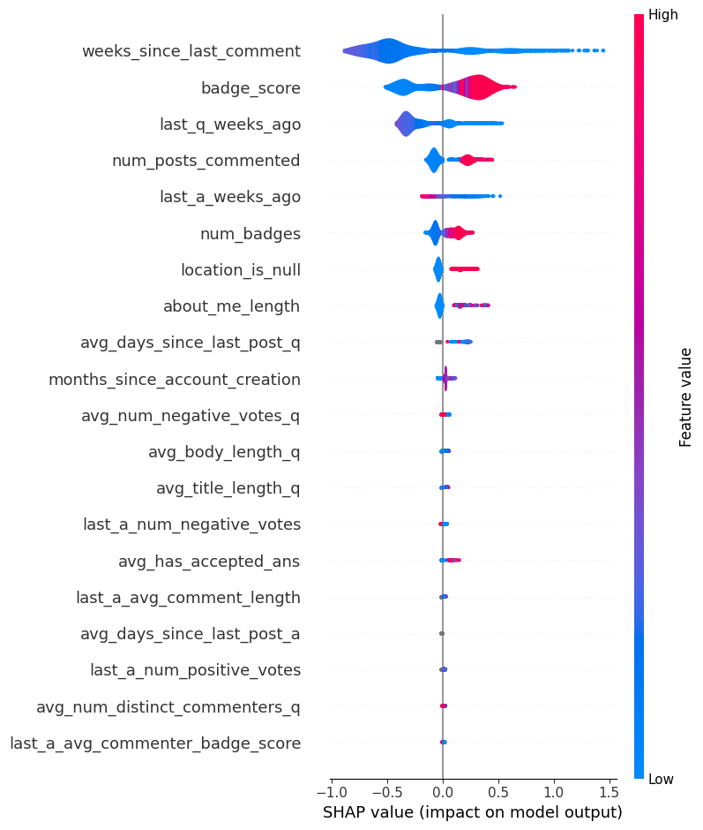
Expert Data Scientist Workflow
Manual work
Task: Will a user be active in the next 6 months?
Exploratory Data Analysis (EDA)
4hrs
Example features
weeks_since_last_comment
Feature Ideation
0.5hr
badge_score
location_is_null
SQL query writing
5hr
XGBoost hparam sweep
2hr
SHAP (feature importance analysis)
1hr

Slide 78
SHAP feature importance analysis
Selected Observations
  Website “seniority” predictive (total number of comments, badge score etc.)
  Time since last active / commented is predictive
  Completed bio (about me, location etc.) is predictive
  Number of positive/negative votes not predictive
  Interacting with “senior” community members not predictive

Slide 79
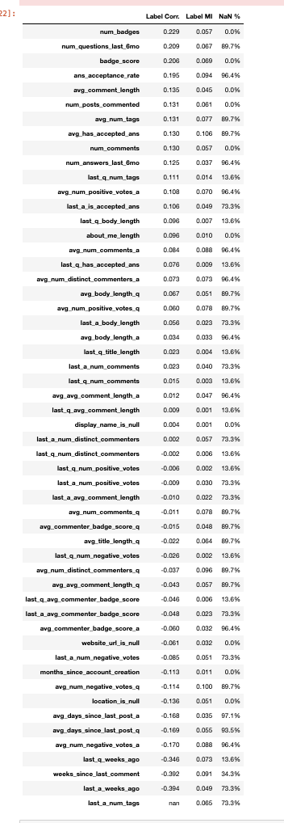
Final list of features
~12 hours of high-quality expert work

Slide 80
Stanford CS224W:
Results
CS224W: Machine Learning with Graphs
Jure Leskovec, Stanford University
http://cs224w.stanford.edu

Slide 81
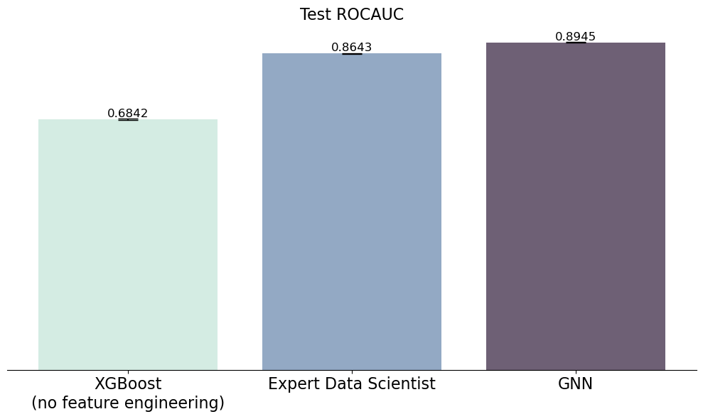
Results
Task: Will a user be active in the next 6 months?
Naive baseline

Slide 82
Results
*Work measured as the marginal effort to solve a new task
12 hours manual work
~682 lines of code
1hr model training
(2 days to model)

Slide 83
Results
Task: Will a user be active in the next 6 months?
12 hours manual work
~682 lines of code
1hr model training
<1 hour manual work
54 lines of code
1hr model training
(2 days to model)

Slide 84
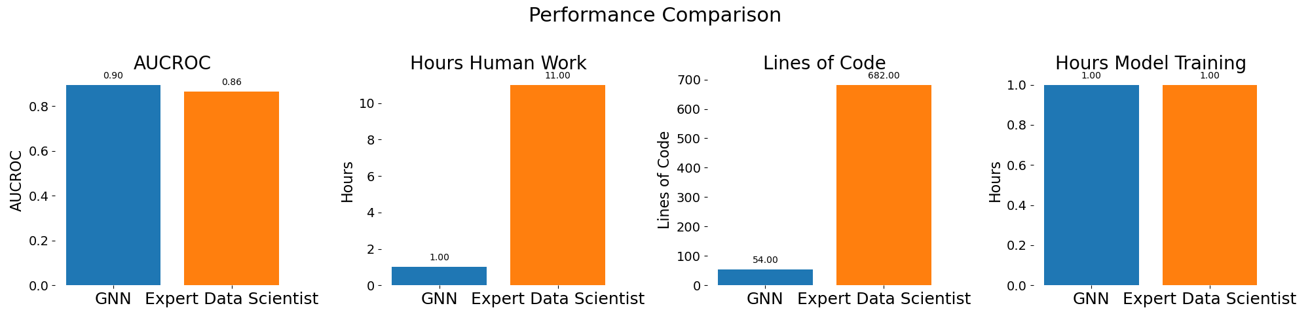
Results
Task: Will a user be active in the next 6 months?

Slide 85

More Relbench tasks

