Slide 1

Stanford CS224W:
Towards Foundation Models for Knowledge Graphs
Note to other teachers and users of these slides: We would be delighted if you found our material useful for giving your own lectures. Feel free to use these slides verbatim, or to modify them to fit your own needs. If you make use of a significant portion of these slides in your own lecture, please include this message, or a link to our web site: http://cs224w.Stanford.edu
CS224W: Machine Learning with Graphs
Charilaos Kanatsoulis and Jure Leskovec, Stanford University
http://cs224w.stanford.edu
Notes:
We introduce a new data structure a more complex data structure that of Heterogeneous graphs
Over the past few lectures we have developed powerful and efficient framework, a GNN toolbox to do ML on graphs. Today we will expand this framework to a larger class of problems that involve heterogeneous graphs.

Slide 2
Announcements
Homework 3 due today
  Gradescope submissions close at 11:59 PM
Exam opens in one week
  Ed post soon about Exam Recitation
Colab 5: will be released today
  Due Thurs 12/5

Slide 3
Stanford CS224W:
Foundation Models
CS224W: Machine Learning with Graphs
Jure Leskovec, Stanford University
http://cs224w.stanford.edu

Slide 4
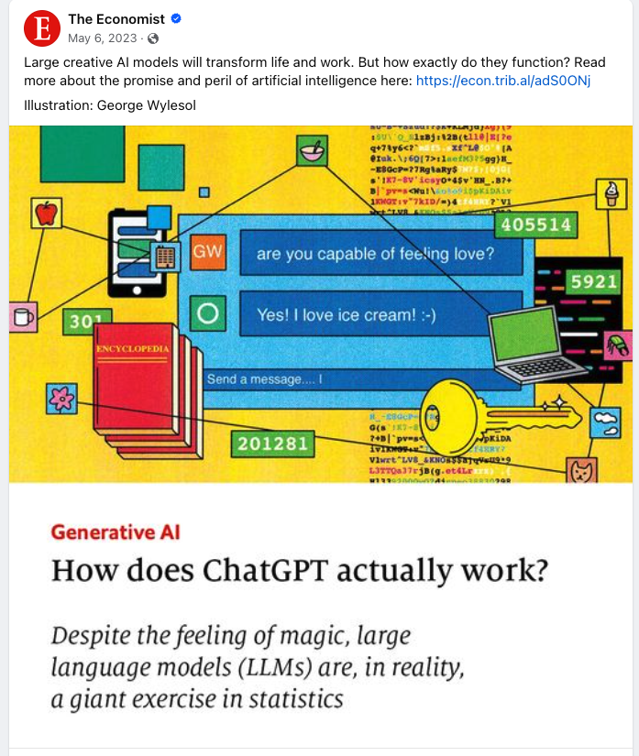
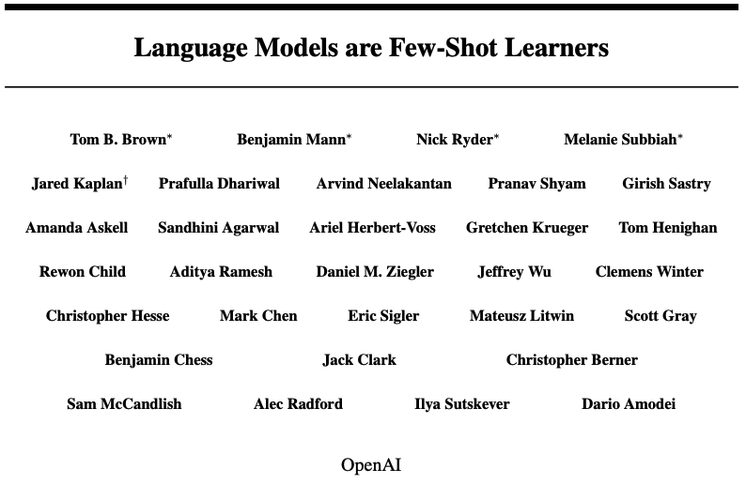
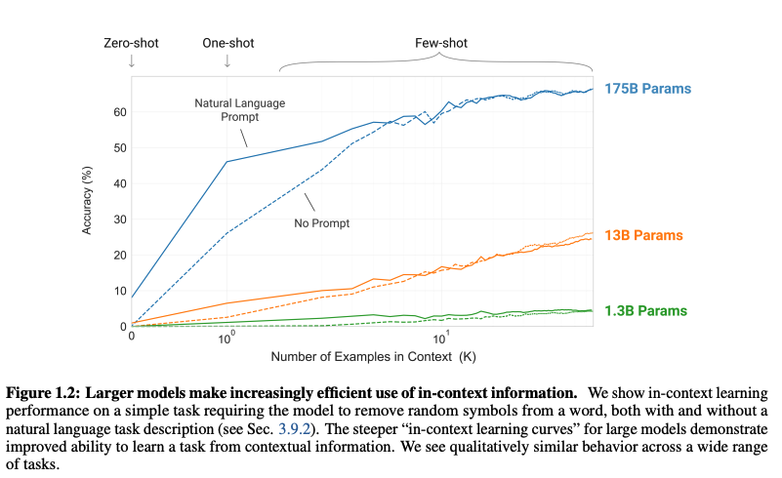
Large Language Models
Notes:
As I have mentioned before, these days we are experiencing an AI revolution, we are observing the revolution of large language models and more generally foundation models
The opportunities for technology and research this tools have initiated are endless
All started by the decision of OpenAI engineers to scale up their models
Long story short they started training over the whole web with with billion or trillion parameter models

Slide 5
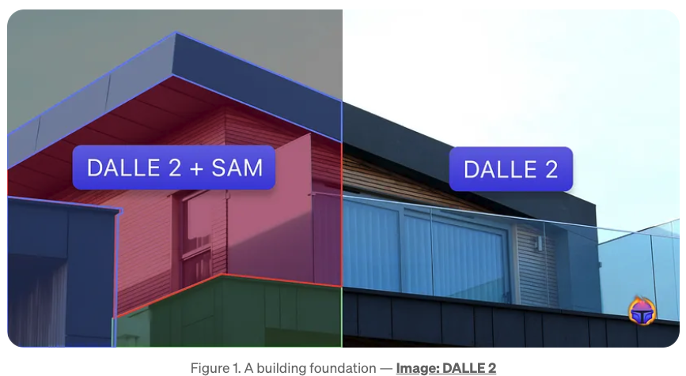
Foundation Models for Comp. Vision
Source: https://medium.com/@tenyks_blogger/the-foundation-models-reshaping-computer-vision-b299a91527fb
Notes:
Motivated by these results scientist and engineers are now building foundation models in various high impact domains
Foundation models have come to computer vision! Initially limited to language tasks, foundation models can now serve as the backbone of computer vision tasks such as image classification, object detection, and image segmentation.

Slide 6
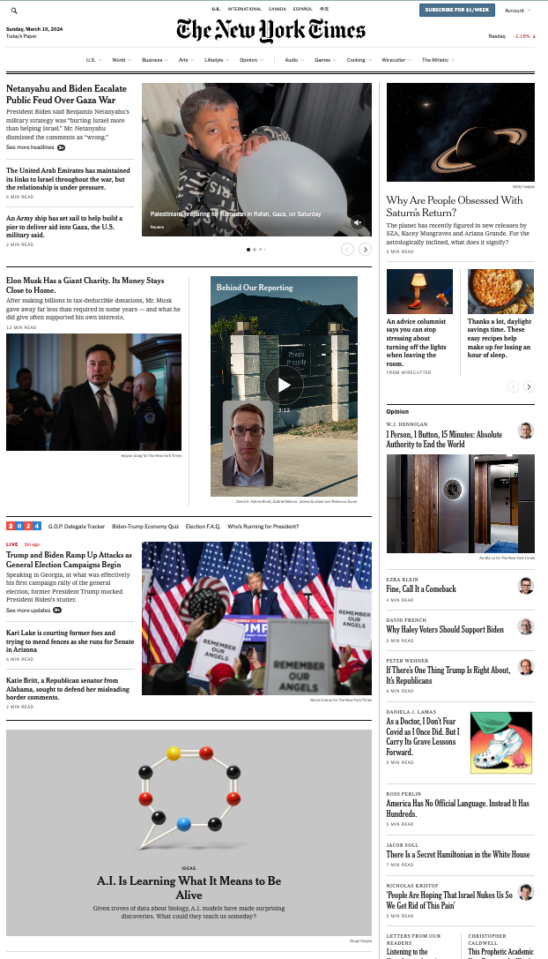
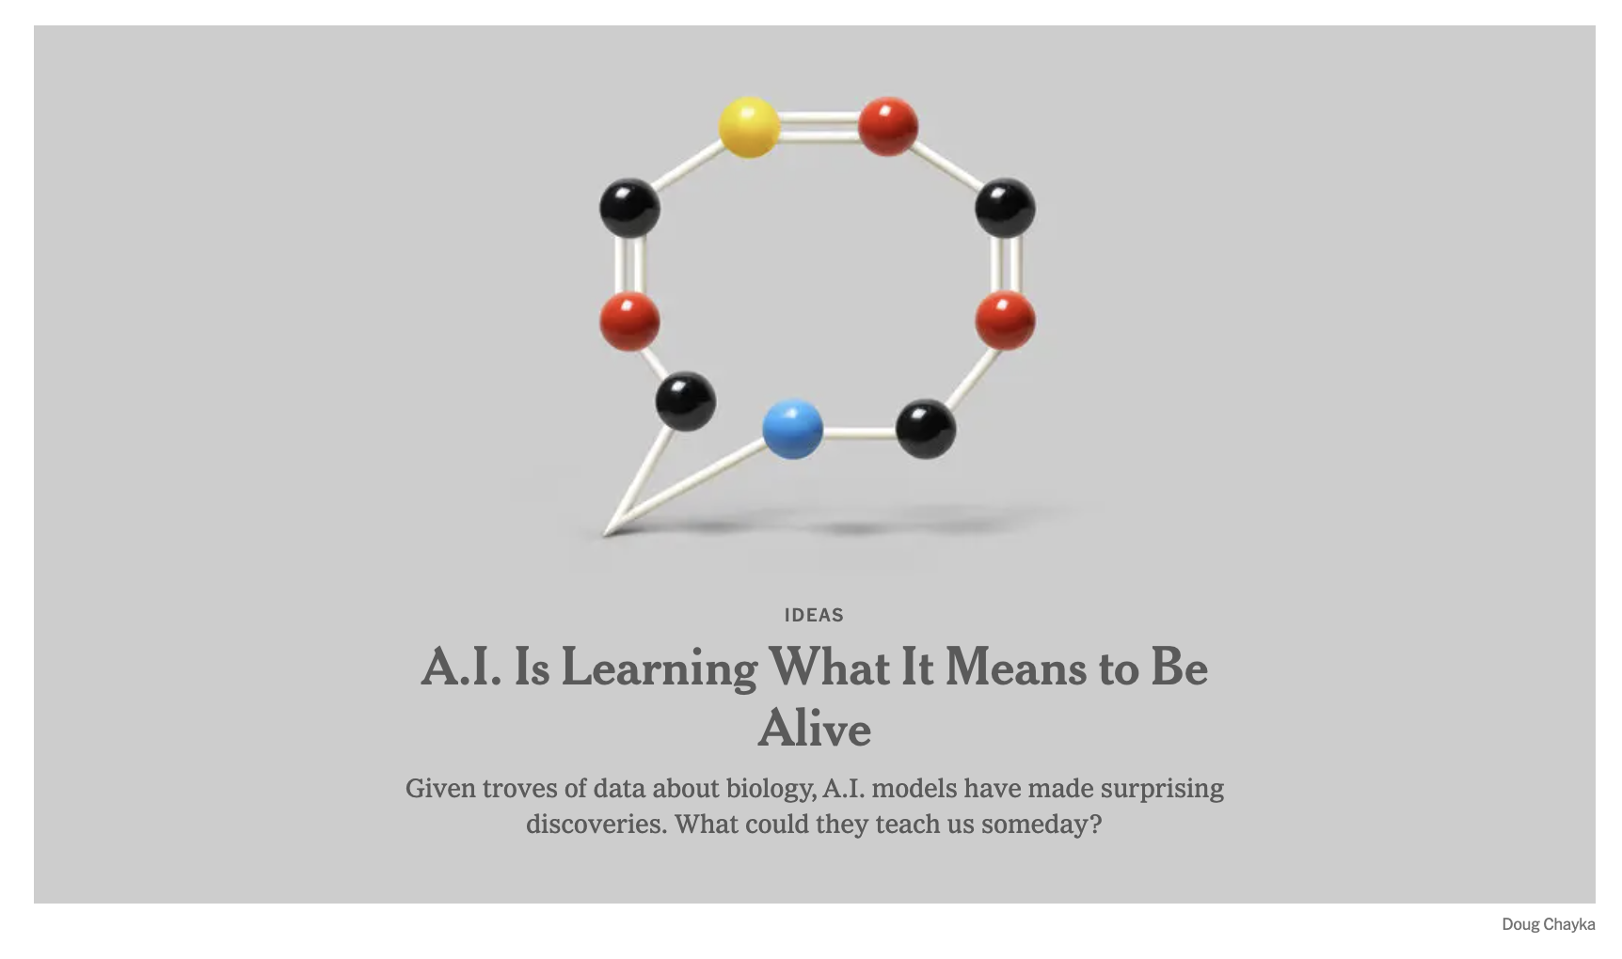
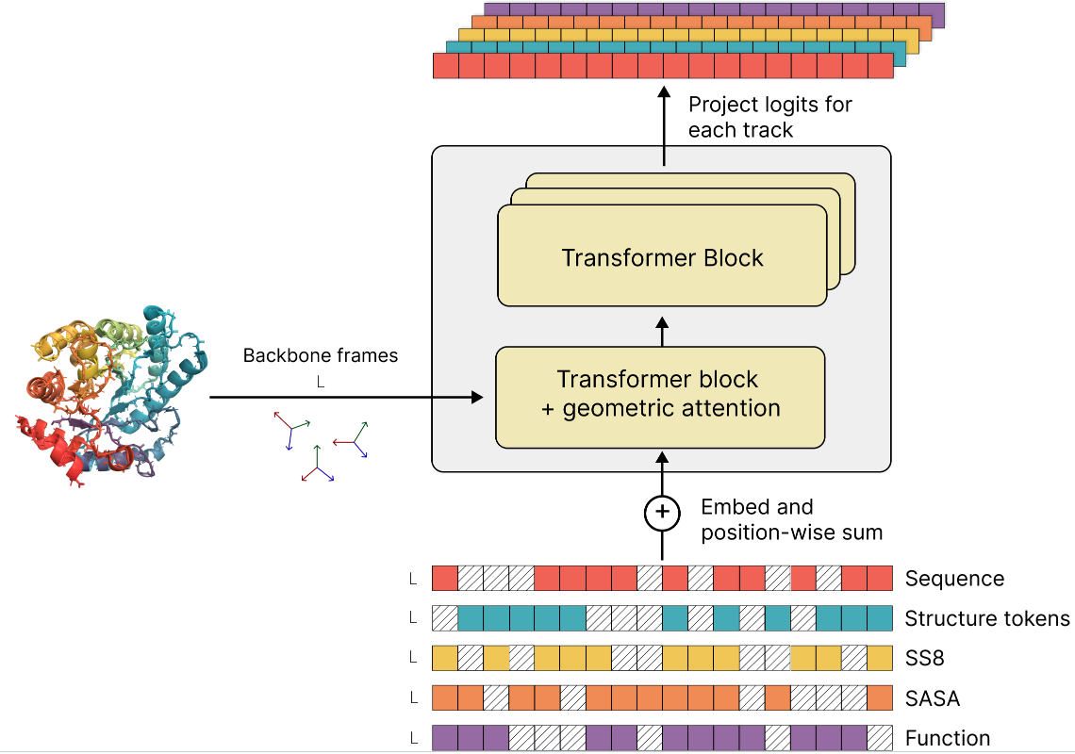
Foundation Models for Biology
Source: https://github.com/evolutionaryscale/esm
Notes:
Many of these endeavors come from Jure’s lab. One of ours projects which made the front page of the NYT is building foundation models for cell biology

Slide 7
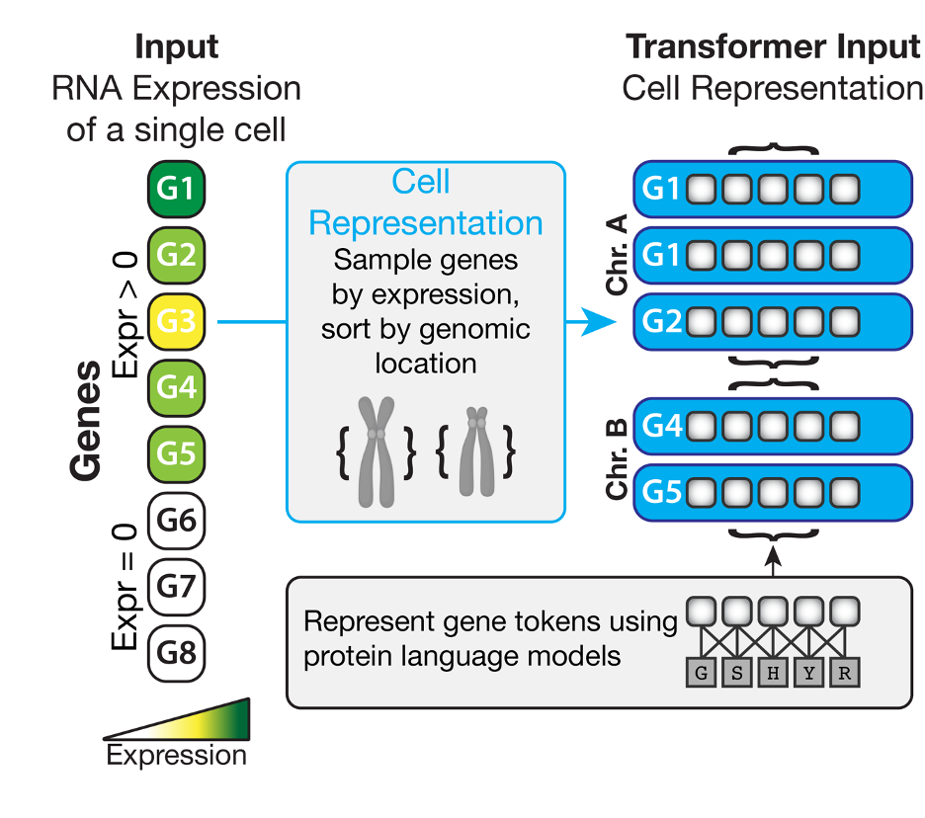
Foundation Models for Cell Biology
UCE creates universal representations of cells
Input:
RNA expression of a single cell/nucleus
Output:
Cell Embedding
Notes:
The input to the model is different cells that are represented by gene expression
In the output of the model we want to generate universal and rich embeddings for each cell

Slide 8
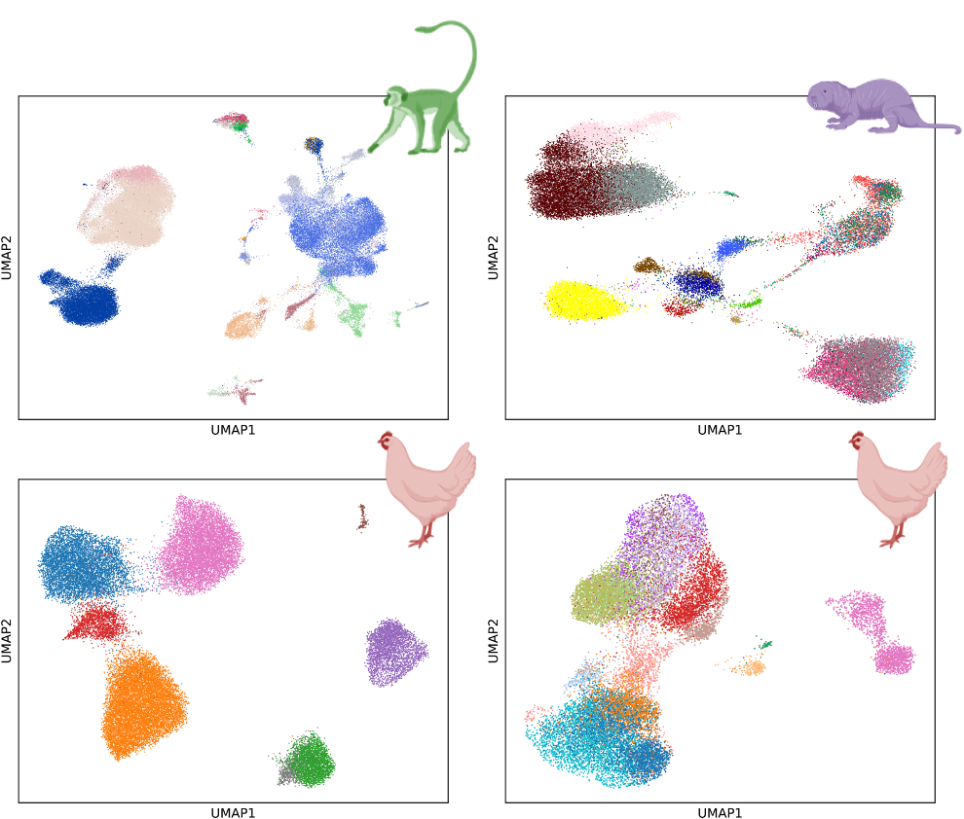
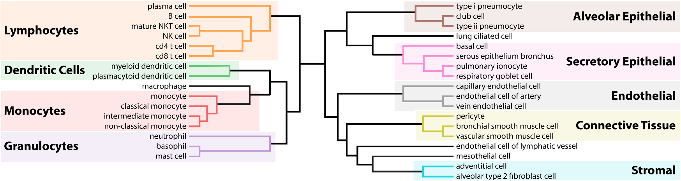
Foundation Models for Cell Biology
Visualize and transfer annotations
Infer Hierarchies
Notes:
These are some results we have observed, I don’t want to go into the very details but we can show that we can generalize to data that have not been used during training
Represent monkey cells and we can also observwe a hierarchical structure of these cells

Slide 9
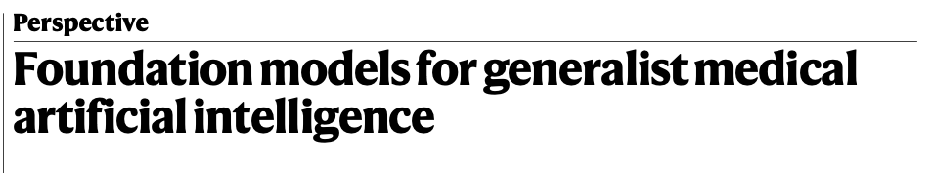
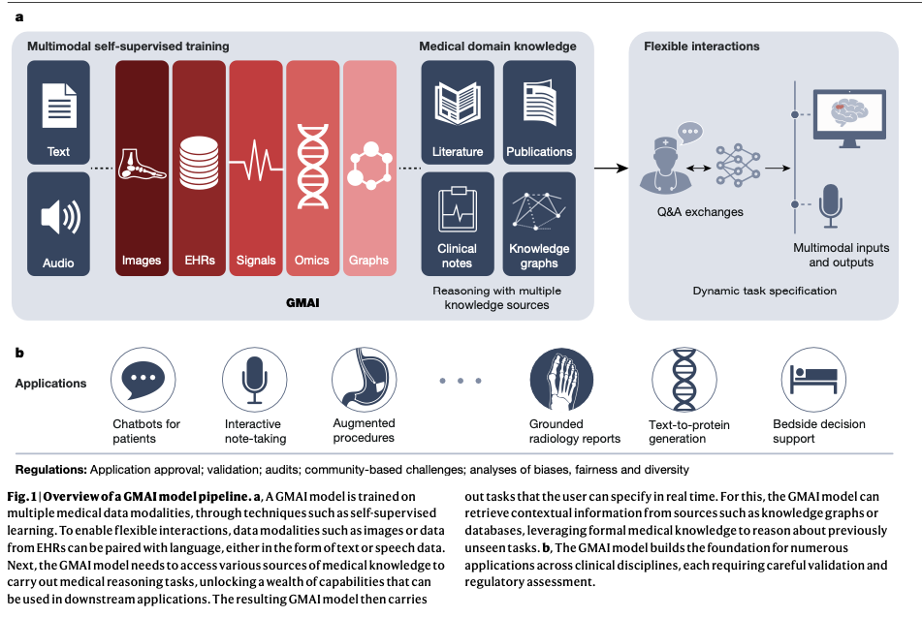
Foundation Models for Medicine

Slide 10
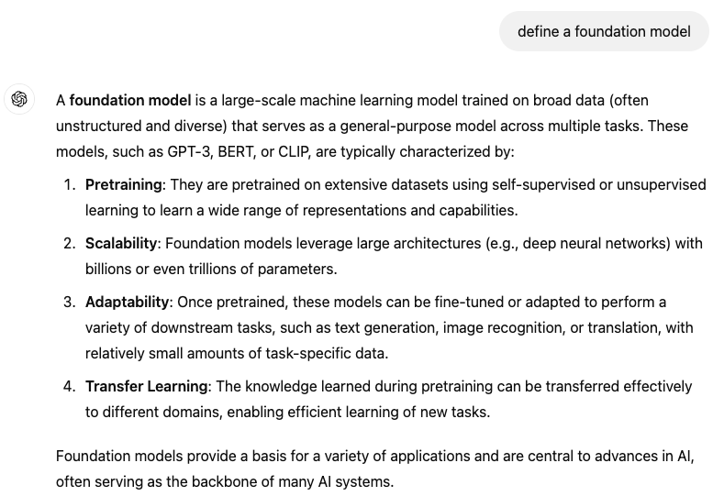
Foundation Models

Slide 11
Foundation Models Characteristics
Foundation models are pretrained architectures
Modern AI trains very large models with a huge amount of data
Foundation models can be used as zero-shot or few-shot learners
They generalize to new entities that have not been observed during training

Slide 12
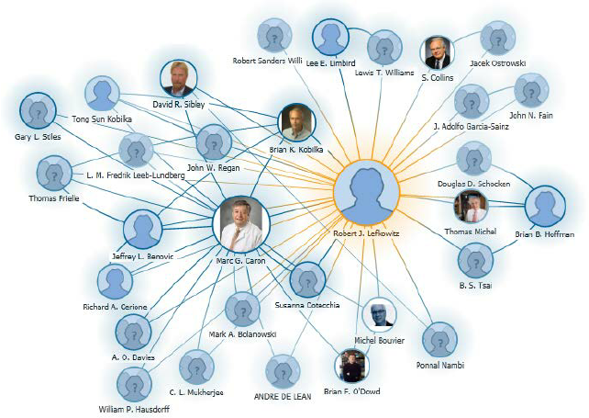
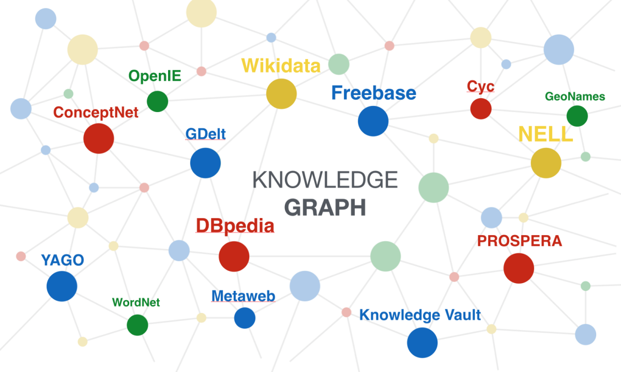
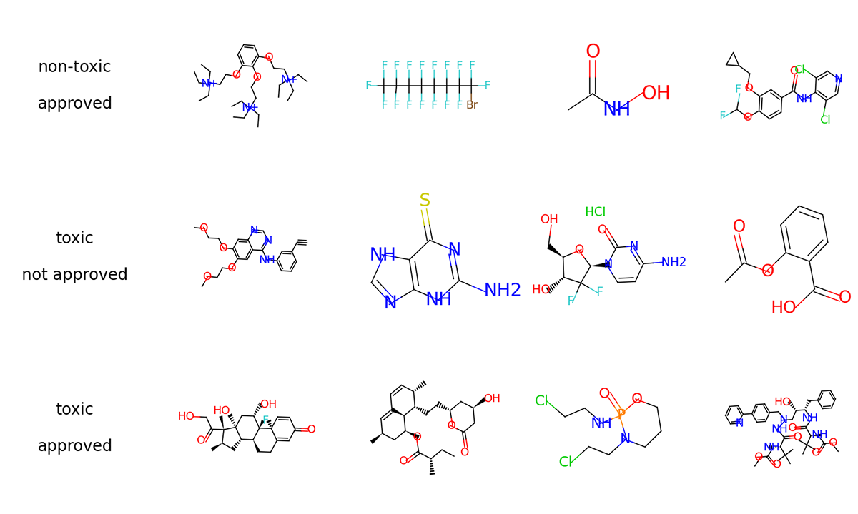
Graph Foundation Models
Challenges
Multiple types of graphs
Multiple types of tasks

Slide 13
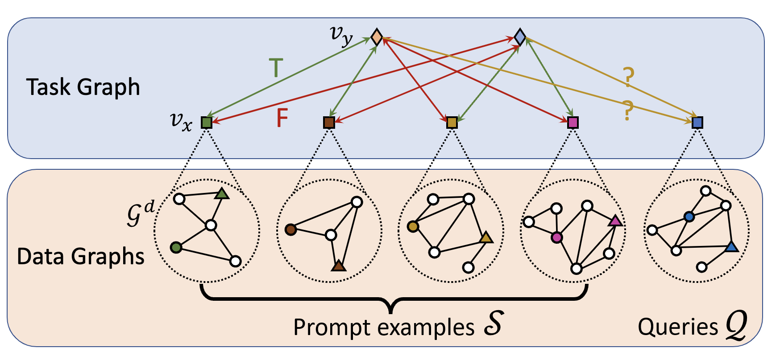
Recap: PRODIGY
Unified framework to learn graph tasks of multiple levels
Agnostic of the graph type
Pretraining
Data/Graph
Data
Gen
Optimize Loss
Model

Slide 14
Towards Foundation Models for KGs
Build a model that learns embeddings for entities and relations of any KG
The model will be trained in an unsupervised fashion
The model will transfer knowledge between different KGs
We will not discuss scalability of the training data and the model
Notes:
First bullet. These embeddings can be later used to perform link prediction in a few shot or zero shot manner

Slide 15
Stanford CS224W:
Knowledge Graphs
CS224W: Machine Learning with Graphs
Jure Leskovec, Stanford University
http://cs224w.stanford.edu
Notes:
Refresh your memory

Slide 16
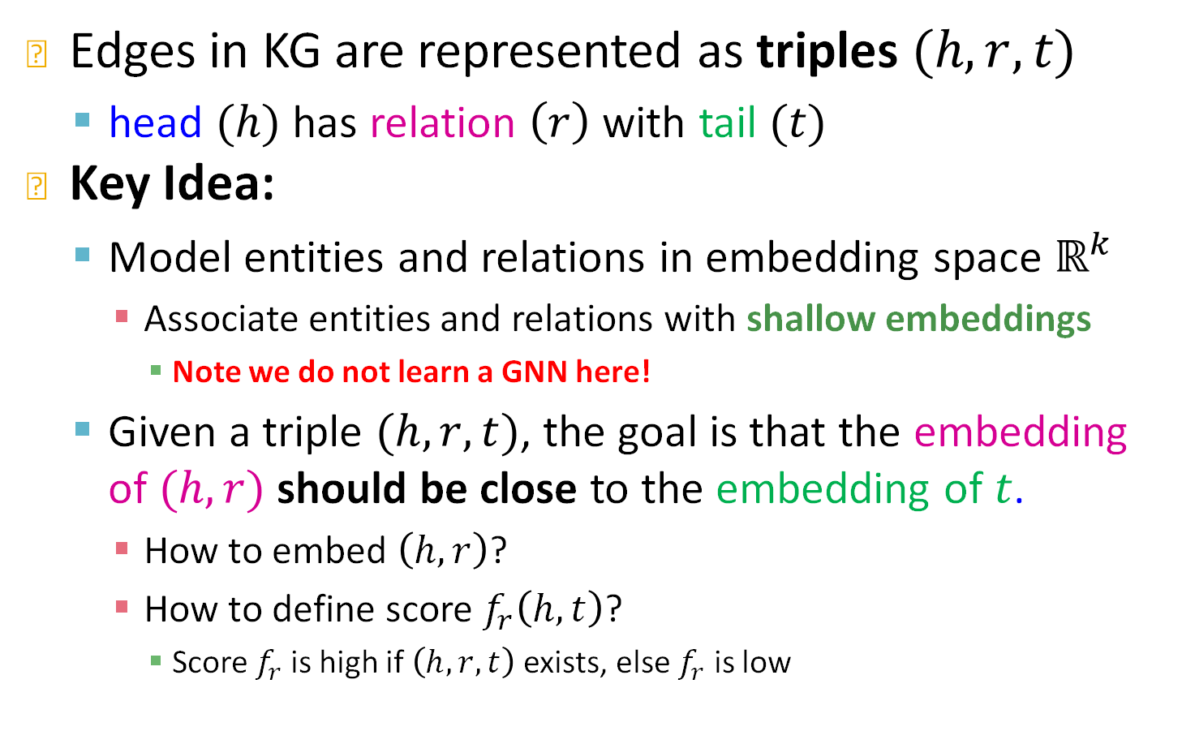
KG Representation
Edges in KG are represented as triples $(h,r,t)$
  head $(h)$ has relation $\left(r\right)$ with tail $(t)$
Key Idea:
  Model entities and relations in embedding space $ℝ^{k}$
    Associate entities and relations with shallow embeddings
      Note we do not learn a GNN here!
  Given a triple $(h,r,t)$, the goal is that the embedding of $(h,r)$ should be close to the embedding of $t$.
    How to embed $\left(h,r\right)$?
    How to define score $f_{r}\left(h,t\right)$?
      Score $f_{r}$is high if $\left(h,r,t\right)$ exists, else $f_{r}$ is low
Notes:
We are going to think of a KG as a set of triples Maria studies CS224w node for maria node for CS224W and there is a relation of type teaches
We are going to compose the entity+relation
Embedding of entity, embedding of relation and we will guess the tail
No GNNs today, but shallow embeddings
How do I score the proximity to the tail

Slide 17
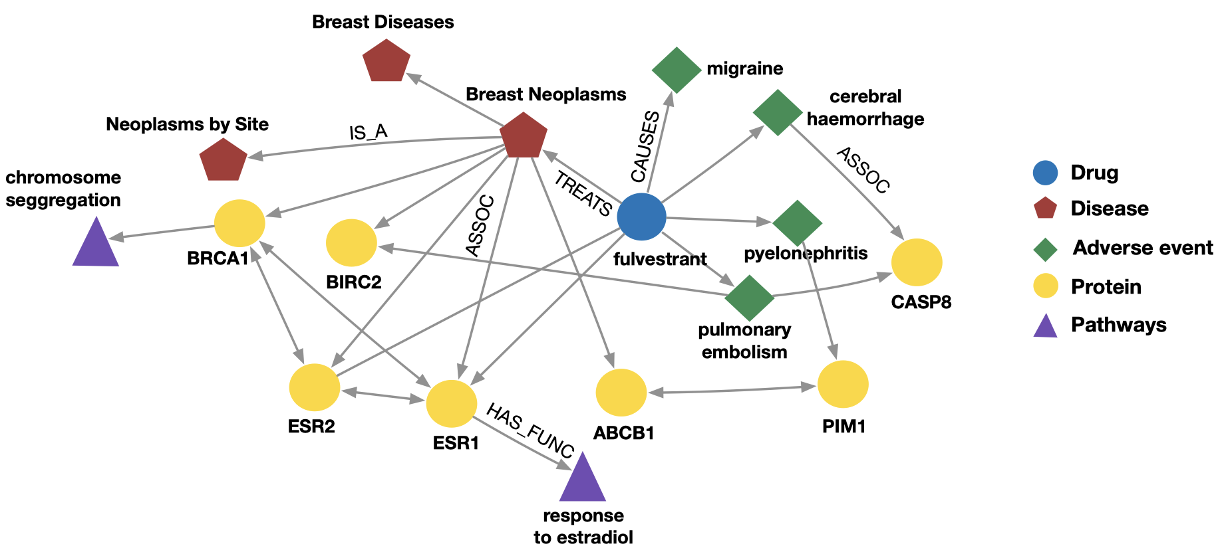
Example: Bio Knowledge Graphs
Node types: drug, disease, adverse event, protein, pathways
Relation types: has_func, causes, assoc, treats, is_a
Notes:
http://home.cse.ust.hk/~yqsong/papers/2017-HIN-Metagraph.pdf
Another example where graphs are heavily used is in biology and medicine
Biology and medicine is doing, is trying to find relationships between different biomedical entities
Here are some proteins that do not work well in your body because you have that disease
This proteins are part of some biological processes called pathways
If you take this drug you will have these adverse side effects,
So overall I codify knowledge from biology and medicine
The links might take months or years to figure out that these proteins interact with each other
Tons of medical analysis to end up with a particular link, e.g., this drug has this side effect.
A way to codify knowledge

Slide 18
Example: Bibliographic Networks
Node types: paper, title, author, conference, year
Relation types: pubWhere, pubYear, hasTitle, hasAuthor, cite
Notes:
What are some examples of these graphs
I want to understand the structure of science and what a scientist is doing
Graph with node types and different relation types between them. So here I have a schema of this graph

Slide 19
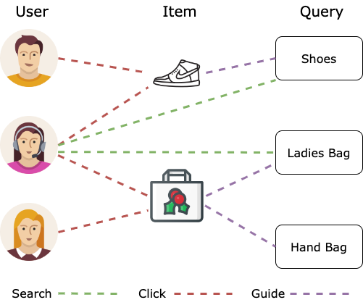
Example: E-Commerce Networks
Example: E-Commerce Graph
  Node types: User, Item, Query, Location, ...
  Edge types: Purchase, Visit, Guide, Search, …
  Different node type's features spaces can be different!
Notes:
There is more
User considered or viewed an item, purchased, went in the website but didn’t buy anything
What is super cool here Data in business world look like this

Slide 20
KG vs Natural Language
Example: E-Commerce Graph
  Natural Language:
  User searches for shoes, User buys hand-bag

Slide 21
KG vs Natural Language
Example: E-Commerce Graph
  Natural Language:
  User searches for shoes, User buys hand-bag
  All entities are words or tokens of the same type
    Homogeneous vocabulary
  Knowledge Graph:
    User, shoes, hand-bag → entities
    Searches, buys → relations
    Two modalities, heterogeneous vocabulary
Notes:
There is more
User considered or viewed an item, purchased, went in the website but didn’t buy anything
What is super cool here Data in business world look like this

Slide 22
KG vs Natural Language
Example: E-Commerce Graph
  Natural Language:
  User searches for shoes, User buys hand-bag
  Tokens are connected sequentially
  Knowledge Graph:
    Entities have an underlying arbitrary graph structure
Notes:
Benefit of KGs is that we can leverage structure and for example avoid hallucinations that happen in LLMs

Slide 23
Towards Foundation Models for KGs
Build a model that learns embeddings for entities and relations of any KG
  Double equivariant architectures
Process the graph structure between entities
  Use Graph Neural Networks
Find a canonical task for unsupervised training
  Knowledge Graph Completion
Notes:
First bullet. These embeddings can be later used to perform link prediction in a few shot or zero shot manner

Slide 24
Stanford CS224W:
Transductive Link prediction
CS224W: Machine Learning with Graphs
Jure Leskovec, Stanford University
http://cs224w.stanford.edu

Slide 25
Recap: KG Completion Task
Given an enormous KG, can we complete the KG?
  For a given (head, relation), we predict missing tails.
J.R.R Tolkien
Science Fiction
missing relation: genre
Example task: predict the tail “Science Fiction” for (“J.K. Rowling”, “genre”)
genre
genre
Influence
genre
Fantasy
Stephen King
genre
Influence
J.K. Rowling
Influence
Influence
C.S. Lewis
genre
Influence
Alan Poe
Tragicomedy
Lloyd Alexander
Notes:
Figure out relationships that are not explicitly stated in the KG
Slightly different than link prediction
KG about literature, books authors and genres The link of a particular genre or author is missing,
JK rowling genre I want to predict science finction
Pattern of connection to predict this missing genre
How is that different from link prediction, I am giving a head the relation and I want to find the tail
Similar to next token prediction

Slide 26

Recap: “Shallow” Encoding
Simplest encoding approach: encoder is just an embedding-lookup
embedding vector for a specific node
embedding matrix
Dimension/size of embeddings
one column per node
Notes:
How are we going to do that
We are going to learn a shallow embedding for every node, for every entity and we are also going to learn an embedding for every relation

Slide 27
Recap: KG Representation
Edges in KG are represented as triples $(h,r,t)$
  head $(h)$ has relation $\left(r\right)$ with tail $(t)$
Key Idea:
  Model entities and relations in embedding space $ℝ^{k}$
    Associate entities and relations with shallow embeddings
      Note we do not learn a GNN here!
  Given a triple $(h,r,t)$, the goal is that the embedding of $(h,r)$ should be close to the embedding of $t$.
    How to embed $\left(h,r\right)$?
    How to define score $f_{r}\left(h,t\right)$?
      Score $f_{r}$is high if $\left(h,r,t\right)$ exists, else $f_{r}$ is low
Notes:
We are going to think of a KG as a set of triples Maria studies CS224w node for maria node for CS224W and there is a relation of type teaches
We are going to compose the entity+relation
Embedding of entity, embedding of relation and we will guess the tail
No GNNs today, but shallow embeddings
How do I score the proximity to the tail

Slide 28
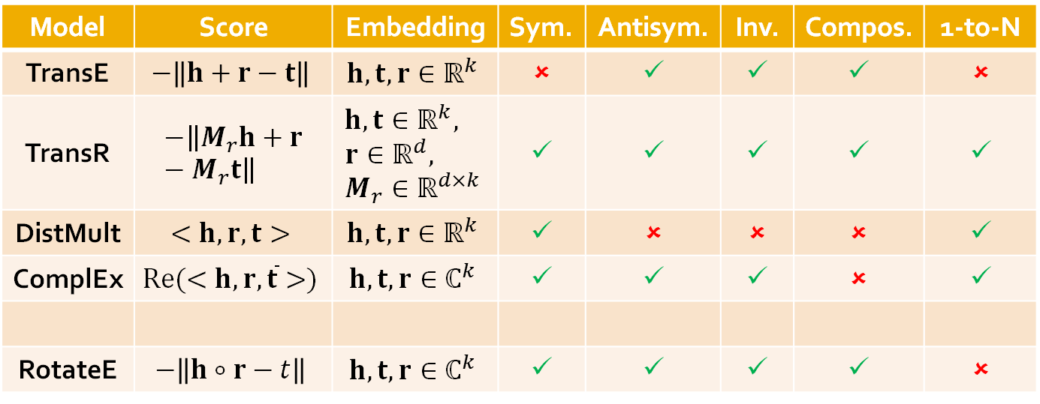
Recap: KG Completion Models
KG embedding Models:
Model | Score | Embedding | Sym. | Antisym. | Inv. | Compos. | 1-to-N
TransE | $$−\left\|h+r−t\right\|$$ | $$h,t,r∈ℝ^{k}$$ | ✗ | ✓ | ✓ | ✓ | ✗
TransR | $$−\left\|M_{r}h+r−M_{r}t\right\|$$ | $$h,t∈ℝ^{k}, \\ r∈ℝ^{d}, \\ M_{r}∈ℝ^{d×k}$$ | ✓ | ✓ | ✓ | ✓ | ✓
DistMult | $$<h,r,t>$$ | $$h,t,r∈ℝ^{k}$$ | ✓ | ✗ | ✗ | ✗ | ✓
ComplEx | $$Re(<h,r,\overline{t}>)$$ | $$h,t,r∈ℂ^{k}$$ | ✓ | ✓ | ✓ | ✗ | ✓
RotateE | $$−\left\|h∘r−t\right\|$$ | $$h,t,r∈ℂ^{k}$$ | ✓ | ✓ | ✓ | ✓ | ✗
Notes:
We use structure agnostic shallow encoders to produce entity and relation embeddings.
The structure of the KG is used only in the loss

Slide 29
KG embedding methods
Structure agnostic shallow encoders learn embeddings for entities and relations
  The entity and relation embeddings are the trainable weights
The structure of the KG is utilized in the loss function
KG embedding methods can only be used on a single KG
  They cannot transfer knowledge between KGs
Notes:
We use structure agnostic shallow encoders to produce entity and relation embeddings.
The structure of the KG is used only in the loss

Slide 30
New entities in Bio KGs
What if a new drug comes in?
Need to retrain the shallow encoder
Notes:
http://home.cse.ust.hk/~yqsong/papers/2017-HIN-Metagraph.pdf
Another example where graphs are heavily used is in biology and medicine
Biology and medicine is doing, is trying to find relationships between different biomedical entities
Here are some proteins that do not work well in your body because you have that disease
This proteins are part of some biological processes called pathways
If you take this drug you will have these adverse side effects,
So overall I codify knowledge from biology and medicine
The links might take months or years to figure out that these proteins interact with each other
Tons of medical analysis to end up with a particular link, e.g., this drug has this side effect.
A way to codify knowledge

Slide 31

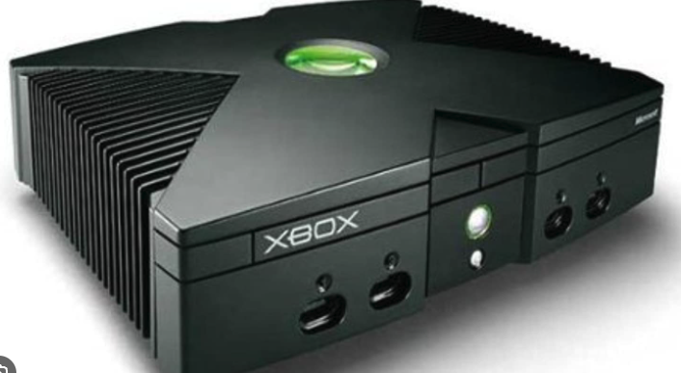
Generalize across similar KGs
What if I want to transfer knowledge from one KG to another?
The KGs have the same relations
Books
Xbox
NBA2K
Notes:
http://home.cse.ust.hk/~yqsong/papers/2017-HIN-Metagraph.pdf
Another example where graphs are heavily used is in biology and medicine
Biology and medicine is doing, is trying to find relationships between different biomedical entities
Here are some proteins that do not work well in your body because you have that disease
This proteins are part of some biological processes called pathways
If you take this drug you will have these adverse side effects,
So overall I codify knowledge from biology and medicine
The links might take months or years to figure out that these proteins interact with each other
Tons of medical analysis to end up with a particular link, e.g., this drug has this side effect.
A way to codify knowledge

Slide 32
Stanford CS224W:
Inductive Link prediction
CS224W: Machine Learning with Graphs
Jure Leskovec, Stanford University
http://cs224w.stanford.edu

Slide 33
Generalize across similar KGs
What if I want to transfer knowledge from one KG to another?
The KGs have the same relations
Solution:
Observe that a KG is a heterogeneous graph
Use a heterogenous GNN
  E.g., RGCN, Heterogenous Graph Transformer
Notes:
http://home.cse.ust.hk/~yqsong/papers/2017-HIN-Metagraph.pdf
Another example where graphs are heavily used is in biology and medicine
Biology and medicine is doing, is trying to find relationships between different biomedical entities
Here are some proteins that do not work well in your body because you have that disease
This proteins are part of some biological processes called pathways
If you take this drug you will have these adverse side effects,
So overall I codify knowledge from biology and medicine
The links might take months or years to figure out that these proteins interact with each other
Tons of medical analysis to end up with a particular link, e.g., this drug has this side effect.
A way to codify knowledge

Slide 34







Relational GCN
What if the graph has multiple relation types?
$$r_{1}$$
B
Target node
$$r_{3}$$
A
$$r_{2}$$
C
$$r_{1}$$
$$r_{3}$$
$$r_{2}$$
F
D
E
$$r_{1}$$
Input graph
Notes:
Note that relation type is different than an edge type. For instance r1 and r2 can be the same edge type but because b and c have different node types we end up modeling the link between b and a and c and a with different relation types

Slide 35










Relational GCN (2)
What if the graph has multiple relation types?
Use different neural network weights for different relation types.
Weights $W_{r_{1}}$ for $r_{1}$
$$r_{1}$$
B
Target node
$$r_{3}$$
A
Weights $W_{r_{2}}$ for $r_{2}$
$$r_{2}$$
C
$$r_{1}$$
$$r_{3}$$
$$r_{2}$$
F
D
E
$$r_{1}$$
Weights $W_{r_{3}}$ for $r_{3}$
Input graph
Notes:
Different update depending on the relation type, different message and different aggregation
Linear transformation depends on a w2, message different depending on the relation type

Slide 36
Relational GCN (3)
What if the graph has multiple relation types?
Use different neural network weights for different relation types!
Aggregation
C
$$r_{1}$$
B
Target node
$$r_{3}$$
B
A
F
$$r_{2}$$
C
A
C
$$r_{1}$$
$$r_{3}$$
$$r_{2}$$
F
E
D
E
$$r_{1}$$
D
Input graph
Neural networks
Notes:
Linear transformation depends on a w2, message different depending on the relation type

Slide 37
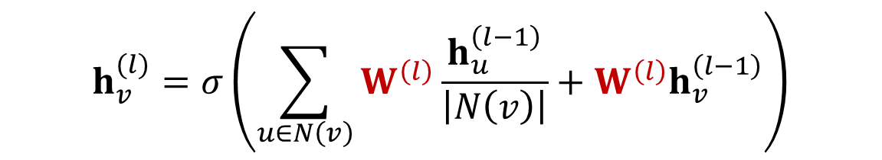
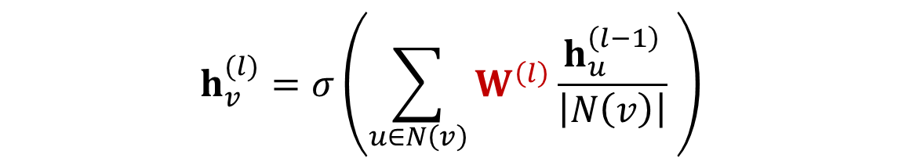
Recap: Classical GNN Layers: GCN
Kipf and Welling. Semi-Supervised Classification with Graph Convolutional Networks, ICLR 2017
(1) Graph Convolutional Networks (GCN)
We add a self-loop
$$h_{v}^{(l)}=σ\left(\sum_{u∈N\left(v\right)}{W^{\left(l\right)}\frac{h_{u}^{\left(l−1\right)}}{\left|N\left(v\right)\right|} }\right)$$
$$h_{v}^{(l)}=σ\left(\sum_{u∈N\left(v\right)}{W^{\left(l\right)}\frac{h_{u}^{\left(l−1\right)}}{\left|N\left(v\right)\right|}+W^{\left(l\right)}h_{v}^{\left(l−1\right)}}\right)$$

Slide 38
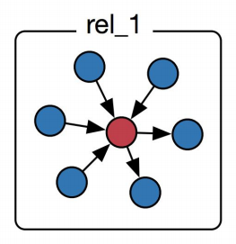
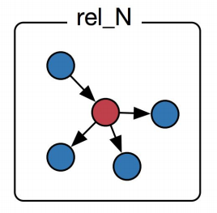
Relational GCN (4)
Introduce a set of neural networks for each relation type!
Weight for rel_1
…
…
Weight for rel_N
Weight for self-loop
Notes:
Remember than in GCN

Slide 39
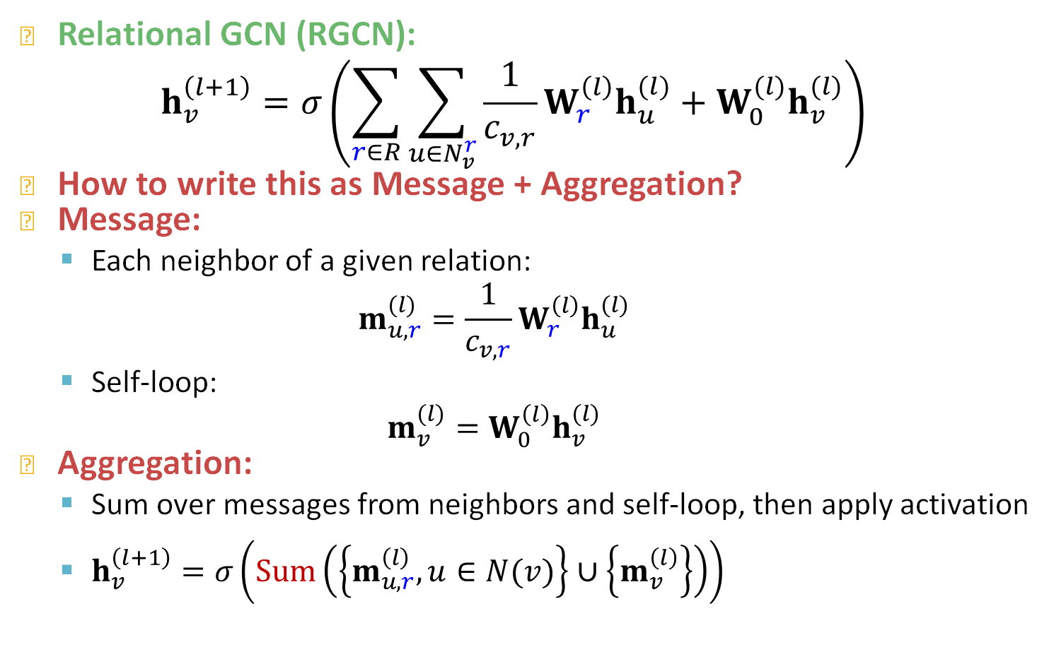
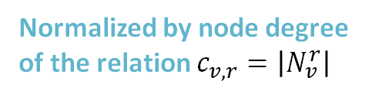
Relational GCN: Definition
Relational GCN (RGCN):
$$h_{v}^{\left(l+1\right)}=σ\left(\sum_{r∈R}{\sum_{u∈N_{v}^{r}}{\frac{1}{c_{v,r}}W_{r}^{\left(l\right)}h_{u}^{(l)}+W_{0}^{(l)}h_{v}^{(l)}}}\right)$$
How to write this as Message + Aggregation?
Message:
  Each neighbor of a given relation:
  $$m_{u,r}^{(l)}=\frac{1}{c_{v,r}}W_{r}^{\left(l\right)}h_{u}^{(l)}$$
  Self-loop:
  $$m_{v}^{(l)}=W_{0}^{\left(l\right)}h_{v}^{(l)}$$
Aggregation:
  Sum over messages from neighbors and self-loop, then apply activation
  $h_{v}^{\left(l+1\right)}=σ\left(Sum\left(\left\{m_{u,r}^{\left(l\right)}, u∈N(v)\right\}∪\left\{m_{v}^{\left(l\right)}\right\}\right)\right)$
Normalized by node degree of the relation $c_{v,r}=\left|N_{v}^{r}\right|$
Notes:
Let’s go from right to left
Aggregation is very similar to a standard GNN
Any issues you can identify?

Slide 40

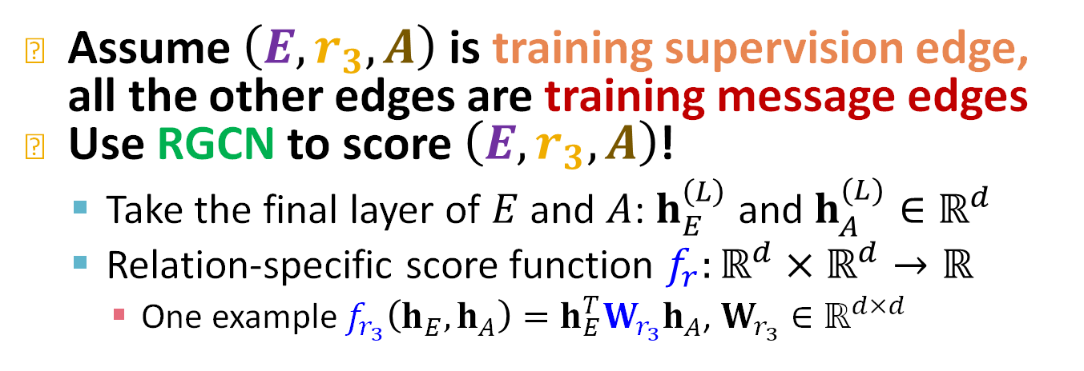







RGCN for Link Prediction (1)
Assume $\left(E,r_{3},A\right)$ is training supervision edge, all the other edges are training message edges
Use RGCN to score $\left(E,r_{3},A\right)$!
  Take the final layer of $E$ and $A$: $h_{E}^{\left(L\right)}$ and $h_{A}^{(L)}∈ℝ^{d}$
  Relation-specific score function $f_{r}:ℝ^{d}×ℝ^{d}→ℝ$
    One example $f_{r_{3}}\left(h_{E}^{ },h_{A}^{ }\right)=h_{E}^{T}W_{r_{3}}h_{A}^{ }$, $W_{r_{3}}∈ℝ^{d×d}$
$$r_{1}$$
B
$$r_{3}$$
A
$$r_{2}$$
C
$$r_{1}$$
$$r_{3}$$
$$r_{2}$$
$$r_{3}$$
F
D
E
$$r_{1}$$
Input Graph
Notes:
For link prediction, you make a prediction for each edge, so if you have different relation types, you want to make sure that prediction head depends on the relation type
Previously if you predict a link between two nodes you take their inner product or you can put a weight matrix between them. All we are doing here is adding this weight matrix in-between is dependent on the relation type
So the score for each link the probability of a link is dependent on the relation type. Another case of having a different prediction head for each relation type.

Slide 41
Heterogeneous GNNs
Structure aware GNN encoders learn embeddings for entities
Structure agnostic shallow encoders learn embeddings for relations
  The relation embeddings are trainable weights
The structure of the KG is also utilized in the loss function
RGCN can be used for inductive link prediction across new entities
  It cannot transfer knowledge between KGs with different relation types
Notes:
We use structure agnostic shallow encoders to produce entity and relation embeddings.
The structure of the KG is used only in the loss

Slide 42
Stanford CS224W:
Inductive Link prediction for new entity and relation types
CS224W: Machine Learning with Graphs
Jure Leskovec, Stanford University
http://cs224w.stanford.edu

Slide 43
Generalize across different KGs
What if I want to transfer knowledge from one KG to another?
The KGs have different entities and relations
Notes:
http://home.cse.ust.hk/~yqsong/papers/2017-HIN-Metagraph.pdf
Another example where graphs are heavily used is in biology and medicine
Biology and medicine is doing, is trying to find relationships between different biomedical entities
Here are some proteins that do not work well in your body because you have that disease
This proteins are part of some biological processes called pathways
If you take this drug you will have these adverse side effects,
So overall I codify knowledge from biology and medicine
The links might take months or years to figure out that these proteins interact with each other
Tons of medical analysis to end up with a particular link, e.g., this drug has this side effect.
A way to codify knowledge

Slide 44
Recap: KG Completion Task
Given a KG, we train a model such that:
  For a given (head, relation), we predict missing tails.
J.R.R Tolkien
Science Fiction
missing relation: genre
Example task: predict the tail “Science Fiction” for (“J.K. Rowling”, “genre”)
genre
genre
Influence
genre
Fantasy
Stephen King
genre
Influence
J.K. Rowling
Influence
Influence
C.S. Lewis
genre
Influence
Alan Poe
Tragicomedy
Lloyd Alexander
Notes:
Figure out relationships that are not explicitly stated in the KG
Slightly different than link prediction
KG about literature, books authors and genres The link of a particular genre or author is missing,
JK rowling genre I want to predict science finction
Pattern of connection to predict this missing genre
How is that different from link prediction, I am giving a head the relation and I want to find the tail

Slide 45
Recap: KG Completion Task
Given a trained model we want:
  For a given (head, relation), we predict missing tails.
UK
Olivia Colman
actor
Born in
Profession
Greece
Example task: predict the tail “Actor” for (“R. Gosling”, “profession”)
Acted in
USA
Profession
Born in
costarred
Yorgos
Lanthimos
directed
The Favorite
Born in
Acted in
directed
Poor Things
Acted in
Emma Stone
missing relation: profession
Profession
Acted in
Costarred
director
Acted in
Ryan Gosling
LaLa Land
Born in
Canada
Notes:
Figure out relationships that are not explicitly stated in the KG
Slightly different than link prediction
KG about literature, books authors and genres The link of a particular genre or author is missing,
JK rowling genre I want to predict science finction
Pattern of connection to predict this missing genre
How is that different from link prediction, I am giving a head the relation and I want to find the tail

Slide 46
Stanford CS224W:
InGram: Inductive KG Embedding via Relation Graphs
J. Lee, C. Chung, JJ. Whang, InGram: Inductive Knowledge Graph Embedding via Relation Graphs, ICML 2023
CS224W: Machine Learning with Graphs
Jure Leskovec, Stanford University
http://cs224w.stanford.edu

Slide 47
Generalize across different KGs
What if I want to transfer knowledge from one KG to another?
The KGs have different entities relations
Solution:
Build double equivariant models
  E.g., InGram
Notes:
http://home.cse.ust.hk/~yqsong/papers/2017-HIN-Metagraph.pdf
Another example where graphs are heavily used is in biology and medicine
Biology and medicine is doing, is trying to find relationships between different biomedical entities
Here are some proteins that do not work well in your body because you have that disease
This proteins are part of some biological processes called pathways
If you take this drug you will have these adverse side effects,
So overall I codify knowledge from biology and medicine
The links might take months or years to figure out that these proteins interact with each other
Tons of medical analysis to end up with a particular link, e.g., this drug has this side effect.
A way to codify knowledge

Slide 48
KG embedding methods
We achieve inductive link prediction on new entities by:
  Structure agnostic shallow encoders to structure aware GNN encoders to learn embeddings for entities
  The structure of the KG was moved from the loss function to the loss function and the model
Let’s do the same for relations
  Utilize the structure of relations to generate relation embeddings
Notes:
We use structure agnostic shallow encoders to produce entity and relation embeddings.
The structure of the KG is used only in the loss

Slide 49
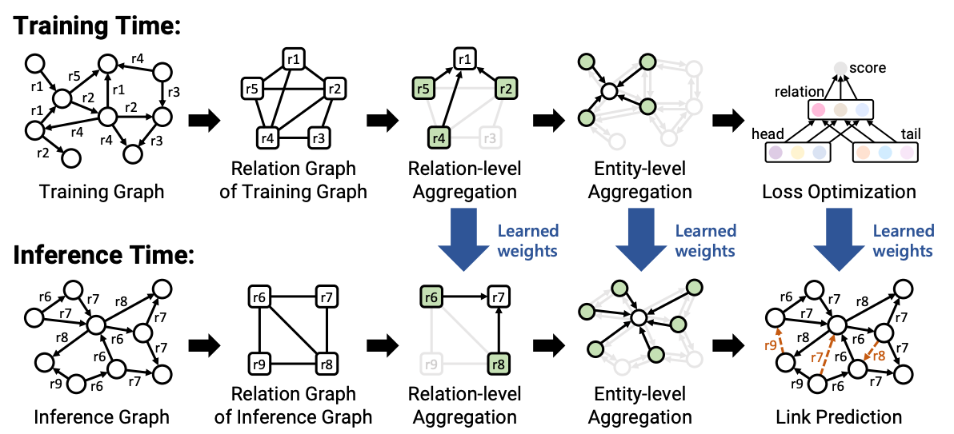
InGram Model
J. Lee, C. Chung, JJ. Whang, InGram: Inductive Knowledge Graph Embedding via Relation Graphs, ICML 2023
Source: https://bdi-lab.kaist.ac.kr/down/ingram_icml2023_slides.pdf
New component: Relation Graph
Notes:
InGram: Inductive Knowledge Graph Embedding via Relation Graphs

Slide 50
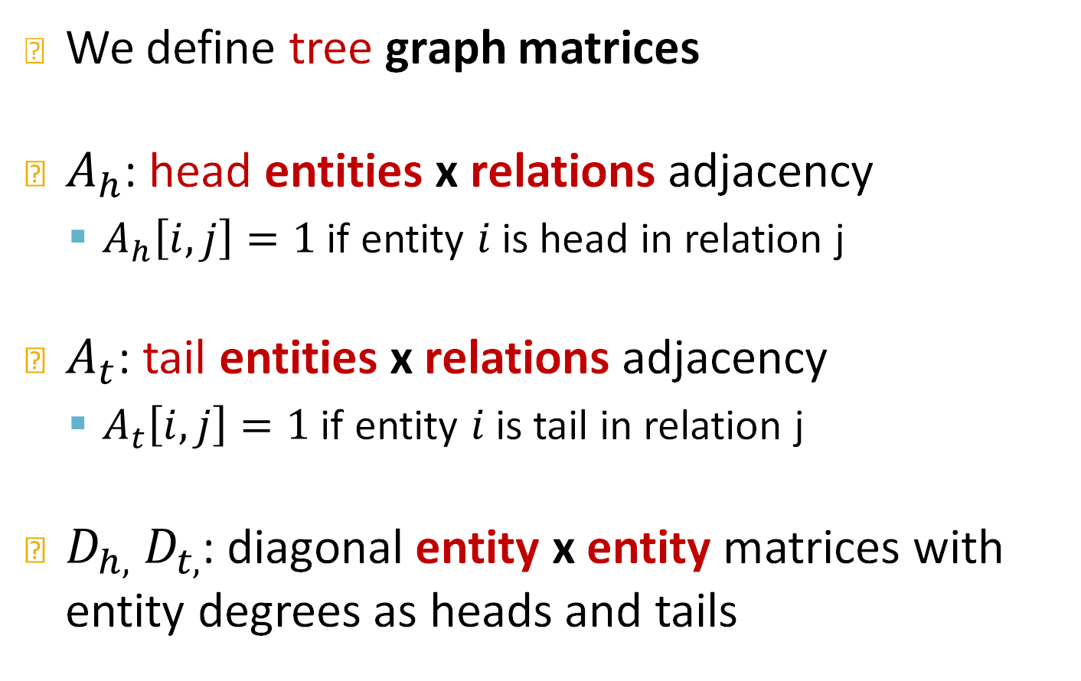
Relation graph
We define tree graph matrices
$A_{h}$: head entities x relations adjacency
  $A_{h}\left[i,j\right]=1$ if entity $i$ is head in relation j
$A_{t}$: tail entities x relations adjacency
  $A_{t}\left[i,j\right]=1$ if entity $i$ is tail in relation j
$D_{h,}{ D}_{t,}$: diagonal entity x entity matrices with entity degrees as heads and tails
Notes:
Formally we can write a hetero
Normal graph has vertices as nodes and edges between vertices, edgeset is a subset of all possible pairs u v
We add two things
a function tau that maps nodes to some categorical variable that describes the node type
Tau is defined on nodes
We introduce a function phi that is defined on edges that gives us the edge types
To the point I made in the previous slide today I will focus on another object r that is a function on a pair of nodes that captures both t anf phi,
so we introduce this parametrization r and we do not need to worry about tau and phi
Let me repeat because this is important

Slide 51
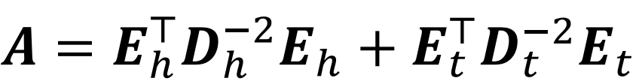
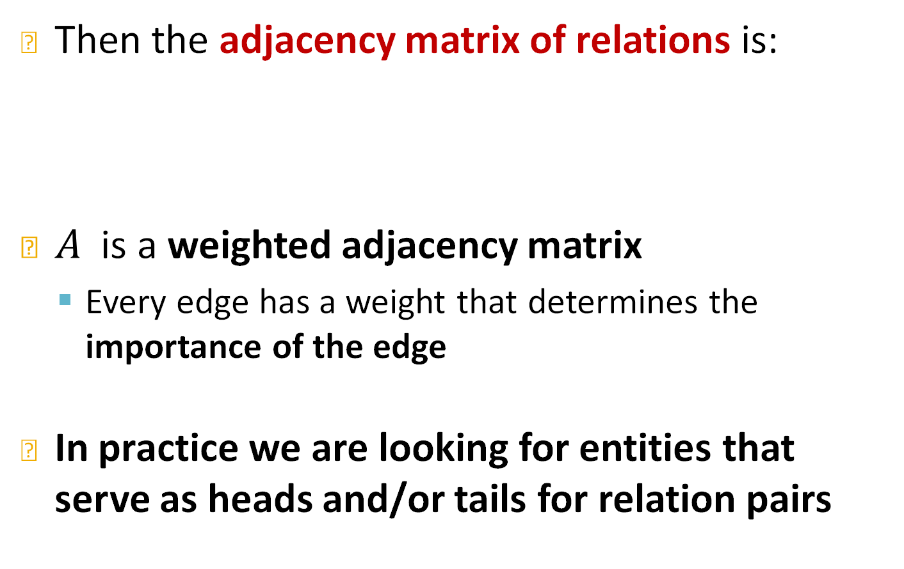
Relation graph
Then the adjacency matrix of relations is:
$A$ is a weighted adjacency matrix
  Every edge has a weight that determines the importance of the edge
In practice we are looking for entities that serve as heads and/or tails for relation pairs
Notes:
Formally we can write a hetero
Normal graph has vertices as nodes and edges between vertices, edgeset is a subset of all possible pairs u v
We add two things
a function tau that maps nodes to some categorical variable that describes the node type
Tau is defined on nodes
We introduce a function phi that is defined on edges that gives us the edge types
To the point I made in the previous slide today I will focus on another object r that is a function on a pair of nodes that captures both t anf phi,
so we introduce this parametrization r and we do not need to worry about tau and phi
Let me repeat because this is important

Slide 52
Relation Graph Construction
Consider relation pairs
  Find entities that serve as heads and/or tails
UK
Olivia Colman
actor
Born in
Profession
Greece
Acted in
USA
Profession
Born in
costarred
Yorgos
Lanthimos
directed
The Favorite
Born in
Acted in
directed
Poor Things
Acted in
Emma Stone
missing relation: profession
Profession
Acted in
Costarred
director
Acted in
Ryan Gosling
LaLa Land
Born in
Canada
Notes:
Figure out relationships that are not explicitly stated in the KG
Slightly different than link prediction
KG about literature, books authors and genres The link of a particular genre or author is missing,
JK rowling genre I want to predict science finction
Pattern of connection to predict this missing genre
How is that different from link prediction, I am giving a head the relation and I want to find the tail

Slide 53
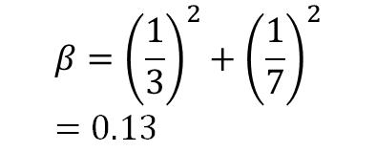
Recap: KG Completion Task
Consider relation pairs
  Find entities that serve as heads and/or tails
UK
Olivia Colman
$$β={\left(\frac{1}{3}\right)}^{2}+{\left(\frac{1}{7}\right)}^{2}=0.13$$
Born in
Greece
Acted in
USA
Born in
Yorgos
Lanthimos
The Favorite
Born in
Acted in
Poor Things
Acted in
Emma Stone
Acted in
Acted in
Ryan Gosling
LaLa Land
Notes:
Figure out relationships that are not explicitly stated in the KG
Slightly different than link prediction
KG about literature, books authors and genres The link of a particular genre or author is missing,
JK rowling genre I want to predict science finction
Pattern of connection to predict this missing genre
How is that different from link prediction, I am giving a head the relation and I want to find the tail

Slide 54
Recap: KG Completion Task
Given a trained model we want:
  (1/3)^2+(1/7)^2+(1/4)^2=0.17
UK
Olivia Colman
actor
Born in
Profession
Greece
USA
Profession
Born in
Yorgos
Lanthimos
Born in
Emma Stone
Profession
director
Notes:
Figure out relationships that are not explicitly stated in the KG
Slightly different than link prediction
KG about literature, books authors and genres The link of a particular genre or author is missing,
JK rowling genre I want to predict science finction
Pattern of connection to predict this missing genre
How is that different from link prediction, I am giving a head the relation and I want to find the tail

Slide 55
Recap: KG Completion Task
Given a trained model we want:
  1/6=0.06
Olivia Colman
actor
Profession
Example task: predict the tail “Actor” for (“R. Gosling”, “profession”)
Profession
Yorgos
Lanthimos
directed
The Favorite
directed
Poor Things
Emma Stone
Profession
director
Notes:
Figure out relationships that are not explicitly stated in the KG
Slightly different than link prediction
KG about literature, books authors and genres The link of a particular genre or author is missing,
JK rowling genre I want to predict science finction
Pattern of connection to predict this missing genre
How is that different from link prediction, I am giving a head the relation and I want to find the tail

Slide 56
Recap: KG Completion Task
Given a trained model we want:
  (1/3)^2+(1/7)^2=0.13
Olivia Colman
actor
Profession
Example task: predict the tail “Actor” for (“R. Gosling”, “profession”)
Acted in
Profession
Yorgos
Lanthimos
The Favorite
Acted in
Poor Things
Acted in
Emma Stone
Profession
Acted in
director
Acted in
Ryan Gosling
LaLa Land
Notes:
Figure out relationships that are not explicitly stated in the KG
Slightly different than link prediction
KG about literature, books authors and genres The link of a particular genre or author is missing,
JK rowling genre I want to predict science finction
Pattern of connection to predict this missing genre
How is that different from link prediction, I am giving a head the relation and I want to find the tail

Slide 57
Recap: KG Completion Task
Given a trained model we want:
  (1/3)^2+(1/7)^2=0.13
Olivia Colman
actor
Profession
Example task: predict the tail “Actor” for (“R. Gosling”, “profession”)
Profession
costarred
Yorgos
Lanthimos
Emma Stone
Profession
Costarred
director
Ryan Gosling
Notes:
Figure out relationships that are not explicitly stated in the KG
Slightly different than link prediction
KG about literature, books authors and genres The link of a particular genre or author is missing,
JK rowling genre I want to predict science finction
Pattern of connection to predict this missing genre
How is that different from link prediction, I am giving a head the relation and I want to find the tail

Slide 58
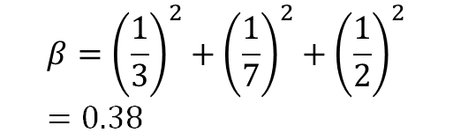
Recap: KG Completion Task
Consider relation pairs
  Find entities that serve as heads and/or tails
Olivia Colman
$$β={\left(\frac{1}{3}\right)}^{2}+{\left(\frac{1}{7}\right)}^{2}+{\left(\frac{1}{2}\right)}^{2}=0.38$$
Acted in
costarred
The Favorite
Acted in
Poor Things
Acted in
Emma Stone
Acted in
Costarred
Acted in
Ryan Gosling
LaLa Land
Notes:
Figure out relationships that are not explicitly stated in the KG
Slightly different than link prediction
KG about literature, books authors and genres The link of a particular genre or author is missing,
JK rowling genre I want to predict science finction
Pattern of connection to predict this missing genre
How is that different from link prediction, I am giving a head the relation and I want to find the tail

Slide 59
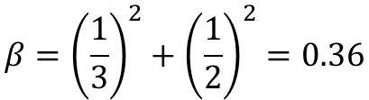
Recap: KG Completion Task
Consider relation pairs
  Find entities that serve as heads and/or tails
Olivia Colman
$$β={\left(\frac{1}{3}\right)}^{2}+{\left(\frac{1}{2}\right)}^{2}=0.36$$
Acted in
Yorgos
Lanthimos
directed
The Favorite
Acted in
directed
Poor Things
Acted in
Emma Stone
Acted in
Acted in
Ryan Gosling
LaLa Land
Notes:
Figure out relationships that are not explicitly stated in the KG
Slightly different than link prediction
KG about literature, books authors and genres The link of a particular genre or author is missing,
JK rowling genre I want to predict science finction
Pattern of connection to predict this missing genre
How is that different from link prediction, I am giving a head the relation and I want to find the tail

Slide 60

Recap: KG Completion Task
Consider relation pairs
  Find entities that serve as heads and/or tails
Olivia Colman
$$β=0$$
costarred
Yorgos
Lanthimos
directed
The Favorite
directed
Poor Things
Emma Stone
Costarred
Ryan Gosling
Notes:
Figure out relationships that are not explicitly stated in the KG
Slightly different than link prediction
KG about literature, books authors and genres The link of a particular genre or author is missing,
JK rowling genre I want to predict science finction
Pattern of connection to predict this missing genre
How is that different from link prediction, I am giving a head the relation and I want to find the tail

Slide 61
Recap: KG Completion Task
Given a trained model we want:
  0.27.
UK
Olivia Colman
Born in
Greece
Example task: predict the tail “Actor” for (“R. Gosling”, “profession”)
USA
Born in
costarred
Yorgos
Lanthimos
Born in
Emma Stone
Costarred
Ryan Gosling
Born in
Canada
Notes:
Figure out relationships that are not explicitly stated in the KG
Slightly different than link prediction
KG about literature, books authors and genres The link of a particular genre or author is missing,
JK rowling genre I want to predict science finction
Pattern of connection to predict this missing genre
How is that different from link prediction, I am giving a head the relation and I want to find the tail

Slide 62
Recap: KG Completion Task
Given a trained model we want:
  0.06.
UK
Olivia Colman
Born in
Greece
Example task: predict the tail “Actor” for (“R. Gosling”, “profession”)
USA
Born in
Yorgos
Lanthimos
directed
The Favorite
Born in
directed
Poor Things
Emma Stone
Ryan Gosling
Born in
Canada
Notes:
Figure out relationships that are not explicitly stated in the KG
Slightly different than link prediction
KG about literature, books authors and genres The link of a particular genre or author is missing,
JK rowling genre I want to predict science finction
Pattern of connection to predict this missing genre
How is that different from link prediction, I am giving a head the relation and I want to find the tail

Slide 63
Relation Graph
We can construct a graph between relations
  Encodes the proximity between different relations
directed
0.06
Born in
costarred
0.27
0.06
0.36
0.13
0.13
0.17
0.38
Profession
0.13
Acted in
Notes:
Figure out relationships that are not explicitly stated in the KG
Slightly different than link prediction
KG about literature, books authors and genres The link of a particular genre or author is missing,
JK rowling genre I want to predict science finction
Pattern of connection to predict this missing genre
How is that different from link prediction, I am giving a head the relation and I want to find the tail

Slide 64
InGram Model
Source: https://bdi-lab.kaist.ac.kr/down/ingram_icml2023_slides.pdf
Next: Relation-level message-passing
Notes:
Let’s go back to the basics, so a graph is an abstract structure that models the connectivity information between different objects or different entities and these objects or entities are the nodes of the graph.
Now it so happens that graphs might consist of different node types. In the paradigm illustrated here we have two types of nodes the blue and the red nodes. In a real world graph these correspond to paper nodes and author nodes when we talk about academic graphs
Or they can represent users and items in e-commerce networks or drugs and diseases in biological networks

Slide 65
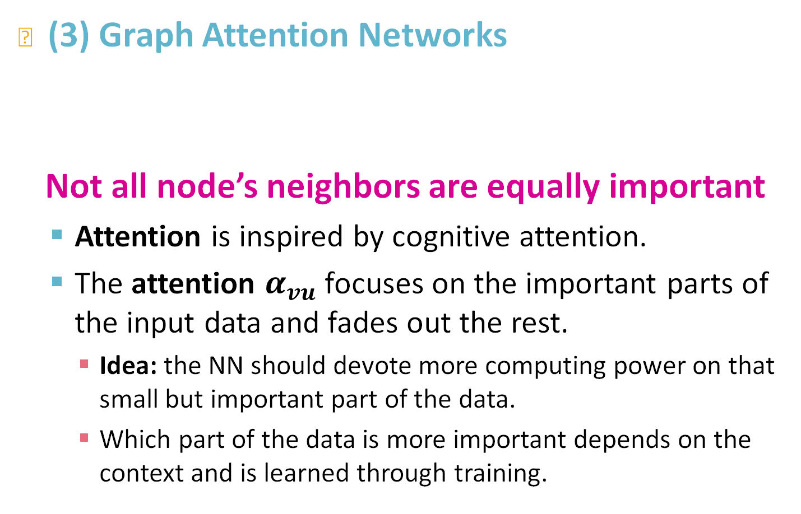
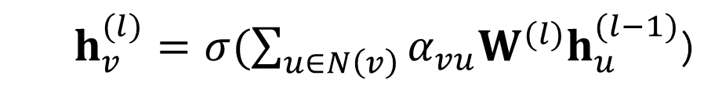
Recap: Graph Attention Network
(3) Graph Attention Networks
Not all node’s neighbors are equally important
  Attention is inspired by cognitive attention.
  The attention $α_{vu}$focuses on the important parts of the input data and fades out the rest.
    Idea: the NN should devote more computing power on that small but important part of the data.
    Which part of the data is more important depends on the context and is learned through training.
  $h_{v}^{(l)}=σ(\sum_{u∈N\left(v\right)}{α_{vu}W^{(l)}h_{u}^{(l−1)}}$)
Attention weights
Notes:
Let's see why I want to break this assumption. You want your model to put more focus on some parts of the data than others
Cognitive attention, so you want your model to put more emphasis on some parts of the data, so in a SN you want your model to learn which of your friends are more important to you than others
Last comment: Importance is represented by the alpha weight and this alpha weight is learned through training

Slide 66

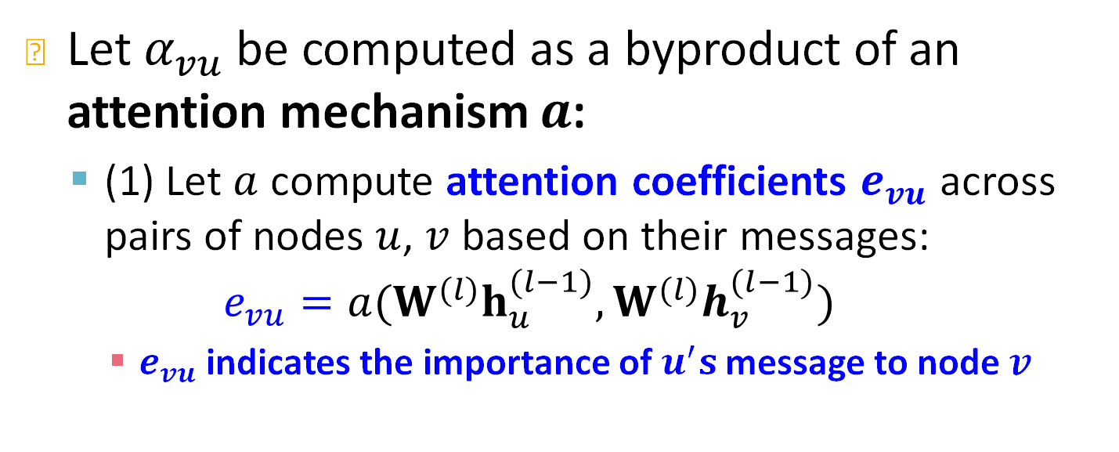



Recap: Attention Mechanism (1)
Let $α_{vu}$ be computed as a byproduct of an attention mechanism $a$:
  (1) Let $a$ compute attention coefficients $e_{vu}$ across pairs of nodes $u$, $v$ based on their messages:
  $$e_{vu}=a(W^{(l)}h_{u}^{(l−1)},W^{(l)}h_{v}^{(l−1)})$$
    $e_{vu}$ indicates the importance of $u^{′}s$message to node $v$
$$h_{B}^{(l−1)}$$
$$e_{AB}$$
$$h_{A}^{(l−1)}$$
  $$e_{AB}=a(W^{(l)}h_{A}^{(l−1)},W^{(l)}h_{B}^{(l−1)})$$
Notes:
To be more specific the attention weight alpha will by a function a that we call attention mechanism
To see this We intorduce the attention coefficients e_VU that are computed by a function a that operates on the messages of u,v. To be more precise
and the reason we do that is because we will later transform this evu to a vn transform this attention coefficients to attention scores
If I aam node a the importance eab shows the importance of node b and this importance is compute as a function alpha of the message of a and the message of b

Slide 67
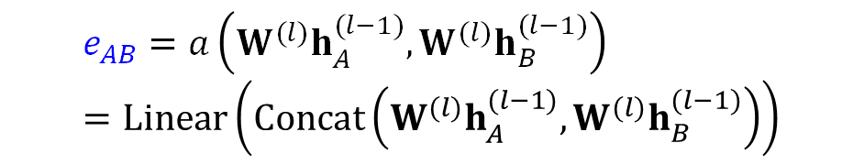
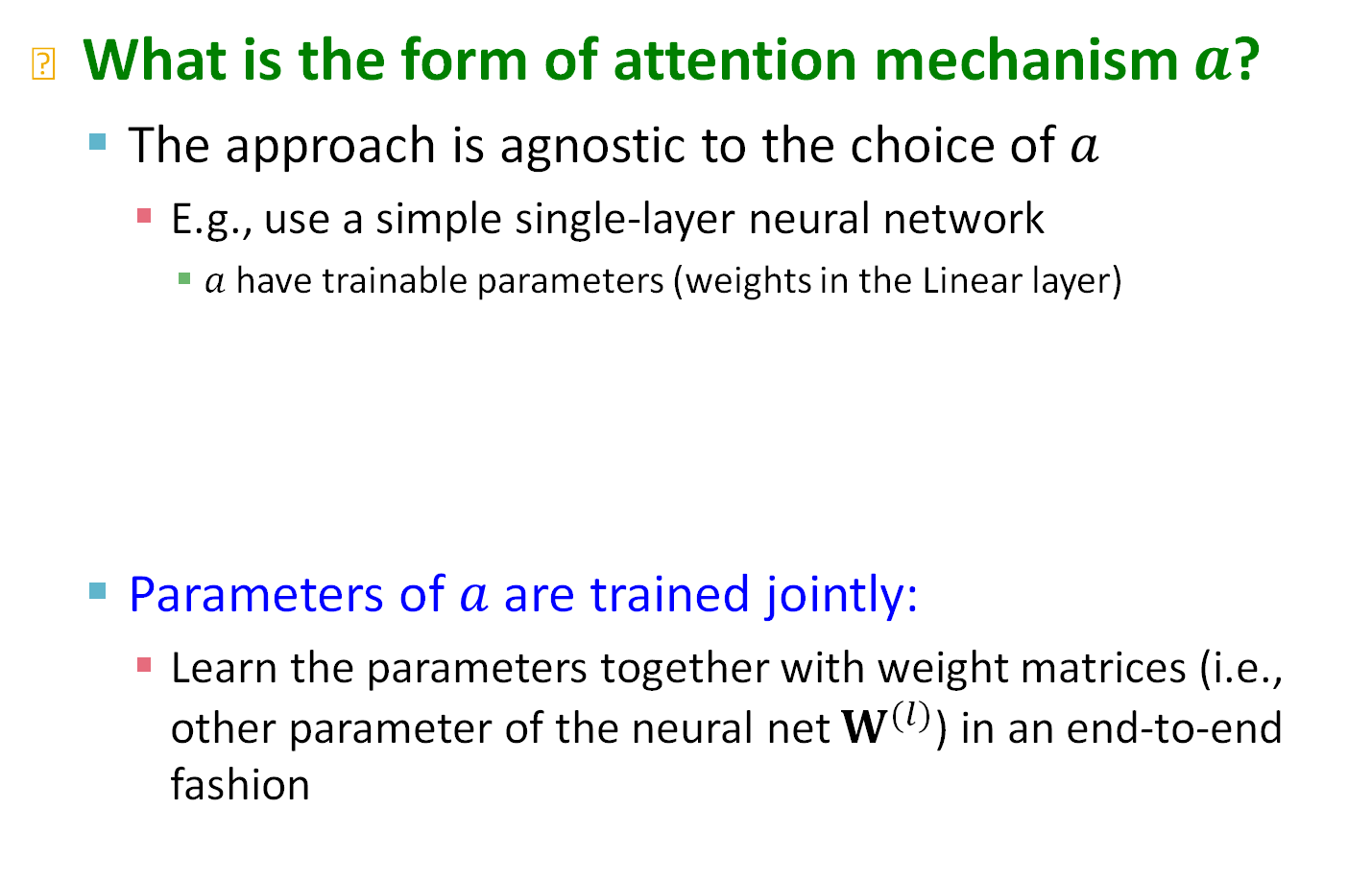



Recap: Attention Mechanism (2)
What is the form of attention mechanism $a$?
  The approach is agnostic to the choice of $a$
    E.g., use a simple single-layer neural network
      $a$ have trainable parameters (weights in the Linear layer)
  Parameters of $a$ are trained jointly:
    Learn the parameters together with weight matrices (i.e., other parameter of the neural net $W^{(l)}$) in an end-to-end fashion
Concatenate
Linear
  $$e_{AB}=a\left(W^{(l)}h_{A}^{(l−1)},W^{(l)}h_{B}^{(l−1)}\right)=Linear\left(Concat\left(W^{(l)}h_{A}^{(l−1)},W^{(l)}h_{B}^{(l−1)}\right)\right)$$
$$e_{AB}$$
$$h_{A}^{(l−1)}$$
$$h_{B}^{(l−1)}$$

Slide 68

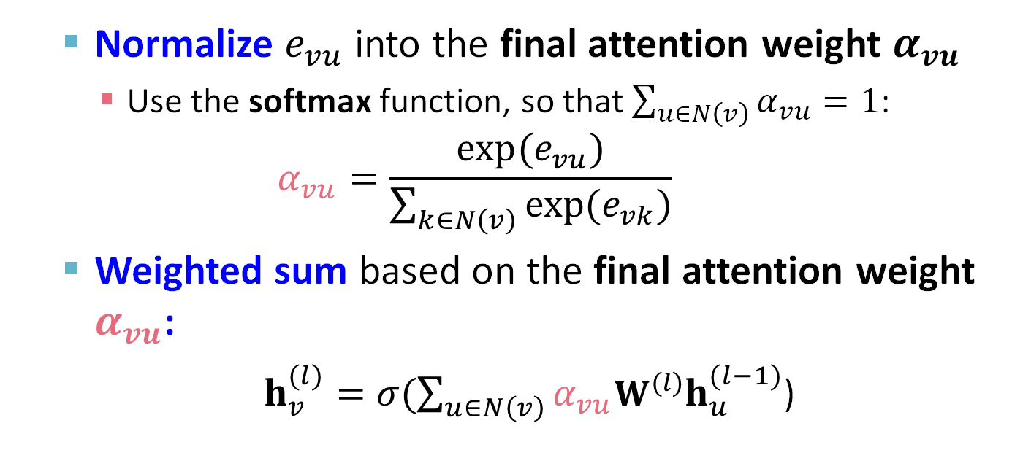


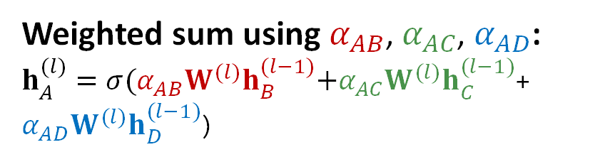


Recap: Attention Mechanism (3)
  Normalize $e_{vu}$ into the final attention weight $α_{vu}$
    Use the softmax function, so that $\sum_{u∈N\left(v\right)}{α_{vu}}=1$:
  $$α_{vu}=\frac{exp⁡(e_{vu})}{\sum_{k∈N\left(v\right)}{exp⁡(e_{vk})}}$$
  Weighted sum based on the final attention weight $α_{vu}$:
  $h_{v}^{(l)}=σ(\sum_{u∈N\left(v\right)}{α_{vu}W^{(l)}h_{u}^{(l−1)}}$)
$$α_{AB}$$
$$h_{B}^{(l−1)}$$
Weighted sum using $α_{AB}$, $α_{AC}$, $α_{AD}$:
$h_{A}^{(l)}=σ(α_{AB}W^{(l)}h_{B}^{(l−1)}\text{+}α_{AC}W^{(l)}h_{C}^{(l−1)}$+ $α_{AD}W^{(l)}h_{D}^{(l−1)}\text{)}$
$$α_{AC}$$
$$h_{C}^{(l−1)}$$
$$α_{AD}$$

Slide 69
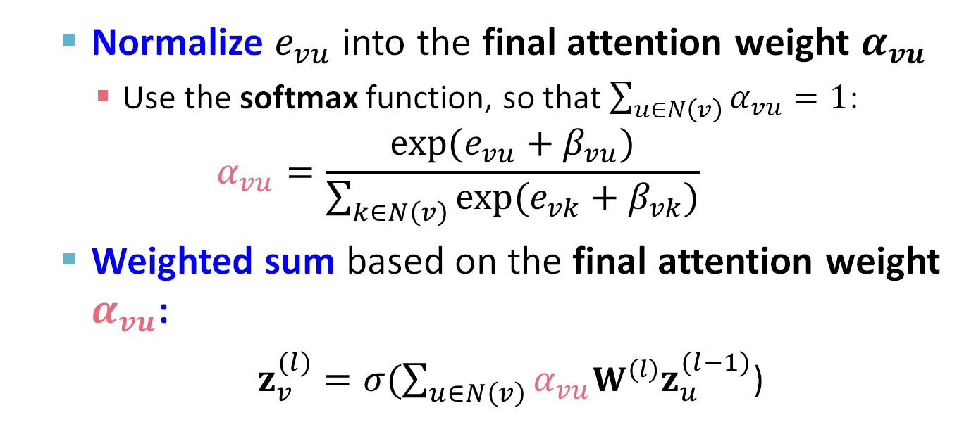


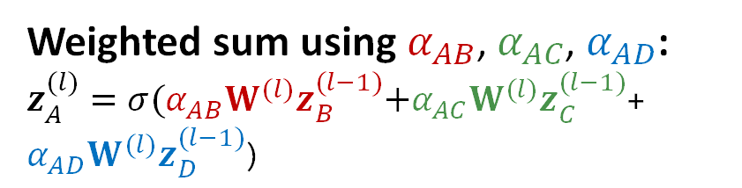
Relation Attention Mechanism
  Normalize $e_{vu}$ into the final attention weight $α_{vu}$
    Use the softmax function, so that $\sum_{u∈N\left(v\right)}{α_{vu}}=1$:
  $$α_{vu}=\frac{exp⁡(e_{vu}+β_{vu})}{\sum_{k∈N\left(v\right)}{exp⁡(e_{vk}+β_{vk})}}$$
  Weighted sum based on the final attention weight $α_{vu}$:
  $z_{v}^{(l)}=σ(\sum_{u∈N\left(v\right)}{α_{vu}W^{(l)}z_{u}^{(l−1)}}$)
$$α_{AB}$$
$$z_{B}^{(l−1)}$$
Weighted sum using $α_{AB}$, $α_{AC}$, $α_{AD}$:
$z_{A}^{(l)}=σ(α_{AB}W^{(l)}z_{B}^{(l−1)}\text{+}α_{AC}W^{(l)}z_{C}^{(l−1)}$+ $α_{AD}W^{(l)}z_{D}^{(l−1)}\text{)}$
$$α_{AC}$$
$$z_{C}^{(l−1)}$$
$$α_{AD}$$

Slide 70
InGram Model
Source: https://bdi-lab.kaist.ac.kr/down/ingram_icml2023_slides.pdf
Next: Entity-level message-passing
Notes:
Let’s go back to the basics, so a graph is an abstract structure that models the connectivity information between different objects or different entities and these objects or entities are the nodes of the graph.
Now it so happens that graphs might consist of different node types. In the paradigm illustrated here we have two types of nodes the blue and the red nodes. In a real world graph these correspond to paper nodes and author nodes when we talk about academic graphs
Or they can represent users and items in e-commerce networks or drugs and diseases in biological networks

Slide 71
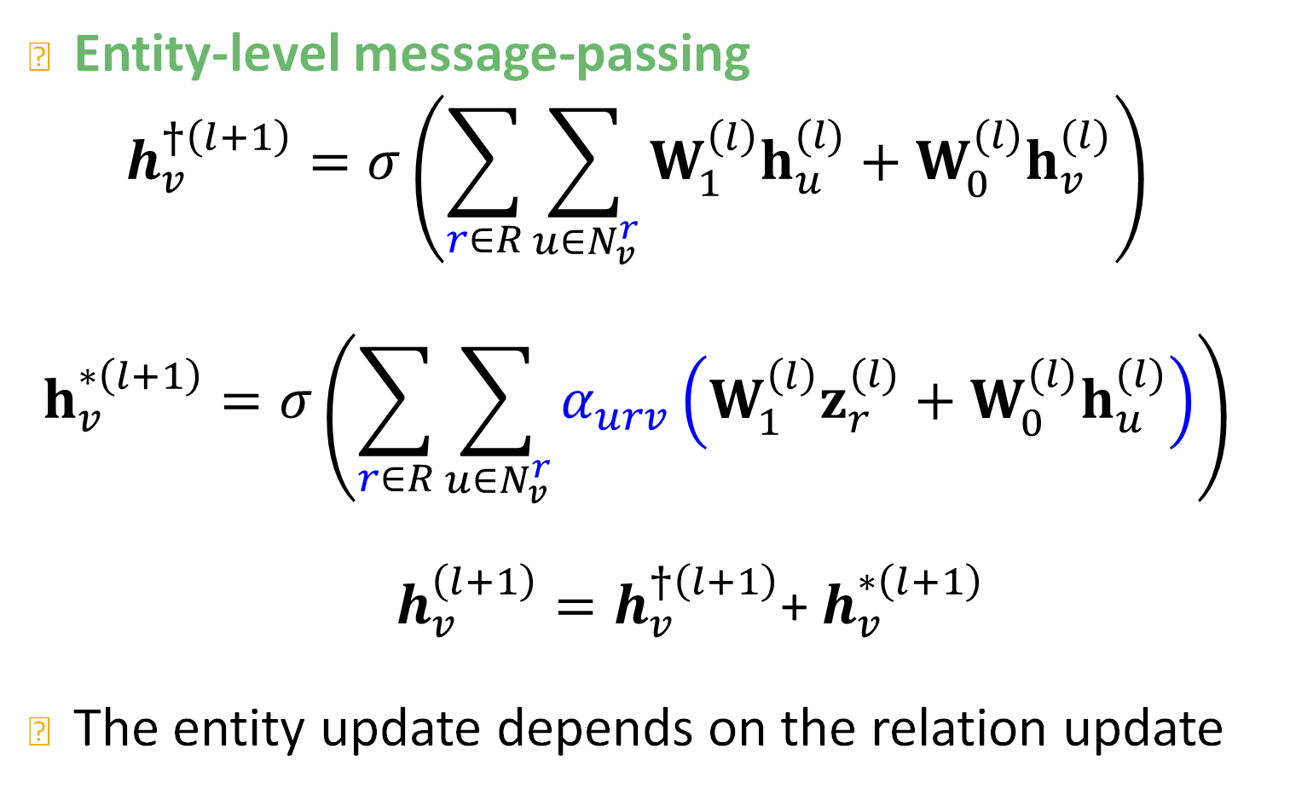
Entity Attention Mechanism
Entity-level message-passing
$$h_{v}^{†\left(l+1\right)}=σ\left(\sum_{r∈R}{\sum_{u∈N_{v}^{r}}{W_{1}^{\left(l\right)}h_{u}^{(l)}+W_{0}^{(l)}h_{v}^{(l)}}}\right)$$
$$h_{v}^{∗\left(l+1\right)}=σ\left(\sum_{r∈R}{\sum_{u∈N_{v}^{r}}{α_{urv}\left({W_{1}^{\left(l\right)}z_{r}^{(l)}+W}_{0}^{(l)}h_{u}^{(l)}\right)}}\right)$$
$h_{v}^{\left(l+1\right)}=h_{v}^{†\left(l+1\right)}$+ $h_{v}^{∗\left(l+1\right)}$
The entity update depends on the relation update
Notes:
Let’s go from right to left
Aggregation is very similar to a standard GNN
Any issues you can identify?

Slide 72
InGram Model
Source: https://bdi-lab.kaist.ac.kr/down/ingram_icml2023_slides.pdf
Next: Link-prediction head
Notes:
Let’s go back to the basics, so a graph is an abstract structure that models the connectivity information between different objects or different entities and these objects or entities are the nodes of the graph.
Now it so happens that graphs might consist of different node types. In the paradigm illustrated here we have two types of nodes the blue and the red nodes. In a real world graph these correspond to paper nodes and author nodes when we talk about academic graphs
Or they can represent users and items in e-commerce networks or drugs and diseases in biological networks

Slide 73
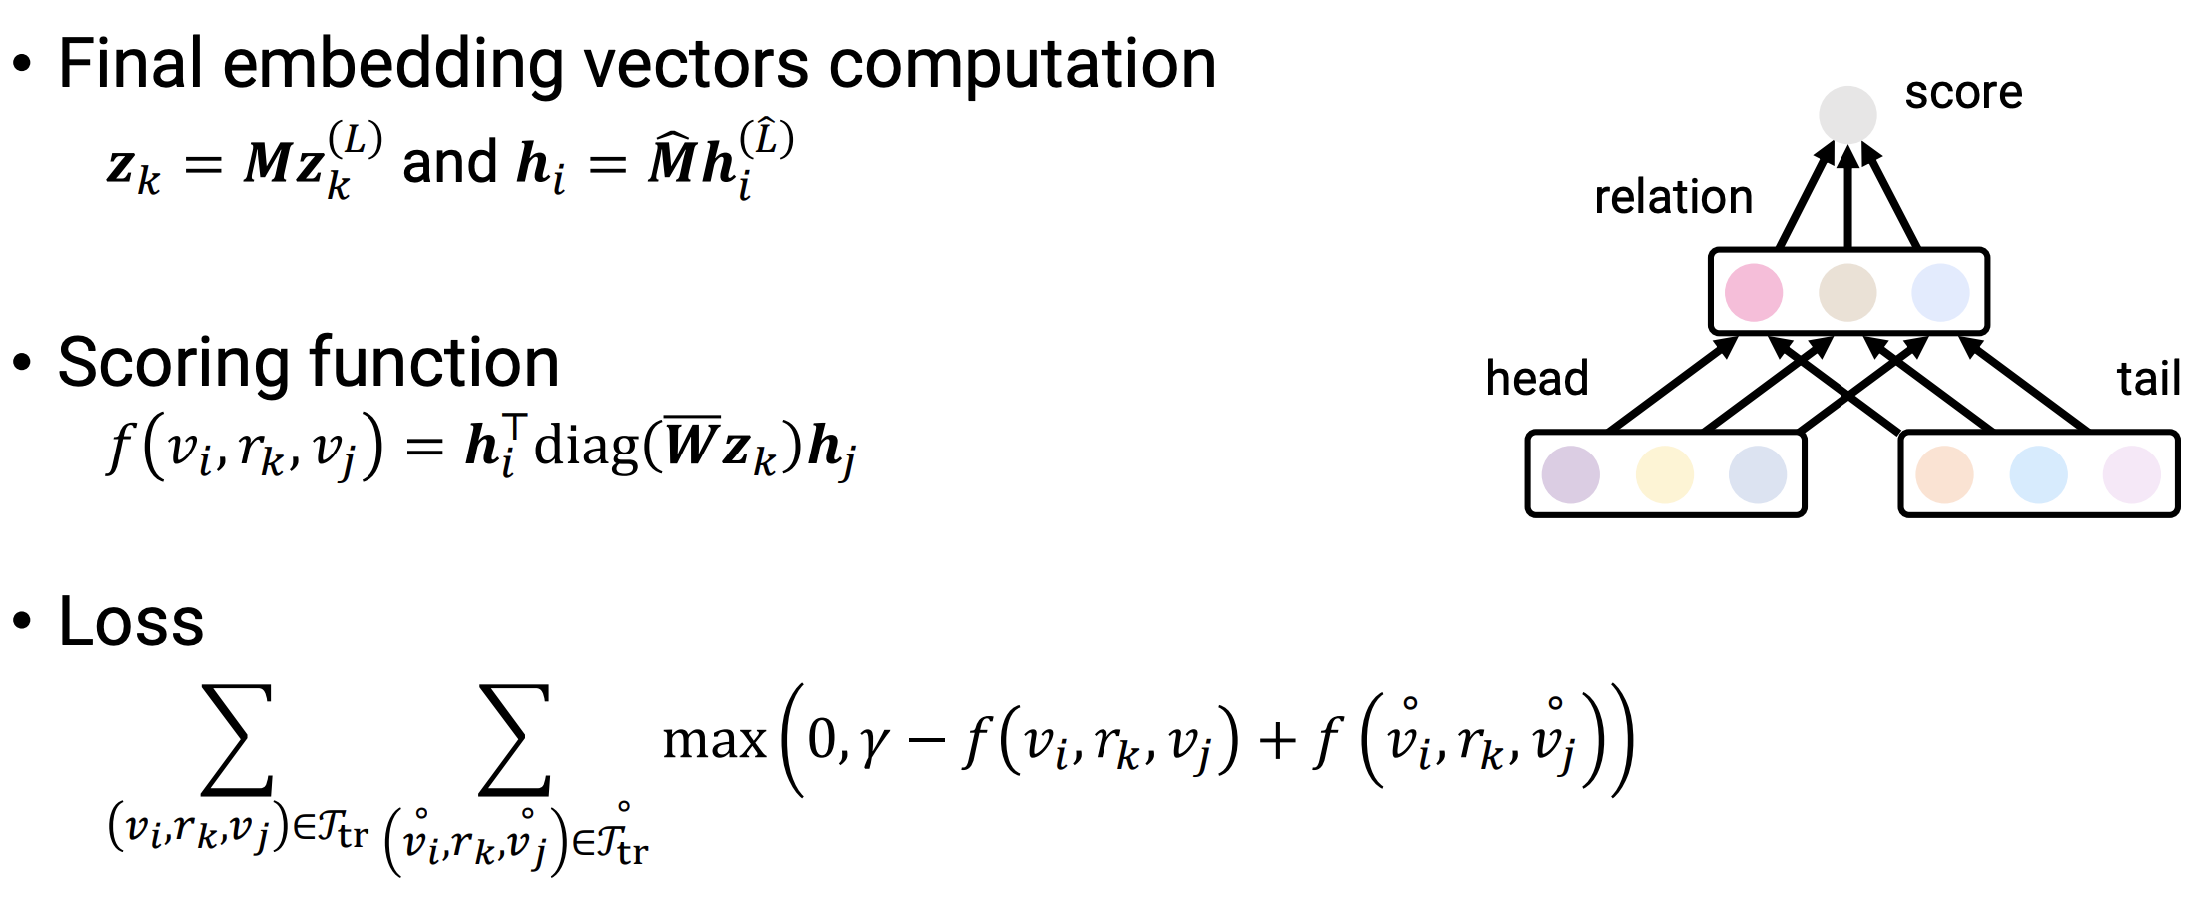
Link-Prediction Head
Source: https://bdi-lab.kaist.ac.kr/down/ingram_icml2023_slides.pdf
Notes:
Let’s go back to the basics, so a graph is an abstract structure that models the connectivity information between different objects or different entities and these objects or entities are the nodes of the graph.
Now it so happens that graphs might consist of different node types. In the paradigm illustrated here we have two types of nodes the blue and the red nodes. In a real world graph these correspond to paper nodes and author nodes when we talk about academic graphs
Or they can represent users and items in e-commerce networks or drugs and diseases in biological networks

Slide 74
InGram
Structure aware GNN encoders learn embeddings for entities
Structure aware GNN encoders learn embeddings for relations
The structure of the KG is also utilized in the loss function
InGram can be used for inductive link prediction across new entities and new relation
  It is a model we can use to train a foundation model
Notes:
We use structure agnostic shallow encoders to produce entity and relation embeddings.
The structure of the KG is used only in the loss

Slide 75
Experiments
Create different datasets from NELL, Wikidata, and Freebase
Test the performance of InGram in Transductive and Inductive link prediction
Notes:
We use structure agnostic shallow encoders to produce entity and relation embeddings.
The structure of the KG is used only in the loss

Slide 76
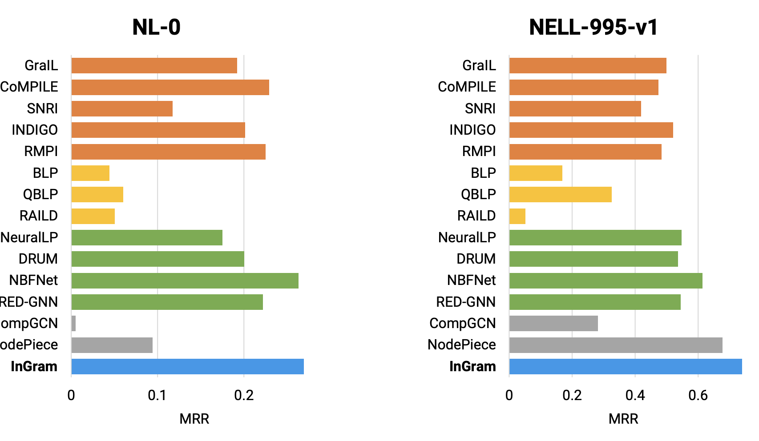
Transductive Link Prediction
Source: https://bdi-lab.kaist.ac.kr/down/ingram_icml2023_slides.pdf
Notes:
We use structure agnostic shallow encoders to produce entity and relation embeddings.
The structure of the KG is used only in the loss

Slide 77
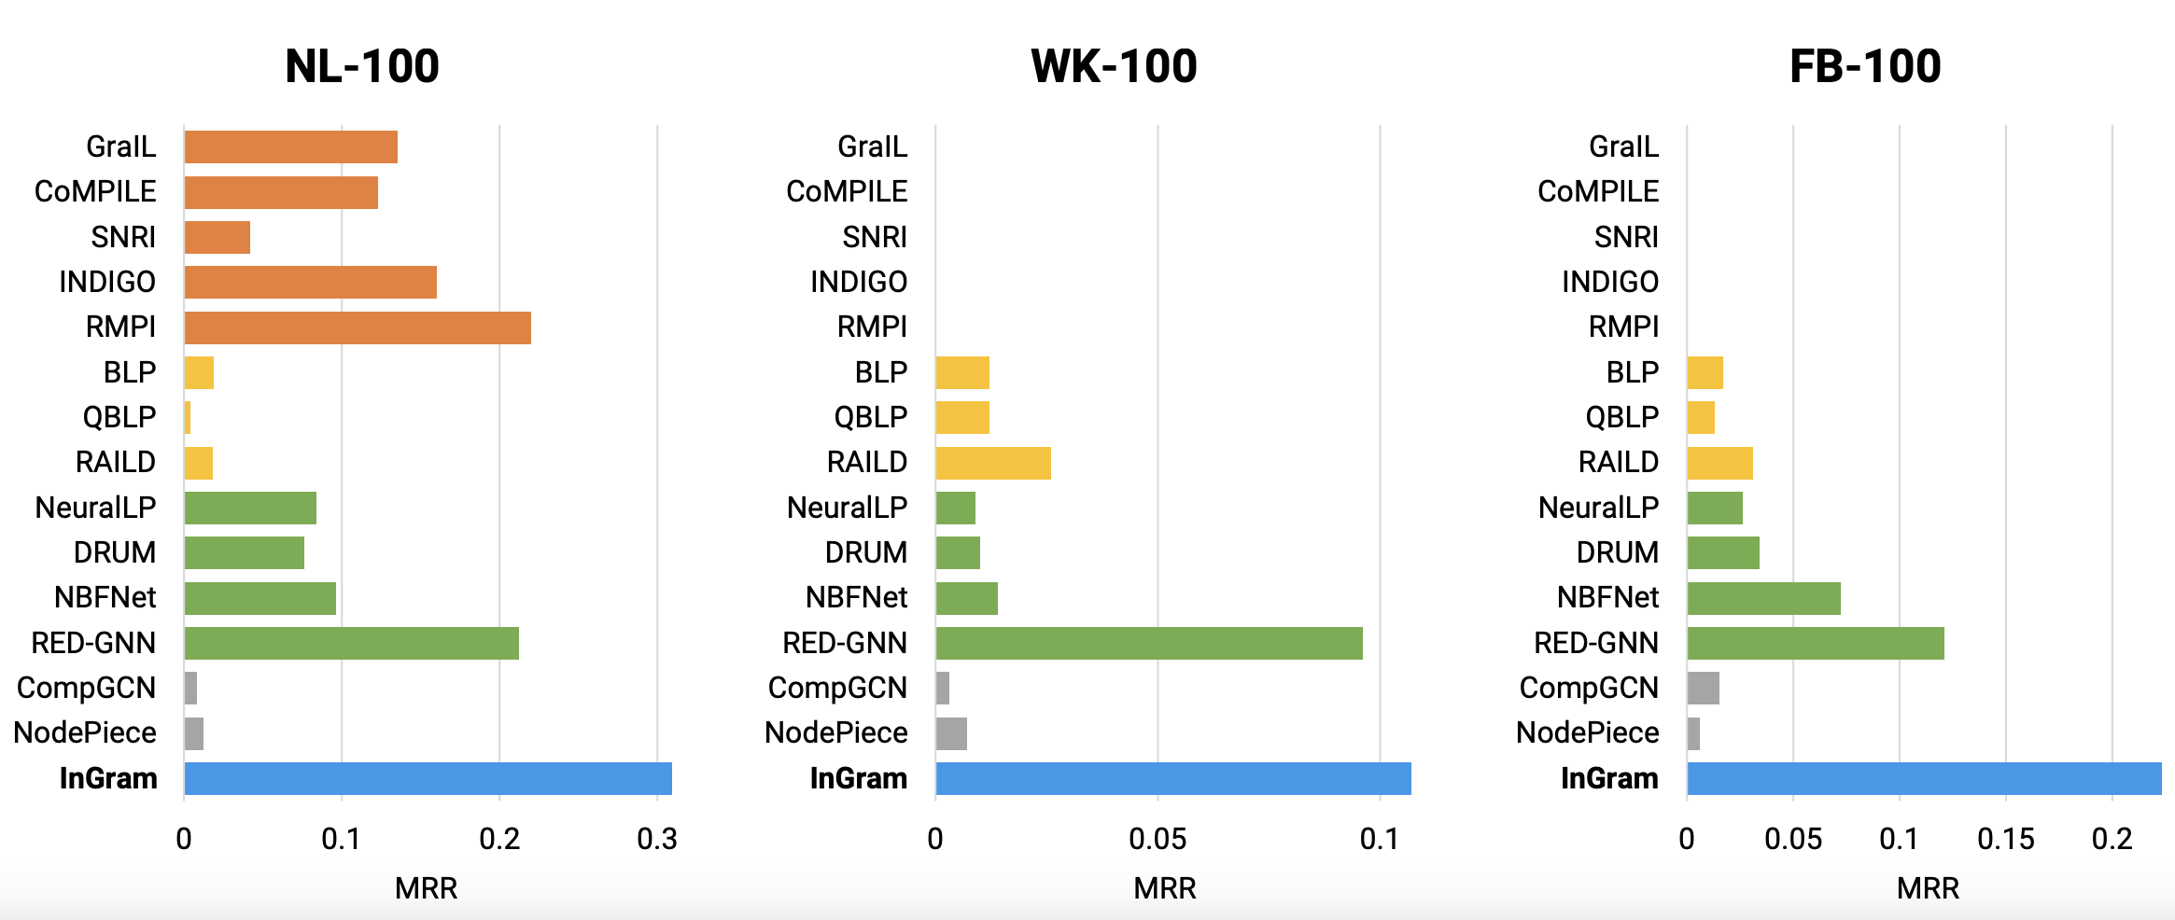
Inductive Link Prediction
Source: https://bdi-lab.kaist.ac.kr/down/ingram_icml2023_slides.pdf
Notes:
We use structure agnostic shallow encoders to produce entity and relation embeddings.
The structure of the KG is used only in the loss

Slide 78
Summary of the Lecture
Introduced a model that learns embeddings for entities and relations of any KG
The model (InGram) is trained in an unsupervised fashion for KG completion
The model can transfer knowledge between different KGs
This is a step towards foundation models for KGs
Notes:
First bullet. These embeddings can be later used to perform link prediction in a few shot or zero shot manner

