Slide 1

Stanford CS224W:
Deep Generative Models for Graphs
Note to other teachers and users of these slides: We would be delighted if you found our material useful for giving your own lectures. Feel free to use these slides verbatim, or to modify them to fit your own needs. If you make use of a significant portion of these slides in your own lecture, please include this message, or a link to our web site: http://cs224w.Stanford.edu
CS224W: Machine Learning with Graphs
Jure Leskovec, Stanford University
http://cs224w.stanford.edu

Slide 2
Announcements
Exam opens this Thursday 11/21
  11/21 5pm to 11/23 5am (36 hour window)
  2 hours long (can't stop + start)
  On gradescope – typeset your answers in Latex or upload images
  Up to Lecture 13
  Recitation: recording on Ed
  More info on Website + Ed
Colab 4 + 5 due after the break (12/3 and 12/5)

Slide 3
Announcements
We need your Medium Account Usernames
  We will add all of you as writers to our CS224w publications.
  Please fill out the google form on Ed with your medium account username by Wednesday EOD.
    https://forms.gle/UtJ3x9dGpNTGCQz1A
    This is a requirement!

Slide 4
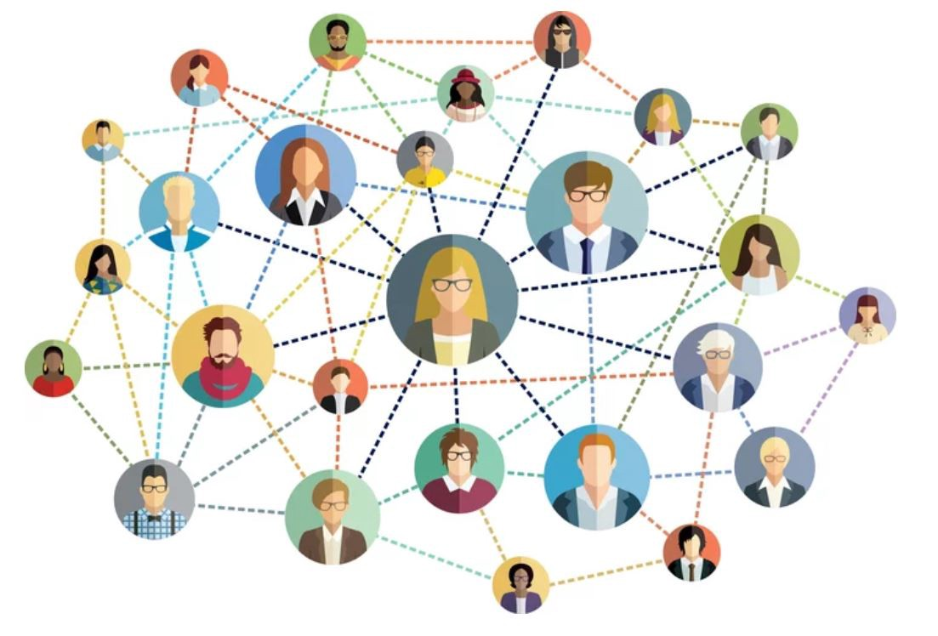
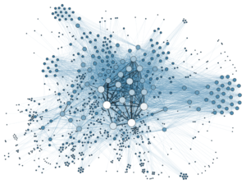
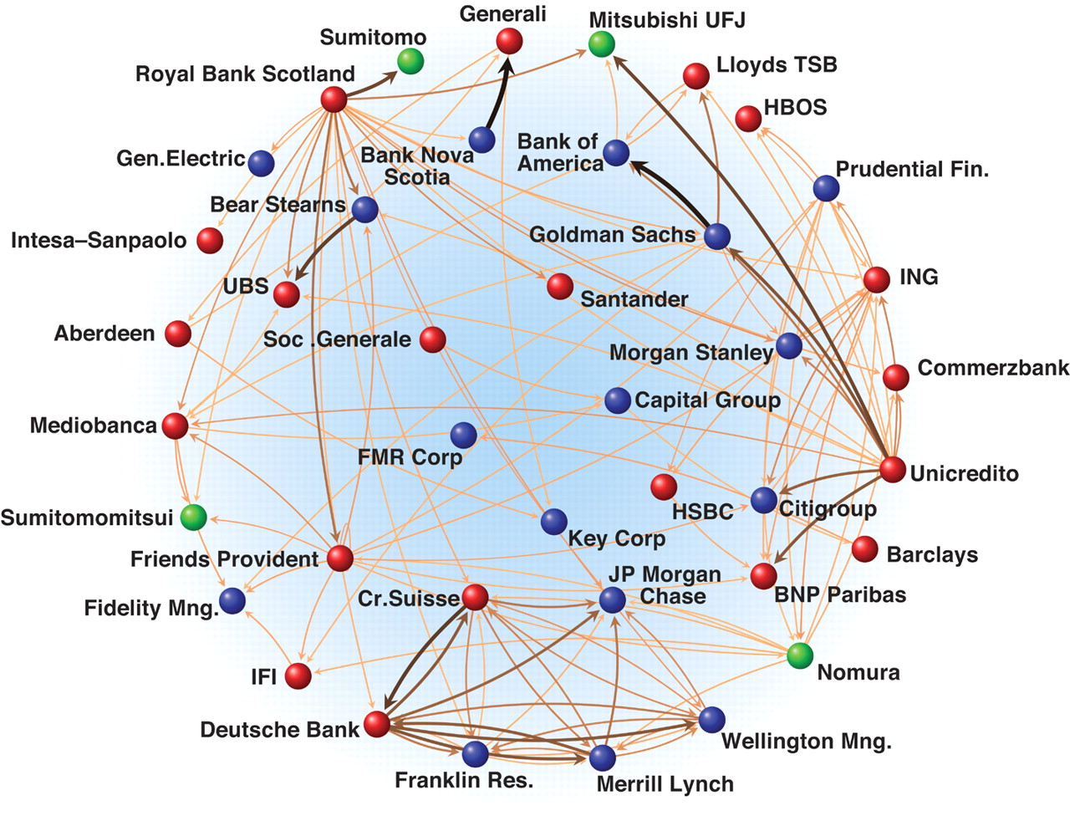
Motivation for Graph Generation
So far, we have been learning from graphs
  We assume the graphs are given
But how are these graphs generated?
Image credit: Medium
Image credit: Science
Image credit: Lumen Learning
Social Networks
Economic Networks
Communication Networks
Notes:
We all know why we study gen models for text or for graphs but

Slide 5
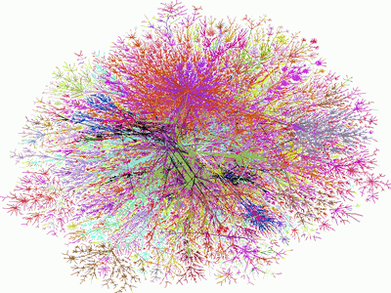
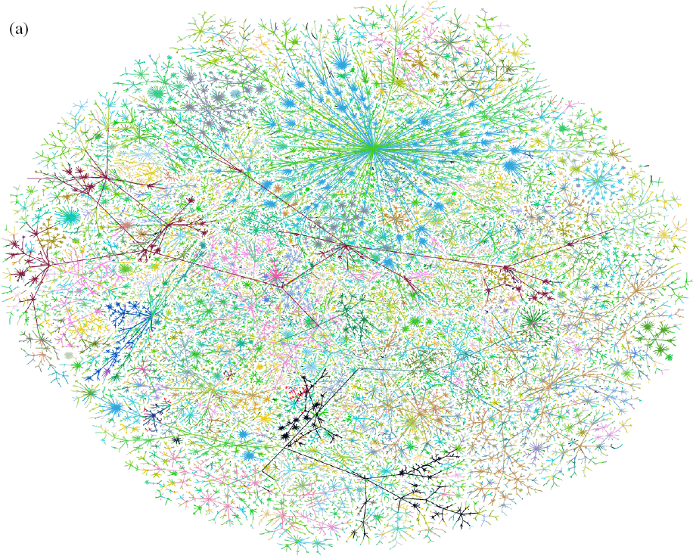

The Problem: Graph Generation
We want to generate realistic graphs, using graph generative models
Applications:
  Drug discovery, material design
  Social network modeling
Graph Generative Model
which is similar to
Generate
$$≈$$
Synthetic graph
Real graph
Notes:
We want them to have same properties
Generating small molecules, design new drugs
Larger molecules for material design
Or allows you to generate a social network and probe it
Ask scientific questions

Slide 6
Why Do We Study Graph Generation
Insights – We can understand the formulation of graphs
Predictions – We can predict how will the graph further evolve
Simulations – We can use the same process to general novel graph instances
Anomaly detection - We can decide if a graph is normal / abnormal
Notes:
Understand the nature of the object, harder than understanding, intermediate step.
Simulate in the future what might happen
Explore paths in silico, explore paths that you cannot do by hand for a chemist
More specific
The first three high level the fourth is a particular instance

Slide 7
History of Graph Generation
Step 1: Properties of real-world graphs
  A successful graph generative model should fit these properties
Step 2: Traditional graph generative models
  Each come with different assumptions on the graph formulation process
Step 3: Deep graph generative models
  Learn the graph formation process from the data
  This lecture!
Notes:
Degree, triangles
Probability distribution over a graph. Distributions have parameters. Fit the distributions parameters to specific graphs and then draw graphs from these distributions
.
Predefined statistical model, we have a deep learning model and train this model with today

Slide 8
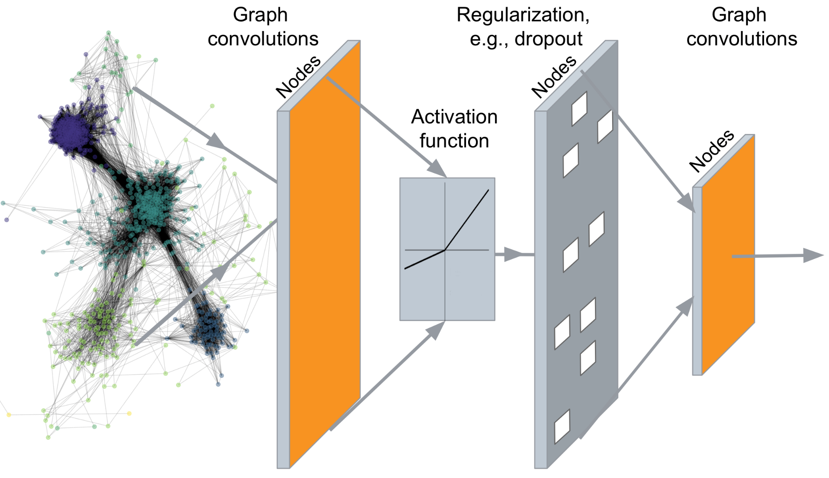
So far: Deep Graph Encoders
…
Output: node embeddings
Notes:
So far we have discussed about encoders

Slide 9
Today: Deep Graph Decoders
…
Output: Graph Structure!
Notes:
Give something as input
The output will be the graph

Slide 10
Stanford CS224W:
Machine Learning for
Graph Generation
CS224W: Machine Learning with Graphs
Jure Leskovec, Stanford University
http://cs224w.stanford.edu

Slide 11
Graph Generation Tasks
Task 1: Realistic graph generation
Generate graphs that are similar to a given set of graphs [Focus of this lecture]
Task 2: Goal-directed graph generation
Generate graphs that optimize given objectives/constraints
  E.g., Drug molecule generation/optimization
Notes:
Realistic looking graph
Not just realistic looking graphs
Generate condition on a property
Instead of generating any molecule we want to generate a specific molecule
We have a molecule it has some properties but not all of them we are interested in and we want to generate one that has all the properties
Lead optimization

Slide 12
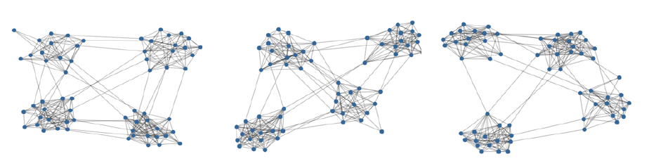
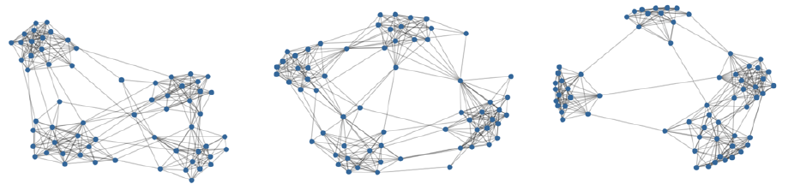
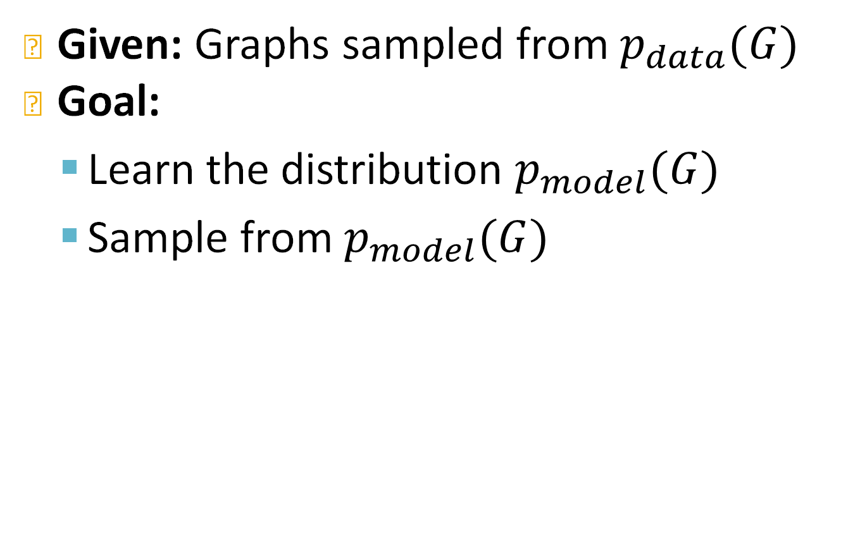
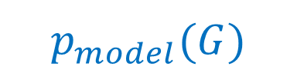
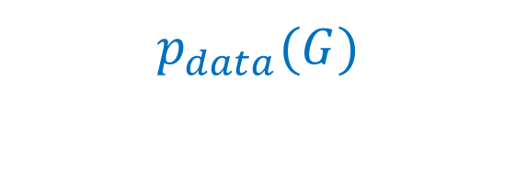
Graph Generative Models
Given: Graphs sampled from $p_{data}(G)$
Goal:
  Learn the distribution $p_{model}(G)$
  Sample from $p_{model}(G)$
$$p_{data}(G)$$
Learn & Sample
$$p_{model}(G)$$
Notes:
What we have a lot of graphs
See as samples from a data distribution

Slide 13
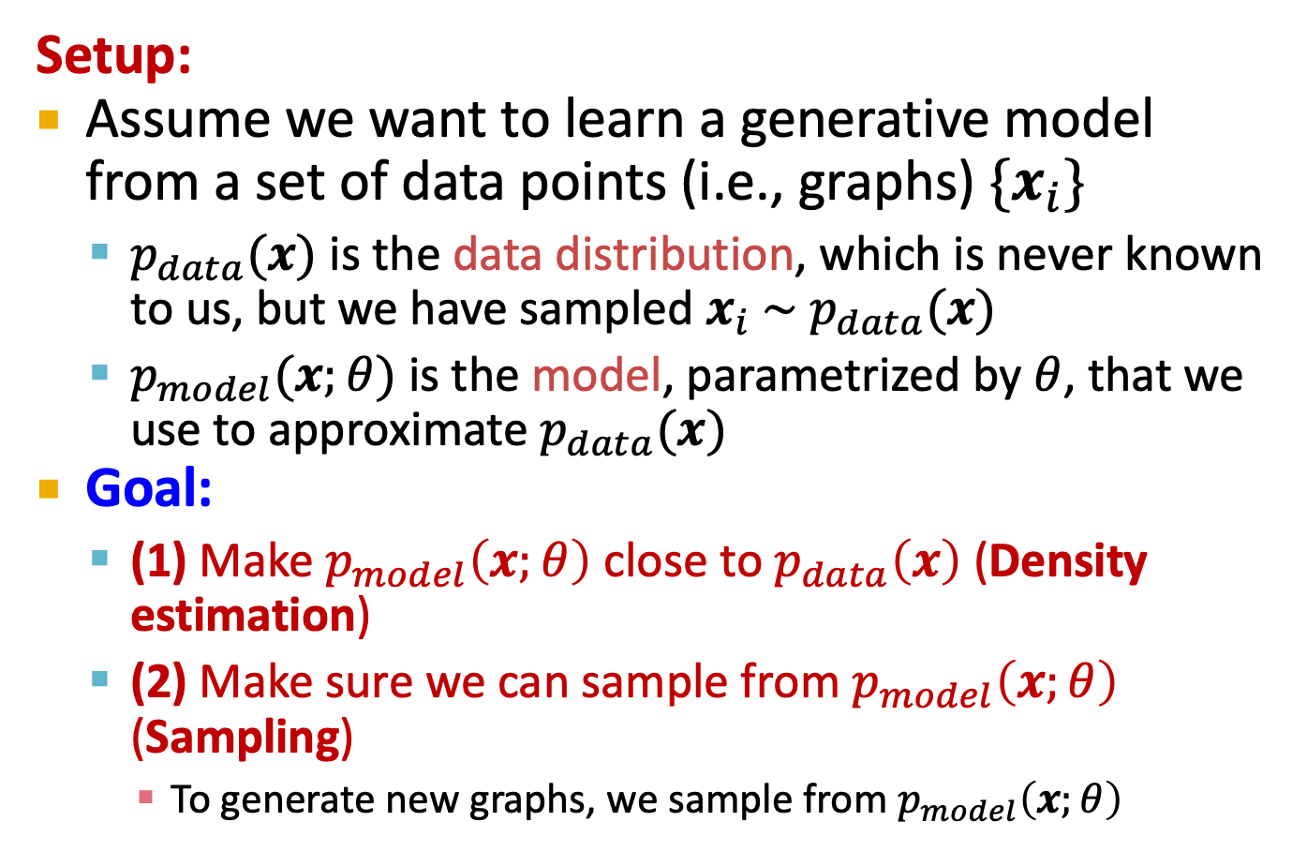
Generative Models Basics
Setup:
Assume we want to learn a generative model from a set of data points (i.e., graphs) ${\{x}_{i}\}$
  $p_{data}(x)$ is the data distribution, which is never known to us, but we have sampled $x_{i} \sim p_{data}(x)$
  $p_{model}(x;θ)$ is the model, parametrized by $θ$, that we use to approximate $p_{data}(x)$
Goal:
  (1) Make $p_{model}\left(x;θ\right)$ close to $p_{data}\left(x\right)$ (Density estimation)
  (2) Make sure we can sample from $p_{model}\left(x;θ\right)$ (Sampling)
    To generate new graphs, we sample from $p_{model}\left(x;θ\right)$
Notes:
We have a way of parametrizing this model distribution

Slide 14
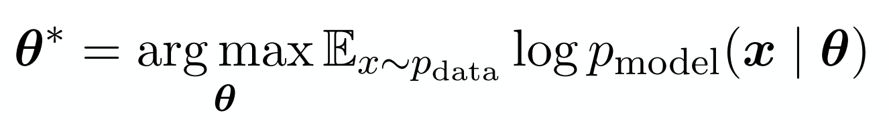
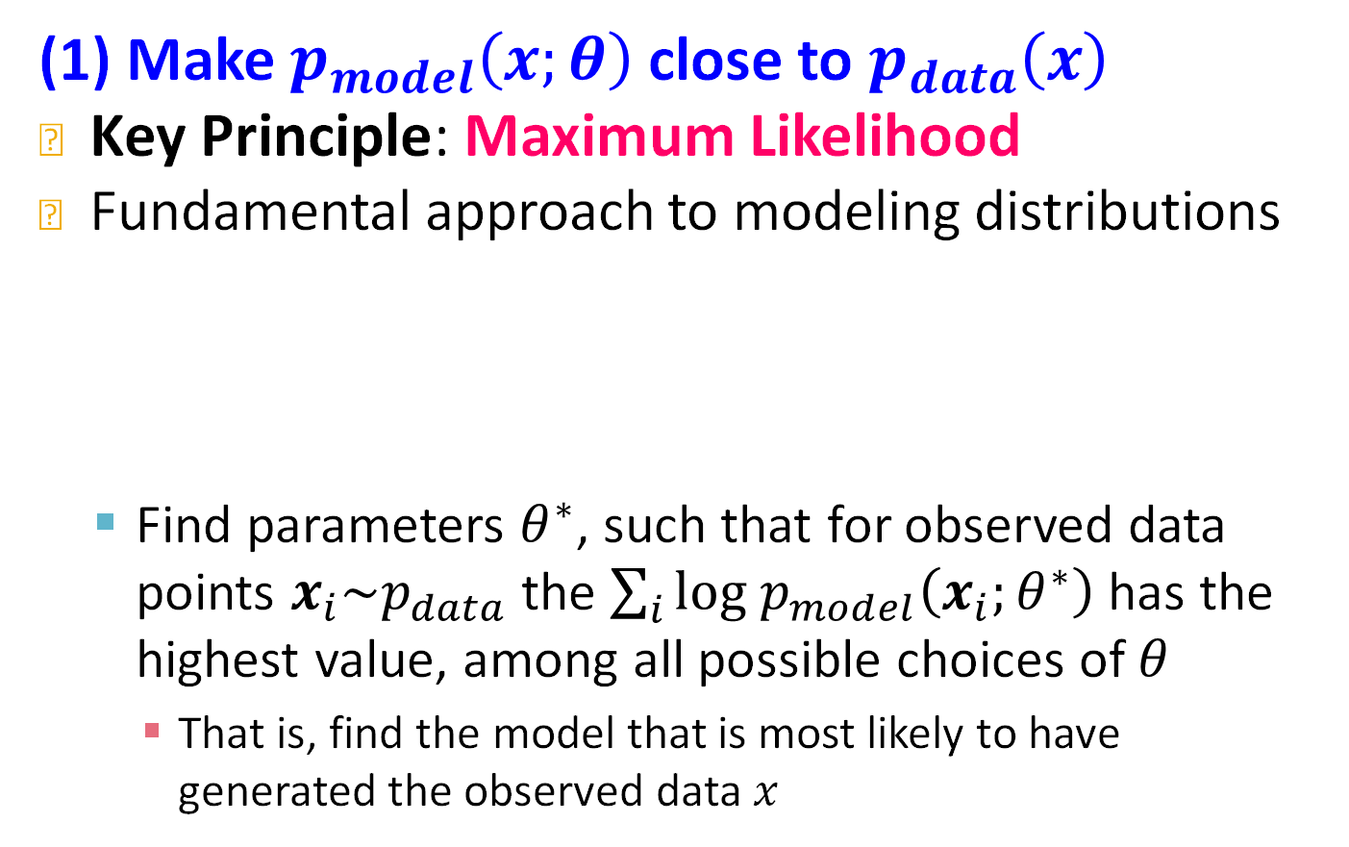
Generative Models Basics
(1) Make $p_{model}\left(x;θ\right)$ close to $p_{data}\left(x\right)$
Key Principle: Maximum Likelihood
Fundamental approach to modeling distributions
  Find parameters $θ^{∗}$, such that for observed data points $x_{i}\sim p_{data}$ the $\sum_{i}{log p_{model}\left(x_{i};θ^{∗}\right)}$has the highest value, among all possible choices of $θ$
    That is, find the model that is most likely to have
    generated the observed data $x$
Notes:
Model that I have has generated this
Samples are independent

Slide 15
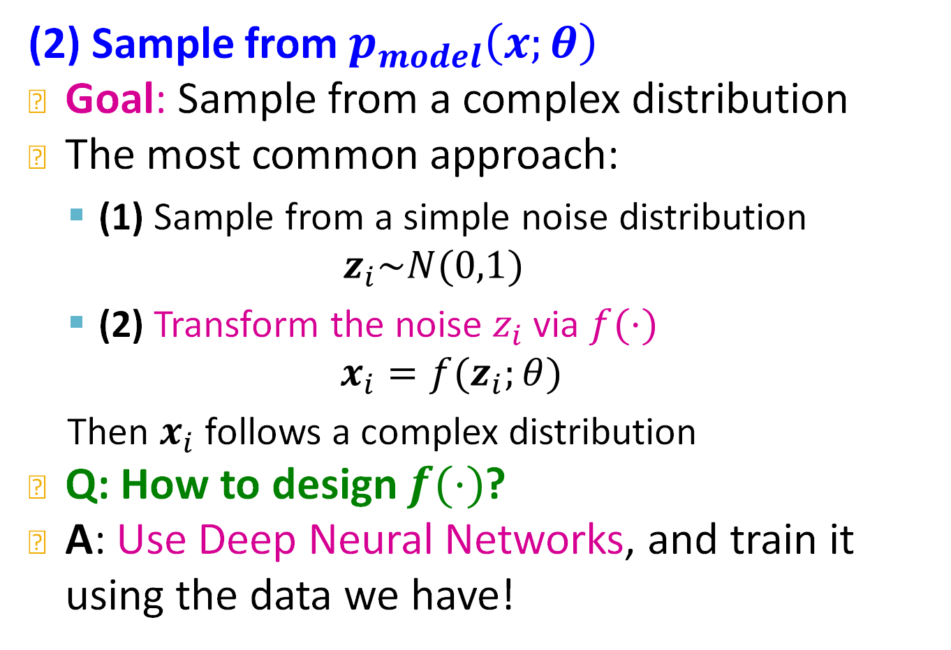
Generative Models Basics
(2) Sample from $p_{model}\left(x;θ\right)$
Goal: Sample from a complex distribution
The most common approach:
  (1) Sample from a simple noise distribution
    $$z_{i}\sim N(0,1)$$
  (2) Transform the noise $z_{i}$ via $f(⋅)$
  $$x_{i}=f(z_{i};θ)$$
  Then $x_{i}$ follows a complex distribution
Q: How to design $f(⋅)$?
A: Use Deep Neural Networks, and train it using the data we have!
Notes:
The are a lot of models but this one is actually very general

Slide 16
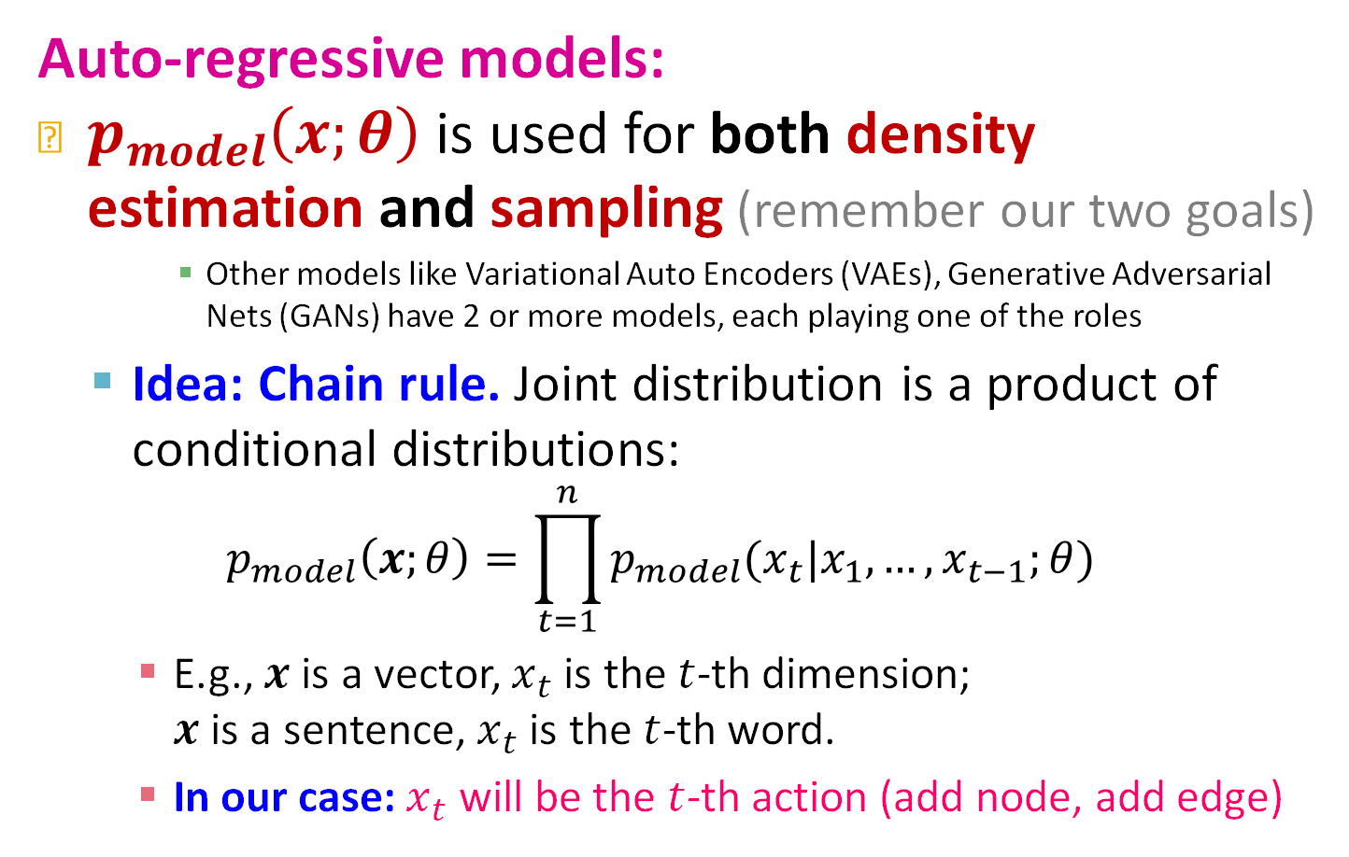
Deep Generative Models
Auto-regressive models:
$p_{model}\left(x;θ\right)$ is used for both density estimation and sampling (remember our two goals)
      Other models like Variational Auto Encoders (VAEs), Generative Adversarial Nets (GANs) have 2 or more models, each playing one of the roles
  Idea: Chain rule. Joint distribution is a product of conditional distributions:
$$p_{model}\left(x;θ\right)=\prod_{t=1}^{n}{p_{model}(x_{t}|x_{1},…,x_{t−1};θ)}$$
    E.g., $x$ is a vector, $x_{t}$ is the $t$-th dimension;
    $x$ is a sentence, $x_{t}$ is the $t$-th word.
    In our case: $x_{t}$ will be the $t$-th action (add node, add edge)
Notes:
Particular type of generative fodel, autoregressive model
Sentence we split into little pieces, what’s the probability of the next one. What’s the probability of generating a word at a time, next token prediction
These pieces will be nodes and edges

Slide 17
Stanford CS224W:
GraphRNN:
Generating Realistic Graphs
CS224W: Machine Learning with Graphs
Jure Leskovec, Stanford University
http://cs224w.stanford.edu

Slide 18
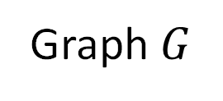
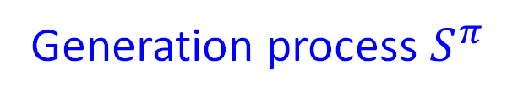
GraphRNN Idea
[You et al., ICML 2018]
Generating graphs via sequentially adding nodes and edges
Graph $G$
1
3
5
2
4
Generation process $S^{π}$
1
1
1
3
1
3
1
3
5
2
2
2
4
2
4
GraphRNN: Generating Realistic Graphs with Deep Auto-regressive Models. J. You, R. Ying, X. Ren, W. L. Hamilton, J. Leskovec. International Conference on Machine Learning (ICML), 2018.
Notes:
Generate another node does it connect to node 1 or node 2

Slide 19


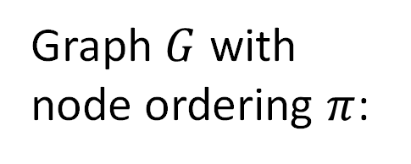







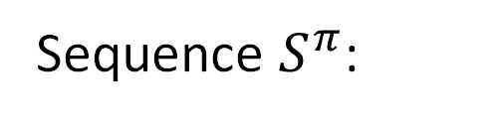

Model Graphs as Sequences
Graph $G$ with node ordering $π$ can be uniquely mapped into a sequence of node and edge additions $S^{π}$
Graph $G$ with
node ordering $π$:
1
3
5
2
4
Sequence $S^{π}$:
1
1
1
3
1
3
1
3
5
2
2
2
4
2
4
$S^{π}=$
$$($$
$$S_{1}^{π}$$
$,$
$$S_{2}^{π}$$
$,$
$$S_{3}^{π}$$
$,$
$$S_{4}^{π}$$
$,$
$$S_{5}^{π}$$
$$)$$

Slide 20
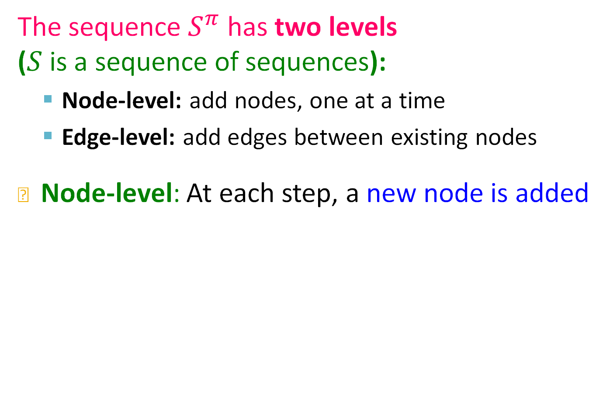







Model Graphs as Sequences
The sequence $S^{π}$ has two levels
($S$ is a sequence of sequences):
  Node-level: add nodes, one at a time
  Edge-level: add edges between existing nodes
Node-level: At each step, a new node is added
1
1
1
3
1
3
1
3
5
2
2
2
4
2
4
$S^{π}=$
$$($$
$$S_{1}^{π}$$
$,$
$$S_{2}^{π}$$
$,$
$$S_{3}^{π}$$
$,$
$$S_{4}^{π}$$
$,$
$$S_{5}^{π}$$
$$)$$
…
“Add node 1”
“Add node 5”
Notes:
Sequence has two axis, adding new node axis and adding new edge axis

Slide 21

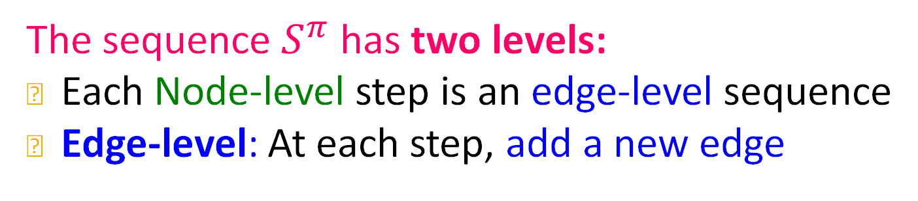




Model Graphs as Sequences
The sequence $S^{π}$ has two levels:
Each Node-level step is an edge-level sequence
Edge-level: At each step, add a new edge
1
3
2
4
$$S_{4}^{π}$$
$S_{4}^{π}=$
$$($$
$$S_{4,1}^{π}$$
$,$
$$S_{4,2}^{π}$$
$,$
$$S_{4,3}^{π}$$
$$)$$
“Not connect 4, 1”
“Connect 4, 2”
“Connect 4, 3”
0
1
1
Notes:
At the edge level is also autoregressive

Slide 22
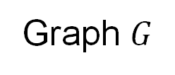

Model Graphs as Sequences
Summary: A graph + a node ordering =
A sequence of sequences
Node ordering is randomly selected (we will come back to this)
Node-level sequence
1
3
0 | 1 | 1 | 0 | 0
1 | 0 | 0 | 1 | 0
1 | 0 | 0 | 1 | 1
0 | 1 | 1 | 0 | 1
0 | 0 | 1 | 1 | 0
$$⇔$$
Edge-level
sequence
5
2
4
Graph $G$
Adjacency matrix
Notes:
Traversing the adjacency
We will do something more smart about the ordering

Slide 23
Model Graphs as Sequences
We have transformed graph generation problem into a sequence generation problem
Need to model two processes:
  1) Generate a state for a new node
  (Node-level sequence)
  2) Generate edges for the new node based on its state (Edge-level sequence)
Approach: Use Recurrent Neural Networks (RNNs) to model these processes!
Same principles apply to Transformers
Notes:
RNN is not the only autoregressive model we can use transformers as well

Slide 24








Background: Recurrent NNs
RNNs are designed for sequential data
  RNN sequentially takes input sequence to update its hidden states
  The hidden states summarize all the information input to RNN
  The update is conducted via RNN cells
Output sequence:
$$y_{1}$$
$$y_{2}$$
RNN cell
RNN cell
Hidden states:
$$s_{0}$$
$$s_{1}$$
$$s_{2}$$
$$…$$
Input sequence:
$$x_{1}$$
$$x_{2}$$
Notes:
Take two input and produce two outputs
Produces an output upon which decisions will be made
And it also generatest an updated state
Roll this out iteratively, autoregressively

Slide 25
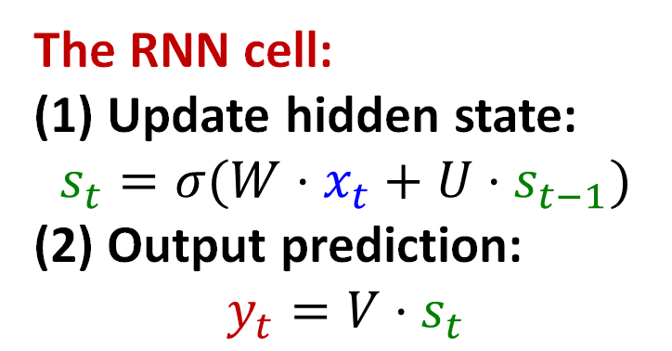
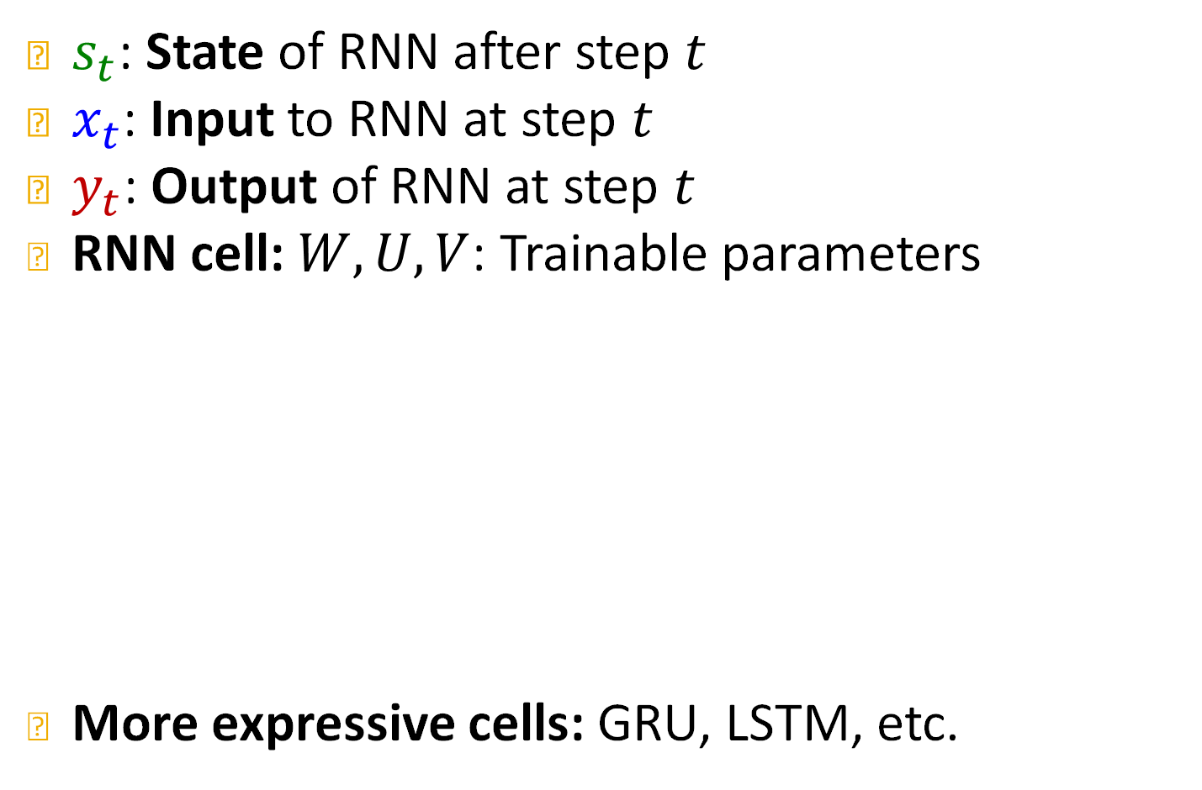




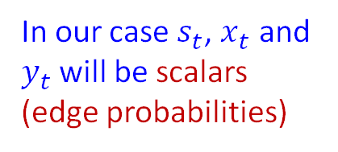
Background: Recurrent NNs
$s_{t}$: State of RNN after step $t$
$x_{t}$: Input to RNN at step $t$
$y_{t}$: Output of RNN at step $t$
RNN cell: $W, U,V$: Trainable parameters
More expressive cells: GRU, LSTM, etc.
In our case $s_{t}$, $x_{t}$ and $y_{t}$ will be scalars
(edge probabilities)
$$y_{t}$$
The RNN cell:
(1) Update hidden state:
$$s_{t}=σ(W⋅x_{t}+U⋅s_{t−1})$$
(2) Output prediction:
$$y_{t}=V⋅s_{t}$$
(2)
(1)
RNN cell
$$s_{t−1}$$
$$s_{t}$$
$$x_{t}$$
Notes:
For each cell we have

Slide 26
GraphRNN: Two levels of RNN
GraphRNN has a node-level RNN and an
edge-level RNN
Relationship between the two RNNs:
  Node-level RNN generates the initial state for edge-level RNN
  Edge-level RNN sequentially predict if the new node will connect to each of the previous node

Slide 27
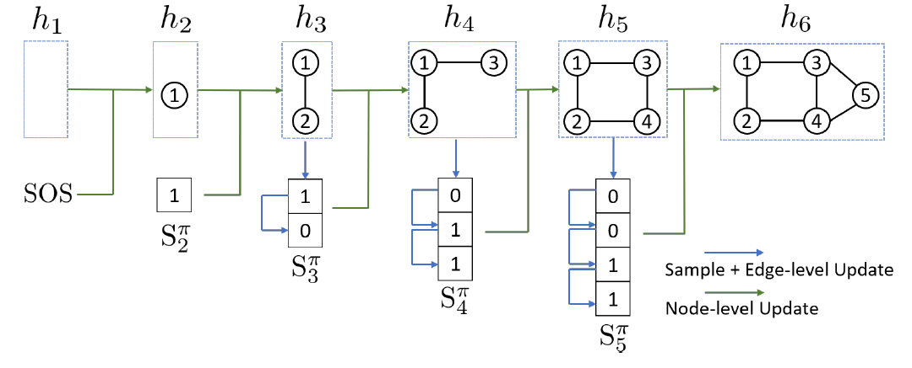
GraphRNN: Two levels of RNN
Node-level RNN generates the initial state for edge-level RNN
Edge-level RNN sequentially predict if the new node will connect to each of the previous node
Notes:
Horizontally we have the node level RNN
Start-of-sentence embedding, zero vector, one-vector
AGAIN

Slide 28
GraphRNN: Two levels of RNN
Node-level RNN generates the initial state for edge-level RNN
Next: How to generate a sequence with RNN?
Edge-level RNN generates edges for the new node,
then update Node-level RNN state using generated results

Slide 29
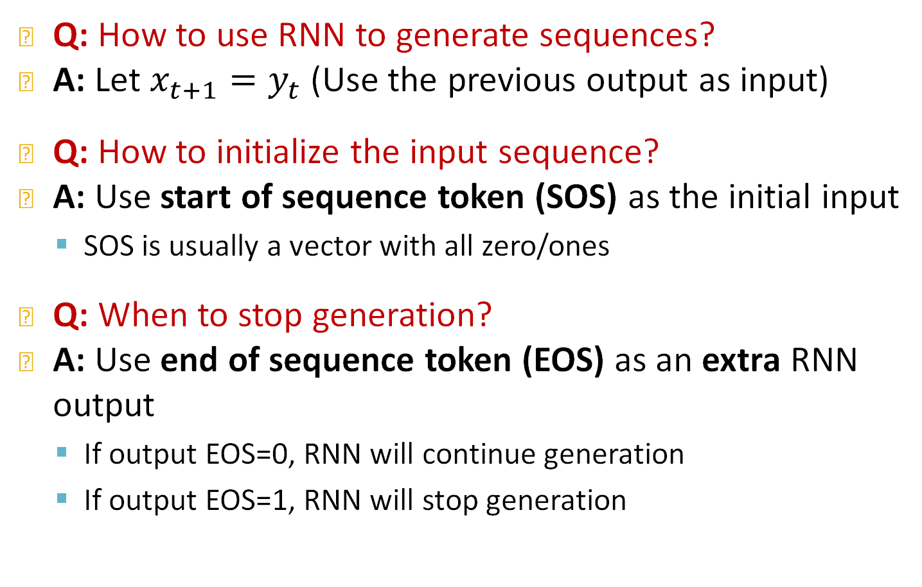
RNN for Sequence Generation
Q: How to use RNN to generate sequences?
A: Let $x_{t+1}=y_{t}$ (Use the previous output as input)
Q: How to initialize the input sequence?
A: Use start of sequence token (SOS) as the initial input
  SOS is usually a vector with all zero/ones
Q: When to stop generation?
A: Use end of sequence token (EOS) as an extra RNN output
  If output EOS=0, RNN will continue generation
  If output EOS=1, RNN will stop generation
Notes:
SOS is “start of sequence”
Model learns to generate the eos token, augmented in the output

Slide 30



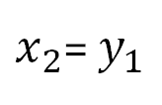






RNN for Sequence Generation
Use the previous output as input
Stop generation
$$y_{1}$$
$$y_{2}$$
$$EOS=1$$
RNN cell
RNN cell
RNN cell
$$s_{0}$$
$$s_{1}$$
$$s_{2}$$
$$…$$
$$s_{T−1}$$
$$x_{1}=SOS$$
$x_{2}$= $y_{1}$
$$x_{T}=y_{T−1}$$
Initialize input
This is good, but this model is deterministic
Notes:
S0 All ones
How do we train this thing? Where is randomness. If this model is deterministic we just learn one graph, our favorite graph

Slide 31


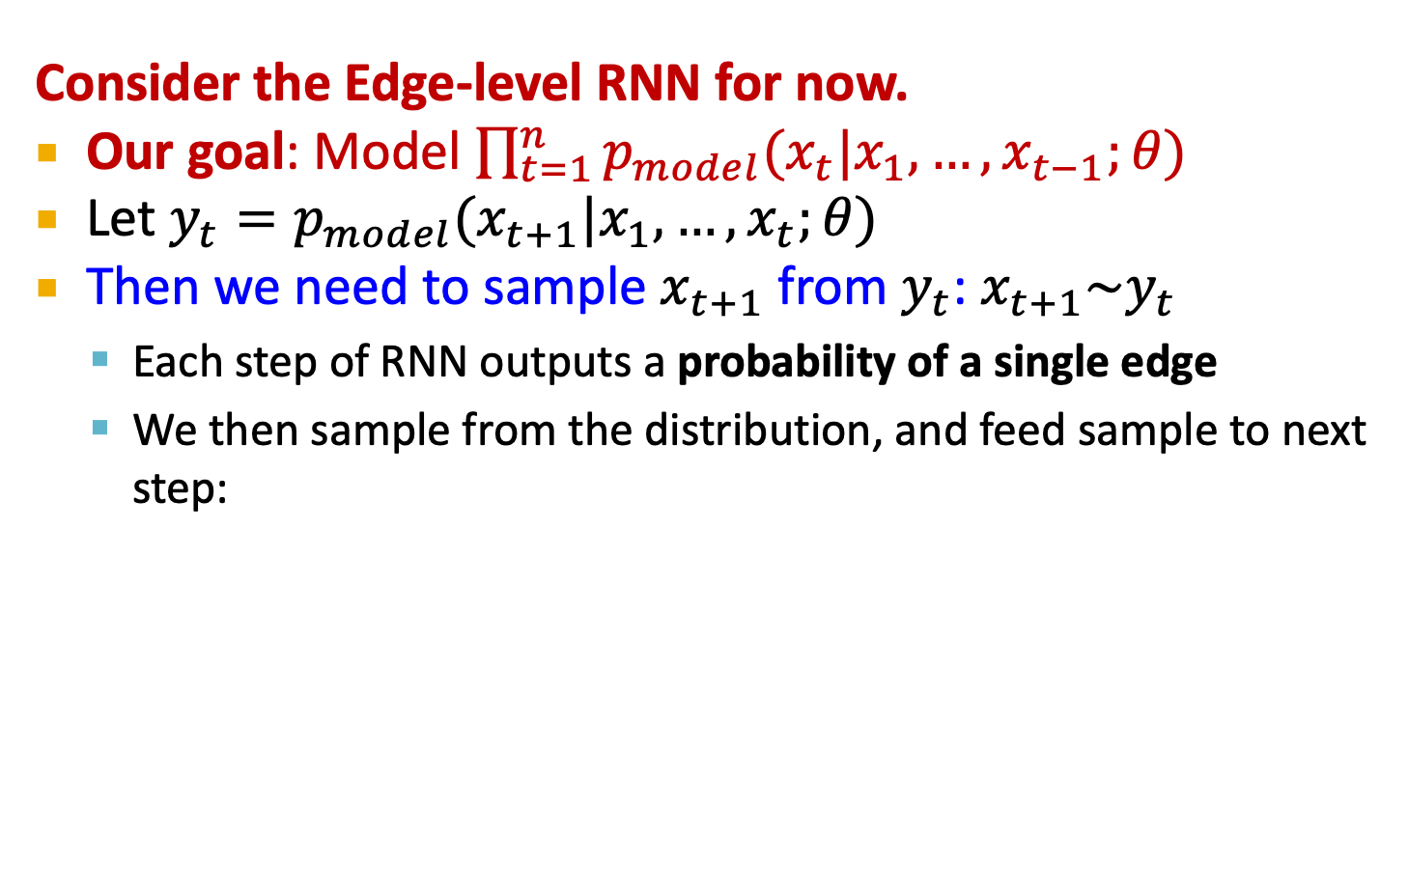







Towards Edge-Level RNN
Consider the Edge-level RNN for now.
Our goal: Model $\prod_{t=1}^{n}{p_{model}(x_{t}|x_{1},…,x_{t−1};θ)}$
Let ${y_{t}=p}_{model}(x_{t+1}|x_{1},…,x_{t};θ)$
Then we need to sample $x_{t+1}$ from $y_{t}$: $x_{t+1}\sim y_{t}$
  Each step of RNN outputs a probability of a single edge
  We then sample from the distribution, and feed sample to next step:
$$y_{1}$$
$$y_{2}$$
$$y_{3}$$
RNN cell
RNN cell
RNN cell
$$…$$
$$s_{0}$$
$$s_{1}$$
$$s_{2}$$
$$s_{3}$$
$$x_{1}=SOS$$
$$x_{2}\sim y_{1}$$
$$x_{3}\sim y_{2}$$
Notes:
Y1 is not going to be a node or an edge. It will be a distribution. Parameters to sample the next x from.
We predict the distribution of the next term, generate the next term by sampling from that distribution
Y is not x2, it will be a distribution from which we will sample x2 from

Slide 32

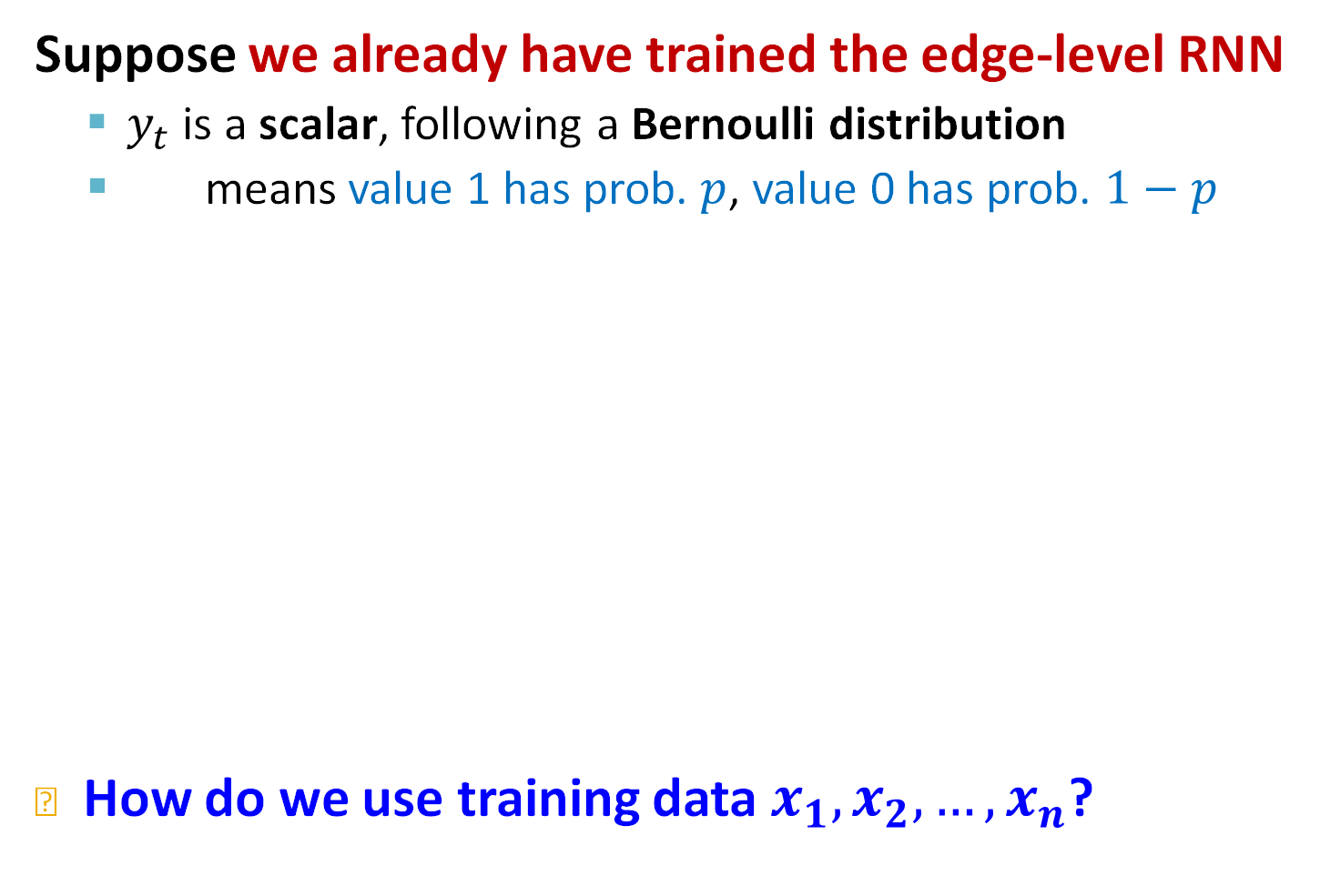










Towards Edge-Level RNN
Suppose we already have trained the edge-level RNN
  $y_{t}$ is a scalar, following a Bernoulli distribution
  means value 1 has prob. $p$, value 0 has prob. $1−p$
How do we use training data $x_{1},x_{2},…,x_{n}$?
$$p$$
$$y_{1}=$$
0.9
$$y_{2}=$$
0.4
$$y_{3}=$$
0.7
RNN cell
RNN cell
RNN cell
$$…$$
$$s_{0}=SOS$$
$$s_{1}$$
$$s_{2}$$
$$s_{3}$$
$$x_{1}=SOS$$
$$x_{2} \sim$$
0.9
$$x_{3} \sim$$
0.4
$$x_{2}=$$
1
$$x_{3}=$$
0
Notes:
AGAIN
Y is a distribution of two choices 0 and 1
Bernulli random variable. Probability of p
Parameters of the bernulli distribution
How to use training data to learn this distribution
State is a summary of our previous decisions

Slide 33

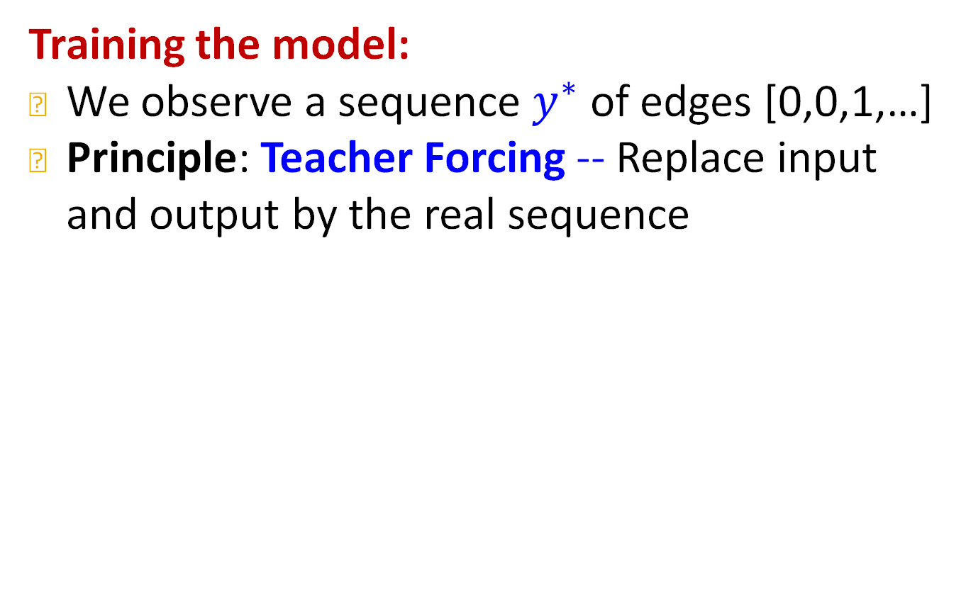











Edge-Level RNN at Training Time
Training the model:
We observe a sequence $y^{∗}$ of edges [0,0,1,…]
Principle: Teacher Forcing -- Replace input and output by the real sequence
Compute loss
$$y_{1}^{∗}=$$
0
$$y_{2}^{∗}=$$
0
$$y_{3}^{∗}=$$
1
$$y_{1}=$$
0.9
$$y_{2}=$$
0.4
$$y_{3}=$$
0.7
RNN cell
RNN cell
RNN cell
$$s_{0}=SOS$$
$$s_{1}$$
$$s_{2}$$
$$s_{3}$$
$$x_{1}=SOS$$
$$x_{2}=$$
0
$$x_{3}=$$
0
Notes:
In generation we sample from the distribution, In training we take the ground truth
Next sample given real data

Slide 34
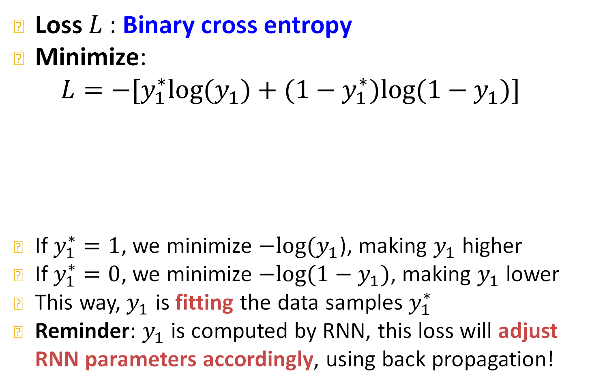


Edge-Level RNN at Training Time
Loss $L$: Binary cross entropy
Minimize:
$$L=−[y_{1}^{∗}log(y_{1})+{(1−y}_{1}^{∗})log⁡(1−y_{1})]$$
If $y_{1}^{∗}=1$, we minimize $−log{(y}_{1}$), making $y_{1}$ higher
If $y_{1}^{∗}=0$, we minimize $−log{(1−y}_{1})$, making $y_{1}$ lower
This way, $y_{1}$ is fitting the data samples $y_{1}^{∗}$
Reminder: $y_{1}$ is computed by RNN, this loss will adjust RNN parameters accordingly, using back propagation!
Compute loss
$$y_{1}^{∗}=$$
0
$$y_{1}=$$
0.9
Notes:
Put some structure in the previous slides

Slide 35
Putting Things Together
Our Plan:
Add a new node: We run Node RNN for a step, and use it output to initialize Edge RNN
Add new edges for the new node: We run Edge RNN to predict if the new node will connect to each of the previous node
Add another new node: We use the last hidden state of Edge RNN to run Node RNN for another step
Stop graph generation: If Edge RNN outputs EOS at step 1, we know no edges are connected to the new node. We stop the graph generation.
Notes:
Note: Output is in fact vector, instead of scalar. Just to simplify figure
Vector has 2 dimensions: whether connect edge, whether stop
0 1 eos

Slide 36

Put Things Together: Training
Assuming Node 1 is in the graph
Now adding Node 2
3
0 | 1 | 1
1 | 0 | 0
1 | 0 | 0
1
2
Observed graph
Node RNN
$$SOS$$
Start the node RNN
Notes:
Note: Output is in fact vector, instead of scalar. Just to simplify figure
Vector has 2 dimensions: whether connect edge, whether stop

Slide 37

Put Things Together: Training
Edge RNN predicts how
Node 2 connects to Node 1
3
0 | 1 | 1
1 | 0 | 0
1 | 0 | 0
1
2
Observed graph
0.5
Edge RNN
$$SOS$$
Will node 2 connect to node 1?
Start the edge RNN
Node RNN
$$SOS$$
Notes:
Note: Output is in fact vector, instead of scalar. Just to simplify figure
Vector has 2 dimensions: whether connect edge, whether stop
Run node RNN we get a new state vector
Teacher forcing we get the groundtruth

Slide 38
Put Things Together: Training
Update Node RNN using Edge RNN’s hidden state
3
0 | 1 | 1
1 | 0 | 0
1 | 0 | 0
1
2
Observed graph
0.5
Edge RNN
$$SOS$$
Node RNN
Node RNN
$$SOS$$
Notes:
Note: Output is in fact vector, instead of scalar. Just to simplify figure
Vector has 2 dimensions: whether connect edge, whether stop

Slide 39
Put Things Together: Training
Edge RNN predicts how Node 3 tries to connects to Nodes 1, 2
3
0 | 1 | 1
1 | 0 | 0
1 | 0 | 0
1
2
0.4
Edge RNN
1
Observed graph
Will node 3 connect to node 2?
Teacher forcing: node 3 will connect to node 1
0.5
Edge RNN
$$SOS$$
0.6
Edge RNN
$$SOS$$
Will node 3 connect to node 1?
Node RNN
Node RNN
$$SOS$$
Notes:
Note: Output is in fact vector, instead of scalar. Just to simplify figure
Vector has 2 dimensions: whether connect edge, whether stop

Slide 40
Put Things Together: Training
Update Node RNN using Edge RNN’s hidden state
3
0 | 1 | 1
1 | 0 | 0
1 | 0 | 0
1
2
0.4
Edge RNN
1
Observed graph
0.5
Edge RNN
$$SOS$$
0.6
Edge RNN
$$SOS$$
Node RNN
Node RNN
Node RNN
$$SOS$$
Notes:
Note: Output is in fact vector, instead of scalar. Just to simplify figure
Vector has 2 dimensions: whether connect edge, whether stop

Slide 41

Put Things Together: Training
Stop generation since we know node 4 won’t connect to any nodes
3
0 | 1 | 1
1 | 0 | 0
1 | 0 | 0
1
2
4
0.4
Edge RNN
1
Observed graph
$$EOS$$
0.5
Edge RNN
$$SOS$$
0.6
Edge RNN
$$SOS$$
0.4
Edge RNN
$$SOS$$
Node RNN
Node RNN
Node RNN
$$SOS$$
Notes:
Note: Output is in fact vector, instead of scalar. Just to simplify figure
Vector has 2 dimensions: whether connect edge, whether stop

Slide 42

Put Things Together: Training
For each prediction, we get supervision from the ground truth
3
0 | 1 | 1
1 | 0 | 0
1 | 0 | 0
1
2
0.4
Edge RNN
1
Observed graph
0
$$EOS$$
0.5
Edge RNN
$$SOS$$
0.6
Edge RNN
$$SOS$$
0.4
Edge RNN
$$SOS$$
1
1
Node RNN
Node RNN
Node RNN
$$SOS$$
Notes:
Note: Output is in fact vector, instead of scalar. Just to simplify figure
Vector has 2 dimensions: whether connect edge, whether stop
Loss on the prediction and the EOS

Slide 43
Put Things Together: Training
Backprop through time:
Gradients are accumulated across time steps
3
0 | 1 | 1
1 | 0 | 0
1 | 0 | 0
1
2
0.4
Edge RNN
1
Observed graph
0
$$EOS$$
0.5
Edge RNN
$$SOS$$
0.6
Edge RNN
$$SOS$$
0.4
Edge RNN
$$SOS$$
1
1
Node RNN
Node RNN
Node RNN
$$SOS$$
Notes:
Note: Output is in fact vector, instead of scalar. Just to simplify figure
Vector has 2 dimensions: whether connect edge, whether stop

Slide 44



Put Things Together: Test
Test time: (1) Sample edge connectivity based on predicted distribution
(2) Replace input at each step by GraphRNN’s own predictions
3
0 | 1 | 1
1 | 0 | 0
1 | 0 | 0
1
2
0.2
Edge RNN
0
Observed graph
$$\sim$$
0
0.9
Edge RNN
$$SOS$$
0.2
Edge RNN
$$SOS$$
0.5
Edge RNN
$$SOS$$
$$\sim$$
$$\sim$$
$$\sim$$
1
0
$$EOS$$
Node RNN
Node RNN
Node RNN
$$SOS$$
Notes:
Note: Output is in fact vector, instead of scalar. Just to simplify figure
Vector has 2 dimensions: whether connect edge, whether stop
Connect nodes 1 and 2
Node RNN does not take the output of edge RNN as an input
State vector summarizes the distribution, no need to pass the actual distribution

Slide 45
Put Things Together: Test
Test time: (1) Sample edge connectivity based on predicted distribution
(2) Replace input at each step by GraphRNN’s own predictions
3
0 | 1 | 0
1 | 0 | 0
0 | 0 | 0
1
2
0.2
Edge RNN
0
Generated graph
$$\sim$$
0
0.9
Edge RNN
$$SOS$$
0.2
Edge RNN
$$SOS$$
0.5
Edge RNN
$$SOS$$
$$\sim$$
$$\sim$$
$$\sim$$
1
0
$$EOS$$
Node RNN
Node RNN
Node RNN
$$SOS$$
Notes:
Note: Output is in fact vector, instead of scalar. Just to simplify figure
Vector has 2 dimensions: whether connect edge, whether stop
Connect nodes 1 and 2
Node RNN does not take the output of edge RNN as an input

Slide 46

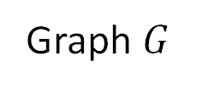
GraphRNN: Two levels of RNN
Quick Summary of GraphRNN:
  Generate a graph by generating a two-level sequence
  Use RNN to generate the sequences
Next: Making GraphRNN tractable, proper evaluation
Node-level RNN
1
3
0 | 1 | 1 | 0 | 0
1 | 0 | 0 | 1 | 0
1 | 0 | 0 | 1 | 1
0 | 1 | 1 | 0 | 1
0 | 0 | 1 | 1 | 0
$$⇔$$
Edge-level RNN
5
2
4
Graph $G$
Adjacency matrix

Slide 47
Stanford CS224W:
Scaling Up and Evaluating Graph Generation
CS224W: Machine Learning with Graphs
Jure Leskovec, Stanford University
http://cs224w.stanford.edu

Slide 48
Issue: Tractability
Any node can connect to any prior node
Too many steps for edge generation
  Need to generate full adjacency matrix
  Complex too-long edge dependencies
“Recipe” to generate the left graph:
Add node 1
Add node 2
Add node 3
Connect 3 with 2 and 1
Add node 4
…
1
3
2
5
4
Random node ordering:
Node 5 may connect to any/all previous nodes
How do we limit this complexity?
Notes:
When you are at the n-th node you need to make decisions for n-1 edges
When you are at the 5th node …
Revise bfs 2nd layer deep
1:09

Slide 49
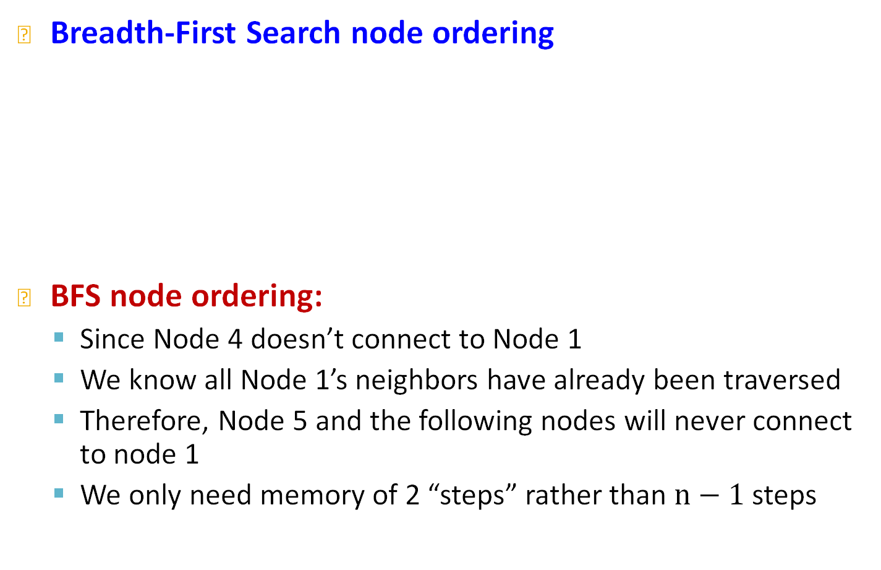
Solution: Tractability via BFS
Breadth-First Search node ordering
BFS node ordering:
  Since Node 4 doesn’t connect to Node 1
  We know all Node 1’s neighbors have already been traversed
  Therefore, Node 5 and the following nodes will never connect to node 1
  We only need memory of 2 “steps” rather than $n−1$ steps
“Recipe” to generate the left graph:
Add node 1
Add node 2
Connect 2 with 1
Add node 3
Connect 3 with 1
Add node 4
Connect 4 with 3 and 2
1
3
5
2
4
BFS ordering

Slide 50
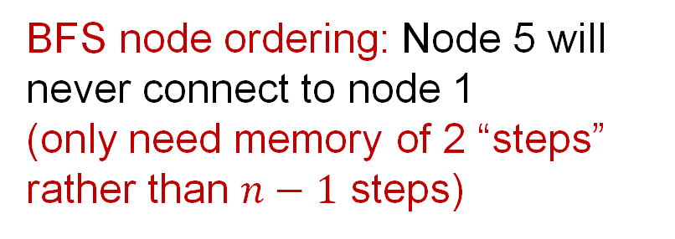
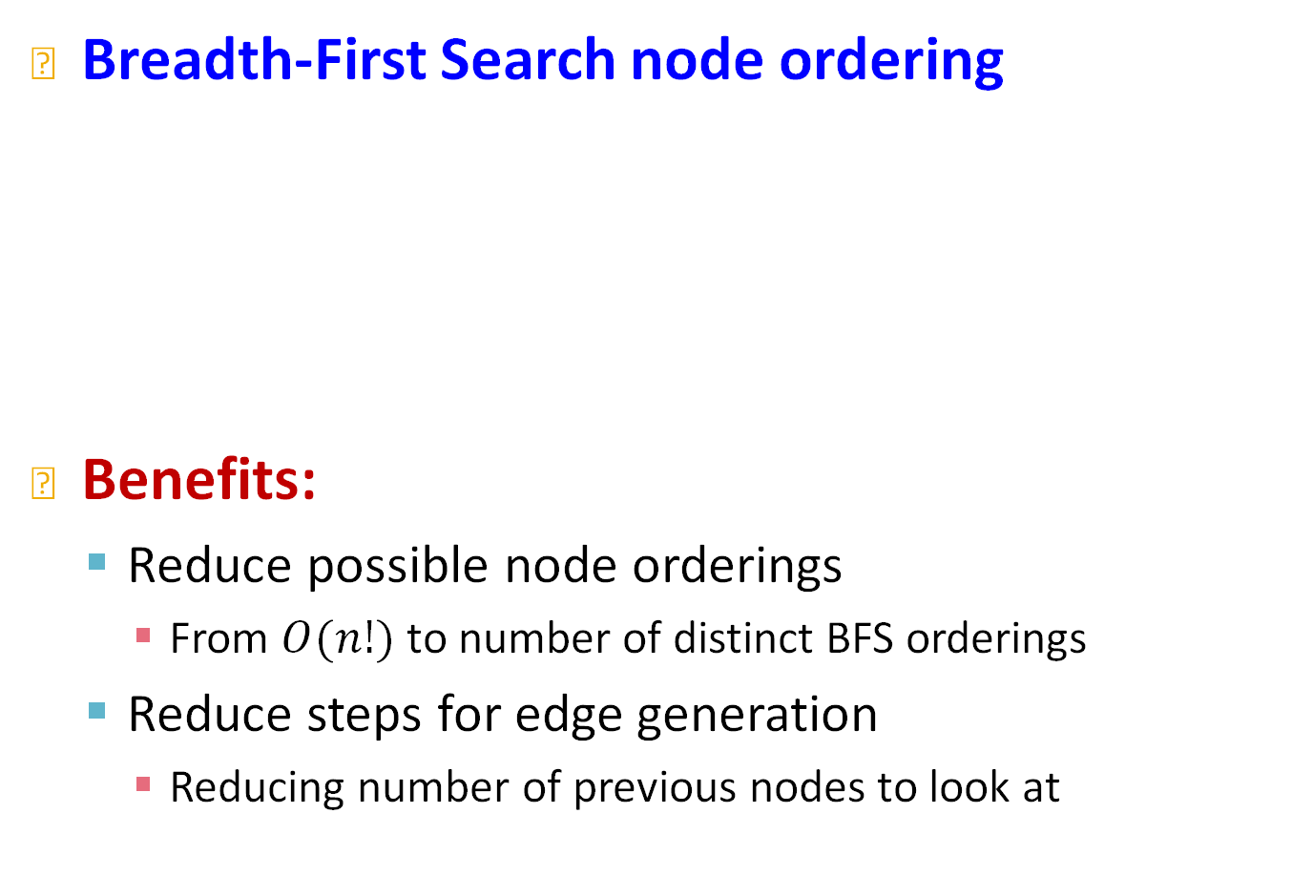
Solution: Tractability via BFS
Breadth-First Search node ordering
Benefits:
  Reduce possible node orderings
    From $O(n!)$ to number of distinct BFS orderings
  Reduce steps for edge generation
    Reducing number of previous nodes to look at
BFS node ordering: Node 5 will never connect to node 1
(only need memory of 2 “steps” rather than $n−1$ steps)
1
3
5
2
4
BFS ordering

Slide 51
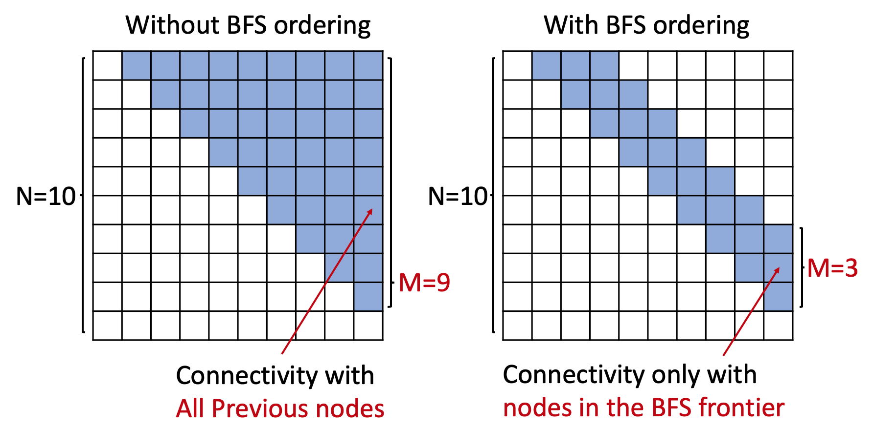
Solution: Tractability via BFS
BFS reduces the number of steps for edge generation
Adjacency matrices
Notes:
Scales linearly with the size of the graph

Slide 52
Evaluating Generated Graphs
Task: Compare two sets of graphs
Goal: Define similarity metrics for graphs
Solution
  (1) Visual similarity
  (2) Graph statistics similarity
How similar?
Notes:
Distances between graphs is harder than graph isomorphism
Distances between statistics of graphs

Slide 53
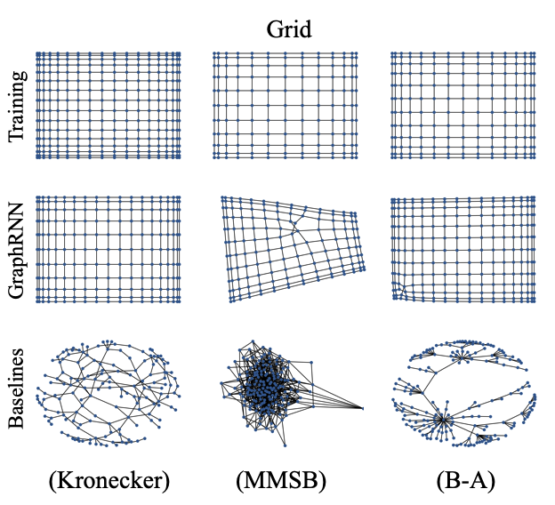
(1) Visual Similarity
Notes:
Multiple membership stochastic block model

Slide 54
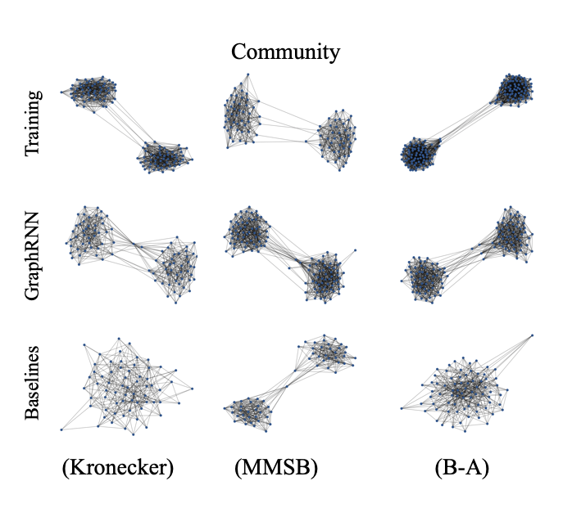
(1) Visual Similarity

Slide 55
(2) Graph statistics similarity
Can we do more rigorous comparison?
Issue: Direct comparison between two graphs is hard (isomorphism test is NP)!
Solution: Compare graph statistics!
Typical Graph Statistics:
  Degree distribution (Deg.)
  Clustering coefficient distribution (Clus.)
  Orbit count statistics (Orbit)
Note: Each statistic is a probability distribution

Slide 56
(2) Graph statistics similarity
Give more details in this section.
How is this computed.
Issue: want to compare sets of training graph statistics and generated graph statistics
Solution:
Step 1: How to compare two graph statistics
  Earth Mover Distance (EMD)
Step 2: How to compare sets of graph statistics
  Maximum Mean Discrepancy (MMD) based on EMD
How similar?

Slide 57
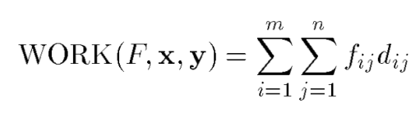
(2) Graph statistics similarity
The optimal flow is found by solving this linear optimization problem. The earth mover's distance is defined as the work normalized by the total flow:
Give more details in this section.
How is this computed: WORK(F,x,y)
And so on.
Step 1: Earth Mover Distance (EMD)
  Compare similarity between 2 distributions
  Intuition: Measure the minimum effort that move earth from one pile to the other
High EMD
Low EMD
Degree dist. x
Degree dist. y
Degree dist. x
Degree dist. y
The EMD can be solved as the optimal flow and is found by solving this linear optimization problem.
We want to find a flow F, with f_{ij} the flow between distributions x_{i} and y_{j}, that minimizes the overall cost. d_{ij} is the ground distance between x_{i} and y_{j}.

Slide 58
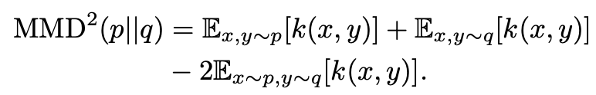

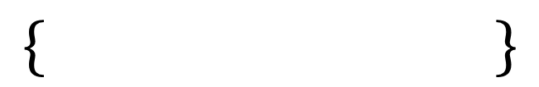

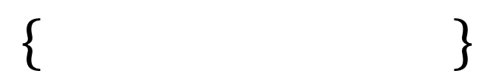

(2) Graph statistics similarity
Give more details in this section.
What is the MMD^2 formula mean?
How is this computed for our case?
Step 2: Maximum Mean Discrepancy (MMD)
  Idea of representing distances between distributions as distances between mean embeddings of feature
  Recall: We compare 2 sets of graph statistics (distributions)
$$\{2,3,5\}$$
High MMD
$$\{8,2,3\}$$
$$\{2,3,5\}$$
Low MMD
$$\{5,4,2\}$$
Similarity between set elements: L2 distance
(Each element is a scalar)
$$\{ \}$$
MMD
$$\{ \}$$
Similarity between set elements: EMD
(Each element is a distribution)

Slide 59
(2) Graph statistics similarity
Putting things together
How similar?
Compute graph statistics
Report MMD:
set distance
where similarity between set elements are computed by EMD distribution distance

Slide 60
(2) Graph statistics similarity
Example
How similar?
Compute clustering coefficient
Report MMD:
set distance
 | Erdos-Renyi | Kronecker | GraphRNN
MMD score | 1.24 | 1.67 | 0.002

Slide 61
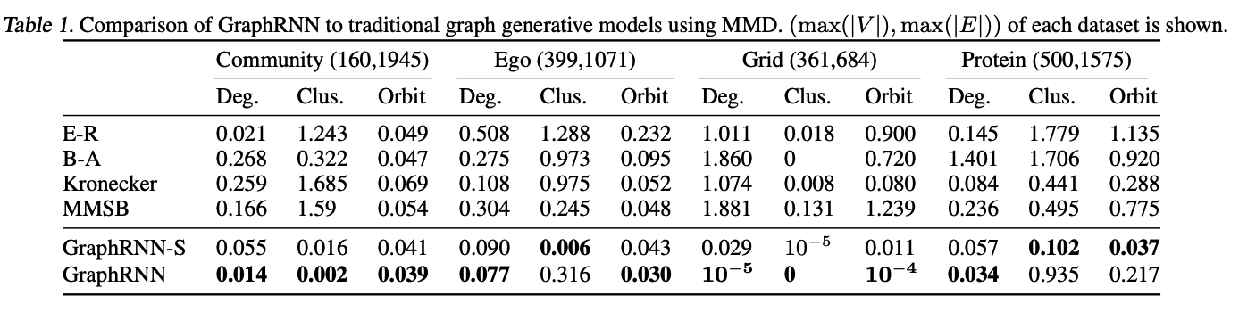
(2) Graph statistics similarity
Compared to traditional graph generative models, GraphRNN can generated graphs with statistics very close to ground-truth graphs

Slide 62
Stanford CS224W:
Application of Deep Graph Generative Models to Molecule Generation
CS224W: Machine Learning with Graphs
Jure Leskovec, Stanford University
http://cs224w.stanford.edu

Slide 63
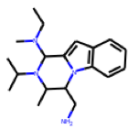
Application: Drug Discovery
[You et al., NeurIPS 2018]
Question: Can we learn a model that can generate valid and realistic molecules with optimized property scores?
Model
output
that optimizes
Property
e.g., drug_likeness=0.95
Graph Convolutional Policy Network for Goal-Directed Molecular Graph Generation. J. You, B. Liu, R. Ying, V. Pande, J. Leskovec. Neural Information Processing Systems (NeurIPS), 2018.
Notes:
Not just generating something but generating something that optimizes a property!
Chemists have a 0 1 score of how drug like a molecule is

Slide 64
Goal-Directed Graph Generation
Generating graphs that:
Optimize a given objective (High scores)
  e.g., drug-likeness
Obey underlying rules (Valid)
  e.g., chemical validity rules
Are learned from examples (Realistic)
  Imitating a molecule graph dataset
    We have just covered this part
Notes:
Objective we want to optimize, e.g., graph likeness, we want to get high scores wrt that objective
3 properties

Slide 65
The Hard Part:
Generating graphs that:
Optimize a given objective (High scores)
  e.g., drug-likeness
Obey underlying rules (Valid)
  e.g., chemical validity rules
Are learned from examples (Realistic)
  Imitating a molecule graph dataset
    Covered this part when introducing GraphRNN
Including a “Black-box” to Graph Generation:
Objectives like drug-likeness are governed by physical law which is assumed to be unknown to us.

Slide 66
Idea: Reinforcement Learning
A ML agent observes the environment, takes an action to interact with the environment, and receives positive or negative reward
The agent then learns from this loop
Key idea: Agent can directly learn from environment, which is a blackbox to the agent
ML Agent
Observation,
Reward
Action
Environment

Slide 67
Solution: GCPN
Graph Convolutional Policy Network (GCPN) combines graph representation + RL
Key component of GCPN:
Graph Neural Network captures graph structural information
Reinforcement learning guides the generation towards the desired objectives
Supervised training imitates examples in given datasets
Notes:
Two forms of training

Slide 68
GCPN vs. GraphRNN
Commonality of GCPN & GraphRNN:
  Generate graphs sequentially
  Imitate a given graph dataset
Main Differences:
  GCPN uses GNN to predict the generation action
    Pros: GNN is more expressive than RNN
    Cons: GNN takes longer time to compute than RNN
  GCPN further uses RL to direct graph generation to our goals
    RL enables goal-directed graph generation
Notes:
GNN is more expressive takes the whole graph as an input

Slide 69
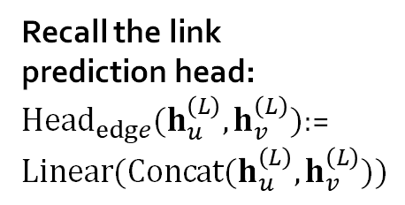
GCPN vs. GraphRNN
Sequential graph generation
GraphRNN: predict action based on RNN hidden states
GCPN: predict action based on GNN node embeddings
0
1
1
1
3
1
3
Node RNN
Edge RNN
Edge RNN
Edge RNN
2
2
4
RNN hidden state captures the generated graph so far
Recall the link prediction head:
${Head}_{edge}(h_{u}^{\left(L\right)},h_{v}^{\left(L\right)})$:= $Linear(Concat(h_{u}^{\left(L\right)},h_{v}^{\left(L\right)}))$
1
3
1
3
1
3
GNN
2
4
2
4
2
4
Node embeddings
Predict potential links using node embeddings

Slide 70
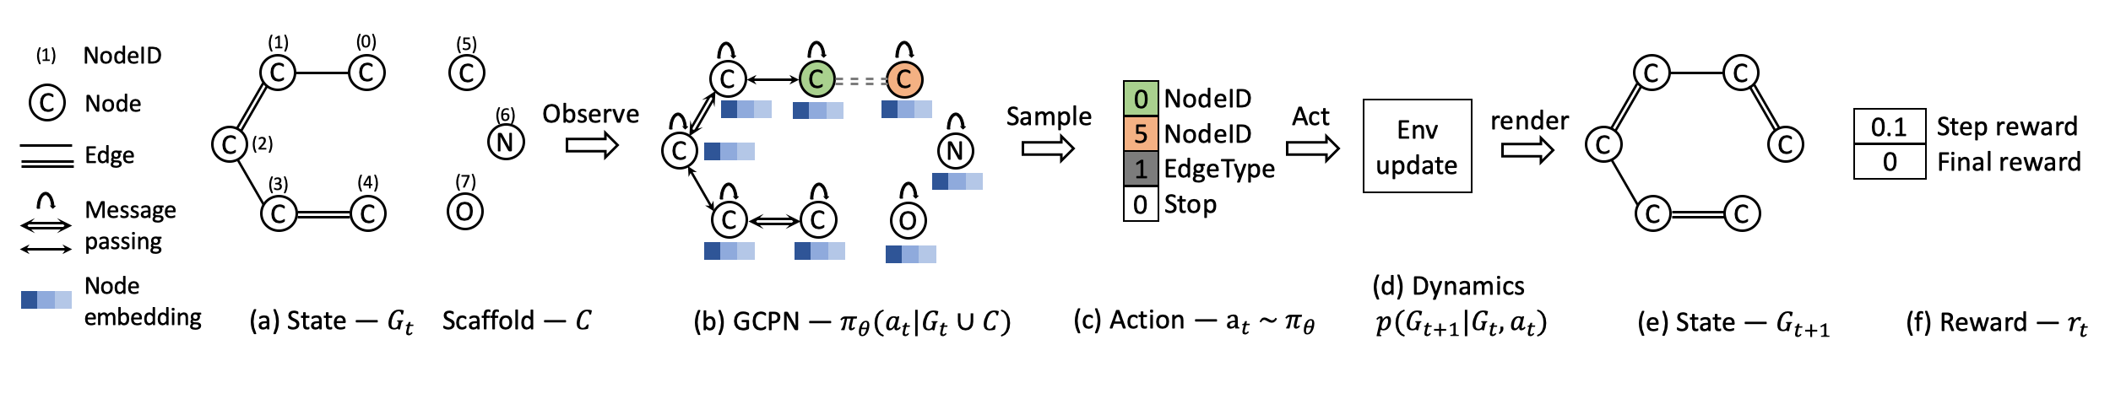
Overview of GCPN
(a) Insert nodes
(b,c) Use GNN to predict which nodes to connect
(d) Take an action (check chemical validity)
(e, f) Compute reward

Slide 71
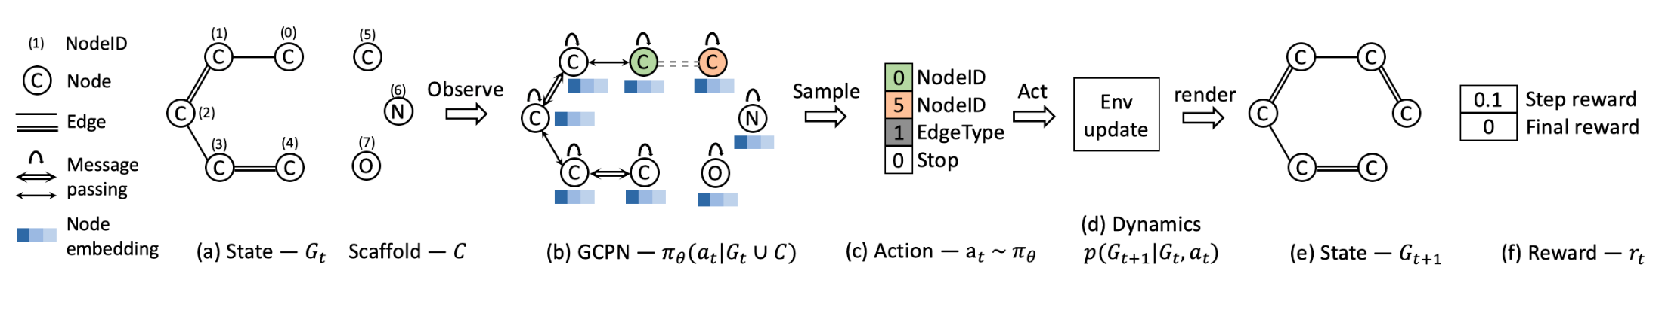
How Do We Set the Reward?
Step reward: Learn to take valid action
  At each step, assign small positive reward for valid action
Final reward: Optimize desired properties
  At the end, assign positive reward for high desired property
Reward = Final reward + Step reward

Slide 72
How Do We Train?
Two parts:
(1) Supervised training: Train policy by imitating the action given by real observed graphs. Use gradient.
  We have covered this idea in GraphRNN
(2) RL training: Train policy to optimize rewards. Use standard policy gradient algorithm.
  Refer to any RL course, e.g., CS234

Slide 73
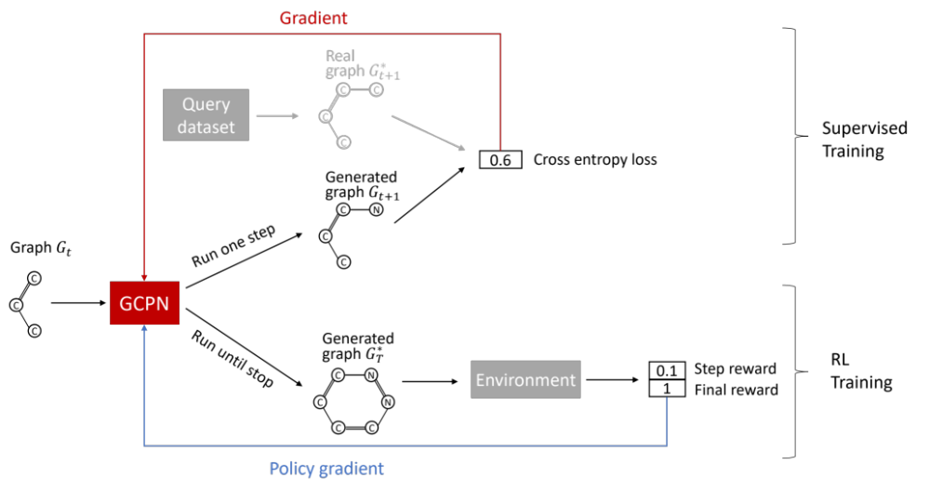
Training GCPN

Slide 74

Qualitative Results
Visualization of GCPN graphs:
Property optimization Generate molecules with high specified property score
Notes:
The first two columns are moles gen to optimize different objectives, and the third column shows how our model improve
More results are shown and
quantitative estimate of drug-likeness

Slide 75
Qualitative Results
Visualization of GCPN graphs:
Constrained optimization: Edit a given molecule for a few steps to achieve higher property score
Starting structure
Finished structure
Increase the solubility in octanol
Notes:
The first two columns are moles gen to optimize different objectives, and the third column shows how our model improve
More results are shown and

Slide 76
Summary of Graph Generation
Complex graphs can be successfully generated via sequential generation using deep learning
Each step a decision is made based on hidden state, which can be
  Implicit: vector representation, decode with RNN
  Explicit: intermediate generated graphs, decode with GCN
Possible tasks:
  Imitating a set of given graphs
  Optimizing graphs towards given goals

