Slide 1
CS276: Information Retrieval and Web Search
Christopher Manning and Pandu Nayak
Lecture 13: Support vector machines and machine learning on documents
[Borrows slides from Ray Mooney]

Slide 2
Text classification
Last lecture: Basic algorithms for text classification
  Naive Bayes classifier
    Simple, cheap, high bias, linear
  K Nearest Neighbor classification
    Simple, expensive at test time, high variance, non-linear
  Vector space classification: Rocchio
    Simple linear discriminant classifier; perhaps too simple*
Today
  Support Vector Machines (SVMs)
    Including soft margin SVMs and kernels for non-linear classifiers
  Some empirical evaluation and comparison
  Text-specific issues in classification
Notes:
*Li and Yiming Yang 2003 ICML give very good performance from Rocchio, whereas Dumais et al. don’t

Slide 3
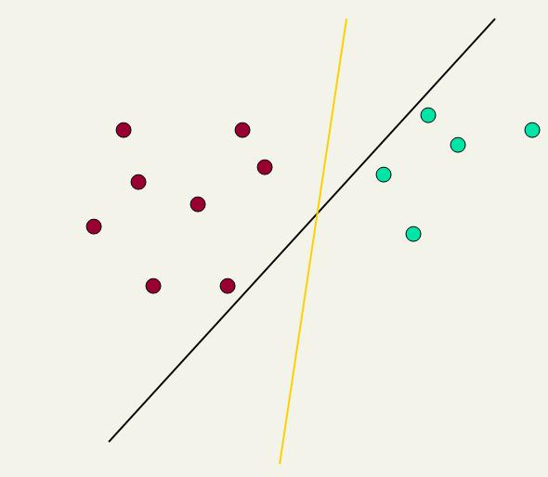
Linear classifiers
A hyperplane decision boundary
Ch. 15
Lots of possible choices for a, b, c.
Some methods find a separating hyperplane, but not the optimal one [according to some criterion of expected goodness]
  E.g., perceptron
A Support Vector Machine (SVM) finds an optimal* solution.
  Maximizes the distance between the hyperplane and the “difficult points” close to decision boundary
  One intuition: if there are no points near the decision surface, then there are no very uncertain classification decisions
    The decision boundary has a “margin”
This line represents the decision boundary:
ax + by − c = 0
Notes:
But note that Naïve Bayes also finds an optimal solution … just under a different definition of optimality. So does Rocchio.

Slide 4
Another intuition
Sec. 15.1
If you have to place a fat separator between classes, you have less choices, and so the capacity of the model has been decreased

Slide 5
Support Vector Machine (SVM)
Sec. 15.1
SVMs maximize the margin around the separating hyperplane.
    A.k.a. large margin classifiers
The decision function is fully specified by a subset of training samples, the support vectors.
Solving SVMs is a quadratic programming problem
Seen by many as the most successful current text classification method*
Support vectors
Maximizes
margin
Narrower
margin
*but other discriminative methods often perform very similarly

Slide 6
Maximum Margin: Formalization
Sec. 15.1
w: decision hyperplane normal vector
x_{i}: data point i
y_{i}: class of data point i (+1 or -1) NB: Not 1/0
Classifier is: f(x_{i}) = sign(w^{T}x_{i} + b)
Functional margin of x_{i} is: y_{i} (w^{T}x_{i} + b)
The functional margin of a dataset is twice the minimum functional margin for any point
  The factor of 2 comes from measuring the whole width of the margin
Problem: we can increase this margin simply by scaling w, b….
Notes:
Blackboard after this!

Slide 7
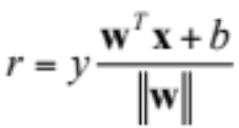
Geometric Margin
Sec. 15.1
Distance from example to the separator is
Examples closest to the hyperplane are support vectors.
Margin ρ of the separator is the width of separation between support vectors of classes.
x
ρ
Derivation of finding r:
Dotted line x’ − x is perpendicular to
decision boundary so parallel to w.
Unit vector is w/|w|, so line is rw/|w|.
x’ = x – yrw/|w|.
x’ satisfies w^{T}x’ + b = 0.
So w^{T}(x –yrw/|w|) + b = 0
Recall that |w| = sqrt(w^{T}w).
So w^{T}x –yr|w| + b = 0
So, solving for r gives:
r = y(w^{T}x + b)/|w|
r
x′
w
Notes:
Looking for distance r. Dotted line x’-x is perpendicular to decision boundary so parallel to w. Unit vector is w/|w|, so this one is rw/|w|.
x’ = x – rw/|w|. X’ satisfies wx+b = 0.
So wT(x –rw/|w|) + b = 0
Recall that |w| = sqrt(wTw). So, solving for r gives:
r = y(wTx + b)/|w|

Slide 8

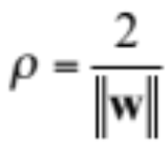
Linear SVM Mathematically
A different way of looking at things – constrain functional margin
Sec. 15.1
Assume that the functional margin of each data item is at least 1, then the following two constraints follow for a training set {(x_{i} ,y_{i})}
For support vectors, the inequality becomes an equality
Then, since each example’s distance from the hyperplane is
The margin is:
w^{T}x_{i} + b ≥ 1 if y_{i} = 1
w^{T}x_{i} + b ≤ −1 if y_{i} = −1

Slide 9
Linear Support Vector Machine (SVM)
Sec. 15.1
ρ
w^{T}x_{a} + b = 1
Hyperplane
w^{T} x + b = 0
Extra scale constraint:
min_{i=1,…,n} |w^{T}x_{i} + b| = 1
This implies:
w^{T}(x_{a}–x_{b}) = 2
ρ = ‖x_{a}–x_{b}‖₂ = 2/‖w‖₂
w^{T}x_{b} + b = -1
w^{T} x + b = 0

Slide 10
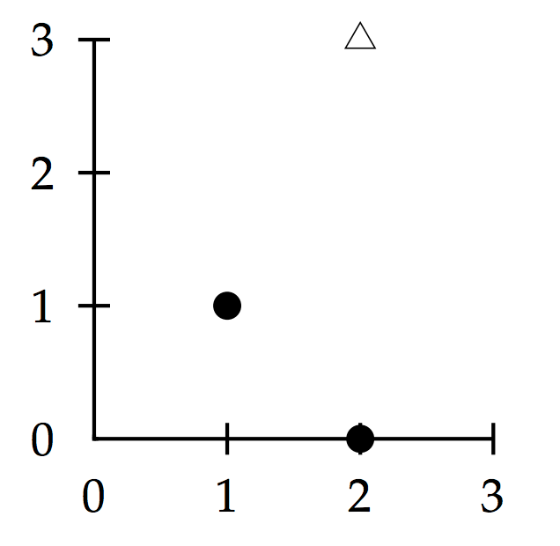
Worked example: Geometric margin
Maximum margin weight vector is parallel to line from (1, 1) to (2, 3). So weight vector is (1, 2).
Decision boundary is normal (“perpendicular”) to it halfway between.
It passes through (1.5, 2)
So y = x₁ +2x₂ − 5.5
Geometric margin is √5
Extra margin

Slide 11
Worked example: Functional margin
Let’s minimize w given that
y_{i}(w^{T}x_{i} + b) ≥ 1
Constraint has = at SVs;
w = (a, 2a) for some a
a+2a+b = −1 2a+6a+b = 1
So, a = 2/5 and b = −11/5
Optimal hyperplane is:
w = (2/5, 4/5) and b = −11/5
Margin ρ is 2/|w|
= 2/√(4/25+16/25)
= 2/(2√5/5) = √5

Slide 12
Linear SVMs Mathematically (cont.)
Sec. 15.1
We can therefore formulate the quadratic optimization problem:
A better formulation (min ‖w‖= max 1/‖w‖ ):
Find w and b such that
is maximized; and for all {(x_{i} , y_{i})}
w^{T}x_{i} + b ≥ 1 if y_{i}=1; w^{T}x_{i} + b ≤ −1 if y_{i} = −1
Find w and b such that
Φ(w) =½ w^{T}w is minimized;
and for all {(x_{i} ,y_{i})}: y_{i} (w^{T}x_{i} + b) ≥ 1

Slide 13
Solving the Optimization Problem
Sec. 15.1
This is now optimizing a quadratic function subject to linear constraints
Quadratic optimization problems are a well-known class of mathematical programming problem, and many (intricate) algorithms exist for solving them (with many special ones built for SVMs: SMO, Pegasos, …)
The solution usually involves constructing a dual problem where a Lagrange multiplier α_{i} is associated with every constraint in the primary problem:
Find w and b such that
Φ(w) =½ w^{T}w is minimized;
and for all {(x_{i} ,y_{i})}: y_{i} (w^{T}x_{i} + b) ≥ 1
Find α₁…α_{N} such that
Q(α) =Σα_{i} - ½ΣΣα_{i}α_{j}y_{i}y_{j}x_{i}^{T}x_{j} is maximized and
(1) Σα_{i}y_{i} = 0
(2) α_{i} ≥ 0 for all α_{i}

Slide 14
The Optimization Problem Solution
Sec. 15.1
The solution has the form:
Each non-zero α_{i} indicates that corresponding x_{i} is a support vector.
Then the classifying function will have the form:
Notice that it relies on an inner product between the test point x and the support vectors x_{i}
  We will return to this later.
Also keep in mind that solving the optimization problem involved computing the inner products x_{i}^{T}x_{j} between all pairs of training points.
w = Σα_{i}y_{i}x_{i} b = y_{k}- w^{T}x_{k} for any x_{k} such that α_{k} ≠ 0
f(x) = Σα_{i}y_{i}x_{i}^{T}x + b

Slide 15
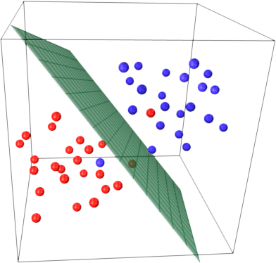
Three dimensions … almost separating

Slide 16
Soft Margin Classification
Sec. 15.2.1
If the training data is not linearly separable, slack variables ξ_{i} can be added to allow misclassification of difficult or noisy examples.
Allow some errors
  Let some points be moved to where they belong, at a cost
Still, try to minimize training set errors, and to place hyperplane “far” from each class (large margin)
ξ_{i}
ξ_{j}
Notes:
Note that you have to not only get over the line but to the margin

Slide 17
Soft Margin Classification Mathematically
Sec. 15.2.1
The old formulation:
The new formulation incorporating slack variables:
Parameter C can be viewed as a way to control overfitting
  A regularization term
Find w and b such that
Φ(w) =½ w^{T}w is minimized and for all {(x_{i} ,y_{i})}
y_{i} (w^{T}x_{i} + b) ≥ 1
Find w and b such that
Φ(w) =½ w^{T}w + CΣξ_{i} is minimized and for all {(x_{i} ,y_{i})}
y_{i} (w^{T}x_{i} + b) ≥ 1 − ξ_{i} and ξ_{i} ≥ 0 for all i

Slide 18
Soft Margin Classification – Solution
Sec. 15.2.1
The dual problem for soft margin classification:
Neither slack variables ξ_{i} nor their Lagrange multipliers appear in the dual problem!
Again, x_{i} with non-zero α_{i} will be support vectors.
Solution to the dual problem is:
Find α₁…α_{N} such that
Q(α) =Σα_{i} - ½ΣΣα_{i}α_{j}y_{i}y_{j}x_{i}^{T}x_{j} is maximized and
(1) Σα_{i}y_{i} = 0
(2) 0 ≤ α_{i} ≤ C for all α_{i}
w is not needed explicitly for classification!
w = Σα_{i}y_{i}x_{i}
b = y_{k}(1- ξ_{k}) - w^{T}x_{k} where k = argmax α_{k’}
k’
f(x) = Σα_{i}y_{i}x_{i}^{T}x + b

Slide 19
Classification with SVMs
Sec. 15.1
Given a new point x, we can score its projection onto the hyperplane normal:
  I.e., compute score: w^{T}x + b = Σα_{i}y_{i}x_{i}^{T}x + b
    Decide class based on whether < or > 0
  Can set confidence threshold t.
Score > t: yes
Score < -t: no
Else: don’t know
1
0
-1

Slide 20
Linear SVMs: Summary
Sec. 15.2.1
The classifier is a separating hyperplane.
The “important” training points are the support vectors; they define the hyperplane.
Quadratic optimization algorithms can identify which training points x_{i} are support vectors with non-zero Lagrangian multipliers α_{i}.
Both in the dual formulation of the problem and in the solution, training points appear only inside inner products:
Find α₁…α_{N} such that
Q(α) =Σα_{i} - ½ΣΣα_{i}α_{j}y_{i}y_{j}x_{i}^{T}x_{j} is maximized and
(1) Σα_{i}y_{i} = 0
(2) 0 ≤ α_{i} ≤ C for all α_{i}
f(x) = Σα_{i}y_{i}x_{i}^{T}x + b

Slide 21
Non-linear SVMs
Sec. 15.2.3
Datasets that are linearly separable (with some noise) work out great:
But what are we going to do if the dataset is just too hard?
How about … mapping data to a higher-dimensional space:
0
x
0
x
x²
0
x

Slide 22
Non-linear SVMs: Feature spaces
Sec. 15.2.3
General idea: the original feature space can be mapped to some higher-dimensional feature space where the training set is separable:
Φ: x → φ(x)

Slide 23
The “Kernel Trick”
Sec. 15.2.3
The linear classifier relies on an inner product between vectors K(x_{i},x_{j})=x_{i}^{T}x_{j}
If every datapoint is mapped into a high-dimensional space via some transformation Φ: x → φ(x), the inner product becomes:
K(x_{i},x_{j})= φ(x_{i}) ^{T}φ(x_{j})
A kernel function is some function K that corresponds to an inner product in some expanded feature space.
Example:
2-dimensional vectors x=[x₁ x₂]; let K(x_{i},x_{j})=(1 + x_{i}^{T}x_{j})²,
Need to show that K(x_{i},x_{j})= φ(x_{i}) ^{T}φ(x_{j}):
K(x_{i},x_{j}) = (1 + x_{i}^{T}x_{j})²,= 1+ x_{i1}²x_{j1}² + 2 x_{i1}x_{j1} x_{i2}x_{j2}+ x_{i2}²x_{j2}² + 2x_{i1}x_{j1} + 2x_{i2}x_{j2} =
= [1 x_{i1}² √2 x_{i1}x_{i2} x_{i2}² √2x_{i1} √2x_{i2}]^{T} [1 x_{j1}² √2 x_{j1}x_{j2} x_{j2}² √2x_{j1} √2x_{j2}]
= φ(x_{i}) ^{T}φ(x_{j}) where φ(x) = [1 x₁² √2 x₁x₂ x₂² √2x₁ √2x₂]

Slide 24

Kernels
Sec. 15.2.3
Why use kernels?
  Make non-separable problem separable.
  Map data into a better representational space
Common kernels
  Linear
  Polynomial K(x,z) = (1+x^{T}z)^{d}
    Gives feature conjunctions
  Radial basis function (balls – infinite dimensional space)
Haven’t been very useful in text classification

Slide 25
Text Classification Evaluation:
Classic Reuters-21578 Data Set
Sec. 15.2.4
Most (over)used data set
21578 documents
9603 training, 3299 test articles (ModApte/Lewis split)
118 categories
  An article can be in more than one category
  Learn 118 binary category distinctions
Average document: about 90 types, 200 tokens
Average number of classes assigned
  1.24 for docs with at least one category
Only about 10 out of 118 categories are large
Common categories
(#train, #test)
Earn (2877, 1087)
Acquisitions (1650, 179)
Money-fx (538, 179)
Grain (433, 149)
Crude (389, 189)
Trade (369,119)
Interest (347, 131)
Ship (197, 89)
Wheat (212, 71)
Corn (182, 56)

Slide 26
Reuters Text Categorization data set (Reuters-21578) document
Sec. 15.2.4
<REUTERS TOPICS="YES" LEWISSPLIT="TRAIN" CGISPLIT="TRAINING-SET" OLDID="12981" NEWID="798">
<DATE> 2-MAR-1987 16:51:43.42</DATE>
<TOPICS><D>livestock</D><D>hog</D></TOPICS>
<TITLE>AMERICAN PORK CONGRESS KICKS OFF TOMORROW</TITLE>
<DATELINE> CHICAGO, March 2 - </DATELINE><BODY>The American Pork Congress kicks off tomorrow, March 3, in Indianapolis with 160 of the nations pork producers from 44 member states determining industry positions on a number of issues, according to the National Pork Producers Council, NPPC.
Delegates to the three day Congress will be considering 26 resolutions concerning various issues, including the future direction of farm policy and the tax law as it applies to the agriculture sector. The delegates will also debate whether to endorse concepts of a national PRV (pseudorabies virus) control and eradication program, the NPPC said.
A large trade show, in conjunction with the congress, will feature the latest in technology in all areas of the industry, the NPPC added. Reuter
&#3;</BODY></TEXT></REUTERS>

Slide 27
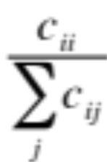
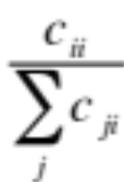
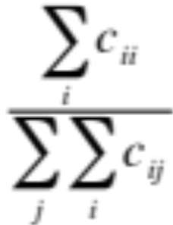
Per class evaluation measures
Sec. 15.2.4
Recall: Fraction of docs in class i classified correctly:
Precision: Fraction of docs assigned class i that are actually about class i:
Accuracy: (1 - error rate) Fraction of docs classified correctly:

Slide 28
Micro- vs. Macro-Averaging
Sec. 15.2.4
If we have more than one class, how do we combine multiple performance measures into one quantity?
Macroaveraging: Compute performance for each class, then average.
Microaveraging: Collect decisions for all classes, compute contingency table, evaluate.

Slide 29
Micro- vs. Macro-Averaging: Example
Sec. 15.2.4
Class 1
Class 2
Micro Ave. Table
 | Truth: yes | Truth: no
Classifier: yes | 10 | 10
Classifier: no | 10 | 970
 | Truth: yes | Truth: no
Classifier: yes | 90 | 10
Classifier: no | 10 | 890
 | Truth: yes | Truth: no
Classifier: yes | 100 | 20
Classifier: no | 20 | 1860
Macroaveraged precision: (0.5 + 0.9)/2 = 0.7
Microaveraged precision: 100/120 = .83
Microaveraged score is dominated by score on common classes

Slide 30
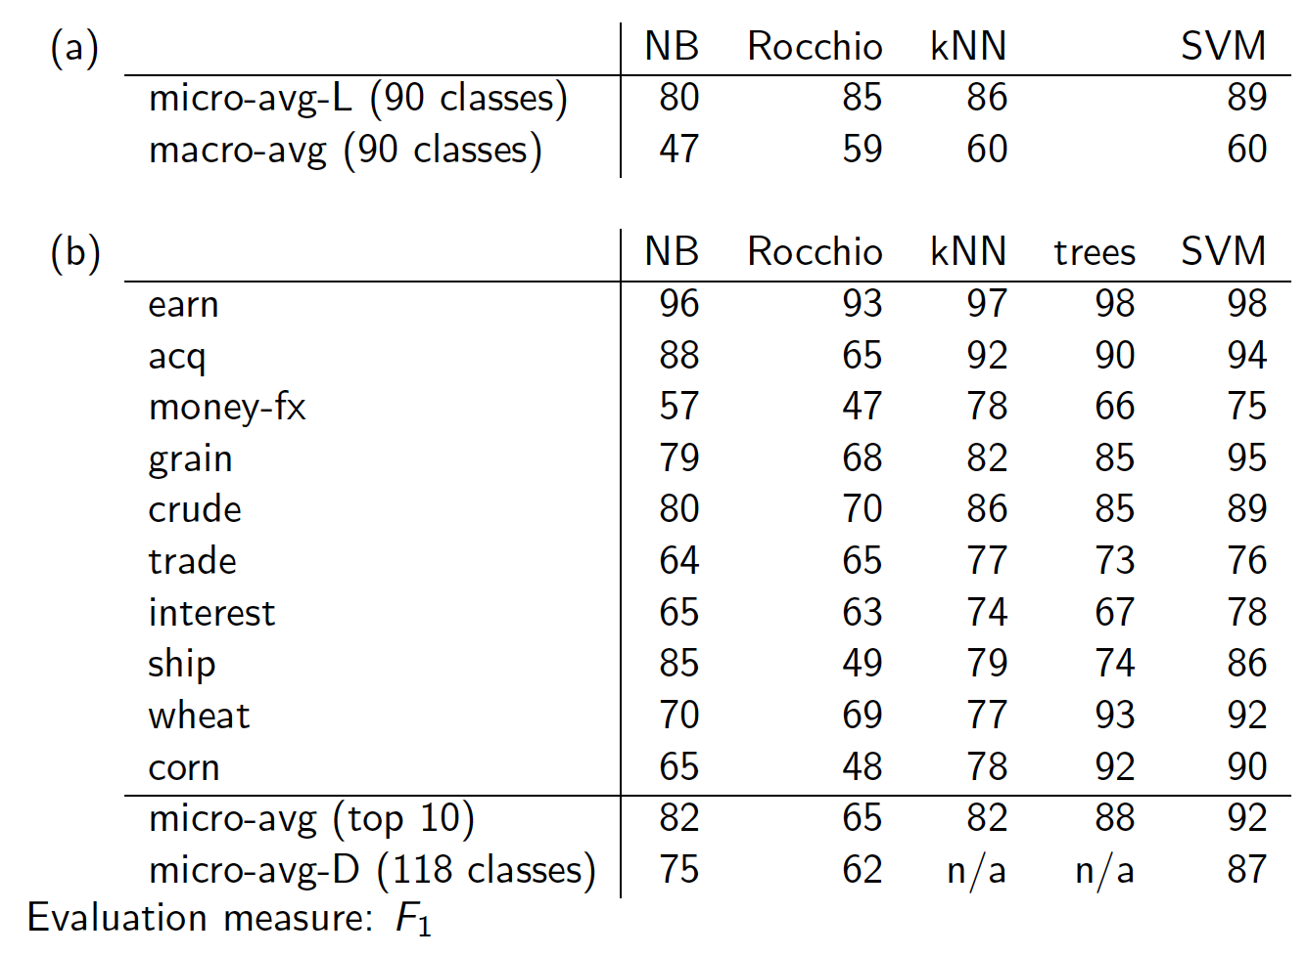
Sec. 15.2.4
Notes:
Top numbers Li and Yang 2003, bottom Joachims 1998 or Dumais et al 1998

Slide 31
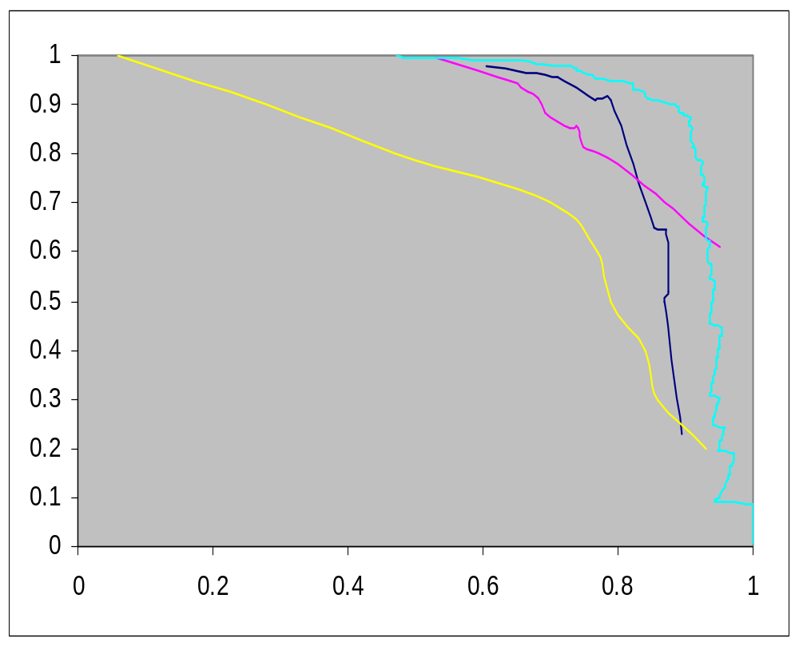
Precision-recall for category: Crude
Recall
LSVM
Decision Tree Naïve Bayes
Rocchio
Dumais (1998)
Precision

Slide 32
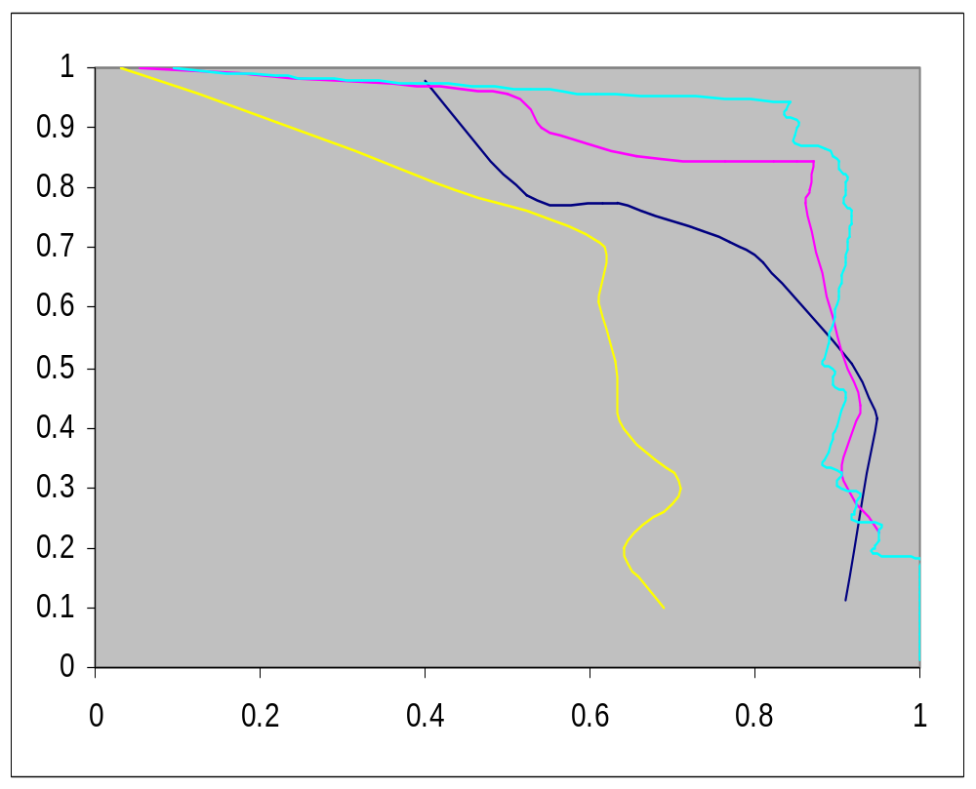
Precision-recall for category: Ship
Sec. 15.2.4
Recall
LSVM
Decision Tree Naïve Bayes
Rocchio
Dumais (1998)
Precision

Slide 33
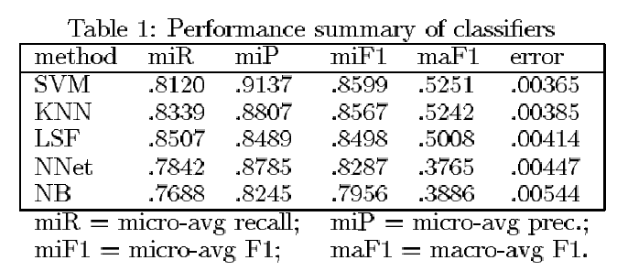
Yang&Liu: SVM vs. Other Methods
Sec. 15.2.4

Slide 34
Good practice department:
Make a confusion matrix
Sec. 15.2.4
This (i, j) entry means 53 of the docs actually in
class i were put in class j by the classifier.
Class assigned by classifier
Actual Class
53
In a perfect classification, only the diagonal has non-zero entries
Look at common confusions and how they might be addressed

Slide 35
The Real World
Sec. 15.3
P. Jackson and I. Moulinier. 2002. Natural Language Processing for Online Applications
“There is no question concerning the commercial value of being able to classify documents automatically by content. There are myriad potential applications of such a capability for corporate intranets, government departments, and Internet publishers”
“Understanding the data is one of the keys to successful categorization, yet this is an area in which most categorization tool vendors are extremely weak. Many of the ‘one size fits all’ tools on the market have not been tested on a wide range of content types.”

Slide 36
The Real World
Sec. 15.3.1
Gee, I’m building a text classifier for real, now!
What should I do?
How much training data do you have?
  None
  Very little
  Quite a lot
  A huge amount and its growing
Notes:
Only got up to here in 2017! Move some stuff from this lecture to the last lecture?

Slide 37
Manually written rules
Sec. 15.3.1
No training data, adequate editorial staff?
Never forget the hand-written rules solution!
  If (wheat or grain) and not (whole or bread) then
    Categorize as grain
In practice, rules get a lot bigger than this
  Can also be phrased using tf or tf.idf weights
With careful crafting (human tuning on development data) performance is high:
  Construe: 94% recall, 84% precision over 675 categories (Hayes and Weinstein IAAI 1990)
Amount of work required is huge
  Estimate 2 days per class … plus maintenance

Slide 38
Very little data?
Sec. 15.3.1
If you’re just doing supervised classification, you should stick to something high bias
  There are theoretical results that Naïve Bayes should do well in such circumstances (Ng and Jordan 2002 NIPS)
The interesting theoretical answer is to explore semi-supervised training methods:
  Bootstrapping, EM over unlabeled documents, …
The practical answer is to get more labeled data as soon as you can
  How can you insert yourself into a process where humans will be willing to label data for you??

Slide 39
A reasonable amount of data?
Sec. 15.3.1
Perfect!
We can use all our clever classifiers
Roll out the SVM!
But if you are using an SVM/NB etc., you should probably be prepared with the “hybrid” solution where there is a Boolean overlay
  Or else to use user-interpretable Boolean-like models like decision trees
  Users like to hack, and management likes to be able to implement quick fixes immediately

Slide 40
A huge amount of data?
Sec. 15.3.1
This is great in theory for doing accurate classification…
But it could easily mean that expensive methods like SVMs (train time) or kNN (test time) are less practical
Naïve Bayes can come back into its own again!
  Or other methods with linear training/test complexity like (regularized) logistic regression (though much more expensive to train)

Slide 41
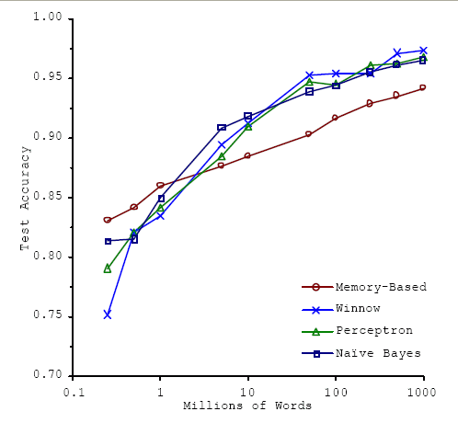
Accuracy as a function of data size
Sec. 15.3.1
With enough data the choice of classifier may not matter much, and the best choice may be unclear
  Data: Brill and Banko on context-sensitive spelling correction
But the fact that you have to keep doubling your data to improve performance is a little unpleasant

Slide 42
How many categories?
Sec. 15.3.2
A few (well separated ones)?
  Easy!
A zillion closely related ones?
  Think: Yahoo! Directory, Library of Congress classification, legal applications
  Quickly gets difficult!
    Classifier combination is always a useful technique
      Voting, bagging, or boosting multiple classifiers
    Much literature on hierarchical classification
      Mileage fairly unclear, but helps a bit (Tie-Yan Liu et al. 2005)
      Definitely helps for scalability, even if not in accuracy
    May need a hybrid automatic/manual solution

Slide 43
How can one tweak performance?
Sec. 15.3.2
Aim to exploit any domain-specific useful features that give special meanings or that zone the data
  E.g., an author byline or mail headers
Aim to collapse things that would be treated as different but shouldn’t be.
  E.g., part numbers, chemical formulas
Does putting in “hacks” help?
  You bet!
    Feature design and non-linear weighting is very important in the performance of real-world systems

Slide 44
Upweighting
Sec. 15.3.2
You can get a lot of value by differentially weighting contributions from different document zones:
That is, you count as two instances of a word when you see it in, say, the abstract
  Upweighting title words helps (Cohen & Singer 1996)
    Doubling the weighting on the title words is a good rule of thumb
  Upweighting the first sentence of each paragraph helps (Murata, 1999)
  Upweighting sentences that contain title words helps (Ko et al, 2002)

Slide 45
Two techniques for zones
Sec. 15.3.2
Have a completely separate set of features/parameters for different zones like the title
Use the same features (pooling/tying their parameters) across zones, but upweight the contribution of different zones
Commonly the second method is more successful: it costs you nothing in terms of sparsifying the data, but can give a very useful performance boost
    Which is best is a contingent fact about the data

Slide 46
Text Summarization techniques in text classification
Sec. 15.3.2
Text Summarization: Process of extracting key pieces from text, normally by features on sentences reflecting position and content
Much of this work can be used to suggest weightings for terms in text categorization
    See: Kolcz, Prabakarmurthi, and Kalita, CIKM 2001: Summarization as feature selection for text categorization
  Categorizing with title,
  Categorizing with first paragraph only
  Categorizing with paragraph with most keywords
  Categorizing with first and last paragraphs, etc.

Slide 47
Does stemming/lowercasing/… help?
Sec. 15.3.2
As always, it’s hard to tell, and empirical evaluation is normally the gold standard
But note that the role of tools like stemming is rather different for TextCat vs. IR:
  For IR, you often want to collapse forms of the verb oxygenate and oxygenation, since all of those documents will be relevant to a query for oxygenation
  For TextCat, with sufficient training data, stemming does no good. It only helps in compensating for data sparseness (which can be severe in TextCat applications). Overly aggressive stemming can easily degrade performance.

Slide 48
Measuring Classification
Figures of Merit
Not just accuracy; in the real world, there are economic measures:
  Your choices are:
    Do no classification
      That has a cost (hard to compute)
    Do it all manually
      Has an easy-to-compute cost if you’re doing it like that now
    Do it all with an automatic classifier
      Mistakes have a cost
    Do it with a combination of automatic classification and manual review of uncertain/difficult/”new” cases
  Commonly the last method is cost efficient and is adopted
    With more theory and Turkers: Werling, Chaganty, Liang, and Manning (2015). On-the-Job Learning with Bayesian Decision Theory. http://arxiv.org/abs/1506.03140
Notes:
This is the slide I got to in 2015. SHORTEN!

Slide 49
A common problem: Concept Drift
Categories change over time
Example: “president of the united states”
  1999: clinton is great feature
  2010: clinton is bad feature
One measure of a text classification system is how well it protects against concept drift.
  Favors simpler models like Naïve Bayes
Feature selection: can be bad in protecting against concept drift

Slide 50
Summary
Support vector machines (SVM)
  Choose hyperplane based on support vectors
    Support vector = “critical” point close to decision boundary
  (Degree-1) SVMs are linear classifiers.
  Kernels: powerful and elegant way to define similarity metric
  Perhaps best performing text classifier
    But there are other methods that perform about as well as SVM, such as regularized logistic regression (Zhang & Oles 2001)
  Partly popular due to availability of good software
    SVMlight is accurate and fast – and free (for research)
    Now lots of good software: libsvm, TinySVM, scikit-learn, ….
Comparative evaluation of methods
Real world: exploit domain specific structure!

Slide 51
Resources for today’s lecture
Ch. 15
Christopher J. C. Burges. 1998. A Tutorial on Support Vector Machines for Pattern Recognition
S. T. Dumais. 1998. Using SVMs for text categorization, IEEE Intelligent Systems, 13(4)
Yiming Yang, Xin Liu. 1999. A re-examination of text categorization methods. 22nd Annual International SIGIR
Tong Zhang, Frank J. Oles. 2001. Text Categorization Based on Regularized Linear Classification Methods. Information Retrieval 4(1): 5-31
Trevor Hastie, Robert Tibshirani and Jerome Friedman. Elements of Statistical Learning: Data Mining, Inference and Prediction. Springer-Verlag, New York.
T. Joachims, Learning to Classify Text using Support Vector Machines. Kluwer, 2002.
Fan Li, Yiming Yang. 2003. A Loss Function Analysis for Classification Methods in Text Categorization. ICML 2003: 472-479.
Tie-Yan Liu, Yiming Yang, Hao Wan, et al. 2005. Support Vector Machines Classification with Very Large Scale Taxonomy, SIGKDD Explorations, 7(1): 36-43.
‘Classic’ Reuters-21578 data set: http://www.daviddlewis.com/resources/testcollections/reuters21578/
Notes:
Put in recent SVM work!

