Slide 1
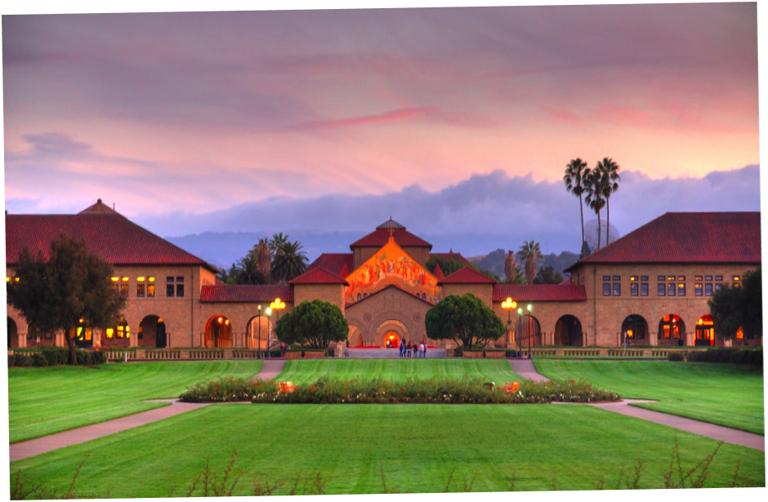
Retrieval Augmented Generative AI
BIODS 271 / CS 277
Tanveer Syeda-Mahmood

Slide 2
Topics
Deployment considerations for foundational models
Types of training
The RAG paradigm
Variations within the RAG paradigm
  Search-based methods
  Vector search methods
  ML methods
  Multimodal RAG
Explanation of assignment

Slide 3
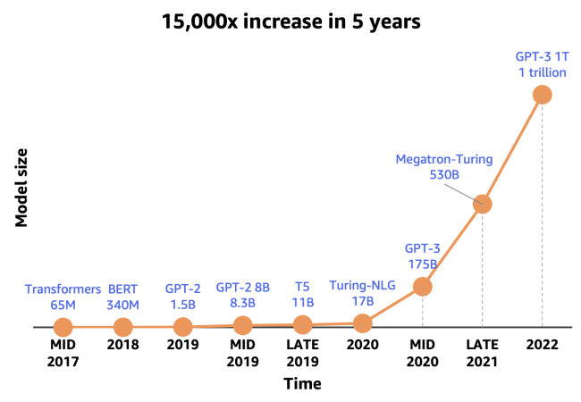
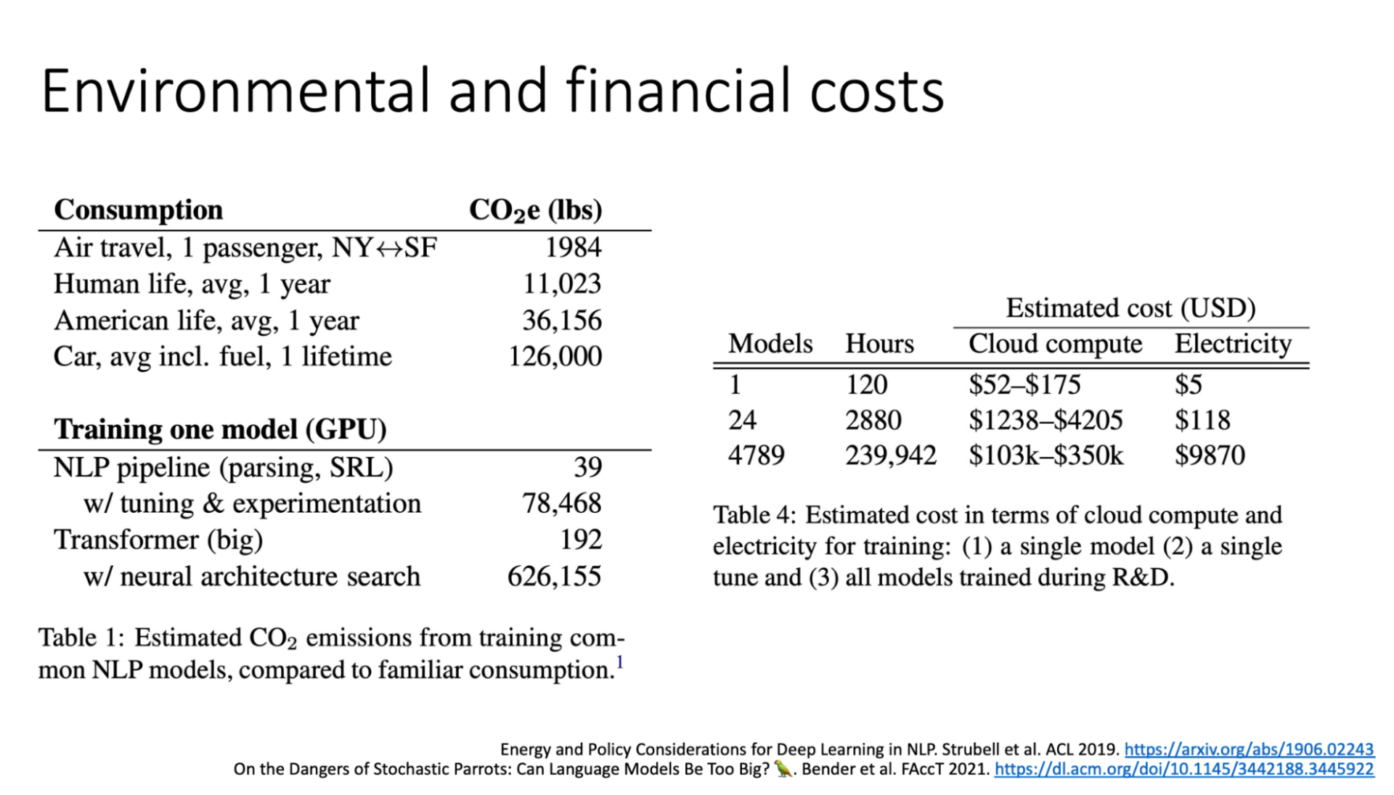
Deploying Considerations for Foundational Models
https://neptune.ai/blog/nlp-models-infrastructure-cost-optimization
High computational requirements
  High throughput, low latency affected by:
    Question complexity of the question, response length
    E.g. GPT-3 needs a minimum of 16GB GPU memory
Storage capacity:
  Multiple copies of the whole model in a single storage device is difficult
  Distributed inference is needed
Bandwidth requirements pos problems
Energy consumption can be huge
Cost
Notes:
running cost of the chatGPT is around $100,000 per day or $3M per month.
OpenAI’s GPT-3 model, with 175B parameters, requires over 300GB of storage
A100 ->6,912 CUDA cores, 432 tensor cores, and 40 GB or 80 GB of high-bandwidth memory (HBM2)
The H100 GPU features 640 Tensor Cores and 128 RT Cores, providing high-speed processing of complex data sets. I
t also features 80 Streaming Multiprocessors (SMs) and 18,432 CUDA cores, delivering up to 10.6 teraflops of single-precision performance and 5.3 teraflops of double-precision performance.

Slide 4
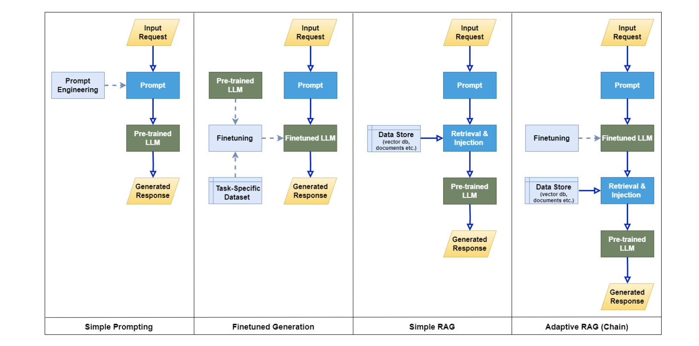
Using Foundational Models
  Given a foundation model deployed on cloud, will it work for your problem as is?
  Pre-training
    Usually done by large providers
  Fine-tuning
    Further training a pre-trained model on a task specific dataset for downstream task
    Exploits domain-specific context, but cannot easily expand or revise
  Prompt engineering
    Instructional prompting
    Chain of thought prompting
    Auto-prompt generation
    Ensures prompts optimized to help the model understand the intent and context of the request.
  RAG
    Anchors the generation on factual and time relevant information, along with information source transparency.
Notes:
In simple terms, pre-training a neural network refers to first training a model on one task or dataset. Then using the parameters or model from this training to train another model on a different task or dataset.

Slide 5
Retrieval augmented generation
Practical approach to improve the model response with latest onsite knowledge
Minimizes hallucinations
Time-relevant
Increases transparency and gives traceable reasoning
Cost-effective way to deploy models
Pivotal technology for chatbots and practical applications.

Slide 6
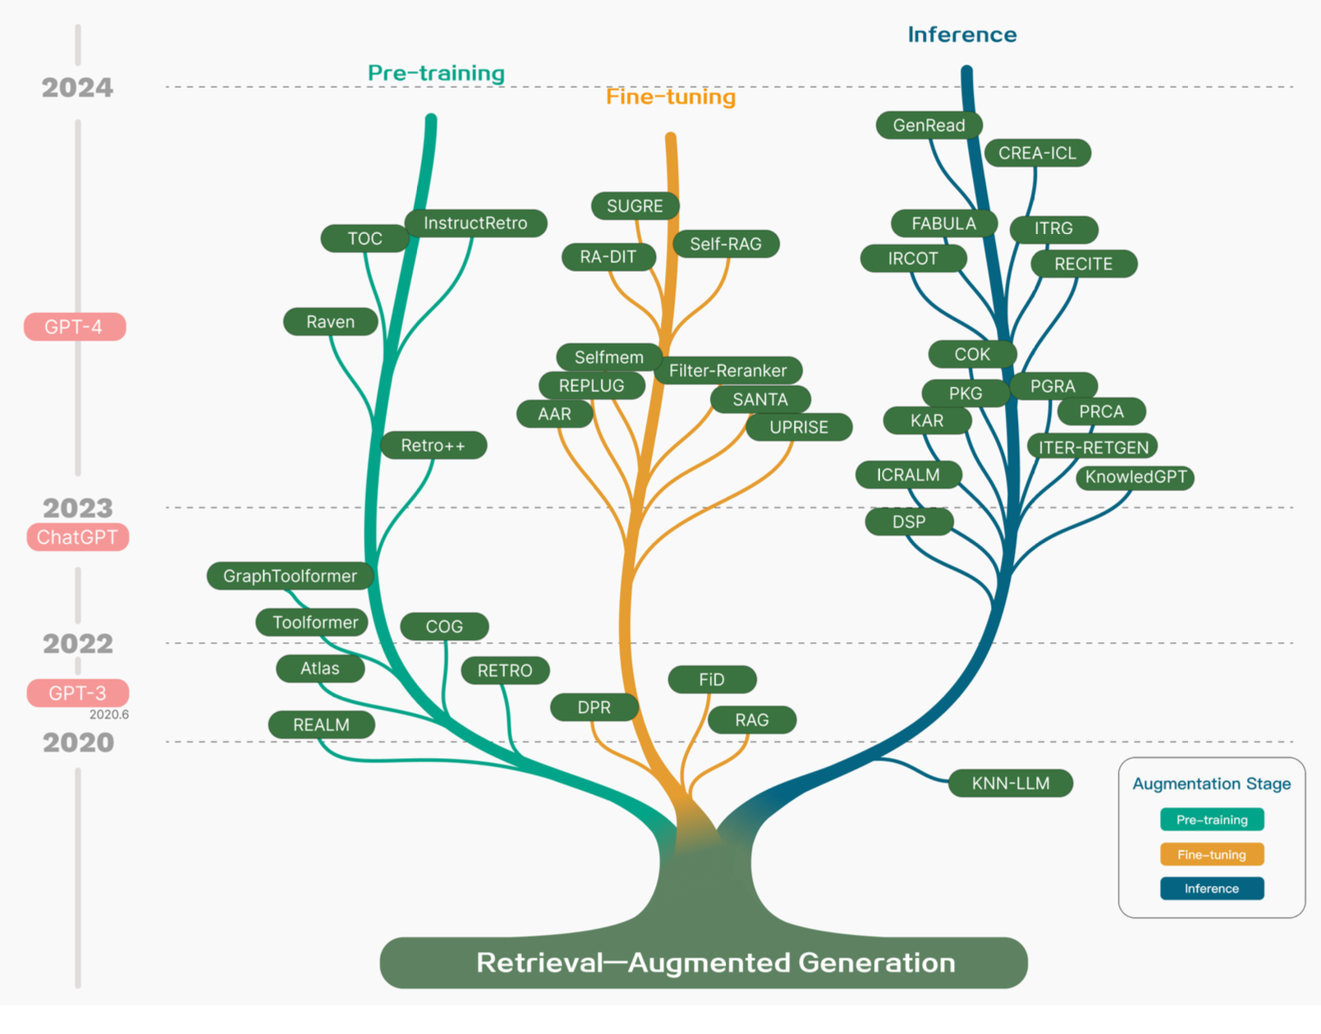
Evolution of RAG
Pre-training (MLM, Seq2Seq)
Inference
RAG + fine-tuning

Slide 7
Retrieval augmented generation
2 Key steps
  External Data Retrieval
  Response Generation
Types of RAG
  Naïve RAG
  Advanced RAG
  Modular RAG
  Multimodal RAG
Retrieval-Augmented Generation for Large Language Models: A Survey, Jan 2024
Notes:
Retrieval-Augmented Generation for Large Language Models: A Survey
https://arxiv.org/abs/2312.10997

Slide 8
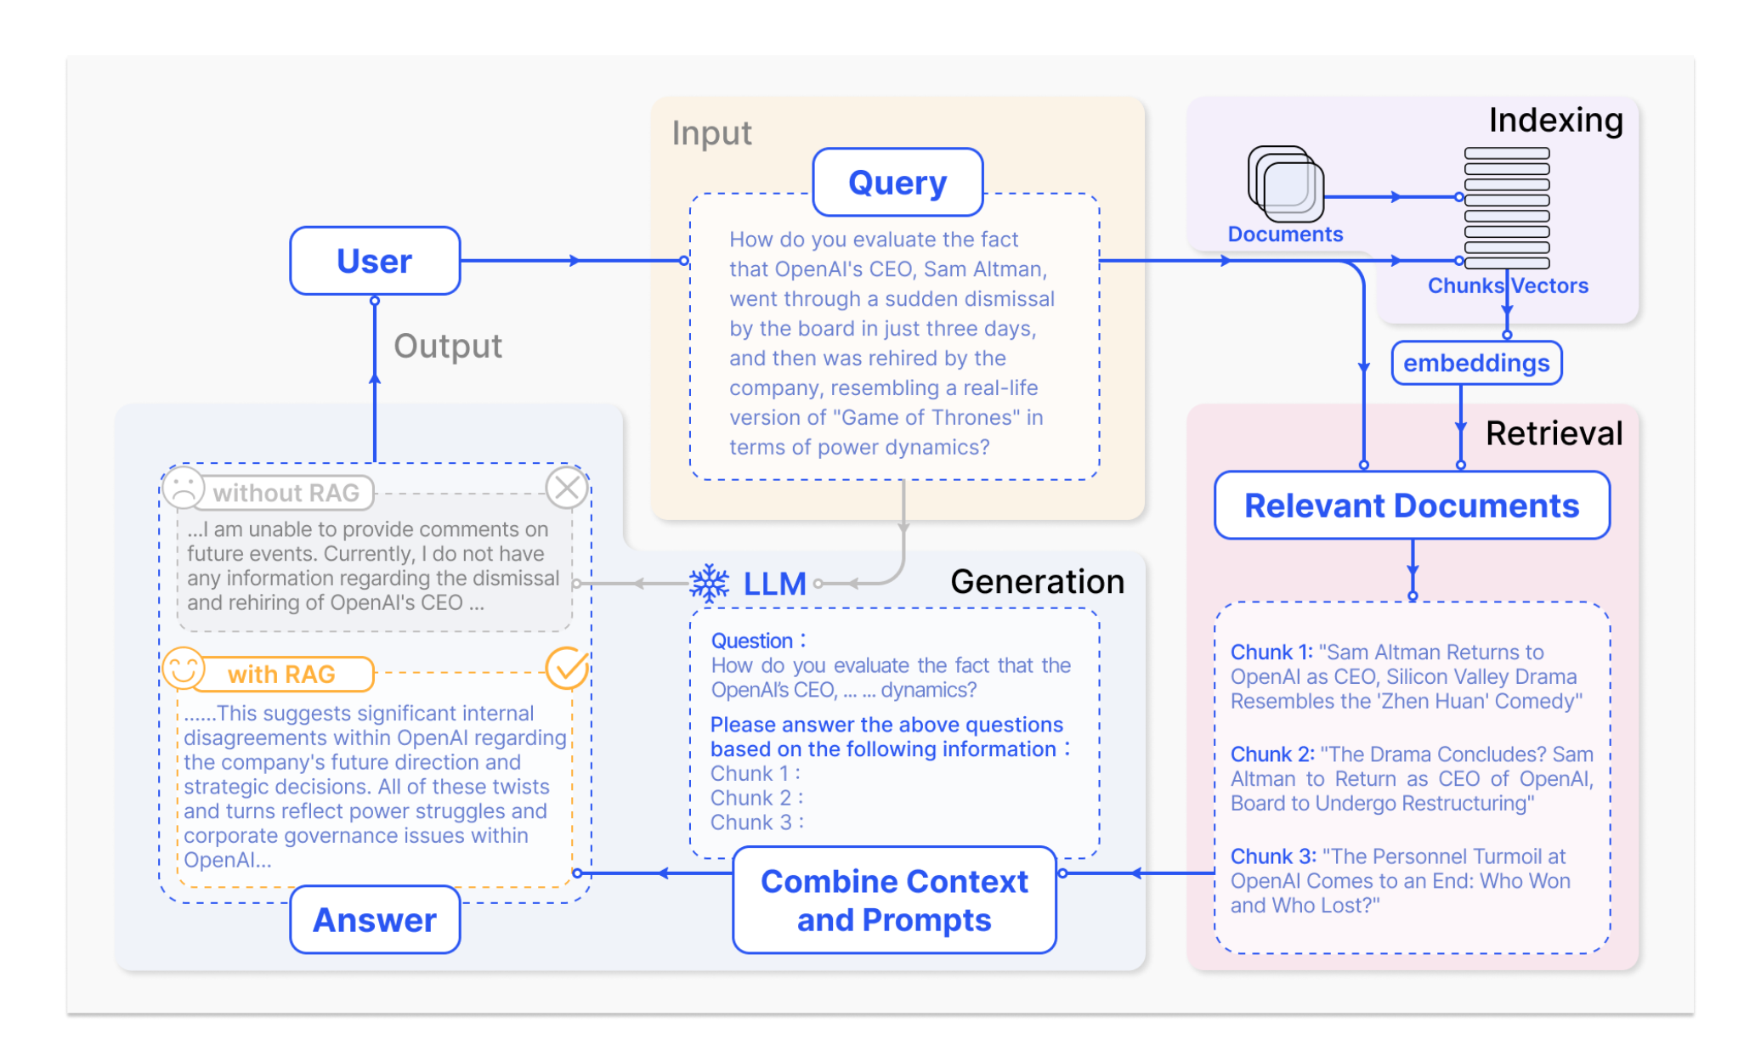
RAG example
What to retrieve?
  Tokens, chunks, knowledge graphs, multimodal data
When to retrieve?
  Iteratively versus 1-shot
How to use the retrieved information?
  Integrate into the model architecture
A typical use of RAG in a QA scenario

Slide 9
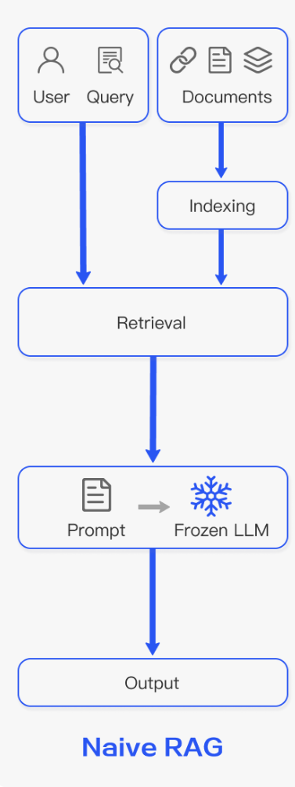
Naïve RAG
Indexing
  Text conversion
  Chunking documents
  Encoding documents
  Index generation (k-NN), e.g. Faiss index
Retrieval
  Cosine similarity retrieval by encoding query
Generation
    Responses to the information contained within the provided documents
    In cases of ongoing dialogues, any existing conversational history can be integrated into the prompt,
    enabling the model to engage in multi-turn dialog
Problems:
    Low precision and recall
    Irrelevant context in responses
    Augmentation from the retrieved chunks tricky due to redundancies and repetition
    Novel content generation may not be possible

Slide 10
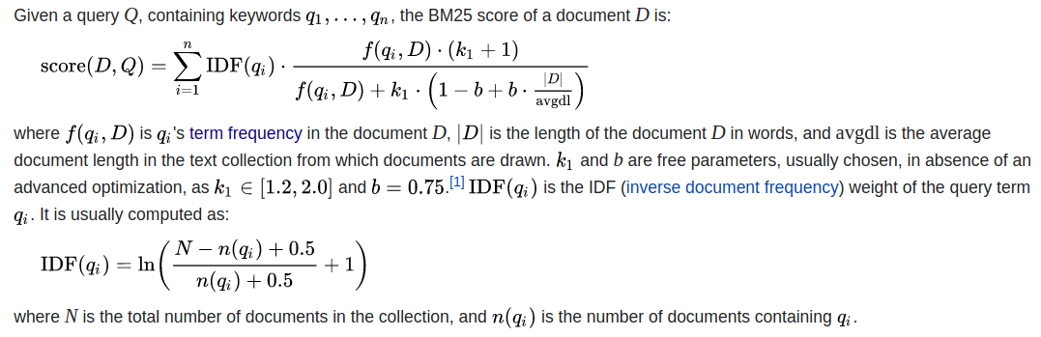
Lexical Retrieval Methods - Unsupervised
Based on traditional document retrieval approaches
BM25
  Term Frequency (TF):
  Inverse Document Frequency (IDF):
  Document Length Normalization:
Notes:
BM25 – Best Match 25
RS = ∑((IDF * TF * (k1 + 1)) / (TF + k1 * (1 — b + b * (doc_length / avg_doc_length))))

Slide 11
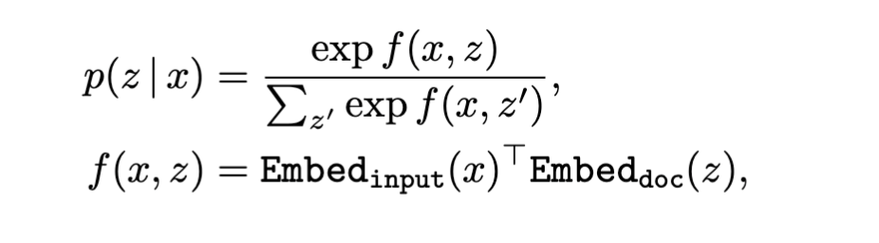
Semantic retrieval - Unsupervised
Vector encode the query and the document
Use cosine similarity to retrieve nearest document
Other retrievers (softmax over relevant scores):

Slide 12
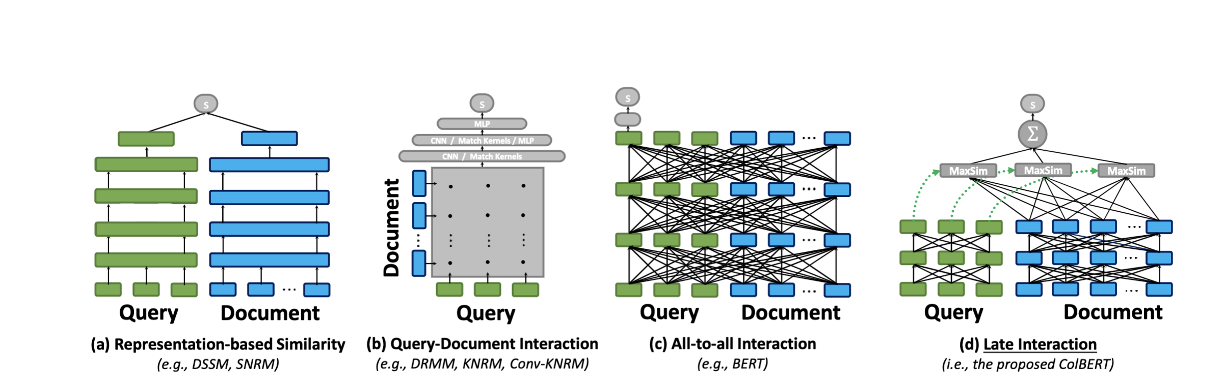
Neural IR approaches
An interaction matrix that reflects the similarity between
every pair of words across q and d fed to a classifier for relevance
Use a transformer to match and decode to a similarity value
Query and document representation pre-computed and single vectors cosine similarity
COLBERT
Notes:
possible to pre-compute document representations offline in representation based approaches

Slide 13
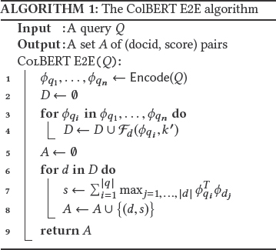
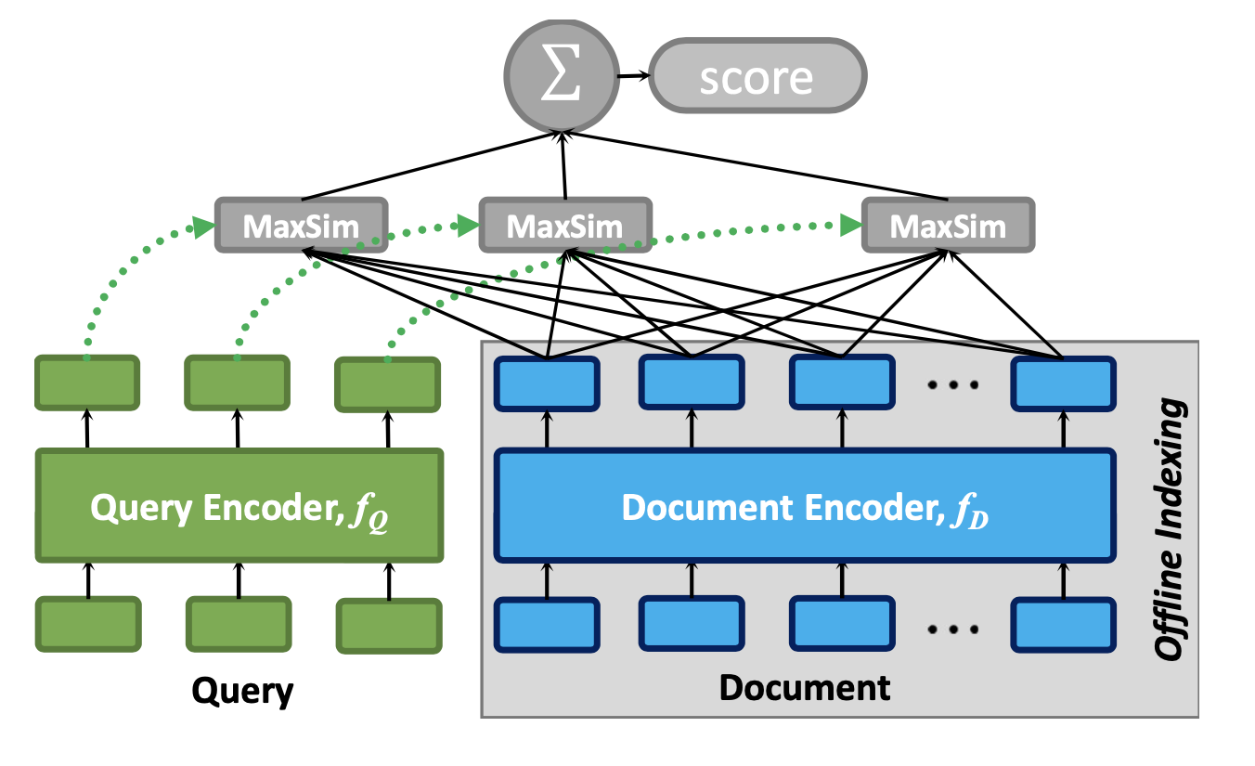
ColBERT
Contextualized late interaction over BERT

Slide 14
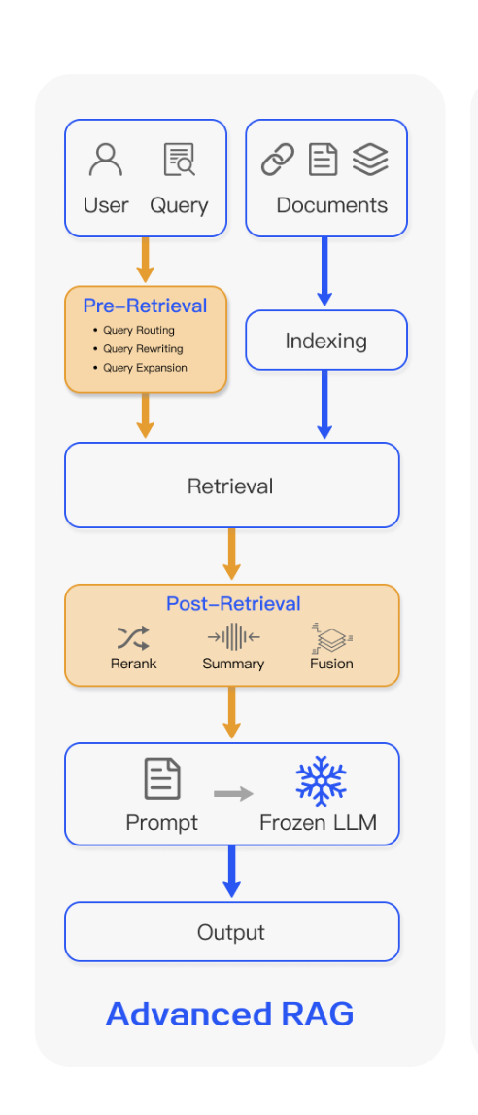
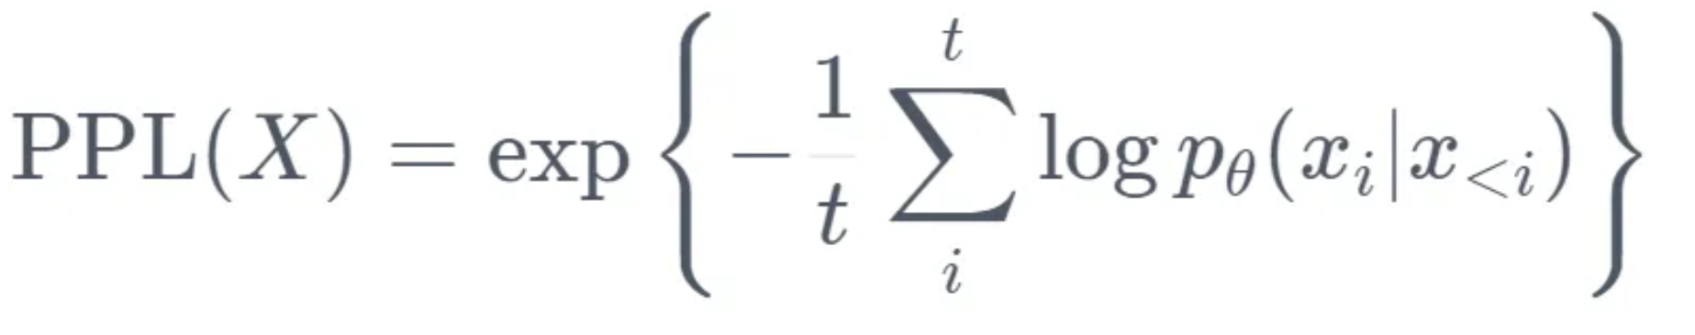
Advanced RAG Methods
Indexing
  Prefiltering text, Decide what to tokenize
  Adding metadata, Better chunking
Retrieval
  Fine tuning embedding (pairs of questions and answers are used to teach the retrieval engine).
    E.g. BGE model on enterprise knowledge
  Sparse, Dense, and Multivector models
    E.g. COLBERT, SpladeV2
  Dynamic embedding
    E.g. Open AI’s embeddings-ada-02, adapts to the context in which words are used
Post-retrieval augmentation
  Re-ranking
    E.g. Langchain (document diversity, selection of documents)
  Perplexity-based filtering (mutual information)
Notes:
Beijing Academy of Artificial Intelligence (BAAI). BGE model
ColBERT [4] or AligneR [5] are multivector models
Splade is a Sparse IR model
Dense IR models are cosine similarity based
LangChain is a framework designed to simplify the creation of applications using large language models.

Slide 15
Semantic retrieval - Supervised
BERT:
“The. ------ is the currency of the United Kingdom” (answer: “pound”)
  What knowledge is encoded in the model but where?
    Implicitly in the parameters of the network
    Storage space is limited by the size of the network => build larger and larger networks
REALM (ICML2020) ():
  Retrieval-Augmented Language Model (REALM) pre-training, which augments
    language model pre-training algorithms
    Learned neural document retriever using an unsupervised fill-in-the-blank training objective.
Perplexity score can be used as a loss function for training

Slide 16
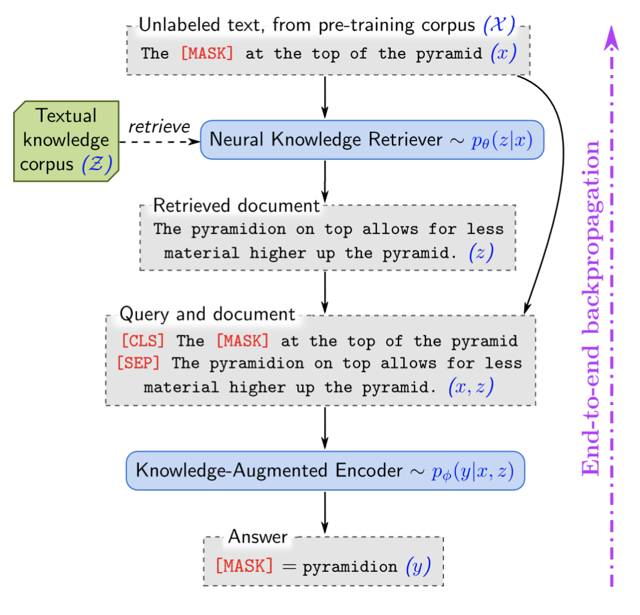
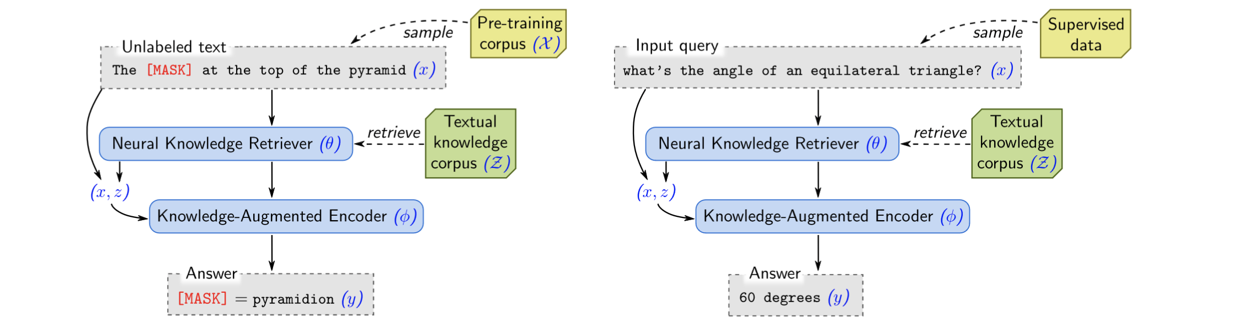
REALM
REALM: Retrieval-augmented language model pre-training
Unsupervised pre-training.
Supervised fine-tuning.
https://arxiv.org/abs/2002.08909
Perplexity score can be used as a loss function for training

Slide 17
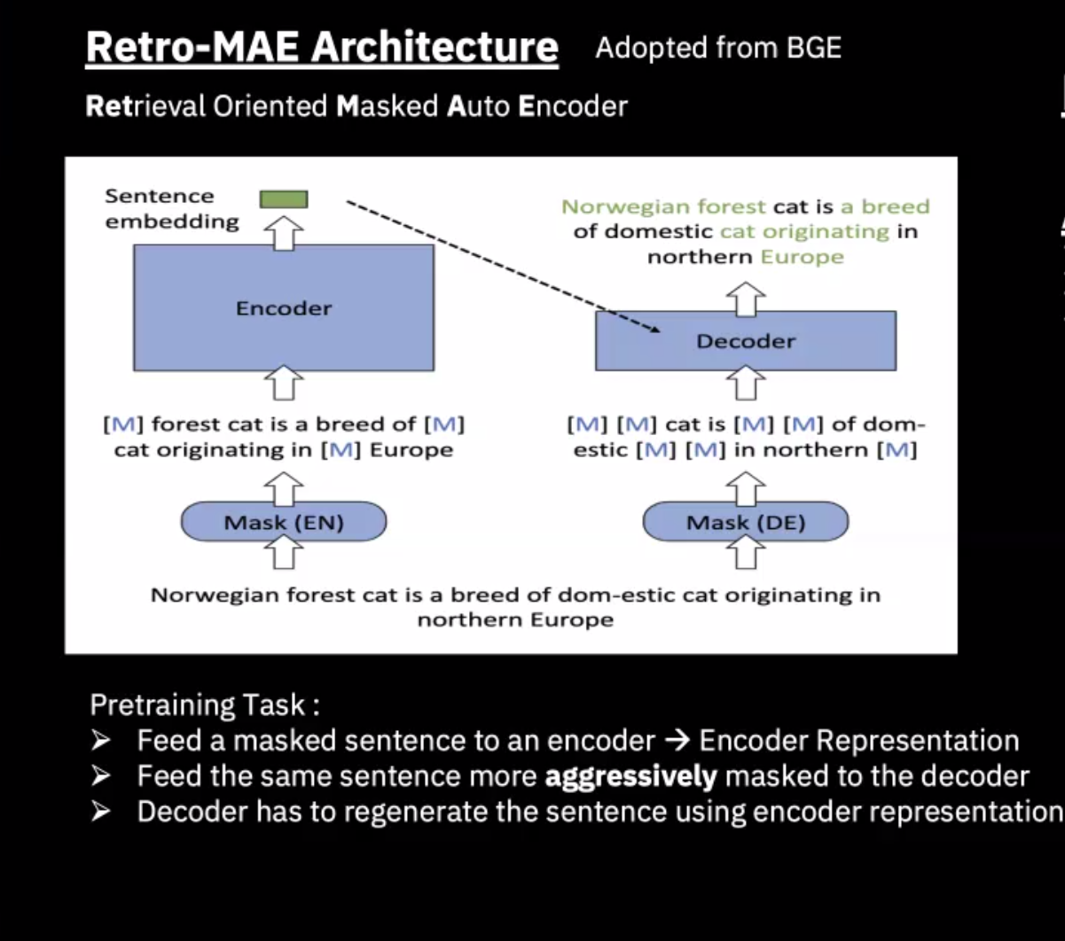
BGE Model
General embedding model
Currently top of leaderboard (Multi-task evaluation benchmark)

Slide 18
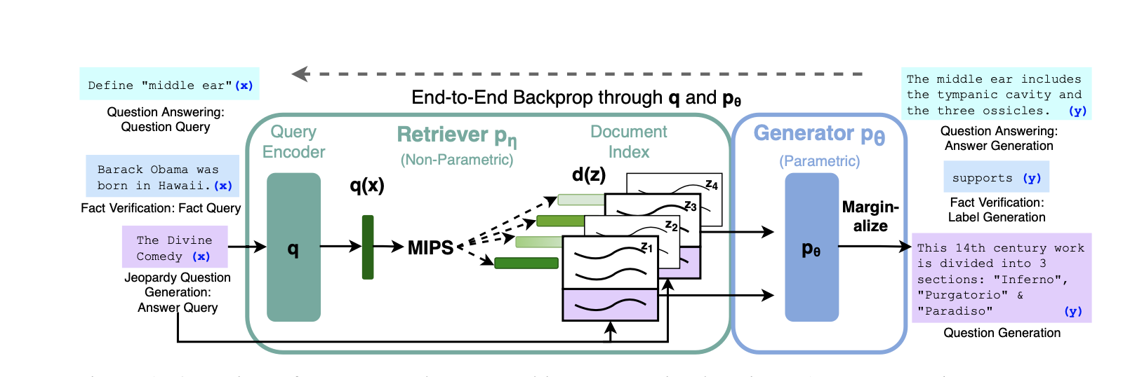
RAG – Parametric + Non-parametric memories
Combines a knowledge retrieval based on vector similarity search
Once the documents are retrieved, fed along with the prompt to a decoder
Trained in a supervised manner for downstream seq2seq translation
DPR
BART
Non-parametric memory
Parametric memory
RAG introduced bu Lewis et al., ICML2020, https://arxiv.org/abs/2005.11401
Notes:
Retrieval-Augmented Generation for Large Language Models: A Survey
https://arxiv.org/abs/2312.10997

Slide 19
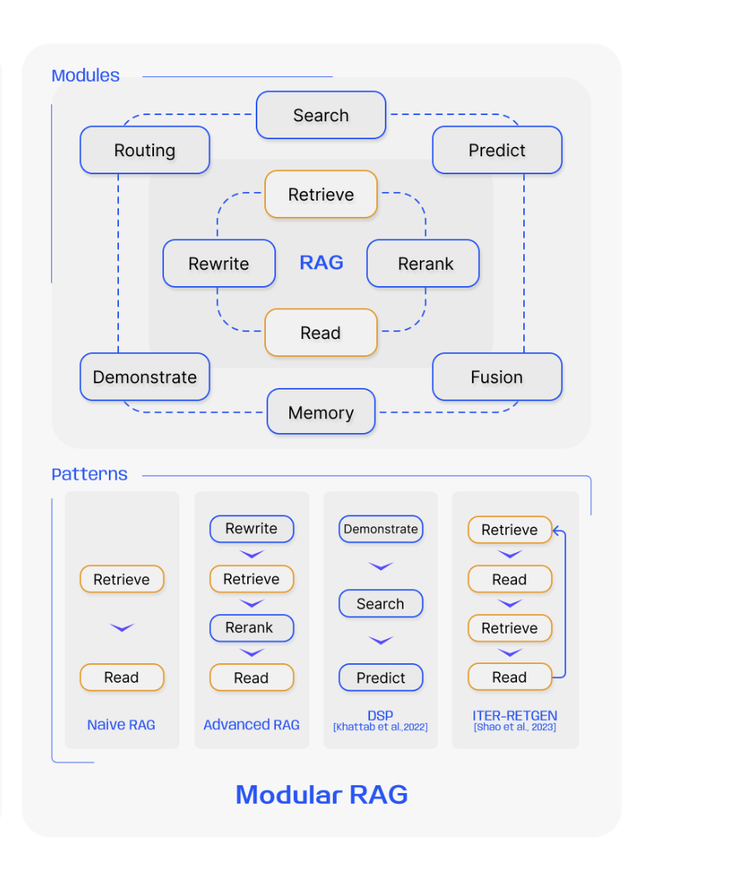
Modular RAG
Mixture of modules and retrieval patterns
  E.g. a search module for similarity retrieval and applying a fine-tuning approach in the retriever

Slide 20
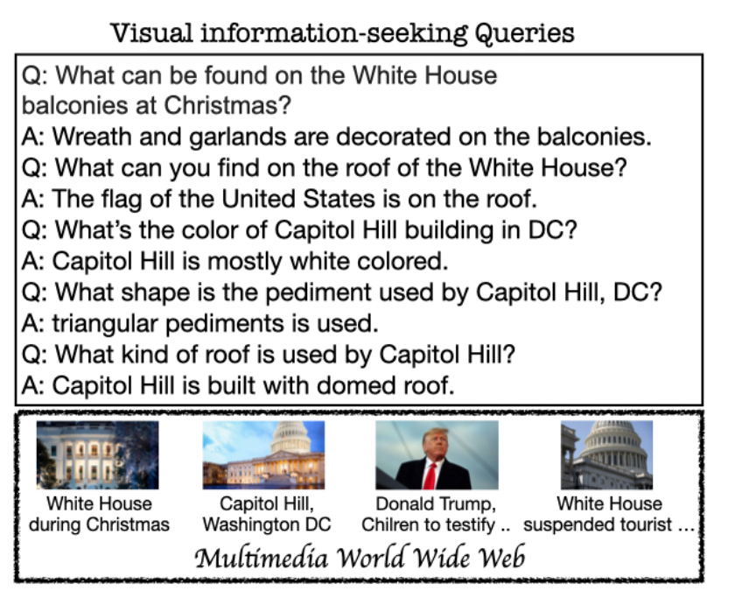
Multimodal RAG
Uses image and text information to retrieve relevant documents
The retrieval model can be pre-trained

Slide 21
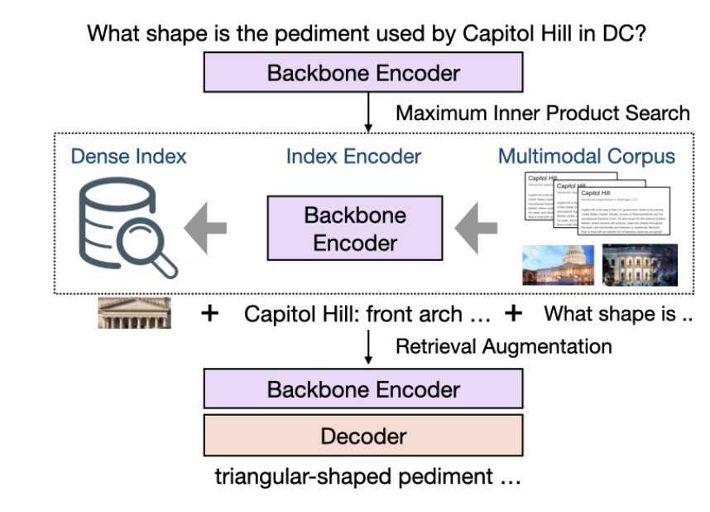
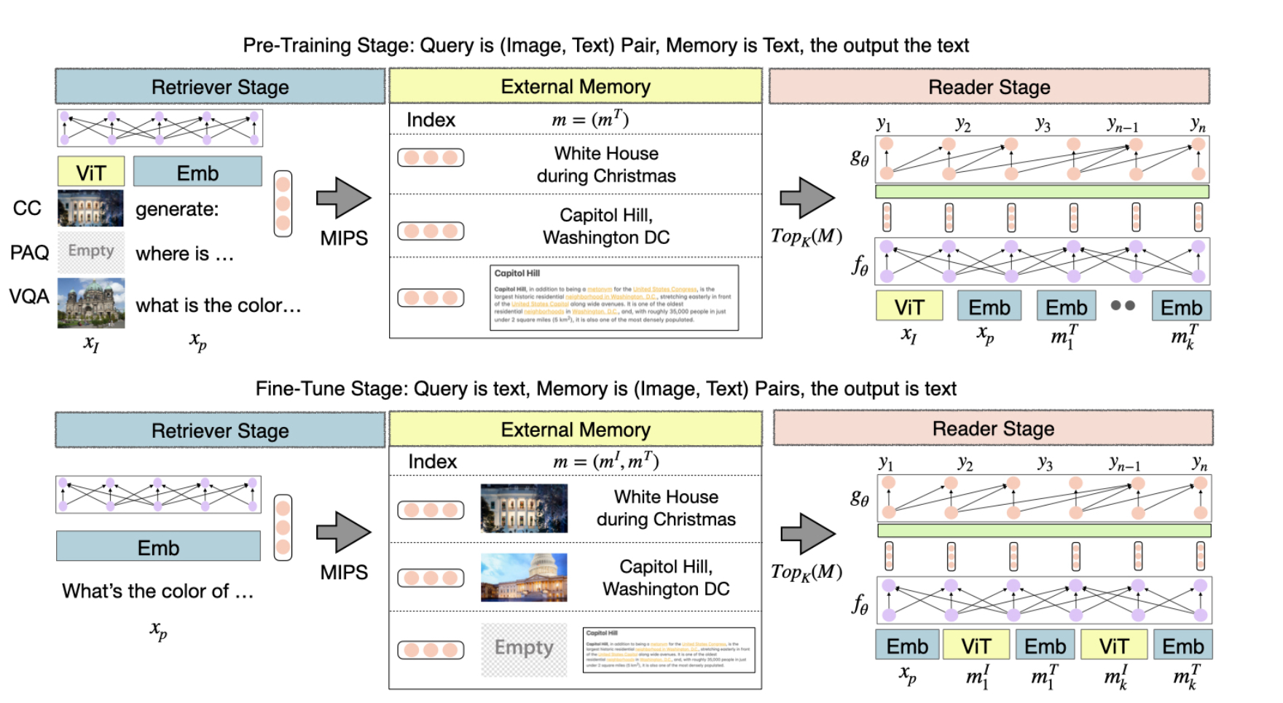
MURAG – Multimodal RAG
https://arxiv.org/abs/2210.02928
During pre-training: Train an encoder to produce relevant captions from a textual memory bank.
During RAG: Use the same encoder for encoding image-text pairs in a multimodal memory bank. Input is a textual prompt, the retrieved documents are multimodal, which are then fed to the generator to generate text
Notes:
for the generic query prompt q, and image I to retrieve textual phrases Mt from memory, which when given to the generator generate captions that correspond to the image. The encoder learns to produce the relevant representation for q and I.
MIPS – maximum innter product search

Slide 22
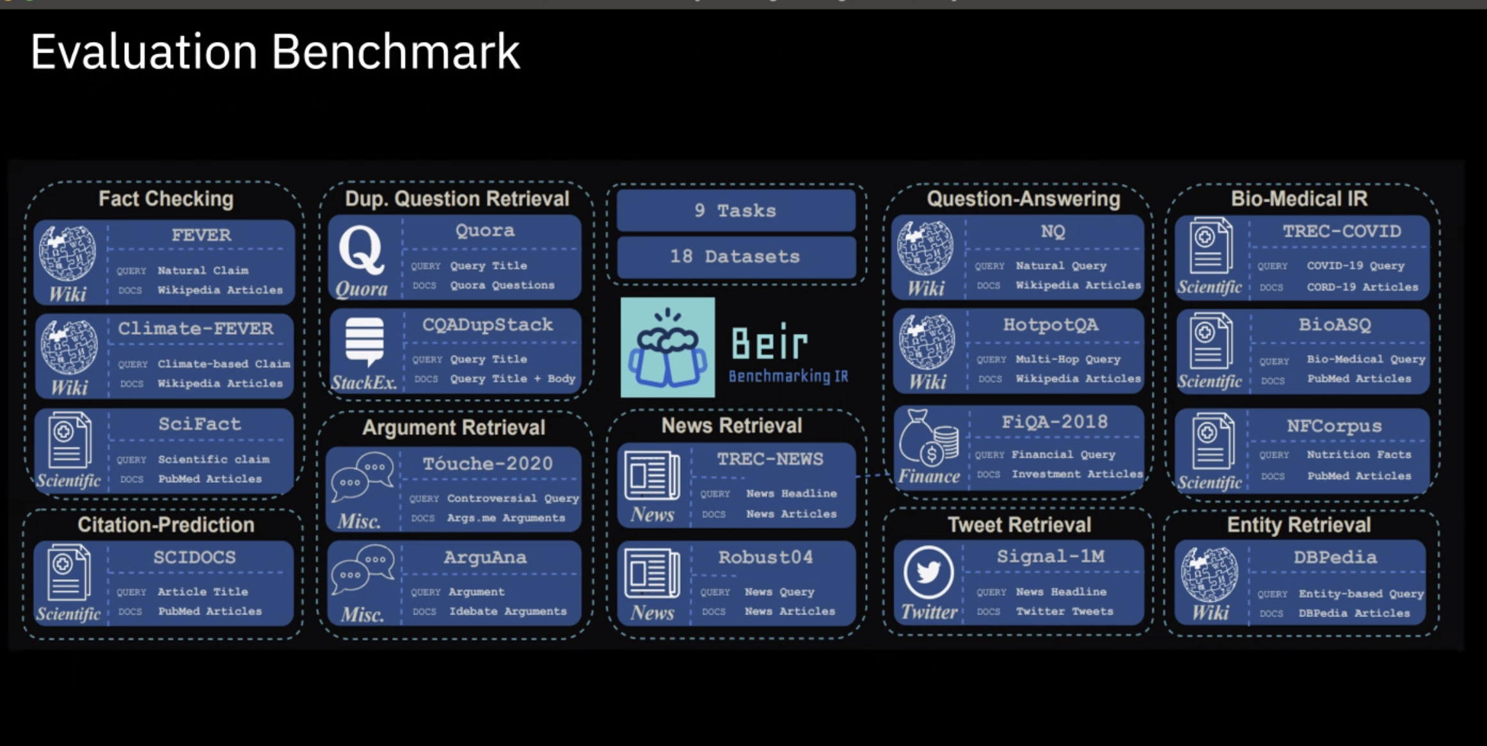
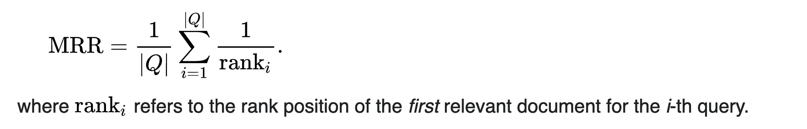
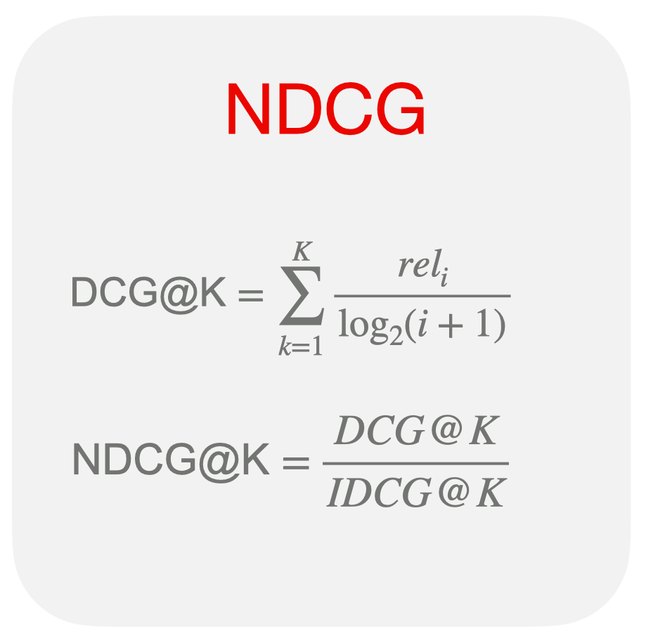
Benchmarks
Bier Benchmark
  18 datasets, 9 tasks
The MTEB benchmark (Multi-Task Evaluation Benchmark)
  56 datasets distributed among 8 distinct tasks.
  2000+ outcomes on the leaderboard.
Evaluation metrics
  NDCG (normalized discounted cumulative gain), MRR(mean reciprocal rank), Precision, Recall, Accuracy
  NDCG allows for fair comparisons between lists of varying lengths and relevance distribution

Slide 23
Newer concepts in RAG
Using commercial search engines with lexical and vector support
  Build SpladeV2 and other models underneath
Self-teaching generative AI through memorization of generated output
Multi-query fusion
LLM-based query routing to relevant knowledge sources
iterative prompting and correction

Slide 24
Open Questions
Challenges:
  What representation capture semantics of documents?
  What embedding spaces bring queries and documents closer?
  How to introduce LLM preferences into the retrieval engine?
  Context Length
  Robustness
  Integrating RAG with fine-tuning

