Slide 1
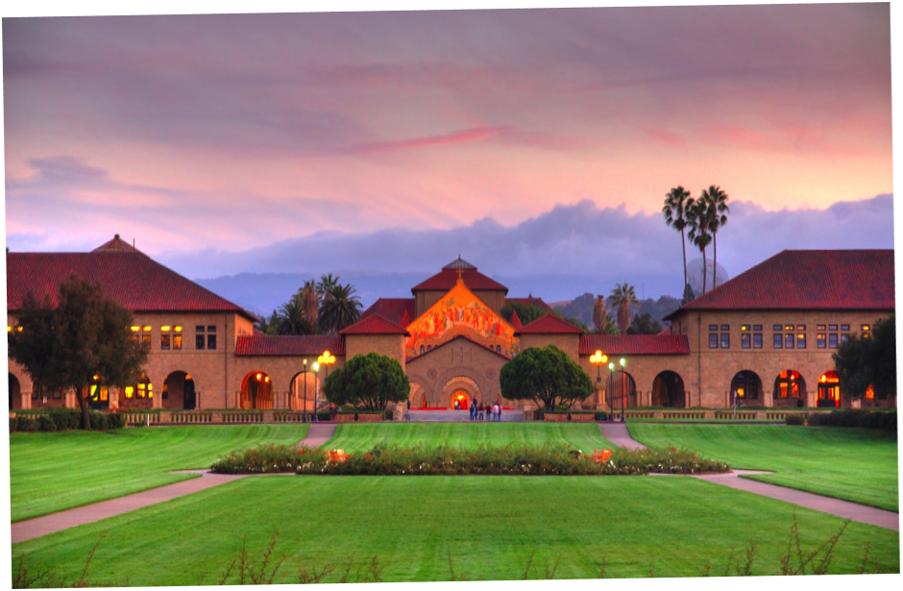
Foundational Models:
Advanced Topics & Deployment Considerations
BIODS 271 / CS 277
Tanveer Syeda-Mahmood

Slide 2
Topics
Multimodal fusion in foundational models
Hallucinations in foundation models
  Image-guided fact-checking
Deployment considerations of foundational models
Notes:
Potential implications of far-reaching
4 billion users on google search use BERT

Slide 3
Multimodal fusion in foundation models
Notes:
Potential implications of far-reaching
4 billion users on google search use BERT

Slide 4
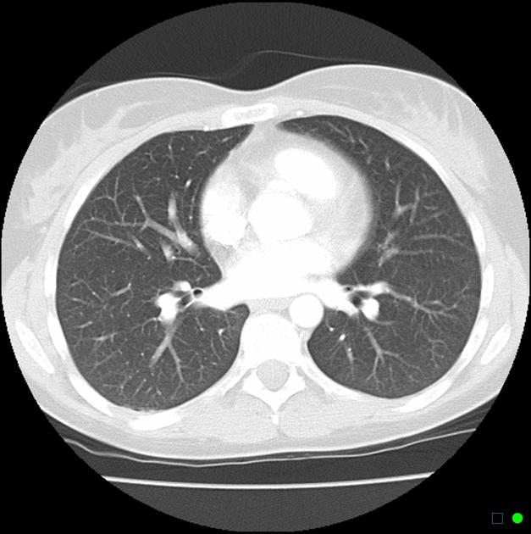
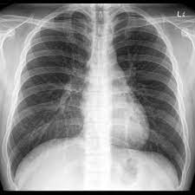
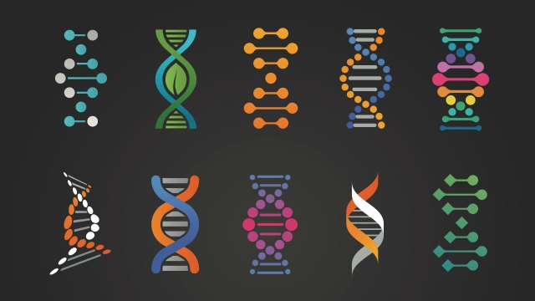

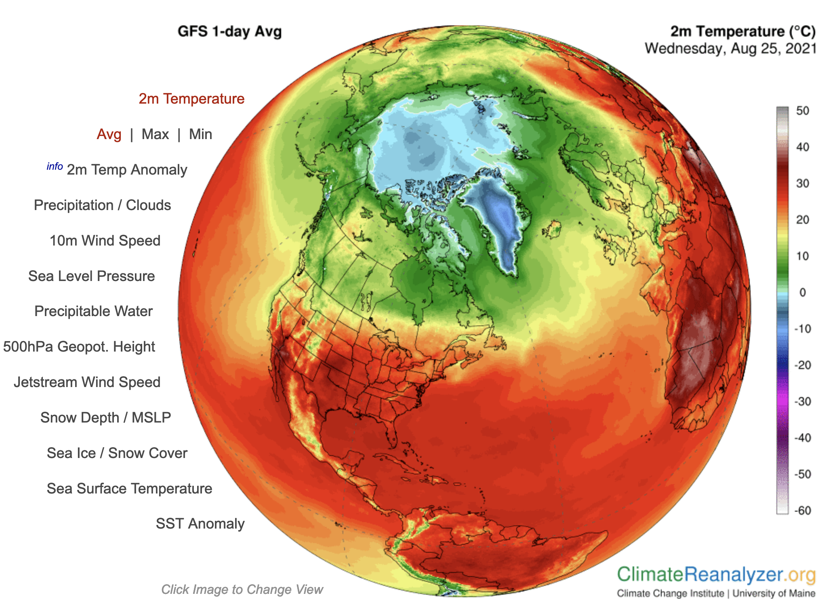
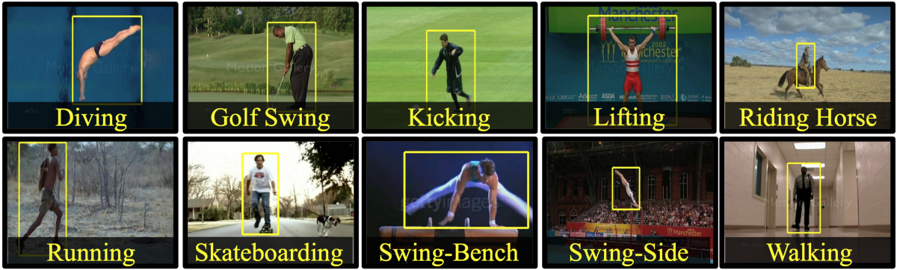
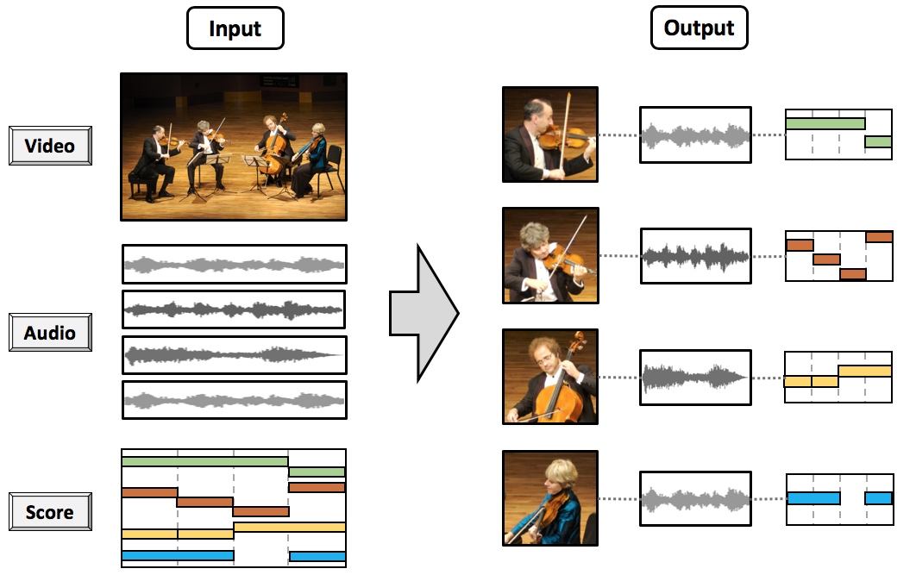
Multimodal Fusion Across Scales
Imaging
Occurs in many domains
  Observations about a problem can be made through many modalities over different scales
Effectively leveraging all the information present in these modalities is important
  Improved detection
  Better prediction and recurrence
  Understanding the mechanisms
Representation Learning
+
Fusion
Genomics
Clinical
Outcomes
Video/Images
Sensor Data
Audio Recording
?
Scene Understanding
Fusion
Notes:
Problem is important, lots of complexities that are not well addressed although there is potential to address them.

Slide 5
Multimodal fusion across scales – The challenge
Representation
  How to represent and summarize multimodal data across scales ?
  Each modality may need a different representation to capture its information
  Domain nuances
Alignment
  How to capture the relationship between (sub)elements from two or more different modalities (spatial and temporal) across scales?
  Capture modality relationships
Fusion
  How to combine information that is mutually reinforcing or complementary?
  Fusion may need to be across both space and time
  When does fusion help?
Features:
  Irrelevant features
  Missing features
  Errors in features

Slide 6


Multi-Graph Neural Fusion Network
A generalized end-to-end learning framework that handles
  Variable number of modalities
  Fine-grained modeling of features and their interactions
  Interpretable
  Noisy data
  Missing data
  Error-prone data
Fuses modality information meeting multimodal fusion requirements
Workshop on Machine Learning for Multimodal Healthcare Data, 2023

Slide 7


Fusing Modalities by Multiplexed
Graph Neural Networks for
Outcome Prediction in Tuberculosis
Niharika S. D’Souza *, Hongzhi Wang, Andrea Giovannini, Antonio Focubierta Rodriguez, Kristen L. Beck, Orest Boyko, Tanveer F. Syeda-Mahmood
IBM Research, Almaden, USA
Notes:
Hello everyone, my name is xxx. I am a yyy at IBM Research, Almaden, San Jose.
The problem of multimodal fusion is very relevant in clinical data science, especially in disease diagnosis. In this work, we develop a novel graph neural network framework that we derive from multi-graph representation theory and can be applied to general problems in multimodal fusion

Slide 8
Multimodal Fusion For Healthcare
Imaging
Representation Learning
+
Fusion
Genomics
Clinical
Outcomes
Inference from each modality is not definitive and may have uncertainty or errors
Each modality may need a different representation to capture its information
Not all modality evidence may be present or relevant for each instance of the problem
Challenges
Notes:
In a complex disease such as tuberculosis, the evidence for the disease and its evolution may be present in multiple modalities, for example in imaging, genomics or other clinical modalities. Effective patient-tailored outcome prediction and therapeutic guidance will require fusing evidence from these modalities
Multimodal Fusion is extremely challenging
Individual modality information may be subject to uncertainty or errors
Second, each modality may require a separate representation scheme depending on the granularity in information.
Third, there may be incomplete or missing information within the data acquisition. Additionally, not all features across modalities may be relevant to study the task at hand.

Slide 9
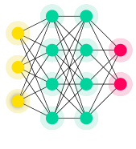
Traditional Multimodal Fusion Strategies
concatenation
outcomes
outcomes
Early Fusion
Intermediate/Late Fusion
Notes:
Here is a brief outline on traditional strategies for multimodal fusion. Assuming we have each modality’s features vectorized as shown in this cartoon diagram, the early fusion approach concatenates features from each modality as a first step. The second step is to pass this representation through a learning algorithm, for example a deep neural network to map to outcomes.

Slide 10
Traditional Multimodal Fusion Strategies
concatenation
outcomes
outcomes
Early Fusion
Intermediate/Late Fusion
Notes:
The late and intermediate fusion approach is slightly different. Here, each modality’s information is encoded by its own unique representation learning scheme, and then fused in two possible ways. The first could be before the decision making step as with intermediate fusion. This would require a mapping module to relate the intermediate representation to the outcome. Otherwise, there may be separate decisions drawn from each modality and fused at the end, as with late fusion

Slide 11
Traditional Multimodal Fusion Strategies
concatenation
outcomes
outcomes
Limitations:
Complexity grows with increasing number of concatenated features
Learning and fusing representations at scales
Exploiting correlations/inter-dependence within modality features
Notes:
Some of the limitations to these approaches are:
The complexity of learning grows with an increase in the number of features and modalities
Representing observations at scale may be challenging, even for deep networks, especially when the notion of spatial/temporal organization in features does not hold
For the fusion strategy to be expressive, it should be amenable to exploiting and capturing inter- and intra feature dependence and correlation
Existing methods rely on vector representations, but not offer a direct mechanism to incorporate the inter-dependence between these features during fusion. Such pair-wise interactions are more easily captured is in structured representations such as graphs, eg KGs in genomics

Slide 12
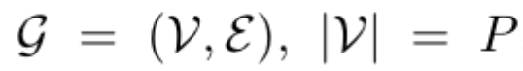
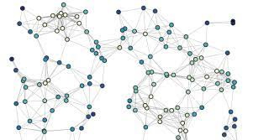

Graph Based Representation Learning
Nodes: Features/ Entities
Edges: Capture dependence within features
Adjacency Matrix:
Do not require spatial contiguity/organisation of nodes
Can represent data at arbitrary scales
Notes:
A graph denotes a set of interconnected entities or nodes, with the interconnections captured by edges between these nodes. For example, if our graph G consists of vertices and edges, the vertices could denote features within a modality, while the edges could capture interdependence within features. The connectivity information is encoded in an adjacency matrix A
<click>Such graph representations are attractive as do not apriori assume contiguity or spatial organization within nodes and can be used to compactly represent data at arbitrary scales when necessary

Slide 13
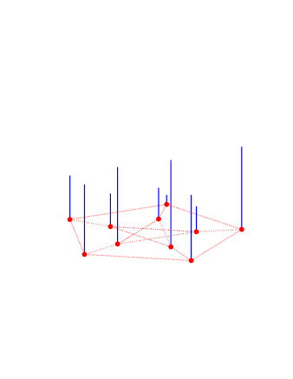
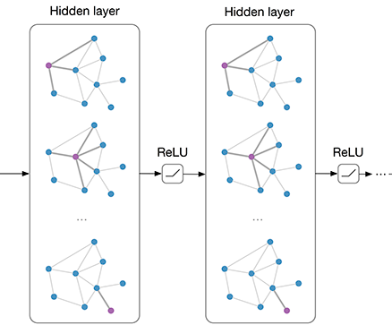
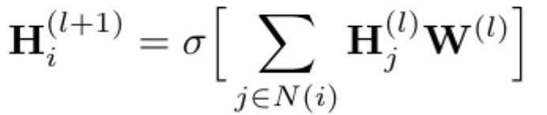

Graph Neural Networks
Mixed Modality Graph
Basic Message Passing
Graph signal
Output
Graph topology
Messages at
layer
Filter at layer
non. linearity
Graph topology: Intrinsic connectivity in the graph
Graph signal: Node/edge attributes for propagation
Message Passing: Tracking the information flow within the graph based on local neighbourhoods
T Wu et al. “Graph Interaction Network for Scene Parsing”, ECCV 2020
Notes:
Thus, Graph Convolutional Networks have become a popular tool for multimodal fusion. At the input all features from all modalties may be combined into a mixed modality graph as shown here
The key building blocks for the GNN is the graph topology, or the latent connectivity in the graph structure, and the graph signal, which could denote the node attributes associated with the graph.
<click>GNNs perform message passing to tracksthe information flow within the graph. Typically by aggregating information from the graph signals based on the intrinsic topology. As such, this is used to create abstractions of the graph that are useful for a downstream task of different types, for example node based classification.
<click>Basic MP equations are indicated here, where for each node, the filtered representation depends upon the contribution from its immediate neighbours at each GNN layer.

Slide 14
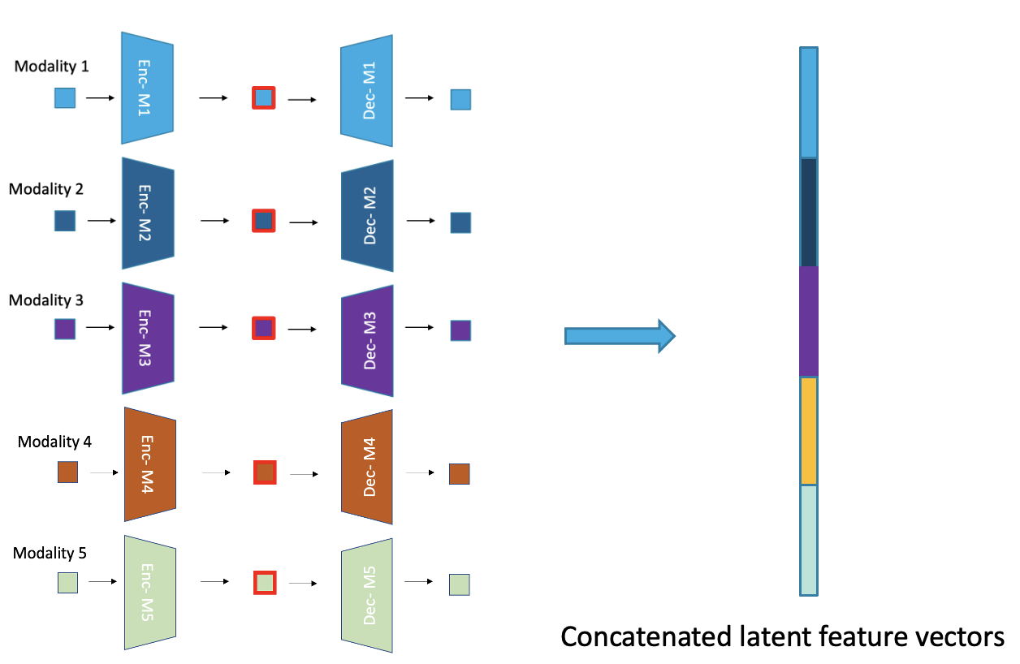
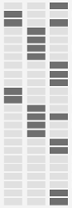
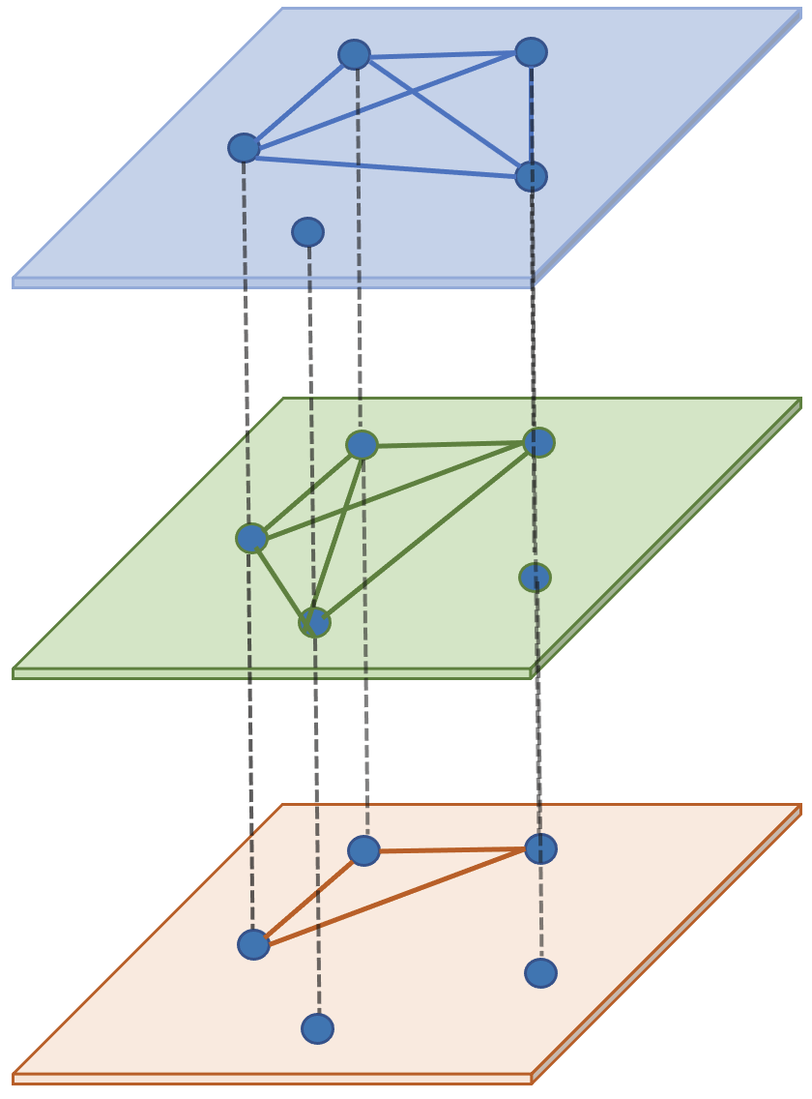
Multiplexed Graph Representation Learning
Concept-AE
Multiplex Graph
c-AE
c-AE
K
K Planes
Concatenated Feature Vector
Notes:
Since the individual features are typically high dimensional, we use modality specific encoders to reduce the within-modality redundancy.
In order to perform structured reasoning across these features, we need to bring these representation into a common semantic space. <click> Therefore, the latent features from the modality encoders are concatenated into a joint feature vector. The concatenated features are brought to a common low dimensional subspace through a common autoencoder (c-AE) trained for reconstruction
<click>Each latent dimension of the autoencoder captures an abstract aspect of the multimodal fusion problem. Features projected to be salient in the same latent dimension are likely to form meaningful joint and form a “conceptual” plane of the multiplexed graph.
<click>Mathematically, we calculate the salient features by perturbing their input values and observing the effect sizes in the concept space and then thresholding the values to infer saliency. For example, in each blue plane, the features shaded in black will be form a fully connected subgraph, while no in-plane connections exist among other features. The vertical connections in the multiplex only exist among copies of nodes across planes, i.e by going along the rows of the p matrix

Slide 15
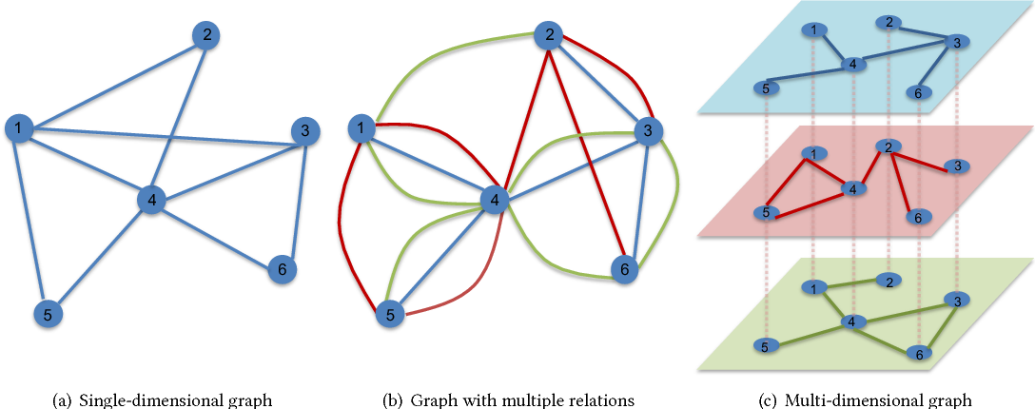

Multi-Graphs for Multimodal Learning
Single view graph:
Graph with single edge types
Multi-graph:
Each relation is a distinct edge type
Notes:
In the real world, entities may interact in multiple different ways, as in the case of multigraphs. For example, here, we have three edge types denoted by three colours. Each type of connectivity gives rise to its own adjacency structure. Capturing different ionnectivity patterns simultaneously is important to the problem of multimodal fusion, as feature interactions tend to be more nuanced and complex. Therefore, we will explore such representations within our fusion framework. Unfortunately, most traditional GNN approaches are inadequate in this setting.

Slide 16
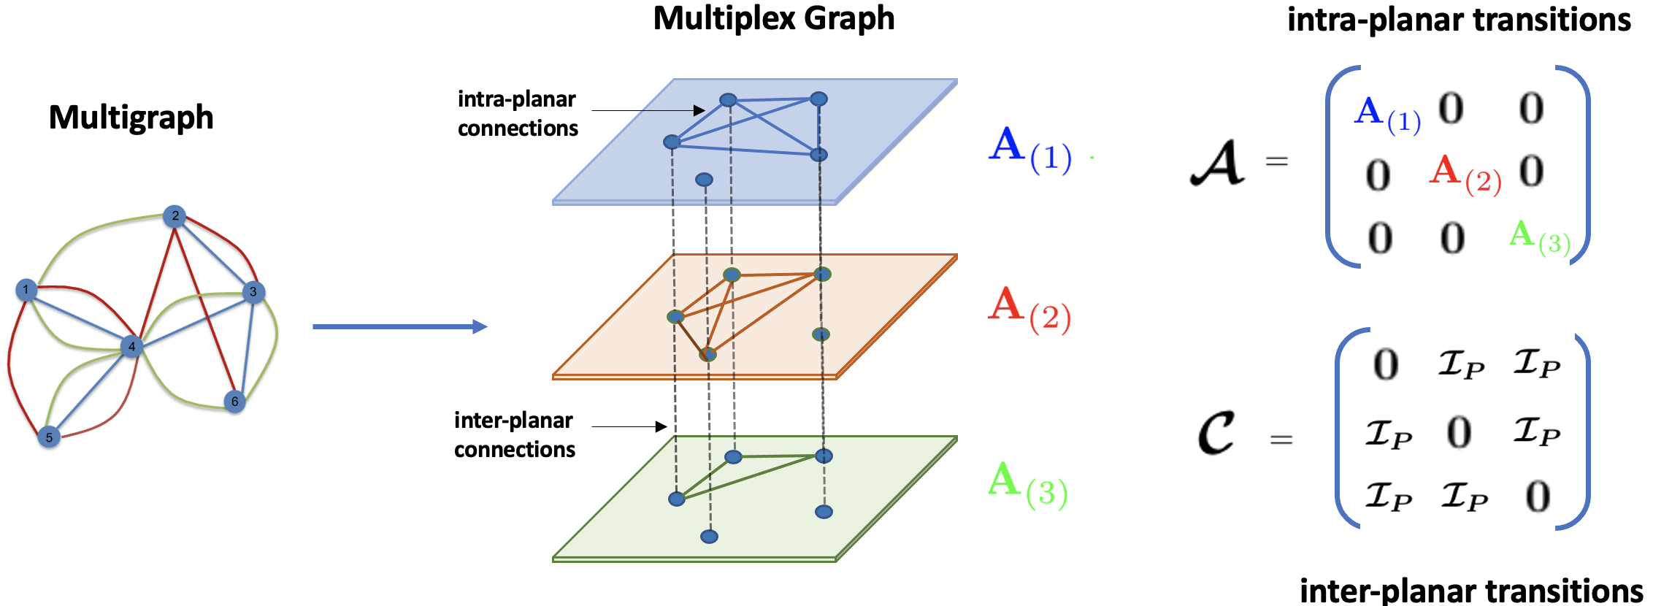
The Multiplex Framework
Motivation: Using intra- and inter “planar” connections to keep track of information flow across and within modality features
Notes:
A multiplexed graph is a special type of multi-graph in which the same set of nodes are allowed interact in multiple ways. Each plane represents one facet of connectivity, for example, in case of transportation networks, if one plane capture connectivity within roadways, another could capture airway connectivity. Vertical edges connect copies of the same nodes across planes
<click> Analogous to adjacency matrices for conventional graphs ,there are two main building blocks that are native to the multiplex graphs. The first is the intra planar adjacency matrix script - a blocked representation of the individual relational adjacency matrices. This matrix helps us keep track of within planar transitions given by the red, green or blue relation.
The second is the inter-planar transition matrix. This is blocked identity matrix across layers and captures transitions across the planes. Paths within the multiplex graph can be formed by combining both types of connections.
For multimodal fusion, our key motivation is to explicitly model patterns of interaction within and across modalities and use them for inference in a systematic fashion.

Slide 17
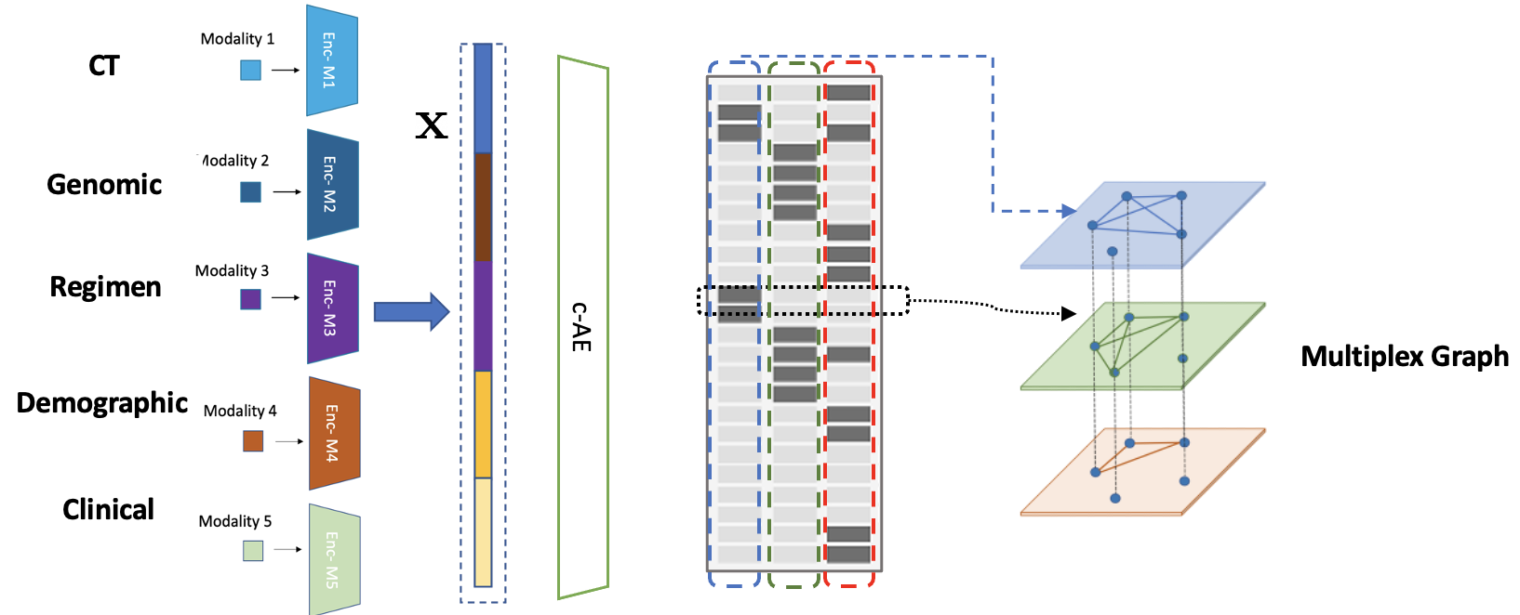
Multiplexed Graph Representation Learning
Notes:
Let us now look at the representation learning module first

Slide 18
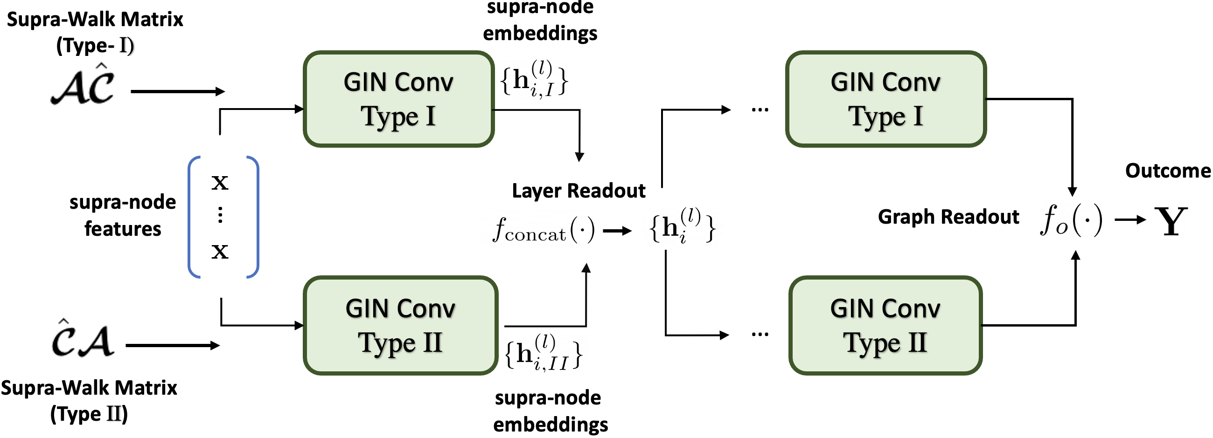
Multiplexed Graph Neural Networks
Notes:
The inference module is a novel graph neural network designed for reasoning from multiplexed graphs.

Slide 19
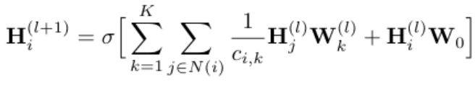
Prior Work on Multigraph Learning
Graph Conv layer
Graph Conv layer
Graph Conv layer
Graph Conv layer
+
+
Graph Conv layer
Graph Conv layer
Message Passing:
Separates message passing across edge-types and then aggregate
May miss several higher order paths arising from cross modal connections
Schlichtkrull, Michael, et al .“Modeling relational data with graph convolu-tional networks.”European semantic web conference. Springer, Cham, 2018.
Notes:
The literature on multi-graphs is relatively sparsely populated. One of the seminal works in this area is the relational GCN paper which looks at information propagation in heterogenous graphs via graph convolutional operations. <click> The building block is the R-GCN block, which performs individualized message passing on relationships of the same type. For our toy example, the R-GCN may have three blocks for message passing on blue, green and red type relations. It then collapses the distinct message types by summing at the end.
<click>A cascade of such blocks may be used to map to a downstream task.
<click>Mathematically, the message passing operation may be described by this equation. In the first term, each component of the sum is for one relation type k, where the filter Wk operates on the neighbours defined by relation k. After separate message passing, the outer sum aggregates across relations. The second term in the sum handles self contributions.
<click>Some of the main caveats in this approach is that the message passing across edge types is disparate, and may not necessarily exploit cross relational dependencies. This may miss several higher order paths that thus arise. In our approach, we will seek to specifically address this problem

Slide 20
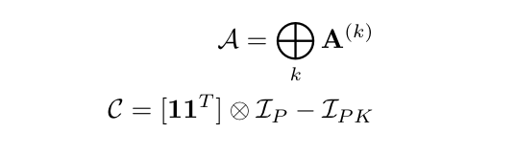


Defining Walks on the Multiplex
Intra-planar adjacency matrix
Inter-planar transition matrix
A walk consists of one of two types of steps:
First take intra-planar step, then allowed to transition
First allowed to transition, then take intra planar step
Cozzo, Emanuele, et al. Multiplex networks: basic formalism and structural properties.. Berlin: Springer, 2018
Notes:
A typical GNN schema comprises of two components: (1) a message passing scheme for propagating information across the graph and (2) task-specific supervision to guide the representation learning. For ordinary graphs, the adjacency matrix A and its matrix powers allows us to keep track of neighhorhoods (at arbitrary l hop distance) within the graph during message passing. Therefore, we use the theory of walks on the multiplex to perform message passing within multiplex graph neural networks.
For the multiplex graph, we can use the intra- and inter planar adjacency matrices, to keep track of paths within the graph.
<click>So, we have walks of two main types depending on how the transitions can be combined exhaustively. In the first type of transition, we can take an intra planar step first, and are then allowed to transition across planes. We refer to this as type I steps
Alternatively, we may first be allowed to transition across planes, and may then take an intra planar step. This is the step of type II.
These definitions help us keep track of the individual transitions that may constitute a walk between any two nodes. At the same time, they also allow us to systematically distinguish between intra- and inter-planar interactions

Slide 21

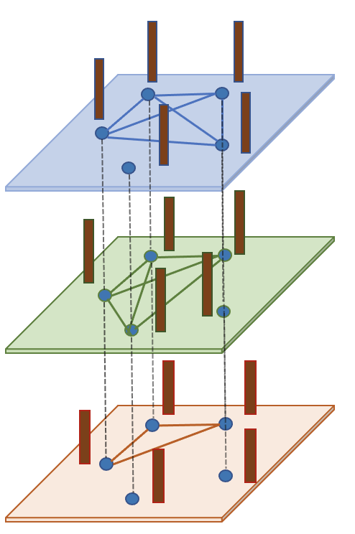
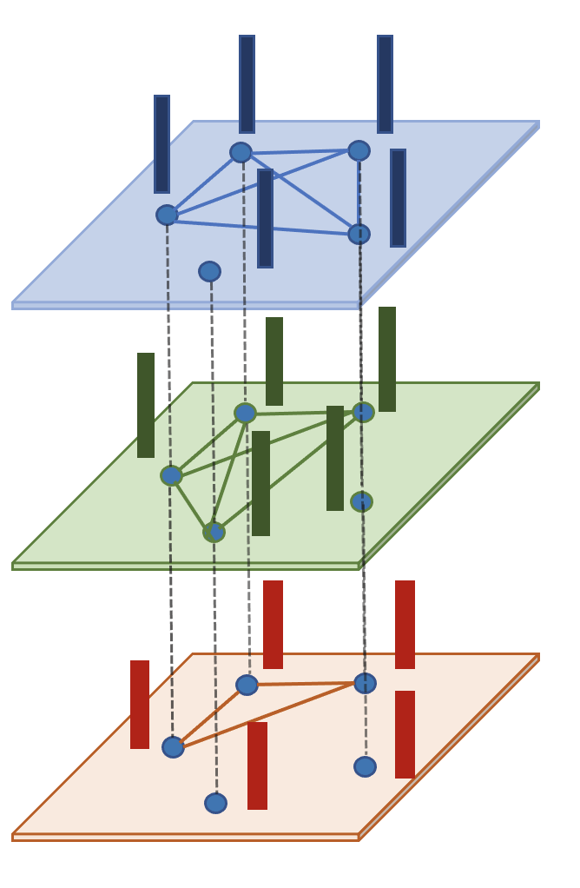
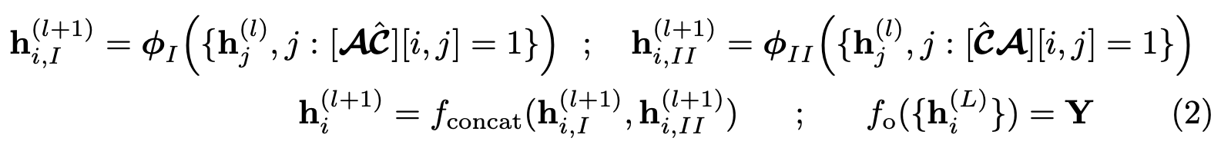
Multiplex Graph Neural Network
…
…
GINConv
Type I Filtering
GINConv
Type II Filtering
Layer-wise readout
Graph readout
Notes:
We use these two supra-walk matrices to perform message passing. The node features x are repeated across the planes of the multiplex to form the input supra node features.
Since at each step of the walk, we have two possible options for transitions, we design the multiplex GNN layer to consists of two branches, one for the connectivity of type I and the second for the connectivity of type II. <click>
We choose the layer-wise filtering operations to be the GIN Conv operations for both branches. <click>. After inferring the two filtered supra-node embeddings hI and hII, they are concatenated to form the layer readout. Notice that although each plane started out with the same input features x, after filtering, the features in each plane maintain their distinct identity depending upon the individual neighbourhood information. Unlike prior work in which this information is averaged out in the representation, our GNN operations allows us to perform reasoning at the granularity of both the relationships or planes, as well as at the nodes. This is a key advantage in terms of explainability.
<click>Many such layers can be placed in cascade to traverse the multiplex graph.
<click> Finally, the graph readout provides the output label corresponding to the input graph and is a two layered MLP network. The parameters to be learned during inference are the weight and bias parameters of the convolutional branches and the graph readout MLP. We can use standard backpropagation and gradient based optimization to infer these.

Slide 22
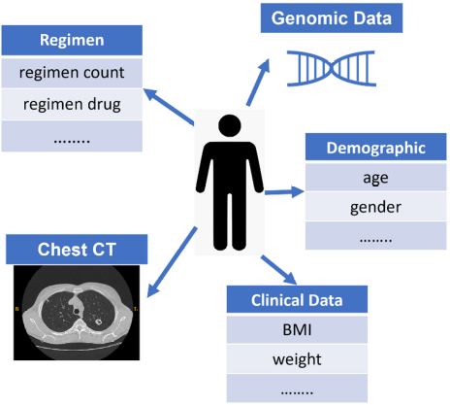
TB Dataset
Five modalities:
Imaging (CT annotations) – 2084 DenseNet features
Genomic (SNP) - 4048 categorical features
Demographic – 29 categorical, 1 continuous
Clinical – 1726 categorical, 1 continuous
Regimen – 233 categorical
Five Class Classification: Cured, Failure, Still on treatment, Completed, Died
Notes:
We evaluate on a public dataset from the NIH for Tuberculosis treatment outcome prediction.
There are 5 different data modalities. Each modality may have mixture of categorical and continuous features. Outcomes in tuberculosis are believed to arise out of many complex interactions between such data featues. This is what we seek to explicitly mine and leverage as a part of our multiplexed graph representation learning and inference.
The outcome prediction is a five class classification task with the classes as cured, failure, still on treatment, completed and died.

Slide 23
Baseline Comparisons
Fusion Baselines:
No fusion /Individual modality prediction
Early fusion
Intermediate fusion
Uncertainty based late fusion (Wang et. al. 2021)
Ablations:
Relational GCN on a Multiplexed Graph (Schlichtkrull et. al. ,2018)
Relational GCN w/o Latent Encoder (Schlichtkrull et. al. ,2018)
GCN on monoplex feature graph (Kipf and Weling et. al., 2016)
Notes:
We compare our framework against 4 baseline models, namely no fusion or prediction from each of the individual modalities. This baseline helps us evaluate the benefit provided by fusing evidence across different data modalities.
The early fusion baseline is a simple two layered MLP run on the original concatenated features. Since the input features are high-dimensional, this method would have a large model size and parameterization
In the intermediate case, we perform fusion after the modality encoder projections by using the concatenated feature as input. This also helps us evaluate the benefit of utilizing the graph representation learning through the concept -Autoencoder for inference
Finally, we compare against a recent work from our group which utilizes the uncertainty in predictions from individual modalities and performs late fusion of the results or prediction.
The ablations studies help us systematically evaluate each individual component of our framework.
For the first two comparisons, we utilize a state-of-the-art GNN, i.e. the relational GCN described in the introductory slides for inference. In the first comparison, the relational GCN is run of the multiplexed graph obtained from the concept auto-encoder. This hleps evaluate the benefit of using the multiplexed GNN message passing for reasoning.
Second, the relational GCN is run on a fully connected multiplex without the latent encodings and salient projections. This helps establish the efficacy of utilizing the concept space and salient projects to select features that interact in a significant fashion in the data modalties.
Finally, we also perform a comparison against a traditional GCN on the averaged connectivity features. This helps evaluate the benefit of using multiplexed representations that model different modes of interaction in the context of multimodal fusion.

Slide 24
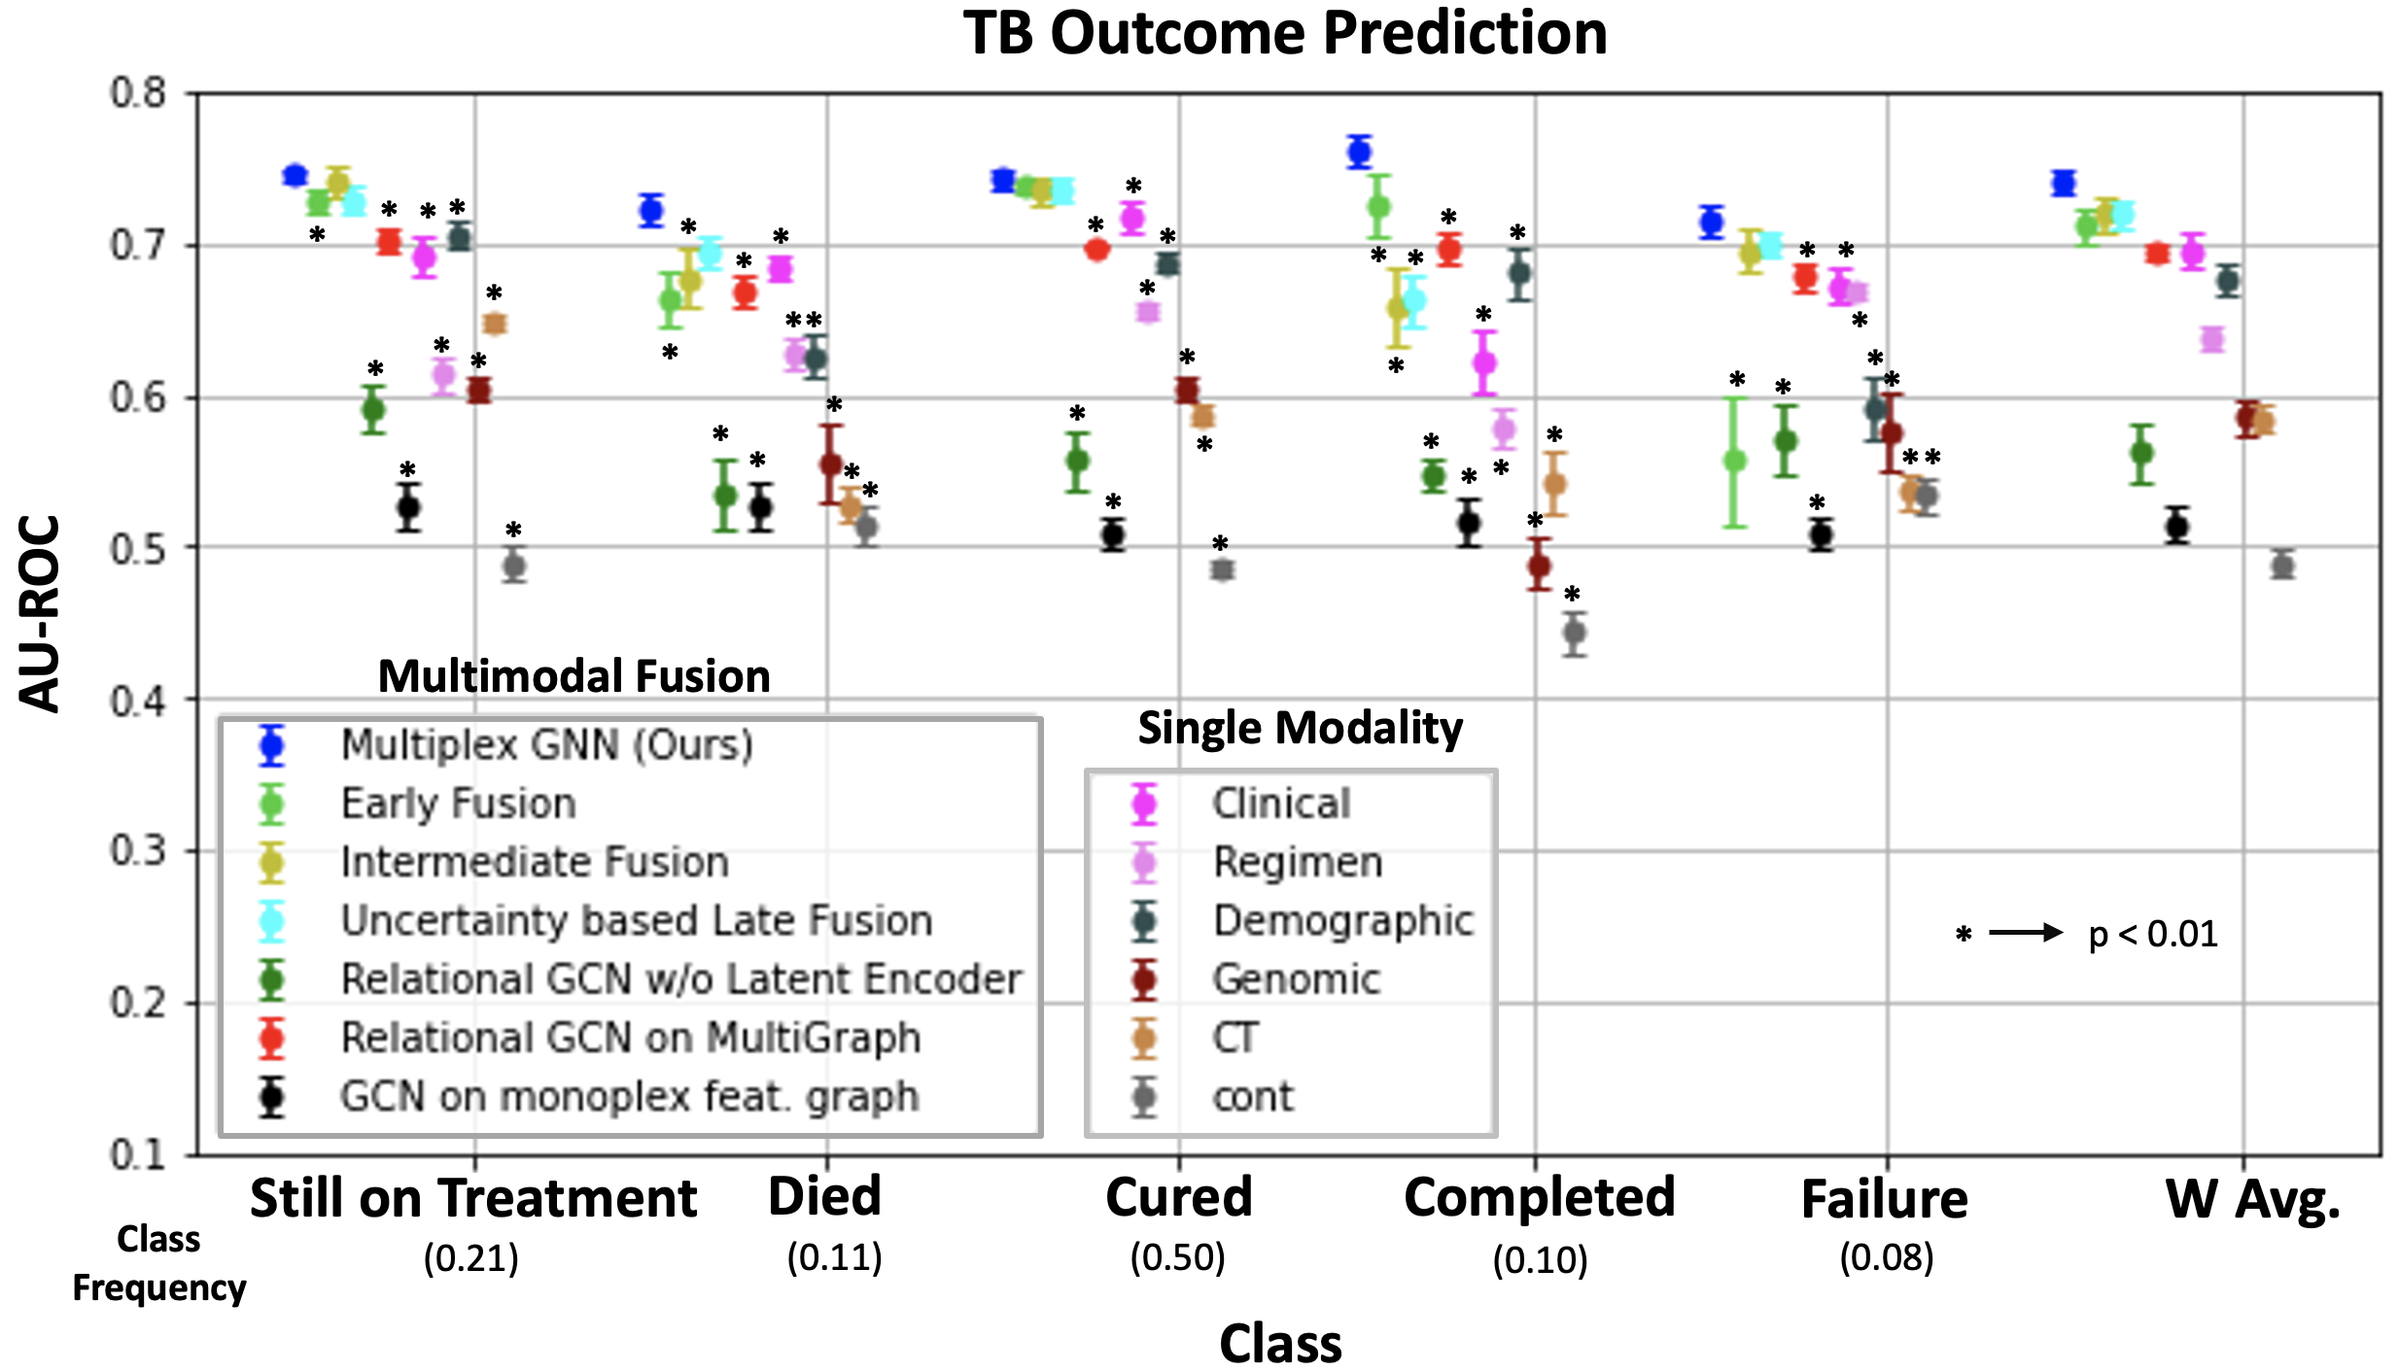
Results
Notes:
We measure performance using the per-class AUC and the weighted average AUC over 10 different random splits of the data. We measure statistical significance via the de-long test. Higher AUC indicates better performance. Comparisons against our model marked with a star reach statistical significance.
<click> We observe Our framework provides large gains over the fusion baselines and ablations. A majority of the comparisons reach statistical significance indicating that the provided gains are robust to random data splits and initializations.
We surmise that the salient learned conceptual patterns are more successful at uncovering cross modal interactions between features that are explanative of patient outcomes. At the same time the Multiplexed GNN takes into account the multi-faceted interactions within and across the modality features in a structured fashion that is tailored to patient outcome prediction. Overall, our Multiplexed Framework is a powerful new tool for structured reasoning within multimodal data

Slide 25
Hallucinations in foundation models
Notes:
Potential implications of far-reaching
4 billion users on google search use BERT

Slide 26
Fact-checking Generative AI in healthcare
Radiology report correction:
  Source : From the paper in MLMI 2023
    https://arxiv.org/abs/2307.14634

Slide 27

Fact Checking of AI-Generated Radiology Reports
Razi Mahmood¹, Diego Machado Reyes¹, Ge Wang¹,
Mannudeep Kalra², M.D., Pingkun Yan¹
Rensselaer Polytechnic Institute, Harvard/MGH Hospital
^{mahmor@rpi.edu}
Notes:
Hello, my name is Razi Mahmood, and I will be presenting my summer research work on fact checking of automatically generated radiology reports. This work was guided by researchers from IBM Research as well as RPI as I just started graduate school this Fall.

Slide 28
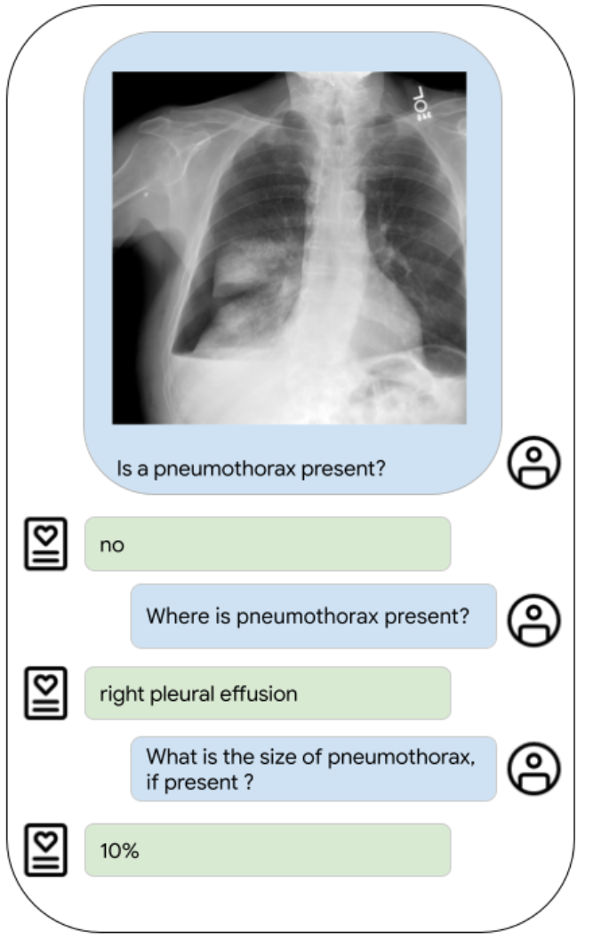
Fact checking of radiology reports
Currently, no fact checking for radiology report
Radiology reports are primarily assessed for quality by:
  Match of generated report to ground truth
    E.g. using BLEU, ROUGE and other scores
    Ground truth not available in clinical workflows
  Vision-language prompting in quality assurance (QA):
    E.g. Elixir-B phase 2 from Google
    Not practical for clinical workflows
Elixir Model Prompting
Notes:
Currently, there is no formal fact-checking happening for radiology reports. Most researchers show their results by comparison to ground truth reports through lexical similarity scores such as BLEU or ROUGE scores. In practice, since we will not have ground truth, we will not have these to fact-check in clinical workflows.
Newer work by Google on the Elixir model has tried to address report quality assurance using imaging but with carefully crafted language prompting though which is again not practical for clinical workflows.

Slide 29
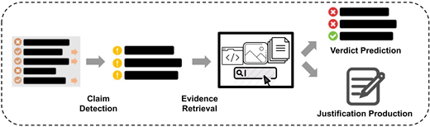
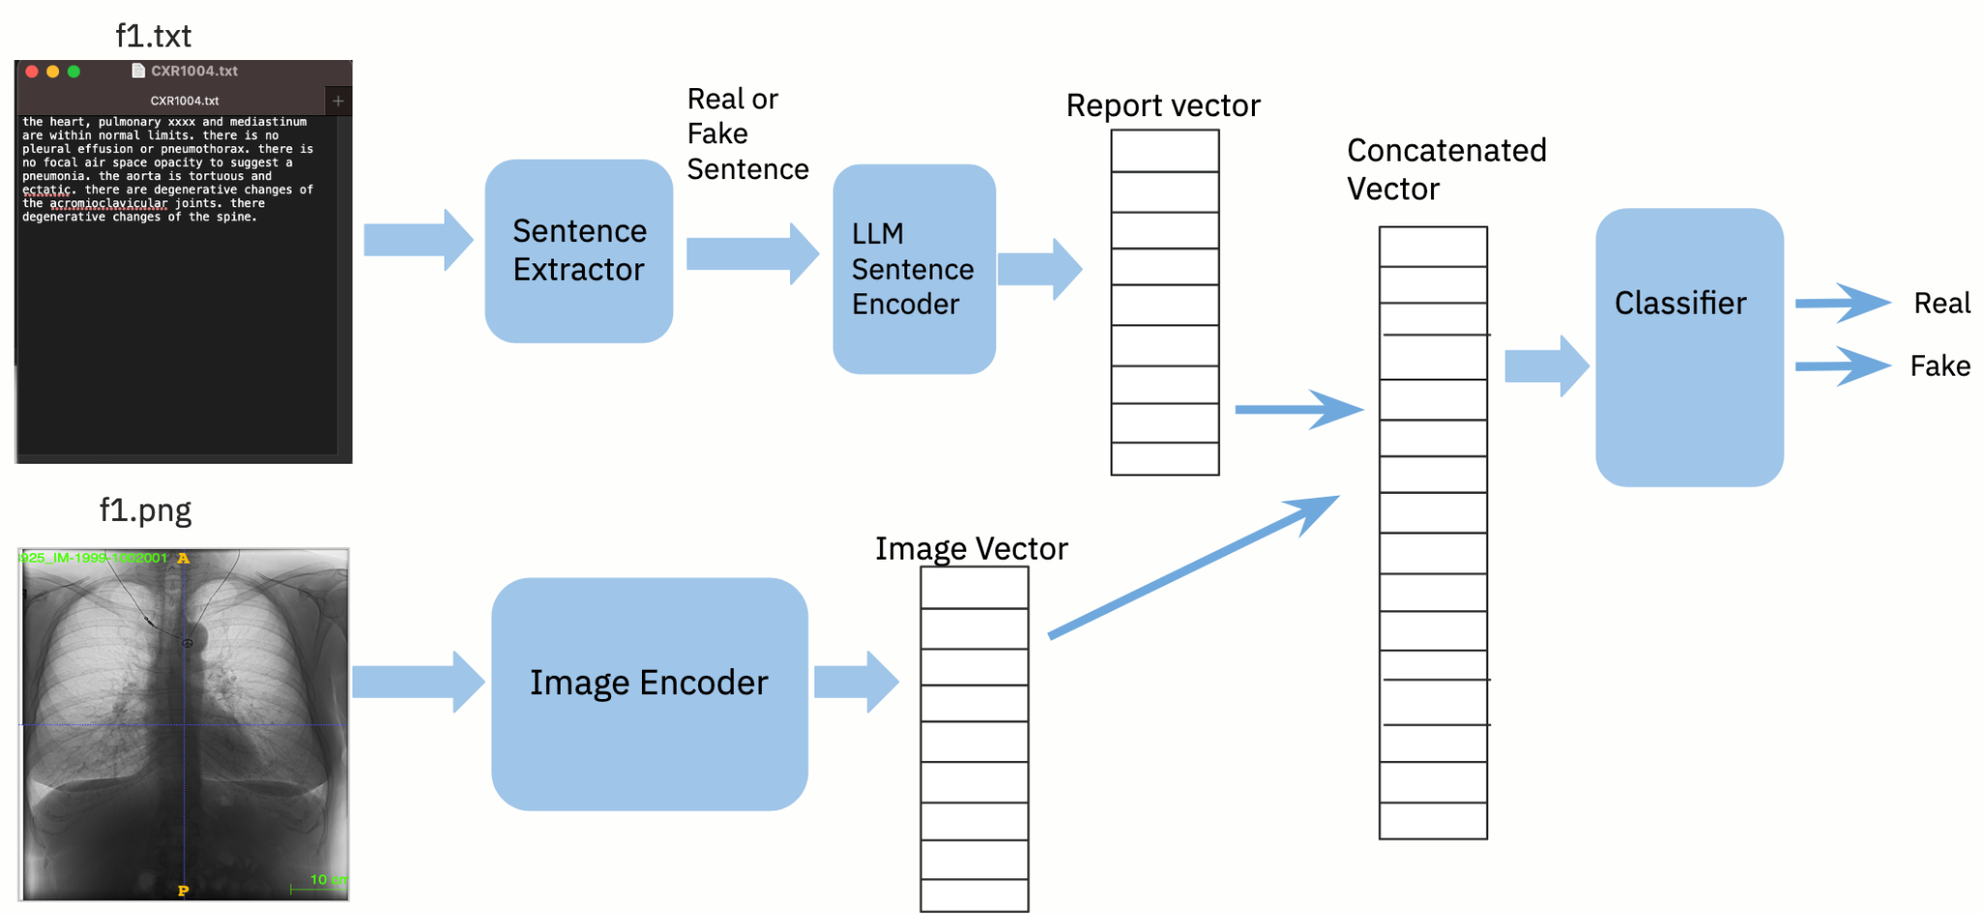
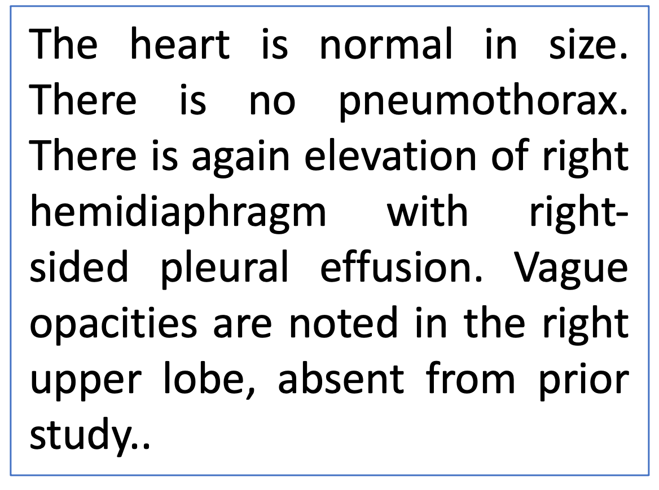
Fact checking for generative AI
Fact checking of automated text done in computational journalism:¹
  Identifies potential claims
  Retrieves evidence from external source
  Verifies the claim
Won’t work for radiology reports:
  Description is of findings seen in image
  Specific to current patient
  Verifying facts needs associated image
Fact-checking Datasets: FEVER, Liar
Our Idea: Use associated radiology image for fact-checking of radiology reports
Notes:
Since the automated report is an example of generative AI, we can ask if the fact-checking methods used for generative AI may work for this domain.
Fact checking is mostly done in computational journalism for automatically generated news, social media posts, and articles. It involves 3 major steps, namely, identify potential claims that require verification, retrieve evidence from external sources such as web sources that support or refute the claim, and finally verify the claim to assess the truth. What is a claim could be context-sensitive, such as, “over six million Americans had COVID-19 in January”.
Such claims exist even in the context of radiology reports, and naturally refer to sentences describing findings such as “pneumothorax” here. However, as they are specific to a given patient, it will be difficult to fact-check them by consulting external sources. Besides, since many of the findings refer to image content, fact-checking based on text alone will be insufficient.
This is our key idea in this paper, We are proposing to fact check a radiology report by using its associated image.

Slide 30
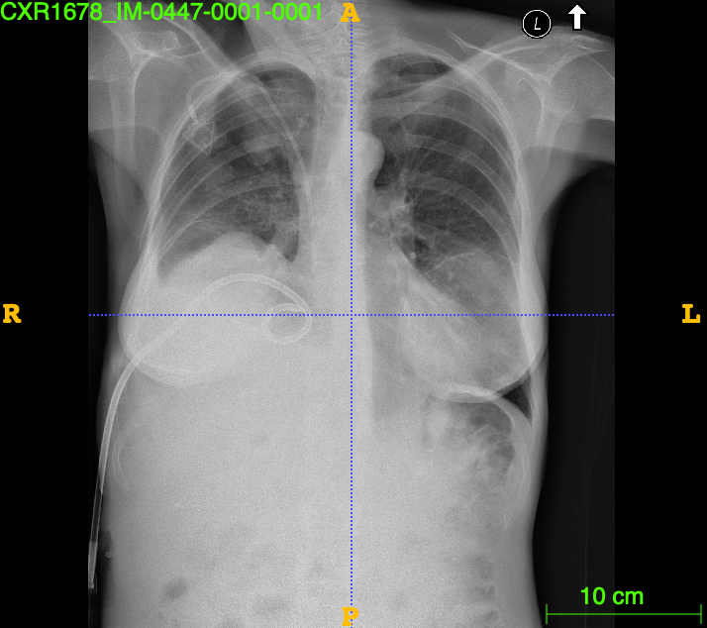
Fact-checking with Image
Original Report
The heart is normal in size. Right chest tube tip is again seen at the cavoatrial junction. There is no pneumothorax. There is again elevation of right hemidiaphragm with right-sided pleural effusion. Vague opacities are noted in the right upper lobe, absent from prior study. These may be related to overlying rib lesions versus true pulmonary nodules. The left lung appears grossly clear. Drainage catheter seen overlying the right upper quadrant.
Real Sentence
Given Image
Desired Joint Image-Text Embedding
There is no pneumothorax
Real Finding: No pneumothorax
Present in image
Fake Sentence
There are diffuse increased interstitial markings, suggestive of pulmonary fibrosis in bilateral lungs.
Real Sentence should be closer to the image in embedding space
Fake Finding: interstitial markings
Not present in image
Notes:
Since our idea is to fact-check based on image, we would want to see whether a sentence such as this is real, i.e. belongs in the report of an image such as this or is fake, i.e. describes a finding that is not present in the image. If we form a joint embedding space of images and text, we expect to find the green sentence vectors to be closer to the image than the red sentence vectors.

Slide 31
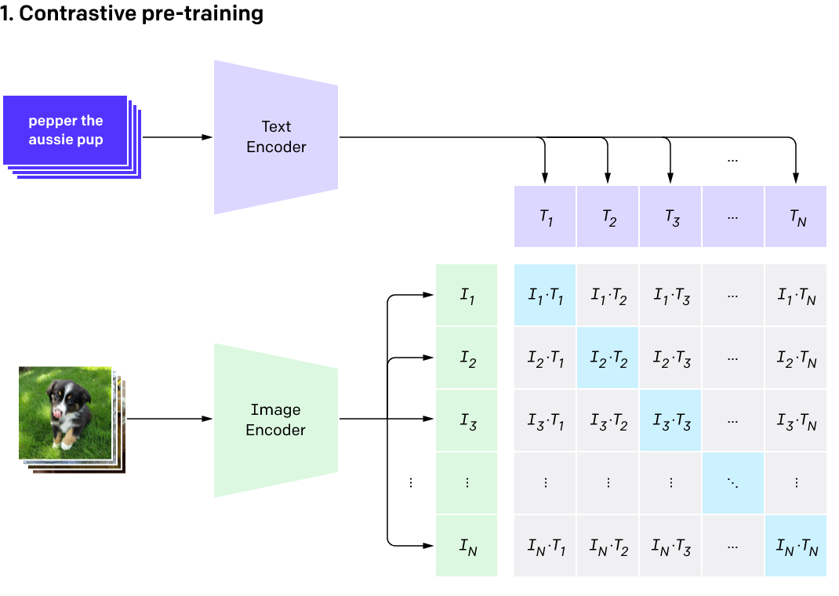
CLIP : Joint Image-Text Embedding
There are diffuse increased interstitial markings, suggestive of pulmonary fibrosis in bilateral lungs.
CLIP Joint Image-Text Embedding
There is no pneumothorax
Cosine similarity used to determine nearest vectors
Notes:
One such joint image-text embedding is the CLIP model for general images and their captions. Vision & language transformer encodings of image and text are used to create a new joint image-text embedding using self-supervised contrastive learning. The typical way in which CLIP is used nowadays is to directly take the image or text string as input, project it into the CLIP embedding space and find the nearest text or image vector using cosine similarity.

Slide 32
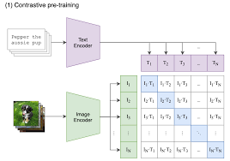
Projecting to a higher-dimensional space
There are diffuse increased interstitial markings, suggestive of pulmonary fibrosis in bilateral lungs.
Joint Image-text embedding
Concatenate pairs of image-text vectors
There is no pneumothorax
Decision boundary
Real sentence-image pair
Fake sentence-image pair
Higher-dimensional space
Notes:
However, the reality is that if we CLIP-encode real or fake sentences along with an image, their cosine similarities are very similar, and their joint embeddings are mushed close together like this.
Our method basically creates a new joint image-text space in which these vectors can be better separated. Specifically, we transform the CLIP embedding vectors of images and sentences into a higher dimensional space by concatenating the vectors into pairs. Thus in this example, the 3 vectors of image and the two sentences actually project to only two points in the higher dimensional space and are hopefully farther apart in order to allow us to build a classifier that can separate them.

Slide 33
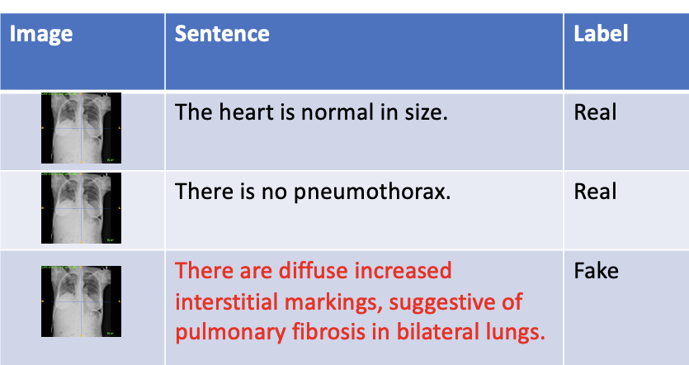
Fact-checking Model - Training
Real/Fake Label
Fact-checking Model
Labeled
Image-sentence pairs DB
Combined Feature
There is no pneumothorax.
512x1
CLIP
Encoder
1024 x1
sentence
SVM
Classifier
512x1
Image
CLIP
Encoder
linear kernel
Classifier learns the image-text associations of Real and Fake pairs
Notes:
To train our fact-checking model, given a dataset of sentence-image pairs (some real and some fake), we encode the sentences through CLIP producing a 512x1 vector, and the image is encoded through CLIP producing another 512x1 vector. The two vectors are concatenated to form a 1024x1 vector, which is then given the label associated with the sentence to train a simple SVM classifier with linear kernel. The classifier then learns to separate the real sentence-image pair from the fake sentence-image pairs.

Slide 34
Fact-checking Model for Report Correction
Report Corrector
Fact-checking Model
AI-generated report
1024 x1
Extract sentence
CLIP Encoder
512x1
SVM
Classifier
CLIP Encoder
512x1
Real/Fake
Remove Fake Sentences
Given Image
Corrected Report
Notes:
This model once trained can now become part of our report corrector. Given an AI-generated report, and the associated image, it extracts sentences from the report, pairs them with the image, and classifies them as real or fake. Any detected fake sentences would be removed from the AI report to produce a corrected report.

Slide 35
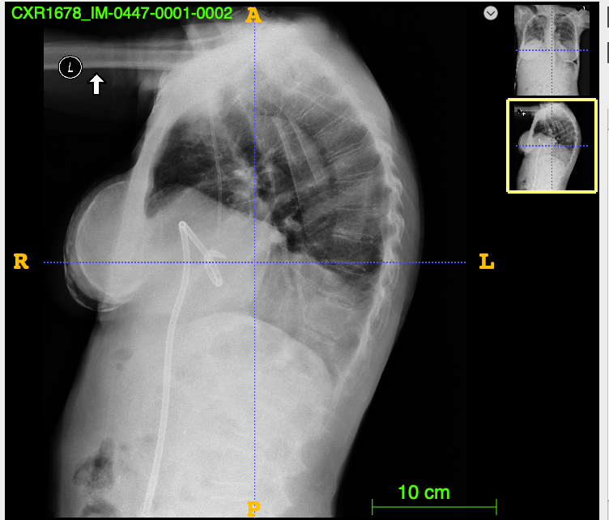
CXR1678 – Missed finding
Original Report
The heart is normal in size. Right chest tube tip is again seen at the cavoatrial junction. There is no pneumothorax. There is again elevation of right hemidiaphragm with right-sided pleural effusion. Vague opacities are noted in the right upper lobe, xxxx from prior study. These may be related to overlying rib lesions versus true pulmonary nodules. The left lung appears grossly clear. Drainage catheter seen overlying the right upper quadrant.
Missing finding Case
The heart is normal in size.
There is no pneumothorax.
There is again elevation of right hemidiaphragm with right-sided pleural effusion.
Vague opacities are noted in the right upper lobe, xxxx from prior study.
These may be related to overlying rib lesions versus true pulmonary nodules.
The left lung appears grossly clear.
Drainage catheter seen overlying the right upper quadrant.
Finding missed: “chest tube position”
Notes:
Here is an original report associated with this imaging study showing frontal and lateral views.
If we randomly remove a sentence such as this, we have a case of missed finding in the report produced by this perturbation. The finding we missed in this case is about the position of the chest tube.

Slide 36
CXR1678 – Incorrect Finding – Irrelevant finding
Original Report
The heart is normal in size. Right chest xxxx tip is again seen at the cavoatrial junction. There is no pneumothorax. There is again elevation of right hemidiaphragm with right-sided pleural effusion. Vague opacities are noted in the right upper lobe, xxxx from prior study. These may be related to overlying rib lesions versus true pulmonary nodules. The left lung appears grossly clear. Drainage catheter seen overlying the right upper quadrant.
Modified Report – Irrelevant finding added
The heart is normal in size.
Right chest xxxx tip is again seen at the cavoatrial junction.
There is no pneumothorax.
There is again elevation of right hemidiaphragm with right-sided pleural effusion.
Vague opacities are noted in the right upper lobe, xxxx from prior study.
These may be related to overlying rib lesions versus true pulmonary nodules.
The left lung appears grossly clear.
Drainage catheter seen overlying the right upper quadrant.
There are diffuse increased interstitial markings, suggestive of pulmonary fibrosis in bilateral lung xxxx..
Finding added:” interstitial markings”
Notes:
Next, we perturb the original report by adding a new sentence found in some other report describing a non-overlapping finding of interstitial markings that is not present in our given image. This simulates a case of incorrect finding of the irrelevant type.

Slide 37
CXR1678 – Incorrect finding - Reverse Finding Case
Original Report
The heart is normal in size. Right chest xxxx tip is again seen at the cavoatrial junction. There is no pneumothorax. There is again elevation of right hemidiaphragm with right-sided pleural effusion. Vague opacities are noted in the right upper lobe, xxxx from prior study. These may be related to overlying rib lesions versus true pulmonary nodules. The left lung appears grossly clear. Drainage catheter seen overlying the right upper quadrant.
Modified Report – Reverse Finding Case
The heart is normal in size.
Right chest xxxx tip is again seen at the cavoatrial junction.
There is pneumothorax.
There is again elevation of right hemidiaphragm with right-sided pleural effusion. Vague opacities are noted in the right upper lobe, xxxx from prior study.
These may be related to overlying rib lesions versus true pulmonary nodules.
The left lung appears grossly clear.
Drainage catheter seen overlying the right upper quadrant.
Finding reversed: “pneumothorax”
Notes:
Next, we perturb the original report to reverse the polarity of a finding making the finding a positive occurrence instead of the negative occurrence reported. This simulates a different kind of incorrectness.

Slide 38
CXR1678 – Complex errors – Exchanged findings
Original Report
The heart is normal in size. Right chest xxxx tip is again seen at the cavoatrial junction. There is no pneumothorax. There is again elevation of right hemidiaphragm with right-sided pleural effusion. Vague opacities are noted in the right upper lobe, xxxx from prior study. These may be related to overlying rib lesions versus true pulmonary nodules. The left lung appears grossly clear. Drainage catheter seen overlying the right upper quadrant.
Modified Report – Exchanged Finding Case
The heart is normal in size.
There is no pneumothorax.
There is again elevation of right hemidiaphragm with right-sided pleural effusion.
Vague opacities are noted in the right upper lobe, xxxx from prior study.
These may be related to overlying rib lesions versus true pulmonary nodules.
the left lung appears grossly clear.
Drainage catheter seen overlying the right upper quadrant.
There is a small left pleural effusion/hemothorax.
Finding removed: “chest tube position” Finding added: “pleural effusion”
Notes:
Finally, we show here cases where combinations of perturbations are happening involving an exchange of findings. Here, a chest tube line finding is replaced with pleural effusion.

Slide 39

Experimental Results
Raw data:
  Indiana Chest X-rays dataset downloaded from Kaggle
  Findings per sentence annotation came from IBM Research
Dataset | Patients | Images | Views chosen | Reports | Positive Findings | Negative Findings
Indiana Chest X-rays | 1786 | 7470 | 2557 | 2557 | 119 | 64
Synthetic data generated through report perturbation:
Fake Reports | Unique Sentences | Image-Sentence Pairs | Missed finding cases | Irrelevant Findings | Reverse Findings | Exchanged Findings
7671 | 3850 | 25535 | 17% | 19.4% | 25% | 38.6%
Notes:
We now present some experimental results using this synthetic dataset generated to train the classifier. The raw data came from a popular Kaggle chest X-ray collection of Indiana reports and images. The findings associated with the sentences of the reports was provided courtesy of IBM Research from their earlier work.
From the original 2557 unique reports coming from 1786 patients, we generated 4 times as many fake reports with the incidence distribution of errors of each finding case ranging from 17-38% as shown.

Slide 40
Results - Classifier performance - Real/Fake
Using a 60-20-20 split on patients
Training patients | Testing Patients | Held-out Patients | Training sentence-image pairs | Testing sentence-image pairs | Hold-out Reports
1071 | 357 | 358 | 20326 | 2550 | 3661
Accuracy | AUC | Precision | Recall | F1-score
84.2% | 0.87 | 86.2% | 93.1% | 0.9
Perturbation cases | Number of pairs | %age correctly labeled | Expected Label
Missed finding | 433 | 79% | Real
Add finding | 495 | 90% | Fake
Reverse finding | 638 | 70% | Fake
Exchange finding | 984 | 86% | Fake
Notes:
To train the classifier, we divided the dataset using a 60-20-20 split at the patient level leaving non-overlapping patients in train, test and hold out dataset. The holdout dataset was used to evaluate report quality. About 25,535 sentence-image pairs were generated from the synthetic report dataset.
Our first result is on classification accuracy of the Real versus Fake classification. Using the linear SVM with a threshold of 0.5, we get the performance as shown in this table. From the Real and Fake classes identified, we broke down the results for the sentence-image pairs based on the provenance of their perturbation operation. As can be seen, added findings were more easily recognized as fake but the missing findings also got recognized at about 80% accuracy. The lowest performance was seen for the negated cases in reverse findings, possibly because of annotation errors for negations.

Slide 41
Deployment considerations of foundational models

Slide 42
Deployment considerations
  Community development
    APIs, fine-tuning, distillation, Instructlab
  Privacy and security
  Legal and ethical considerations
  Societal impact
  Safety
  Fairness
  Trustworthy AI
  AI Misuse

Slide 43
Deployment of foundational models
Secure deployment
  Are APIs secure?
Fine-tuning
    How much difference does it make?
Can we do distillation
  train smaller, more focused models that can achieve the same (or better) performance for a fraction of the price.
Can we democratize foundational models
  Feed knowledge and own collectively?
Notes:
Google keyword search versus ChatGPT – cost-wise10 times as much

Slide 44
Problems with FM
Homogenization
  Defects of foundation model are inherited by all the adapted models downstream.
Distributional shifts
  Broader training base gives better prep
  Fine-tuning can help
  Spurious correlations or changes over time may not be well-handled by foundational models
    Background color for object recognition
    Surgical markers for medical diagnostics
    annotator biases in crowdsourced data
    Demographic biases
Representational bias
  Intrinsic versus extrinsic
Notes:
Spurious correlations as statistical correlations between features and labels with predictive power on the training distribution but not on the test distribution.
Models learn these spurious correlations largely because the foundation model training and adaptation data exhibit these biases

Slide 45
Legal and ethical considerations
Training data not aligned with business values.
Deploy models in a responsible and ethical manner:
  need technologies for additional oversight, testing, and validation.
  internal detection systems to identify misuse of their products
Legal issues with FM:
  How model was trained, liability for model predictions, protections for model output (i.e. who is seeing it)
    E.g. Fine-tuned foundation models that classify individuals in ways that correlate with protected attributes (e.g., race, gender) may face challenges under civil rights laws.
  Who can be sued?
    Liability of users, foundation model providers, and application developers
Notes:
The models are trained on an enormous quantity of data from the wild, and not all of that

Slide 46
Societal and Economic Impact
Affecting economy unfairly productivity, wage inequality, and ownership.
  FM can be deployed to
    Substitute for human labor
    Augment humans
    Discover new tasks and opportunities
  Increased concentration of ownership and power, or more decentralization.
Affecting labor
  FM transform tasks involving cognitive work, e.g. content creation and communication

Slide 47
Societal Impact
Persuasive text influencing decisions in a harmful way
  Polarization, media addiction
  Hate speech
  Copyright protection
  environmental or geopolitical harms
    Robotic agents trained to mimic humans in videos may attempt to punch or knock-out their human operators if their training data includes videos of boxing matches.
    Catastrophic if they occur in warfare systems (resulting in unwanted discharge of weapons, possibly igniting a conflict
    critical infrastructure (accidental destruction of critical energy or agricultural capabilities
    Political instability, economic collapse

Slide 48
AI risk in various enterprise business processes
Human resources: hiring, compensation (fairness, explainability, robustness)
Marketing: targeted advertising (fairness)
Healthcare: healthcare diagnostics, e.g. skin cancer detection (fairness, explainability)
Healthcare: treatment prioritization, e.g. kidney allocation, COVID-19 vaccine (fairness, explainability)
Finance: delinquency collections (fairness, explainability)
Finance: mobile money lending approval (fairness)
Insurance: disability settlement, life-insurance (fairness, explainability)
Healthcare Insurance: risk/utilization prediction, care management (fairness, explainability)
Quality of service: interactive voice response systems, outage prediction (fairness, robustness)
Retail: delivery planning optimization (fairness, uncertainty, explainability)
Retail: shift scheduling, sub-contractor selection (fairness, explainability)
Infrastructure: fiber-optic rollout (fairness, explainability)
Infrastructure: cell tower siting, transportation route planning (fairness, explainability)
48

Slide 49
AI Fairness
inequitable outcomes: the treatment of people that is unjust, especially due to unequal distribution along lines that c
compound historical discrimination [Hellman 2021]. Like any AI system, foundation models can compound existing inequities by producing unfair outcomes, entrenching systems of power, and disproportionately distributing negative consequences of technology to those already marginalized
Intrinsic versus extrinsic harm (due to their adaptation in downstream applications)
Intrinsic bias
  Representational bias (under or over representation ) leads to homogenization
  Extrinsic harm can be representational (depicting of black women)
  Abuse (chat bots use toxic content)
  Voice assistants not able to server African American accents
  ese technologies are used to conduct interviews for employment or transcribe courtroom proceedings. Mo
  group-based prejudice [
(2) Biases and harms in the foundation model regime originate from many sources (e.g., training and adaptation data, modelling and adaptation decisions, modeler diversity and community values).

Slide 50
AI Misuse
Capabilities are intentionally leveraged to cause harm to populations or individual
  generate high-quality, cheap, and personalized content for harmful purposes. In this section, w
  manipulative content creation and harassment.
  impersonate speech, motions, or writing, and potentially be misused to embarrass, intimidate, and extort victims.
  Cheaper content creation with few-shot learning techniques
  Low cost of adaptation means
    content is personalized much faster, even targeting a single individual
Earlier methods of fact-checking disinformation no longer work
  fake social media profiles commonly steal profile photos from dating sites, which are discoverable through reverse image searches. Similarly, disinformation websites frequently use plagiarized content to mask deceptive content
Notes:
2017 influence operation that originated in Russia and targeted Americans was $12.2 million
[DiResta et al. 2018]. More recently, individuals in Russia paid $75-$200 per article to American freelancers as part of a disinformation campaign
Easy curation of ChatGPT output than to hire content creators
arms race” between harmful content generators and detectors.

Slide 51
Topics not covered
  Reasoning
  Agent-based systems
  Robotic foundational models
  Explainability/interpretability
  Large-scale alignment (Labrador)

Slide 52
Top cited papers in FM
Unsupervised Representation Learning with Deep Convolutional Generative Adversarial Networks , Radford et al. (2016) (17012)
  This paper introduced DCGANs, a type of generative model that uses convolutional neural networks to generate images with high fidelity.
Attention Is All You Need , Vaswani et al. (2017)
  This paper introduced the Transformer architecture, which revolutionized natural language processing by enabling parallel training and inference on long sequences of text.,
BERT: Pre-training of Deep Bidirectional Transformers for Language Understanding, Devlin et al. (2018) , 111166
  This paper introduced BERT, a language model that uses bidirectional context to better understand the meaning of words in a sentence. BERT has become a widely used pretraining model in natural language processing.
Language Models are Few-Shot Learners, Brown et al. (2020) , 22215
  This paper introduced GPT-3, a language model that can perform a wide range of natural language tasks with little or no task-specific training. GPT-3 is notable for its large size (175 billion parameters) and its ability to generate coherent and convincing text.
DALL-E: Creating Images from Text, Ramesh et al. (2021) ,3307
  This paper introduced DALL-E, a generative model that can create images from textual descriptions. DALL-E has demonstrated impressive capabilities in generating realistic and imaginative images from natural language input.
On the Opportunities and Risks of Foundation Models, Rishi Bommasani, Percy Liang, et al. (2021), 2475
  This paper highlights progress made in the field of foundation models, while also acknowledging their risks—particularly the potential ethical and societal concerns, the impact on job displacement, and the potential for misuse by bad actors.

