Slide 1

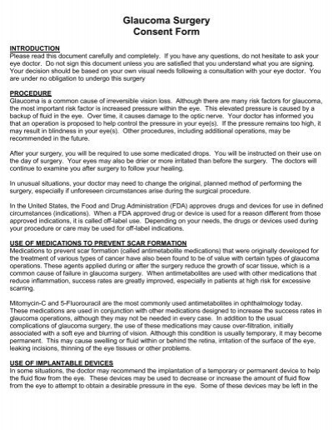
Using ChatGPT to Facilitate Truly Informed Medical Consent
Medical consent forms are difficult to understand.
Written at college level, but 54% of Americans have reading proficiency at <=6th grade.
Is this really informed?
Ali et al. NEJM AI in press
Notes:
Next we will discuss how to use LLM to help patients by making medical consent easier to understand.
A key component of = is that patients understand understand the risks and benefits of different treatment options and make informed consent.

Slide 2
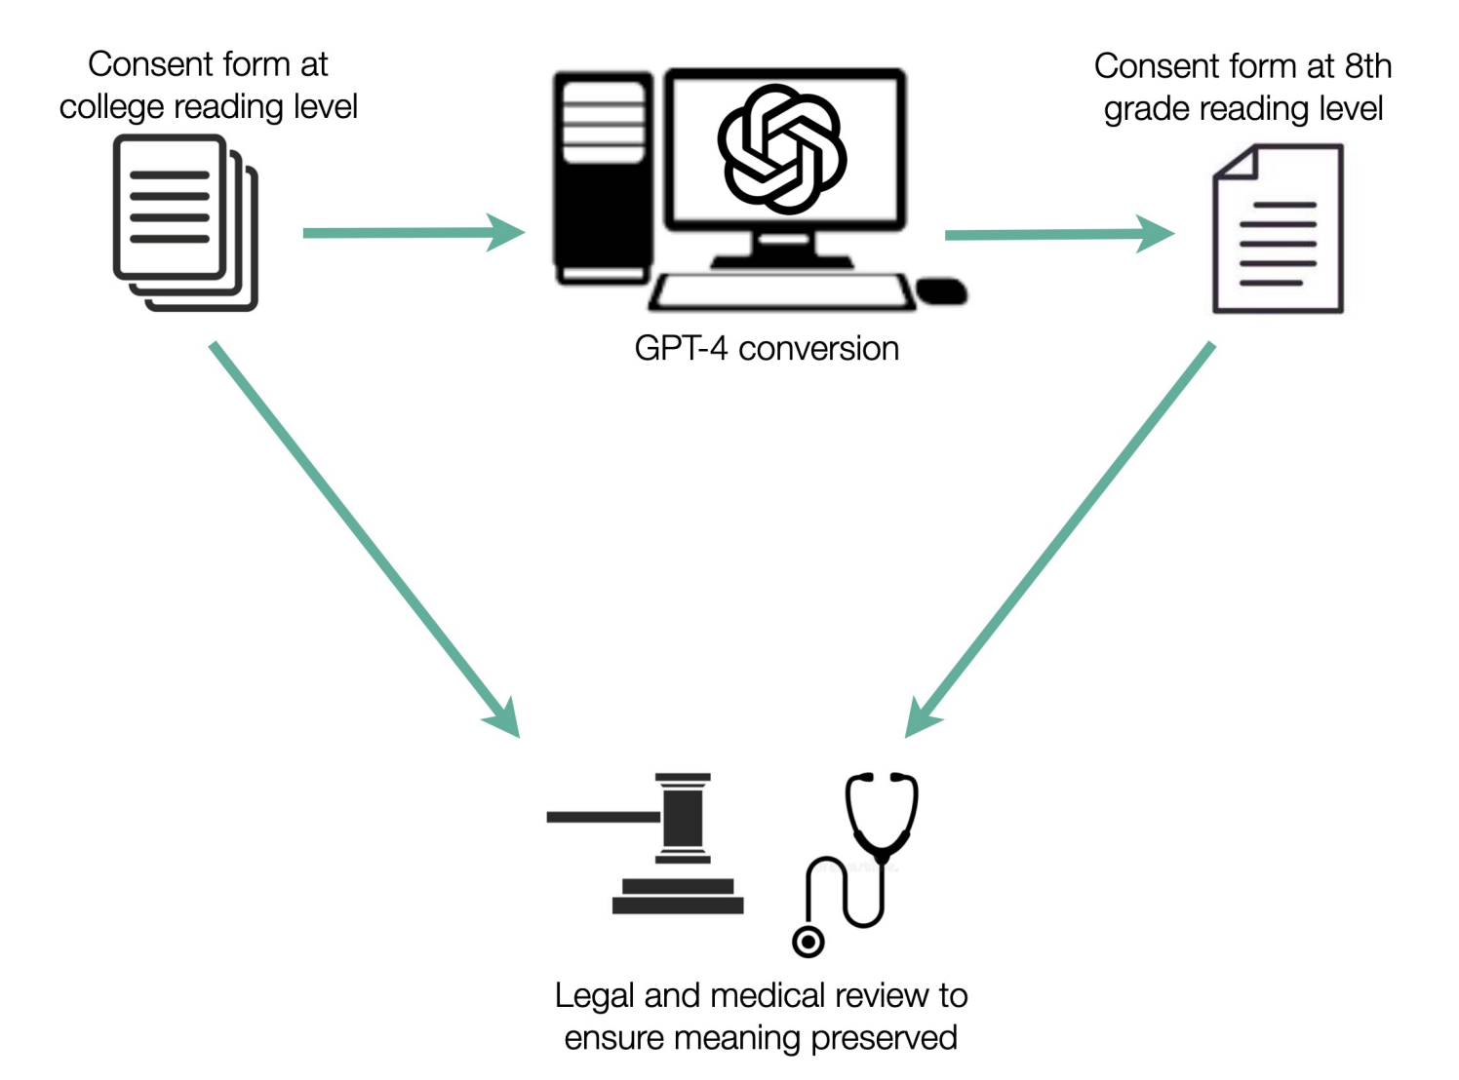
Using ChatGPT to Facilitate Truly Informed Medical Consent
Ali et al. NEJM AI in press

Slide 3
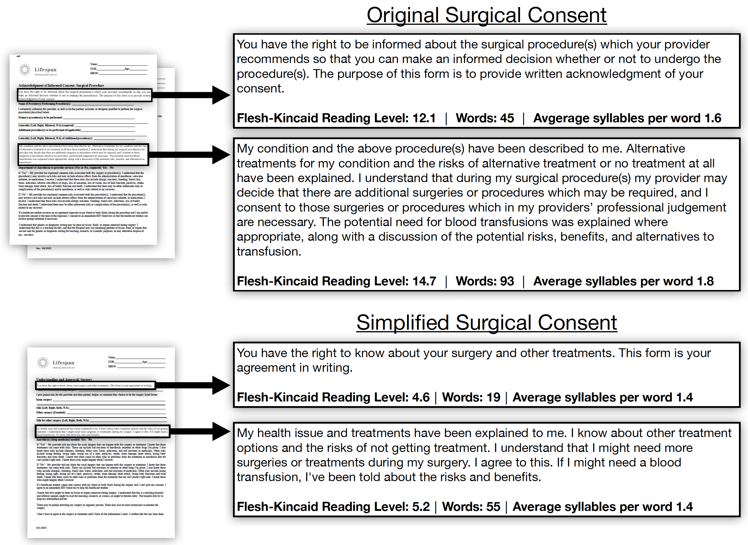
ChatGPT simplifies medical consent forms
Ali et al. NEJM AI in press

Slide 4
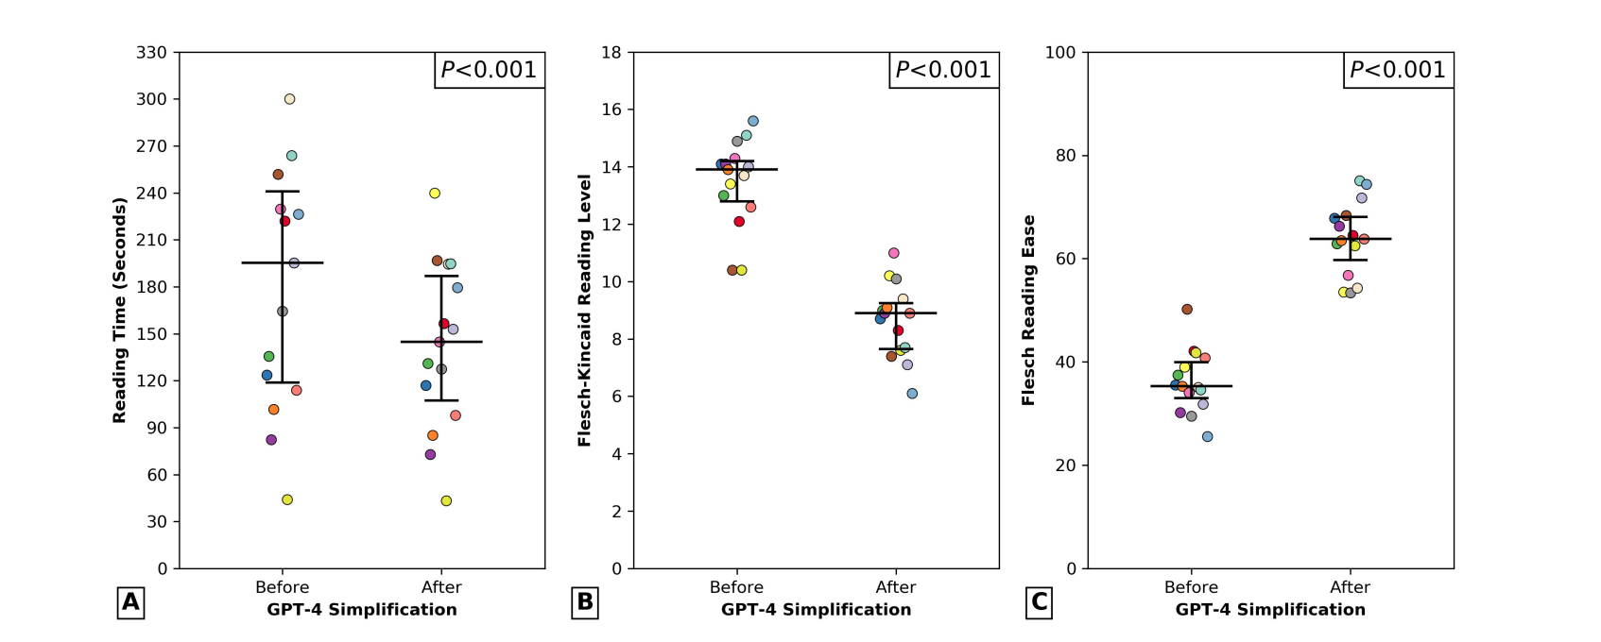
ChatGPT simplifies medical consent forms
Ali et al. NEJM AI in press

Slide 5
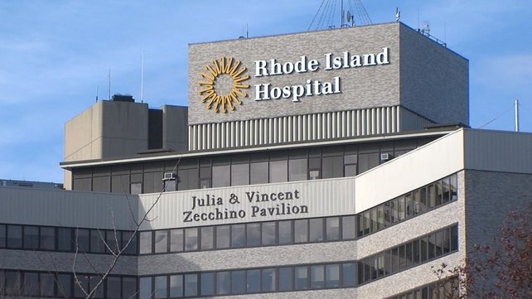
Deployment of AI generated consent forms
In Sept. 2023, LLM generated consent forms used at Lifespan, Rhode Island’s largest healthcare system (>35K surgical procedures annually).
Ali et al. NEJM AI in press

Slide 6
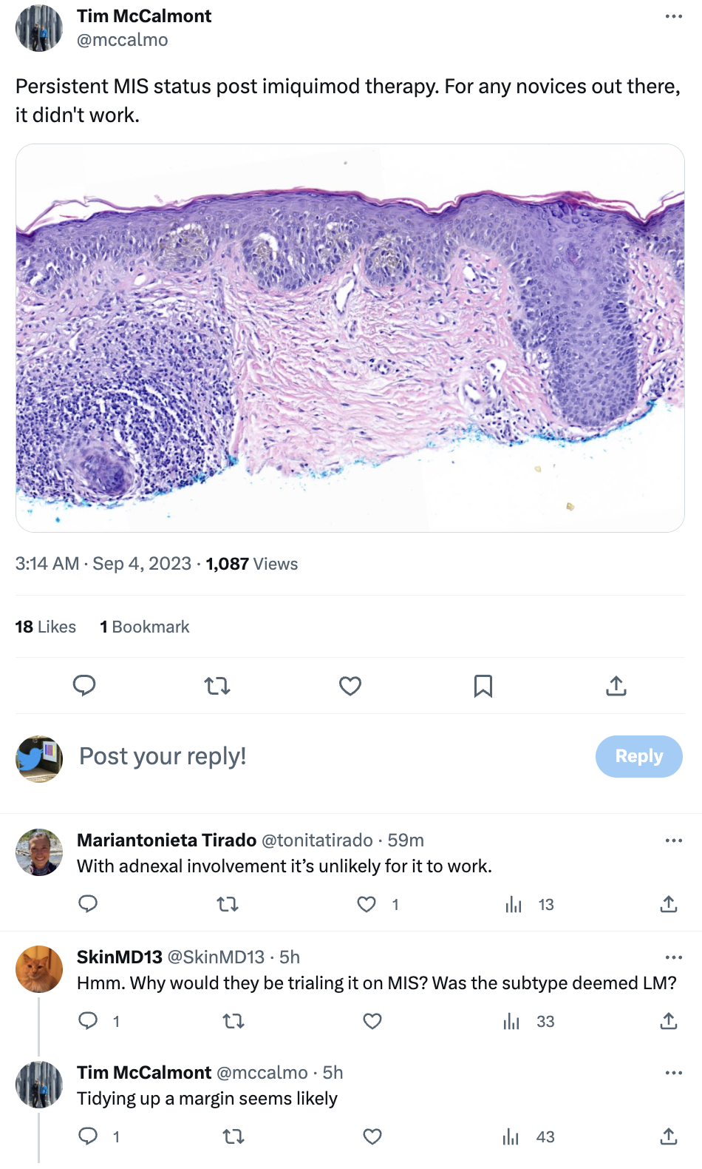
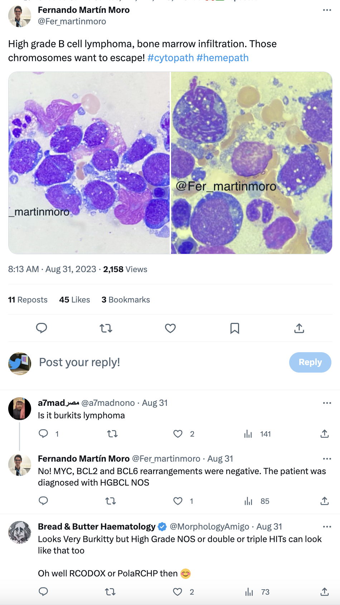
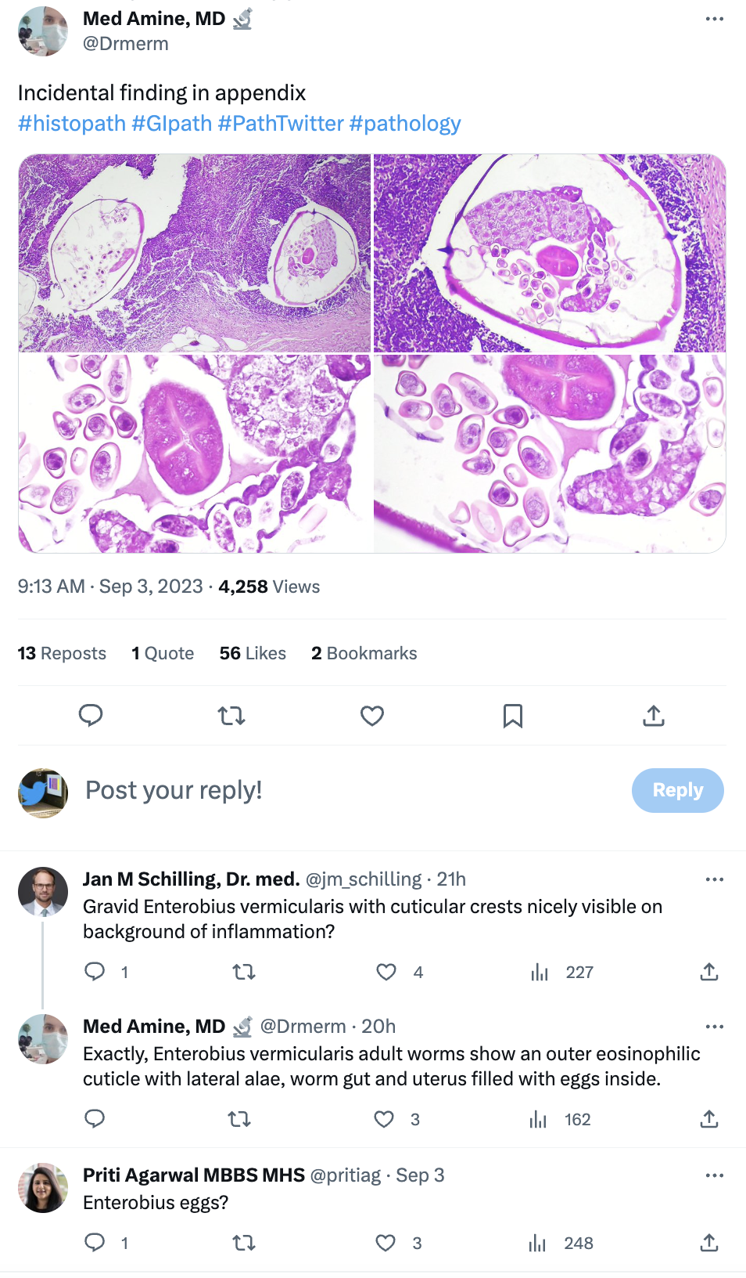
Much medical knowledge is shared on Twitter
Notes:
What’s very interesting is that when pathologists encounter ambiguous images, the national Pathology Academy actually encourages them to share and discuss these images with their colleagues on Twitter. So pathologists often post these images, and you see these very informative Twitter threads of experts chiming in.
So we thought that these Tweets is a great untapped resource for teaching medical chatbots to understand pathology images and to generate informative conversations based on the images.

Slide 7
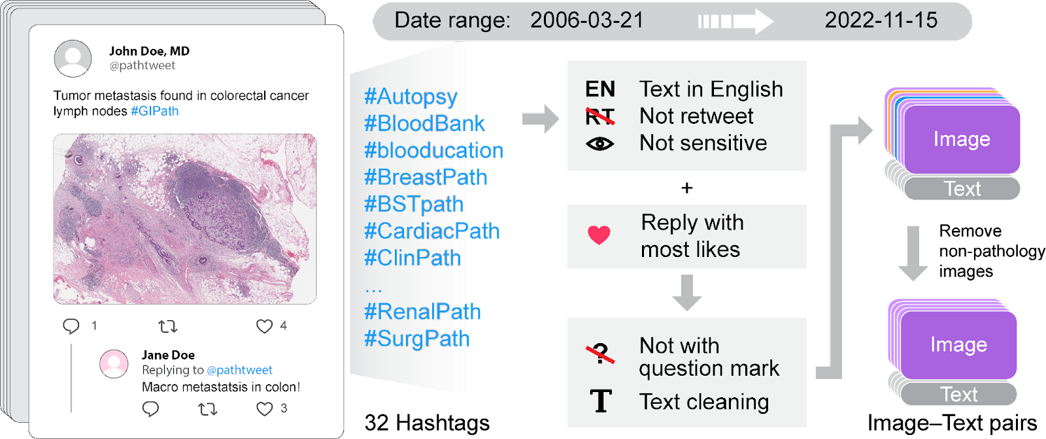
Creating OpenPath: >200K high-quality Twitter image-text pairs
Largest public dataset of pathology image + discussions.
Huang*, Bianchi* et al. Nature Medicine 2023.
Notes:
We created OpenPath dataset by curating the high-quality pathology discussions on Twitter. We used official hashtags that the national pathology academy asked their members to use. After a lot of filtering, we identified over 200K Twitter threads.

Slide 8
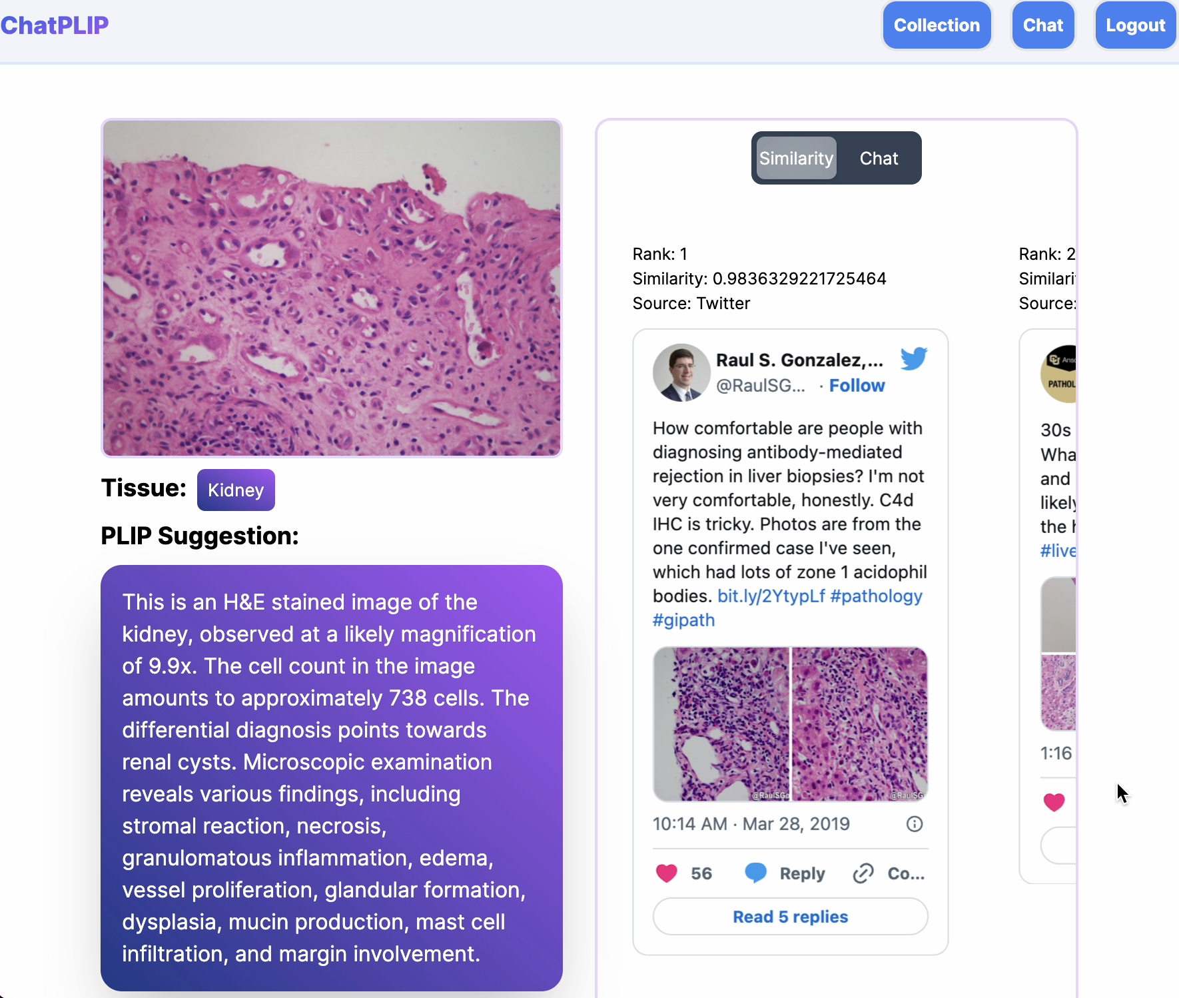
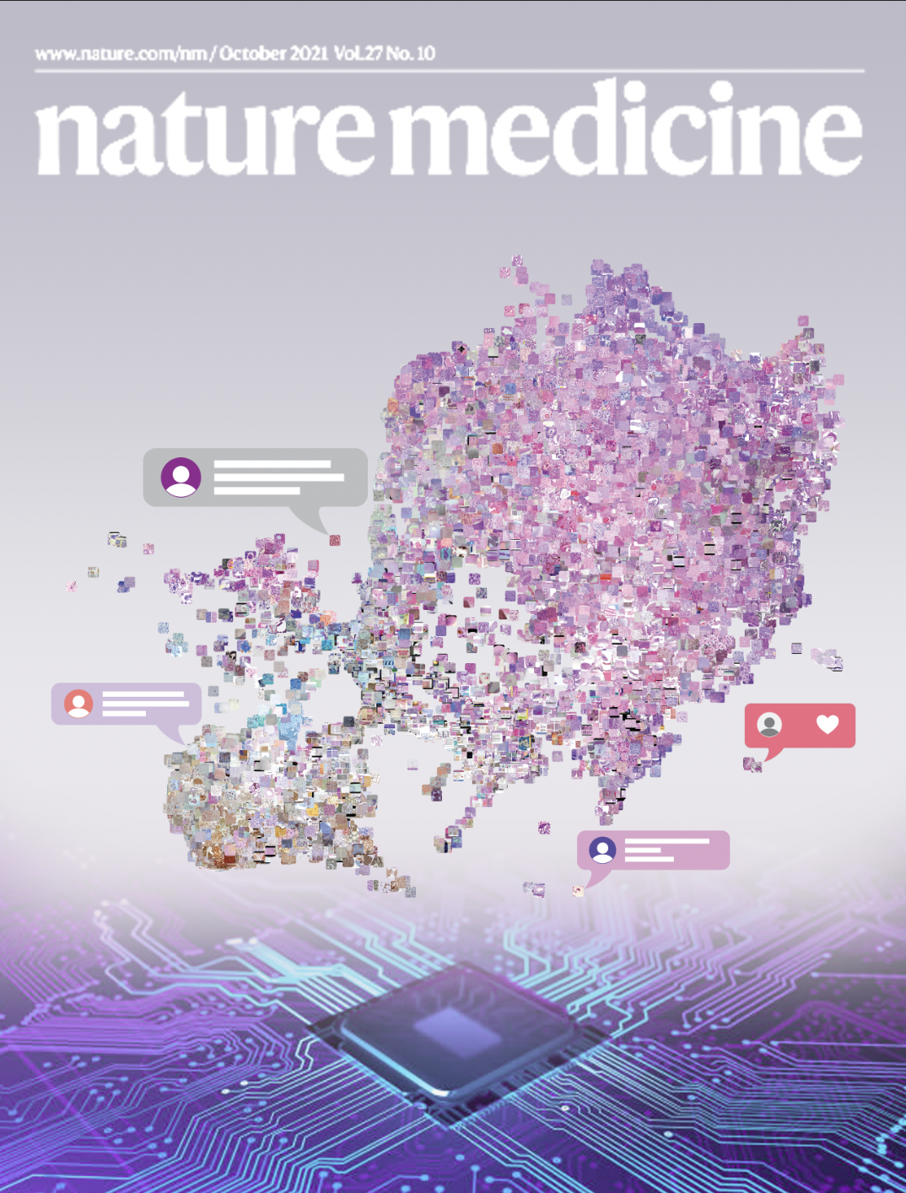
PLIP facilitates knowledge sharing and clinical decision support.
Huang*, Bianchi* et al. Nature Medicine (cover story) 2023.
Notes:
The paper is just came out on the cover of Nature Medicine today There’s a lot of experiments in the paper demonstrating that PLIP has good results

Slide 9
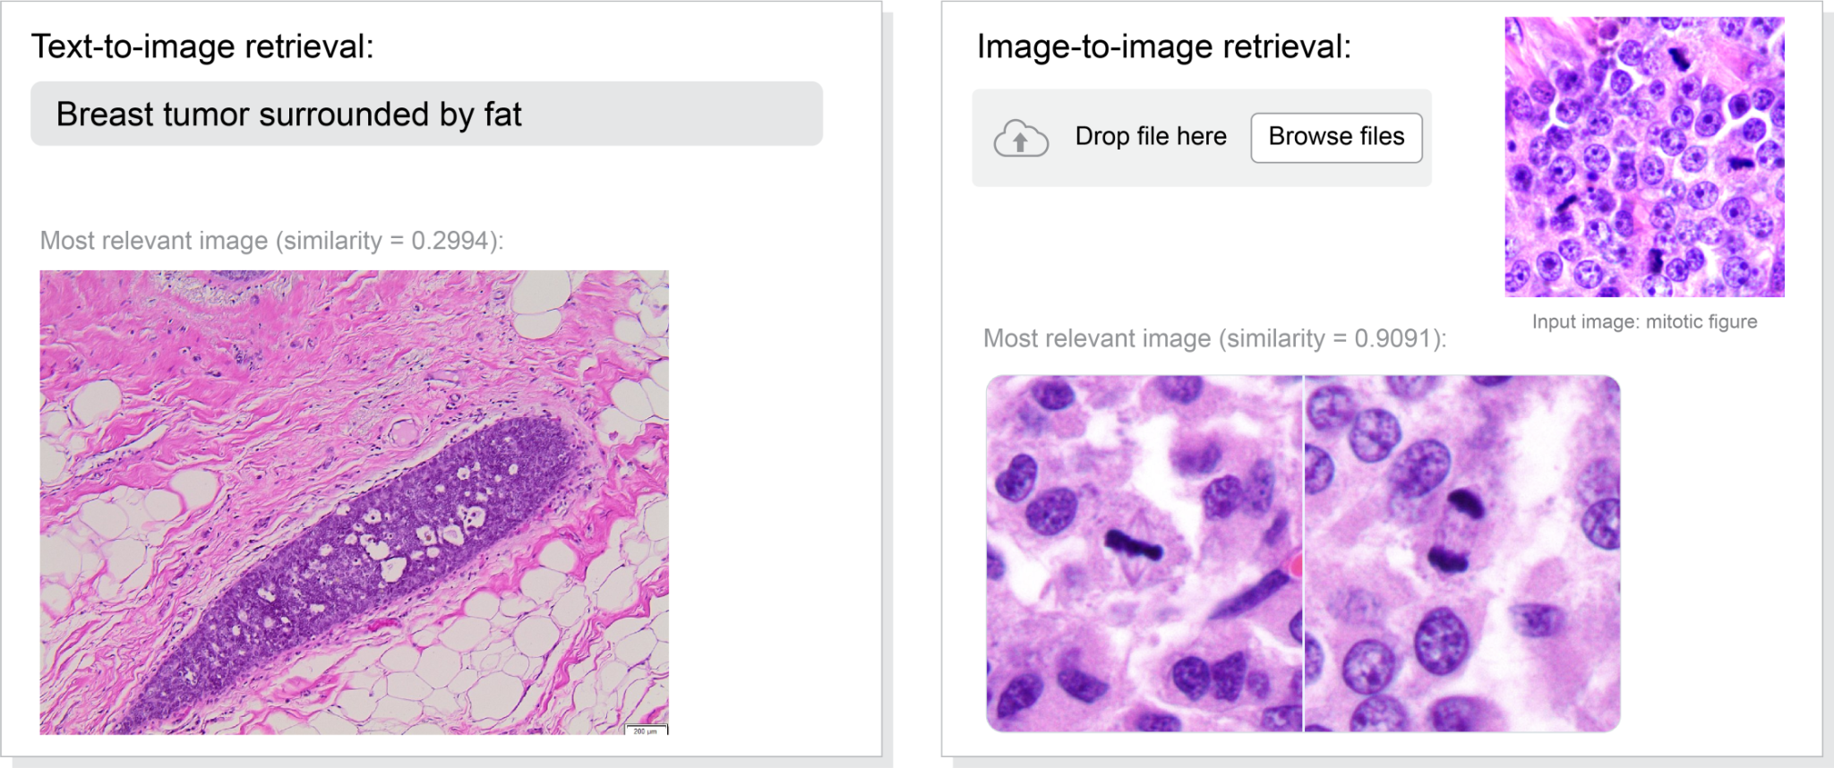
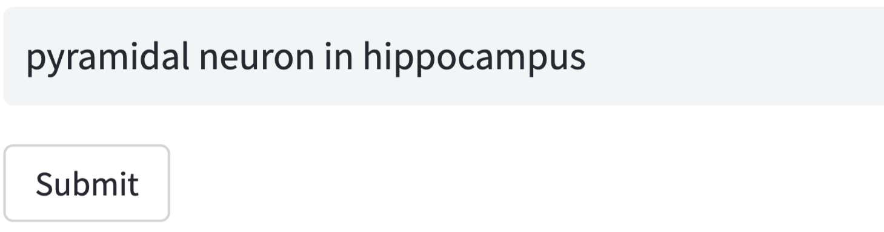
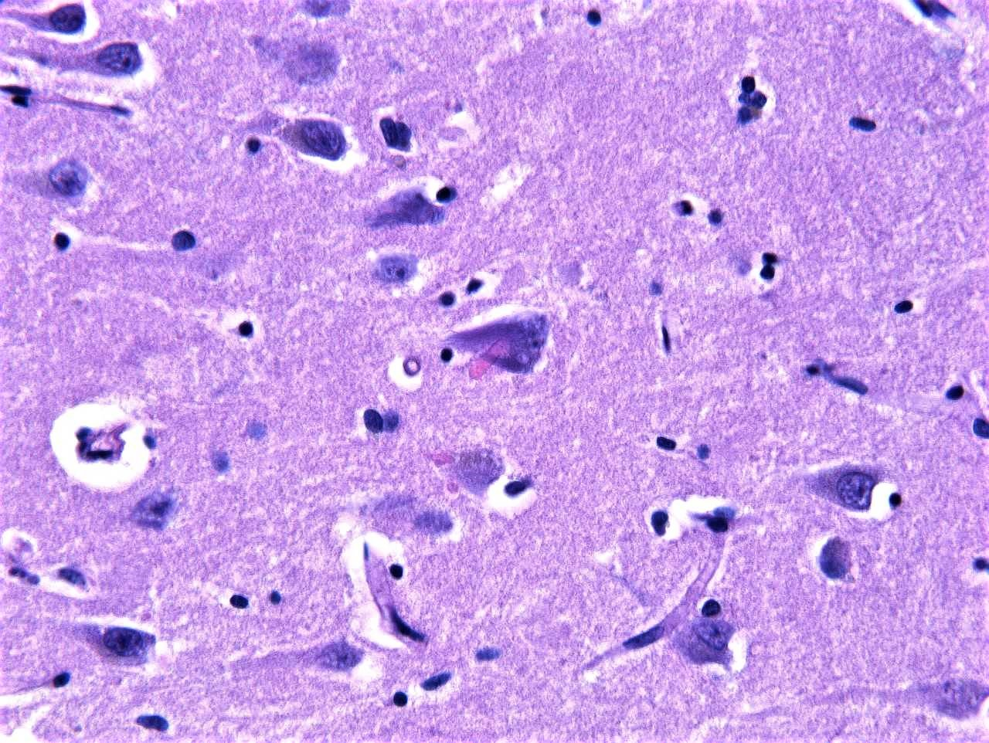
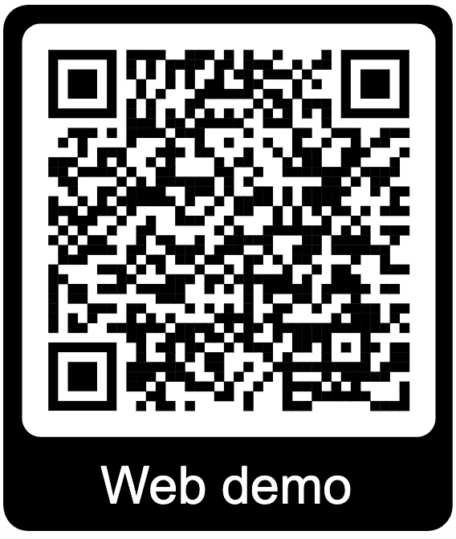
PLIP can serve as a powerful search engine for medicine
👈 Search engine is available online now.

Slide 10
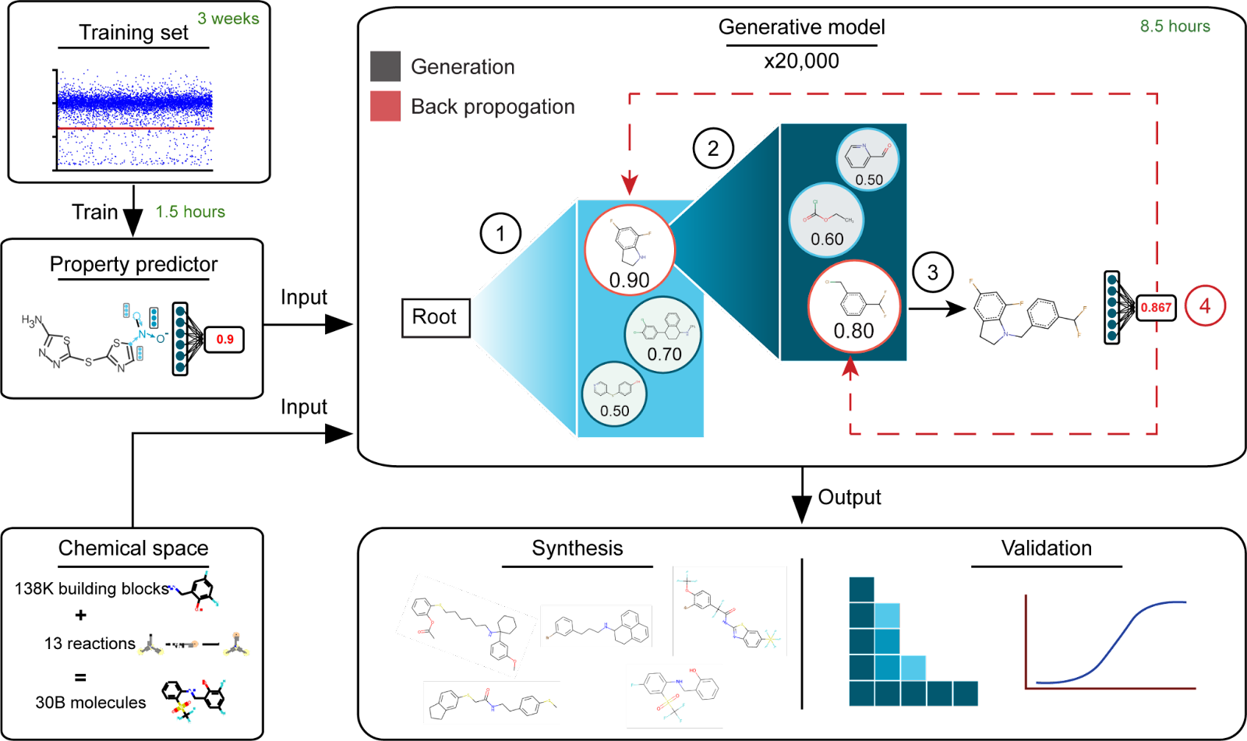
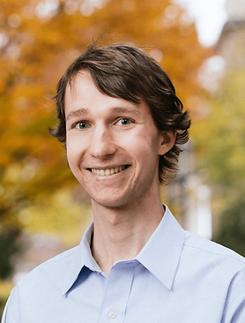
Generative AI for novel antibiotics
Kyle Swanson
Swanson et al. Nature MI in press.
Notes:
First AI generated antibiotics that’s experimentally validated.

