Slide 1
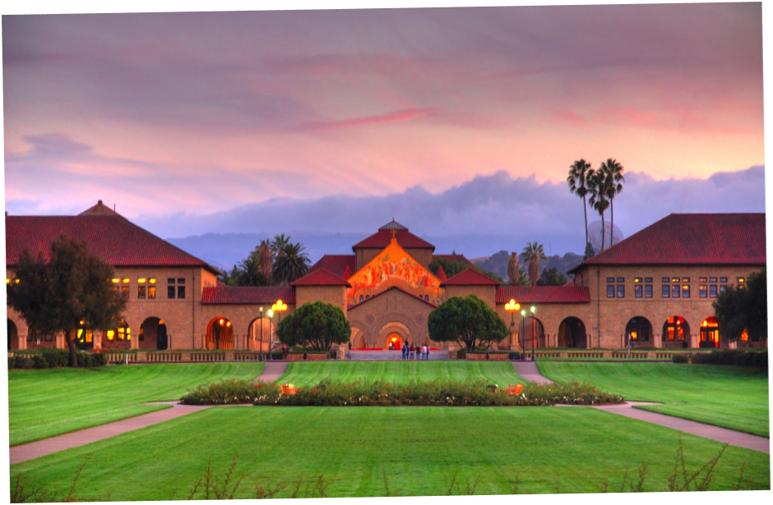
Vision-Language Models
BIODS 271 / CS 277
Tanveer Syeda-Mahmood
Akshay Chaudhuri
Maya Varma

Slide 2
Foundational models
Base models trained on large-scale data in a self-supervised or semi-supervised manner that can be adapted for several other downstream tasks”.
Paradigm shift:
  Replace narrow task-specific models with:
    Broader and generic base models
    Train once and adapt for multiple applications
This is a good thing because:
  Rapid model development
  Better performance
  Emergent intelligence from massive training data

Slide 3
Vision-language models
Foundational for tasks:
  Zero-shot classification
  Detection
  Zero shot Segmentation
  Captioning
  Language generation
  Masked prediction (visual or language)
  Contextual reasoning
  Question answering
Notes:
Zero-shot classification (CLIP)
Detection (CLIPSeg)
Zero shot Segmentation (e.g. SAM)
Captioning (CLIPCAP)
Language generation (CLIP+GPT3)
Masked prediction (visual or language) (Flamingo)
Contextual reasoning (KnowledgeCLIP)
Question answering (VisDial)
Accomplish new tasks by prompting and no retraining (any task?)
Take visual or textual prompts (E.g SAM)

Slide 4
Vision-language models (VLM) - Evolution
Zero-shot learning
  Had the label vocabulary defined, images of all labels not provided
  The classifier learns the association between labels and can carry over the analogy to new ones
Image Captioning
  Vision encoder for objects
  Text decoder for generation of text
Visual QA
  Vision encoder for objects
  Text decoder for generation of text
VLM
  Translating images into embedding features that can be jointly trained with token embeddings.
  Learning good image embeddings that can work as a prefix for a frozen, pre-trained language model.
  Using a specially designed cross-attention mechanism to fuse visual information into layers of the language model.
  Combine vision and language models without any training.

Slide 5
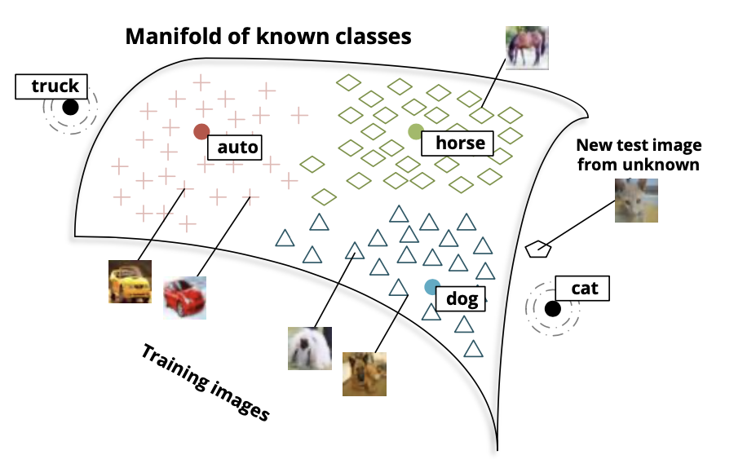
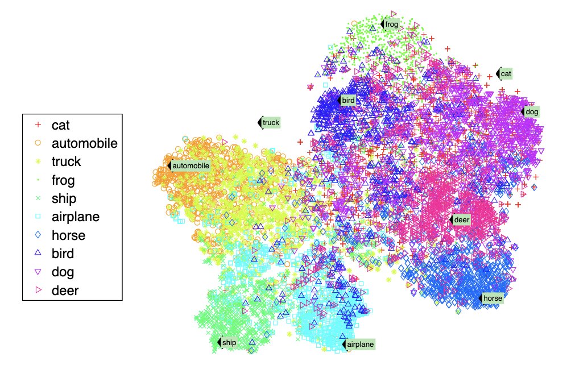
Zero shot learning – early attempts to generalize
All class labels known ahead of time
A simple case of caption as isolated words or class names
Whole image label prediction
R. Socher et al., “Zero-shot learning through cross-modal transfer,” in Proc. NeurIPS 2013
Notes:
Key requirement is that the image projects close to the class with nearby semantics. Pre-supposes that the word vectors are close by – assumed ensured by word embedding methods

Slide 6
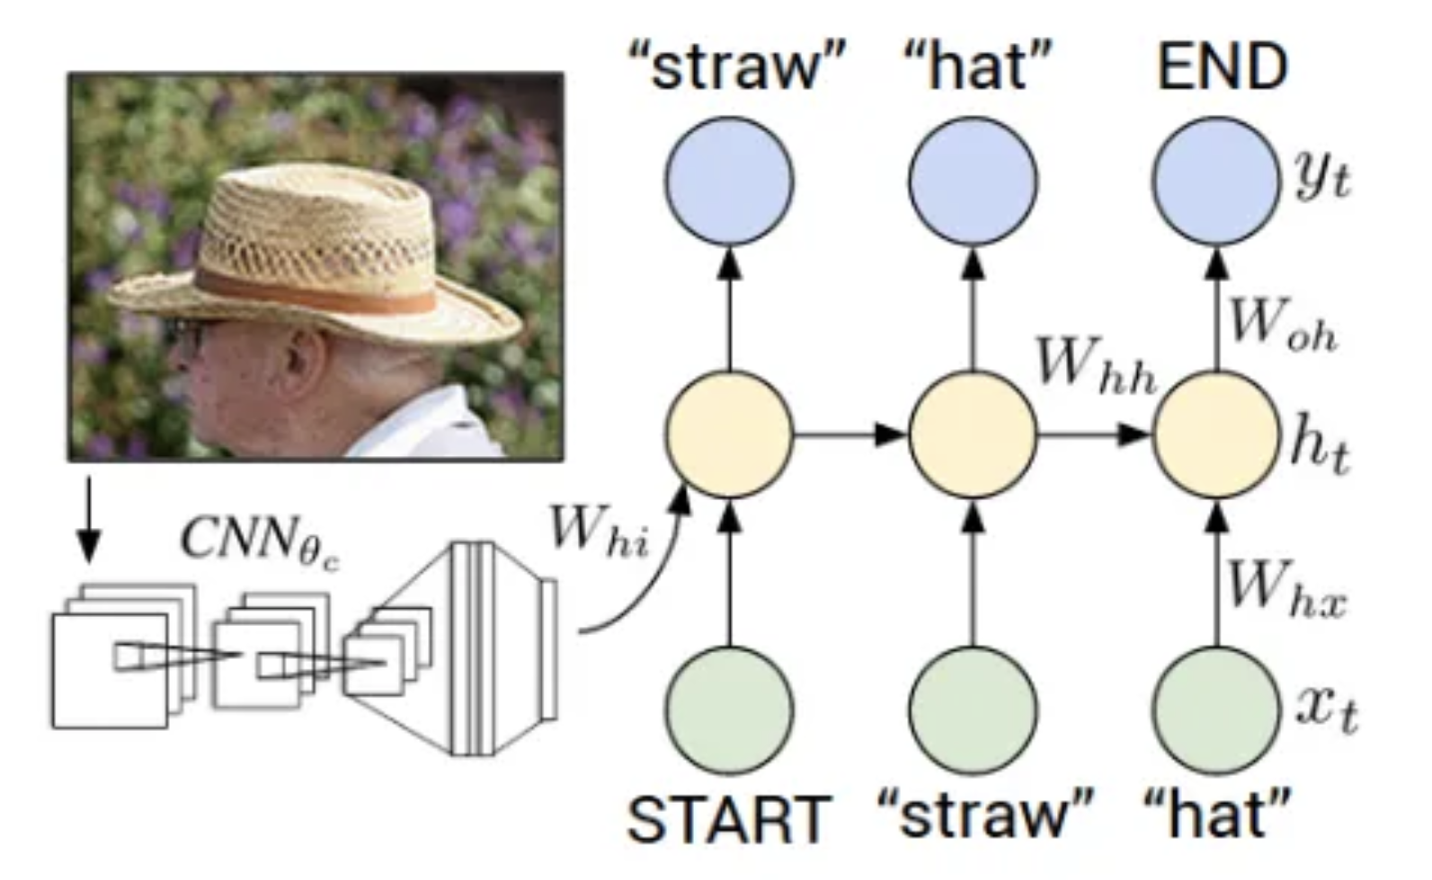
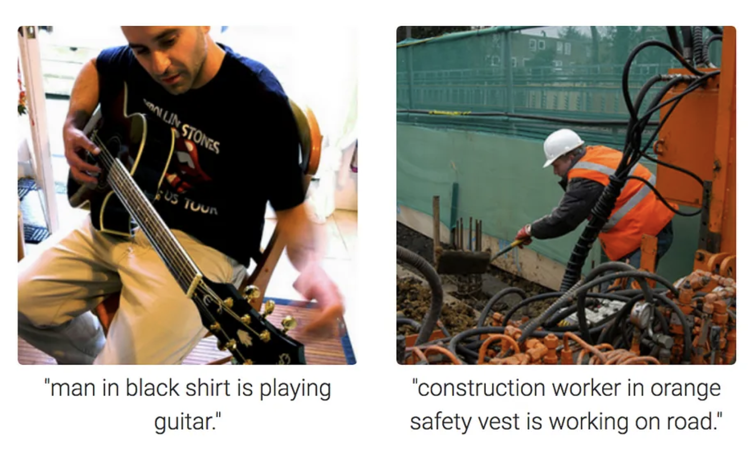
Visual captioning – From image to language
Trained on pairs of image and text
Associates objects, scenes, color with text
Caption is a longer phrase
All vocabulary generated from captions
Whole image caption prediction
Visual Encoder + Language Decoder.
Inference time: Only an image
K. Xu et al., Show, Attend and Tell: Neural Image Caption Generation with Visual Attention, CVPR 2015
https://towardsdatascience.com/image-captioning-in-deep-learning-9cd23fb4d8d2

Slide 7
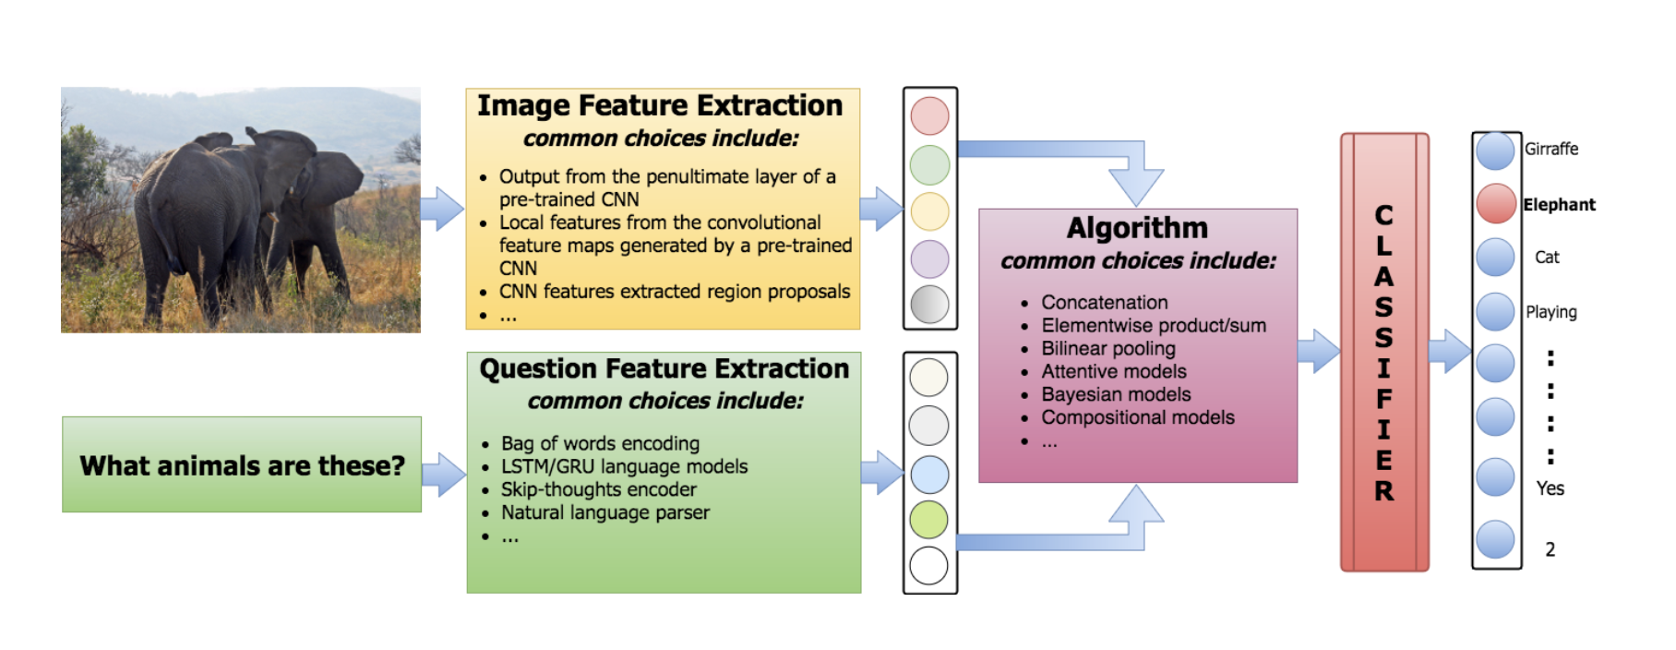
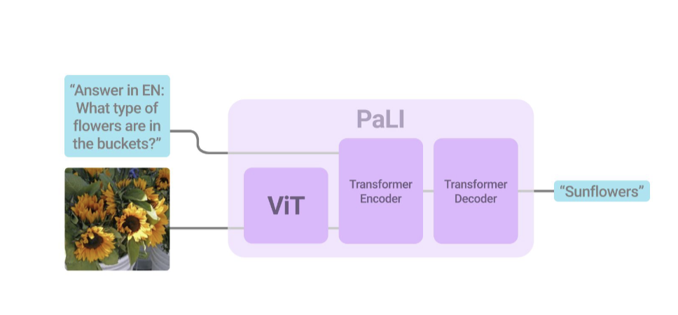
Visual QA
Training : Image + text question input -> Answer vocabulary is a classification task
Inference: Image + question input -> Answer text
K. Kafle and K. Kanna, Visual Question Answering: Datasets, Algorithms, and Future Challenges
X. Chen, PALI: A jointly-scaled multilingual language-image model, ICLR 2023
Notes:
captioning system is at liberty to arbitrarily choose the level of granularity of its image analysis which is in contrast to VQA, where the level of granularity is specified by the nature of the question asked.
Most papers evaluate on multiple downstream tasks, captioning, VQA, etc.

Slide 8
Essential elements of VLM
Model architecture
    Dual encoder, Fusion, Encoder-decoder
Training objectives
  Contrastive, generative
Large-scale training and prompting
  Pre-training, Fine-tuning, prompt tuning/engineering

Slide 9
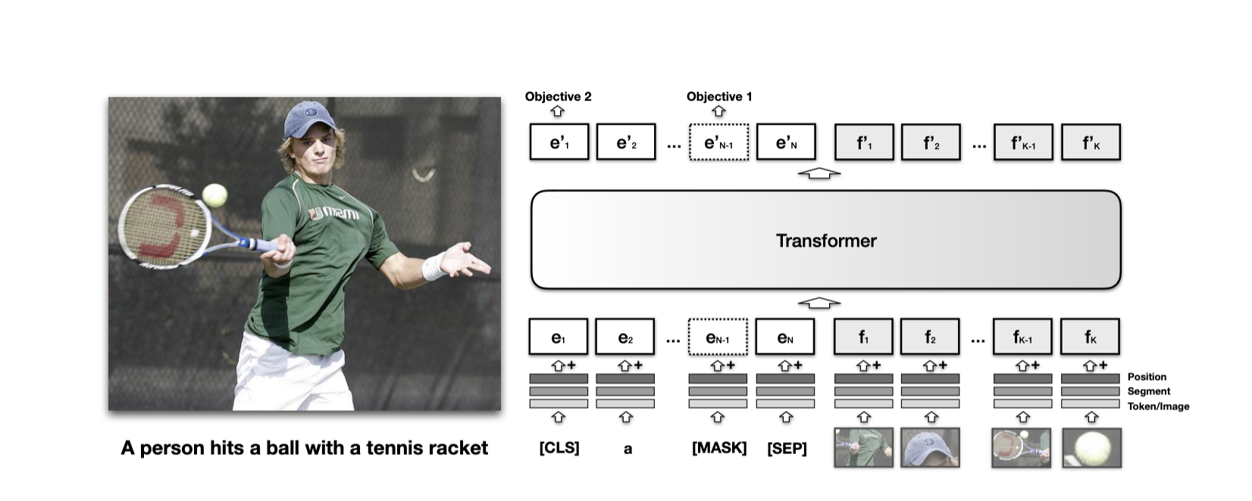
VLM- Combining image and text in a transformer
  Translating images into embedding features that can be jointly trained with token embeddings.
Intermixed: VisualBERT: A Simple and Performant Baseline for Vision and Language
2019 -2021

Slide 10
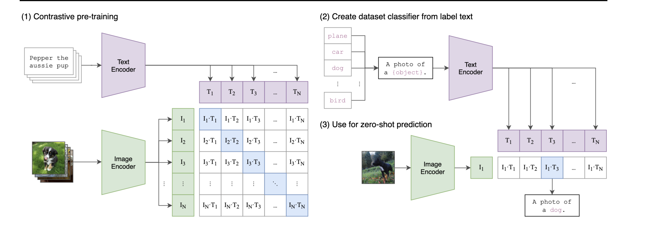
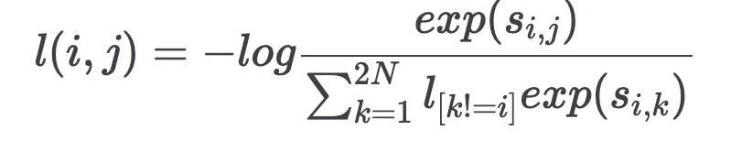
VLM – Contrastively trained VLMs
Trains a text and image encoder to maximize the similarity of the paired captions contrastively
CLIP
CLIP – Training data : curated and cleaned image-text pairs, Loss: Symmetric cross-entropy loss
ALIGN – Noisy training data, Loss: normalized Softmax loss on cosine similarity
Florence –CLIP + multiple heads for multiple tasks, E.g. DETR for detection
FILIP-Contrastive training at the token level for image-text pairs for fine-grained learning
FLIP, MaskCLIP--Mask pixels for image-text associations
OpenCLIP--Trained on LAION image-text pairs

Slide 11
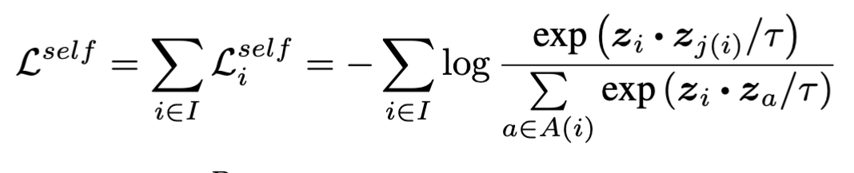
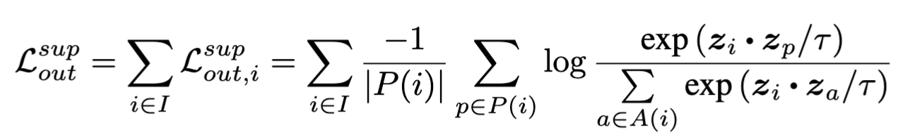
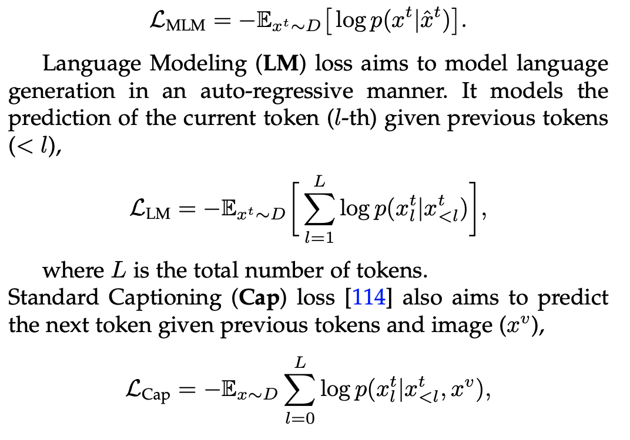
Many choices of loss functions
Contrastive variants
  Contrastive loss (ITC), Matching loss (ITM)
  Self-supervision loss (SimCLR)
  Supervised contrastive loss
Generative variants
  MLM (bi-directional)
  LM (auto-regressive)
  Cap Loss (predict next token given previous tokens and whole image)
  Flamingo Loss (predict next token given previous image and text tokens)

Slide 12
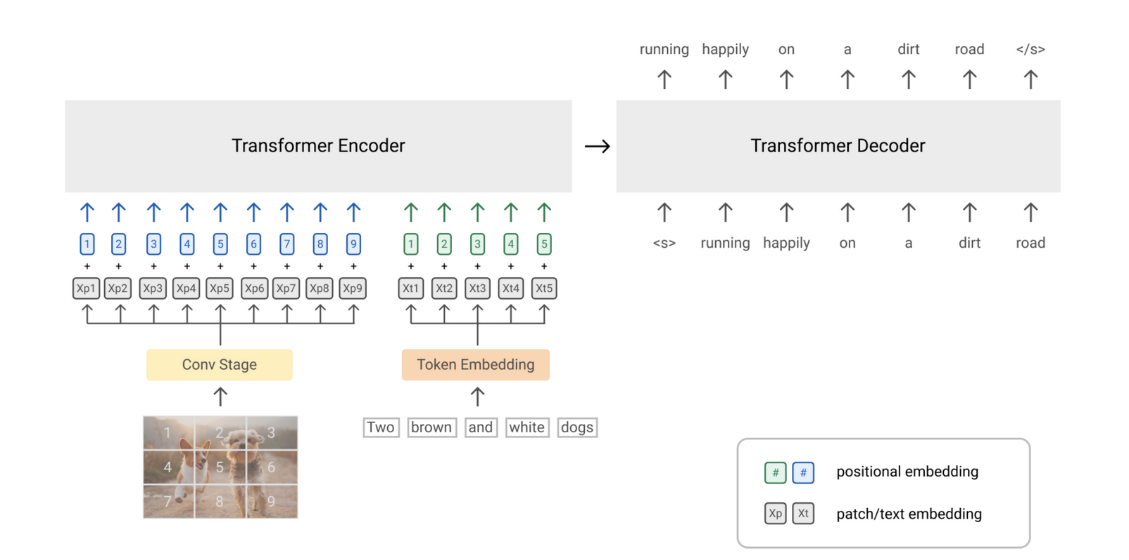
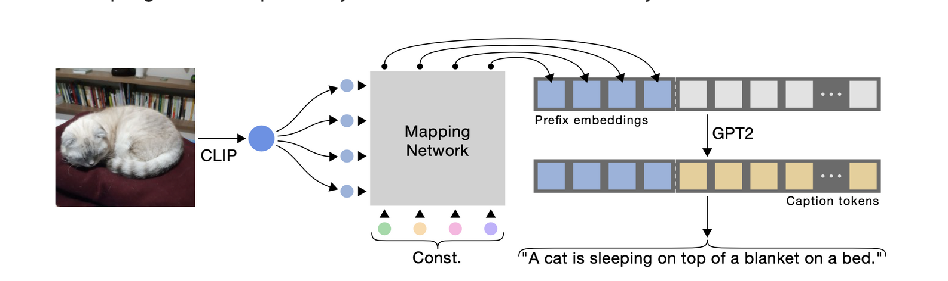
VLM- Vision prefix for an LLM
  Learning good image embeddings that can work as a prefix for a frozen, pre-trained language model.
Frozen, CLIPCAP, language models with vision encoders
2019 -2021

Slide 13
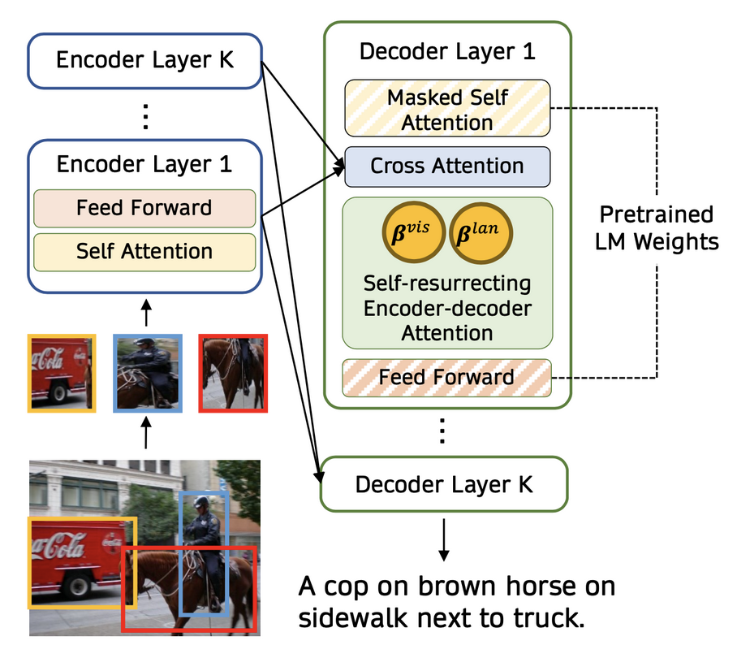
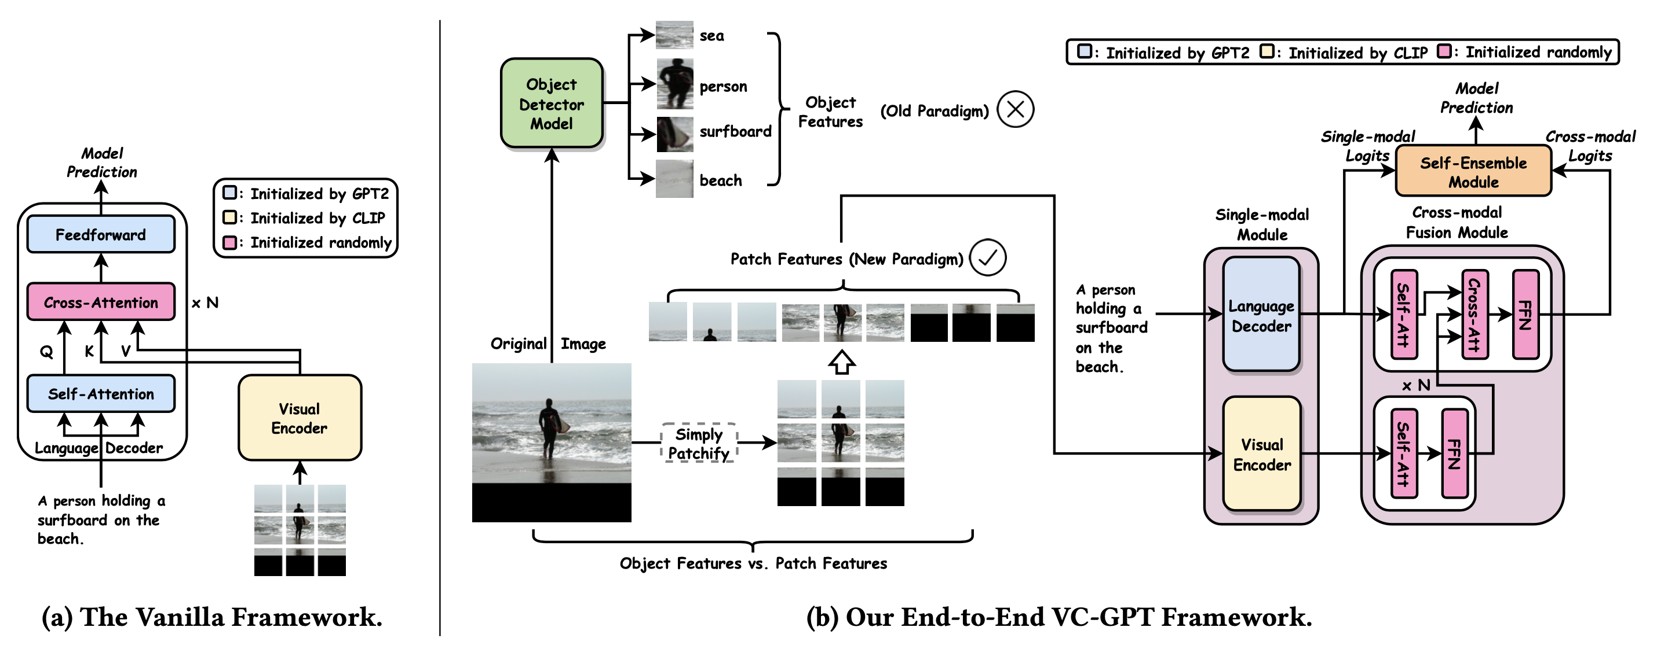
VLM - Text-Image Cross-Attention Fuse Mechanisms
VisualGPT
VC-GPT
Notes:
https://lilianweng.github.io/posts/2022-06-09-vlm/

Slide 14
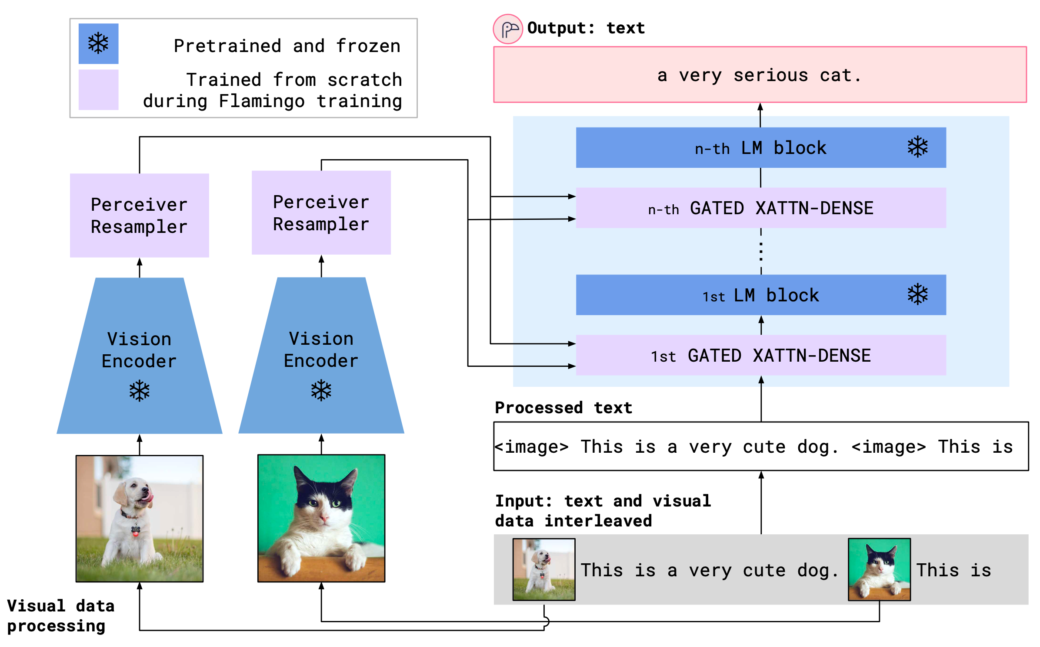
VLM - Multimodal Generative AI
Flamingo
Interleaved placement of multimodal input
Notes:
https://lilianweng.github.io/posts/2022-06-09-vlm/

Slide 15
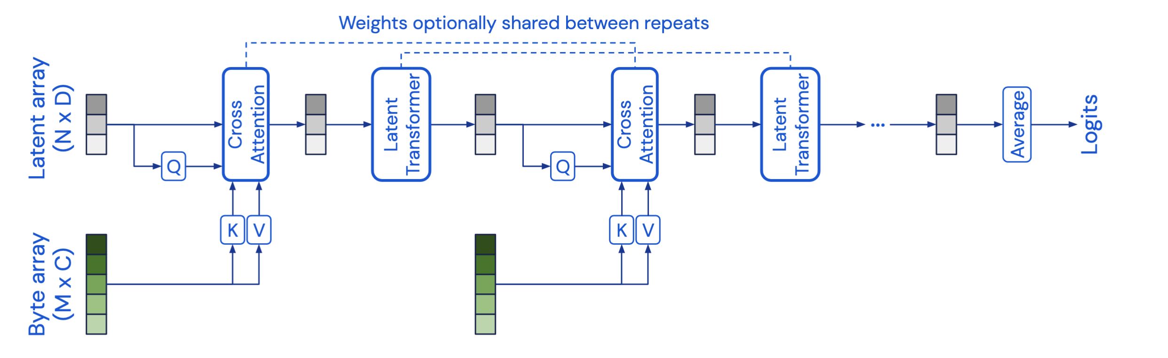
VLM - Perceiver
A type of fully end-to-end clustering of the inputs with latent positions as cluster centers, leveraging a highly asymmetric cross-attention layer.
A small fixed number of visual tokens per image/video, given a large and variable number of visual input features
A. Jaegle, et al., Perceiver: General Perception with Iterative Attention

Slide 16
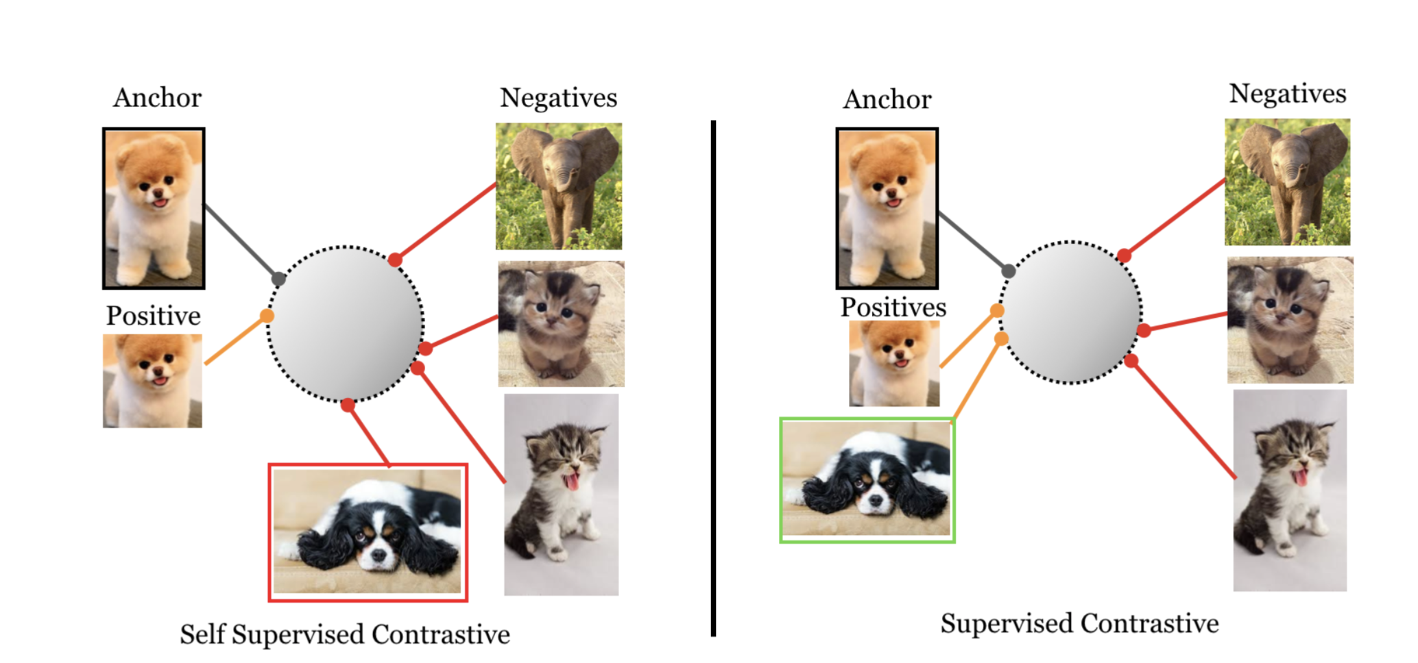
Many choices of loss functions
Contrastive variants
  Contrastive loss (ITC), Matching loss (ITM)
  Self-supervision loss (SimCLR)
  Text-to-pixel contrastive (TPC)
  Region-word alignment loss (RWA)
  Region-word contrastive loss (RWC)
  Unified contrastive learning (UniCL)
  Supervised contrastive loss
Generative variants
  MLM (bi-directional)
  LM (auto-regressive)
  Cap Loss (predict next token given previous tokens and whole image)
  Flamingo Loss (predict next token given previous image and text tokens)

Slide 17
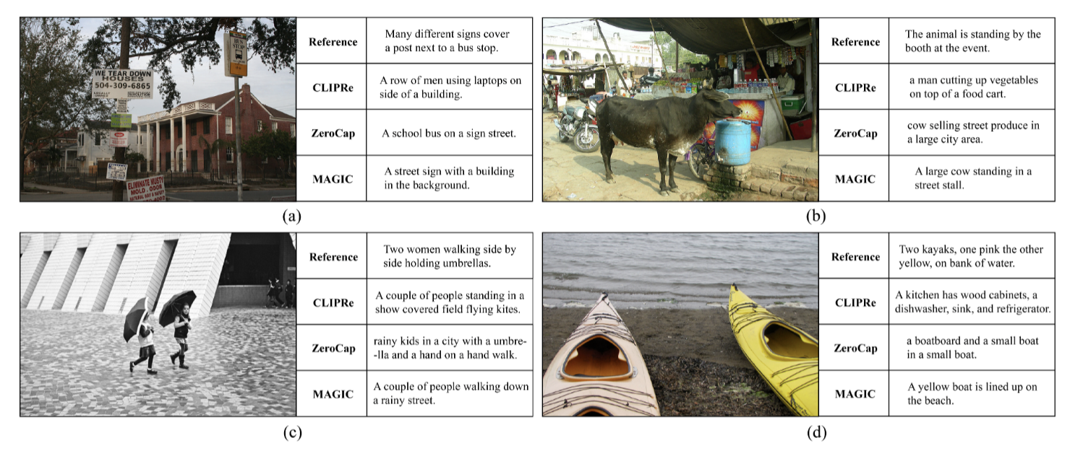
VLM – No training
Stitching pretrained language and vision models together without training any additional parameters (unsupervised).
MAGIC
guided decoding according to a CLIP-based score named magic score to sample the next token using an objective function but no fine-tuning of LM

Slide 18
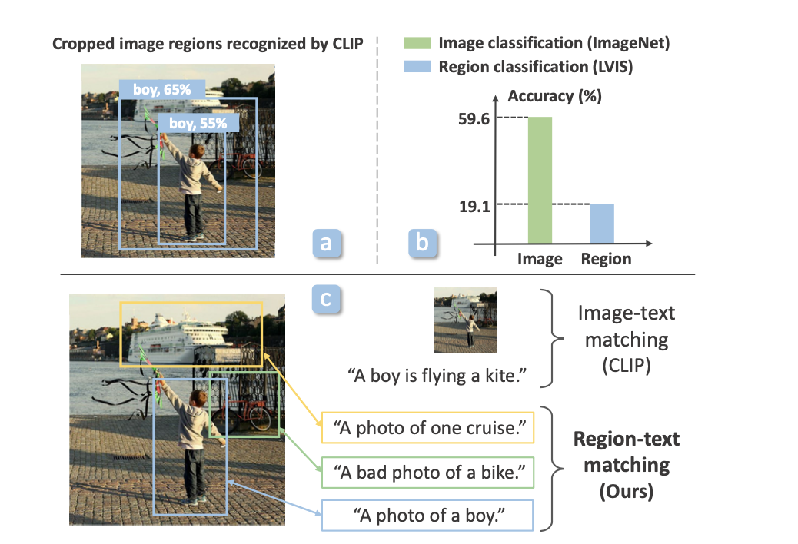
VLM – Segmentation
CLIP on regions fails to recognize objects

Slide 19
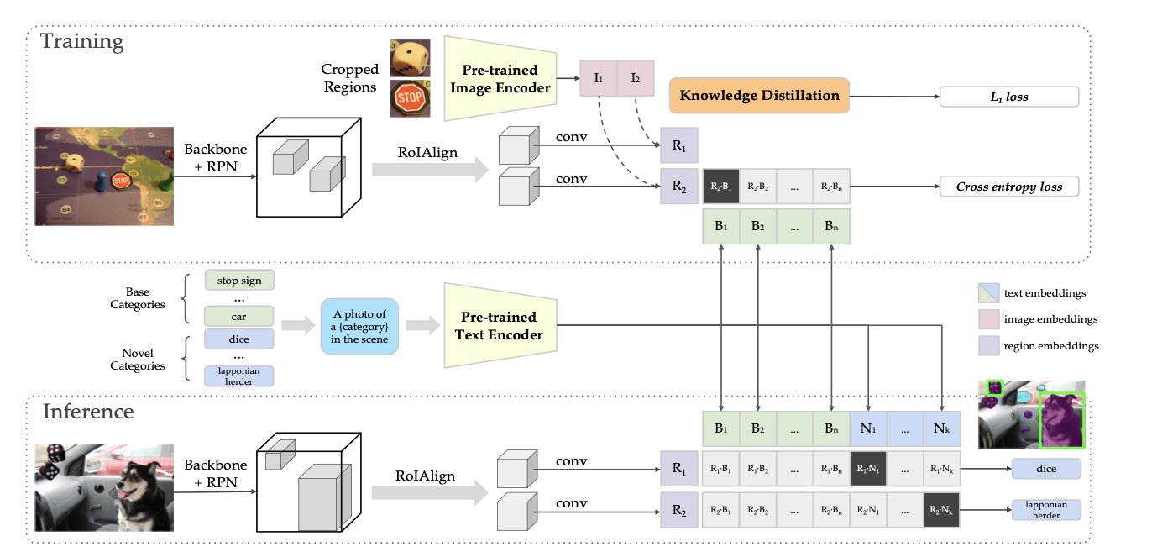
VLM – Visual Grounding
ViLD – Distill the knowledge from the alignment of region embedding to image embeddings of cropped regions during training.
Notes:
During inference the regional embedding will be able to match to the new categories if they are the nearest.
This method needs cropped templates for alignment

Slide 20
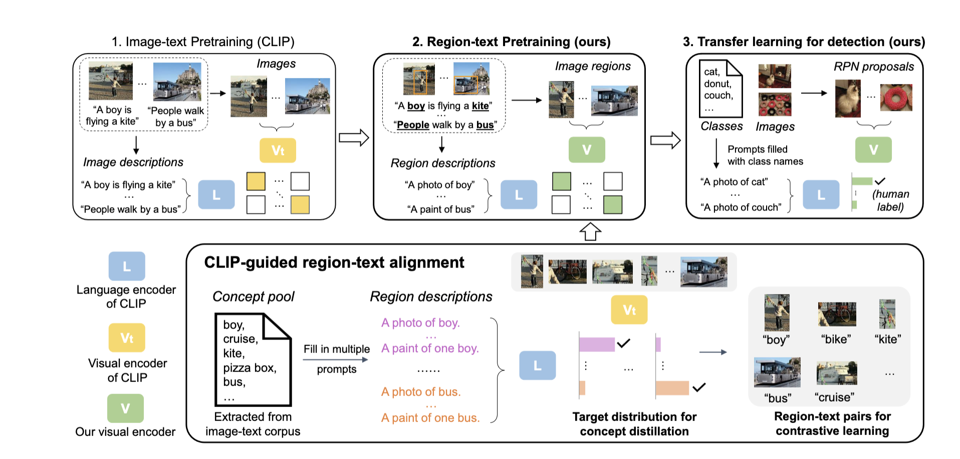
VLM – Visual Grounding
RegionCLIP – Contrastively learned region-text alignment
Notes:
No cropped templates needed. Instead carefully prompting with contrastive learning allows for zero shot detection.

Slide 21
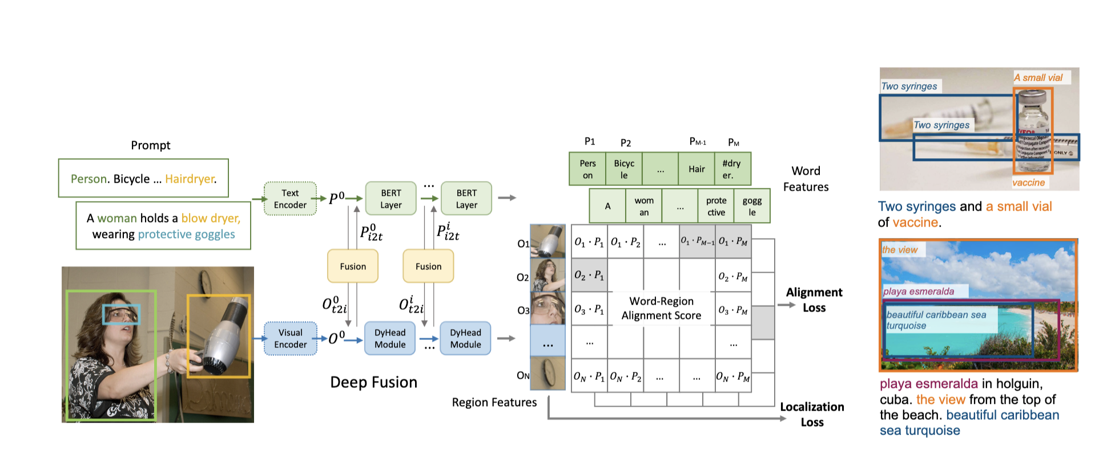
VLM – Phrase Grounding
Given an image and a corresponding caption, the Phrase Grounding task aims to ground each entity mentioned by a noun phrase in the caption to a region in the image.
GLIP – grounded language pre-training

Slide 22
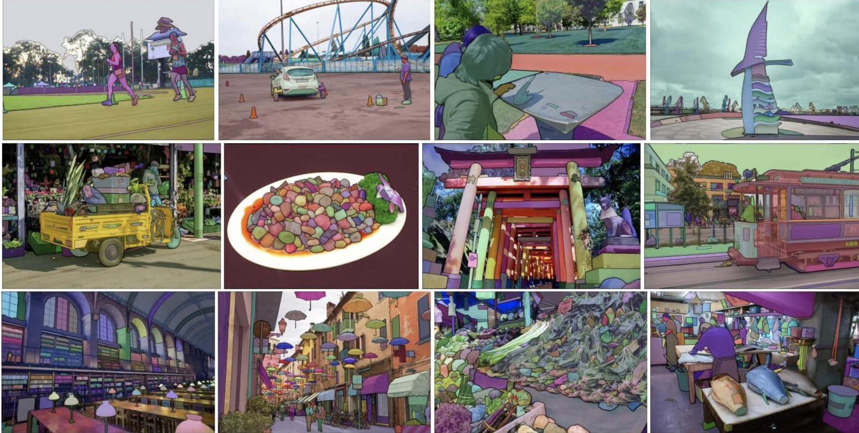
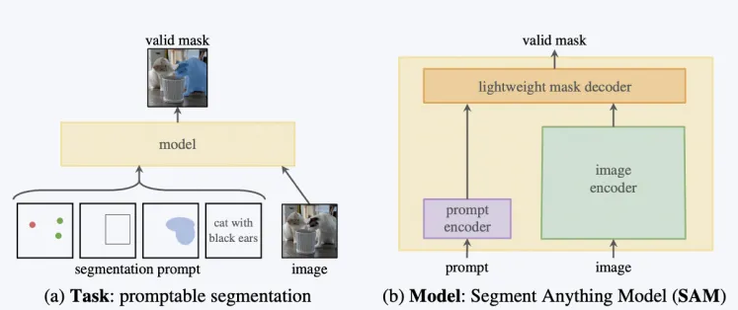
VLM – Zero shot segmentation
powerful image encoder, a prompt encoder, and a lightweight mask decoder.
Segment Anything – (SAM)

Slide 23
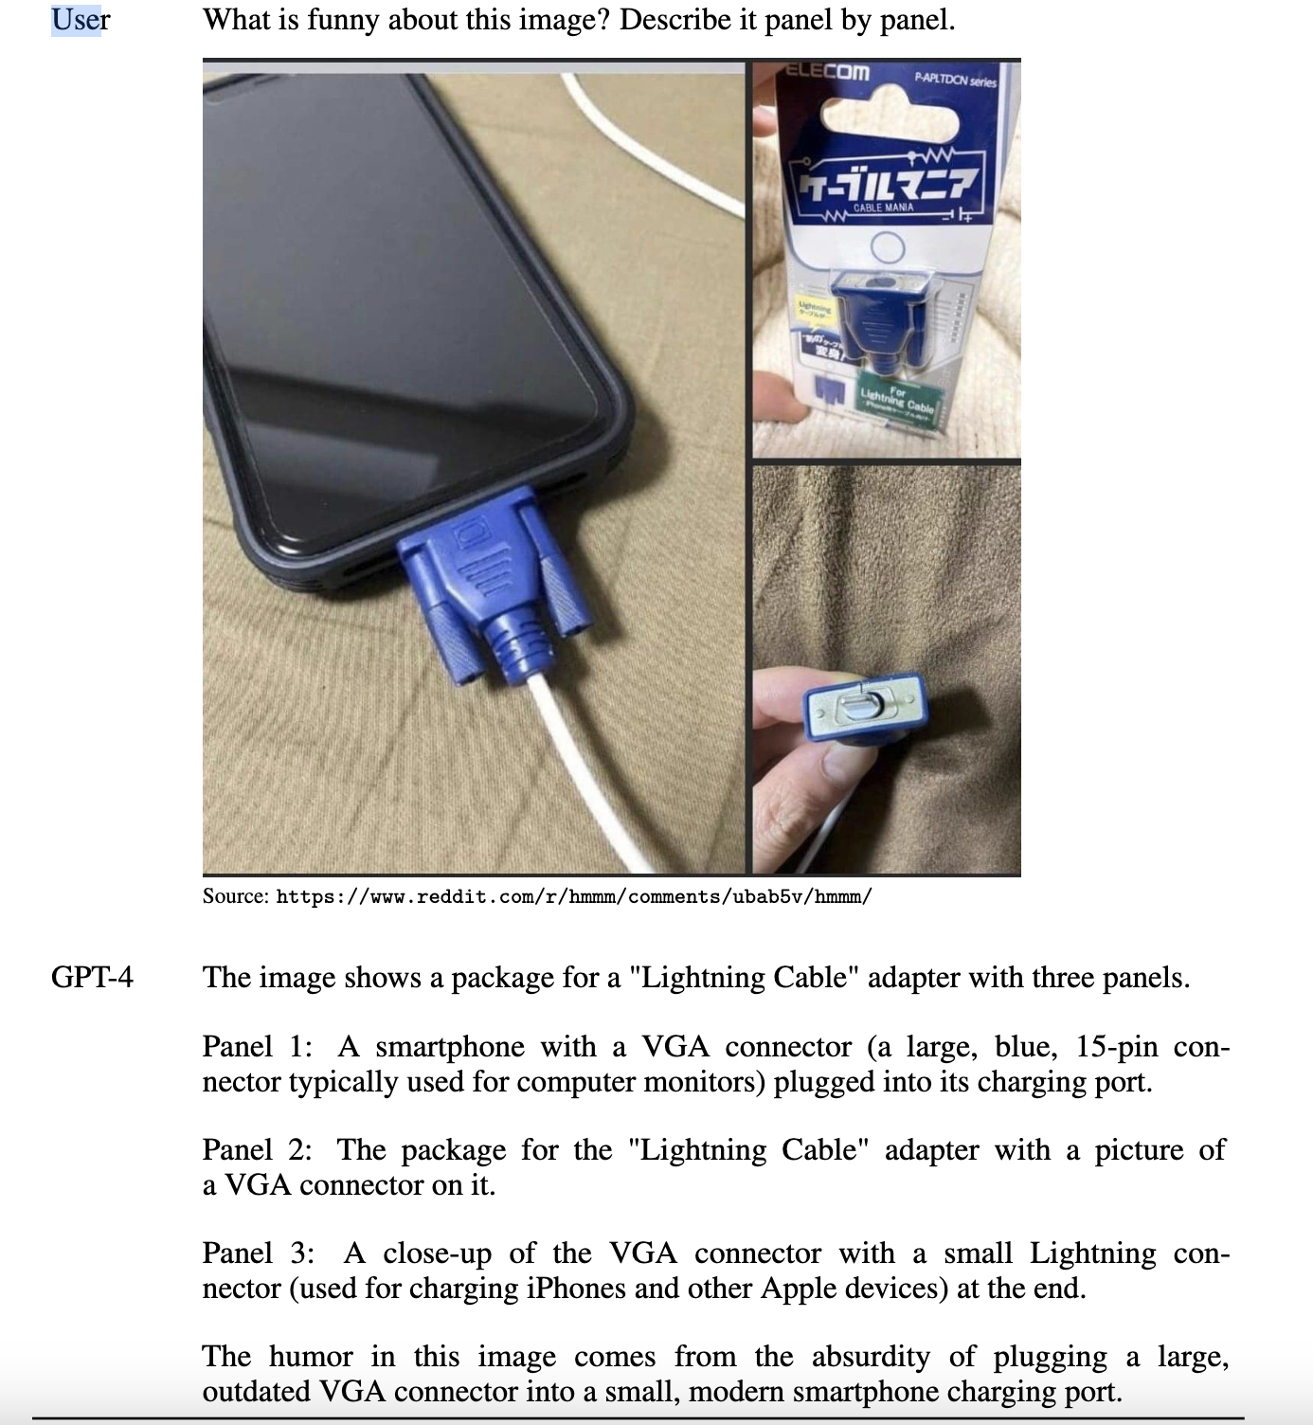
VLM – Conversational VLM
GPT4
MiniGPT4
  Vicuna LLM + VitG+Qformer
X-rayGPT
  XrayGPT, consists of a Vicuna LLM as a text encoder and a MedClip for an image encoder

Slide 24
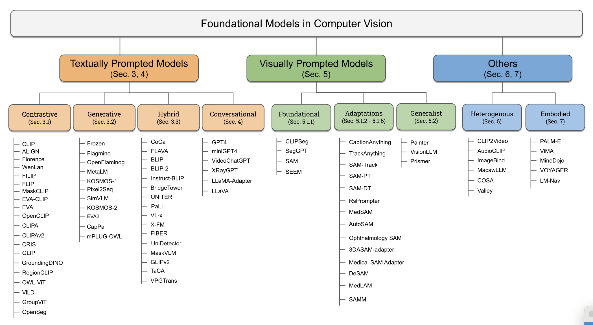
Taxonomy of FM in Vision
Foundational Models Defining a New Era in Vision: A Survey and Outlook

Slide 25
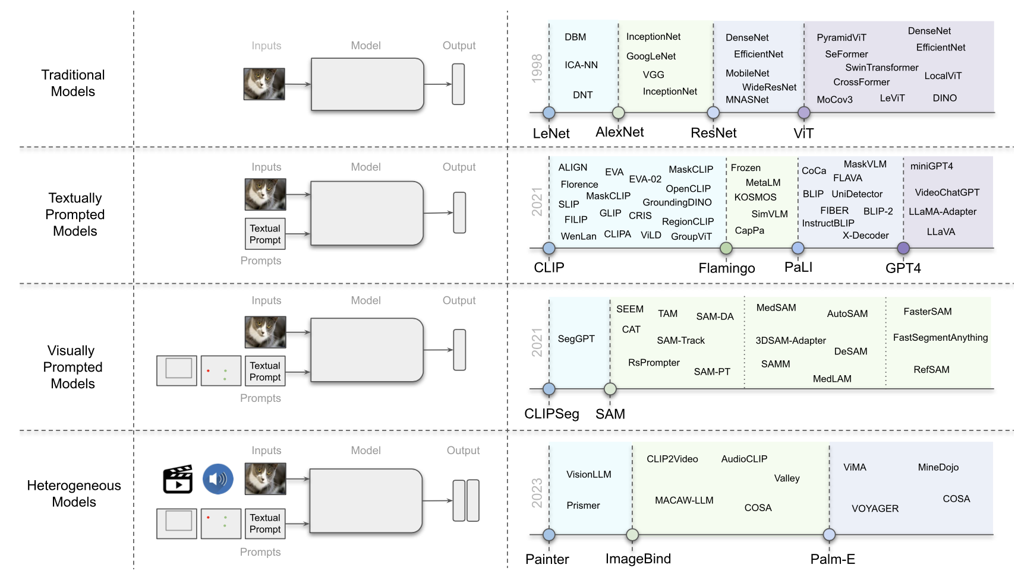
Summary of VLM
Foundational Models Defining a New Era in Vision: A Survey and Outlook

Slide 26
Summary
VLMs are powerful models reaching a high level of semantic understanding of the content
  Both at a whole image level and regional level
Retrieval use case not well represented in downstream use cases.
  Potentially powerful for search

