Slide 1

Clinical Needs for Foundational Models
BIODS 271 / CS 277
Tanveer Syeda-Mahmood

Slide 2
Healthcare-specific Foundation Models
Some target tasks addressed by foundational models may not be as useful for healthcare-specific use cases:
  Sentiment analysis
  Masked language prediction
  Question answering
  Captioning
  Language translation
  Summarization
  Language generation
  Classification
  Segmentation
  Speech to text
Notes:
Foundational models could be customized for healthcare tasks by
Pre-training
Fine-tuning
Prompt tuning
RAG

Slide 3
User base for Healthcare FM
  Providers/Staff/Technicians
    Clinicians: : Primary care, PCP, Radiologists, Cardiologists, Oncologists, Radiation oncologists, Interventional cardiologists, radiologists, …
    Nursing and other hospital staff
    Technicians
  Payers/Backoffice
    Insurance, payer-provider networks, Medicare
    Backoffice staff
  CIO/IT Staff
    IT/Data warehousing, CRO
    Training
  Clinical researchers/Academics
    Clinical study research
    Clinical education & training
  Patients

Slide 4
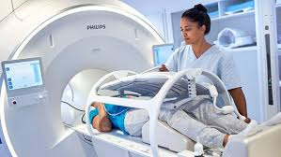
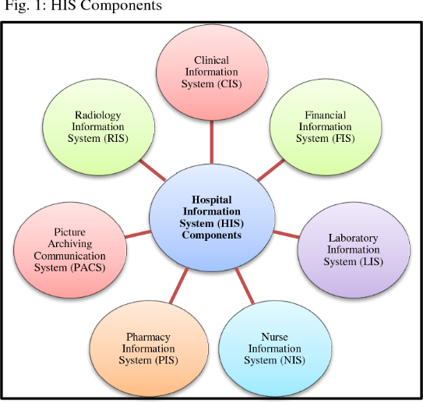
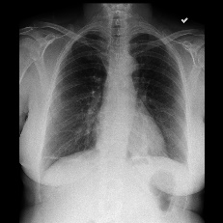
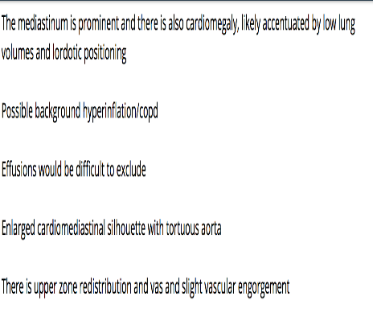
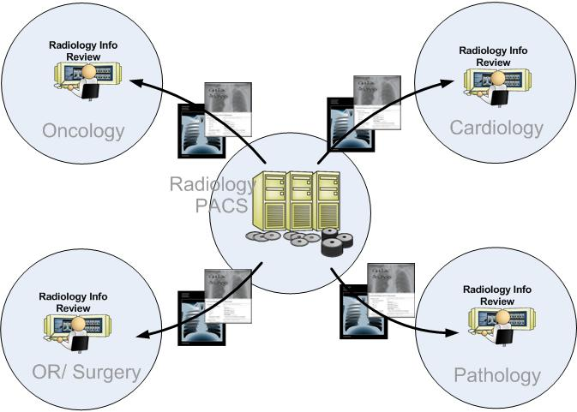
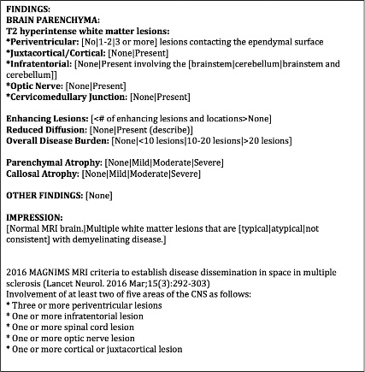
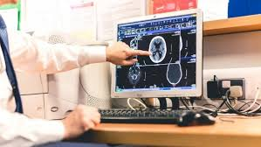
Clinical Needs for FMs
Technical assessment during imaging
Worklist prioritization
Referral routing, Telemedicine
Preliminary read – disruptive technology to expedite a dictation-driven workflow
EMR
Imaging
EMR
X-ray Read Service
Preliminary report
PACS
Radiology
Read
Imaging study
Radiologist-corrected report
Notes:
http://medsieve01.almaden.ibm.com:8080/DeepEyesApp20/login.html

Slide 5
What are the clinical needs of providers?
Technical assessments of imaging exams
Screening and triage (first reader)
Disease segmentation and tracking
Measurement quantification
Patient summaries, KPI
Diagnostic decision support (second reader)
  Recommendations for diagnosis, treatment or outcome
  Normal/abnormal discrimination
  Anomaly detection & classification
Automated reporting
Foundational Models
  DNN
  LM
  LLM
  VLM
FM Workflows
  Applications using multiple FM
Notes:
Concept extraction from textual reports
Recommendations for diagnosis, treatment and outcome

Slide 6
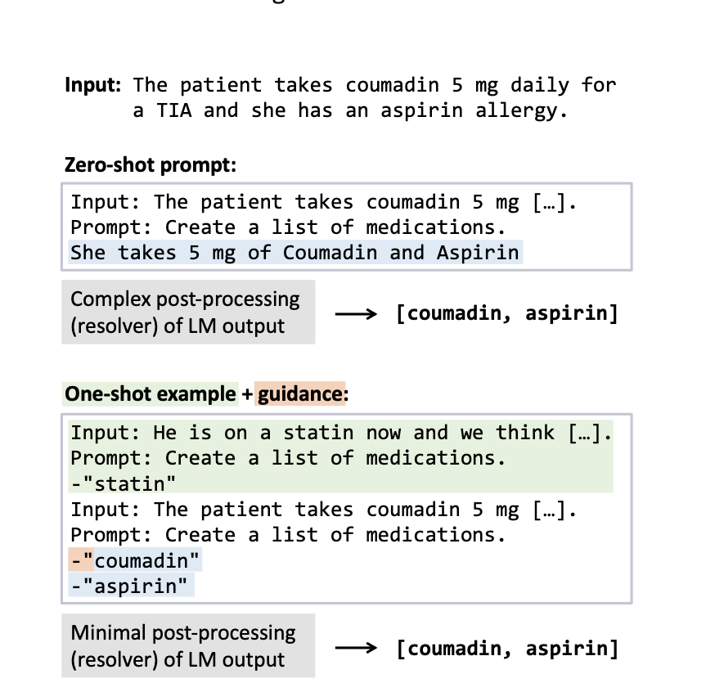
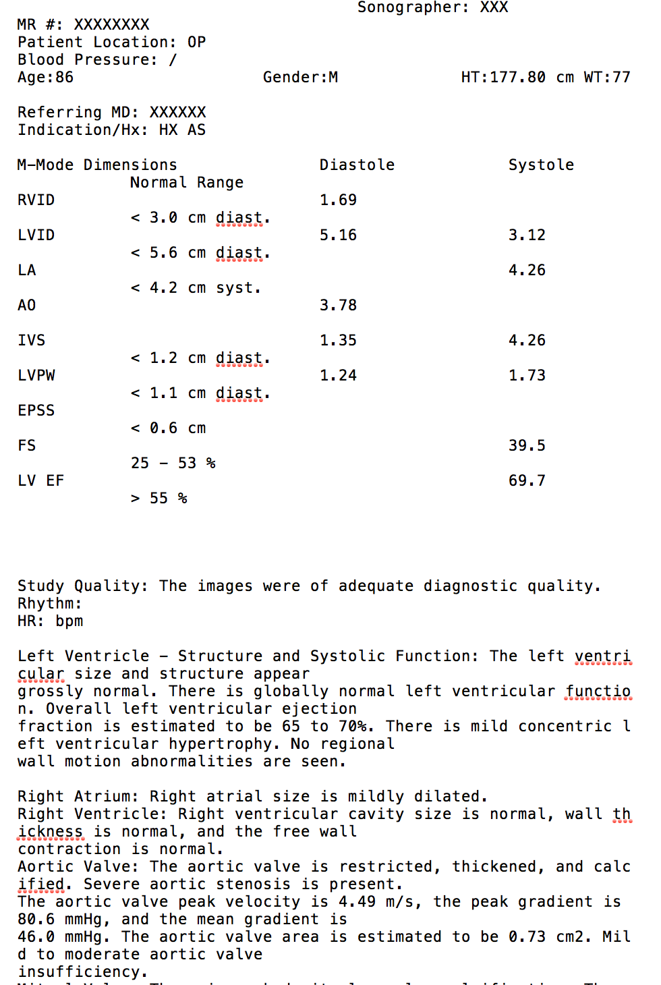
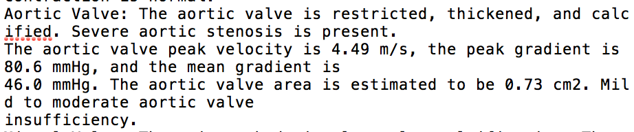
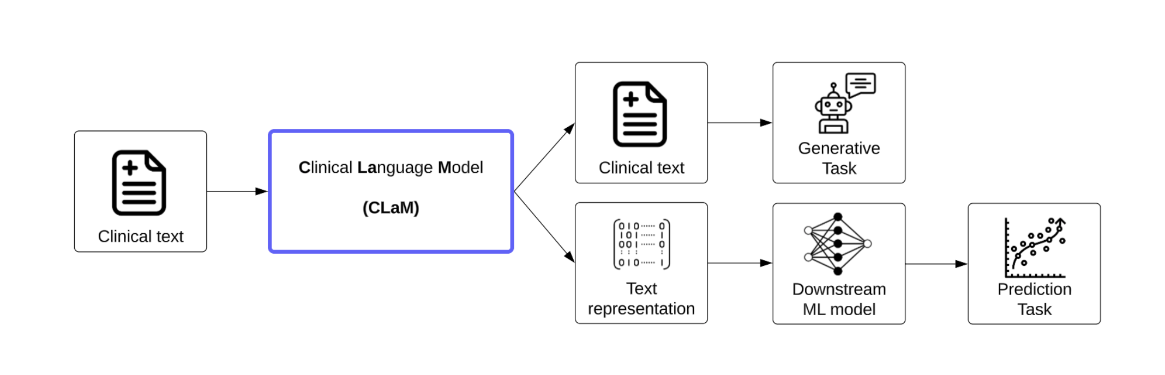
Clinical text analysis
Extracted clinical features
Organ Name | Measurement Name | Measurement value | Severity range as per AHA
Aortic Valve | Disease | Aortic Stenosis | Severe
Aortic Valve | Peak velocity | 4.49m/s | Severe
Aortic Valve | Mean pressure gradient | 46.0mmHg | Severe
Aortic valve | AVA | 0.73 cm2 | moderate
Comparison of text analytics
Data | Size | Comparison to state of the art | Precision | Recall
I2b2 collection | 179 discharge summaries | cTakes | 46.7% | 79.6%
 |  | WHIA | 72.6% | 90.4%
Echocardiogram collection | 753 echo reports | cTakes | 34.0% | 59.6%
 |  | WHIA | 78.2% | 79.3%
Large Language Models are Few-Shot Clinical Information Extractors, EMLP2022

Slide 7
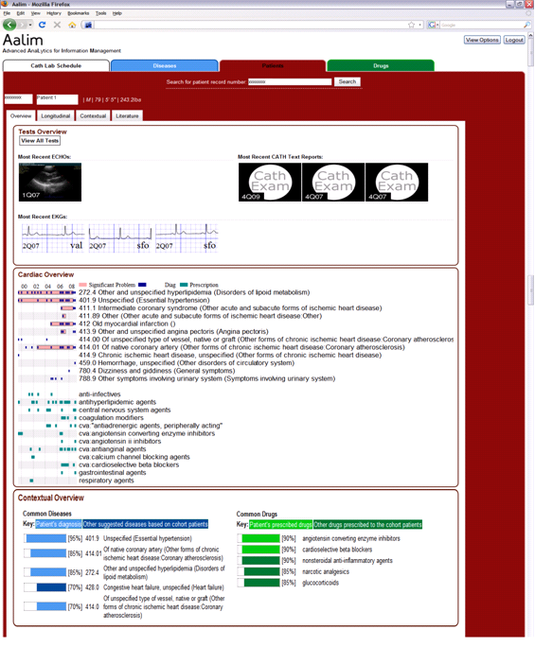
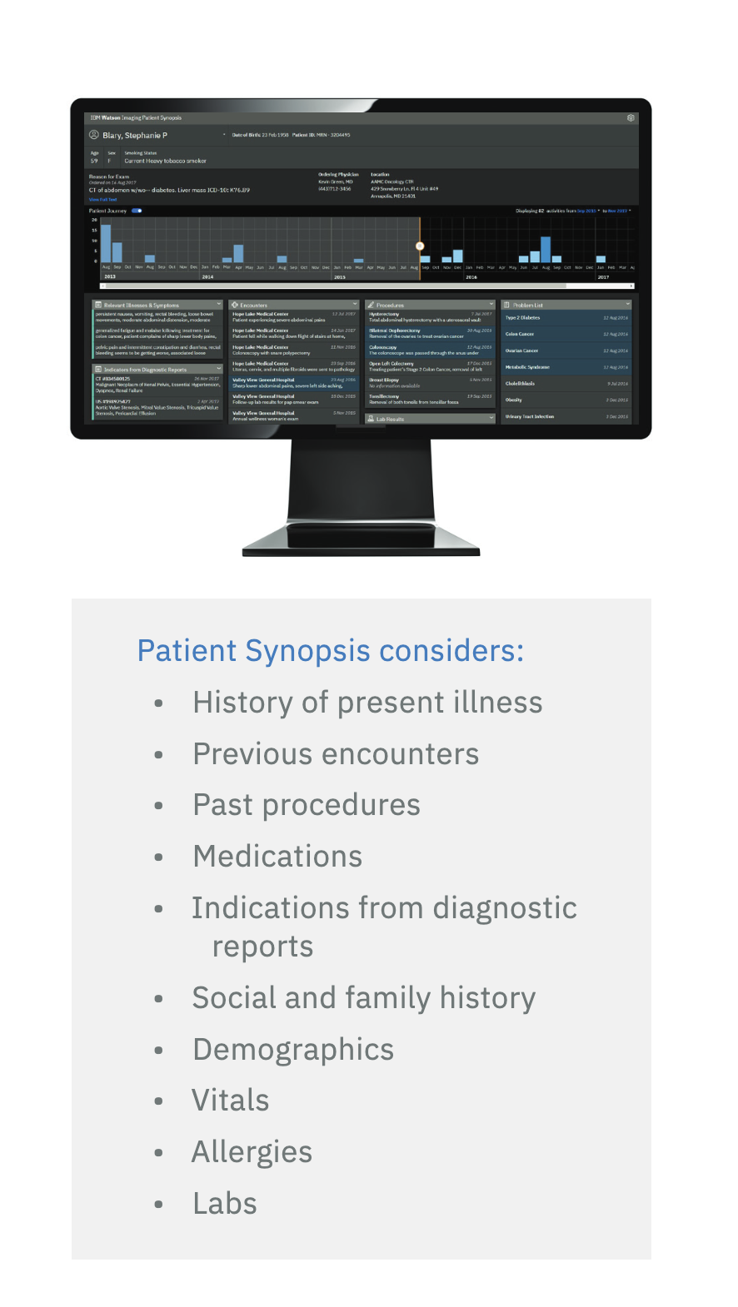
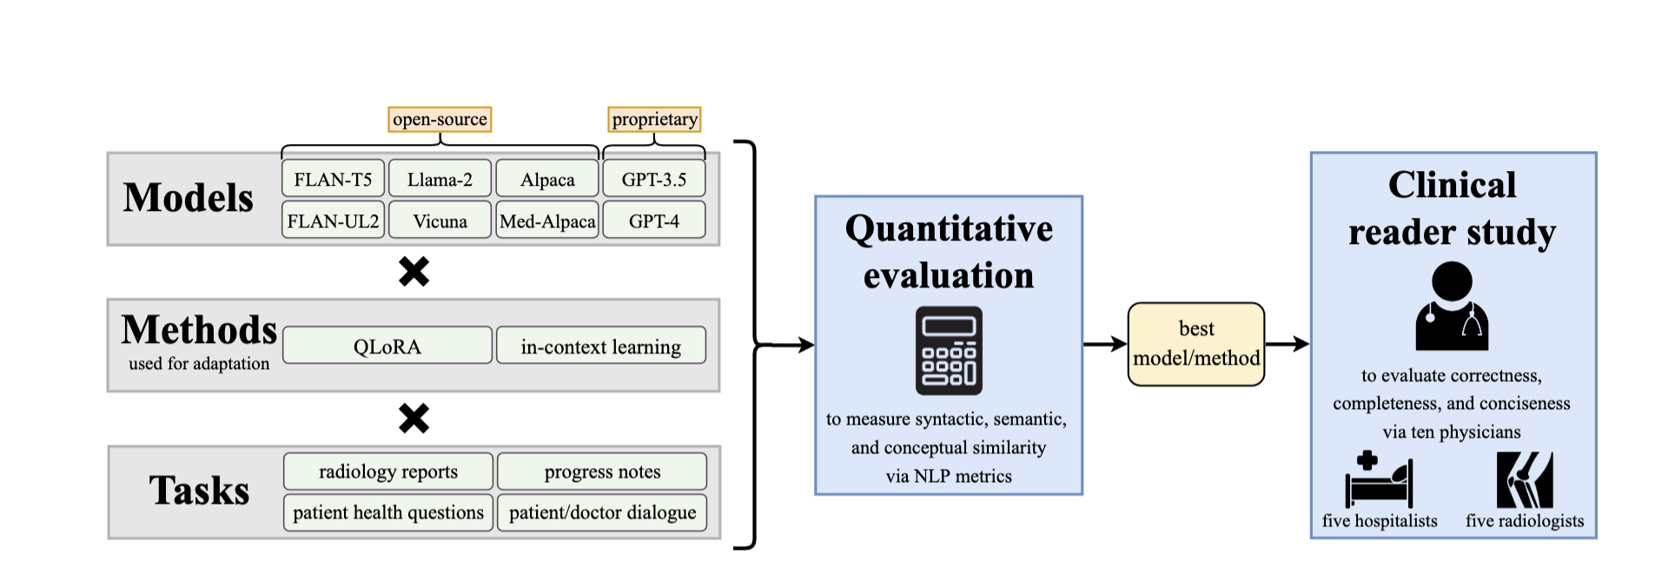
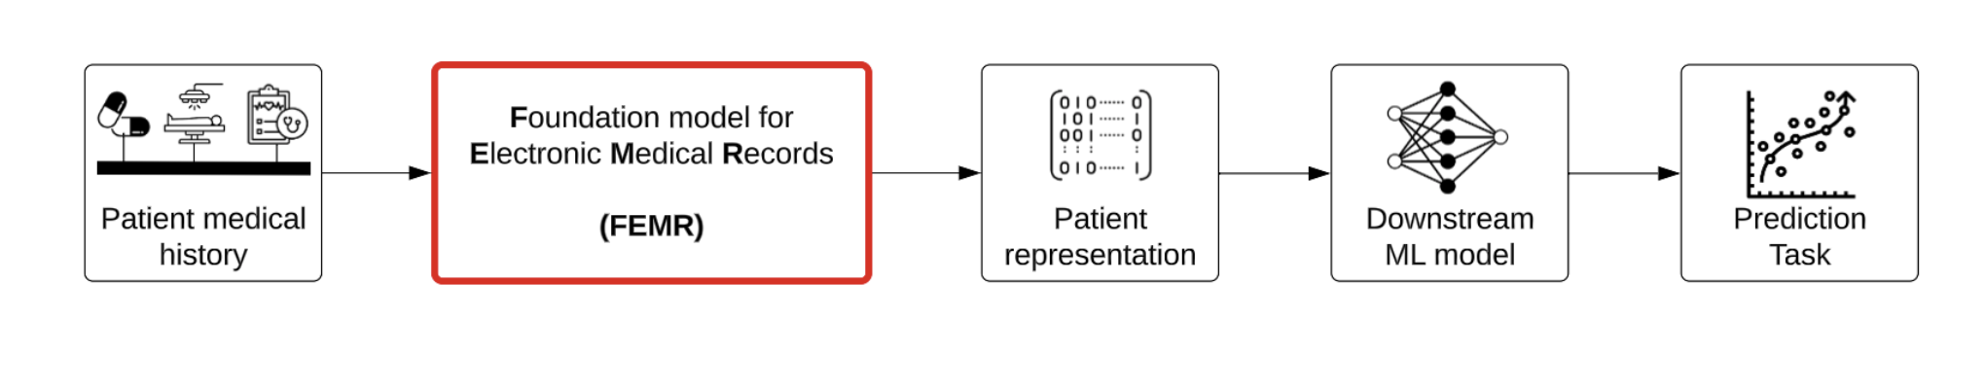
Patient summaries
Clinical Text Summarization: Adapting Large Language Models Can Outperform Human Experts

Slide 8
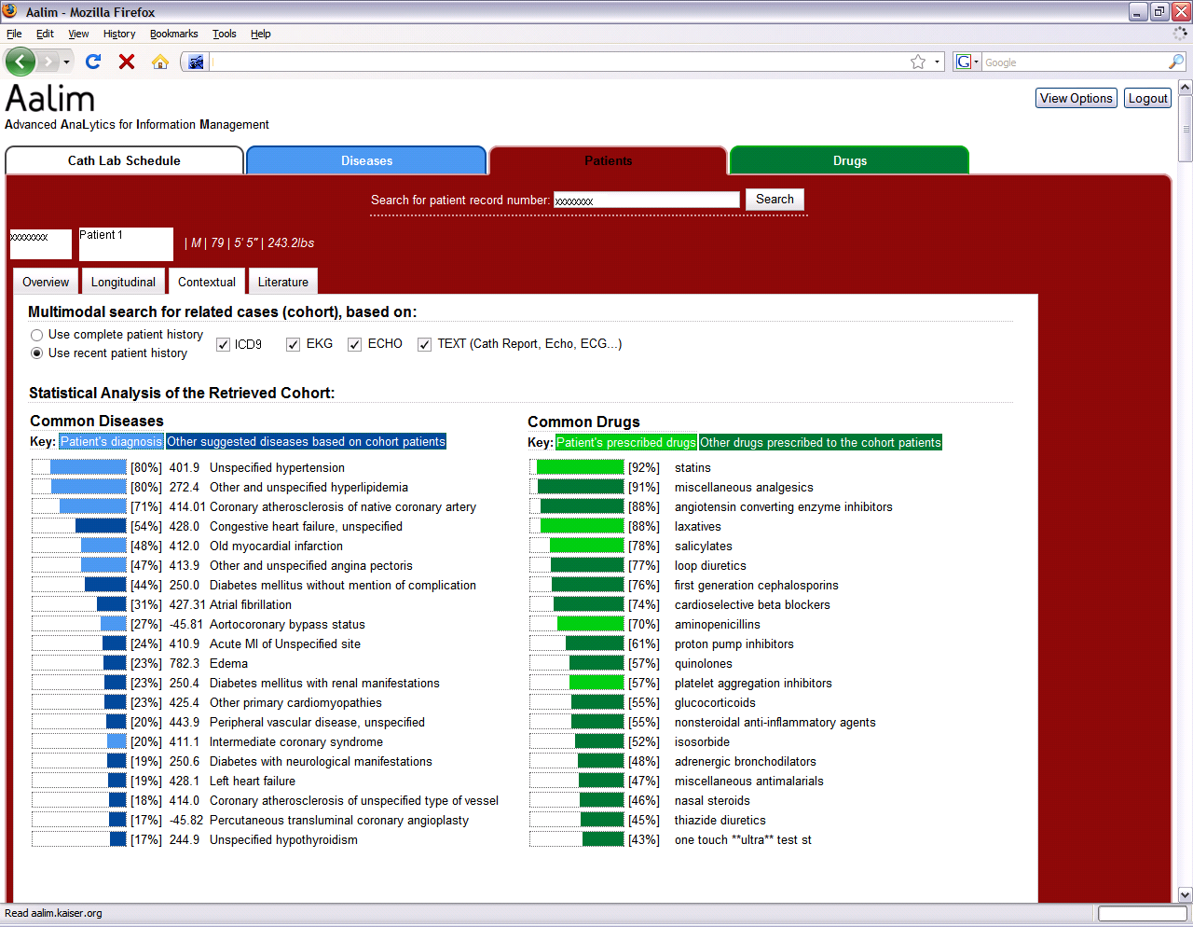
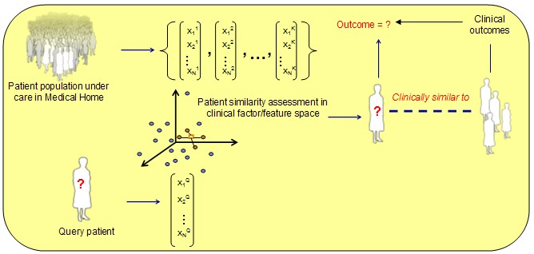
Clinical Decision Support
Patient similarity-guided decision support
The patient overview pages summarizes patient information.
First multimodal cardiac clinical decision support deployed at Kaiser Hospitals
8

Slide 9
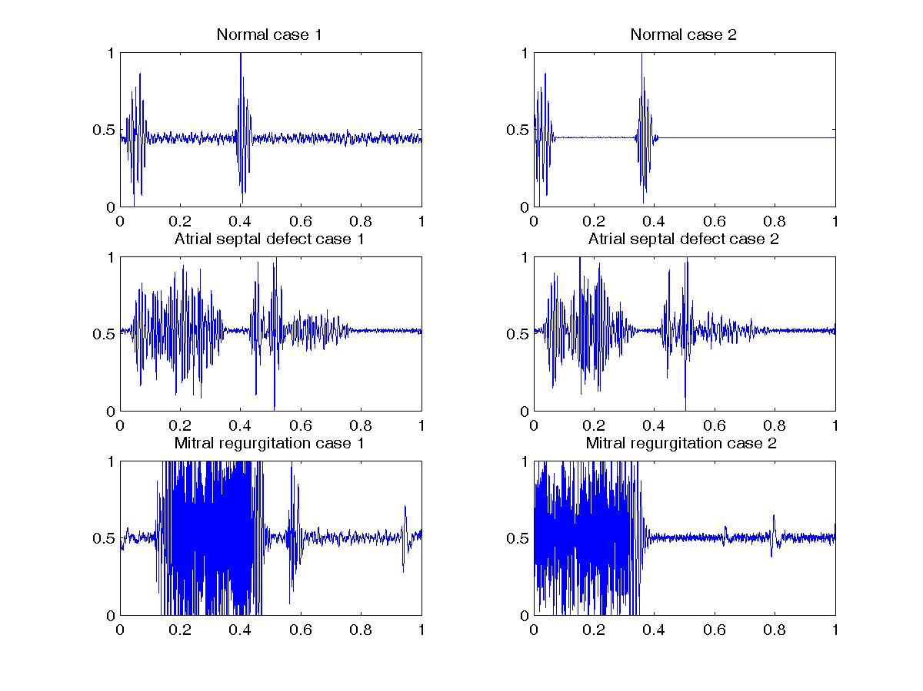


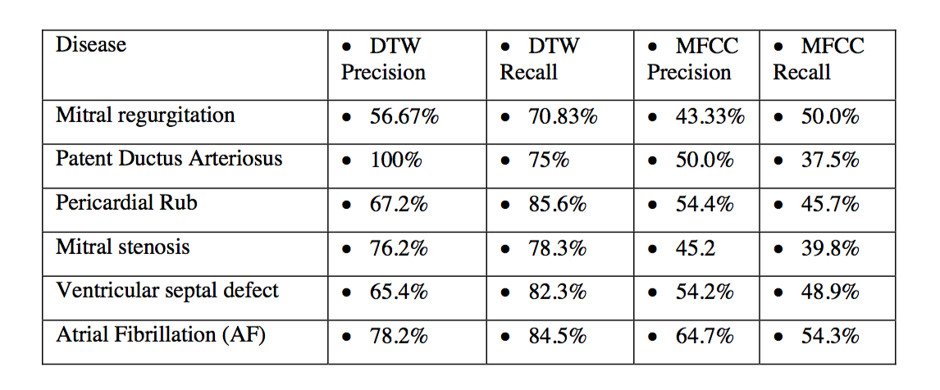
Multimodal clinical decision support – Heart Sounds
Key features:
  Heart sounds as visual signals
  Morphological shape analysis of envelop shapes
  Differential diagnosis and decision support can be achieved by finding similar heart sounds
  Published in ECCV’2008. Patented. More coming.
Diseases handled:
  Stenosis – Aortic, mitral
  Regurgitation – Aortic, mitral,
  Congenital – ASD, VSD, PDA,
  Other – MVP, AF
  Trainable on other diseases using the patient similarity paradigm
Datasets tested: Small (about 200 samples)
  Medical training sets from schools and industry
    UCLA, Boston hospital, Case Western, Bioscience, 3M
Query Matching sound
Matching heart sounds with their diagnosis
200 patient samples study
Use cases: screening and reading normals, alerts, worklist prioritization, integration with digital stethoscopes for a new device, adding heart sounds to patient records, remote monitoring via smartphone relay of heart sounds, quality control.

Slide 10
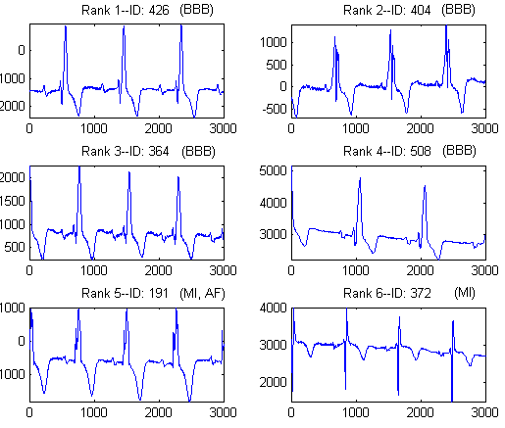
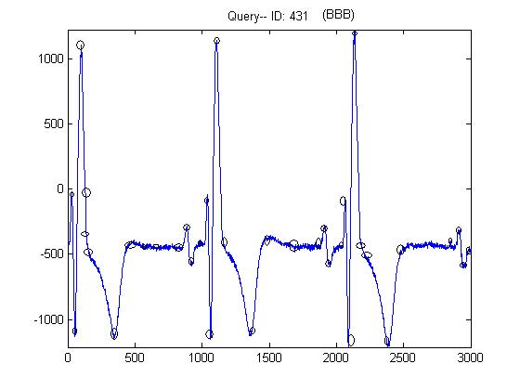
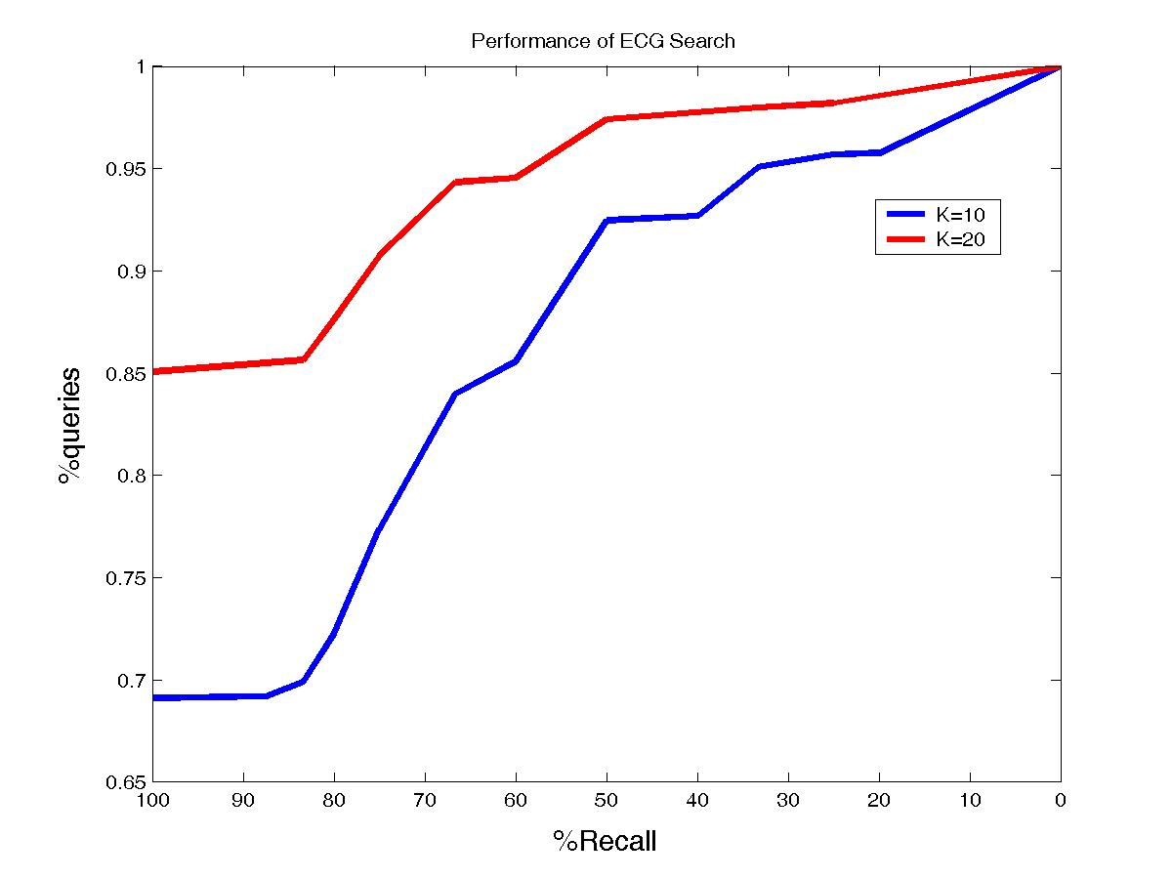
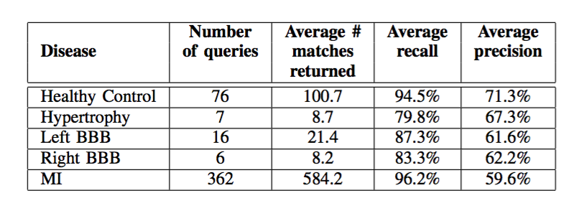
Multimodal clinical decision support – EKG
Key features:
  Morphological shape analysis of EKG shapes
  Dynamic shape warping algorithm patent
  Differential diagnosis and decision support can be achieved by finding similar EKG signals
  Published in EMBC’2007. Patented.
Query EKG
Diseases handled:
  Hypertrophy, BBB, MI, AF
  Normal/abnormal discrimination
  Arrhythmia, bradycardia, tachycardia
  Trainable on any disease using the patient similarity paradigm
Matching EKGs
BBB:67%
MI: 33%
AF:16%
Datasets tested: Reasonably large (over 25,000 EKG)
  Standard datasets
    PTB, Physionet
  Kaiser patients (over 3000 patients)
  12 channel, 15 channel, 3 channel
In ECCV’06
85% of them were completely consistent
with the official human interpretation (100% recall),
Physionet PTB 547 patient study
Use cases: screening and reading normals, triage, alerts, worklist prioritization, patient synopsis, differential diagnosis, next test prediction

Slide 11
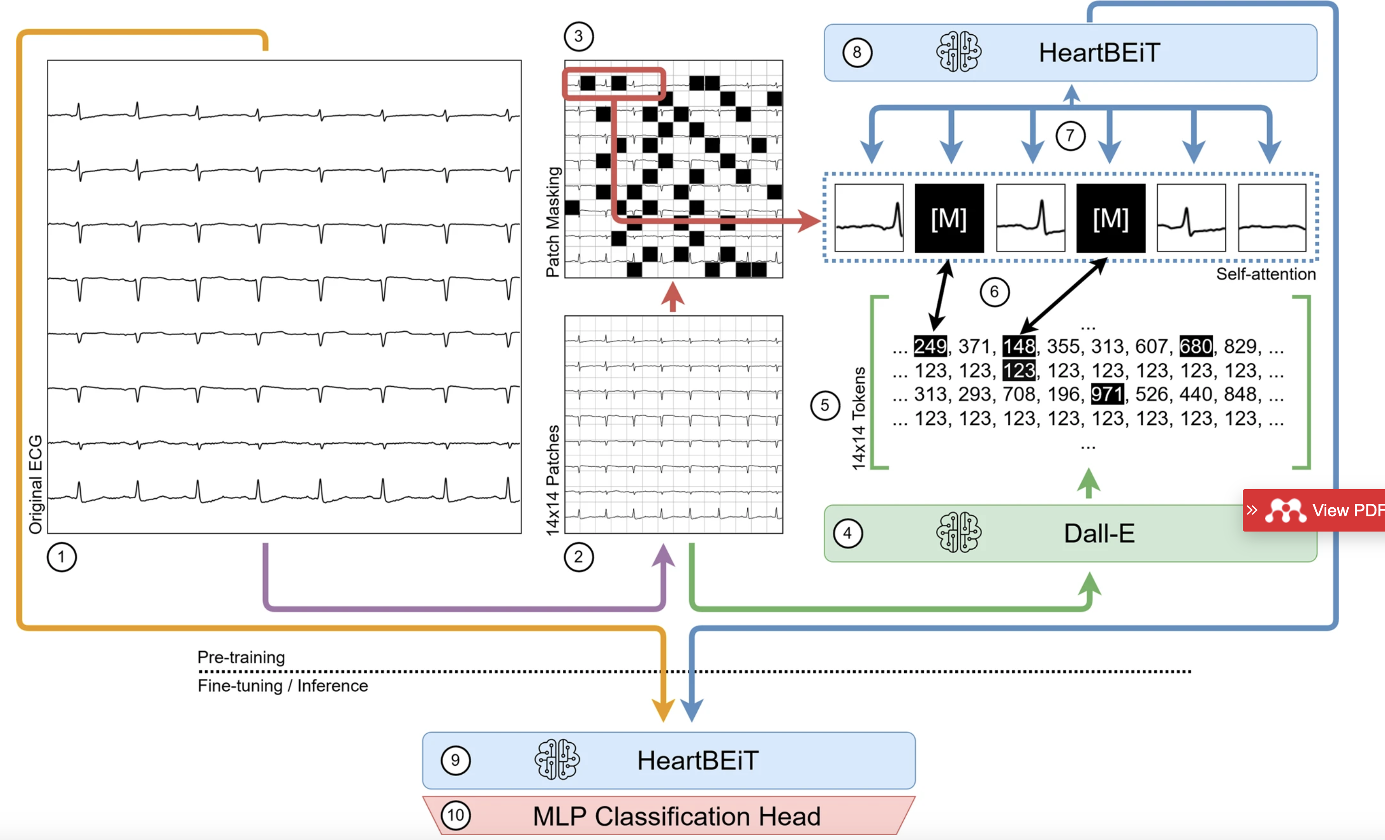
EKG classification using transformers

Slide 12
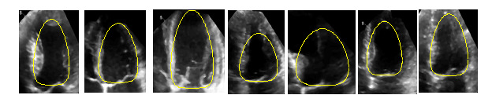
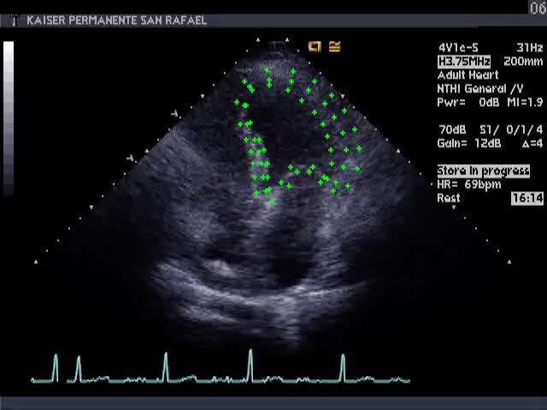
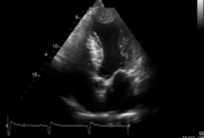

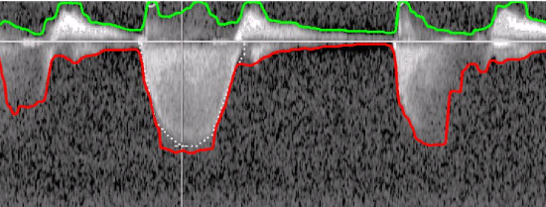
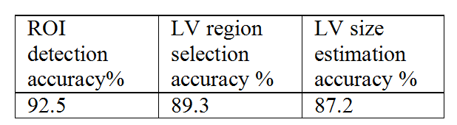
Multimodal clinical decision support – Cardiac echo
Key features:
  Comprehensive end-to-end echocardiographic analysis from DICOM to measurement extraction and diagnosis using many techniques ranging from computer vision, medical imaging, to deep learning
  Mode recognition, viewpoint recognition, LV detection, LV characterization, Doppler analysis, disease detection, disease recognition, measurement extraction – end to end processing of echos.
  Published in EMBC’2010, MICCAI’2012, EMBC’2008 MMBIA’2008, ICDAR’2009, MMBIA’2009 EMBC’2010,CVPR’2010, CVPR’2010, ISBI’2013, ISBI’2013, ICPR’2014, ISBI’2014, AMIA’2014, ISBI’2015, MICCAI’2015, MICCAI’2016, MICCAI’2016, ISBI’2017, Several patents.
LV abnormality detection
Diseases handled:
  Hypertrophy, cardiomyopathy, hypokinesia, valvular diseases, aneurysms
  Normal/abnormal discrimination
  Trainable on any disease given sufficient examples with the deep learning approach
LV tracking
Doppler analysis
In ECCV’06
Datasets available: Reasonably large, Kaiser (5000), 123sonography (2000), Sentara (3000). 24390 individual frames from 971 cases. Different algorithms tested on different collections. Needd more normals
Cardiac aneurysm detection
654 patient study for dilated cardiomyopathy
Use cases: screening and reading normals, triage, alerts, worklist prioritization, patient synopsis, next test prediction, differential diagnosis, second opinions, peer review, integrated diagnostics with measurements, discrepancy detection, automated reporting, heart failure prediction, quality control, portable echo interpretation

Slide 13
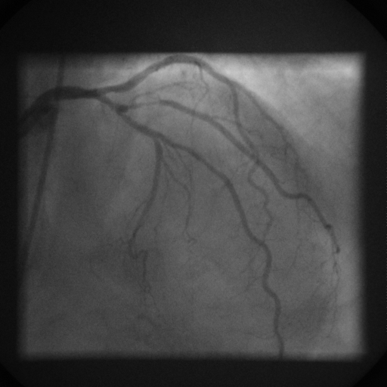
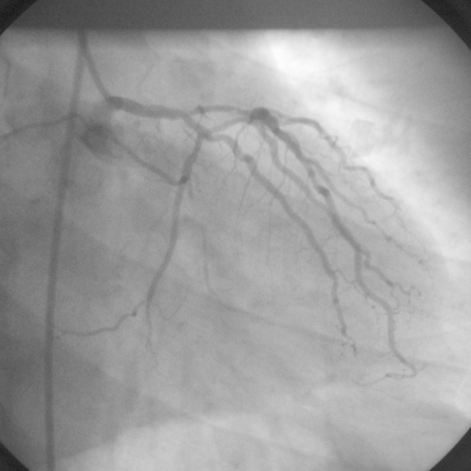
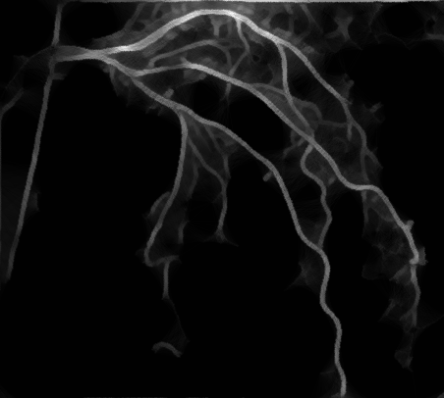
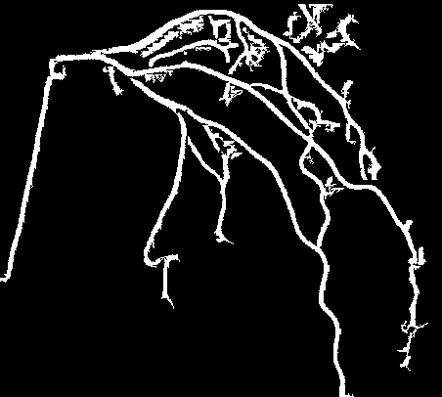
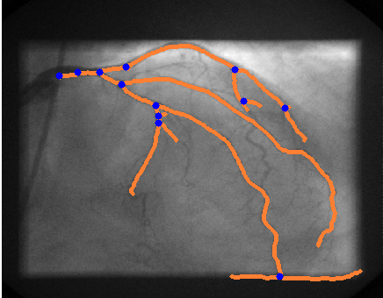
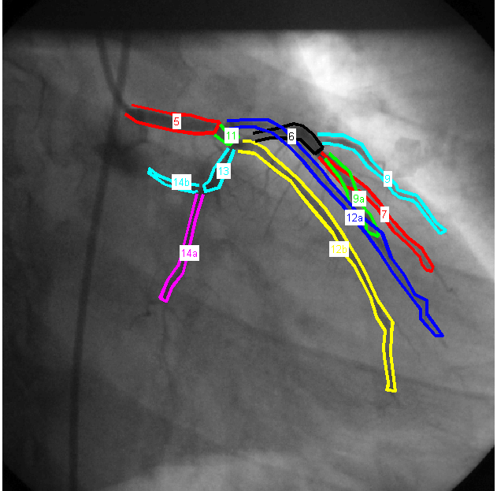
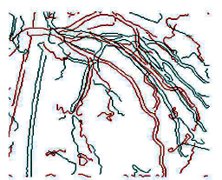
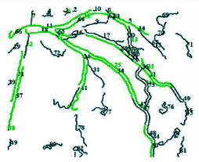
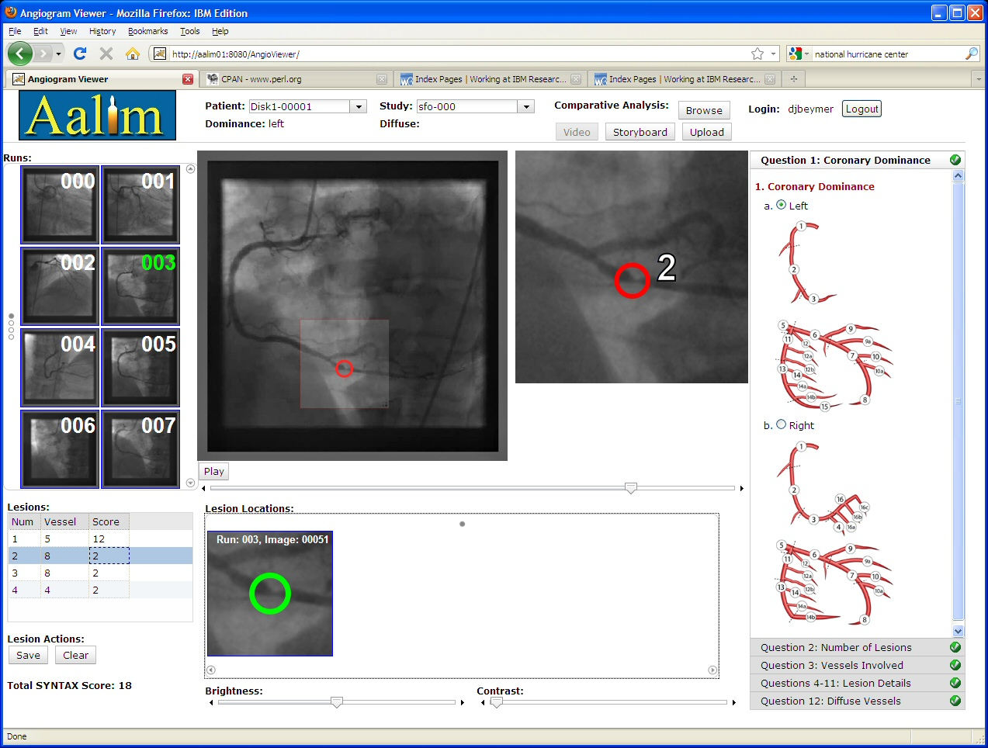
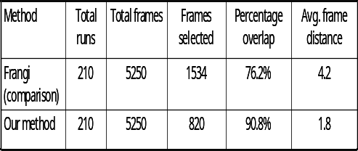
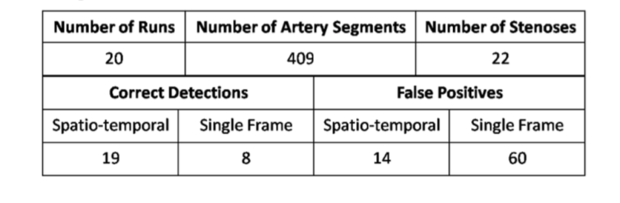
Multimodal clinical decision support – Coronary angiography
Key features:
  Comprehensive end-to-end angiography analysis from DICOM to stenosis using many techniques ranging from computer vision, medical imaging, to deep learning
  viewpoint recognition, coronary tree extraction, coronary tree matching, syntax score element computation, automatic stenosis detection. similarity retrieval, lumen characterization.
  Published in EMBC’2010, ICPR’2010, ISBI’2011, FIMH’2011, MMBIA’2012, MICCAI’2012, FIMH’2013. Several patents.
Diseases handled:
  Coronary artery disease
  Coronary stenosis
Salient frame selection
Datasets tested: Low-medium (around 200 angiogram videos) Kaiser is primary source
In ECCV’06
Use cases: integrated diagnostics, decision support, risk prediction, automated measurements, automated SYNTAX score for decision making, patient synopsis/image summarization.
Stenosis Detection Accuracy
86% Sensitivity
96% Specificity

Slide 14
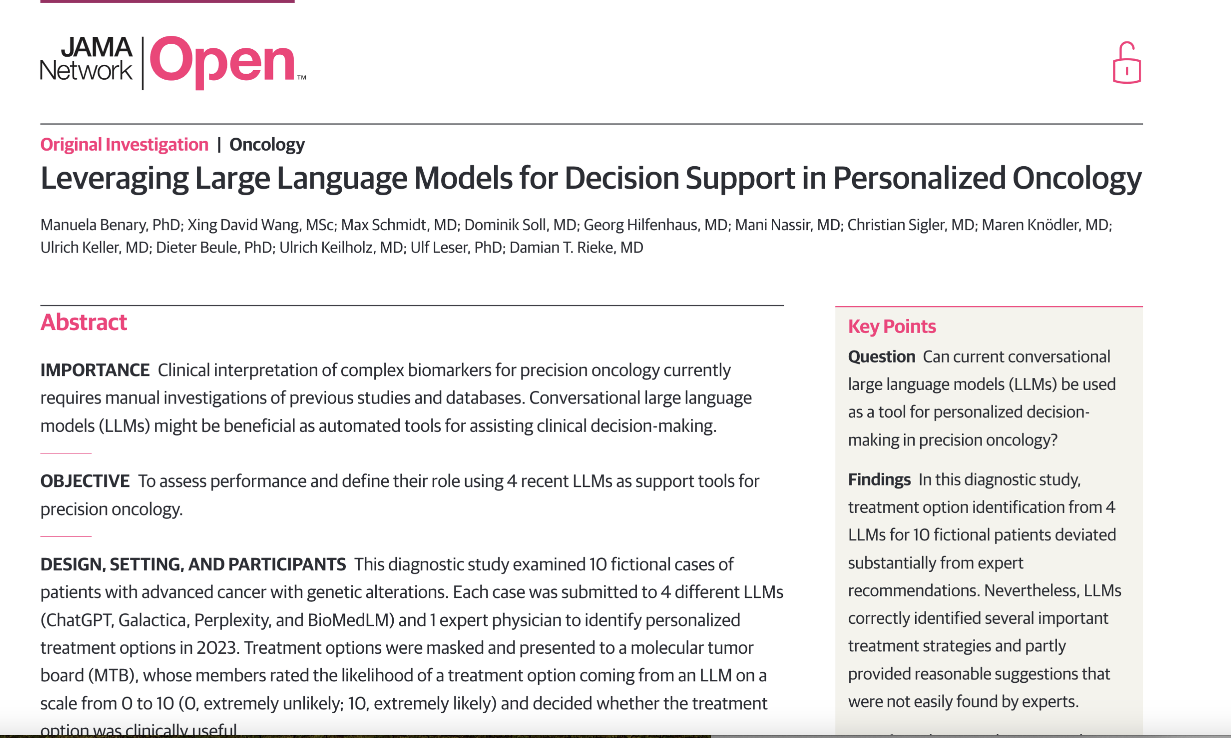
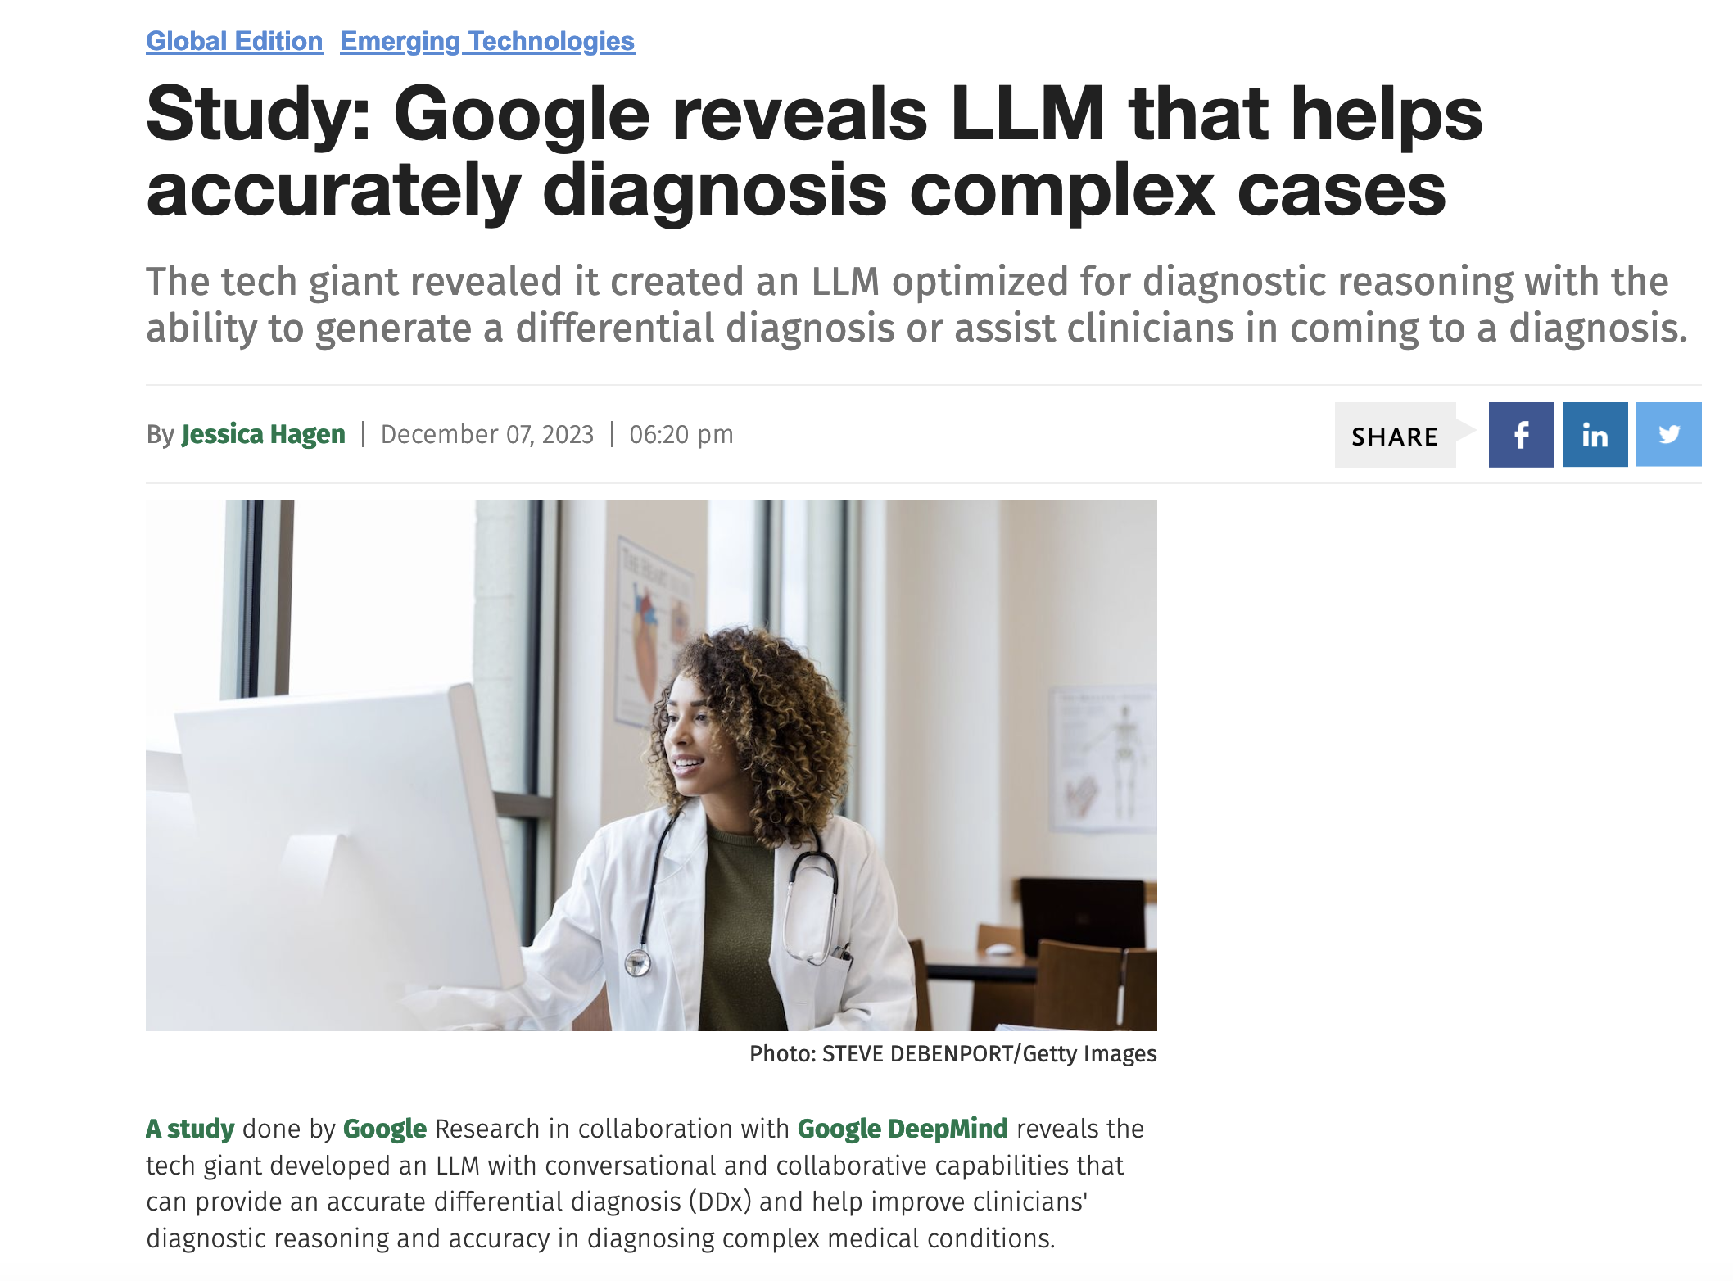
Clinical Decision Support - Current
The patient overview pages summarizes patient information.
14

Slide 15
What are the clinical needs of payers/back office/CIO/IT?
Pre-authorization
Revenue cycle management
Risk identification
  30-day Readmission prediction
Auditing and compliance
EMR/Healthcare informatics
Peer review
Clinical trial search
Foundational Models
  Statistical ML models
  DNN
  LM
  LLM
  VLM
  LLM for Search
FM Workflow applications
Data science tools
Notes:
Identify patients at risk for diseases
Spotting deviations, inconsistencies, fraud (diagnosis, billing), need for tests
Uncover major trends in the population for key findings in imaging
Assess performance
Risk identification
Identify patients at risk for diseases
Auditing and compliance
Spotting deviations, inconsistencies, fraud (diagnosis, billing), need for tests
Uncover major trends
Uncover major trends in the population for key findings in imaging
Peer review
Compare performance of radiologists

Slide 16
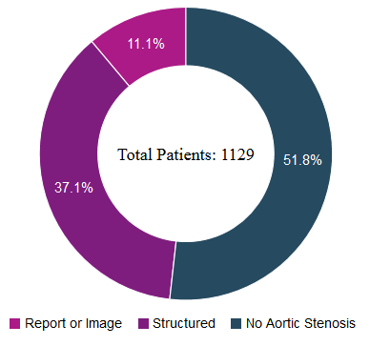
Peer Review - Aortic Stenosis study
Study 1 – at Kaiser hospitals
Total Patients: 1,129
Patients with AS: 547
Diagnosed by Provider 421
Undiagnosed or Tracked: 126
  Reports: 97
  Images: 29
Study 2: At Sentara Hospitals
Total Patients: 3090
Patients with AS: 664
Diagnosed by Provider 581
Discrepancies found: 83
Nearly 30% discrepancies found by ML models!
Identifying Patients at Risk for Aortic Stenosis Through Learning from Multimodal Data, MICCAI 2016

Slide 17
Clinical needs of FM for researchers
Clinical Research and Education
  Compare effectiveness of treatments
  Predictive analytics
  Developing new guidelines for treatment
  Enhance medical curriculums
  Clinical trials research
  Accelerated discovery research (major area)
Foundational Models
  Statistical ML models
  DNN
  LM
  LLM
  VLM
  FM for search
  Multimodal fusion models
FM Workflow applications
Data science tools
Notes:
Mention clinical hub
Compare effectiveness of treatments
Correlations of diseases to treatments and outcome
Predictive analytics
Likelihood of disease development
Developing new guidelines for treatment
Overall improvement in quality of care
Collaborate with standards bodies
Enhance radiology curriculums
Equip curriculum in future with informatics-derived conclusions
Radiology training with big data

Slide 18
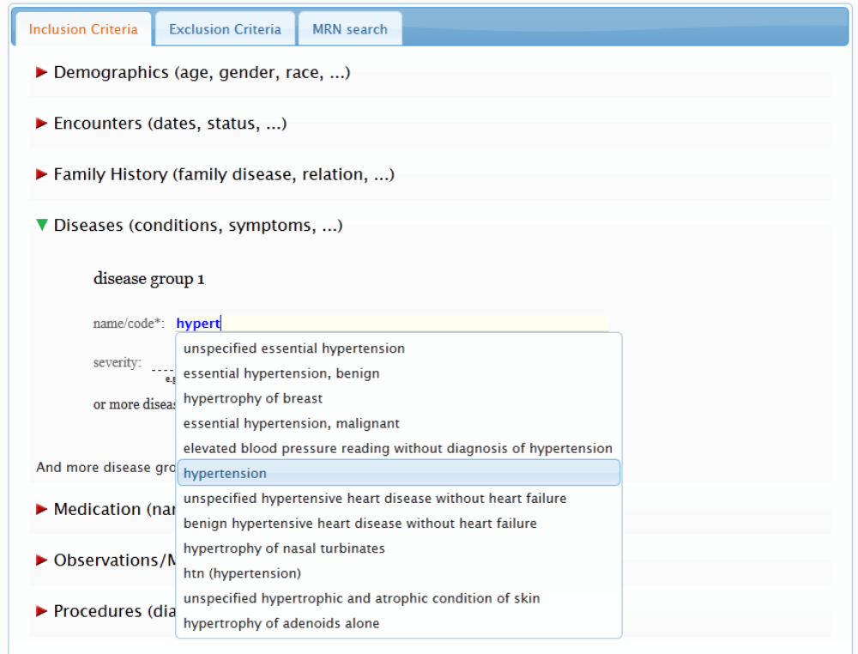
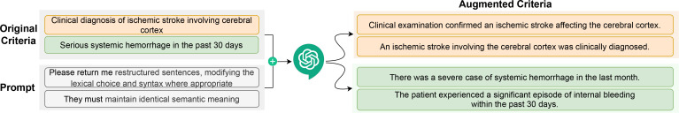
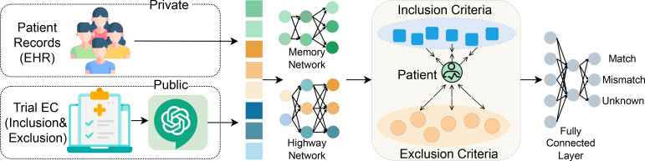
Searching patients for clinical trials
Clinical trial search for suitable patients from Epic EMR
Deployed for 6 years at Cedars-Sinai over 1M patients
Large Language Models for Healthcare Data Augmentation: An Example on Patient-Trial Matching, AMIA 2023
Notes:
Recurrent networks - these models are trained to predict the
next (set of) word(s) to output after having read a stream of word. However, their memory (en-
coded by hidden states and weights) is typically too small, and is not compartmentalized enough
to accurately remember facts from the past (knowledge is compressed into dense vectors). RNNs
are known to have difficulty in performing memorization, for example the simple copying task of
outputting the same input sequence they have just read.
Memory networks:
The central idea is to combine the successful learning strategies developed in the machine
learning literature for inference with a memory component that can be read and written to
Highway networks are deep layer networks that can be trained efficiently

Slide 19
Clinical needs for patients
  Remote monitoring alerts
  Mobile tracking
  Triage and referral routing
  Patients-like-me
Foundational Models
  Statistical ML models
  DNN
  LM
  LLM
  VLM
  FM for search
FM Workflow applications
Data science tools
Anomaly detection
Notes:
Mention FormPad, Stethoscope

Slide 20
Most relevant use case of FM
Automated report generation
  From dictation to report
  From image to report
How good are the current automated report generation using LLM?
  XrayGPT, GPT4,..
  Hallucinations
A case study of automated reporting
  Turing study on chest X-ray preliminary reads (preview)

Slide 21
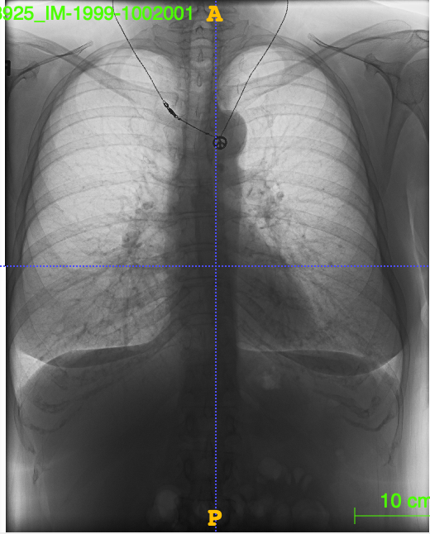
A Turing Test for Radiology AI
Chest X-ray
Automated Preliminary Read
There are atherosclerotic changes of the aorta. There are calcified right hilar and mediastinal lymph nodes. Arthritic changes of the skeletal structures are noted.

