Slide 1
MapReduce System and Theory
  CS 345D
  Semih Salihoglu
  (some slides are copied from Ilan Horn, Jeff Dean, and Utkarsh Srivastava’s
  presentations online)

Slide 2
Outline
System
  MapReduce/Hadoop
  Pig & Hive
Theory:
    Model For Lower Bounding Communication Cost
    Shares Algorithm for Joins on MR & Its Optimality

Slide 3
Outline
System
  MapReduce/Hadoop
  Pig & Hive
Theory:
    Model For Lower Bounding Communication Cost
  Shares Algorithm for Joins on MR & Its Optimality

Slide 4









MapReduce History
2003: built at Google
2004: published in OSDI (Dean&Ghemawat)
2005: open-source version Hadoop
2005-2014: very influential in DB community

Slide 5
Google’s Problem in 2003: lots of data
Example: 20+ billion web pages x 20KB = 400+ terabytes
One computer can read 30-35 MB/sec from disk
  ~four months to read the web
~1,000 hard drives just to store the web
Even more to do something with the data:
  process crawled documents
  process web request logs
  build inverted indices
  construct graph representations of web documents

Slide 6
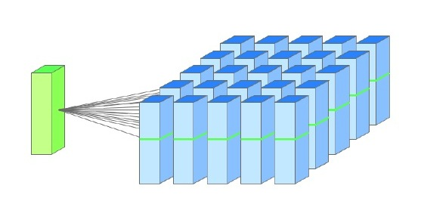
Special-Purpose Solutions Before 2003
Spread work over many machines
Good news: same problem with 1000 machines < 3 hours

Slide 7
Problems with Special-Purpose Solutions
Bad news 1: lots of programming work
  communication and coordination
  work partitioning
  status reporting
  optimization
  locality
Bad news II: repeat for every problem you want to solve
Bad news III: stuff breaks
  One server may stay up three years (1,000 days)
  If you have 10,000 servers, expect to lose 10 a day

Slide 8
What They Needed
A Distributed System:
  Scalable
  Fault-Tolerant
  Easy To Program
  Applicable To Many Problems

Slide 9
MapReduce Programming Model
Map Stage
…
<in_k_{n}, in_v_{n}>
<in_k₁, in_v₁>
<in_k₂, in_v₂>
map()
map()
…
map()
<r_k₁, r_v₁>
<r_k₁, r_v₂>
<r_k₁, r_v₃>
<r_k₅, r_v₂>
<r_k₂, r_v₁>
<r_k₅, r_v₁>
<r_k₂, r_v₂>
Reduce Stage
Group by reduce key
<r_k₁,
{r_v_{1,} r_v_{2,} r_v₃}>
<r_k₂,
{r_v_{1,} r_v₂}>
…
<r_k₅,
{r_v_{1,} r_v₂}>
…
reduce()
reduce()
reduce()
…
out_list₁
out_list₂
out_list₅

Slide 10
Example 1: Word Count
Input <document-name, document-contents>
Output: <word, num-occurrences-in-web>
  e.g. <“obama”, 1000>
map (String input_key, String input_value):
  for each word w in input_value:
  EmitIntermediate(w,1);
reduce (String reduce_key, Iterator<Int> values):
  EmitOutput(reduce_key + “ “ + values.length);

Slide 11
Example 1: Word Count
<doc₁, “obama is the president”>
<doc₂, “hennesy is the president of stanford”>
…
<doc_{n}, “this is an example”>
<“obama”, 1>
…
<“this”, 1>
<“hennesy”, 1>
<“is”, 1>
<“is”, 1>
<“is”, 1>
<“the”, 1>
<“the”, 1>
<“an”, 1>
<“president”, 1>
…
<“example”, 1>
Group by reduce key
<“the”,
{1, 1}>
<“obama”,
{1}>
…
<“is”,
{1, 1, 1}>
…
<“the”, 2>
<“obama”, 1>
<“is”, 3>

Slide 12
⋈
Example 2: Binary Join R(A, B) S(B, C)
Input <R, <a_i, b_j>> or <S, <b_j, c_k>>
Output: successful <a_i, b_j, c_k> tuples
map (String relationName, Tuple t):
Int b_val = (relationName == “R”) ? t[1] : t[0]
Int a_or_c_val = (relationName == “R”) ? t[0] : t[1]
EmitIntermediate(b_val, <relationName, a_or_c_val>);
reduce (Int b_{j}, Iterator<<String, Int>> a_or_c_vals):
int[] aVals = getAValues(a_or_c_vals);
int[] cVals = getCValues(a_or_c_vals) ;
foreach a_{i},c_{k} in aVals, cVals => EmitOutput(a_{i},b_{j}, c_{k});

Slide 13
⋈
Example 2: Binary Join R(A, B) S(B, C)
<‘R’,
<a₁, b₃>>
<‘R’,
<a₂, b₃>>
<‘S’,
<b₃, c₁>>
<‘S’,
<b₃, c₂>>
<‘S’,
<b₂, c₅>>
<b₃,
<‘R’, a₁>>
<b₃,
<‘R’, a₂>>
<b₃,
<‘S’, c₁>>
<b₃,
<‘S’, c₂>>
<b₂,
<‘S’, c₅>>
Group by reduce key
<b₃,
{<‘R’, a₁>,<‘R’, a₂>,
<‘S’, c₁>, <‘S’, c₂>}>
R
a₁ | b₃
a₂ | b₃
S
b₃ | c₁
b₃ | c₂
<b₂,
{<‘S’, c₅>}>
<a₁, b_{3,} c₁>
<a₁, b_{3,} c₂>
No output
<a₂, b_{3,} c₁>
<a₂, b_{3,} c₂>

Slide 14
Programming Model Very Applicable
Can read and write many different data types
Applicable to many problems
distributed grep | web access log stats
distributed sort | web link-graph reversal
term-vector per host | inverted index construction
document clustering | statistical machine translation
machine learning | Image processing
… | …

Slide 15
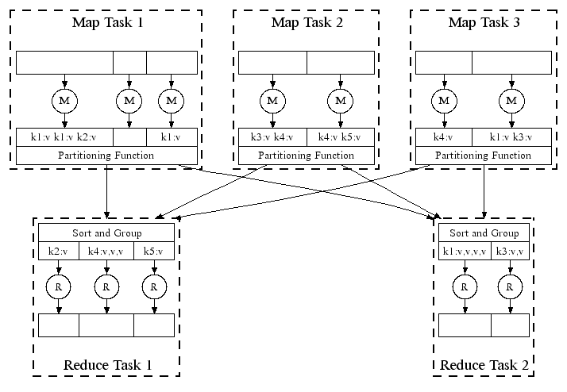
MapReduce Execution
Master Task
Usually many more map tasks than machines
E.g.
  200K map tasks
  5K reduce tasks
  2K machines

Slide 16
Fault-Tolerance: Handled via re-execution
On worker failure:
  Detect failure via periodic heartbeats
  Re-execute completed and in-progress map tasks
  Re-execute in progress reduce tasks
  Task completion committed through master
Master failure
  Is much more rare
  AFAIK MR/Hadoop do not handle master node failure

Slide 17
Other Features
Combiners
Status & Monitoring
Locality Optimization
Redundant Execution (for curse of last reducer)
Overall: Great execution environment for large-scale data

Slide 18
Outline
System
  MapReduce/Hadoop
  Pig & Hive
Theory:
    Model For Lower Bounding Communication Cost
  Shares Algorithm for Joins on MR & Its Optimality

Slide 19
MR Shortcoming 1: Workflows
Many queries/computations need multiple MR jobs
2-stage computation too rigid
Ex: Find the top 10 most visited pages in each category
Visits
UrlInfo
User | Url | Time
Amy | cnn.com | 8:00
Amy | bbc.com | 10:00
Amy | flickr.com | 10:05
Fred | cnn.com | 12:00
Url | Category | PageRank
cnn.com | News | 0.9
bbc.com | News | 0.8
flickr.com | Photos | 0.7
espn.com | Sports | 0.9
19

Slide 20
Top 10 most visited pages in each category
Visits(User, Url, Time)
UrlInfo(Url, Category, PageRank)
MR Job 1: group by url + count
UrlCount(Url, Count)
MR Job 2:join
UrlCategoryCount(Url, Category, Count)
MR Job 3: group by category + count
TopTenUrlPerCategory(Url, Category, Count)
20

Slide 21
MR Shortcoming 2: API too low-level
Visits(User, Url, Time)
UrlInfo(Url, Category, PageRank)
MR Job 1: group by url + count
Common Operations are coded by hand: join, selects, projection, aggregates, sorting, distinct
UrlCount(Url, Count)
MR Job 2:join
UrlCategoryCount(Url, Category, Count)
MR Job 3: group by category + find top 10
TopTenUrlPerCategory(Url, Category, Count)
21

Slide 22
MapReduce Is Not The Ideal Programming API
Programmers are not used to maps and reduces
We want: joins/filters/groupBy/select * from
Solution: High-level languages/systems that compile to MR/Hadoop

Slide 23
High-level Language 1: Pig Latin
2008 SIGMOD: From Yahoo Research (Olston, et. al.)
Apache software - main teams now at Twitter & Hortonworks
Common ops as high-level language constructs
  e.g. filter, group by, or join
Workflow as: step-by-step procedural scripts
Compiles to Hadoop

Slide 24
Pig Latin Example
visits = load ‘/data/visits’ as (user, url, time);
gVisits = group visits by url;
urlCounts = foreach gVisits generate url, count(visits);
urlInfo = load ‘/data/urlInfo’ as (url, category, pRank);
urlCategoryCount = join urlCounts by url, urlInfo by url;
gCategories = group urlCategoryCount by category;
topUrls = foreach gCategories generate top(urlCounts,10);
store topUrls into ‘/data/topUrls’;

Slide 25
Pig Latin Example
visits = load ‘/data/visits’ as (user, url, time);
gVisits = group visits by url;
urlCounts = foreach gVisits generate url, count(visits);
urlInfo = load ‘/data/urlInfo’ as (url, category, pRank);
urlCategoryCount = join urlCounts by url, urlInfo by url;
gCategories = group urlCategoryCount by category;
topUrls = foreach gCategories generate top(urlCounts,10);
store topUrls into ‘/data/topUrls’;
Operates directly over files

Slide 26
Pig Latin Example
visits = load ‘/data/visits’ as (user, url, time);
gVisits = group visits by url;
urlCounts = foreach gVisits generate url, count(visits);
urlInfo = load ‘/data/urlInfo’ as (url, category, pRank);
urlCategoryCount = join urlCounts by url, urlInfo by url;
gCategories = group urlCategoryCount by category;
topUrls = foreach gCategories generate top(urlCounts,10);
store topUrls into ‘/data/topUrls’;
Schemas optional;
Can be assigned dynamically

Slide 27
Pig Latin Example
visits = load ‘/data/visits’ as (user, url, time);
gVisits = group visits by url;
urlCounts = foreach gVisits generate url, count(visits);
urlInfo = load ‘/data/urlInfo’ as (url, category, pRank);
urlCategoryCount = join urlCounts by url, urlInfo by url;
gCategories = group urlCategoryCount by category;
topUrls = foreach gCategories generate top(urlCounts,10);
store topUrls into ‘/data/topUrls’;
User-defined functions (UDFs) can be used in every construct
  Load, Store
  Group, Filter, Foreach

Slide 28
Pig Latin Execution
visits = load ‘/data/visits’ as (user, url, time);
gVisits = group visits by url;
urlCounts = foreach gVisits generate url, count(visits);
urlInfo = load ‘/data/urlInfo’ as (url, category, pRank);
urlCategoryCount = join urlCounts by url, urlInfo by url;
gCategories = group urlCategoryCount by category;
topUrls = foreach gCategories generate top(urlCounts,10);
store topUrls into ‘/data/topUrls’;
MR Job 1
MR Job 2
MR Job 3

Slide 29
Pig Latin: Execution
Visits(User, Url, Time)
UrlInfo(Url, Category, PageRank)
visits = load ‘/data/visits’ as (user, url, time);
gVisits = group visits by url;
visitCounts = foreach gVisits generate url, count(visits);
urlInfo = load ‘/data/urlInfo’ as (url, category, pRank);
visitCounts = join visitCounts by url, urlInfo by url;
gCategories = group visitCounts by category;
topUrls = foreach gCategories generate top(visitCounts,10);
store topUrls into ‘/data/topUrls’;
MR Job 1: group by url + foreach
UrlCount(Url, Count)
MR Job 2:join
UrlCategoryCount(Url, Category, Count)
MR Job 3: group by category + for each
TopTenUrlPerCategory(Url, Category, Count)
29

Slide 30
High-level Language 2: Hive
2009 VLDB: From Facebook (Thusoo et. al.)
Apache software
Hive-QL: SQL-like Declarative syntax
  e.g. SELECT *, INSERT INTO, GROUP BY, SORT BY
Compiles to Hadoop

Slide 31
Hive Example
INSERT TABLE UrlCounts
(SELECT url, count(*) AS count
FROM Visits
GROUP BY url)
INSERT TABLE UrlCategoryCount
(SELECT url, count, category
FROM UrlCounts JOIN UrlInfo ON (UrlCounts.url = UrlInfo .url))
SELECT category, topTen(*)
FROM UrlCategoryCount
GROUP BY category

Slide 32
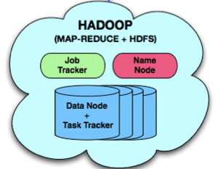
Hive Architecture
Query Interfaces
Command Line
Web
JDBC
Compiler/Query Optimizer

Slide 33
Hive Final Execution
Visits(User, Url, Time)
UrlInfo(Url, Category, PageRank)
INSERT TABLE UrlCounts
(SELECT url, count(*) AS count
FROM Visits
GROUP BY url)
INSERT TABLE UrlCategoryCount
(SELECT url, count, category
FROM UrlCounts JOIN UrlInfo ON (UrlCounts.url = UrlInfo .url))
SELECT category, topTen(*)
FROM UrlCategoryCount
GROUP BY category
MR Job 1: select from-group by
UrlCount(Url, Count)
MR Job 2:join
UrlCategoryCount(Url, Category, Count)
MR Job 3: select from-group by
TopTenUrlPerCategory(Url, Category, Count)
33

Slide 34
Pig & Hive Adoption
Both Pig & Hive are very successful
Pig Usage in 2009 at Yahoo: 40% all Hadoop jobs
Hive Usage: thousands of job, 15TB/day new data loaded

Slide 35
MapReduce Shortcoming 3
Iterative computations
Ex: graph algorithms, machine learning
Specialized MR-like or MR-based systems:
  Graph Processing: Pregel, Giraph, Stanford GPS
  Machine Learning: Apache Mahout
General iterative data processing systems:
  iMapReduce, HaLoop
  **Spark from Berkeley** (now Apache Spark), published in HotCloud`10 [Zaharia et. al]

Slide 36
Outline
System
  MapReduce/Hadoop
  Pig & Hive
Theory:
    Model For Lower Bounding Communication Cost
  Shares Algorithm for Joins on MR & Its Optimality

Slide 37
Tradeoff Between Per-Reducer-Memory and Communication Cost
q = Per-Reducer-
Memory-Cost
Map
Reduce
key | values
drugs_{<1,2>} | Patients_{1,} Patients₂
drugs_{<1,3>} | Patients_{1,} Patients₃
… | …
drugs_{<1,n>} | Patients_{1,} Patients_{n}
… | …
drugs_{<n, n-1>} | Patients_{n}, Patients_{n-1}
<drug₁, Patients₁>
<drug₂, Patients₂>
…
<drug_{i}, Patients_{i}>
…
<drug_{n}, Patients_{n}>
…
r = Communication
Cost
6500 drugs
6500*6499 > 40M reduce keys

Slide 38
Example (1)
Similarity Join
  Input R(A, B), Domain(B) = [1, 10]
  Compute <t, u> s.t |t[B]-u[B]| ≤ 1
Input
Output
A | B
a₁ | 5
a₂ | 2
a₃ | 6
a₄ | 2
a₅ | 7
<(a₁, 5), (a₃, 6)>
<(a₂, 2), (a₄, 2)>
<(a₃, 6), (a₅, 7)>

Slide 39
Example (2)
Hashing Algorithm [ADMPU ICDE ’12]
Split Domain(B) into p ranges of values => (p reducers)
p = 2
(a₁, 5)
(a₂, 2)
(a₃, 6)
(a₄, 2)
(a₅, 7)
[1, 5]
Reducer₁
[6, 10]
Reducer₂
Replicate tuples on the boundary (if t.B = 5)
Per-Reducer-Memory Cost = 3, Communication Cost = 6

Slide 40
Example (3)
p = 5 => Replicate if t.B = 2, 4, 6 or 8
[1, 2]
Reducer₁
(a₁, 5)
(a₂, 2)
(a₃, 6)
(a₄, 2)
(a₅, 7)
[3, 4]
Reducer₂
[5, 6]
Reducer₃
[7, 8]
Reducer₄
[9, 10]
Reducer₅
Per-Reducer-Memory Cost = 2, Communication Cost = 8

Slide 41
Same Tradeoff in Other Algorithms
Multiway-joins ([AU] TKDE ‘11)
Finding subgraphs ([SV] WWW ’11, [AFU] ICDE ’13)
Computing Minimum Spanning Tree (KSV SODA ’10)
Other similarity joins:
  Set similarity joins ([VCL] SIGMOD ’10)
  Hamming Distance (ADMPU ICDE ’12 and later in the talk)

Slide 42
We want
General framework applicable to a variety of problems
Question 1: What is the minimum communication for any MR algorithm, if each reducer uses ≤ q memory?
Question 2: Are there algorithms that achieve this lower bound?

Slide 43
Next
Framework
  Input-Output Model
  Mapping Schemas & Replication Rate
Lower bound for Triangle Query
Shares Algorithm for Triangle Query
Generalized Shares Algorithm

Slide 44
Framework: Input-Output Model
Input Data
Elements
I: {i₁, i₂, …, i_{n}}
Output Elements
O: {o₁, o₂, …, o_{m}}

Slide 45
⋈
Example 1: R(A, B) S(B, C)
|Domain(A)| = n, |Domain(B)| = n, |Domain(C)| = n
(a_{1,} b₁)
…
(a_{1,} b_{n})
…
(a_{n,} b_{n})
(a_{1,} b₁, c₁)
…
(a_{1,} b_{1,} c_{n})
…
(a_{1,} b_{n}, c_{n})
(a_{2,} b₁, c₁)
…
(a_{2,} b_{n}, c_{n})
…
(a_{n,} b_{n}, c_{n})
R(A,B)
(b_{1,} c₁)
…
(b_{1,} c_{n})
…
(b_{n,} c_{n})
S(B,C)
n² + n² = 2n²
possible inputs
n³ possible outputs

Slide 46
⋈
⋈
Example 2: R(A, B) S(B, C) T(C, A)
|Domain(A)| = n, |Domain(B)| = n, |Domain(C)| = n
(a_{1,} b₁)
…
(a_{n,} b_{n})
(a_{1,} b₁, c₁)
…
(a_{1,} b_{1,} c_{n})
…
(a_{1,} b_{n}, c_{n})
(a_{2,} b₁, c₁)
…
(a_{2,} b_{n}, c_{n})
…
(a_{n,} b_{n}, c_{n})
R(A,B)
(b_{1,} c₁)
…
(b_{n,} c_{n})
S(B,C)
(c_{1,} a₁)
…
(c_{n,} a_{n})
T(C,A)
n² + n² + n² = 3n²
input elements
n³ output elements

Slide 47
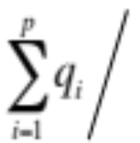

Framework: Mapping Schema & Replication Rate
p reducer: {R_{1,} R₂, …, R_{p}}
q max # inputs sent to any reducer R_{i}
Def (Mapping Schema): M : I → {R_{1,} R₂, …, R_{p}} s.t
  R_{i} receives at most q_{i} ≤ q inputs
  Every output is covered by some reducer
Def (Replication Rate):
  r =
q captures memory, r captures communication cost

Slide 48
Our Questions Again
Question 1: What is the minimum replication rate of any mapping schema as a function of q (maximum # inputs sent to any reducer)?
Question 2: Are there mapping schemas that match this lower bound?

Slide 49
⋈
⋈
Triangle Query: R(A, B) S(B, C) T(C, A)
|Domain(A)| = n, |Domain(B)| = n, |Domain(C)| = n
(a_{1,} b₁)
…
(a_{n,} b_{n})
(a_{1,} b₁, c₁)
…
(a_{1,} b_{1,} c_{n})
…
(a_{1,} b_{n}, c_{n})
(a_{2,} b₁, c₁)
…
(a_{2,} b_{n}, c_{n})
…
(a_{n,} b_{n}, c_{n})
R(A,B)
(b_{1,} c₁)
…
(b_{n,} c_{n})
S(B,C)
(c_{1,} a₁)
…
(c_{n,} a_{n})
T(C,A)
3n² input elements
n³ outputs
each input contributes
to N outputs
each output depends on
3 inputs

Slide 50

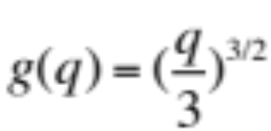
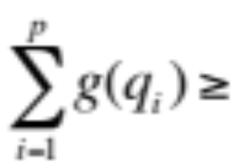
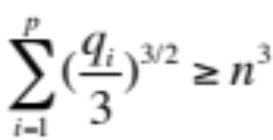
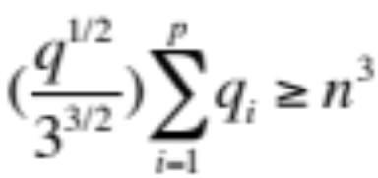



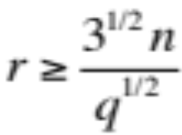
Lower Bound on Replication Rate (Triangle Query)
Key is upper bound : max outputs a reducer can cover with ≤ q inputs
Claim: (proof by AGM bound)
All outputs must be covered:
Recall: r = r =

Slide 51
Memory/Communication Cost Tradeoff (Triangle Query)
Shares Algorithm
n
One reducer
for each output
r =replication
rate
All inputs
to one
reducer
3
1
3
n²/3
3n²
q =max # inputs
to each reducer

Slide 52
Shares Algorithm for Triangles
p = k³ reducers indexed as r_{1,1,1} to r_{k,k,k}
We say each attribute A, B, C has k “shares”
h_{A}, h_{B}, and h_{C} from n -> k are indep. and perfect
(a_{i}, b_{j}) in R(A, B) → r_{(ha(ai), hb(bj),*)}
  E.g. If h_{A}(a_{i}) = 3, h_{B}(b_{j}) = 4, send it to r_{3,4,1,} r_{3,4,2,} …, r_{3,4,k}
(b_{j}, c_{l}) in S(B, C) → r_{(*, hb(bj), hc(cl))}
(c_{l}, a_{i}) in T(C, A) → r_{(ha(ai), *, hc(cl))}
Correct: dependencies of (a_{i}, b_{j,} c_{l}) meets at r_{(ha(ai), hb(bj), hc(cl))}
  E.g. if h_{C}(c_{l}) = 2, all tuples are sent to r_{3,4,2}

Slide 53
Shares Algorithm for Triangles
let p=27
h_{A}(a₁) = 2
h_{B}(b₁) = 1
h_{C}(c₁) = 3
(a₁, b₁) => r_{2,1,*}
(b₁, c₁) => r_{*,1,3}
(a₁, c₁) => r_{2,*,3}
r₁₁₁
…
r₁₁₃
(a_{1,} b₁)
…
(a_{n,} b_{n})
…
R(A,B)
r₂₁₁
r₂₁₂
(b_{1,} c₁)
…
(b_{n,} c_{n})
r₂₁₃
r₂₁₃
S(B,C)
…
r₂₂₃
…
(c_{1,} a₁)
…
(c_{n,} a_{n})
r₂₃₃
T(C,A)
…
r = k => p^{1/3}
q=3n²/p^{2/3}
r₃₁₃
r₃₃₃

Slide 54
Shares Algorithm for Triangles
Shares’ replication rate:
  r = k => p^{1/3} and q=3n²/p^{2/3}
Lower Bound for r >= (3^{1/2}n)/q^{1/2}
Substitute q in LB r >= p^{1/3}
Special case 1:
  p=n³, q=3, r=n
  Equivalent to trivial algorithm one reducer for each output
Special case 2:
  p=1, q=3n², r=1
  Equivalent to the trivial serial algorithm

Slide 55
Other Lower Bound Results [Afrati et. al., VLDB ’13]
Hamming Distance 1
Multiway joins: R(A,B) S(B, C) T(C, A)
Matrix Multiplication
⋈
⋈

Slide 56
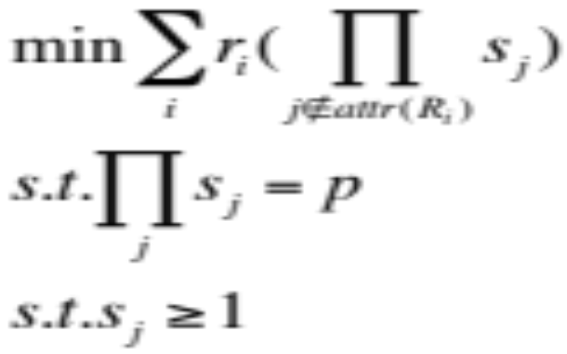
Generalized Shares ([AU] TKDE ’11)
R_{i}, i=1,…,m relations. Let r_{i} =|R_{i}|
A_{j}, j=1,…,n attributes
Q = \Join R_{i}
Give each attribute “share” s_{i}
p reducers indexed by r_{1,1,..,1} to r_{s1,s2,…,sn}
Minimize total communication cost:

Slide 57
Example: Triangles
R(A, B), S(B, C), T(C, A)
|R|=|S|=|T|=n²
Total communication cost:
  min |R|s_{C} + |S|s_{A} + |T|s_{B}
  s.t s_{A}s_{B}s_{C} = p
  Solution: s_{A}=s_{B}=s_{C}=p^{1/3}=k

Slide 58
Shares is Optimal For Any Query
General shares solves a geometric program
Always has solution and solvable in poly time
  observed by Chris and independently by Beame, Koutris, Suciu (BKS))
BKS proved, shares’ comm. cost vs. per-reducer memory optimal for any query

Slide 59
Open MapReduce Theory Questions
Shares communication cost grows with p for most queries
  e.g. triangle communication cost p^{1/3}|I|
  best for one round (again per-reducer memory)
Q1: Can we do better with multi-round algorithms:
  Are there 2 round algorithms with O(|I|) cost?
  Answer is no for general queries. But maybe for a class of queries?
  How about constant round MR algorithms?
  Good work in PODS 2013 by Beame, Koutris, Suciu from UW
Q2: How about instance optimal algorithms?
Q3: How can we guard computations against skew? (good work in arxiv by Beame, Koutris, Suciu)

Slide 60
References
MapReduce: Simplied Data Processing on Large Clusters [Dean&Ghemawarat OSDI ’04]
Pig Latin: A Not-So-Foreign Language for Data Processing [Olston et. al. SIGMOD ’08]
Hive – A Petabyte Scale Data Warehouse Using Hadoop [Thusoo ’09 VLDB]
  Spark: Cluster Computing With Working Sets [Zaharia et. al. HotCloud`10]
Upper and lower bounds on the cost of a map-reduce computation [Afrati et. al., VLDB ’13]
Optimizing Joins in a Map-Reduce Environment [Afrati et. al., TKDE ‘10]
Parallel Evaluation of Conjunctive Queries [Koutris & Suciu, PODS ’11]
Communication Steps For Parallel Query Processing [Beame et. al., PODS `13]
Skew In Parallel Query Processing [Beame et. al., arxiv]

