Slide 1
What can we do about repeats?
Two main approaches:
Cluster the reads
Link the reads

Slide 2
What can we do about repeats?
Two main approaches:
Cluster the reads
Link the reads

Slide 3
What can we do about repeats?
Two main approaches:
Cluster the reads
Link the reads

Slide 4
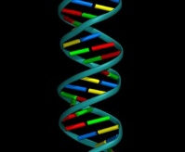
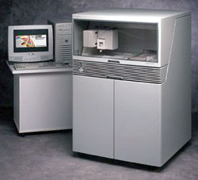


Sequencing and Fragment Assembly
AGTAGCACAGACTACGACGAGACGATCGTGCGAGCGACGGCGTAGTGTGCTGTACTGTCGTGTGTGTGTACTCTCCT
3x10⁹ nucleotides
A
R
B
ARB, CRD
or
ARD, CRB ?
C
R
D

Slide 5
Sequencing and Fragment Assembly
AGTAGCACAGACTACGACGAGACGATCGTGCGAGCGACGGCGTAGTGTGCTGTACTGTCGTGTGTGTGTACTCTCCT
3x10⁹ nucleotides

Slide 6
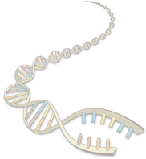
Fragment Assembly
(in whole-genome shotgun sequencing)

Slide 7
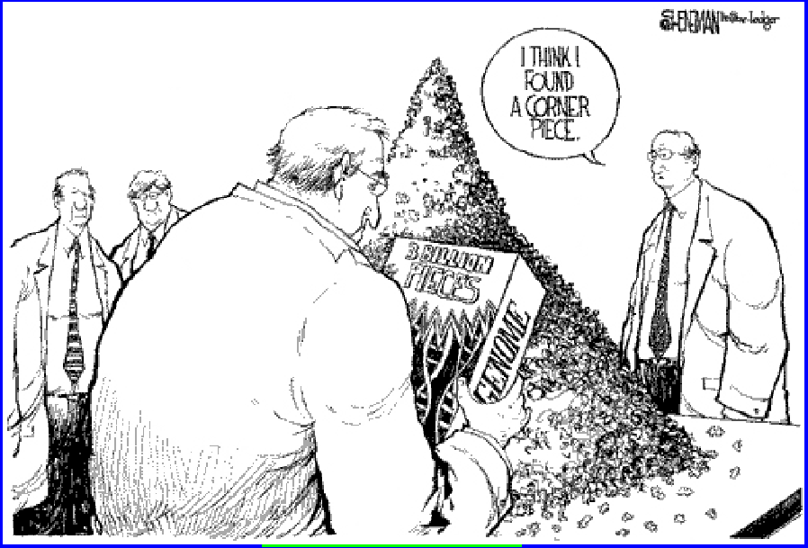
Fragment Assembly
Given N reads…
Where N ~ 30 million…
We need to use a linear-time algorithm

Slide 8
Steps to Assemble a Genome
Some Terminology
read a 500-900 long word that comes
out of sequencer
mate pair a pair of reads from two ends
of the same insert fragment
contig a contiguous sequence formed
by several overlapping reads
with no gaps
supercontig an ordered and oriented set
(scaffold) of contigs, usually by mate
pairs
consensus sequence derived from the
sequene multiple alignment of reads
in a contig
1. Find overlapping reads
2. Merge some “good” pairs of reads into longer contigs
3. Link contigs to form supercontigs
4. Derive consensus sequence
..ACGATTACAATAGGTT..

Slide 9
1. Find Overlapping Reads
(read, pos., word, orient.)
aaactgcag
aactgcagt
actgcagta
…
gtacggatc
tacggatct
gggcccaaa
ggcccaaac
gcccaaact
…
actgcagta
ctgcagtac
gtacggatc
tacggatct
acggatcta
…
ctactacac
tactacaca
(word, read, orient., pos.)
aaactgcag
aactgcagt
acggatcta
actgcagta
actgcagta
cccaaactg
cggatctac
ctactacac
ctgcagtac
ctgcagtac
gcccaaact
ggcccaaac
gggcccaaa
gtacggatc
gtacggatc
tacggatct
tacggatct
tactacaca
aaactgcagtacggatct
aaactgcag
aactgcagt
…
gtacggatct
tacggatct
gggcccaaactgcagtac
gggcccaaa
ggcccaaac
…
actgcagta
ctgcagtac
gtacggatctactacaca
gtacggatc
tacggatct
…
ctactacac
tactacaca

Slide 10
1. Find Overlapping Reads
Find pairs of reads sharing a k-mer, k ~ 24
Extend to full alignment – throw away if not >98% similar
TACA
TAGATTACACAGATTAC
T GA
||
|||||||||||||||||
| ||
TAGT
TAGATTACACAGATTAC
TAGA
Caveat: repeats
  A k-mer that occurs N times, causes O(N²) read/read comparisons
  ALU k-mers could cause up to 1,000,000² comparisons
Solution:
  Discard all k-mers that occur “too often”
    Set cutoff to balance sensitivity/speed tradeoff, according to genome at hand and computing resources available

Slide 11
1. Find Overlapping Reads
Create local multiple alignments from the overlapping reads
TAGATTACACAGATTACTGA
TAGATTACACAGATTACTGA
TAG TTACACAGATTATTGA
TAGATTACACAGATTACTGA
TAGATTACACAGATTACTGA
TAGATTACACAGATTACTGA
TAG TTACACAGATTATTGA
TAGATTACACAGATTACTGA

Slide 12
1. Find Overlapping Reads
Correct errors using multiple alignment
TAGATTACACAGATTACTGA
TAGATTACACAGATTACTGA
TAGATTACACAGATTACTGA
TAGATTACACAGATTACTGA
TAGATTACACAGATTATTGA
TAG-TTACACAGATTATTGA
TAGATTACACAGATTACTGA
TAGATTACACAGATTACTGA
TAG-TTACACAGATTACTGA
TAG-TTACACAGATTATTGA
insert A
correlated errors—
probably caused by repeats
⇒ disentangle overlaps
replace T with C
TAGATTACACAGATTACTGA
TAGATTACACAGATTACTGA
TAGATTACACAGATTACTGA
In practice, error correction removes
up to 98% of the errors
TAG-TTACACAGATTATTGA
TAG-TTACACAGATTATTGA

Slide 13
2. Merge Reads into Contigs
Overlap graph:
  Nodes: reads r₁…..r_{n}
  Edges: overlaps (r_{i}, r_{j}, shift, orientation, score)
Reads that come
from two regions of
the genome (blue
and red) that contain
the same repeat
Note:
of course, we don’t
know the “color” of
these nodes

Slide 14
2. Merge Reads into Contigs
repeat region
Unique Contig
Overcollapsed Contig
We want to merge reads up to potential repeat boundaries

Slide 15
2. Merge Reads into Contigs
Remove transitively inferable overlaps
  If read r overlaps to the right reads r₁, r₂, and r₁ overlaps r₂, then (r, r₂) can be inferred by (r, r₁) and (r₁, r₂)
r
r₁
r₂
r₃

Slide 16
2. Merge Reads into Contigs

Slide 17
Repeats, errors, and contig lengths
Repeats shorter than read length are easily resolved
  Read that spans across a repeat disambiguates order of flanking regions
Repeats with more base pair diffs than sequencing error rate are OK
  We throw overlaps between two reads in different copies of the repeat
To make the genome appear less repetitive, try to:
  Increase read length
  Decrease sequencing error rate
Role of error correction:
Discards up to 98% of single-letter sequencing errors
decreases error rate
⇒ decreases effective repeat content
⇒ increases contig length

Slide 18
3. Link Contigs into Supercontigs
Normal density
Too dense
⇒ Overcollapsed
Inconsistent links
⇒ Overcollapsed?

Slide 19
3. Link Contigs into Supercontigs
Find all links between unique contigs
Connect contigs incrementally, if ≥ 2 forward-reverse links
supercontig
(aka scaffold)

Slide 20
3. Link Contigs into Supercontigs
Fill gaps in supercontigs with paths of repeat contigs
Complex algorithmic step
  Exponential number of paths
  Forward-reverse links

Slide 21
4. Derive Consensus Sequence
TAGATTACACAGATTACTGA TTGATGGCGTAA CTA
TAGATTACACAGATTACTGACTTGATGGCGTAAACTA
TAG TTACACAGATTATTGACTTCATGGCGTAA CTA
TAGATTACACAGATTACTGACTTGATGGCGTAA CTA
TAGATTACACAGATTACTGACTTGATGGGGTAA CTA
TAGATTACACAGATTACTGACTTGATGGCGTAA CTA
Derive multiple alignment from pairwise read alignments
Derive each consensus base by weighted voting
(Alternative: take maximum-quality letter)

Slide 22
De Brujin Graph formulation
Given sequence x₁…x_{N}, k-mer length k,
Graph of 4^{k} vertices,
Edges between words with (k-1)-long overlap
Reads
de Bruijn Graph
Potential Genomes
AAGA
ACTT
ACTC
ACTG
AGAG
CCGA
CGAC
CTCC
CTGG
CTTT
…
CCG
TCC
AAGACTCCGACTGGGACTTT
AAGACTGGGACTCCGACTTT
CGA
CTC
AAG
AGA
GAC
ACT
CTT
TTT
GGA
CTG
GGG
TGG
Slide by Michael Schatz

Slide 23
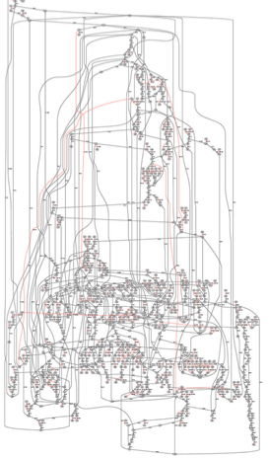
Node Types
Isolated nodes (10%)
Tips (46%)
Bubbles/Non-branch (9%)
Dead Ends (.2%)
Half Branch (25%)
Full Branch (10%)
(Chaisson, 2009)
Slide by Michael Schatz

Slide 24
Error Correction
  Errors at end of read
    Trim off ‘dead-end’ tips
  Errors in middle of read
    Pop Bubbles
  Chimeric Edges
    Clip short, low coverage nodes
B’
A
A
B
B
B’
A
C
A
B*
C
B
A
B
A
B
x
C
D
C
D
Slide by Michael Schatz
Notes:
After correction, more opportunities for path compression
Hard to distinguish errors from repeats -> coverage can indicate

Slide 25
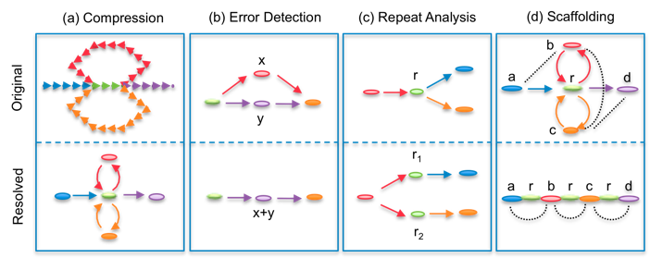
De Brujin Graph formulation

Slide 26
4. Derive Consensus Sequence
TAGATTACACAGATTACTGA TTGATGGCGTAA CTA
TAGATTACACAGATTACTGACTTGATGGCGTAAACTA
TAG TTACACAGATTATTGACTTCATGGCGTAA CTA
TAGATTACACAGATTACTGACTTGATGGCGTAA CTA
TAGATTACACAGATTACTGACTTGATGGGGTAA CTA
TAGATTACACAGATTACTGACTTGATGGCGTAA CTA
Derive multiple alignment from pairwise read alignments
Derive each consensus base by weighted voting
(Alternative: take maximum-quality letter)

Slide 27

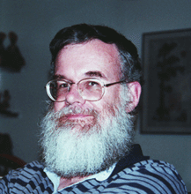
History of WGA
1997
1982: λ-virus, 48,502 bp
1995: h-influenzae, 1 Mbp
2000: fly, 100 Mbp
2001 – present
  human (3Gbp), mouse (2.5Gbp), rat*, chicken, dog, chimpanzee, several fungal genomes
Let’s sequence the human genome with the shotgun strategy
That is impossible, and a bad idea anyway
Phil Green
Gene Myers

Slide 28
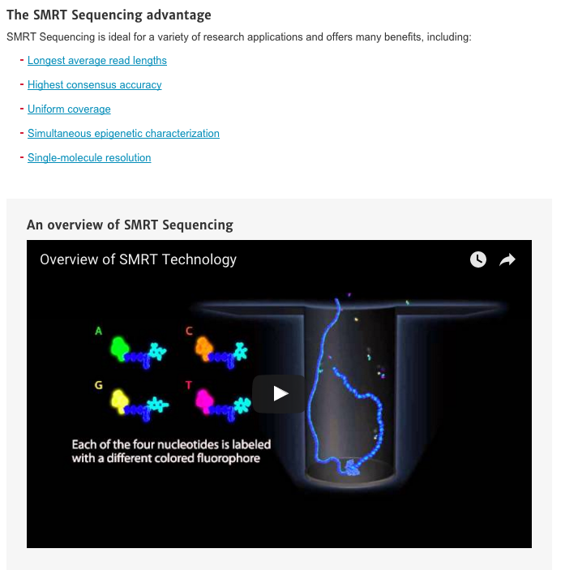
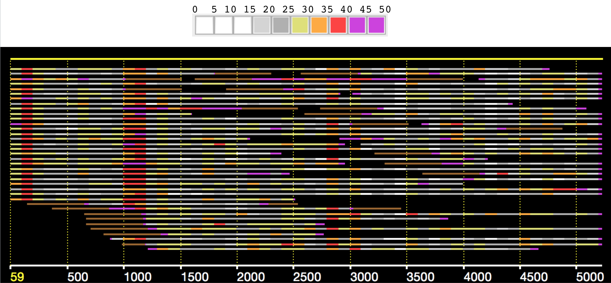
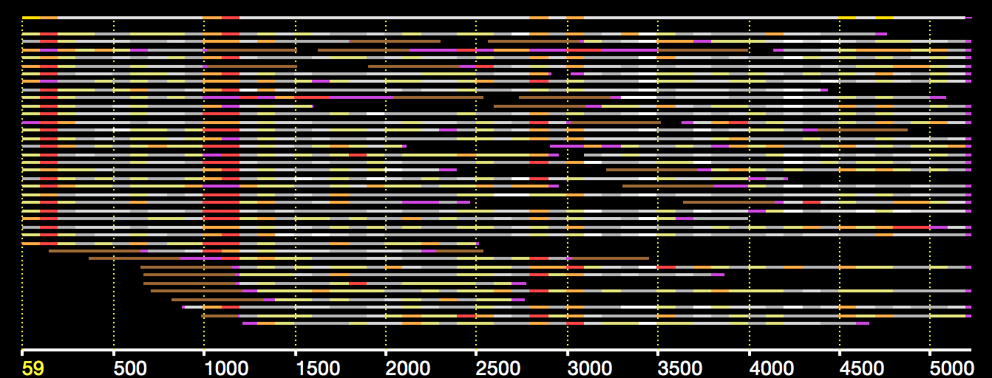
Pacific Biosciences SMRT technology

Slide 29

Oxford Nanopore

Slide 30
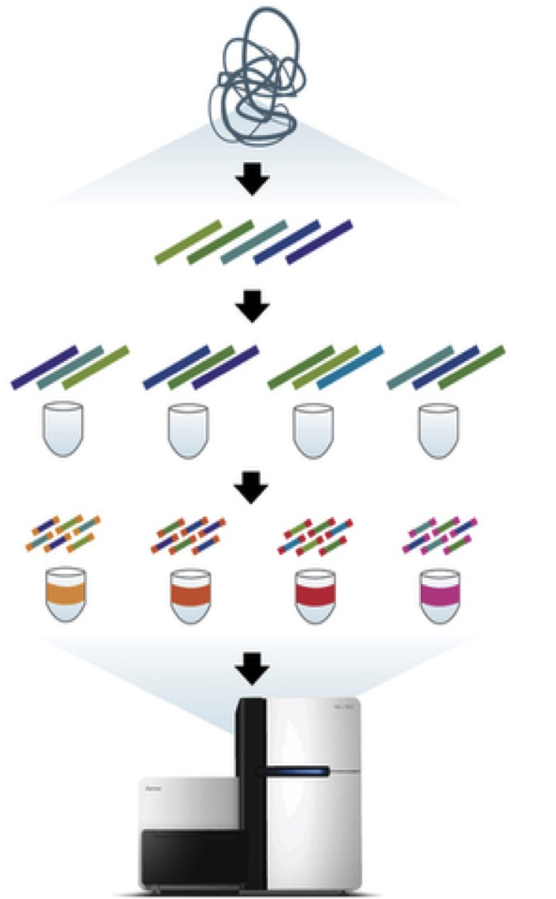
Moleculo Overview
1. Sample DNA is sheared into fragments of about 10 kbp
2. Fragments are diluted and placed into 384 wells
3. Fragments are amplified through long-range PCR, cut into short fragments and barcoded
4. Short fragments are pooled together and sequenced
Notes:
An alternative that has emerged recently involves diluting long fragments of DNA, and barcoding short reads that come from such haploid long fragments.
One such protocol is Moleculo, which is now owned by Illumina. In moleculo, the sample DNA is sheared into fragments of about 10kb.
Fragments are diluted and placed into 384 wells, each containing about 1% of the target genome.
Fragments are amplified through long-range PCR, cut into short fragments and barcoded
Short fragments are then pooled and sequenced.

Slide 31
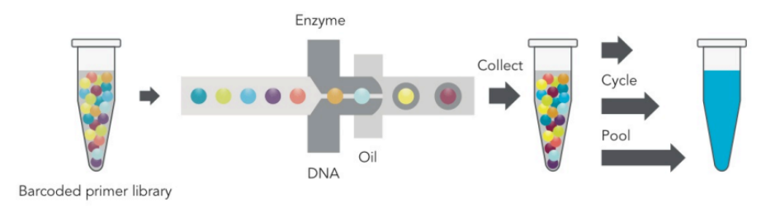
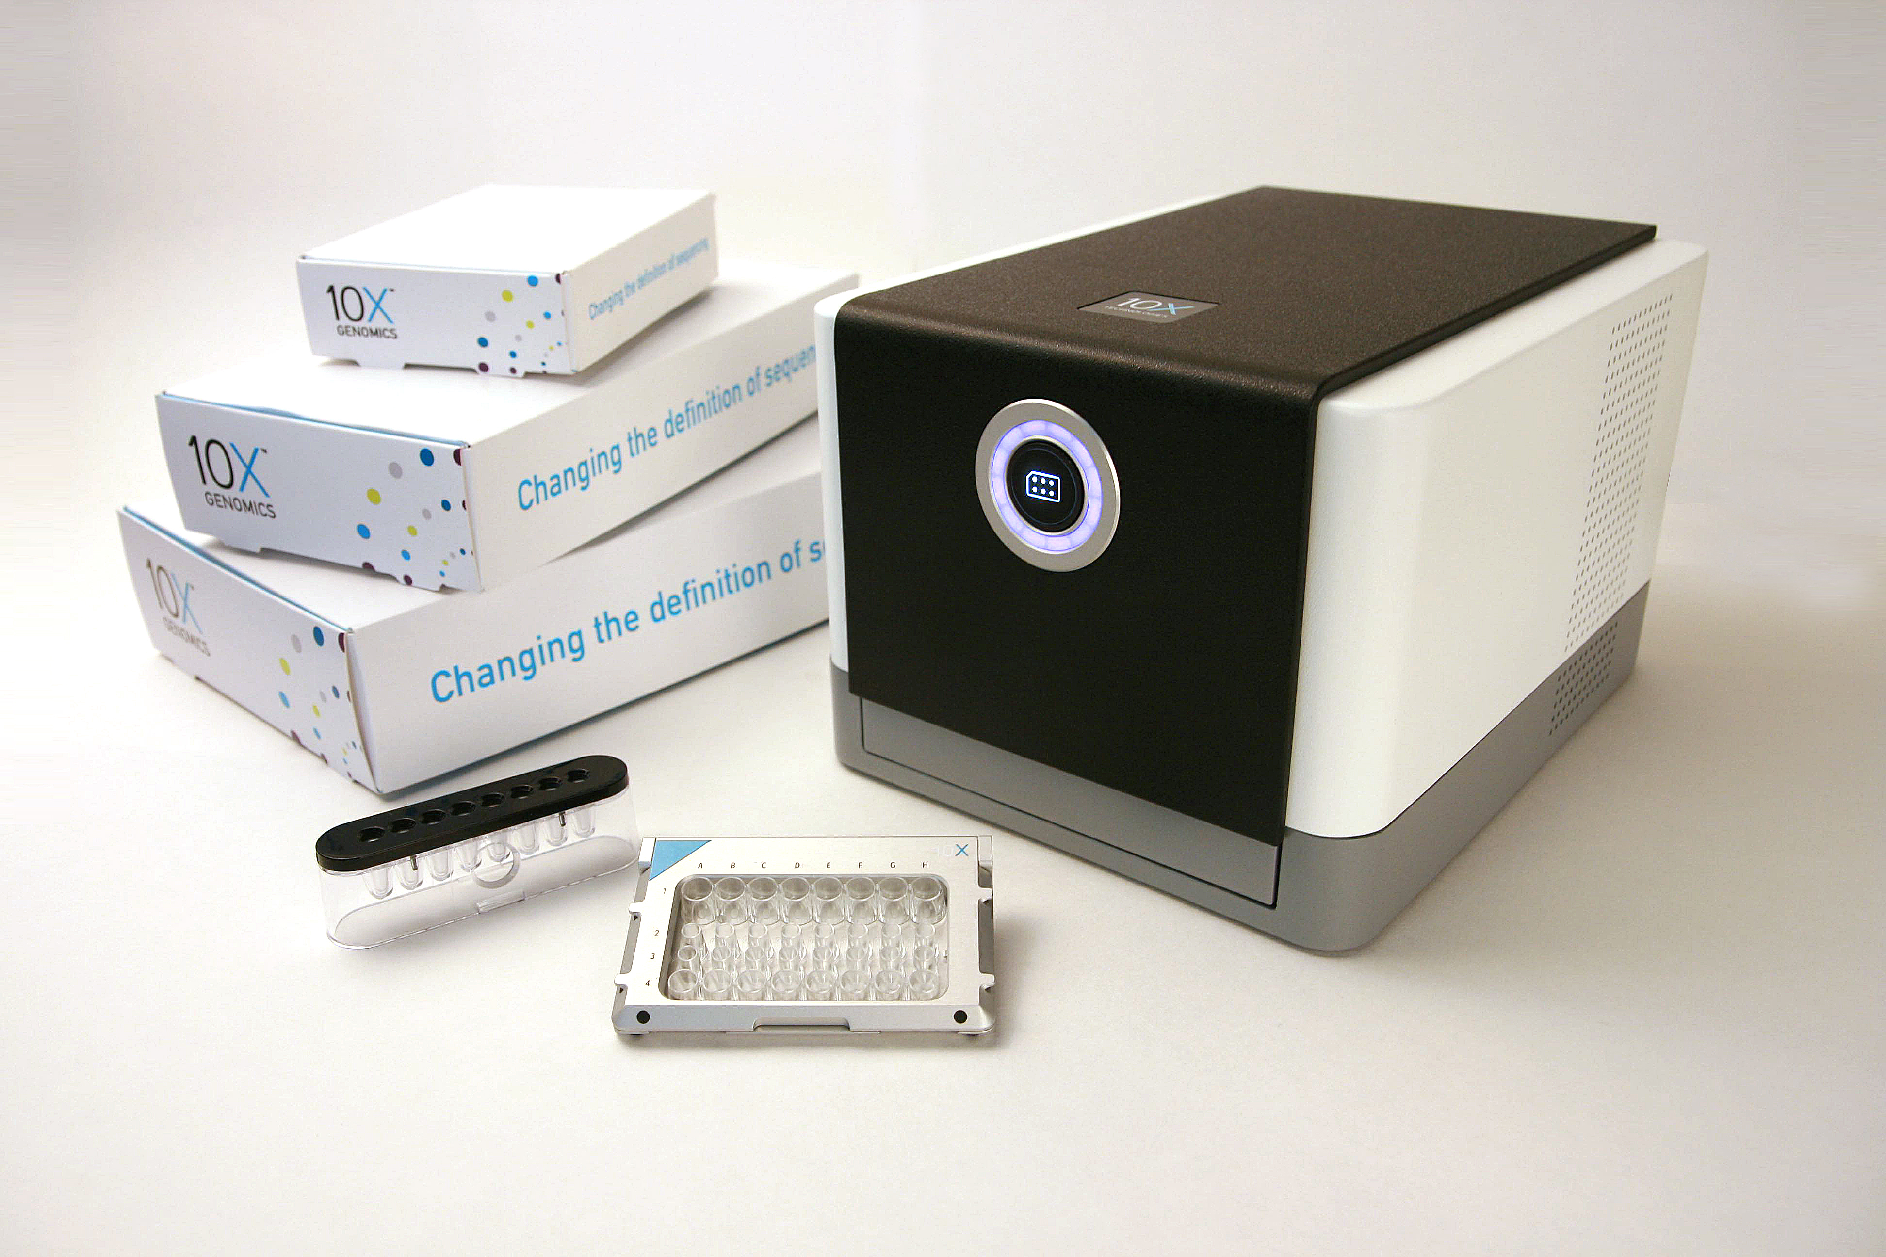
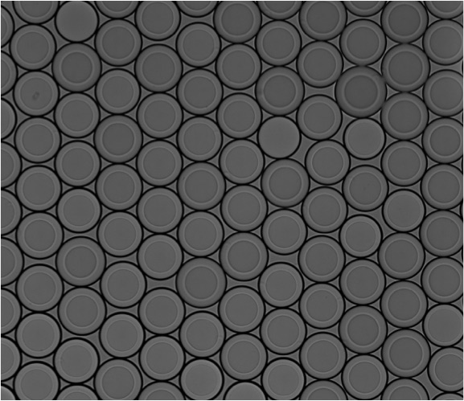
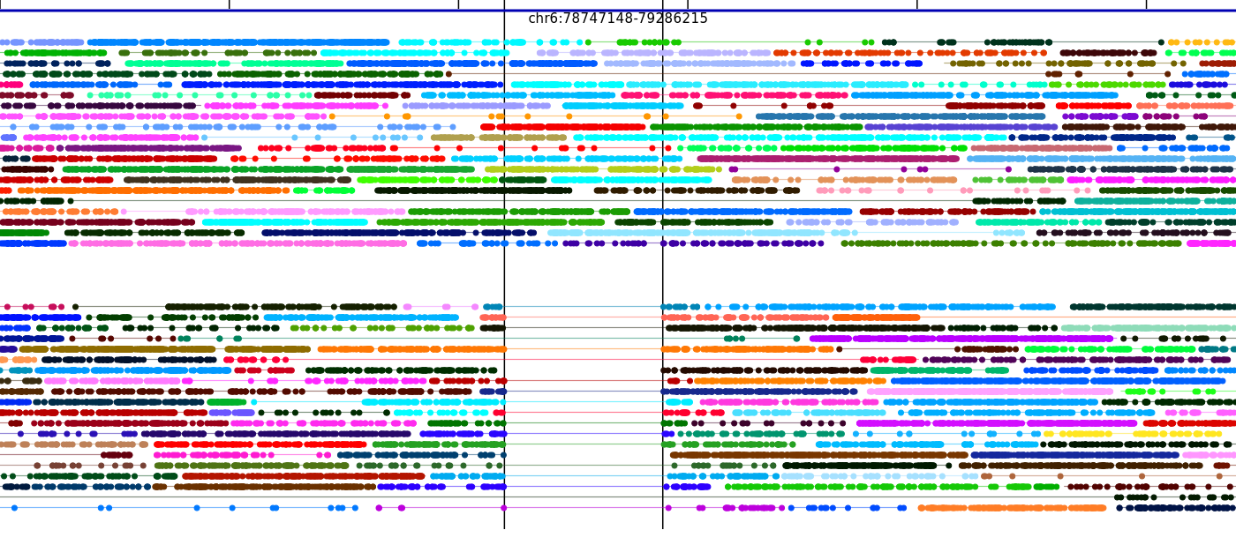
10x System
Massively Parallel Partitioning
10X Instrument & Reagents
Read Clouds (“linked reads”)
Hap1
Hap2
X 200,000+
Phased 60Kb deletion
10X CONFIDENTIAL
Notes:
We did all this work with Moleculo.
Now, I am excited that there is an even better technology coming out, 10x, with which we started collaborating. 10x is like Moleculo on steroids, having very long fragments of 50kb or more, and more than 100,000 separately barcoded compartments.
In conclusion, read clouds are a promising way to get a much more accurate and detailed view of genomes, for genome resequencing, but also for de novo sequencing and metagenomics.

Slide 32
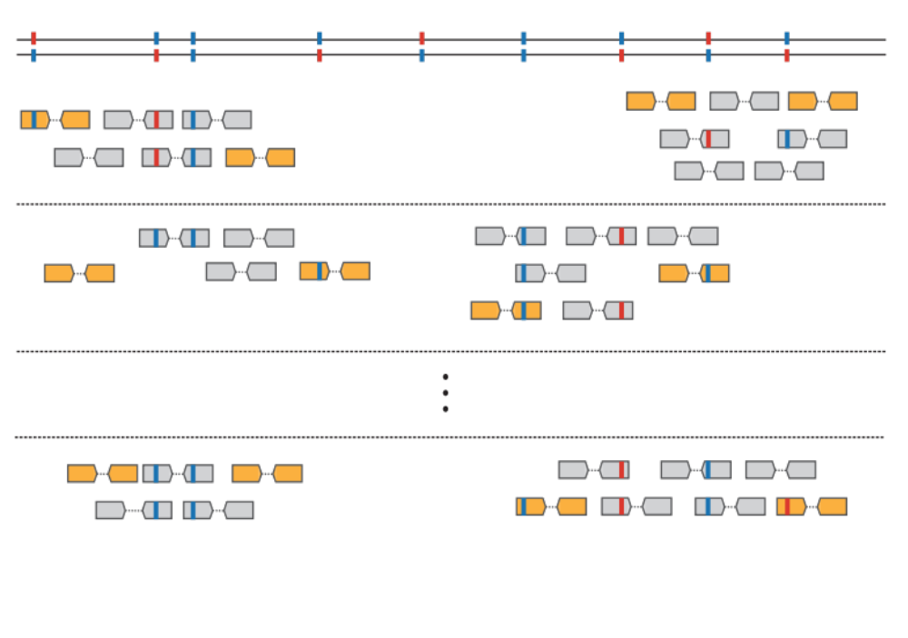
Read Clouds
Well 1
x
C_{R}
Synthetic Long Reads (SLR):
C_{R} >= 50x
Read Clouds:
C_{R} < 1x
X
Well 2
C_{F}
Well n
C_{F}C_{R}
Coverage = Xx
Notes:
Each well has a unique barcode. When we align the fragments from one well into the genome, they form clouds of reads, the span of a cloud being the length of the original long fragment, typically 10kb.
Given a coverage C_F of the genome with long fragments, and a coverage C_R of each long fragment with reads, the total sequencing coverage is C_f times C_R.
The beauty of such data is that each read cloud comes from a single original molecule, and therefore the sequence variation within the cloud is phased.

Slide 33
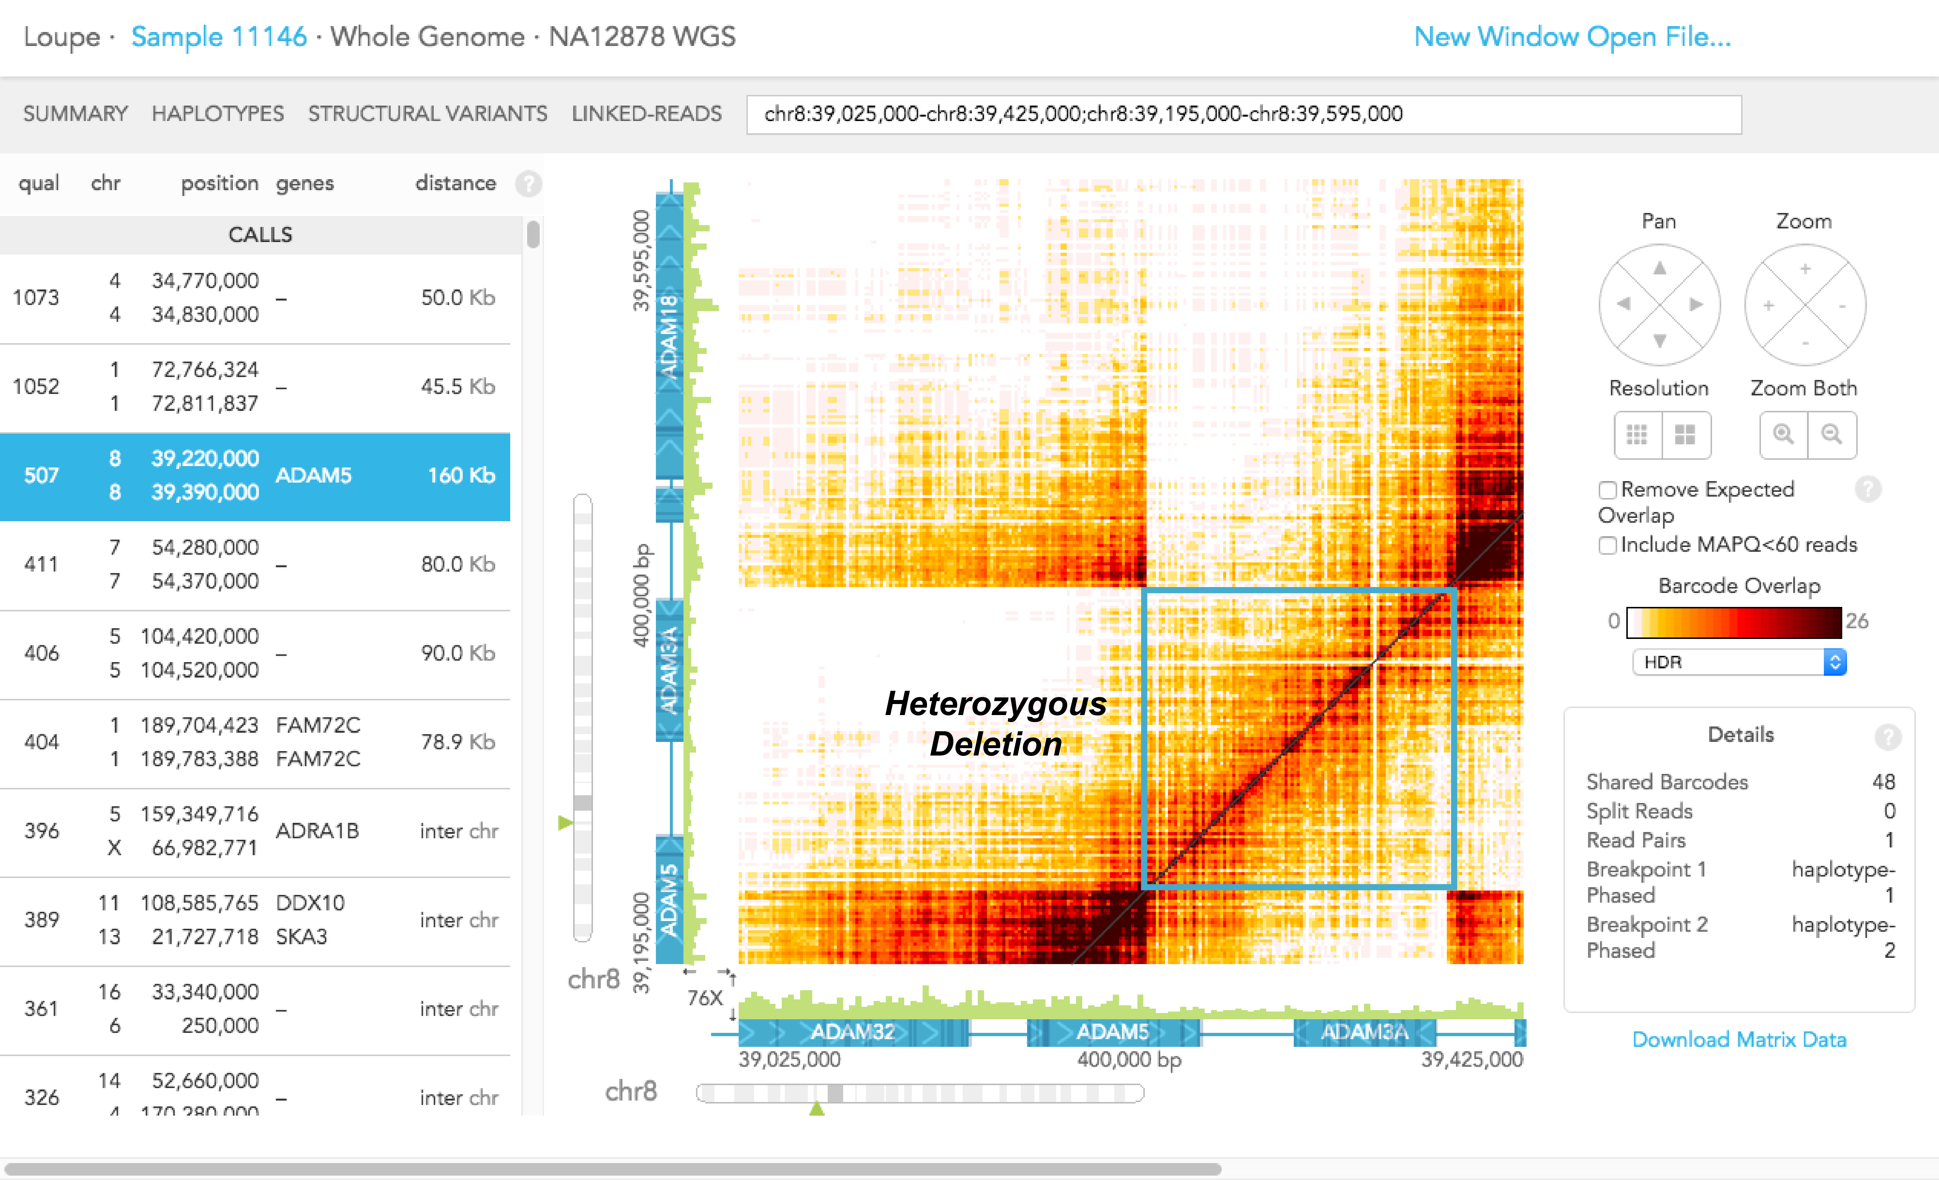
Detecting Structural Variants

Slide 34
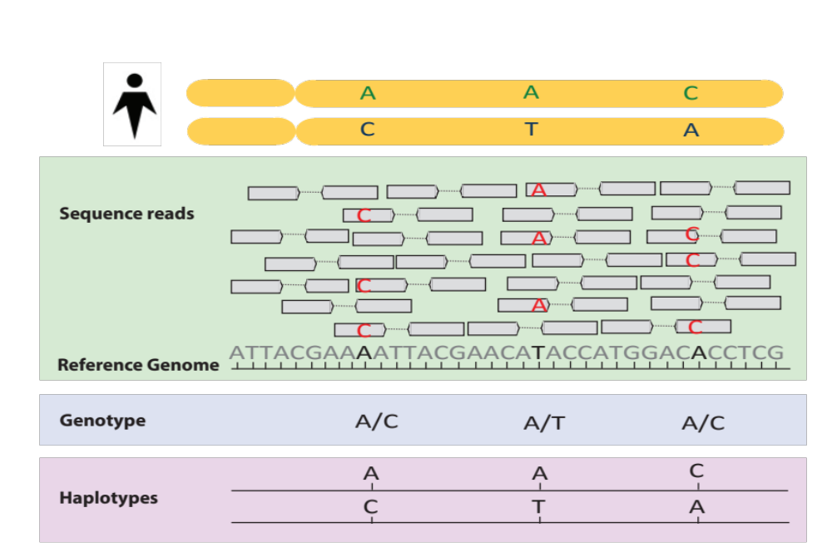
Phasing

Slide 35
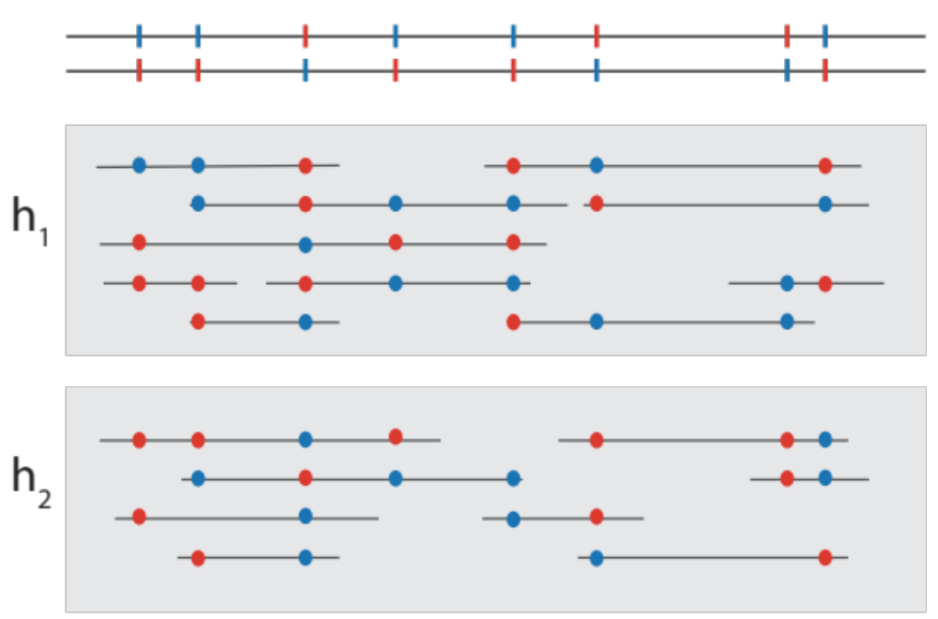
Phasing with Read Clouds

Slide 36
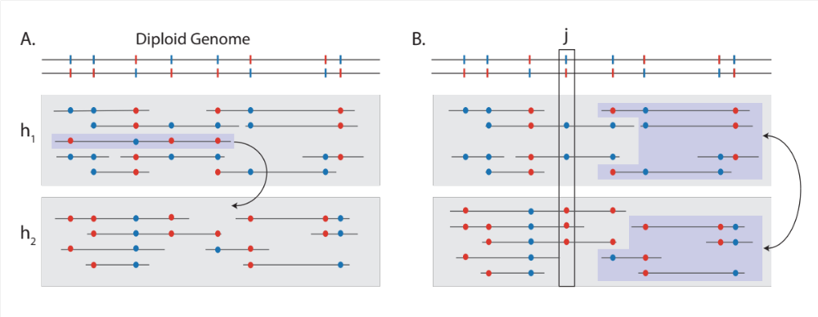
Phasing with Read Clouds

Slide 37
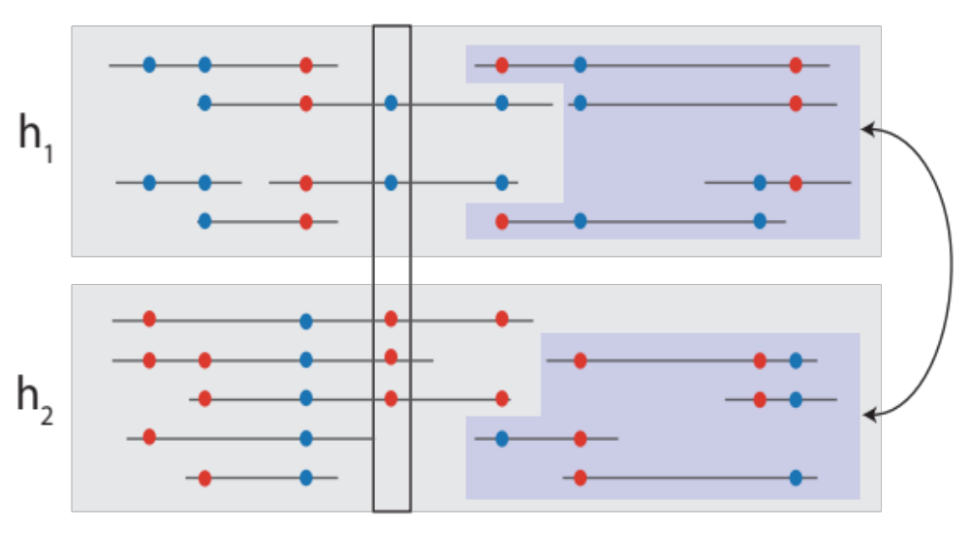
Phasing with Read Clouds

Slide 38
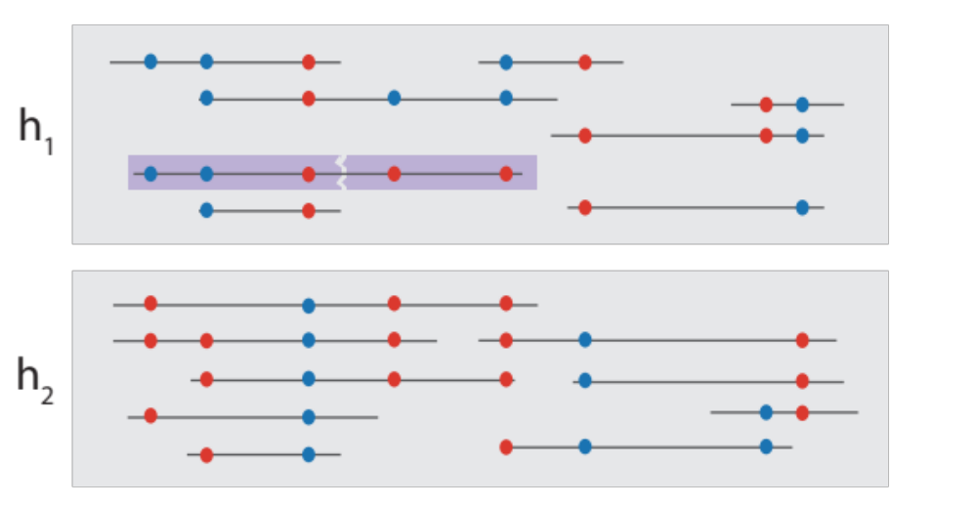
Phasing with Read Clouds

Slide 39
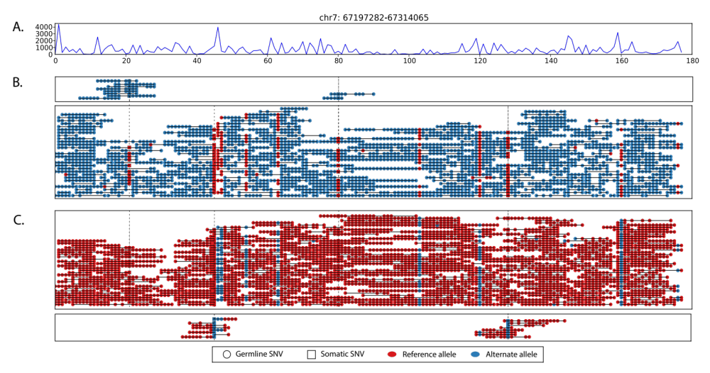
Phasing with Read Clouds

