Slide 1

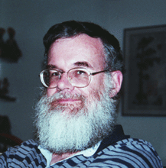
History of WGA
1997
1982: λ-virus, 48,502 bp
1995: h-influenzae, 1 Mbp
2000: fly, 100 Mbp
2001 – present
  human (3Gbp), mouse (2.5Gbp), rat*, chicken, dog, chimpanzee, several fungal genomes
Let’s sequence the human genome with the shotgun strategy
That is impossible, and a bad idea anyway
Phil Green
Gene Myers

Slide 2
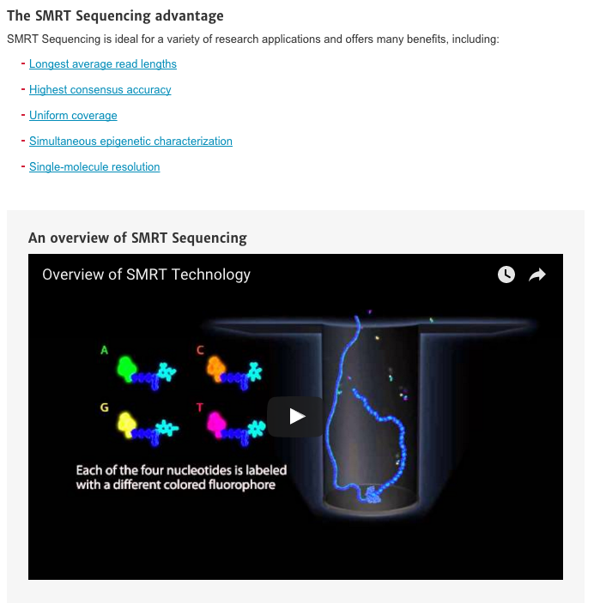
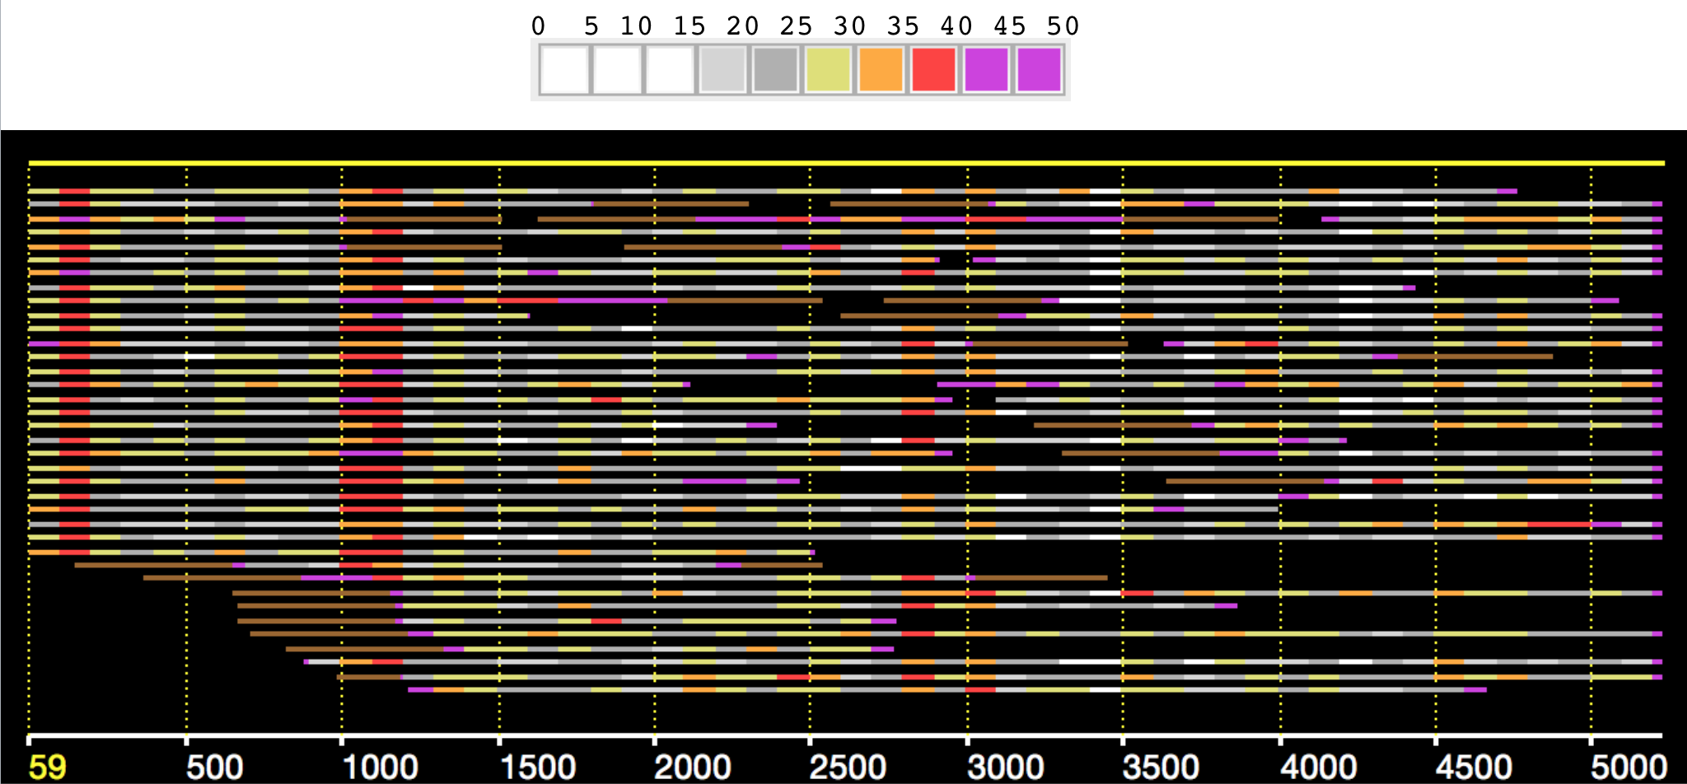
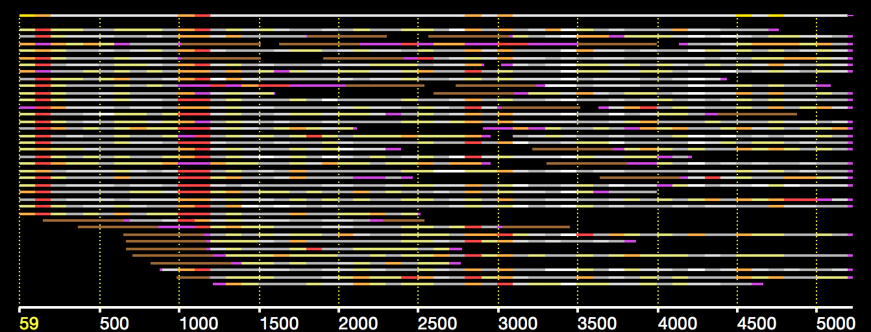
Pacific Biosciences SMRT technology

Slide 3

Oxford Nanopore

Slide 4
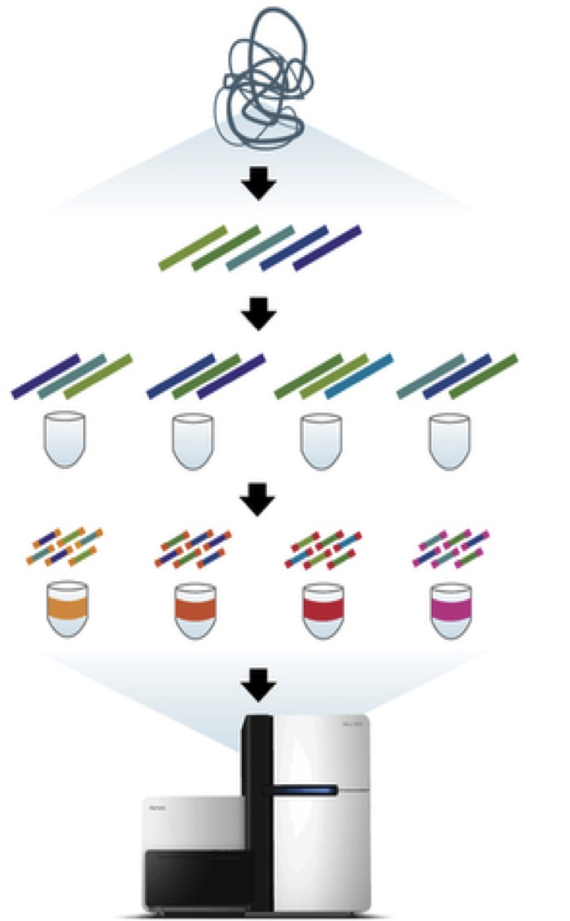
Moleculo Overview
1. Sample DNA is sheared into fragments of about 10 kbp
2. Fragments are diluted and placed into 384 wells
3. Fragments are amplified through long-range PCR, cut into short fragments and barcoded
4. Short fragments are pooled together and sequenced
Notes:
An alternative that has emerged recently involves diluting long fragments of DNA, and barcoding short reads that come from such haploid long fragments.
One such protocol is Moleculo, which is now owned by Illumina. In moleculo, the sample DNA is sheared into fragments of about 10kb.
Fragments are diluted and placed into 384 wells, each containing about 1% of the target genome.
Fragments are amplified through long-range PCR, cut into short fragments and barcoded
Short fragments are then pooled and sequenced.

Slide 5
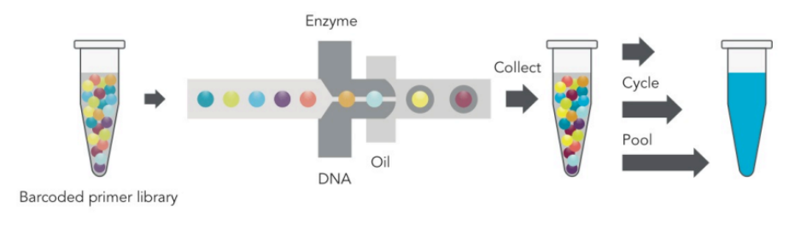
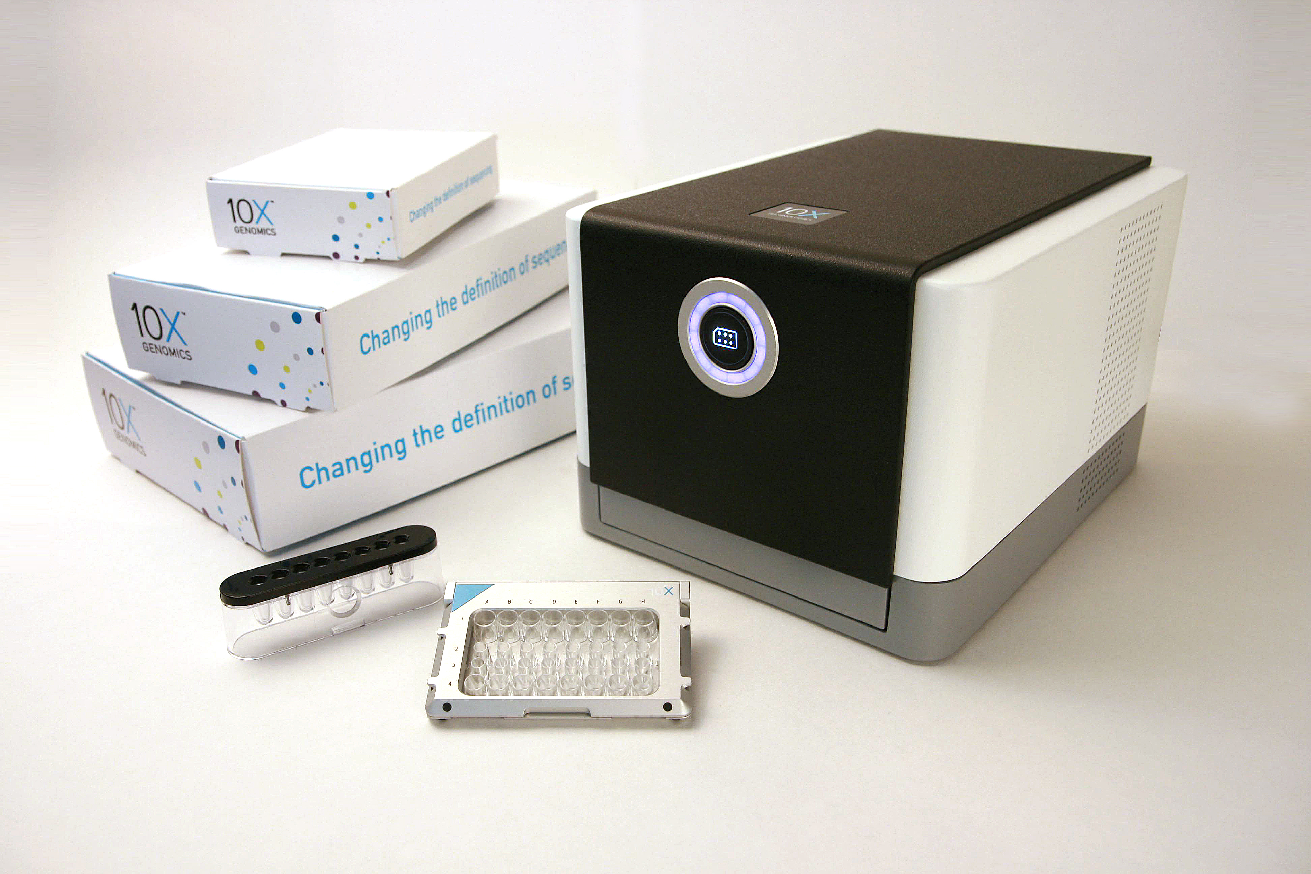
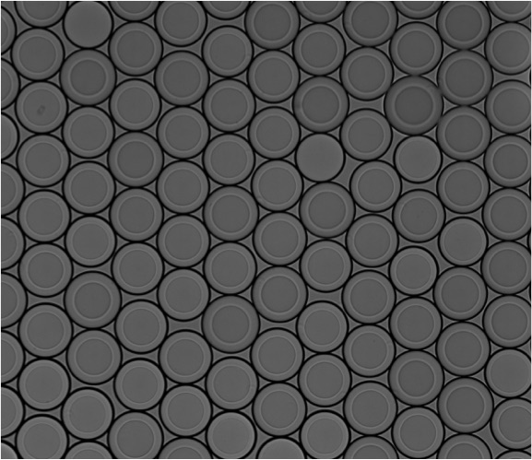
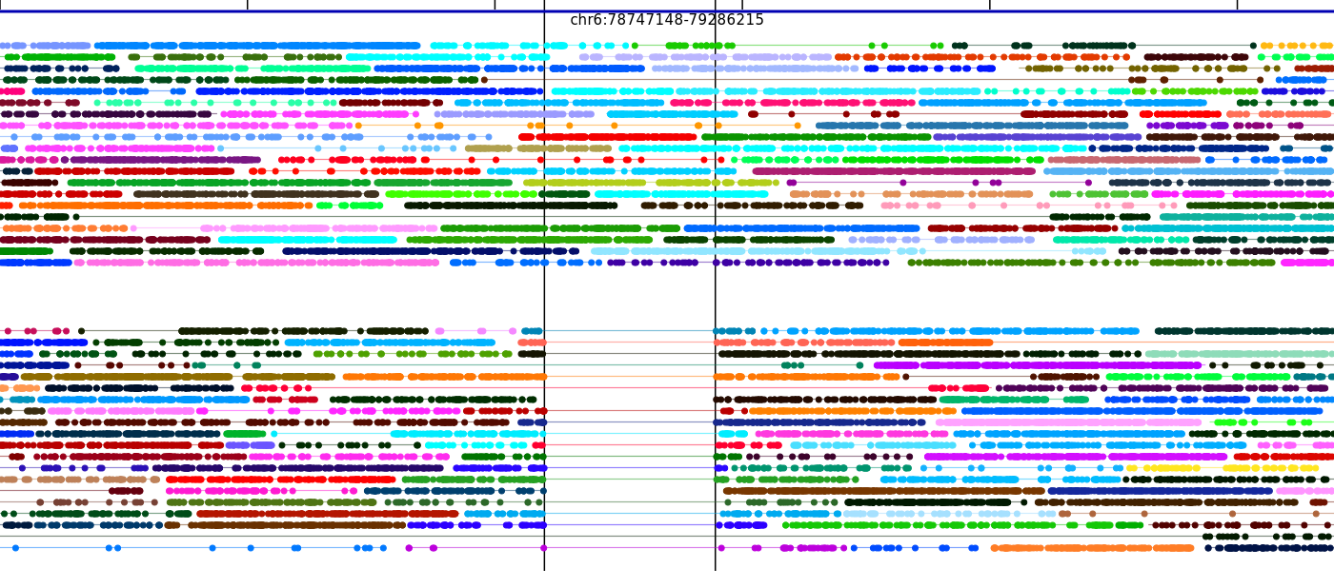
10x System
Massively Parallel Partitioning
10X Instrument & Reagents
Read Clouds (“linked reads”)
Hap1
Hap2
X 200,000+
Phased 60Kb deletion
10X CONFIDENTIAL
Notes:
We did all this work with Moleculo.
Now, I am excited that there is an even better technology coming out, 10x, with which we started collaborating. 10x is like Moleculo on steroids, having very long fragments of 50kb or more, and more than 100,000 separately barcoded compartments.
In conclusion, read clouds are a promising way to get a much more accurate and detailed view of genomes, for genome resequencing, but also for de novo sequencing and metagenomics.

Slide 6
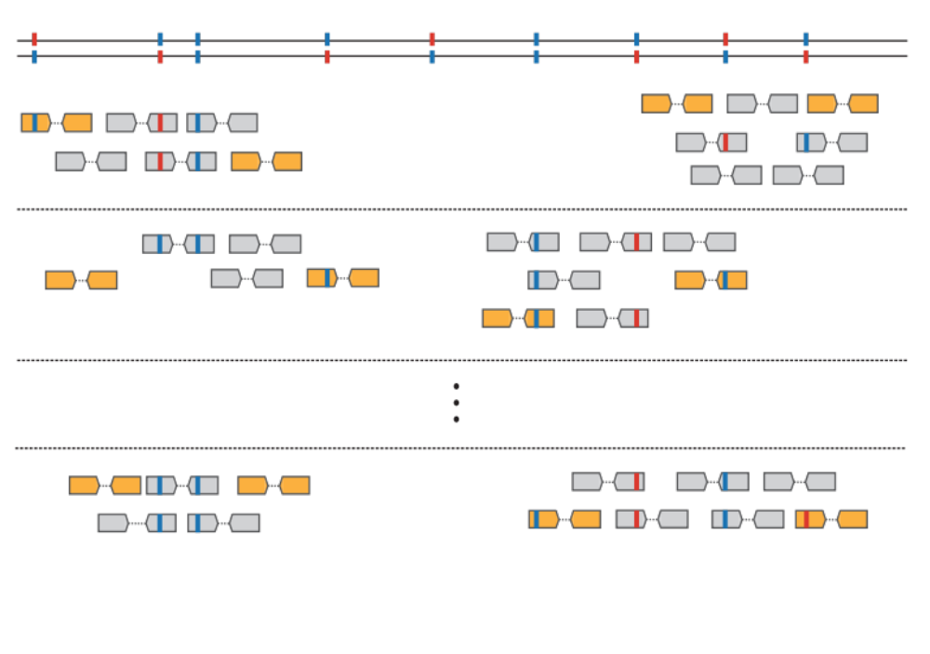
Read Clouds
Well 1
x
C_{R}
Synthetic Long Reads (SLR):
C_{R} >= 50x
Read Clouds:
C_{R} < 1x
X
Well 2
C_{F}
Well n
C_{F}C_{R}
Coverage = Xx
Notes:
Each well has a unique barcode. When we align the fragments from one well into the genome, they form clouds of reads, the span of a cloud being the length of the original long fragment, typically 10kb.
Given a coverage C_F of the genome with long fragments, and a coverage C_R of each long fragment with reads, the total sequencing coverage is C_f times C_R.
The beauty of such data is that each read cloud comes from a single original molecule, and therefore the sequence variation within the cloud is phased.

Slide 7
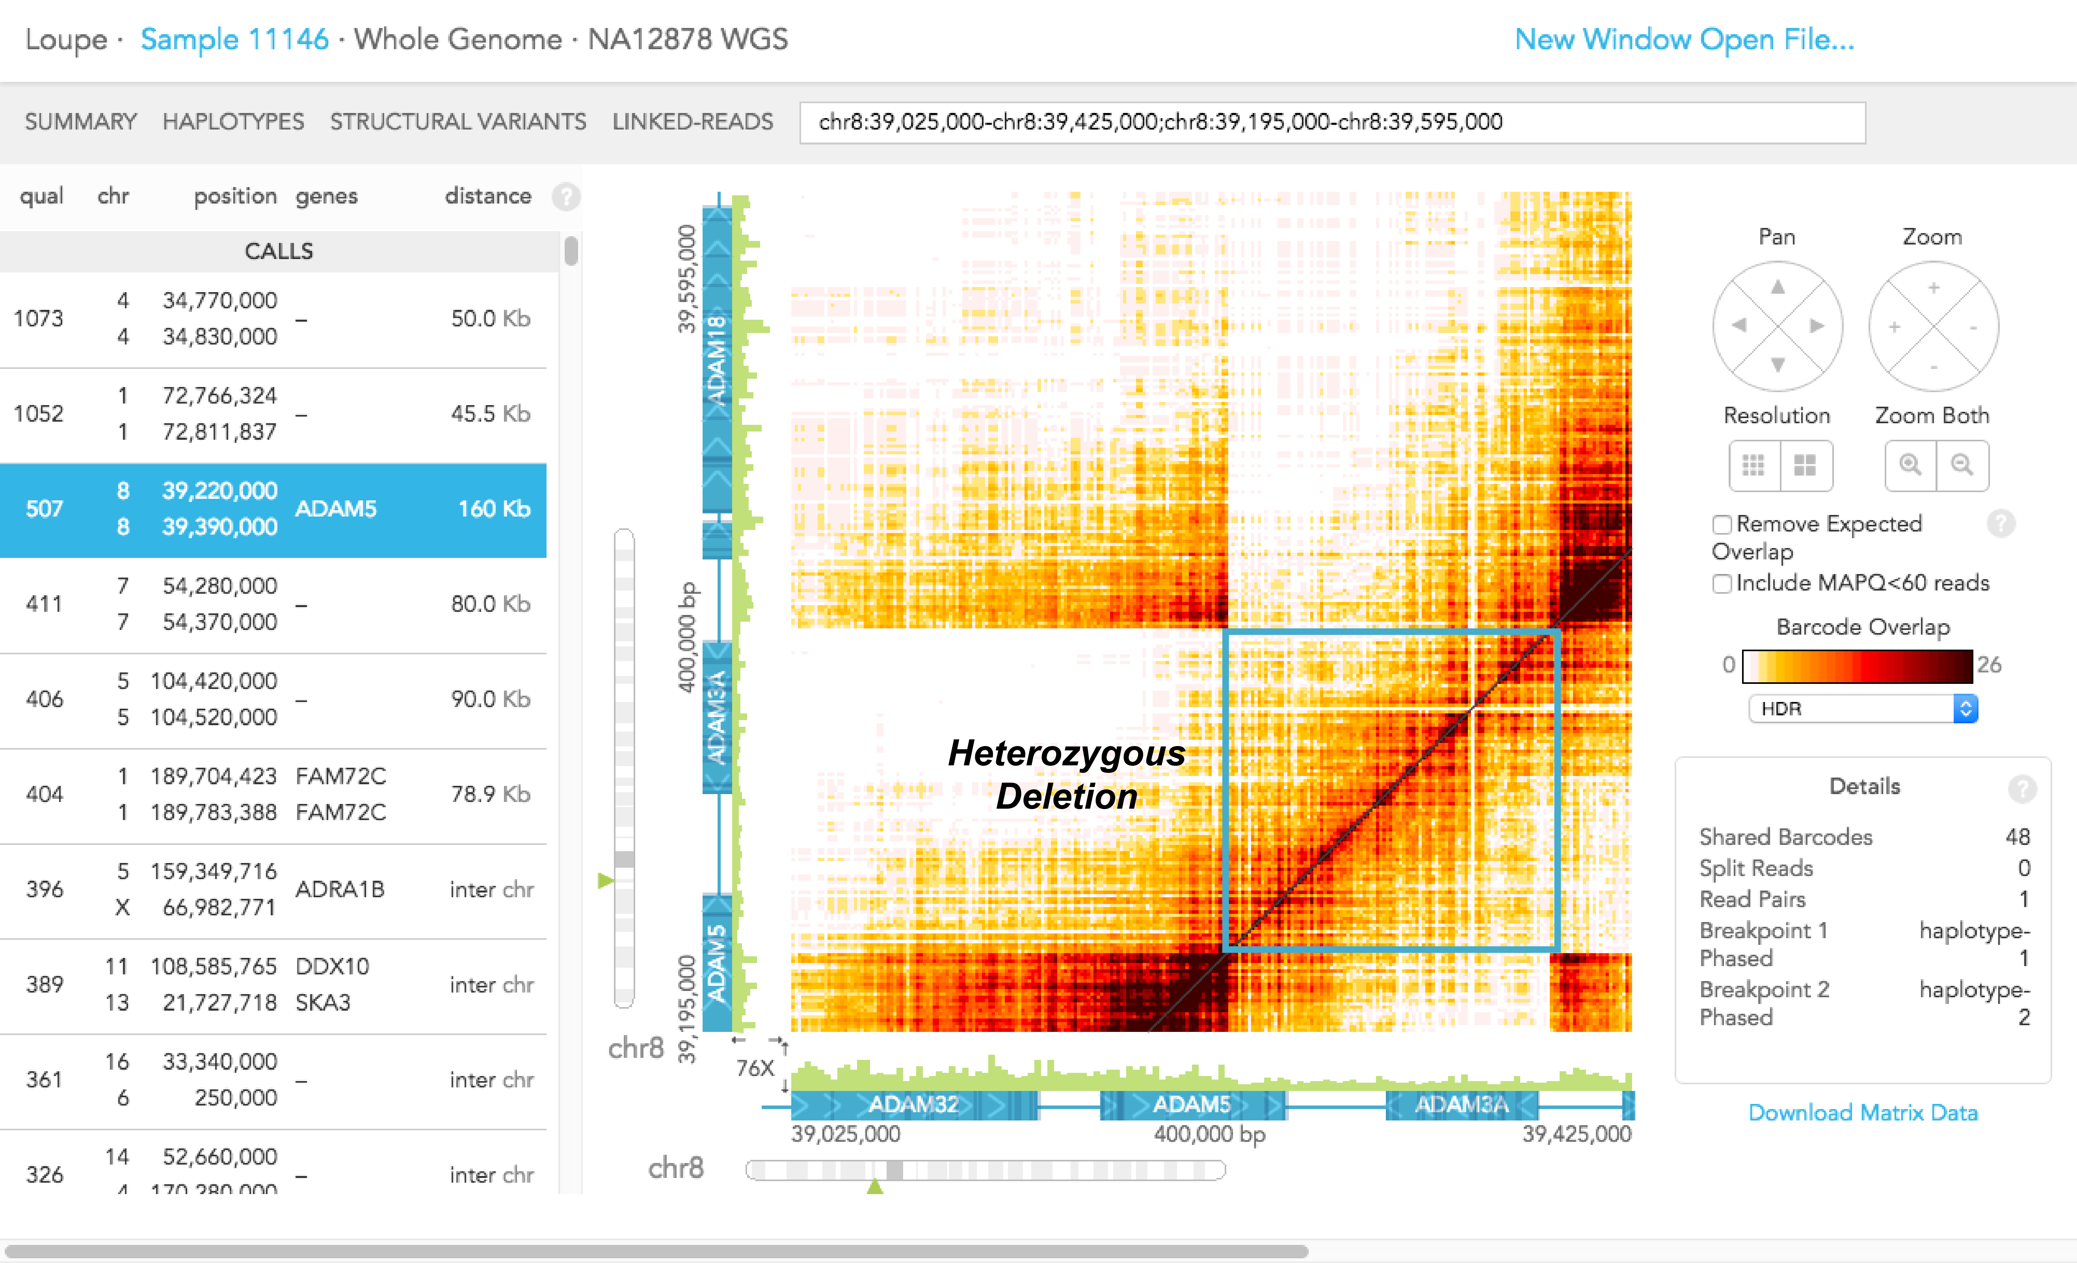
Detecting Structural Variants

Slide 8
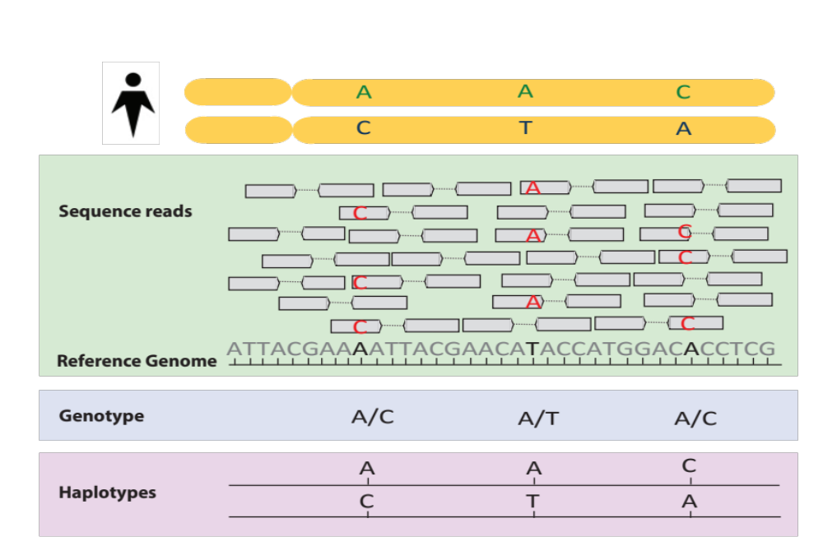
Phasing

Slide 9
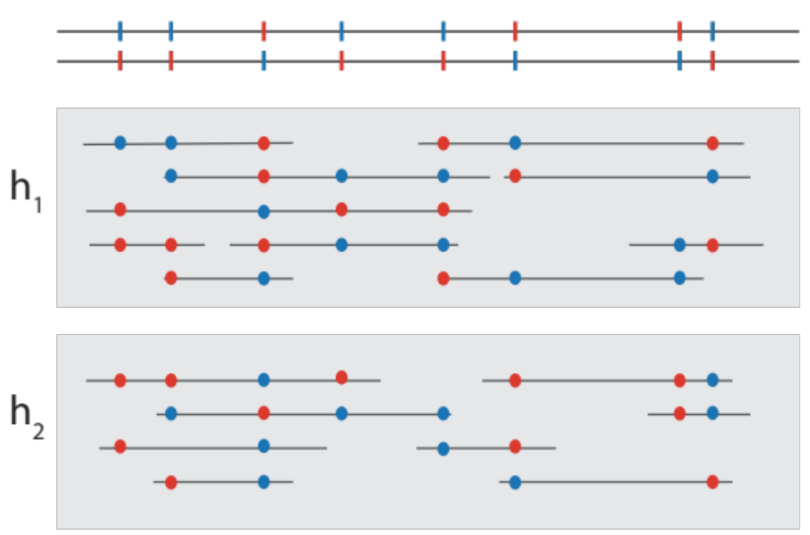
Phasing with Read Clouds

Slide 10
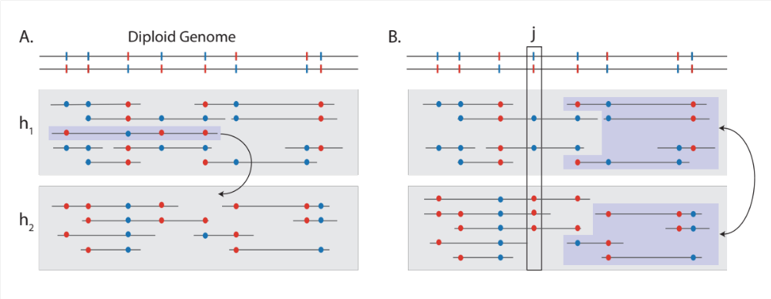
Phasing with Read Clouds

Slide 11
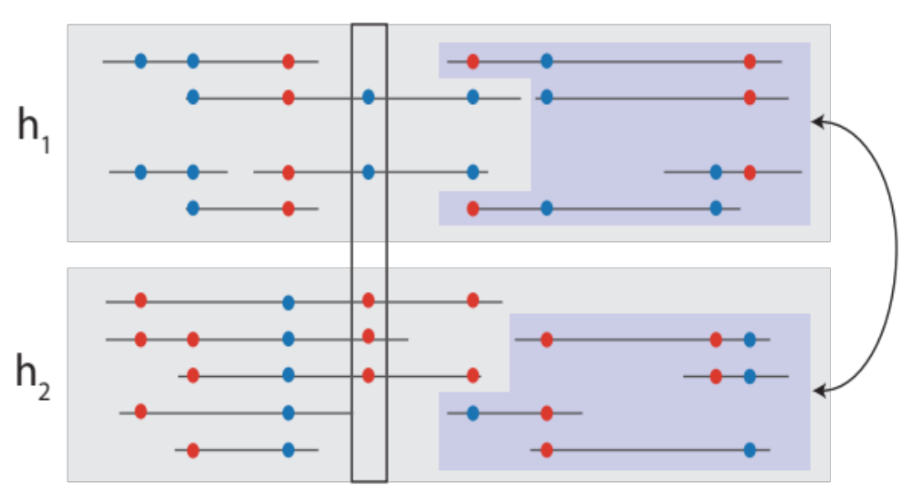
Phasing with Read Clouds

Slide 12
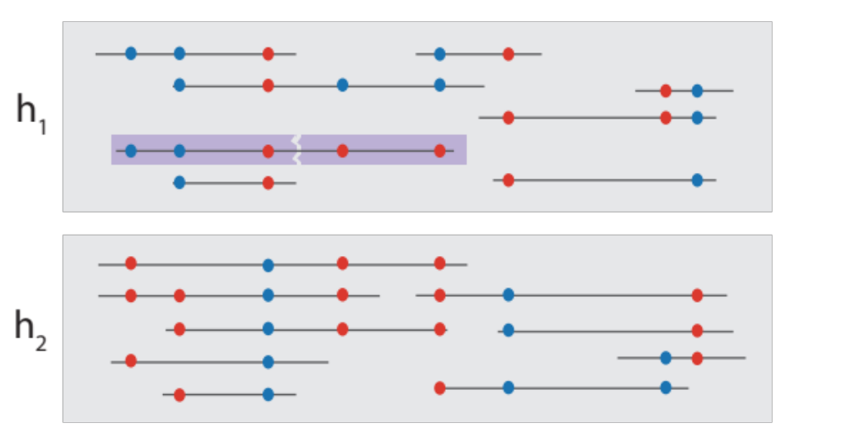
Phasing with Read Clouds

Slide 13
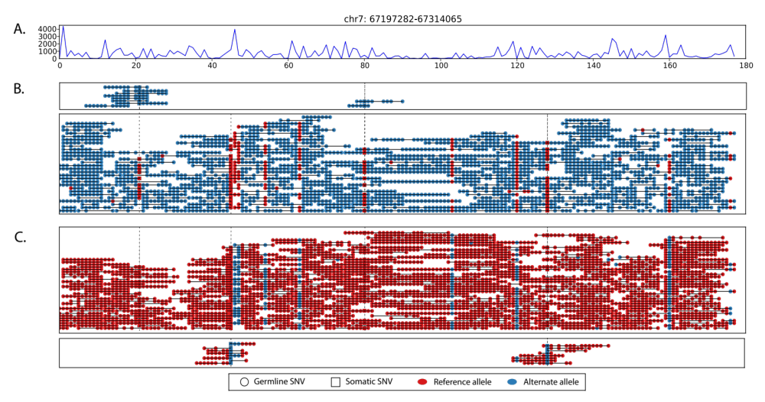
Phasing with Read Clouds

Slide 14
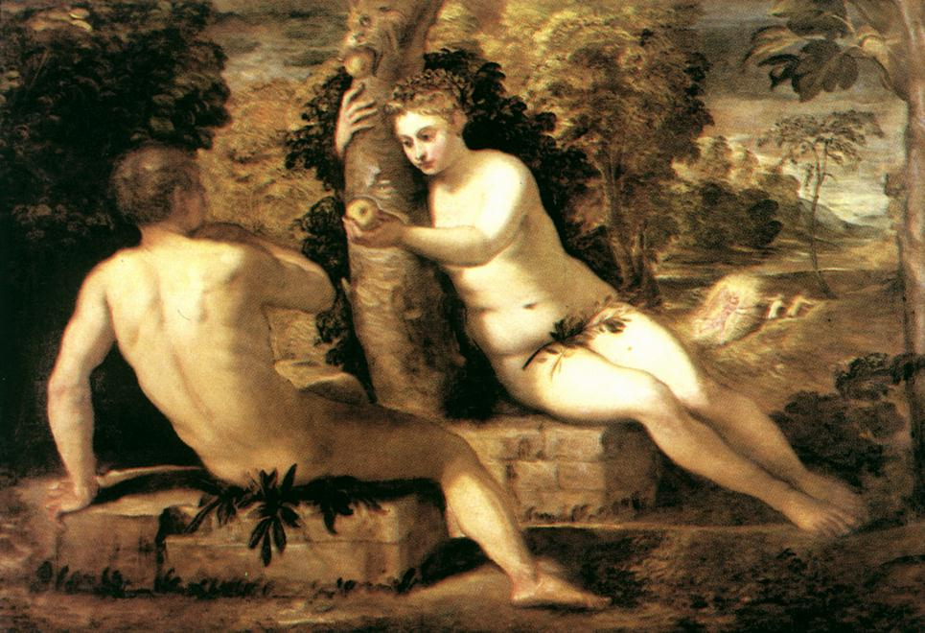
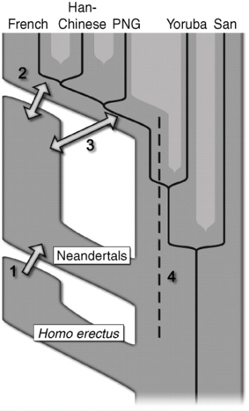
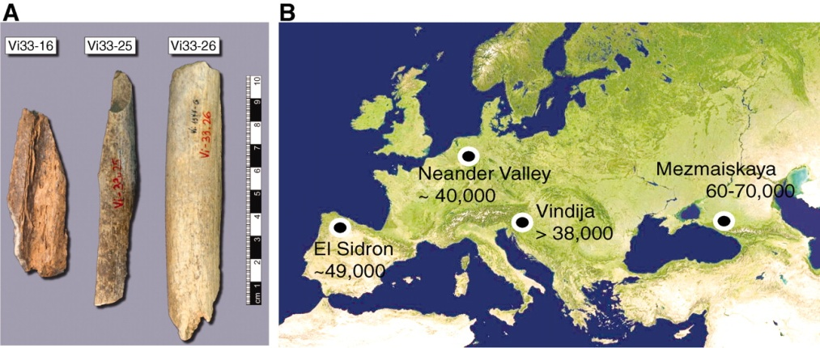
Human population migrations
Out of Africa, Replacement
  Single mother of all humans (Eve) ~99,000 – 150,000yr
  Single father of all humans (Adam) ~120,000 - 340,000yr
  Humans out of Africa ~50000 years ago replaced others (e.g., Neandertals)
Multiregional Evolution
  Generally debunked, however,
  ~5% of human genome in Europeans, Asians is Neanderthal, Denisova

Slide 15

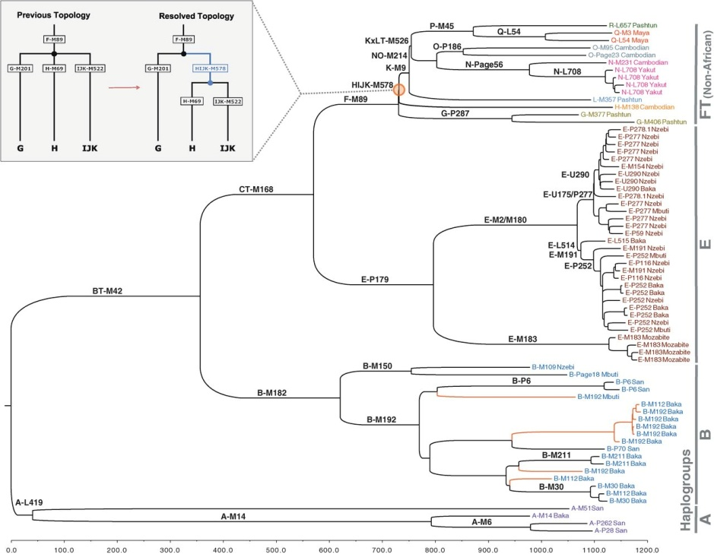
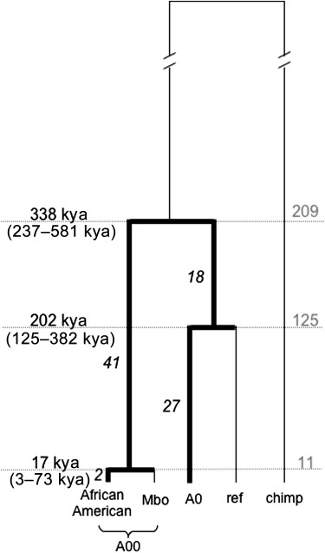








Coalescence
Y-chromosome coalescence

Slide 16


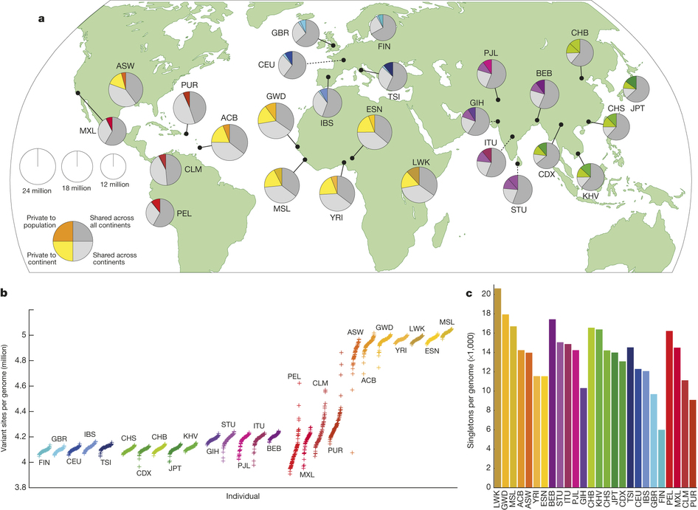
Population Sequencing –
1000 Genomes Project
Notes:
a, Summary of inferred haplotypes across a 100-kb region of chromosome 2 spanning the genes ALMS1 and NAT8, variation in which has been associated with kidney disease⁴⁵. Each row represents an estimated haplotype, with the population of origin indicated on the right. Reference alleles are indicated by the light blue background. Variants (non-reference alleles) above 0.5% frequency are indicated by pink (typed on the high-density SNP array), white (previously known) and dark blue (not previously known). Low frequency variants (<0.5%) are indicated by blue crosses. Indels are indicated by green triangles and novel variants by dashes below. A large, low-frequency deletion (black line) spanning NAT8 is present in some populations. Multiple structural haplotypes mediated by segmental duplications are present at this locus, including copy number gains, which were not genotyped for this study. Within each population, haplotypes are ordered by total variant count across the region. Population abbreviations: ASW, people with African ancestry in Southwest United States; CEU, Utah residents with ancestry from Northern and Western Europe; CHB, Han Chinese in Beijing, China; CHS, Han Chinese South, China; CLM, Colombians in Medellin, Colombia; FIN, Finnish in Finland; GBR, British from England and Scotland, UK; IBS, Iberian populations in Spain; LWK, Luhya in Webuye, Kenya; JPT, Japanese in Tokyo, Japan; MXL, people with Mexican ancestry in Los Angeles, California; PUR, Puerto Ricans in Puerto Rico; TSI, Toscani in Italia; YRI, Yoruba in Ibadan, Nigeria. Ancestry-based groups: AFR, African; AMR, Americas; EAS, East Asian; EUR, European. b, The fraction of variants identified across the project that are found in only one population (white line), are restricted to a single ancestry-based group (defined as in a, solid colour), are found in all groups (solid black line) and all populations (dotted black line). c, The density of the expected number of variants per kilobase carried by a genome drawn from each population, as a function of variant frequency (see Supplementary Information). Colours as in a. Under a model of constant population size, the expected density is constant across the frequency spectrum.

Slide 17
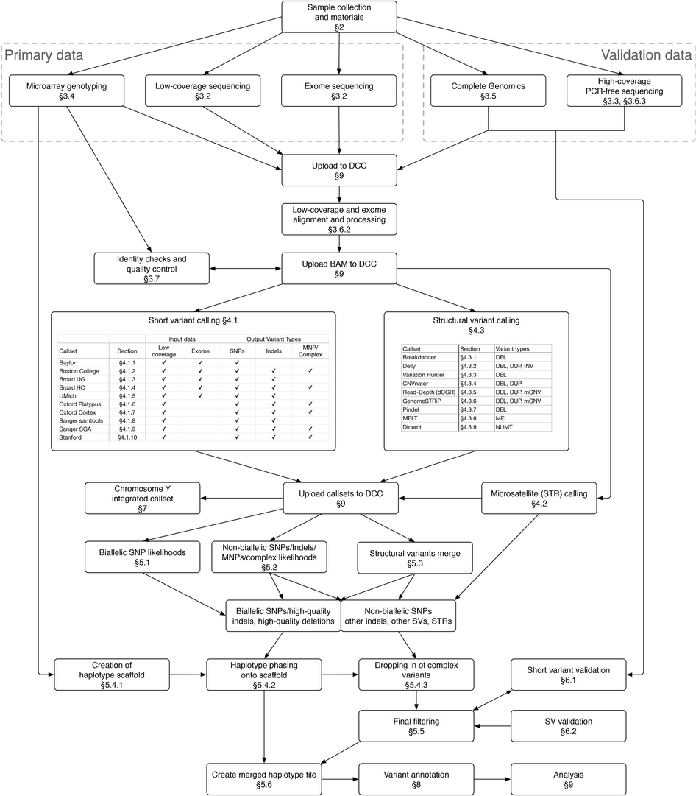
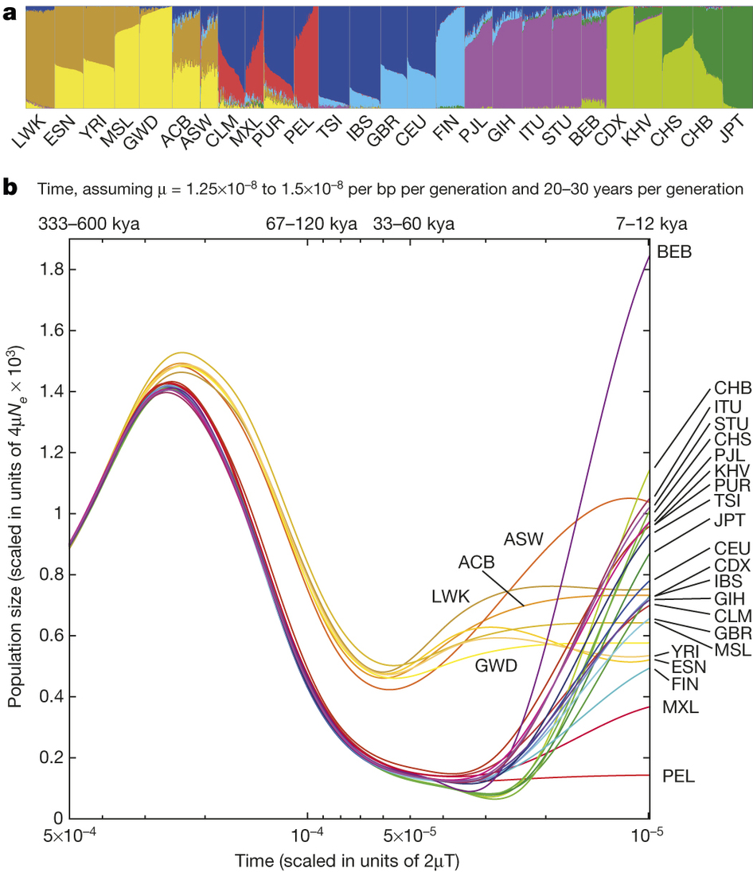
Population Sequencing –
1000 Genomes Project
Notes:
a, Summary of inferred haplotypes across a 100-kb region of chromosome 2 spanning the genes ALMS1 and NAT8, variation in which has been associated with kidney disease⁴⁵. Each row represents an estimated haplotype, with the population of origin indicated on the right. Reference alleles are indicated by the light blue background. Variants (non-reference alleles) above 0.5% frequency are indicated by pink (typed on the high-density SNP array), white (previously known) and dark blue (not previously known). Low frequency variants (<0.5%) are indicated by blue crosses. Indels are indicated by green triangles and novel variants by dashes below. A large, low-frequency deletion (black line) spanning NAT8 is present in some populations. Multiple structural haplotypes mediated by segmental duplications are present at this locus, including copy number gains, which were not genotyped for this study. Within each population, haplotypes are ordered by total variant count across the region. Population abbreviations: ASW, people with African ancestry in Southwest United States; CEU, Utah residents with ancestry from Northern and Western Europe; CHB, Han Chinese in Beijing, China; CHS, Han Chinese South, China; CLM, Colombians in Medellin, Colombia; FIN, Finnish in Finland; GBR, British from England and Scotland, UK; IBS, Iberian populations in Spain; LWK, Luhya in Webuye, Kenya; JPT, Japanese in Tokyo, Japan; MXL, people with Mexican ancestry in Los Angeles, California; PUR, Puerto Ricans in Puerto Rico; TSI, Toscani in Italia; YRI, Yoruba in Ibadan, Nigeria. Ancestry-based groups: AFR, African; AMR, Americas; EAS, East Asian; EUR, European. b, The fraction of variants identified across the project that are found in only one population (white line), are restricted to a single ancestry-based group (defined as in a, solid colour), are found in all groups (solid black line) and all populations (dotted black line). c, The density of the expected number of variants per kilobase carried by a genome drawn from each population, as a function of variant frequency (see Supplementary Information). Colours as in a. Under a model of constant population size, the expected density is constant across the frequency spectrum.

Slide 18
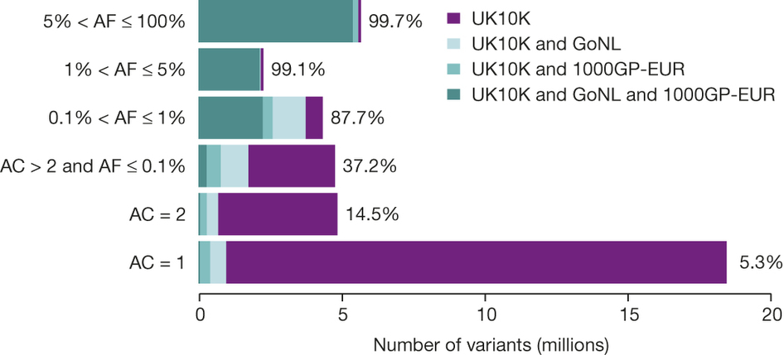
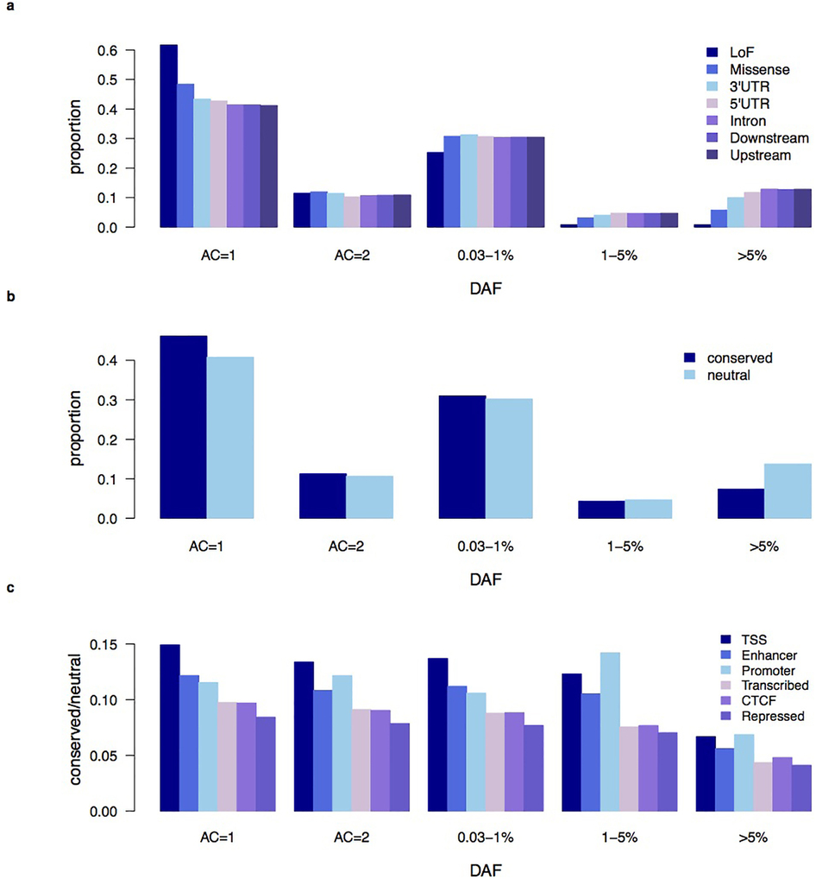
Population Sequencing – UK10K
Notes:
Rare variants <0.5% frequency across all populations

Slide 19

Population Sequencing
C = 2-7x
A/T
C/C
C/G
1,000 to
1,000,000
A/A
C/T
G/G
A/A
T/T
C/G
A/A
C/T
G/G
Notes:
Next, I will switch gears and talk about population sequencing.
In many recent projects such as UK10K, or the CHARGE project by Baylor and collaborators, a large cohort of individuals is sequenced at relatively low coverage. Then, the task in hand is find the sequence variation present in the cohort, and genotype the individual in every locus that is heterozygous in the population.
The idea of such a project is that low-coverage sequencing is only a fraction of the cost of full sequencing, allowing us for a given budget to sequence many more individuals. Each additional individual at low coverage is more informative than if the same budget was used to sequence a previous individual at higher coverage.

Slide 20
Population Sequencing
C = 2-7x
A/T
C/C
C/G
1,000 to
1,000,000
A/A
C/T
G/G
A/A
T/T
C/G
A/A
C/T
G/G
G₁, …, G_{N}; G_{i} = g_{i1} … g_{in}; g_{ij} ∈ {0, 1, 2}
P₁, …, P_{N}; P_{i} : [ p_{ijg} = Prob(g_{ij} = g | data) ]
Notes:
Here we are given sequencing reads from N individuals, and we want to find all heterozygous loci in the population, and also find the genotypes of each individual in each locus.
We also denote by P1… PN the matrices of probabilities of each individual having a given genotype (0, 1, or 2) in each locus.
So, we want to find Gi, and one way to do this would be through estimating the matrix P from the sequencing data.

Slide 21

Population Sequencing
2-7x
A/T
C/C
C/G
When C is high (>30x),
Prob(g_{ij} = g | data) ~
Prob(g_{ij} = g | reads mapping on (i, j))
fast & easy
When C is low,
Prob(g_{ij} = g | data) needs to leverage LD:
positions j’ ≠ j in all individuals
in principle, intractable
1,000 to
1,000,000
A/A
C/T
G/G
A/A
T/T
C/G
A/A
C/T
G/G
G₁, …, G_{N}; G_{i} = g_{i1} … g_{in}; g_{ij} ∈ {0, 1, 2}
P₁, …, P_{N}; P_{i} : [ p_{ijg} = Prob(g_{ij} = g | data) ]
1000 Genomes Project, 2535 individuals, 7x sequencing
Notes:
When the coverage C is high, the problem is easy.
The probability of a given genotype position in an individual can be accurately estimated by considering only the reads of that individual that map in that locus.
This is a fast and easy calculation, relatively speaking.
However, when C is low, we need to leverage the inherent Linkage Disequilibrium of the population. In principle, we want to estimate LD simultaneously with uncovering the variation and performing the genotyping, in all individuals jointly. This is computationally a challenging task, and given a complex LD model, it is of course intractable.

Slide 22




HMM-based models
Li and Stephens 2003
Given m reference haplotypes, and a target sample,
Find the most likely path of haplotype pairs
m² states, m⁴ transitions per position
1,1
1,1
1,1
1,1
1,2
1,2
1,2
1,2
$$m,m$$
$$m,m$$
$$m,m$$
$$m,m$$

Slide 23
Previous Methods
glfMultiples + Thunder
  HMM-based algorithm; each hidden state is a pair of reference haplotypes, observations are genotype likelihoods
SNPTools
  Estimate genotyping likelihoods using a BAM-specific binomial mixture model
  Infer genotypes and haplotypes using HMM approach (constrained Li-Stephens)
GATK
  UnifiedGenotyper – Bayesian genotype likelihood model
  HaplotypeCaller – local reassembly
Beagle
  HMM-based approach

Slide 24

Informative Neighbors
target SNP
$k$-”nearest” neighbors
in terms of linkage disequilibrium
(5,0)
(3,0)
(1,0)
(5,0)
(6,0)
(R_{ref}, R_{alt}) = Σ_{{target, nbrs}}(r_{ref}, r_{alt}) = (20, 0)

Slide 25
Informative Neighbors
target SNP
$k$-”nearest” neighbors
in terms of linkage disequilibrium
(2,3)
(2,1)
(1,0)
(4,1)
(2,4)
(R_{ref}, R_{alt}) = Σ_{{target, nbrs}}(r_{ref}, r_{alt}) = (11, 9)

Slide 26




How to pick k nearest neighbors fast
Correlation Coefficient:
r² = (p_{AB} – p_{A}p_{B})² / p_{A}p_{B}p_{a}p_{b}
Caveat: need genotyping, phasing
$$i$$
$$j$$
Sample 1
1
1
Let
S_{i} = { samples covering minor allele }
S_{i}’ = { read counts of minor allele }
S_{i} = {1, 2, 3, 10}
S_{j} = {1, 3, 4}
S_{i}’ = {1, 2, 3, 3, 3, 10}
S_{j}’ = {1, 3, 3, 3, 3, 3, 4, 4}
Sim₁(i, j) = (S_{i} S_{j}) / (S_{i} U S_{j})
Sim₂(i, j) = (S_{i}’ S_{j}’) / (S_{i}’ U S_{j}’)
Sim₃(i, j) = ((S_{i}’ S_{j}’) / (S_{i}’ U S_{j}’))²
Sample 2
1
0
Sample 3
3
5
Sample 4
0
2
$$⋮$$
Sample 10
1
0

Slide 27
Genetic distance between NNs
common SNPs
rare SNPs

Slide 28
Overview of Reveel
2-6x
Reveel:
Identify candidate polymorphic sites
Calculate k nearest neighbors
  Jaccard indices Sim₁, Sim₂, Sim₃
Initialize G⁽⁰⁾
Summarization/Maximization
  p^{(n+1)}_{ijg} = Prob(g_{ij} = g | G^{(n)}, data)
  g^{(n+1)}_{ijg} = argmax p^{(n+1)}_{ijg}
Recalculate k nearest neighbors
  Approximate Correlation Coefficient (Schaid 2004)
Summarization/Maximization
Recalculate k nearest neighbors
  Approximate CC, Entropy
Summarization/Maximization
A/T
C/C
C/G
A/A
C/T
G/G
A/A
T/T
C/G
A/A
C/T
G/G
G₁, …, G_{N}; G_{i} = g_{i1} … g_{in}; g_{ij} ∈ {0, 1, 2}
P₁, …, P_{N}; P_{i} : [ p_{ijg} = Prob(g_{ij} = g | data) ]
Notes:
I will now describe a new algorithm that my student, Lin Huang developed recently. It doesn’t have a name yet, so let me call it LPG, for Lin’s Population Genotyper.
Here is the algorithm in a nutshell.
First, we identify candidate polymorphic sites in the population.
Then, we perform expectation maximization where we initialize the genotype calls G, estimate the probability of each genotype given the current calls and given all data, then maximize new updated genotype calls based on the probabilities that we just estimated, then estimate new probabilities, and so on until convergence.
The important feature of the algorithm, which we strived to achieve, is to model LD in a way that is effective in giving high accuracy, yet very fast to compute.

Slide 29
Overview of Reveel
2-6x
Reveel:
Identify candidate polymorphic sites
Calculate k nearest neighbors
  Jaccard indices Sim₁, Sim₂, Sim₃
Initialize G⁽⁰⁾
Summarization/Maximization
  p^{(n+1)}_{ijg} = Prob(g_{ij} = g | G^{(n)}, data)
  g^{(n+1)}_{ijg} = argmax p^{(n+1)}_{ijg}
Recalculate k nearest neighbors
  Approximate Correlation Coefficient (Schaid 2004)
Summarization/Maximization
Recalculate k nearest neighbors
  Approximate CC, Entropy
Summarization/Maximization
A/T
C/C
C/G
A/A
C/T
G/G
A/A
T/T
C/G
A/A
C/T
G/G
G₁, …, G_{N}; G_{i} = g_{i1} … g_{in}; g_{ij} ∈ {0, 1, 2}
P₁, …, P_{N}; P_{i} : [ p_{ijg} = Prob(g_{ij} = g | data) ]
Candidate Polymorphic site
Essentially, pos’n j where some individuals have at least 2 reads with same minor allele
Notes:
I will now describe a new algorithm that my student, Lin Huang developed recently. It doesn’t have a name yet, so let me call it LPG, for Lin’s Population Genotyper.
Here is the algorithm in a nutshell.
First, we identify candidate polymorphic sites in the population.
Then, we perform expectation maximization where we initialize the genotype calls G, estimate the probability of each genotype given the current calls and given all data, then maximize new updated genotype calls based on the probabilities that we just estimated, then estimate new probabilities, and so on until convergence.
The important feature of the algorithm, which we strived to achieve, is to model LD in a way that is effective in giving high accuracy, yet very fast to compute.

Slide 30
Overview of Reveel
2-6x
Reveel:
Identify candidate polymorphic sites
Calculate k nearest neighbors
  Jaccard indices Sim₁, Sim₂, Sim₃
Initialize G⁽⁰⁾
Summarization/Maximization
  p^{(n+1)}_{ijg} = Prob(g_{ij} = g | G^{(n)}, data)
  g^{(n+1)}_{ijg} = argmax p^{(n+1)}_{ijg}
Recalculate k nearest neighbors
  Approximate Correlation Coefficient (Schaid 2004)
Summarization/Maximization
Recalculate k nearest neighbors
  Approximate CC, Entropy
Summarization/Maximization
A/T
C/C
C/G
A/A
C/T
G/G
A/A
T/T
C/G
A/A
C/T
G/G
G₁, …, G_{N}; G_{i} = g_{i1} … g_{in}; g_{ij} ∈ {0, 1, 2}
P₁, …, P_{N}; P_{i} : [ p_{ijg} = Prob(g_{ij} = g | data) ]
At each position j,
Use sum of read counts at j and its nearest neighbors
Notes:
I will now describe a new algorithm that my student, Lin Huang developed recently. It doesn’t have a name yet, so let me call it LPG, for Lin’s Population Genotyper.
Here is the algorithm in a nutshell.
First, we identify candidate polymorphic sites in the population.
Then, we perform expectation maximization where we initialize the genotype calls G, estimate the probability of each genotype given the current calls and given all data, then maximize new updated genotype calls based on the probabilities that we just estimated, then estimate new probabilities, and so on until convergence.
The important feature of the algorithm, which we strived to achieve, is to model LD in a way that is effective in giving high accuracy, yet very fast to compute.

Slide 31
Overview of Reveel
2-6x
Reveel:
Identify candidate polymorphic sites
Calculate k nearest neighbors
  Jaccard indices Sim₁, Sim₂, Sim₃
Initialize G⁽⁰⁾
Summarization/Maximization
  p^{(n+1)}_{ijg} = Prob(g_{ij} = g | G^{(n)}, data)
  g^{(n+1)}_{ijg} = argmax p^{(n+1)}_{ijg}
Recalculate k nearest neighbors
  Approximate Correlation Coefficient (Schaid 2004)
Summarization/Maximization
Recalculate k nearest neighbors
  Approximate CC, Entropy
Summarization/Maximization
A/T
C/C
C/G
A/A
C/T
G/G
A/A
T/T
C/G
A/A
C/T
G/G
G₁, …, G_{N}; G_{i} = g_{i1} … g_{in}; g_{ij} ∈ {0, 1, 2}
P₁, …, P_{N}; P_{i} : [ p_{ijg} = Prob(g_{ij} = g | data) ]
p^{(n+1)}_{ijg} = P(g_{ij} = g | G^{(n)}, reads)
~ P(g_{ij} = g | g_{kNN}, reads)
= P(reads | g_{ij} = g) P(g_{ij} = g | g_{kNN)})
P(g_{ij} = g | g_{kNN}) =
Let C₀, C₁, C₂ = # samples matching i in kNN, with j^{th} genotype pos’n = 0, 1, 2
P(g_{ij} = g | g_{kNN}) = C_{g} / (C₀ + C₁ + C₂)
Notes:
I will now describe a new algorithm that my student, Lin Huang developed recently. It doesn’t have a name yet, so let me call it LPG, for Lin’s Population Genotyper.
Here is the algorithm in a nutshell.
First, we identify candidate polymorphic sites in the population.
Then, we perform expectation maximization where we initialize the genotype calls G, estimate the probability of each genotype given the current calls and given all data, then maximize new updated genotype calls based on the probabilities that we just estimated, then estimate new probabilities, and so on until convergence.
The important feature of the algorithm, which we strived to achieve, is to model LD in a way that is effective in giving high accuracy, yet very fast to compute.

Slide 32
Overview of Reveel
2-6x
Reveel:
Identify candidate polymorphic sites
Calculate k nearest neighbors
  Jaccard indices Sim₁, Sim₂, Sim₃
Initialize G⁽⁰⁾
Summarization/Maximization
  p^{(n+1)}_{ijg} = Prob(g_{ij} = g | G^{(n)}, data)
  g^{(n+1)}_{ijg} = argmax p^{(n+1)}_{ijg}
Recalculate k nearest neighbors
  Approximate Correlation Coefficient (Schaid 2004)
Summarization/Maximization
Recalculate k nearest neighbors
  Approximate CC, Entropy
Summarization/Maximization
A/T
C/C
C/G
A/A
C/T
G/G
A/A
T/T
C/G
A/A
C/T
G/G
G₁, …, G_{N}; G_{i} = g_{i1} … g_{in}; g_{ij} ∈ {0, 1, 2}
P₁, …, P_{N}; P_{i} : [ p_{ijg} = Prob(g_{ij} = g | data) ]
Correlation Coefficient:
r² = (p_{AB} – p_{A}p_{B})² / p_{A}p_{B}p_{a}p_{b}
Caveat: need genotyping, phasing
Schaid 2004:
D = 1/N (2N_{AABB}+N_{AABb}+N_{AaBB}+½N_{AaBb})
- 2p_{A}p_{B}
A faster alternative:
D = ½ Sim₁(i, j) + p_{A}p_{B}(p_{A}+p_{B}-½ p_{A}p_{B}-2)
Notes:
I will now describe a new algorithm that my student, Lin Huang developed recently. It doesn’t have a name yet, so let me call it LPG, for Lin’s Population Genotyper.
Here is the algorithm in a nutshell.
First, we identify candidate polymorphic sites in the population.
Then, we perform expectation maximization where we initialize the genotype calls G, estimate the probability of each genotype given the current calls and given all data, then maximize new updated genotype calls based on the probabilities that we just estimated, then estimate new probabilities, and so on until convergence.
The important feature of the algorithm, which we strived to achieve, is to model LD in a way that is effective in giving high accuracy, yet very fast to compute.

Slide 33
Overview of Reveel
2-6x
Reveel:
Identify candidate polymorphic sites
Calculate k nearest neighbors
  Jaccard indices Sim₁, Sim₂, Sim₃
Initialize G⁽⁰⁾
Summarization/Maximization
  p^{(n+1)}_{ijg} = Prob(g_{ij} = g | G^{(n)}, data)
  g^{(n+1)}_{ijg} = argmax p^{(n+1)}_{ijg}
Recalculate k nearest neighbors
  Approximate Correlation Coefficient (Schaid 2004)
Summarization/Maximization
Recalculate k nearest neighbors
  Approximate CC, Entropy
Summarization/Maximization
A/T
C/C
C/G
A/A
C/T
G/G
A/A
T/T
C/G
A/A
C/T
G/G
G₁, …, G_{N}; G_{i} = g_{i1} … g_{in}; g_{ij} ∈ {0, 1, 2}
P₁, …, P_{N}; P_{i} : [ p_{ijg} = Prob(g_{ij} = g | data) ]
Identify the sites at which decision trees formed by kNNs have high entropy
Reduce entropy by replacing one or more kNNs
Optional:
Run BEAGLE on the high-AF alleles
Merge imputed genotypes
Notes:
I will now describe a new algorithm that my student, Lin Huang developed recently. It doesn’t have a name yet, so let me call it LPG, for Lin’s Population Genotyper.
Here is the algorithm in a nutshell.
First, we identify candidate polymorphic sites in the population.
Then, we perform expectation maximization where we initialize the genotype calls G, estimate the probability of each genotype given the current calls and given all data, then maximize new updated genotype calls based on the probabilities that we just estimated, then estimate new probabilities, and so on until convergence.
The important feature of the algorithm, which we strived to achieve, is to model LD in a way that is effective in giving high accuracy, yet very fast to compute.

Slide 34
Simulations
Simulated data set: ~ low-coverage 1KGP
  2,535 samples, 1-Mbp region: Chr 20 (43-44 Mbp) of GRCh37
  Using COSI to simulate variations
  Reads same positions, lengths, qualities as reads in 1KGP
  Injecting sequencing base errors, mapping with BWA
Sample size | 100 | 500 | 1000 | 2535
Reveel | 1.8 | 14.6 | 47.4 | 273
Reveel+Beagle | 3.1 | 25.3 | 71.2 | 526
Reveel-lite | 1.5 | 7.8 | 21.7 | 145
SNPTools+Beagle | 8.2 | 217 | 1089 | >5days
GATK+Beagle | 13.4 | 388 | 1806 | >5days
glfMultiples+Thunder | 307 | 2736 | 6120 | ~15 days
Genotyping Accuracy
Computation Time (mins)
Notes:
OK, how well does it all perform.
To assess performance, we first ran simulations similar to low-coverage 1000 genomes project.
We used 2535 samples, and simulated a 1Mbp region of chromosome 20. We used Cosi to simulate variation, and generated reads similar to those in 1KGP.
We injected sequencing errors, and mapped using BWA.
We compared LPG with Thunder, the current state of the art, and also with a pipeline of GATK plus Beagle. We found that LPG is the most accurate method, with slightly better accuracy than Thunder. What is more important, LPG is hundreds of times faster, and moreover its speed scales almost linearly with number of individuals, as compared to Thunder which scales quadratically.
We looked at accuracy as a f,ujnction of variant allele frequency, and found that our method is especially better than other methods in low variant allele frequencies. Curiously, pefromance drops slightly at higher VAF, which is similar also with GATK.

Slide 35

Simulations
Simulated data set: ~ low-coverage 1KGP
  2,535 samples, 1-Mbp region: Chr 20 (43-44 Mbp) of GRCh37
  Using COSI to simulate variations
  Reads same positions, lengths, qualities as reads in 1KGP
  Injecting sequencing base errors, mapping with BWA
$n$=1000
Genotyping Accuracy
Notes:
OK, how well does it all perform.
To assess performance, we first ran simulations similar to low-coverage 1000 genomes project.
We used 2535 samples, and simulated a 1Mbp region of chromosome 20. We used Cosi to simulate variation, and generated reads similar to those in 1KGP.
We injected sequencing errors, and mapped using BWA.
We compared LPG with Thunder, the current state of the art, and also with a pipeline of GATK plus Beagle. We found that LPG is the most accurate method, with slightly better accuracy than Thunder. What is more important, LPG is hundreds of times faster, and moreover its speed scales almost linearly with number of individuals, as compared to Thunder which scales quadratically.
We looked at accuracy as a f,ujnction of variant allele frequency, and found that our method is especially better than other methods in low variant allele frequencies. Curiously, pefromance drops slightly at higher VAF, which is similar also with GATK.

Slide 36
Performance on 1000 Genomes Data
population | # of samples in 1KGP | # of samples in HapMap3 | population | # of samples in 1KGP | # of samples in HapMap3
ACB | 96 | 0 | ASW | 66 | 50
BEB | 86 | 0 | CDX | 99 | 0
CEU | 99 | 90 | CHB | 103 | 94
CHS | 108 | 0 | CLM | 94 | 0
ESN | 99 | 0 | FIN | 99 | 0
GBR | 92 | 0 | GIH | 106 | 93
GWD | 113 | 0 | IBS | 107 | 0
ITU | 103 | 0 | JPT | 104 | 97
KHV | 101 | 0 | LWK | 101 | 90
MSL | 85 | 0 | MXL | 67 | 56
PEL | 86 | 0 | PJL | 96 | 0
PUR | 105 | 0 | STU | 103 | 0
TSI | 108 | 96 | YRI | 109 | 103
Compared on a 5-Mbp region on chromosome 20 (43-48 Mbp)
Notes:
We also benchmarked performance on 1000 Genome Project individuals, and in particular HapMap individuals that have been deep sequenced by 1000 genomes, so that we know their underlying true genotypes. We compared performance on low coverage sequencing of a 5Mbp region of chromosome 20, for which we know the ground truth because of the high coverage sequencing data.

Slide 37
Performance on 1000 Genomes Data
SNP discovery
  Discover 171,734 likely polymorphic sites in 26 populations
  Benchmark: Complete Genomics data
Method | false positive rate | sensitivity
Reveel | 0.021% | 95.80%
Reveel+Beagle | 0.020% | 95.92%
Reveel-lite | 0.021% | 95.80%
GATK+Beagle | 0.035% | 95.62%
glfMultiples+Thunder | 0.037% | 95.80%
SNPTools+Beagle | 0.035% | 95.66%
GotCloud (w/ filters) | 0.007% | 91.29%
Integrated (w/ filters) | 0.011% | 95.89%
Notes:
Again, we found that we performed comparably to Thunder and much better than GATK.
Our running time was about 300 times faster than Thunder.
I would like to note that the vast majority of variants in this dataset are high allele frequency, while in our simulations, we perform best in comparison to other methods in low allele frequency variants.

Slide 38
Performance on 1000 Genomes Data
Benchmark: Complete Genomics samples
R: Reveel; RL: Reveel-lite; R+B: Reveel+Beagle; g+T: glfMultiples+Thunder; S+B: SNPTools+Beagle; G+B: GATK+Beagle
Notes:
Again, we found that we performed comparably to Thunder and much better than GATK.
Our running time was about 300 times faster than Thunder.
I would like to note that the vast majority of variants in this dataset are high allele frequency, while in our simulations, we perform best in comparison to other methods in low allele frequency variants.

