Slide 1
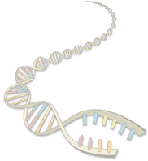
DNA Sequencing

Slide 2
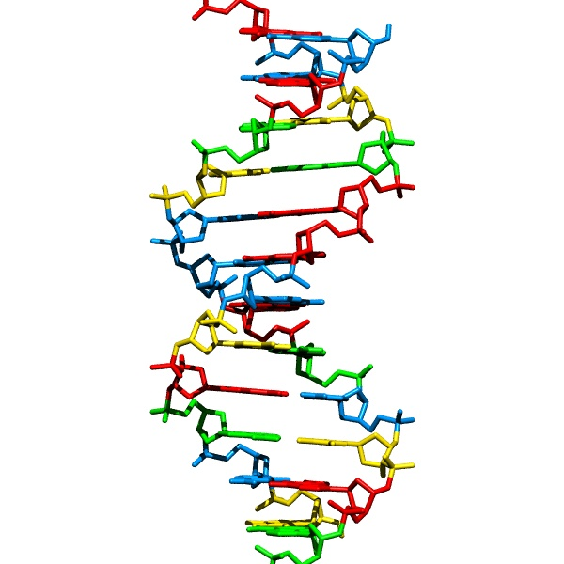
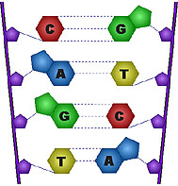
DNA sequencing
How we obtain the sequence of nucleotides of a species
…ACGTGACTGAGGACCGTG
CGACTGAGACTGACTGGGT
CTAGCTAGACTACGTTTTA
TATATATATACGTCGTCGT
ACTGATGACTAGATTACAG
ACTGATTTAGATACCTGAC
TGATTTTAAAAAAATATT…

Slide 3
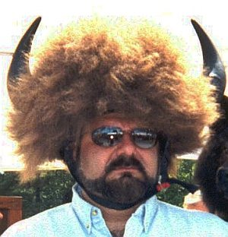
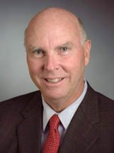
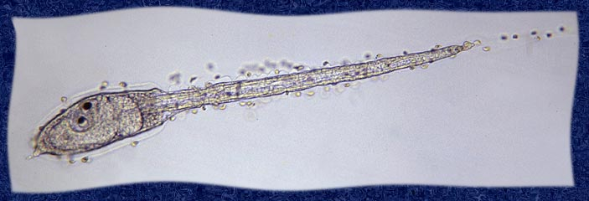
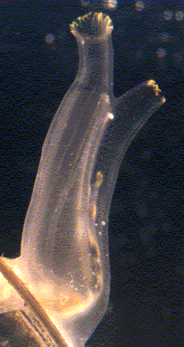
Which representative of the species?
Which human?
Answer one:
Answer two: it doesn’t matter
Polymorphism rate: number of letter changes between two different members of a species
Humans: ~1/1,000
Other organisms have much higher polymorphism rates
  Population size!
Notes:
Just beneath the surface of the ocean floats a tiny egg. Within it's hull of follicle cells the embryo of Ciona, a sea squirt or Ascidian, is beginning to develop. The shape of the egg does not give any clue of the creature that it is going to be. Now about a third of a millimeter it is waiting to become a larva, and this larva is a rather surprising creature.
The larva is developing within a few weeks. A head and a tail are evolving. When you look carefully you can see a rod that stiffens the tail. We know such a device as a notochord. A trained zoologist would identify the animal as belonging to the Phylum Chordata, and that is the same group we humans belong to. (See footnote).
Also the internal organs are beginning to show. But the image is a bit deceiving. What seems to be an eye is in fact a device for equilibrium called the 'Otolith'. Above it we find the light sense organ, the 'Ocellus'
So there is something suspicious about these so-called sea squirts. Freed from it's shell a familiar form has appeared. Clearly the resemblance with a tadpole larva is seen. The little creature swims for a few hours to find a good spot somewhere on a solid surface. Then a surprising thing happens.
This larva is not going to evolve into a fish, amphibian or anything like that. With the front of it's head it attaches itself to a surface. Within minutes resorption of the larva tail commences and the sea squirt will stay on that same spot for all it's life

Slide 4
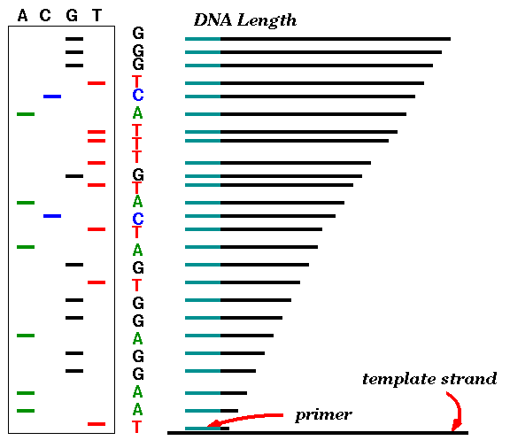
Ancient sequencing technology – Sanger
Gel Electrophoresis
Start at primer (restriction site)
Grow DNA chain
Include dideoxynucleoside (modified a, c, g, t)
Stops reaction at all possible points
Separate products with length, using gel electrophoresis

Slide 5
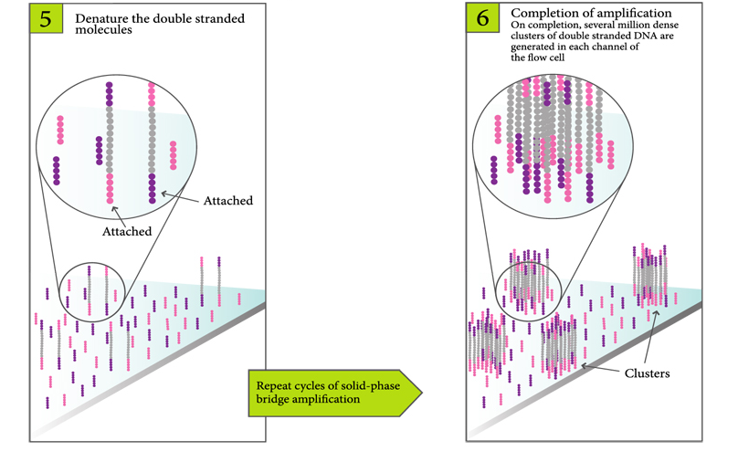
Illumina cluster concept
Slide Credit: Arend Sidow

Slide 6
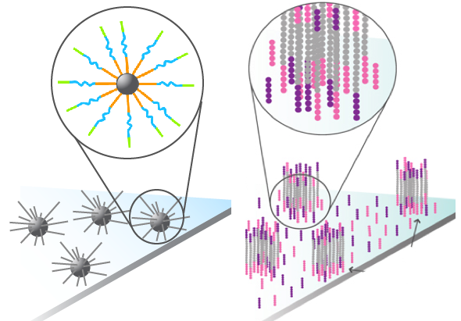
Clonally Amplified Molecules on Flow Cell
1µM
Slide Credit: Arend Sidow

Slide 7

Sequencing by Synthesis, One Base at a Time
3’-
…-5’
G
T
A
T
T
T
T
C
G
G
C
A
C
A
G
A
G
A
C
T
T
C
T
G
Cycle 1: Add sequencing reagents
First base incorporated
Remove unincorporated bases
Detect signal
Cycle 2-n: Add sequencing reagents and repeat
Slide Credit: Arend Sidow

Slide 8
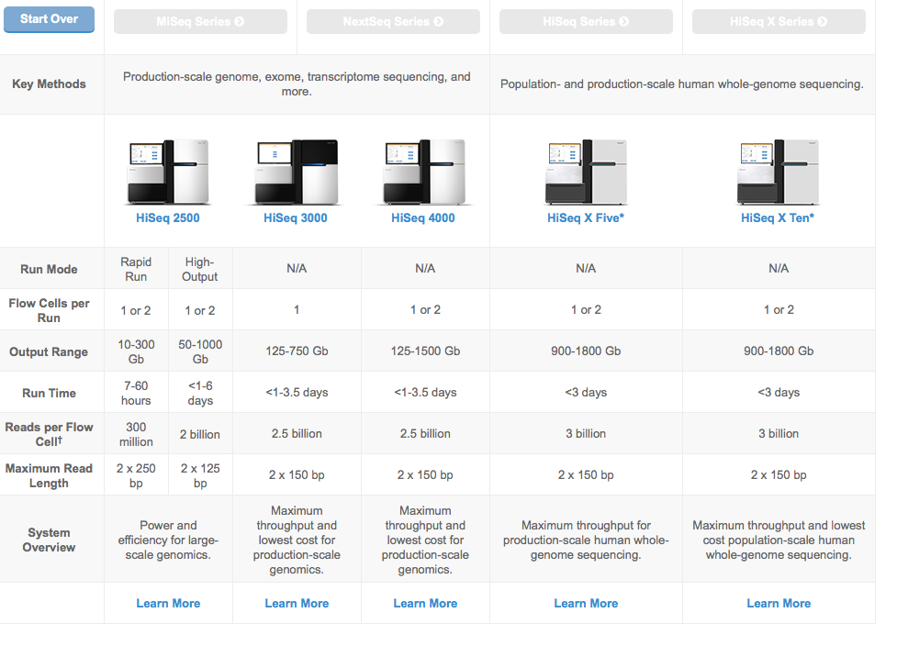
Illumina HiSeq

Slide 9
Method to sequence longer regions
genomic segment
cut many times at random (Shotgun)
Get one or two reads from each segment
~900 bp
~900 bp

Slide 10
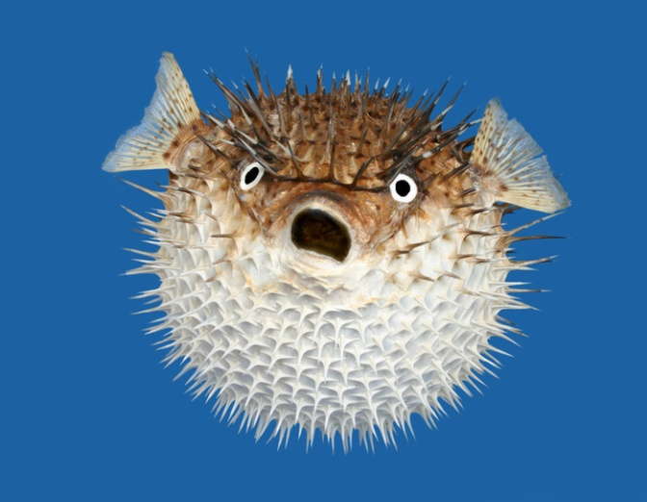
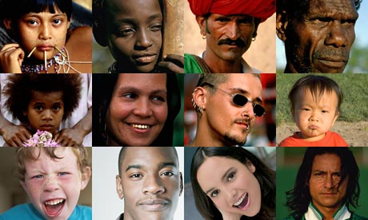
Two main assembly problems
De Novo Assembly
Resequencing

Slide 11
Resequencing: Read Mapping
Slide Credit: Arend Sidow

Slide 12
Resequencing: Variation Discovery
Slide Credit: Arend Sidow

Slide 13
Reconstructing the Sequence
(De Novo Assembly)
reads
Cover region with high redundancy
Overlap & extend reads to reconstruct the original genomic region

Slide 14
Definition of Coverage
C
Length of genomic segment: G
Number of reads: N
Length of each read: L
Definition: Coverage C = N L / G
How much coverage is enough?
Lander-Waterman model: Prob[ not covered bp ] = e^{-C}
Assuming uniform distribution of reads, C=10 results in 1 gapped region /1,000,000 nucleotides

Slide 15
Repeats
Bacterial genomes: 5%
Mammals: 50%
Repeat types:
Low-Complexity DNA (e.g. ATATATATACATA…)
Microsatellite repeats (a₁…a_{k})^{N} where k ~ 3-6
  (e.g. CAGCAGTAGCAGCACCAG)
Transposons
  SINE (Short Interspersed Nuclear Elements)
e.g., ALU: ~300-long, 10⁶ copies
  LINE (Long Interspersed Nuclear Elements)
  ~4000-long, 200,000 copies
  LTR retroposons (Long Terminal Repeats (~700 bp) at each end)
  cousins of HIV
Gene Families genes duplicate & then diverge (paralogs)
Recent duplications ~100,000-long, very similar copies

Slide 16
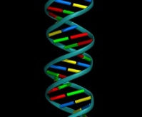
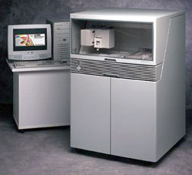


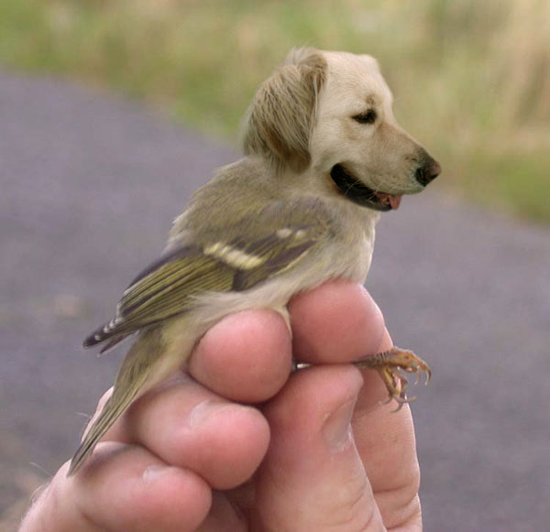
Sequencing and Fragment Assembly
AGTAGCACAGACTACGACGAGACGATCGTGCGAGCGACGGCGTAGTGTGCTGTACTGTCGTGTGTGTGTACTCTCCT
3x10⁹ nucleotides
50% of human DNA is composed of repeats
Error!
Glued together two distant regions

Slide 17
What can we do about repeats?
Two main approaches:
Cluster the reads
Link the reads

Slide 18
What can we do about repeats?
Two main approaches:
Cluster the reads
Link the reads

Slide 19
What can we do about repeats?
Two main approaches:
Cluster the reads
Link the reads

Slide 20
Sequencing and Fragment Assembly
AGTAGCACAGACTACGACGAGACGATCGTGCGAGCGACGGCGTAGTGTGCTGTACTGTCGTGTGTGTGTACTCTCCT
3x10⁹ nucleotides
A
R
B
ARB, CRD
or
ARD, CRB ?
C
R
D

Slide 21
Sequencing and Fragment Assembly
AGTAGCACAGACTACGACGAGACGATCGTGCGAGCGACGGCGTAGTGTGCTGTACTGTCGTGTGTGTGTACTCTCCT
3x10⁹ nucleotides

Slide 22
Fragment Assembly
(in whole-genome shotgun sequencing)

Slide 23
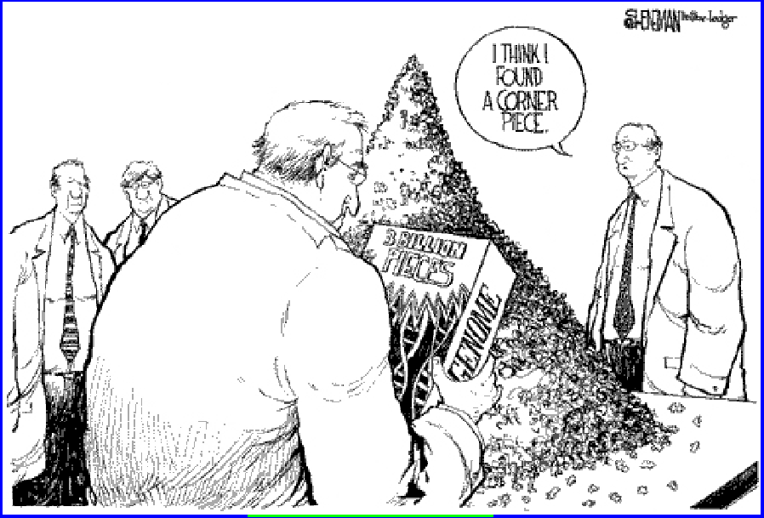
Fragment Assembly
Given N reads…
Where N ~ 30 million…
We need to use a linear-time algorithm

Slide 24
Steps to Assemble a Genome
Some Terminology
read a 500-900 long word that comes
out of sequencer
mate pair a pair of reads from two ends
of the same insert fragment
contig a contiguous sequence formed
by several overlapping reads
with no gaps
supercontig an ordered and oriented set
(scaffold) of contigs, usually by mate
pairs
consensus sequence derived from the
sequene multiple alignment of reads
in a contig
1. Find overlapping reads
2. Merge some “good” pairs of reads into longer contigs
3. Link contigs to form supercontigs
4. Derive consensus sequence
..ACGATTACAATAGGTT..

Slide 25
1. Find Overlapping Reads
(read, pos., word, orient.)
aaactgcag
aactgcagt
actgcagta
…
gtacggatc
tacggatct
gggcccaaa
ggcccaaac
gcccaaact
…
actgcagta
ctgcagtac
gtacggatc
tacggatct
acggatcta
…
ctactacac
tactacaca
(word, read, orient., pos.)
aaactgcag
aactgcagt
acggatcta
actgcagta
actgcagta
cccaaactg
cggatctac
ctactacac
ctgcagtac
ctgcagtac
gcccaaact
ggcccaaac
gggcccaaa
gtacggatc
gtacggatc
tacggatct
tacggatct
tactacaca
aaactgcagtacggatct
aaactgcag
aactgcagt
…
gtacggatct
tacggatct
gggcccaaactgcagtac
gggcccaaa
ggcccaaac
…
actgcagta
ctgcagtac
gtacggatctactacaca
gtacggatc
tacggatct
…
ctactacac
tactacaca

Slide 26
1. Find Overlapping Reads
Find pairs of reads sharing a k-mer, k ~ 24
Extend to full alignment – throw away if not >98% similar
TACA
TAGATTACACAGATTAC
T GA
||
|||||||||||||||||
| ||
TAGT
TAGATTACACAGATTAC
TAGA
Caveat: repeats
  A k-mer that occurs N times, causes O(N²) read/read comparisons
  ALU k-mers could cause up to 1,000,000² comparisons
Solution:
  Discard all k-mers that occur “too often”
    Set cutoff to balance sensitivity/speed tradeoff, according to genome at hand and computing resources available

Slide 27
2. Merge Reads into Contigs
Overlap graph:
  Nodes: reads r₁…..r_{n}
  Edges: overlaps (r_{i}, r_{j}, shift, orientation, score)
Reads that come
from two regions of
the genome (blue
and red) that contain
the same repeat
Note:
of course, we don’t
know the “color” of
these nodes

Slide 28
2. Merge Reads into Contigs
repeat region
Unique Contig
Overcollapsed Contig
We want to merge reads up to potential repeat boundaries

Slide 29
2. Merge Reads into Contigs
Remove transitively inferable overlaps
  If read r overlaps to the right reads r₁, r₂, and r₁ overlaps r₂, then (r, r₂) can be inferred by (r, r₁) and (r₁, r₂)
r
r₁
r₂
r₃

Slide 30
2. Merge Reads into Contigs

Slide 31
3. Link Contigs into Supercontigs
Find all links between unique contigs
Connect contigs incrementally, if ≥ 2 forward-reverse links
supercontig
(aka scaffold)

Slide 32
3. Link Contigs into Supercontigs
Fill gaps in supercontigs with paths of repeat contigs
Complex algorithmic step
  Exponential number of paths
  Forward-reverse links

Slide 33
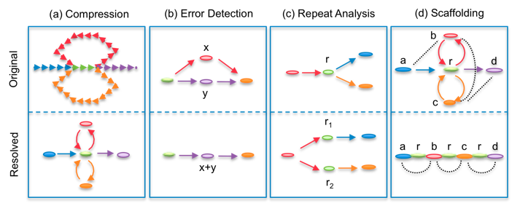
De Brujin Graph formulation
Given sequence x₁…x_{N}, k-mer length k,
Graph of 4^{k} vertices,
Edges between words with (k-1)-long overlap

Slide 34
4. Derive Consensus Sequence
TAGATTACACAGATTACTGA TTGATGGCGTAA CTA
TAGATTACACAGATTACTGACTTGATGGCGTAAACTA
TAG TTACACAGATTATTGACTTCATGGCGTAA CTA
TAGATTACACAGATTACTGACTTGATGGCGTAA CTA
TAGATTACACAGATTACTGACTTGATGGGGTAA CTA
TAGATTACACAGATTACTGACTTGATGGCGTAA CTA
Derive multiple alignment from pairwise read alignments
Derive each consensus base by weighted voting
(Alternative: take maximum-quality letter)

Slide 35
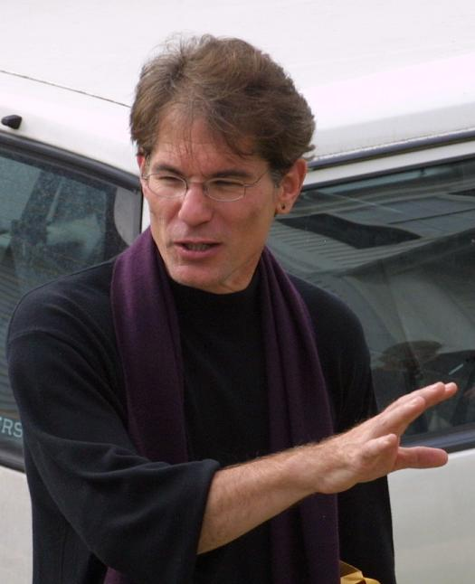
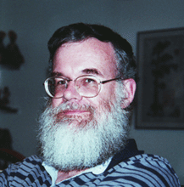
History of WGA
1997
1982: λ-virus, 48,502 bp
1995: h-influenzae, 1 Mbp
2000: fly, 100 Mbp
2001 – present
  human (3Gbp), mouse (2.5Gbp), rat*, chicken, dog, chimpanzee, several fungal genomes
Let’s sequence the human genome with the shotgun strategy
That is impossible, and a bad idea anyway
Phil Green
Gene Myers

