Slide 1
CS448f: Image Processing For Photography and Vision
Fast Filtering

Slide 2
Problems in Computer Vision

Slide 3
Computer Vision in One Slide
1) Extract some features from some images
2) Use these to formulate some (hopefully linear) constraints
3) Solve a system of equations your favorite method to produce...

Slide 4
Computer Vision in One Slide
0) Blur the input
1) Extract some features from some images
2) Use these to formulate some (hopefully linear) constraints
3) Solve a system of equations your favorite method to produce...

Slide 5
Why do we blur the input?
To remove noise before processing
So we can use simpler filters later
To decompose the input into different frequency bands
  tonemapping, blending, etc

Slide 6
Fast Filtering
  Composing Filters
  Fast Rect and Gaussian Filters
  Local Histogram Filters
  The Bilateral Grid
Applications
  Joint Bilateral Filter
  Flash/No Flash
  Joint Bilateral Upsample
  ASTA

Slide 7
Fast Filtering
  Composing Filters
  Fast Rect and Gaussian Filters
  Local Histogram Filters
  The Bilateral Grid
Applications
  Joint Bilateral Filter
  Flash/No Flash
  Joint Bilateral Upsample
  ASTA
This thing is awesome.

Slide 8
Composing Filters
F is a bad gradient filter
It’s cheap to evaluate
  val = Im(x+5, y) – Im(x-5, y)
G is a good gradient filter ->
It’s expensive to evaluate
  for (dx=-10; dx<10; dx++)
    val += filter(dx)*Im(x+dx, y)
F=
G=

Slide 9
Composing Filters
But F * B = G
and convolution is associative
so: G*Im = (F*B)*Im = F*(B*Im)
=
*

Slide 10
Composing Filters
So if you need to take lots of good filters:
Blur the image nicely once Im₂ = (B*Im)
Use super simple filters for everything else
F₁ * Im₂ F₂ * Im₂ F₃ * Im₂ ...
You only performed one expensive filter (B)
Let’s make the expensive part as fast as possible

Slide 11
Fast Rect Filters
Suggestions?

Slide 12
Fast Rect Filters
10 | 50 | 50 | 60 | 10 | 10 | 10 | 50 | 40 | 50
10
÷5

Slide 13
Fast Rect Filters
10 | 50 | 50 | 60 | 10 | 10 | 10 | 50 | 40 | 50
60
÷5

Slide 14
Fast Rect Filters
10 | 50 | 50 | 60 | 10 | 10 | 10 | 50 | 40 | 50
110
÷5
22

Slide 15
Fast Rect Filters
10 | 50 | 50 | 60 | 10 | 10 | 10 | 50 | 40 | 50
170
÷5
22 | 28

Slide 16
Fast Rect Filters
10 | 50 | 50 | 60 | 10 | 10 | 10 | 50 | 40 | 50
180
÷5
22 | 28 | 36

Slide 17
Fast Rect Filters
10 | 50 | 50 | 60 | 10 | 10 | 10 | 50 | 40 | 50
180
÷5
22 | 28 | 36 | 36

Slide 18
Fast Rect Filters
10 | 50 | 50 | 60 | 10 | 10 | 10 | 50 | 40 | 50
140
÷5
22 | 28 | 36 | 36 | 28

Slide 19
Fast Rect Filters
10 | 50 | 50 | 60 | 10 | 10 | 10 | 50 | 40 | 50
140
÷5
22 | 28 | 36 | 36 | 28 | 28

Slide 20
Fast Rect Filters
10 | 50 | 50 | 60 | 10 | 10 | 10 | 50 | 40 | 50
120
÷5
22 | 28 | 36 | 36 | 28 | 28 | 24

Slide 21
Fast Rect Filters
10 | 50 | 50 | 60 | 10 | 10 | 10 | 50 | 40 | 50
160
÷5
22 | 28 | 36 | 36 | 28 | 28 | 24 | 32

Slide 22
Fast Rect Filters
10 | 50 | 50 | 60 | 10 | 10 | 10 | 50 | 40 | 50
150
÷5
22 | 28 | 36 | 36 | 28 | 28 | 24 | 32 | 30

Slide 23
Fast Rect Filters
10 | 50 | 50 | 60 | 10 | 10 | 10 | 50 | 40 | 50
140
÷5
22 | 28 | 36 | 36 | 28 | 28 | 24 | 32 | 30 | 28

Slide 24
Fast Rect Filters
Complexity?
  Horizontal pass: O((w+f)h) = O(wh)
  Vertical pass: O((h+f)w) = O(wh)
  Total: O(wh)
Precision can be an issue
0 | 0 | 5¹⁰ | 5 | 0 | 0 | 0 | 0 | 0 | 0
5⁹ | 5⁹ | 5⁹ | 5⁹ | 5⁹ | 0 | -1 | -1 | -1 | -1

Slide 25
Fast Rect Filters
How can I do this in-place?

Slide 26
Gaussian Filters
How can we extend this to Gaussian filters?
Common approach:
  Take FFT O(w h ln(w) ln(h))
  Multiply by FFT of Gaussian O(wh)
  Take inverse FFT O(w h ln(w) ln(h))
  Total cost: O(w ln(w) h ln(h))
Cost independent of filter size ☺
Not particularly cache coherent ☹

Slide 27
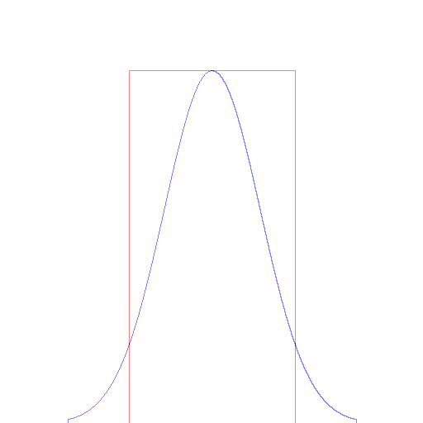
Gaussian v Rect

Slide 28
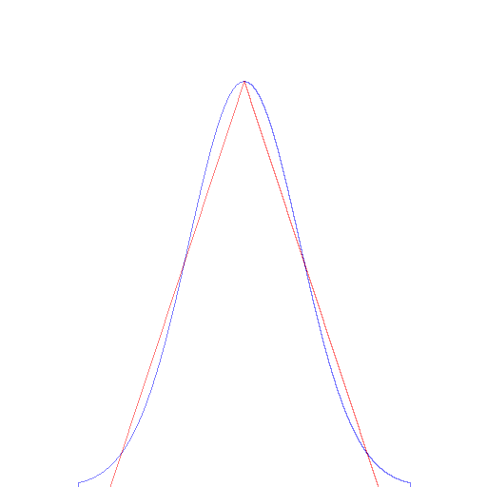
Gaussian v Rect*Rect

Slide 29
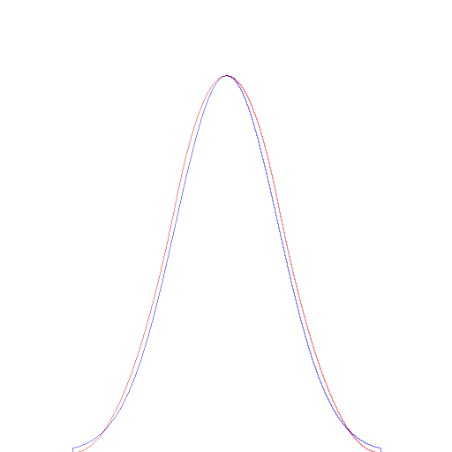
Gaussian v Rect³

Slide 30
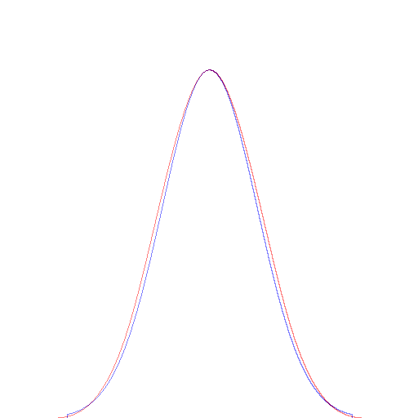
Gaussian v Rect⁴

Slide 31
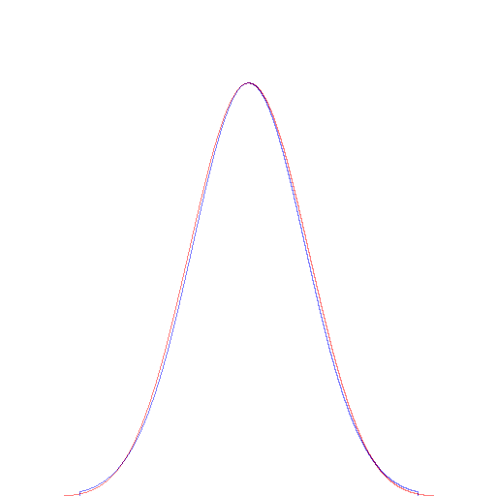
Gaussian v Rect⁵

Slide 32
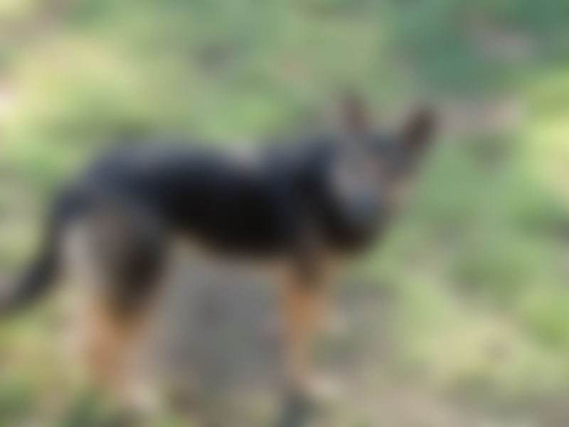
Gaussian

Slide 33

Rect (RMS = 0.00983)

Slide 34
Gaussian

Slide 35
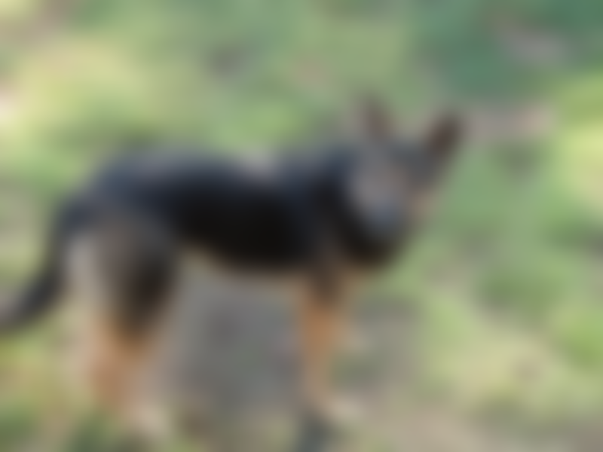
Rect² (RMS = 0.00244)

Slide 36
Gaussian

Slide 37

Rect³ (RMS = 0.00173)

Slide 38
Gaussian

Slide 39

Rect⁴ (RMS = 0.00176)

Slide 40
Gaussian

Slide 41
Rect⁵ (RMS = 0.00140)

Slide 42
Gaussian Filters
Conclusion: Just do 3 rect filters instead
Cost: O(wh)
Cost independent of filter size ☺
More cache coherent ☺
Be careful of edge conditions ☹
Hard to construct the right filter sizes: ☹

Slide 43
Filter sizes
Think of convolution as randomly scattering your data around nearby
How far data is scattered is described by the standard deviation of the distribution
standard deviation = sqrt(variance)
Variance adds
  Performing a filter with variance v twice produces a filter with variance 2v

Slide 44
Filter sizes
Think of convolution as randomly scattering your data around nearby
How far data is scattered is described by the standard deviation of the distribution
standard deviation = sqrt(variance)
Variance adds
  Performing a filter with variance v twice produces a filter with variance 2v

Slide 45
Filter Sizes
Variance adds
  Performing a filter with variance v twice produces a filter with variance 2v
Standard deviation scales
  A filter with standard deviation s, when scaled to be twice as wide, has standard deviation 2s

Slide 46
Constructing a Gaussian out of Rects
A rect filter of width 2w+1 has variance: w(w+1)/3
Attainable standard deviations using a single rect [sqrt(w(w+1)/3)]:
  0.82 1.41 2 2.58 3.16 3.74 4.32 ...
Composing three identical rects of width 2w+1 has variance: w(w+1)
Attainable std devs [sqrt(w(w+1))]:
  1.41 2.45 3.46 4.47 5.48 6.48 7.48 ... 1632.5

Slide 47
Constructing a Gaussian out of Rects
Attainable standard deviations using three different odd rect filters:
  1.41 1.825 2.16 2.31 2.45 2.58 2.83 2.94 3.06 ... 8.25 8.29 8.32 8.37 8.41 8.45 8.48
BUT: if they’re too different, the result won’t look Gaussian
Viable approach: Get as close as possible with 3 identical rects, do the rest with a small Gaussian

Slide 48
Integral Images
Fast rects are good for filtering an image...
But what if we need to compute lots of filters of different shapes and sizes quickly?
Classifiers need to do this
+1
-1
+1
-2

Slide 49
Integrate the Image ahead of time
Each pixel is the sum of everything above and left
ImageStack -load dog1.jpg -integrate x
  -integrate y

Slide 50
Integral Images
Fast to compute (just run along each row and column adding up)
Allows for arbitrary sized rect filters

Slide 51
Integral Images
Fast to compute (just run along each row and column adding up)
Allows for arbitrary sized rect filters
+

Slide 52
Integral Images
Fast to compute (just run along each row and column adding up)
Allows for arbitrary sized rect filters
-

Slide 53
Integral Images
Fast to compute (just run along each row and column adding up)
Allows for arbitrary sized rect filters
-

Slide 54
Integral Images
Fast to compute (just run along each row and column adding up)
Allows for arbitrary sized rect filters
+

Slide 55
Integral Images
Fast sampling of arbitrary rects
Precision can be an issue
Can only be used for rect filters...

Slide 56
Higher Order Integral Images
Fast sampling of arbitrary polynomials

Slide 57
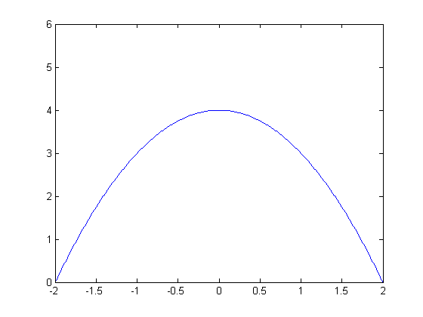
Higher Order Integral Images
Let’s say we want to evaluate a filter shaped like (4-x²) centered around each pixel

Slide 58
Higher Order Integral Images

Slide 59
Higher Order Integral Images
We can compute each term using the integral images of various orders.
No summations over u required.

Slide 60
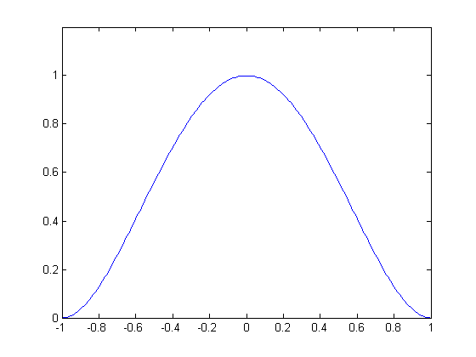
Gaussians using
Higher Order Integral Images
Construct a polynomial that looks kinda like a Gaussian, e.g. (x-1)²(x+1)²

Slide 61
IIR Filters
We can also use feedback loops to create Gaussians...

Slide 62
IIR Filters
0 | 0 | 64 | 0 | 0 | 0 | 0 | 0 | 0 | 0
÷2
0

Slide 63
IIR Filters
0 | 0 | 64 | 0 | 0 | 0 | 0 | 0 | 0 | 0
÷2
0 | 0

Slide 64
IIR Filters
0 | 0 | 64 | 0 | 0 | 0 | 0 | 0 | 0 | 0
÷2
0 | 0 | 32

Slide 65
IIR Filters
0 | 0 | 64 | 0 | 0 | 0 | 0 | 0 | 0 | 0
÷2
0 | 0 | 32 | 16

Slide 66
IIR Filters
0 | 0 | 64 | 0 | 0 | 0 | 0 | 0 | 0 | 0
÷2
0 | 0 | 32 | 16 | 8

Slide 67
IIR Filters
0 | 0 | 64 | 0 | 0 | 0 | 0 | 0 | 0 | 0
÷2
0 | 0 | 32 | 16 | 8 | 4

Slide 68
IIR Filters
0 | 0 | 64 | 0 | 0 | 0 | 0 | 0 | 0 | 0
÷2
0 | 0 | 32 | 16 | 8 | 4 | 2

Slide 69
IIR Filters
0 | 0 | 64 | 0 | 0 | 0 | 0 | 0 | 0 | 0
÷2
0 | 0 | 32 | 16 | 8 | 4 | 2 | 1

Slide 70
IIR Filters
0 | 0 | 64 | 0 | 0 | 0 | 0 | 0 | 0 | 0
÷2
0 | 0 | 32 | 16 | 8 | 4 | 2 | 1 | 0.5

Slide 71
IIR Filters
0 | 0 | 64 | 0 | 0 | 0 | 0 | 0 | 0 | 0
÷2
0 | 0 | 32 | 16 | 8 | 4 | 2 | 1 | 0.5 | 0.25

Slide 72
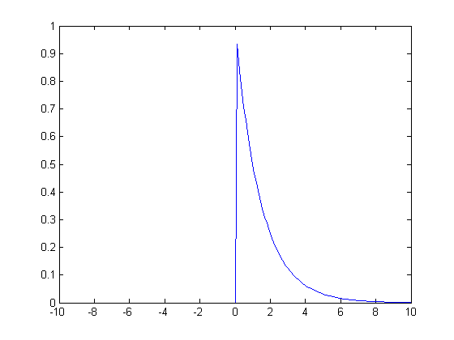
IIR = Infinite Impulse Response
A single spike has an effect that continues forever
The example above was an exponential decay
Equivalent to convolution by:

Slide 73
IIR Filters
Can be done in place ☺
Makes large, smooth filters, with very little computation ☺
Somewhat lopsided...

Slide 74
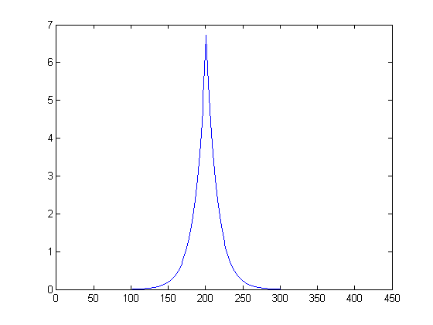
IIR Filters
One forward pass, one backward pass
= exponential decay convolved with flipped exponential decay
Somewhat more Gaussian-ish

Slide 75
More Advanced IIR Filters
a
b
c
d
e
Each output is a weighted average of the next input, and the last few outputs

Slide 76
More Advanced IIR Filters
It’s possible to optimize the parameters to match a Gaussian of a certain std.dev.
It’s harder to construct a family of them that scales across standard deviations

Slide 77
Filtering by Resampling
This looks like we just zoomed a small image
Can we filter by downsampling then upsampling?

Slide 78

Filtering by Resampling

Slide 79

Filtering by Resampling
Downsampled with rect (averaging down)
Upsampled with linear interpolation

Slide 80

Use better upsampling?
Downsampled with rect (averaging down)
Upsampled with bicubic interpolation

Slide 81

Use better downsampling?
Downsampled with tent filter
Upsampled with linear interpolation

Slide 82

Use better downsampling?
Downsampled with bicubic filter
Upsampled with linear interpolation

Slide 83
Resampling Simulation

Slide 84

Best Resampling
Downsampled, blurred, then upsampled with bicubic filter

Slide 85
What's the point?
Q: If we can blur quickly without resampling, why bother resampling?
A: Memory use
Store the blurred image at low res, sample it at higher res as needed.

Slide 86
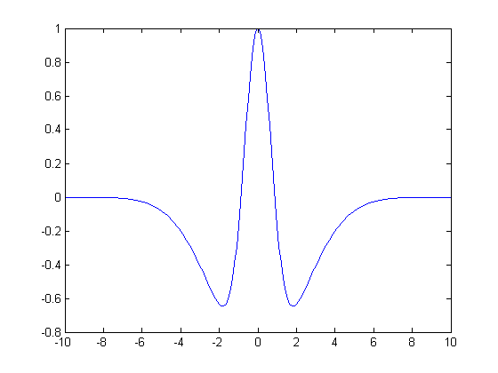
Recap: Fast Linear Filters
Separate into a sequence of simpler filters
  - e.g. Gaussian is separable across dimension
  - and can be decomposed into rect filters
2) Separate into a sum of simpler filters

Slide 87
Recap: Fast Linear Filters
3) Separate into a sum of easy-to-precompute components (integral images)
- great if you need to compute lots of different filters
4) Resample
- great if you need to save memory
5) Use feedback loops (IIR filters)
- great if you never need to change the std.dev. of your filter

Slide 88
Your mission:
Implement one of these fast Gaussian blur methods
We only care about standard deviations above 2.
We don’t care about boundary conditions (ie we’ll ignore everything within 3 standard deviations of the boundary)
It should be faster than -gaussianblur, and accurate enough to have no visual artifacts
  precise timing and RMS requirements will be put up soon

Slide 89
Your mission:
This time we care more about speed and less about accuracy. (40% 20%)
There will be a competition the Tuesday after the due date.
Due next Thursday at 11:59pm.
Email us as before to submit.

Slide 90
Histogram Filtering
The fast rect filter
  maintained a sum
  updated it for each new pixel
  didn't recompute from scratch
What other data structures might we maintain and update for more complex filters?

Slide 91
Histogram Filtering
The min filter, max filter, and median filter
  Only care about what pixel values fall into neighbourhood, not their location
  Maintain a histogram of the pixels under the filter window, update it as pixels enter and leave

Slide 92
Histogram Updating

Slide 93
Histogram Updating
 |  |  |  |  |  |  |  |  |  | +
 |  |  |  |  |  |  |  |  |  |  | +
 |  |  |  |  |  |  |  |  |  |  |  | +
 |  |  |  |  |  |  |  |  |  |  |  | +
 |  |  |  |  |  |  |  |  |  |  |  | +
 |  |  |  |  |  |  |  |  |  |  | +
 |  |  |  |  |  |  |  |  |  | +

Slide 94
Histogram Updating

Slide 95
Histogram Updating
 |  |  |  |  |  |  | -
 |  |  |  |  |  | -
 |  |  |  |  | -
 |  |  |  |  | -
 |  |  |  |  | -
 |  |  |  |  |  | -
 |  |  |  |  |  |  | -

Slide 96
Histogram Updating

Slide 97
Histogram-Based Fast Median
Maintain:
  hist = Local histogram
  med = Current Median
  lt = Number of pixels less than current median
  gt = Number of pixels greater than current median

Slide 98
Histogram-Based Fast Median
while (lt < gt):
  med--
  Update lt and gt using hist
while (gt < lt):
  med++
  Updated lt and gt using hist

Slide 99
Histogram-Based Fast Median
Complexity?
Extend this to percentile filters?
Max filters? Min filters?

Slide 100
The Bilateral Filter
Pixels are mixed with nearby pixels that have a similar value

Slide 101
The Bilateral Filter
We can combine the exponential terms...

Slide 102
Linearizing the Bilateral Filter
The product of an 1D gaussian and an 2D gaussian across different dimensions is a single 3D gaussian.
So we're just blurring in some 3D space
Axes are:
  image x coordinate
  image y coordinate
  pixel value

Slide 103
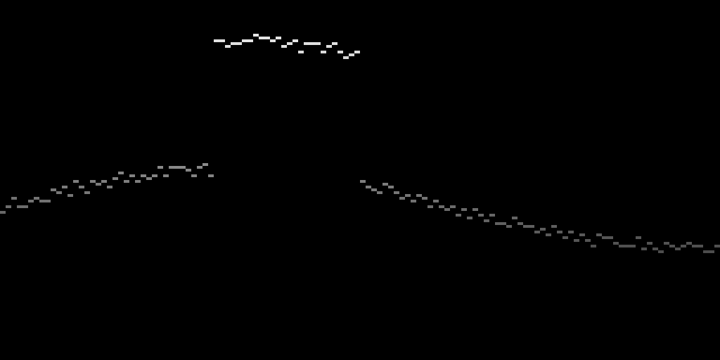
The Bilateral Grid – Step 1
Chen et al SIGGRAPH 07
Take the 2D image Im(x, y)
Create a 3D volume V(x, y, z), such that:
  Where Im(x, y) = z, V(x, y, z) = z
  Elsewhere, V(x, y, z) = 0

Slide 104

The Bilateral Grid – Step 2
Blur the 3D volume (using a fast blur)

Slide 105
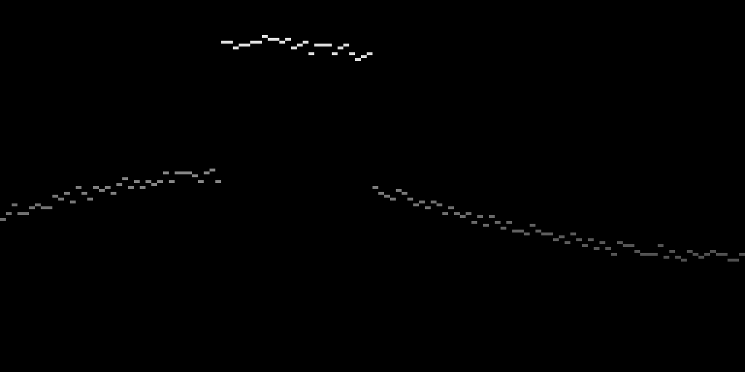
The Bilateral Grid – Step 3
Slice the volume at z values corresponding to the original pixel values

Slide 106
Comparison
Input
Regular blur
Bilateral Grid Slice

Slide 107
Pixel Influence
Each pixel blurred together with
  those nearby in space (x coord on this graph)
  and value (y coord on this graph)

Slide 108
Pixel Influence
Each pixel blurred together with
  those nearby in space (x coord on this graph)
  and value (y coord on this graph)
No crosstalk over this edge

Slide 109
The weight channel
This actually just computes:
We need:

Slide 110
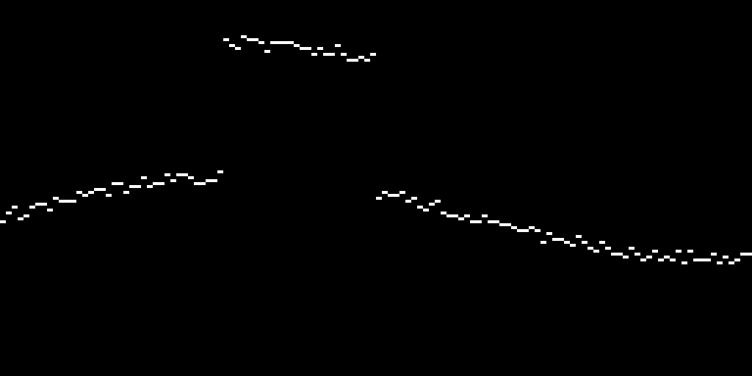
The weight channel
Solution: add a weight channel
Create a 3D volume V(x, y, z), such that:
  Where Im(x, y) = z, V(x, y, z) = (z,1)
  Elsewhere, V(x, y, z) = (0,0)
At the end, divide by the weight channel

Slide 111

Bilateral Grid = Local Histogram Transform
Take the weight channel:
Blur in space (but not value)

Slide 112

Bilateral Grid = Local Histogram Transform
One column is now the histogram of a region around a pixel!
If we blur in value too, it’s just a histogram with fewer buckets
Useful for median, min, max filters as well.

Slide 113
The Elephant in the Room
Why hasn’t anyone done this before?
For a 5 megapixel image at 3 bytes per pixel, the bilateral grid with 256 value buckets would take up:
  5*1024*1024*(3+1)*256 = 5120 Megabytes
But wait, we never need the original grid, just the original grid blurred...

Slide 114
Use Filtering by Resampling!
Construct the bilateral grid at low resolution
  Use a good downsampling filter to put values in the grid
  Blur the grid with a small kernel (eg 5x5)
  Use a good upsampling filter to slice the grid
Complexity?
  Regular bilateral filter: O(w*h*f*f)
  Bilateral grid implementation:
    time: O(w*h)
    memory: O(w/f * h/f * 256/g)

Slide 115
Use Filtering by Resampling!
Construct the bilateral grid at low resolution
  Use a good downsampling filter to put values in the grid
  Blur the grid with a small kernel (eg 5x5)
  Use a good upsampling filter to slice the grid
Complexity?
  Regular bilateral filter: O(w*h*f*f)
  Bilateral grid implementation:
    time: O(w*h)
    memory: O(w/f * h/f * 256/g)
Gets smaller as the filter gets larger!

Slide 116
Dealing with Color
I’ve treated value as 1D, it’s really 3D
The bilateral grid should hence really be 5D
Memory usage starts to go up...
Most people just use distance in luminance instead of full 3D distance
  values in grid are 3D colors (4 bytes per entry)
  positions of values is just the 1D luminance
  = (R+G+B)/3

Slide 117



Using distance in 3D vs
Just using distance in luminance
Same luminance
Input
Full Bilateral
Luminance Only Bilateral

Slide 118
Wait, this ‘limitation’ can be useful
Values in the bilateral grid are the things we want to blur
Positions (and hence distances) in the bilateral grid determine which values we mix
So we could, for example, get the positions from one image, and the values from another

Slide 119



Joint Bilateral Filter
Input Image
Reference Image
Result

Slide 120
Joint Bilateral Application
Flash/No Flash photography
Take a photo with flash (colors look bad)
Take a photo without flash (noisy)
Use the edges from the flash photo to help smooth the blurry photo
Then add back in the high frequencies from the flash photo
Digital Photography with Flash and No-Flash Image Pairs
Petschnigg et al, SIGGRAPH 04

Slide 121
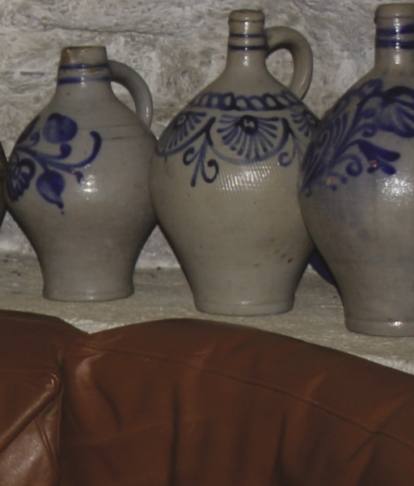
Flash:

Slide 122
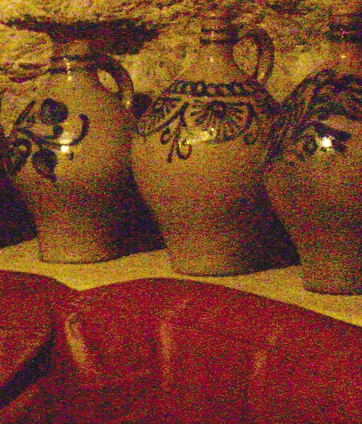
No Flash:

Slide 123
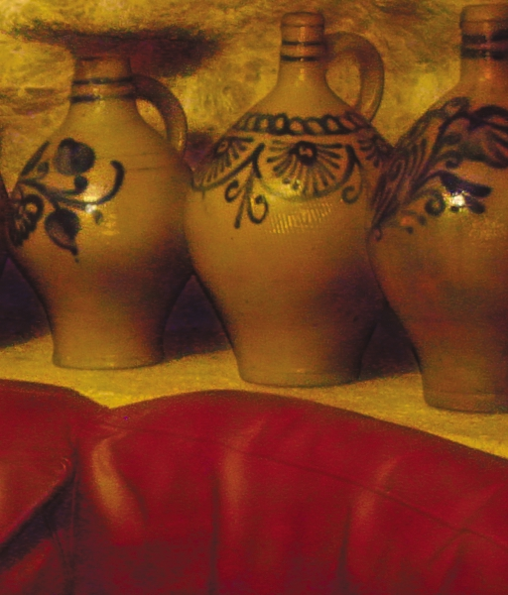
Result:

Slide 124
Joint Bilateral Upsample
Kopf et al, SIGRAPH 07
Say we’ve computed something expensive at low resolution (eg tonemapping, or depth)
We want to use the result at the original resolution
Use the original image as the positions
Use the low res solution as the values
Since the bilateral grid is low resolution anyway, just:
  read in the low res values at positions given by the downsampled high res image
  slice using the high res image

Slide 125
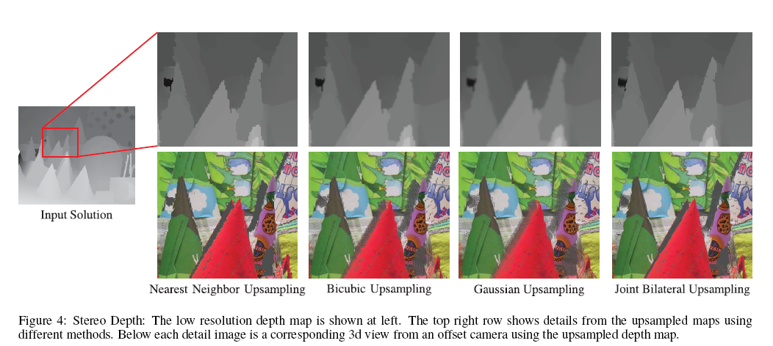
Joint Bilateral Upsample Example
Low resolution depth, high resolution color
Depth edges probably occur at color edges

Slide 126
One final use of the bilateral filter
Video Enhancement Using Per-Pixel Virtual Exposures
Bennett & McMillan, SIGGRAPH 05
ASTA: Adaptive Spatio-Temporal Accumulation
Do a 3D bilateral filter on a video
Where something isn’t moving, it will mostly average over time
Where something is moving, it will just average over space

Slide 127
Key Ideas
Filtering (even bilateral filtering) is O(w*h)
You can also filter by downsampling, possibly blurring a little, then upsampling
The bilateral grid is a local histogram transform that’s useful for many things

