Slide 1
CS448f: Image Processing For Photography and Vision
Fast Filtering Continued

Slide 2
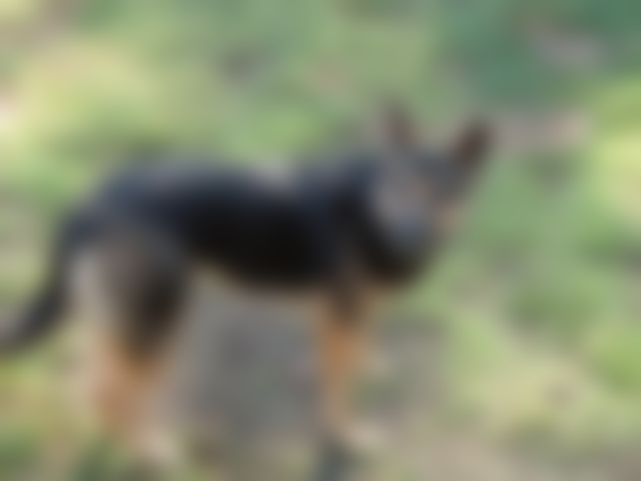
Filtering by Resampling
This looks like we just zoomed a small image
Can we filter by downsampling then upsampling?

Slide 3

Filtering by Resampling

Slide 4

Filtering by Resampling
Downsampled with rect (averaging down)
Upsampled with linear interpolation

Slide 5

Use better upsampling?
Downsampled with rect (averaging down)
Upsampled with bicubic interpolation

Slide 6

Use better downsampling?
Downsampled with tent filter
Upsampled with linear interpolation

Slide 7

Use better downsampling?
Downsampled with bicubic filter
Upsampled with linear interpolation

Slide 8
Resampling Simulation

Slide 9

Best Resampling
Downsampled, blurred, then upsampled with bicubic filter

Slide 10
Best Resampling
Equivalent to downsampled, then upsampled with a blurred bicubic filter

Slide 11
What's the point?
Q: If we can blur quickly without resampling, why bother resampling?
A: Memory use
Store the blurred image at low res, sample it at higher res as needed.

Slide 12
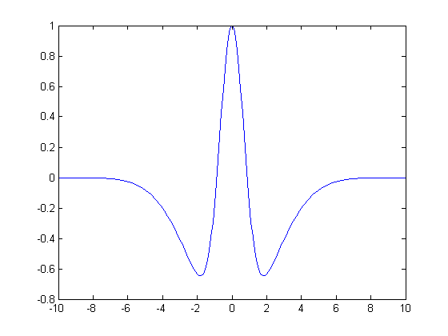
Recap: Fast Linear Filters
Separate into a sequence of simpler filters
  - e.g. Gaussian is separable across dimension
  - and can be decomposed into rect filters
2) Separate into a sum of simpler filters

Slide 13
Recap: Fast Linear Filters
3) Separate into a sum of easy-to-precompute components (integral images)
- great if you need to compute lots of different filters
4) Resample
- great if you need to save memory
5) Use feedback loops (IIR filters)
- great, but hard to change the std.dev of your filter

Slide 14
Histogram Filtering
The fast rect filter
  maintained a sum
  updated it for each new pixel
  didn't recompute from scratch
What other data structures might we maintain and update for more complex filters?

Slide 15
Histogram Filtering
The min filter, max filter, and median filter
  Only care about what pixel values fall into neighbourhood, not their location
  Maintain a histogram of the pixels under the filter window, update it as pixels enter and leave

Slide 16
Histogram Updating

Slide 17
Histogram Updating
 |  |  |  |  |  |  |  |  |  | +
 |  |  |  |  |  |  |  |  |  |  | +
 |  |  |  |  |  |  |  |  |  |  |  | +
 |  |  |  |  |  |  |  |  |  |  |  | +
 |  |  |  |  |  |  |  |  |  |  |  | +
 |  |  |  |  |  |  |  |  |  |  | +
 |  |  |  |  |  |  |  |  |  | +

Slide 18
Histogram Updating

Slide 19
Histogram Updating
 |  |  |  |  |  |  | -
 |  |  |  |  |  | -
 |  |  |  |  | -
 |  |  |  |  | -
 |  |  |  |  | -
 |  |  |  |  |  | -
 |  |  |  |  |  |  | -

Slide 20
Histogram Updating

Slide 21
Histogram-Based Fast Median
Maintain:
  hist = Local histogram
  med = Current Median
  lt = Number of pixels less than current median
  gt = Number of pixels greater than current median

Slide 22
Histogram-Based Fast Median
while (lt < gt):
  med--
  Update lt and gt using hist
while (gt < lt):
  med++
  Updated lt and gt using hist

Slide 23
Histogram-Based Fast Median
Complexity?
Extend this to percentile filters?
Max filters? Min filters?

Slide 24
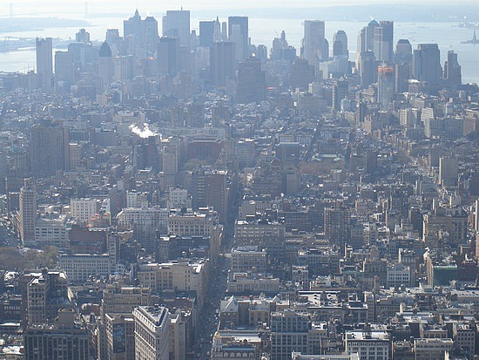
Use of a min filter: dehazing

Slide 25

Large-support min filter

Slide 26
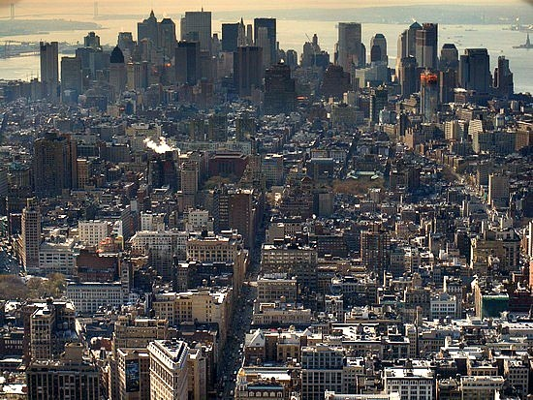
Difference (brightened)

Slide 27
Weighted Blurs
Perform a Gaussian Blur weighted by some mask
Pixels with low weight do not contribute to their neighbors
Pixels with high weight do contribute to their neighbors

Slide 28
Weighted Blurs
Can be expressed as:
Where w is some weight term
How can we implement this quickly?

Slide 29
Weighted Blurs
Use homogeneous coordinates for color!
Homogeneous coordinates uses (d+1) values to represent d-dimensional space
All values of the form [a.r, a.g, a.b, a] are equivalent, regardless of a.
To convert back to regular coordinates, divide through by the last coordinate

Slide 30
Weighted Blurs
This is red: [1, 0, 0, 1]
This is the same red: [37.3, 0, 0, 37.3]
This is dark cyan: [0, 3, 3, 6]
This is undefined: [0, 0, 0, 0]
This is infinite: [1, 5, 2, 0]

Slide 31
Weighted Blurs
Addition of homogeneous coordinates is weighted averaging
[x.r₀ x.g₀ x.b₀ x] + [y.r₁ y.g₁ y.b₁ y]
= [x.r₀+y.r₁ x.g₀+y.g₁ x.b₀+y.b₁ x+y]
= [(x.r₀+y.r₁)/(x+y)
(x.g₀+y.g₁)/(x+y)
(x.b₀+y.b₁)/(x+y)]

Slide 32
Weighted Blurs
Often the weight is called alpha and used to encode transparency, in which case this is known as “premultiplied alpha”.
We’ll use it to perform weighted blurs.

Slide 33

Image:

Slide 34

Weight:

Slide 35

Result:

Slide 36
Result:
Why bother with uniform weights?
Well... at least it gets rid of the sum of the weights term in the denominator of all of these equations:

Slide 37
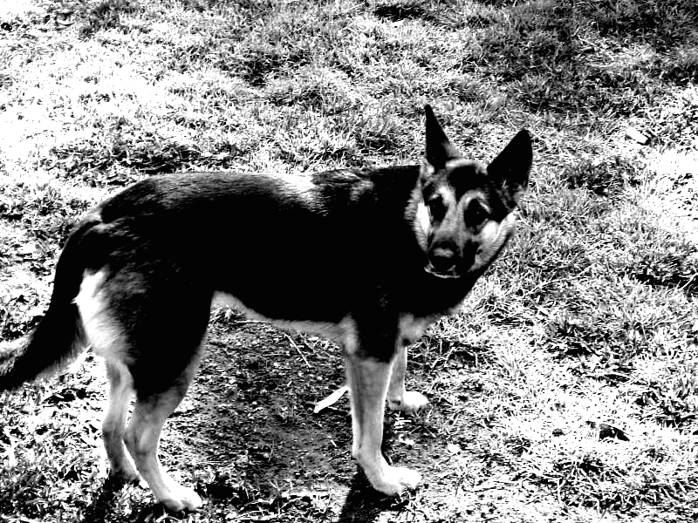
Weight:

Slide 38
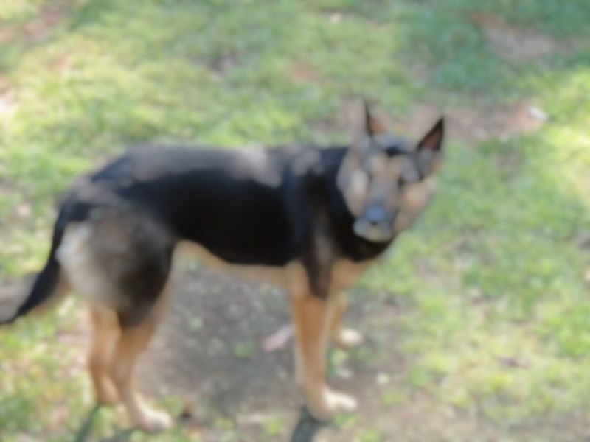
Result: Like a max filter but faster

Slide 39
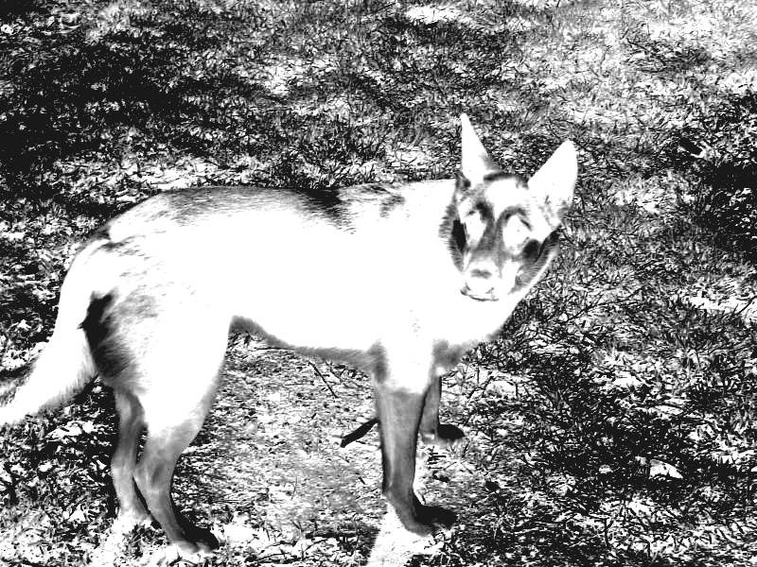
Weight:

Slide 40
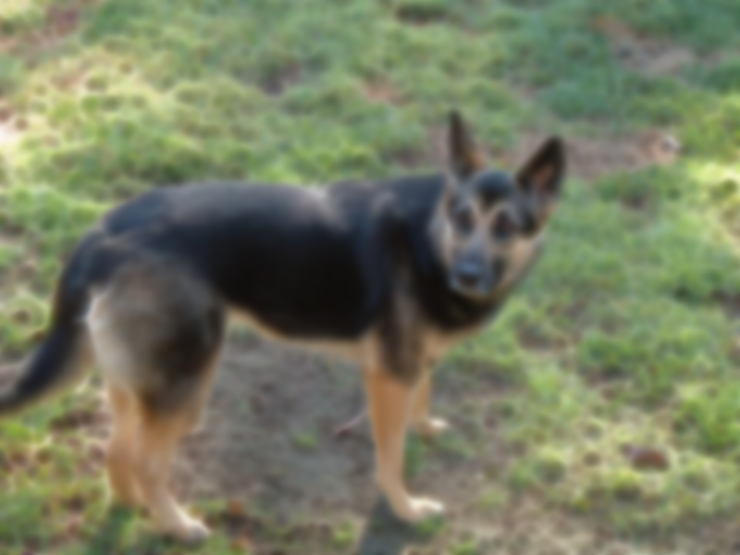
Result: Like a min filter but faster

Slide 41

Weight:

Slide 42

Result: A blur that ignores the dog

Slide 43
In ImageStack:
Convert to homogeneous coordinates:
  ImageStack -load dog1.jpg -load mask.png
  -multiply -load mask.png -adjoin c ...
Perform the blur
  ... -gaussianblur 4 ...
Convert back to regular coordinates
  ... -evalchannels “[0]/[3]” “[1]/[3]” “[2]/[3]”
  -save output.png

Slide 44
The Bilateral Filter
Pixels are mixed with nearby pixels that have a similar value
Is this a weighted blur?

Slide 45
The Bilateral Filter
No, there’s no single weight per pixel ☹
What if we picked a fixed intensity level a, and computed:

Slide 46
The Bilateral Filter
This formula is correct when I(x) = a
And is just a weighted blur, where the weight is:

Slide 47
The Bilateral Filter
So we have a formula that only works for pixel values close to a
How can we extend it to work for all pixel values?

Slide 48
The Bilateral Filter
1) Pick lots of values of a
2) Do a weighted blur at each value
3) Each output pixel takes its value from the blur with the closest a
  or interpolate between the nearest 2 a’s
Fast Bilateral Filtering for the Display of High-Dynamic-Range Images
  Durand and Dorsey 2002
  Used an FFT to do the blur for each value of a

Slide 49
The Bilateral Filter
Here’s a better way to think of it:
We can combine the exponential terms...

Slide 50
Linearizing the Bilateral Filter
The product of an 1D gaussian and an 2D gaussian across different dimensions is a single 3D gaussian.
So we're just doing a weighted 3D blur
Axes are:
  image x coordinate
  image y coordinate
  pixel value

Slide 51
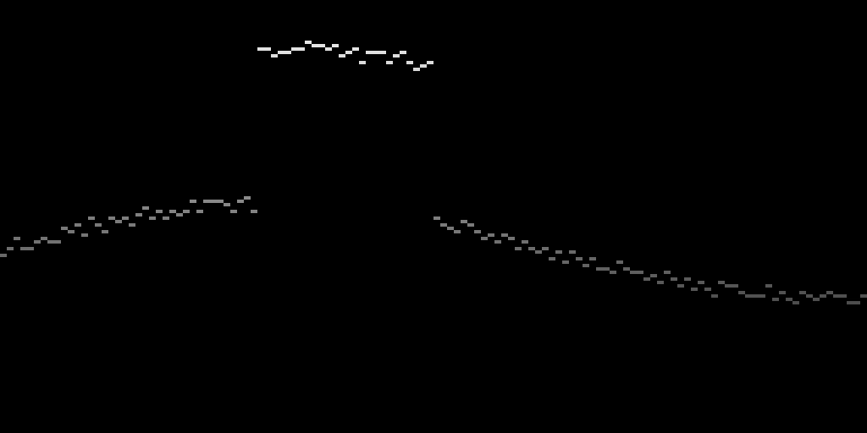
The Bilateral Grid – Step 1
Chen et al SIGGRAPH 07
Take the 2D image Im(x, y)
Create a 3D volume V(x, y, z), such that:
  Where Im(x, y) = z, V(x, y, z) = (z, 1)
  Elsewhere, V(x, y, z) = (0, 0)

Slide 52

The Bilateral Grid – Step 2
Blur the 3D volume (using a fast blur)

Slide 53
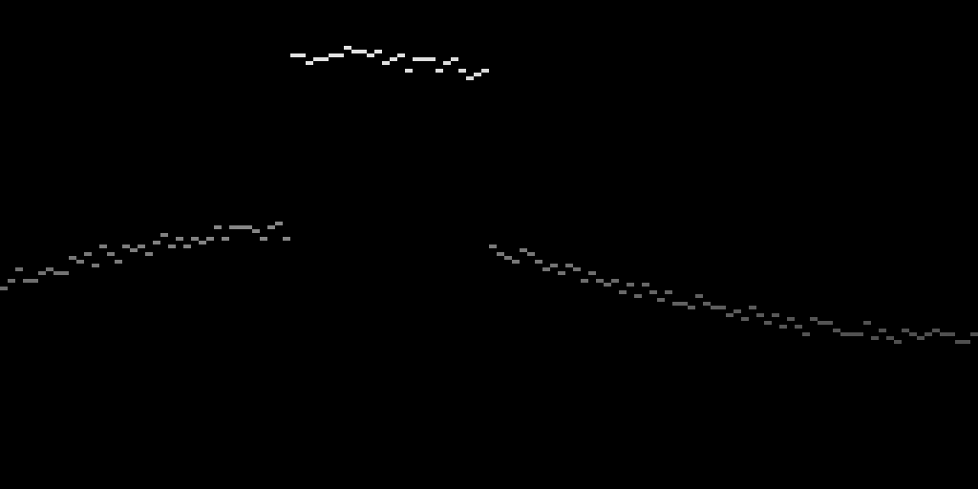
The Bilateral Grid – Step 3
Slice the volume at z values corresponding to the original pixel values

Slide 54
Comparison
Input
Regular blur
Bilateral Grid Slice

Slide 55
Pixel Influence
Each pixel blurred together with
  those nearby in space (x coord on this graph)
  and value (y coord on this graph)

Slide 56
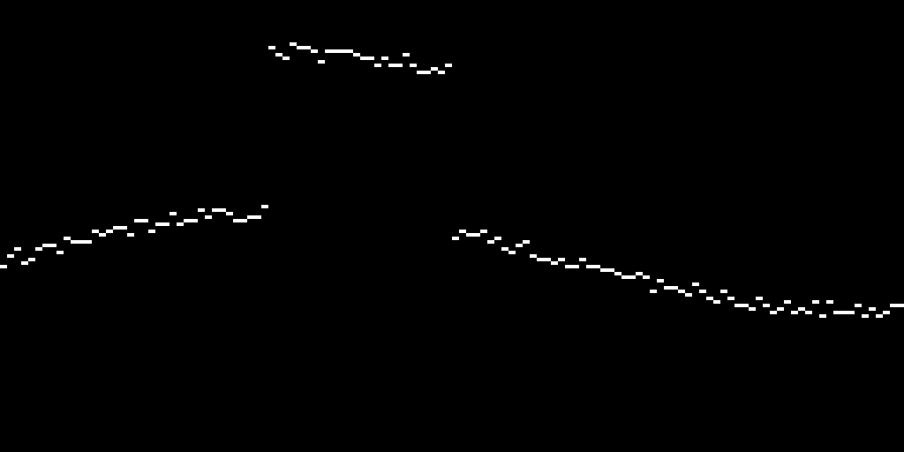

Bilateral Grid = Local Histogram Transform
Take the weight channel:
Blur in space (but not value)

Slide 57

Bilateral Grid = Local Histogram Transform
One column is now the histogram of a region around a pixel!
If we blur in value too, it’s just a histogram with fewer buckets
Useful for median, min, max filters as well.

Slide 58
The Elephant in the Room
Why hasn’t anyone done this before?
For a 5 megapixel image at 3 bytes per pixel, the bilateral grid with 256 value buckets would take up:
  5*1024*1024*(3+1)*256 = 5120 Megabytes
But wait, we never need the original grid, just the original grid blurred...

Slide 59
Use Filtering by Resampling!
Construct the bilateral grid at low resolution
  Use a good downsampling filter to put values in the grid
  Blur the grid with a small kernel (eg 5x5)
  Use a good upsampling filter to slice the grid
Complexity?
  Regular bilateral filter: O(w*h*f*f)
  Bilateral grid implementation:
    time: O(w*h)
    memory: O(w/f * h/f * 256/g)

Slide 60
Use Filtering by Resampling!
A Fast Approximation of the Bilateral Filter using a Signal Processing Approach
  Paris and Durand 2006

Slide 61
Dealing with Color
I’ve treated value as 1D, it’s really 3D
The bilateral grid should hence really be 5D
Memory usage starts to go up...
Cost of splatting and slicing = 2^{d}
Most people just use distance in luminance instead of full 3D distance
  values in grid are 3D colors (4 bytes per entry)
  positions of values is just the 1D luminance
  = (R+G+B)/3

Slide 62
Bilateral Grid Demo and Video

Slide 63



Using distance in 3D vs
Just using distance in luminance
Same luminance
Input
Full Bilateral
Luminance Only Bilateral

Slide 64
There is a disconnect between positions and values
Values in the bilateral grid are the things we want to blur
Positions (and hence distances) in the bilateral grid determine which values we mix
So we could, for example, get the positions from one image, and the values from another

Slide 65


Joint Bilateral Filter
Input Image
Reference Image
Result

Slide 66
Joint Bilateral Application
Flash/No Flash photography
Take a photo with flash (colors look bad)
Take a photo without flash (noisy)
Use the edges from the flash photo to help smooth the blurry photo
Then add back in the high frequencies from the flash photo
Digital Photography with Flash and No-Flash Image Pairs
Petschnigg et al, SIGGRAPH 04

Slide 67
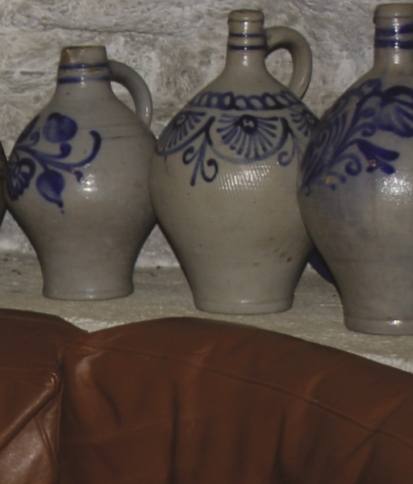
Flash:

Slide 68
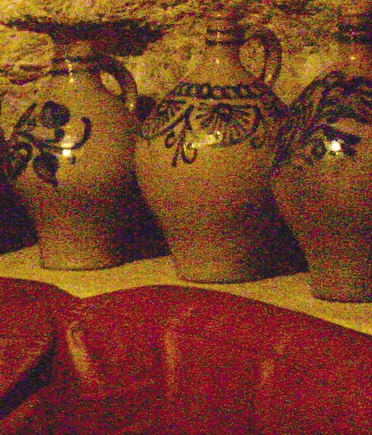
No Flash:

Slide 69
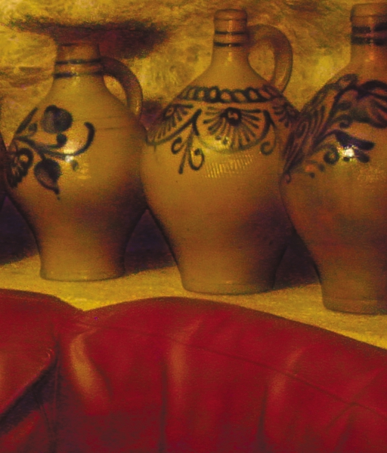
Result:

Slide 70
Joint Bilateral Upsample
Kopf et al, SIGRAPH 07
Say we’ve computed something expensive at low resolution (eg tonemapping, or depth)
We want to use the result at the original resolution
Use the original image as the positions
Use the low res solution as the values
Since the bilateral grid is low resolution anyway, just:
  read in the low res values at positions given by the downsampled high res image
  slice using the high res image

Slide 71
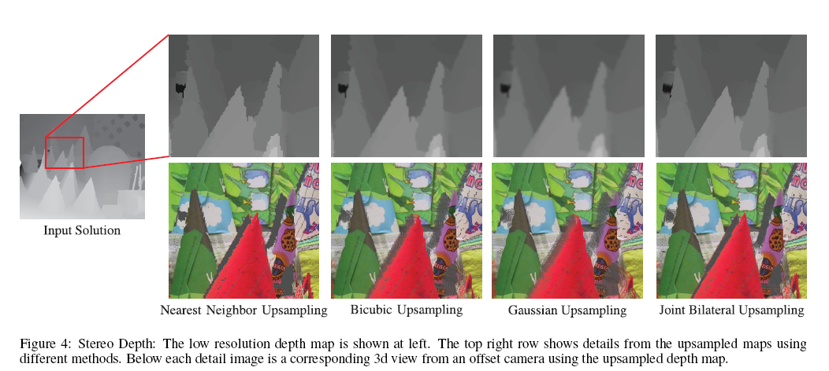
Joint Bilateral Upsample Example
Low resolution depth, high resolution color
Depth edges probably occur at color edges

Slide 72
Non-Local Means
Average each pixel with other pixels that have similar local neighborhoods
Slow as hell

Slide 73
Think of it this way:
Blur pixels with other pixels that are nearby in patch-space
Can use a bilateral grid!
  Except dimensionality too high
  Not enough memory
  Splatting and Slicing too costly (2^{d})
Solution: Use a different data structure to represent blurry high-D space
(video)

Slide 74
Key Ideas
Filtering (even bilateral filtering) is O(w*h)
You can also filter by downsampling, possibly blurring a little, then upsampling
The bilateral grid is a local histogram transform that’s useful for many things

