Slide 1
Hadoop

Slide 2
Motivation
Sometimes you just have too much data
A few hundred KB can be processed in Excel
A few hundred MB can be processed with a script
A few TB can be stored in a database on a hard drive
What do you do when you have hundreds of TB? You have to store the data on hundreds of different computers.

Slide 3
Motivation
Divide and conquer
Imagine if you had to do 100 Math 51 psets. It might take 100 weeks.
Now imagine 100 students doing 1 pset each. It would only take 1 week, because all the psets are getting worked on at once
Similarly, instead of 1 computer doing 100 tasks, you could have 100 computers doing 1 task each
How do you decide which computer does which task?

Slide 4
Motivation
Ease of use
Hadoop simplifies the process. Hadoop is good at
Handling HUGE quantities of data
Parallelizing work
Continuing even when some of the computers doing the work break
Hadoop does many of the scary things for you

Slide 5
How it works
Examples are coming
It’s built on a tool called MapReduce
In the Map Stage, each computer analyzes its chunk of data
In the Shuffle Stage, each computer gives pieces of the analysis to other computers
In the Reduce Stage, each computer synthesizes the pieces of analysis it was given in the Shuffle Stage

Slide 6
Wordcount Example
The problem
Suppose we want to count the number of times any one word occurs in our data.
For example, in the phrase “One fish, two fish, red fish, blue fish”:
“One” occurs 1 time
“Fish” occurs 4 times
“Two” occurs 1 time
“Red” occurs 1 time
“Blue” occurs 1 time

Slide 7
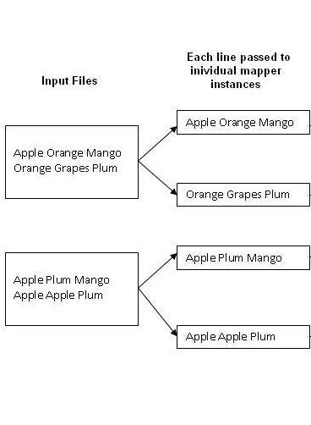
Wordcount Example
Step 1: Read the data
Let’s say we have 2 input files and 4 computers
Hadoop gives each computer a portion of the data

Slide 8
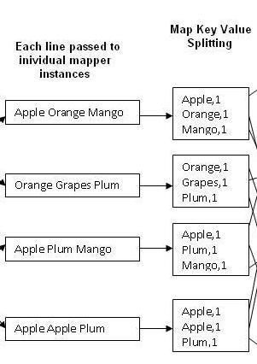
Wordcount Example
Step 2: Map Stage
Each computer processes its data by separating each word

Slide 9
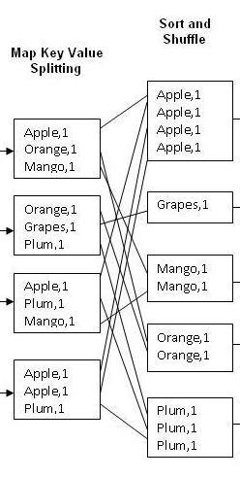
Wordcount Example
Step 3: Shuffle Stage
What it has analyzed so far is given to other computers for further processing
In this case, it’s every occurrence of each word to a different computer

Slide 10
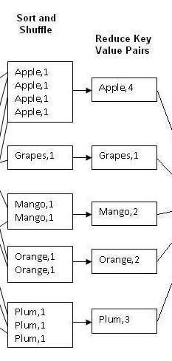
Wordcount Example
Step 4: Reduce Stage
Each computer synthesizes the information it was given
It adds up the occurrences of each word from wherever it came from

Slide 11
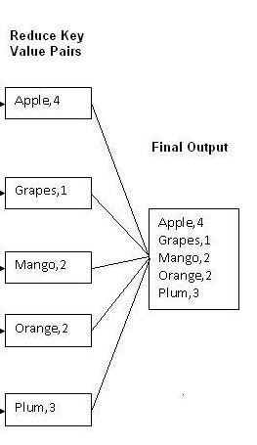
Wordcount Example
Step 5: Read the final output
You’re done! Hadoop now spits the processed data back out

Slide 12
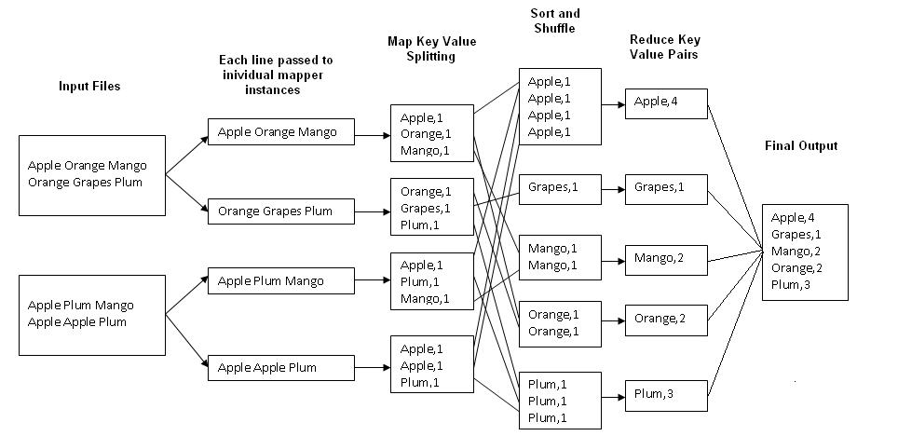
Wordcount Example
All together now
Image credit: http://kickstarthadoop.blogspot.com/2011/04/word-count-hadoop-map-reduce-example.html

Slide 13
Average Example
The Problem
Say we have a bunch of movie ratings, and we want to find the average rating for each movie.
So if Avengers had:
Two 4 star ratings
Two 5 star ratings
Its average rating would be 4.5 stars

Slide 14
Average Example
Step 1: Read the data
The data would be given to a bunch of different computers
Computer 1 might have Avengers: 4 stars, Avengers: 2 stars, Harry Potter: 5 stars, Harry Potter: 5 stars
Computer 2 might have Harry Potter: 5 stars, Avengers: 4 stars, Harry Potter: 3 stars

Slide 15
Average Example
Step 2: Map Stage
Each computer would parse their data into key value pairs.
Computer 1 would have: <Avengers, 4>, <Avengers, 2>, <Harry Potter, 5>, <Harry Potter, 5>
Computer 2 would have: <Harry Potter, 5>, <Avengers, 3>, <Harry Potter, 3>

Slide 16
Average Example
Step 3: Shuffle Stage
Each computer would send their data to the other computers.
Computer 1 would send <Avengers, 4>, <Avengers, 2> to Computer 2
Computer 1 would keep <Harry Potter, 5>, <Harry Potter, 5>
Computer 2 would keep <Avengers, 3>
Computer 2 would send <Harry Potter, 5>, <Harry Potter, 3> to Computer 1

Slide 17
Average Example
Step 4: Reduce Stage
Each computer would process their data
Computer 1 would have <Harry Potter, 5>, <Harry Potter, 5>, <Harry Potter, 5>, <Harry Potter, 3>.
That would be averaged to <Harry Potter, 4.5>
Computer 2 would have <Avengers, 3>, <Avengers, 4>, <Avengers, 2>
That would be averaged to <Avengers, 3>

Slide 18
Average Example
Step 5: The answer
Hadoop would give the result back to whoever asked for it
Computer 1 would send you <Harry Potter, 4.5>
Computer 2 would send you <Avengers, 3>
You now have the average ratings for each movie

Slide 19
Problems
Slow and inflexible
It has to send data in between all these machines, which can make it slower
You’re forced to put your code into two functions: map and reduce. You don’t have much control over anything else
These tradeoffs can be worth it when you have hundreds of TB of data or an analysis that takes a long time on one machine. But if you don’t have that much data, you might consider just using a more conventional technique

