Slide 1
Data Brokers
Katherine Sun

Slide 2

WAT
Collects information (about people)
  Public Records
  Web browsing
  Credit Card History
  Other data brokers
Sells for:
  Advertising
  Identification
  Research

Slide 3

HOW BIG?
Acxiom
  1.4 billion consumer transactions
  700 billion data elements
  3 billion added a month

Slide 4

Biggest and Baddest
Axciom
  1.15B revenue (2012)
Equifax
Experian
TransUnion

Slide 5

Danger zone

Slide 6


Acxiom
2003, 1.6 billion customer records stolen between client transmission
  2 Hackers sentenced to 8 year prison terms

Slide 7
Sequoia one llc
Gen x Marketing
Illegally sold payday loan applicant’s financial information
Buyer: Ideal Financial Solutions Inc.
Debited $7.1 million from 500,000 people through unauthorized charges

Slide 8
Targeting Vulnerable Communities
…identified marketing lists with titles like “‘Rural and Barely Making It,’ ‘Ethnic Second-City Strugglers,’ ‘Retiring on Empty: Singles,’ ‘Tough Start: Young Single Parents,’ and ‘Credit Crunched: City Families.'”
“Assimilation Codes,” indicating a person’s degree of familiarity with the English language.
Should this profiling be allowed?

Slide 9
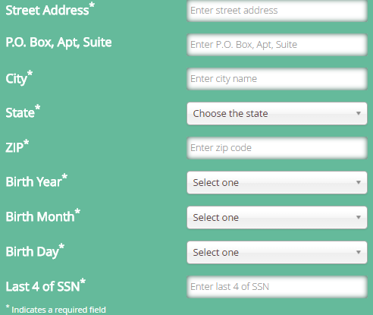

Aboutthedata.com
A website created by Acxiom for transparency

Slide 10
Federal Trade commission
“Data Brokers: A Call for Transparency and Accountability”
May 2014
Lack of Transparency
  Data brokers hide how they get their data and who they give it to
Sensitive Bins
  “Urban Scramble” “Mobile Mixers” – Low Income Latino/Afro-Amer
  “Rural Everlasting” – singles over 66 with “low net worth and education”

Slide 11

Cont.
Unnecessary storing of consumer data
Lack of consumer ability to delete data

Slide 12
Proposed edits
Centralized Portal
  A cohesive site with information and opt-out
  Data Broker Accountability and Transparency Act
Consumer Access
  Know what your data says, ability to opt out, ability to edit wrong data
Consumer Notice
  Make retailers tell people their data is being collected
Protect Sensitive Data
  Health records, etc.

Slide 13
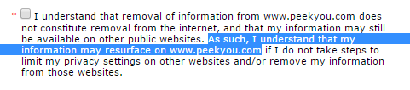
Opting - Out
All require you to be a member to opt out.
Some require… additional ID to opt out.
Mailing, driver’s license, some even ask for social security.
Mass opt-out sites are not honored

Slide 14
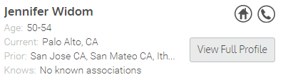

White Pages
Phone, 4 prev addresses, and age for Jennifer Widom
No information on Katherine Sun (yay?)
No information on Akash

