Slide 1
Big Data Fallacies
A Journey into the Dark Side
Kevin Li

Slide 2


Slide 3
Information
Visualization
Databases
Artificial Intelligence
Big Data
Optimization
Statistical Learning
Data Structures
Massive Data Sets
Data Mining
Machine Learning
Modeling
Cloud Computing

Slide 4
CS 448B
CS 124
CS 145
CS 221
CS 46N
CME 375
CS 229T
CS 166
CS 341
STATS 202
CS 229
CS 264
CS 309A

Slide 5
Could it ever go wrong?

Slide 6
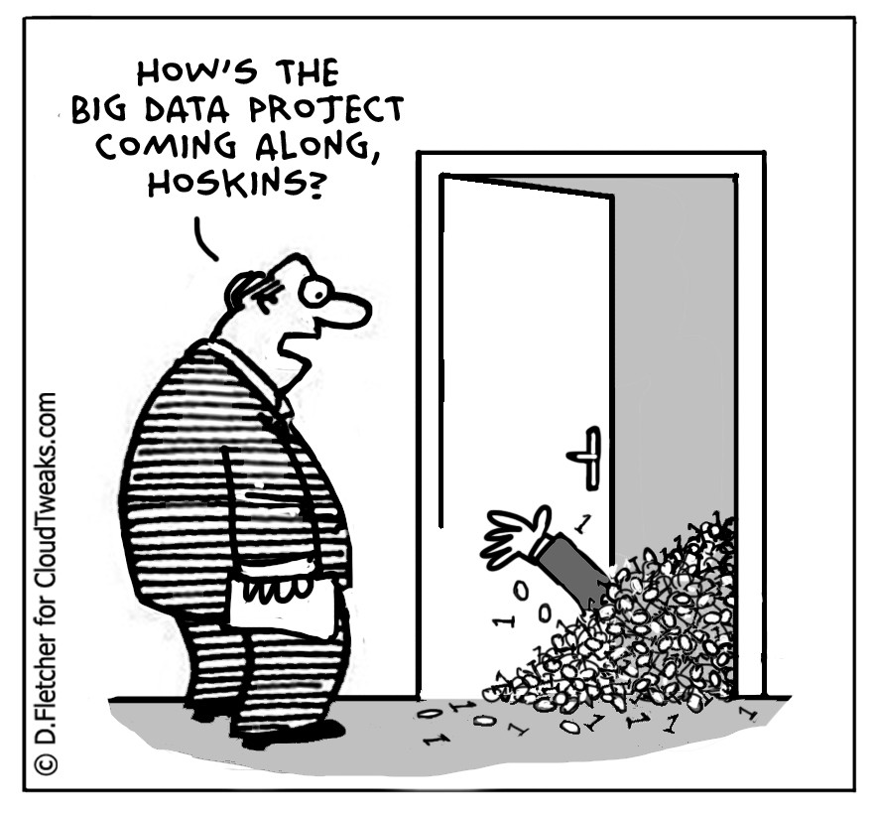
Bigger ≠ Better
Notes:
Source: http://www.smartdatacollective.com/charles-settles/199906/big-data-big-money-roi-business-intelligence

Slide 7
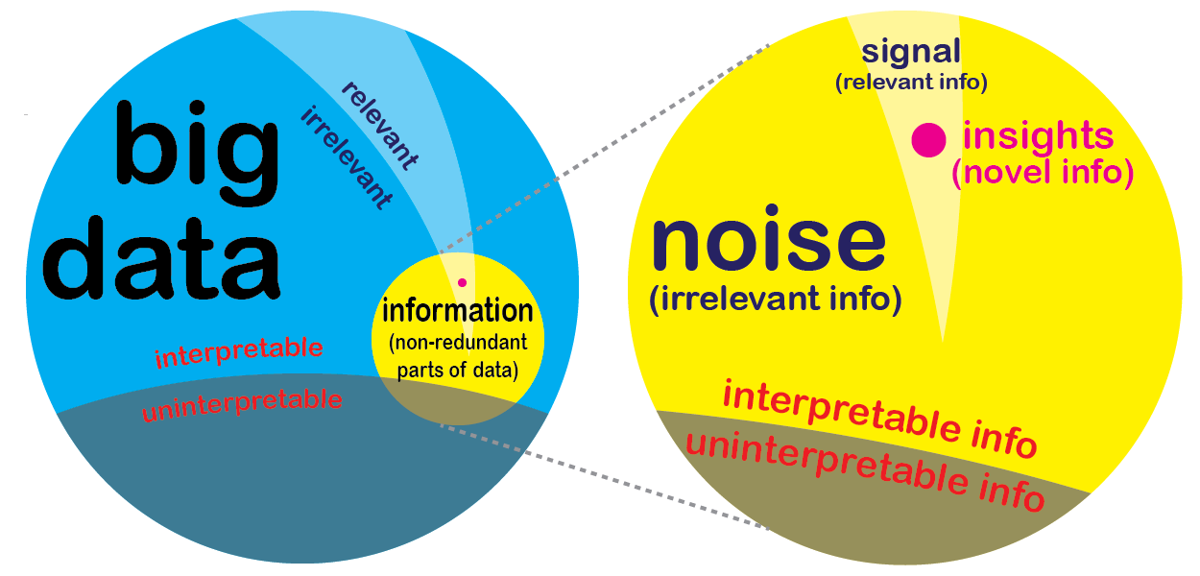
Notes:
Source: http://techcrunch.com/2012/11/25/the-big-data-fallacy-data-%E2%89%A0-information-%E2%89%A0-insights/

Slide 8
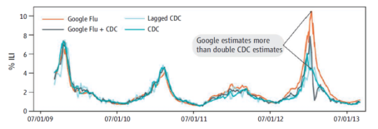
Notes:
Source: http://siliconangle.com/blog/2014/03/24/google-flu-trends-a-case-of-big-data-gone-bad/

Slide 9
How to find the best model?
Find out if a student will major in CS
Given 50,000 student profiles with their major
Construct a major “predictor”
How should we use the data?
How complex should the model be?
How do we tell if our model is good?

Slide 10
Rote Learning
0 error algorithm
Training: store data set
Model:
  If student in data, return major
  Otherwise, crash
Focus on improving unforeseen future performance

Slide 11
How to prevent overfitting?
Focus on relevant parts of data - select fewer features
Keep the model simple - restrict the predictor’s complexity
Test your model - use validation sets

Slide 12
Say... we processed the data correctly,
what else can go wrong?

Slide 13
Statistics can lie.
Study that collected data on income and education
Found that white Americans need a higher level of education to achieve the same level of income as black Americans
Conclusion: reverse discrimination??

Slide 14
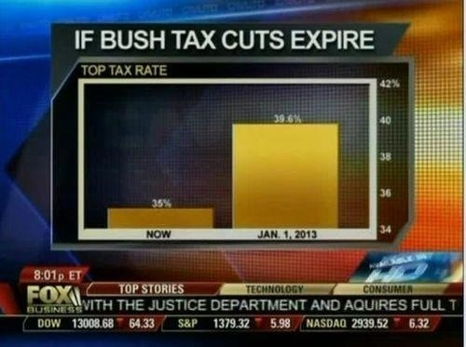
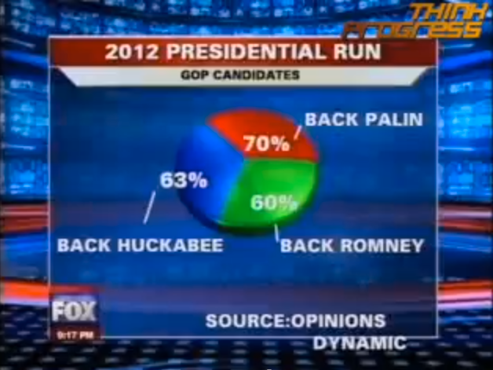
Graphs can also lie.
Notes:
Source: http://data.heapanalytics.com/how-to-lie-with-data-visualization/

Slide 15
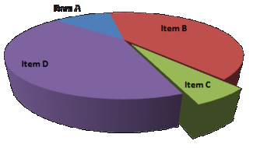
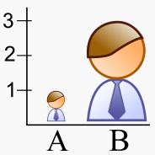
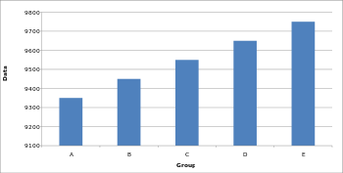
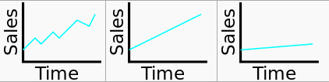
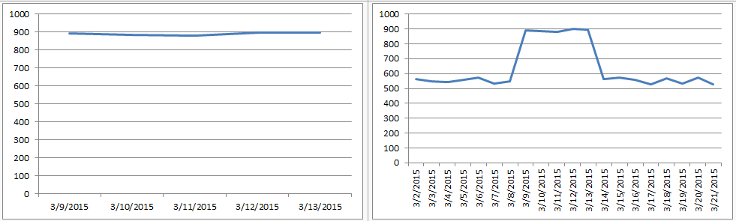
Graphs can also lie.
Notes:
Source: https://en.wikipedia.org/wiki/Misleading_graph

Slide 16
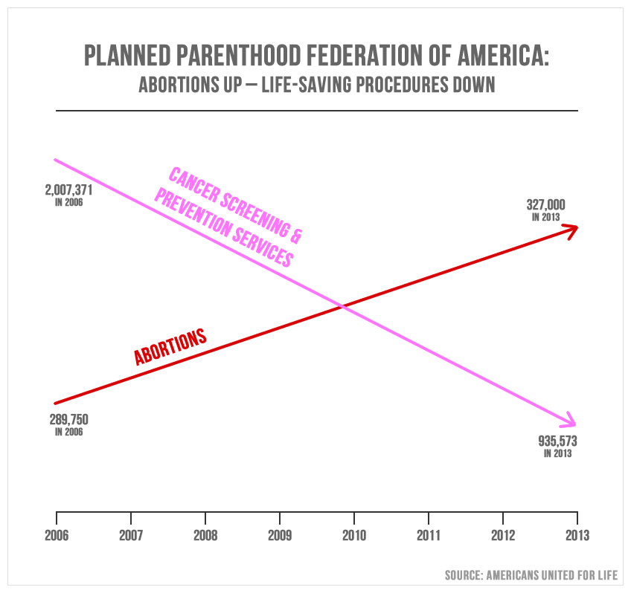
Notes:
Source: http://www.politifact.com/truth-o-meter/statements/2015/oct/01/jason-chaffetz/chart-shown-planned-parenthood-hearing-misleading-/

Slide 17
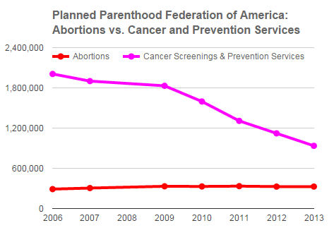
Notes:
Source: http://www.politifact.com/truth-o-meter/statements/2015/oct/01/jason-chaffetz/chart-shown-planned-parenthood-hearing-misleading-/

Slide 18
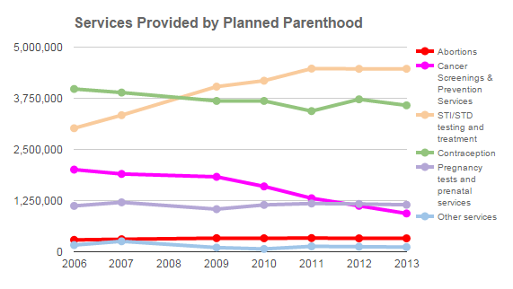
Notes:
Source: http://www.politifact.com/truth-o-meter/statements/2015/oct/01/jason-chaffetz/chart-shown-planned-parenthood-hearing-misleading-/

Slide 19
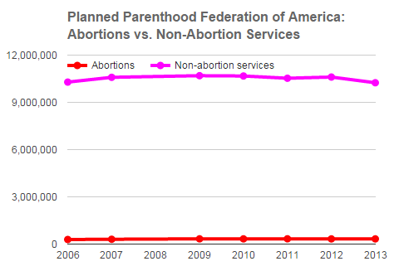
Notes:
Source: http://www.politifact.com/truth-o-meter/statements/2015/oct/01/jason-chaffetz/chart-shown-planned-parenthood-hearing-misleading-/

Slide 20
Perfect data + Correct analysis = Happy ending?

Slide 21
No.

Slide 22
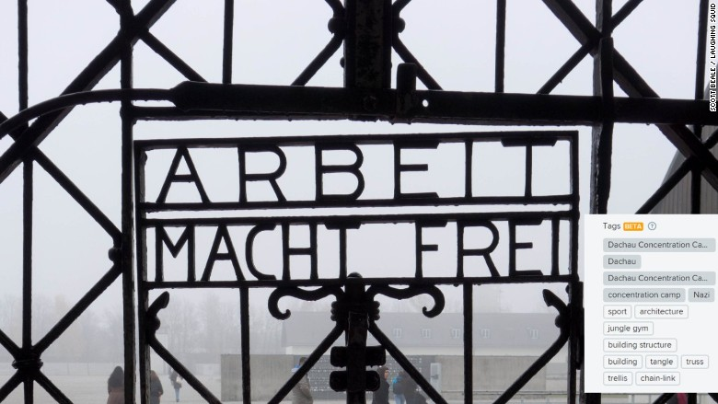
Twitter auto-tagging

Slide 23
Can machines be racist?
Princeton Review uses big data to determine quotes
Pricing determined by ZIP code
Asians twice as likely to be offered higher price
Even in lower income neighborhoods
http://www.propublica.org/article/asians-nearly-twice-as-likely-to-get-higher-price-from-princeton-review
Racist?
Preventable?

Slide 24
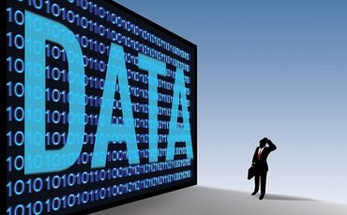
What is the takeaway?
Big Data is not easy to use
Big Data isn’t always trustworthy
Big Data can’t immediately solve everything

