Slide 1
The Effect of sampling bias on big data
By using the Readers digest poll of the 1936 election as a case study, we examine how the sample of data used affects the outcome of the Survey.
Rachel Heymach
CS46
Jennifer Widom
Akash Das Sarma

Slide 2
Background history
Before the 1936 poll, Readers digest was known for their unprecedented accuracy in predicting presidential elections, including the election of 1932 which was correct and was within 1% of the recorded poll results. During the 1930’s, the US was in the middle of the great depression.

Slide 3
How the survey was conducted
Reader’s Digest sent out 10 million mock ballots to a randomized sample from lists such as phone directories, club membership lists, and magazine subscriptions. This sample is very large and contained almost a tenth of the population (although they claim that it represented 1 in 4). From there they used the data collected from the 2.4 million surveys sent back to determine that Landon was going to win over Roosevelt with 57% to 43% respectively.

Slide 4
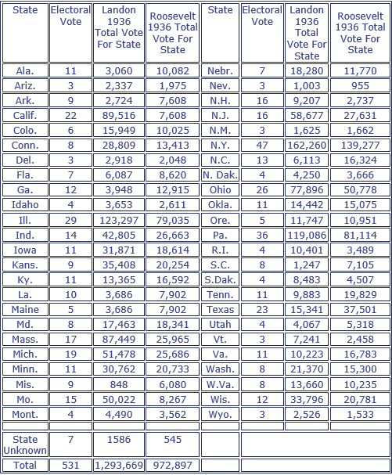
The data
Chart from http://historymatters.gmu.edu/d/5168/

Slide 5
Does anyone else see flaws???
Flaw #1: The sample selected was from phone directories and magazine subscriptions. In 1936. During the depression. Many people were homeless during this time and telephones were considered luxuries for even the people who managed to keep their homes.
This type of sample bias comes into play when the sample selected (mainly middle-upper class citizens in this case) do not properly represent the population you are predicting the outcome for (the entire US population).

Slide 6
Does anyone else see flaws???
Flaw #2: out of 128 million people in the US in 1936, 10 million people were asked to respond, of that 10 million only 2.4 million mailed back their surveys.
This flaw in the poll is called nonresponse bias and actually resulted for two reasons. The first reason is that with mail surveys, the mock ballot could have been seen as another random piece of junk mail and thrown away. The second reason, bringing a more substantial bias is due to the fact that people with stronger opinions are often the ones to share them and people who are shy or unsure of their actions won’t respond as often.

Slide 7
The result
As expected, since the sample was not representative of the population, the sample poll did not accurately depict the national population’s poll in 1936. Reader’s Digest had a record high of 19% in sampling error, the greatest error of any major public opinion poll.

Slide 8
How to avoid sample bias
It is important when creating your sample for big data projects that the sample is as close to unbiased as possible. Phone surveys are cheaper but less affective as in person surveys. Surveys of convenience occur when the sample is not random, rather just taken in the simplest way possible. As mentioned earlier, call in and mail surveys often result in nonresponse bias and only show the strongest of opinions instead of a more distributed spread. Larger samples result in more precise data with smaller standard deviations but only when the sample in unbiased. It is often better to have an unbiased smaller sample than to have a large bias sample as the size often just increases the errors caused by the sampling bias.

Slide 9
Thank you internet (sources)
https://www.math.upenn.edu/~deturck/m170/wk4/lecture/case1.html
http://www.jstor.org/stable/2749114?seq=4#page_scan_tab_contents
http://historymatters.gmu.edu/d/5168/
https://www.ma.utexas.edu/users/mks/statmistakes/biasedsampling.html
http://www.mnforsustain.org/united_states_population_growth_graph.htm
http://www.history.com/topics/great-depression

