Slide 1
The Internet of Things
Exploring Big Data’s Missing Soulmate
Shrey Gupta, Stanford University, CS46N

Slide 2
What’s an Internet of Things?
A network of physical “things” embedded with electronic chips, sensors, software and network connectivity
Allows for normal objects to become “smart” by collecting and sharing data, and adjusting accordingly
Seen as an extremely granular level of infrastructure

Slide 3
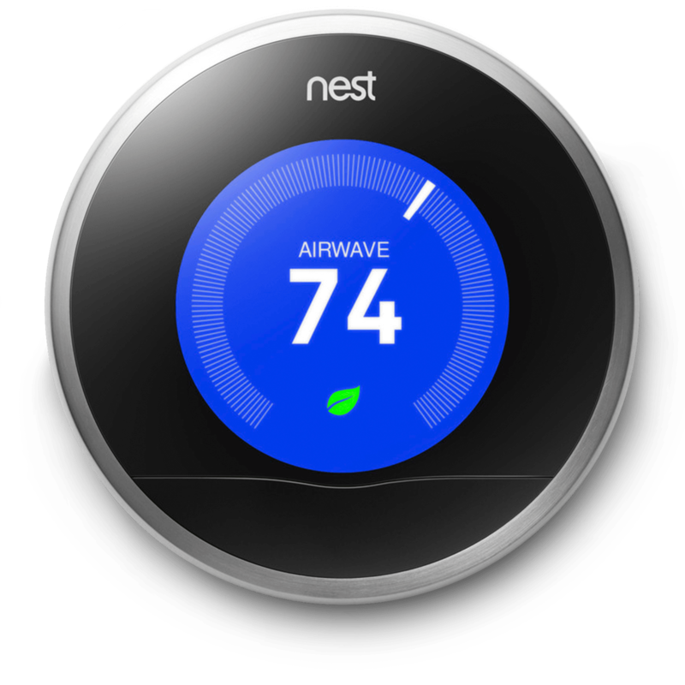
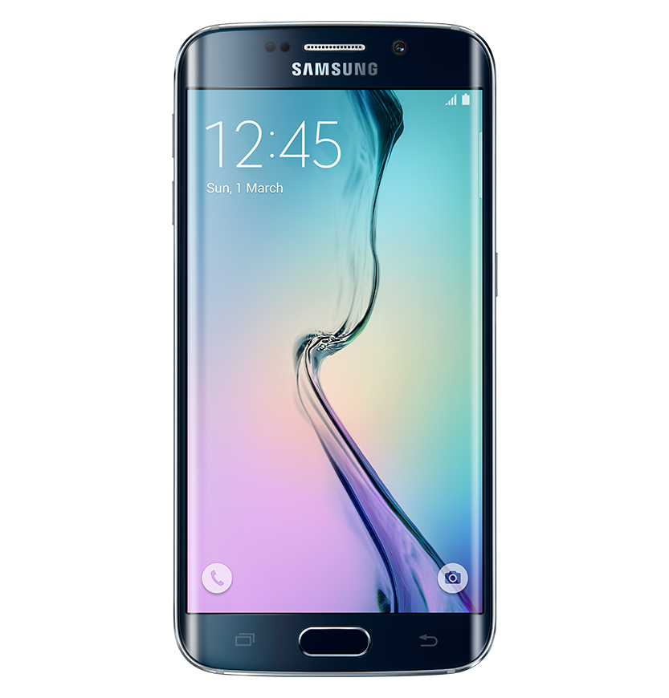
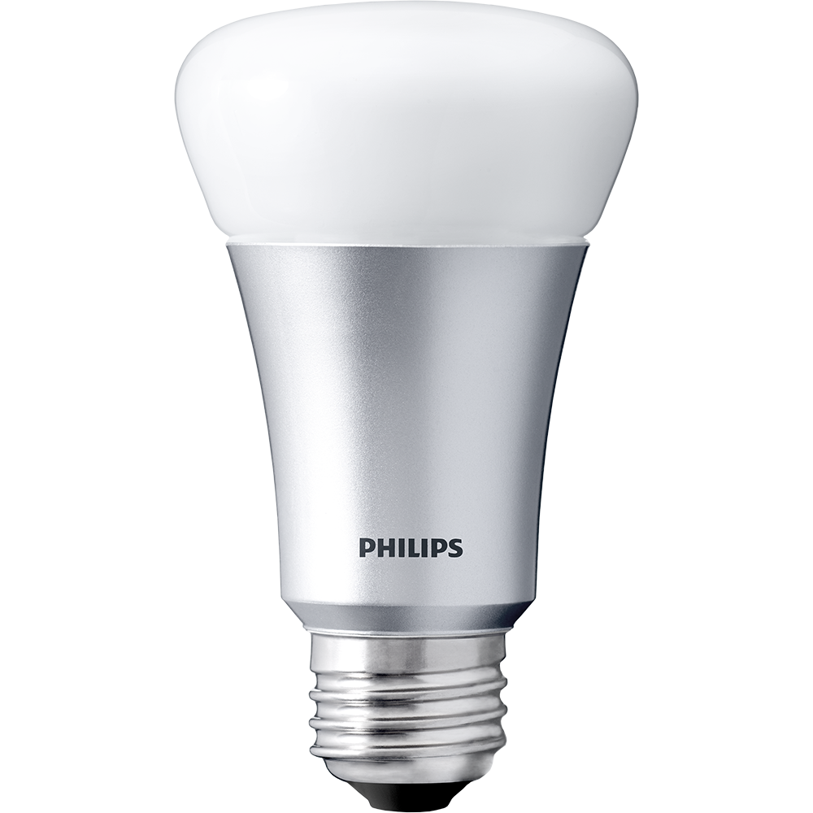
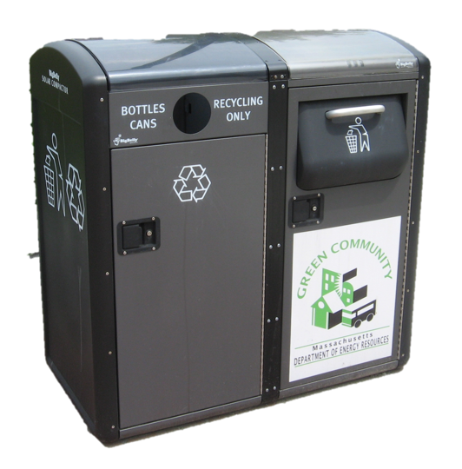


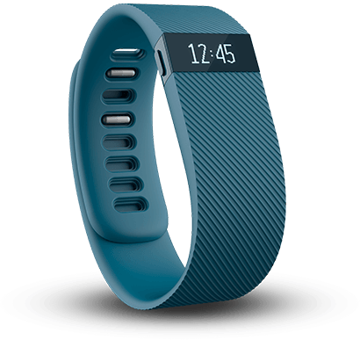
Examples of the IOT

Slide 4
The Grand Vision:
Direct integration between the physical world and the digital world.

Slide 5
“In the next century, planet earth will don an electronic skin. It will use the Internet as a scaffold to support and transmit its sensations.”
--Neil Gross, Bloomberg, 1999

Slide 6
Review of Big Data: The 4 V’s
Review of Big Data: The 5 V’s
VOLUME: Scale of Data
+ VARIETY: Forms and sources of Data
+ VELOCITY: Rate of Data Production
+ VERACITY: Accuracy of Data Collected
VALUE: Applications of Big Data

Slide 7
How the IOT Augments Big Data
IOT + Big Data = New Possibilities
VOLUME: More data available than ever before!
VARIETY: Data from all varieties of physical objects!
VELOCITY: Data can be collected at more frequent intervals!
VERACITY: Data is more specific and accurate to real world!

Slide 8
32 billion
IOT Connected Devices by 2020.
Notes:
Factors:
Low-cost, low-power sensor technology
Widespread wireless connectivity
Huge amounts of available and affordable cloud-based storage and computational power
Plenty of internet addresses to go round (IPv6 = 2^128 addresses)

Slide 9
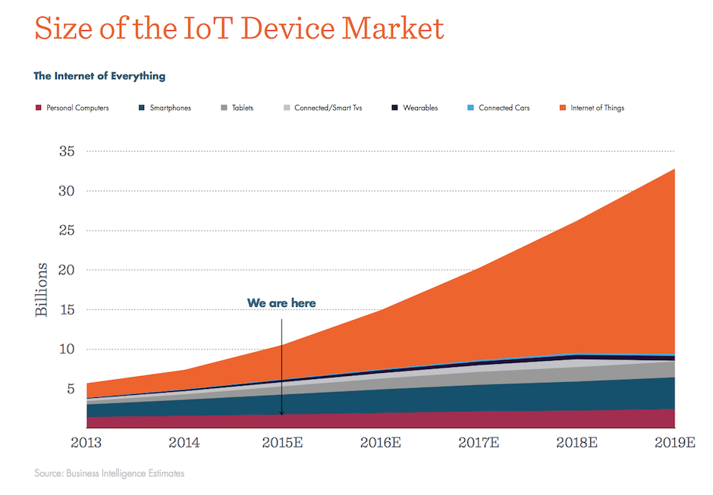

Slide 10
The Smart Grid
Efficiency: Smart grids can predict power consumption patterns and build reserves accordingly
Secure: Ability to detect and signal grid disruptions to other microgrids
Sustainability: Lower footprint and emissions due to more efficient electricity routing
A vision for a more efficient, secure, and sustainable power grid

Slide 11
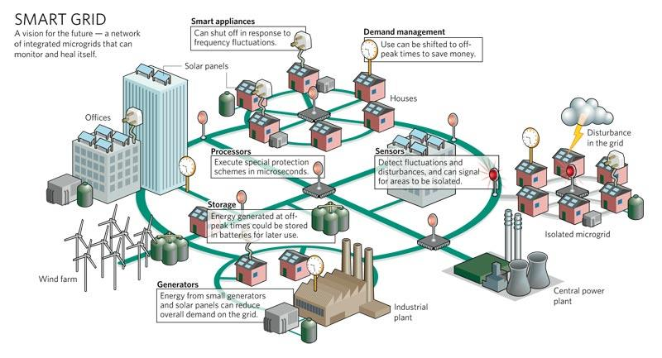

Slide 12
2.03 trillion
Economic Benefit from Smart Grid by 2035

Slide 13
Vehicle to Vehicle Networks
Traffic control: Cars can communicate with each other and road infrastructure to provide efficient traffic
  Traffic signals
  More efficient car spacing
Safety: Cars can sense their surroundings and communicate their intents, preventing accidents.
V2V Networks reimagine traffic control and roadside safety

Slide 14
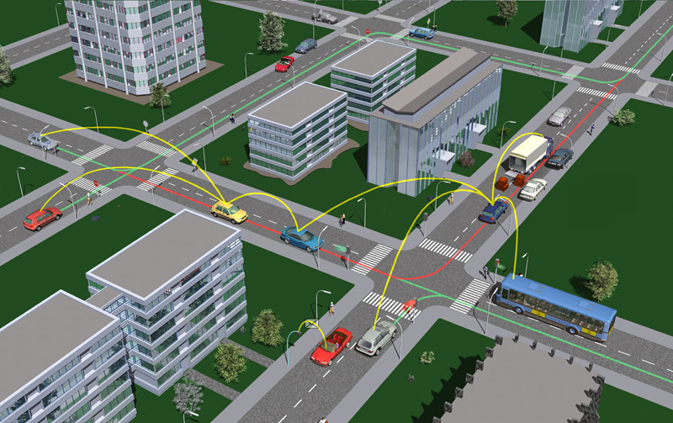

Slide 15
83%
Reduction in Car Accidents

Slide 16
