Slide 1
Mr. Watson and Big Data
Travis Ramirez
11/?/2015

Slide 2
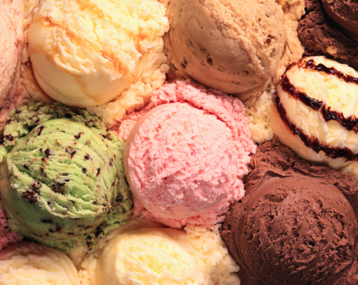
FOOD
Necessity
Unique taste buds
What is a good dish?
Peanut Butter and Jelly Sandwich
Ketchup and Mustard Hotdog
What’s your favorite ice cream flavor?

Slide 3
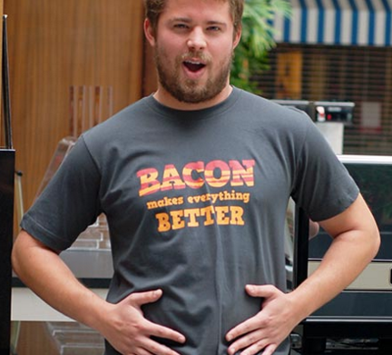
BACON?
Bacon is better
906,539 user ratings
Sandwiches with bacon had largest improvements in ratings
Computer scientist confirmed results and also noted: cream cheese, whipped cream, strawberries, and avocado.
Potential big data in our food?

Slide 4
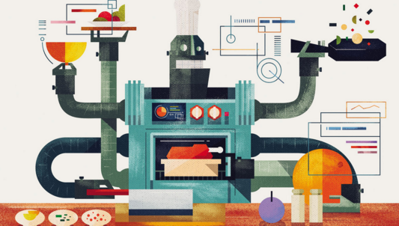
WHO is Mr. Watson?
IBM researchers joined the food industry analytics by creating a computer program that generates original recipes.
“Mr. Watson” is a cognitive technology that processes more like a human than a computer
Watson ingests a huge amount of unstructured data — recipes, books, academic studies, tweets.
New flavors

Slide 5
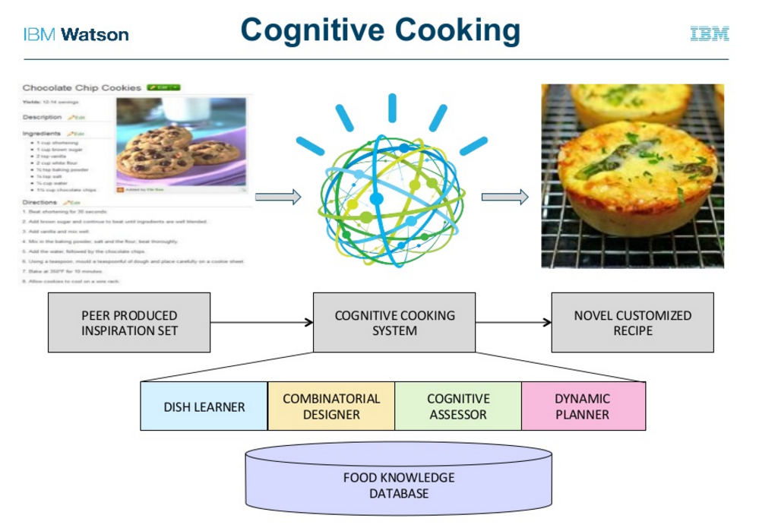
Computer Programming
Program asks for parameters for the type of recipe. (ingredient, dish)
Computer searches through collection of data that includes relationships of ingredients in particular recipes and the chemical compounds present in each ingredient.
Computer starts to generate new ideas based on traditional recipes and the parameters.
The computer selects the big ideas based on novelty and quality.
The recipes are created and presented as a list for the team to go try in the kitchen.

Slide 6
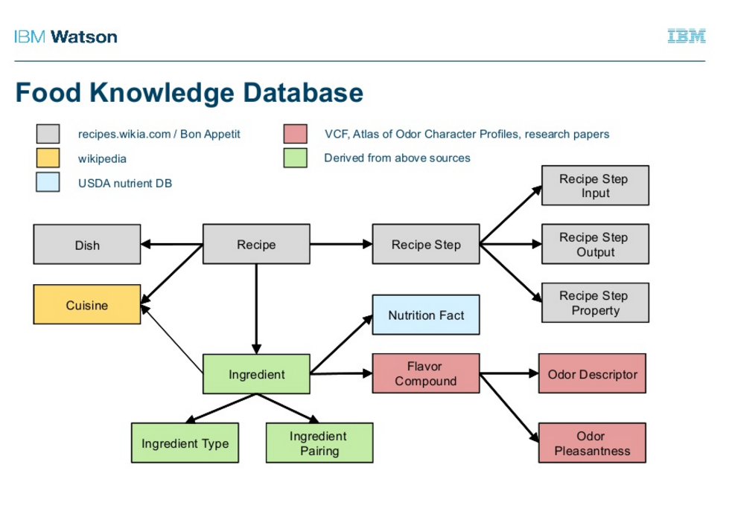
How it works?

Slide 7
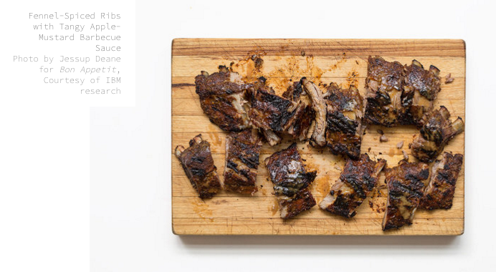
Rating System
Each recipe is rated by three metrics.
“Surprise” measures how rare the flavor combination is.
“Pleasantness,” measures how much people enjoy a flavor on a molecular level
“Synergy or pairing” factors in how well common compounds mix together.
Data is the secret ingredient in the quest to a new recipe.
Brings a new flavor to the market by making the development process more efficient.

Slide 8
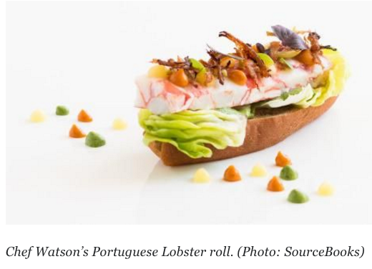
IBM Recipe Examples
Portuguese lobster roll, with appetizing “saffron fluid gel”
Belgian bacon pudding, a desert containing dried porcini mushrooms
Vietnamese apple kebab, with the vaunted mushroom-and-strawberry pairing
Hoof-n-Honey ale, with veal stock
Thai-Jewish chicken, with potato latkes and rice balls
The shrimp cocktail, which is a beverage with actual shrimp in it
Kenyan Brussels spouts, with cardamom

Slide 9
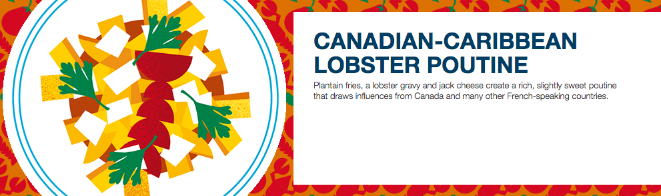
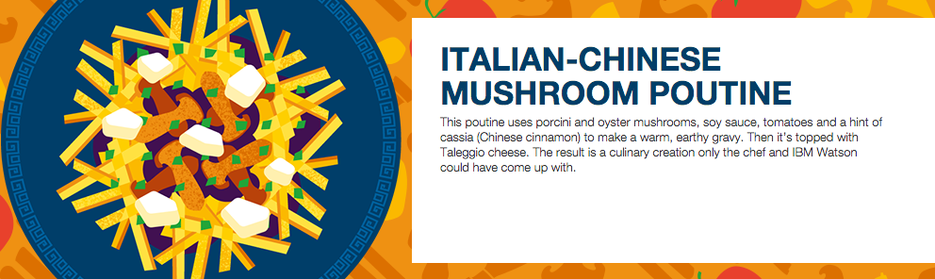
Cross-Cultural Foods

Slide 10
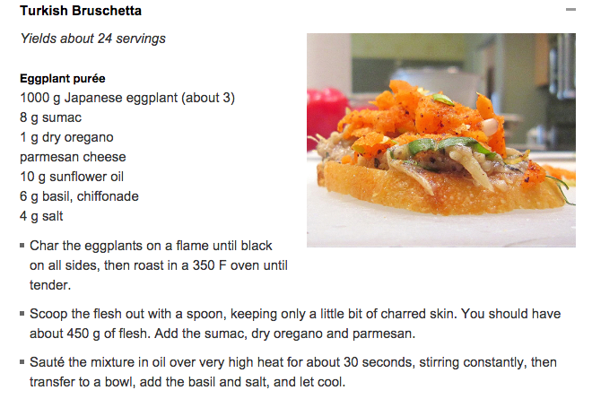
Would YOU EAT…?

Slide 11
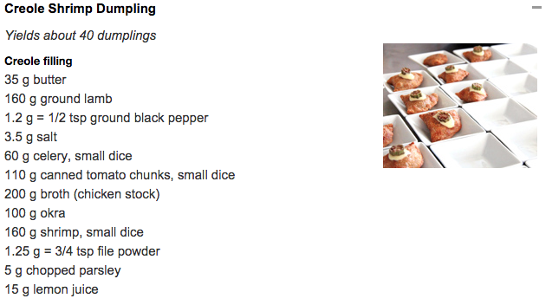
Would you eat…?

Slide 12
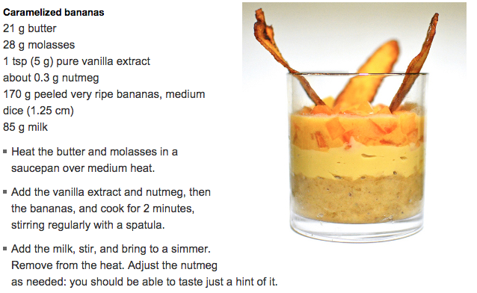
Would you Eat…?

Slide 13
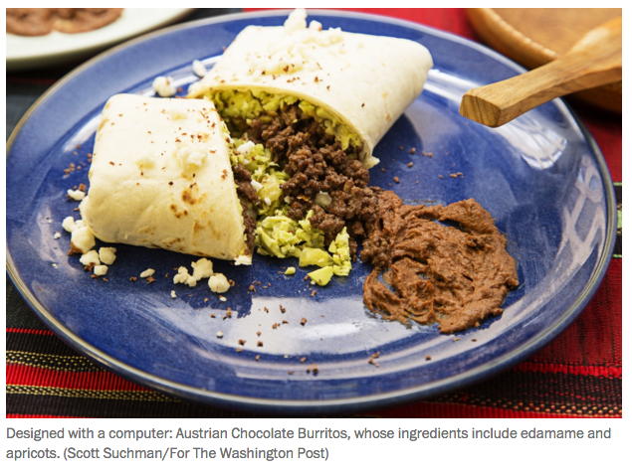
Would you eat…?
Austrian Chocolate Burrito, which has a beef filling flavored with dark chocolate and ground cinnamon, a cocoa-apricot purée, and mashed edamame (100 percent surprise, 75 percent pleasant, and 45 percent synergy).

Slide 14
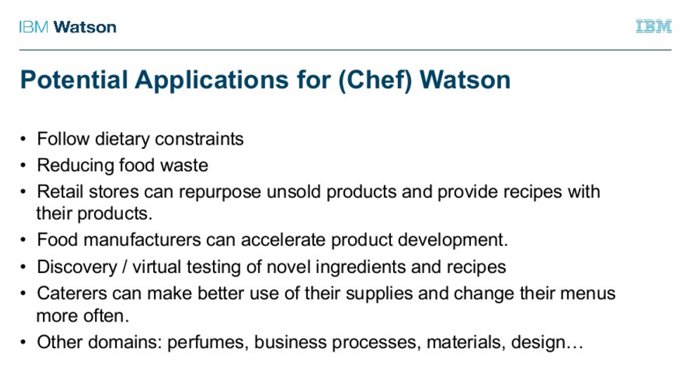
The Future

