Slide 1
Dataset
Includes:
  Sierra Leone
  Guinea
  Liberia
  United Kingdom
  United States
  Italy

Slide 2
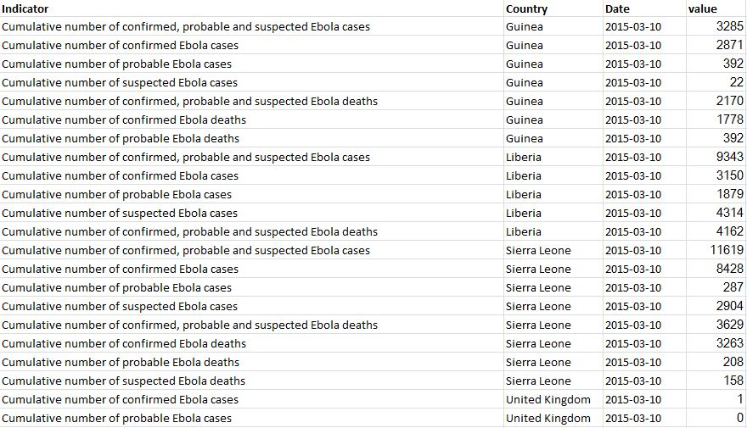
Includes:
  Sierra Leone
  Guinea
  Liberia
  United Kingdom
  United States
  Italy

Slide 3
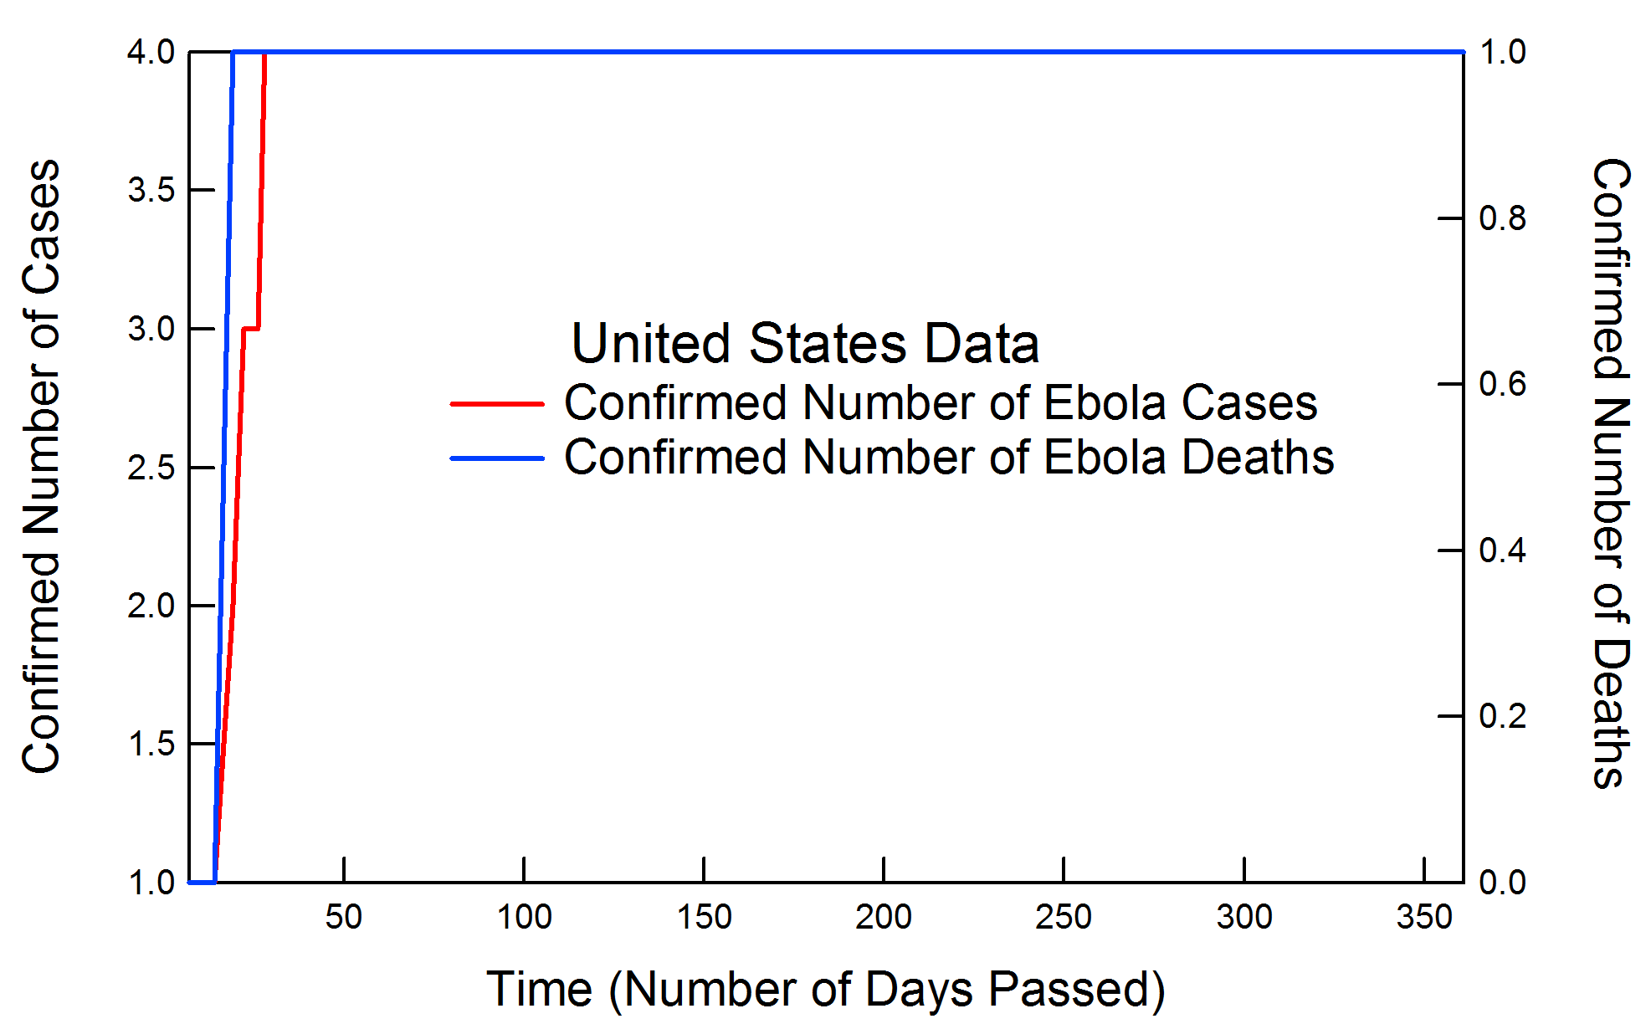
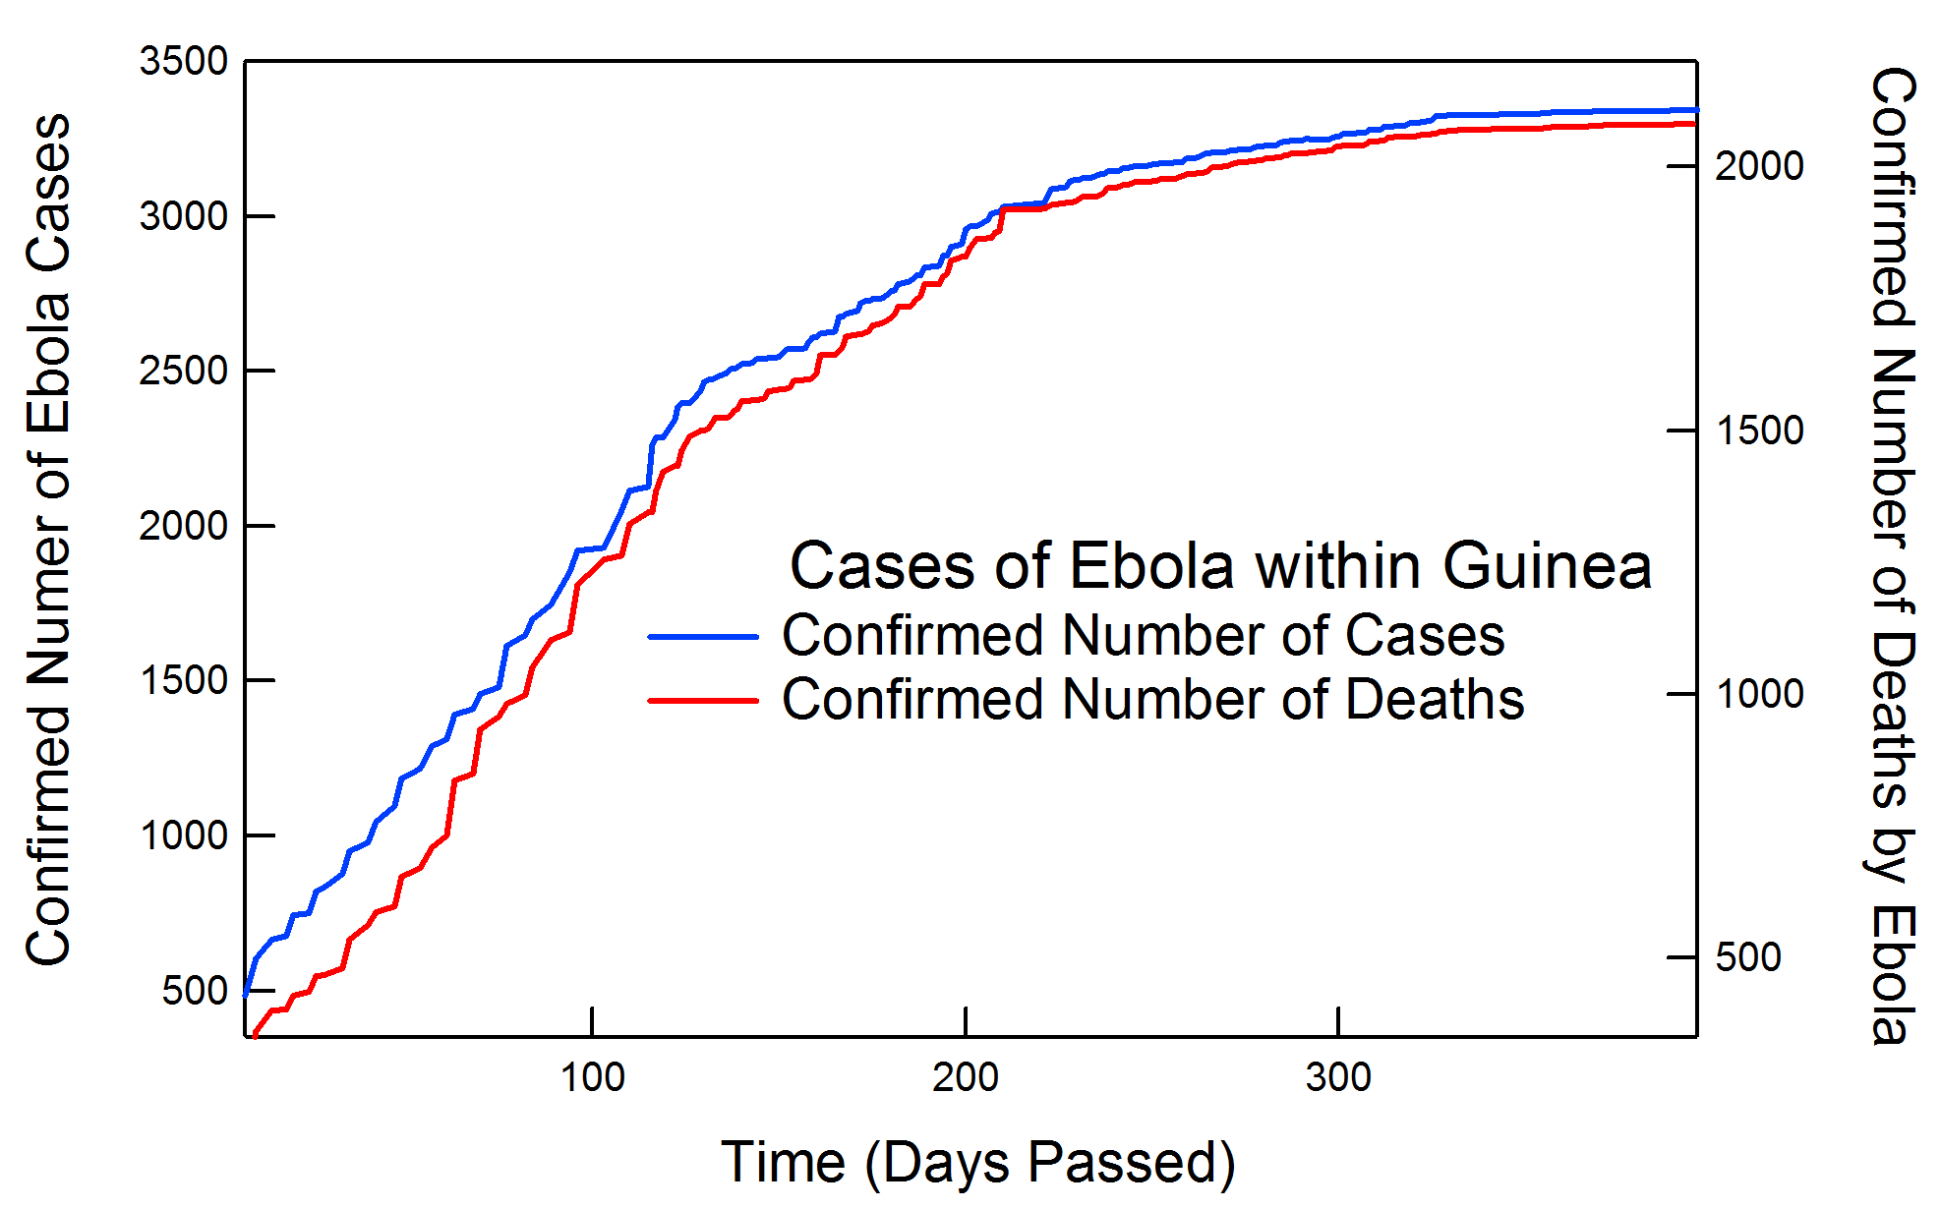

Slide 4
