Slide 1
NFL Predictions
Katherine Sun ☺

Slide 2
Question
Do NFL point spread predictions get more accurate week to week?

Slide 3
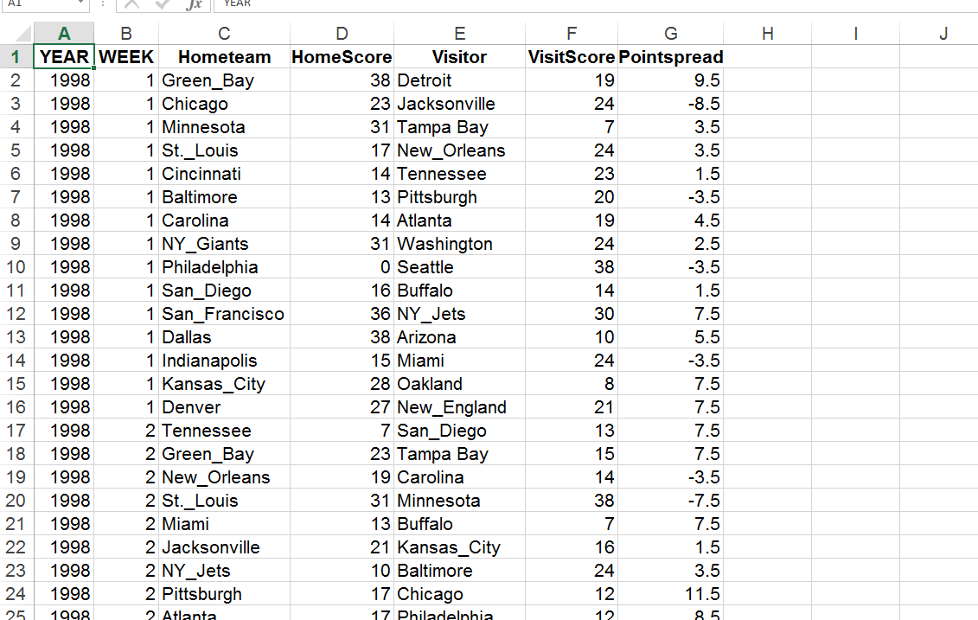
736 Datasets!!!
Much data!
Very Big!

Slide 4
Data Cleanup
Subtract Home by Visitor
Subtract Predicted by Real
Set those all to absolute
Aggregate by week
Find average of each week

Slide 5
The Result?

Slide 6
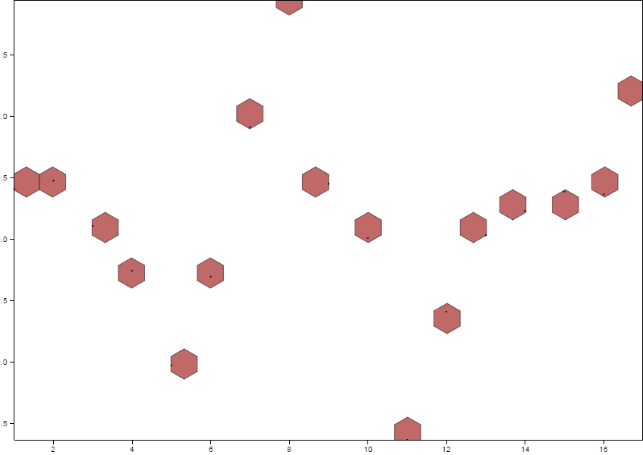
Wow! Look at
that variation!

Slide 7
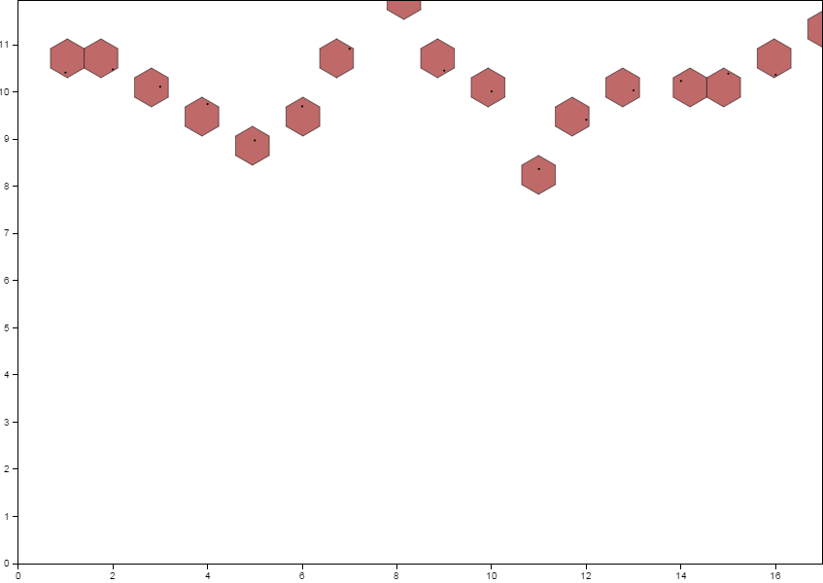
Lol jk not really

Slide 8
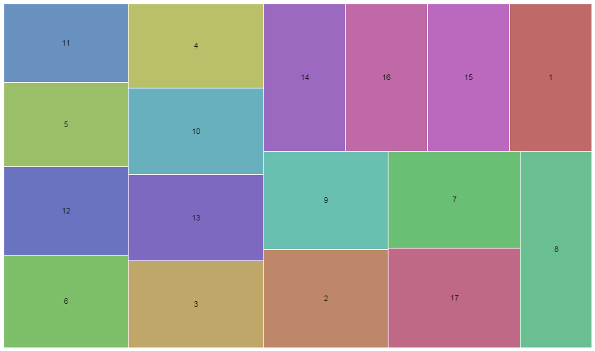


Slide 9
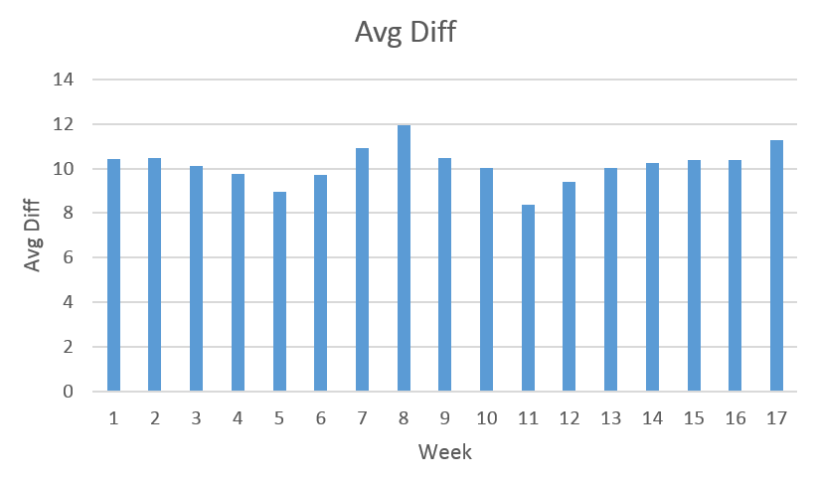

Slide 10
Week | Avg Diff
1 | 10.41111
2 | 10.47778
3 | 10.10976
4 | 9.743902
5 | 8.973684
6 | 9.695122
7 | 10.91463
8 | 11.95
9 | 10.45238
10 | 10.01111
11 | 8.366667
12 | 9.411111
13 | 10.03333
14 | 10.23333
15 | 10.38889
16 | 10.36667
17 | 11.27778

