Slide 1

Michael Araya, Ravina Jain, Elizabeth Overton, Michael Tucker

Slide 2
Need for Dry Bike Seats At Stanford
8,180 acres of land
Over 18,000 bike racks
Average of 16.18 inches of rain per year
Majority of Rain: November-March
<http://transportation.stanford.edu/alt_transportation/BikingAtStanford.shtml>.
<http://facts.stanford.edu/about/lands>

Slide 3
Prevalence of Wet Bikes Worldwide
China
  Population: 1,342,700,000 people
  Biking population: >500,000,000
Japan
  Population: 127,370,000 people
  Biking population: 72,540,000
https://www.spokefly.com/blog/top-10-countries-bicycles-per-capita/

Slide 4
Current Solutions
Paper Towels
  Time Consuming (Forget to grab. Run back to room)
  Wasteful (3 billion lbs used annually. 45 lbs/person)
Plastic Bags
  No convenient place to put after use
  Also wasteful
https://theenergy.coop/community/blog/banish-paper-towel

Slide 5
Design Constraints
For our design our solution should:
  Keep the rider’s butt dry
  Be activated in under 20 seconds
  Not be wasteful
  Not be a hassle/inconvenience
  Cost less than $10

Slide 6
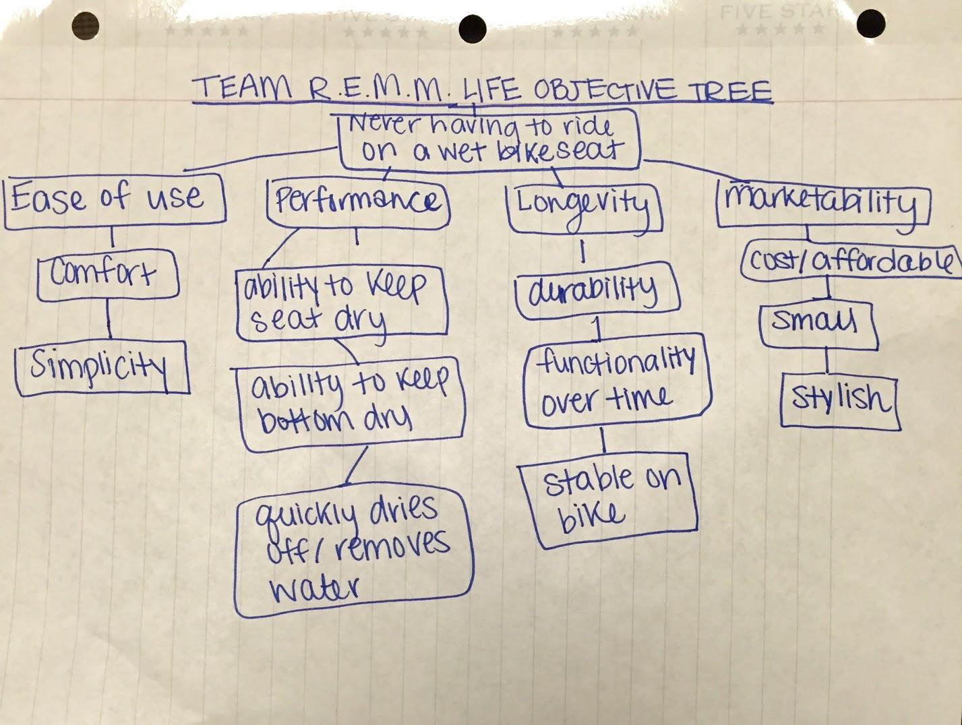
Objective Tree

Slide 7
Design Alternatives Considered
Super-hydrophobic spray
Removable bike seat that is carried with the user
Weather-notification Application
Flip-over bike seat

Slide 8
Superhydrophobic Spray
Spray that repels water
Delicate
Flaw:
  Becomes inactive after experiencing substantial amount of friction/abrasion
Doesn’t work for a product with a one-time installation because friction from bike riders is enough to disrupt water-phobic properties of spray
http://neicorporation.com/products/coatings/superhydrophobic-coating/

Slide 9
Removeable Bike Seat
User can carry and velcro to his/her backpack
Flaw:
  Require a totally new bike seat to be created to allow the bike seat to be disconnected from bike
This idea would cause hassle to the user requiring individual to remember the bike seat

Slide 10
Weather Notification App
Weather application that notifies the user when they need to cover their bike seat
Black body effect
Larger hassle and unreliable

Slide 11
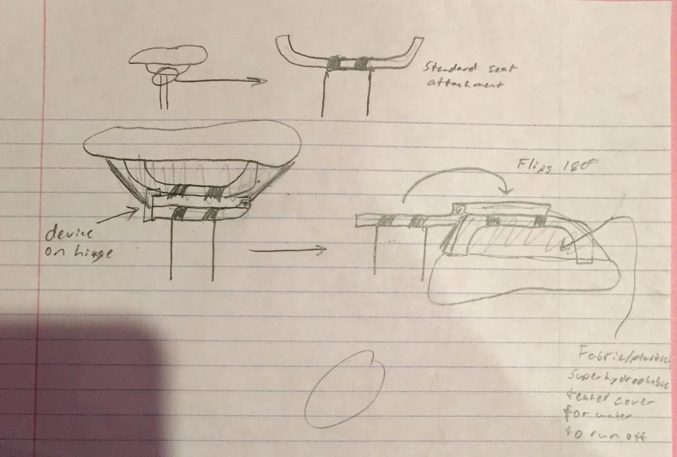
Flip Over Bike Seat
Hinge that connects
the seat post and the
bike seat
Flips open to the side
with the press of a button
Flaw: After testing, we determined that the flipped over bike seat didn’t keep the bike seat completely dry

Slide 12
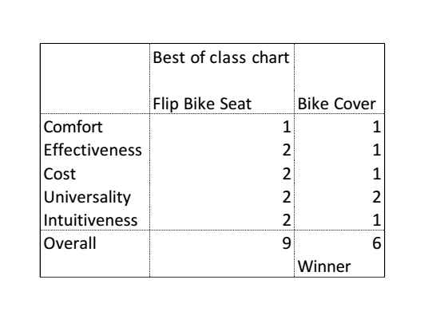
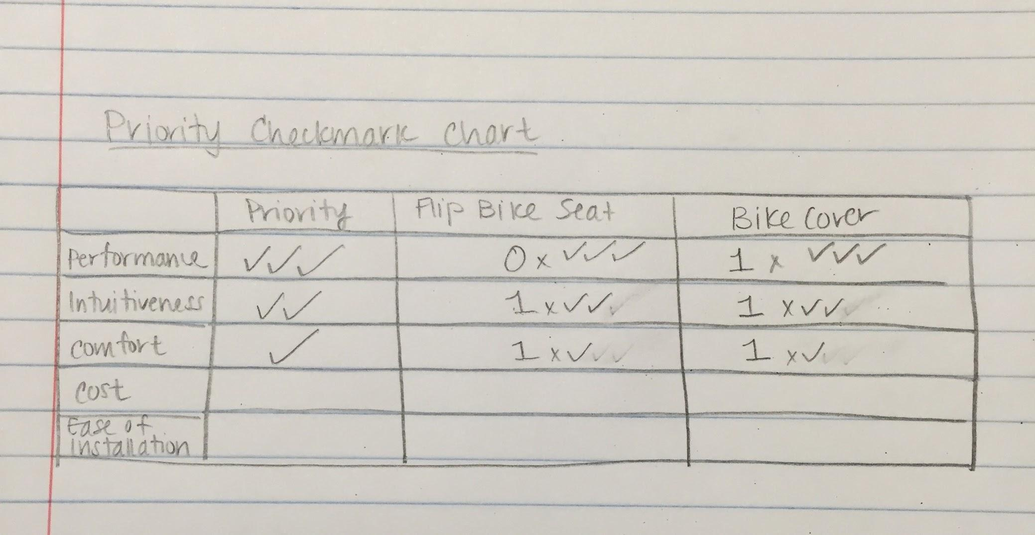
Basis for Design Selection
Simplicity, intuitiveness, and cost

Slide 13
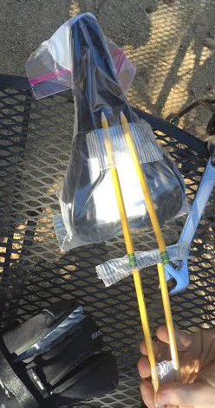
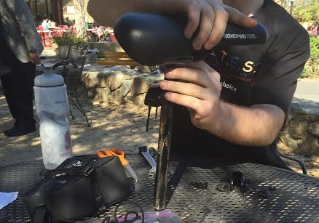
Results of Alternative Analysis
We simulated rain via pouring water on the seat
Water collected on bottom of flip-over seat.
Complicated set-up
Difficult to build.
May compromise
rider safety

Slide 14
Final Design
Retractable bike seat cover:
  Will pull out of an apparatus connected under the bike seat
  Will hook on the front of the bike seat
  After done using, the cover will unhook and retract into apparatus using tape measure-like mechanism

Slide 15
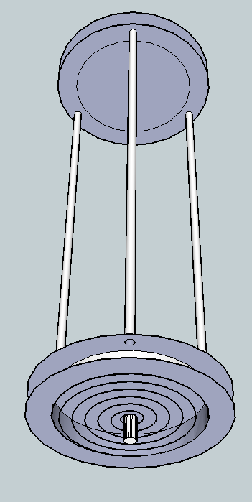
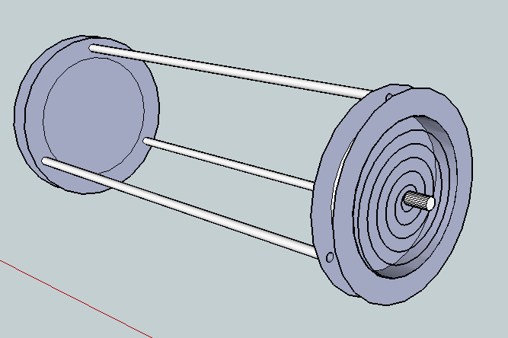
Model of Recoil Mechanism

Slide 16
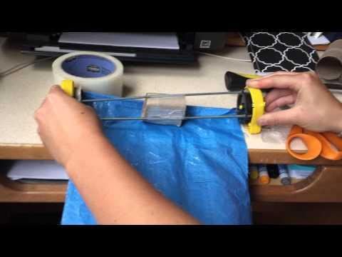
Mechanism Testing

Slide 17
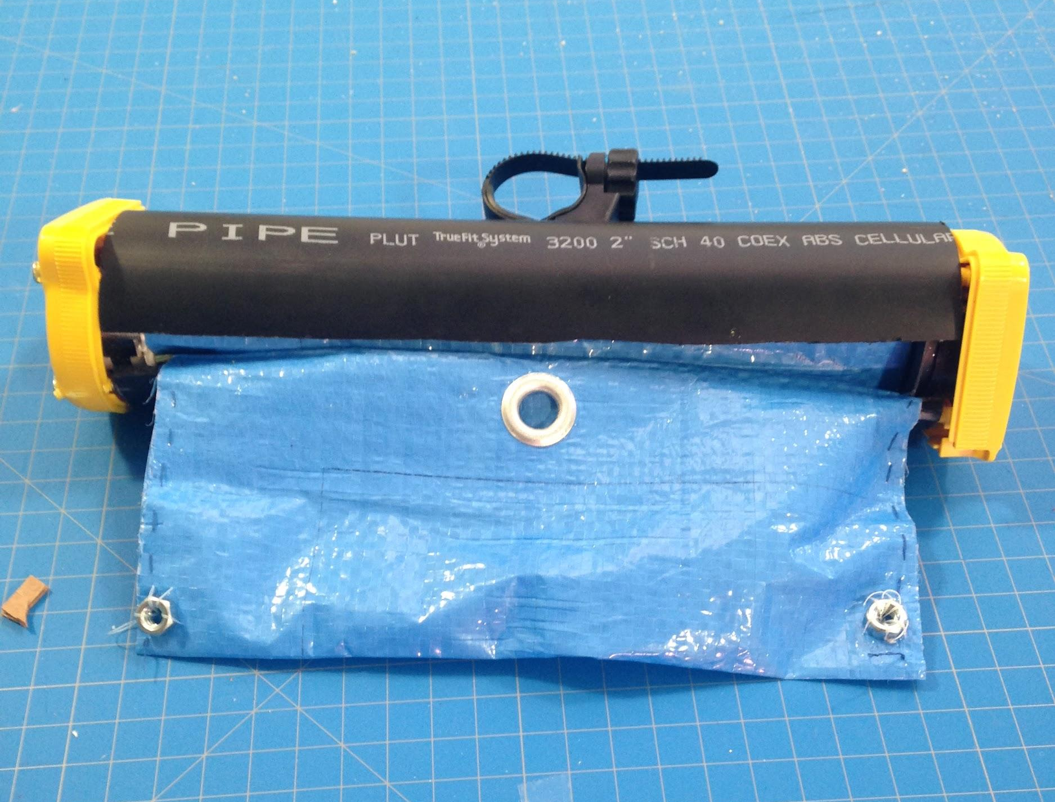
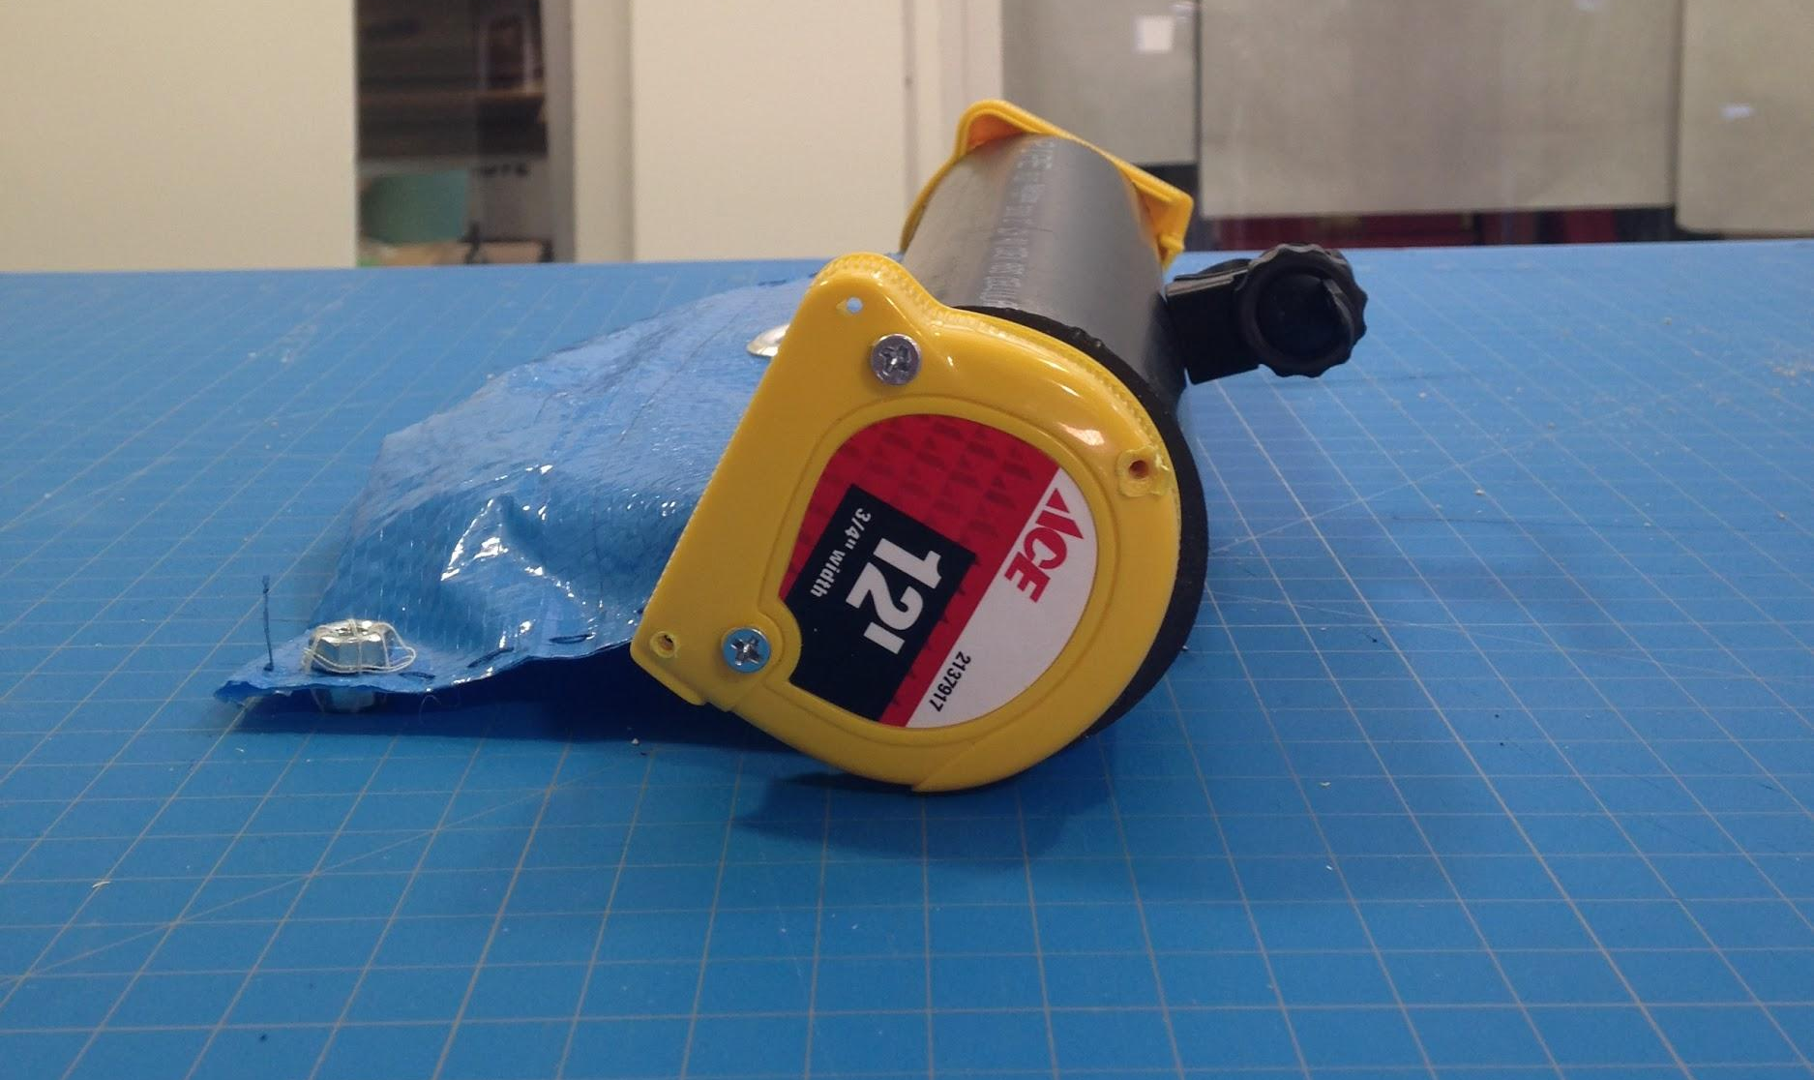
Final Prototype

Slide 18
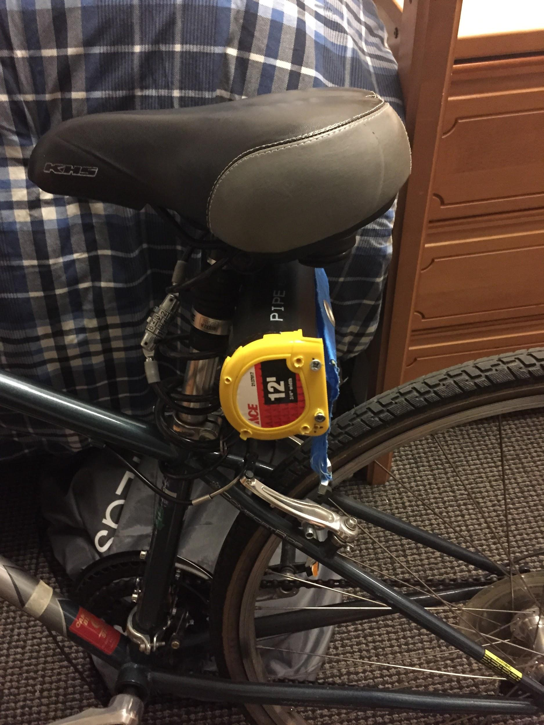
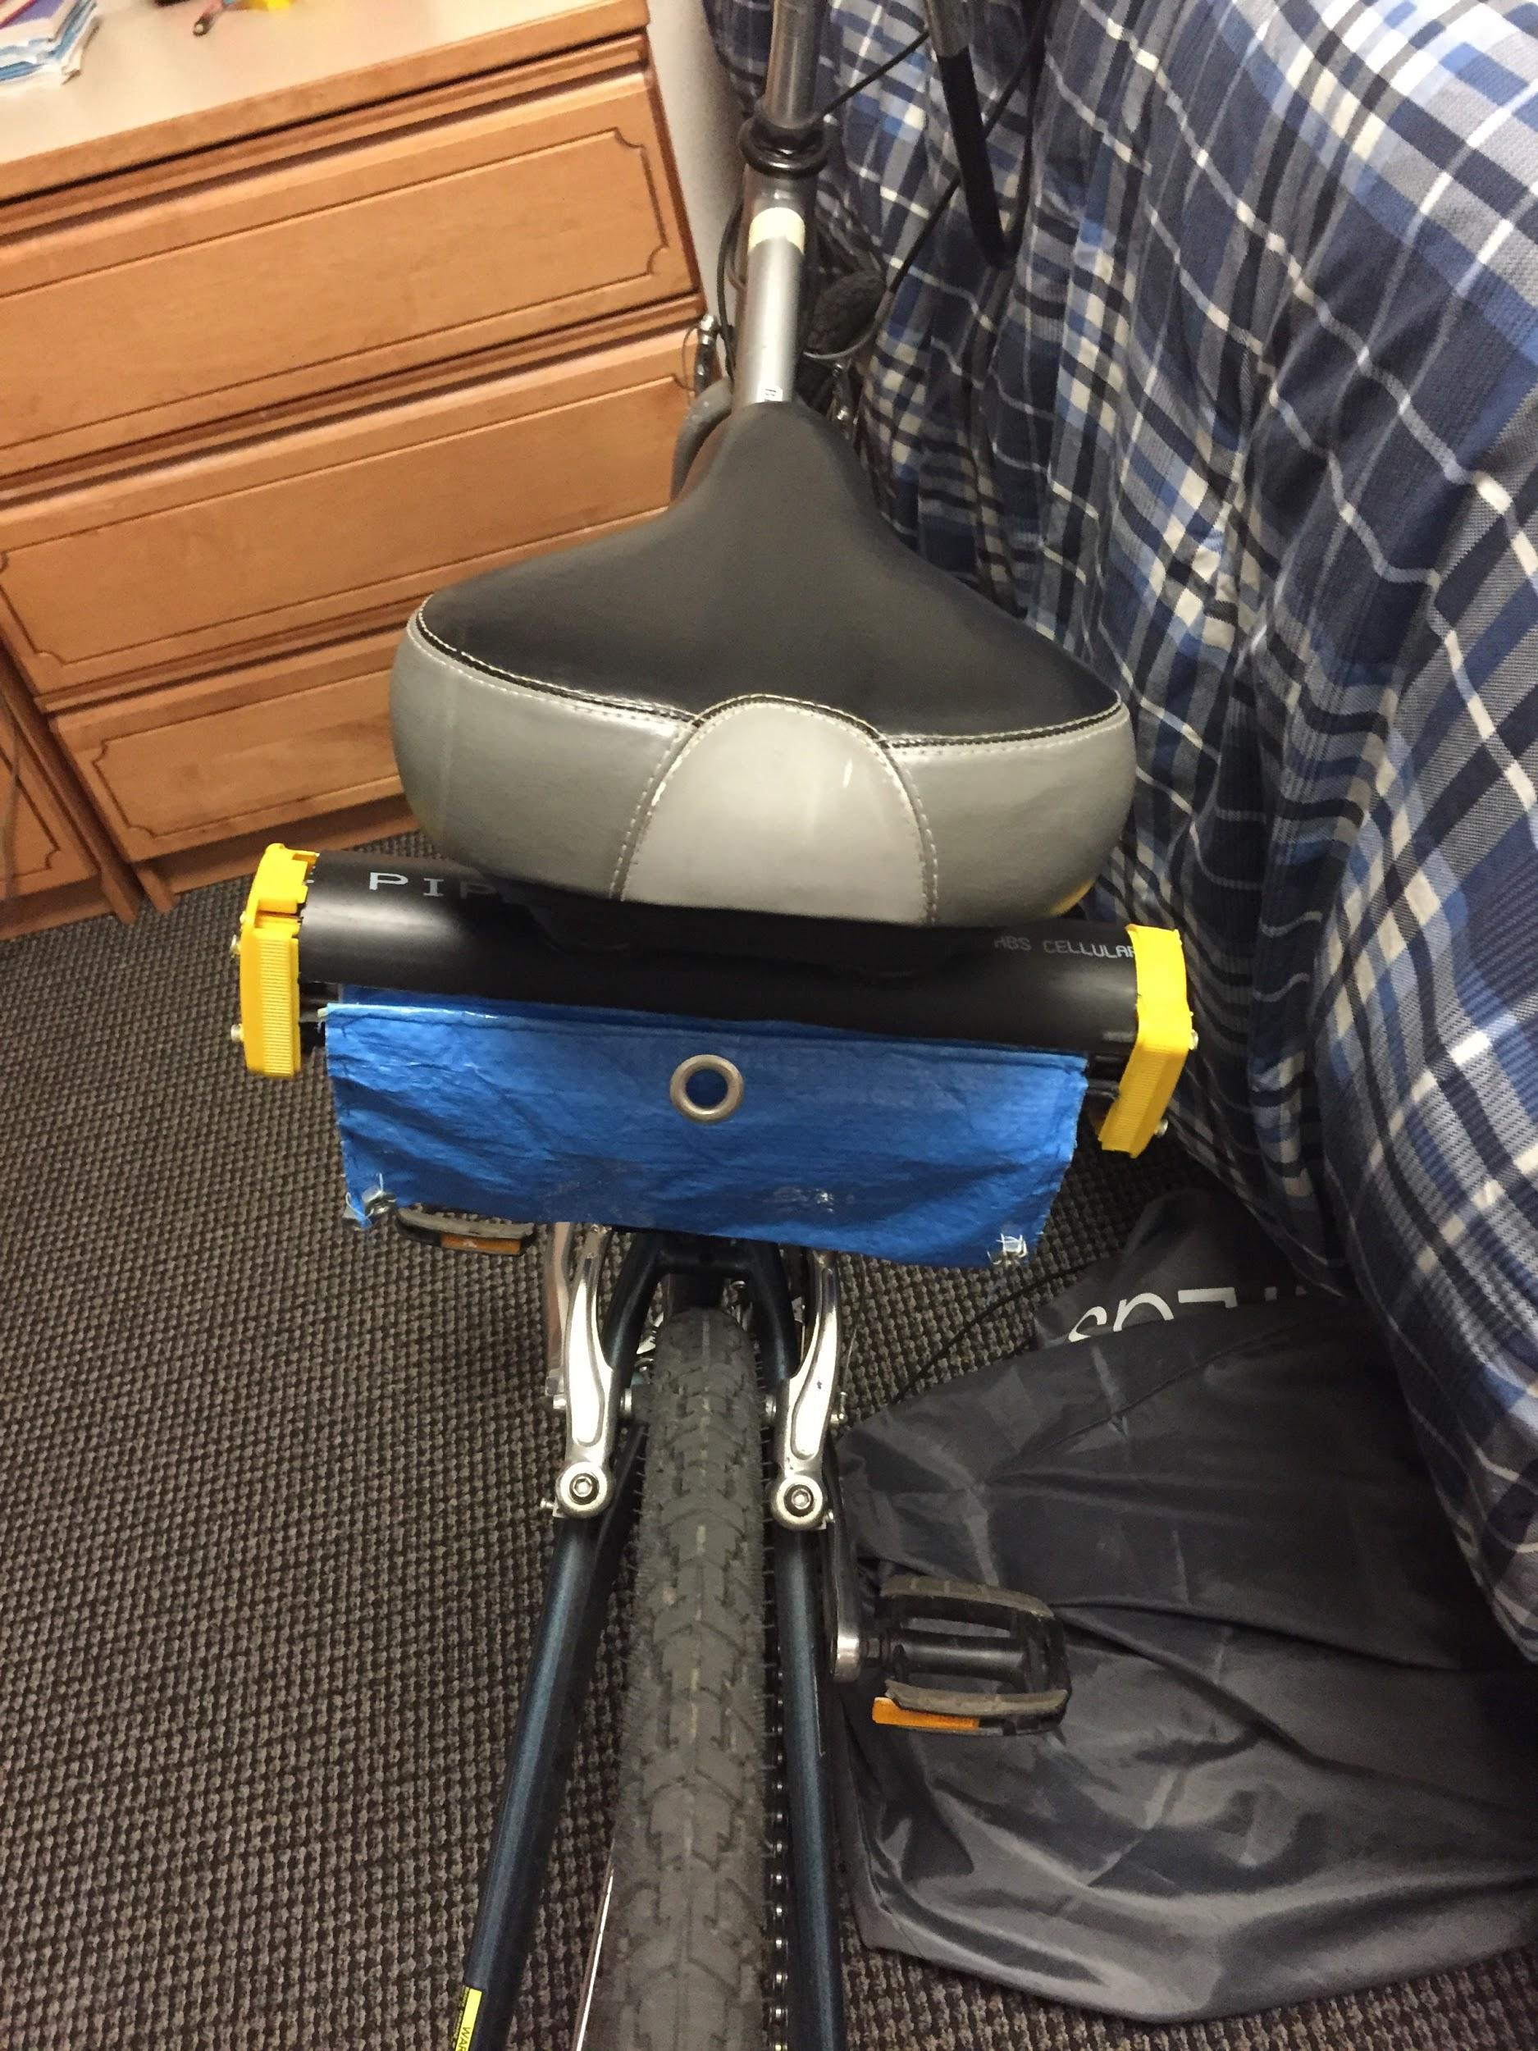
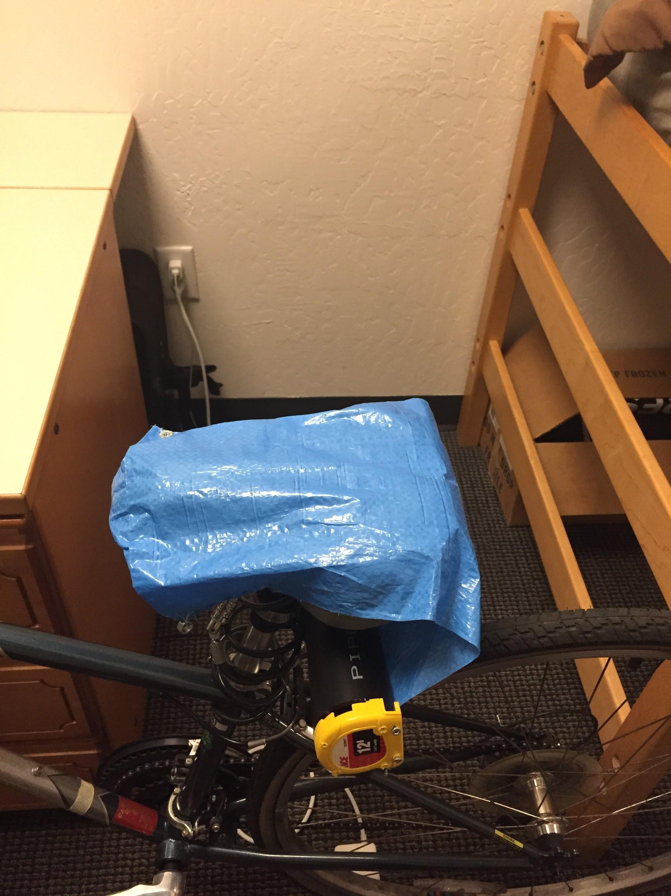
Final Prototype

Slide 19
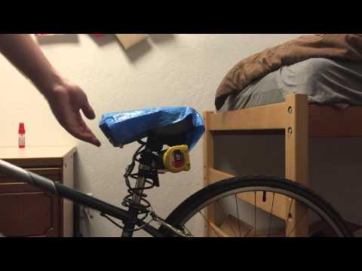
Prototype in Action

Slide 20
Final Materials
Materials
  Tarp
  2” PVC Pipe
  2 tape measures
  3 threaded metal dowels
  Wooden dowels
  Bike light connector
  5 screws
  4 nuts

Slide 21
Cost Analysis
Tape Measure: $4.49 x 2
Tarp: $5
Rods: $2
PVC Pipe: $3
---------------------------------------------
Total: $18.98

Slide 22
Failures
PVC Pipe Slit
Tape Measure holes
Properly aligning mechanism to minimize friction

Slide 23
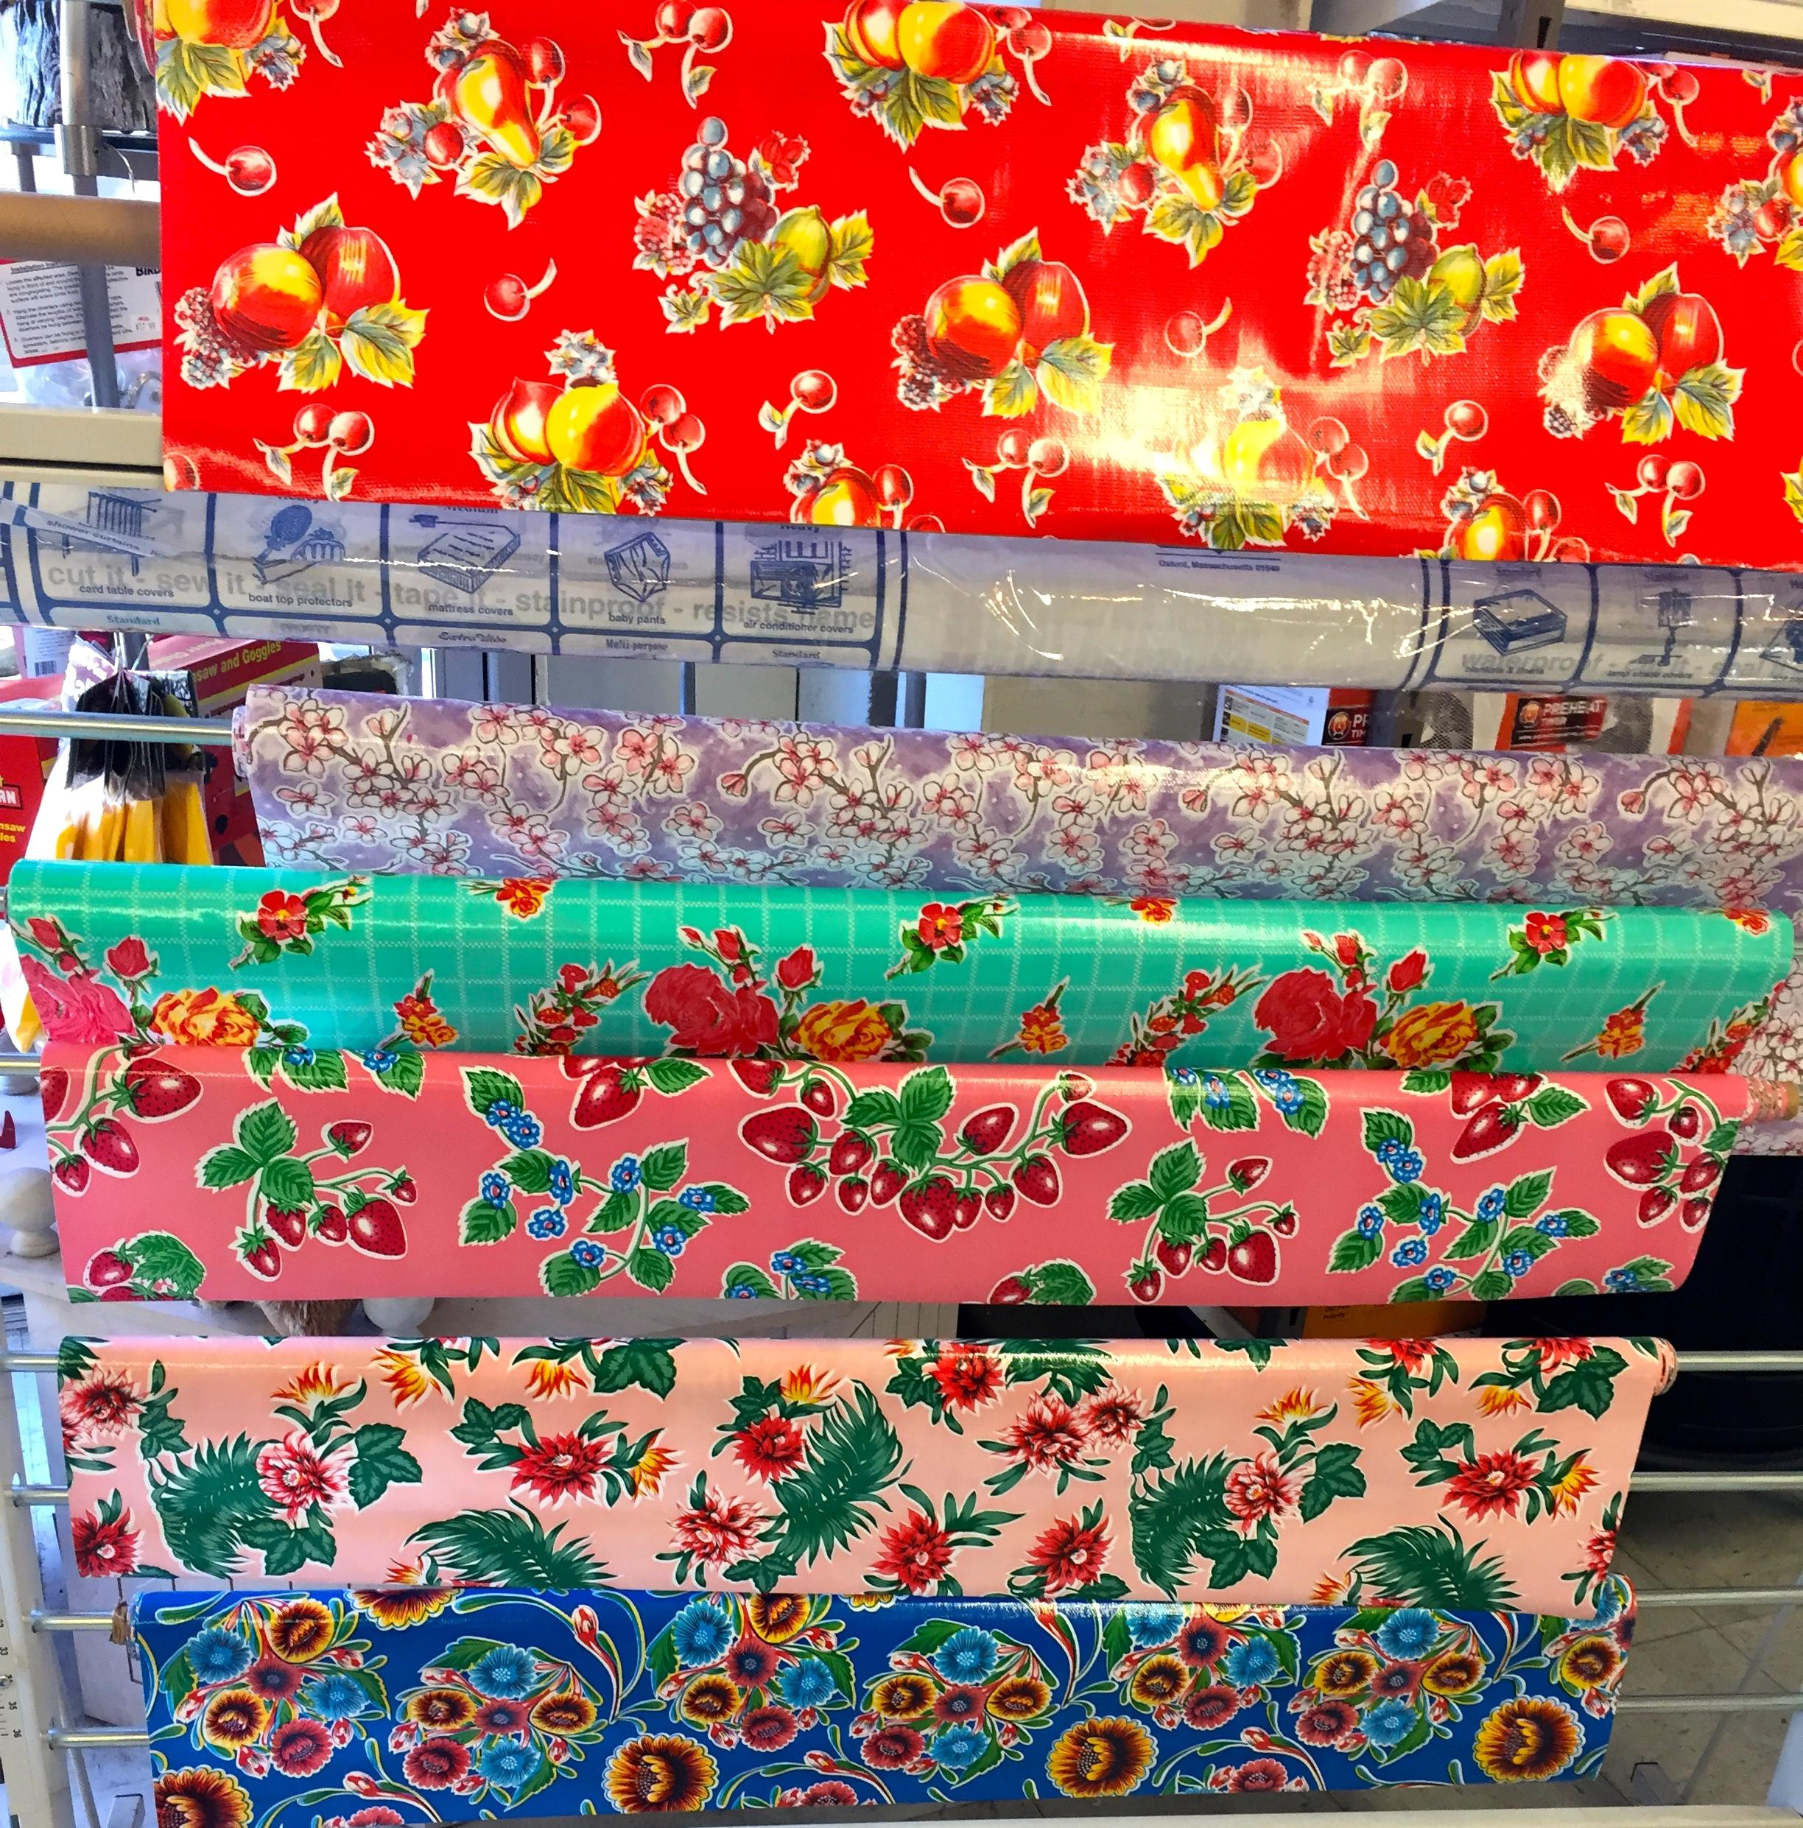
Future Implementation
Mass manufactured for $10
Target: professors, commuters, and
anyone who uses their bike for
transportation
Personalization: drawer-liners

Slide 24
Future Design Research
Solution to wet bike handles
Continually perfect bike seat design
  Reduce size
  Initiated by button press
  Rain detection

Slide 25
Works Cited
Becky. "Banish the Paper Towel." Banish the Paper Towel. The Energy Co-op, 15 Nov. 2014. Web. 17 Mar. 2015. <https://theenergy.coop/community/blog/banish-paper-towel>.
"Bicycling at Stanford." Bicycling at Stanford. Stanford University, 2009. Web. 17 Mar. 2015. <http://transportation.stanford.edu/alt_transportation/BikingAtStanford.shtml>.
"College Hopes and Worries." The Princeton Review. Web. 12 Mar. 2015. <http://www.princetonreview.com/college-hopes-worries-press-release.aspx>.
“Plastics Pipes, Fittings and Valves for the Transport of Fluids.” ISO. 15 March 2015
<http://www.iso.org/iso/iso_technical_committee.html?commid=52500>.
“Precipitation Map of Japan.” World Trade Press. 15 March 2015. Web.
<http://www.bestcountryreports.com/Precipitation_Map_Japan.php>.
"Superhydrophobic Coatings." NEI Corporation. Web. <http://neicorporation.com/products/coatings/superhydrophobic-coating/>.
"Temperature - Precipitation - Sunshine - Snowfall." Climate Palo Alto. US Climate Data, 2015. Web. 17 Mar. 2015. <http://www.usclimatedata.com/climate/palo-alto/california/united-states/usca0830>.
“Top 10 Countries with Most Bicycles per Capita.” Spokefly. 15 March 2015. Web.
<https://www.spokefly.com/blog/top-10-countries-bicycles-per-capita/>.

Slide 26
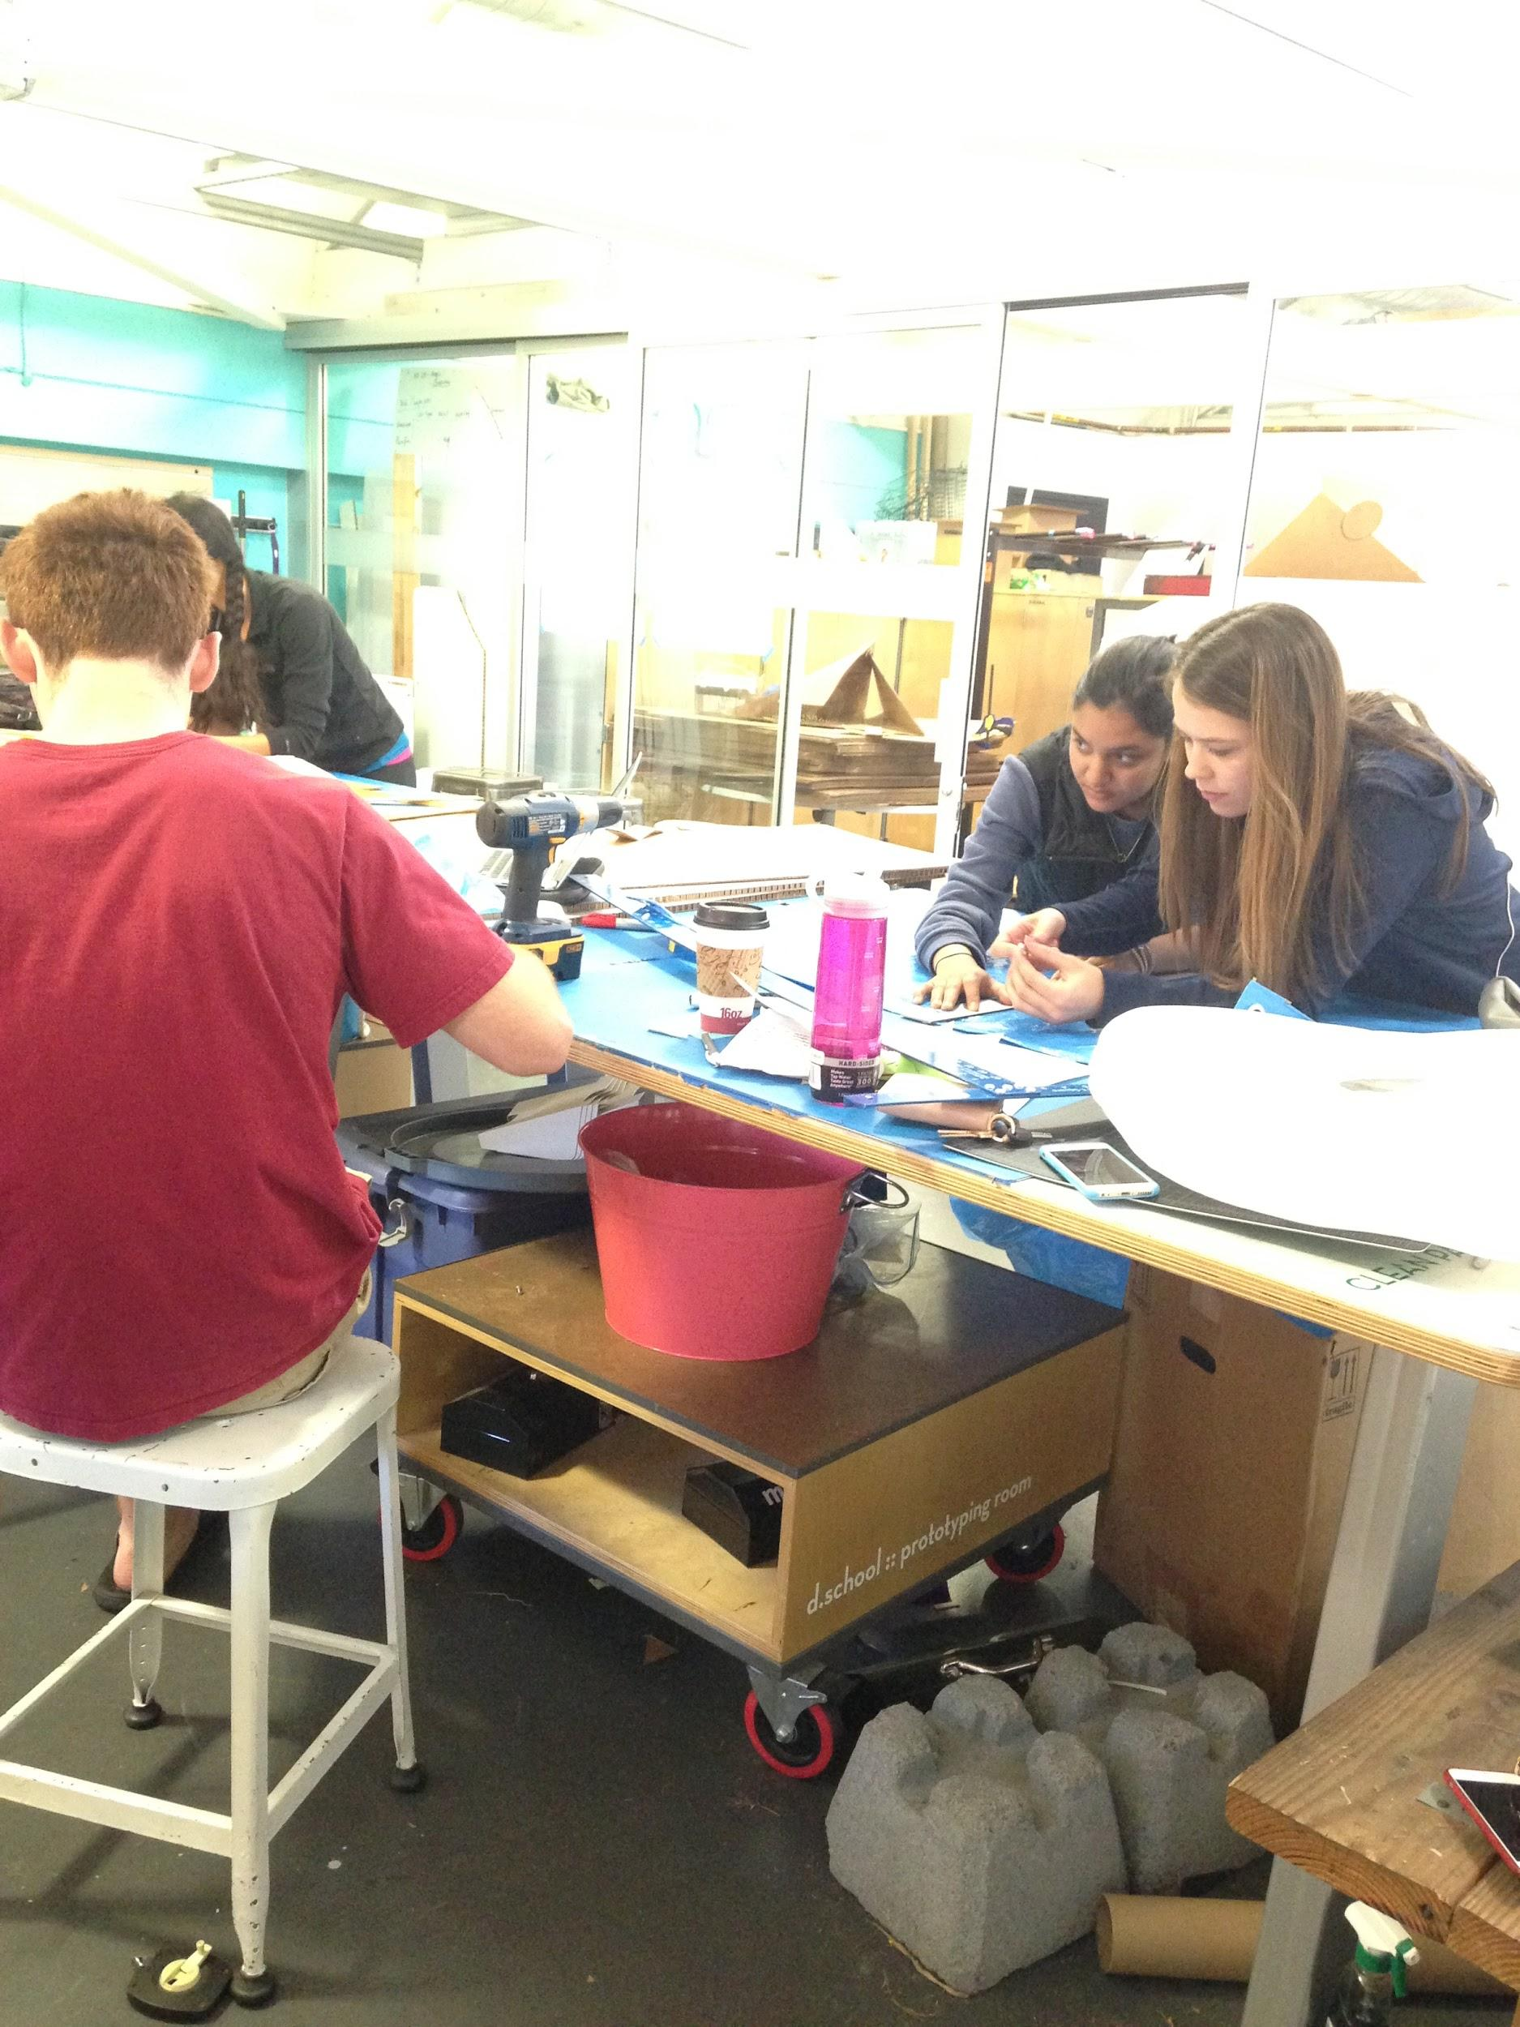
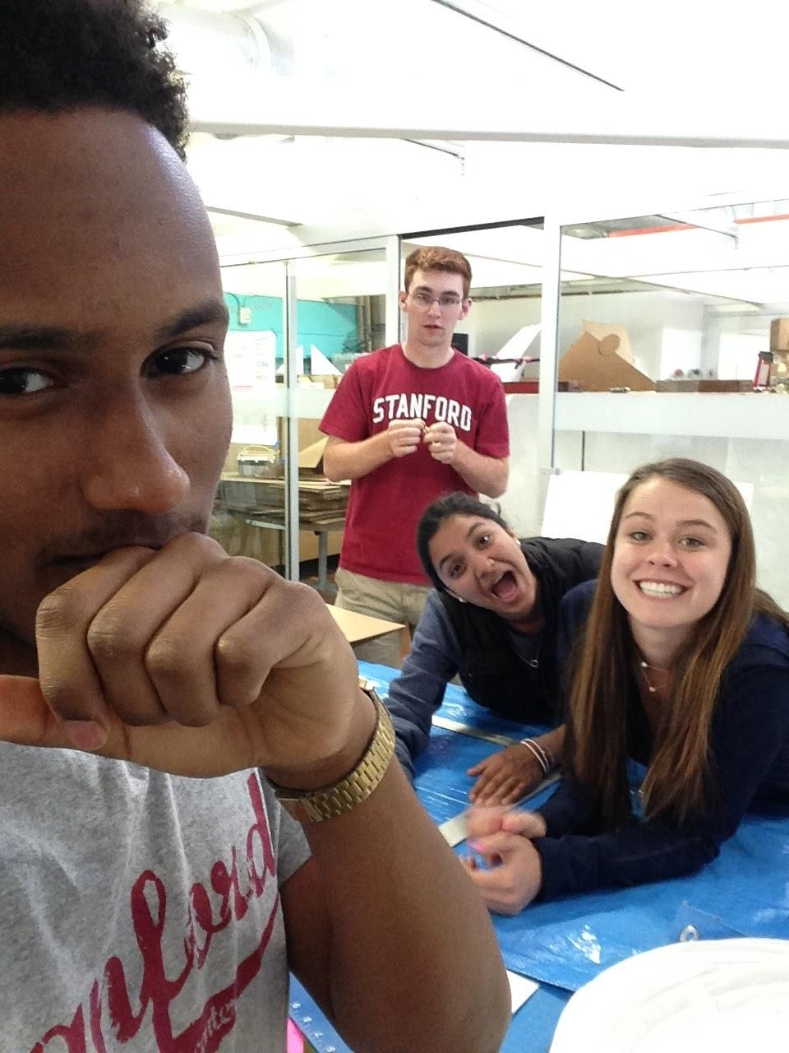
R.E.M.M. Life

