Slide 1
Torch
The Future of Portable Charge
By Andy Feis, Sam Schwager and Cameron Van de Graaf
Notes:
Cam

Slide 2

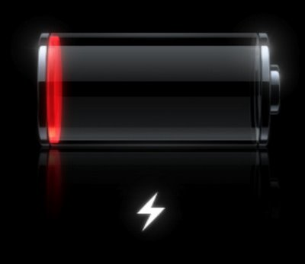
The Problem
Always on the move
Running out/low on battery
Emergency Situations
Pocket Size → Finite Space
Notes:
Andy

Slide 3
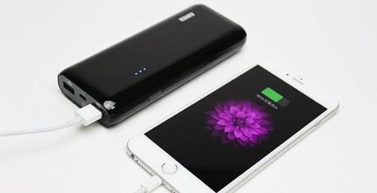
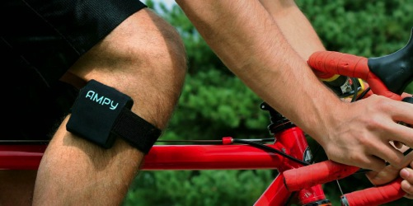
Possible Solutions
Astro E4
Charged by USB Port
Piezoelectric Technology
Why These Fail?
Notes:
Andy

Slide 4

Notes:
Sam

Slide 5
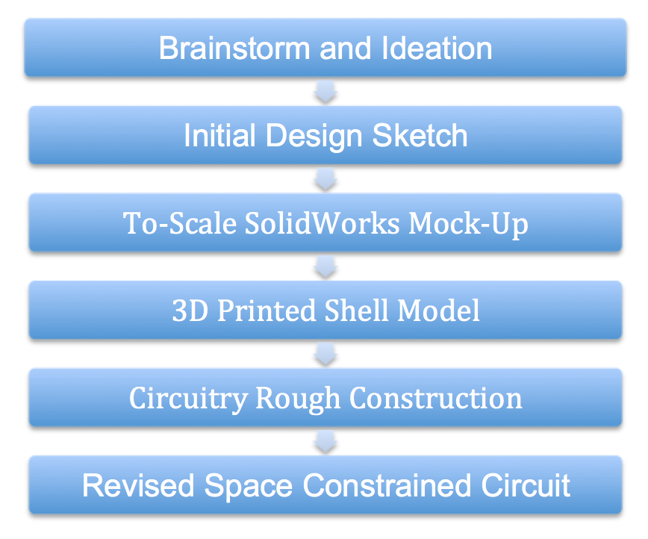
Design Process
Notes:
Sam

Slide 6
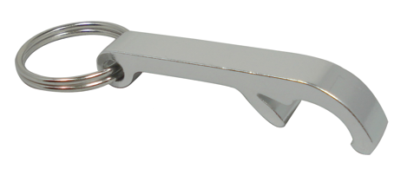
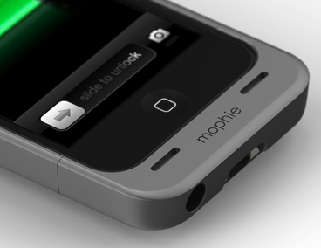
Introducing Torch
Keychain Accessory
Wireless
Multi-Functional
Portability
Usability while Charging
Notes:
Cam

Slide 7
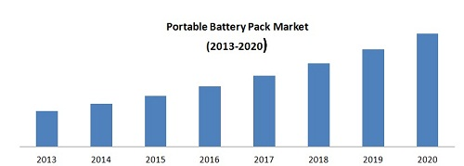
Is there a market?
$10.94 Billion portable battery market
Asia, North America, Europe
BYD Battery Co., Energizer Holding etc.
iPhone 47.4% US Market Share
Notes:
Cam

Slide 8
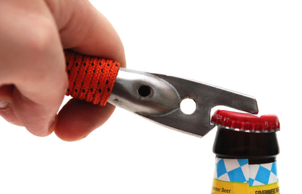
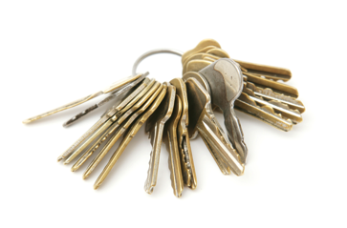
Who is our market?
19 Million College Students
1 Million Greek Life
The Pocket Issue
  Keys
  Cards
  Other Accessories
Notes:
Sam

Slide 9
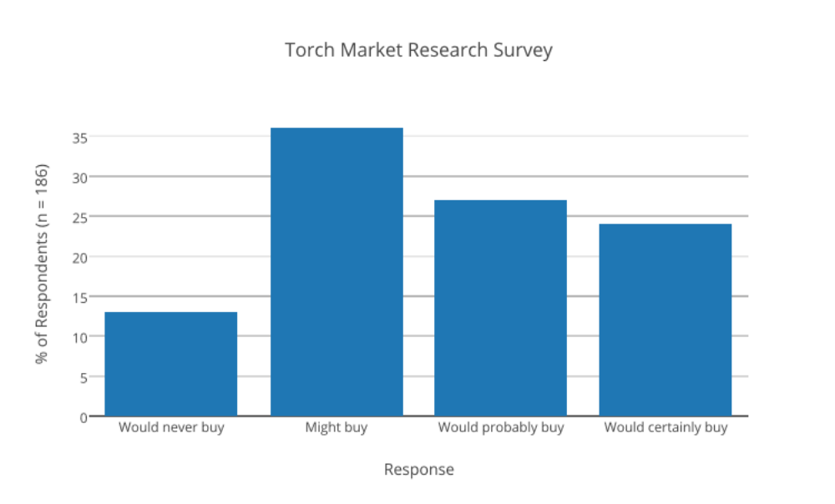
Market Research Survey
Results from Mobile-Social Polling Application – Survey Size 186
Notes:
Cam

Slide 10

Why Torch?
Succulent Margins???
Notes:
Sam

Slide 11


But Really…
Solving a Need
Safety
Convenience
Elegant Design
Notes:
Sam

Slide 12
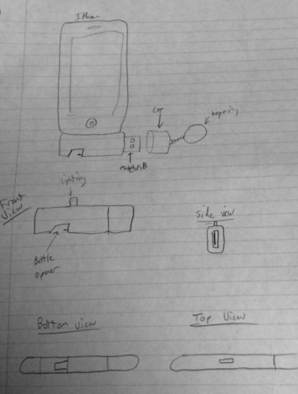
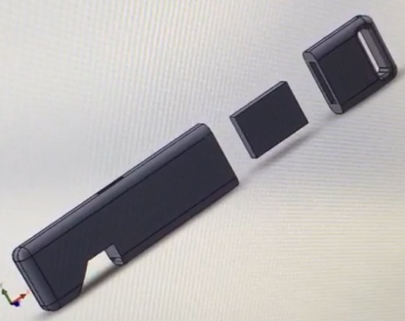
Prototype #1 – The “Shell”
Notes:
Andy

Slide 13
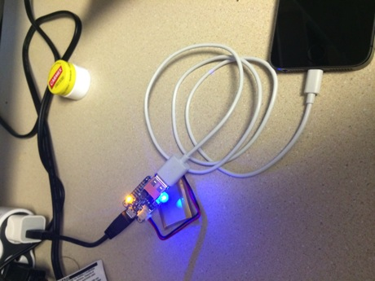
Prototype #1 – The Electronics
Computer or other Charging Source
Male-USB
Circuit
Battery
Circuit
Lightning Port
iPhone
Notes:
Andy

Slide 14
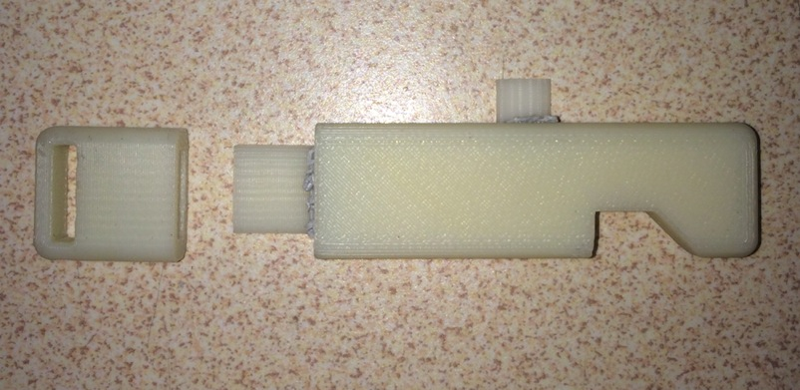
Prototype #1 Realization
Notes:
Andy

Slide 15
Cost Estimates: Version 1
Circuitry - $7.00
Battery - $11.00
Stainless steel shell - $1.50
Lightning port male part - $1.00 (Licensed from Apple)
USB male part - $1.00
Total Cost - $21.50
Notes:
Sam

Slide 16
Version #2
Increased Size of Shell
Decreased Electrical Components
Cut Costs
V2 Cost Estimate:
  Circuitry - $3.50
  Battery - $4.50
  Stainless steel - $0.50
  Lightning port male part - $0.75
  USB male part - $0.75
  Total Cost - $10.00
Notes:
Sam

Slide 17

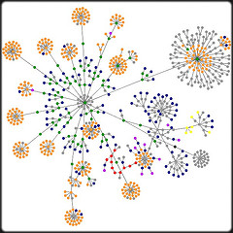
Business Model
Augmenting the College Lifestyle
Nodal Expansion
Greek Life
Building on Proven Success
  Case-Study Model…
Notes:
Sam

Slide 18



Case Studies – Capturing the College Market
Southern Tide
Yik-Yak
Raging Mammoth
Notes:
Cam

Slide 19
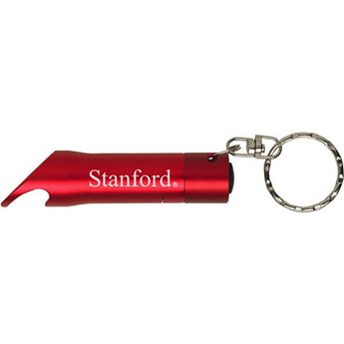
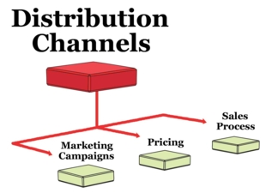
Colleges/Licensing
Partnering with Bookstores
College Licensing Fees
  $4,500 - $21,200/10 Schools
Customization of Greek Letters
Distribution Channels
Notes:
Andy

Slide 20
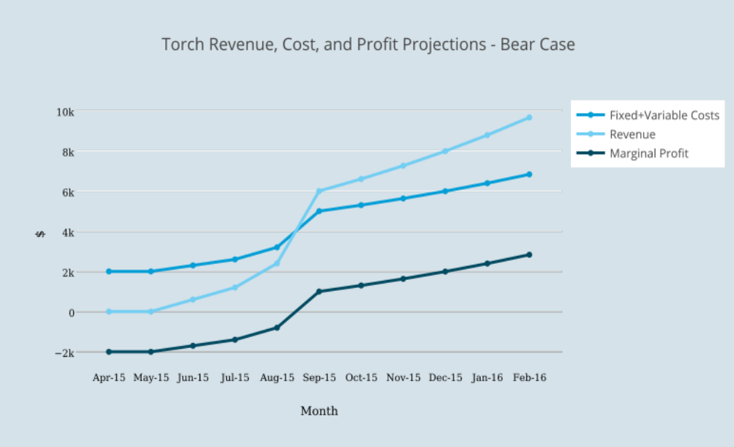
Torch Financials – Bear Case
Notes:
Cam

Slide 21
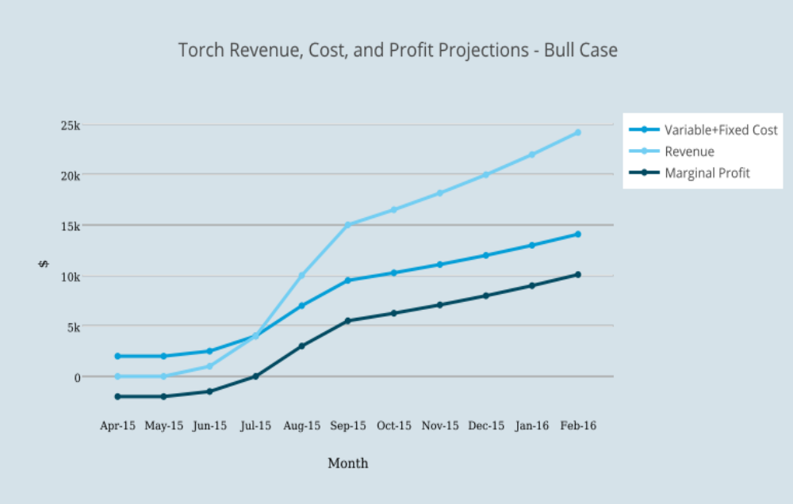
Torch Financials – Bull Case
Notes:
Cam

Slide 22




Passing the Torch – The Future
Notes:
Andy

Slide 23

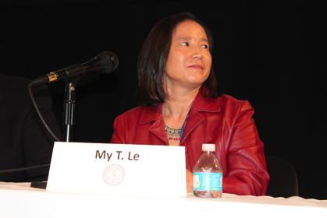
Thank You!
Teachers: Andrea Goldsmith and My Le
Project Adviser: Mark Leather
Notes:
Sam

