Slide 1

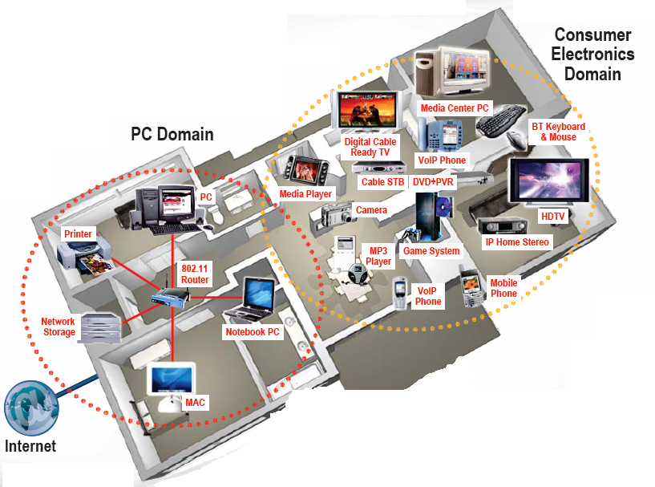




EE 359: Wireless Communications
Announcements and Course Summary

Slide 2
Announcements
  Last HW and bonus HW questions due Sunday 12/10 at 4 pm (no late HWs).
  Final projects must be posted 12/9 (Sat) at midnight.
  25 bonus points for course evaluations (online)
  Final 12/13/2017, 12:15-3:15pm in Thornton 102 (here)
    Covers Chapters 9, 10, 12, 13.1-13.2, 13.4, 14.1-14.4, 15.1-15.4 (+ earlier chps)
  Similar format to MT, but longer: open book, notes.
  If you need a book or calculator, let us know by 12/8 (Fri)
  Practice finals posted (10 bonus points). Turn in for solns, by exam for bonus pts
    Final review and discussion section: Monday, 12/11, 2-4pm, Packard 364.

Slide 3
OHs leading up to final exam
Mine
  This week: today after class, Fri 12-1pm & by appt.
  Next week: Sun 12/10: 5-6pm, Tue 12/11 10:30-12 & by appt.
TAs:
  Thursday, 12/7, 5-6pm Milind OH
  Thursday, 12/7, 6-7pm Milind Email OH
  Saturday, 12/9, 2-4pm Tom OH (HW8 + Exam questions)
  Monday, 12/11, 2-4pm Final review
  Monday, 12/11, 4-6pm Tom OH
  Tuesday, 12/12 2-4pm Milind OH
  Wednesday, 12/13, 9:30am-11:30am, Tom OH

Slide 4
Course Summary
Signal Propagation and Channel Models
Modulation and Performance Metrics
Impact of Channel on Performance
Fundamental Capacity Limits
Flat Fading Mitigation: Diversity and Adaptive Modulation
ISI Mitigation
  Equalization (not covered)
  Multicarrier Modulation/OFDM
  Spread Spectrum
Multiuser Systems
  Multiple access: time/frequency/code/space division
  Random access
Cellular Systems
  Multiuser Detection
  Area Spectral Efficiency

Slide 5


Future Wireless Networks
Ubiquitous Communication Among People and Devices
Wireless Internet access
Nth generation Cellular
Wireless Ad Hoc Networks
Sensor Networks
Wireless Entertainment
Smart Homes/Spaces
Automated Highways
All this and more…
Hard Delay/Energy Constraints
Hard Rate Requirements

Slide 6
Design Challenges
Wireless channels are a difficult and capacity-limited broadcast communications medium
Traffic patterns, user locations, and network conditions are constantly changing
Applications are heterogeneous with hard constraints that must be met by the network
Energy, delay, and rate constraints change design principles across all layers of the protocol stack

Slide 7

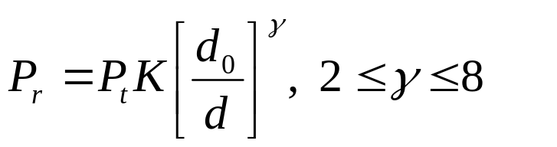
Signal Propagation
Path Loss
  Free space, 2-path, general ray tracing, mmwave
  Simplified model
Shadowing
  dB value is Gaussian
  Find path loss exponent and shadow STD by curve fitting
Multipath
  Ray tracing
  Statistical model
d
P_{r}/P_{t}
d=vt

Slide 8

Outage Probability and Cell Coverage Area
Path loss: circular cells
Path loss+shadowing: amoeba cells
  Tradeoff between coverage and interference
Outage probability
  Probability received power below given minimum
Cell coverage area
  % of cell locations at desired power
  Increases as shadowing variance decreases
  Large % indicates interference to other cells

Slide 9

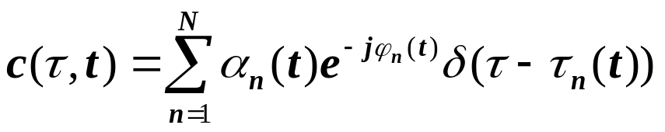
Statistical Multipath Model
Random # of multipath components, each with varying amplitude, phase, doppler, and delay
Leads to time-varying channel impulse response
Narrowband channel
  No signal distortion, just a complex amplitude gain
  Signal amplitude varies randomly (Rayleigh, Ricean, Nakagami).
  2nd order statistics (Bessel function), Average fade duration

Slide 10




Wideband Channels
Individual multipath components resolvable
True when time difference between components exceeds signal bandwidth
Scattering function
  Yields delay spread/coherence BW (σ_{τ}~1/B_{c})
  Yields Doppler spread/coherence time (B_{d}~1/T_{c})
τ
A_{c}(f)
Wideband
0
f
Bc
ρ
Doppler Power Spectrum
s(τ,ρ)=F_{Δt}[A_{c}(τ,Δt)]
τ
Delay Power Spectrum

Slide 11
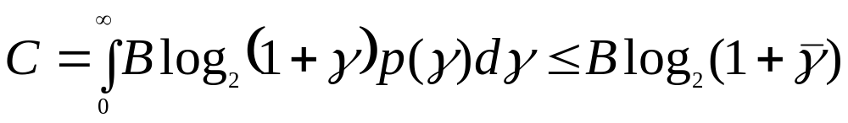
Capacity of Flat Fading Channels
Channel Capacity
  Maximum data rate that can be transmitted over a channel with arbitrarily small error
Capacity of AWGN Channel: Blog₂[1+γ] bps
  γ=P_{r}/(N₀B) is the receiver SNR
Capacity of Flat-Fading Channels
  Nothing known: capacity typically zero
  Fading Statistics Known (few results)
  Fading Known at RX (average capacity)

Slide 12
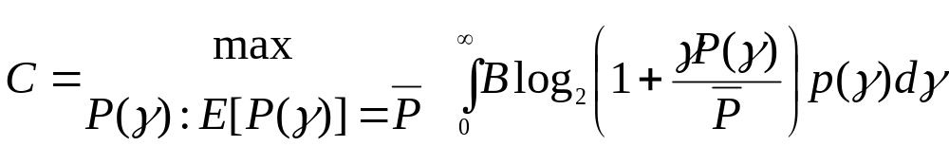
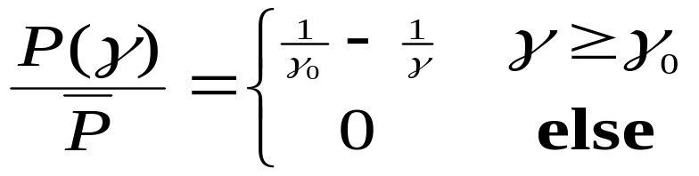

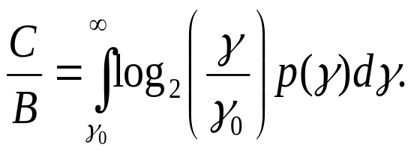
Capacity in Flat-Fading: γ known at TX/RX
Optimal Rate and Power Adaptation
The instantaneous power/rate only depend on p(γ) through γ₀
Waterfilling
1
γ
γ₀
γ

Slide 13
Channel Inversion
Fading inverted to maintain constant SNR
Simplifies design (fixed rate)
Greatly reduces capacity
  Capacity is zero in Rayleigh fading
Truncated inversion
  Invert channel above cutoff fade depth
  Constant SNR (fixed rate) above cutoff
  Cutoff greatly increases capacity
    Close to optimal

Slide 14
Frequency Selective
Fading Channels
For time-invariant channels, capacity achieved by water-filling in frequency
Capacity of time-varying channel unknown
Approximate by dividing into subbands
  Each subband has width B_{c}
  Independent fading in each subband
  Capacity is the sum of subband capacities
1/|H(f)|²
P
B_{c}
f

Slide 15
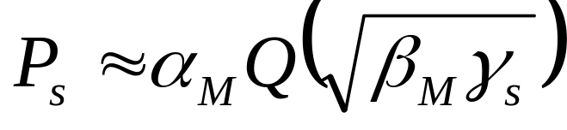
Linear Modulation in AWGN: MPSK and MQAM
ML detection induces decision regions
  Example: 8PSK
P_{s} depends on
  # of nearest neighbors
  Minimum distance d_{min} (depends on γ_{s})
  Approximate expression
d_{min}

Slide 16
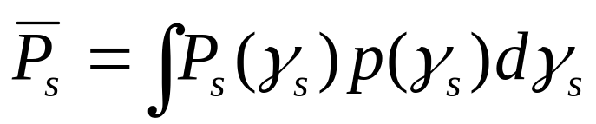
Linear Modulation in Fading
In fading γ_{s} and therefore P_{s} random
Metrics: outage, average P_{s} , combined outage and average.
T_{s}
P_{s}
Outage
P_{s(target)}
P_{s}
T_{s}

Slide 17
Moment Generating
Function Approach
Simplifies average P_{s} calculation
Uses alternate Q function representation
P_{s} reduces to MGF of γ_{s} distribution
Closed form or simple numerical calculation for general fading distributions
Fading greatly increases average P_{s} .

Slide 18
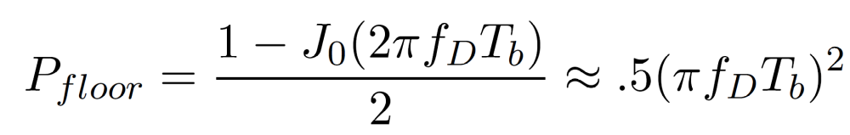
Doppler Effects
High doppler causes channel phase to decorrelate between symbols
Leads to an irreducible error floor for differential modulation
  Increasing power does not reduce error
Error floor depends on f_{D}T_{b} as

Slide 19
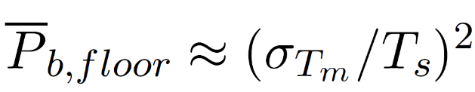
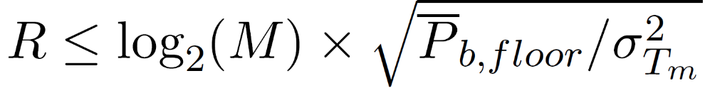
Delay Spread (ISI) Effects
Delay spread exceeding a symbol time causes ISI (self interference).
ISI leads to irreducible error floor:
  Increasing signal power increases ISI power
ISI imposes data rate constraint: T_{s}>>T_{m} (R_{s}<<B_{c})
1
2
4
Delay T_{m}
0
T_{s}
T_{m}
3
5

Slide 20
Diversity
Send bits over independent fading paths
  Combine paths to mitigate fading effects.
Independent fading paths
  Space, time, frequency, polarization diversity.
Combining techniques
  Selection combining (SC)
  Maximal ratio combining (MRC)
Can have diversity at TX or RX
  In TX diversity, weights constrained by TX power

Slide 21
Selection Combining
Selects the path with the highest gain
Combiner SNR is the maximum of the branch SNRs.
CDF easy to obtain, pdf found by differentiating.
Diminishing returns with number of antennas.
Can get up to about 20 dB of gain.

Slide 22
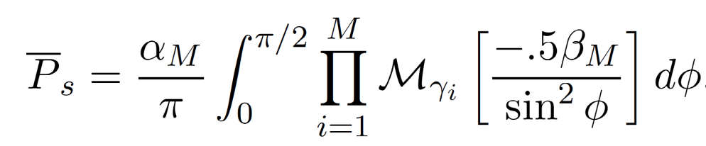
MRC and its Performance
With MRC, γ_{Σ}=Σγ_{i} for branch SNRs γ_{i}
  Optimal technique to maximize output SNR
  Yields 20-40 dB performance gains
  Distribution of γ_{Σ} hard to obtain
Standard average BER calculation
  Hard to obtain in closed form
  Integral often diverges
MGF Approach:
TX diversity has same gains as RX diversity
s
s
s

Slide 23
Variable-Rate Variable-Power MQAM
log₂ M(γ) Bits
One of the
M(γ) Points
To Channel
Point
Selector
M(γ)-QAM
Modulator
Power: S(γ)
Uncoded
Data Bits
Delay
γ(t)
γ(t)
BSPK
4-QAM
16-QAM
Goal: Optimize S(γ) and M(γ) to maximize EM(γ)

Slide 24
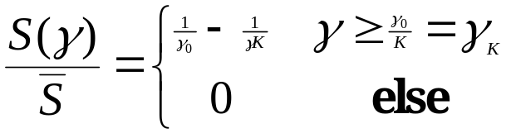

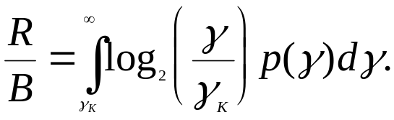
Optimal Adaptive Scheme
Power Water-Filling
Spectral Efficiency
γ_{k}
γ
γ
Equals Shannon capacity with an effective power loss of K.

Slide 25
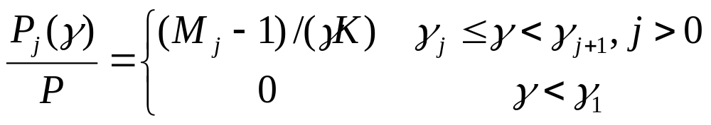
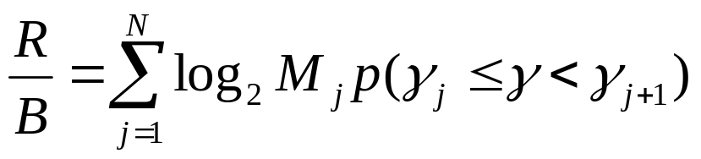
Constellation Restriction
M₃
M(γ)=γ/γ_{Κ}*
M_{D}(γ)
M₂
M₃
M₂
M₁
M₁
0
Outage
γ₀
γ₁=M₁γ_{K}*
γ₂
γ₃
γ
Power adaptation:
Average rate:
Performance
loss of 1-2 dB

Slide 26
Practical Constraints
(not on final)
Constant power restriction
  Another 1-2 dB loss
Constellation updates
  Need constellation constant over 10-100T_{s}
Estimation error and delay
  Lead to imperfect CSIT (assume perfect CSIR)
  Causes mismatch between channel and rate
  Leads to an irreducible error floor

Slide 27
Multiple Input Multiple
Output (MIMO)Systems
MIMO systems have multiple (M) transmit and receiver antennas
Decompose channel through transmit precoding (x=Vx) and receiver shaping (y=U^{H}y)
Leads to R_{H}≤min(M_{t},M_{r}) independent channels with gain σ_{i} (i^{th} singular value of H) and AWGN
Independent channels lead to simple capacity analysis and modulation/demodulation design
~
~
~
~
~
y=Hx+n
y=Σ x+n
H=UΣV^{H}
~
~
~
y_{i}=σ_{i}x+n_{i}

Slide 28
Capacity of MIMO Systems
Depends on what is known at TX and RX and if channel is static or fading
For static channel with perfect CSI at TX and RX, power water-filling over space is optimal:
  In fading waterfill over space (based on short-term power constraint) or space-time (long-term constraint)
Without transmitter channel knowledge, capacity metric is based on an outage probability
  P_{out} is the probability that the channel capacity given the channel realization is below the transmission rate.
Massive MIMO: in high SNR, singular values converge to a constant: C=min(M_{t},M_{r})Blog(1+ρ)

Slide 29








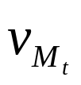
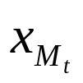
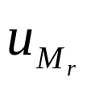
Beamforming
Scalar codes with transmit precoding
y=u^{H}Hvx+u^{H}n
Transforms system into a SISO system with diversity.
  Array and diversity gain
  Greatly simplifies encoding and decoding.
  Channel indicates the best direction to beamform
  Need “sufficient” knowledge for optimality of beamforming
Precoding transmits more than 1 and less than R_{H} streams
  Transmits along some number of dominant singular values

Slide 30
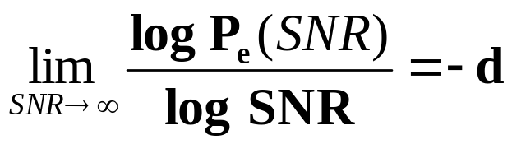
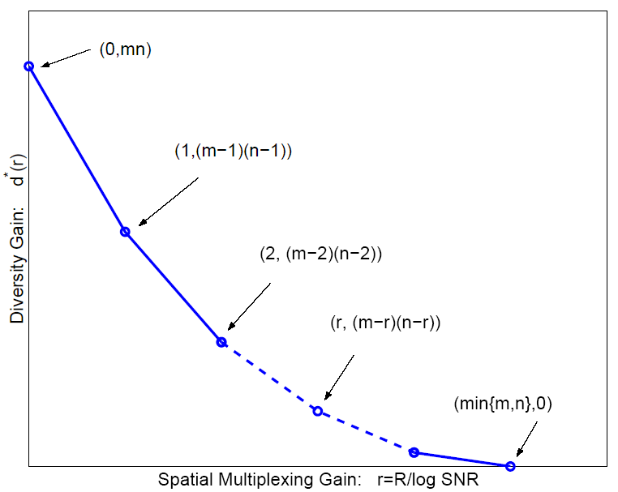
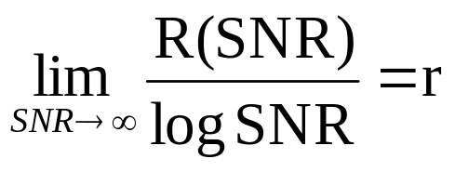
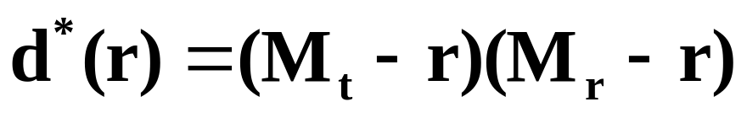
Diversity vs. Multiplexing
Use antennas for multiplexing or diversity
Diversity/Multiplexing tradeoffs (Zheng/Tse)
Error Prone
Low P_{e}

Slide 31



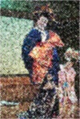

How should antennas be used?
Use antennas for multiplexing:
Use antennas for diversity
High-Rate
Quantizer
ST Code
High Rate
Decoder
Error Prone
Low-Rate
Quantizer
ST Code
High
Diversity
Decoder
Low P_{e}
Depends on end-to-end metric: Solve by optimizing app. metric

Slide 32
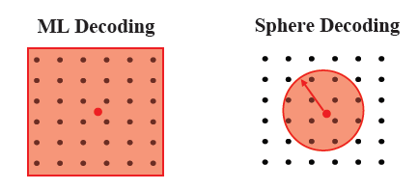
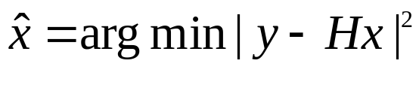
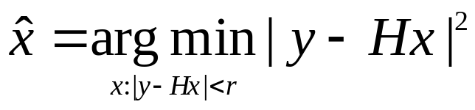
MIMO Receiver Design
Optimal Receiver:
  Maximum likelihood: finds input symbol most likely to have resulted in received vector
  Exponentially complex # of streams and constellation size
Linear Receivers
  Zero-Forcing: forces off-diagonal elements to zero, enhances noise
  Minimum Mean Square Error: Balances zero forcing against noise enhancement
Sphere Decoder:
  Only considers possibilities within a sphere of received symbol.
    If minimum distance symbol is within sphere, optimal, otherwise null is returned

Slide 33
Other MIMO Design Issues
Not covered in lecture/HW/exams
Space-time coding:
  Map symbols to both space and time via space-time block and convolutional codes.
  For OFDM systems, codes are also mapped over frequency tones.
Adaptive techniques:
  Fast and accurate channel estimation
  Adapt the use of transmit/receive antennas
  Adapting modulation and coding.
Limited feedback transmit precoding:
  Partial CSI introduces interference in parallel decomp: can use interference cancellation at RX
  TX codebook design for quantized channel

Slide 34
ISI Countermeasures
Equalization
  Signal processing at receiver to eliminate ISI
  Complex at high data rates, performs poorly in fast-fading
  Not used in state-of-the-art wireless systems
Multicarrier Modulation
  Break data stream into lower-rate substreams modulated onto narrowband flat-fading subchannels
Spread spectrum
  Superimpose a fast (wideband) spreading sequence on top of data sequence, allows resolution for combining or attenuation of multipath components.
Antenna techniques (Massive MIMO)
  (Highly) directional antennas reduce delay spread/ISI

Slide 35
Multicarrier Modulation
Divides bit stream into N substreams
Modulates substream with bandwidth B/N
  Separate subcarriers
  B/N<B_{c} flat fading (no ISI)
Requires N modulators and demodulators
  Impractical: solved via OFDM implementation
R/N bps
QAM
Modulator
x
R bps
Serial
To
Parallel
Converter
cos(2πf₀t)
Σ
R/N bps
QAM
Modulator
x
cos(2πf_{N}t)

Slide 36
Overlapping Substreams
Can have completely separate subchannels
  Required passband bandwidth is B.
OFDM overlaps substreams
  Substreams (symbol time T_{N}) separated in RX
  Minimum substream separation is B_{N}.
  Total required bandwidth is B/2 (for T_{N}=1/B_{N})
B/N
f₀
f_{N-1}

Slide 37
FFT Implementation of OFDM
  Use IFFT at TX to modulate symbols on each subcarrier
  Cyclic prefix makes linear convolution of channel circular, so no interference between FFT blocks in RX processing
  Reverse structure (with FFT) at receiver
X₀
x₀
TX
n(t)
R bps
Add cyclic
prefix and
Parallel
To Serial
Convert
QAM
Modulator
Serial
To
Parallel
Converter
x
D/A
h(t)
+
IFFT
X_{N-1}
x_{N-1}
cos(2πf_{c}t)
y₀
Y₀
RX
Remove
cyclic
prefix and
Serial to
Parallel
Convert
R bps
x
Parallel
To Serial
Convert
QAM
Modulator
LPF
A/D
FFT
y_{N-1}
Y_{N-1}
cos(2πf_{c}t)
Y_{i}=H_{i}X_{i}+n_{i}

Slide 38
OFDM Design Issues
Timing/frequency offset:
  Impacts subcarrier orthogonality; self-interference
Peak-to-Average Power Ratio (PAPR)
  Adding subcarrier signals creates large signal peaks
  Solve with clipping or PAPR-optimized coding
Different fading across subcarriers
  Mitigate by precoding (fading inversion), adaptive modulation over frequency, and coding across subcarriers
MIMO-OFDM
  Apply OFDM across each spatial dimension
  Can adapt across space, time, and frequency
  MIMO-OFDM represented by a matrix, extends matrix representation of OFDM alone (considered in HW)

Slide 39
MIMO-OFDM
Send OFDM symbol along each spatial dimension
  MIMO diversity-capacity benefits, OFDM removes ISI
  Can adapt across time, space, and frequency
OFDM can be represented by a matrix:
  Represents DFT as a matrix: y=Ĥx+ν, Ĥ circulant
  Then vector Y=ΛX+ν_{Q} for Λ an NxN diagonal matrix
  Cyclic prefix added after DFT
MIMO-OFDM matrix representation: y=Hx+ν
  Dimensions are H: NM_{r}x(N+μ)M_{t}; x: (N+μ)M_{t}; y,ν: M_{r}N
  Extends matrix representation of OFDM (example in HW)
  Can adapt across space, time, and frequency
y=Hx+n
y=Σ x+n
H=UΣV^{H}

Slide 40
Direct Sequence
Spread Spectrum
Bit sequence modulated by chip sequence
Spreads bandwidth by large factor (K)
Despread by multiplying by s_{c}(t) again (s_{c}(t)=1)
Mitigates ISI and narrowband interference
  ISI mitigation a function of code autocorrelation
Must synchronize to incoming signal
S(f)
s(t)
s_{c}(t)
S_{c}(f)
S(f)*S_{c}(f)
1/T_{b}
T_{c}
T_{b}=KT_{c}
1/T_{c}
2

Slide 41
ISI and Interference Rejection
Narrowband Interference Rejection (1/K)
Multipath Rejection (Autocorrelation ρ(τ))
  Short codes repeat every Ts, so poor multipath rejection at integer multiples of Ts
  Otherwise take a partial autocorrection
S(f)
I(f)
S(f)
S(f)*S_{c}(f)
I(f)*S_{c}(f)
Info. Signal
Receiver Input
Despread Signal
S(f)
S(f)*S_{c}(f)[αδ(t)+β(t-τ)]
αS(f)
βρS’(f)
Info. Signal
Receiver Input
Despread Signal

Slide 42
RAKE Receiver
Multibranch receiver
  Branches synchronized to different MP components
These components can be coherently combined
  Use SC, MRC, or EGC
x
Demod
y(t)
s_{c}(t)
^
d_{k}
x
Diversity
Combiner
Demod
s_{c}(t-iT_{c})
x
Demod
s_{c}(t-NT_{c})

Slide 43




Multiple Access
Sharing system resources across multiple users
Uplink:
Many Transmitters
to One Receiver.
x
R₃
h₃(t)
x
h₂₂(t)
Downlink:
One Transmitter
to Many Receivers.
x
h₂₁(t)
x
h₁(t)
R₂
R₁
Uplink and Downlink typically duplexed in time or frequency
Full-duplex radios are being considered for 5G systems

Slide 44




Creating Multiple Channels
Code Space
Frequency Division
  OFDMA
Time Division
Code Division
  Code cross-correlation dictates interference
  Multiuser Detection
Space (MIMO Systems)
Hybrid Schemes
Time
  Code Space
Frequency
Time
Frequency
Code Space
Time
Frequency
7C29822.033-Cimini-9/97

Slide 45
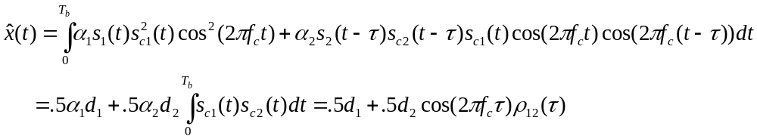
Code Division via DSSS
Interference between users mitigated by code cross correlation
In downlink, signal and interference have same received power
In uplink, “close” users drown out “far” users (near-far problem)
α
α

Slide 46
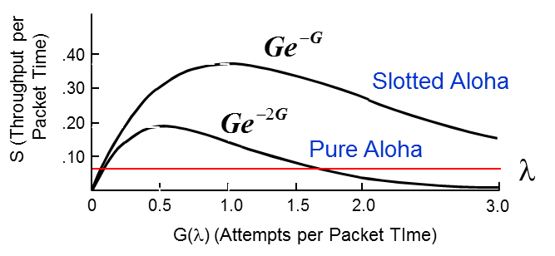
Random Access
• In multiple access, channels are assigned by a centralized controller
- Requires a central controller and control channel
- Inefficient for short and/or infrequent data transmissions
In random access, users access channel randomly when they have data to send
  A simple random access scheme will be explored in homework
• ALOHA Schemes (not covered on exam)
  Data is packetized.
  Packets occupy a given time interval
• Pure ALOHA
• Slotted ALOHA
– send packet whenever data is available
– same as ALOHA but with packet slotting
– a collision occurs for any partial overlap of
– packets sent during predefined timeslots
packets (nonorthogonal slots)
– A collision occurs when packets overlap,
but there is no partial overlap of packets
– Packets received in error are retransmitted
after random delay interval.
– Packets received in error are retransmitted after random delay interval (avoids subsequent collisions).

Slide 47
Cellular System Design
Frequencies/time slots/codes reused at spatially-separated locations
  Exploits power falloff with distance.
  Best efficiency obtained with minimum reuse distance
Base stations perform centralized control functions
  Call setup, handoff, routing, etc.
Ideally, interference results in SINR above desired target.
  The SINR depends on base station locations, user locations, propagation conditions, and interference reduction techniques.
  System capacity is interference-limited as SINR must be above target
  MIMO introduces diversity-multiplexing-interference reduction tradeoff
  Multiuser detection reduces inter/intracell interference: increases capacity
8C32810.43-Cimini-7/98

Slide 48
Multiuser Detection
Multiuser detection (MUD) exploits the fact that the structure of the interference is known
  Maximum likelihood: exponentially complex in number of users N
  Successive interference cancellation (SIC)
Signal 1
-
=
A/D
Signal 1
Demod
A/D
A/D
A/D
Iterative
Multiuser
Detection
Signal 2
Signal 2
Demod
-
=
Why not ubiquitous today?
Power, A/D Precision, Error propagation

Slide 49
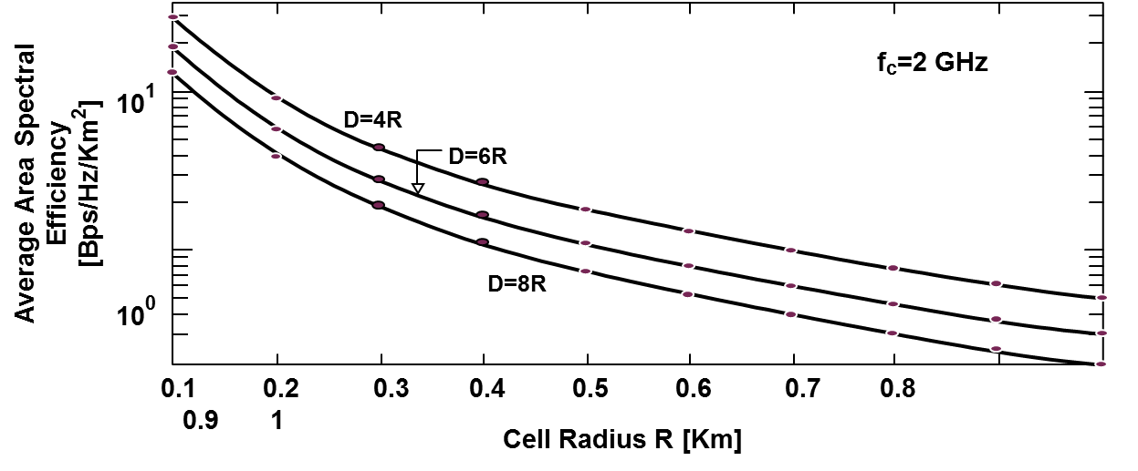
Area Spectral Efficiency (ASE)
System capacity due to optimal cell size and/or reuse distance:
A_{e}=ΣR_{i}/(.25D²π) bps/Hz/Km².
Area Spectral Efficiency
A=.25D²π
S/I increases with reuse distance (increases link capacity).
Tradeoff between reuse distance and link spectral efficiency (bps/Hz).
Capacity increases exponentially as cell size decreases
Future cellular systems will be hierarchical
  Large cells for coverage, small cells for capacity

Slide 50
Megathemes of EE359
The wireless vision poses great technical challenges
The wireless channel greatly impedes performance
  Low fundamental capacity; Channel is randomly time-varying.
  Flat fading and ISI must be compensated for.
Compensate for flat fading with diversity or adaptive mod.
  MIMO provides diversity and/or multiplexing gain
A plethora of ISI compensation techniques exist
  Various tradeoffs in performance, complexity, and implementation.
  OFDM is the dominant technique; works well with MIMO, basis for
  4G/5G Cellular/WiFi due to adaptivity over time/space/frequency
Sharing spectrum among multiple users a major challenge
Cellular systems exploit frequency reuse; better physical layer design, flexibility, and interference reduction needed in 5G

