Slide 1
EE359 – Lecture 14 Outline
Announcements:
  MT today, 2-4pm, 103 Hewlitt, pizza afterwards
  HW posted today, due next Friday
Discrete-Rate Adaptive Modulation
Introduction to MIMO Communications
MIMO Channel Decomposition
MIMO Channel Capacity
MIMO Beamforming

Slide 2

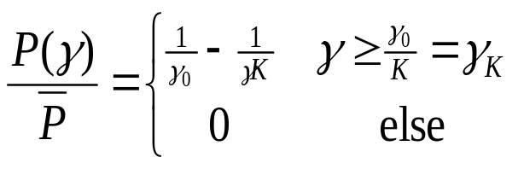

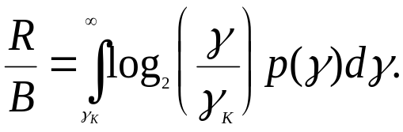
Review of Last Lecture
Introduction to adaptive modulation
  Vary different parameters of modulation relative to fading
Variable-rate variable-power MQAM
  Maximize average throughput by changing rate and power
  Optimal power adaptation is water-filling
  Optimal rate adaptation:
γ_{k}
γ
Equals capacity with effective
power loss K=-1.5/ln(5BER).

Slide 3
Review continued
Constellation Restriction
Restrict M_{D}(γ) to {M₀=0,…,M_{N}}.
Let M(γ)=γ/γ_{Κ}*, where γ_{Κ}* is optimized for max rate
Set M_{D}(γ) to max_{j} M_{j}: M_{j} ≤ M(γ) (conservative)
Region boundaries are γ_{j}=M_{j}γ_{Κ}*, j=0,…,N
Power control maintains target BER
M(γ)=γ/γ_{Κ}*
M₃
M_{D}(γ)
M(γ)=γ/γ_{Κ}
M₂
M₃
M₂
M₁
M₁
0
Outage
γ₀
γ₁=M₁γ_{K}*
γ₂
γ₃
γ

Slide 4
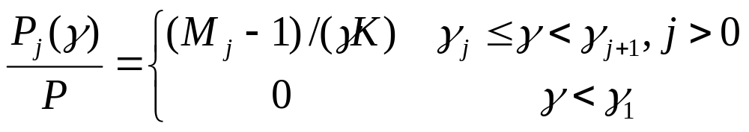
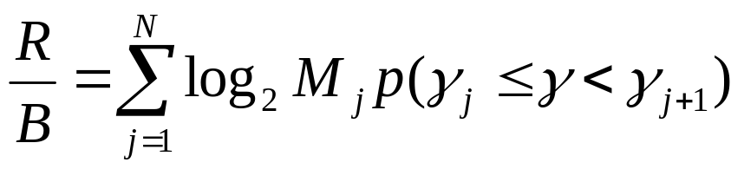
Power Adaptation and Average Rate
Power adaptation: Fixed BER within each region
    E_{s}/N₀=(M_{j}-1)/K
    Channel inversion within a region
  Requires power increase when increasing M(γ)
Average Rate
Practical Considerations (not covered in lecture):
  Cannot update more than every 10-100 symbols
  Estimation error/delay leads to irreducible error floor

Slide 5
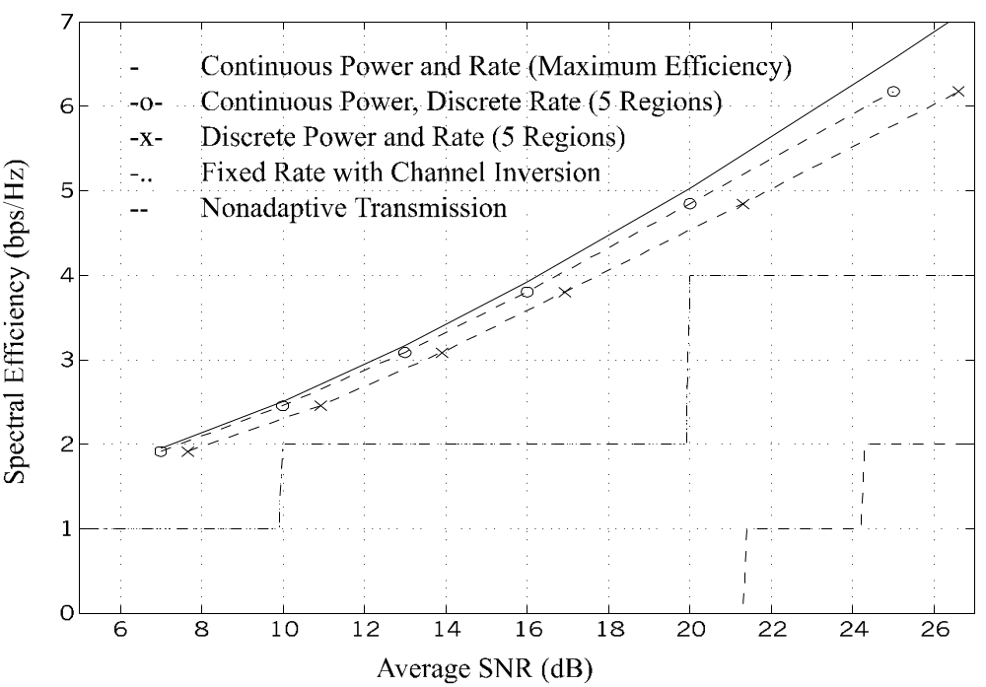
Efficiency in Rayleigh Fading
Spectral Efficiency (bps/Hz)
Average SNR (dB)

Slide 6
Multiple Input Multiple
Output (MIMO)Systems
MIMO systems have multiple transmit and receiver antennas (M_{t} at TX, M_{r} at RX)
Input described by vector x of dimension M_{t}
Output described by vector y of dimension M_{r}
Channel described by M_{r}xM_{t} matrix
Design and capacity analysis depends on what is known about channel H at TX and RX
  If H unknown at TX, requires vector modulation/demod
x=[x₁,…,x_{Mt}]
y=[y₁,…,y_{Mr}]
TX power constraint:
E[xx^{H}]=ρ=P/σ²
y=Hx+n

Slide 7
MIMO Decomposition
Decompose channel through transmit precoding (x=Vx) and receiver shaping (y=U^{H}y)
Leads to R_{H}≤min(M_{t},M_{r}) independent channels with gain σ_{i} (i^{th} singular value of H) and AWGN
Independent channels lead to simple capacity analysis and modulation/demodulation design
~
~
~
~
~
y=Hx+n
y=Σ x+n
H=UΣV^{H}
~
~
~
y_{i}=σ_{ι}x+n_{i}

Slide 8
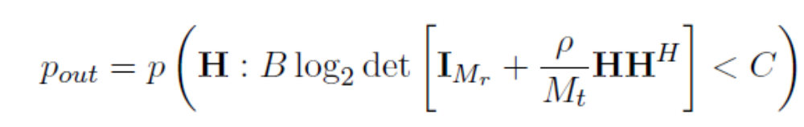
MIMO Fading Channel Capacity
If channel H known, waterfill over space (fixed power at each time instant) or space-time
Without transmitter channel knowledge, capacity is based on an outage probability
  P_{out} is probability that channel capacity given the channel realization is below the transmission rate C
Massive MIMO: random channel gains converge to static values: C = min(M_{t},M_{r}) Blog(1+ρ); ρ is SNR

Slide 9
Main Points
Discretizing the constellation size in adaptive MQMA results in negligible performance loss.
  Constellations cannot be updated faster than 10s to 100s of symbol times: OK for most dopplers.
  Estimation error/delay causes error floor
MIMO systems exploit multiple antennas at both TX and RX for capacity and/or diversity gain
With TX/RX CSI, decomposes into independent channels
Capacity of MIMO systems
  Static channel with TX/RX CSI: sum of capacity on each spatial dimension
  Static channel without TX CSI: capacity metric is outage.
  Fading channel with TX/RX CSI: water-fill power over space or space-time to achieve capacity
  With only RX CSI, capacity metric is outage.
  Massive MIMO: C = min(M_{t},M_{r}) Blog(1+ρ)

