Slide 1
EE360: Lecture 17 Outline
Cross-Layer Design and SDWN
Announcements
  Poster session W 3/12: 4:30pm setup, 4:45 start, pizza@6.
  DiscoverEE days poster session, March 14, 3:30-5:30, Next HW due today
  Final project reports due March 17
QoS in Wireless Network Applications
Network protocol layers
Overview of cross-layer design
Layering as optimization decomposition
Distributed optimization
Software Define Wireless Networks

Slide 2
EE360: Lecture 16 Outline
Sensor Networks and
Energy Efficient Radios
Announcements
  Poster session W 3/12: 4:30pm setup, 4:45 start, pizza@6.
  DiscoverEE days poster session, March 14, 3:30-5:30, signup at http://tinyurl.com/EEposter2014 by today.
  Next HW due March 10
  Final project reports due March 17
Energy-Efficient Cooperative MIMO
Energy-Efficient Multiple Access
Energy-Efficient Routing
Cooperative compression
Green cellular design

Slide 3




Future Network Applications
Internet (for the Z generation)
“Cellular”
Entertainment
Commerce
Smart Homes/Spaces/Structures
Sensor Networks
Automated Highways/Factories
…
Applications have hard delay constraints, rate requirements,
energy constraints, and/or security constraints that must be met
These requirements are collectively called QoS

Slide 4
Challenges to meeting QoS
Underlying channels, networks, and end-devices are heterogenous
Traffic patterns, user locations, and network conditions are constantly changing
Hard constraints cannot be guaranteed, and average constraints can be poor metrics.
No single layer in the protocol stack can support QoS: cross-layer design needed

Slide 5
A Brief Introduction to Protocol Layers
Premise: Break network tasks into logically distinct entities, each
built on top of the service provided by the lower layer entities.
Application
Application
Presentation
Presentation
Session
Session
Transport
Transport
Network
Network
Network
Datalink
Datalink
Datalink
Physical
Physical
Physical
Physical medium
Example: OSI Reference Model

Slide 6
OSI vs. TCP/IP
OSI: conceptually define services, interfaces, protocols
Internet: provides a successful implementation
Application
Application
Telnet
FTP
DNS
Presentation
Session
TCP
UDP
Transport
Transport
Network
Internet
IP
Datalink
Host-to-
network
Packet
radio
LAN
Physical
OSI
TCP/IP

Slide 7
Layer Functionality
Application
  Compression, error concealment, packetization, scheduling, …
Transport
  End-to-end error recovery, retransmissions, flow control, …
Network
  Neighbor discovery and routing
Access
  Channel sharing, error recovery/retransmission, packetization, …
Link
  Bit transmission (modulation, coding, …)

Slide 8
Layering Pros and Cons
Advantages
  Simplification - Breaking the complex task of end-to-end networking into disjoint parts simplifies design
  Modularity – Protocols easier to optimize, manage, and maintain. More insight into layer operation.
  Abstract functionality –Lower layers can be changed without affecting the upper layers
  Reuse – Upper layers can reuse the functionality provided by lower layers
Disadvantages
  Suboptimal: Layering introduces inefficiencies and/or redundancy (same function performed at multiple layers)
  Information hiding: information about operation at one layer cannot be used by higher or lower layers
  Performance: Layering can lead to poor performance, especially for applications with hard QoS constraints

Slide 9
Key layering questions
How should the complex task of end-to-end networking be decomposed into layers
  What functions should be placed at each level?
  Can a function be placed at multiple levels?
  What should the layer interfaces be?
Should networks be decomposed into layers?
  Design of each protocol layer entails tradeoffs, which should be optimized relative to other protocol layers
What is the alternative to layered design?
  Cross-layer design
  No-layer design

Slide 10
Crosslayer Design:
Information Exchange Across Layers
Application
Transport
Network
Access
Link
End-to-End Metrics
Substantial gains in throughput, efficiency, and QoS can be achieved with cross-layer design
Notes:
Interdisciplinary research, design, and development very challenging, but necessary to meet the requirements of future wireless applications

Slide 11
Information Exchange
Applications have information about the data characteristics and requirements
Lower layers have information about network/channel conditions

Slide 12
Crosslayer Techniques
Adaptive techniques
  Link, MAC, network, and application adaptation
  Resource management and allocation
Diversity techniques
  Link diversity (antennas, channels, etc.)
  Access diversity
  Route diversity
  Application diversity
  Content location/server diversity
Scheduling
  Application scheduling/data prioritization
  Resource reservation
  Access scheduling

Slide 13
Rethinking Layering
How to, and how not to, layer? A question on architecture
Functionality allocation: who does what and how to connect them?
  More fuzzy question than just resource allocation but want answers to be rigorous, quantitative and simple
How to quantify benefits of better modulation-codes-schedule-routes... for network applications?

Slide 14
  The Goal
  A Mathematical Theory of Network Architectures
  “Layering As Optimization Decomposition:
  A Mathematical Theory of Network Architectures”
  By Mung Chiang, Steven H. Low, A. Robert Calderbank, John C. Doyle

Slide 15
Layering As Optimization Decomposition
The First unifying view and systematic approach
Network: Generalized NUM
Layering architecture: Decomposition scheme
Layers: Decomposed subproblems
Interfaces: Functions of primal or dual variables
Horizontal and vertical decompositions

Slide 16
NUM Formulation
Objective function: What the end-users and network provider care about
  Can be a function of throughput, delay, jitter, energy, congestion...
  Can be coupled, eg, network lifetime
Variables: What're under the control of this design
Constraint sets: What're beyond the control of this design. Physical and economic limitations. Hard QoS constraints (what the users and operator must have)

Slide 17
Layering
Give insights on both:
  What each layer can do (Optimization variables)
  What each layer can see (Constants, Other subproblems' variables)
  Connections With Mathematics
  Convex and nonconvex optimization
  Decomposition and distributed algorithm

Slide 18

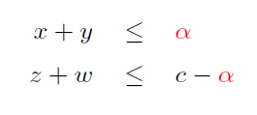
Primal Decomposition
Simple example:
Decomposed into:
New variable α updated by various methods
Interpretation: Direct resource allocation (not pricing-based control)

Slide 19
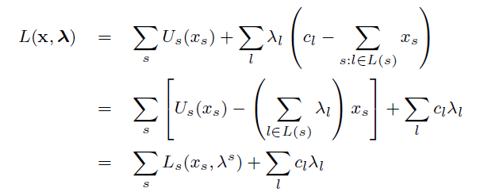
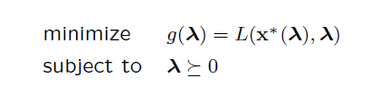
Dual-based Distributed Algorithm
NUM with concave smooth utility functions:
Convex optimization with zero duality gap
Lagrangian decomposition:
Dual problem:

Slide 20
Horizontal vs Vertical Decomposition
Horizontal Decompositions
  Reverse engineering: Layer 4 TCP congestion control: Basic NUM (LowLapsley99, RobertsMassoulie99, MoWalrand00, YaicheMazumdarRosenberg00, etc.)
  Scheduling based MAC is known to be solving max weighted matching
Vertical Decompositions
  Jointly optimal congestion control and adaptive coding or power control (Chiang05a)
  Jointly optimal routing and scheduling (KodialamNandagopal03)
  Jointly optimal congestion control, routing, and scheduling ( ChenLowChiangDoyle06)
  Jointly optimal routing, resource allocation, and source coding(YuYuan05)

Slide 21
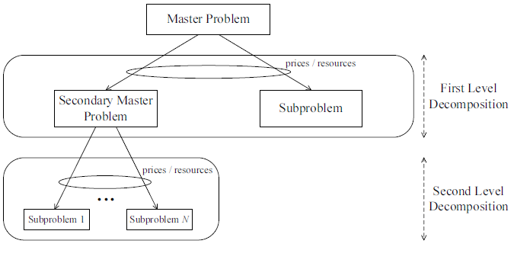
Alternative Decompositions
Many ways to decompose:
Primal Decomposition
Dual Decomposition
Multi-level decomposition
Different combinations
Lead to alternative architectures with different engineering implications

Slide 22
Key Messages
Existing protocols in layers 2,3,4 have been reverse engineered
Reverse engineering leads to better design
Loose coupling through layering price
Many alternatives in decompositions and layering architectures
Convexity is key to proving global optimality
Decomposability is key to designing distributed solution
Still many open issues in modeling, stochastic dynamics, and nonconvex formulations
Architecture, rather than optimality, is the key

Slide 23
Key Questions
  What is the right framework for crosslayer design?
  What are the key crosslayer design synergies?
  How to manage crosslayer complexity?
  What information should be exchanged across layers, and how should this information be used?
  How to balance the needs of all users/applications?

Slide 24
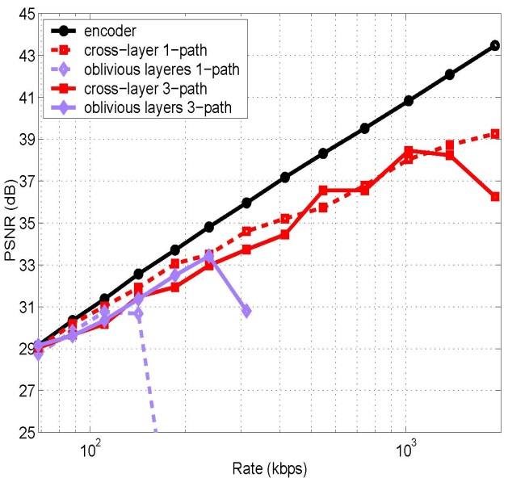
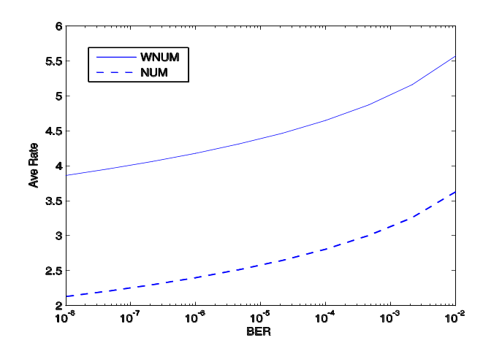
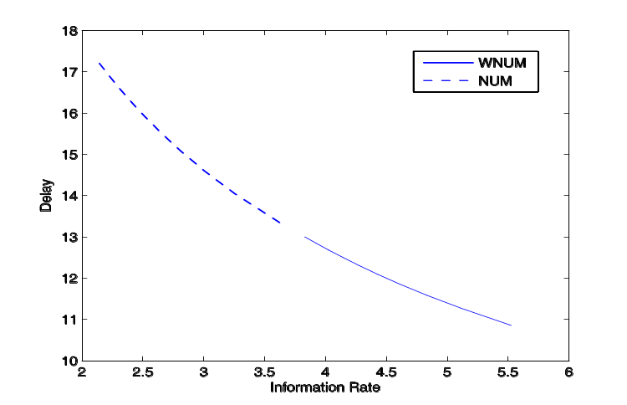
Crosslayer Examples to date
(from Lecture 11)
s
Multipath routing for video
Wireless NUM
5 dB
3-fold increase
100
1000
(logarithmic scale)

Slide 25
Upshot
Cross-layer design imposes tradeoffs
between rate, power/energy, and delay
The tradeoff implications for sensor
networks is poorly understood

Slide 26
Crosslayer Protocol Design in Sensor Networks
Application
Network
Access
Link
Hardware
Subject of Stefan’s presentation
Notes:
Interdisciplinary research, design, and development very challenging, but necessary to meet the requirements of future wireless applications

Slide 27
Summary:
To Cross or not to Cross?
With cross-layering there is higher complexity and less insight.
Can we get simple solutions or theorems?
  What asymptotics make sense in this setting?
  Is separation optimal across some layers?
  If not, can we consummate the marriage across them?
Burning the candle at both ends
  We have little insight into cross-layer design.
  Insight lies in theorems, analysis (elegant and dirty), simulations, and real designs.

Slide 28
Software Defined
Wireless Networking

Slide 29

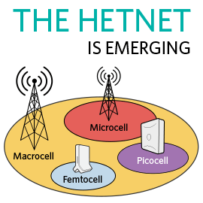






Wireless networks are everywhere, yet…
TV White Space &
Cognitive Radio
- Connectivity is fragmented
- Capacity is limited (spectrum crunch and interference)
- Roaming between networks is ad hoc

Slide 30
Solution: Software-defined wireless networks (SDWN)
What are software-defined networks (SDN): Common themes
  Separate control and data plane
  Open and programmable
  Vendor-agnostic (interoperable)
  network abstraction offered to applications on top of the network
What does it mean to make wireless networks software-defined?

Slide 31
Software-defined wireless network (according to Andrea)
Self-Organizing (SoN)
Open and programmable controllers
Vendor-agnostic interoperable hardware
Ability to tailor network performance to applications

Slide 32


SDWN Basic Premise
  Open-Systems
  Cloud Delivery
  Data-driven
  Dynamically optimized
  Seamless network handoff
  Tailors network to applications
SON
Wireless
Wireless
Big Data
SDN

Slide 33


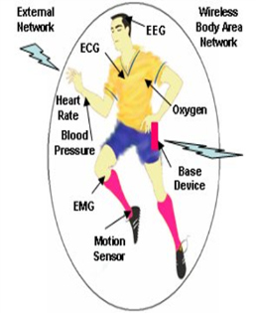

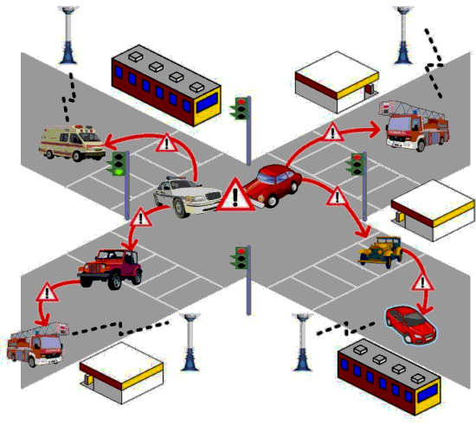

SDWN Architecture
Control Plane
Application / Services Layer
Wireless “Cloud” Network Management
Wi-Fi SDN
Cellular
SDN
Hand Over
Feature Set Operators
mmWave
SDN
CR
SDN
Wi-Fi
Security
Cross-Layer Network Optimization
Wireless “Cloud” Control Layer
Secure, Reliable, Robust Communication
Device Layer

Slide 34
SDWN Architecture Details
Video
Security
Vehicular
Networks
M2M
App layer
Health
Freq.
Allocation
Power
Control
Self
Healing
ICIC
QoS
Opt.
CS
Threshold
SW layer
UNIFIED CONTROL PLANE
Commodity HW
WiFi
HetNets
mmwave
Cognitive Radio

Slide 35
Why do we need a software-defined wireless network?
Don’t wireless networks already have lots of software?
Is SDWN just trying to catch
the wave of the latest fad?

Slide 36
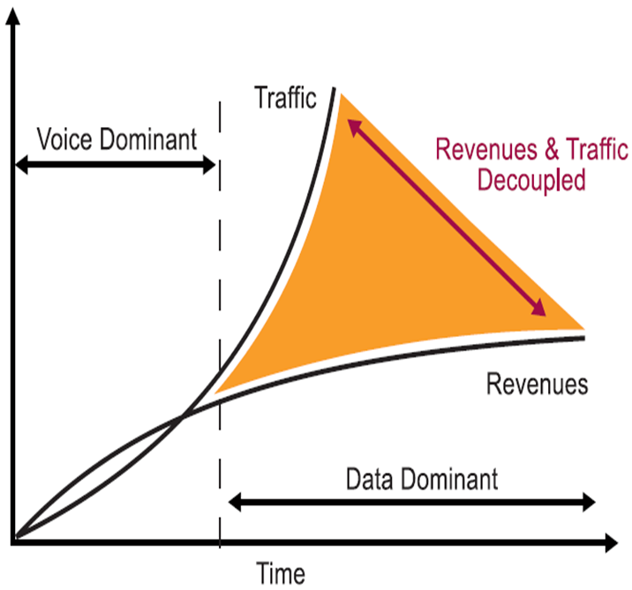
Careful what you wish for…
Growth in mobile data, massive spectrum deficit and stagnant revenues require technical and political breakthroughs for ongoing success of cellular

Slide 37
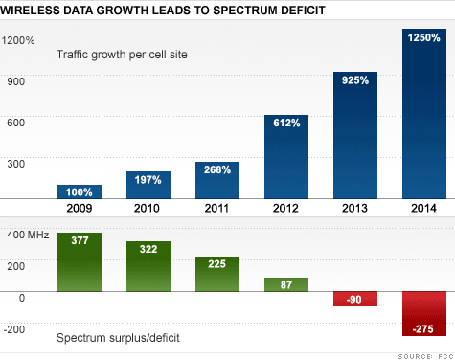
“Sorry, America: Your wireless airwaves are full”
CNNMoneyTech – Feb. 2012
The “Spectrum Crunch”

Slide 38
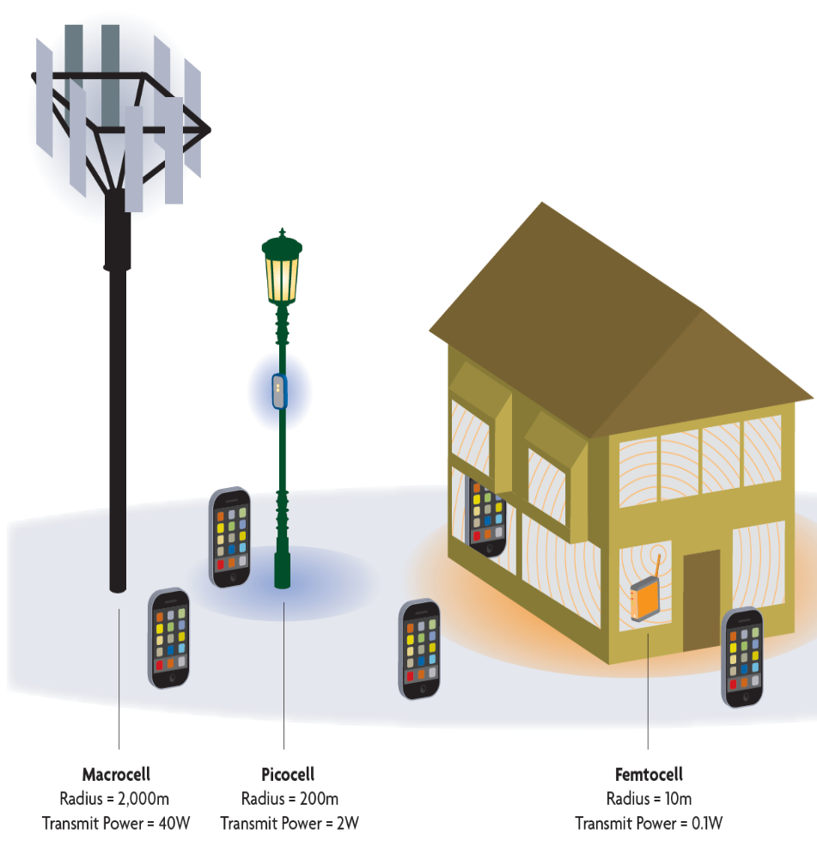







The Future Cellular Network: Hierarchical Architecture
Today’s architecture
3M Macrocells serving 5 billion users
MACRO: solving initial coverage issue, existing network
10x Lower HW COST
PICO: solving street, enterprise & home coverage/capacity issue
10x CAPACITY Improvement
Near 100%
COVERAGE
FEMTO: solving enterprise & home
coverage/capacity issue
Macrocell
Picocell
Femtocell
Challenges:
- Deployment
- Managing interference

Slide 39



SON for LTE small cells is SDWN
Mobile Gateway
Or Cloud
Node Installation
Self
Healing
SoN
Server
Initial Measurements
IP Network
SON
Server
Self Configuration
Measurement
Self Optimization
X2
X2
X2
X2
Small cell BS
Macrocell BS

Slide 40


Can 802.11 solve the spectrum crunch? “The Good” & “The Bad”
Ubiquitous
Free [unlicensed] spectrum
Standards based [sort of]
Established silicon ecosystem
Large ODM base
Not “Carrier-Grade”
Poor and variable Quality-of- Experience
No seamless handoffs
Enterprise Grade very expensive and not scalable for massive deployments

Slide 41
WiFi Networks Today
WiFi provides high-speed connectivity in the home, office, and in public hotspots.
WiFi protocols based on the IEEE 802.11 family of standards: 802.11a/b/g/n
  Next-gen 802.11ac offers peak rate over 1 Gbps.
Designed based on APs with 50-100ft range
Multiple access technique is CSMA/CA

Slide 42
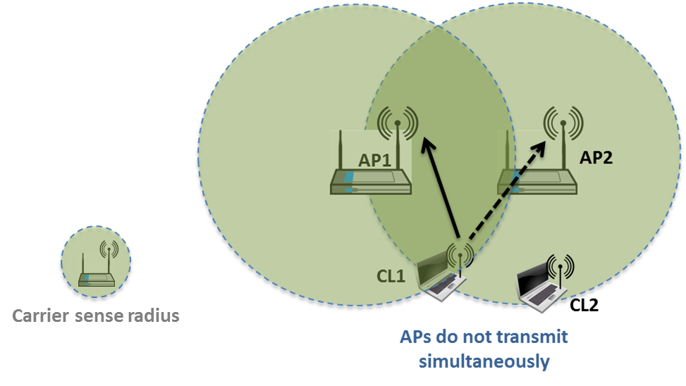
The Big Problem with WiFi
Is not at the PHY layer ☹
The WiFi standard lacks good mechanisms to mitigate interference in dense AP deployments
  Static channel assignment, power levels, and carrier sensing thresholds
  In such deployments WiFi systems exhibit poor spectrum reuse and significant contention among APs and clients
  Result is low throughput and a poor user experience

Slide 43

Why not use SoN-for-WiFi?
Open
Interface
SoN
Server
SoN Server provides configuration, security, and radio resource management for off-the-shelf embedded or stand-alone APs with standard silicon
802.11 standards-compliant AP measurements (throughput, RSSI, PER, etc.)
AP parameters accessed through open interface
Cloud-based SoN Server can sit anywhere in Carrier or Enterprise network
Provides carrier-grade WiFi in terms of throughput and outage (enables SLAs)
Complements distributed SoC optimization

Slide 44


Convergence of Cellular and WiFi

Slide 45
WiFi spectrum complements scarce and bifurcated cellular spectrum
Solution: Network-Initiated Offload:
Current solution is device-driven Wi-Fi offload
  User sessions are disrupted during Offload
  Require software on clients (handset, tablets,…)
    Requires supporting innumerable number of hardware & software combinations
  Quality-of-Service (QOS) is not guaranteed
  Ad-hoc offload generally ad-hoc

Slide 46
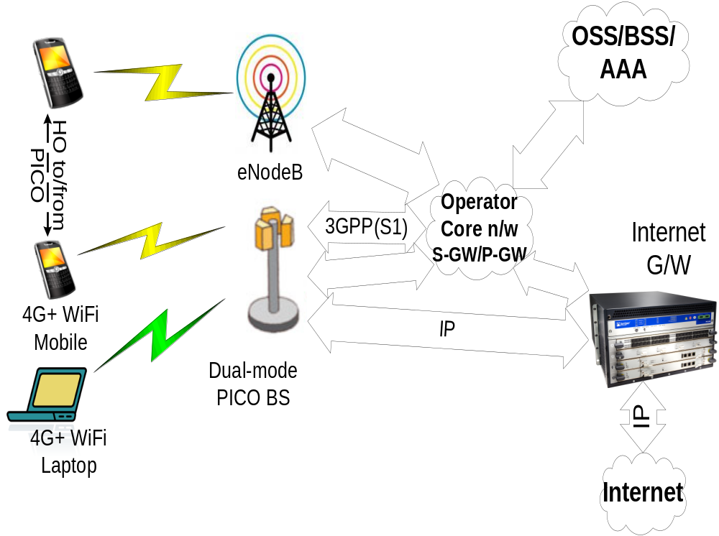
Network-Initiated Offload:
  Exploits all-IP backbone of LTE

Slide 47
Presentation
"Energy-Efficient Communication Protocol for Wireless Microsensor Networks"
By Heinzelman, Chandrakasan, Balakrishnan
Appeared in IEEE Conf. on System Sciences 2000
Presented by Stefan

