Slide 1
EE360: Multiuser Wireless Systems and Networks
Lecture 2 Outline
  Announcements
    HW 0 due Monday (high-impact papers – you decide)
  Bandwidth Sharing in Multiuser Channels
    FD, TD, CD, SD, Hybrid (OFDMA)
  Overview of Multiuser Channel Capacity
  Capacity of Broadcast Channels
    AWGN, Fading, and ISI
  Capacity of MAC Channels
  Duality between BC and MAC channels
  MIMO Channels

Slide 2
Review of Last Lecture
Overview of multiuser wireless systems and networks
  Multiuser systems
  Cellular, Ad-Hoc, Cognitive, and Sensor Networks
Random Access Techniques
  ALOHA
  CSMA-CD
  Reservation Protocols
Random access works poorly in heavily loaded systems

Slide 3
Deterministic Bandwidth Sharing in Multiuser Channels

Slide 4

Deterministic Bandwidth Sharing
Code Space
Frequency Division
Time Division
Code Division
  Multiuser Detection
Space Division (MIMO)
Hybrid Schemes (OFDMA)
Time
Frequency
  Code Space
Time
Frequency
Code Space
Time
Frequency
What is optimal?
Look to Shannon.

Slide 5
OFDMA and SDMA
OFDMA
  Combines OFDM and frequency division multiplexing
  Different subcarriers assigned to different users
SDMA (space-division multiple access)
  Different spatial dimensions assigned to different users
  Implemented via multiuser beamforming (e.g. zero-force beamforming)
  Benefits from multiuser diversity

Slide 6
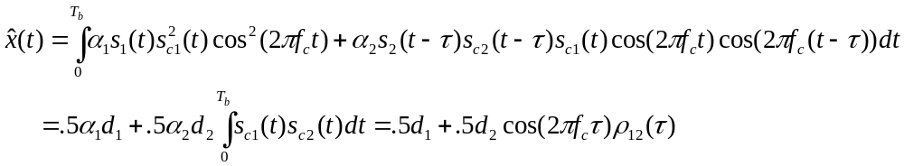
Code Division via
Multiple Access SS
Interference between users mitigated by code cross correlation
In downlink, signal and interference have same received power
In uplink, “close” users drown out “far” users (near-far problem)
α
α

Slide 7
Multiuser Detection
In all CDMA systems and in TD/FD/CD cellular systems, users interfere with each other.
In most of these systems the interference is treated as noise.
  Systems become interference-limited
  Often uses complex mechanisms to minimize impact of interference (power control, smart antennas, etc.)
Multiuser detection exploits the fact that the structure of the interference is known
  Interference can be detected and subtracted out
  Better have a darn good estimate of the interference

Slide 8
Ideal Multiuser Detection
Signal 1
-
=
A/D
Signal 1
Demod
A/D
A/D
A/D
Iterative
Multiuser
Detection
Signal 2
Signal 2
Demod
-
=
Why Not Ubiquitous Today?
Power and A/D Precision

Slide 9
Capacity Limits of
Broadcast Channels

Slide 10




Multiuser Shannon Capacity
Fundamental Limit on Data Rates
Capacity: The set of simultaneously achievable rates {R₁,…,R_{n}}
with arbitrarily small probability of error
R₃
R₂
R₂
R₃
R₁
R₁
Main drivers of channel capacity
  Bandwidth and received SINR
  Channel model (fading, ISI)
  Channel knowledge and how it is used
  Number of antennas at TX and RX
Duality connects capacity regions of uplink and downlink

Slide 11
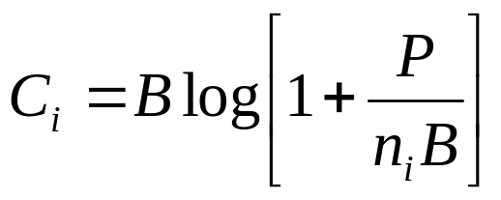
Broadcast Channel Capacity
Region in AWGN
Model
  One transmitter, two receivers with spectral noise density n₁, n₂: n₁<n₂.
  Transmitter has average power Pand total bandwidth B.
Single User Capacity:
  Maximum achievable rate with asymptotically small P_{e}
Set of achievable rates includes (C₁,0) and (0,C₂), obtained by allocating all resources to one user.

Slide 12
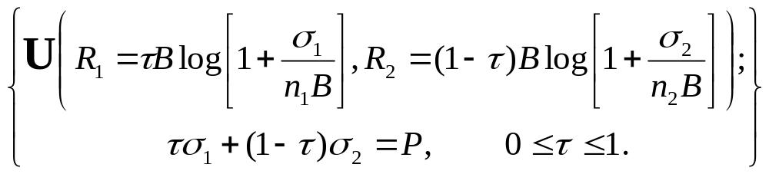
Rate Region: Time Division
Time Division (Constant Power)
  Fraction of time τ allocated to each user is varied
Time Division (Variable Power)
  Fraction of time τ and power σ_{i} allocated to each user is varied

Slide 13
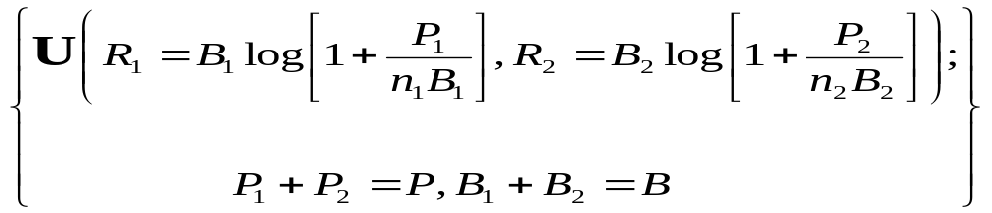
Rate Region: Frequency Division
Frequency Division
  Bandwidth B_{i} and power S_{i} allocated to each user is varied.
Equivalent to TD for B_{i}=τ_{i}B and P_{ι}=τ_{i}σ_{i}.

Slide 14


Superposition Coding
Best user decodes fine points
Worse user decodes coarse points

Slide 15
Code Division
Superposition Coding
  Coding strategy allows better user to cancel out interference from worse user.
DS spread spectrum with spreading gain G and cross correlation ρ₁₂= ρ₂₁ =G:
  By concavity of the log function, G=1 maximizes the rate region.
DS without interference cancellation

Slide 16
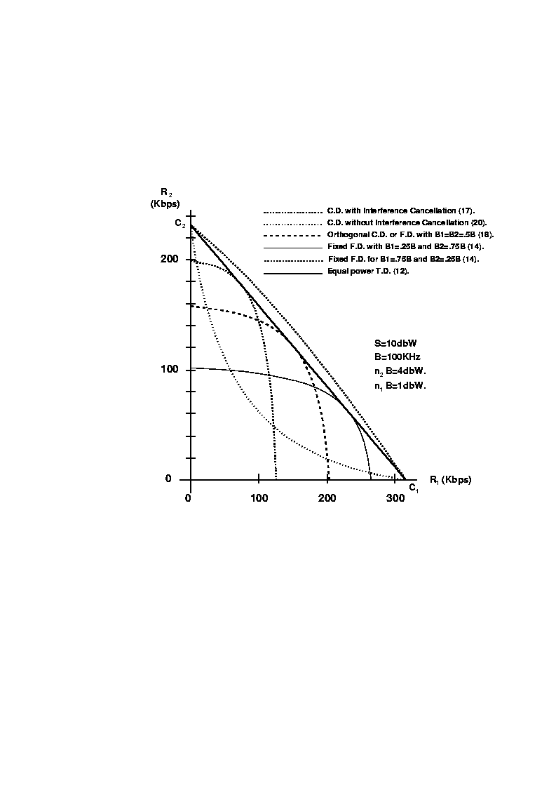

Slide 17
Capacity Limits of Fading
Broadcast Channels

Slide 18
Broadcast and MAC
Fading Channels
Broadcast:
One Transmitter
to Many Receivers.
Wireless
Gateway
Wired
Network
x
g₃(t)
Multiple Access:
Many Transmitters
to One Receiver.
x
g₂(t)
x
g₁(t)
R₂
R₃
R₁
Goal: Maximize the rate region {R₁,…,R_{n}}, subject to some minimum rate
constraints, by dynamic allocation of power, rate, and coding/decoding.
Assume transmit power constraint and perfect TX and RX CSI

Slide 19
Fading Capacity Definitions
Ergodic (Shannon) capacity: maximum long-term rates averaged over the fading process.
    Shannon capacity applied directly to fading channels.
    Delay depends on channel variations.
    Transmission rate varies with channel quality.
Zero-outage (delay-limited*) capacity: maximum rate that can be maintained in all fading states.
    Delay independent of channel variations.
    Constant transmission rate – much power needed for deep fading.
Outage capacity: maximum rate that can be maintained in all nonoutage fading states.
    Constant transmission rate during nonoutage
    Outage avoids power penalty in deep fades
*Hanly/Tse, IT, 11/98

Slide 20
Two-User Fading Broadcast Channel
√h₁[i]
ν₁[i]
x
+
Y₁[i]
X[i]
x
+
Y₂[i]
√h₂[i]
ν₂[i]
At each time i:
n={n₁[i],n₂[i]}
n₁[i]=ν₁[i]/√h₁[i]
+
Y₁[i]
X[i]
+
Y₂[i]
n₂[i]=ν₂[i]/√h₂[i]

Slide 21
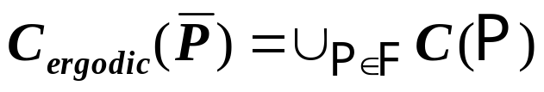
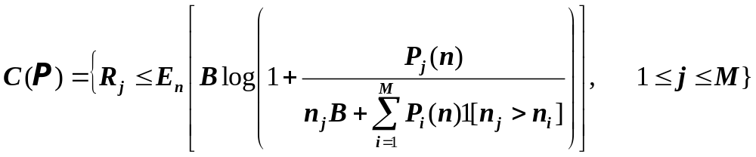
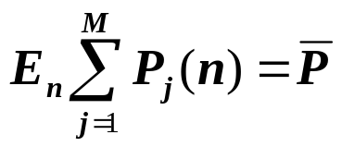
Ergodic Capacity Region*
Capacity region: ,where
  The power constraint implies
Superposition coding and successive decoding achieve capacity
  Best user in each state decoded last
  Power and rate adapted using multiuser water-filling: power allocated based on noise levels and user priorities
*Li/Goldsmith, IT, 3/01

Slide 22
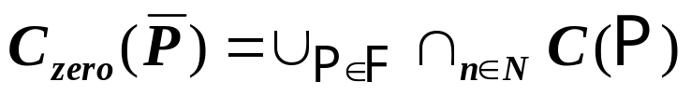
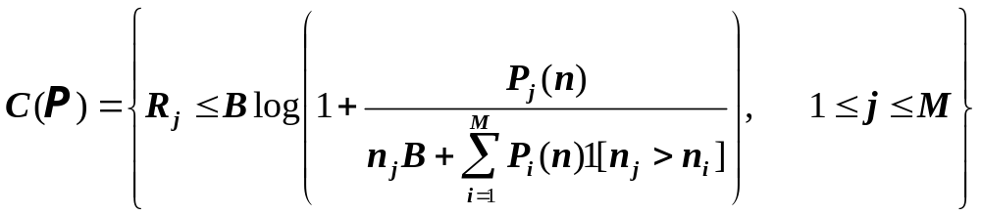
Zero-Outage Capacity Region*
The set of rate vectors that can be maintained for all channel states under power constraint P
Capacity region defined implicitly relative to power:
  For a given rate vector R and fading state n we find the minimum power P^{min}(R,n) that supports R.
  R∈C_{zero}(P) if E_{n}[P^{min}(R,n)] ≤ P
*Li and Goldsmith, IT, 3/01

Slide 23
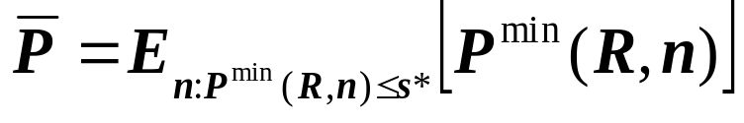
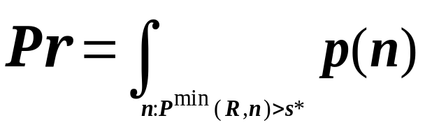
Outage Capacity Region
Two different assumptions about outage:
  All users turned off simultaneously (common outage Pr)
  Users turned off independently (outage probability vector Pr)
Outage capacity region implicitly defined from the minimum outage probability associated with a given rate
Common outage: given (R,n), use threshold policy
  If P^{min}(R,n)>s* declare an outage, otherwise assign this power to state n.
  Power constraint dictates s* :
  Outage probability:

Slide 24
Independent Outage
With independent outage cannot use the threshold approach:
  Any subset of users can be active in each fading state.
Power allocation must determine how much power to allocate to each state and which users are on in that state.
Optimal power allocation maximizes the reward for transmitting to a given subset of users for each fading state
  Reward based on user priorities and outage probabilities.
  An iterative technique is used to maximize this reward.
  Solution is a generalized threshold-decision rule.

Slide 25
Broadcast Channels with ISI
ISI introduces memory into the channel
The optimal coding strategy decomposes the channel into parallel broadcast channels
  Superposition coding is applied to each subchannel.
Power must be optimized across subchannels and between users in each subchannel.

Slide 26
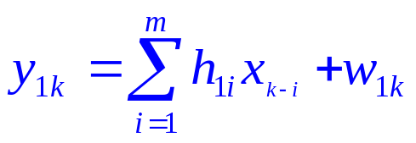
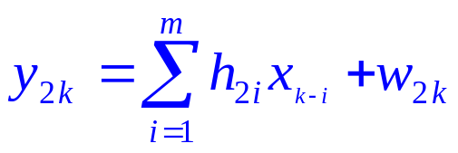
Broadcast Channel Model
w_{1k}
H₁(ω)
x_{k}
w_{2k}
H₂(ω)
Both H₁ and H₂ are finite IR filters of length m.
The w_{1k} and w_{2k} are correlated noise samples.
For 1<k<n, we call this channel the n-block discrete Gaussian broadcast channel (n-DGBC).
The channel capacity region is C=(R₁,R₂).

Slide 27
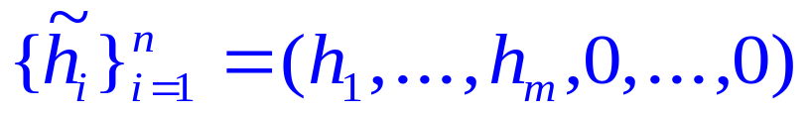
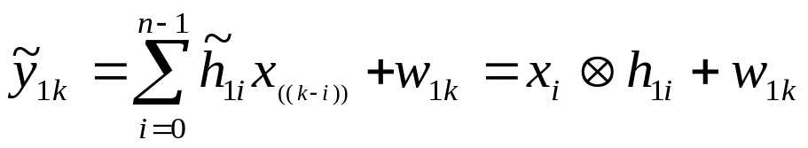
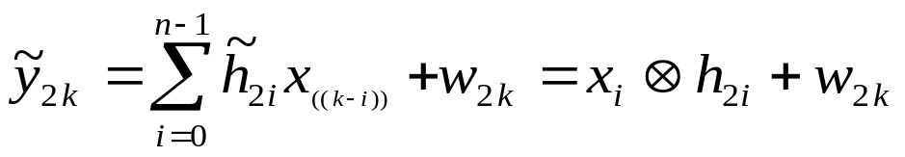
Circular Channel Model
Define the zero padded filters as:
The n-Block Circular Gaussian Broadcast Channel (n-CGBC) is defined based on circular convolution:
0<k<n
where ((.)) denotes addition modulo n.

Slide 28





Equivalent Channel Model
Taking DFTs of both sides yields
Dividing by H and using additional properties of the DFT yields
0<j<n
~
0<j<n
where {V_{1j}} and {V_{2j}} are independent zero-mean Gaussian
random variables with

Slide 29
Parallel Channel Model
V₁₁
+
Y₁₁
X₁
+
Y₂₁
V₂₁
N_{i}(f)/H_{i}(f)
V_{1n}
f
+
Y_{1n}
X_{n}
+
Y_{2n}
V_{2n}

Slide 30
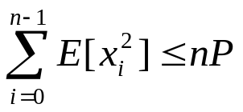
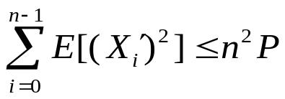
Channel Decomposition
The n-CGBC thus decomposes to a set of n parallel discrete memoryless degraded broadcast channels with AWGN.
  Can show that as n goes to infinity, the circular and original channel have the same capacity region
The capacity region of parallel degraded broadcast
channels was obtained by El-Gamal (1980)
  Optimal power allocation obtained by Hughes-Hartogs(’75).
The power constraint on the original channel is converted by Parseval’s theorem to on the equivalent channel.

Slide 31
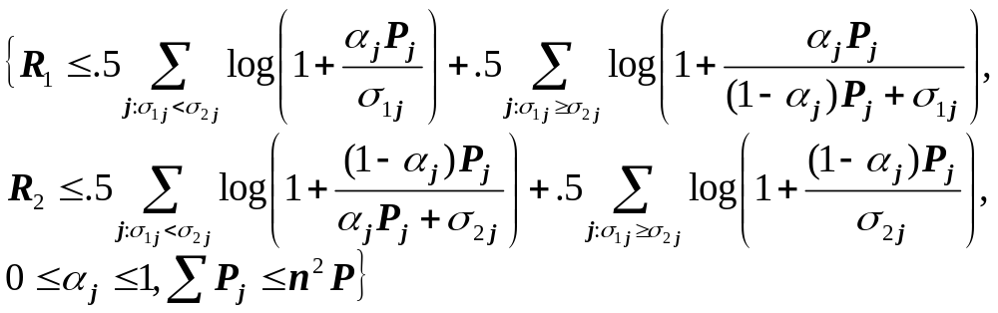

Capacity Region of Parallel Set
Achievable Rates (no common information)
Capacity Region
  For 0<β≤∞ find {α_{j}}, {P_{j}} to maximize R₁+βR₂+λ ΣP_{j}.
  Let (R₁*,R₂*)_{n,β} denote the corresponding rate pair.
  C_{n}={(R₁*,R₂*)_{n,β} : 0<β ≤∞ }, C=liminf_{n} C_{n} .
β
R₂
R₁

Slide 32
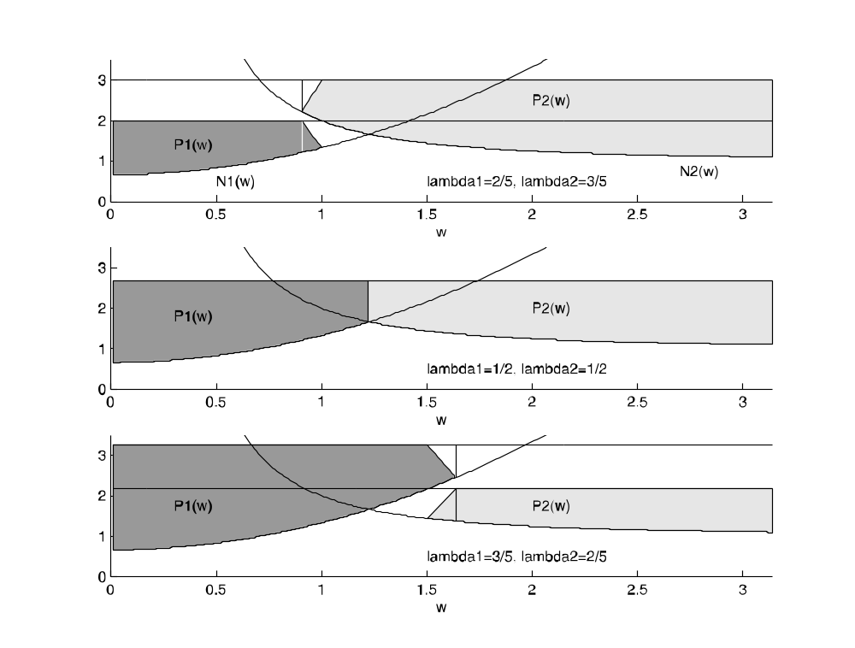
Optimal Power Allocation:
Two Level Water Filling

Slide 33
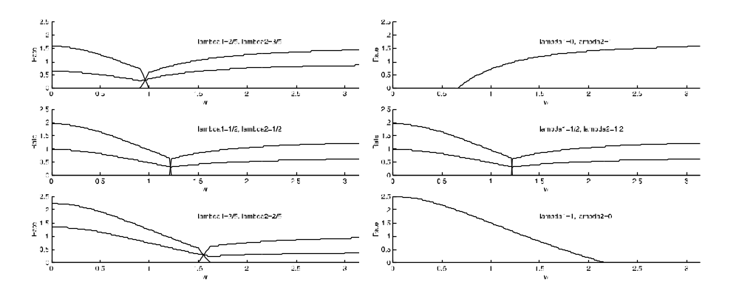
Capacity vs. Frequency

Slide 34
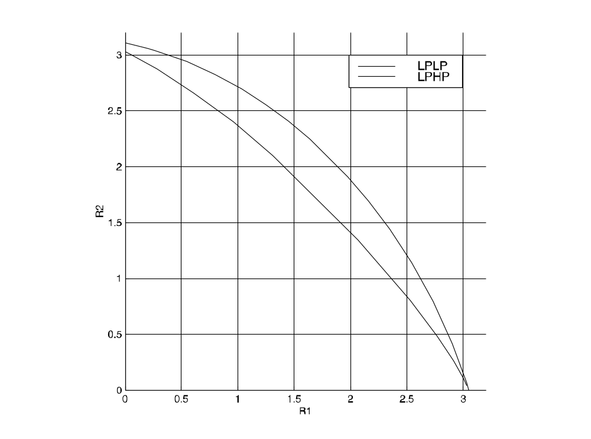
Capacity Region

Slide 35
Capacity Limits of
MAC Channels

Slide 36
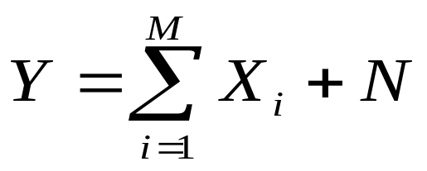
Multiple Access Channel
Multiple transmitters
  Transmitter i sends signal X_{i} with power P_{i}
Common receiver with AWGN of power N₀B
Received signal:
X₁
X₂
X₃

Slide 37
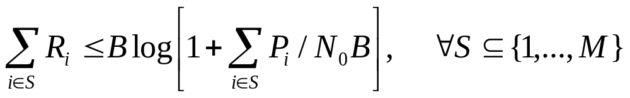
MAC Capacity Region
Closed convex hull of all (R₁,…,R_{M}) s.t.
  For all subsets of users, rate sum equals that of 1 superuser with sum of powers from all users
Power Allocation and Decoding Order
  Each user has its own power (no power alloc.)
  Decoding order depends on desired rate point

Slide 38
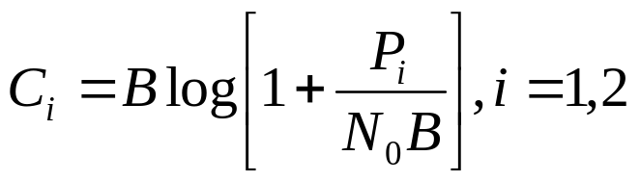
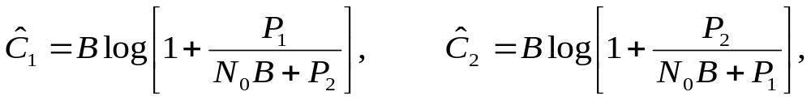
Two-User Region
Superposition coding
w/ interference canc.
Time division
C₂
SC w/ IC and time
sharing or rate splitting
Ĉ₂
Frequency division
SC w/out IC
Ĉ₁
C₁

Slide 39
Fading and ISI
MAC capacity under fading and ISI determined using similar techniques as for the BC
In fading, can define ergodic, outage, and minimum rate capacity similar as in BC case
  Ergodic capacity obtained based on AWGN MAC given fixed fading, averaged over fading statistics
  Outage can be declared as common, or per user
MAC capacity with ISI obtained by converting to equivalent parallel MAC channels over frequency

Slide 40
Duality between
Broadcast and MAC Channels

Slide 41
Comparison of MAC and BC
P
Differences:
  Shared vs. individual power constraints
  Near-far effect in MAC
Similarities:
  Optimal BC “superposition” coding is also optimal for MAC (sum of Gaussian codewords)
  Both decoders exploit successive decoding and interference cancellation
P₁
P₂

Slide 42
MAC-BC Capacity Regions
MAC capacity region known for many cases
  Convex optimization problem
BC capacity region typically only known for (parallel) degraded channels
  Formulas often not convex
Can we find a connection between the BC and MAC capacity regions?
Duality

Slide 43














Dual Broadcast and MAC Channels
Gaussian BC and MAC with same channel gains
and same noise power at each receiver
x
+
x
+
x
+
x
Broadcast Channel (BC)
Multiple-Access Channel (MAC)

Slide 44
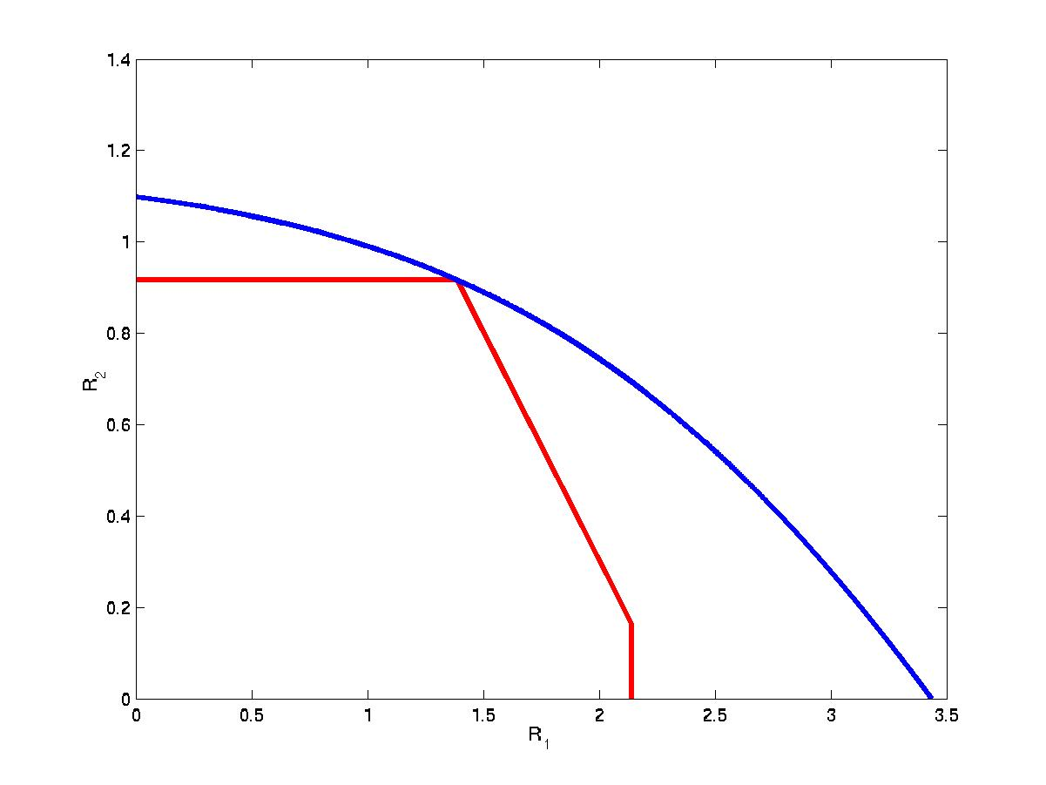

The BC from the MAC
P₁=0.5, P₂=1.5
Blue = BC
Red = MAC
P₁=1, P₂=1
P₁=1.5, P₂=0.5
MAC with sum-power constraint

Slide 45
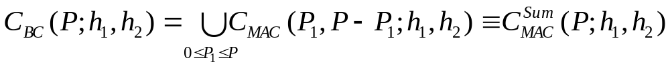

Sum-Power MAC
MAC with sum power constraint
  Power pooled between MAC transmitters
  No transmitter coordination
Same capacity region!
MAC
BC

Slide 46

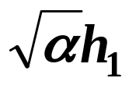
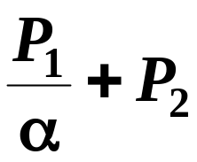


BC to MAC: Channel Scaling
Scale channel gain by √α, power by 1/α
MAC capacity region unaffected by scaling
Scaled MAC capacity region is a subset of the scaled BC capacity region for any α
MAC region inside scaled BC region for any scaling
MAC
+
+
+
BC

Slide 47
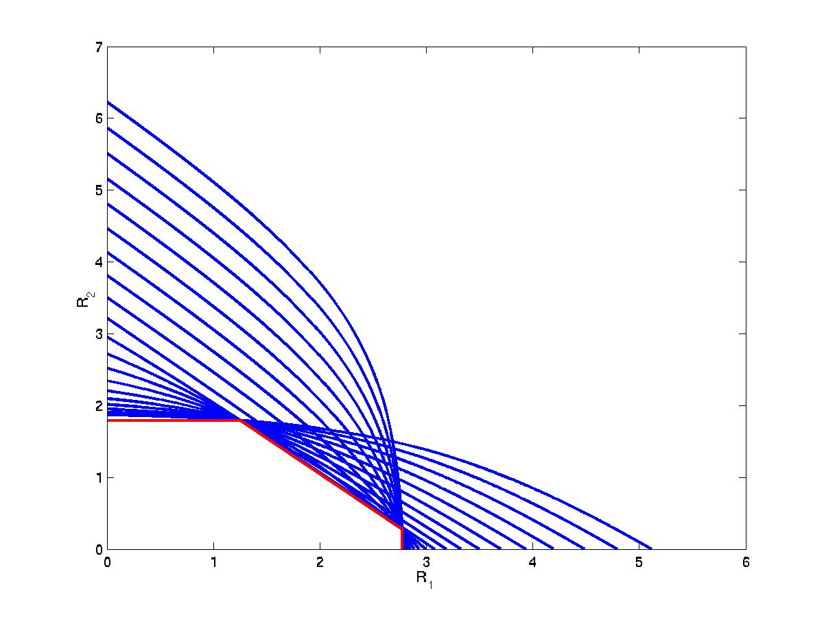

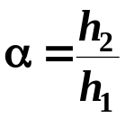

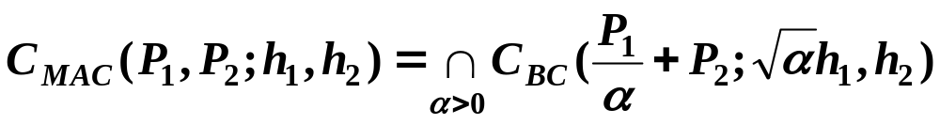
The BC from the MAC
Blue = Scaled BC
Red = MAC

Slide 48
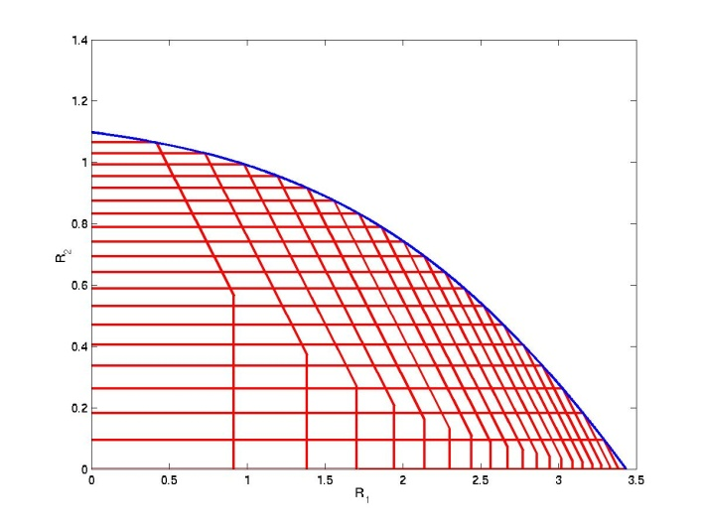

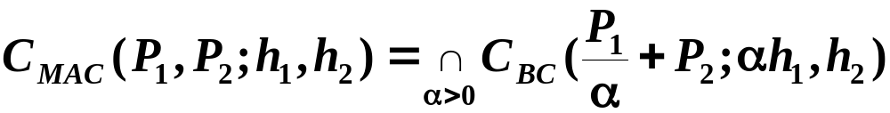
Duality: Constant AWGN Channels
BC in terms of MAC
MAC in terms of BC
What is the relationship between
the optimal transmission strategies?
Notes:
Summary of what we’ve done so far

Slide 49
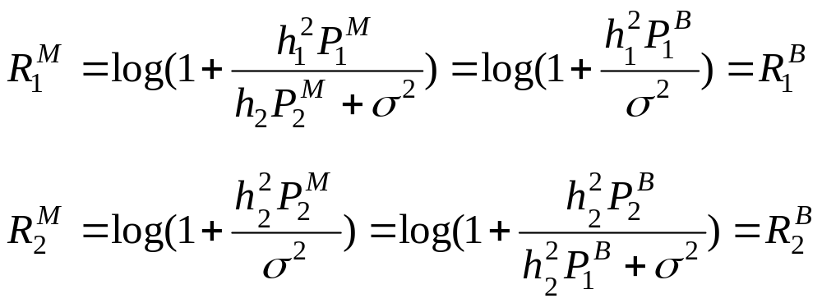
Transmission Strategy Transformations
Equate rates, solve for powers
Opposite decoding order
  Stronger user (User 1) decoded last in BC
  Weaker user (User 2) decoded last in MAC

Slide 50
Duality Applies to Different
Fading Channel Capacities
Ergodic (Shannon) capacity: maximum rate averaged over all fading states.
Zero-outage capacity: maximum rate that can be maintained in all fading states.
Outage capacity: maximum rate that can be maintained in all nonoutage fading states.
Minimum rate capacity: Minimum rate maintained in all states, maximize average rate in excess of minimum
  Explicit transformations between transmission strategies

Slide 51
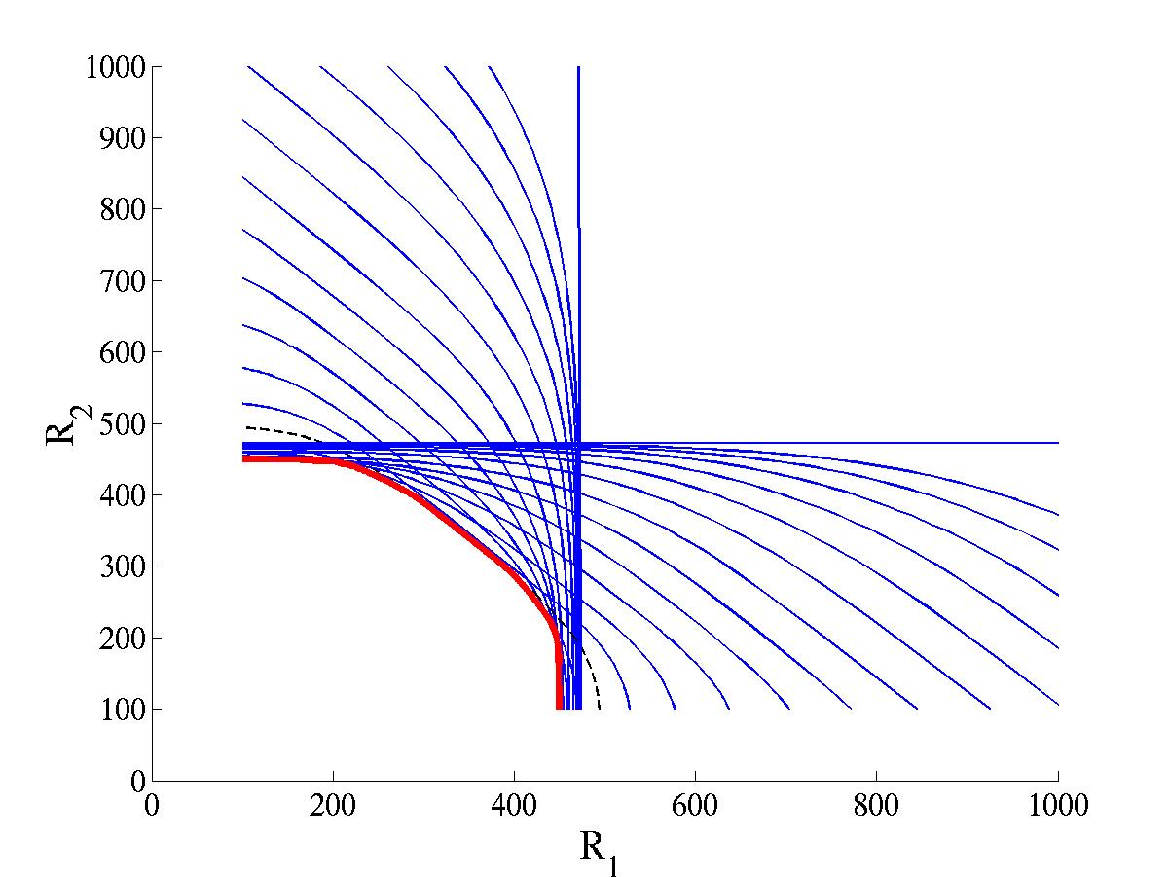
Duality: Minimum Rate Capacity
MAC in terms of BC
Blue = Scaled BC
Red = MAC
  BC region known
  MAC region can only be obtained by duality
What other capacity regions can be obtained by duality?
Broadcast MIMO Channels

Slide 52
Capacity Limits of
Broadcast MIMO Channels

Slide 53


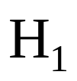




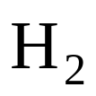

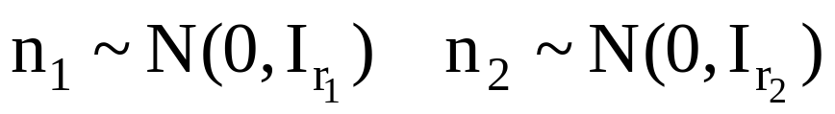
Broadcast MIMO Channel
t≥1 TX antennas
r₁≥1, r₂≥1 RX antennas
Perfect CSI at TX and RX
Non-degraded broadcast channel
Notes:
Channel on the left is the downlink (BC), channel on the right is the uplink (MAC) – notice dual channels have the same channel gains

Slide 54
Dirty Paper Coding (Costa’83)
Basic premise
  If the interference is known, channel capacity same as if there is no interference
  Accomplished by cleverly distributing the writing (codewords) and coloring their ink
  Decoder must know how to read these codewords
Dirty
Paper
Coding
Dirty
Paper
Coding
Clean Channel
Dirty Channel

Slide 55
Modulo Encoding/Decoding
Received signal Y=X+S, -1≤X≤1
  S known to transmitter, not receiver
Modulo operation removes the interference effects
  Set X so that ⎣Y⎦_{[-1,1]}=desired message (e.g. 0.5)
  Receiver demodulates modulo [-1,1]
-1
0
+1
…
…
-7
-5
-3
-1
0
+1
+3
+5
+7
S
X
-1
0
+1

Slide 56
Capacity Results
Non-degraded broadcast channel
  Receivers not necessarily “better” or “worse” due to multiple transmit/receive antennas
  Capacity region for general case unknown
Pioneering work by Caire/Shamai (Allerton’00):
  Two TX antennas/two RXs (1 antenna each)
  Dirty paper coding/lattice precoding (achievable rate)
    Computationally very complex
  MIMO version of the Sato upper bound
  Upper bound is achievable: capacity known!
Notes:
Caire and Shamai solved the 2 transmit antenna, 2 receiver case with only a single receive antenna – found the achievable region and showed it was optimal at the sum rate point.
We consider the general K-user case, where there are an arbitrary number of transmit antennas and arbitrary number of antennas at each receiver – most general scenario. We will develop a duality between the downlink and uplink and show that the achievable region is sum rate optimal.

Slide 57
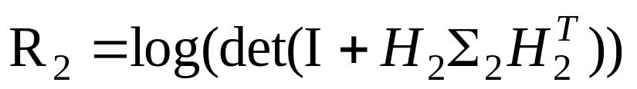
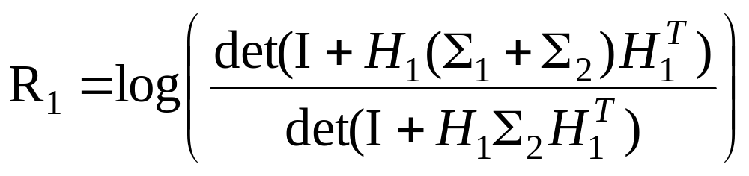
Dirty-Paper Coding (DPC) for MIMO BC
Coding scheme:
  Choose a codeword for user 1
  Treat this codeword as interference to user 2
  Pick signal for User 2 using “pre-coding”
Receiver 2 experiences no interference:
Signal for Receiver 2 interferes with Receiver 1:
Encoding order can be switched
DPC optimization highly complex
Notes:
Can transmit to user 2 as if a single-user channel (I.e. as if user 1 does not exist) due to precoding, dirty paper coding.
Region found by considering all covariance matrices sigma1 and sigma2, subject to a trace constraint (aka power constraint) on the sum of sigma1 and sigma2.
Can also encode in the other order – easily extends to K users.

Slide 58
Does DPC achieve capacity?
DPC yields MIMO BC achievable region.
  We call this the dirty-paper region
Is this region the capacity region?
We use duality, dirty paper coding, and Sato’s upper bound to address this question
First we need MIMO MAC Capacity

Slide 59
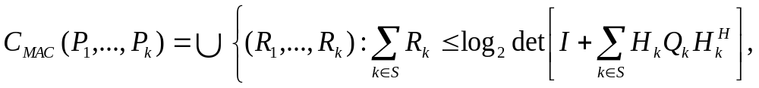
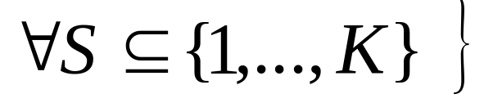
MIMO MAC Capacity
MIMO MAC follows from MAC capacity formula
Basic idea same as single user case
  Pick some subset of users
  The sum of those user rates equals the capacity as if the users pooled their power
Power Allocation and Decoding Order
  Each user has its own power (no power alloc.)
  Decoding order depends on desired rate point
Notes:
Can transmit to user 2 as if a single-user channel (I.e. as if user 1 does not exist) due to precoding, dirty paper coding.
Region found by considering all covariance matrices sigma1 and sigma2, subject to a trace constraint (aka power constraint) on the sum of sigma1 and sigma2.
Can also encode in the other order – easily extends to K users.

Slide 60
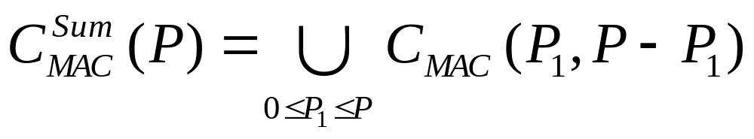
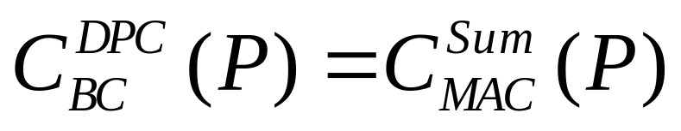
MIMO MAC with sum power
MAC with sum power:
  Transmitters code independently
  Share power
Theorem: Dirty-paper BC region equals the dual sum-power MAC region
P

Slide 61
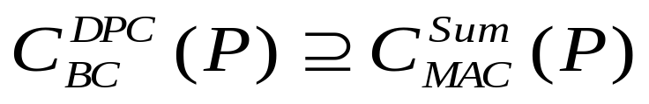
Transformations: MAC to BC
Show any rate achievable in sum-power MAC also achievable with DPC for BC:
  A sum-power MAC strategy for point (R₁,…R_{N}) has a given input covariance matrix and encoding order
  We find the corresponding PSD covariance matrix and encoding order to achieve (R₁,…,R_{N}) with DPC on BC
    The rank-preserving transform “flips the effective channel” and reverses the order
    Side result: beamforming is optimal for BC with 1 Rx antenna at each mobile
DPC BC
Sum MAC
Notes:
Analogy of relationship between powers for scalar case ( now need covariances because have vector signals)
A and B are matrices that represent the interference experiences in the BC and MAC, respectively

Slide 62
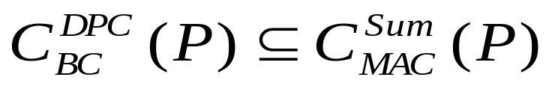
Transformations: BC to MAC
Show any rate achievable with DPC in BC also achievable in sum-power MAC:
  We find transformation between optimal DPC strategy and optimal sum-power MAC strategy
    “Flip the effective channel” and reverse order
DPC BC
Sum MAC
Notes:
Analogy of relationship between powers for scalar case ( now need covariances because have vector signals)
A and B are matrices that represent the interference experiences in the BC and MAC, respectively

Slide 63
Computing the Capacity Region
Hard to compute DPC region (Caire/Shamai’00)
“Easy” to compute the MIMO MAC capacity region
  Obtain DPC region by solving for sum-power MAC and applying the theorem
  Fast iterative algorithms have been developed
  Greatly simplifies calculation of the DPC region and the associated transmit strategy

Slide 64







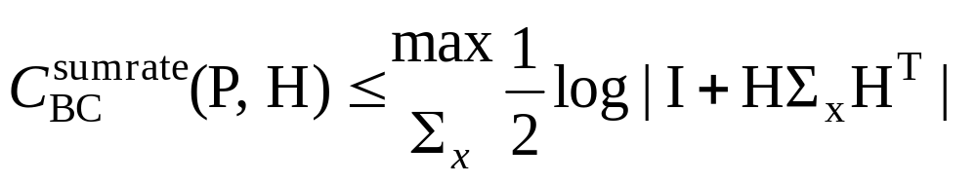
Sato Upper Bound on the
BC Capacity Region
• Based on receiver cooperation
• BC sum rate capacity ≤ Cooperative capacity
+
Joint receiver
+
Notes:
If we allow all receivers to cooperate, the system looks like a single-user multiple-antenna link – clearly the capacity of this link is an upper bound to the sum rate capacity of the BC (where the receivers are not allowed to cooperate)

Slide 65

The Sato Bound for MIMO BC
Introduce noise correlation between receivers
BC capacity region unaffected
  Only depends on noise marginals
Tight Bound (Caire/Shamai’00)
  Cooperative capacity with worst-case noise correlation
Explicit formula for worst-case noise covariance
By Lagrangian duality, cooperative BC region equals the sum-rate capacity region of MIMO MAC
Notes:
In fact, we can make this bound much tighter by introducing noise correlation between the different receivers (that doesn’t affect the BC capacity) – Sato upper bound to the BC

Slide 66

MIMO BC Capacity Bounds
Single User Capacity Bounds
Dirty Paper Achievable Region
BC Sum Rate Point
Sato Upper Bound
Does the DPC region equal the capacity region?
Notes:
Notice that the Sato upper bound is tight (as we proved), and also it is trivial to see that the single-user capacity bounds (i.e. the bounds by considering a single-user channel) are also
Tight – not too much room between achievable region and capacity bounds

Slide 67
Full Capacity Region
DPC gives us an achievable region
Sato bound only touches at sum-rate point
Bergman’s entropy power inequality is not a tight upper bound for nondegraded broadcast channel
A tighter bound was needed to prove DPC optimal
  It had been shown that if Gaussian codes optimal, DPC was optimal, but proving Gaussian optimality was open.
Breakthrough by Weingarten, Steinberg and Shamai
  Introduce notion of enhanced channel, applied Bergman’s converse to it to prove DPC optimal for MIMO BC.

Slide 68
Enhanced Channel Idea
The aligned and degraded BC (AMBC)
  Unity matrix channel, noise innovations process
  Limit of AMBC capacity equals that of MIMO BC
  Eigenvalues of some noise covariances go to infinity
  Total power mapped to covariance matrix constraint
Capacity region of AMBC achieved by Gaussian superposition coding and successive decoding
  Uses entropy power inequality on enhanced channel
  Enhanced channel has less noise variance than original
  Can show that a power allocation exists whereby the enhanced channel rate is inside original capacity region
By appropriate power alignment, capacities equal

Slide 69

Illustration
Original
Enhanced

Slide 70
Main Points
Shannon capacity gives fundamental data rate limits for multiuser wireless channels
Fading multiuser channels optimize at each channel instance for maximum average rate
Outage capacity has higher (fixed) rates than with no outage.
OFDM is near optimal for broadcast channels with ISI
Duality connects BC and MAC channels
  Used to obtain capacity of one from the other
Capacity of broadcast MIMO channel obtained using duality and the notion of an enhanced channel

