Slide 1
EE360: Lecture 7 Outline
Cellular System Capacity and ASE
Announcements
  Proposal feedback next week
  HW 1 posted today or tomorrow
  1st Summary due Feb 3
Dynamic Resource Allocation
Green Cellular System Design
Introduction to Ad Hoc Networks

Slide 2
Dynamic Resource Allocation
Allocate resources as user and network conditions change
Resources:
  Channels
  Bandwidth
  Power
  Rate
  Base stations
  Access
Optimization criteria
  Minimize blocking (voice only systems)
  Maximize number of users (multiple classes)
  Maximize “revenue”: utility function
    Subject to some minimum performance for each user
BASE
STATION

Slide 3
Dynamic Channel Allocation
Fixed channel assignments are inefficient
  Channels in unpopulated cells underutilized
  Handoff calls frequently dropped
Channel Borrowing
  A cell may borrow free channels from neighboring cells
  Changes frequency reuse plan
Channel Reservations
  Each cell reserves some channels for handoff calls
  Increases blocking of new calls, but fewer dropped calls
Dynamic Channel Allocation
  Rearrange calls to pack in as many users as possible without violating reuse constraints
  Very high complexity
“DCA is a 2G/4G problem”

Slide 4
Variable Rate and Power
Narrowband systems
  Vary rate and power (and coding)
  Optimal power control not obvious
CDMA systems
  Vary rate and power (and coding)
    Multiple methods to vary rate (VBR, MC, VC)
  Optimal power control not obvious
Optimization criteria
  Maximize throughput/capacity
  Meet different user requirements (rate, SIR, delay, etc.)
  Maximize revenue

Slide 5
Multicarrier CDMA
Multicarrier CDMA combines OFDM and CDMA
Idea is to use DSSS to spread a narrowband signal and then send each chip over a different subcarrier
  DSSS time operations converted to frequency domain
Greatly reduces complexity of SS system
  FFT/IFFT replace synchronization and despreading
More spectrally efficient than CDMA due to the overlapped subcarriers in OFDM
Multiple users assigned different spreading codes
  Similar interference properties as in CDMA

Slide 6
Rate and Power Control in CDMA*
Optimize power and rate adaptation in a CDMA system
  Goal is to minimize transmit power
Each user has a required QoS
  Required effective data rate
*Simultaneous Rate and Power Control in Multirate
Multimedia CDMA Systems,” S. Kandukuri and S. Boyd

Slide 7
System Model: General
Single cell CDMA
Uplink multiple access channel
Different channel gains
System supports multiple rates

Slide 8
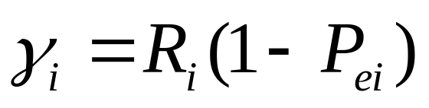
System Model: Parameters
Parameters
  N = number of mobiles
  P_{i} = power transmitted by mobile i
  R_{i} = raw data rate of mobile i
  W = spread bandwidth
QoS requirement of mobile i, _{i}, is the effective data rate

Slide 9
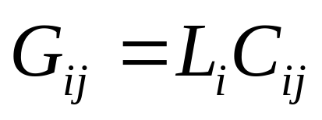
System Model: Interference
Interference between users represented by cross correlations between codes, C_{ij}
Gain of path between mobile i and base station, L_{i}
Total interfering effect of mobile j on mobile i, G_{ij} is

Slide 10
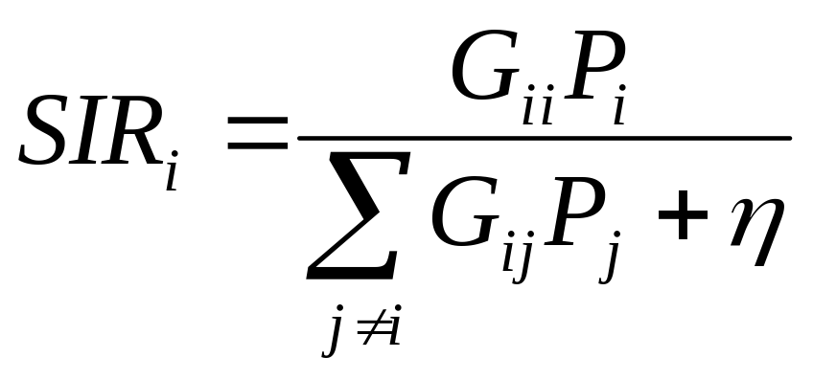
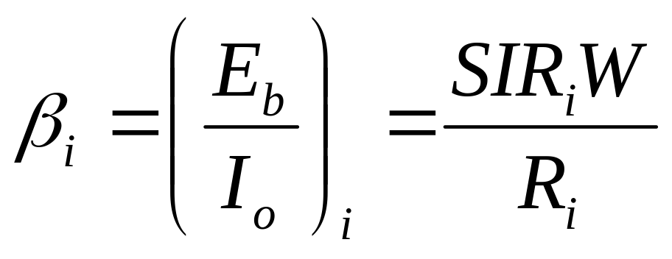
SIR Model (neglect noise)

Slide 11
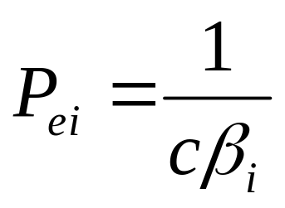
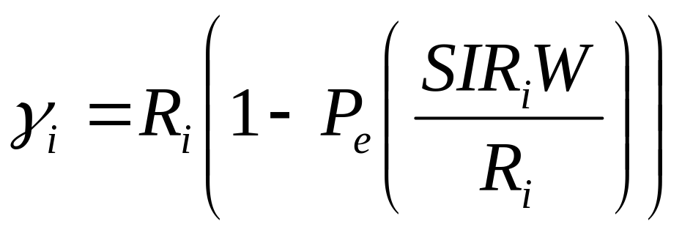
QoS Formula
Probability of error is a function of _{I}
  Formula depends on the modulation scheme
Simplified P_{e} expression
QoS formula

Slide 12
Solution
Objective: Minimize sum of mobile powers subject to QoS requirements of all mobiles
Technique: Geometric programming
  A non-convex optimization problem is cast as a convex optimization problem
Convex optimization
  Objective and constraints are all convex
  Can obtain a global optimum or a proof that the set of specifications is infeasible
  Efficient implementation

Slide 13
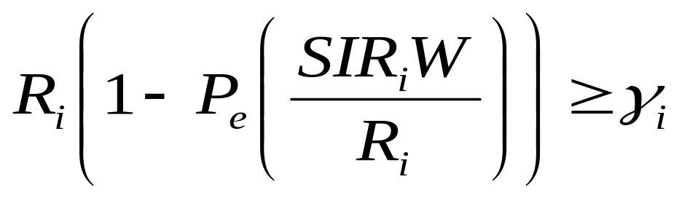
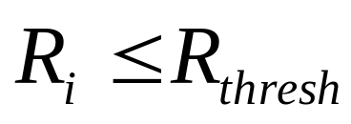

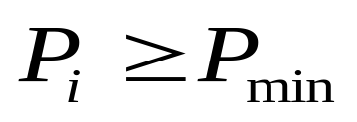

Problem Formulation
Minimize 1^{T}P (sum of powers)
Subject to
Can also add constraints such as

Slide 14
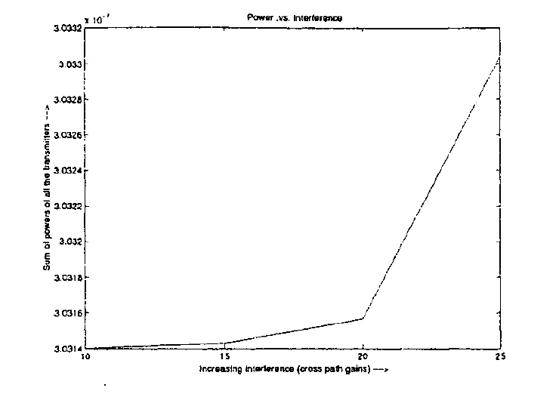
Results
Sum of powers transmitted vs interference

Slide 15
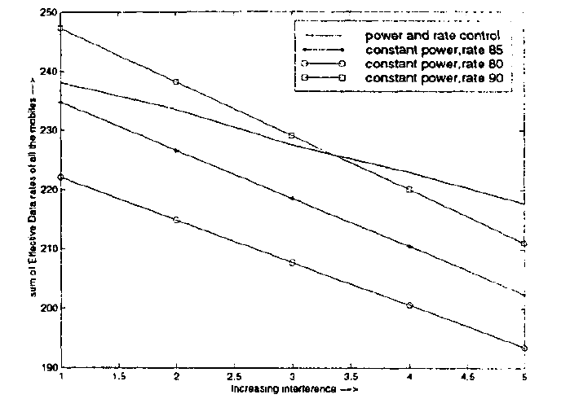
Results
QoS vs. interference

Slide 16

Green” Cellular Networks
Pico/Femto
How should cellular
systems be redesigned
for minimum energy?
Coop
MIMO
Relay
Research indicates that
signicant savings is possible
DAS
Minimize energy at both the mobile and base station via
  New Infrastuctures: cell size, BS placement, DAS, Picos, relays
  New Protocols: Cell Zooming, Coop MIMO, RRM, Scheduling, Sleeping, Relaying
  Low-Power (Green) Radios: Radio Architectures, Modulation, coding, MIMO

Slide 17
Why Green, why now
The energy consumption of cellular networks is growing rapidly with increasing data rates and numbers of users
Operators are experiencing increasing and volatile costs of energy to run their networks
There is a push for “green” innovation in most sectors of information and communication technology (ICT)
There is a wave of companies, industry consortia and government programs focused on green wireless

Slide 18
Enabling Technologies
Infrastucture: Cell size optimization, hierarchical structure, BS/distributed antenna placement, relays
Protocols: Cell Zooming, Cooperative MIMO, Relaying, Radio Resource Management, Scheduling, Sleeping,
Green Radios: Radio architectures, modulation, coding, MIMO

Slide 19
Infrastructure
Cell size optimization
Hierarchical structures
Distributed antenna placement
Relays

Slide 20


Cell Size Optimization
Smaller cells require less TX power at both the BS and mobile
Smaller cells have better capacity and coverage
Smaller cell size puts a higher burden on handoff, backhaul, and infrastructure cost.
Optimized BS placement and multiple antennas can further reduce energy requirements.

Slide 21
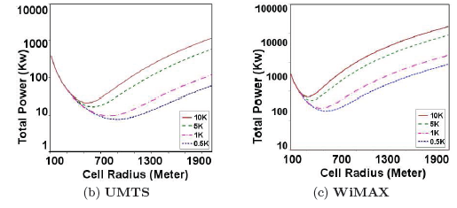
Energy Efficiency vs Cell Size
Small cells reduce required transmit power
But other factors are same as for large cells
  Circuit energy consumption, paging, backhaul, …
Can determine cell power versus radius
  Cell power based on propagation, # users, QoS, etc.
Very large/small cells
are power-inefficienct
Large number of
users -> smaller cells
Number
of Users
Number
of Users
Bhaumik et. al., Green Networking Conference, 2010

Slide 22
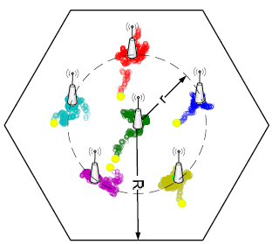
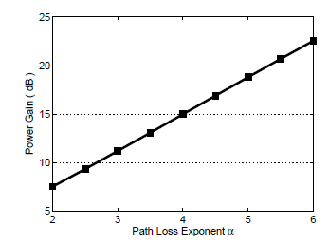
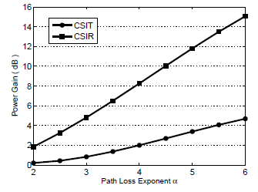
Antenna Placement in DAS
Optimize distributed BS antenna location
Primal/dual optimization framework
Convex; standard solutions apply
For 4+ ports, one moves to the center
Up to 23 dB power gain in downlink
  Gain higher when CSIT not available
6 Ports
3 Ports

Slide 23
Protocols
Cell Zooming
Cooperative MIMO
Relaying
Radio Resource Management
Scheduling
Sleeping

Slide 24
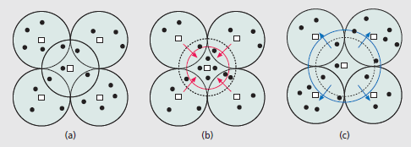
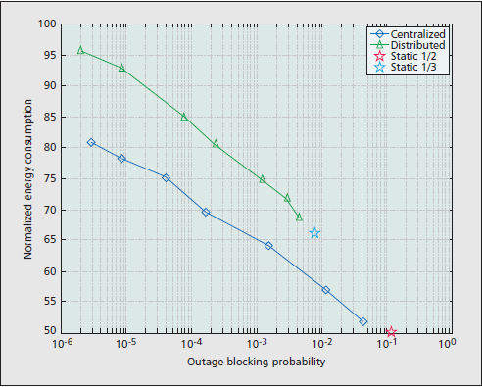
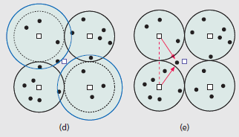
Cell Zooming
Dynamically adjusts cell size (via TX power) based on capacity needs
  Can put central (or other) cells to sleep based on traffic patterns
  Neighbor cells expand or transmit cooperatively to central users
Significant energy savings (~50%)
Work by Zhisheng Niu, Yiqun Wu, Jie Gong, and Zexi Yang

Slide 25
Adding Cooperation and MIMO
Focus of cooperation in
LTE is on capacity increase
Network MIMO: Cooperating BSs form a MIMO array
  MIMO focuses energy in one direction, less TX energy needed
  Can treat “interference” as known signal (MUD) or noise; interference is extremely inefficient in terms of energy
  Can also install low-complexity relays
Mobiles can cooperate via relaying, virtual MIMO, conferencing, analog network coding, …

Slide 26
Radio Design Tradeoffs
under Energy Constraints
Hardware
  Energy minimized when nodes have transmit, sleep, and transient modes
Link
  High-level modulation costs transmit energy but saves circuit energy (shorter transmission time)
  Coding costs circuit energy but saves transmit energy
Access
  Power control impacts connectivity and interference
  Adaptive modulation adds another degree of freedom

Slide 27
Energy-Aware BS Assignment
Determine optimal user BS assignment that minimizes the total transmission power of BSs
Several Algorithms
  Naive distance based
  Brute force search (high complexity)
  Greedy Algorithms
    A: distance based first, then re-associate one by one
    B: associate users one by one

Slide 28
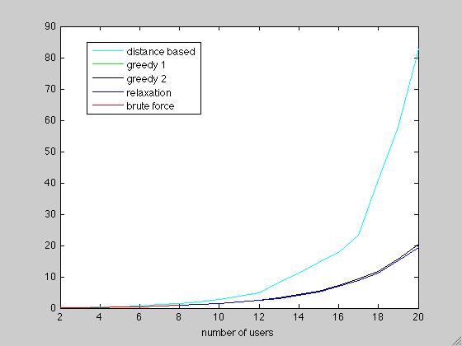
Total Power Consumption (in W)
r=0.8 bit/s/Hz
Interference neglected

Slide 29
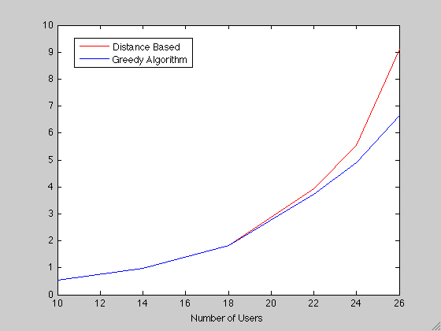
Total Power Consumption (in W)
r=0.1 bit/s/Hz; Path loss exponent is 2

Slide 30
Ad-Hoc Networks
Peer-to-peer communications
  No backbone infrastructure or centralized control
Routing can be multihop.
Topology is dynamic.
Fully connected with different link SINRs
Open questions
  Fundamental capacity
  Optimal routing
  Resource allocation (power, rate, spectrum, etc.) to meet QoS
Notes:
-No backbone: nodes must self-configure into a network.
-In principle all nodes can communicate with all other nodes, but multihop routing can reduce the interference associated with direct transmission.
-Topology dynamic since nodes move around and link characteristics change.
-Applications: appliances and entertainment units in the home, community networks that bypass the Internet. Military networks for robust flexible easily-deployed network (every soldier is a node).

Slide 31
Ad-Hoc Network
Design Issues
Ad-hoc networks provide a flexible network infrastructure for many emerging applications.
The capacity of such networks is generally unknown.
Transmission, access, and routing strategies for ad-hoc networks are generally ad-hoc.
Crosslayer design critical and very challenging.
Energy constraints impose interesting design tradeoffs for communication and networking.

Slide 32
Medium Access Control
Nodes need a decentralized channel access method
  Minimize packet collisions and insure channel not wasted
  Collisions entail significant delay
Aloha w/ CSMA/CD have hidden/exposed terminals
802.11 uses four-way handshake
  Creates inefficiencies, especially in multihop setting
Exposed
Terminal
Hidden
Terminal
1
2
3
4
5

Slide 33
Frequency Reuse
More bandwidth-efficient
Distributed methods needed.
Dynamic channel allocation hard for packet data.
Mostly an unsolved problem
  CDMA or hand-tuning of access points.

Slide 34
DS Spread Spectrum:
Code Assignment
Common spreading code for all nodes
  Collisions occur whenever receiver can “hear” two or more transmissions.
  Near-far effect improves capture.
  Broadcasting easy
Receiver-oriented
  Each receiver assigned a spreading sequence.
  All transmissions to that receiver use the sequence.
  Collisions occur if 2 signals destined for same receiver arrive at same time (can randomize transmission time.)
  Little time needed to synchronize.
  Transmitters must know code of destination receiver
    Complicates route discovery.
    Multiple transmissions for broadcasting.

Slide 35
Transmitter-oriented
  Each transmitter uses a unique spreading sequence
  No collisions
  Receiver must determine sequence of incoming packet
    Complicates route discovery.
    Good broadcasting properties
  Poor acquisition performance
Preamble vs. Data assignment
  Preamble may use common code that contains information about data code
  Data may use specific code
  Advantages of common and specific codes:
    Easy acquisition of preamble
    Few collisions on short preamble
    New transmissions don’t interfere with the data block

Slide 36
Introduction to Routing
Destination
Source
Routing establishes the mechanism by which a packet traverses the network
A “route” is the sequence of relays through which a packet travels from its source to its destination
Many factors dictate the “best” route
Typically uses “store-and-forward” relaying
  Network coding breaks this paradigm

Slide 37
Routing Techniques
Flooding
  Broadcast packet to all neighbors
Point-to-point routing
  Routes follow a sequence of links
  Connection-oriented or connectionless
Table-driven
  Nodes exchange information to develop routing tables
On-Demand Routing
  Routes formed “on-demand”
“A Performance Comparison of Multi-Hop Wireless Ad Hoc Network
Routing Protocols”: Broch, Maltz, Johnson, Hu, Jetcheva, 1998.

Slide 38
Relay nodes in a route
Source
Relay
Destination
Intermediate nodes (relays) in a route help to forward the packet to its final destination.
Decode-and-forward (store-and-forward) most common:
  Packet decoded, then re-encoded for transmission
  Removes noise at the expense of complexity
Amplify-and-forward: relay just amplifies received packet
  Also amplifies noise: works poorly for long routes; low SNR.
Compress-and-forward: relay compresses received packet
  Used when Source-relay link good, relay-destination link weak
Often evaluated via capacity analysis

Slide 39
Routing Techniques
Flooding
  Broadcast packet to all neighbors
Point-to-point routing
  Routes follow a sequence of links
  Connection-oriented or connectionless
Table-driven
  Nodes exchange information to develop routing tables
On-Demand Routing
  Routes formed “on-demand”
“E.M. Royer and Chai-Keong Toh, “A review of current routing protocols for ad hoc
mobile wireless networks,” IEEE Personal Communications Magazine, Apr 1999.”

Slide 40
Route dessemination
Route computed at centralized node
  Most efficient route computation.
  Can’t adapt to fast topology changes.
  BW required to collect and desseminate information
Distributed route computation
  Nodes send connectivity information to local nodes.
  Nodes determine routes based on this local information.
  Adapts locally but not globally.
Nodes exchange local routing tables
  Node determines next hop based on some metric.
  Deals well with connectivity dynamics.
  Routing loops common.

Slide 41
Reliability
Packet acknowledgements needed
  May be lost on reverse link
  Should negative ACKs be used.
Combined ARQ and coding
  Retransmissions cause delay
  Coding may reduce data rate
  Balance may be adaptive
Hop-by-hop acknowledgements
  Explicit acknowledgements
  Echo acknowledgements
    Transmitter listens for forwarded packet
    More likely to experience collisions than a short acknowledgement.
  Hop-by-hop or end-to-end or both.

Slide 42
Cooperation in Wireless Networks
Routing is a simple form of cooperation
Many more complex ways to cooperate:
  Virtual MIMO , generalized relaying, interference forwarding, and one-shot/iterative conferencing
Many theoretical and practice issues:
  Overhead, forming groups, dynamics, synch, …

Slide 43
Summary
Adaptive techniques in cellular can improve significantly performance and capacity, especially in LTE
“Green” cellular system design spans multiple layers of the protocol stack
The distributed and relay nature of ad hoc networks makes all aspects of their design more challenging than celullar.
Notes:
Next lecture: ASE, capacity, CoMP, DAS

