Slide 1
Lecture 3
PoW Longest Chain Protocol:
Attacks and Security Analysis
EE 374
April 7, 2025

Slide 2
Agenda
Hw 1 out, due this Friday
Office hours this week: on zoom
Next lecture: Robin Linus (in person)
Today:
  Cryptographic hash functions
  Nakamoto’s private double-spend attack
  Analysis of attack
  Bitcoin security analysis: safety and liveness

Slide 3



Data agreement:
Proof-of-work longest chain protocol
Longest chain
Genesis

Slide 4



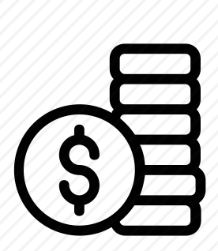
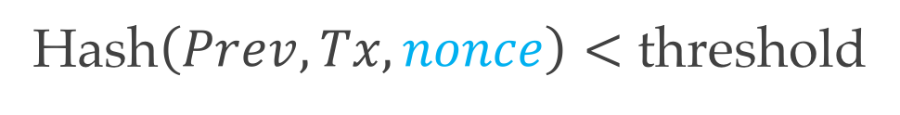
Proof-of-Work
Blockchain
000083207594
Hash of previous block Prev
083207594000
083207594000
000015473998
000097380089
Proof-of-work
Transactions Tx
000097380089
000098738900
000098738900
^89$%!0x0x1
000074984985
000074984985
000074984985
Hash$\left(Prev, Tx, nonce\right)<$ threshold
000074984985
?
24162534567
39478358989
02948734898
47895743895
000019234344
18739847932
000019234344
Mining new block
Notes:
The hash connects different blocks. Security

Slide 5
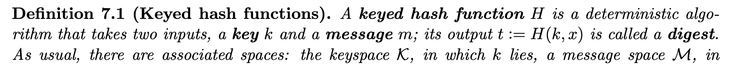
Hash Functions

Slide 6




Private double-spend attack
Public chain
Genesis
Longest chain
Notes:
When can the adversary start mining? Before or after the transaction enters into the ledger.?
VB: Before. The goal is the mine on the parent of the block that includes the tx.

Slide 7

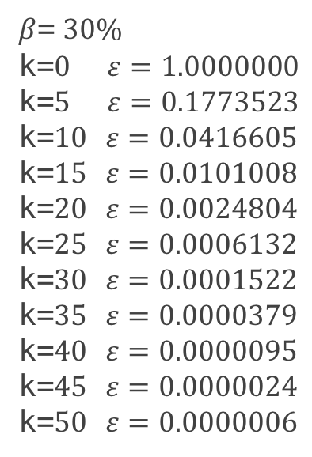
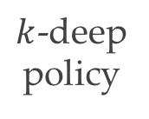
Defense: k-deep confirmation
Public chain
Genesis
Longest chain
$β$= $30\%$
k=$0$ $ε=1.0000000$
k=$5$ $ε=0.1773523$
k=$10$ $ε=0.0416605$
k=$15$ $ε=0.0101008$
k=$20$ $ε=0.0024804$
k=$25$ $ε=0.0006132$
k=$30$ $ε=0.0001522$
k=$35$ $ε=0.0000379$
k=$40$ $ε=0.0000095$
k=$45$ $ε=0.0000024$
k=$50$ $ε=0.0000006$
Adversarial power
$k$-deep
policy
Nakamoto’s table

Slide 8

Error vs confirmation depth
$ε$
confirmation
error prob.
10
20
30
40
50
depth k

Slide 9
Analysis

Slide 10
Distribution of mining time

Slide 11
Analysis

Slide 12
Safety
A block b is safe if once it is confirmed, it remains on the ledger in the view of any node at any future time……..
regardless of the adversary’s attack.
What we showed is safety with high probability……..
under a specific attack.

Slide 13
Example: balance attack

Slide 14
Safety analysis (for level 1 block)
any successful attack
private attack

Slide 15

Safety theorem for Bitcoin
Theorem:
Each Bitcoin block is safe with probability of confirmation error going to zero exponential in k if

Slide 16
Is Safety Enough?
What happens if no honest blocks are confirmed?
We need liveness.
A protocol is live if a non-zero fraction of honest blocks are confirmed.

Slide 17
Bitcoin: chain growth and chain quality

Slide 18
Bitcoin: liveness theorem
Theorem:
Bitcoin is live if

