Slide 1
Tendermint Recap and
Economic Security for PoS Consensus
EE 374 Lecture 11

Slide 2
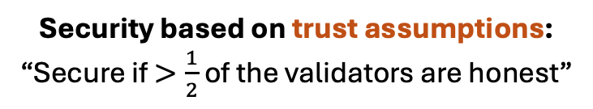
Trust Assumptions vs. Economic Security
Tendermint
(Cosmos chains)
PoW Longest-Chain Protocol
(Bitcoin)
Gasper
(PoS Ethereum)
Security based on trust assumptions:
“Secure if $>\frac{1}{2}$ of the validators are honest”
Economic Security:
“If security is violated, then the adversary loses 10M USD”
Bitcoin: A Peer-to-Peer Electronic Cash System. Nakamoto; 2008
Cosmos. Kwon and Buchman; 2016
Combining GHOST and Casper. Buterin et al.; 2020

Slide 3






PoS Protocols
Withdrawal Request
Withdrawal Granted
Pool
P
Q
PoS
Chain
Client observes the protocol.
Validator set changes
Notes:
Suppose we do have slashable safety.
If there is a question, adversary ‘simulation argument’. We also need to assume the protocol proceeds at a certain speed and clients keep track of time.

Slide 4
Example: Staking on Ethereum
1) To register a new validator node on Ethereum:
Deposit 32 ETH into the Ethereum deposit contract.
Submit a transaction that includes key credentials for the validator.
2) Wait for a period of at least four epochs
  To ensure that RANDAO cannot be manipulated.
3) Entry queue: Pending validators then voted in by active validator as determined by the churn limit.

Slide 5
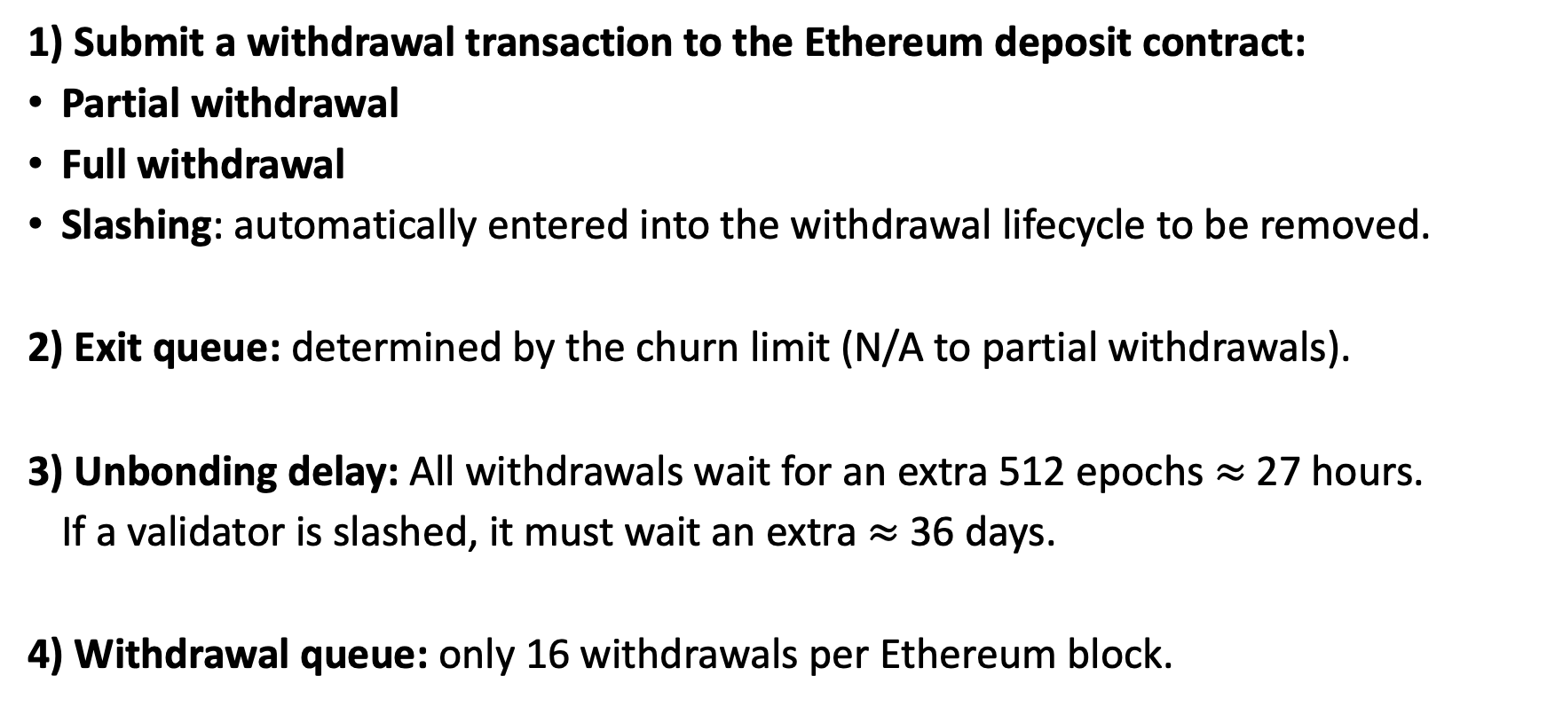
Example: Unbonding on Ethereum
1) Submit a withdrawal transaction to the Ethereum deposit contract:
Partial withdrawal
Full withdrawal
Slashing: automatically entered into the withdrawal lifecycle to be removed.
2) Exit queue: determined by the churn limit (N/A to partial withdrawals).
3) Unbonding delay: All withdrawals wait for an extra 512 epochs $≈$ 27 hours.
If a validator is slashed, it must wait an extra $≈$ 36 days.
4) Withdrawal queue: only 16 withdrawals per Ethereum block.

Slide 6
From Accountable to Slashable Safety
Accountable safety: If there is a safety violation, 1/3 adversarial validators can be provably identified as protocol violators.
PoS chains allow withdrawal of stake!
Slashable safety: If there is a safety violation, 1/3 adversarial validators can be provably identified as protocol violators before they withdraw their stake (i.e., unbond).
Theorem: Without additional trust assumptions,
no PoS protocol provides slashable safety with any resilience.
Notes:
Neither the PoS protocols nor accountable safety are sufficient for economic security.

Slide 7



Long Range Attacks
Withdrawal Request
Withdrawal Granted
Pool
P
Q
PoS
Chain
Late-coming clients
Pool
Q’
Withdrawal Request
Withdrawal Granted
Double signatures
Cannot slash!
Safety violation: Alice and Bob must identify a validator in Q’
But, how would they know that the chain built by Q’ appeared late?

