Slide 1
PoS long range attacks
+ light clients
EE 374 Lecture 12

Slide 2









Long Range Attacks
Withdrawal Request
Withdrawal Granted
Pool
P
Q
PoS
Chain
Late-coming clients
Pool
Q’
Double signatures
Cannot slash!
Cannot slash the validators in Q’ since they have already unbonded1

Slide 3
How does Ethereum deal with this?
Make the unbonding time long so that “social consensus” is established as to which is the correct fork.
How long does it take 2/3 of the stake to exit?
2/3 stake = 1,075,418 *2/3 ~ 700k withdrawals.
16 withdrawals per block.
Exit time ~ 1 week.

Slide 4
How does Cosmos deal with this?
Use a long unbonding time: 21 days
For important clients, require them to be online at least once every 21 days.
Eg., bridges to other blockchains.
This is cumbersome and makes the unbonding time long.

Slide 5
Idea: external trusted party
Need a trusted party always online to watch over the PoS chain.
This trusted party will record the evolution of the validator set.
All late-joining clients can refer to this trusted party to figure out the correct chain to follow.
The trusted party timestamps events on the PoS chain.

Slide 6
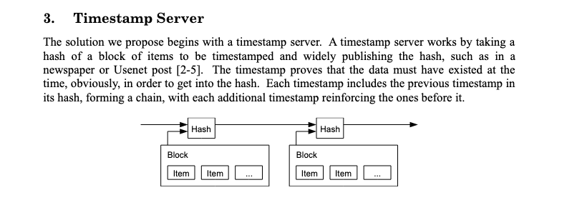
Bitcoin as the trusted timestamp server

Slide 7


Achieving Slashable Safety
Withdrawal time = Bitcoin timestamp confirmation time
Reduces withdrawal delay from weeks to hours.
k deep
…
Arrow of Time
block hash & 2/3 quorum of signatures
too late, unsuccessful
unbonded
attack chain
withdrawal request
Notes:
Once the block hash and the quorum of signatures become k deep, and there is no conflicting block hash and quorum of signatures on Bitcoin, withdrawal request is approved.
Client rejects the attack chain, that is does not confirm its blocks, since its timestamp is later than that of the blocks on the top fork.

Slide 8
Data Availability Attack
Upon observing a timestamp that:
has valid signatures (quorum certificate)
does not have the data
take emergency brake
no longer follow this PoS chain
…
2. Grow the canonical chain
1. Prepare a private fork with hidden block data
3. Reveal the private fork after the canonical chain
Notes:
To prevent data availability attacks…
Clients should stop following the PoS chain
upon observing a data unavailable checkpoint on Bitcoin.
If checkpoints do not contain validator signatures…
Any adversary can put a random block hash,
and stall the clients!!

Slide 9
Slashable Safety via Bitcoin Timestamping
Bitcoin
Bitcoin
succinct commitments
transactions
PoS chain
chain / ledger
Theorem: This protocol provides
slashable safety with resilience 1/3
liveness with resilience of 1/3
Bitcoin-Enhanced Proof-of-Stake Security: Possibilities and Impossibilities
Tas et al.; IEEE S&P 2023

Slide 10
Section 3:
Scaling blockchains
EE 374 Lecture 12

Slide 11
The scaling problem
Bitcoin’s throughput is 7 tps. Ethereum is about 20 tps.
How do we increase the throughput of a blockchain without compromising decentralization and security? (The blockchain trilemma)
Decentralization means that one can be a client or run a validator with limited compute communication and storage capability.
Idea: focus on only the txs one is interested in.

Slide 12
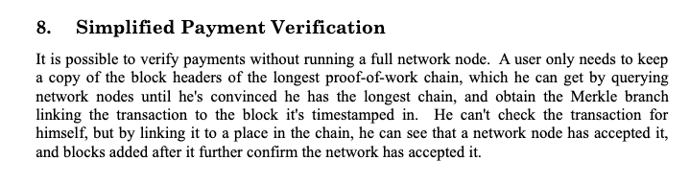
Nakamoto has thought of this

Slide 13
Some numbers
The entire Bitcoin blockchain occupies 656 Gbytes of data
The total size of the headers is about 71Mbytes.
4 orders of magnitude difference.

Slide 14
Light client tx verification
Goal: check if a given tx is in the Bitcoin ledger
Download a chain of headers from a network node.
Need to verify three things:
Is proof of work done properly?
Is the chain the longest (heaviest) chain?
Is the given tx in one of the blocks?

Slide 15
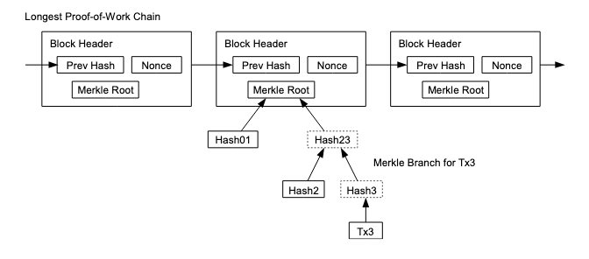
Merkle trees

