Slide 1
Lecture 9:
Tendermint and Finality
4/28/25

Slide 2
Agenda
HW 4 due Friday
Today:
  The Tendermint protocol
  Partially synchronous networks
  finality and availability
  availability-finality dilemma
  Ebb-and-flow protocols and Ethereum PoS.

Slide 3
Tendermint: security properties
Tendermint is safe and live when the network is synchronous.
Tendermint is safe even without any assumptions on network delay!
Stronger statement: Tendermint is secure under the partially synchronous network model (DLS 88)
Safety under partial synchrony is also called finality.

Slide 4
Tendermint vs Bitcoin

Slide 5






Bitcoin
“Peers I don’t hear are
offline doing nothing
available under dynamic participation

Slide 6
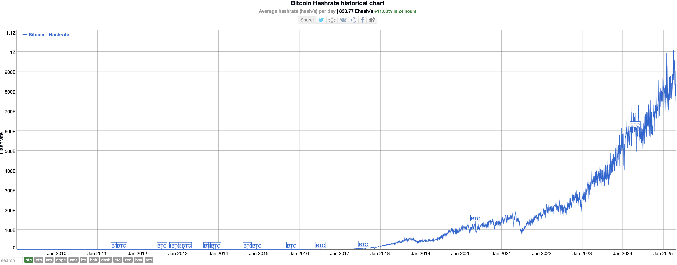
Dynamic availability in action

Slide 7


Tendermint
“Peers I don’t hear are
plotting against me!”
final under network partition

Slide 8
Availability-Finality Dilemma
Bitcoin is dynamically available but is not final.
Tendermint has finality, but not dynamically available.
Best of both worlds?

Slide 9
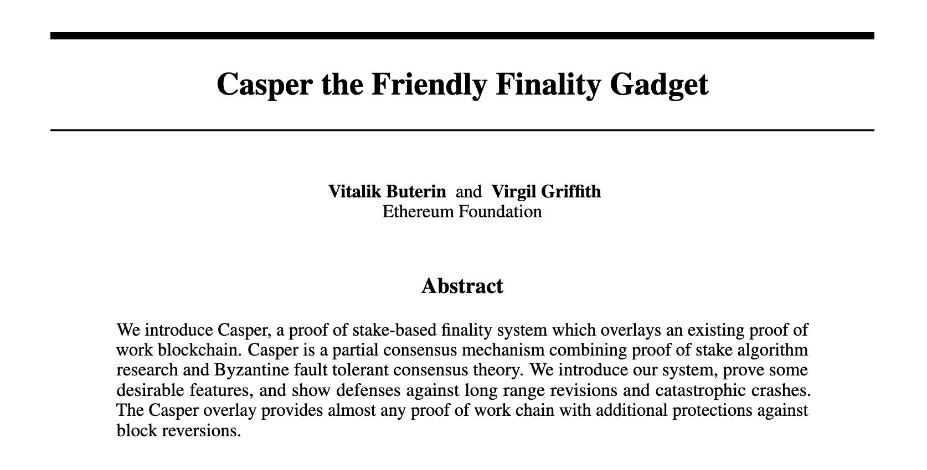
Finality gadgets

Slide 10
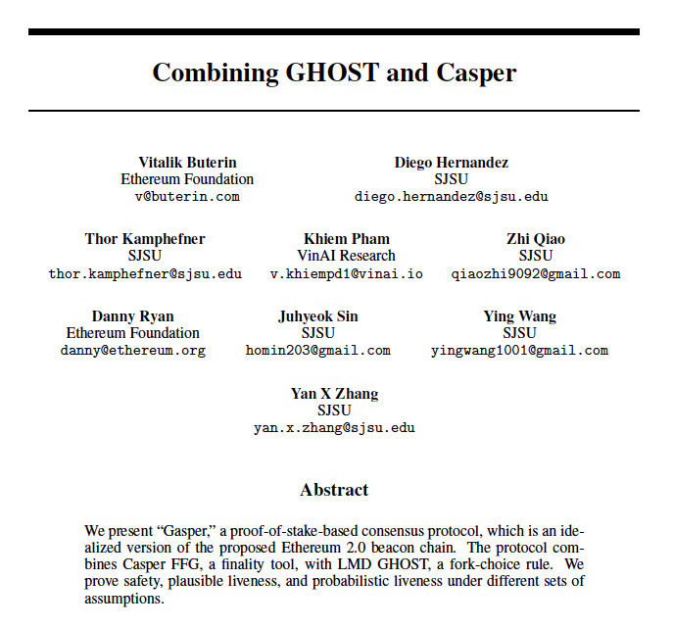

Slide 11
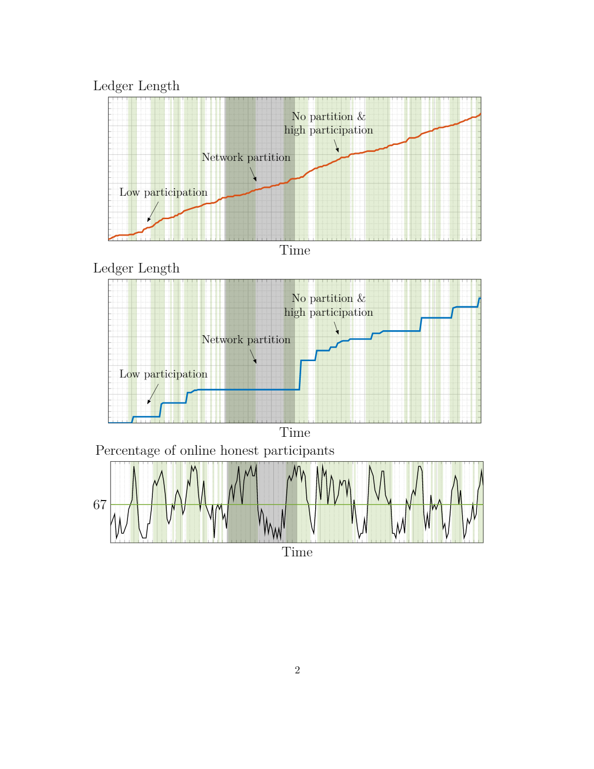
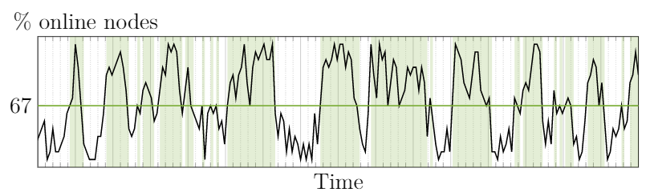
Ledger dynamics
Dynamic availability
Finality
Longest chain
protocol
BFT protocol
Notes:
Change “online honest participoants to online validators

Slide 12
Availability and Finality
Dynamic availability
Finality
Is there a consensus protocol that provides both availability and finality?
No.

Slide 13
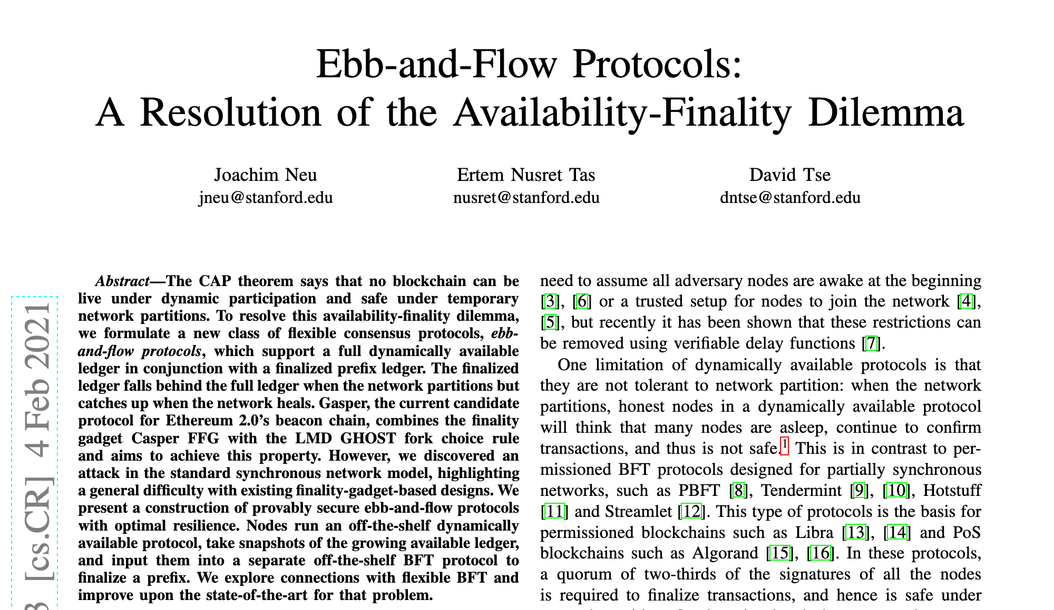

Slide 14
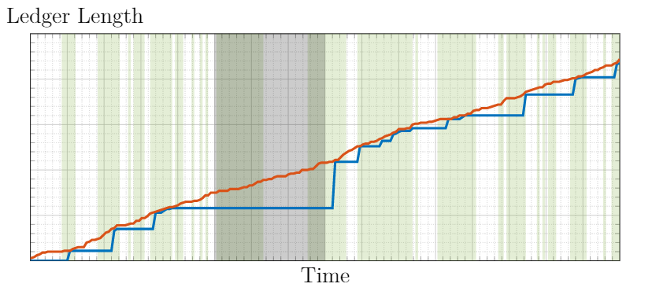
Resolving the Availability-Finality Dilemma
finalized prefix
available ledger
available ledger
finalized prefix
Protocols with this ebb-and-flow property exist!
Notes:
Do use two ledgers. Directly represent as a prefix with the full ledger

Slide 15
