Slide 1
Linear Horizontal Scaling via
Data Availability
Lecture 16
May 28, 2025
Notes:
Hi. My name is Joachim Neu, and together with my coauthors Nusret Tas and David Tse I welcome you to our presentation on Ebb-and-Flow Protocols: A Resolution of the Availability-Finality Dilemma.

Slide 2
Lecture 16
Presentation next Wed during last lecture.
Today: horizontal scaling and data availability
Key tool: verifiable information dispersal.

Slide 3
Horizontal Scaling Recap
Goal: scale the throughput linearly with the number of nodes while maintaining security and decentralization.
Decentralization: O(1) compute, communication and storage per node.

Slide 4





Rollups Recap: Compute-Limited Scaling
Delegation of a smart contract’s execution to off-chain operator
Rollup
10
5
7
8
12
3
6
9
Main Chain
10
5
6
9

Slide 5
On-chain vs off-chain data storage
On-chain data storage is a viable scaling solution if compute is the bottleneck.
But as we continue to scale, communication and storage will become bottleneck.
One solution is to store the data off chain but only put the data off-chain.

Slide 6







Example: Validium
Data Availability Committee
Users
tx
tx
tx
Rollup
txs_{t-1}
txs_{t}
state_{t-1}
state_{t}
Validity
Availability
Main Chain
Data Availability

Slide 7



Desiderata
Nodes
Disperse(…)
Retrieve(…)
B
B’
n
Operator
f ≤ t = Resilience
User
Dispersal returns certificate of retrievability for the content
Given certificate of retrievability, retrieval returns “the” content
Certificate of retrievability verifiable by smart contract (3rd party)
O(1) communication & storage as throughput scale

Slide 8
Data availability Primitive
Setup: 1^{λ} → (pp, sp₁, …, sp_{n})
Commit: B → C
Disperse: B → P
Verify: (P, C) → 0/1
Retrieve: (P, C) → B
Global public params
Local secret params per storage node
Commitment
Block of data
Certificate of retrievability

Slide 9
Efficient data availability
How to store data efficiently across a set of storage nodes?
Putting the same data in all the nodes is reliable but very inefficient.
Splitting the data across all nodes is efficient but very unreliable.
Erasure coding gives both efficiency and reliability.

Slide 10
Example: Reed Solomon code
Information symbols : u_1,u_2……u_k
Form polynomial P(x) = u_1 + u_2 * x + ……..u_k x^k-1
Coded symbols: c_i = P(x_i), i=1………n.
From any k coded symbols, one can recover the k information symbols.

Slide 11

Linear erasure codes
Finite field $ℤ_{q}$
MDS code: Any k columns of G are linearly independent
→ Can solve for u^{T} (“decode”) from any k entries of c^{T}
Generator matrix
G
Codeword
k
n
Information
u^{T}
=
c^{T}

Slide 12
Straw Man Data Availability
Split a block B into chunks u_1,…….u_k
Code the chunks into c_1,………c_n.
Send c_j to node j.
Node j sends signature on c_j..
If there is a quorum q of signatures, then a certificate of retrievability is obtained.

Slide 13
Problem
What happens if a malicious operator sends malformed coded data to the nodes and trick the honest nodes to sign ?
Need verifiability.
Idea: linear vector commitments (think of hash functions with structure)

Slide 14
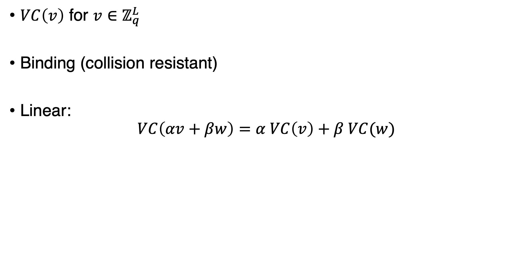
Linear vector commitment
“Constant-Size Commitments to Polynomials and Their Applications”, Kate et al., ASIACRYPT’10
Finite field $ℤ_{q}$
$VC\left(v\right)$ for $v∈ℤ_{q}^{L}$
Binding (collision resistant)
Linear:
$$VC\left(αv+βw\right)=α VC\left(v\right)+β VC(w)$$

Slide 15






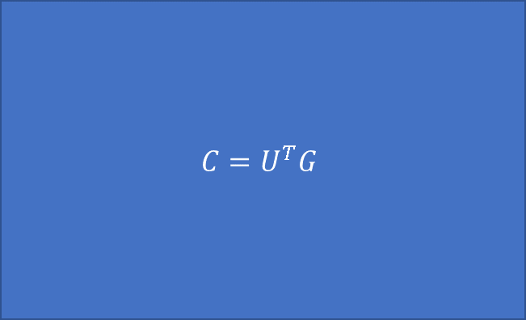

Apply to L instances of the coding problem
k
n
$$U^{T}$$
$$C=U^{T}G$$
L
$$Encode^{⨂L}$$
$$VC^{⨂k}$$
$$VC^{⨂n}$$
$$h_{1} ……… h_{k}$$
$$Encode$$
$$VC^{⨂k}\left(U^{T}\right)G=VC^{⨂n}\left(U^{T}G\right)$$

Slide 16
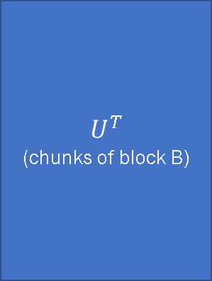



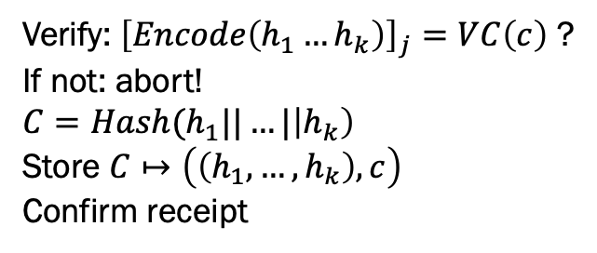


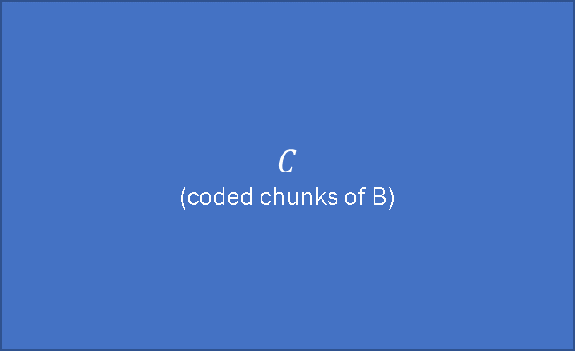
Construction – High Level
AVID-FP: “Verifying distributed erasure-coded data”, Hendricks et al., PODC’07
$$U^{T}$$
(chunks of block B)
$$C$$
(coded chunks of B)
$$Encode^{⨂L}$$
$$VC^{⨂k}$$
Disperse
Verify: ${\left[Encode\left(h_{1}…h_{k}\right)\right]}_{j}=VC\left(c\right)$ ?
If not: abort!
$$C=Hash(h_{1}||…|\left|h_{k}\right)$$
Store $C↦\left(\left(h_{1},…, h_{k}\right), c\right)$
Confirm receipt
$$h_{1} ……… h_{k}$$
Commit
Retrieve
$${C=Hash(h}_{1}||…||h_{k})$$
Verify
$$Sign(sk_{j}, \left(ack, C\right))$$
Collect q signatures
j

Slide 17
Data Availability: Security
Commitment-Binding: Commit(…) is a deterministic binding commitment (ie, collision resistant).
Correctness: If an honest client invokes Disperse(B), then it eventually outputs a certificate of retrievability P so that
Verify(P, Commit(B)) = 1.
Availability: If Verify(P, C) = 1, then Commit(Retrieve(P, C)) = C.
What is the resilience t for these properties to hold?

Slide 18
Security analysis
If n – t > = q, then we have correctness
If q-t > = k, then we have availability.
So t = min (q – k, n – q) for security.
t* = (n-k)/2
Rate of code = k/n

